Slide 1




Fermi operator expansion method for nuclei and inhomogeneous nuclear matter at finite temperature
Nakatsukasa, Takashi
Center for Computational Sciences
University of Tsukuba
Supported by
Nuclear physics across energy scales@C3NT, Wuhan, China, 2025.9.19-21

Slide 2
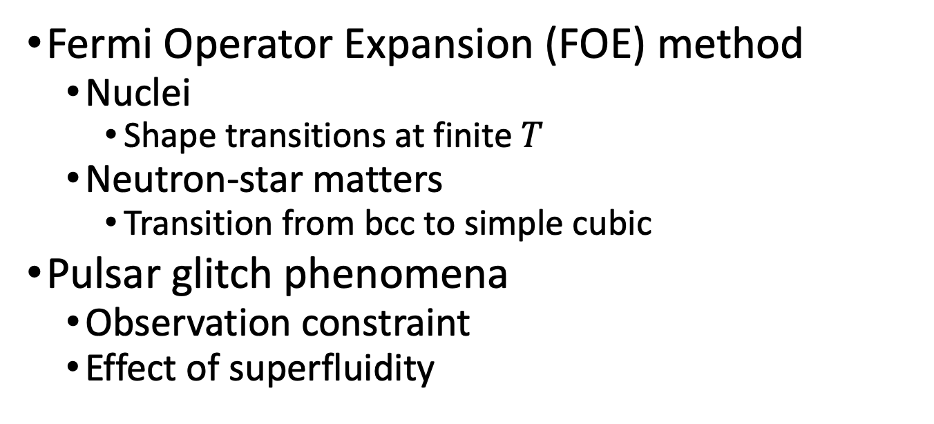
Contents
Fermi Operator Expansion (FOE) method
  Nuclei
    Shape transitions at finite $T$
  Neutron-star matters
    Transition from bcc to simple cubic
Pulsar glitch phenomena
  Observation constraint
  Effect of superfluidity

Slide 3
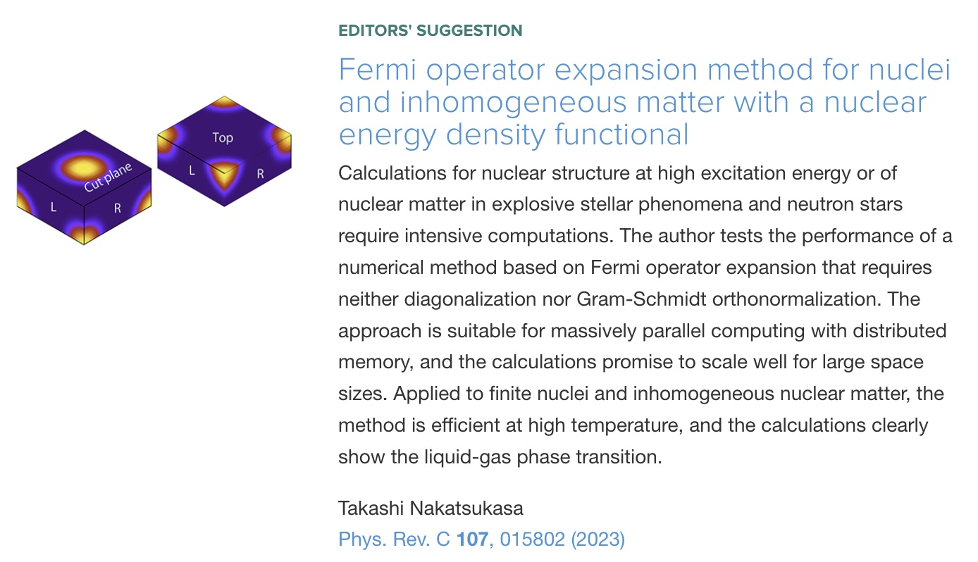
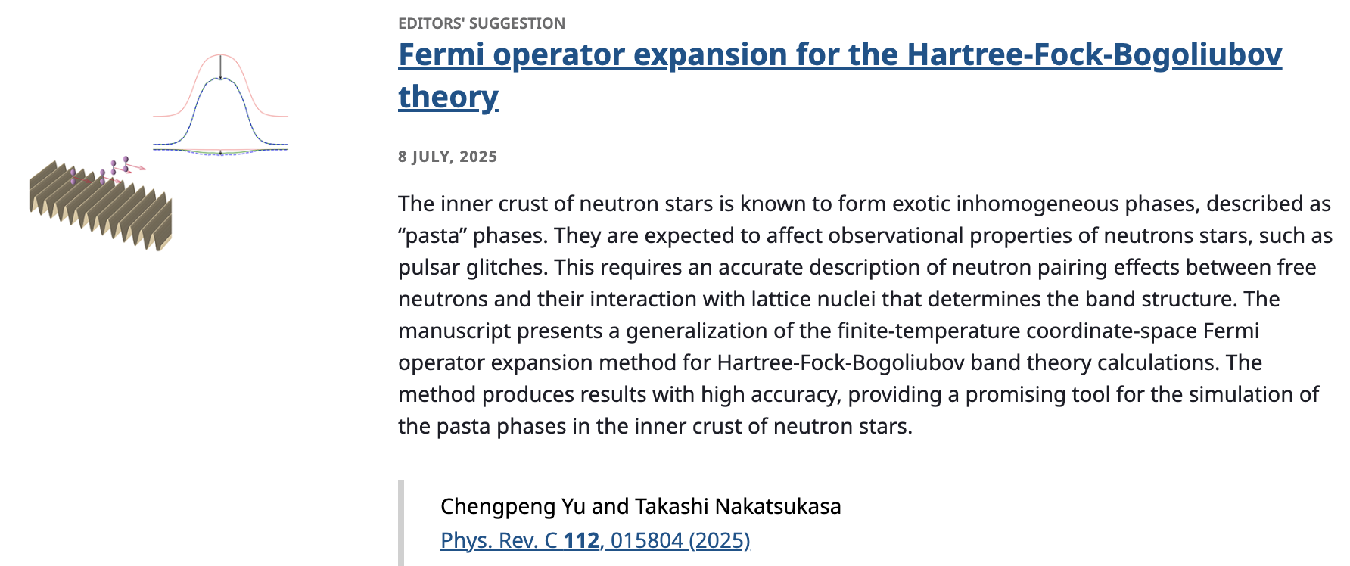

Slide 4
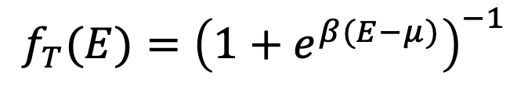


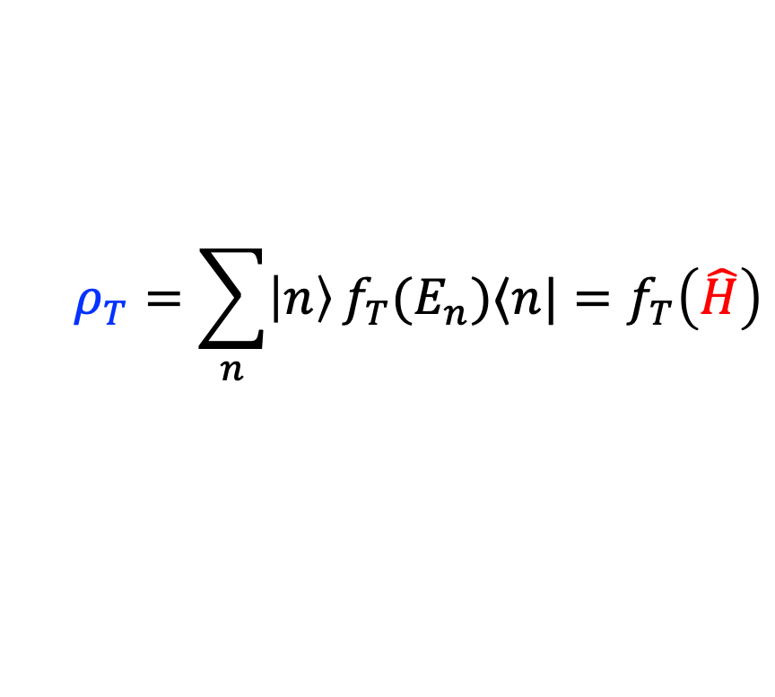
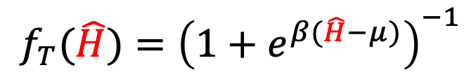
Density operator at finite T
Fermi-Dirac distribution function
Fermi-Dirac distribution operator ($\hat{H}$: s.p. Hamiltonian)
One-body density
$$f_{T}(E)={\left(1+e^{β(E−μ)}\right)}^{−1}$$
$$f_{T}(\hat{H})={\left(1+e^{β(\hat{H}−μ)}\right)}^{−1}$$
$$ρ_{T}=\sum_{n}{\left|n\right\rangle }f_{T}(E_{n})⟨n|=f_{T}\left(\hat{H}\right)$$
$$\hat{H}\left|n\right\rangle =E_{n}\left|n\right\rangle$$

Slide 5
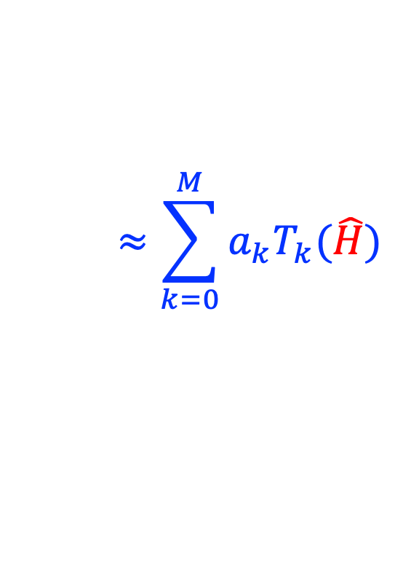
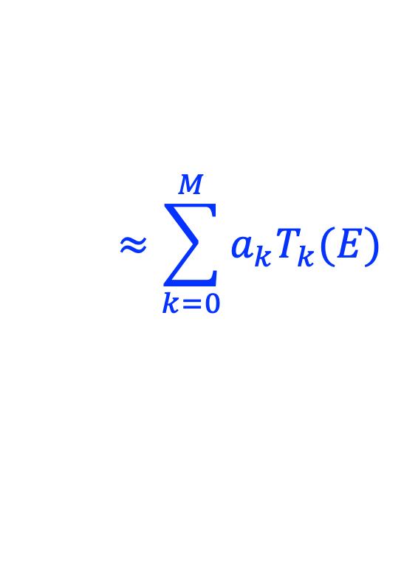
Density operator at finite T
Fermi-Dirac distribution function
Fermi-Dirac distribution operator
One-body density
$$≈\sum_{k=0}^{M}{a_{k}T_{k}(E)}$$
$$f_{T}(E)={\left(1+e^{β(E−μ)}\right)}^{−1}$$
$$f_{T}(\hat{H})={\left(1+e^{β(\hat{H}−μ)}\right)}^{−1}$$
$$ρ_{T}=\sum_{n}{\left|n\right\rangle }f_{T}(E_{n})⟨n|=f_{T}\left(\hat{H}\right)$$
$$≈\sum_{k=0}^{M}{a_{k}T_{k}(\hat{H})}$$
$$\hat{H}\left|n\right\rangle =E_{n}\left|n\right\rangle$$

Slide 6
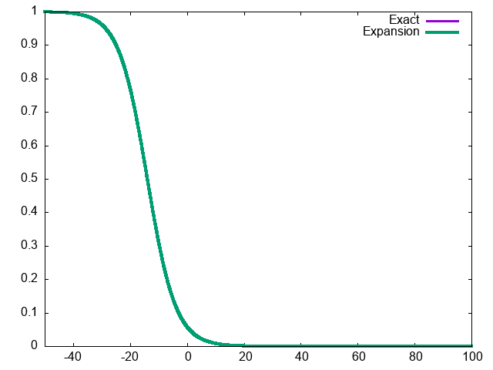
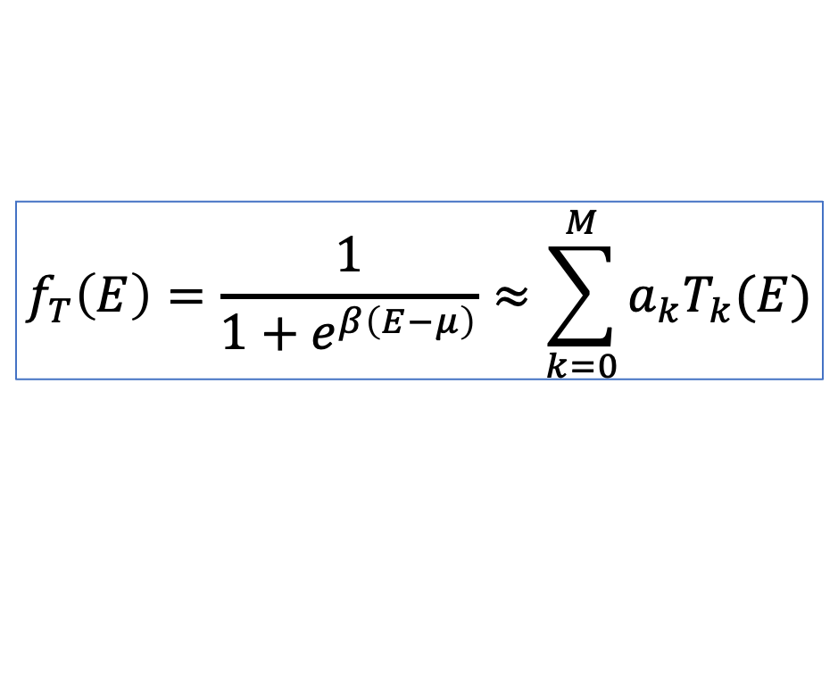

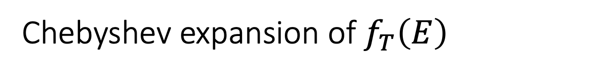


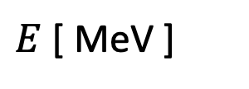
Chebyshev expansion of $f_{T}\left(E\right)$
$$μ=−14 MeV$$
$$T=5 MeV, M=200$$
$$f_{T}\left(E\right)$$
$$f_{T}\left(E\right)=\frac{1}{1+e^{β\left(E−μ\right)}}≈\sum_{k=0}^{M}{a_{k}T_{k}(E)}$$
$E$ [ MeV ]

Slide 7
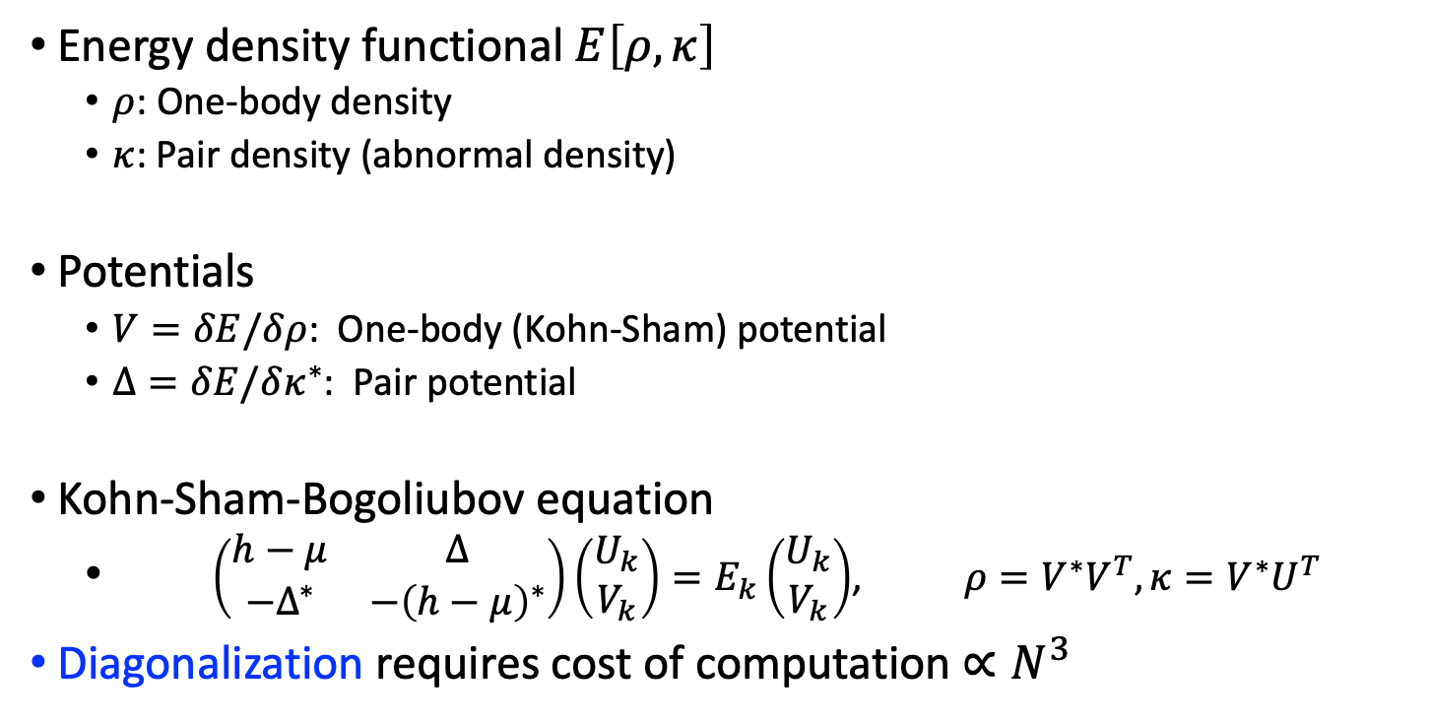


Energy density functional method
Energy density functional $E\left[ρ,κ\right]$
  $ρ$: One-body density
  $κ$: Pair density (abnormal density)
Potentials
  $V=δE/δρ$: One-body (Kohn-Sham) potential
  $Δ=δE/δκ^{∗}$: Pair potential
Kohn-Sham-Bogoliubov equation
  $\left(\begin{matrix}h−μ & Δ \\ −Δ^{∗} & −{\left(h−μ\right)}^{∗}\end{matrix}\right)\left(\begin{matrix}U_{k} \\ V_{k}\end{matrix}\right)=E_{k}\left(\begin{matrix}U_{k} \\ V_{k}\end{matrix}\right)$, $ρ=V^{∗}V^{T},κ=V^{∗}U^{T}$
Diagonalization requires cost of computation $∝N^{3}$
$$ρ\left(rσ,r′σ′\right)=\left\langle ψ^{†}\left(r′σ′\right)ψ(rσ)\right\rangle$$
$$κ\left(r\right)=\left\langle ψ\left(r↓\right)ψ(r↑)\right\rangle$$

Slide 8

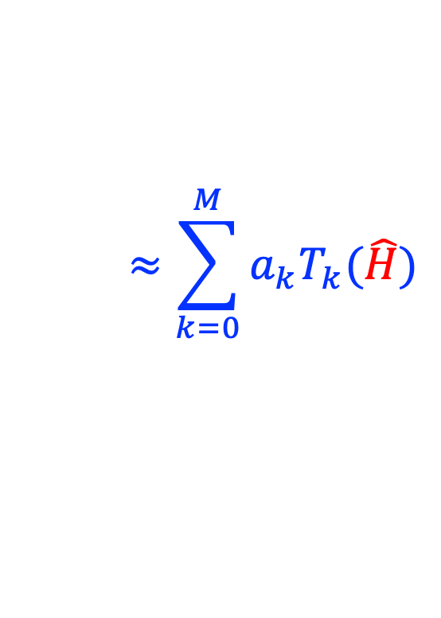

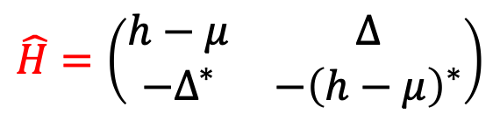
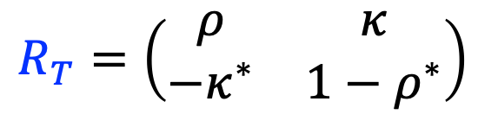
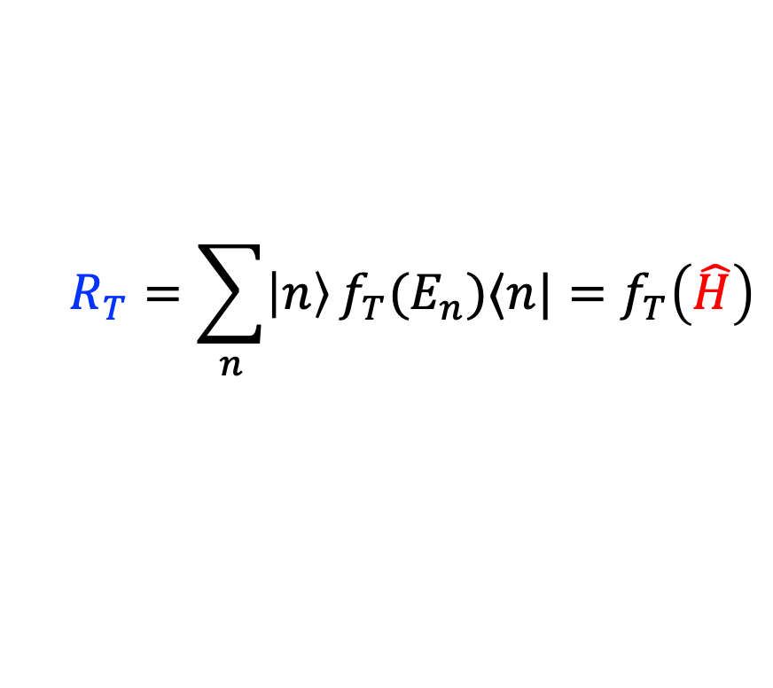
Generalized density operator at finite T
C.Yu, TN, PRC 112 (2025) 015804
Hamiltonian ($2×2$), Generalized density ($2×2$)
Fermi-Dirac distribution operator
Generalized one-body density
$$\hat{H}=\left(\begin{matrix}h−μ & Δ \\ −Δ^{∗} & −{\left(h−μ\right)}^{∗}\end{matrix}\right)$$
$$R_{T}=\left(\begin{matrix}ρ & κ \\ −κ^{∗} & 1−ρ^{∗}\end{matrix}\right)$$
$$f_{T}(\hat{H})={\left(1+e^{β(\hat{H}−μ)}\right)}^{−1}$$
$$≈\sum_{k=0}^{M}{a_{k}T_{k}(\hat{H})}$$
$$R_{T}=\sum_{n}{\left|n\right\rangle }f_{T}(E_{n})⟨n|=f_{T}\left(\hat{H}\right)$$

Slide 9
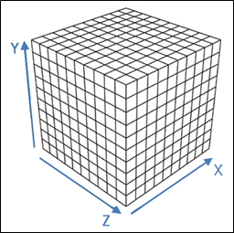
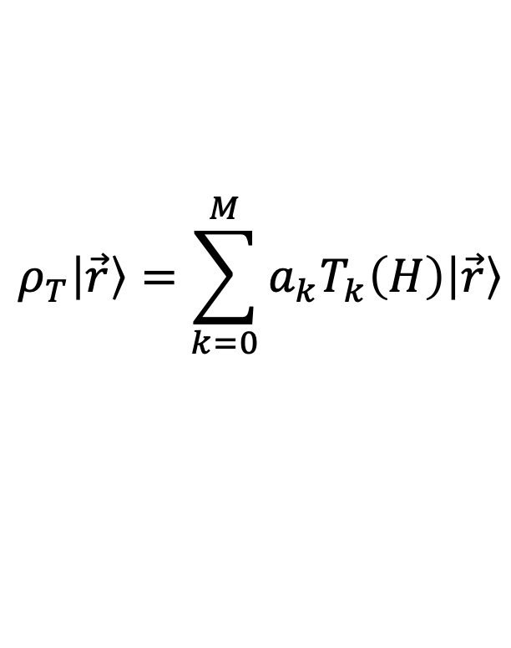
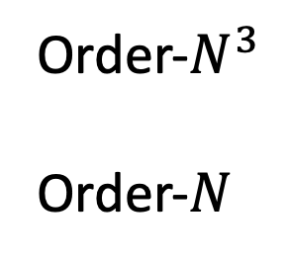
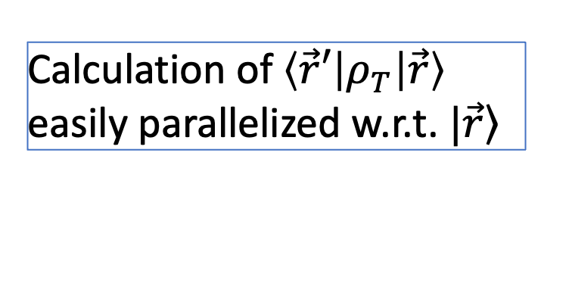
Code (suitable for parallel computing)
Fortran code with MPI+OpenMP
Energy density functional w/o pairing
  Rectangular box with periodic boundary condition
  FFT to construct the Coulomb potential
  Kinetic energy computed with the finite difference
  3D square lattice
$$ρ_{T}\left|\vec{r}\right\rangle =\sum_{k=0}^{M}{a_{k}T_{k}\left(H\right)\left|\vec{r}\right\rangle }$$
Order-$N^{3}$
Order-$N$
Calculation of $\left\langle \vec{r}′ | ρ_{T} | \vec{r}\right\rangle$
easily parallelized w.r.t. $|\left.\vec{r}\right\rangle$
“Near-sightedness”

Slide 10
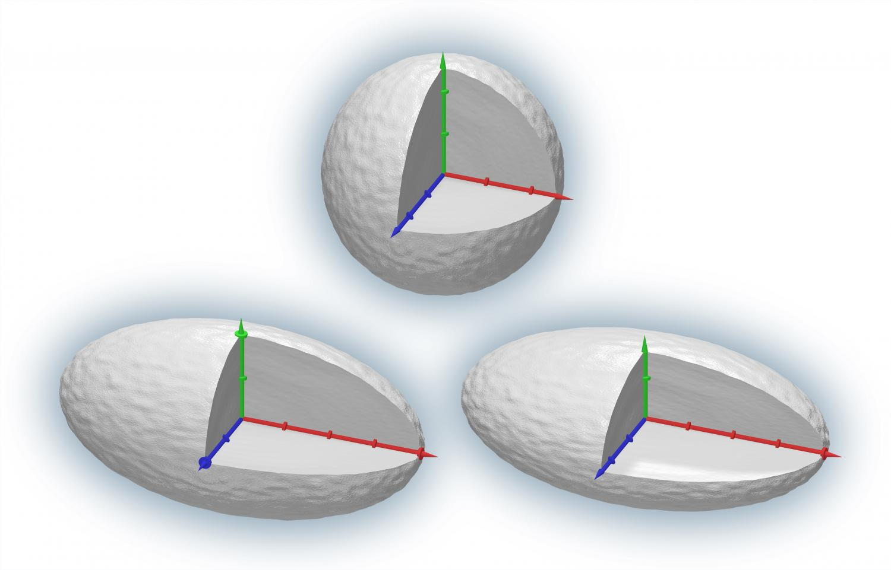



Shape phase transition: ²⁴Mg nucleus
Nakatsukasa, Phys. Rev. C 107, 015802 (2023)
$$E_{kin}$$
$$E$$
$$F$$
Spherical
Triaxial
Prolate
Uniform matter

Slide 11
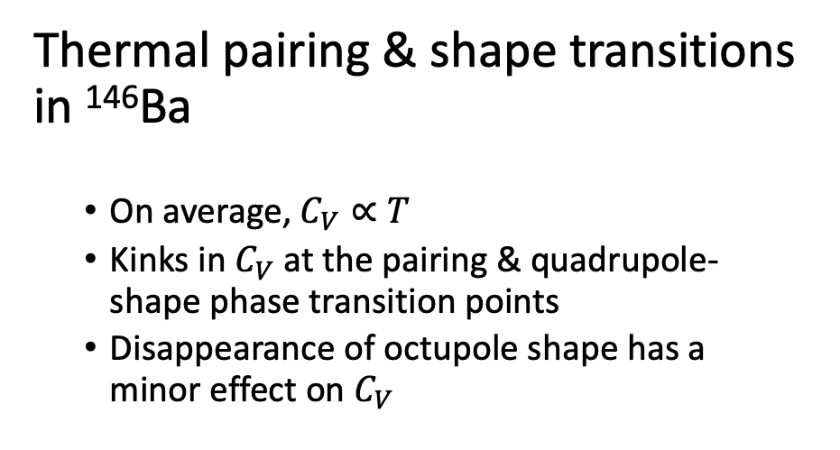
Pairing & shape transitions
Thermal pairing & shape transitions in ¹⁴⁶Ba
  On average, $C_{V}∝T$
  Kinks in $C_{V}$ at the pairing & quadrupole-shape phase transition points
  Disappearance of octupole shape has a minor effect on $C_{V}$
Kashiwaba, Nakatsukasa, Phys. Rev. C 101, 045804 (2020)

Slide 12
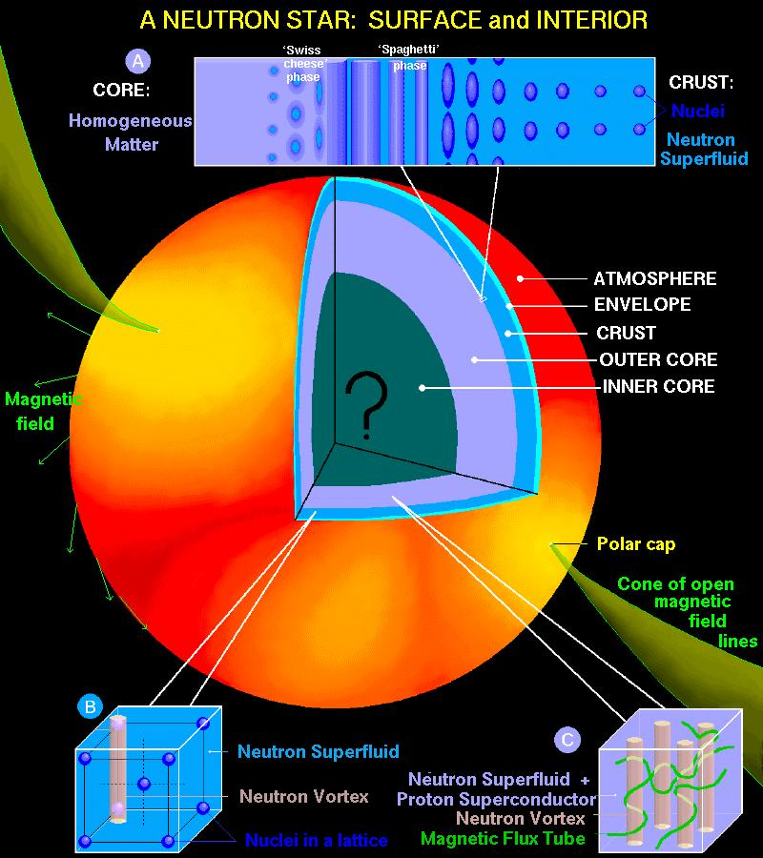

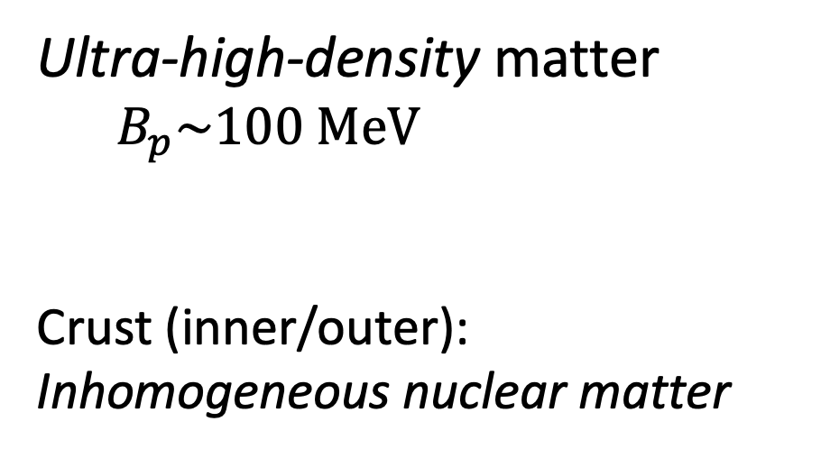
Neutron stars
Macroscopic nucleus
(Radius: ~10 km)
Ultra-high-density matter
  $B_{p}\sim 100 MeV$
Crust (inner/outer): Inhomogeneous nuclear matter
Courtesy to
Dany Page (UNAM)

Slide 13
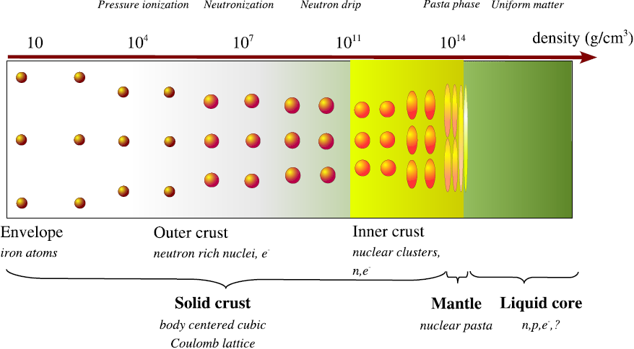
Crust of neutron stars
Chamel and Haensel, Living Rev. Relativity 11, 10 (2008)

Slide 14

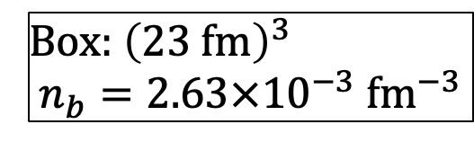

Inhomogeneous symmetric nuclear matter
Nakatsukasa, Phys. Rev. C 107, 015802 (2023)
Box: ${\left(23 fm\right)}^{3}$
$$n_{b}=2.63×{10}^{−3} fm^{−3}$$
From Bcc to simple cubic
$T=5$ MeV
$T=2$ MeV

Slide 15



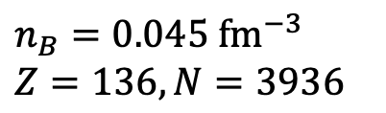
Benchmark calculation (fcc)
SLy4
Kashiwaba, Nakatsukasa, Phys. Rev. C 101, 045804 (2020)
Beta equilibrium state with fcc in a cell of ${\left(45 fm\right)}^{3}$
$T=200$ keV
Se
$$μ_{n}=10 MeV$$
$ρ_{n}=0.036 {fm}^{−3}$
$$Δ_{n}≈1.2 MeV$$
Se
Se
Se
$n_{B}=0.045 {fm}^{−3}$
$Z=136,N=3936$
Emergence of deformed Se nuclei “beyond drip line”

Slide 16
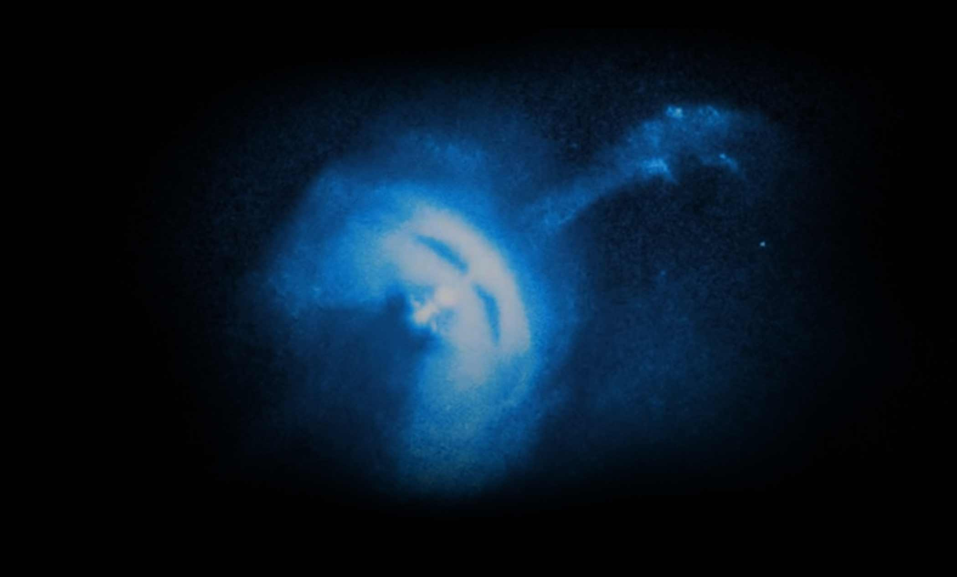
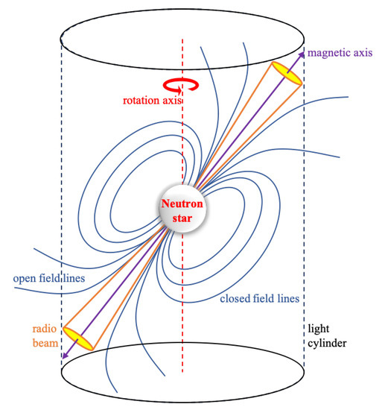
Pulsar glitch
S. Zhou et al., Universe 8, 641 (2022)

Slide 17
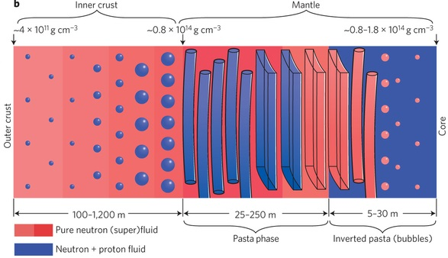
Inner crust
(ρ₀=3×10¹⁴ g cm⁻³ )
0.001ρ₀
0.5 ρ₀
Neutron drip line
Nuclei beyond the neutron drip line
+ low-density neutrons gas
+ electrons gas
William G. Newton (2013)

Slide 18
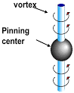
Most promising glitch mechanisms
Two components in the inner crust:
Charged nuclei and superfluid neutrons
Vortex pinning-unpinning (Anderson-Itoh 1975; Alper et al. 1981, 1993, 1996)
Glitch origin: Inner crust
Neutrons
Nuclei

Slide 19
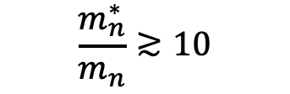
Glitch crisis?
Andersson et al., PRL 109, 241103 (2012)
Chamel, PRL 110, 011101 (2013)
Moments of inertia ratio with entrainment
N. Chamel, PRC 85, 035801 (2012)
$$\frac{m_{n}^{∗}}{m_{n}}≳10$$
Neutron gas is not “free”.
Contradiction with standard nuclear matter EOS
Need more superfluid neutrons in the crust

Slide 20
Slab phase (1D)
Band calculation
Kashiwaba, Nakatsukasa, Phys. Rev. C 100, 035804 (2019)

Slide 21
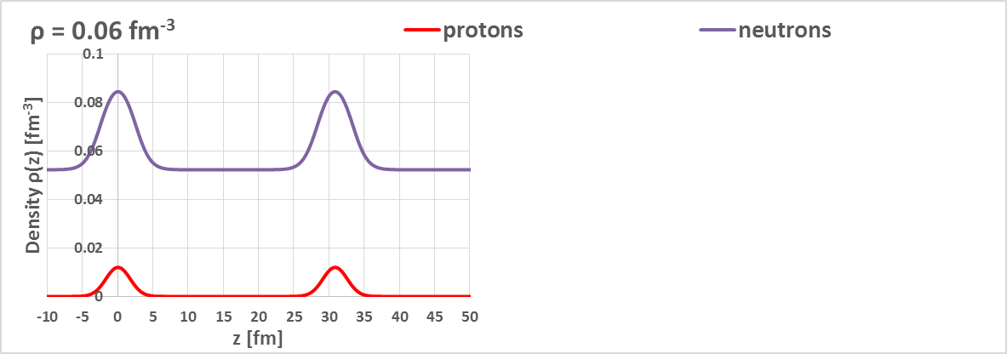
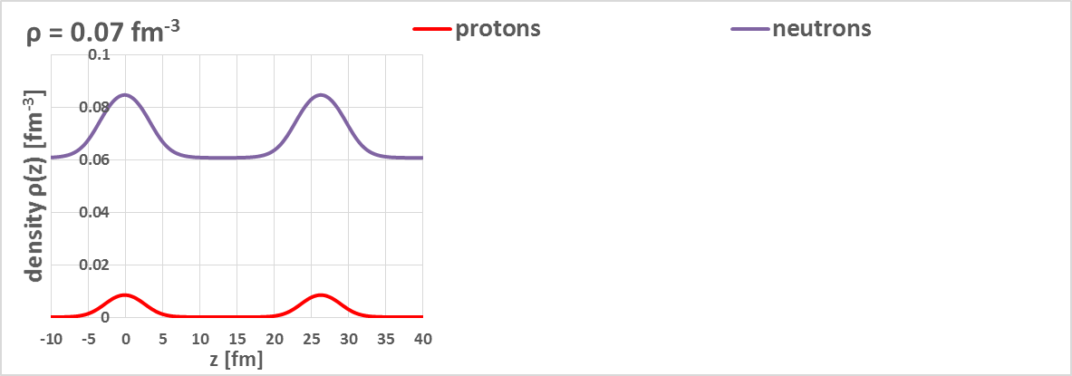
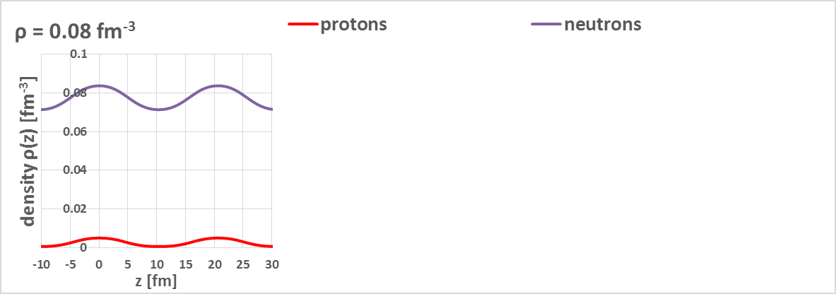




$ρ=0.06$ fm⁻³
Density distributions
Neutrons
beta equilibrium
$$μ_{n}=μ_{p}+μ_{e}$$
$$n⇆p+e+ν$$
30.8 fm
Protons
$ρ=0.07$ fm⁻³
Z/A = 2 ~4 %
26.4 fm
$ρ=0.08$ fm⁻³
Protons are also dripped near the transition to uniform matter
High density
20.4 fm

Slide 22


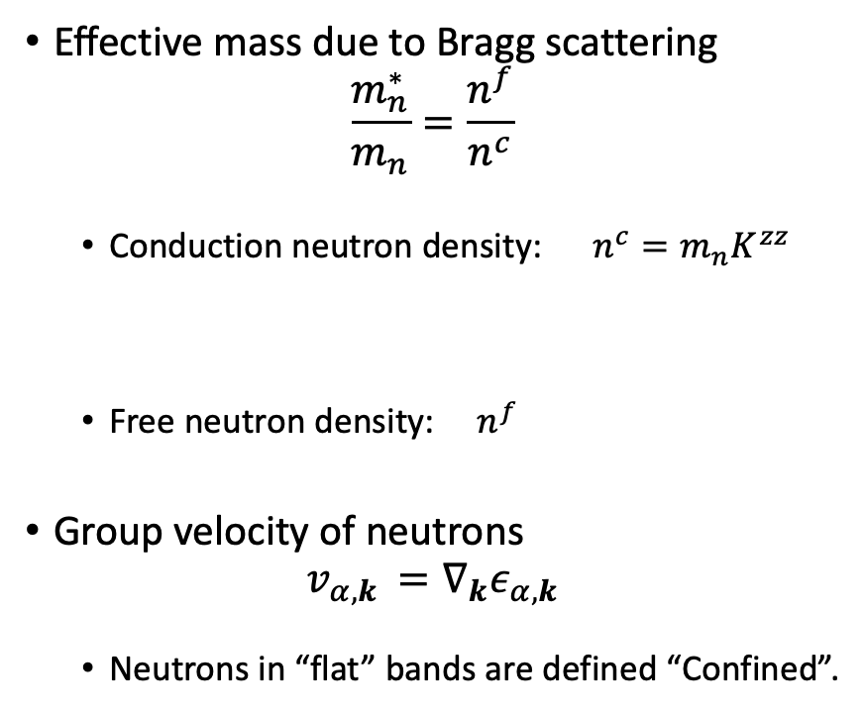







Effective mass
Effective mass due to Bragg scattering
$$\frac{m_{n}^{∗}}{m_{n}}=\frac{n^{f}}{n^{c}}$$
  Conduction neutron density: $n^{c}=m_{n}K^{zz}$
  Free neutron density: $n^{f}$
Group velocity of neutrons
$$v_{α,k }=∇_{k}ε_{α,k}$$
  Neutrons in “flat” bands are defined “Confined”.
$$n_{B}=0.07 {fm}^{−1}$$
Free neutrons
Confined neutrons
$$−0.12$$
$$−0.06$$
$$0$$
$$0.06$$
$$0.12$$
$$−π/a$$
$$π/a$$
$$k_{z} [ {fm}^{−1} ]$$

Slide 23
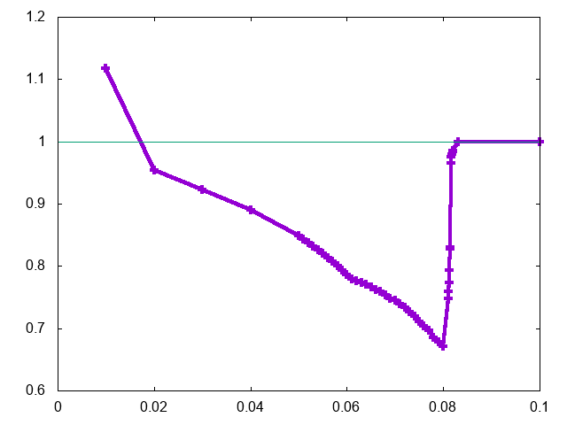
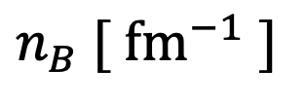



Anti-entrainment effect?
Kashiwaba, Nakatsukasa, Phys. Rev. C 100, 035804 (2019)
Uniform matter
Slab phase
$$\frac{m_{n}^{∗}}{m_{n}}=1$$
$$m^{∗}/m$$
$$\frac{m_{n}^{∗}}{m_{n}}≈0.7$$
The Bragg scattering enhances the neutron mobility!
$$n_{B} [ {fm}^{−1} ]$$
Anti-entrainment effect

Slide 24
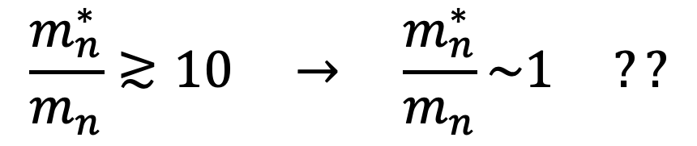
Effect of superfluid neutrons
$$\frac{m_{n}^{∗}}{m_{n}}≳10 → \frac{m_{n}^{∗}}{m_{n}}\sim 1 ??$$

Slide 25

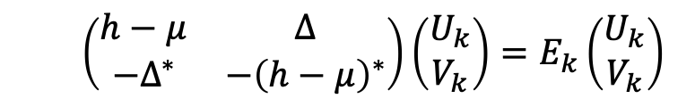
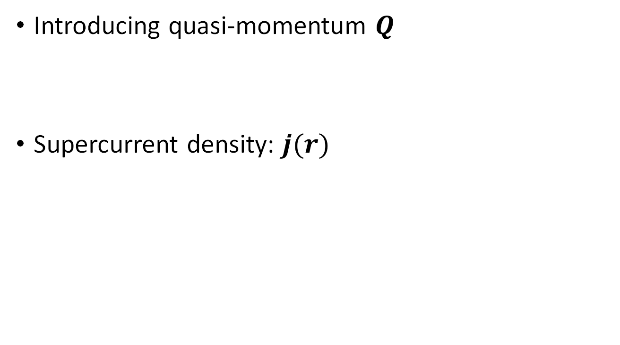
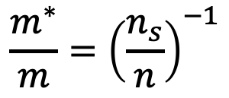
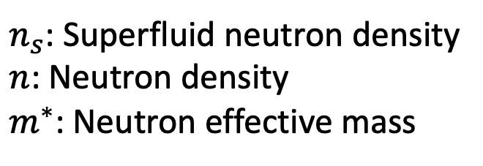
Superfluid current
  $$\left(\begin{matrix}h−μ & Δ \\ −Δ^{∗} & −{\left(h−μ\right)}^{∗}\end{matrix}\right)\left(\begin{matrix}U_{k} \\ V_{k}\end{matrix}\right)=E_{k}\left(\begin{matrix}U_{k} \\ V_{k}\end{matrix}\right)$$
Introducing quasi-momentum $Q$
Supercurrent density: $j(r)$
$$Δ\left(r\right)→ Δ{\left(r\right)e}^{2iQ⋅r}$$
$$\frac{m^{∗}}{m}={\left(\frac{n_{s}}{n}\right)}^{−1}$$
$n_{s}$: Superfluid neutron density
$n$: Neutron density
$m^{∗}$: Neutron effective mass

Slide 26










Superfluid neutrons: Reduction of effective mass
Adopting the potential at $n_{B}=0.07 {fm}^{−3}$
Band structure
$$m_{n}^{∗}/m_{n}$$
$$μ_{n}$$
$μ_{n}=3$ MeV
1
0
3
$$−\frac{π}{a}$$
$$\frac{π}{a}$$
$Δ_{n}$ [ MeV ]
$$k$$

Slide 27





Effective mass for superfluid neutrons
N. Chamel, PRC 85, 035801 (2012)
$$m_{n}^{∗}/m_{n}$$
$μ_{n}=3$ MeV
$2\sim 3.5$ (?)
$Δ_{n}$ [ MeV ]
$$0.6\sim 1$$
Superfluid effect: Reduction in effective mass (1/4 at low density)
Consistency with inner-crust origin of pulsar glitch phenomena

Slide 28

Summary
Fermi Operator Expansion
  Shape transitions at finite $T$
  FOE method to inhomogeneous nuclear matter (band calculation)
  Self-consistent band calculation: anti-entrainment
  Effect of superfluid neutrons
  ${m^{∗}}/m≈1/4$ at $n_{B}=0.02−0.03 {fm}^{−3}$
Possible revival of pulsar glitch model
Perspectives
  2D/3D calculation
Future issues
  Structure optimization at a given pressure
  Self-organized systems

Slide 29
Collaborators
Chengpeng Yu (Postdoc at Univ. Tsukuba)
Yu Kashiwaba (former PhD student)
Mao Tsuchida (former Msc student)

Slide 30




Multidisciplinary Cooperative Research & HPCI General Projects
筑波大学計算科学研究センター 学際共同利用 & HPCI一般利用課題
Miyabi
*Miyabiは、筑波大学計算科学研究センターと東京大学情報基盤センターが設置した最先端共同HPC基盤施設（ JCAHPC）によって運用されています。
*Miyabi is operated by JCAHPC : Joint Center for Advanced High Performance Computing

Slide 31
Backups

Slide 32



Order-N
Wu, Jayanthi, Phys. Rep. 358 (2002) 1
Iterative computation of $T_{k}\left(H\right)\left|i\right\rangle$
Calculation of $ρ_{T}\left(\vec{r},{\vec{r}}^{′}\right)$ requires only a region around ${\vec{r}}^{′}$
Truncation for $H^{n}\left|\vec{r}\right\rangle$, setting $c_{\vec{d}}=0$ for $\left|\vec{d}\right|>d_{0}$
$$H\left|\vec{r}\right\rangle =\sum_{\vec{d}}{c_{\vec{d}}|\vec{r}+\vec{d}⟩}$$
$$H^{n}\left|\vec{r}\right\rangle =\sum_{\vec{d}}{c_{\vec{d}}|\vec{r}+\vec{d}⟩}$$
Order-N

Slide 33








Off-diagonal elements of $ρ(0,\vec{r})$
$$\log\left|ρ(0,r)\right|$$
$$ρ_{B}=0.03 {fm}^{−3}$$
$T=5$ [ MeV ]
$T=50$ [ MeV ]
$T=10$ [ MeV ]
$r$ [ fm ]

Slide 34


Observation constraint
Andersson et al., PRL 109, 241103 (2012)
Moment of inertia ratio ($I_{n}$: Neutron MoI, $I$: Total MoI)
Characteristic age of pulsar
$$τ_{c}=−\frac{Ω_{p}}{2{\dot{Ω}}_{p}}$$
$$\sum_{i}{\frac{ΔΩ_{p}^{i}}{Ω_{p}}}$$
Mod. Julian date

Slide 35
Observation constraint
Andersson et al., PRL 109, 241103 (2012)
Moment of inertia ratio ($I_{n}$: Neutron MoI, $I$: Total MoI)
Characteristic age of pulsar
$$τ_{c}=−\frac{Ω_{p}}{2{\dot{Ω}}_{p}}$$
$$\sum_{i}{\frac{ΔΩ_{p}^{i}}{Ω_{p}}}$$
These ratios are consistent with the superfluid neutrons in the inner crust.
Mod. Julian date

Slide 36









Neutron bands
$μ_{n}=11.9$MeV
Free neutrons
Confined neutrons
$$−0.12$$
$$−0.06$$
$$0$$
$$0.06$$
$$0.12$$
$$−π/a$$
$$k_{z} [ {fm}^{−1} ]$$
$$π/a$$

