Slide 1



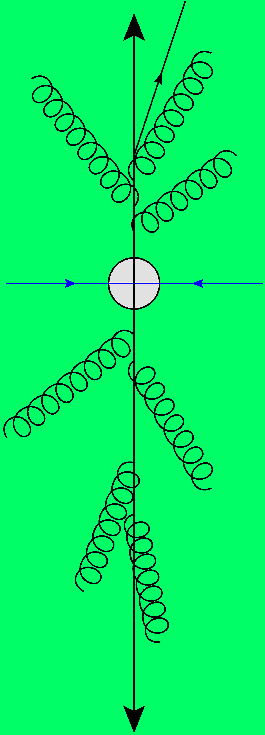
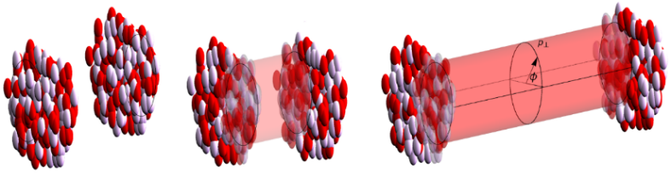
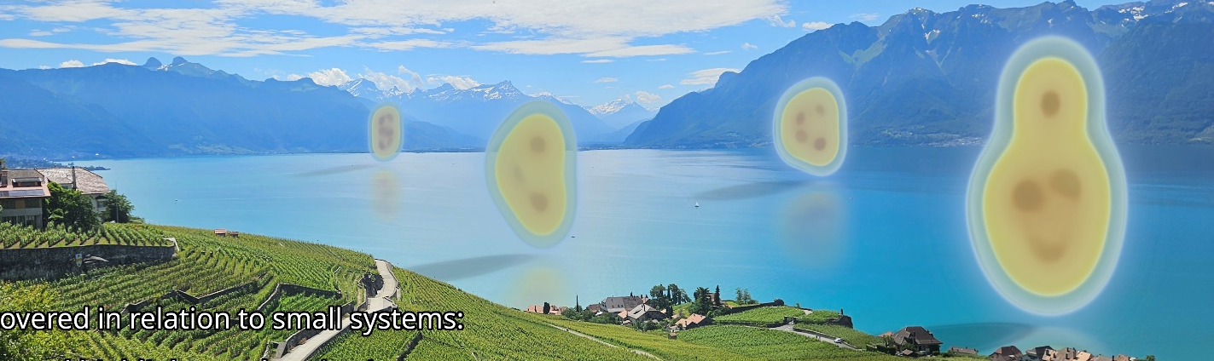
A theory discussion on new results from oxygen and neon collisions at the LHC
Work mostly with Govert Nijs and Giuliano Giacalone
Wilke van der Schee
Nuclear physics across energy scales, Wuhan
21 September 2025

Slide 2
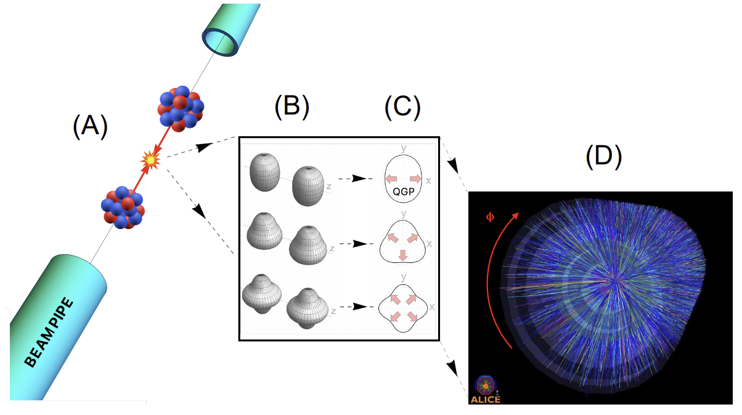
The shape of nuclei
Hydrodynamics converts position space anisotropy into momentum space anisotropy
Benjamin Bally, James Daniel Brandenburg, Giuliano Giacalone, Ulrich Heinz, Shengli Huang, Jiangoyng Jia, Dean Lee, Yen-Jie Lee, Wei Li, Constantin Loizides, Matthew Luzum, Govert Nijs, Jacquelyn Noronha-Hostler, Mateusz Ploskon, WS, Bjoern Schenke, Chun Shen, Vittorio Somà, Anthony Timmins, Zhangbu Xu and You Zhou
Imaging the initial condition of heavy-ion collisions and nuclear structure across the nuclide chart (2022)

Slide 3
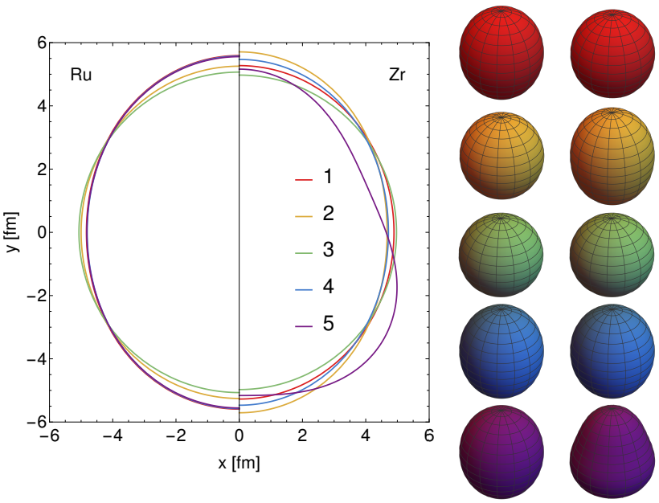
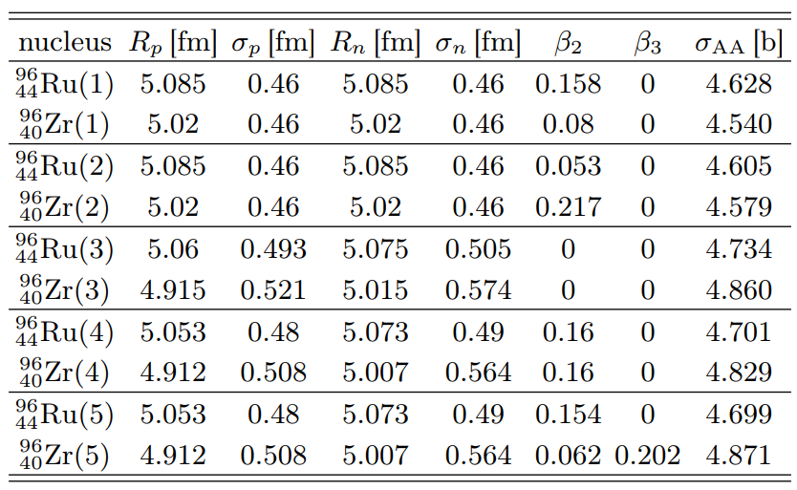
Isobar collisions at STAR
Wilke van der Schee, CERN
Five different cases simulated:
e-A scattering experiments(STAR case 1)
Theory (finite-range liquid drop model, STAR 2)
DFT with neutron skin (spherical) [1]
DFT with neutron skin (deformed, β₂ = 0.16) [1]
As 4, but with β₂ from electric transition probability and β₃ from comparing AMPT with STAR [2]
[1] Hao-jie Xua, Hanlin Lib, Xiaobao Wanga, Caiwan Shena and Fuqiang Wang, Determine the neutron skin type by relativistic isobaric collisions (2021)
[2] Chunjian Zhang and Jiangyong Jia, Evidence of quadrupole and octupole deformations in 96Zr+96Zr and 96Ru+96Ru collisions at ultra-relativistic energies (2021)

Slide 4



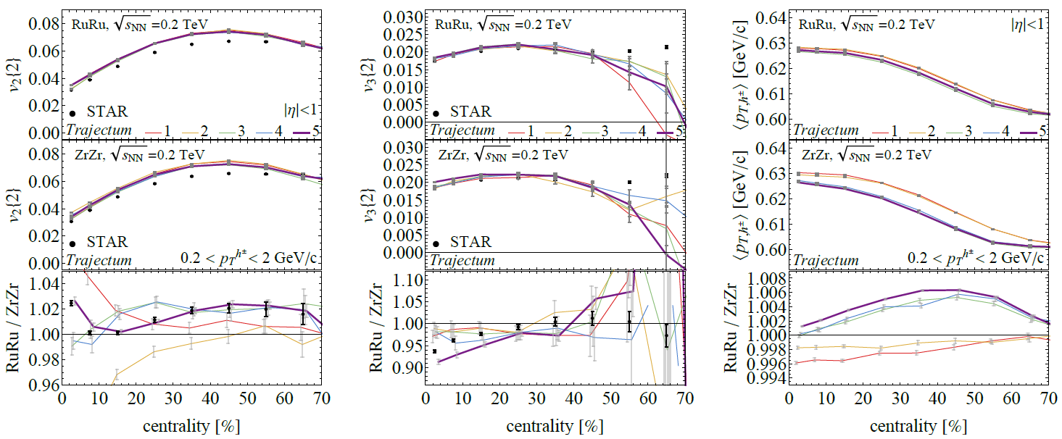
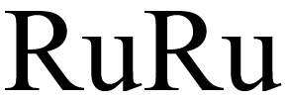
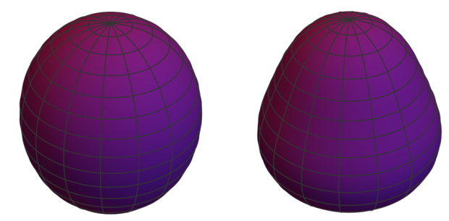
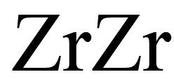
Isobar collisions at STAR – Flow and mean p_{T}
Wilke van der Schee, CERN
Statistics better for best case (5, with 5M collisions)
Excellent fit, especially for v2 ratio, v3 ratio overestimated at central
Note that Trajectum is not fitted to RHIC energies, no absolute agreement
Mean transverse momentum is a prediction
STAR, Search for the Chiral Magnetic Effect with Isobar Collisions at √s_{NN} = 200 GeV by the STAR Collaboration at RHIC (sept 2021)

Slide 5
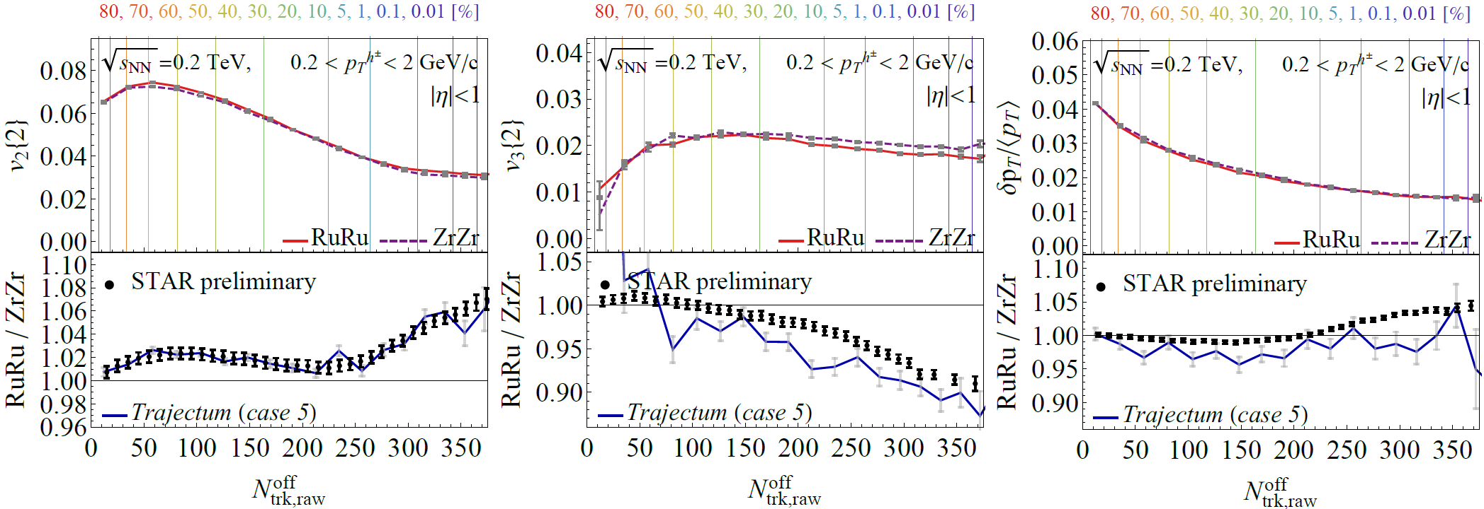


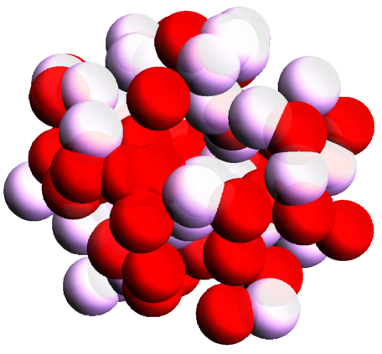
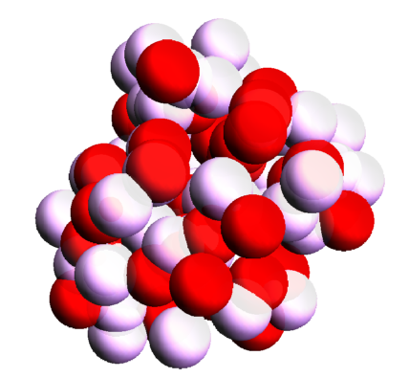
Extremely ultracentral collisions
Wilke van der Schee, CERN
Going to 0.01% centrality (we sample from 250M Trento events)
Excellent match v2, v3 en pt fluct somewhat overpredicted
Extremely ultracentral is ideal regime to probe nuclear structure
> β₂
> β₃
Averaged
Fluctuating (realistic)
ATHIC2021 talk Chunjian Zhang, https://drupal.star.bnl.gov/STAR/files/ATHIC_Nov_STAR_SBU_ChunjianZhang.pdf

Slide 6
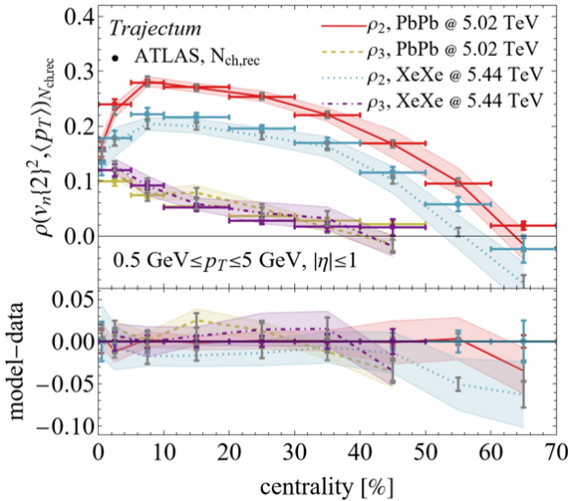
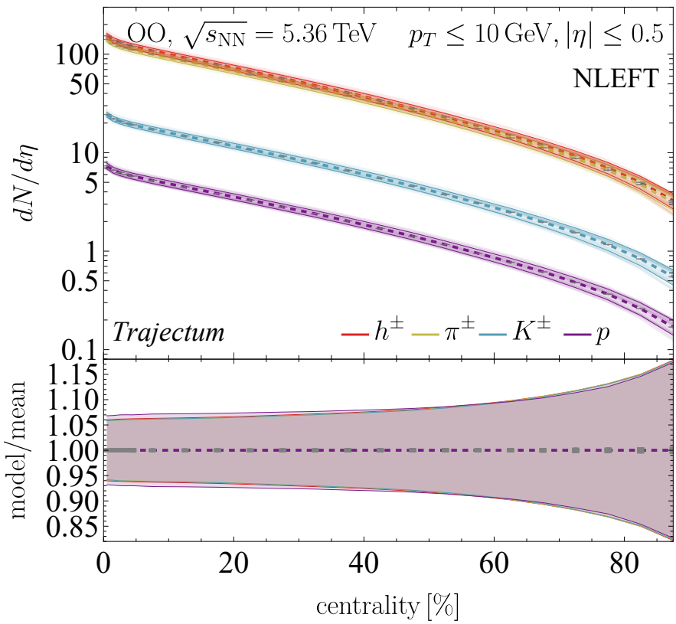
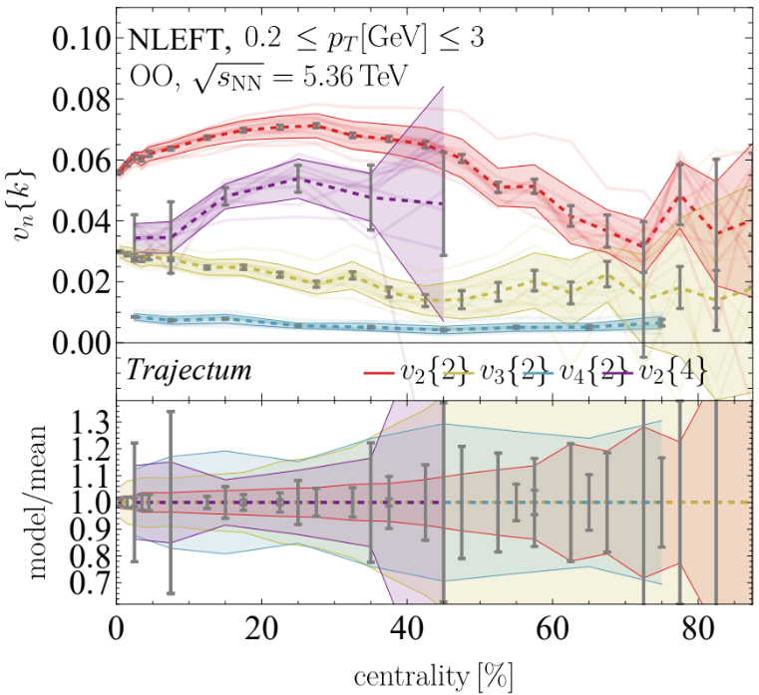
Exciting times: heavy ions is now a precision science
Systematic uncertainties, also in theoretical estimates
Uncertainty comes from Bayesian posterior
Full correlations among datapoints is included
Uncertainties can be small
~6% for multiplicity in OO
~2-5% for anisotropic flow (except v₂{4}: statistics dominate)
Corollaries:
We need to understand the shapes of colliding nuclei precisely
We need to have the full model of heavy ion collisions under control
This is necessary to understand `the details’ such as:
Hydrodynamisation
Extreme hydrodynamics: when gradients are large
First and second order viscous gradient corrections, during hydro and freeze-out
Giuliano Giacalone et al, The unexpected uses of a bowling pin: exploiting 20Ne isotopes for precision characterizations of collectivity in small systems (2024)
CMS, First measurement of pseudorapidity distributions of charged hadrons in oxygen-oxygen collisions at √s_{NN}= 5.36 TeV (2025)

Slide 7
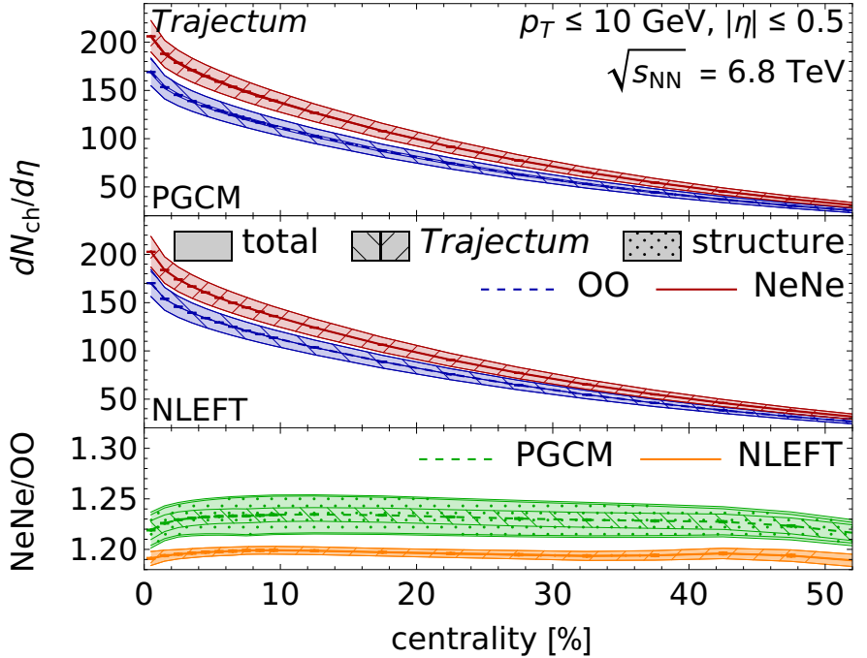
Exciting times: light ion collisions allow(ed?) for genuine predictions
Hydrodynamic predictions for light ion collisions All the way to dN/dη ~ 10; hydro at its limits?
Model is (only!) fitted to PbPb data
We will get back to structure shortly
Giuliano Giacalone et al, The unexpected uses of a bowling pin: exploiting 20Ne isotopes for precision characterizations of collectivity in small systems (2024)
CMS, First measurement of pseudorapidity distributions of charged hadrons in oxygen-oxygen collisions at √s_{NN}= 5.36 TeV (2025)

Slide 8

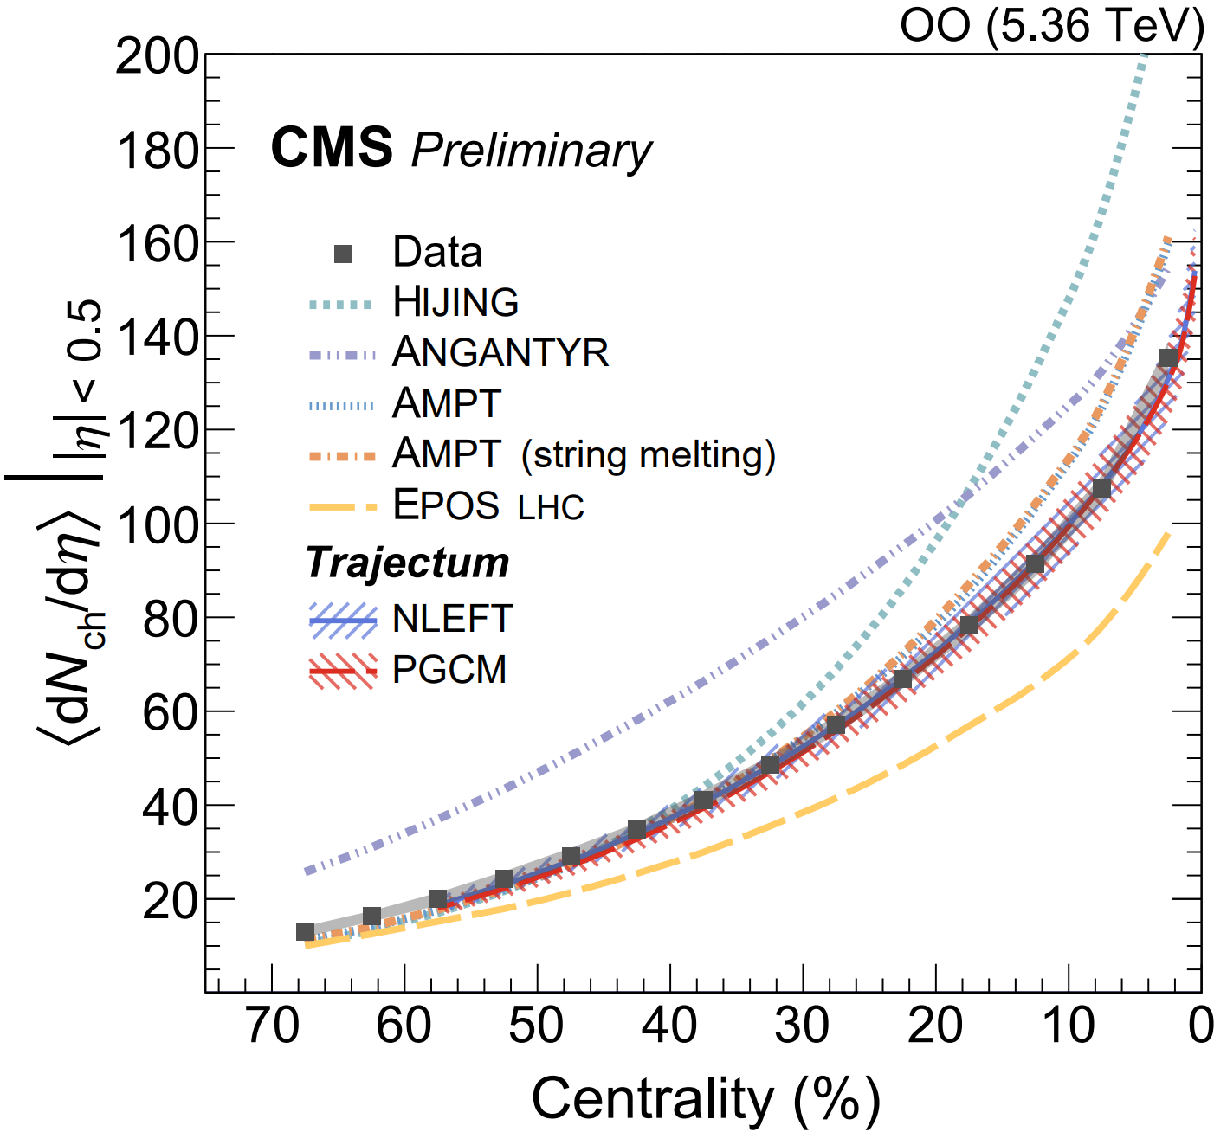
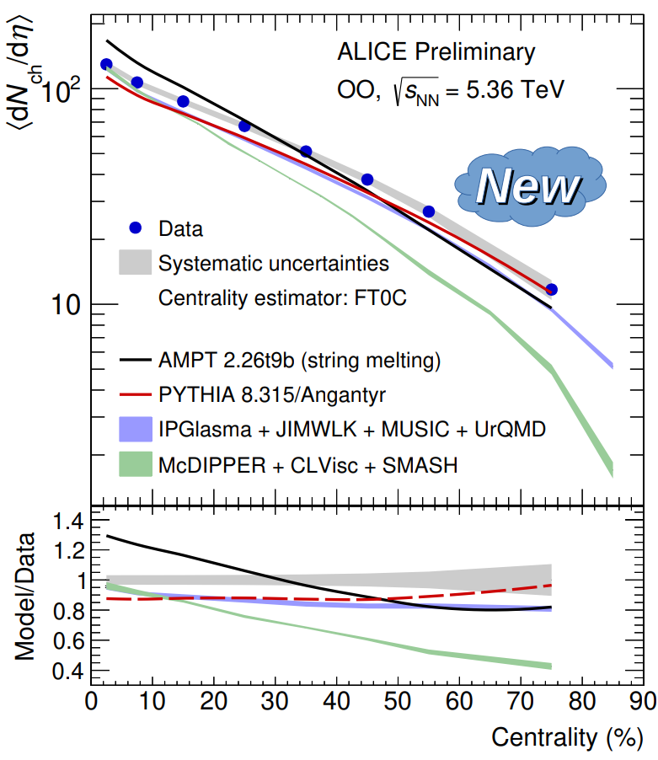
Exciting times: light ion collisions allow(ed?) for genuine predictions
Hydrodynamic predictions for light ion collisions All the way to dN/dη ~ 10; hydro at its limits?
Model is (only!) fitted to PbPb data
We will get back to structure shortly
Agreement almost too good to be true? Also: non-hydro models tend to be off (but notice lack of syst uncertainty)
Giuliano Giacalone et al, The unexpected uses of a bowling pin: exploiting 20Ne isotopes for precision characterizations of collectivity in small systems (2024)
CMS, First measurement of pseudorapidity distributions of charged hadrons in oxygen-oxygen collisions at √s_{NN}= 5.36 TeV (2025)
https://indico.cern.ch/event/1479384/contributions/6663047/attachments/3131557/5555439/IS_mult_v3.pdf

Slide 9
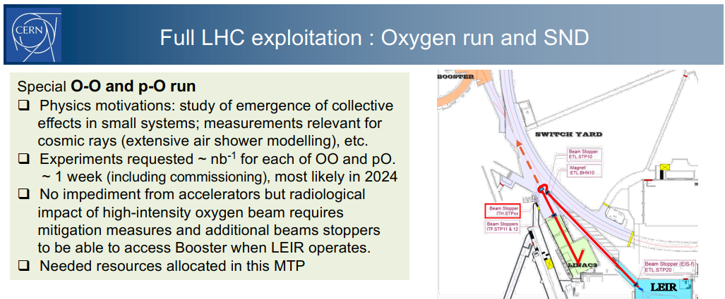
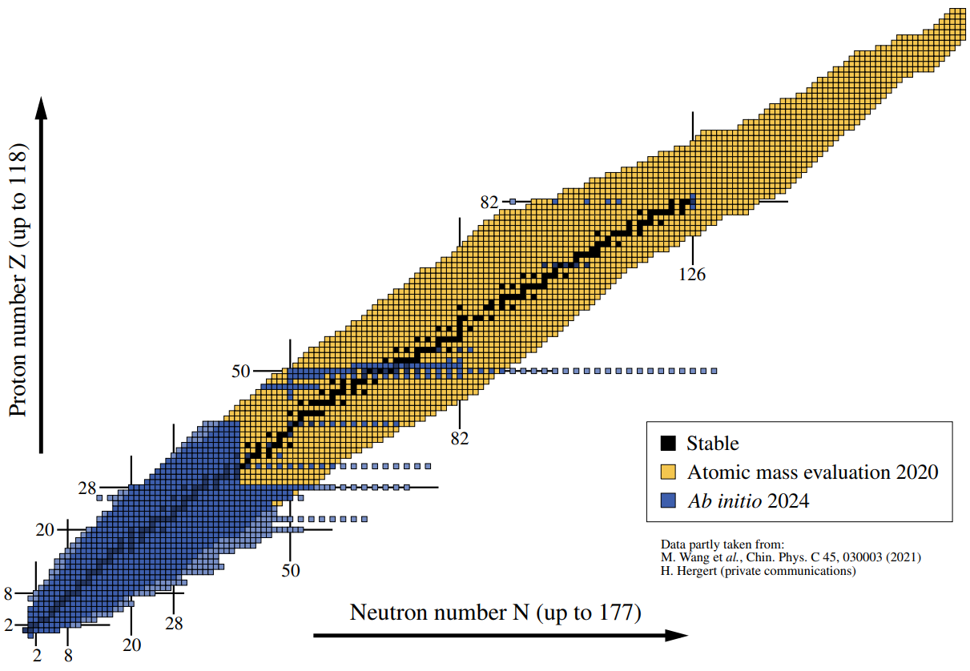
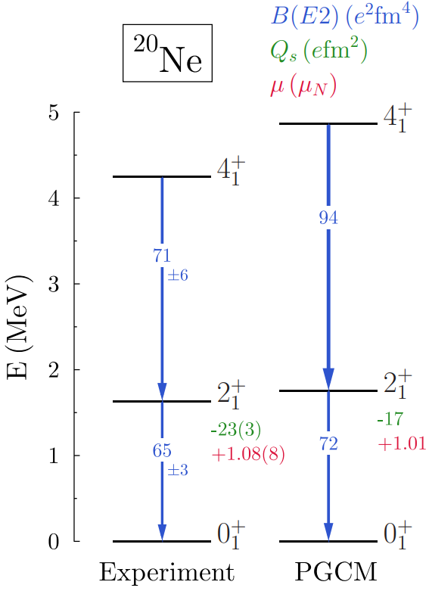
Synergy between HIC and nuclear structure
LHC seems like an expensive machine to determine the shapes of nuclei
Ion collisions are unique: yoctosecond imaging of the ground state
Much like a collapse of the wave function (nucleon positions)
Thickness function: two-dimensional projection / random orientation
Very complementary to `standard’ nuclear structure:
Charge profile, excitation energies, isospin density (PREX)
Two-way transfer: heavy ion community needs to know the structure accurately
Fluctuations are enormous
Unlikely to learn much without full control of the shape
Giuliano Giacalone et al, Nuclear Physics Confronts Relativistic Collisions Of Isobars (2025)

Slide 10
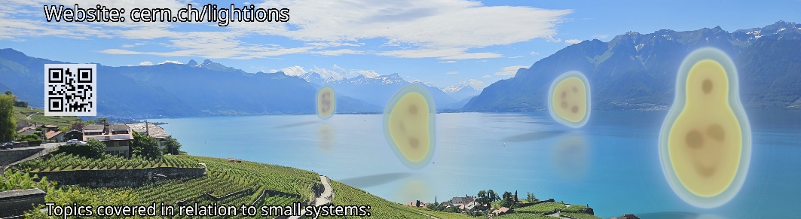

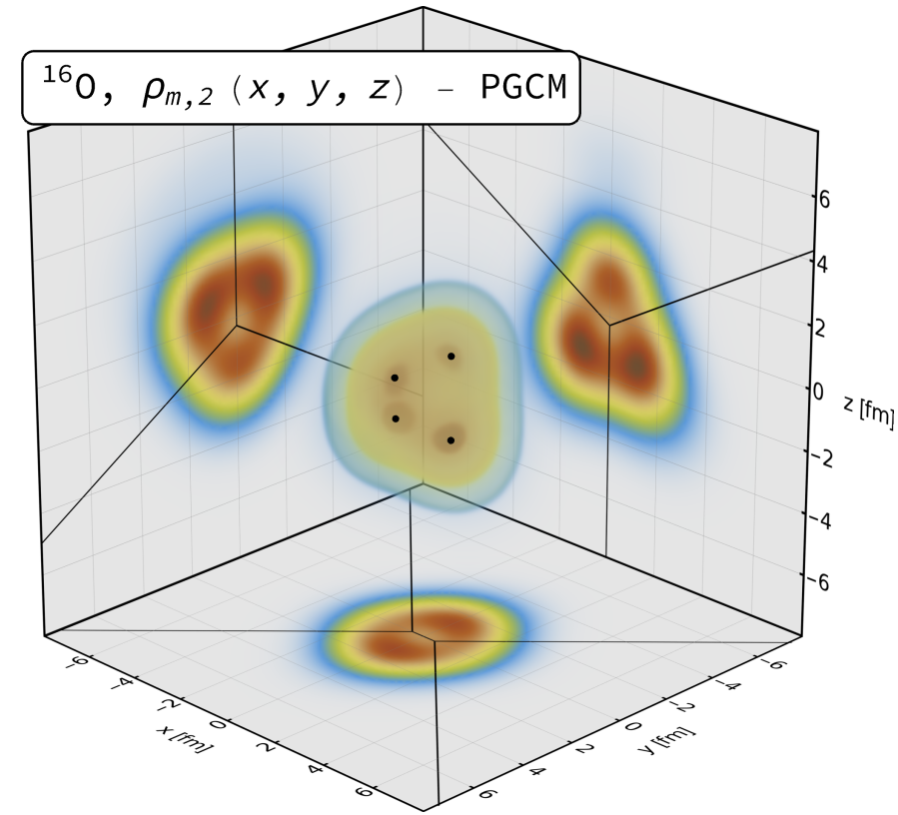
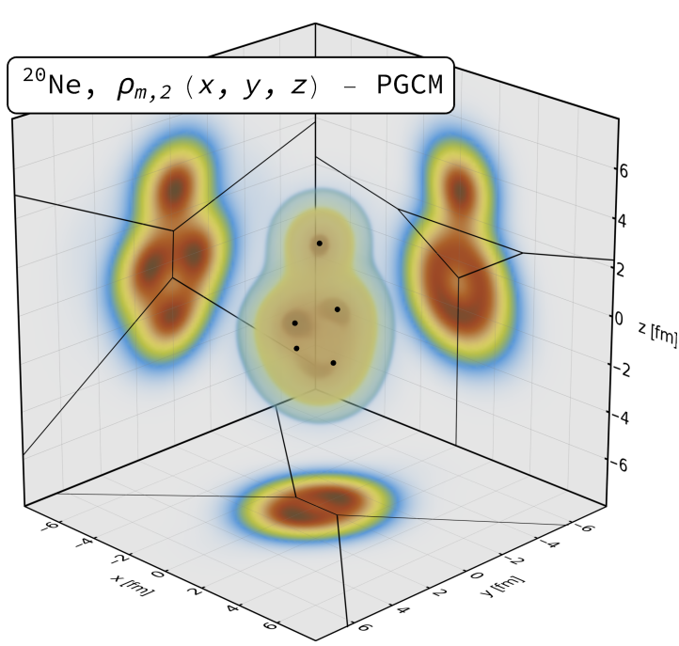
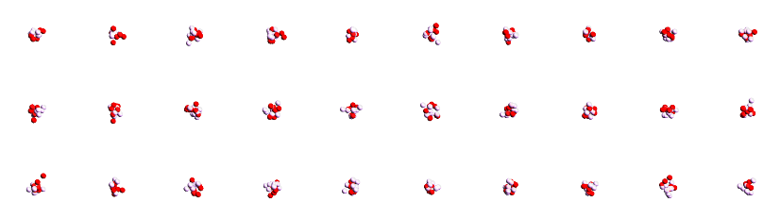
¹⁶Oxygen and ²⁰Neon nuclear structure
Studied using two complementary nuclear structure methods:
State-of-the-art Projected Generator Coordinate Method (PGCM)
N³LO chiral EFT with Hartree-Fock-Bogoliubov constrained states
We sample 4 nucleons in Voronoi regions determined by 4 or 5 local maxima
`Pinhole’ configurations from Nuclear Lattice Effective Field Theory (NLEFT)
Minimal pionless EFT Hamiltonian, lattice of eight sites (spacing = 1.315fm)
Output is directly nucleon positions (!) (but note negative weights for 1/3 configs ☹)
We still cluster the nucleons to optimise the breaking of periodic lattice
Giuliano Giacalone, Benjamin Bally, Govert Nijs, Shihang Shen et al,The unexpected uses of a bowling pin: exploiting 20Ne isotopes for precision characterizations of collectivity in small systems (2024)

Slide 11
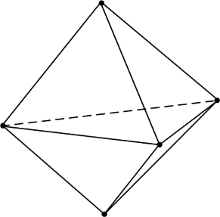
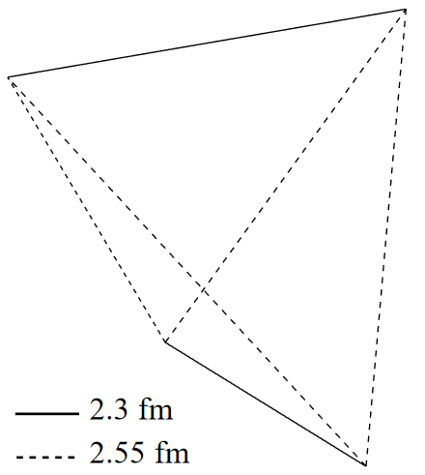
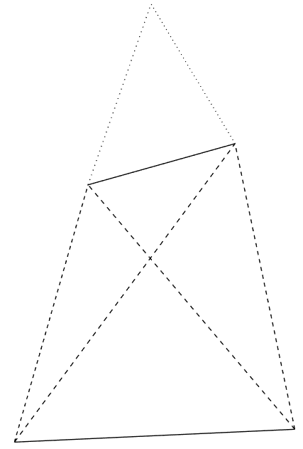
Alphas from nuclear structure
Two big surprises (at least to me ☺)
¹⁶O alphas do not form a regular tetrahedron (!) → more like two coupled rods Similar results in NLEFT
²⁰Ne alphas do not form a bipyramid (!) → seemingly randomly placed on top… (was a challenge to find due to breaking of symmetry, credit to Benjamin Bally)
Of course the intuition of alphas as point particles with interaction energy is really quite naïve…
Giuliano Giacalone, Benjamin Bally, Govert Nijs, Shihang Shen et al,The unexpected uses of a bowling pin: exploiting 20Ne isotopes for precision characterizations of collectivity in small systems (2024)

Slide 12
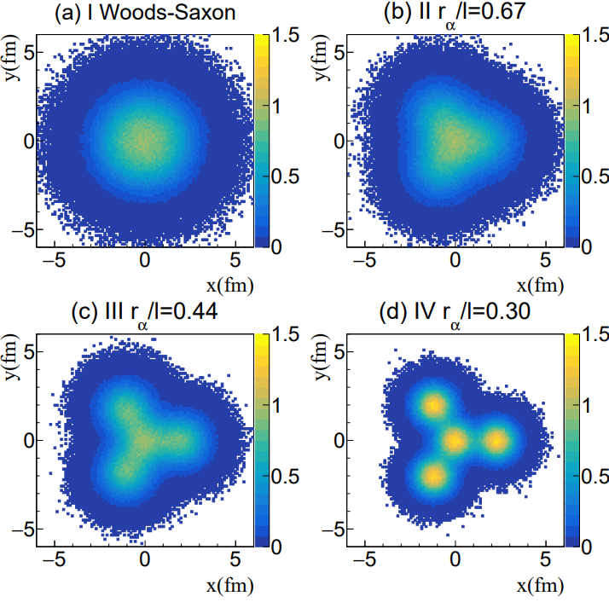
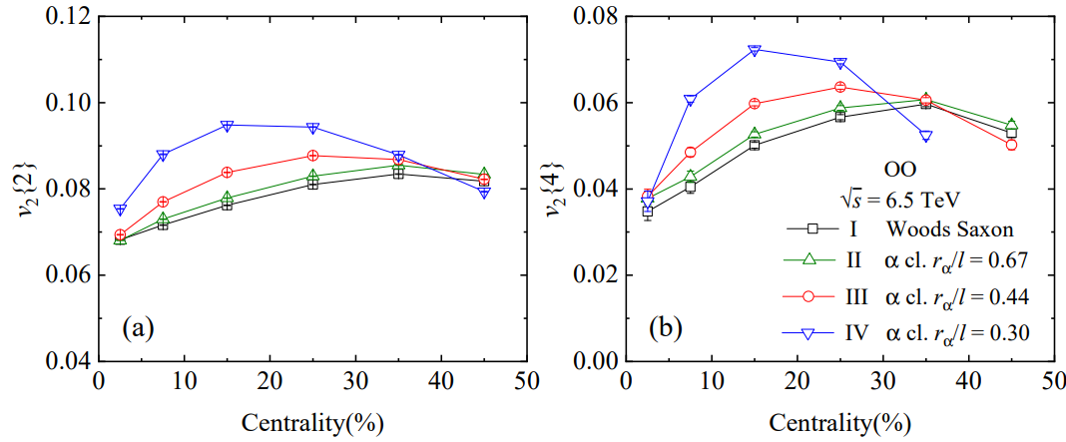
How do we see α-clustering?
The first obvious try: compare Woods-Saxon with alpha clustered shape
Significantly different flow
PGCM ab initio close to case II (green, not very different from WS)
But how to correct for systematic uncertainty due to viscosity etc etc?
Nicholas Summerfield, Bing-Nan Lu, Christopher Plumberg, Dean Lee, Jacquelyn Noronha-Hostler and Anthony Timmins, 16O16O at RHIC and the LHC comparing α clustering vs substructure (2021)
Yuanyuan Wang, Shujun Zhao, Boxing Cao, Ho-jie Xu and Huichao Song, Exploring the compactness of α cluster in 16O nuclei with relativistic 16O+16O Collisions (2024)

Slide 13
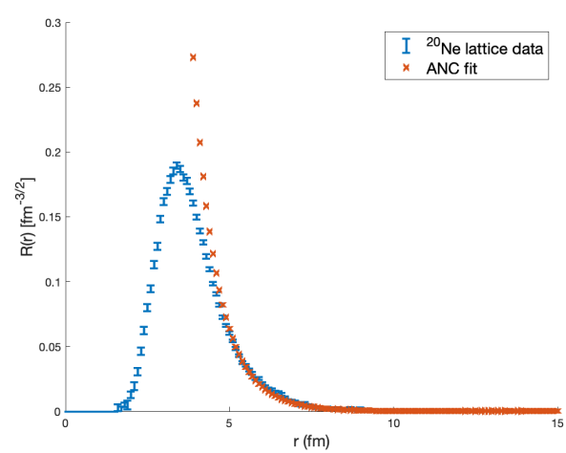
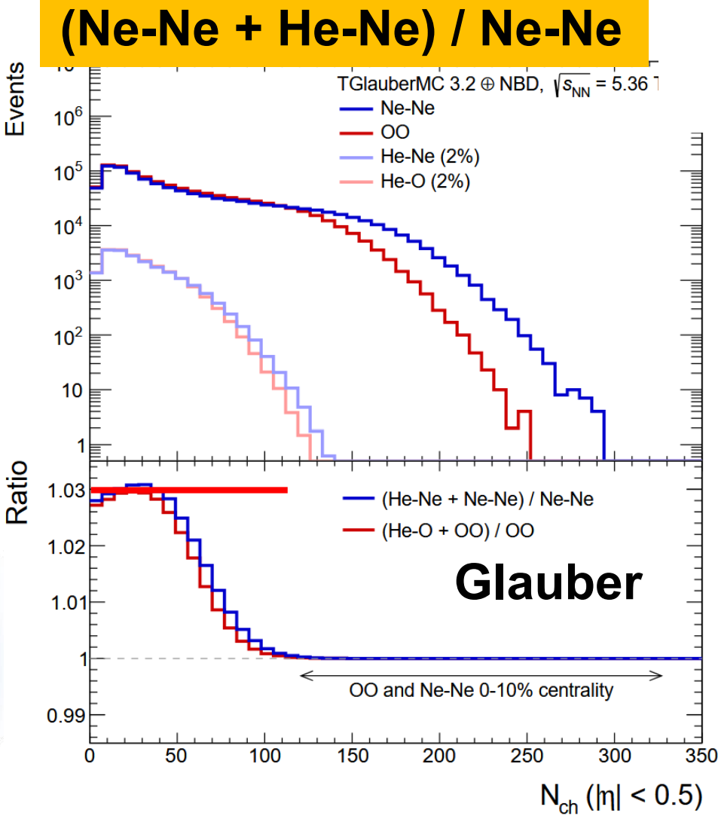
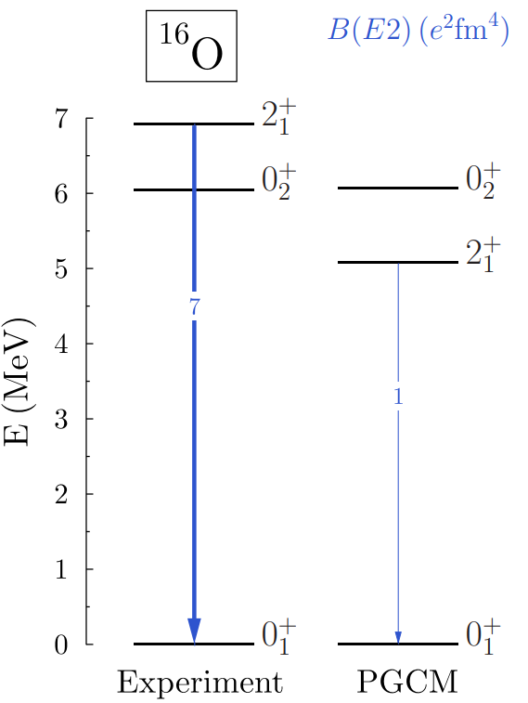
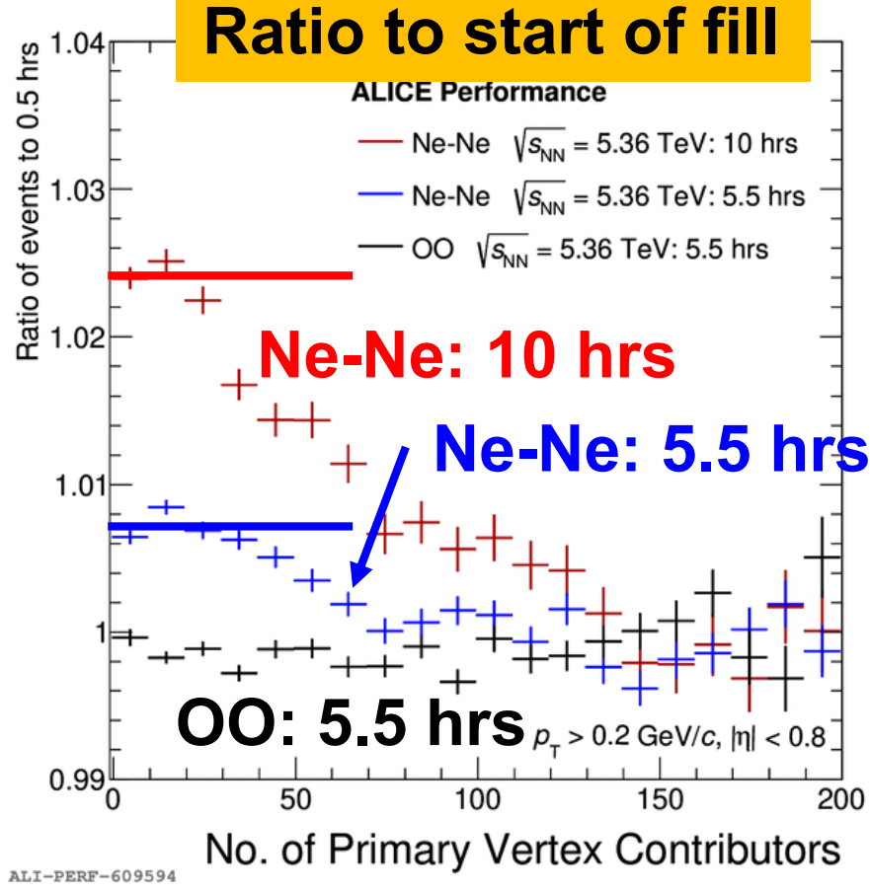
Did we see α – clustering? (I think yes)
After 10 hours convincingly 2% ²⁰Ne – ⁴He collisions in ALICE
Not seen in Oxygen collisions (!)
Not yet seen in other experiments (pile-up, different bunches?)
The (only?) convincing argument why this happens:
Neon top α breaks off
Related: First excited state Neon much lower energy
Much more convincing than flow measurements
Unexpected benefit: first time asymmetric nuclear collisions at top LHC energy (!)
Especially mean p_{T} will be interesting to verify size and hydrodynamic paradigm
Possible to distinguish E-by-E? V0A versus V0C, ZDC asymmetry, mean p_{T}?
E. Harris et al, Quantifying α clustering in the ground states of ¹⁶O and ²⁰Ne (2025)
Govert Nijs and WS, Transmutation of 16O and 20Ne at the Large Hadron Collider (2025)
https://indico.cern.ch/event/1436085/contributions/6107509/attachments/2966206/5218662/talk_bally_cern_13112024.pdf
https://indico.cern.ch/event/1479384/contributions/6631982/attachments/3130687/5553818/JFGO8p.pdf

Slide 14
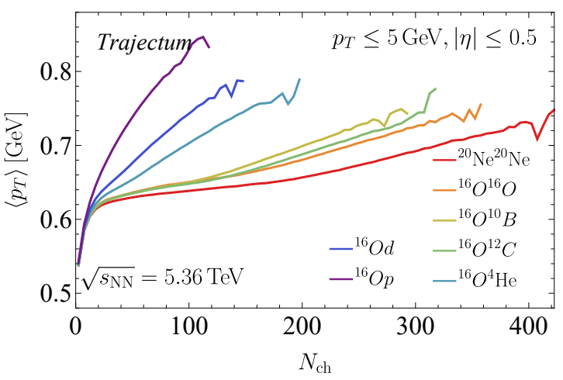
Transmutation: a prediction
The mean transverse momentum of Ne-He will be measured and large
Close analogy with `speed of sound’, or ultracentral PbPb
But in much smaller system (!)
WS and Govert Nijs, Transmutation of 16O and 20Ne at the Large Hadron Collide (2025)

Slide 15
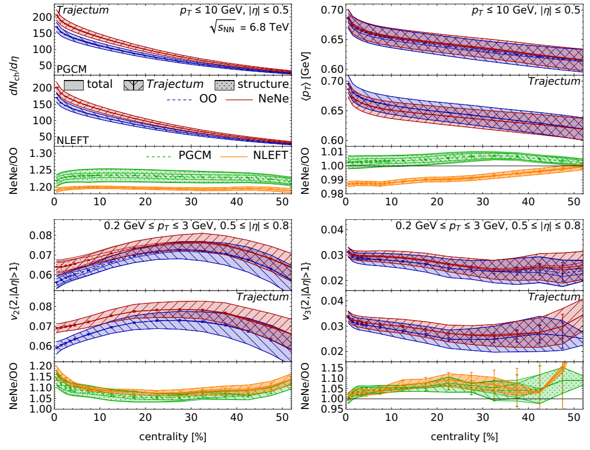
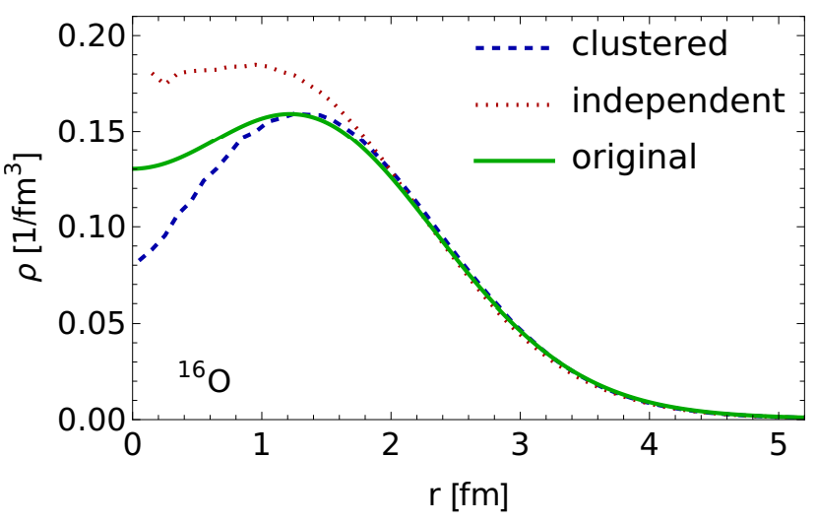
Hydrodynamic predictions --- four observables
Important: systematic uncertainty
From hydro: Bayesian posterior (Trento, viscosity etc etc)
From structure:
PGCM: mostly sampling from density profile
NLEFT: breaking of periodicity, reweighting action
Most of hydro uncertainty cancels in Ne/O ratios

Slide 16
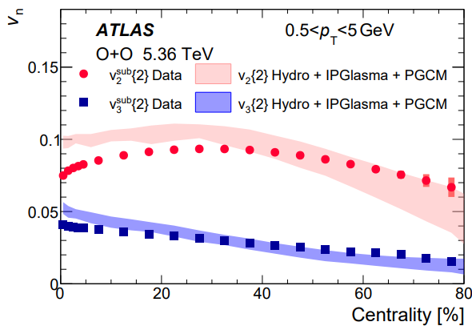
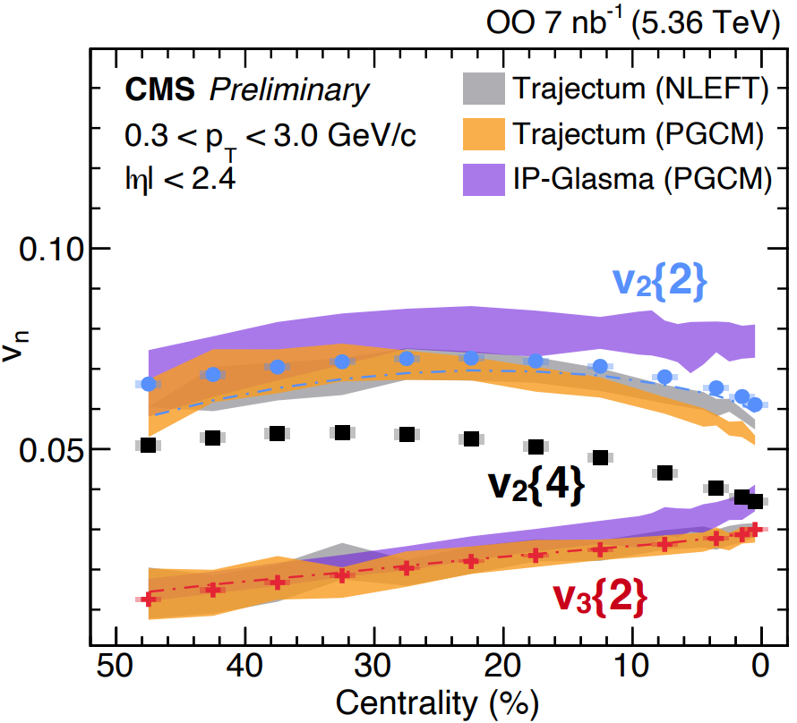
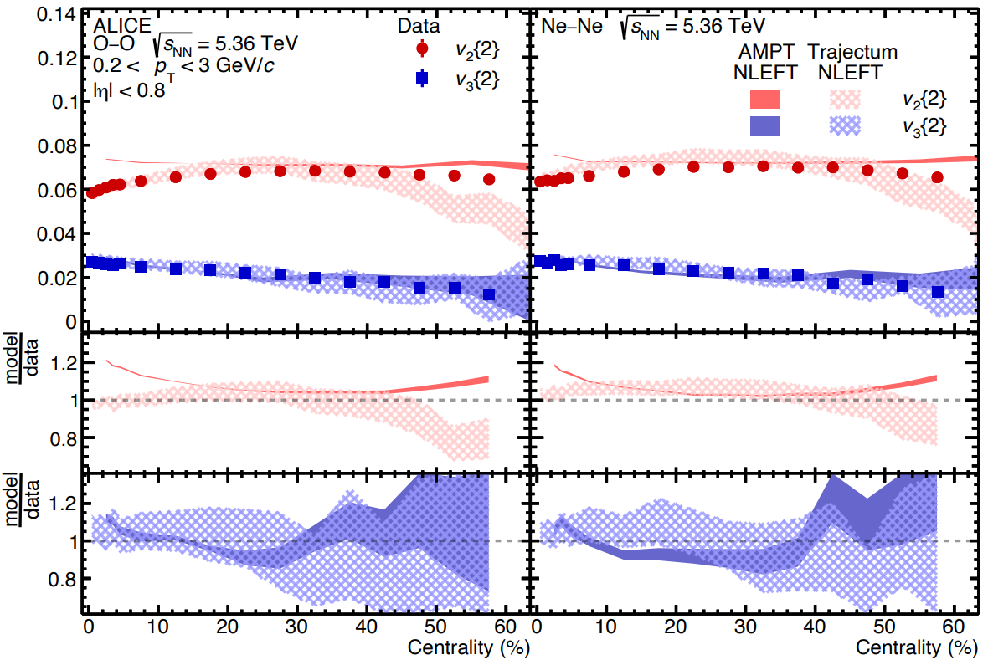
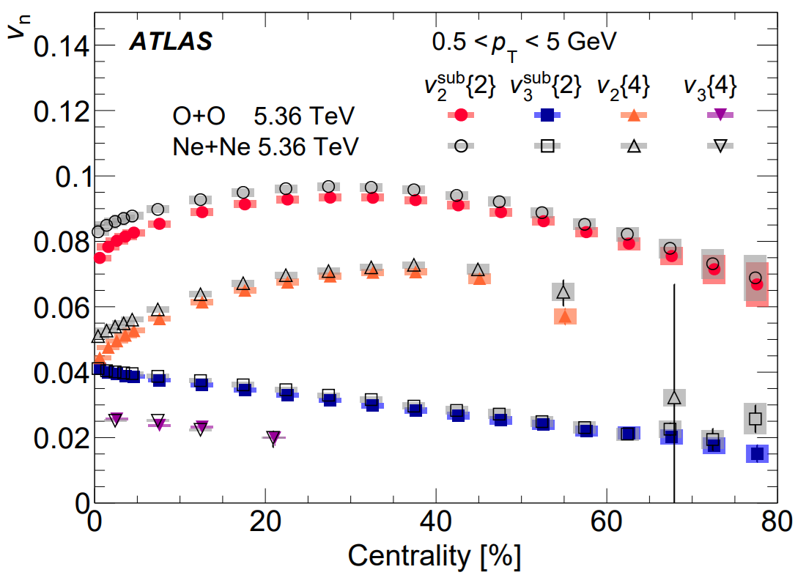
Anisotropic flow
Overall very good agreement
AMPT and IP-GLASMA about 20% too high for central elliptic flow
Trajectum about 20% low for peripheral (but see ATLAS for non-flow subtraction)
https://cds.cern.ch/record/2942004/files/HIN-25-009-pas.pdf (CMS)
https://arxiv.org/pdf/2009.05171 (ATLAS)
https://arxiv.org/abs/2009.06428 (ALICE)

Slide 17
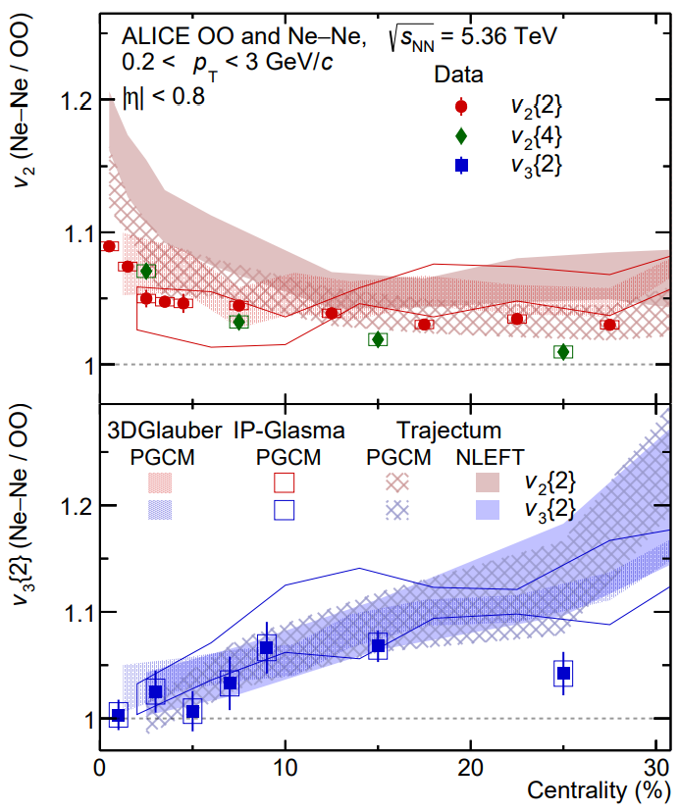
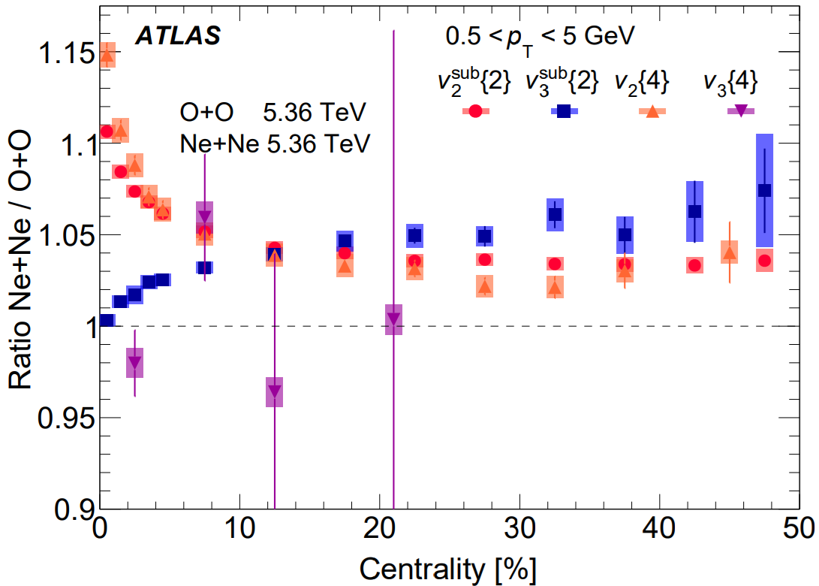
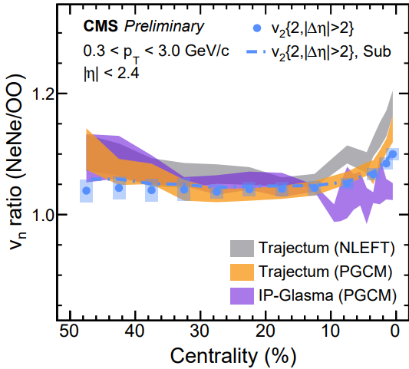
Anisotropic flow --- ratio
0-1% elliptic flow ratio significantly overestimated
But: uncertainty is only one standard deviation (treat uncertainty seriously)
Also: PGCM significantly closer (but see next slide)
https://cds.cern.ch/record/2942004/files/HIN-25-009-pas.pdf (CMS)
https://arxiv.org/pdf/2009.05171 (ATLAS)
https://arxiv.org/abs/2009.06428 (ALICE)

Slide 18
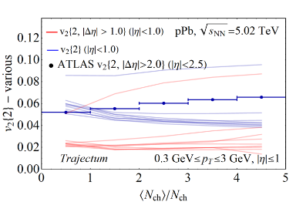
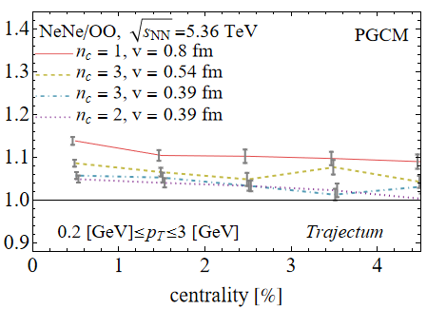
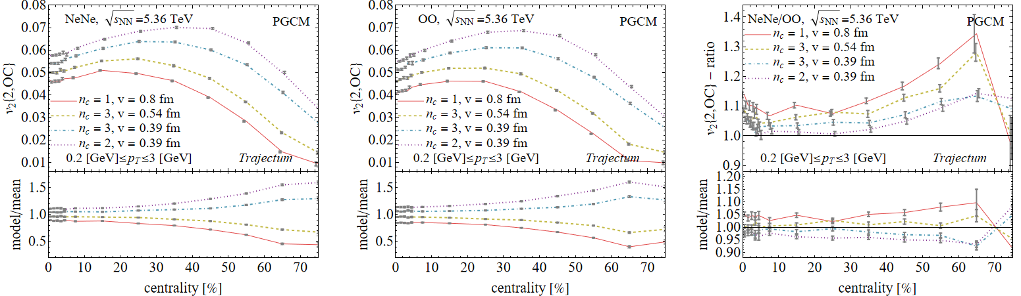
Anisotropic flow --- ratio: subnucleonic structure
Actually: not all uncertainties cancel in the ratio
Subnucleonic structure affects oxygen significantly more than neon
Reducing 0-1% ratio by up to 10%
Potentially even making NLEFT viable as a structure
Consistent with IP-Glasma?
→ Seeing first hints about how we can learn about hydro, small systems, initial stage, nuclear structure etc etc
NEW in IS2025

Slide 19
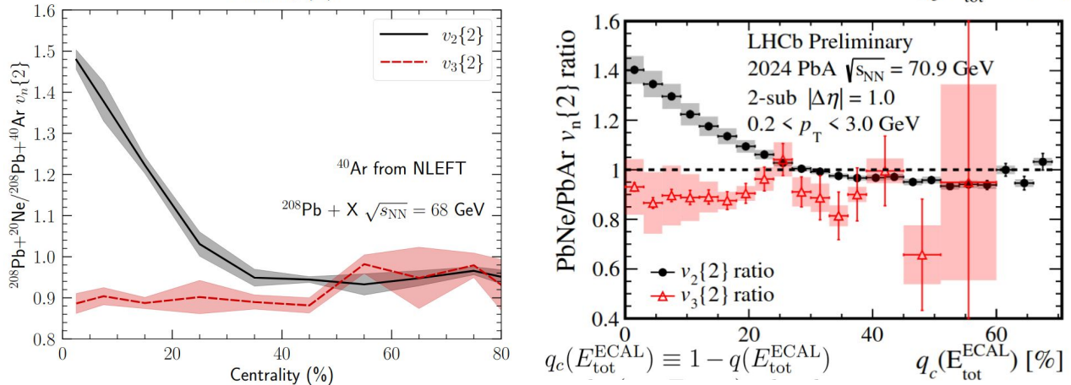
Anisotropic flow --- SMOG2
Fixed target mode LHCb
Lower energy, asymmetric 3+1D hydro
Very accurate predictions from NLEFT + Chun Shen QM25, including v₃
https://indico.cern.ch/event/1479384/contributions/6663093/attachments/3132588/5557527/IS25.pdf (SMOG2)
https://indico.cern.ch/event/1334113/contributions/6289808/ (Bjoern Schenke, Chun Shen,Heikki Mäntysaari and Wenbin Zhao)

Slide 20

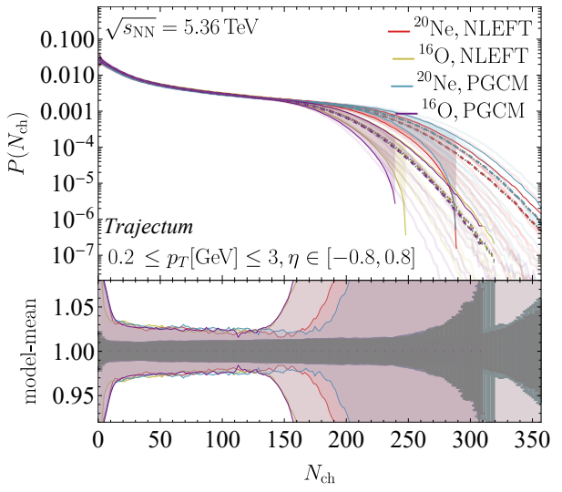















Exciting times!
Many more measurements will follow
Mean p_{T}, higher order correlations like ρ₂, ultracentral fluctuations, spectra, jets
Much better understanding of the shape
Hydrodynamics at its limits!
Energy loss in small systems
Ne-He collisions

Slide 21
Back-up

Slide 22
Ion running in 2026
How to use 3 weeks of LHC?

Slide 23
Continue the PbPb program at 5.36
Advantages:
Might be the best way to get largest number of binary collisions?
This is not obvious
There is a large medium; easiest way to see medium modifications?
On the other hand: larger background make measurements less precise?
We know what we get; not much need to think too much
But new interesting physics in other systems?
Disadvantages
What again is the measurement that can only be done with more PbPb?
Multicharmed hadrons

Slide 24
Other ions?
Advantages:
The cleanest way to vary system size
May allow even higher nucleon-nucleon luminosity for rare probes?
A wide variety of data leads to a more in depth understanding (soft + hard sector)
Synergy with nuclear structure
Both to understand the structure, and to chose a nucleus we know well
Running at top energy? Short ⁴He run?
Good experience changing ions; filling up the nuclear chart logarithmic in A

Slide 25


Which ion?
⁴⁰Ca or ⁴⁸Ca
Nice spherical nuclei; interesting for the neutron skin, synergy with neutron stars
⁷⁶Ge and/or ⁷⁶Se
Very relevant for neutrinoless double beta decay; nicely in between Neon and Xenon sizewise
⁸⁴Kr
Synergy with injector/HEARTS++

Slide 26

An interesting sidenote: Transmutation
A model for (clusters) of spectator nucleons:
Group them if they are close in space and momentum
Momentum is sampled from the Fermi distribution:
GEMINI code decays clusters (which are in excited states)
Competition with photon emission (making cluster stable in ground state)
Our model allows participants to also be spectator (ask for details)
Momentum of the cluster is a result of the model + GEMINI
WS and Govert Nijs, Transmutation of 16O and 20Ne at the Large Hadron Collide (2025)

Slide 27

Transmutation: results
Lots of elements, but with 0.034% momentum cut not much `survives’ (compare total hadronic cross section: 1.42b)
Dominant are deuteron and Helium-4
Quite crucially depends on momentum distribution; large systematic uncertainty since nucleons are not really `free’

Slide 28
The mean transverse momentum
Uncertainty (especially in ratio) completely dominated by nuclear structure
Mean transverse momentum dominated by size plasma
Actually the (charged) radius of oxygen and neon is well constrainted:
¹⁶O [fm]: 2.76 (NLEFT), 2.87 (PGCM), 2.6955 (exp)
²⁰Ne [fm]: 3.17 (NLEFT) 3.09 (PGCM), 3.0055 (exp)
Ratio: 1.14 (NLEFT), 1.08 (PGCM), 1.11 (experiment)
So the discrepancy is fairly well understood and the true mean p_{T} ratio likely lies somewhere in the middle

Slide 29




The mean transverse momentum – an interplay with hard probes
A path-length approach to energy loss: assume energy loss ~ T³ and extrapolate from (central) PbPb
Also significant difference between PGCM and NLEFT
WS, Isobel Kolbe, Govert Nijs, Kumail Ruhani, Ishtiaq Ahmed and Shahin Iqbal, Three models for charged hadron nuclear modification from light to heavy ions (2025)

Slide 30

The mean transverse momentum – an interplay with hard probes
A path-length approach to energy loss: assume energy loss ~ T³ and extrapolate from (central) PbPb
Also significant difference between PGCM and NLEFT
CMS data somewhere in the middle? (no uncertainties available though…)
WS, Isobel Kolbe, Govert Nijs, Kumail Ruhani, Ishtiaq Ahmed and Shahin Iqbal, Three models for charged hadron nuclear modification from light to heavy ions (2025)

Slide 31



The neutron skin - posterior
Trento:
Three parameters are most sensitive to the neutron skin:
The nucleon width and the Trento parameters p and q
Small correlation with width (cross section is highly sensitive to w)
Very strong anticorrelation with p; centrality dependence is important

Slide 32


The neutron skin – final result
Transform to neutron radius minus proton radius
Final result consistent but smaller than PREX II
Uncertainty is about 20% smaller than PREX II
Cross section is crucially important, but also centrality dependence
Important to vary Trento parameters in particular
PREX II, Accurate Determination of the Neutron Skin Thickness of ²⁰⁸Pb through Parity-Violation in Electron Scattering (2022)
Baishan Hu et al, Ab initio predictions link the neutron skin of 208Pb to nuclear forces (2021)

Slide 33

Highlighted observables
Anisotropic flow and
ρ_{n} correlator

Slide 34


Xenon deformation: three posterior distributions
Main chain (red),
Xenon is a highly deformed triaxial nucleus (!)
Without 0-1% ultracentral collisions (green),
Essential to get constraint on elliptic deformation
Without ρ_{n} anisotropic flow – mean pT correlator (purple)
No constraint on triaxiality

Slide 35


Transmutation: potentially interesting
If sufficiently under control we can also study O-He, O-d, Ne-He and Ne-d collisions (!)
Especially the mean transverse momentum would be easy and (!) interesting
Tell-tale sign: at lower multiplicity mean pT rises over time due to transmutation
WS and Govert Nijs, Transmutation of 16O and 20Ne at the Large Hadron Collide (2025)

Slide 36

Exciting times! (again?)

Slide 37

A true prediction using hydrodynamics (rare these days…)
Non-trivial curve; non-monotonicity was unexpected
Extremely precise (<0.1%) due to uncertainty cancellations in the ratio (theory & experiment (!))
Fernando G. Gardim, Giuliano Giacalone and Jean-Yves Ollitrault, The mean transverse momentum of ultracentral heavy-ion collisions: A new probe of hydrodynamics (2019)
Govert Nijs and WS, Predictions and postdictions for relativistic lead and oxygen collisions with the computational simulation code Trajectum (2021)
Austin Baty, Overview of Recent CMS results, https://indico.cern.ch/event/1139644/contributions/5343932/ (see also Cesar Bernardes)

Slide 38


What is happening?
(Extremely) ultracentral collisions are not driven by impact parameter
Size does not extend beyond radius Lead nucleus
(Local) fluctuations drive up multiplicity
Average temperature can still increase
A simplified picture:
Entropy increase → multiplicity increases
Temperature increases → mean pt increases (assuming ideal hydro + constant `work’ done in rapidity direction)
Slope: sensitive to speed of sound (solely ?!):
Fernando G. Gardim, Giuliano Giacalone and Jean-Yves Ollitrault, The mean transverse momentum of ultracentral heavy-ion collisions: A new probe of hydrodynamics (2019)

