Slide 1
CEPC computing resources
Xiaomei Zhang Weidong Li KaiLi Zhang Boping Chen

Slide 2
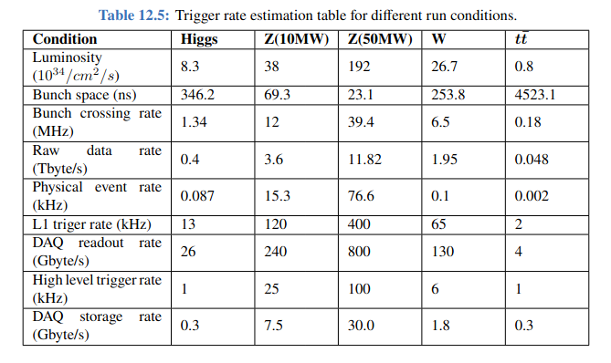
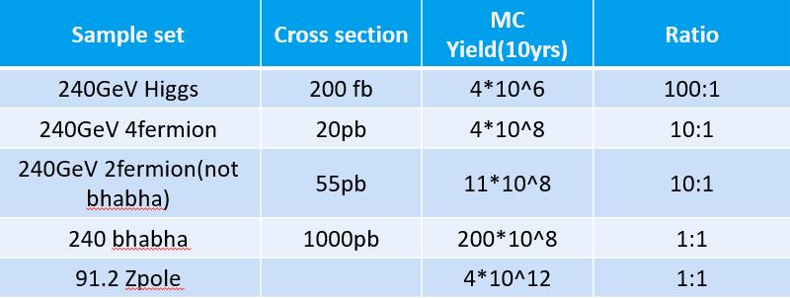
Basis for estimation
Accelerator TDR
MC simulation statistics
Online trigger rate estimation

Slide 3
Raw data rate and volume in Higgs mode
Energy: 240GeV
Trigger rate: 1kHz
Online event data size: ~300kB
DAQ rate: 0.3GB/s
Running time: 3600 hours
Data volume per year （1IP）:
  0.3GB/s*3600h=3.7PB/year

Slide 4
MC data size and volume for Higgs mode
MC event data size: 1MB
Full MC simulation events per year: ~2*10⁹ (MC: Data = 10：1)
Data volume per year: 2*10⁹ *1MB=~2PB (~1 IP, 1year)
Sample set | Cross section | MC Yield(10yrs) | Ratio | Data size for 1 year
240GeV Higgs | 200 fb | 4*10^6 | 100:1 | 40TB
240GeV 4fermion | 20pb | 4*10^8 | 10:1 | 0.4PB
240GeV 2fermion (no bhabha) | 55pb | 11*10^8 | 10:1 | 1.1PB
240 bhabha | 1000pb | 200*10^8 | 1:1 | 2PB

Slide 5
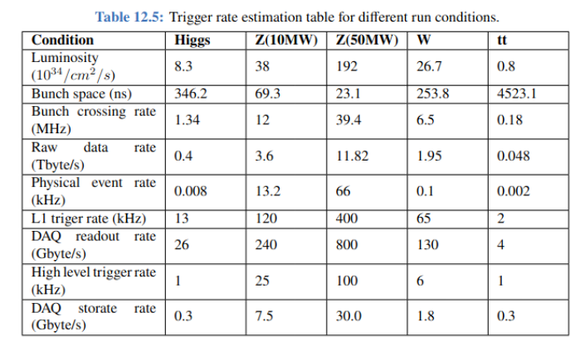
Raw data rate and volume in Z mode
91GeV energy (50MW)
Trigger rate: 100kHz (100 Higgs)
event data size: ~300kB
Storge rate: 30GB/s
Data volume per year:
  30GB/s*3600h=370PB/year

Slide 6

MC data size and volume for Z mode
MC event data size: 1MB
Full MC simulation events each year: 1*10¹² (Z 1:1)
Data volume (per year): 1*10¹² *1MB=1EB (1IP, 1year)

Slide 7
Total data volume
Higgs mode
  3.7PB (Real) + 2PB (MC) =~5.7PB
Z mode
  370PB (Real) + 1EB (MC) =~1.4EB
Z的数据量是Higgs的250倍？
Z的MC数据量是Higgs的2.7倍？

Slide 8
CPU time and resources estimated each year
Higgs mode | CPU time (CPU Seconds/event) | Iteration | Event number | Total CPU time (CPU hours)
Sim | 60 | 2 | 2*10⁹ | 6.7 * 10⁷
Rec | 10 | 2 | 13*10⁹ | 7.2 * 10⁷
Z mode | CPU time (CPU Seconds/event) | Iteration | Event number | Total CPU time (CPU hours)
Sim | 60 | 2 | 1*10¹² | 33 * 10⁹
Rec | 10 | 2 | 1.3*10¹² | 7.2 * 10⁹
Higgs Mode
  Total CPU time: ~14*10⁷ CPU hours (~ 320 KHS06 years)*
  ~20,000 CPU cores needed, supposed 80% CPU utilization
Z mode (300 times Higgs mode)
  Total CPU time: ~ 40*10⁹ CPU hours (~90 MHS06 years)
  ~6,000,000 CPU cores needed
* 1 CPU core = 20 HS06

Slide 9
Backup

Slide 10
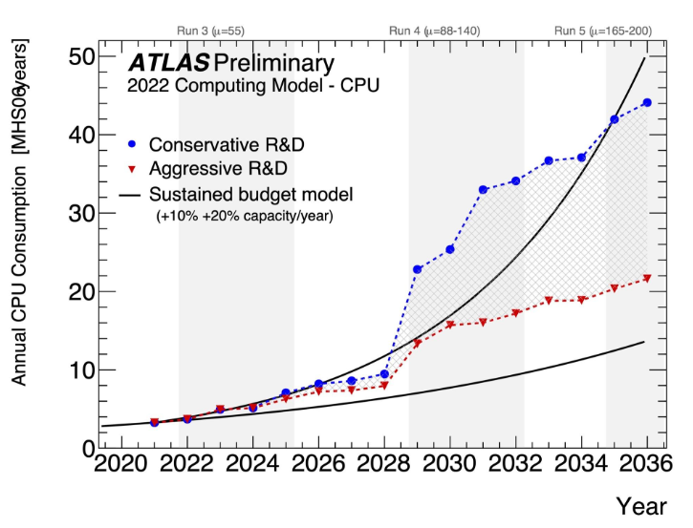
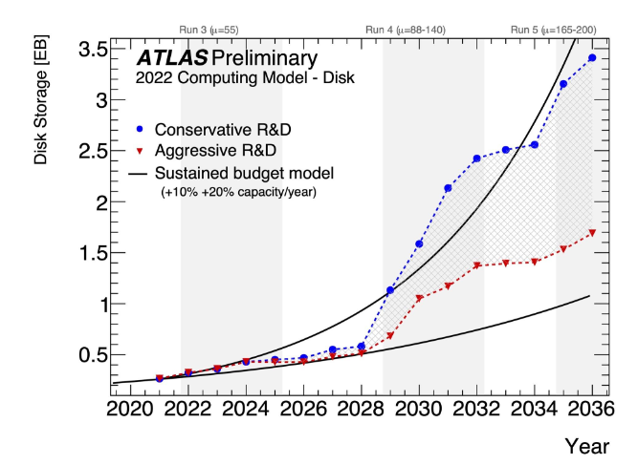
ATLAS in HL-LHC
Disk storage: 0.5EB/year
Resource: 10MHS06year

Slide 11
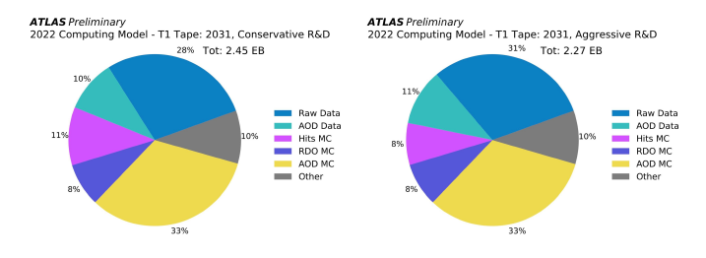
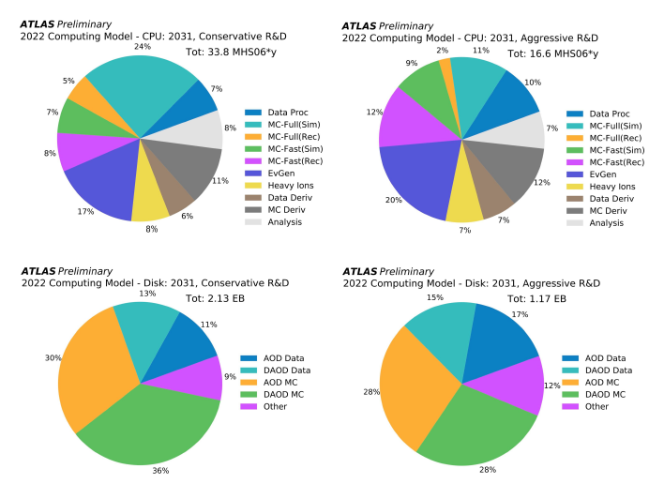
Atlas Run4
Altas Raw: 230PB
Disk storage: 2.1EB
Resource: 34MHS06year

