Slide 1


CEPC Muon Detector
--- Ref-TDR status
Xiaolong Wang (Fudan U.)
on behalf of the Muon Detector Group
Tuesday Meeting, 02/18/2025

Slide 2
Current Focus: TDR Edition
Current status:
  Muon chapter has 30 pages, but many details should be input.
  HSE/LPI/MIPT have joined Muon group. They can contribute to the edition.

Slide 3
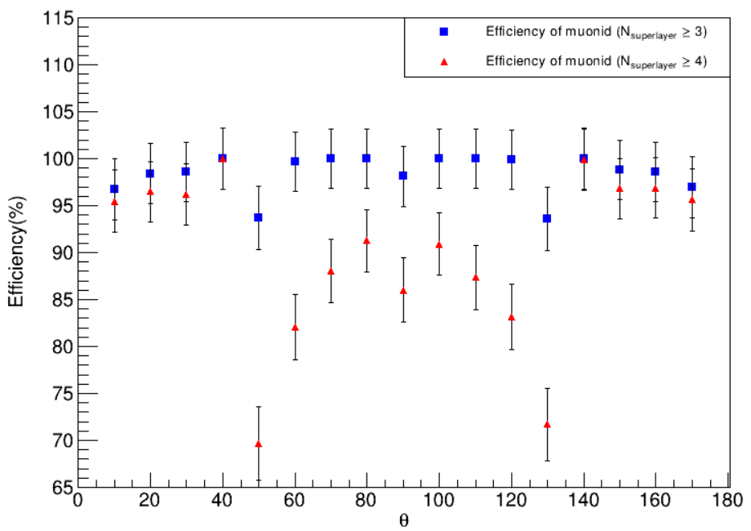
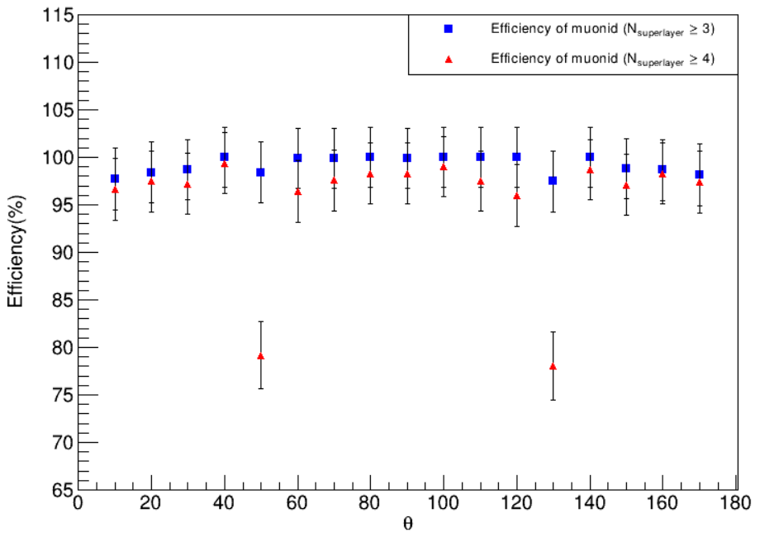
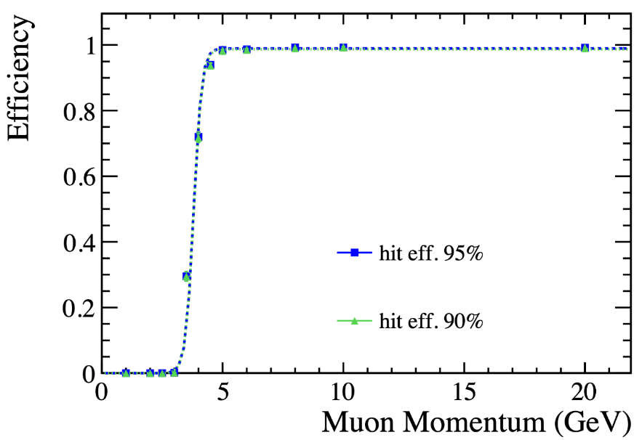
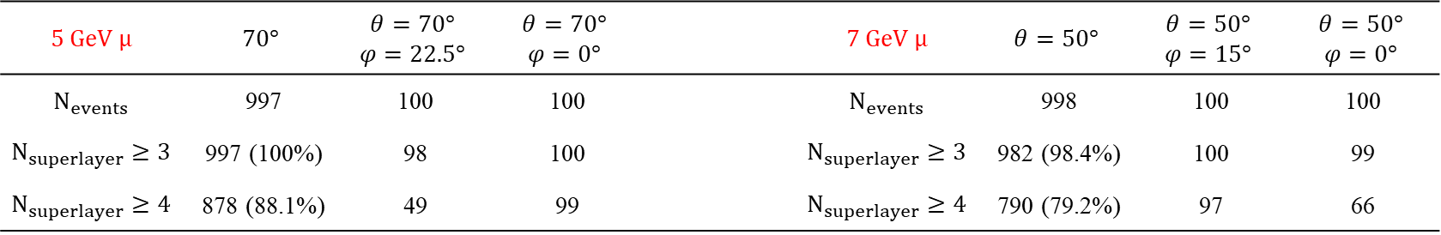
Software and simulation
--- Muon ID and fake rate
$$5 GeV μ$$ | $$70°$$ | $$θ=70°$$ $$φ=22.5°$$ | $$θ=70°$$ $$φ=0°$$ |  | $$7 GeV μ$$ | $$θ=50°$$ | $$θ=50°$$ $$φ=15°$$ | $$θ=50°$$ $$φ=0°$$
$$N_{events}$$ | 997 | 100 | 100 |  | $$N_{events}$$ | 998 | 100 | 100
$$N_{superlayer}≥3$$ | 997 (100%) | 98 | 100 |  | $$N_{superlayer}≥3$$ | 982 (98.4%) | 100 | 99
$$N_{superlayer}≥4$$ | 878 (88.1%) | 49 | 99 |  | $$N_{superlayer}≥4$$ | 790 (79.2%) | 97 | 66
$$5 GeV μ$$
Muon ID efficiency of the barrel
$$7 GeV μ$$
Strange to see the Muon ID eff drops at some regions when requiring N_hit_layer >= 4.

Slide 4
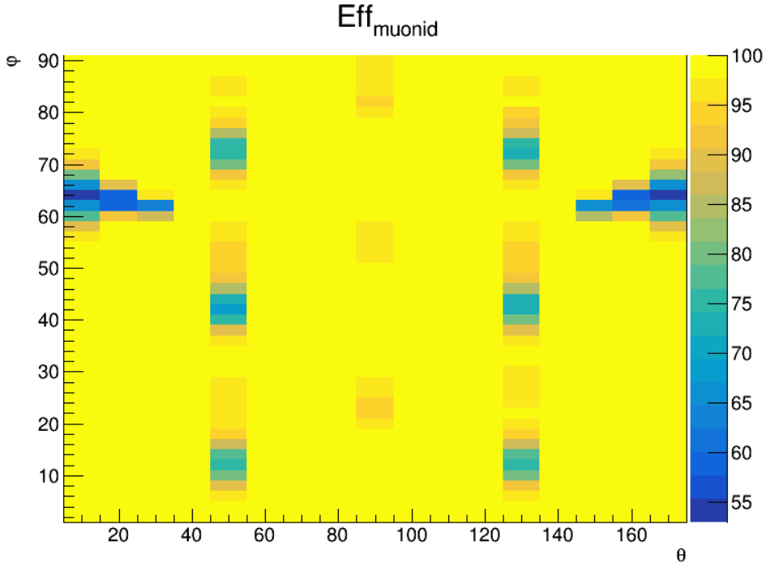
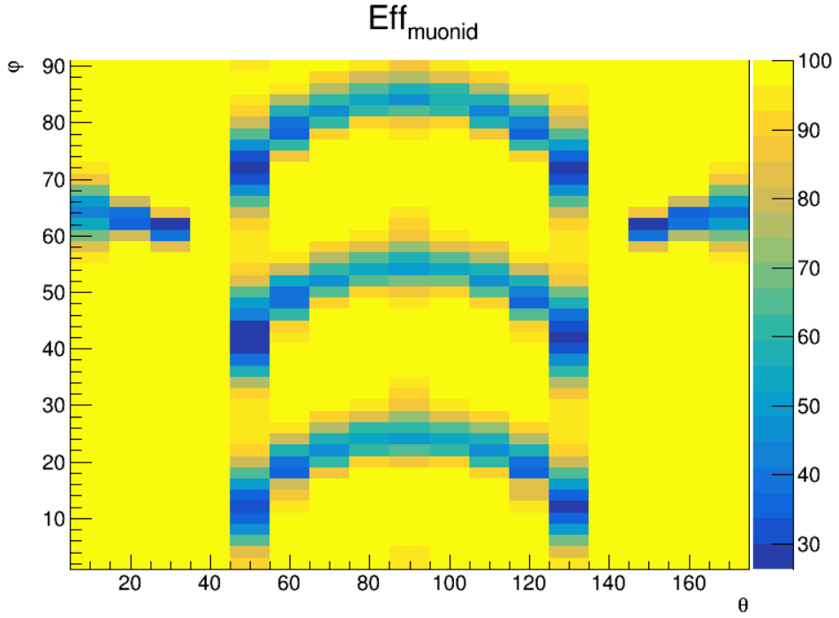
Muon ID eff drop due to gaps
$$N_{superlayer}≥3$$
$$N_{superlayer}≥4$$
Performing more studies of the gap regions in software and simulation.

Slide 5
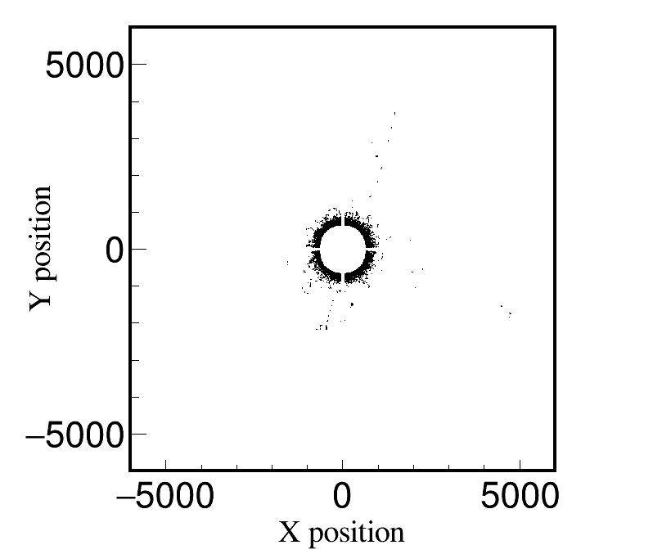
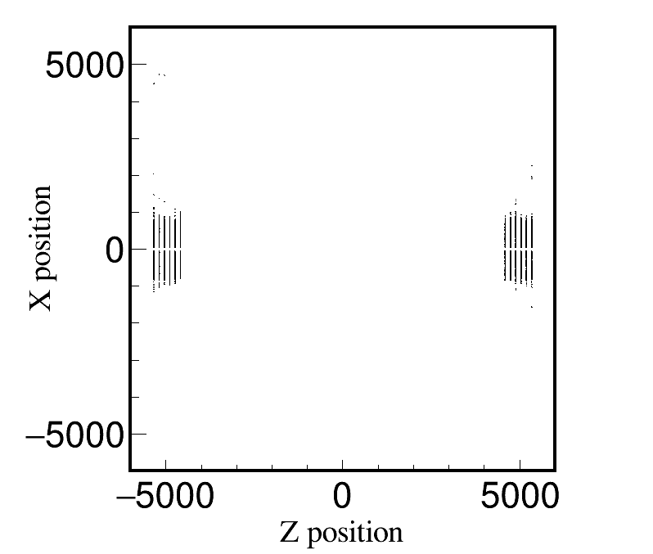
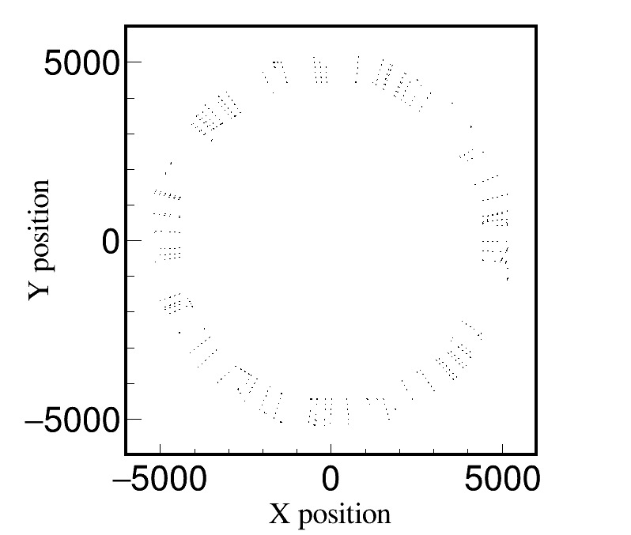

Hit rate due to beam backgrounds
Barrel
Endcap
Removing hits with small or no deposited energies, the hit rate is reduced.

Slide 6
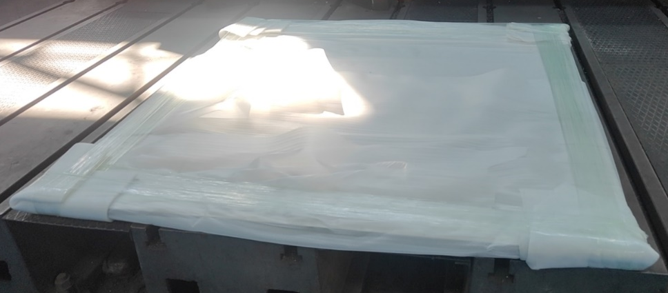
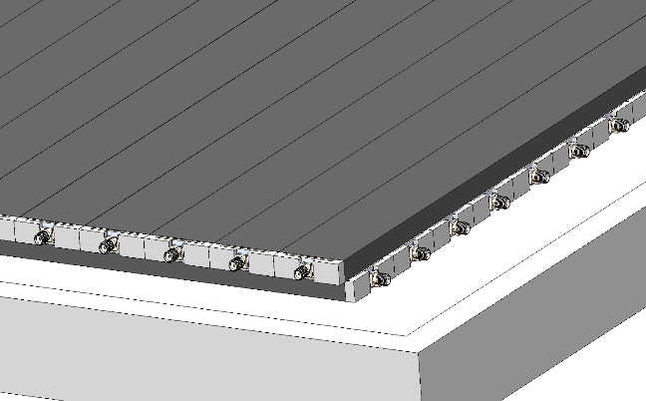
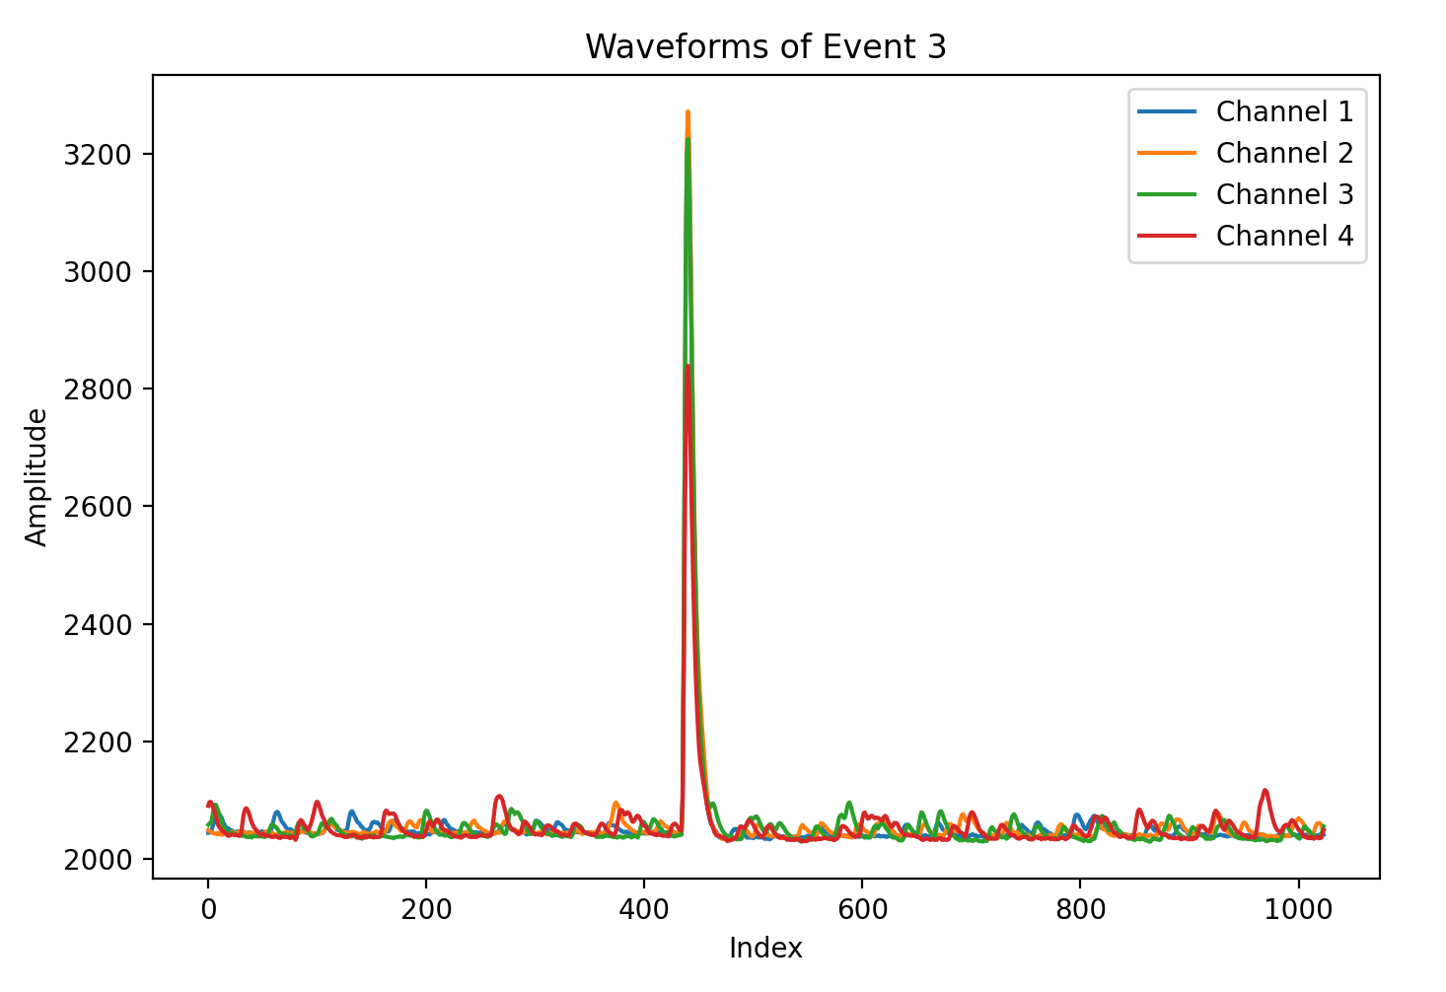
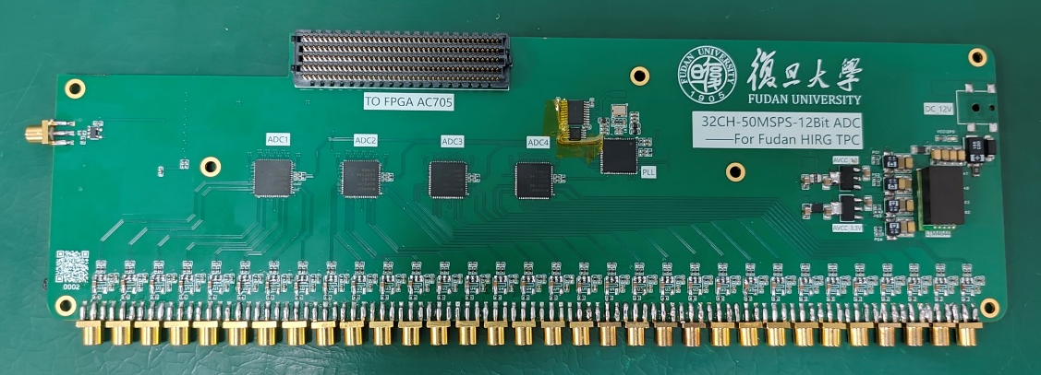
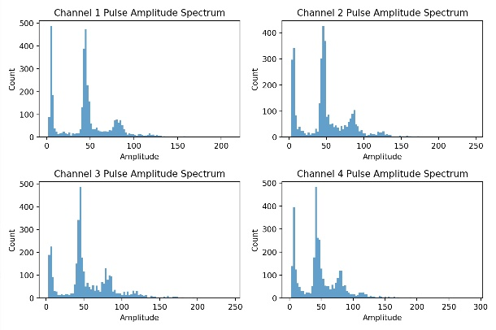
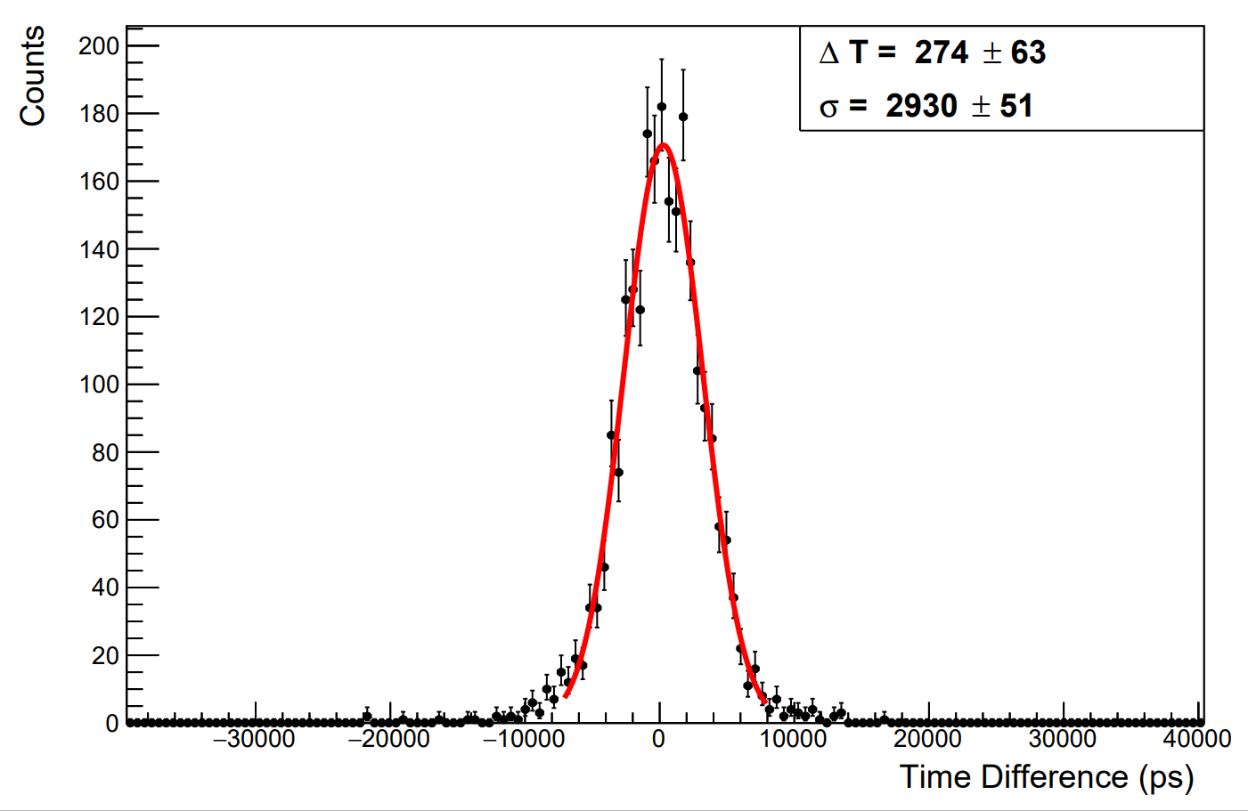
Start for prototype
The plan:
  One aluminum frame is ready.
  WLS fibre will be ready in the early March.
  Still have some SiPMs, will purchase more.
  Will purchase scintillator strips soon.
  New designed DAQ made in Fudan can be used for testing.
p.e. spectrum
ADC芯片：AD9637 × 4
通道数：32通道
采样率：80 MSPS
采样精度：12bit
协议：Serial LVDS
Can be extended to more channels.
Good performance, except the time resolution (2ns).

Slide 7
Thank you!

Slide 8
Electronics
uMB: Muon management board
–Up to 24 RJ45 connectors, CAT6 shielded cable (up to 2.5 m) to uMB
– Fiber to backend
– Power input (AWG16 x4), 48V

Slide 9
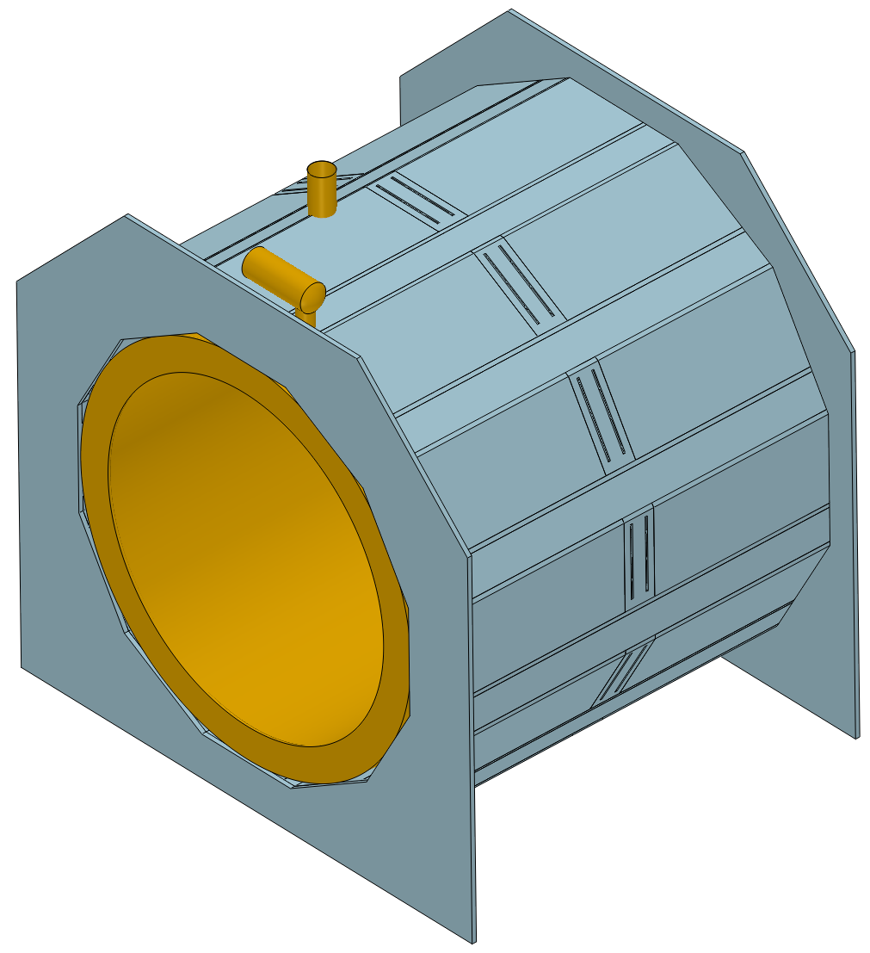
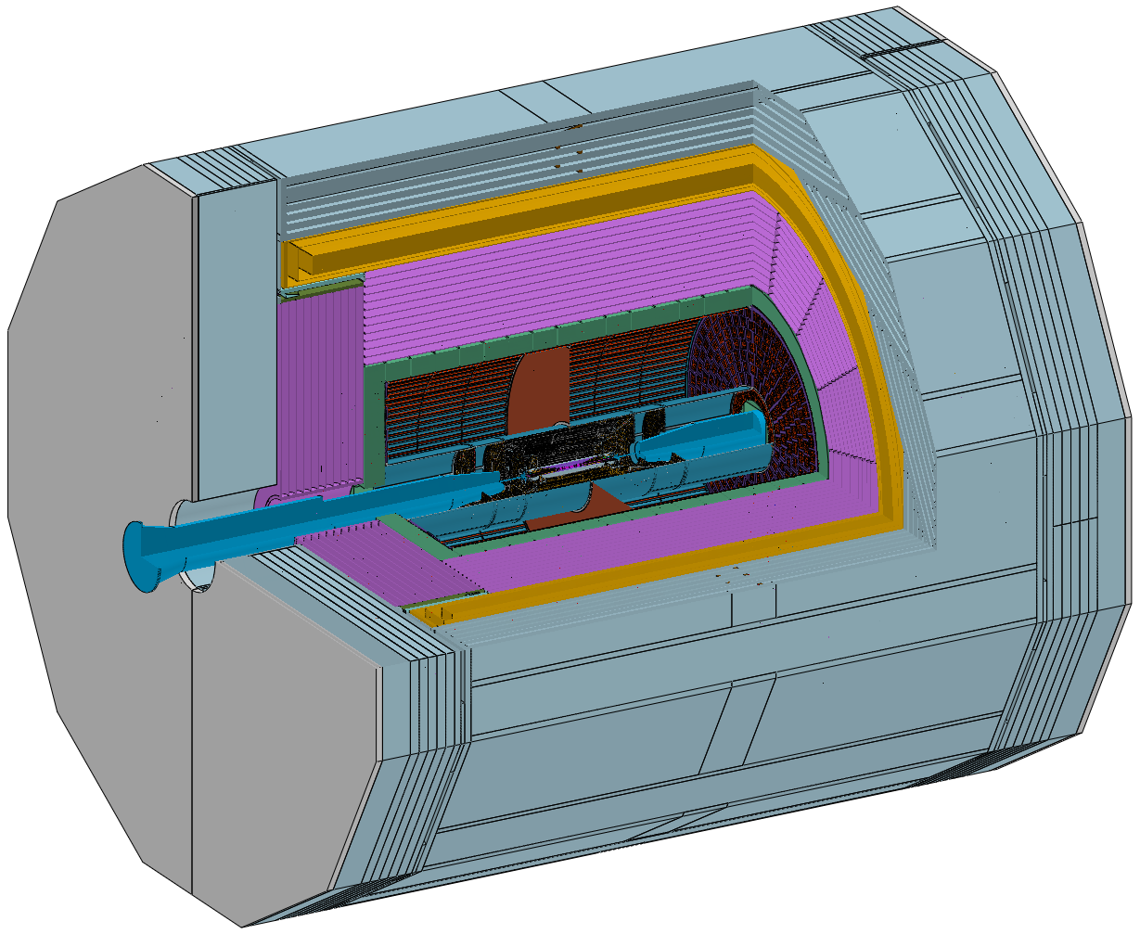
Barrel - installation
线缆出口
Install from the side.
线缆挪到两边输出，尽可能与其他系统的走线一致。

