Slide 1
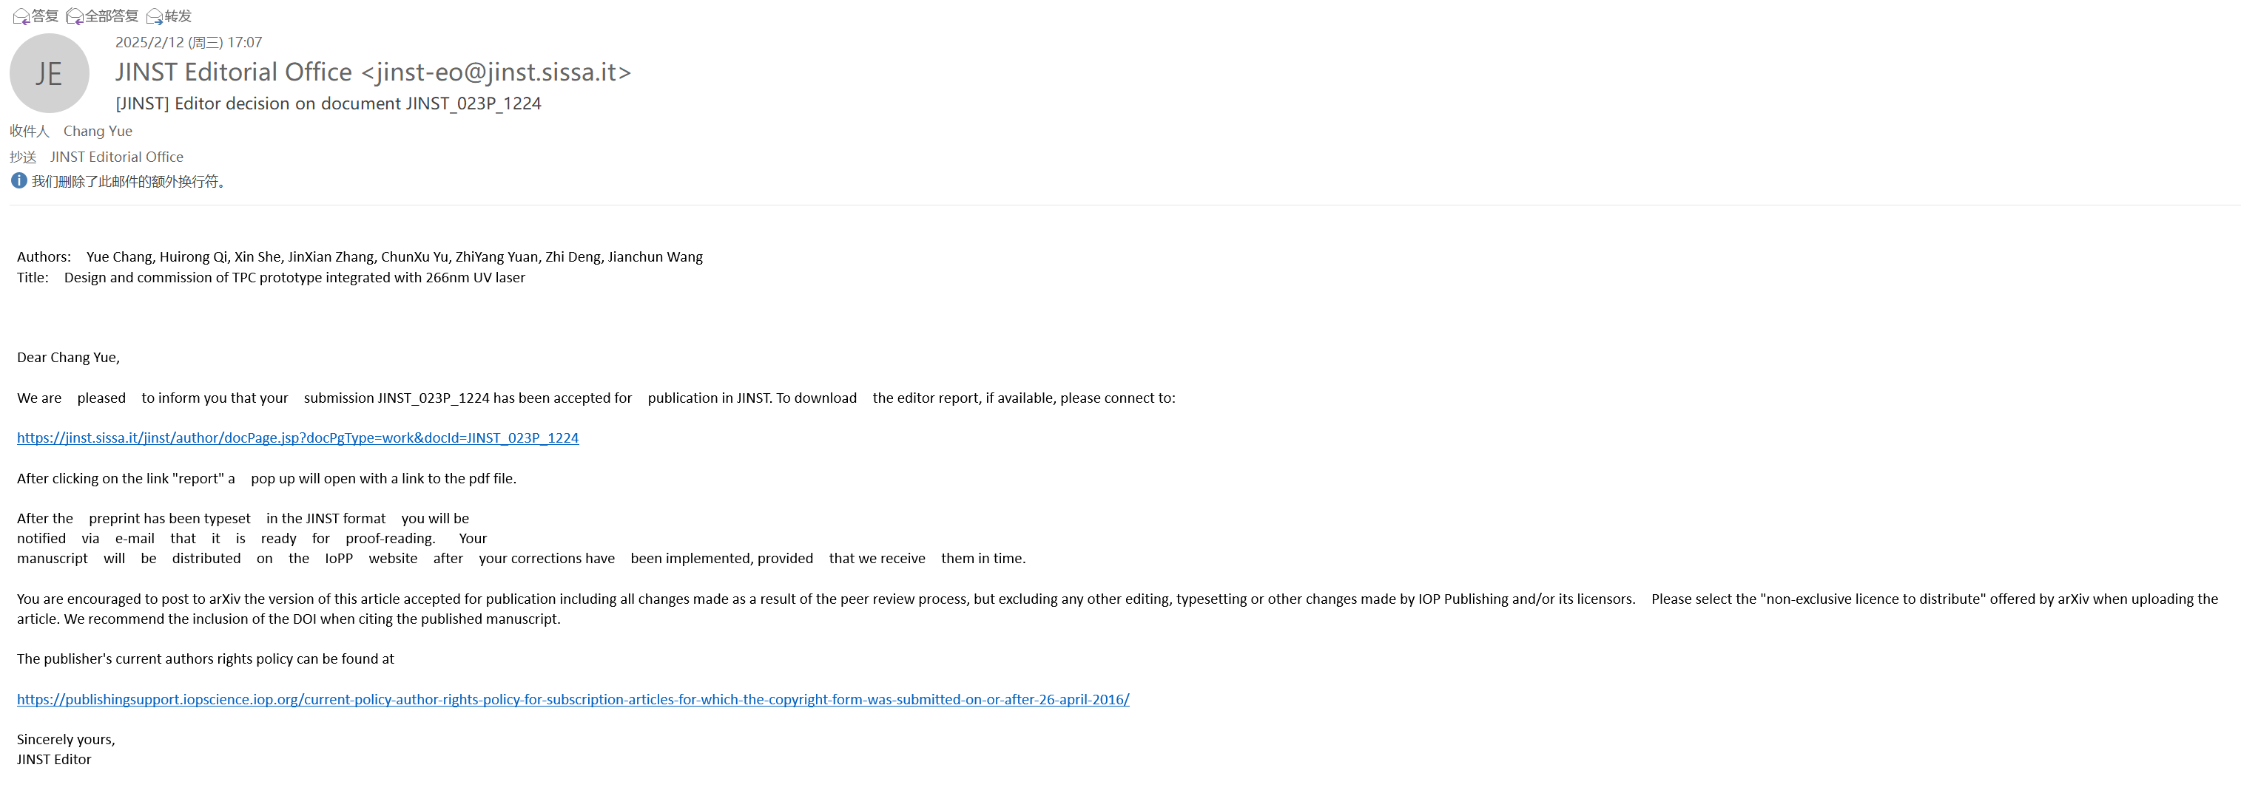
Accepted for Publication in JINST

Slide 2
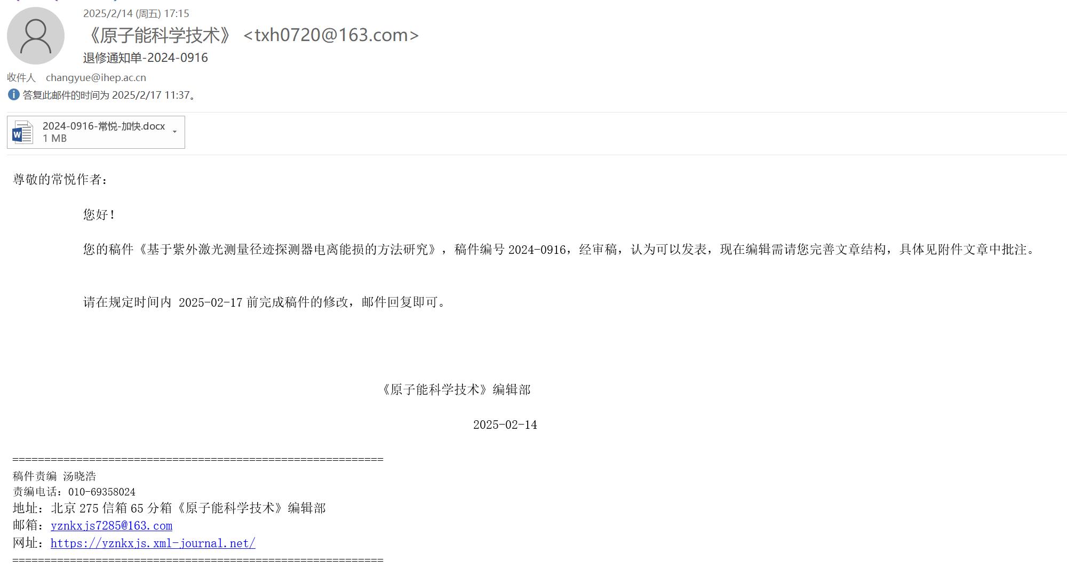
Accepted for Publication in Atomic Energy Science and Technology

Slide 3
The first round of reviews has been responded to, and the current status of the article is "Awaiting EIC decision."

Slide 4
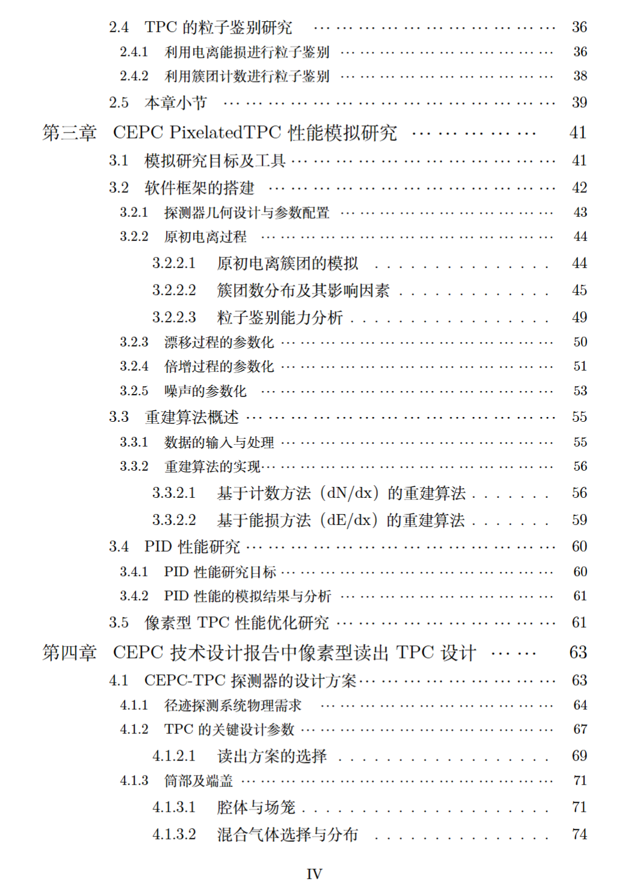
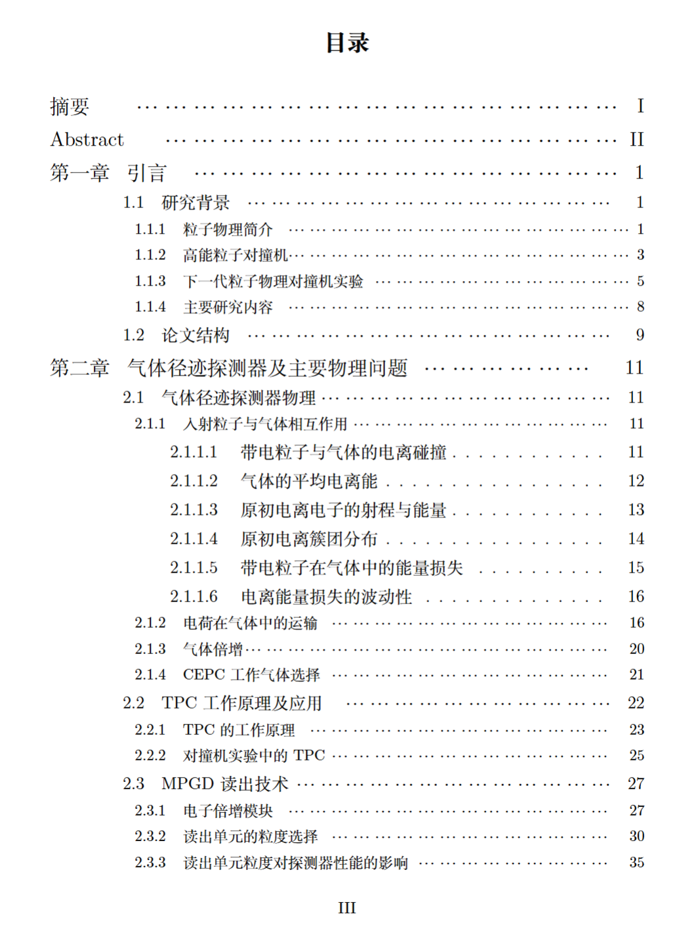
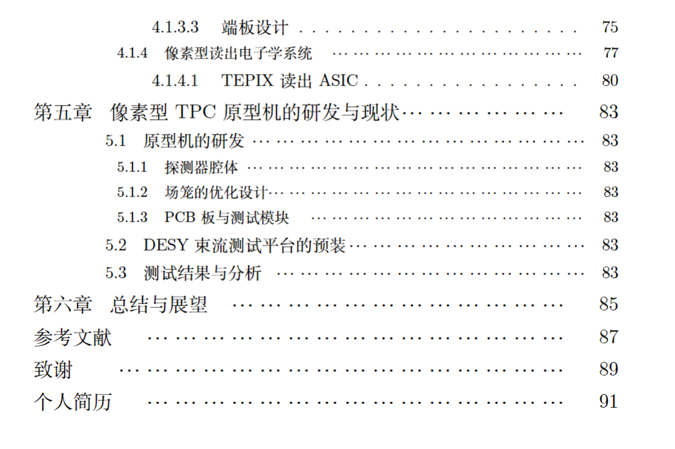
Thesis
Next week
This week

