Slide 1
Research Progress
Wiriya Ruangyoo
The collaboration between Nankai University
and Suranaree University of Technology
18 February 2025

Slide 2
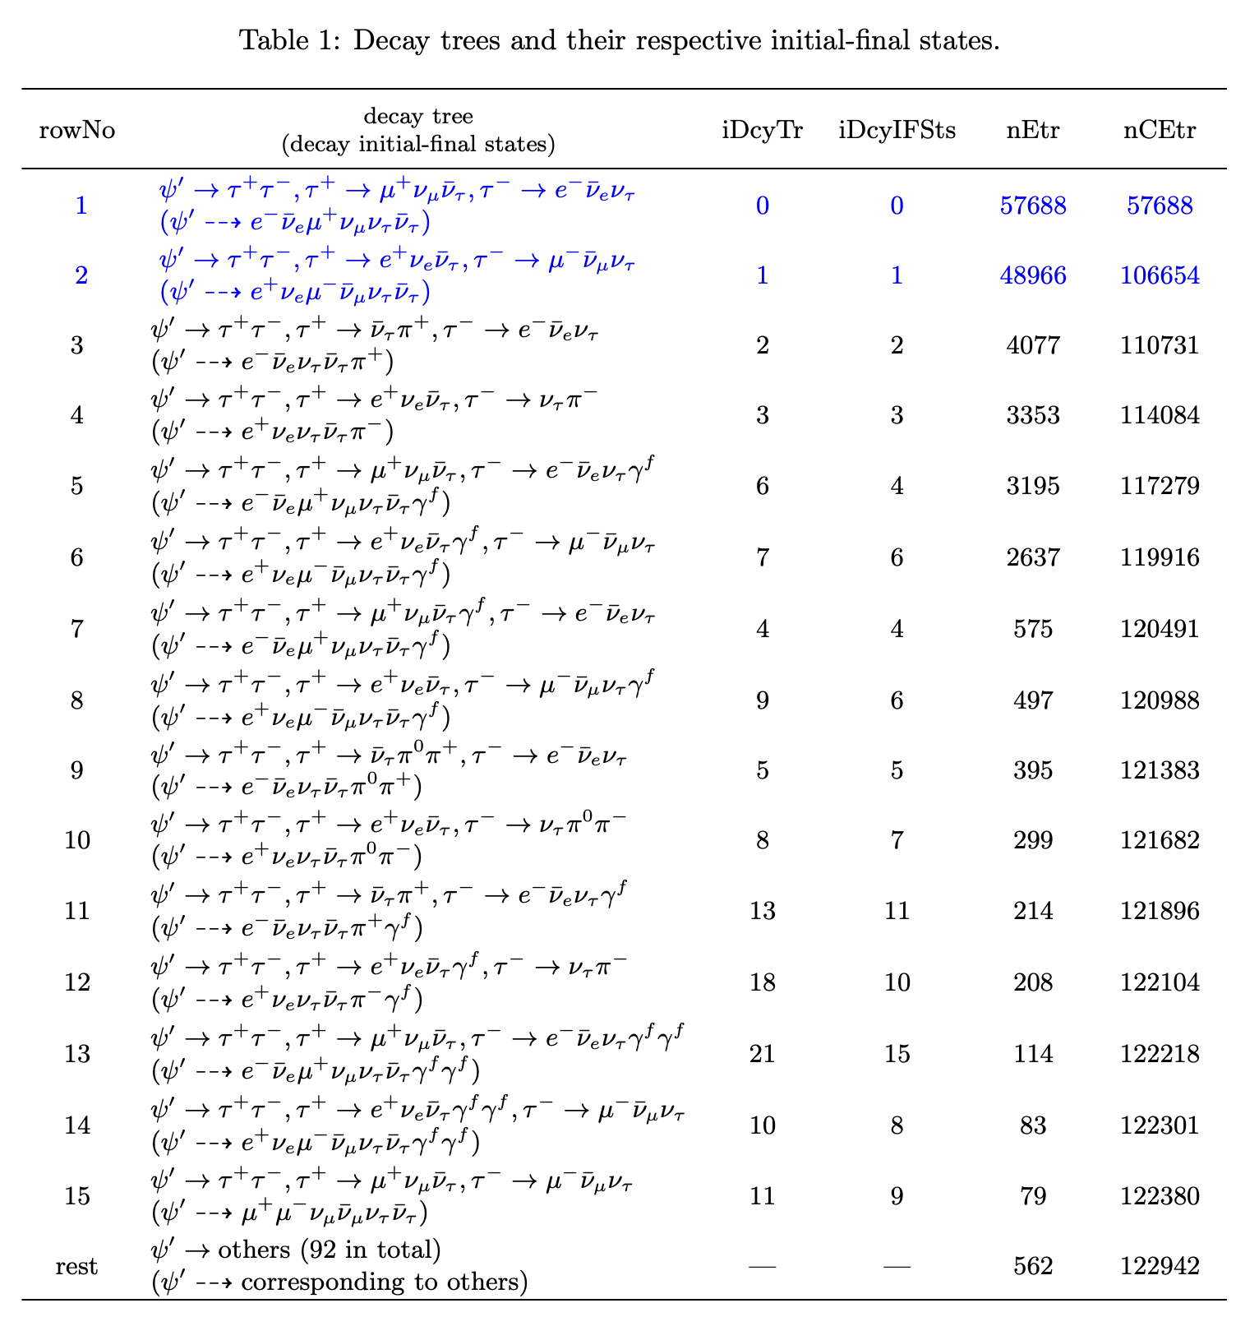
After using Muc_depth (FOM by myself) [7. 63% for BGs]
The main BG is $ψ^{′}→e π 3ν$

Slide 3
Conclusion the particle selection
Classes | Particles
 | Electron | Muon(Pion)
Momentum | P < 1.2 GeV/c | P < 1.2 GeV/c
$$χ_{dEdx}$$ | $−2<χ_{dEdx}^{e}<2$ | ${−2<χ}_{dEdx}^{μ}<2$
 | Or $χ_{e, dEdx}^{2}<4$ | Or $χ_{μ, dEdx}^{2}<4$
Deposited energy | 0 < E < 1.2 | 0 < E < 0.3
E/P ratio | $0.6<E/P<1.2$ | $E/P<0.6$
$$|Δtof|$$ | $${\left|Δtof\right|}_{e}<0.3$$ | $${\left|Δtof\right|}_{μ}<0.3$$
MUC condition | Muc_depth > 0 && Muc_depth > 59*(p_{mu} - 0.63)
$$cos θ_{mis}$$ | - 0.99 < $cos θ_{mis}$< 0.99

Slide 4
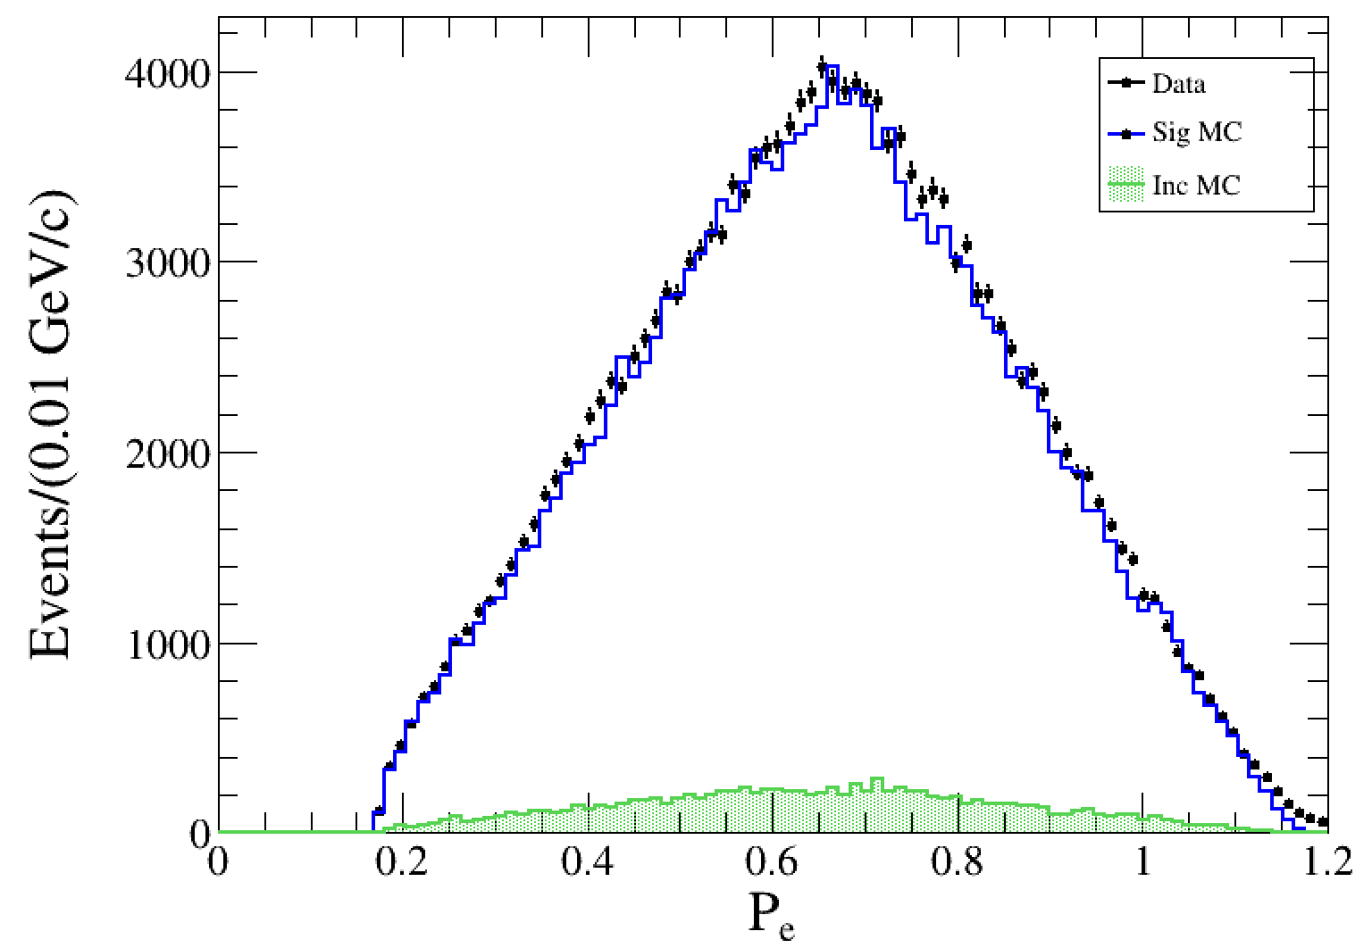
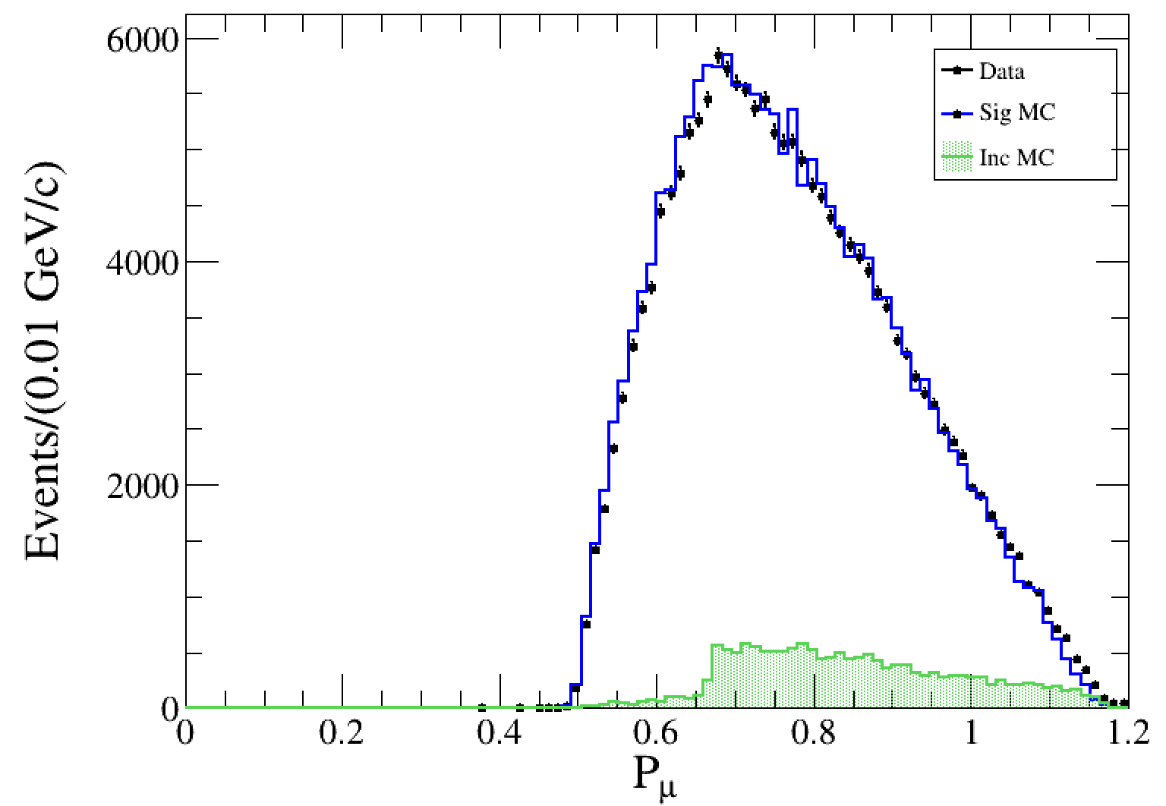

Slide 5
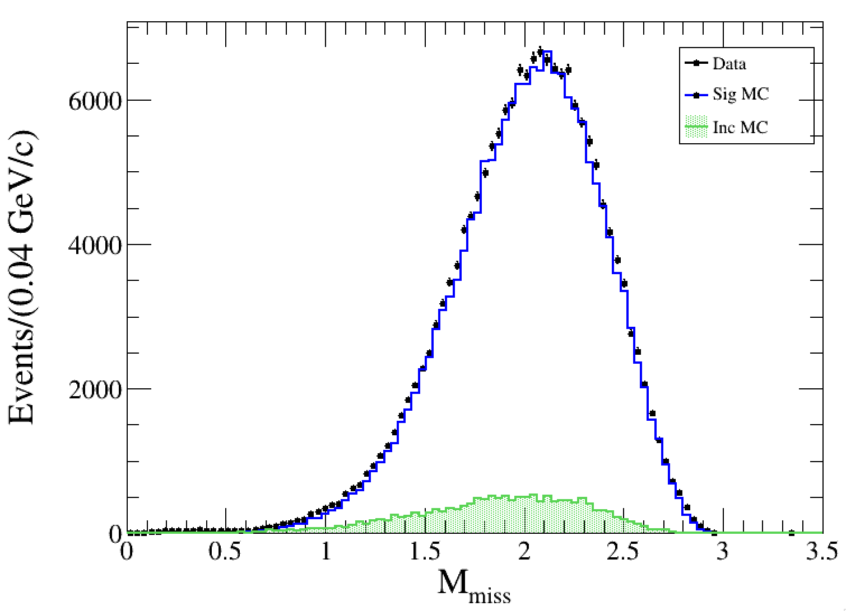
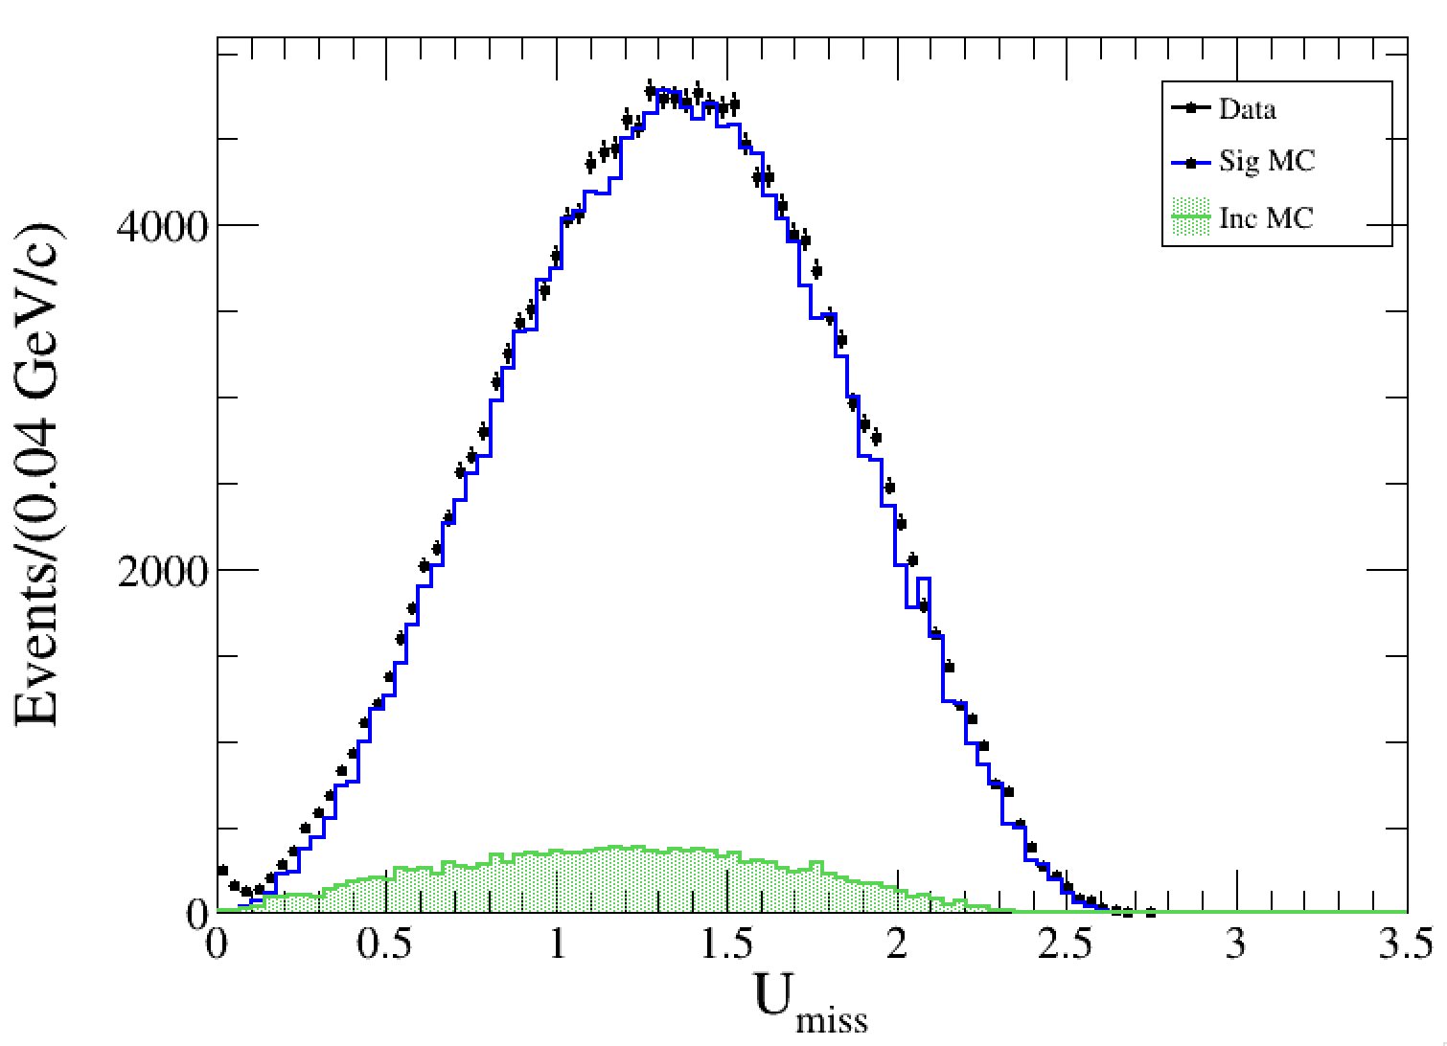
4-Neutrinos (missing particles)

Slide 6
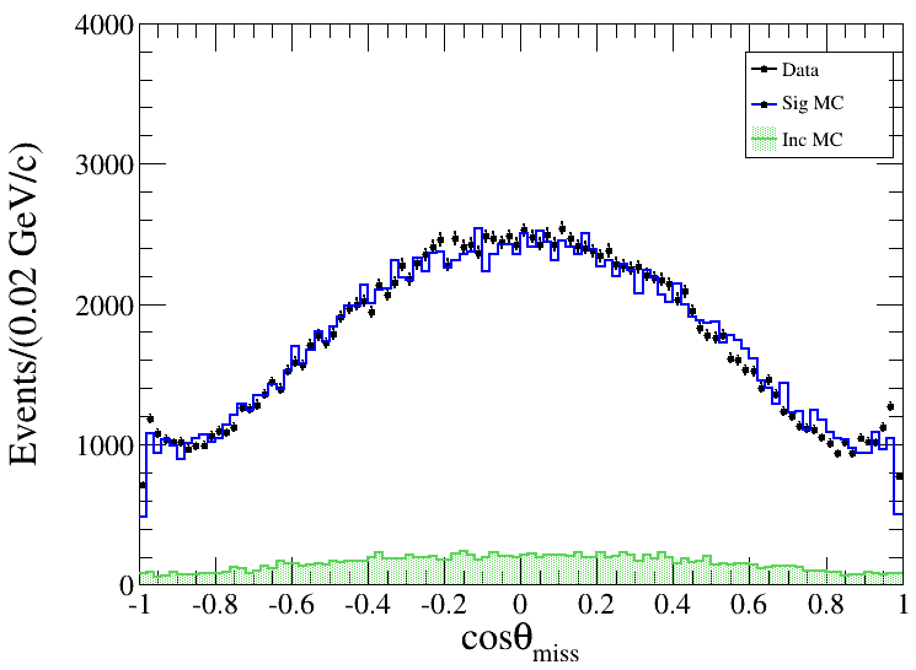

Slide 7
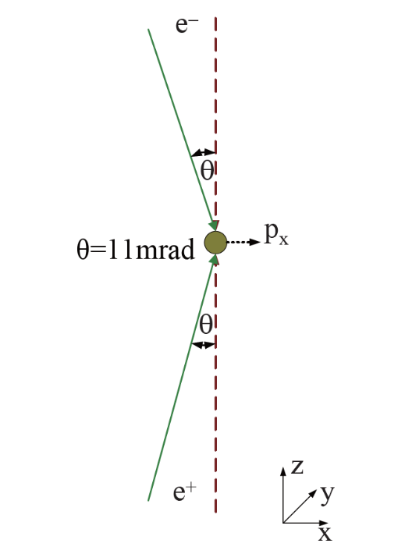
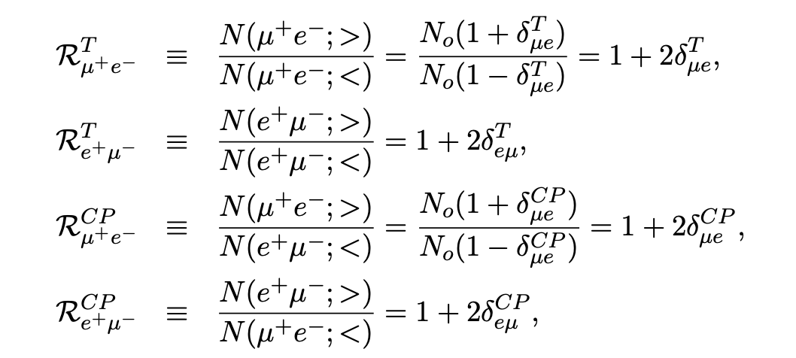
Study the T/CP violation
$p_{e_{1}}=\left[p_{i}∗\sin\left(θ\right), 0, p_{i}∗\cos\left(θ\right)\right]$ for R1
$p_{e_{2}}=[p_{i}∗\sin\left(θ\right), 0, −p_{i}∗cos⁡(θ)]$ for R2
$$<A> = <p_{ei}∙{(p}_{ef}×p_{μ})>$$

Slide 8
$$N(<A>_{e^{+}μ^{−}}>0)$$
$$N(<A>_{e^{+}μ^{−}}<0)$$
$$N(<A>_{μ^{+}e^{−}}>0)$$
$$N(<A>_{e^{+}μ^{−}}<0)$$
$$<A> = <p_{ei}∙{(p}_{ef}×p_{μ})>$$
$$R_{μ^{+}e^{−}}^{T}=1.0464008$$
$$R_{e^{+}μ^{−}}^{T}=0.945728$$
$$R_{μ^{+}e^{−}}^{CP}=0.994923$$
$$R_{e^{+}μ^{−}}^{CP}=0.994661$$
$δ_{μe}^{T}$ = 0.0232004
$δ_{eμ}^{T}$ = -0.027136
$δ_{μe}^{CP}$ = -0.0025385
$δ_{eμ}^{CP}$ = -0.0026698

Slide 9
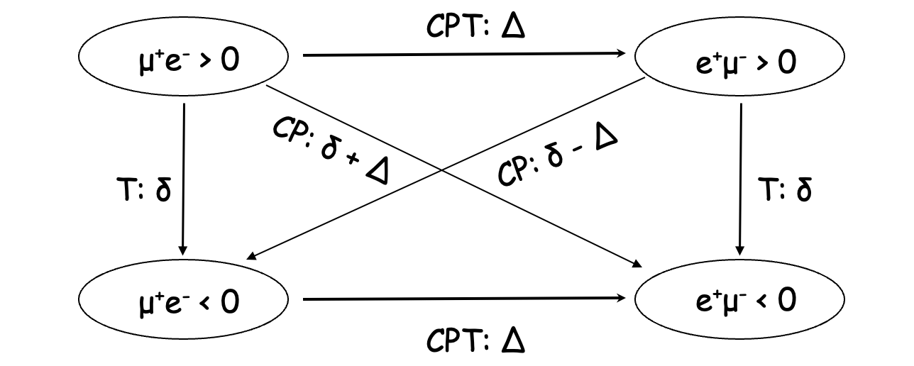
$$R_{μ^{+}e^{−}}^{T}∙R_{e^{+}μ^{−}}^{T}=0.989611 → δ=−0.00259725$$
$$R_{μ^{+}e^{−}}^{CP}∙R_{e^{+}μ^{−}}^{CP}=0.989611 → δ=−0.00259725$$
On the paper, they set the $δ=δ_{μe}^{T}$ or $δ_{eμ}^{T}$
My results do not relate with the equation since $R_{μ^{+}e^{−}}^{T}≠R_{e^{+}{ μ}^{−}}^{T}$

Slide 10
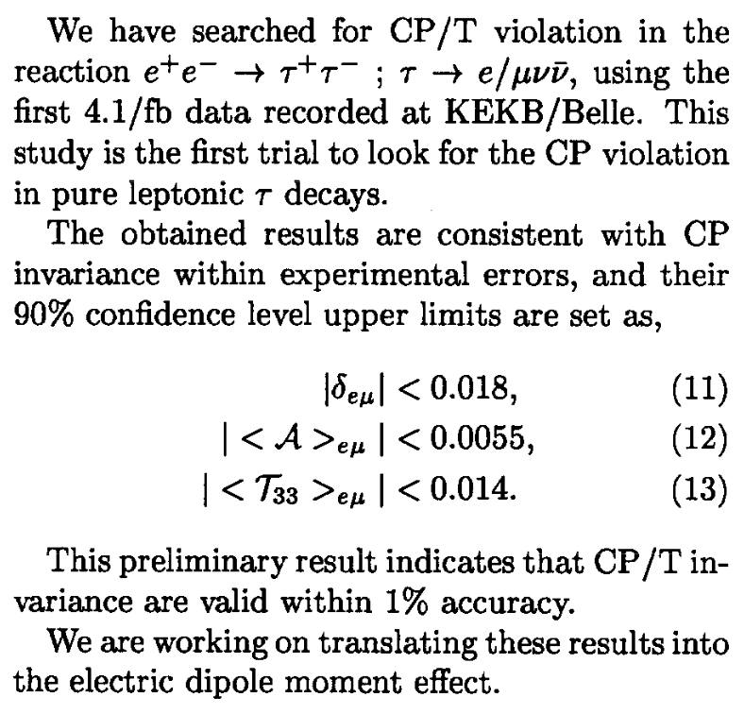
In 2001

