Slide 1


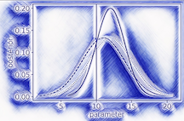
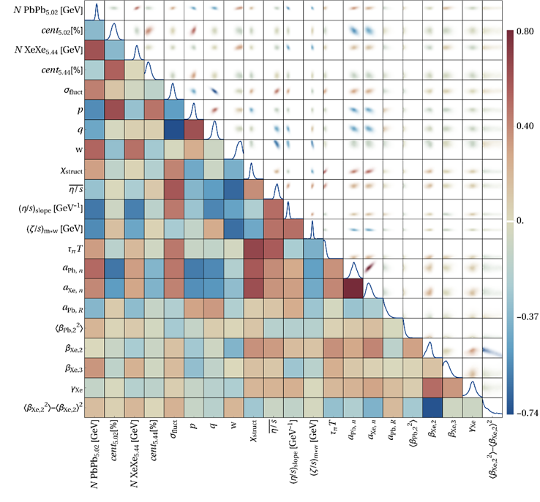
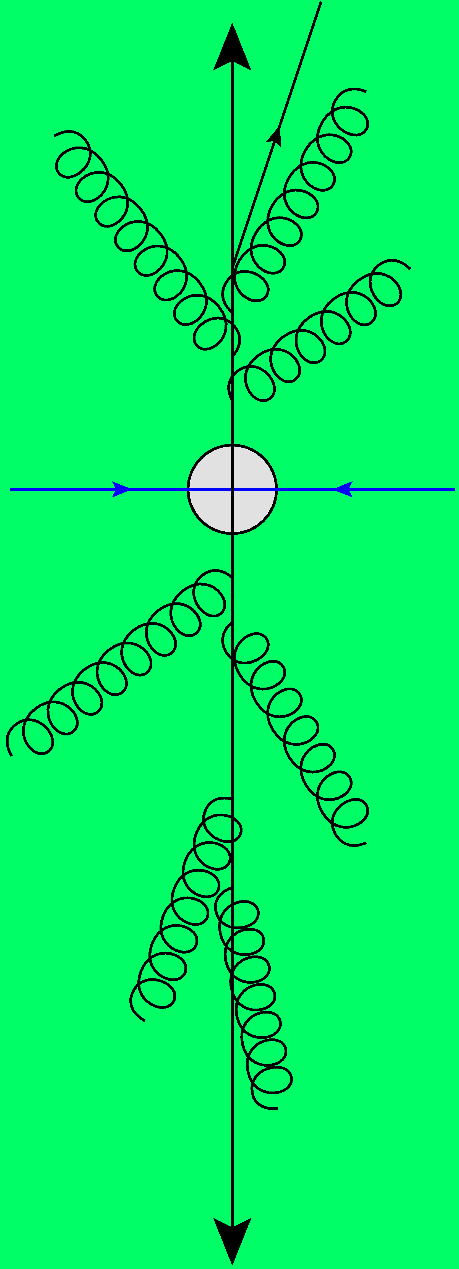
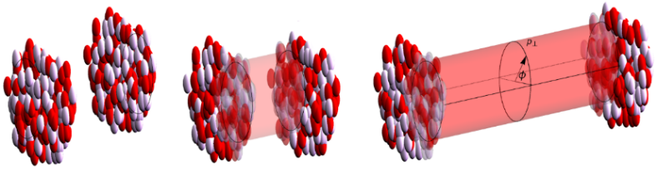
Bayesian inference in heavy ion collisions
Wilke van der Schee
Precision Frontier of QCD Matter: Inference and Uncertainty Quantification
Wuhan, China, 2 September 2025

Slide 2
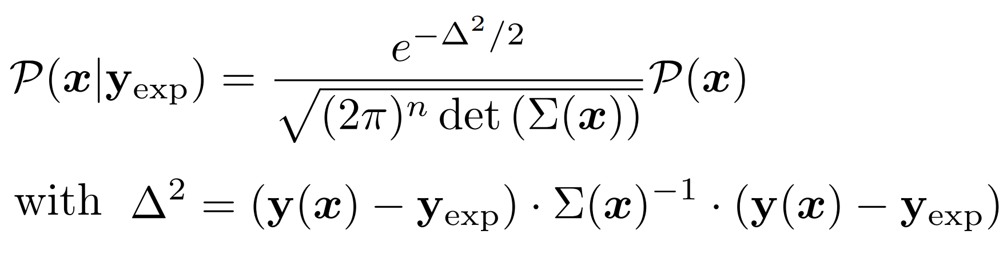
Bayes theorem is about uncertainties
Bayes theorem:
A mathematical theorem with three basic ingredients:
A (physics) model with experimental data Parameter posterior not realistic if model is not realistic
Prior probability Often more relevant than one would wish
Uncertainties:
Statistical and emulator uncertainties are relatively easy
Correlated observables already significantly harder
Systematic (model) uncertainty often impossible to estimate Becomes more relevant if emulator is more accurate
What happens if we have many parameters? Too few parameters? Too many data points? Too few datapoints?
Can we trust our posterior? Only with a realistic model (for data considered) and realistic uncertainty

Slide 3
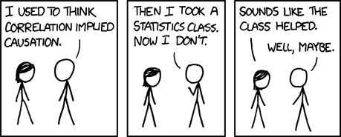
Two messages --- precision era of HIC
Wealth of data poses a significant challenge
Necessary to fully utilise experimental knowledge
Correlation matrix often important (Unknown) systematic uncertainty often important Rarely data follows standard χ² distribution …
Often necessary to `interpret’ results:
Some observables may be more reliable than others
Some parameters can be trusted better than others
Correlation doesn't imply causation, but it does waggle its eyebrows suggestively and gesture furtively while mouthing 'look over there'.

Slide 4

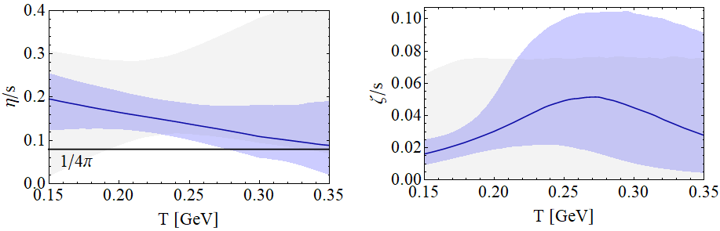

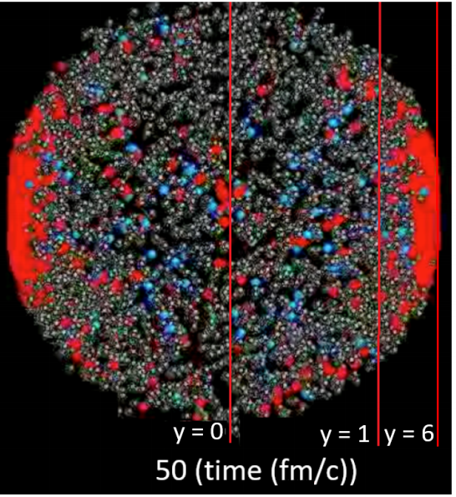
Standard model of heavy ion collisions
Wilke van der Schee, CERN/Utrecht
(# parameters)
Initial stage (13)
Viscous hydrodynamics (10)
Cascade of hadrons (2)
SMASH
Subnucleonic structure? (8)
Non-thermal flow? (2) with hydrodynamised initial stage
Fluctuations? (1)
Shape (2)
Shear viscosity (4)
Bulk viscosity (3)
Second order transports: 2
EOS: 1
Jonah Bernhard, Scott Moreland and Steffen Bass, Bayesian estimation of the specific shear and bulk viscosity of quark–gluon plasma (2019)
Govert Nijs, WS, Umut Gursoy and Raimond Snellings, A Bayesian analysis of Heavy Ion Collisions with Trajectum (2020)

Slide 5
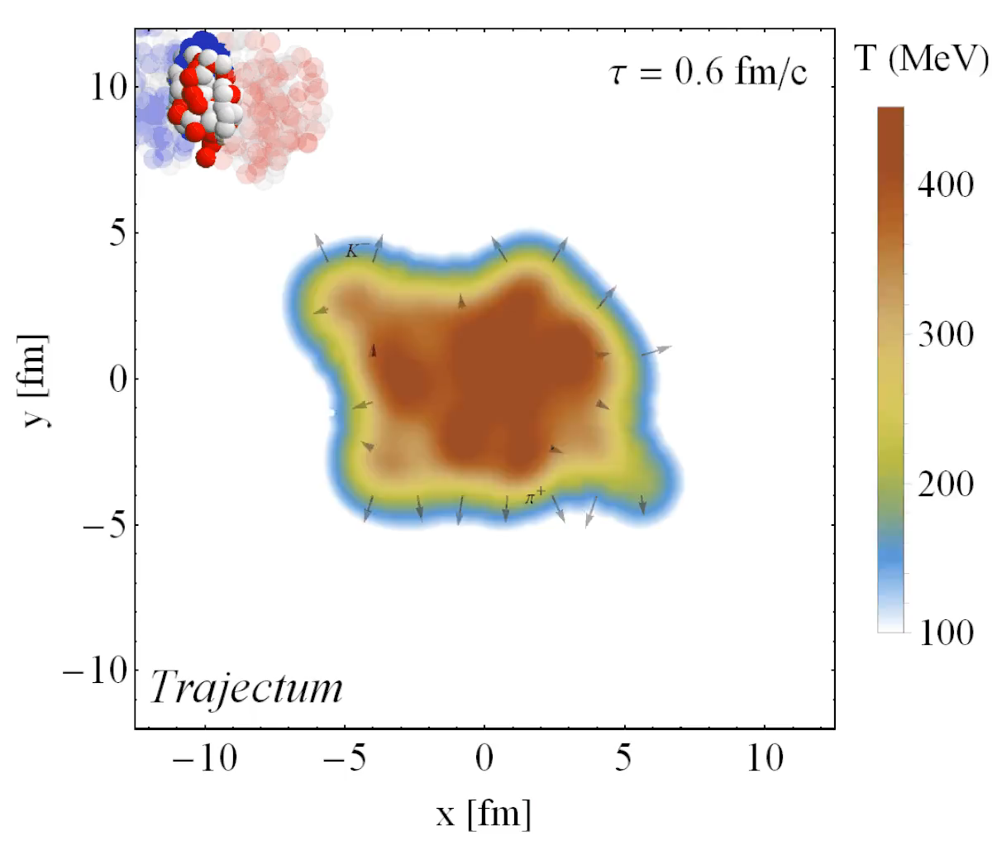
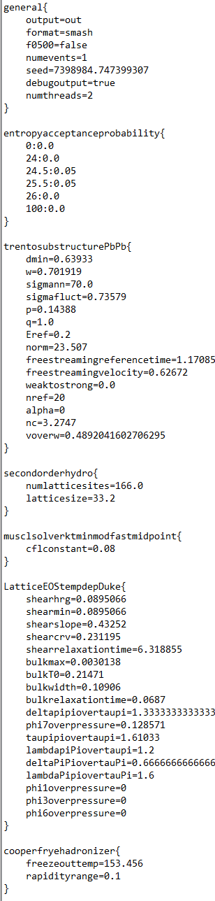
A visualisation
Depends on parameters (see param file, right)
In this case Trajectum (many other models available)
Compute observables as close to experiment as possible
http://sites.google.com/view/govertnijs/trajectum
http://wilkevanderschee.nl/trajectum

Slide 6
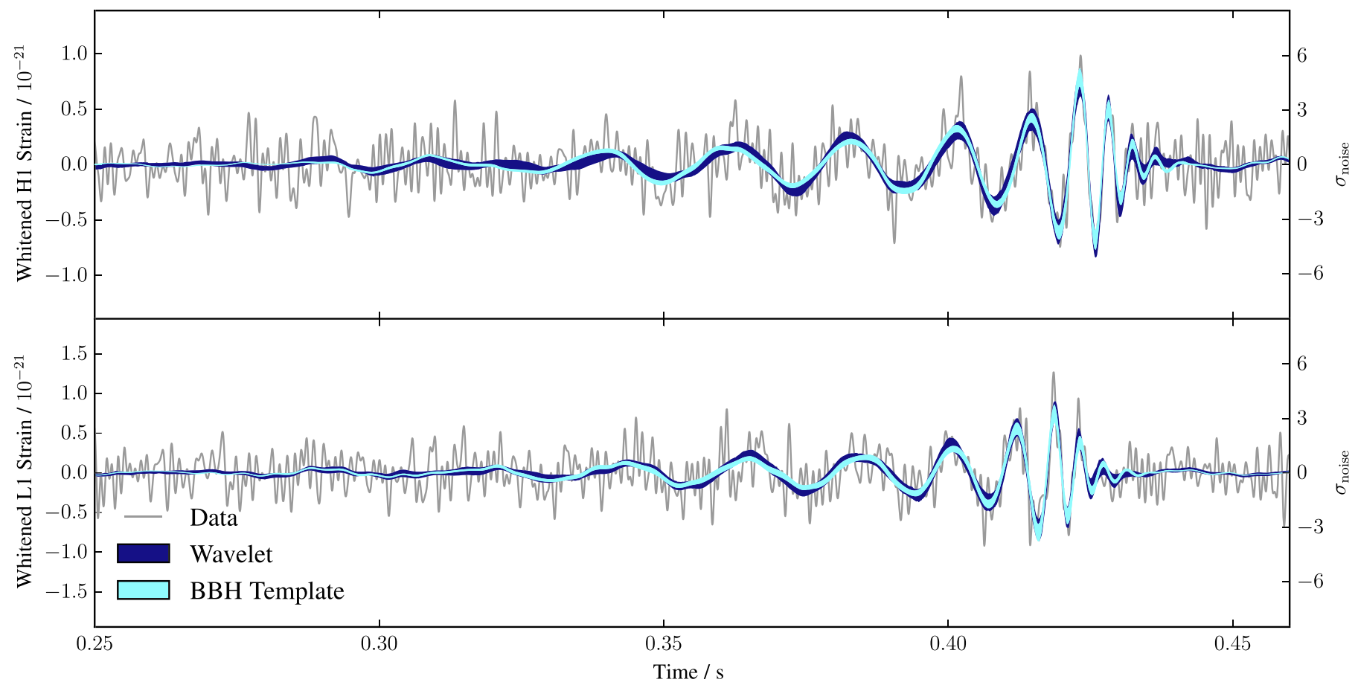
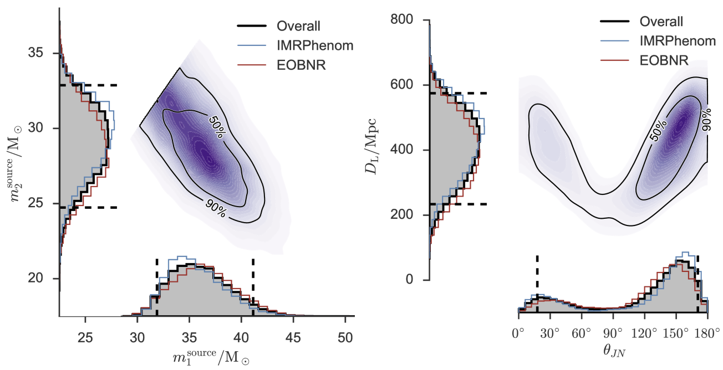
Performing a global analysis
Wilke van der Schee, CERN/Utrecht
Bayes theorem:
Same technique: gravitational waves
Model depends on parameters non-linearly
Run model on 3000 `design’ points
Use an emulator for any point in parameter space (GP)
Markov Chain Monte Carlo
653 data points
Obtain posterior probability density of parameters
Compare posterior with data
Can include high statistics run
LIGO, Properties of the Binary Black Hole Merger GW150914 (2016)
Notes:
Parameters influence observables in complex and non-linear way
Global analysis needed
Run on design points + emulate
MCMC with Bayes theorem and over 500 datapoints
Verify that high probability parameter set works well with other observables
Similar to gravitational waves with for instance waveform determines correlation between distance and inclination

Slide 7
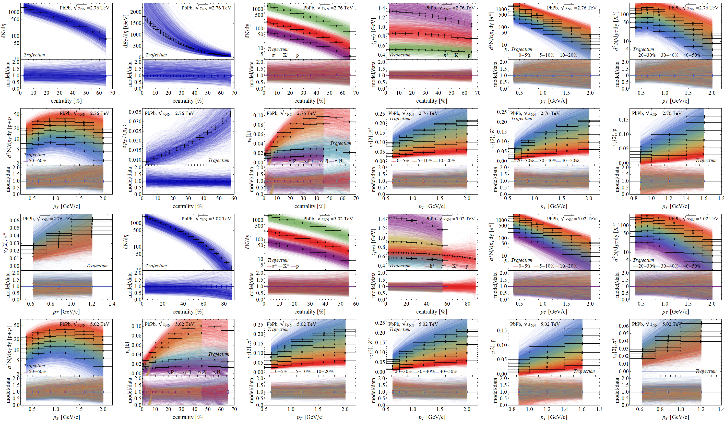
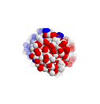
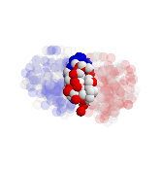
Experimental observables: a wealth of data
Prior

Slide 8
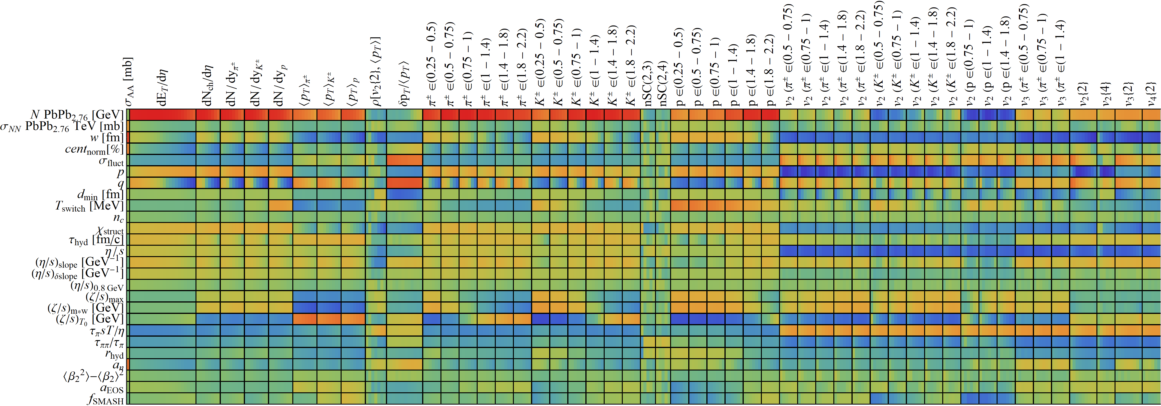
Design parameter-observable correlations:
Wilke van der Schee, CERN/Utrecht

Slide 9
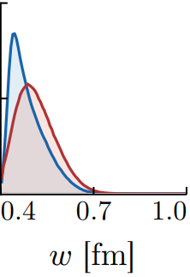
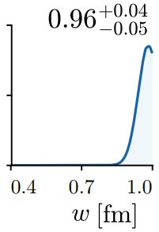
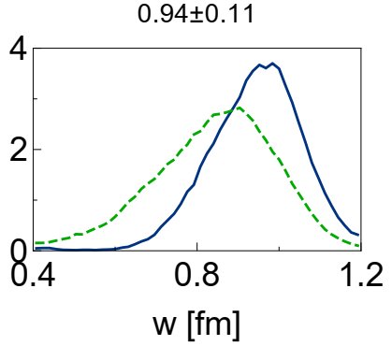
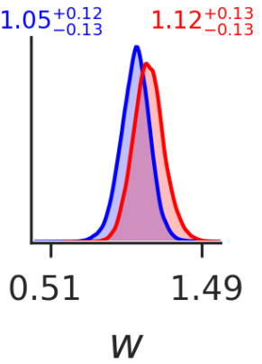
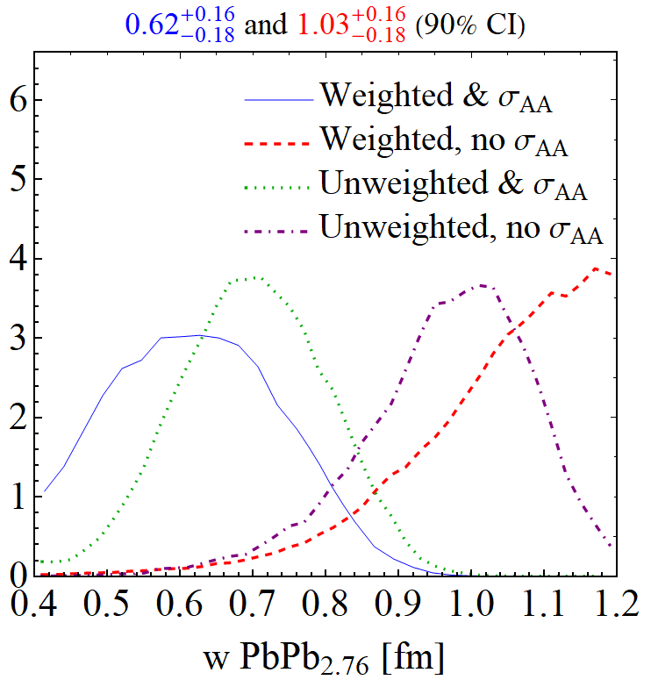
Bayes theorem: three words of caution
Trajectum, 2022
Trajectum, 2020
JETSCAPE, 2020
Duke + OSU, 2016
Duke nature physics, 2018
Nucleon width increased in 2018 (very significantly) and decreased (very significantly) in 2022
Turns out that the width was inconsistent with the total hadronic PbPb cross section (measured in 2022)
What happened?
In 2018: the initial stage model changed
In 2022: new measurement, but also: Many subtle changes in many data points `pulled’ to large width
Govert Nijs, WS, Hadronic Nucleus-Nucleus Cross Section and the Nucleon Size (2022)

Slide 10
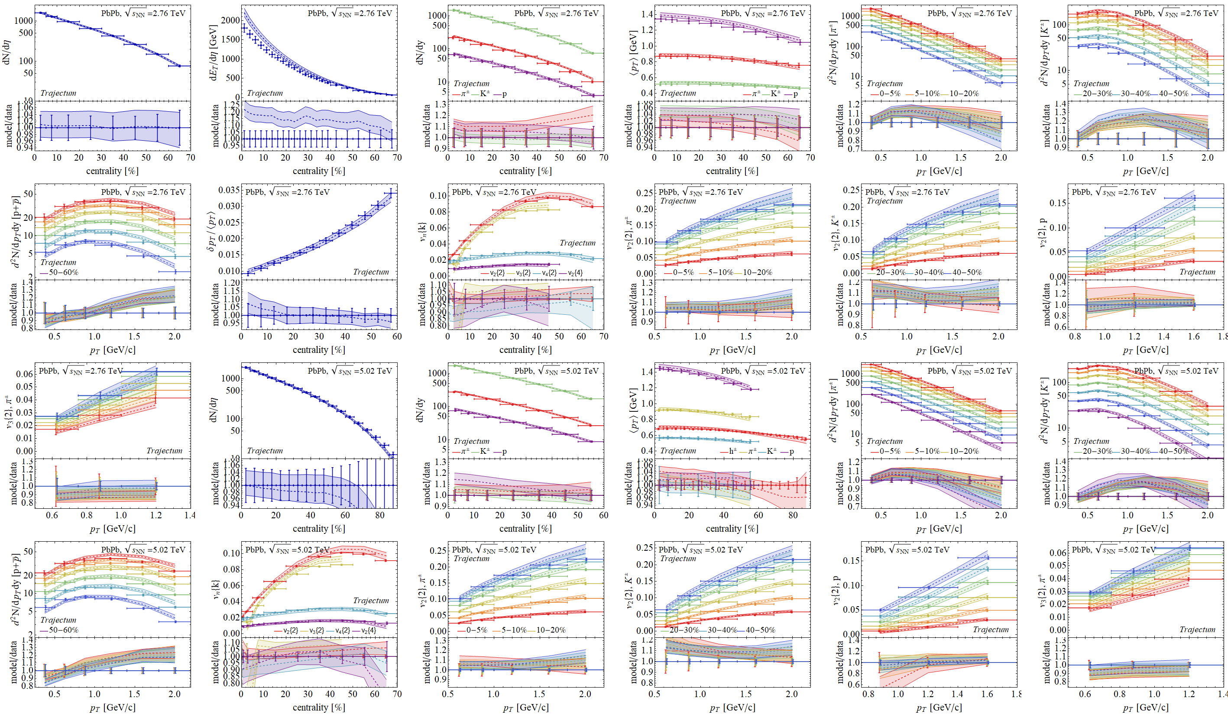
Experimental observables: a wealth of data
With σ_{PbPb}

Slide 11
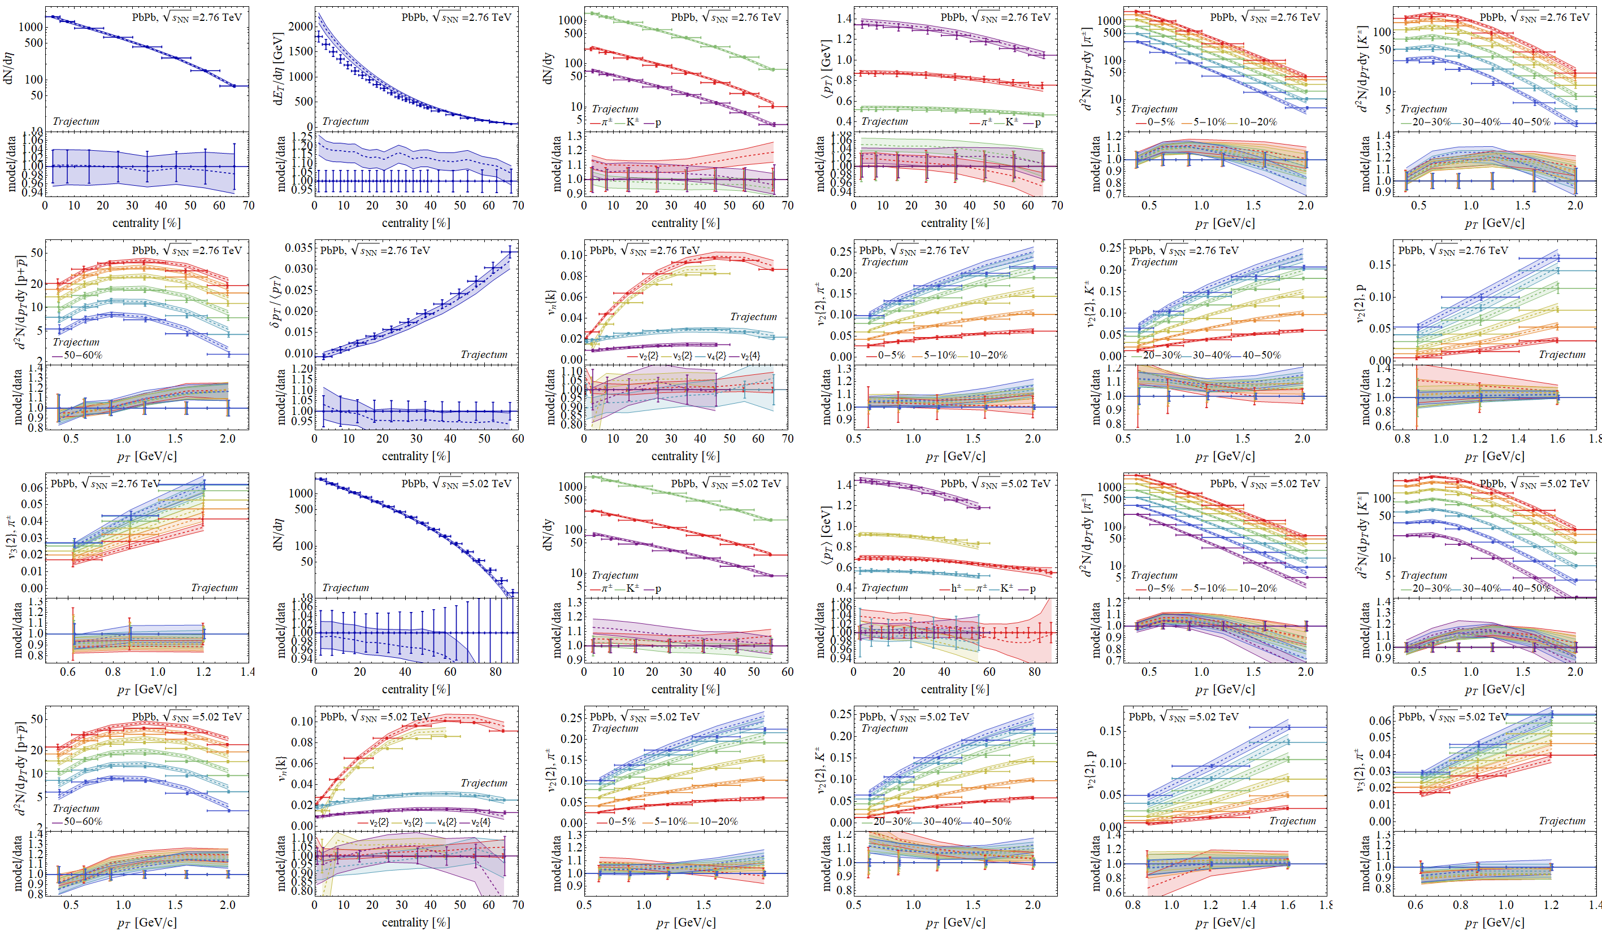
Experimental observables: a wealth of data
No σ_{PbPb}

Slide 12

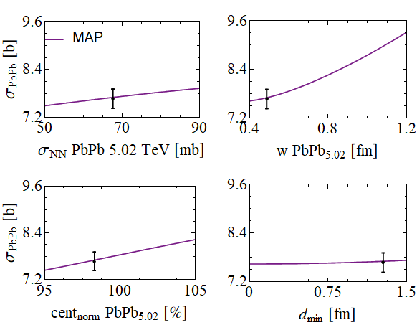
The nucleon width and the total PbPb hadronic cross section What is easier to measure the width than by simply measuring the size?
Wilke van der Schee, CERN/Utrecht
Fix nucleon-nucleon cross section:
e.g. collision probability tuned to σ_{NN} for Gaussian profile ρ
Theoretically, cross section only depends on
Nucleon-nucleon cross section
Nucleon Gaussian width (dominant)
Centrality normalisation
Minimum inter-nucleon spacing
Makes the cross section a robust observable
Basically implying every model needs to get this right
Basically implying the nucleon width should be small
See also David d’Enterria and Constantin Loizides, Progress in the Glauber Model at Collider Energies (2020)

Slide 13
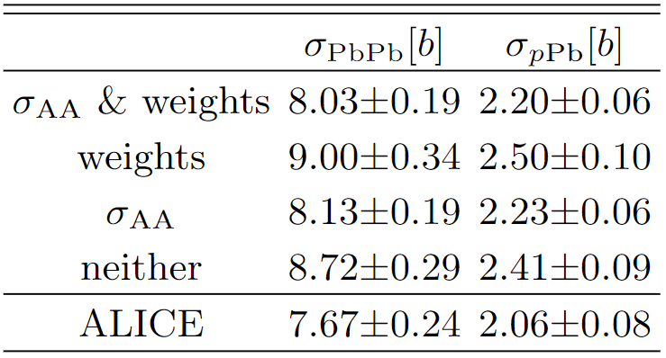
Why was the width overestimated?
Without cross section width is large, about 1.0 fm
With the cross section width is smaller, about 0.7 fm
Still tension with cross section: other data pushes width higher
Need to capture `trust’ in observables: weighting
Weight unity: cross section + integrated & unidentified
Weight ½: integrated identified observables
Weight ¼: p_{T}-differential identified observables
Reduced weight: p_{T} > 1.5 GeV (π+K) and centrality > 50%
With weighting cross section comes out correctly
Broader uncertainties: reflect less `trust’ due to weighting
Also: description of data not much worse with smaller width
Important that Bayes factor is an addition of many (correlated!) data points

Slide 14
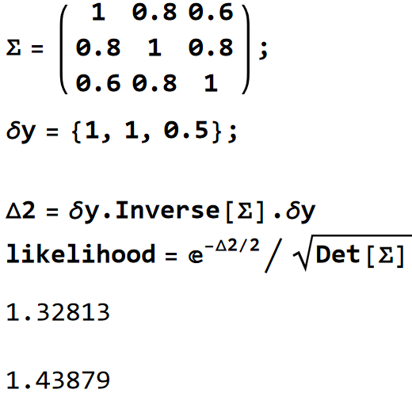
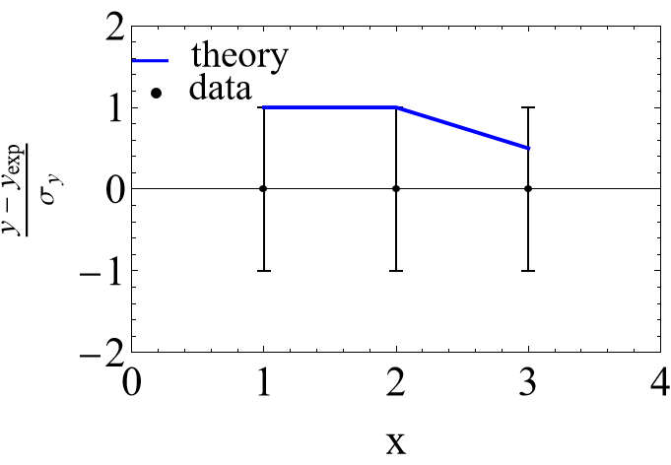
Four simple examples
Bayes theorem:
What’s the likelihood?
For uncorrelated uncertainties?
0.325
If 1 & 2 are fully correlated?
Ill defined / infinity
If 1 & 3 are fully correlated?
Ill defined / zero
For a realistic covariance matrix?
1.439

Slide 15
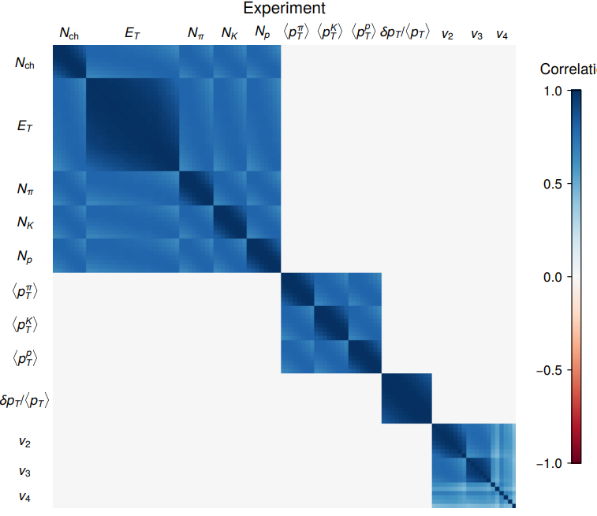
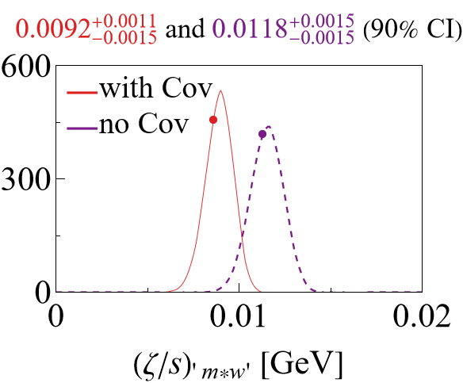
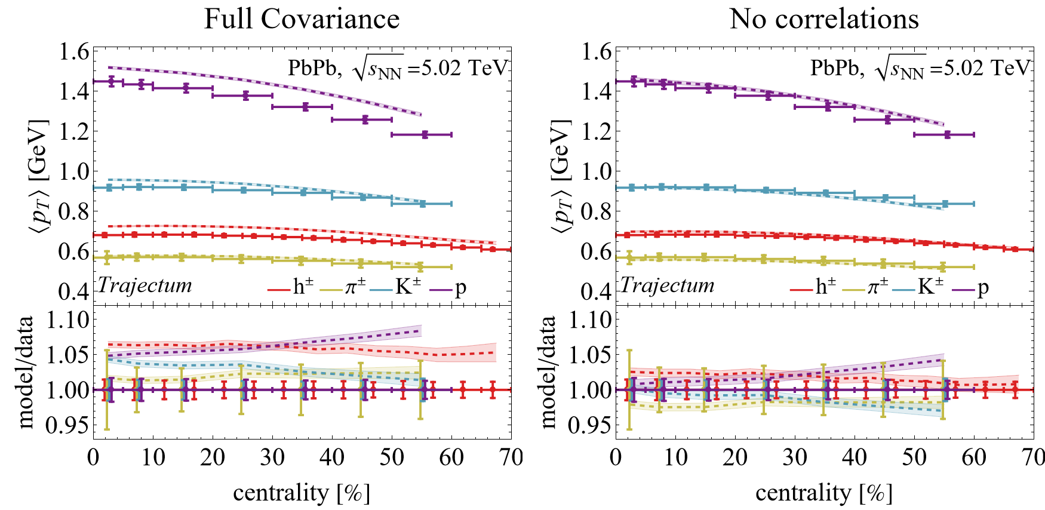

A real example: mean p_{T}
Most analyses likely follow the `Nature Physics’ approach*
Only correlations between equal observables
If subobservables differ: multiply by 80%
Covariance between two centralities:
Likely not very realistic for many observables…
For e.g. mean p_{T} it really matters:
Changes bulk viscosity beyond uncertainty
Jonah E. Bernhard, J. Scott Moreland & Steffen A. Bass, Bayesian estimation of the specific shear and bulk viscosity of quark–gluon plasma (Nature Physics, 2019)
*“for which we assume a reasonable correlation structure,”

Slide 16
Bayes theorem: three words of caution
Trajectum, 2022
Trajectum, 2020
JETSCAPE, 2020
Duke + OSU, 2016
Duke nature physics, 2018
First lesson:
Be careful with many data points that `pull’ the Bayes factor
Are really all known and unknown uncertainties included in the covariance matrix? Including correlations?

Slide 17
Bayes theorem: three words of caution
Second: does the model capture all the (relevant) physics?
In practice always compromise between computational cost and completeness of the model
Hints can be seen in correlation matrix
When `fixing’ one parameter this affects all other (correlated!) parameters
`Posterior’ density unreliable if `artificially’ restricting a relevant parameter
Meaning of `relevant’ depends on computation

Slide 18
Experimental observables: a wealth of data
Posterior

Slide 19
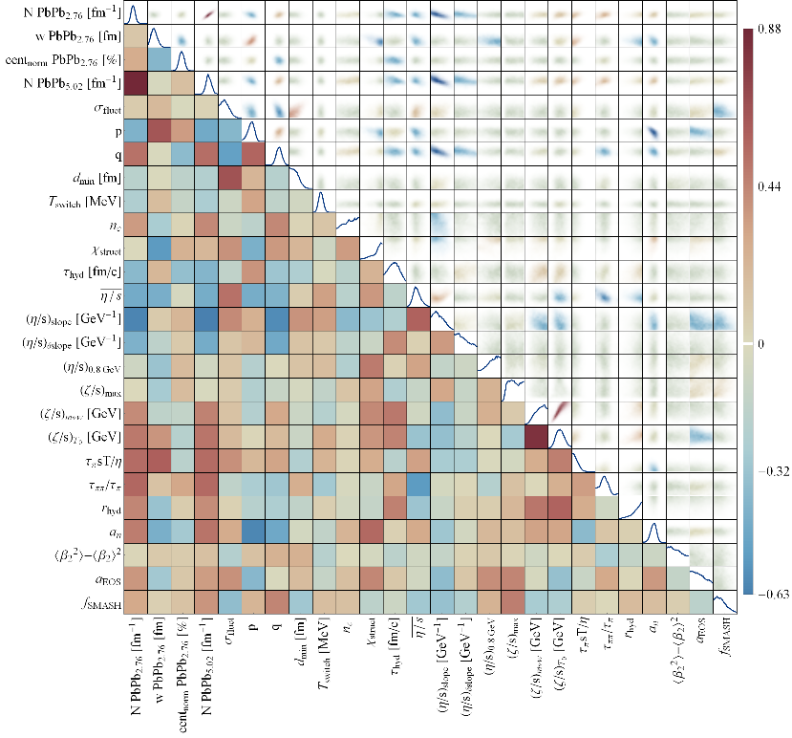
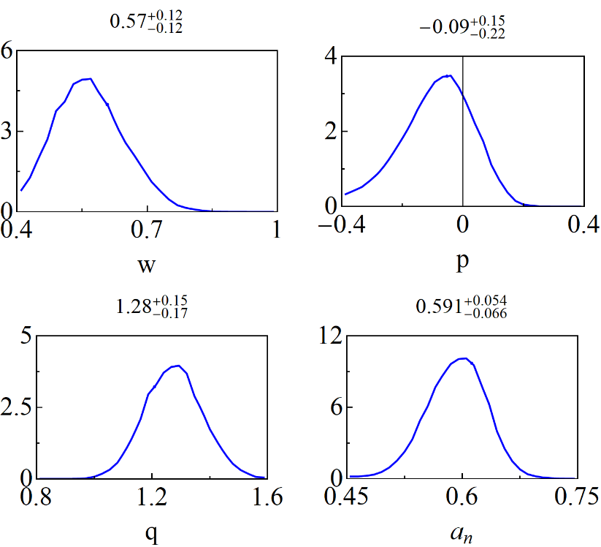
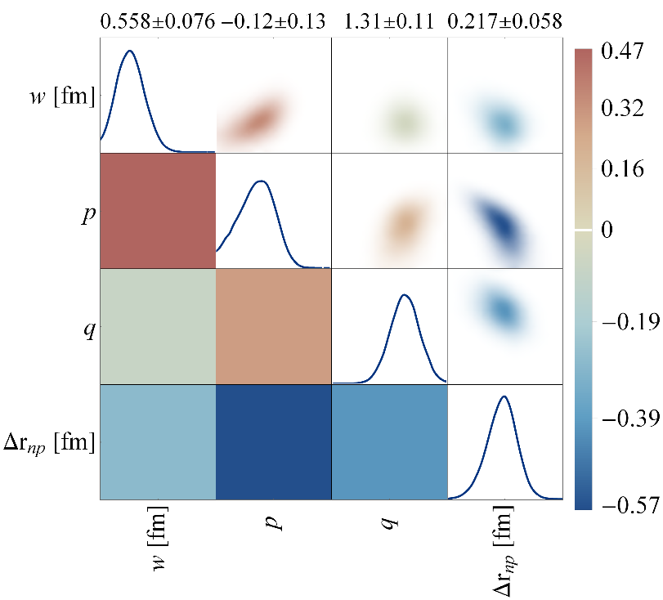
The neutron skin - posterior
Trento:
Three parameters are most sensitive to the neutron skin:
The nucleon width and the Trento parameters p and q
Small correlation with width (cross section is highly sensitive to w)
Very strong anticorrelation with p; centrality dependence is important

Slide 20

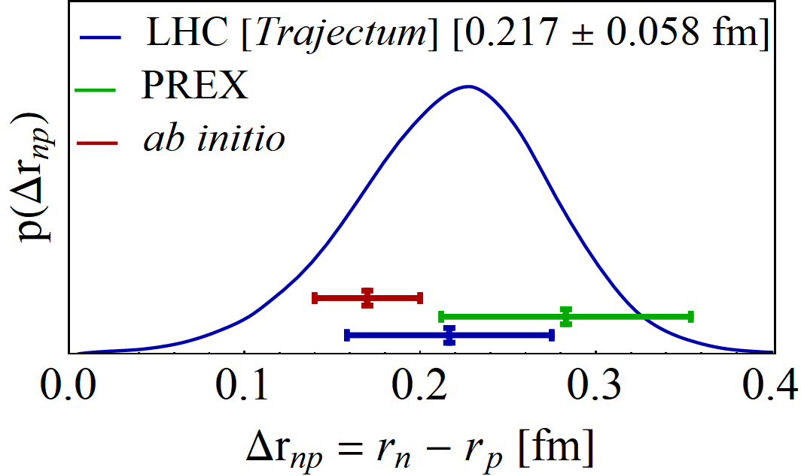
The neutron skin – final result
Transform to neutron radius minus proton radius
Final result consistent but smaller than PREX II
Uncertainty is about 20% smaller than PREX II
Cross section is crucially important, but also centrality dependence
Important to vary Trento parameters in particular
PREX II, Accurate Determination of the Neutron Skin Thickness of ²⁰⁸Pb through Parity-Violation in Electron Scattering (2022)
Baishan Hu et al, Ab initio predictions link the neutron skin of 208Pb to nuclear forces (2021)

Slide 21
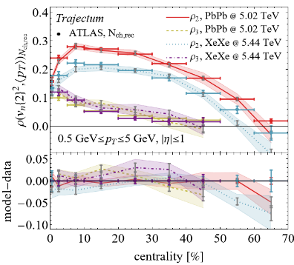
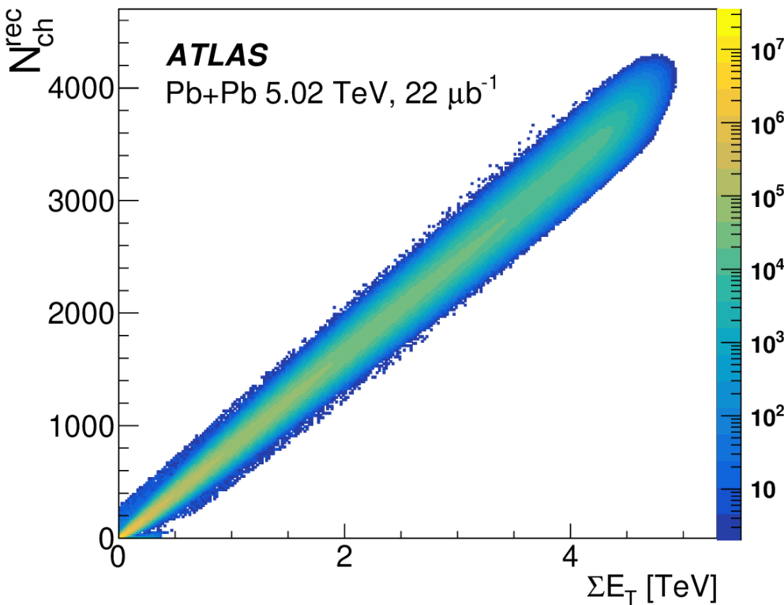
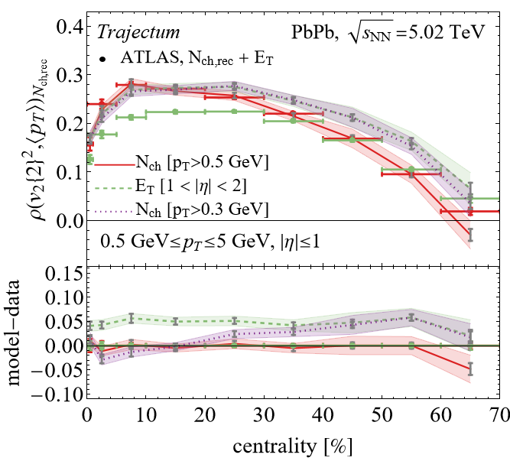
More recent progress: more precision
Slightly technical, message: with more precision a better (model) understanding is needed
Forward (E_{T}) versus mid-rapidity (Nch)
Forward considered `better’ (ATLAS, lower spread)
Mid-rapidity closer to our model (boost invariant)
Somewhat ironic:
ATLAS sees big effect at central collisions
Trajectum has big effect at peripheral collisions
Trajectum: big effect p_{T} cut on N_{ch} (purple)
ATLAS, Correlations between flow and transverse momentum in Xe+Xe and Pb+Pb collisions at the LHC with the ATLAS detector: a probe of the heavy-ion initial state and nuclear deformation (2022)

Slide 22
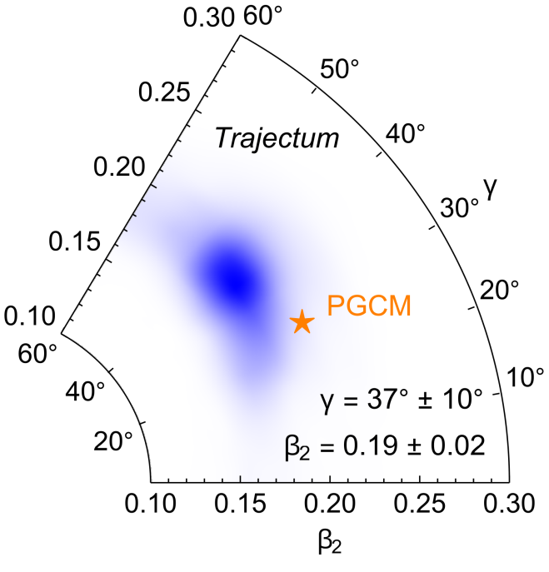
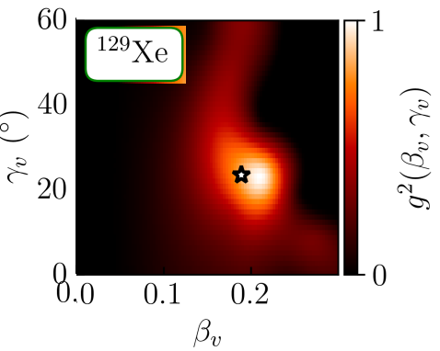
More recent progress: Xenon deformation
LHC [Trajectum]
First quantitative measurement of Xenon triaxiality
Matches well with theoretical PGCM estimate
Theory [PGCM]
Benjamin Bally, Michael Bender, Giuliano Giacalone and Vittorio Soma, Evidence of the triaxial structure of ¹²⁹Xe at the Large Hadron Collider (2021)

Slide 23
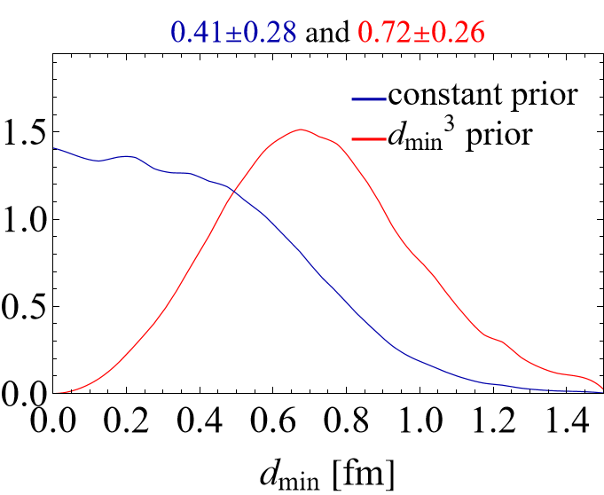
Bayes theorem: three words of caution
Third: the prior is important
If the data is `strong’ the prior doesn’t matter
In practice it often matters…
Bayesian analysis or global analysis
The only way to `properly’ combine all the wealth of data and knowledge we have
Be careful about the known and unknown uncertainties, including correlations
Kyle Cranmer, Practical Statistics for the LHC

Slide 24
Discussion
Bayesian or global analyses
Essential tool to assess parameters in view of experimental data
Becoming more mainstream: public tools by e.g. JETSCAPE
The uncertainties are essential and sometimes difficult to control
A personal biased overview of an answer to “Bayesian inference”
Not covered: Technical implementation, non-flow effects, rapidity gaps, very peripheral or high pT, hadronic afterburner, collisions across beam energies and system sizes (light ions)
Heavy ions as a precision science
Uncertainties are small: apples-to-apples comparison is essential
Many `basic’ observables turn out to be interesting ☺ (no time to cover ultracentral..)
Jonah E. Bernhard, J. Scott Moreland & Steffen A. Bass, Bayesian estimation of the specific shear and bulk viscosity of quark–gluon plasma (Nature Physics, 2019)

Slide 25
Back up / discussion

Slide 26
Global analysis, technical practicalities
P(x|y_{exp}) can be a 25-dimensional function where y(x) is expensive to evaluate
Markov Chain Monte Carlo (emcee) can require order 10M evaluations
Technical steps to evaluate it
Compute y(x) for nicely spreaded sample of points (latin hypercube sampling, order 500 points)
PCA on observables, keep order 20 principal components (PCs)
Build a Gaussian Process Emulator for those PCs
Basically a glorified interpolating function in higher dimensions
`Easier’ if observables do not depend much on parameters (large length scale)
Validated and includes emulation uncertainty (often dominant)
Sample posterior of x to obtain systematic model uncertainty due to parameters
Jonah E. Bernhard, J. Scott Moreland & Steffen A. Bass, Bayesian estimation of the specific shear and bulk viscosity of quark–gluon plasma (Nature Physics, 2019)
Jonah E. Bernhard, Bayesian parameter estimation for relativistic heavy-ion collisions (2018), https://github.com/jbernhard/hic-param-est

Slide 27
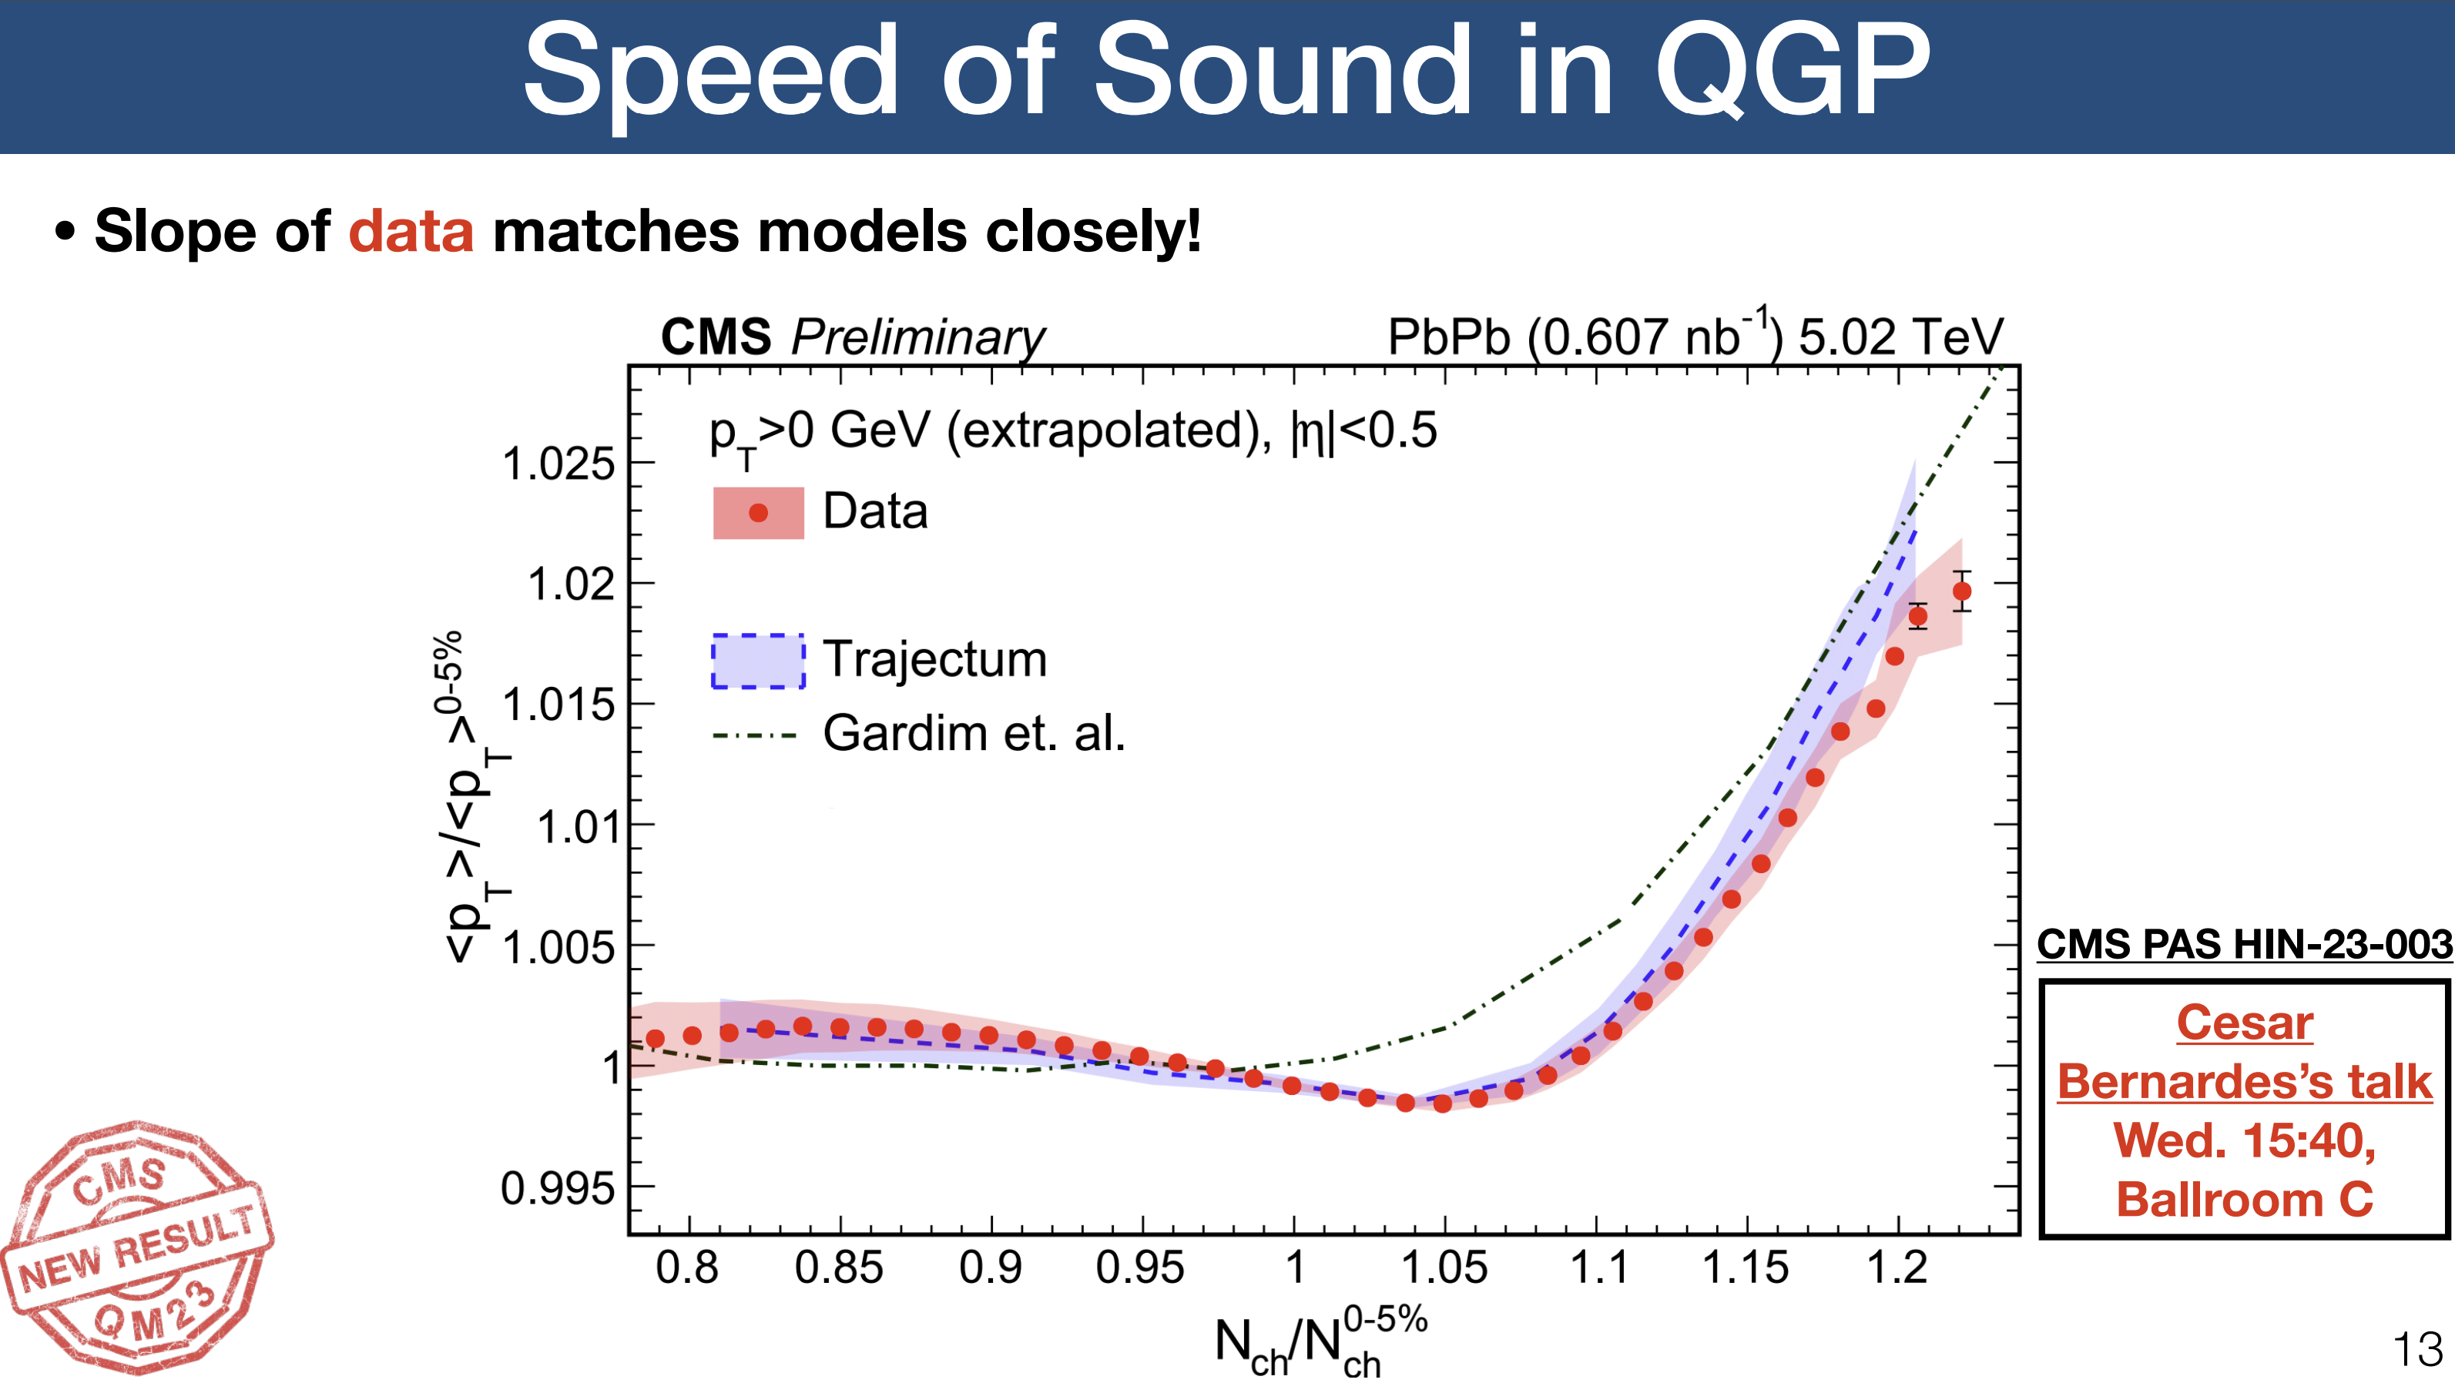
A true prediction using hydrodynamics (rare these days…)
Non-trivial curve; non-monotonicity was unexpected
Extremely precise (<0.1%) due to uncertainty cancellations in the ratio (theory & experiment (!))
Fernando G. Gardim, Giuliano Giacalone and Jean-Yves Ollitrault, The mean transverse momentum of ultracentral heavy-ion collisions: A new probe of hydrodynamics (2019)
Govert Nijs and WS, Predictions and postdictions for relativistic lead and oxygen collisions with the computational simulation code Trajectum (2021)
Austin Baty, Overview of Recent CMS results, https://indico.cern.ch/event/1139644/contributions/5343932/ (see also Cesar Bernardes)

Slide 28
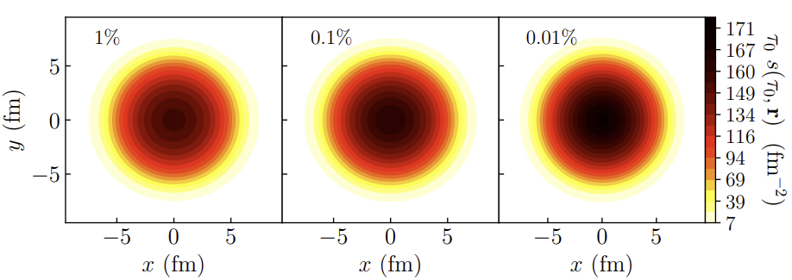
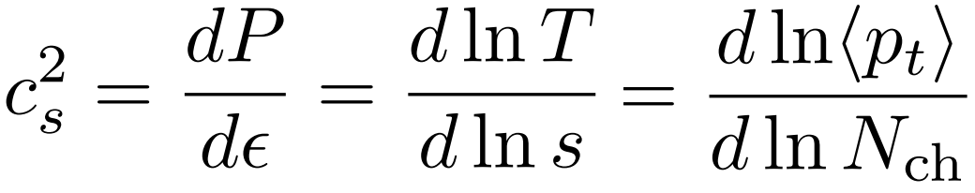
What is happening?
(Extremely) ultracentral collisions are not driven by impact parameter
Size does not extend beyond radius Lead nucleus
(Local) fluctuations drive up multiplicity
Average temperature can still increase
A simplified picture:
Entropy increase → multiplicity increases
Temperature increases → mean pt increases (assuming ideal hydro + constant `work’ done in rapidity direction)
Slope: sensitive to speed of sound (solely ?!):
Fernando G. Gardim, Giuliano Giacalone and Jean-Yves Ollitrault, The mean transverse momentum of ultracentral heavy-ion collisions: A new probe of hydrodynamics (2019)

Slide 29
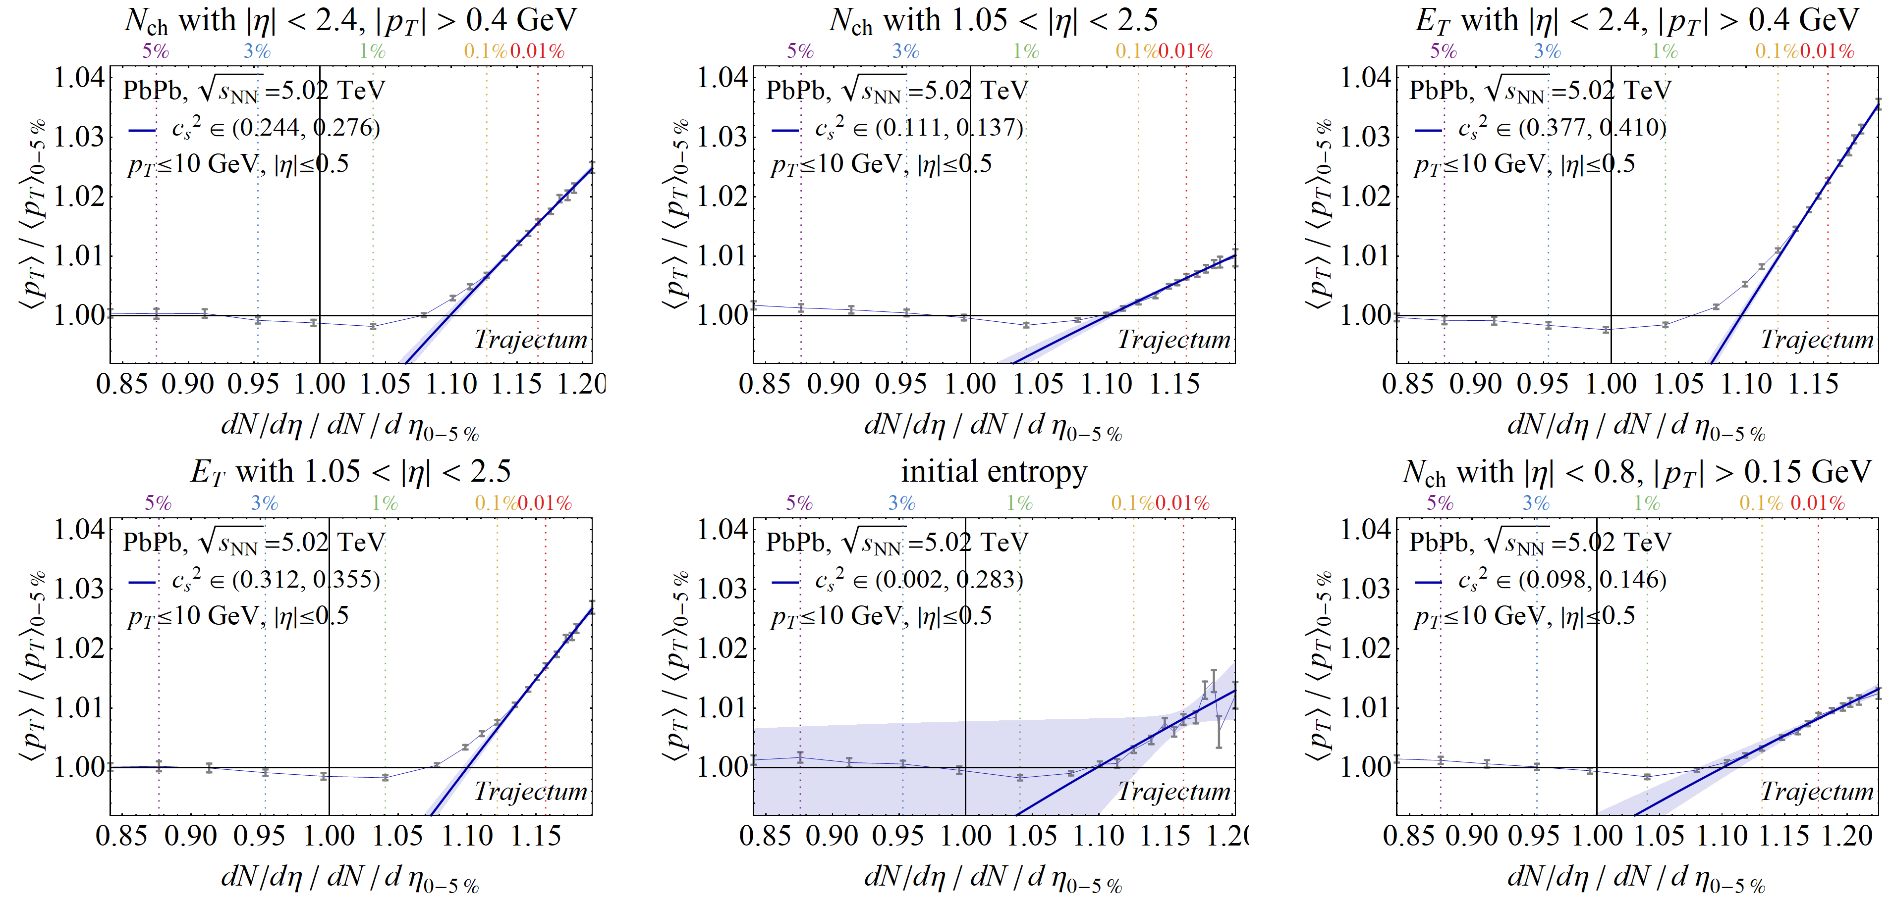
What then determines the slope?
Centrality cuts are very important..; boost invariant, self-correlation, computationally expensive for |η|>1.5
`Trajectum’
`V0’
`CMS FCAL’
`other theory’
‘ITS’

Slide 30
An example analysing data: centrality

Slide 31
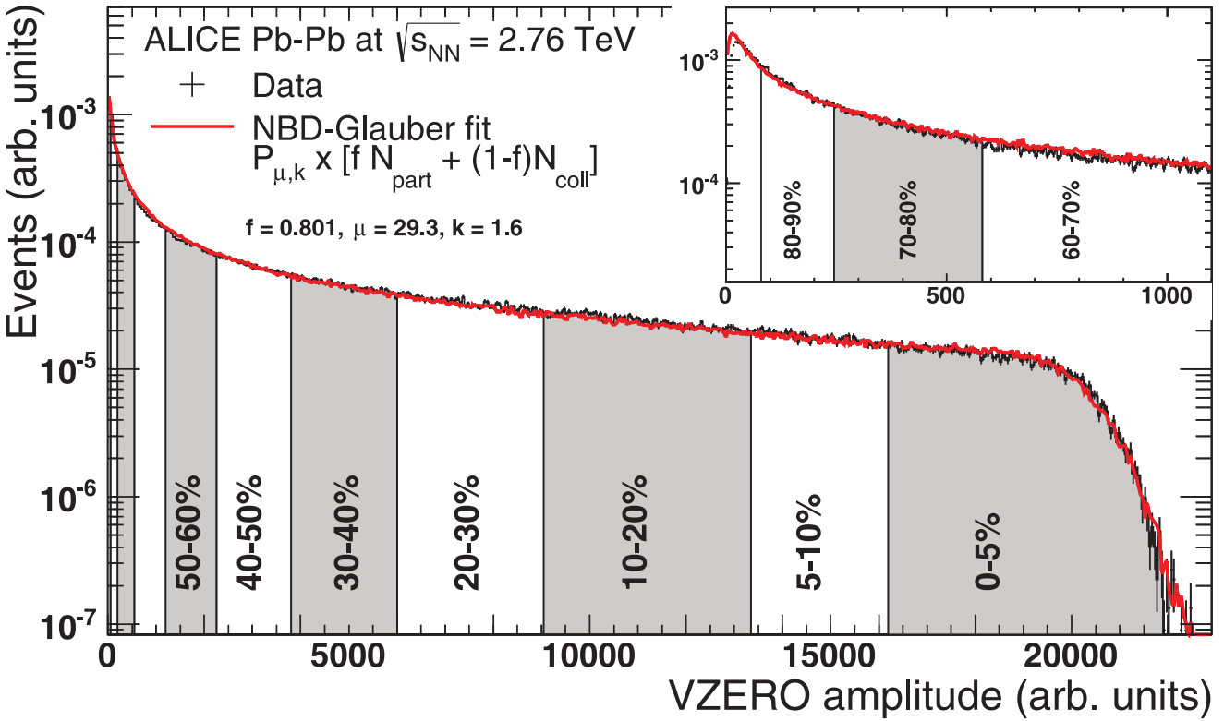


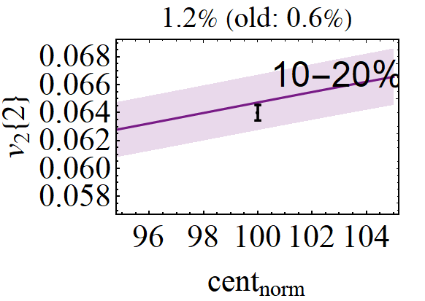
An example analysing data: centrality
Historically: centrality meant impact parameter
Impact parameter is however never observable
Traditionally V0 signal (multiplicity at forward rapidity) as a proxy
Especially with small systems (p-Pb) the definition matters
Modern point of view: centrality is event activity
But where?
Also, 90-100% cannot be measured but is modelled Do we have the anchor point at 90% under control?
If not, all observables shift as a function of centrality (!)
`the ultimate’ correlation of observables
Related to total hadronic PbPb cross section
ALICE , Centrality determination of Pb-Pb collisions at √s_{NN} = 2.76 TeV (2013)
ALICE luminosity determination for Pb-−Pb collisions at √s_{NN} = 5.02 TeV (2022)

Slide 32
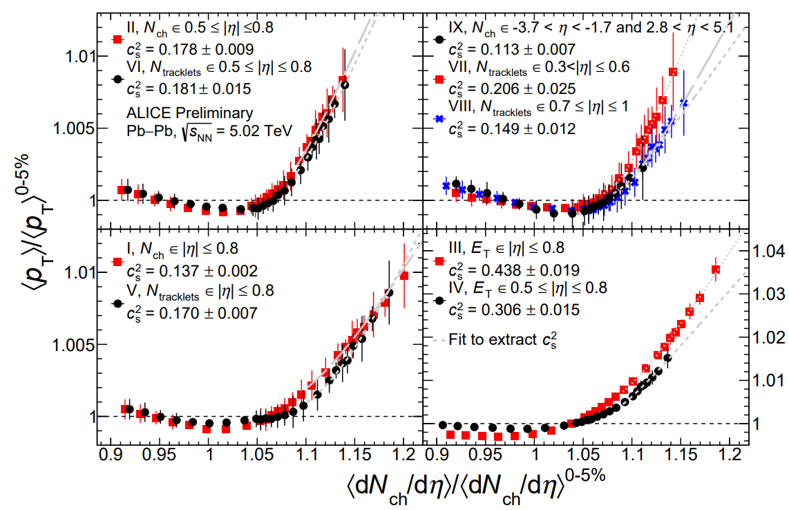
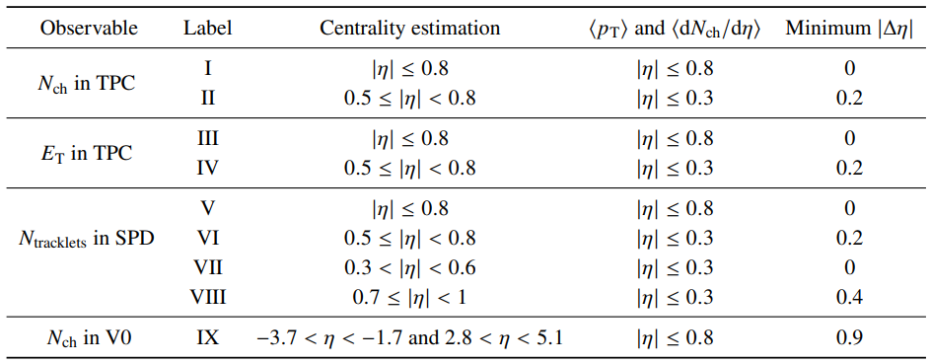
An example analysing data: centrality
An even more modern perspective: apples-to-apples comparison theory/experiment
Even relevant in PbPb collisions; for instance in ultracentral:
Apples-to-apples only possible if theoretical modelling is valid at the centrality definition
Can be problematic especially for boost invariant models (forward rapidity poorly described)
ALICE, Assessing the QGP speed of sound in ultra-central heavy-ion collisions (2024)

Slide 33
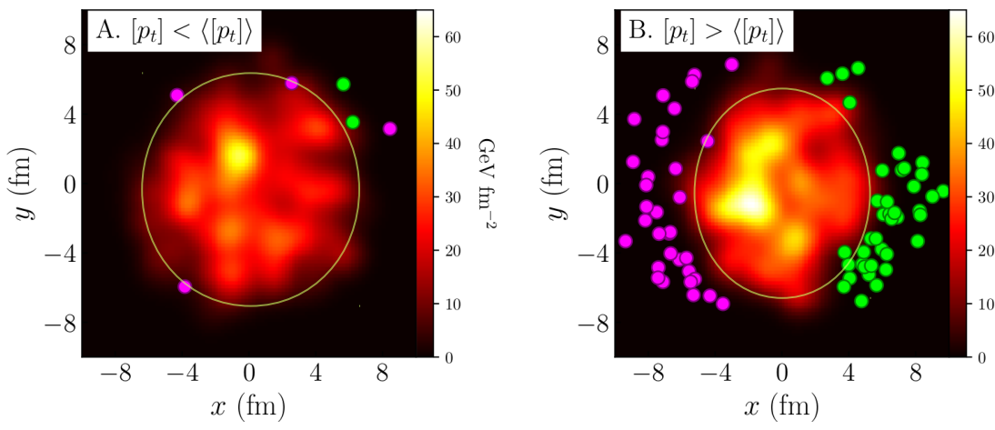

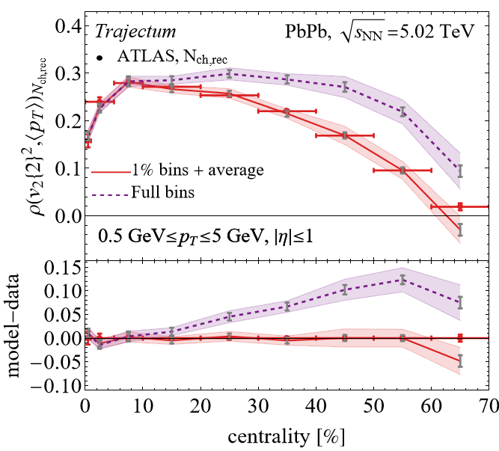
Centrality selection: the ρ₂ correlator
: correlation anisotropic flow and transverse momentum
True correlator: zero if flow and momentum are independent
Intuition: smaller system → larger pT
Intuition: more elliptic → higher v2{2}
Intuition: central: smaller system often a bit more elliptical
Centrality is an important detail:
The correlator is done in small centrality bins (1% for us)
Obtain larger bins by averaging
Relatively big effect (up to 0.1, exp uncert. is 0.01)
But how do we define centrality?
Giuliano Giacalone and Chun Shen, Manipulating strong electromagnetic fields with the average transverse momentum of relativistic nuclear collisions (2021)

Slide 34
Centrality selection: the ρ₂ correlator
Credit to ATLAS: HEPdata has 445 tables (!) that allows to figure these things out
Forward (E_{T}) versus mid-rapidity (Nch): apples-to-apples
Forward considered `better’ (ATLAS, lower spread)
Mid-rapidity closer to model (boost invariant)
Somewhat ironic:
ATLAS sees big effect at central collisions
Trajectum has big effect at peripheral collisions
Trajectum: big effect p_{T} cut on N_{ch} (purple)
ATLAS, Correlations between flow and transverse momentum in Xe+Xe and Pb+Pb collisions at the LHC with the ATLAS detector: a probe of the heavy-ion initial state and nuclear deformation (2022)

