Slide 1


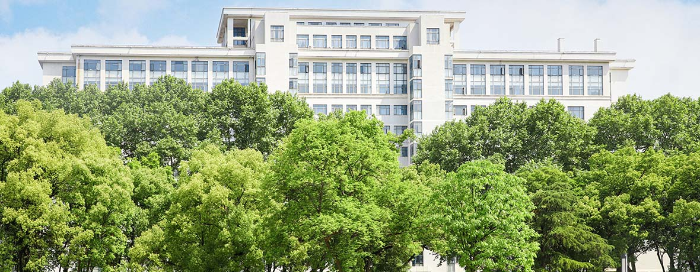
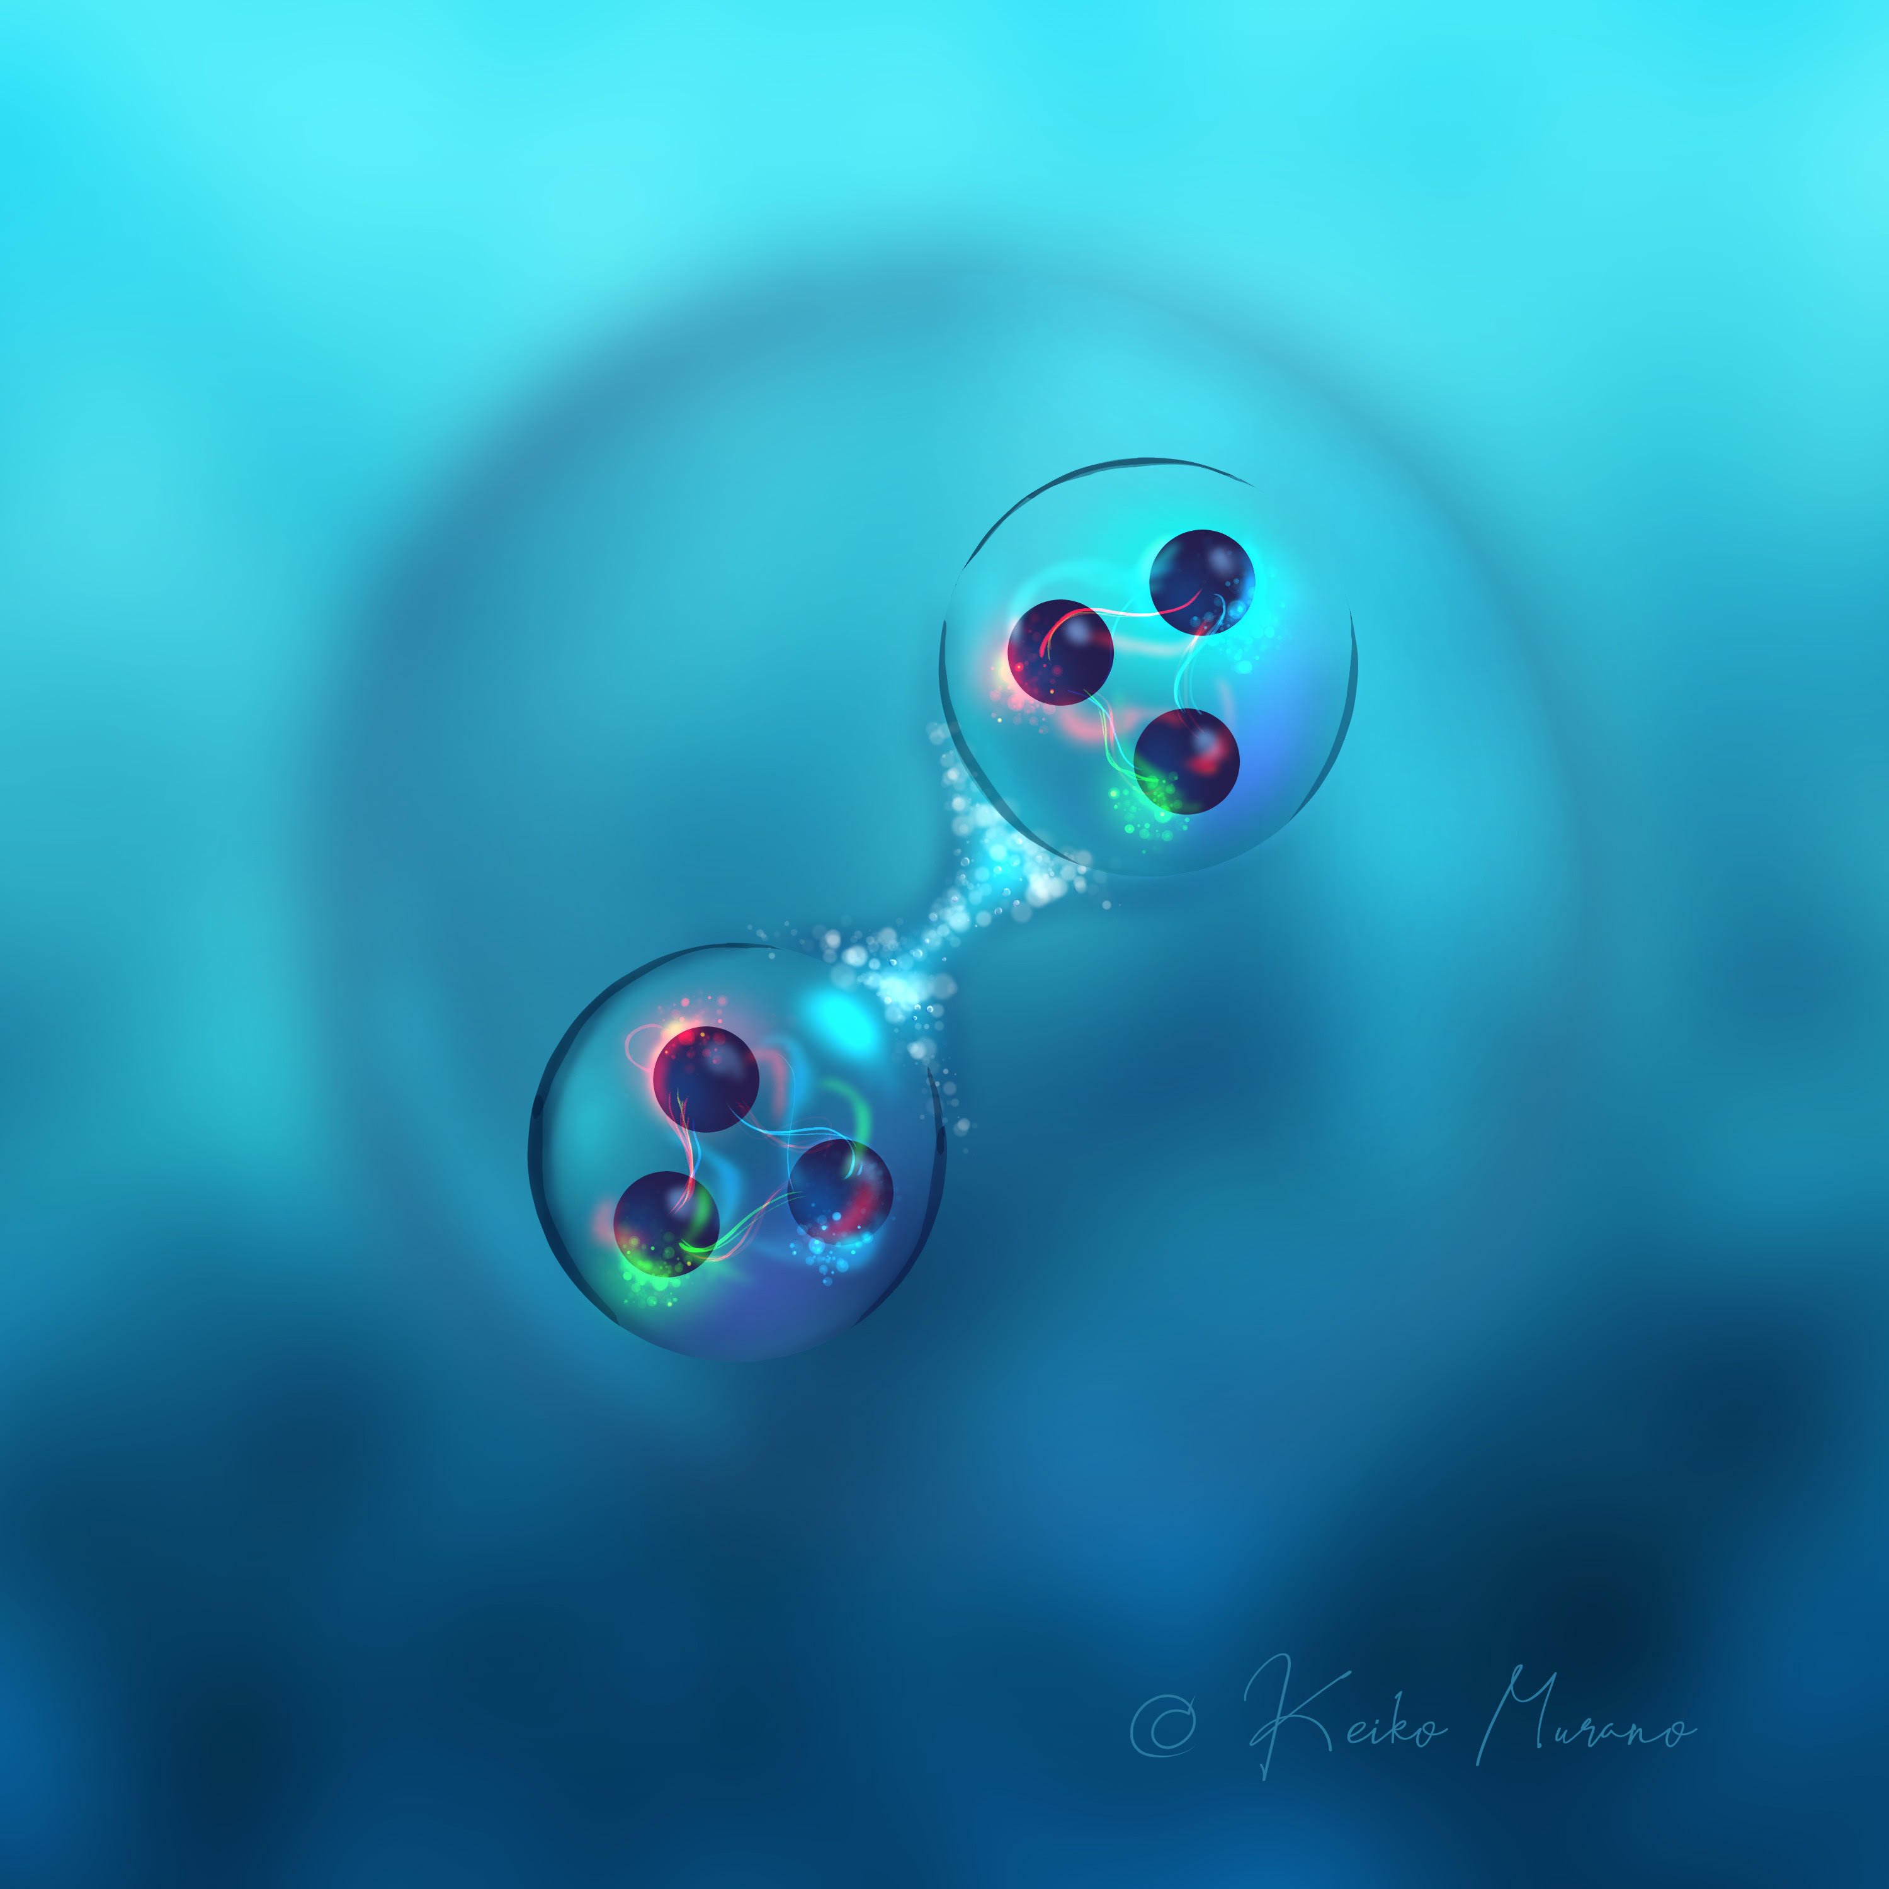
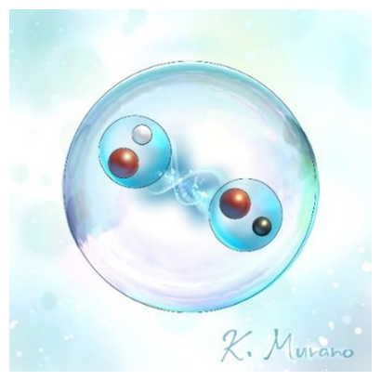
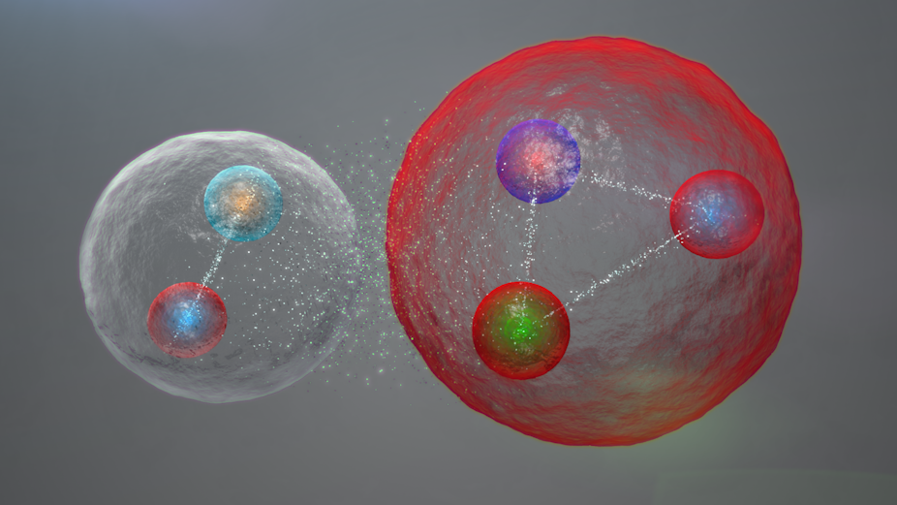

I. Building blocks of matter (10 min.)
II. QCD phase structure (05 min.)
III. Hot QCD plasma (15 min.)
IV. Cold QCD plasma (15 min.)
V. Summary (05 min.)
Hadron-Hadron Interactions from Lattice QCD
- Theory meets experiments -
Tetsuo Hatsuda (RIKEN iTHEMS)
Introduction to HAL QCD Method
Baryon-Baryon Interactions (ΛΛ−ΝΞ, ΝΩ, ΩΩ)
Meson-Meson Interactions (D-D* and T_{cc}⁺ )
4. Meson-Baryon Interactions ($s\overline{s}$ -$N$, $c\overline{c}$ -$N$)
5. Two-pion Exchange universality
6. Summary
Lattice QCD
Hadron-hadron int.
Baryon-baryon int.
Meson-meson int. (T_{cc}⁺)
Meson-baryon int. (φ-N, J/ψ-N, η_{c}-N)
Summary
-
u
s
s
s
c
C3NT workshop (CCNU) Sept. 3, 2025
c
s
s
s
-
d

Slide 2
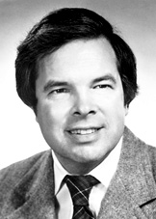


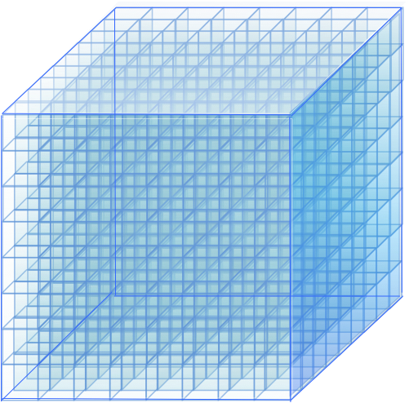
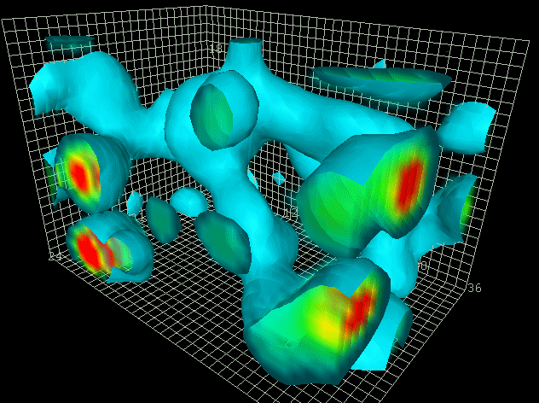
LQCD (since 1974) : Ab initio approach to solve QCD
K. Wilson
quarks
gluons
a
4-dim.
Euclidean
Lattice
L
by D.Leinweber

Slide 3
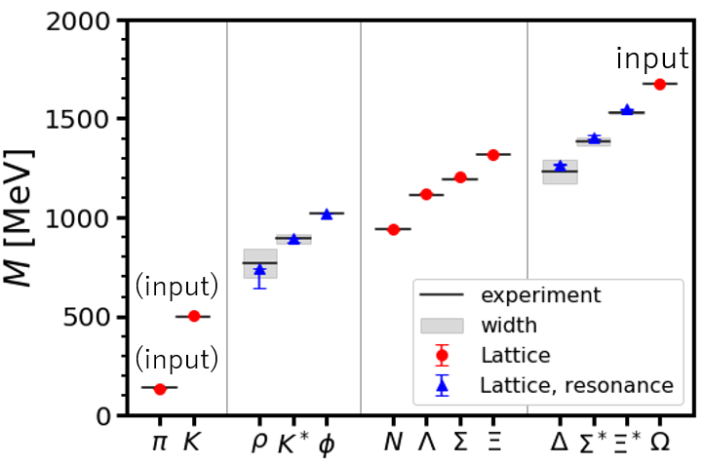
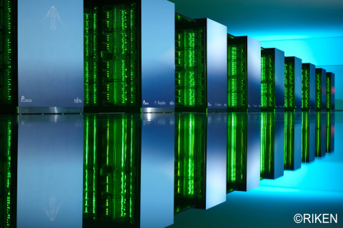
LQCD (since 1974) : Ab initio approach to solve QCD
K. Wilson
quarks
gluons
(2+1)-flavor QCD on
FUGAKU@RIKEN (440PFlops)
m_{π}=137.1 MeV, L=8.1 fm
a
4-dim.
Euclidean
Lattice
L
by D.Leinweber

Slide 4

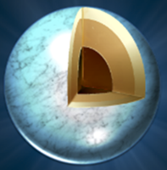
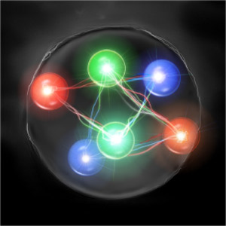
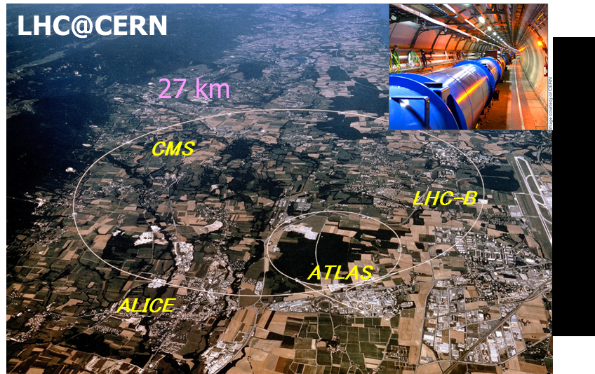
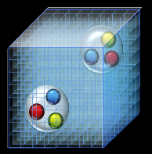
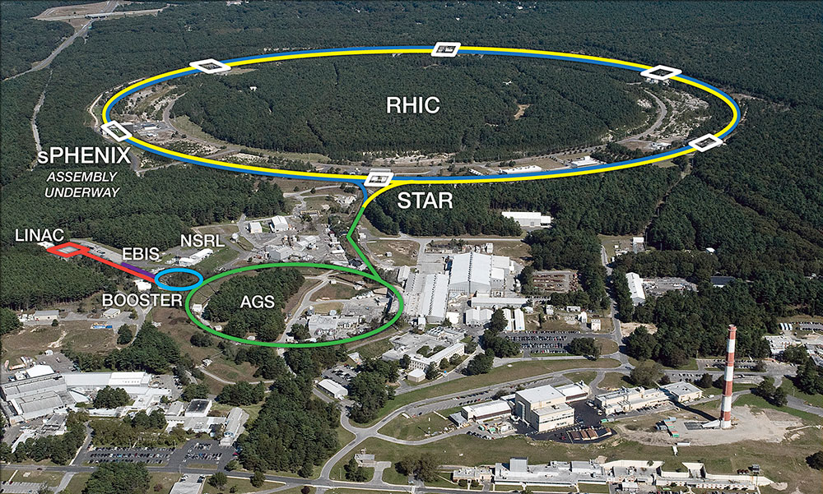
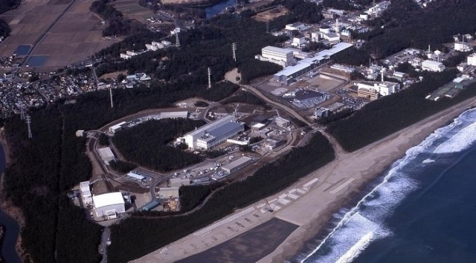
Hadron-hadron interactions : Why do we care ?
Nuclear forces & Hyperon forces
⇔ Atomic nuclei, hypernuclei, and EoS for neutron stars
Exotic hadrons & Exotic nuclei
⇔ Deeper understanding of “confinement”
Scattering experiments,
hadron spectroscopy,
hypernuclear spectroscopy
Femtoscopy (RHIC, LHC)
NS and NS merger observations
Era of “co-evolution”
of LQCD and Expt.
RHIC@BNL
J-PARC@KEK
GSI, J-Lab., BESIII, Belle, BaBar …

Slide 5
HAL QCD Method
5

Slide 6
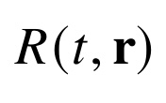

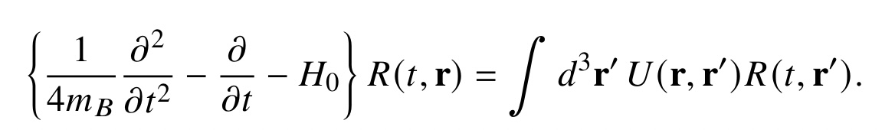
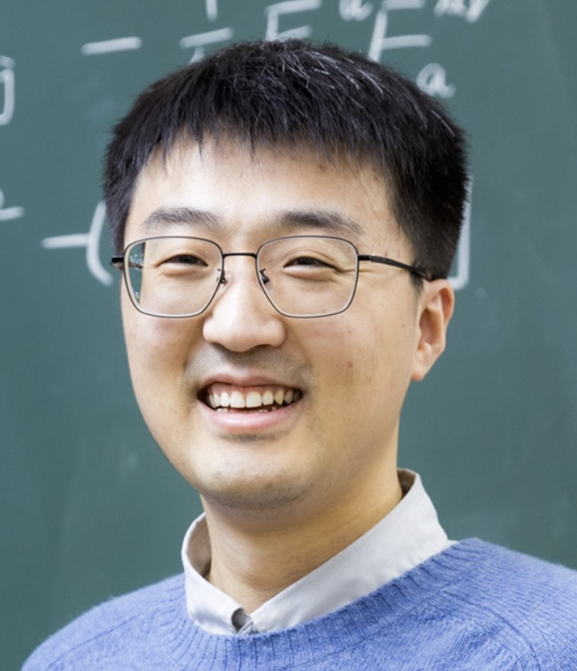
How to extract hadron-hadron int. in LQCD ?
Spacetime correlation of composite particles
・ Haag-Nishijima-Zimmermann formula (1958)
・ Borchers Theorem (1960)
HAL QCD Method
Correlation of “almost-local” composite operators
Ishii, Aoki & Hatsuda,
PRL 99 (2007);
Ishii+ [HALQCD Coll.],
PLB 712 (2012)
R → U (Inverse Problem)
・ Haag-Nishijima-Zimmermann formula (1958)
・ Borchers Theorem (1960)
Derivative expansion: U(r,r’) = V₀(r) + V₂(r) ∇² δ(r-r’) + …
・ Neural network : U_{θ}(r,r’)
L. Wang, T. Hastuda, Y. Lyu, arXiv:2410.03082
Lingxiao Wang
(RIKEN)
Notes:
\begin{eqnarray}
& & \! \! \! \! \! \! \! \! \! \! \! \! \! \! \! \! \! \! \! \! \! \langle N_1({\bf x},t) N_2({\bf y},t) {\cal J}_1^{\dagger}(0) {\cal J}_2^{\dagger}(0) \rangle \nonumber \\
& =& \! \! \! \! \! \! \sum_{n}\langle 0| N_1({\bf x})N_2({\bf y})|n\rangle a_n e^{-E_n t} \nonumber \\
& \xrightarrow{t>t^*} &\! \! \! \! \phi({\bf r},t) = \sum_{n<n^*} b_n \phi_n({\bf r}) e^{-E_n t} \nonumber
\end{eqnarray}
\begin{align*}
C(r,\tau) = \sum_n \Psi_{n}(r) e^{-E_n \tau}
\end{align*}

Slide 7
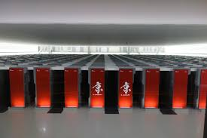
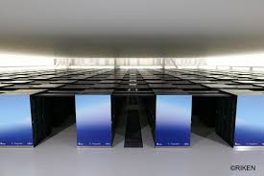
Fugaku
@RIKEN
400 PFlops
(2020-)
(2+1)-flavor
V=(8.1 fm)³ , m_{π}=138 MeV
(2+1)-flavor
V=(8.1 fm)³ , m_{π}=146 MeV
Large Scale LQCD Simulations of Hadron-Hadron Int.
(case for HAL QCD Collaboration since 2010)
(KEK) T. Aoyama
(RIKEN) S. Aoki, T. Doi, T. Hatsuda, Y. Liu,
L. Zhang, R. Yamada, L. Wang
(Nihon) T. Inoue
(Rissho) T. Sugiura
(TIT) K. Murakami
(TMU) K. Murase
(YITP) E. Itou
(Kyoto) T. M. Doi
(RCNP) N. Ishii, P. Junnarkar, H. Nemura
(Osaka) Y. Ikeda, K.Sasaki
(Birjand) F. Etminan
(Bonn) H. Tong
V=(8.1 fm)³ , m_{π}=146 MeV
V=(8.1 fm)³ , m_{π}=137 MeV
K @RIKEN: 11PFlops (2011-2019)
FUGAKU @RIKEN: 440 PFlops (2020-)

Slide 8
Baryon-Baryon Interactions
- roles of strangeness and charm -
ΛΛ−ΝΞ (S=-2)
ΝΩ (S=-3)
ΩΩ (S=-6)

Slide 9
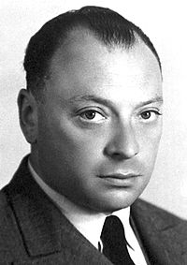
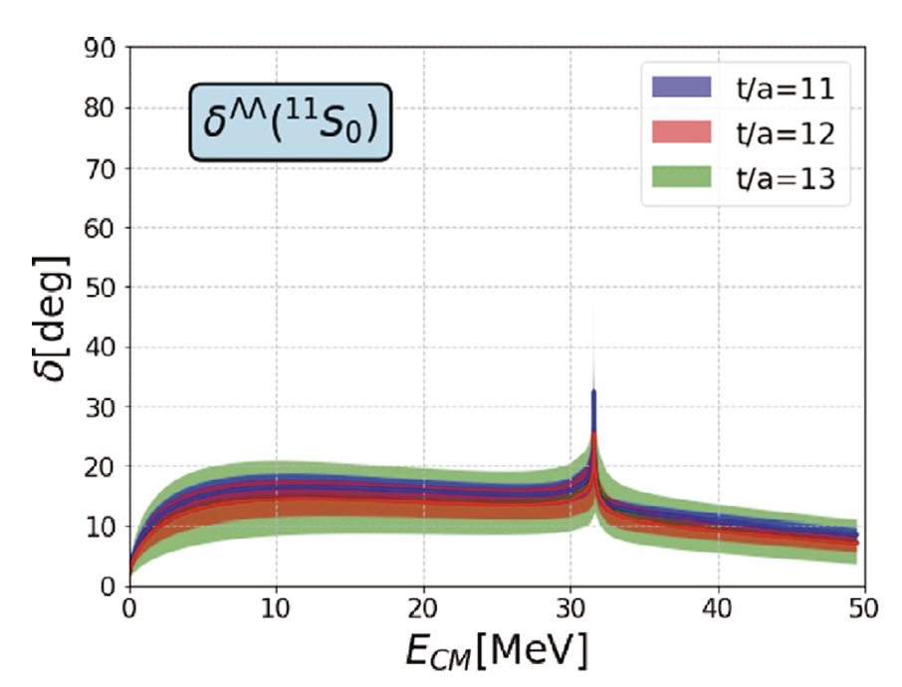
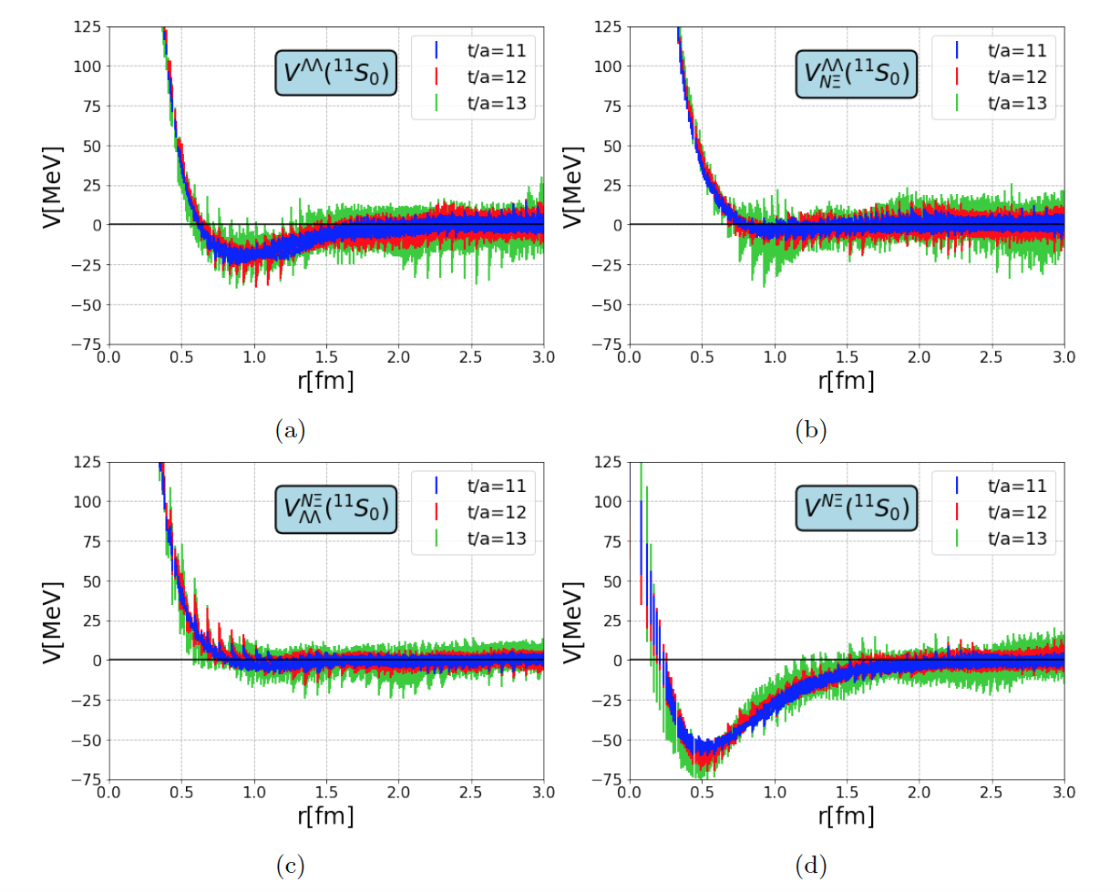
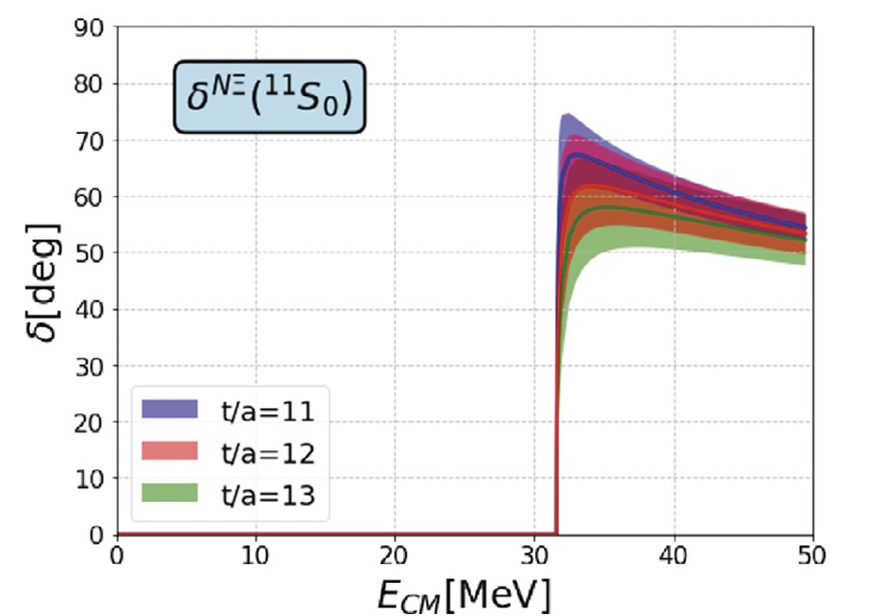
ΛΛ-NΞ system (LQCD)
Sasaki+ [HAL QCD Coll.]
Nucl. Phys. A998 (2020) 121737
Small ΛΛ
attraction
Short-range
NΞ-ΛΛ coupling
I=0, J^{P}=0⁺
Short-range
NΞ-ΛΛ coupling
Large NΞ
attraction

Slide 10





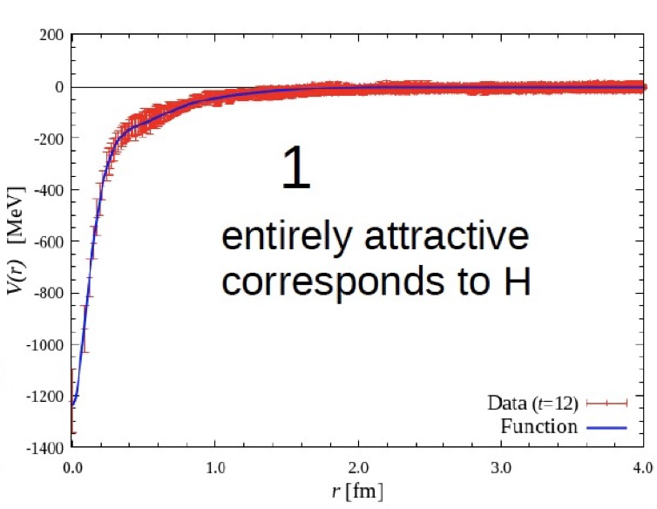
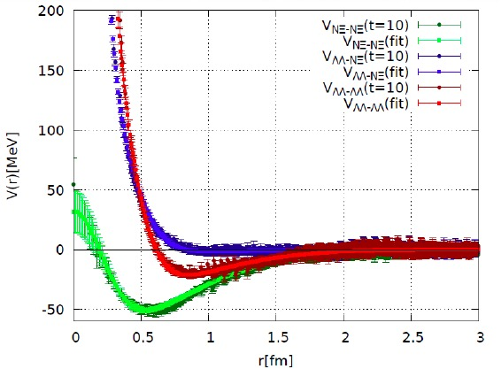
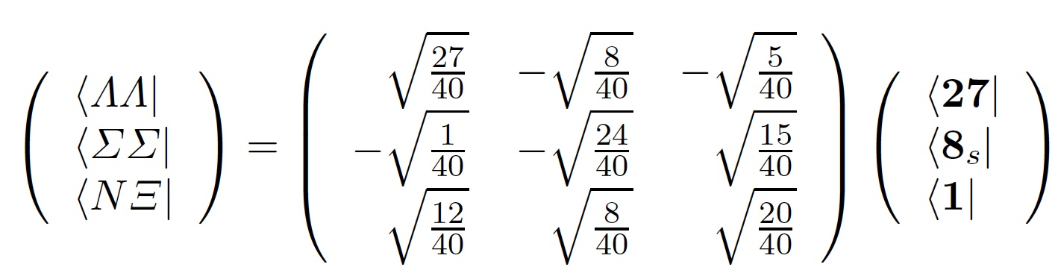



H-resonance (?)
Fate of “H (uuddss)” dibaryon from LQCD
m_{ud}=m_{s}
_{(~ 100 MeV)}
m_{ud} < m_{s}
_{(~10MeV) (~100MeV)}
Inoue et al., [HAL QCD Coll.]
Nucl. Phys. A881 (2012) 28
Sasaki et al., [HAL QCD Coll.]
Nucl. Phys. A998 (2020) 121737

Slide 11
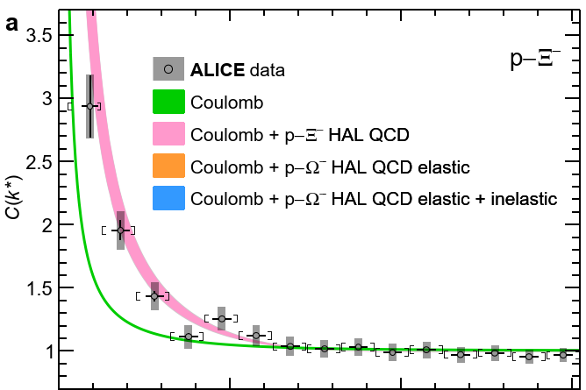
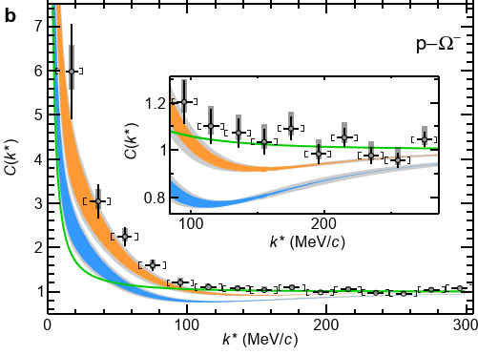


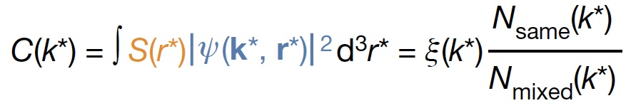
NΞ femtoscopy (expt.)
ALICE Coll. (LHC), Nature 588 (2020) 232
(pp, √s = 13 TeV)

Slide 12
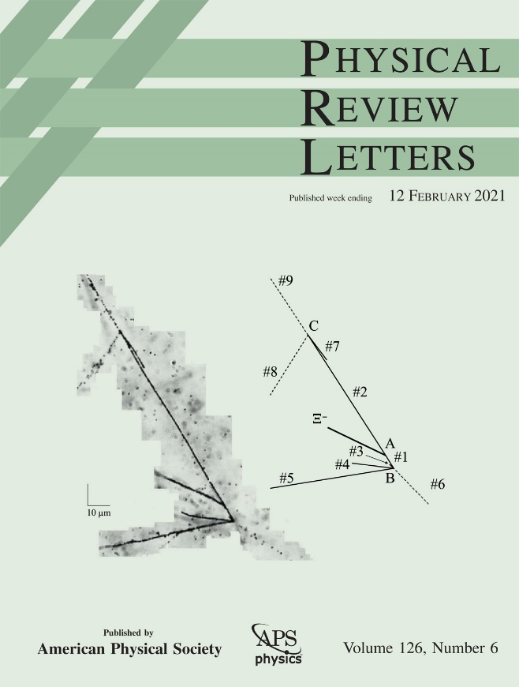
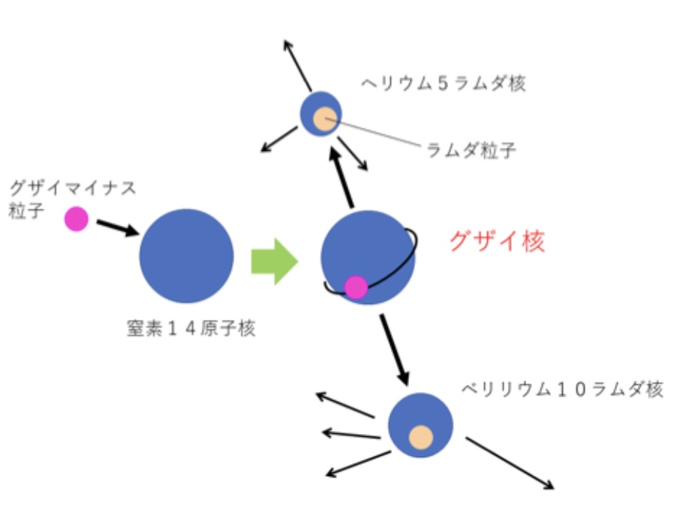
Ξ hypernuclei at J-PARC (expt.)
E07 Coll. (J-PARC),
Phys.Rev.Lett. 126 (2021) 062501
⁵_{Λ}He
Λ
Ξ⁻
¹⁴N
¹⁰_{Λ} Be
LQCD prediction of
・attraction in NΞ in ¹¹S₀
・weak NΞ -ΛΛ coupling
cosisitent with the expt. data
Isaka+, Phys.Rev. C109 (2024) 044317

Slide 13
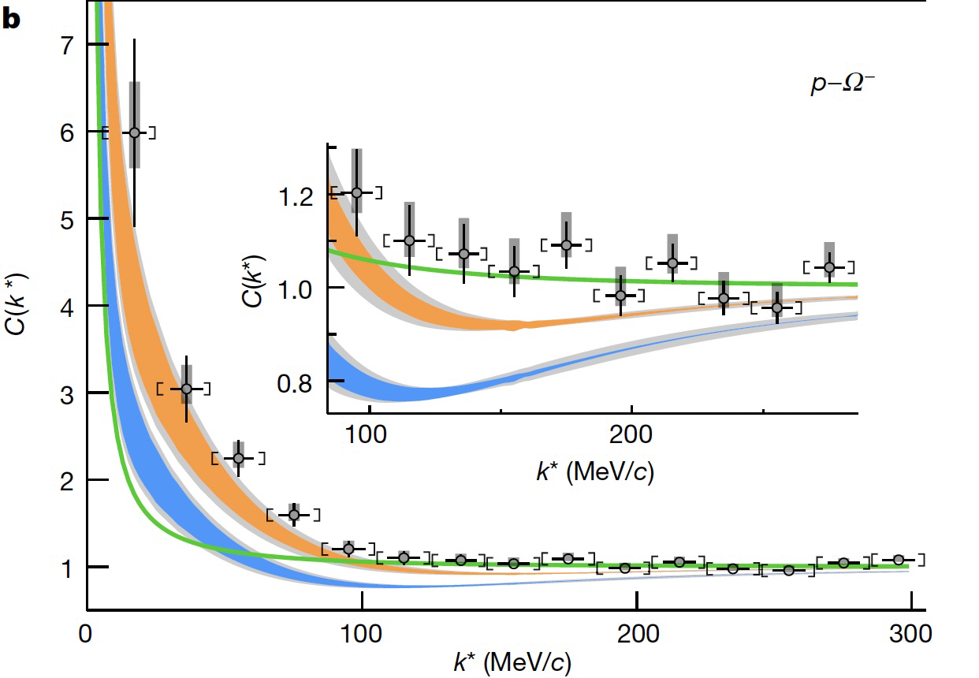
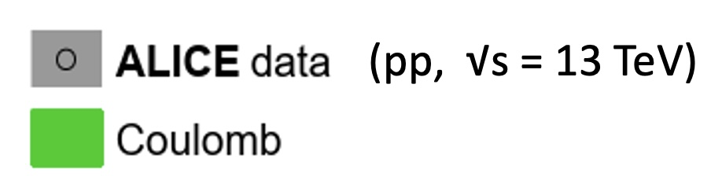
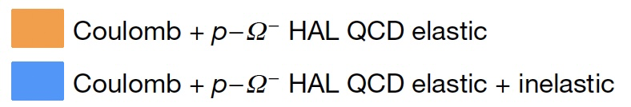
NΩ system (LQCD)
NΩ (⁵S₃)
NΩ (⁵S₂)
(m_{π}=146 MeV)
ALICE Coll. (LHC),
Nature (2020)
Iritani+ [HAL QCD Coll.],
PLB (2019)

Slide 14
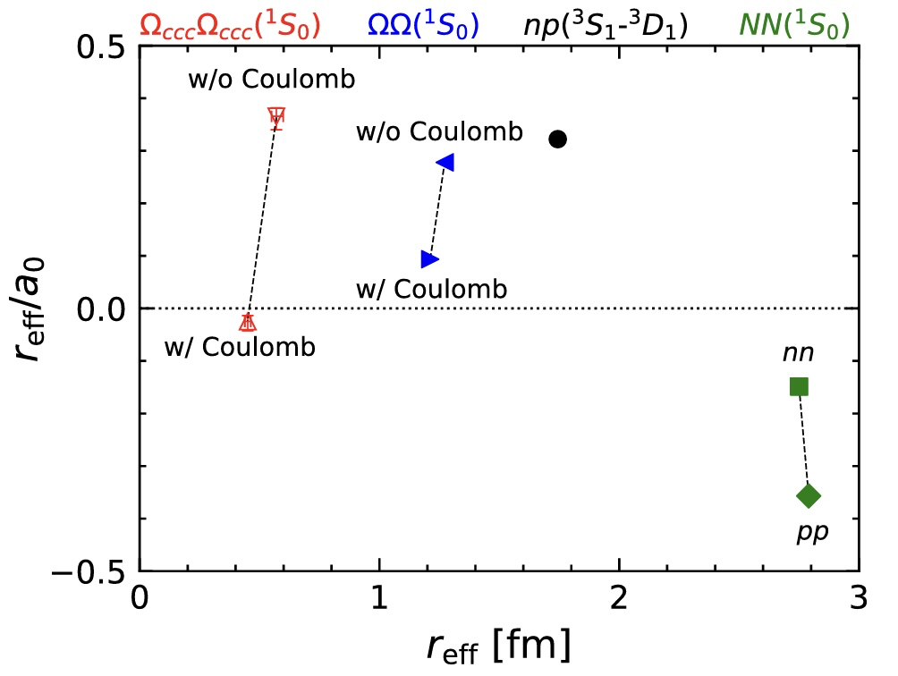
ΩΩ systems in LQCD
Lyu, Tong + [HAL QCD Coll.],
PRL 127 (2021) 072003
NΩ (⁵S₃)
bound
.
system | n-p | n-Ω | Ω-Ω | Ω_{ccc}-Ω_{ccc}
channel | ³SD₁ | ⁵S₂ | ¹S₀ | ¹S₀
a₀ [fm] | +5.4 | +5.3(4) | +12.9 | -19(10)
B [MeV] | 2.2 | 1.5(3) | 0.7(7) | -
unbound
LQCD with Coulomb correction
system | n - Ω⁻ | Ω⁻ - Ω⁻ | Ω_{ccc}⁺⁺-Ω_{ccc}⁺⁺
channel | ⁵S₂ | ¹S₀ | ¹S₀
a₀ [fm] | +5.3(4) | +12.9 | -19(10)
B [MeV] | 1.5(3) | 0.7(7) | -
w/ Coulomb attraction
system | p - Ω⁻ | Ω⁻ - Ω⁻
channel | ⁵S₂ | ¹S₀
B [MeV] | 2.5(4) | 0.7(7)
w/ Coulomb repulsion

Slide 15
Meson-Meson Interactions
- genuine tetraquark ?-
D⁰
-
u
c
-
d
c
D*⁺
T_{cc}⁺(3875)
15

Slide 16
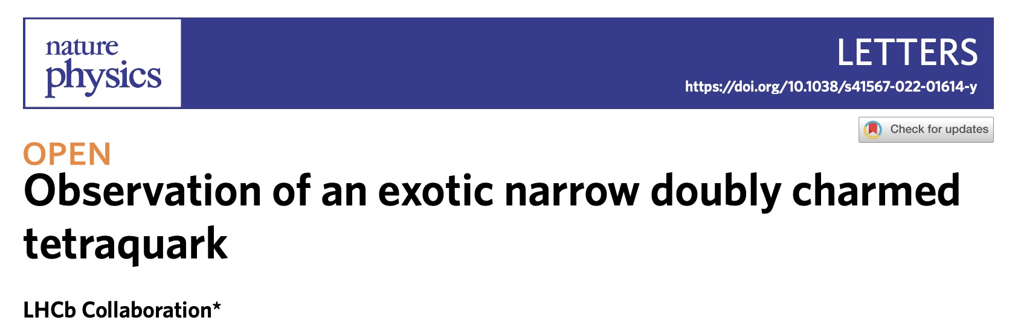
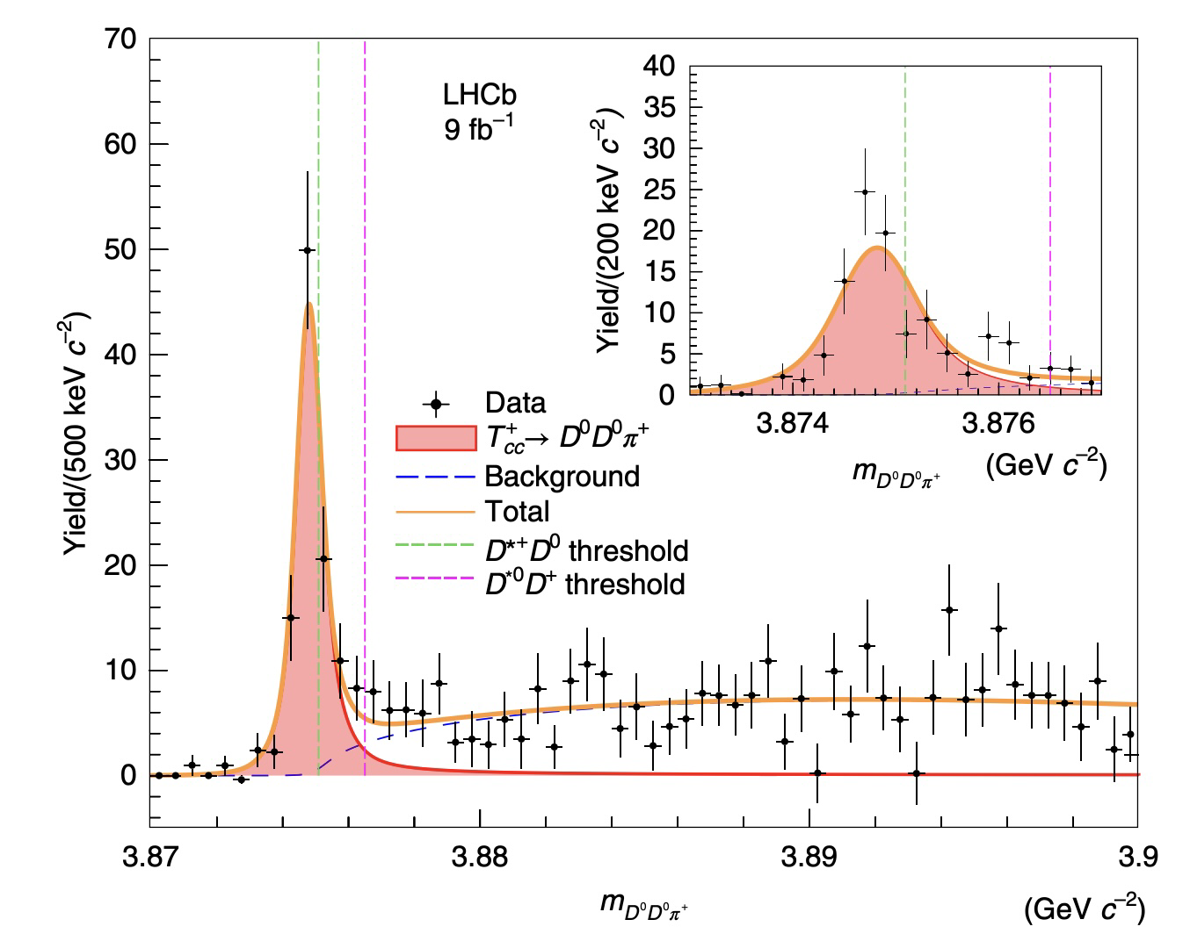

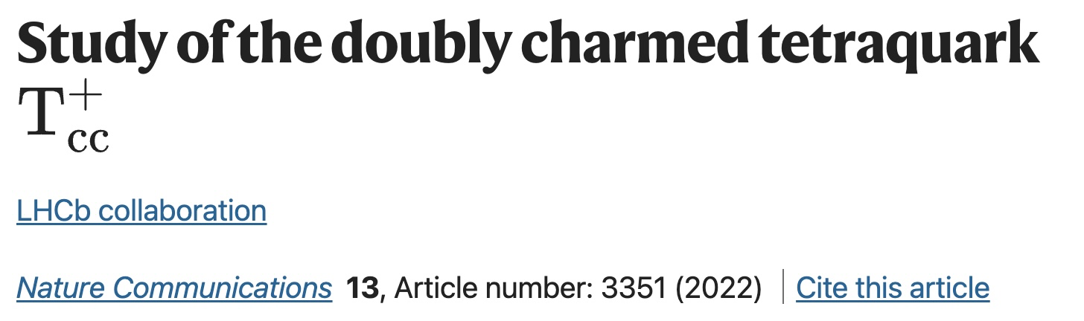
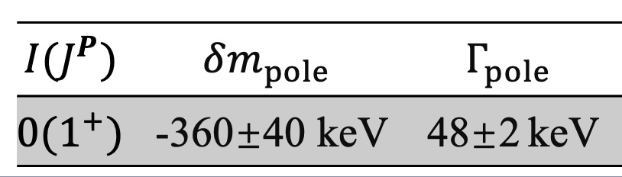
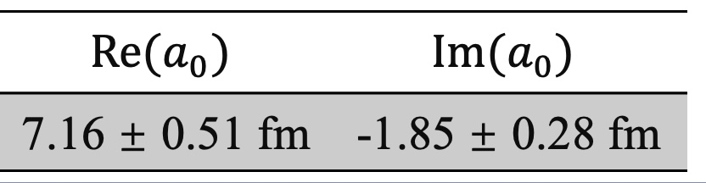
T_{cc}⁺(3875)
16

Slide 17
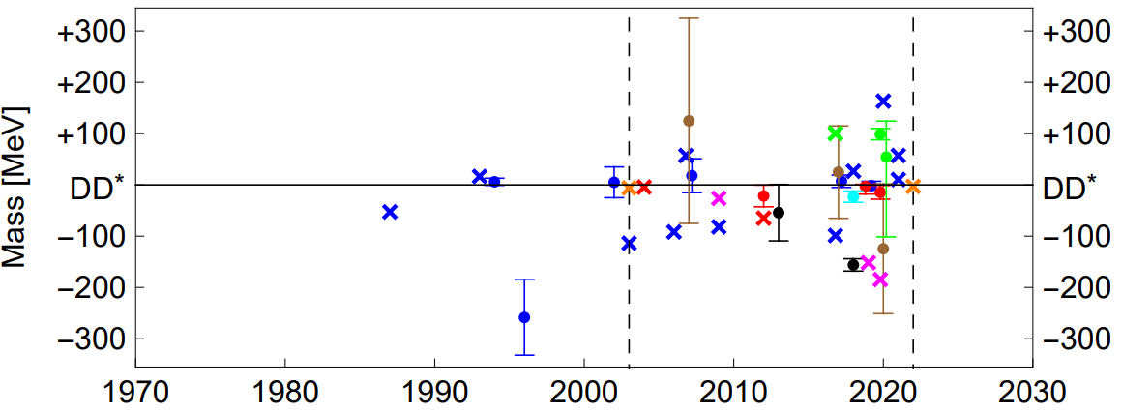
Theory history (< 2022) of T_{cc}⁺ ($cc\overline{u}\overline{d})$ ($IJ^{P}={01}^{+}$)
Quark models
Hadronic molecule
Hybrid
QCS sum rules
Lattice QCD
H.-X. Chen et al., Rept. Prog. Phys. 86, 026201 (2023)
$±300$ MeV uncertainty with respect to DD* threshold
17

Slide 18
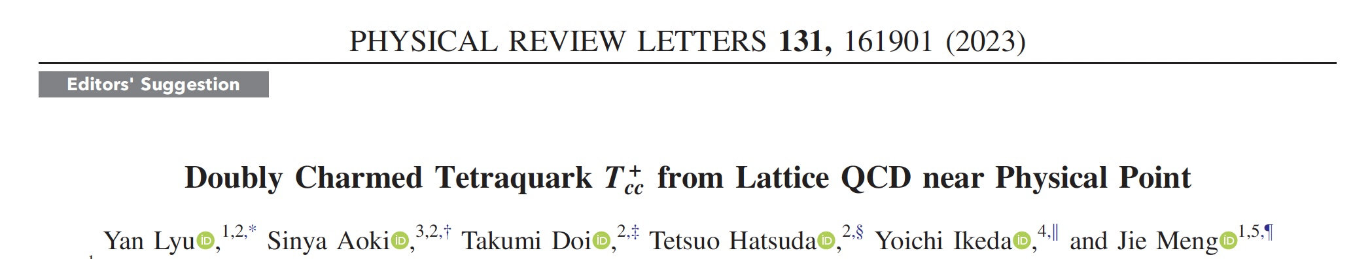
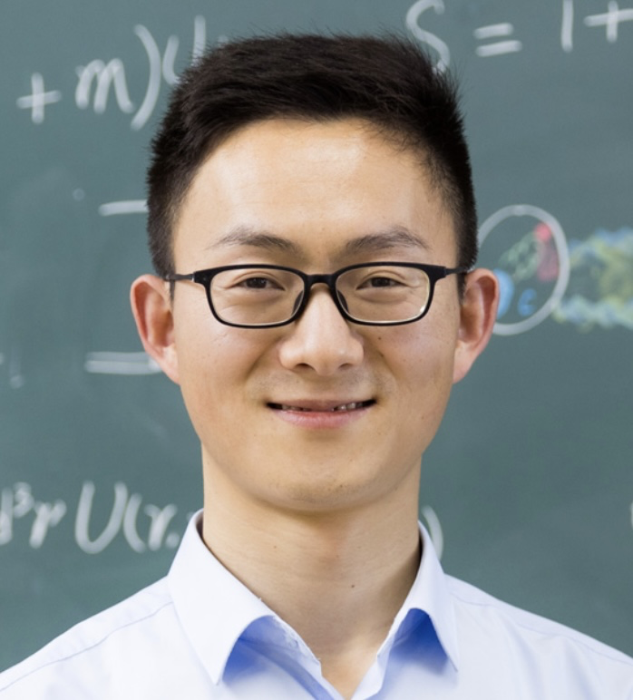
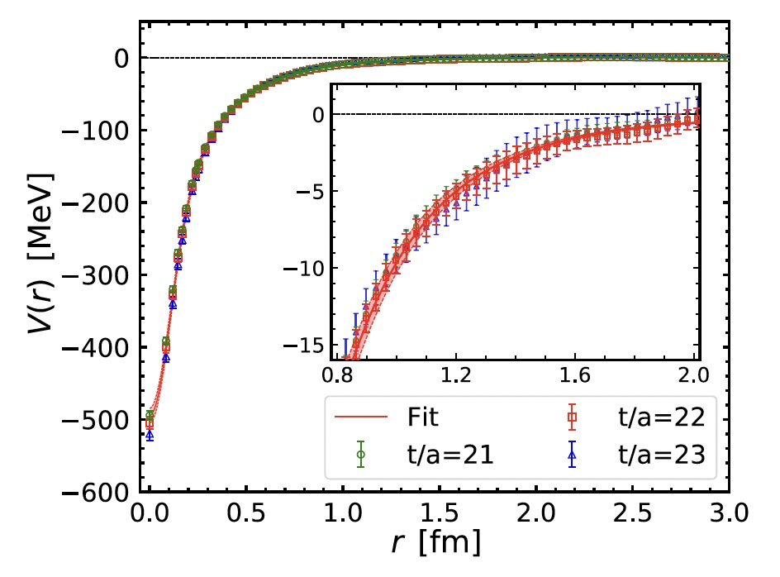
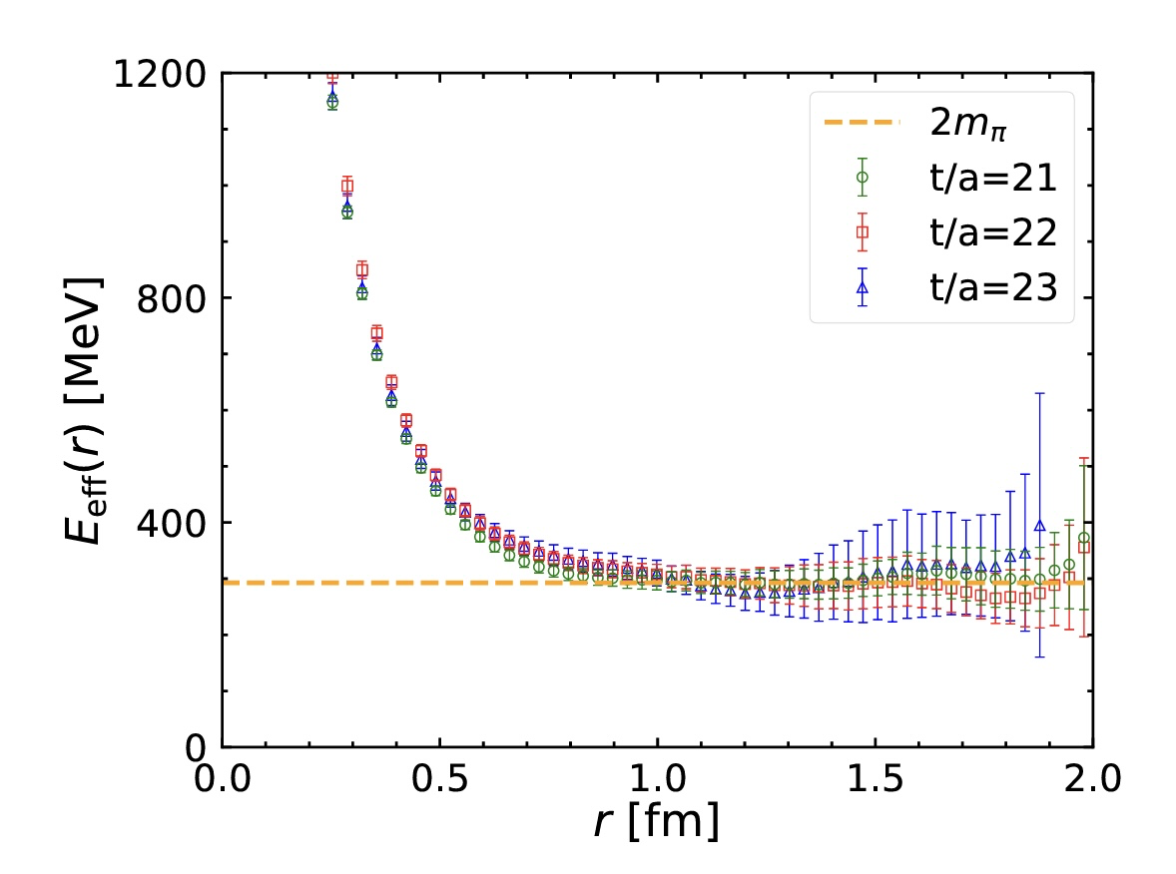
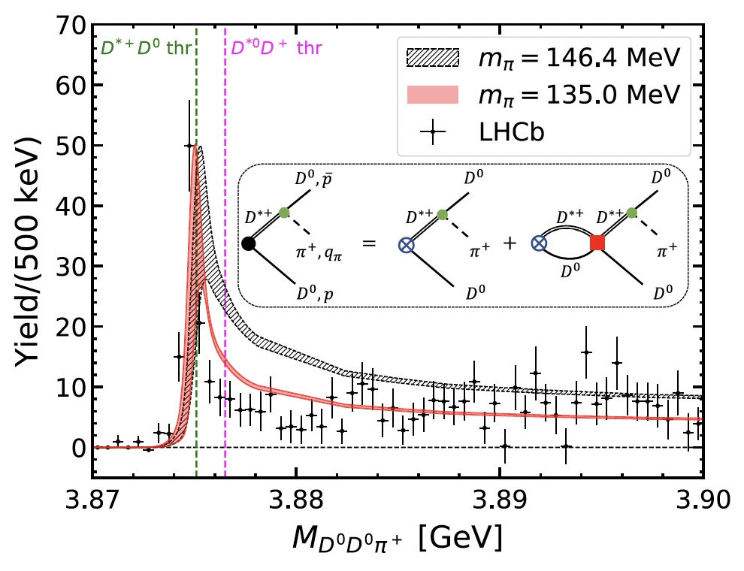
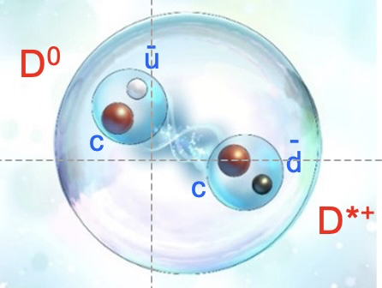
Lyu+ [HAL QCD Coll.],
PRL 131 (2023)
HAL QCD Collaboration
Yan Lyu
(RIKEN)
18
18

Slide 19
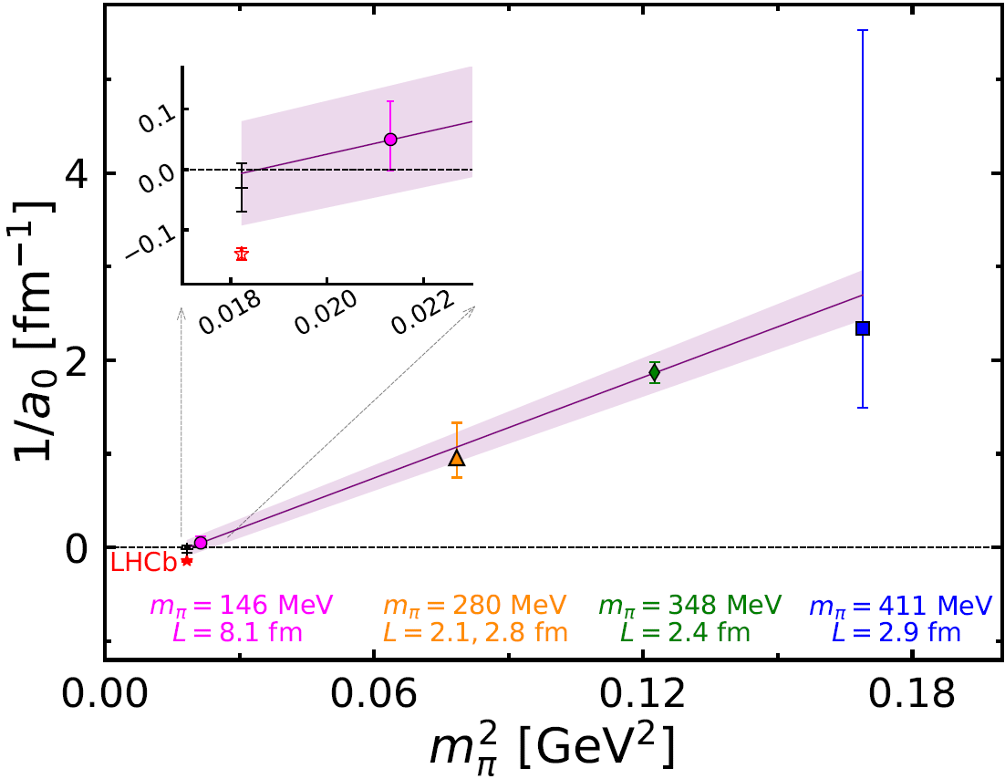
DD* scattering length as a function of the pion mass
HAL QCD: Ikeda+, PLB (2014)
Luscher: Chen et al., PLB (2022)
Luscher: Padmanath and Prelovsek, PRL (2022)
HAL QCD: Yan+, PRL(2023)
Future problems
(i) Isospin breaking (QED and QCD)
(ii) coupled channel effect at the physical point simulations
(iii) consideration of the left-hand-cut from OPEP : Lyu, Doi, Aoki, arXiv:2501.16804
19

Slide 20

Meson-Baryon Interactions
- color-dipole and nucleon -
$s\overline{s}$ -$N$
$c\overline{c}$ -$N$
20

Slide 21
Question:
What is the force between
“neutral particles” at long range ?

Slide 22

Question:
What is the force between
“neutral particles” at long range ?
Answer:
QED
2-photon exchange force
= van der Waals (Casimir-Polder) force → -1/r⁷

Slide 23

Question:
What is the force between
“neutral particles” at long range ?
Answer:
QED
2-photon exchange force
= van der Waals (Casimir-Polder) force → -1/r⁷
QCD
2-pion exchange force
Bhanot and Peskin, Nucl. Phys. B156 (1979) 391
Fujii and Kharzeev, Phys. Rev. D60 (1999) 114039
Brambilla, Klein, Tarrus Castella and Vairo Phys. Rev. D93 (2016) 054002
Brief overview: T. Hatsuda; https://arxiv.org/abs/2507.08359

Slide 24







Yan Lyu
(RIKEN)
total spin 3/2
m_{π}=146 MeV
Two-pion Tail at r > (2m_{π})⁻¹
Krein and Casttela , Phys. Rev. D98 (2018) 0140289.

Slide 25

An attempt to combine Expt. data and Lattice data
spin-1/2 φp interaction
= ALICE data (spin-3/2 & spin-1/2) - Lattice data (spin-3/2)
Chizzali, Kamiya, Del Grande, Doi, Fabbietti, Hatsuda and Lyu,
Phys.Lett. B 848 (2024) 138358

Slide 26


What about $c\overline{c}$ -$N$ interaction ?
$c\overline{c}$ $N$
26

Slide 27




HAL QCD Collaboration
Yan Lyu
(RIKEN)
$c\overline{c}$ $N$

Slide 28



Scattering length and effective range
Preliminary
J/ψ optical potential in nuclear matter
(Pauli correction necessary? → A. Gal (PLB & NPA (2023))
Krein, Tsushima, Thomas,
Nuclear-bound quankonia and heavy-flavor hadrons
Prog. in Part. Nucl. Phys. 100 (2018) 161
⇔

Slide 29




“Evidence” of uncorrelated TPE at long distance
φp
J/ψ-N
η_{c}-N

Slide 30

Summary
Hadron-hadron int. from LQCD near the physical pion mass (146 MeV)
opens the door to the “coevolution” of LQCD and Expt.
(examples)
BB: ΛΛ−ΝΞ, ΝΩ, ΩΩ, MM: T_{cc}⁺ , MB: $s\overline{s}$ -$N$, $c\overline{c}$ -$N$
Take-home message
1. No H dibaryon below ΛΛ.
2. ΩΩ could be bound (first stable B=2 system other than the deuteron?)
3. Two-pion exchange universality for interaction of flavor-singlet hadrons.
New results on hadron-hadron int.
at the physical pion mass (137 MeV)
will come soon.
Open issues:
- three body force
- isospin breaking (QED & QCD)
especially near threshold.
Stay tuned !
m_{π}=137 MeV , V=(8.1 fm)³
FUGAKU @RIKEN: 440 PFlops (2020-)

Slide 31
感谢大家的聆听！

Slide 32
Backup slides

Slide 33

Percent-level determination of g_{A} from LQCD
Chang (LBNL/iTHEMS)+, Nature 558 (2018) 91
(g_{A})_{LQCD} = 1.271(13)
(g_{A})_{expt} = 1.272(2)
(τ_{ｎ})_{LQCD} = 884(15) s
(τ_{ｎ})_{PDG} = 880.2(1.0) s

Slide 34




HAL QCD Procedure: an example
(ΩΩ at m_{π}=146MeV)
Gongyo+ [HAL QCD], PRL 120 (2018) 212001
Lyu+ [HAL QCD], PRD 105 (2022) 074512
Ω
Ω
Potential
V_{C} (x,y,0)
Ψ_{n} (r) and E_{n} in a finite volume
Phase shift in the infinite volume

Slide 35

Coupled Channel S=-2 system (¹¹S₀)
K. Sasaki+ [HAL QCD Coll.]
Nucl. Phys. A998 (2020)
Small ΛΛ
attraction
ΞN phase shift in HAL QCD
I=0, S=0: attractive
I=0, S=1: weakly attractive
I=1, S=0: weakly repulsive
I=1, S=1: weakly attractive
Short-range
NΞ-ΛΛ coupling
I=0, J^{P}=0⁺
Short-range
NΞ-ΛΛ coupling
Large NΞ
attraction

Slide 36




Femtoscopy : particle correlations in pp, pA and AA
C(k*)
Koonin, Phys. Lett. B 70, 43 (1977).
Lednicky and Lyuboshits, Yad. Fiz. 35, 1316 (1981).
Pratt, Phys. Rev. D 33, 1314 (1986).
Anchishkin, Heinz, and Renk, Phys. Rev. C 57, 1428 (1998).
Lednicky, Lyuboshits, and Lyuboshits, Phys. At. Nucl. 61, 2950 (1998).
Haidenbauer, Nucl. Phys. A 981, 1 (2019).
R k*
Morita et al., Phys. Rev. C101 (2020) 015201
Notes:
\begin{align*}
C_{\rm expt}(k^*) = \frac{\xi(k^*) N_{\rm same}(k^*)}{N_{\rm mixed}(k^*)} =
\end{align*}
\begin{eqnarray*}
& & C_{\rm theo}(k^*) \\
& & = \int d^3 r \textcolor[rgb]{1,0.4,0.4}{S(r,k^*)} \textcolor[rgb]{0.2,0.4,1}{|\Psi(r,k^*)|^2} \nonumber \\
& & = 1+ \int d^3 r {S(r,k^*)} [ {|\Psi_0(r,k^*)|^2 - |j_0( k^* r)|^2 }]
\end{eqnarray*}

Slide 37



Fully coupled channel analysis
Kamiya+, Phys. Rev. C 105 (2022) 014915

Slide 38




Isaka+,
Phys.Rev. C109 (2024) 044317
¹⁴N
p-state
Ξ⁻
¹⁴N
s-state
Ξ⁻
HyperAMD calculation
with HAL QCD NΞ int.
KEK/J-PARC
expt.
LQCD prediction of
・attraction in NΞ in ¹¹S₀
・weak NΞ- ΛΛ coupling
conisistent with the expt.data
Attempts towards lighter Ξ-nuclei such as ³He-Ξ and ααNΞ:
Hiyama+, PRL 124 (2020); PRC 106 (2022)

Slide 39

Hyperon embedded in cold nuclear matter (HAL QCD + BHF)
Inoue [HAL QCD Coll.], Few-body Syst. 62 (2021) 106
Hiyama, Sasaki, Miyamoto, Doi, Hatsuda, Yamamoto, and Rijken, PRL 124 (2020) 092501
29

Slide 40
Hyperon embedded in cold nuclear matter (HAL QCD + BHF)
ΞN phase shift in HAL QCD
I=0, S=0: attractive
I=0, S=1: weakly attractive
I=1, S=0: weakly repulsive
I=1, S=1: weakly attractive
Inoue [HAL QCD Coll.], Few-body Syst. 62 (2021) 106
Hiyama, Sasaki, Miyamoto, Doi, Hatsuda, Yamamoto, and Rijken, PRL 124 (2020) 092501
30

Slide 41


quasi-bound NΩ and bound ΩΩ ?
NΩ (⁵S₃)
NΩ (⁵S₂)
Iritani+ [HAL QCD Coll.], PLB 792 (2019) 284
Gongyo+ [HAL QCD Coll.], PRL 120 (2018) 212001
Tong+ [HAL QCD Coll.], PRL 127 (2021) 072003
w/ Coulomb attraction
w/ Coulomb repulsion

Slide 42


NΩ correlation in pp
LHC ALICE Coll., Nature 588 (2020) 232

Slide 43
quasi-bound NΩ and bound ΩΩ ?
NΩ (⁵S₃)
NΩ (⁵S₂)
Iritani+ [HAL QCD Coll.], PLB 792 (2019) 284
Gongyo+ [HAL QCD Coll.], PRL 120 (2018) 212001
Tong+ [HAL QCD Coll.], PRL 127 (2021) 072003
w/ Coulomb attraction
w/ Coulomb repulsion

Slide 44




φp bound state
in spin ½ channel?
(B = 12.8- 56.1 MeV)

Slide 45





Thresholds
[MeV]
(Lat., Exp.)
$Λ_{c}\overline{D}$ (4169, 4156)
$120$ MeV
$NJ/ψ$ (4047, 4036)
$100$MeV
$Nη_{c}$ (3948, 3923)

Slide 46









Energy levels
Nature
Lattice
[MeV]
$$π^{0}\left(134.98\right)$$
$$D^{0}\left(1864.84\right)$$
$$D^{∗0}\left(2006.85\right)$$
$$π^{+}\left(139.57\right)$$
$$D^{+}\left(1869.66\right)$$
$$D^{∗+}\left(2010.26\right)$$
$$π\left(146.4\right)$$
$$D\left(1878.2\right)$$
$$D^{∗}\left(2018.1\right)$$
$$D^{∗}D^{∗}$$
4036.2
4017.1
$$D^{∗+}D^{∗0}$$
$DDπ$($L=8.1$fm)
3974.3
$$DDπ\left(L→∞\right)$$
$$D^{∗}D$$
3902.8
3896.3
3876.5
3875.1
$$D^{∗0}D^{+}$$
$$D^{∗+}D^{0}$$
3869.5
3869.3
$$D^{+}D^{0}π^{0}$$
$$D^{0}D^{0}π^{+}$$
The lowest energy level of $DDπ$ ($D^{∗}D^{∗}$) is around 78 (140) MeV above on the lattice

Slide 47

Spin averaged $J/ψ$ $−N$scattering length

Slide 48



TPE between nucleons (NN):
Kaiser, Brockmann Weise, Nucl. Phys. A (1997)
TPE between two flavor-singlet hadrons (e.g. J/ψ-J/ψ)
Bhanot and Peskin, Nucl. Phys. B (1979)
Fujii and Kharzeev, Phys. Rev.D (1999)
Brambilla et al., Phys. Rev.D (2016)
TPE between flavor-singlet hadron and N (e.g. φ-N, J/ψ-N)
Krein, Casttela , Phys. Rev. D (2018)
48

