Slide 1
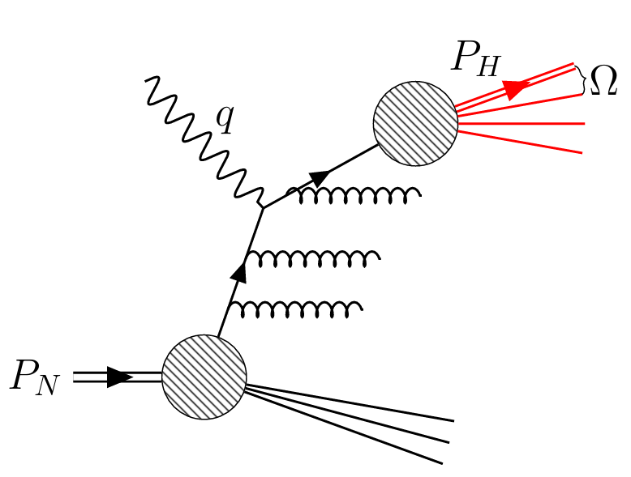
Fragmentation Energy Correlators in SIDIS
$$l′$$
$$l$$
Shutao Zhang
Peking University
$$γ^{∗}$$
In collaboration with:
Qing-Hong Cao, Zhite Yu, C.-P. Yuan, HuaXing Zhu
Paper in preparation:
arXiv: 2505.xxxxx
30th Mini-workshop on the frontier of LHC
Notes:
Hello everyone, I am Shutao Zhang. Today I want to introduce Fagmentation Energy Correlators in SIDIS process. This work is in collaboration with Zhite Yu, Professor Zhu, Professor C.-P. Yuan and Professor Qing-Hong Cao.
This work is in preparation for publication. The representation is organized as follows: Firstly, I introduce motivation, then I spend some time to introduce the observable and new non-perturbative function to factorize. I will show some nice properties of the Fragmentation energy correlator during this part. Secondly, I introduce the relation of our new-defined Fragmentation energy correlator to TMDs, which gives a simple moment correspondence between them. Finally, I will quickly go through our calculation of hard factors.
So The **SIDIS** means semi-inclusive deep inelastic scattering process, which I believe many of you have already been familiar with. Basically, it studies $ep$ collision, and a high energy virtual photon is emmited by an electron and hit the proton, according to the asymptotic freedom, the photon interact with partons inside a proton. The final state is many hadrons generated by parton fragmentation. The observable of SIDIS is differential cross section with respect to outgoing electron and a specific hadron you want to tag.
OK, now lets get into some details.

Slide 2
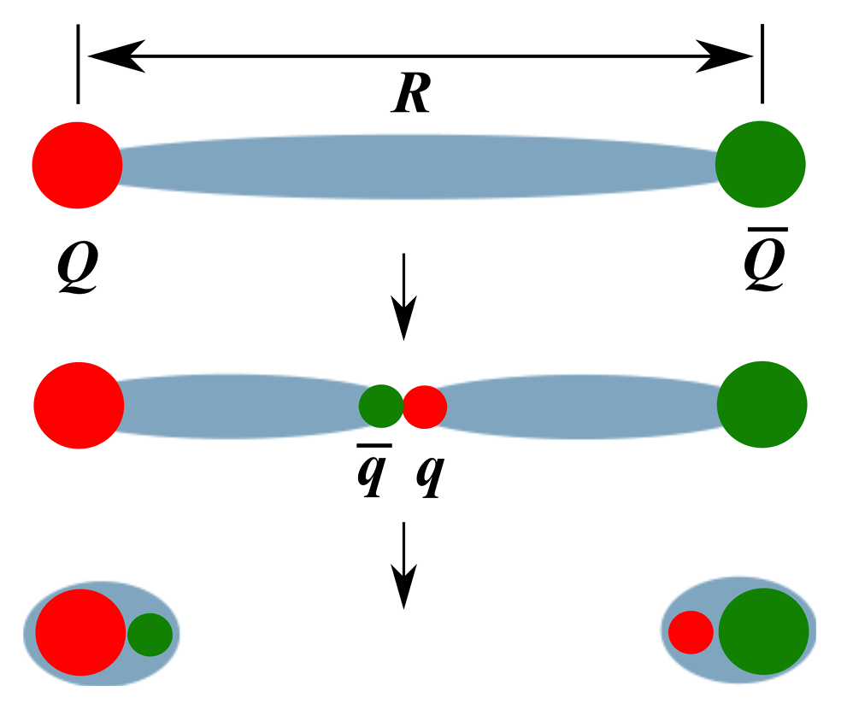
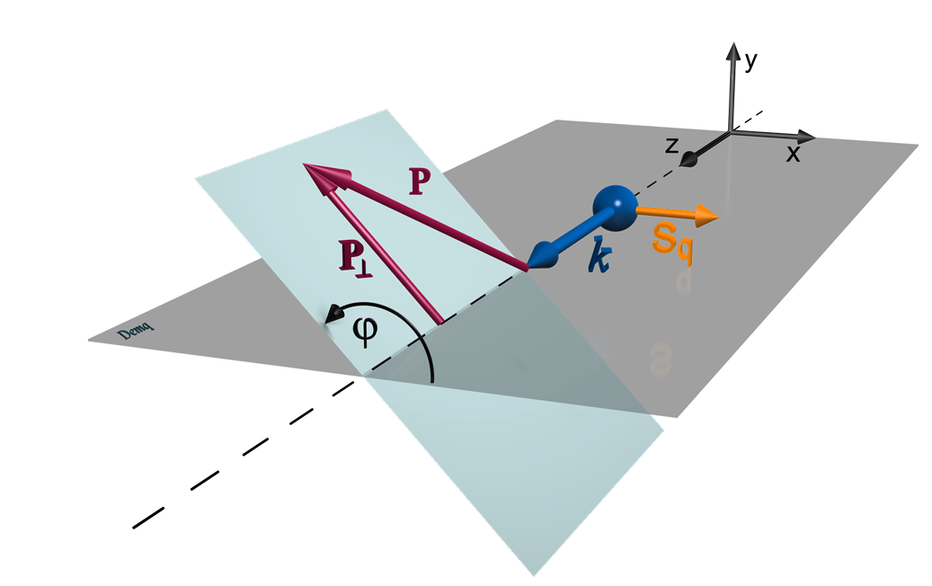
Unveiling Confinement and Spin Structure
The mystery of confinement
Still not calculable
Learn by experiments
[M. N. Chernodub, 2010]
Spin structure influences Fragmentation
Collins effect
Inner dynamics in fragmenting
3D imaging
[H. H. Matevosyan, A. W. Thomas, and W. Bentz, 2012]

Slide 3
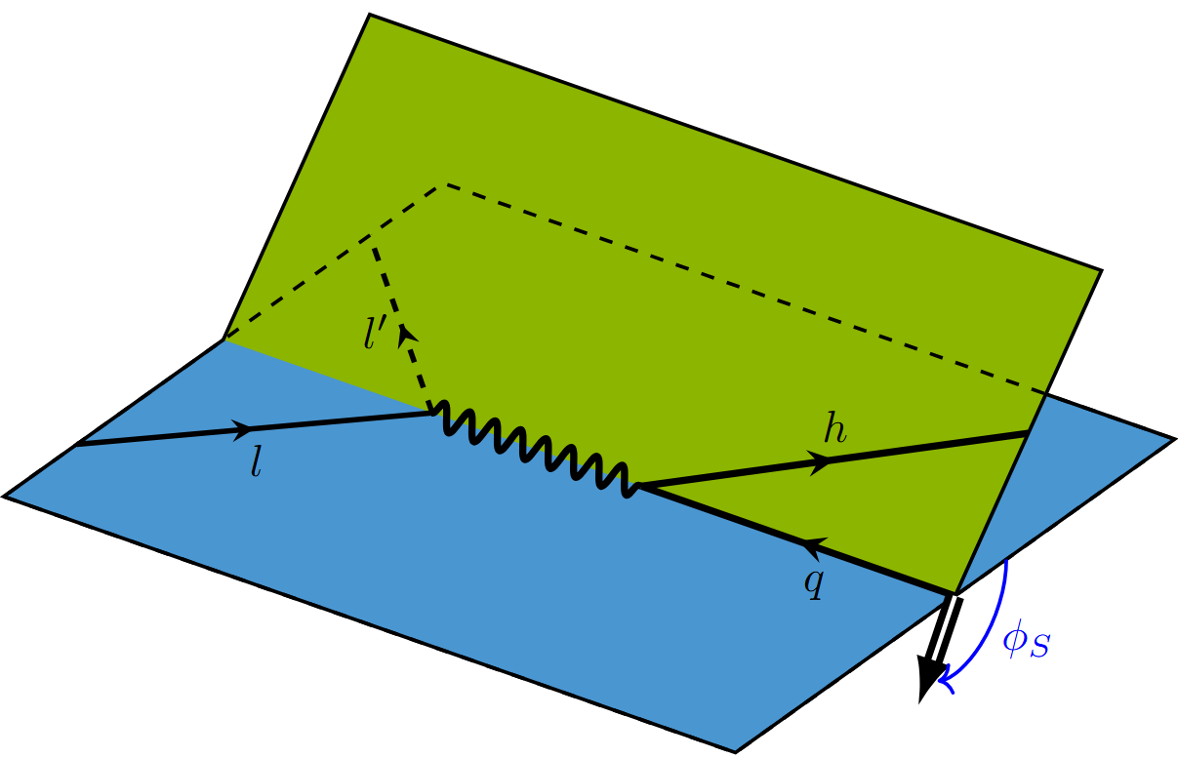
Experimental Tool: Semi-Inclusive DIS
Semi-Inclusive Deep Inelastic Scattering (SIDIS)
$e+p→e^{′}+h+X$.
Non-perturbative in PDF and fragmentation.
[M. Boglione, 2011]
Transverse momentum dependent functions
Small $p_{hT}$ leads to:
New TMD functions
3D imaging
$φ_{h}$ dependence from spin structure
$$p_{hT}$$
$$φ_{h}$$
$$S_{T}$$

Slide 4
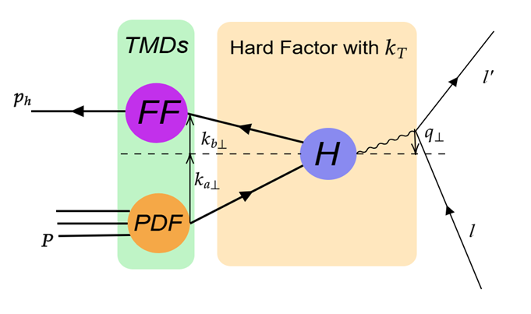
3D Imaging: TMDs
John Collins, 1993
Extraction Problem:
Entanglement with TMD PDF.
Notes:
% TMDs have different meanings for confinement.
% TMD FF tells transverse direction information of fragmentation.
% Phenomenon to confinement.
% Small qT region factorization valid. Showering gives Sudakov effects, exponential of log ^2 bt distribution
In SIDIS, traditionally, Transverse momentum dependent parton distribution function (or TMD PDF) is used to probe the three dimensional structure of nucleon. And TMD fragmentation function or TMD FF tells the transverse direction of fragmentation
%and TMD fragmentation function (or TMD FF) describes the inverse process, parton to hadron. But the TMD FF not just a simple inverse process because it involves different final state interactions.
The biggest motivation to investigate these functions is to learn confinement by phenomenon, which we can’t solve under perturbation calculation.
This is TMD Factorization for SIDIS. It’s valid under small q_T region. This is diagrammatic sketch of the process(pt to pic), each parton and the photon have a small transverse momentum, that is so called small qT region. As one should notice from this equation, there is a convolution integral of ka perp and kb perp! That means TMD FF is entangled with TMD PDF. This leads to the extraction problem of TMD FF. And, the Sudakov effects complicate the extraction more.
Let put TMDs aside temporarily, and get some insights from Energy energy correlator.

Slide 5
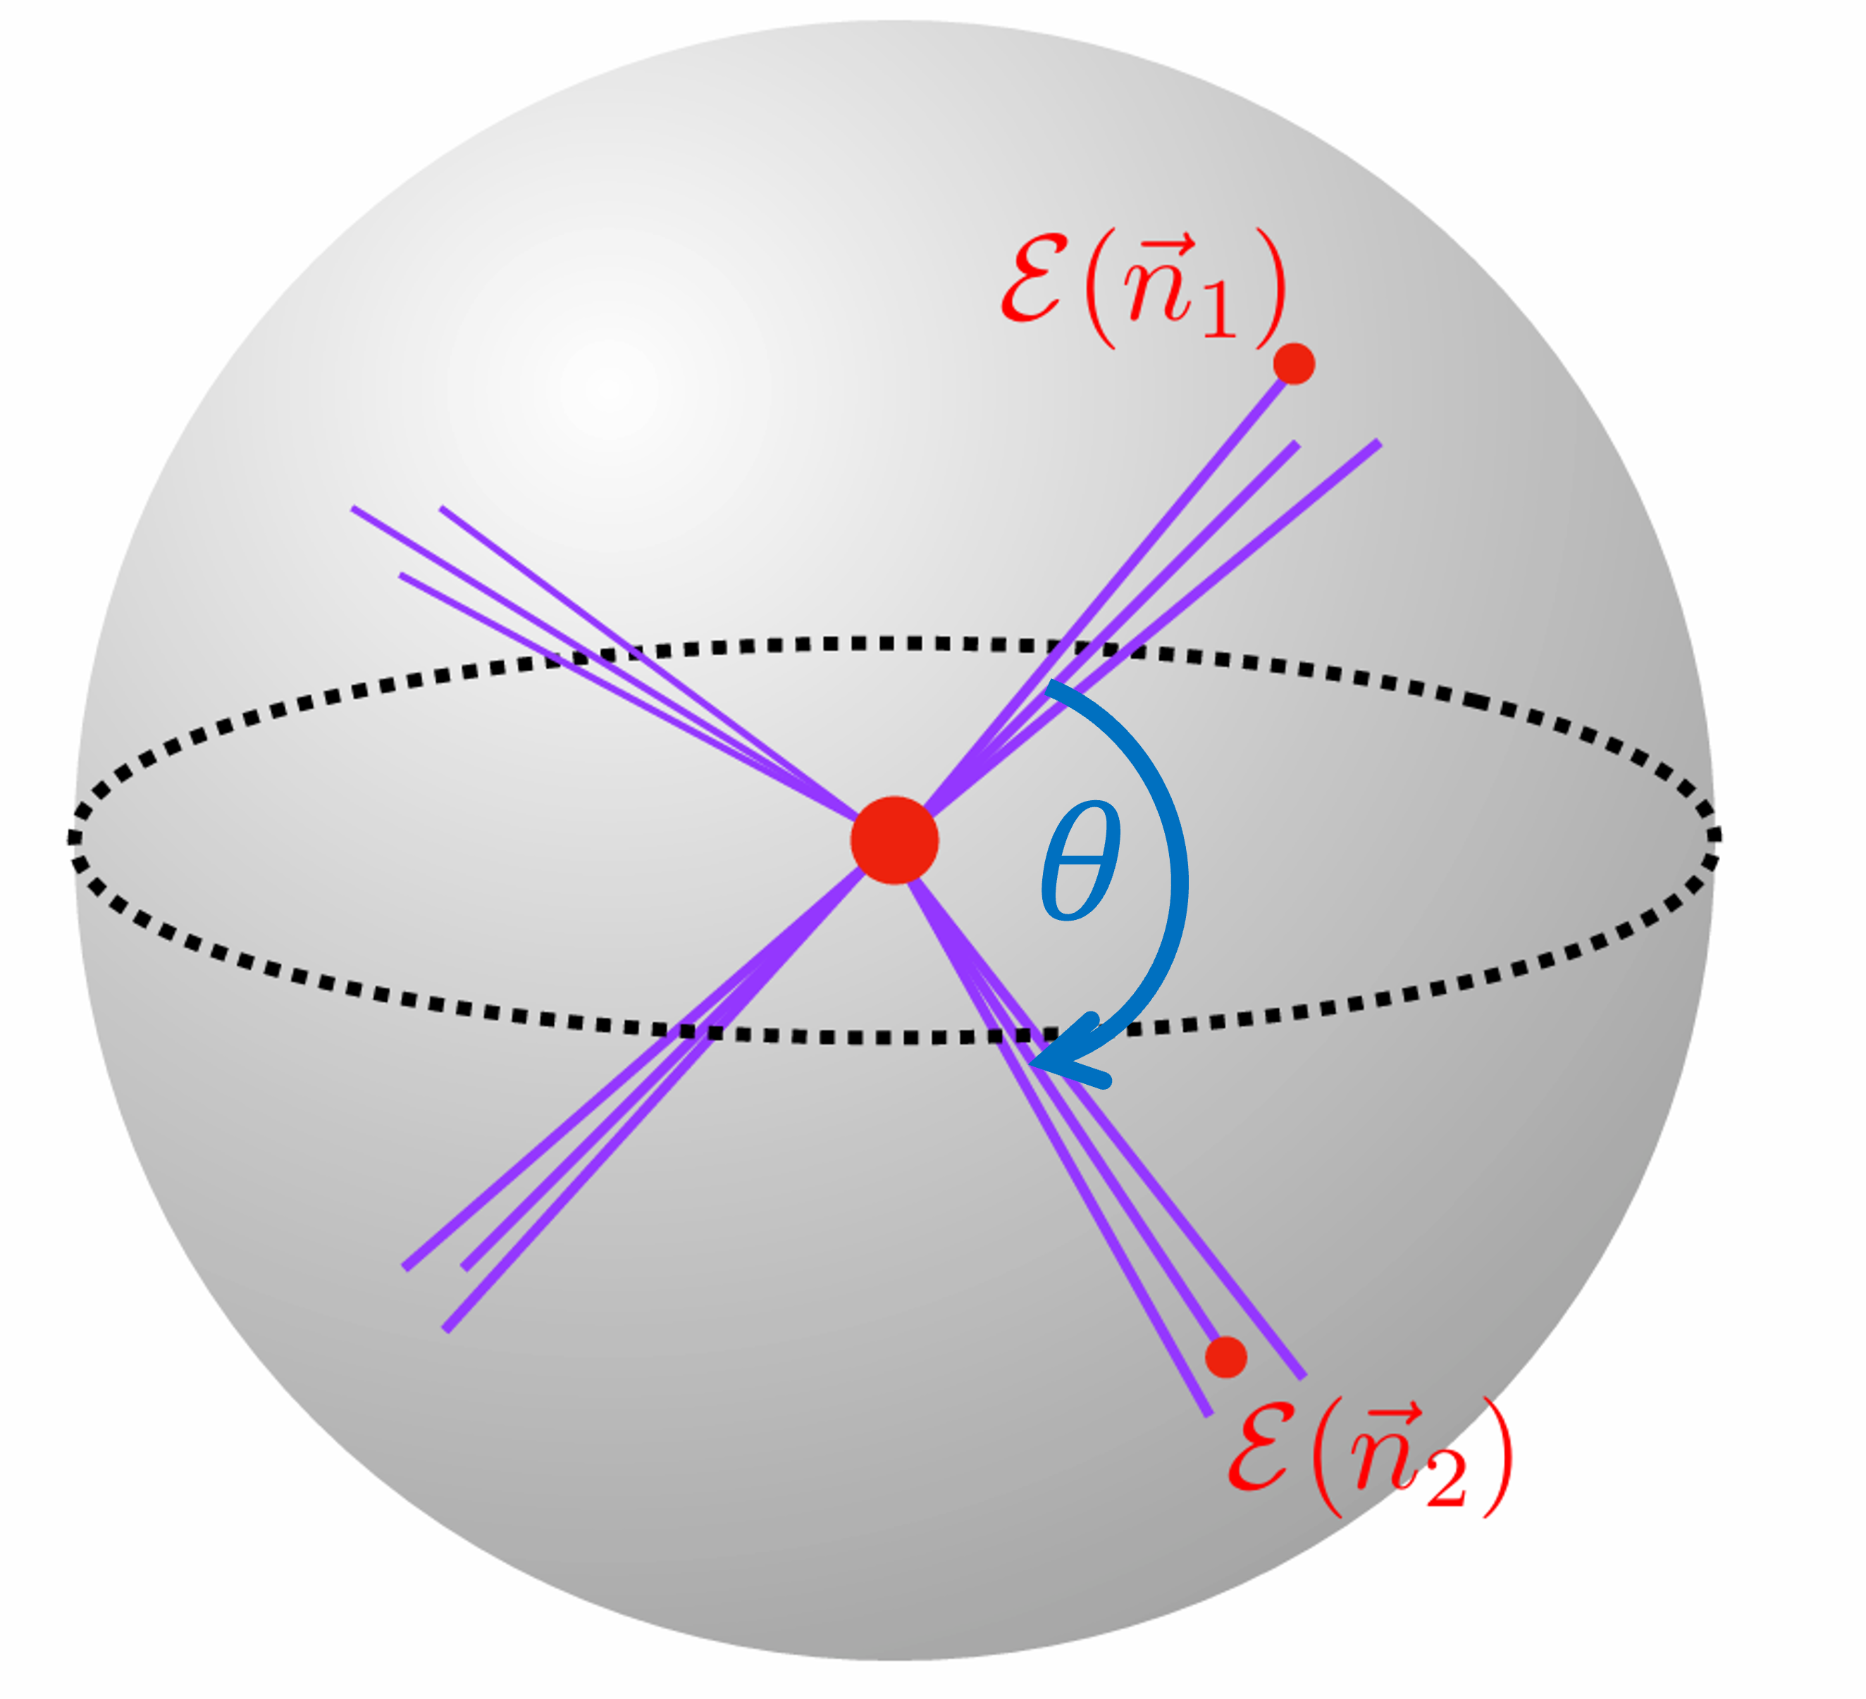
New Opportunities: The Energy-Energy Correlator
Basham, Brown, Ellis and Love, 1978
Definition of Energy-Energy Correlator(EEC)
Probe two energy flux coincidently
Widely used for probing microscopic details
Strong Coupling Constant
The CMS Collaboration, 2402.13846 …
Nucleon Structure
X.H. Liu, H.X. Zhu, 2209.02080 …
Many Other Applications
…
Notes:
% Explain pic1, red point hard process, energy flux: weight by energy.
% IRC safe observables, not sensitive to non-perturbative. Reliably compare between theory and exp.
% High order compute, well defined detection
% Add xL definition \sims theta, draw theta
% Region 1, 3 precise; 2 confinement
Energy energy correlator or eec is defined just like the ball pic, red point in the middle is hard process, two energy flux are tracked and also their spreading angle theta and azimuthal angle. It is Infrared and collinear(co linear) safe or IRC safe observable. Which allows precise calculation, well-defined detection and reliable comparison between theory and exp.
% linear depends on energy, IRC safe not sensitive to non-perturbative effect.
So the following is precise experimental data. xL here is defined with this and is just as theta shown in the ball. It shows pretty scaling law in the hadron free region and the perturbative region. And give us information about confinement.

Slide 6
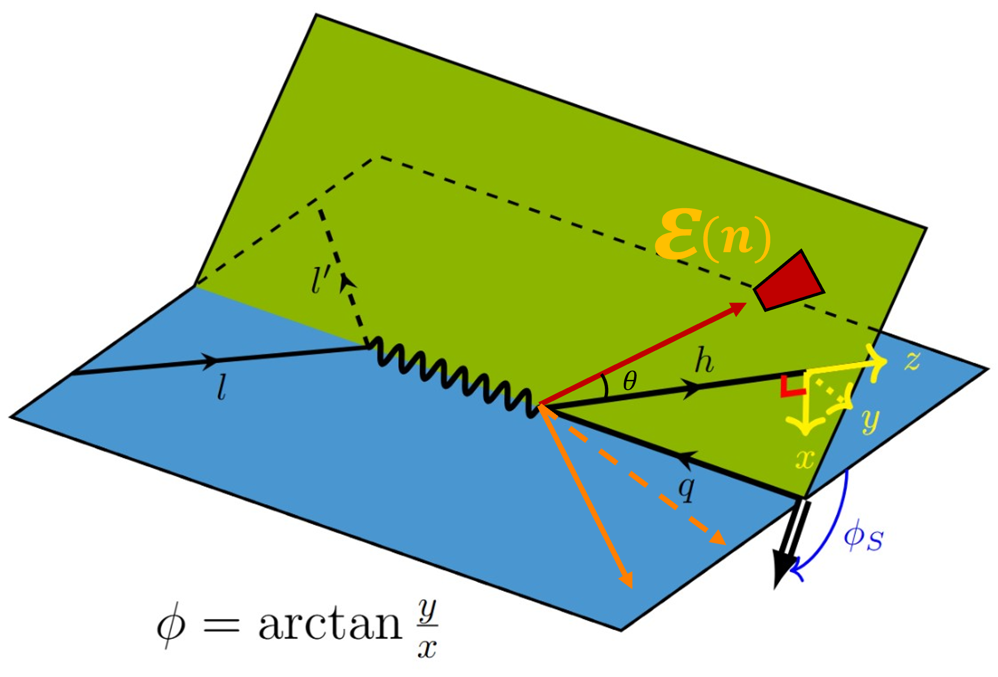
Observable Definition
Observe final state hadron, with energy flux around it
$$φ$$
$$x$$
$$y$$
$$S_{T}$$
$$S_{T}$$
Project to hadron frame
Fragmentation Energy Correlator (FEC)
Notes:
% Explain the picture, sim to SIDIS; parallel pictures.
% Theta and phi, non-perturbative;
% Particularly phi distribution. Rotation around z asymmetry; parton spin; transversity function transfer to quark.
% Plane picture to draw phi.
Here’s what we did. The left-hand side is normal SIDIS. In the middle is what we want to observe and the right side is projected plane of hadron frame. Compared to SIDIS, we not only observe some specific hadron, but also an energy flux around it. And the direction of the energy flux is defined in the hadron reference and not necessarily lying in the x-y plane. The spreading angle theta provides another probe for non-perturbative information. As shown to the right, the energy flux projection in the hadron frame’s xy plane has an angle with the x-axis, which is phi we defined.
What is particularly interesting in this work, is the azimuthal distribution of phi. There is an asymmetry in phi distribution. So how it comes out? That’s from the azimuthal asymmetry of the outgoing parton. For the initial state, proton may possess a transverse spin, which can be transferred to the incident parton by transversity function, and then transferred to outgoing parton. This effect happens to be under description of our Fragmentation energy correlator.

Slide 7
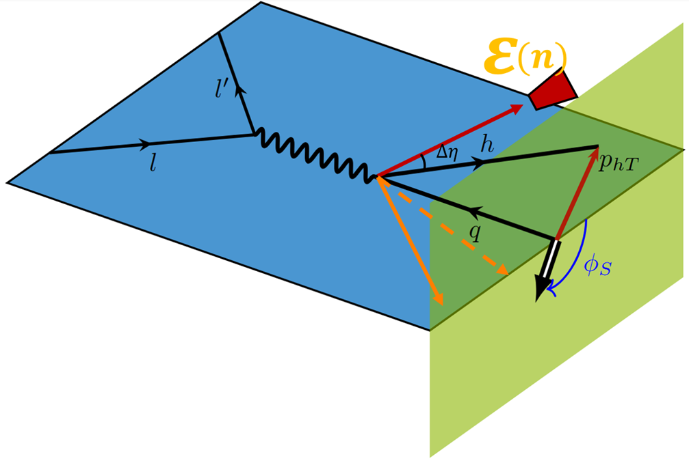
Match to Experiments
Inclusively observe the $p_{hT}$, which leads to collinear factorization
Extra handle for the non-perturbative effects
Collinear factorization
Angles replace PT
Similar structure functions to TMD FFs
$$φ_{h}$$
Unpolarized
Collins Type
FEC
$$q_{F}=m_{π}e^{y_{π}−η}≈\frac{P_{h}^{+}θ}{2}$$
TMD FF
Notes:
We see that an energy scale naturally emerge from the FEC, which is actually the only energy scale in the FEC. we can call it q_F. It’s defined as mh times exponential of Delta eta or y_h-eta. We see that it is related to spreading angle, and it’s exactly linear proportional to theta in collinear limit. It does not surprise us actually. As mentioned in the morning by Ian Moult, the theta angle images the intrinsic energy scales of QCD.
This qF conveniently and essentially describe the transverse energy scale, and image the non-perturbative structure in a more universal way. OK, words or mouth guarantee nothing, How to show that? One important point to clarify its universality is how does this function vary with different system energy?

Slide 8
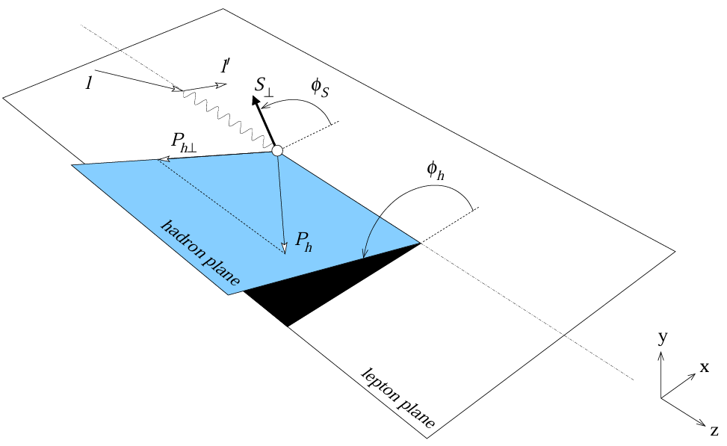
Difference from TMD
FEC
[A. Bacchetta, U. D’Alesio, M. Diehl, C. A. Miller, 2004]
[John Collins, 1993]
SIDIS
Notes:
Back to the very beginning, we talked about the motivation for TMDs, they are used for probing transverse structure of fragmenting or inner nucleon. Here we can use FEC to do the similar thing, but with a very nice collinear factorization without convolution of k_perp.

Slide 9
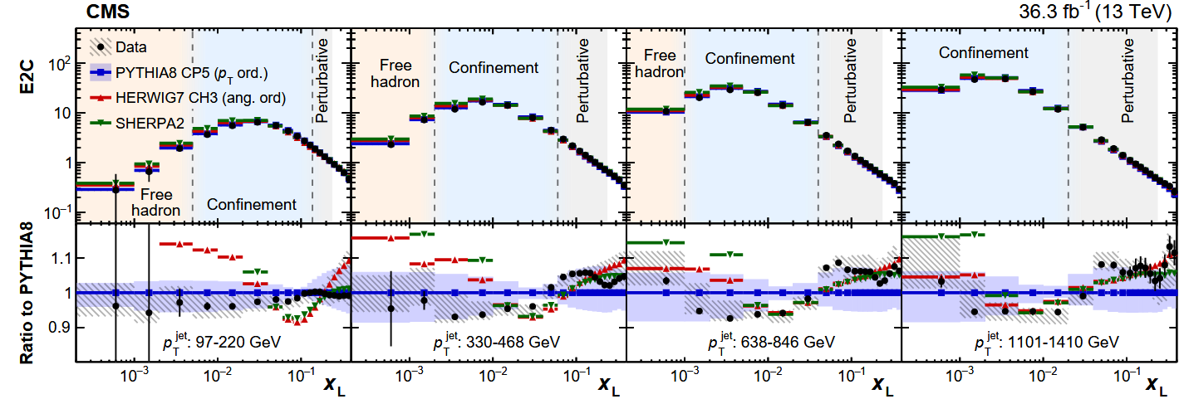
Pythia Simulation
Use Pythia to show confinement with FEC (Unpol.).
Scaling law in experiments
$$q_{F}≈\frac{P_{h}^{+}θ}{2}$$
$$χ_{L}=$$
[CMS, 2024]
Notes:
And what we do here is to simulate the jet production in the e+ e- annihilation. We choose the same z fraction with different center mass energy.
To the left is free hadron, slope approximately 2, to the right is perturbative region. They are in great agreement of the scaling law of EEC.
And the interesting thing we can see is that the confinement place at each system energy is the same, which gives proof of our universality.

Slide 10
Magnitude
X.H. Liu and H.X. Zhu, 2024
Very Interesting Moment Relation to TMD FF. consistence
Easily Decide the Experimental Signal Magnitude.
TMD FF
FEC

Slide 11
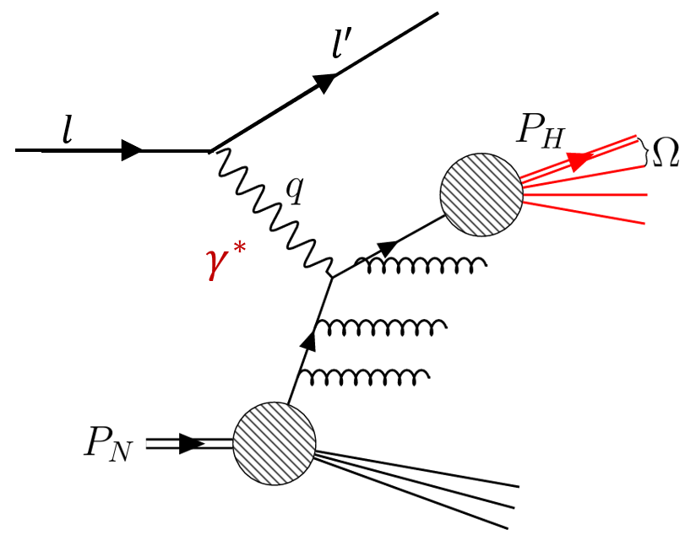
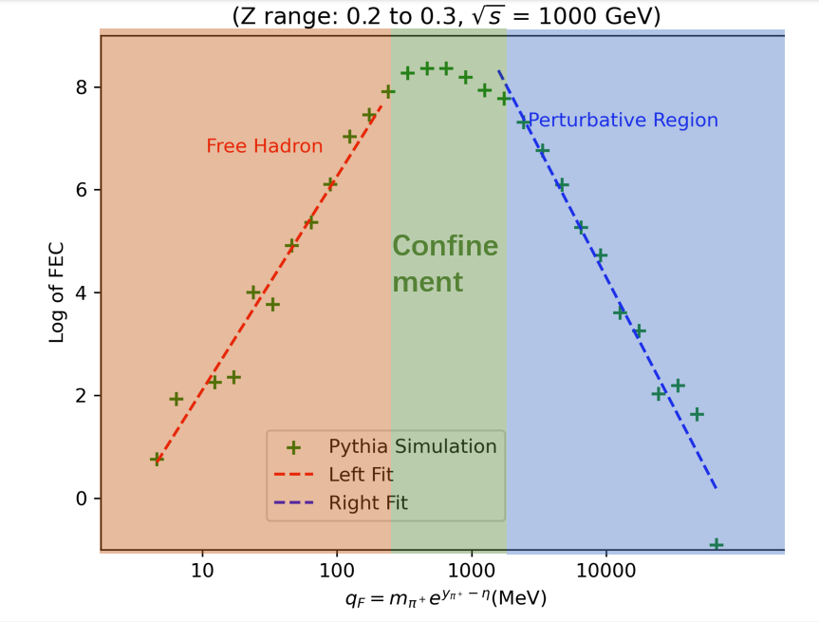
Summary
Introduce the boost invariant Fragmentation Energy Correlators as a probe for transverse structure of fragmenting hadrons.
Spin asymmetry can be shown via Collins type FEC, with a nice collinear factorization.
Naturally connecting to TMD moments.

Slide 12
Thank You!

