Slide 1
CGEM Daily Test Plan Discuss
Tingxuan Zeng
2025-02-19

Slide 2
New threshold scan code development
A new faster and easier way to implement the threshold scan function in hardware level from Damiano.
Finished code implemented according to instructions.

Slide 3
Test plan today
4:30pm 2h testing hour with GUFI closed.
./bin/launch_TP_multithread → load default config for all GEMROCs
./bin/scan_td_multithread → TD scan for all GEMROCs, set TD value for all GEMROCs
./bin/scan_thr → do thr scan for all GEMROCs, set threshold value for each channel

Slide 4
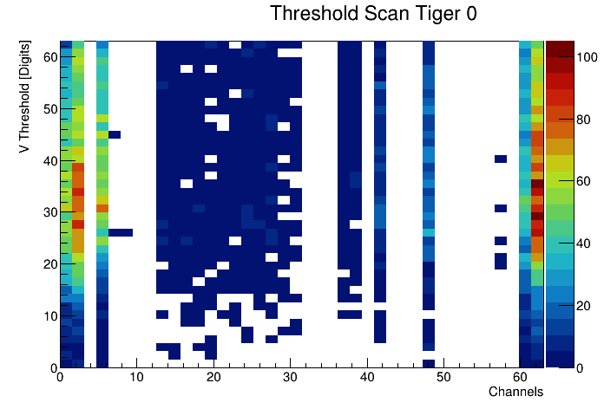
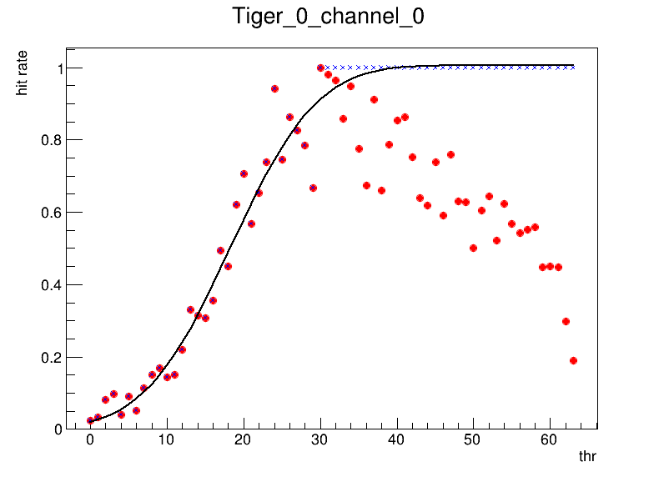
Threshold scan test
Test with GEMROC 0, Tiger 0
Some channels can fit a good value, some not.

Slide 5
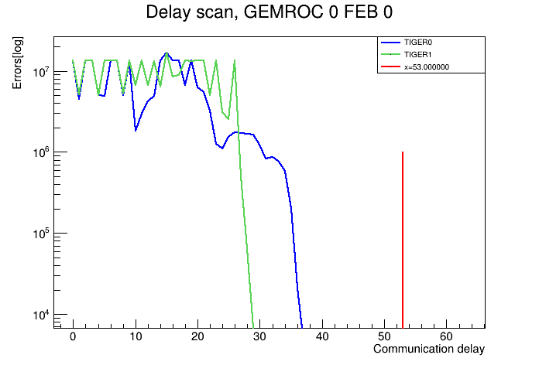
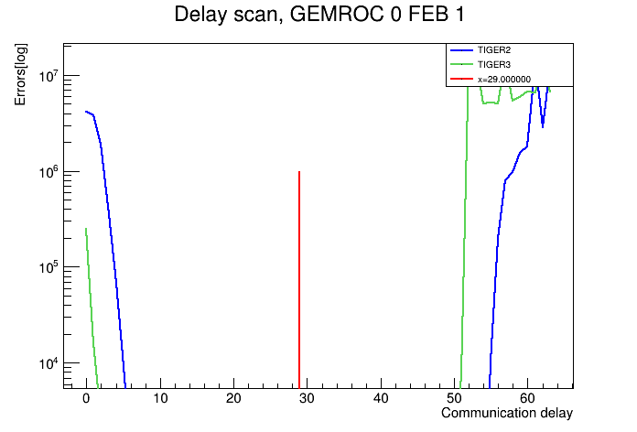
TD Scan Test
Basic functions all are right.
When Multithread test with all GEMROCs, there have some recv fails at the same time with the root fInterpreter not initialized error.
Maybe because the root lib is not thread safe. Debugging .

Slide 6
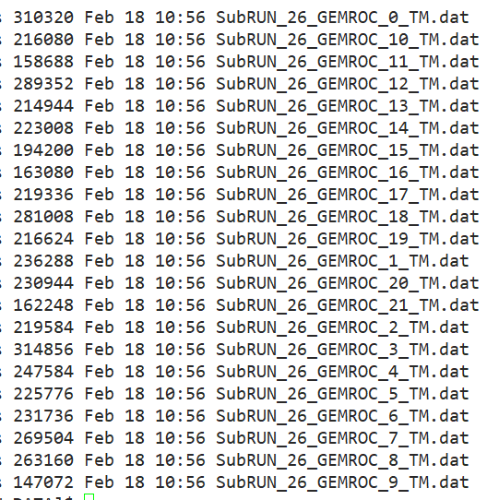
Beginning : Data file merge
GUFI and BESIII take data synchronizely.
Get data files from GUFI and BESIII.
Build a Event according to GEMROC L1 count and
BESIII global event ID.
Insert the data fragment from GUFI as a subdetector fragment to the BESIII data file.
Merged all GEMROC’s data to a binary file according to L1 count.
Throw away 4368 bytes from GEMROC 5,8,20 with an extra wrong data packet(L1 count=11101)
Check data format: the other data packets are all right.

Slide 7
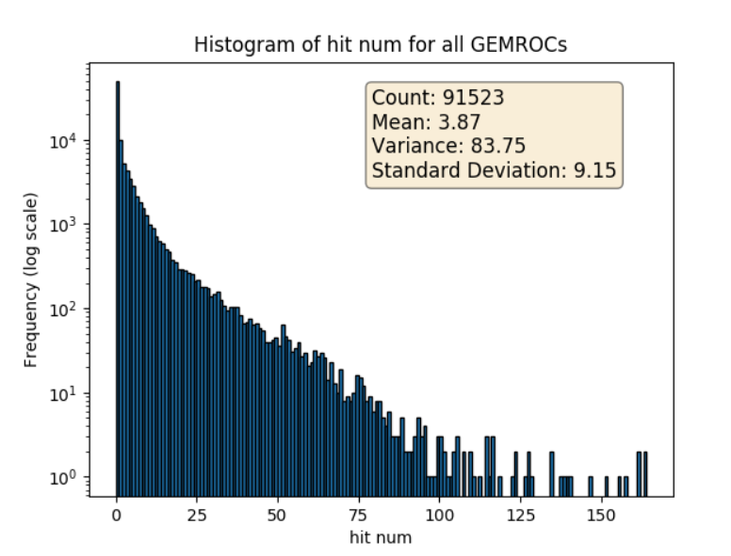
4160 Events.
GEMROC L1_count from 9948 to 14108.
Data format right
L1 count right
Check bit all 0.

Slide 8
……
GEMROC 8 has a wrong packet with L1 count=11101 first(trailer not right), and then comes another right packet with L1 count=11101 (check every 8 byte from the beginning of the wrong packet to find a right packet)
Throw 1456 bytes wrong data away

Slide 9
……
GEMROC 5 has a wrong packet with L1 count=11101 first(trailer not right), and then comes another right packet with L1 count=11101 (check every 8 byte from the beginning of the wrong packet to find a right packet)
Throw 1456 bytes wrong data away

Slide 10
……
GEMROC 20 has a wrong packet with L1 count=11101 first(trailer not right), and then comes another right packet with L1 count=11101 (check every 8 byte from the beginning of the wrong packet to find a right packet)
Throw 1456 bytes wrong data away

Slide 11
summary
finished the implementation of thr scan function
test with all gemrocs with the config code
Checked GUFI data file and merged them into a single file according to GEMROC L1 count.
Begin to prepare the data file merge code with BESIII data file and the GUFI data file.(1%)
next
More tests to do with all GEMROCs.
Prepare the data file merge code with BESIII data file and the GUFI data file.(need a few days)
Test with DC board interrupt read out mode after Angelo comes.
Implement a standalone UDP read out mode (need a few days)
Integrate UDP read out mode code into BESIII framework.(need a few days)

Slide 12
Thanks!

