Slide 1
Top Quark EW Coupling Precision Measurement
21/02/2025
Mustapha BIYABI

Slide 2
The usual form factors denoted F1, F2 defined :
Top EW Couplings Parametrizations
Which can be translated to :
Relation :
Maximize numerically a global likelihood L with respect to all form factors:
Where :

Slide 3
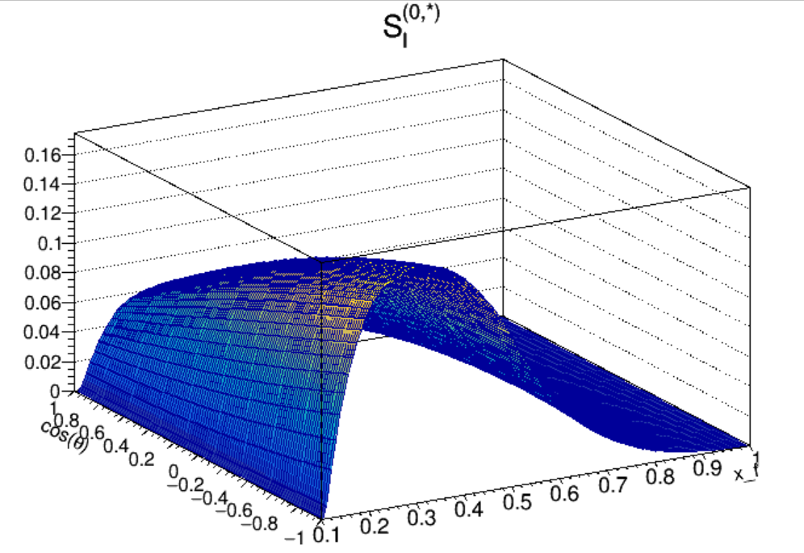
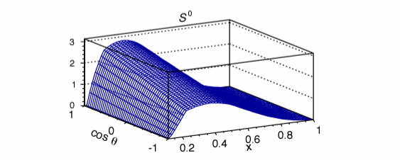
SM Contribution
- Plot the SM part in terms of the Lepton polar angle and normalized Energy :
- The$\sin^{2}θ$ is set to 0.23.
- Mass of Z to 91 GeV.
- Fine structure to 0.0072973525643.
CEPC: @360GeV
FCCee : @365GeV

Slide 4
Likelihood
- There are nine different functions, and eight form factors δi to be evaluated from a given sample of tt events.
Minimize the negative Log-likelihood (- logL) with respect to all form factors:
- Minimazation Setup is ready.

Slide 5
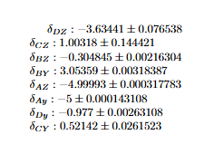
Likelihood Minimazation
$Let All the Parameters to vary :$
$Using TMinuit for Likelihood Minimization :$
SDtartGamma : {0.1, 0.1, 0.1, 0.1, 0.1, 0.1, 0.1,0.1};
Low_limit : {-5, -5 ,-5, -5, -5, -5, -5, -5};
Up_limit : {5, 5,5, 5, 5, 5, 5, 5};
StepSize : 0.001
Nbr of iter : 10000
Nbr of para : 8.

