Slide 1
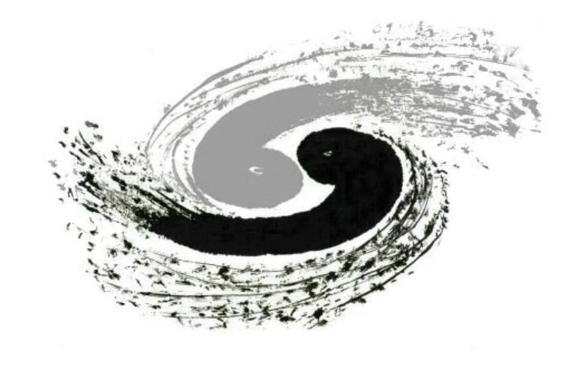
CEPC top coupling & top mass discussion
Huayu Liu
huayuliu9499@163.com
Sun Yat-sen University
21/2/2025

Slide 2
Outline
Detailed overview of top EW CP measurement at ILC
Detailed overview of top EW CP measurement at FCC
Review what need to do
Status and To do

Slide 3
Detailed overview of top EW CP measurement at ILC
Link
Outline:

Slide 4
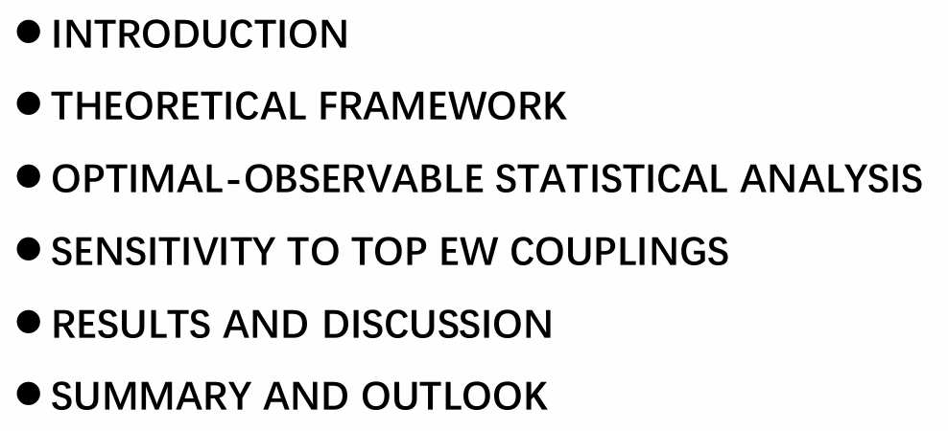
Detailed overview of top EW CP measurement at FCC
Link
Outline:

Slide 5
Review what need to do
Goal: top EW CP measurement at CEPC
Strategy: Try the similar method of ILC
Observerables :
Cross Section(count):
Forward Backward Asymmetry:
Slope of the helicity angle distribution $λ_{t}$:
Thoery predictions:
Cross Section:
Forward Backward Asymmetry:
The fraction of right-handed tops
Here I represent two kinds of beam P,P’=-1,1 and P,P’1,-1
Correction:
The cross section for any kinds of beam can be shown as:
The observables $A_{FB}^{t}$and $λ_{t}$ vary only very mildly with the beam polarisation.

Slide 6
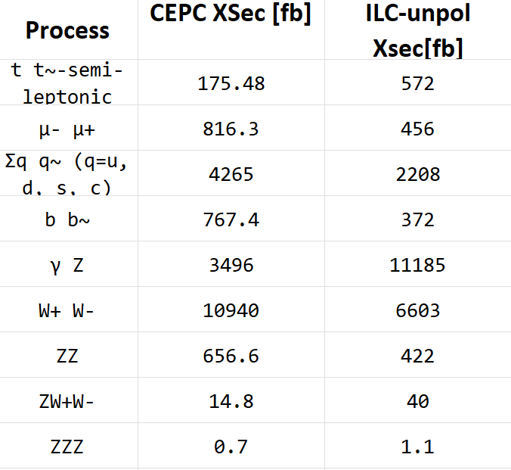
Review what need to do
Differences comparing to ILC:
Unpolarized beams P,P’=0,0;
The $A_{FB}^{t}$ and $λ_{t}$ is not mildly depends on beam polarisation,So we still can do similar things with ILC.And it is mentioned last page The cross section for any kinds of beam can be shown as:
It also needs to be explained so we can use -+ and +- to do it. Finally, like ILC, calculate the statistical uncertainty brought by unpolarized beams
For xsec (thanks to Mustapha):

Slide 7
Status and To do
Status:
Signal Data (from Mustaphaa and shudong)
A code to do the similar combination as ILC to reconstruct hadronic top
Obsessive measurements in code form
To do
Try to separate two completely polarized datasets from unpolarized data, with each dataset having half of the luminosity.
Convert Thoery predictions in ILC into the corresponding form of unpolarized beam in CEPC
Design a similar statistic to minimize instead of solving indefinite equations directly.
All the things are on-going,it need more time .

