Slide 1
Supercooled Phase Transitions: Why Thermal History of Hidden Sector Matters in Analysis of Pulsar Timing Array Signals
Presenter: He-Xu Zhang
Feb. 21st, 2025
Based on: 2501.14986v1

Slide 2
Outline
Background & Motivation
Model & Supercooled Hidden Sector Phase Transition
Thermal History of the Hidden and Visible Sectors
Gravitational Wave Spectrum & Benchmark Models
Conclusion & Outlook

Slide 3
Background & Motivation
Pulsar timing arrays (PTAs) such as PPTA, EPTA, and NANOGrav have detected a gravitational wave background in the nano-Hertz frequency range.
Fitting PTA signals find that the nucleation parameter $β/H$ must be less than approximately ${10}^{2}$, which indicates a strongly supercooled phase transition.

Slide 4
The Hidden ${U(1)}_{X}$ Model
Hidden sector with spontaneously broken ${U(1)}_{X}$ ​symmetry:
Includes:
Dark complex scalar field$Φ$, dark fermion $q$, hidden gauge field $A_{μ}$
$B_{μ}$ is the gauge field of the SM’s ${U(1)}_{Y}$ hypercharge symmetry
Kinetic gauge mixing connects the hidden sector to the Standard Model.

Slide 5
The Hidden ${U(1)}_{X}$ Model
The effective temperature dependent hidden sector potential:
where
One-loop corrections at $T=0$ :
Finite thermal correction:
Thermal corrected masses:

Slide 6
Supercooled Hidden Sector Phase Transition
As a trivial discussion, we assume the temperature ratio between the hidden and the visible sector $ξ=\frac{T_{h}}{T_{v}}=1$.
The mean bubble separation $R_{∗}$ is an important parameter for the calculation of GWs produced by bulk fluid motion and bubble collision.
Generally, we estimate it by the linear coefficient in a Taylor expansion:
In the case of strong supercooled phase transitions, the mean bubble separation should be calculated from the bubble number density so that

Slide 7
Supercooled Hidden Sector Phase Transition
The probability of finding a point still in the false vacuum
The percolation temperature $T_{h,p}$is defined as
The parameter space ($λ_{h},g_{x}$) is divided into four distinct regions, each colored differently to represent different types of phase transitions:
Case 1: Upper dark region—“ultracooled” Lower dark region—“crossover”
Case 2: No percolation or FOPTs do not complete
Case 3: FOPT successfully completes—“U-shaped action $S_{3}/T$ curve”
Case 4: Weak supercooled PTs or non-supercooled PTs—“tangent-like action curve”

Slide 8
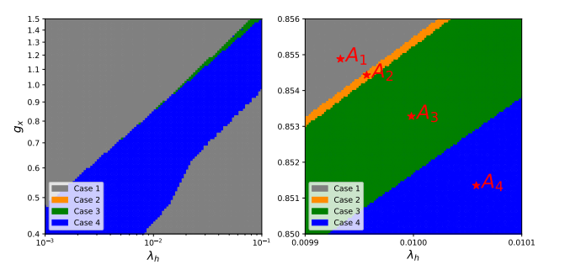
Supercooled Hidden Sector Phase Transition
$A_{1}−A_{4}$ are four characteristic points

Slide 9
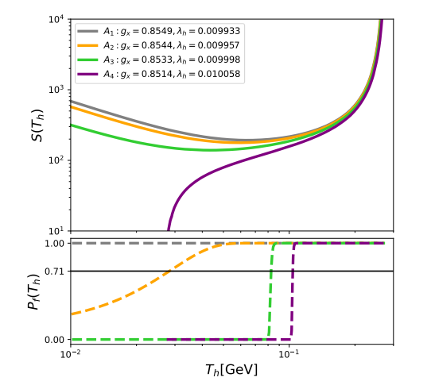
Supercooled Hidden Sector Phase Transition
Case 3 is of particular interest because it generates GWs strong enough to fit PTA signals.

Slide 10
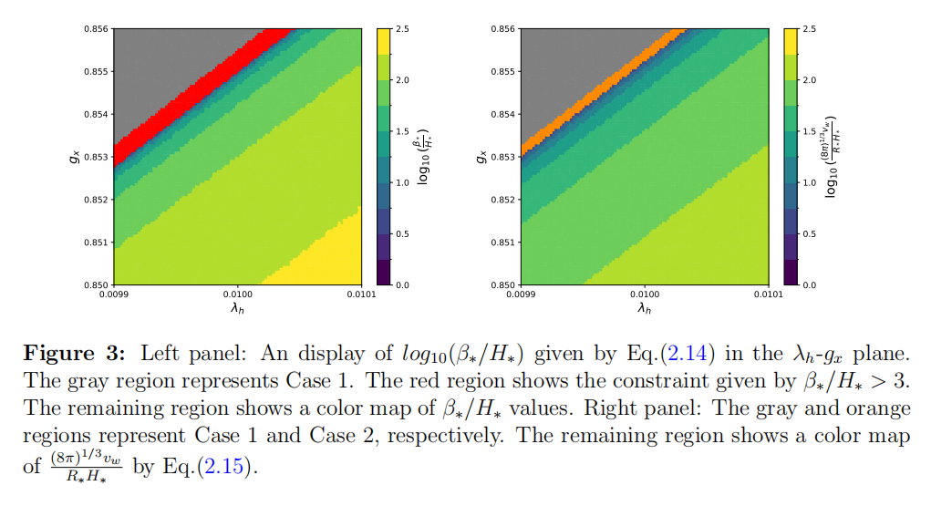
Supercooled Hidden Sector Phase Transition
For given values of $λ_{h}$ and $g_{x}$, $β_{∗}/H_{∗}$ consistently yields larger values than $\frac{{\left(8π\right)}^{1/3}v_{w}}{R_{∗}H_{∗}}$, indicating that using $β_{∗}/H_{∗}$ leads to an underestimation of the GW power spectrum.

Slide 11
GW Spectrum & Benchmark Models
Parameters values of the benchmark points BP1-BP5
The temperature ratio during the phase transition, $ξ_{p}$, is generally large, which enables a strong phase transition, with $α_{tot}\sim O(1)$.
While this would have excluded them under the previous constraint $β_{∗}/H_{∗}>3$, these points are now valid since we employ the mean bubble separation $R_{∗}$ instead.

Slide 12
Thermal History of the Hidden and Visible Sectors
In most cases the temperature ratio $ξ$($T_{v}$) varies significantly during and before the phase transition, especially for a decaying hidden sector.
The evolution function, ζ($T_{h}$), can modify the evolution history of the Hubble parameter and, consequently, affect the percolation temperature

Slide 13
Why thermal history important
Two types of transition strength parameters:
— controls the GW power spectrum
The effective number of additional neutrino species from BBN constraint
Observable signals in PTAs → maximize $α_{tot}$→ maximize $ξ_{p}$
Satisfy the BBN constraint on $∆N_{eff}$ → $ξ_{reh}$ as small as possible
A conflict：
Solution: a dark sector decaying at pre-BBN temperature

Slide 14
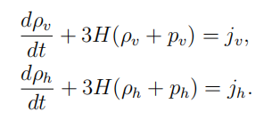
Thermal evolution of coupled hidden and visible sectors
Define
The evolution equation for ξ(T) is given by

Slide 15
Thermal evolution of coupled hidden and visible sectors
Phase 1 (red), before reheating;
Phase 2 (green), after the reheating;
Phase 3 (purple), after the hidden sector particles decouple from each other.

Slide 16
Thermal evolution of coupled hidden and visible sectors
When the hidden sector temperature falls below this mass,
”Cannibalism”:
Once the cannibalism phase ends, the hidden sector becomes fully non-relativistic, causing $g_{eff}^{h,rad}$ to decrease exponentially. Consequently, the constraint on ${∆N}_{eff}$ is naturally satisfied.

Slide 17
Thermal History of the Hidden and Visible Sectors
As a comparison, consider two different scenarios: $ζ_{1}=const.=1/ξ_{p}$, and $ζ_{2}=ζ$($T_{h}$).
The percolation temperatures differ by 100%.
The GW power spectrum differ by four orders of magnitude.
This change in $T_{h,p}$ significantly affects other parameters, including $α_{tot}$, $H_{∗}$ and $R_{∗}$.

Slide 18
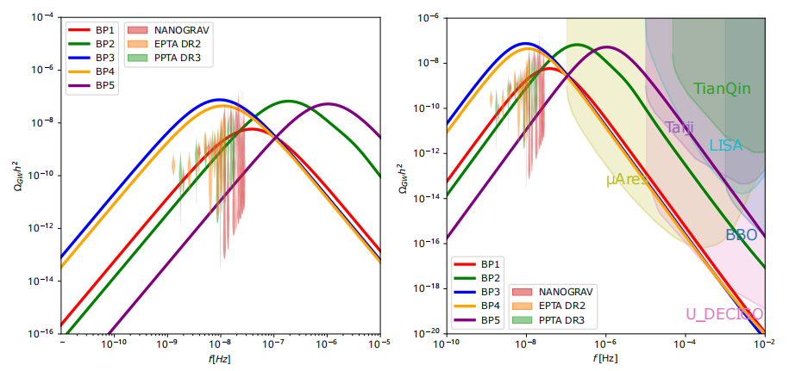
GW Spectrum & Benchmark Models
The supercooled phase transitions also can produce detectable signals in the higher frequency regions above NanoGrav.

Slide 19
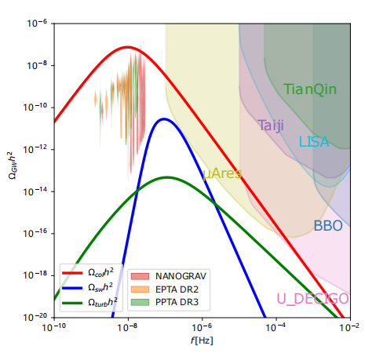
Contribution to the GW Signal
3 primary contributions:
bubble collisions + sound waves + turbulence

Slide 20
Summary
The mean bubble separation ($R_{∗}$) provides a more accurate description of strong supercooled phase transitions than the inverse timescale $β_{∗}$. The latter leads to an underestimation of the final GW power spectrum.
The temperature evolution of the hidden and visible sectors significantly impacts the GW spectrum. Accurate modeling of this evolution is essential for interpreting PTA data and understanding the early universe's thermal history.
They find a solution simultaneously satisfying both $∆N_{eff}$ while generating a sufficiently large $α_{tot}$ to explain PTA signal.

