Slide 1
CGEM Daily Test Plan Discuss
Tingxuan Zeng
2025-02-21

Slide 2
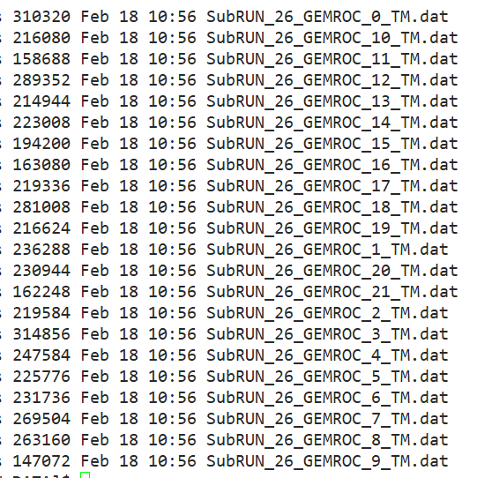
Data file merge Code development
Merge all gemrocs data files into one data file.
Add BESIII event/file headers to conform to the BESIII file format. (50%)
……

Slide 3
clarify about data file check
When I said “data wrong” on 19/2 meeting , it means not consistent with the data format. If we have more than 1 packet with same GEMROC L1 count on purpose to avoid data losing. We can merge them into 1.
From Michela
When I said “data right” on 19/2 meeting , it means consistent with the data format, no including the hit content check. Just check the format and L1 count.
 | first L1 Count | last L1 Count | event number
GEMROC 0-2，5, 7-21， | 9949 | 14108 | 4160
GEMROC 3, 4, 6 | 9948 | 14108 | 4161

Slide 4
summary
Begin to prepare the data file merge code with BESIII data file and the GUFI data file.(50%)
continue to cooperate with the testing.
Thanks!

