Slide 1

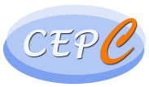
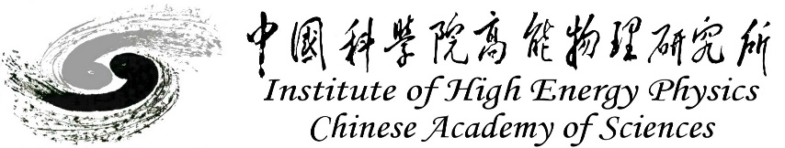
CEPC Detector Magnet
Feipeng Ning
On behalf of Detector magnet team
April 14, 2025, CEPC Detector Review

Slide 2
Content
Requirements
Physical design of the magnet
Conductor and dummy coil development
Cryogenic system
Mechanical design of the magnet
R&D in the future
Cost estimation
Research team
Summary

Slide 3
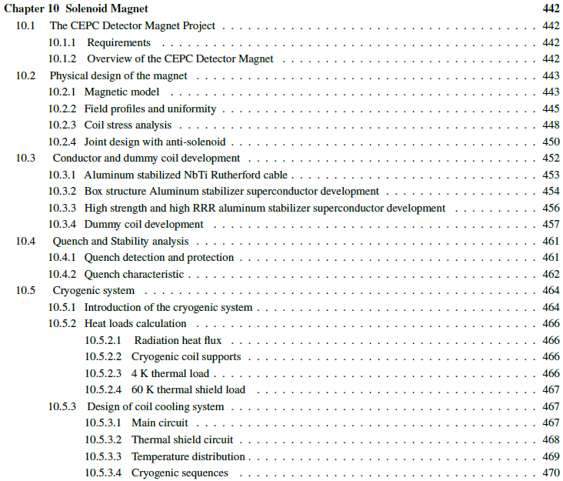
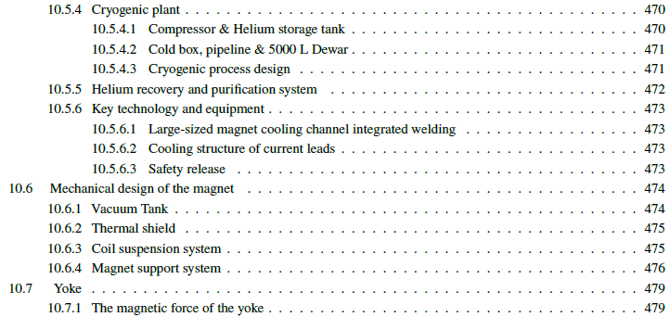
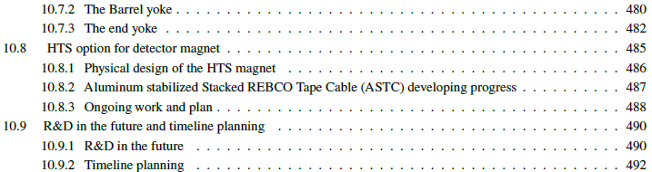
Requirements
This report is about the design and development of the detector magnet for the Ref-TDR. It is related to Chapter 10.

Slide 4
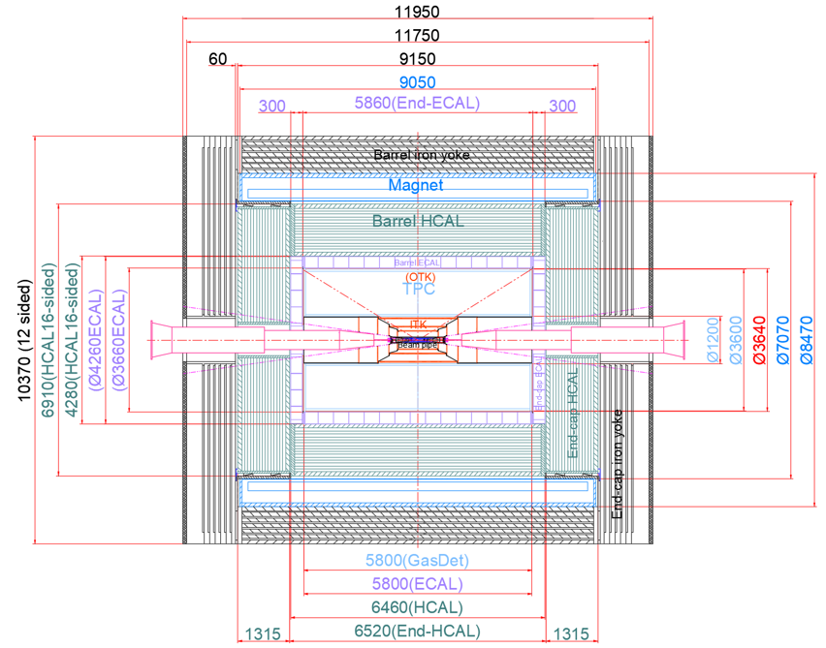
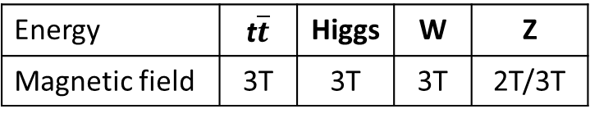
Requirements
Position and size
Magnetic field
Inner diameter | 7070 mm
Thickness | 700 mm
Outer diameter | 8470 mm
Length | 9050 mm
Magnet
Energy | t$\overline{t}$ | Higgs | W | Z
Magnetic field | 3T | 3T | 3T | 2T/3T
Magnet

Slide 5
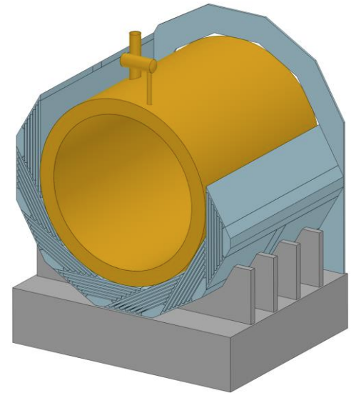
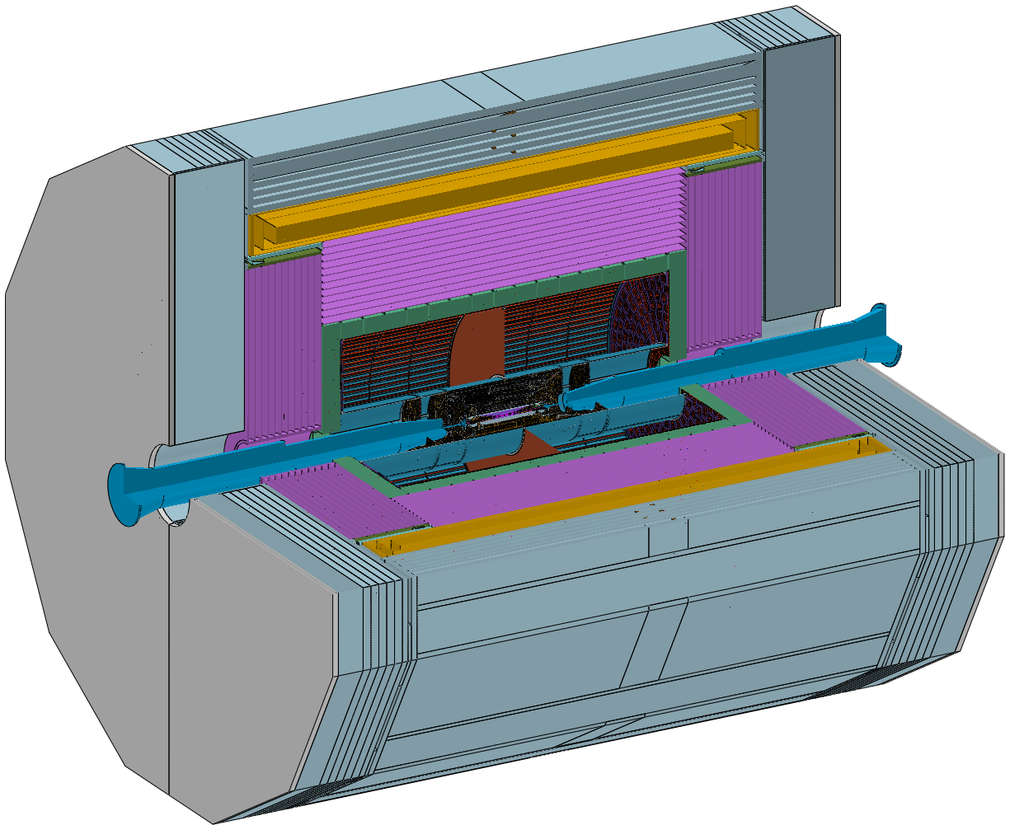
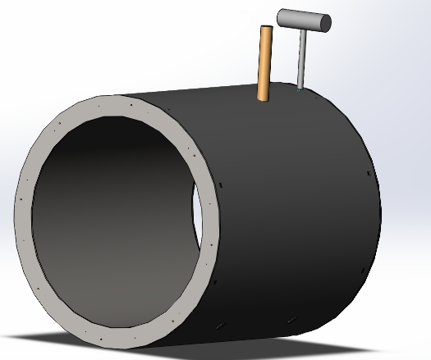
Physical design of the solenoid magnet
Design of the magnet
Magnet parameters:
Central magnetic field | 3 T
Inner diameter | 7070 mm
Outer diameter | 8470 mm
Thickness | 700 mm
Length | 9050 mm
Cold mass | 185 tons
Yoke weight | 2960 tons
Magnet weight | 290 tons
Yoke + Muon
Solenoid magnet
HCal
5

Slide 6
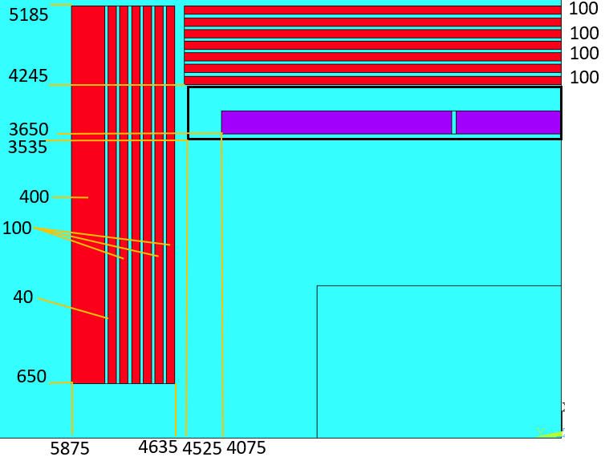
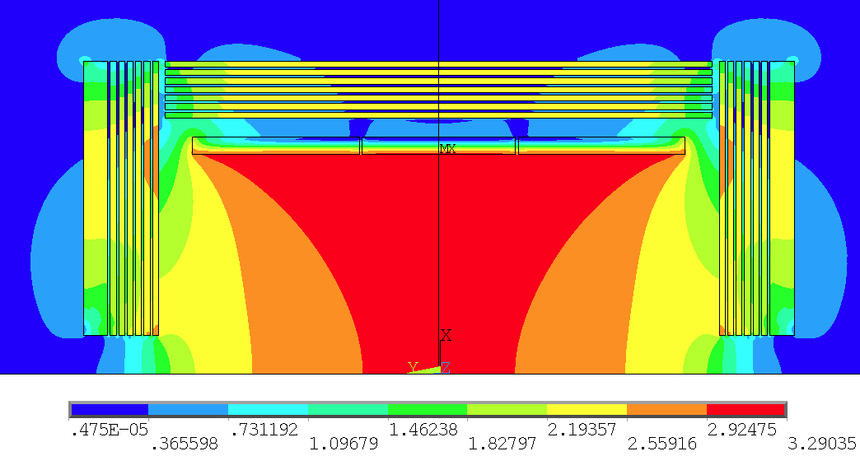
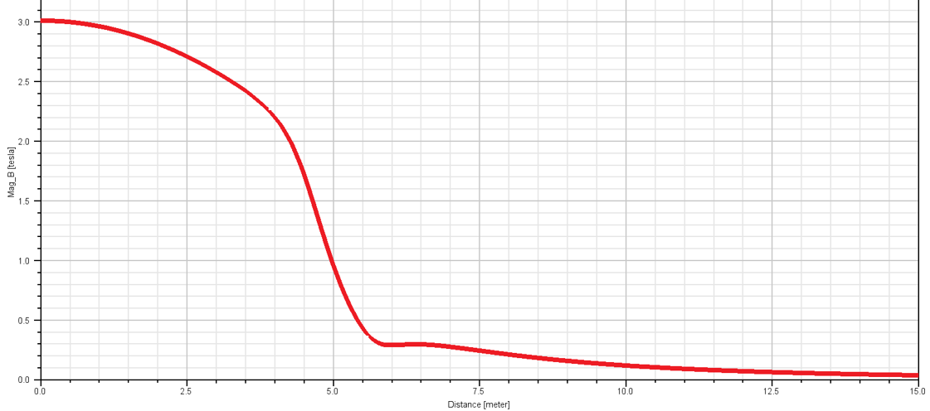

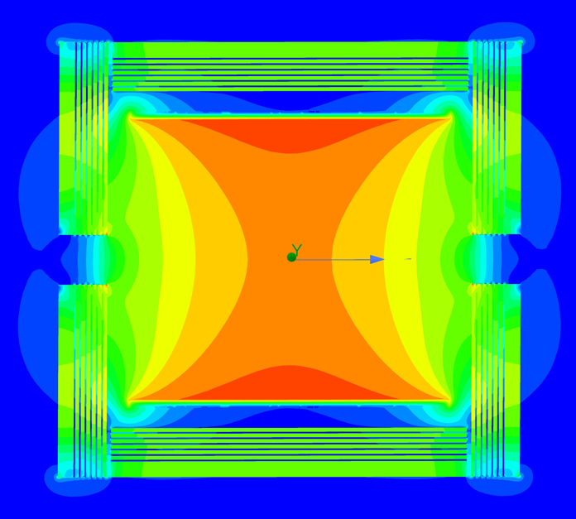

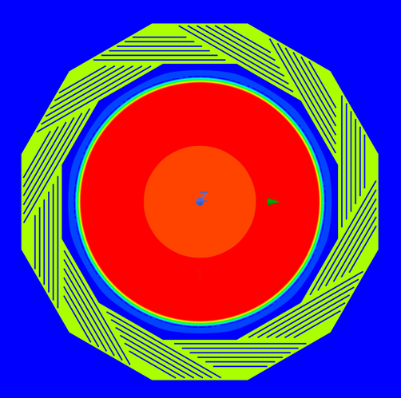
Physical design of the solenoid magnet
Physical design of the magnet
Coil parameters:
Central magnetic field | 3 T
Inner diameter | 7300 mm
Operating current | 17 kA
Cable length | 33 km
Inductance | 11 H
Stored Energy | 1.54 GJ
2D Magnetic field simulation
3D Magnetic field simulation
6
Magnetic field distribution on the axis
3D Magnetic field simulation

Slide 7
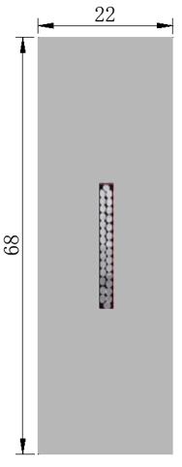
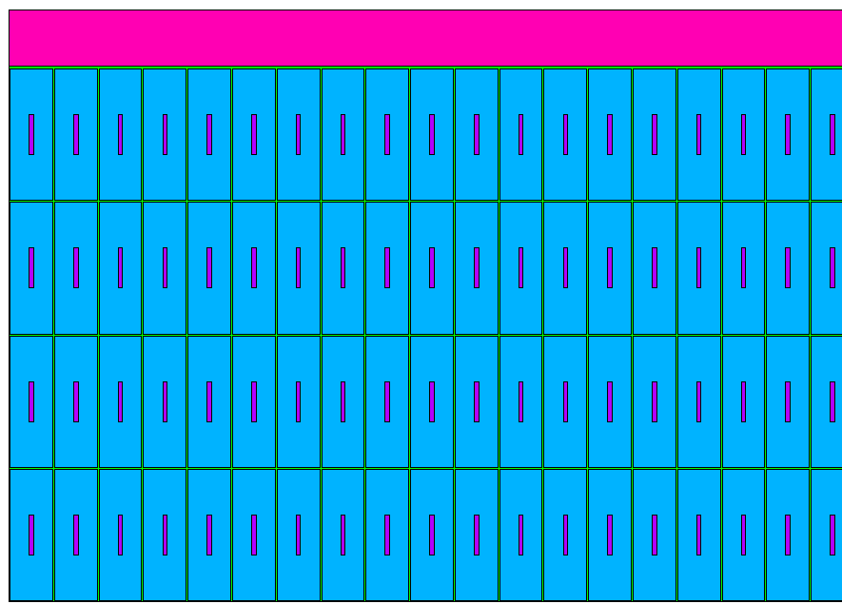
Physical design of the solenoid magnet
Stress analysis
NbTi Rutherford cable
Material | Von Mises stress (MPa)
Coil at 4.2 K
Aluminum stabilizer | 4.4-86.1
SC cable | 174-243
Al alloy support | 4.6-36.2
Coil at 4.2 K, energized
Aluminum stabilizer | 41.5-95.9
SC cable | 54.9-221
Al alloy support | 43.2-87.4
High strength and High RRR Al stabilizer
Coil structure
Cable structure
We will update the coil design in real-time based on the development of high strength aluminum stabilizer and aluminum stabilized superconducting cable.
7

Slide 8
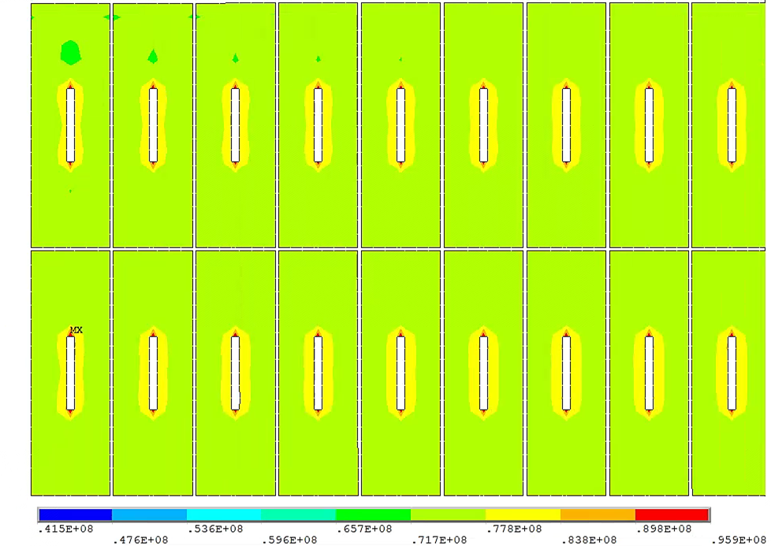
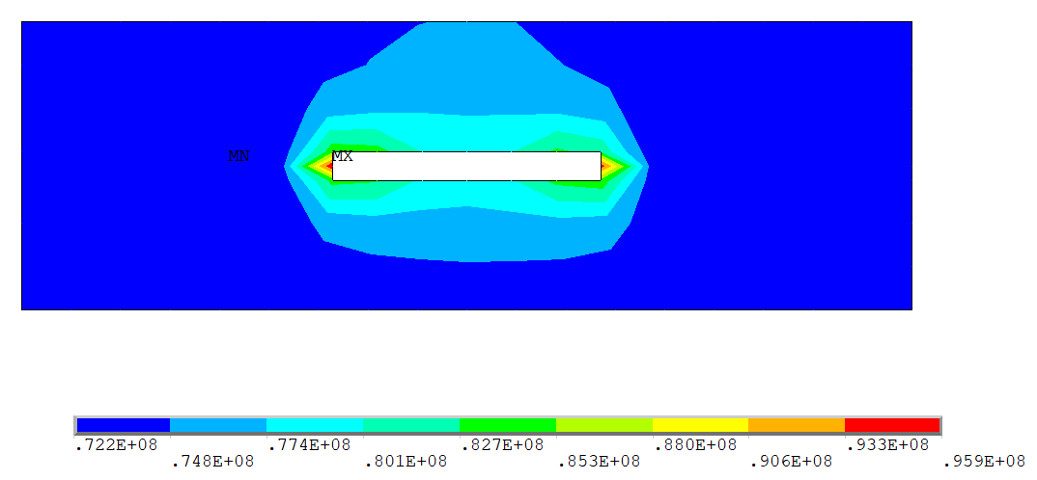
Physical design of the solenoid magnet
Coil Stress analysis
The maximum von mise stress on the aluminum stabilizer (96MPa) is close to the yield strength of the material (105MPa). The safety margin is less than 1/3 of 0.2% yield strength.
The maximum stress on the aluminum stabilizer is only in a very small local area, near the Rutherford cable, with the majority of the region within the stress 70-80 MPa, indicating that the coil can operate safely.
We are still doing the R&D of aluminum stabilizers, aiming to achieve higher strength by combining the required RRR values for quench simulations.

Slide 9
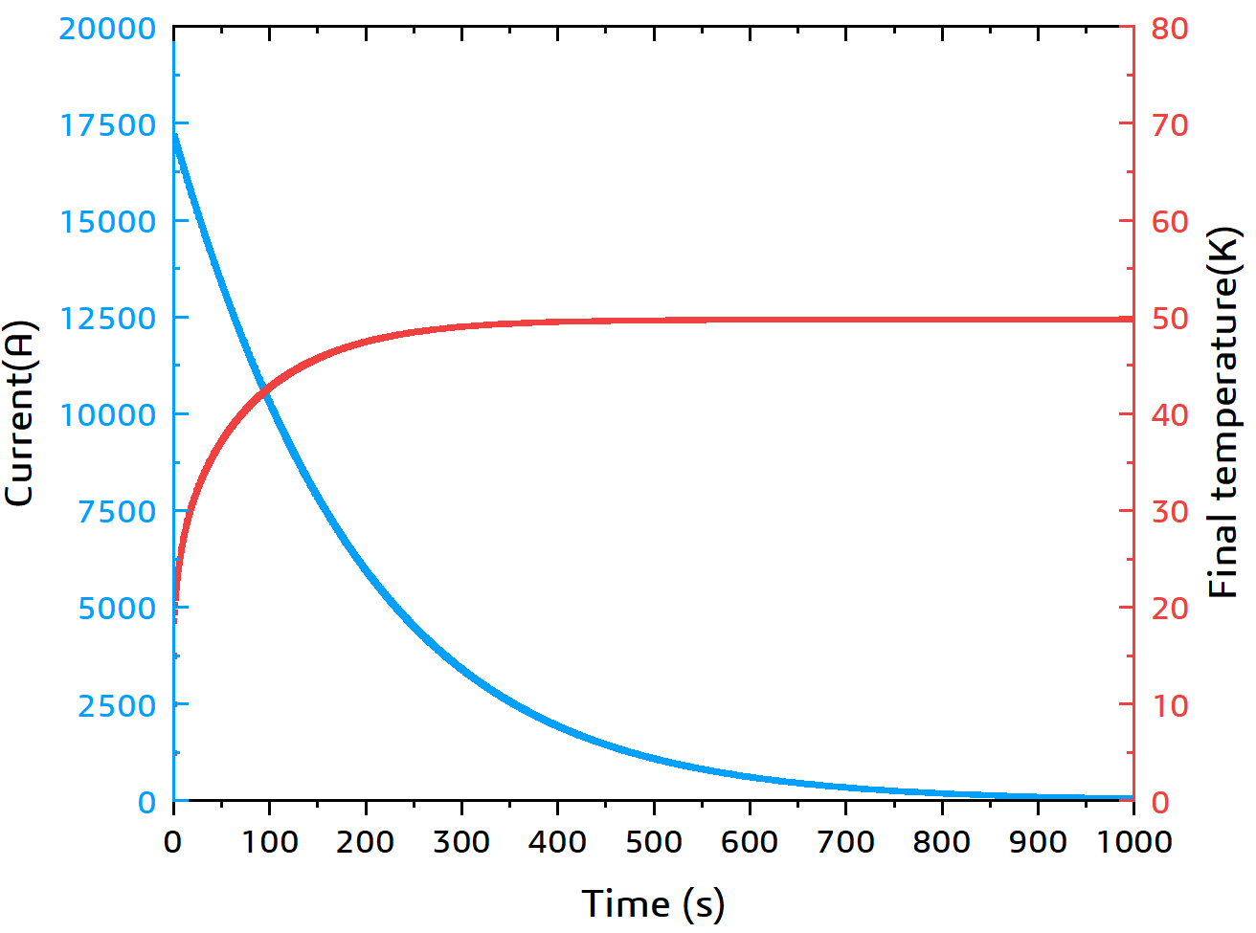
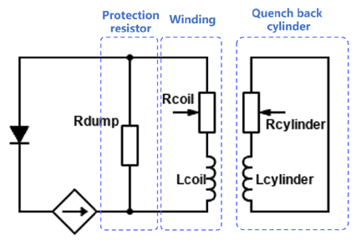
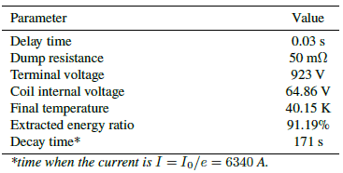
Physical design of the solenoid magnet
Quench protection
Fast dump discharge
The coil protection system is based on a 50 mΩ dump resistor. The maximum voltage and temperature rise of the coil after quench have been controlled within a safe range.
50mΩ
No breakers opening delay
9

Slide 10
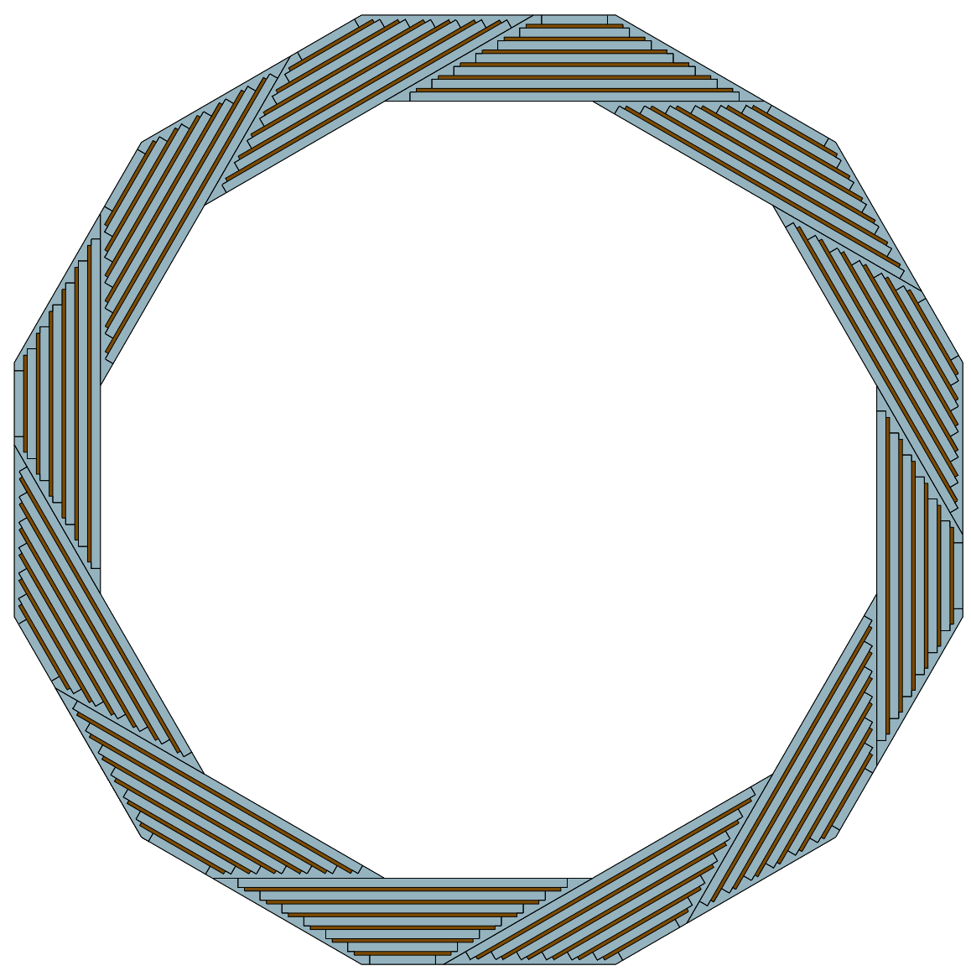
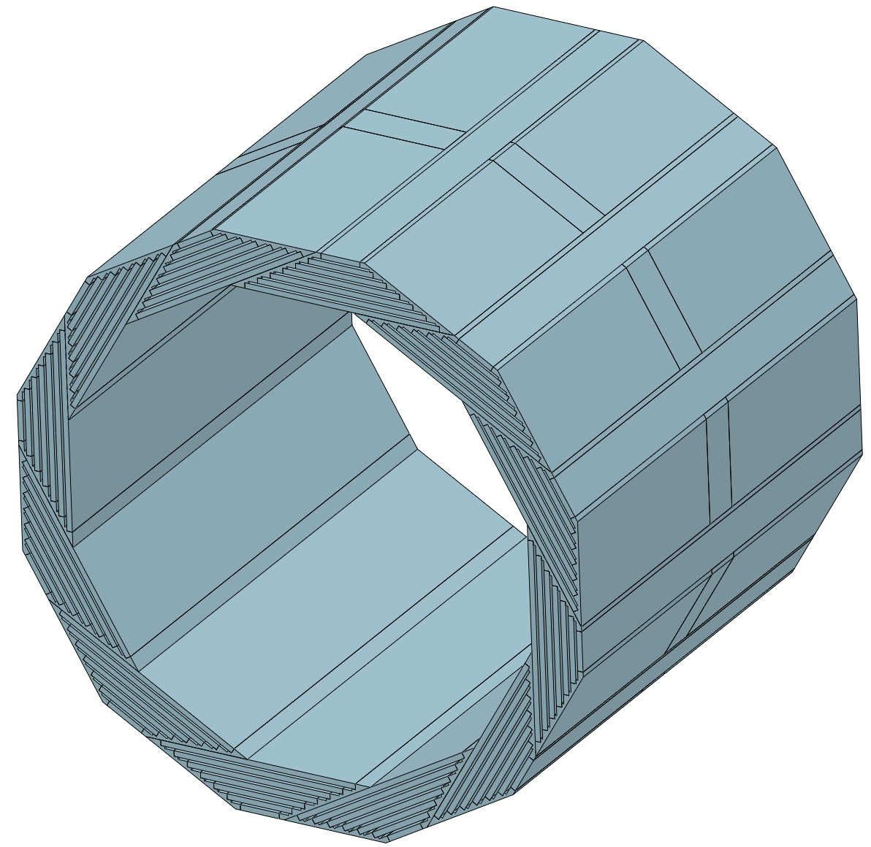
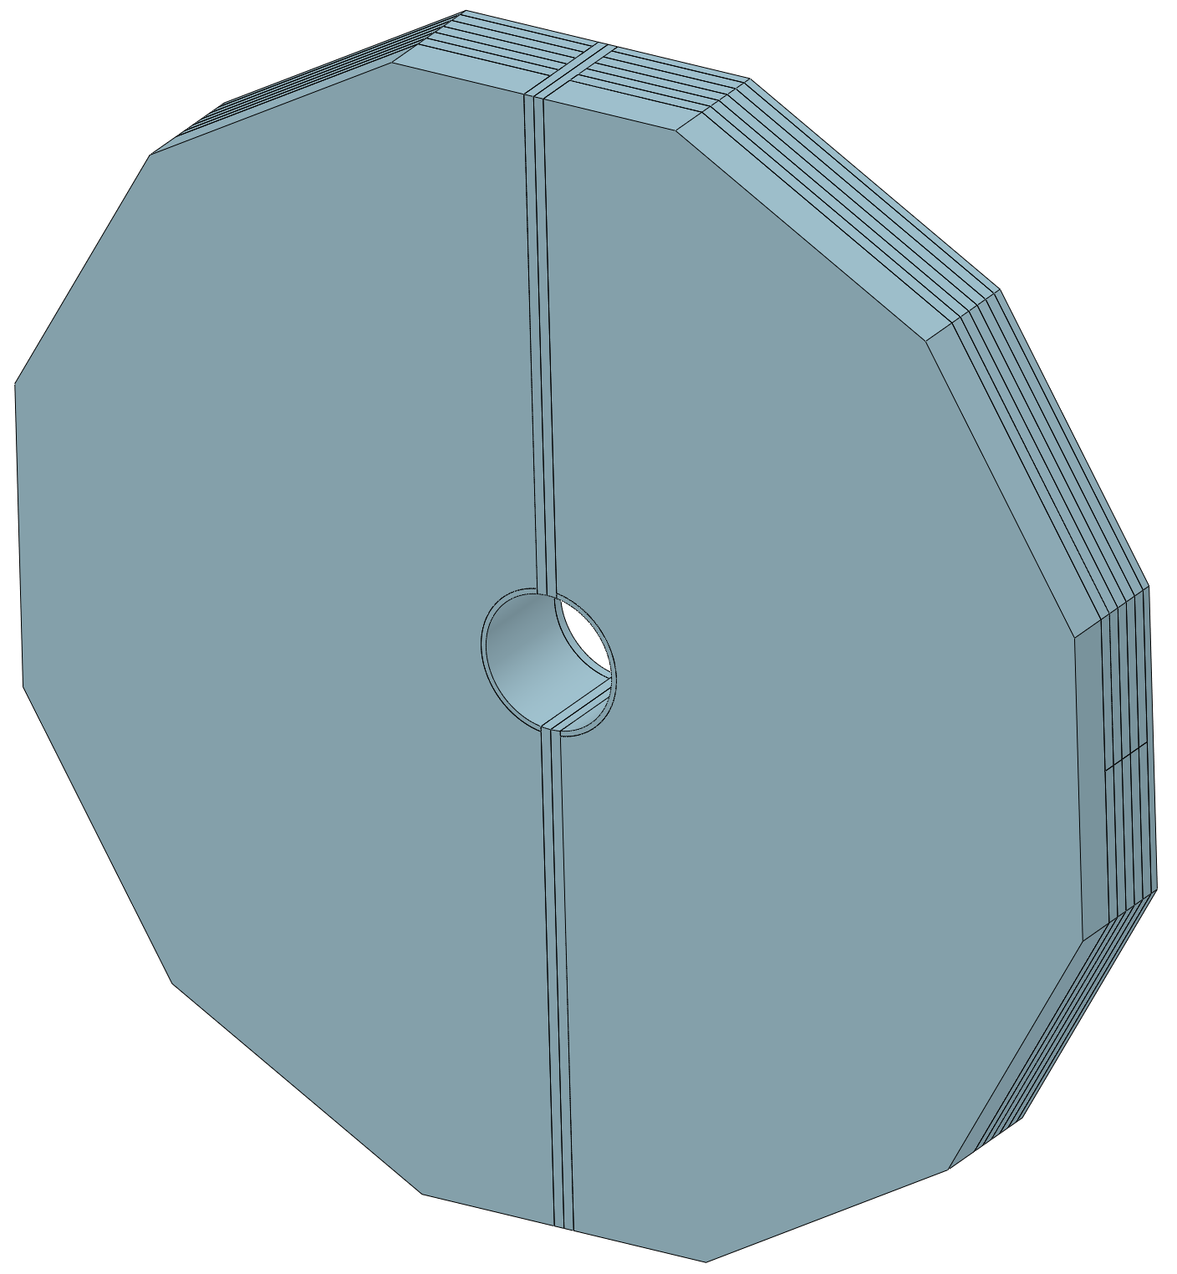
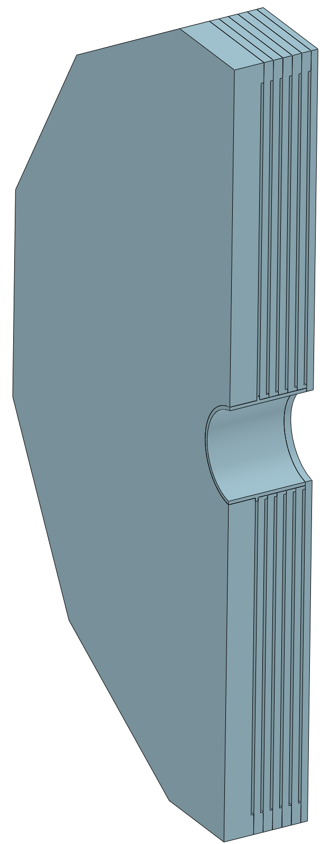
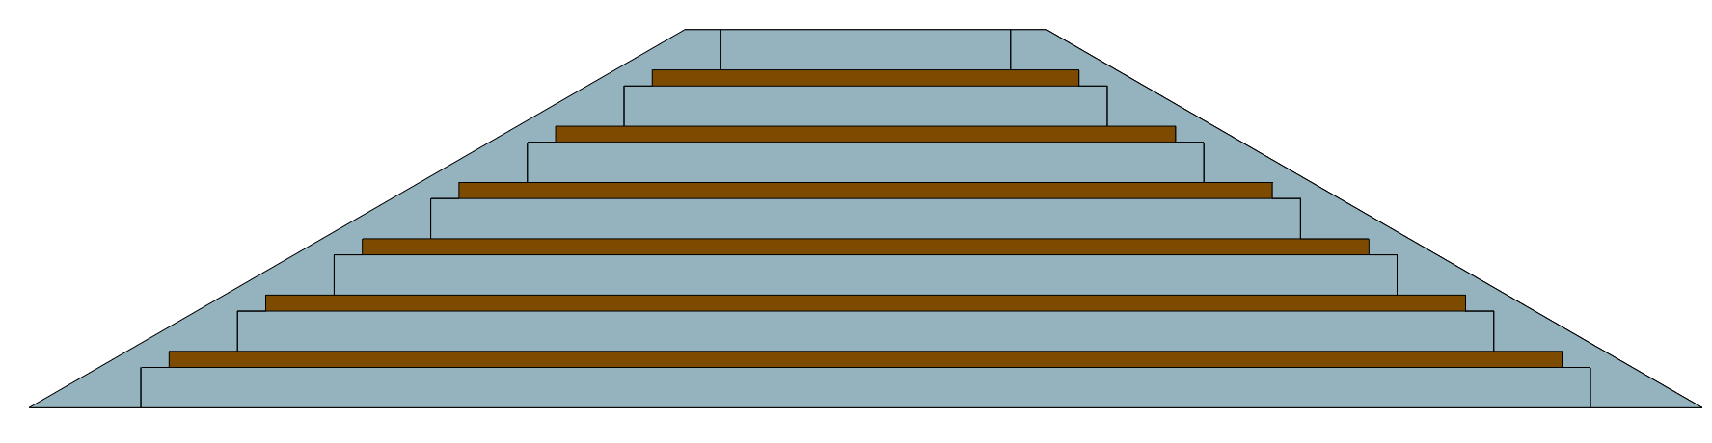
Physical design of the solenoid magnet
Yoke
Yoke parameters：
In order to reduce the detection dead zone of the muon detector, the barrel yoke is designed as a spiral structure.
Barrel yoke (ton) | 1560
Each End yoke (ton) | 700
Total Yoke (ton) | 2960
Diameter(m) & length (m) | 10.37&11.75
Barrel yoke: 1560 tons
Single module of the barrel yoke
130 tons
End yoke
700 tons
10

Slide 11
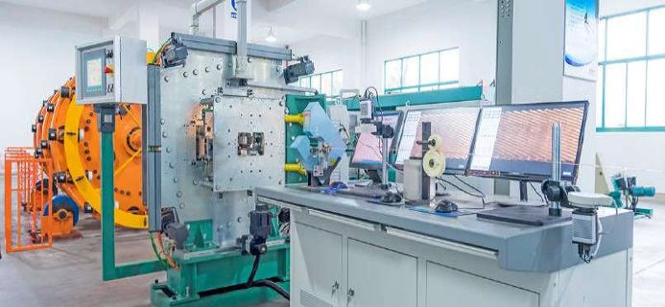
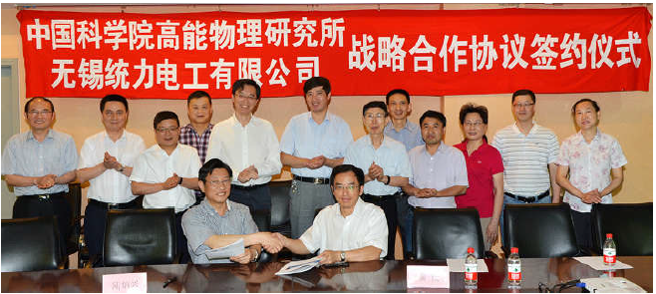
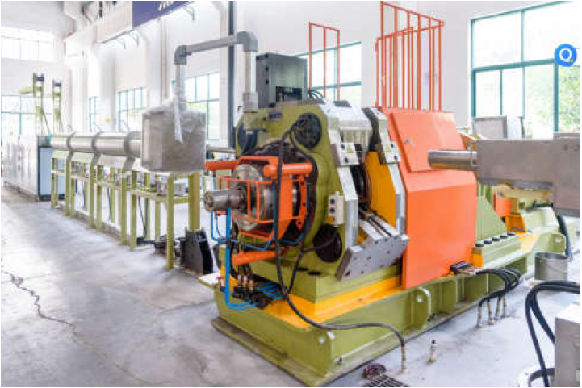
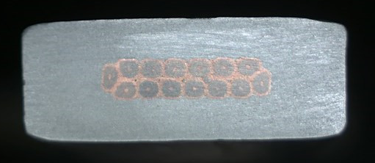
Conductor and dummy coil development
Conductors
  Conductor is the foundation of the magnet development. Most of the detector magnets used or will use the Aluminum-stabilized Nb-Ti/Cu conductors.
NbTi Rutherford cable
Rutherford Cable
High strength and High RRR Al stabilizer
Aluminum stabilized NbTi/Cu conductor
The IHEP and Toly company have jointly established an aluminum coated conductor production line in 2015.
Extrusion machine
11

Slide 12
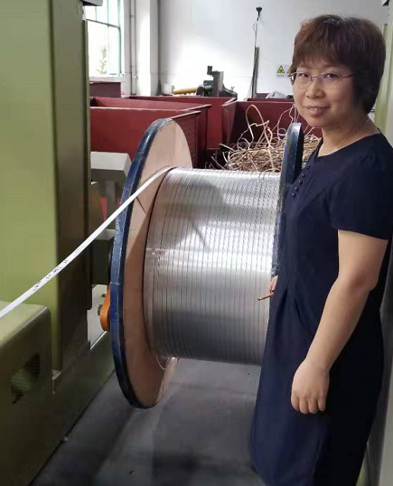
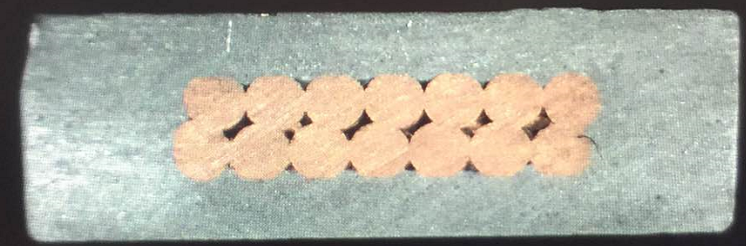
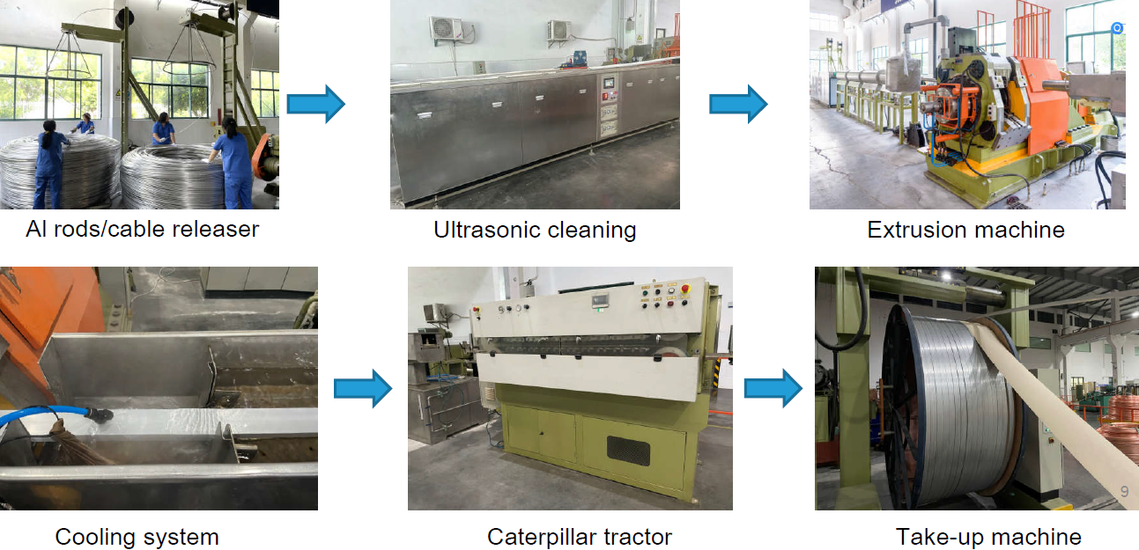
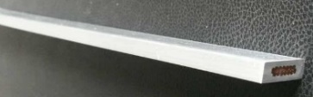
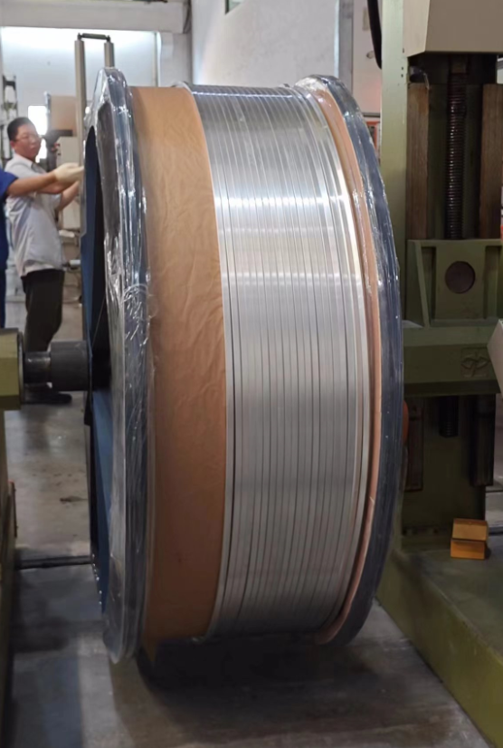
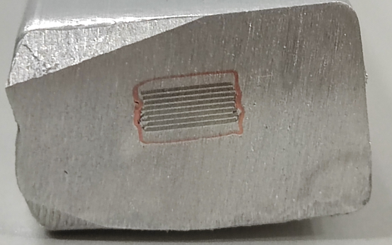
Conductor and dummy coil development
LTS: Aluminum stabilized NbTi Rutherford cable
Al-stabilized Conductors
1.5 km
HTS: Aluminum stabilized Stacked REBCO Tape Cable
Aluminum coated conductor production line
100 m
12

Slide 13
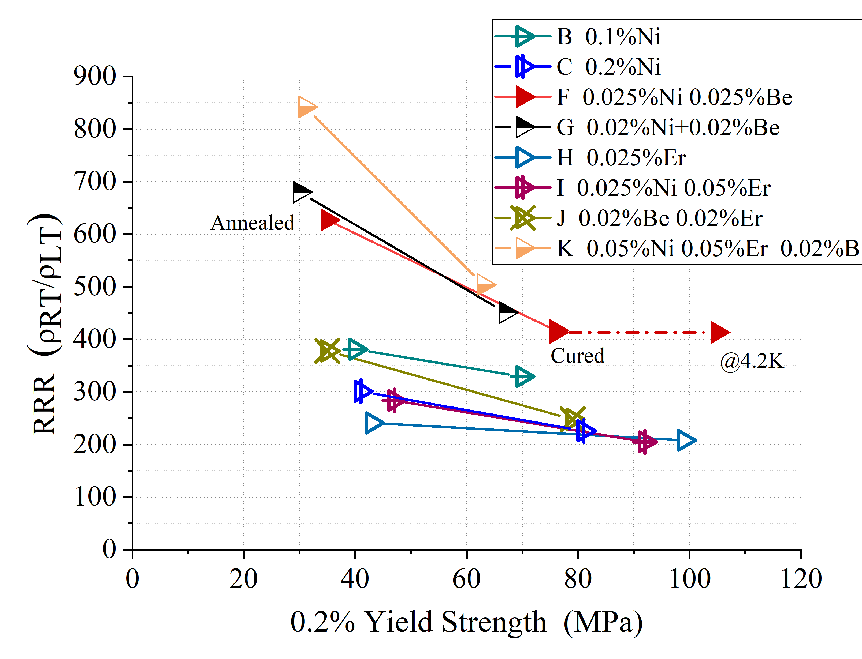
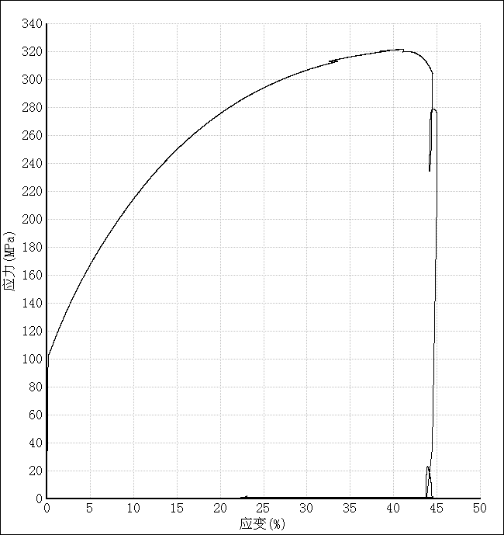
Conductor and dummy coil development
R&D of High Strength and High RRR Aluminum- Stabilizer for Superconducting Cable
Yield strength > 100 MPa@4.2K, 74 MPa at room temperature, RRR value > 400
By doping Ni-0.025% Be-0.025.
The Al-0.025%Ni-0.025%Be alloy prepared from 4N8-aluminum achieved high 0.2% yield strength of 75MPa (R.T.) with RRR of 417.
We are still doing the R&D on high-strength pure aluminum to improve its yield strength and solve the problems encountered in mass production.
Poisson’s ratio | 0.33/0.34
Young modulus | See the curve
Thermal expansivity | 14.23×10⁻⁶ K⁻¹
4.2KRp_{0.25} | 105MPa
13

Slide 14
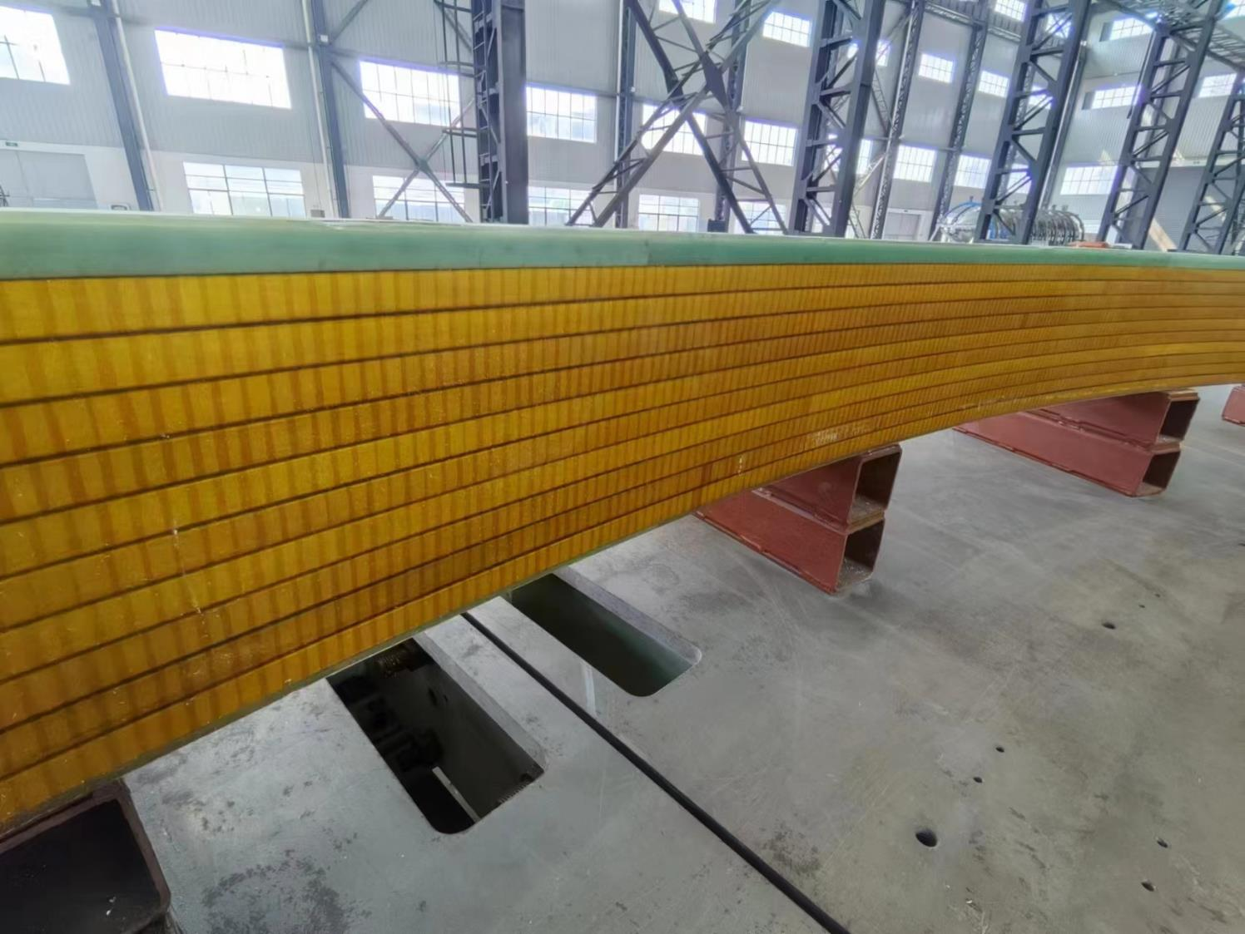
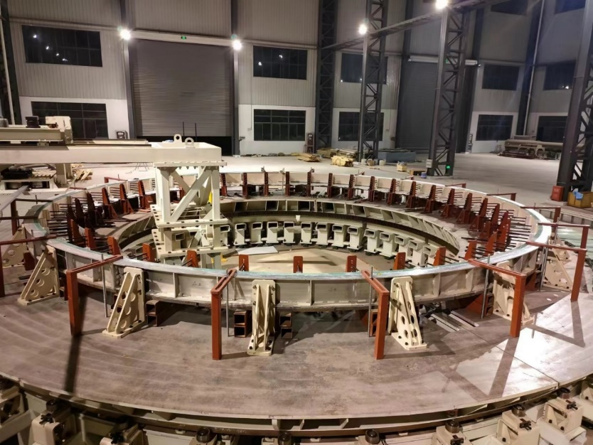
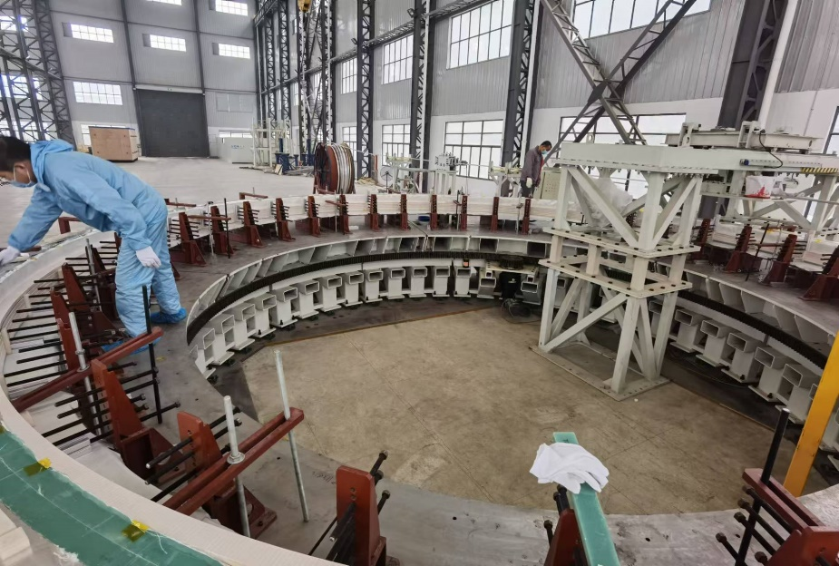
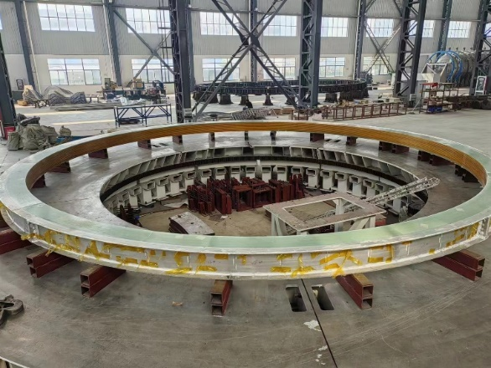
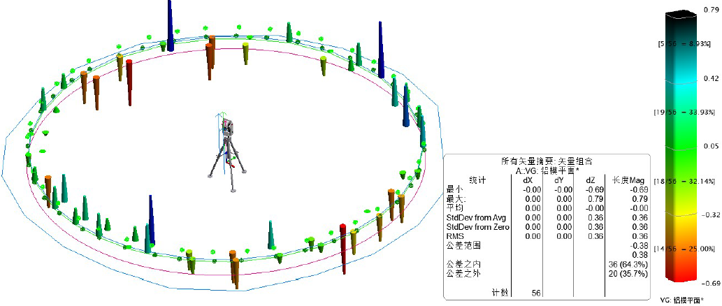
Conductor and dummy coil development
Dummy coil development
Coil winding, vacuum leak detection, epoxy impregnation curing.
4 layers*10 turns
φ7.2m dummy coil
Large scale superconducting coil winding platform
Coil winding
The manufacturing accuracy is controlled within ± 1mm
Dummy coil
14

Slide 15
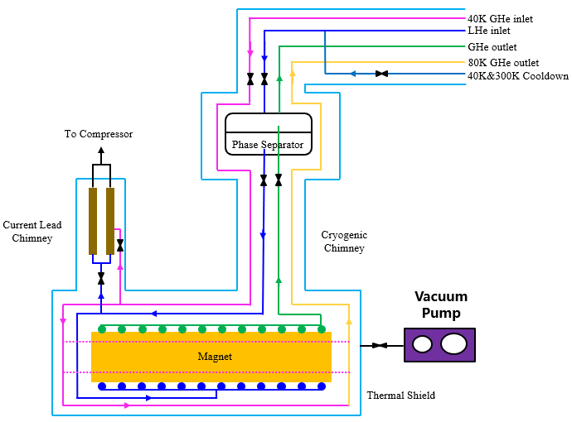
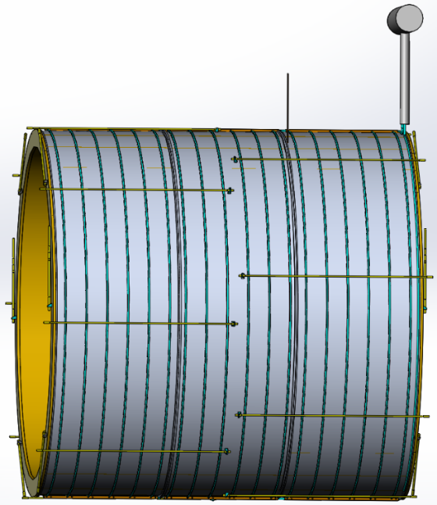
Cryogenic system
Uniform temperature distribution;
High heat transfer efficiency, not limited by source pressure and pressure drop;
Low cost. No need for liquid helium circulation pump
Cooling methods: Thermal siphon
 | Thermosyphon | Force flow
Difference | Need more space to install the phase separator | A liquid helium circulating pump is required
heat exchange capability | 1200 W/(K·m²) | 412.1 W/(K·m²)
Coil maximum temperature | 4.982 K | 5.383 K
Coil average temperature | 4.591 K | 4.972 K
Inner diameter of Liquid helium pipes | Φ15 mm | Φ 20 mm
Cooling process diagram
Cooling structure
The verification experiment are being design.
15

Slide 16
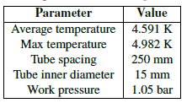
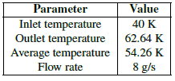
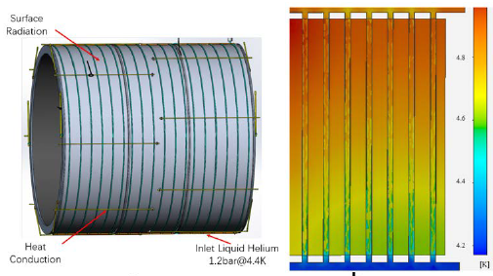
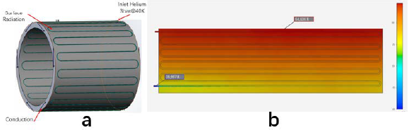
Cryogenic system
Coil temperature distribution:
Thermal shield temperature distribution:
Boundary Conditions and Temperature Contour of the coil
Boundary Conditions and Temperature Contour of the thermal shield

Slide 17


Cryogenic system
Cryogenic System Flowchart

Slide 18



Mechanical design
2D
Completed the design of the 2D chain and the space occupied by each component.
3D
Completed the design of the 3D structure, added suspension system, cooling pipes, and connection structure.
suspension rod
coil
Thermal shield

Slide 19




Mechanical design
Suspension system
Coil suspension system (185 tons):
8 axial rods each end
6 radial rods each end
Material: titanium alloy
 | Diameter | Length | amount
Axial rods | 30 mm | 3530 mm | 16
Radial rods | 40 mm | 1700 mm | 8
Main pull rods | 48 mm | 1650 mm | 4
Forces and torques resulting from axial and radial offset, and from angular tilt of the coil.
Thermal shield suspension system:
6 radial rods each end
Material: titanium alloy
Axial displacement (cm) | 1 | 3 | 10
Axial force (kN) | 484 | 1498 | 5034
Radial displacement (cm) | 1 | 3 | 10
Radial force (kN) | 34.3 | 236 | 656
Angular tilt (angle) | 1/407.5 =0.14° | 3/407.5 =0.42° | 10/407.5 =1.41°
Torque (kN.m) | 1965 | 6170 | 19935

Slide 20
R&D in the future
High strength and high RRR value aluminum stabilizer research.
Full size Aluminum stabilized superconducting cable development.
Detailed design of mechanical system. Optimize the thickness design of magnet.

Slide 21


Cost estimation
Cost of the detector magnet

Slide 22

Research Team
IHEP: staff 13; engineer 5; post doctor 1; students 3
Cooperative institutes and Universities: SJTU, SWJTU, NCEPU, TSINGHUA, IEE, IPC, IPP and so on.
Cooperative companies: Wuxi Toly (aluminum stabilized conductors), Hefei Keye ( coil winding platform and dummy coil development), Xinjiang Zhonghe ( Aluminum stabilizer), WST ( LTS wires), SSCT ( HTS tapes), and so on.
Welcome international cooperation.

Slide 23



Research Team
Experience: BES III detector magnet
Design, processing, manufacturing, and assembly experience of BES III detector magnet;
Safe, stable, and accident free operation for nearly 20 years.

Slide 24





Research Team
Experiences: 12T Dipole Magnet
12T Dipole Magnet
Development of the LPF1 NbTi+Nb₃Sn dual-aperture model dipole magnet from 2017.
Dipole field reached 12 T in 2*Φ14 mm apertures in May 2021 and 12.47 T in July after a thermal cycle.

Slide 25



Research Team
Experience: Aluminum stabilized superconducting conductors
LTS: NbTi cable
Aluminum stabilized NbTi Rutherford cable
HTS: ReBCO cable
Aluminum stabilized Stacked REBCO Tape Cable
Dimensions: 15*4.7mm²
Number of strands ：14
Materiel : Al(99.99% purity)
Complete time:2017.8
Shear strength (COPPER &Al) > 35MPa
Length: 1.5 km
Dimensions: 15*10 mm²
Number of tapes ：14
Materiel: Al 1100
Complete time: 2023.12
Length: 100 m
1.5 km
100 m
This is the only aluminum coated superconducting cable production line in the world at present.

Slide 26
Summary
1. We carried out the physical design, mechanical design, and cryogenic system design of the magnet.
2. We have completed the writing of Ref-TDR and will continue to optimize the plan, develop cables, and validate the project in the future.
3. The research team has a lot of experience in developing superconducting magnets, and is confident in the implementation of the project.

Slide 27
Thank you for your attention!
April 14, 2025, CEPC Detector Review

