Slide 1
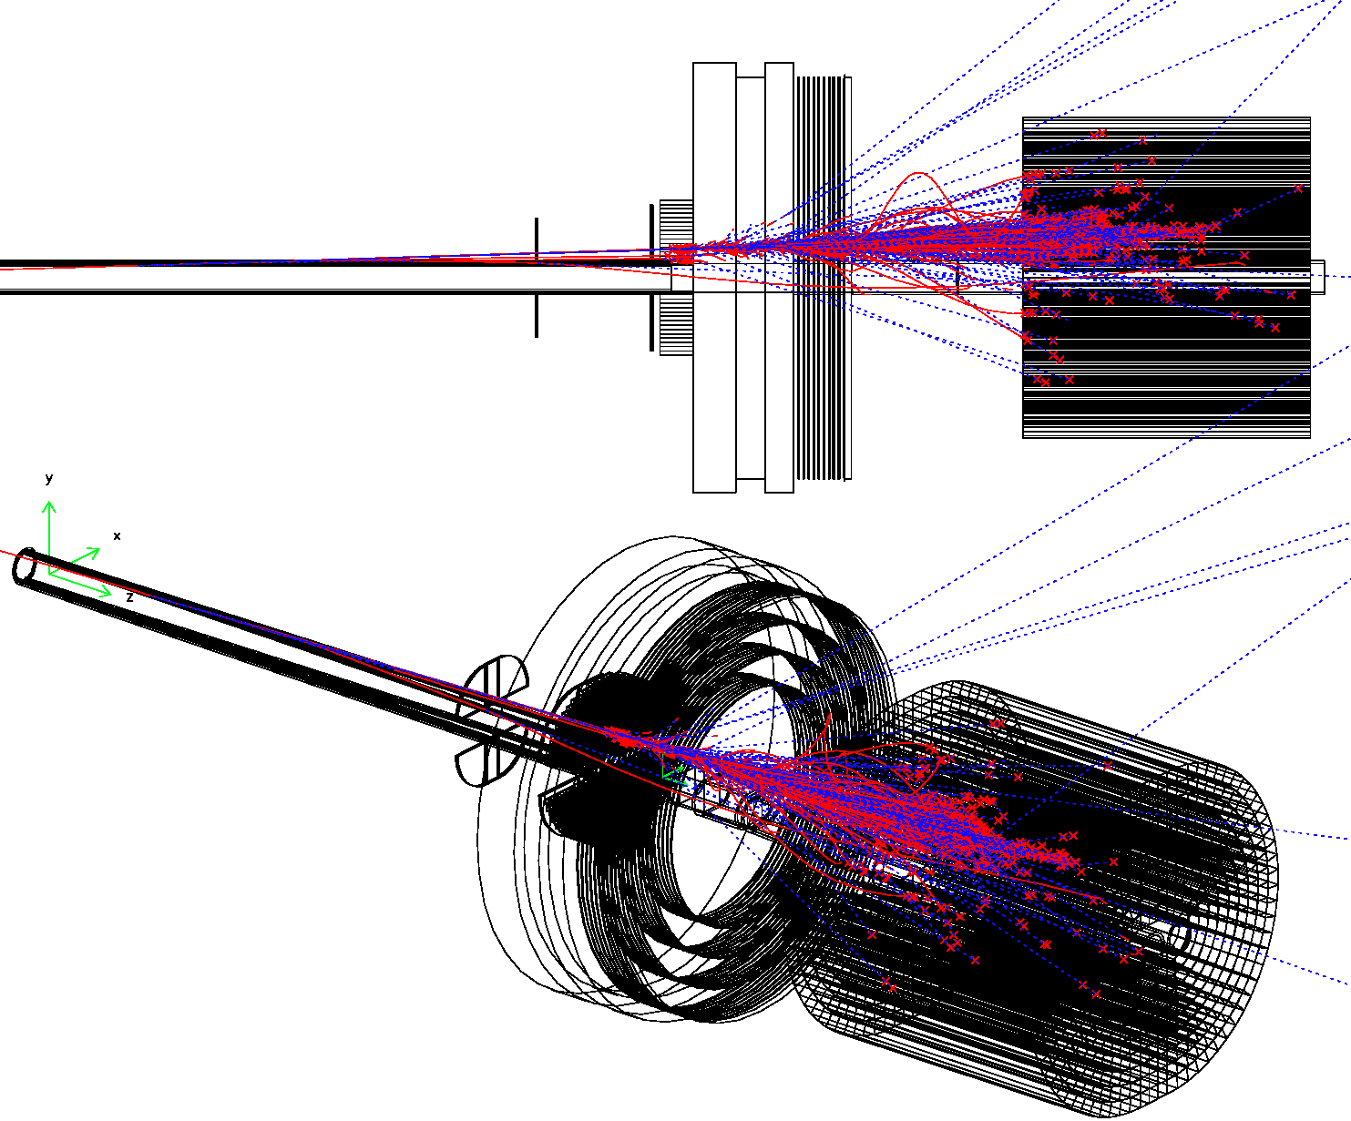
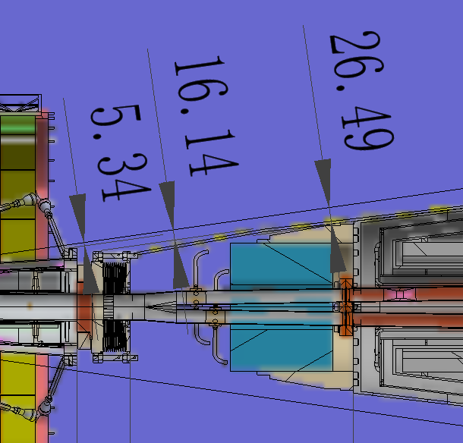
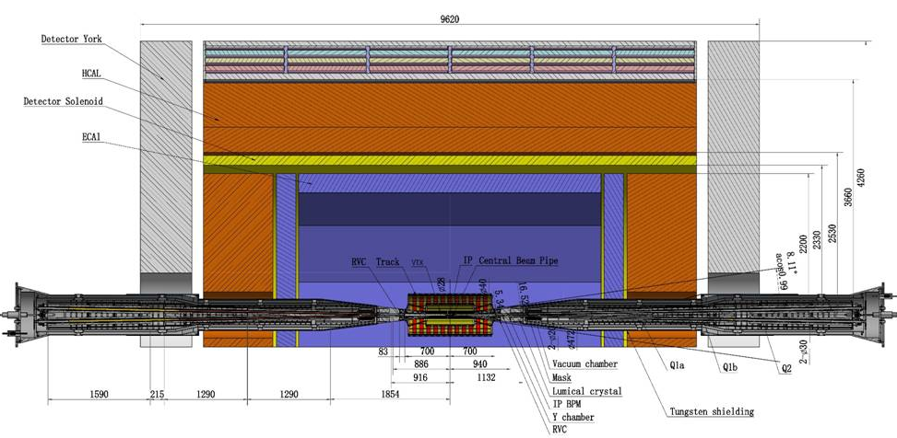
LumiCal, electron tagging for
two-photon heavy flavor production
2023.08.18 10:50
Suen Hou 侯書雲
Academia Sinica
suen@sinica.edu.tw
IP chamber flange
RVC
BPM & cable
Lumical& support
Cryostat
https://indico.ihep.ac.cn/event/19839/

Slide 2
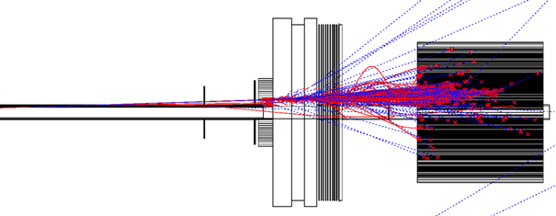
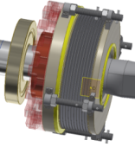
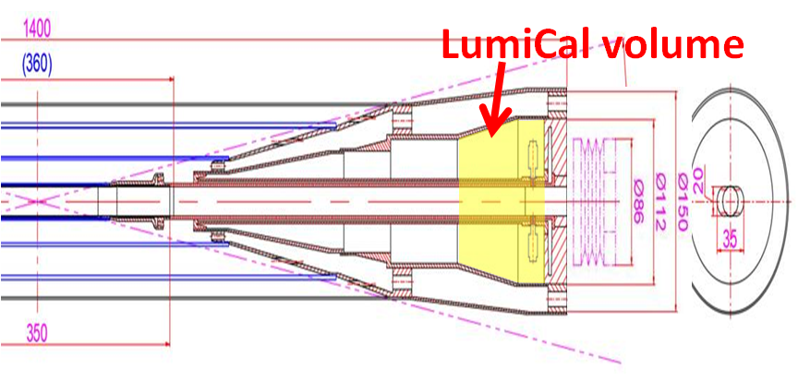
LumiCal: Luminosity 10⁻⁴ precision
2x10³⁶ luminosity at Z-pole, goal is for 10⁻⁴ systematics
ø 20 mm racetrack beampipe beam crossing at 33 mRad
ø 20 mm racetrack beampipe
Bhabha fiducial acceptance
large X-section with lower θ_{min}
Electro IP tracking
minimal beam-pipe thickness
1.5 mm Be window
error on-mean on fiducial edge
for Bhabha event counting
< δθ_{min} > → 10⁻⁴
Beampipe, IP to flange z= ± 700 mm
2

Slide 3
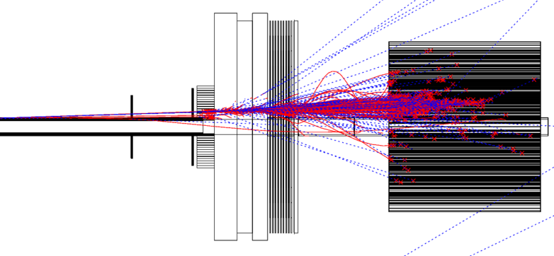
MDI configurations: LumiCal
CEPC Accelerator parameters to LumiCal Bhabha detection
beam-crossing: 33 mRad
IP beam bunch @ Z-pole: σ_{x} σ_{y} σ_{z} = 6 μm, 35 nm, 9 mm
Bunch crossing: 23 ns
Luminosity: cm⁻²s⁻¹: 2 x 10³⁶
Beam-pipe materials & Space
Before Flange: z = 560~700 mm
r=10mm, thickness = 1mm
@20 mRad traversing = 50 mm,
= 0.14 X₀ (Be), 0.56 X₀ (Al)
Two Si-wafers for e± impact θ
2X₀ LYSO = 23 mm
Behind bellow: 900~1100 mm
Flange+Bellow : ~60 mm, 6 X₀
17 X₀ LYSO 200 mm
for e± shower
Flange Bellow
Z= 560 640 670 900 mm
Si Si
LYSO
LYSO

Slide 4
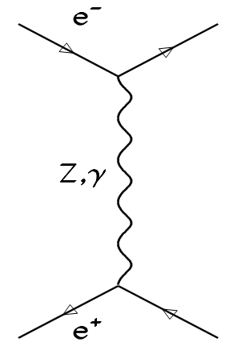
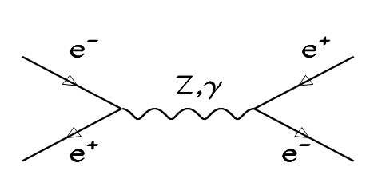
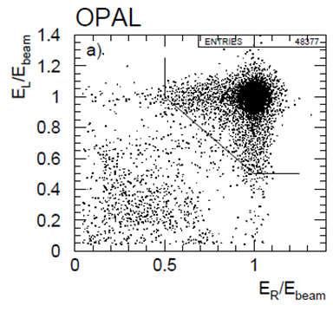
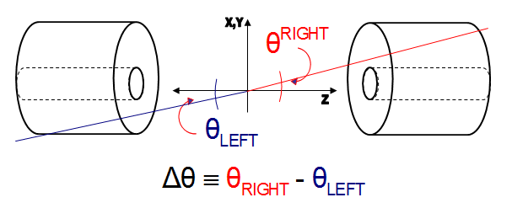
Luminosity by Bhabha elastic scattering
Physics events, e.g. Z-pole,
N = σ ∙ ∫L L: Luminosity of e⁺e⁻ collisions
Luminosity by counting Bhabha events
e⁺e⁻ → e⁺e⁻(γ) QED theo. precision < 0.1%
a pair of electrons, E(e±) = E_{beam}
back-to-back
precision θ of e, e(γ)
within fiducial region
LO Bhabha
NLO eeγ

Slide 5
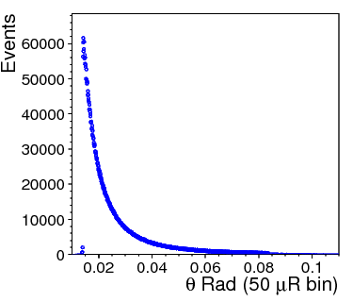
Bhabha luminosity precision
Luminosity= counting Bhabha events
In a fiducial θ region
systematic error :
δL/L ~ 2 δθ/θ_{min}
Require δL/L = 10⁻³
at z = ±1 m, θ_{min} = 20 mRad
→ δθ = 10 μRad or dr = 10 μm
Error due to offset on Z
→ 0.5 mm on Z or dr = δz x θ = 10 μm
Bhabha cross section
θ-angle distribution
detector spatial resolution
count Bhabha
in Fiducial region
Luminosity systematics
due to
events counted in/miss fiducial region
➔ spatial resolution = offset/error on the mean of θ_{min}

Slide 6
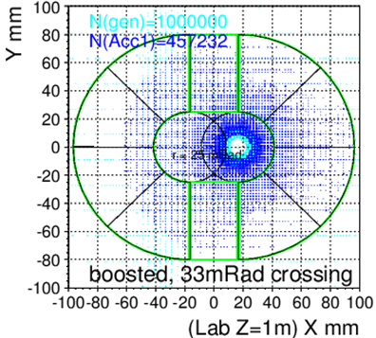
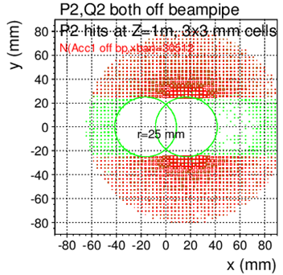
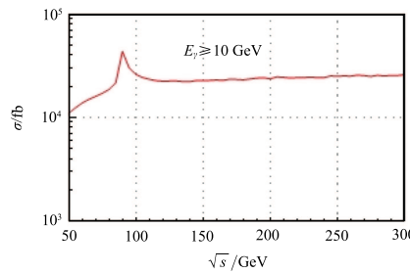
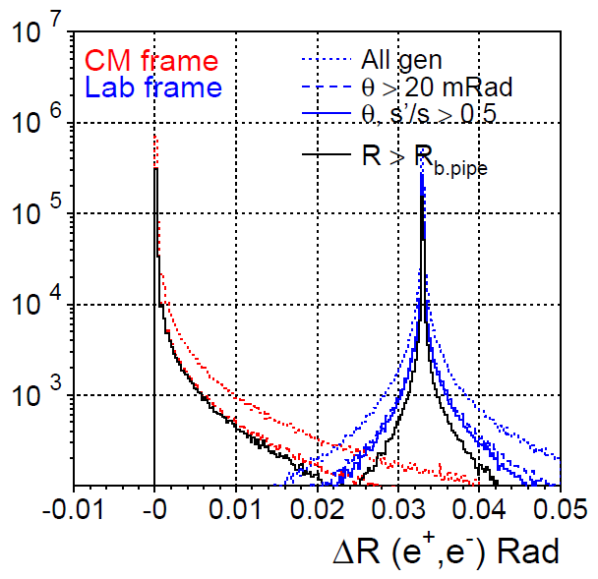
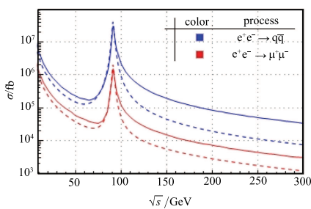
BHLUMI + beam-crossing
BHLUMI QED 0.06% precision (PLB 450, 262)
CMS m_{Z} = 92. 3 GeV, fiducial region: Th1<θ<Th2, s’> 0.5s
CEPC boost : e⁺e⁻ beam crossing, 33 mRad
X-section : count events in fiducial region,
w.r.t. QED calculation
Boost to +x
scattered e+,e-
symm. to outgoing pipe
X-sec. Lab frame
acceptance @ z= 1m
r > 25 mm, |y|> 25 mm
c.f. σ(Z→qq) = 41 nb
Multi. Scatt., rad. Bhabha,
→ wider back-back
Eγ >10 GeV
Bhabha ee →ee
Open-angle –π,
of scattered e+ e-
LAB both e⁺, e⁻ detected
θ>15 mRad | θ>15mR & |y|>15mm
257.8 | 245.9
θ>25 mRad | θ>25mR & |y|>25mm
85.4 nb | 78.0 nb
θ>30 mRad | θ>30mR & |y|>30mm
54.9 | 49.1
Z-pole
Chinese Phys. C 40 033001
6

Slide 7
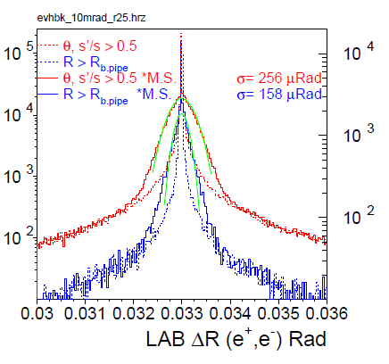
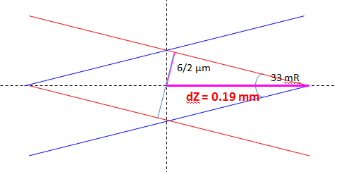
Tracking of IP position
Deviation to electron θ by IP spread
beam bunch σ_{x} = 6 μm σ_{z} = 9 mm
crossing @ 33 mRad
Beam crossing spot: σ_{z} = 0.38 mm
e⁺, e⁻ back-back angle
compare scattered e⁺, e⁻
θ , φ smeared 100 μR
IP collision spot
e⁺
e⁻
Si position detector
LYSO

Slide 8
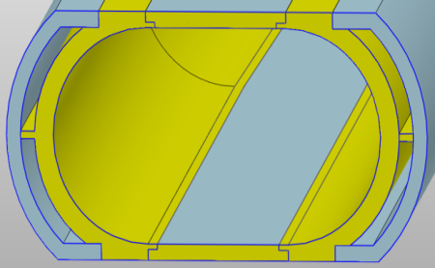
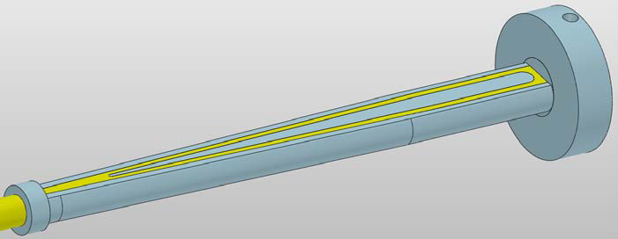
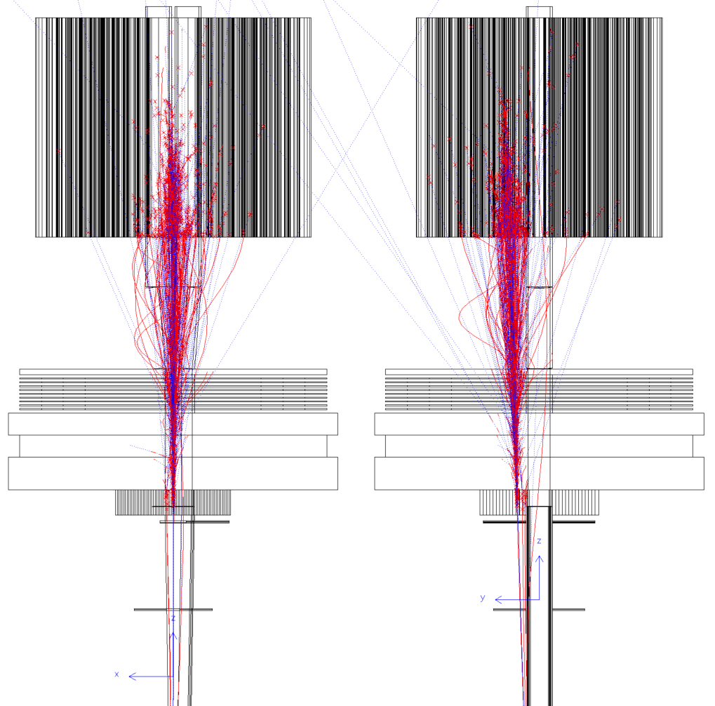
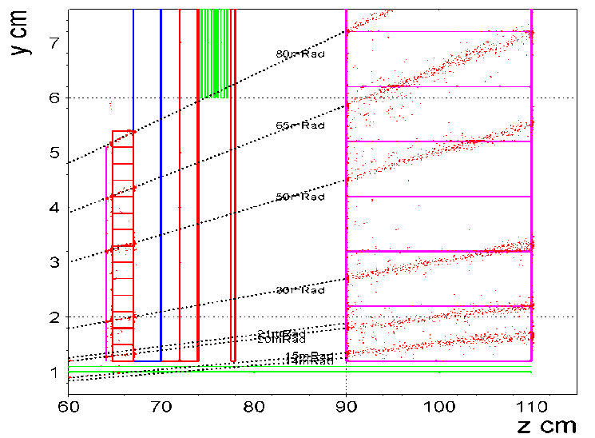
Reduce mult. scatt. & preshower
1 mm Be thin pipe window
33mm = 0.09X₀ traversing @ 30mR
20mm
+20mm
+10 blades
+5mm
Fe 1X₀=17.6mm
Flange
30mm Steal
LYSO
200 mm
= 17.4 X₀
Al Be
Low-mass
window
Flange +
Bellow
= 75mm = 4.3 X₀
Si wafers
Mult. Scatt. traversing 1 mm Be pipe
symmetric, Gaussian
RMS = 60 μRad @ 30 mRad
LYSO 23 mm
= 2 X₀
preshower
e.g. 50 GeV electron
traversing 2mm Al pipe @30mR
= 67mm thick @30mR = 0.75 X₀
8

Slide 9
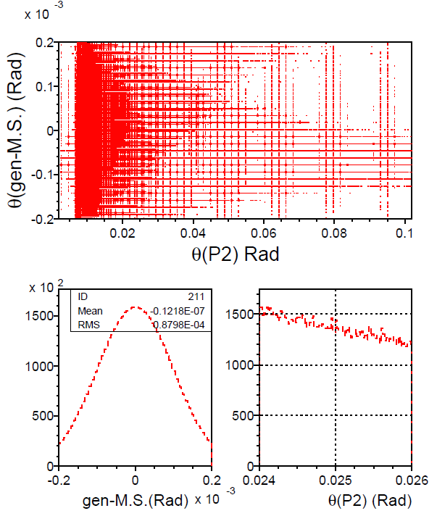
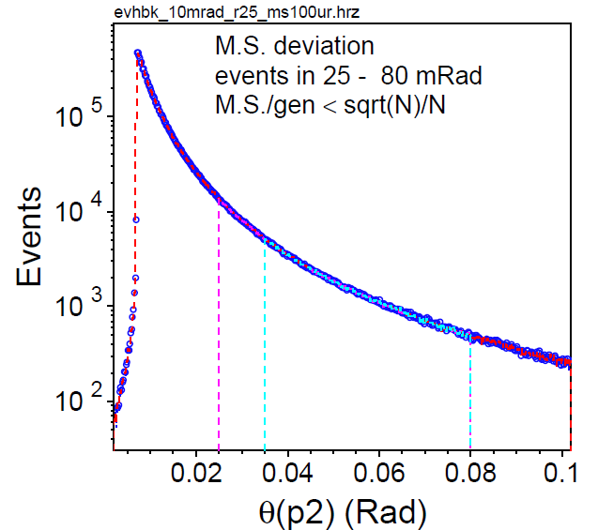
10⁻⁴ systematics, multiple scattering
BHLUMI smear θ’, φ’ of scattered e⁺, e⁻
Multi. Scatt. 100 μRad θ’= θxGauss(100μR), φ’= φxGauss(100μR)
δN/N systematics:
δN = count event deviation due to M.S.
M.S is Gaussian, Symmetric
at θ_{min}= 25 mRad, slope of Bbhabha
in neiboring 100 μRad bins to 25mR
δN(@25mR)/N(25-80 mR) <10⁻⁴
θ_{min}
select events
on θ dist.
Θ =
25 mRad
10⁻⁴ is determined by survey of
the mean position

Slide 10
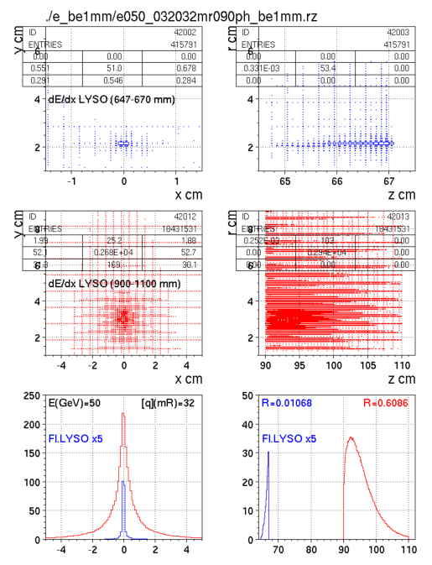
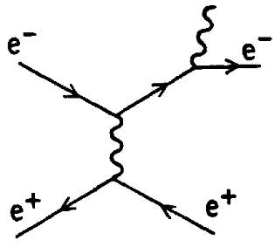
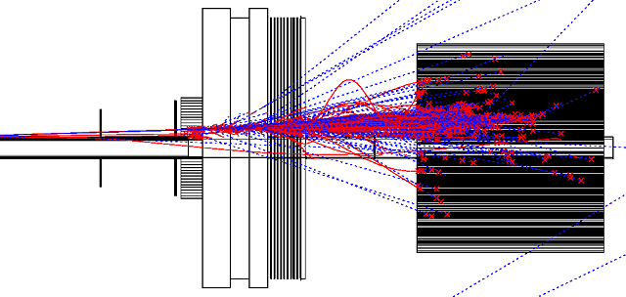
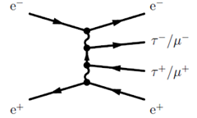
Electron/gamma, Physics application
y
2X₀
LYSO
50 GeV electron @ θ = 32 mRad, φ=90º
1mm Be beam pipe
2X0 LYSO + 4.3X0 Flange,Bellow + 17X0 LYSO
Shower deposition
in front LYSO: 1.0 %
in back LYSO: 61 %
x z
y
17X₀
LYSO
Pre-shower design before flange
two Si wafers: electron tracking
5 μm resolution
2X0 LYSO: e/γ identification
Physics purpose
Radiative Bhabha,
e+γ versus QED
two-photon,
electron tagging for Q²
x z
deposit in Z
dis. in X
2X0
LYSO
17X0
LYSO
10

Slide 11
LumiCal summary
Investigated for luminosity to 10⁻⁴ systematics
LumiCal construction survey to < 1 μm
monitoring on beam, IP, detector z deviations
challenge for δN/N < 10⁻⁴ counting Bhabha in fiducial θ_{min}

Slide 12
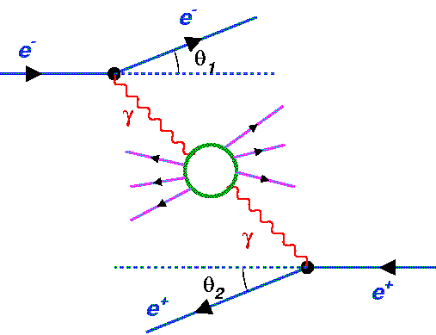
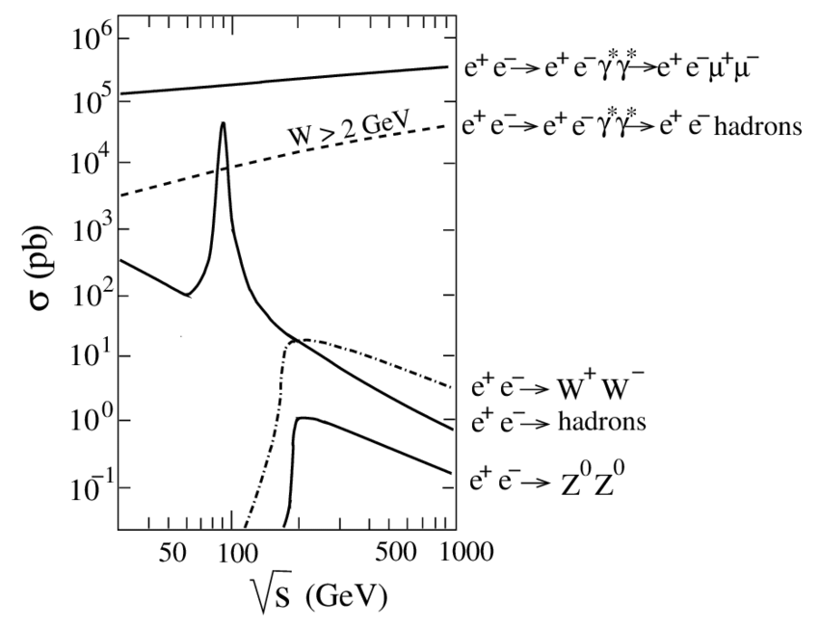
two-photon physics at e⁺e⁻ collider
two-photon topics:
electron-tagging by forward detector
Resonances : π⁰, η, η’, f₂, a₂, η ,η_{c}, χ_{c}
Lepton pairs: γγ → μμ, ττ
Vector boson pairs γγ → ππ, ρρ, KK, pp
Cross section very large
detection
limited by low W_{γγ}
VMD
Vector
Meson
Domin.
model
QCD topics:
Photon structure F₂ (x,Q²)
Jet production γγ → hadrons
V.G. Serbo arXiv:hep-ph/0510335v2

Slide 13
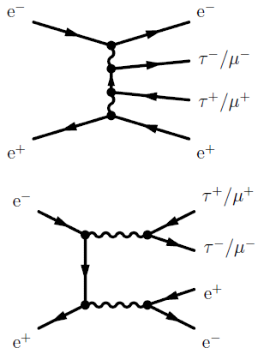
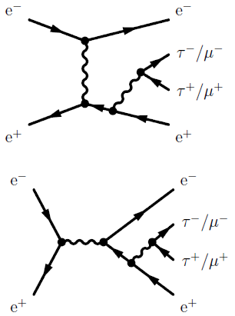
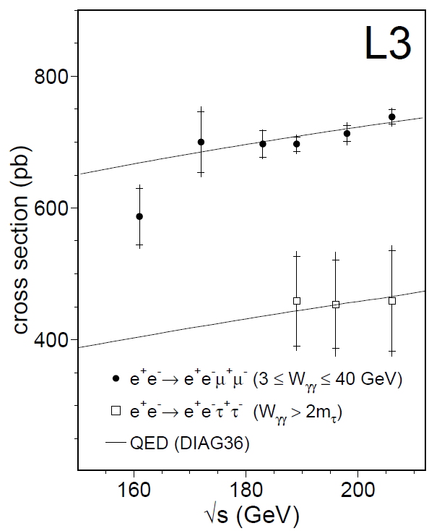
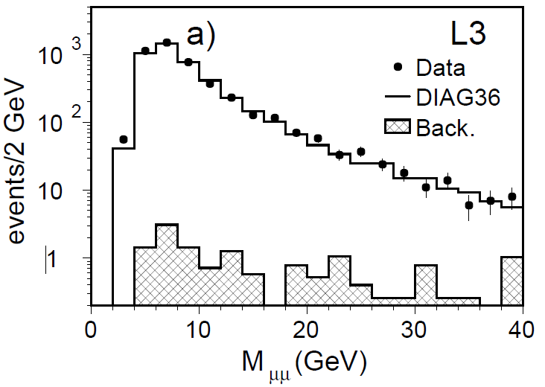
two-photon γγ → ℓ⁺ℓ⁻
Classical γγ channel
QED process, well calculated
e⁺e⁻ → e⁺e⁻ℓ⁺ℓ⁻, DIAG36
L3 measurement (2003)
Un-tagged events
multiperipheral
bremsstrahlung
γγ → μ⁺μ⁻
3 ≤ W_{γγ} ≤ 40 GeV
conversion
annihilation
τ⁻ → e⁻ν_{τ}ν_{e}
τ⁺→ π⁺π⁰ν_{τ}
γγ → τ⁺τ⁻
W_{γγ} > 2m_{τ}
PLB 585, 53 (2004)

Slide 14
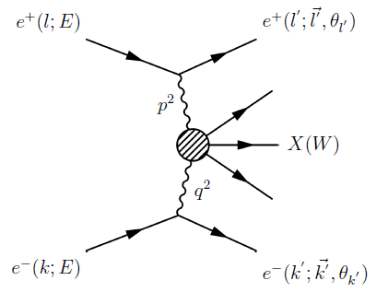
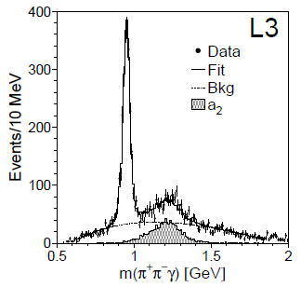
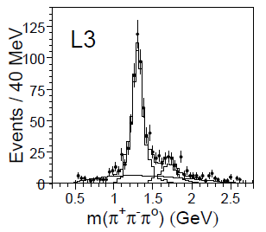
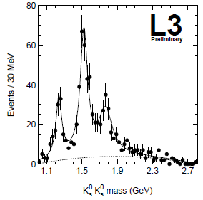
two-photon Resonances
Vector Meson Dominance (VMD)
γγ resonance: C-even, J≠1
spin-parity analysis
η′(958)
a₂(1320)
f₂’(1525)
f_{J} (1710)
a₂(1320)
a₂(1750)

Slide 15
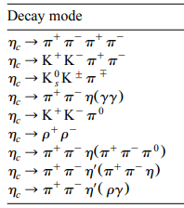
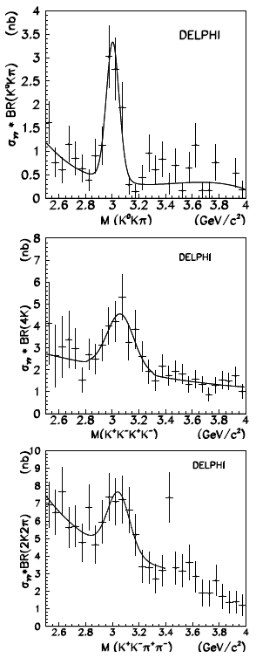
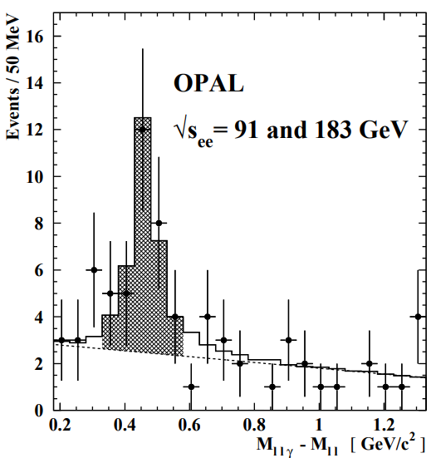
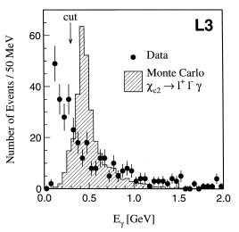
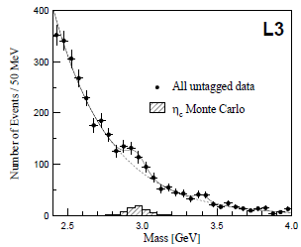
γγ Charm resonances η_{c}, χ_{c2}
χ_{c2} (3555)
η_{c}(2980) L3
η_{c}(2980) DELPHI
PLB 439, 197 (1998)
PLB 453, 73 (1999)
PLB 31 461 155 (1999)
EPJC 31 481 (2003)

Slide 16
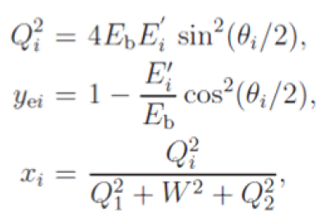
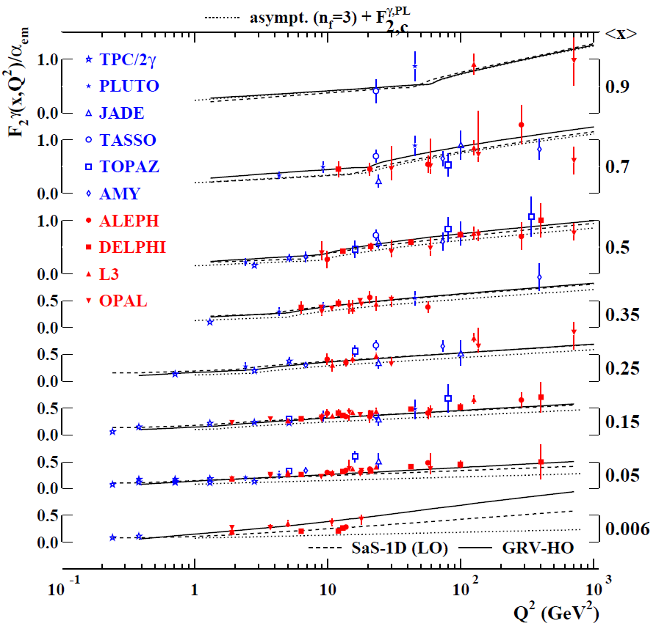
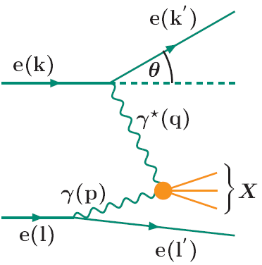
photon structure, single-tag
Deep inelastic eγ scattering
probe
tag
Q² = −q² >0
target
photon
anti-tag

Slide 17
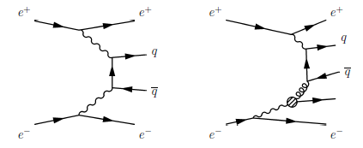
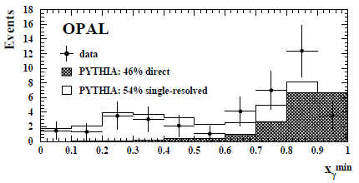
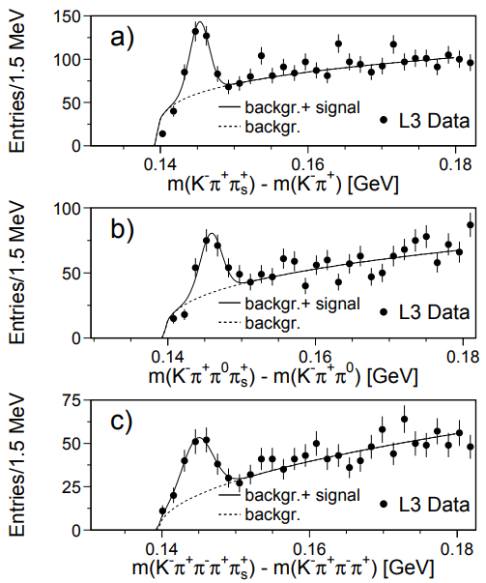
γγ open-Charm D*±
Direct
Single
resolved
x_{γ} ~1
for Direct proc.
x_{γ}
EPJC 16 579 (2000)
L3
PLB 535:59 (2002)
EPJC 28 (2003) 437

Slide 18
γγ open-beauty production
DELPHI, L3
anti-tagged hadronic
b-jet semi-leptonic: e, mu
PYTHIA PYTHIA
+SaS1D
ALEPH
two-photon hadronic
b-tagging by long-lifetime
JHEP 09 (2007) 102
PLB 619 71 (2005)
DELPHI 2003 CONF-A325 , EPJC 33 s482 (2004)

Slide 19
Summary on two-photon
two-photon final states
detected by central tracker, Ecal, with small E_{γγ} < √s
scattered electrons
tagged by LumiCal
Requires two-photon trigger:
multiple low energy tracks + Ecal clusters
➔ CEPC statistics will clarify two-photon c, b production
higher two-photon Q² to photon structure

