Slide 1
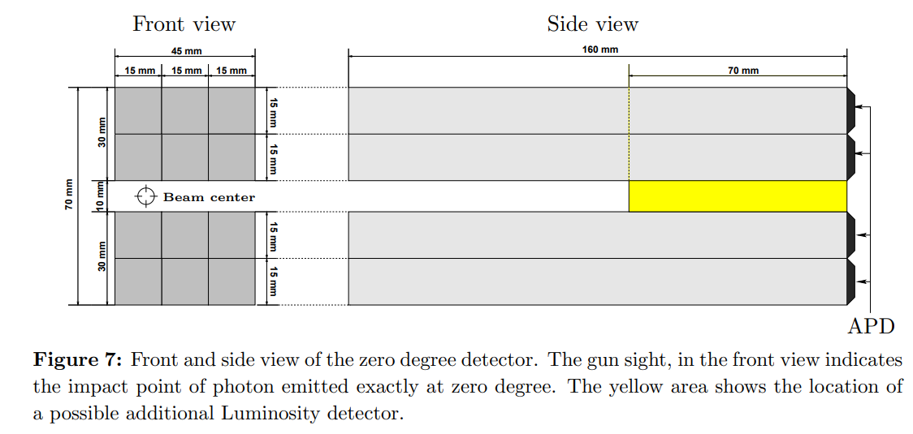
ZDD Event Rate
Wang Yilun (Nanjing University) Ma Renjie (Nanjing University)
Zhang Lei (Nanjing University)

Slide 2
Contents
Introduction
Reproduction of Proposal Results
Radiative Bhabha Event Rate
Conclusion

Slide 3
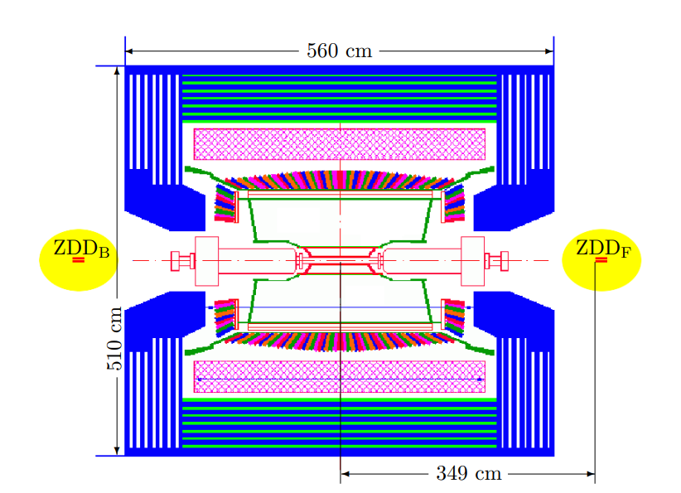
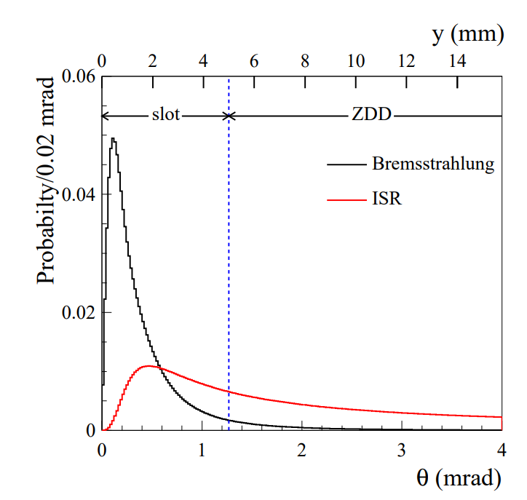
Introduction
ZDD includes two identical stations,
forward and backward direction of BESIII Detector
Designed for detecting ISR (initial state radiation)
with hadronic final states
Acceptance at few mrad around around $θ=0°$ and $θ=180°$
Also used to detect radiative bhabha events (Bremsstrahlung)
to measure bunch luminosity
Notes:
ZDD包含两部分，在Besiii的前后方向各一个，设计用于探测强子末态过程的初态辐射光子，所以其接收范围为theta0度和180度附近的几毫弧度范围。同时，其也能探测到辐射bhabha事例的光子，也就是韧致辐射光子，来测量束团的对撞亮度

Slide 4
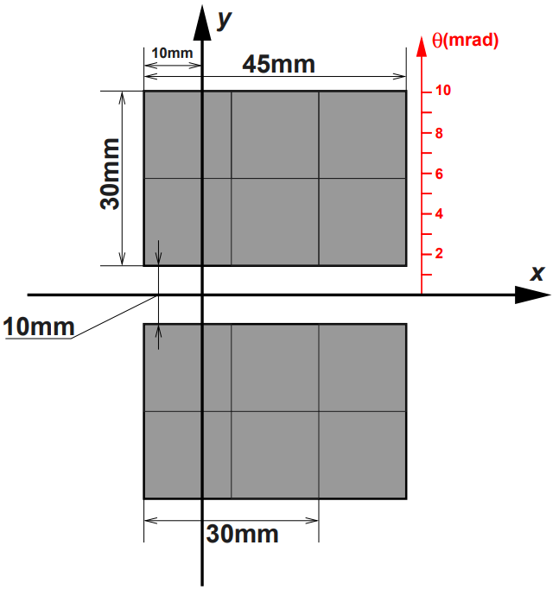
Introduction
Center of photon beam at
$$x=−12.5 mm$$
Lorentz Boost,
$$θ_{boost}=3.58165 mrad$$
Notes:
光子束流中心位于探测器中心偏左12.5mm的位置，因此将质心系下的辐射光子进行洛伦兹变换到此位置。

Slide 5
Introduction - BBBrem
BBBrem : Beam-Beam Bremsstrahlung, by R. Kleiss and H. Burkhardt
Fortran version and C++ version
Monte Carlo simulation of radiative bhabha scattering in the very forward direction
Only the electron radiate the photon
Parameters :
Beam Energy
Relative photon cutoff
nEvents
Seed
Cutoff, generate only sqrt(-t) > cutoff [GeV]
https://github.com/KatsOide/SAD/tree/master/contrib/BBBrem_dir
Notes:
接着介绍使用的产生子BBBrem，其有fortran和C++两个版本，我们使用的是C++版本。其为模拟超前区辐射Bhabha过程的产生子。BBBrem产生的事例仅电子发射光子，参数设置有质心能量，相对光子能量截断，事例数，随机数种子和 t截断

Slide 6
Reproduction of Proposal Results

Slide 7
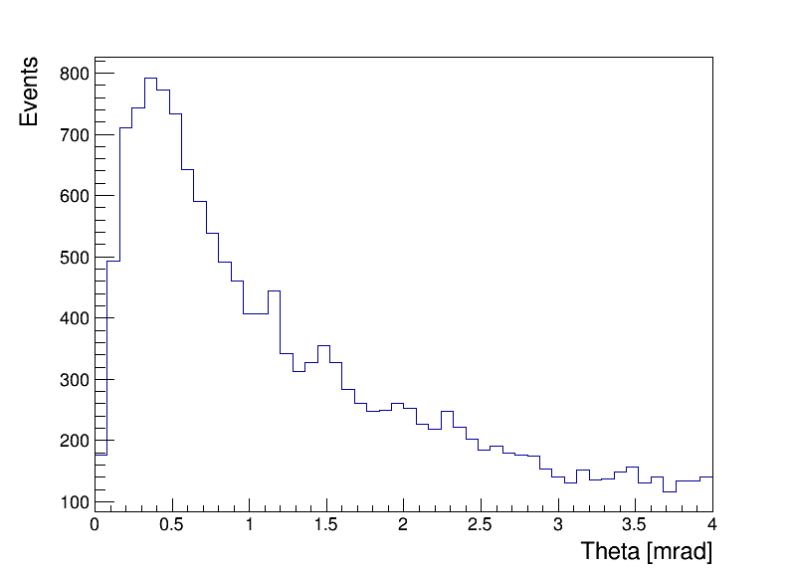
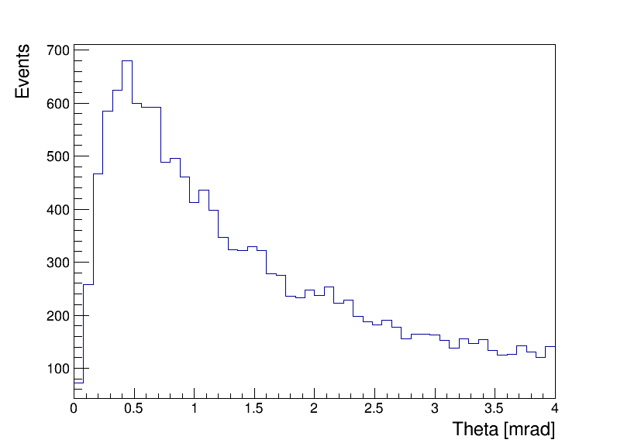
Reproduction of Proposal Results - ISR Photon
Proposal
Phokhara $ee→γ_{ISR}+π^{+}π^{−}$
Phokhara $ee→γ_{ISR}+μμ$
BOSS 7.1.2, Phokhara 9.1
$$E_{CM}=3.78 GeV$$
Notes:
首先是重现proposal里ISR光子的分布，在 BOSS7.1.2 环境下使用 Phokhara9.1 版本，分别绘制了ee到pipi和ee到mumu两个过程的ISR光子分布，接近proposal里的结果

Slide 8
Reproduction of Proposal Results - Bremsstrahlung
BBBrem Generator config
$E_{beam}=1. 89 GeV, E_{CM}=3.78 GeV$
Relative photon cutoff $rk=0.026455026$
$nEvent=100000$
$cutoff=0$
( generate only sqrt(-t) > cutoff [GeV] )
Generated 4 times, totalling $4×{10}^{5}$ events
Results
$E_{γ}^{min}=E_{beam}×rk$
$=1. 89 GeV×0.026455026$
$≈0.05 GeV=50 MeV$
$σ=176.995 mb$
$2σ=353.990 mb$
Some Random numbers give “nan” result
Proposal :
Notes:
接着是对韧致辐射，使用BBBrem产生子，在3.78GeV质心能量下产生了40万个事例，光子能量截断设置为和proposal相同的50MeV，截面为176.995 mb，两侧即为 353.990 mb，接近proposal中的结果，产生子在某些随机数下会给出nan结果，不知道会不会有所影响

Slide 9
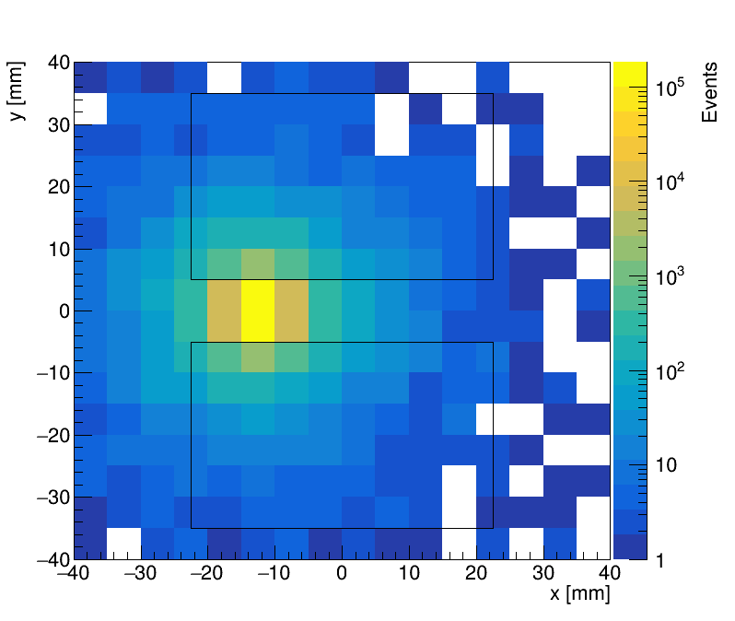
Reproduction of Proposal Results - Bremsstrahlung
BBBrem @ Ecm = 3.78 GeV
ZDD at z = ± 3490 mm
400000 Events ~176.995 mb (353.990 mb)
ZDD receiving：
1 electron 7750 events 1.938 %
2 electron 878 events 0.220 %
1e + γ 1135 events 0.284 %
2e + γ 533 events 0.133 %
γ only 7023 events 1.756 %
Events with γ 8691 events 2.173 % 7.692 mb
Events with γ or e 17319 events 4.330 % 15.328 mb
Photon
Notes:
这里是光子在ZDD上的分布，左图中的框为ZDD范围，在40万个事例中，接收到1个电子的事例为7750，占比%1.938。其他同理，接收到光子的事例为8691，占比%2.173，换算成截面为7.692 mb。接收到光子或电子的事例为17319，占比%4.330，换算成截面为15.328 mb，但是这是不考虑磁场的情况，实际情况下电子的事例很可能少很多

Slide 10
Reproduction of Proposal Results - Bremsstrahlung
If hitting from the bottom is considered
Approximately equivalent to ZDD at z = ± 3650 mm
400000 Events ~176.995 mb (353.990 mb)
ZDD receiving：
1 electron 7959 events 1.990 %
2 electron 910 events 0.228 %
1e + γ 1248 events 0.312 %
2e + γ 553 events 0.138 %
γ only 7637 events 1.909 %
Events with γ 9438 events 2.360 % 8.354 mb
Events with γ or e 18307 events 4.577 % 16.202 mb
Notes:
如果考虑粒子从底面击中，则近似等效将探测器放置在z=3650 mm处，探测到的事例有所增加，但增加并不多。

Slide 11
Reproduction of Proposal Results - Bremsstrahlung
Approximately equivalent to ZDD at z = ± 4000 mm
400000 Events ~176.995 mb (353.990 mb)
ZDD receiving：
1 electron 8391 events 2.098 %
2 electron 988 events 0.247 %
1e + γ 1416 events 0.354 %
2e + γ 567 events 0.142 %
γ only 8918 events 2.230 %
Events with γ 10901 events 2.725 % 9.646 mb
Events with γ or e 20280 events 5.070 % 17.947 mb
Proposal :
To match the cross section in proposal, ZDD needs to be
at least $z=4000 mm$
Notes:
如果要达到proposal上的截面，则探测器需要放置在z=4000mm以上，在z=4000mm处探测到光子的截面为9.646 mb

Slide 12
Radiative Bhabha Event Rate

Slide 13
Radiative Bhabha Event Rate
BBBrem Generator config
$E_{beam}=2.34 GeV, E_{CM}=4.68 GeV$
Relative photon cutoff $rk=0.021367521$
$nEvent=100000$
$cutoff=0$
( generate only sqrt(-t) > cutoff [GeV] )
Generated 10 times, totalling ${10}^{6}$ events
Results
$E_{γ}^{min}=E_{beam}×rk$
$=2.34 GeV×0.021367521$
$≈0.05 GeV=50 MeV$
$σ=194.799 mb$
$2σ=389.598 mb$
Some Random numbers give “nan” result
Notes:
计算质心能量4.68GeV下的事例率，同样使用BBBrem产生子，光子能量截断为50MeV，产生10^6个事例，双侧截面为389.598 mb

Slide 14
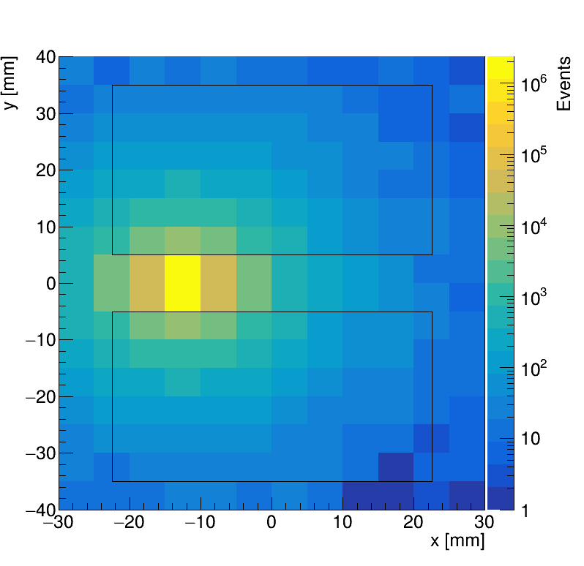
Radiative Bhabha Event Rate
ZDD at z = ± 3490 mm
$5×{10}^{6}$ Events ~194.791 mb (389.582 mb)
ZDD receiving：
1 electron 76808 events 1.536 %
2 electron 7723 events 0.154 %
1e + γ 8861 events 0.177 %
2e + γ 5153 events 0.103 %
γ only 58266 events 1.165 %
Events with γ 72280 events 1.446 % 5.632 mb
Events with γ or e 156811 events 3.136 % 12.218 mb
BBBrem @ Ecm = 4.68 GeV
Photon
Notes:
同样绘制光子的击中分布，接收到光子的事例为14 448，占比%1.445，换算成截面为5.629 mb。

Slide 15
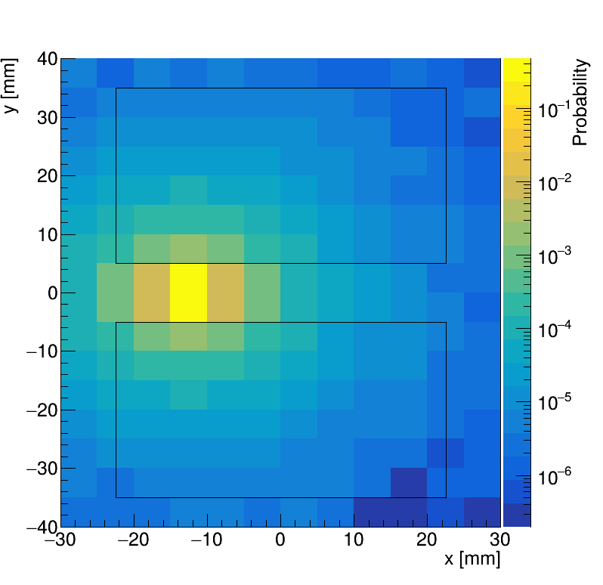
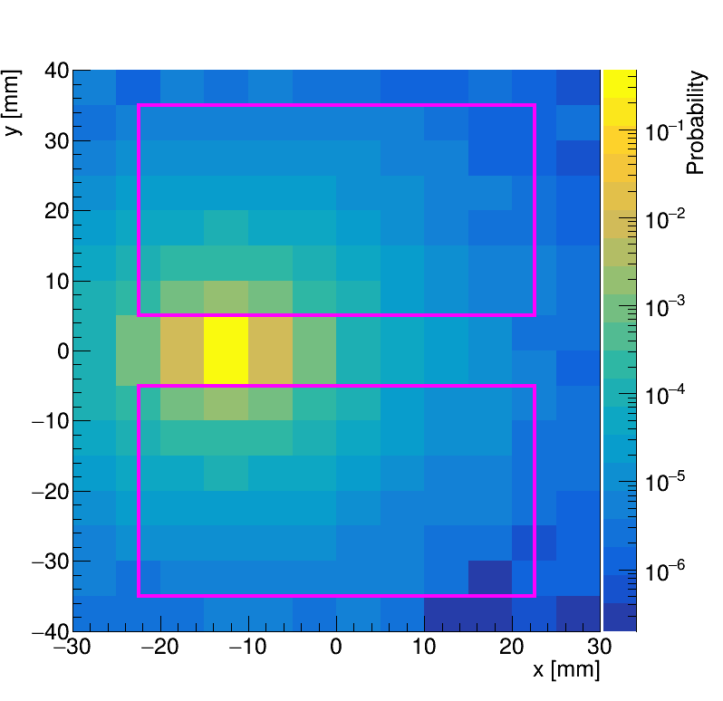
Radiative Bhabha Event Rate
BBBrem @ Ecm = 4.68 GeV
Photon
（归一化）
（改了框的颜色）
Notes:
同样绘制光子的击中分布，接收到光子的事例为14 448，占比%1.445，换算成截面为5.629 mb。

Slide 16
Radiative Bhabha Event Rate
γ only
$$EventRate=L×σ=1.5×{10}^{33} {cm}^{−2}s^{−1}×5.629 mb$$
$$=8.44 MHz$$
$$=2.11 MHz \left(per detector part\right)$$
$8.44MHz×6 ns=0.0507$ events per bunch
$0.0507/4=0.0127$ events per bunch per detector part
Notes:
如果只看光子，则在亮度为1.5*10^33 每平方厘米每秒时，其总事例率为8.44MHz，由于探测器分为前后两侧，每侧上下两部分，所以每部分的事例率为2.11 MHz，根据对撞间隔为6ns，即为0.0127每bunch。

Slide 17
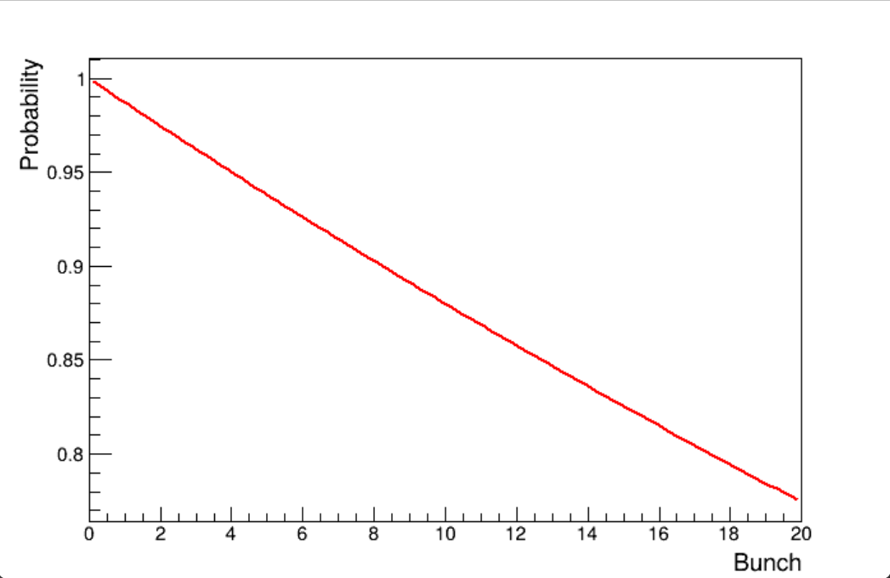
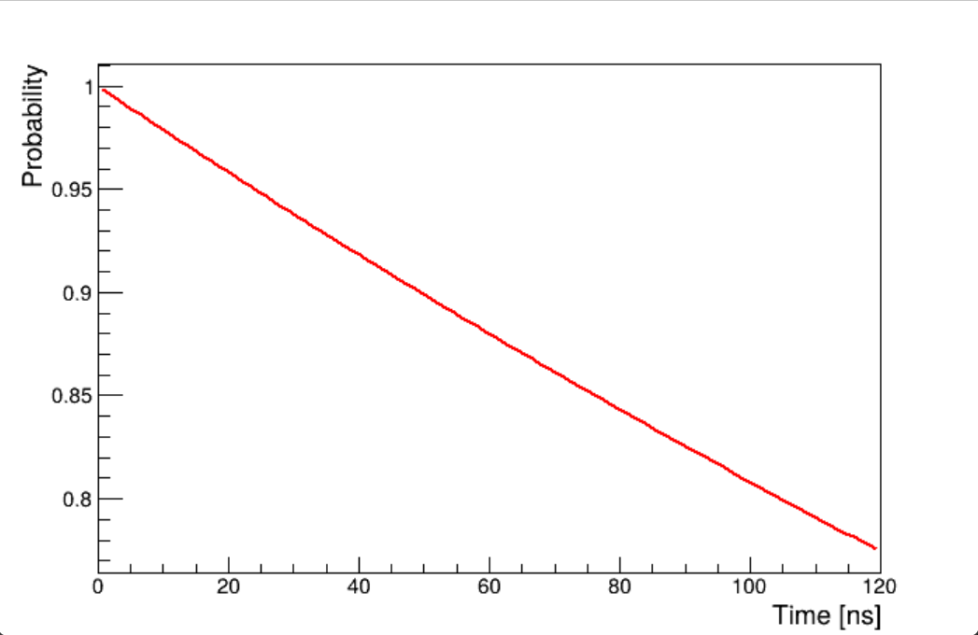
Radiative Bhabha Event Rate
Probability of no bremsstrahlung photon hits after an event
(0.0127 events per bunch per detector part)
Notes:
只考虑光子，绘制每部分探测器探测到一次事例后没有粒子击中的概率的结果，例如，约8个束团的时间间隔，也就是48ns时间内，这部分探测器有90%的概率不被再次击中

Slide 18
Conclusion
The bremsstrahlung cross section and ISR photon distribution in the proposal is reproduced. However, the cross section of ZDD receiving bremsstrahlung photon doesn’t agree.
Used BBBrem to calculate the bremsstrahlung cross section. With $E_{CM}=4.68 GeV$ and $E_{γ}>50 MeV$，the total cross section is 389.598 mb.
The distribution of bremsstrahlung photon on ZDD is drawn. Considering photon hitting the ZDD, the cross section becomes 5.629 mb.
According to the Luminosity and bunch spacing, the hit rate is 2.11 MHz per detector part, 0.0127 per bunch. 90 % probability of not receiving particle again in about 8 bunch spacing, or 48 ns.
Notes:
总结，重现了proposal里的韧致辐射总截面和ISR光子分布，但是ZDD接收到韧致辐射光子的截面并不一致。使用了BBBrem计算韧致辐射截面，在质心能量为4.68GeV, 光子能量大于50MeV的情况下，总截面为389.598 mb。绘制了韧致辐射光子在ZDD位置处的分布，光子能打到ZDD上的截面为5.629 mb。最后，根据亮度和束团间隔，光子事例率为2.11MHz每部分探测器，也就是平均每次束团对撞0.0127个事例。如果需要90%的情况下这部分探测器都不接收到光子，则时间为大约8个束团间隔， 也就是约48ns。

Slide 19
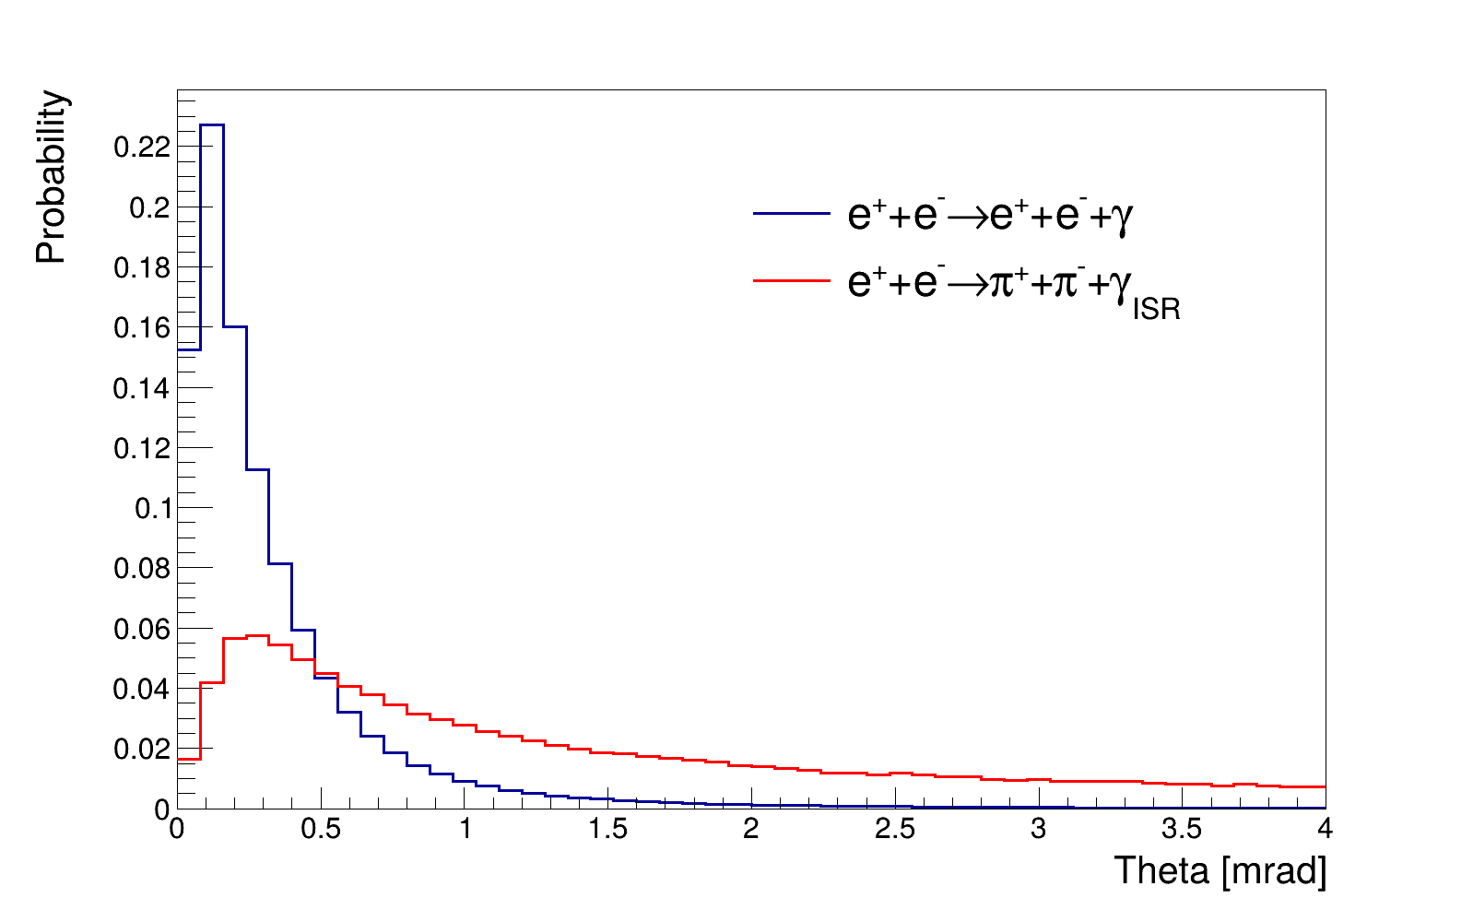
ISR 和 Bremsstrahlung 比较
ISR : Phokhara
Bremsstrahlung : BBBrem

Slide 20
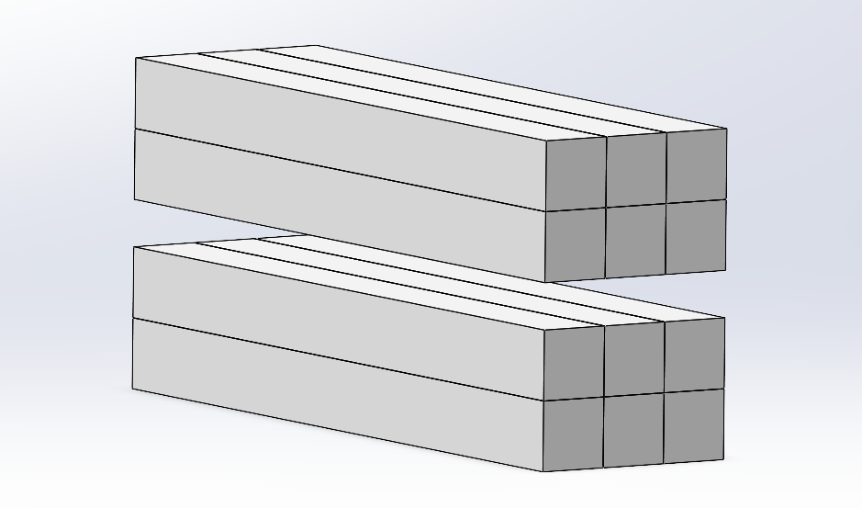
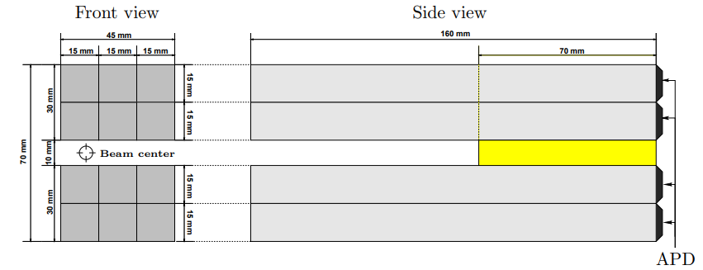
ZDD 模型
(尝试了一下软件，后续跟着设计再改)

Slide 21
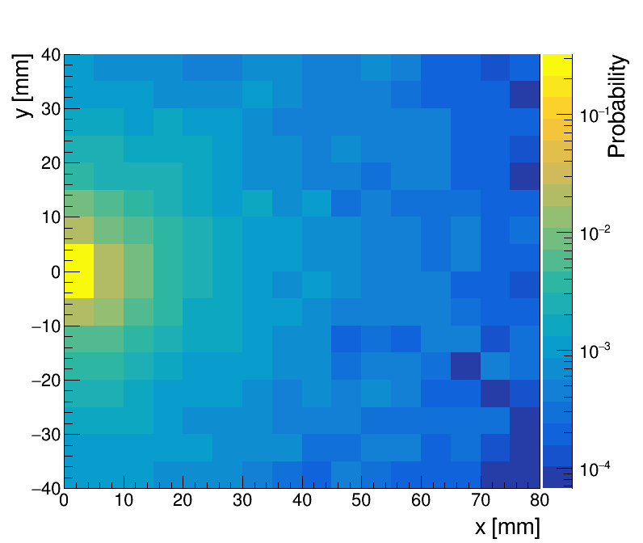
双光子，用 ee 不变质量模拟 $π^{0}$
$$e^{+}+e^{−}→e^{+}+e^{−}+e^{+}+e^{−}$$
$$π^{0}$$
环境：BOSS 7.0.9
产生子：BesTwogam
事例数：400 000 events
将左侧事例对称到右边，等效 800 000 events
$$0.13957−0.01<M_{ee}<0.13957+0.01$$
ZDD位置，$z=3490 mm$

Slide 22
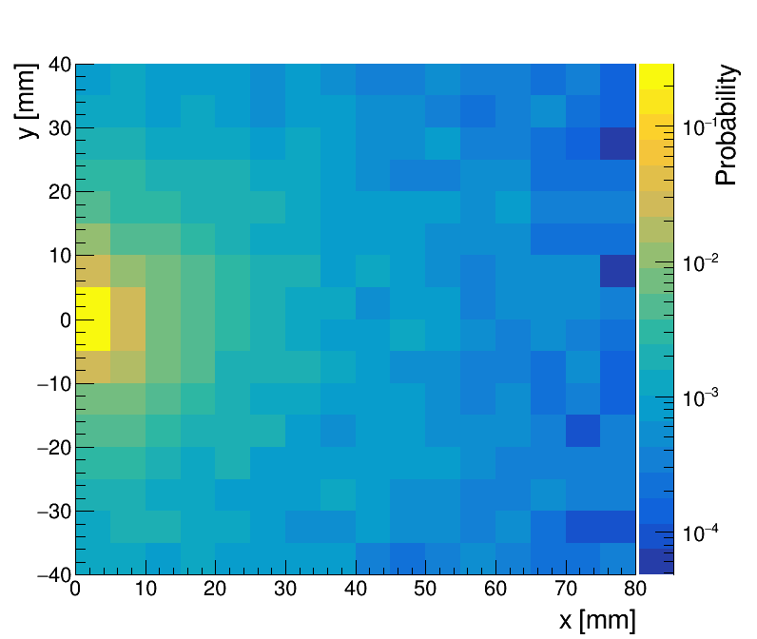
双光子，用 ee 不变质量模拟 $η$
$$e^{+}+e^{−}→e^{+}+e^{−}+μ^{+}+μ^{−}$$
$$η$$
环境：BOSS 7.0.9
产生子：BesTwogam
事例数：400 000 events
将左侧事例对称到右边，等效 800 000 events
$$0.57486−0.01<M_{μμ}<0.57486+0.01$$
ZDD位置，$z=3490 mm$

Slide 23
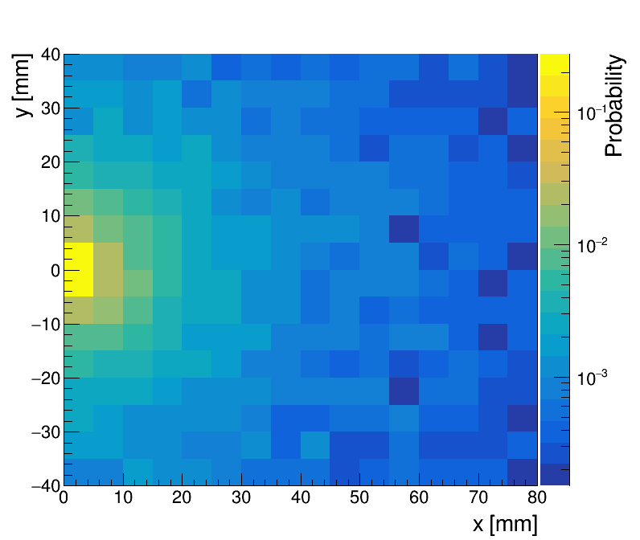
双光子，用 ee 不变质量模拟 $η^{′}$
$$e^{+}+e^{−}→e^{+}+e^{−}+μ^{+}+μ^{−}$$
$$η^{′}$$
环境：BOSS 7.0.9
产生子：BesTwogam
事例数：400 000 events
将左侧事例对称到右边，等效 800 000 events
$$0.95778−0.01<M_{μμ}<0.95778+0.01$$
ZDD位置，$z=3490 mm$

