Slide 1



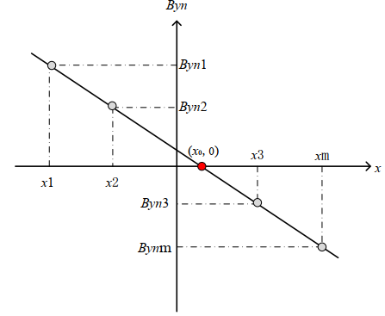
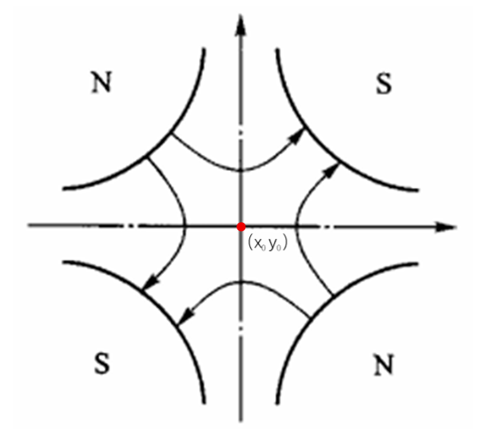
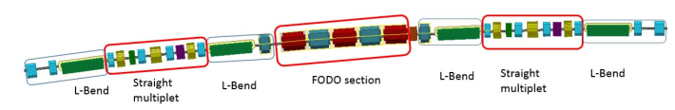
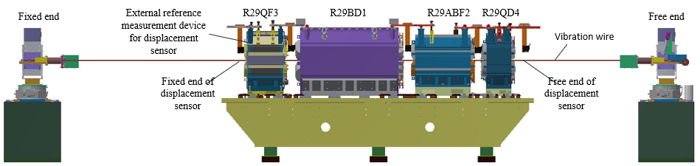
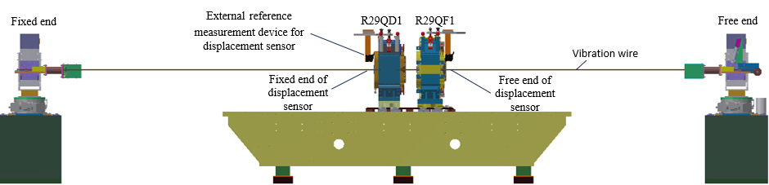
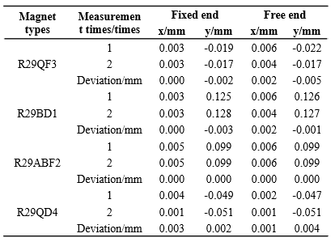
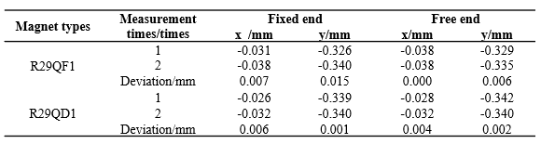
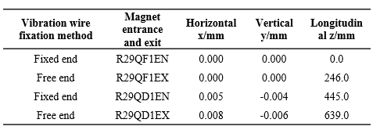
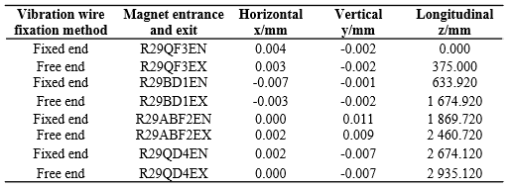
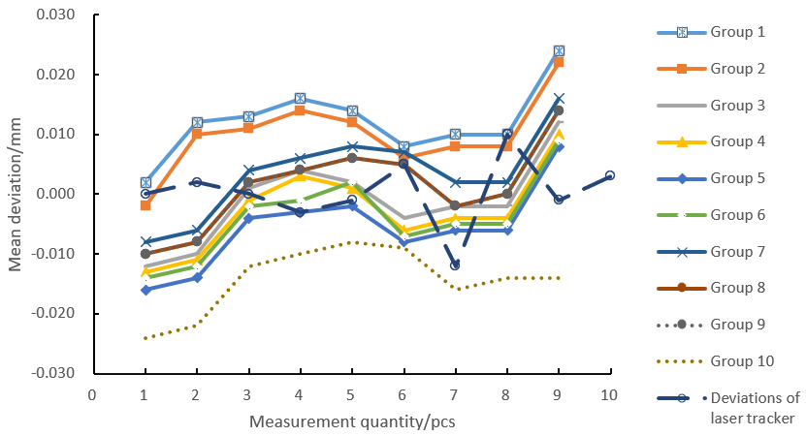
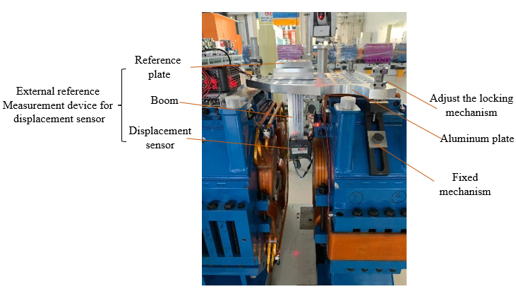

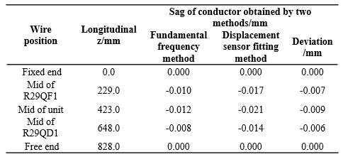
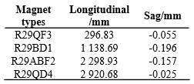
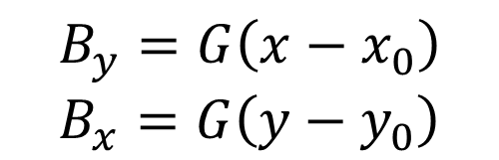
The Application of Vibration Wire Measurement Technology in Pre-alignment Unit of HEPS Storage Ring
Luping Yan¹, Lan Dong¹², Tong Wang ¹² , Xiaolong Wang ¹², Yuanying Han ¹, Xiaoyang Liu ¹,
Luyan Zhang ¹, Haoyue Yan ¹, Shang Lu ¹
1. Institute of High Energy Physics, ChineseAcademy of Sciences, Beijing, 100049, China
2. Dongguan Neutron Science Center, Dongguan 523803, China
Luping Yan, IHEP
yanluping@ihep.ac.cn
Abstract
Abstract
The High Energy Photon Source (HEPS), China's first fourth-generation synchrotron light source, requires a pre-alignment precision of 0.03 mm between unit magnets in the storage ring pre-alignment units. This poster presents the 3-magnet and 5-magnet unit structures of the HEPS storage ring, where the vibrating wire technique is employed for magnetic center measurement. A laser displacement system has been developed to enhance sag correction accuracy. Experimental results demonstrate that the fitting deviations of both standard unit types are better than 0.015 mm, meeting the pre-alignment precision requirements.
Introduction
Principle
The storage ring of HEPS has a circumference of approximately 1.3 km and consists of 288 pre-alignment standard units, including 96 three-magnet units, 96 five-magnet units and 96 eight-magnet units. the alignment accuracy between magnets in the pre-alignment units is a critical technical indicator for ensuring long-term stable and efficient operation of the storage ring. Currently, multi-laser systems are used for magnetic center pre-alignment in the HEPS storage ring pre-alignment units. To ensure the reliability and accuracy of this high-precision measurement system, it is essential to introduce vibration wire technology as an independent high-precision measurement system for verifying the alignment accuracy of the pre-alignment units.
Vibration wire magnetic center measurement technology involves scanning vibration wire in both horizontal and vertical directions near the approximate magnetic center of a magnet to detect the magnetic field distribution and determine the magnetic center position. The relationship between the magnetic field components of a quadrupole magnet and their deviation from the magnetic center is given by:
$$B_{y}=G\left(x−x_{0}\right)$$
$$B_{x}=G\left(y−y_{0}\right)$$
Layout of a standard unit equipment
Diagram of vertical quadrupole magnetic field
Schematic of horizontal magnetic center
measurement method for quadrupole magnets
Three-magnet unit
Five-magnet unit
The selected pre-alignment three-magnet unit R29DQ1 consists of 2 quadrupole magnets and 1 corrector magnet. The corrector magnet is used to correct beam deviations from the orbit. Mechanical center calibration can meet alignment accuracy requirements, so it is not included in the scope of this vibration wire magnetic center verification measurement.
The selected pre-alignment five-magnet unit R29FD1 consists of 4 quadrupole magnets and 1 corrector magnet.
The pre-alignment five-magnet unit vibrating-wire scanning schematic diagram
The pre-alignment three-magnet unit vibrating-wire scanning schematic diagram
Repeatability result of vibrating-wire magnetic center scanning
in pre-alignment three-magnet unit
BEPCII-U
Repeatability result of vibrating-wire magnetic center scanning in pre-alignment three-magnet unit
Manufacture
Upper layer
Vibrating-wire scanning results of the pre-alignment three-magnet unit in the HEPS storage ring
Laser displacement system-Repeatability
Vibrating-wire scanning results of the pre-alignment five-magnet unit in the HEPS storage ring
The working principle of a laser displacement sensor involves emitting a laser beam onto the surface of the measured object and receiving the reflected light signal to calculate the distance.
Laser displacement system-Compare
Repeatability test results of external reference for laser displacement sensor
Wire sag of three-magnet and
five-magnet units
Comparison of Sag obtained by two methods

