Slide 1





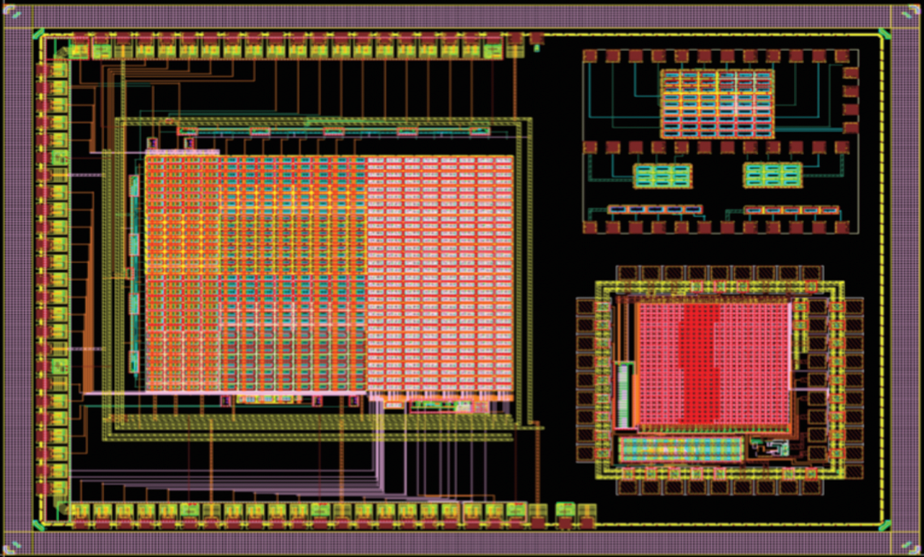
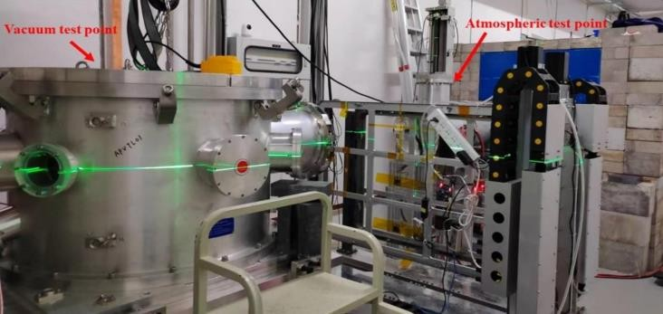
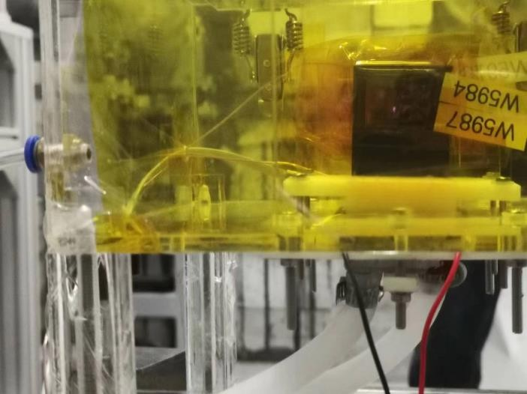
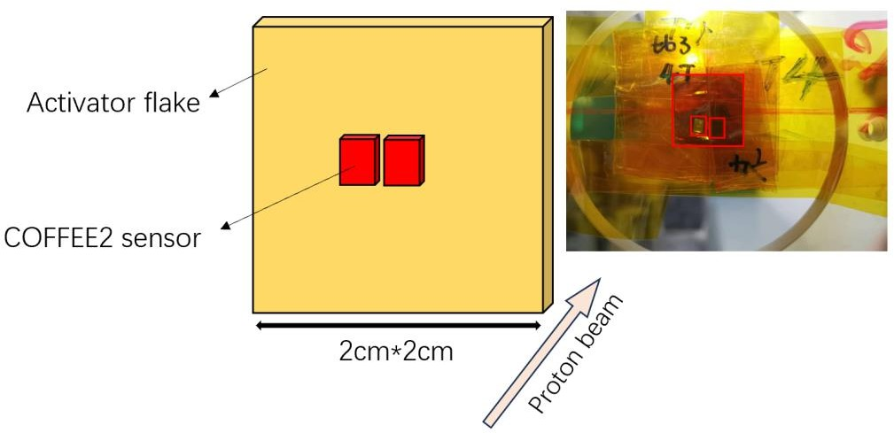

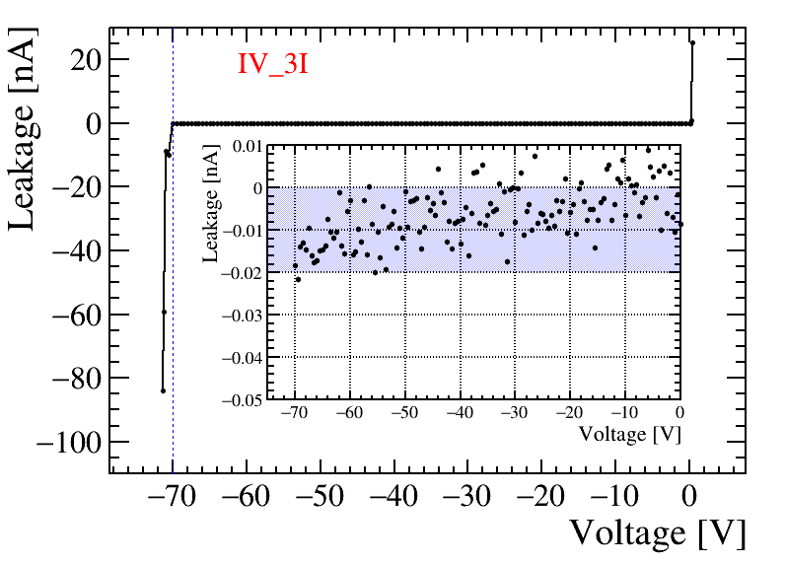
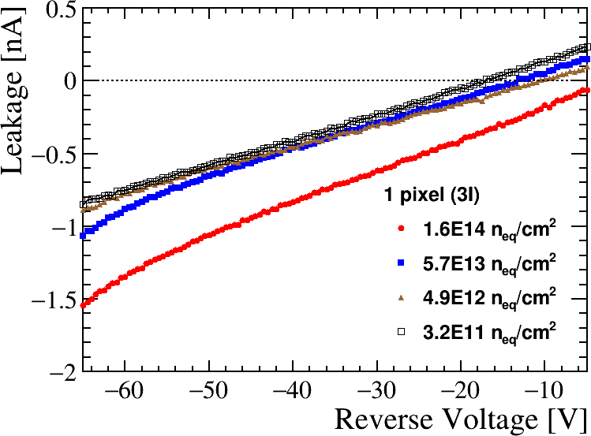
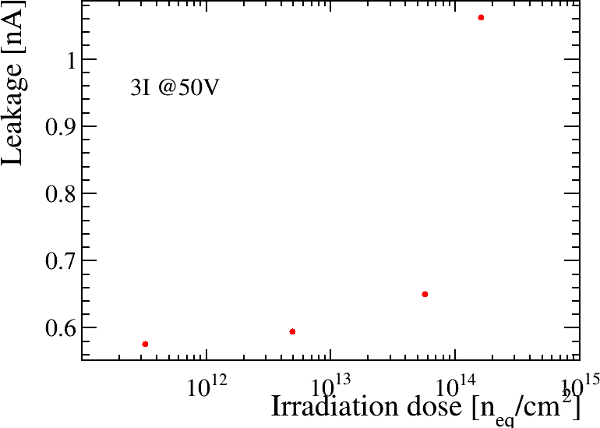
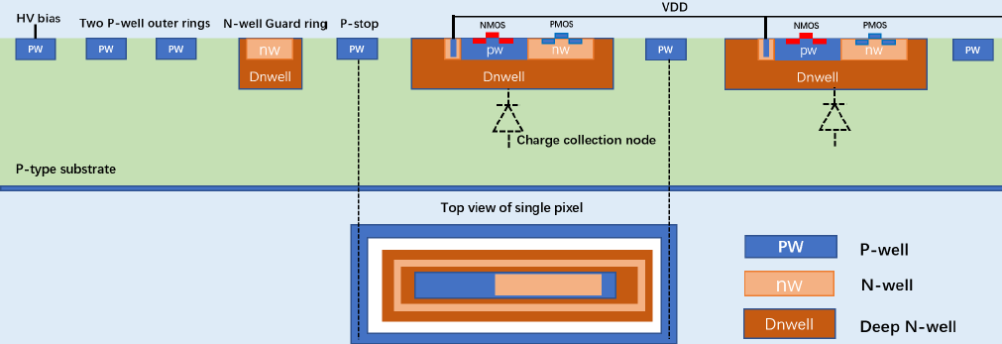
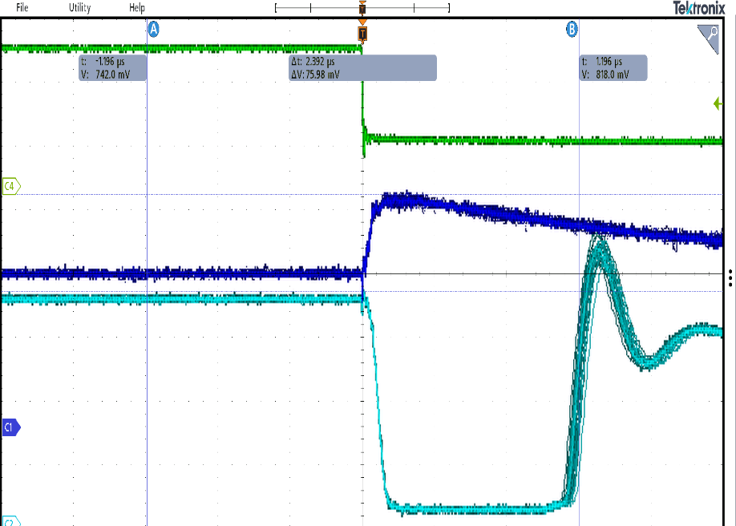
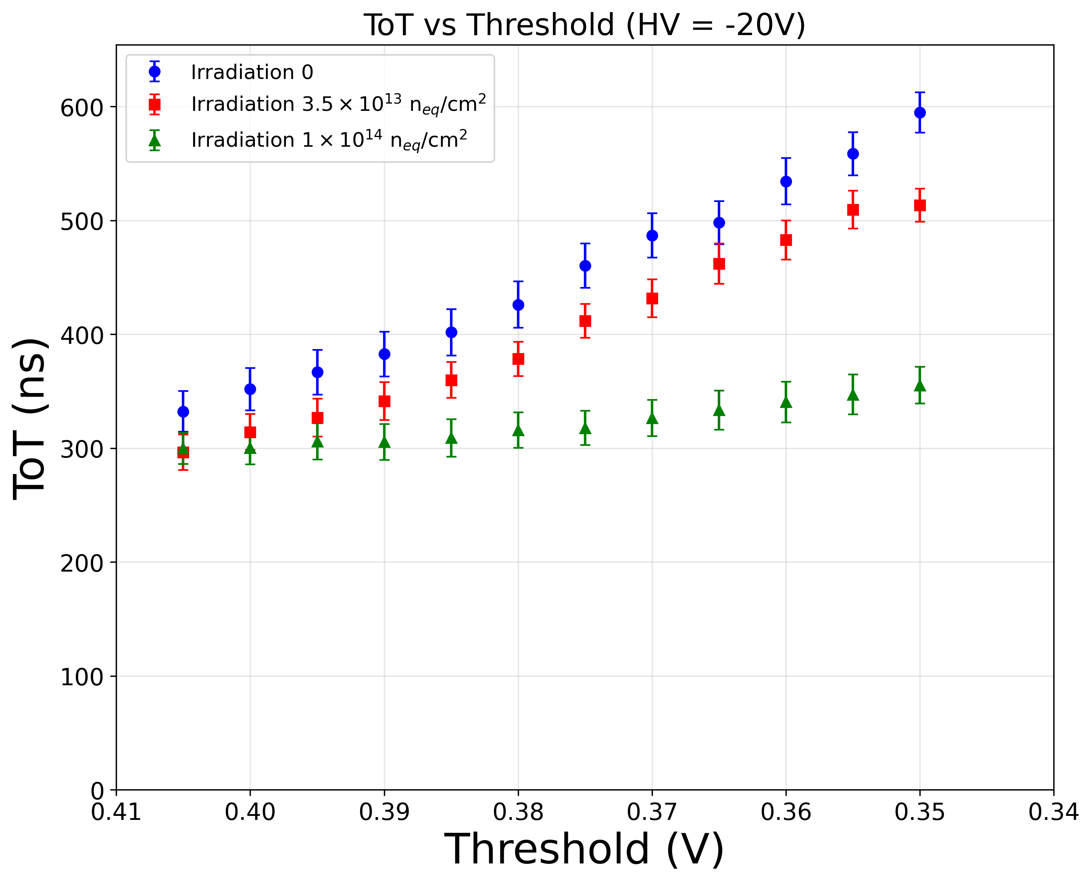
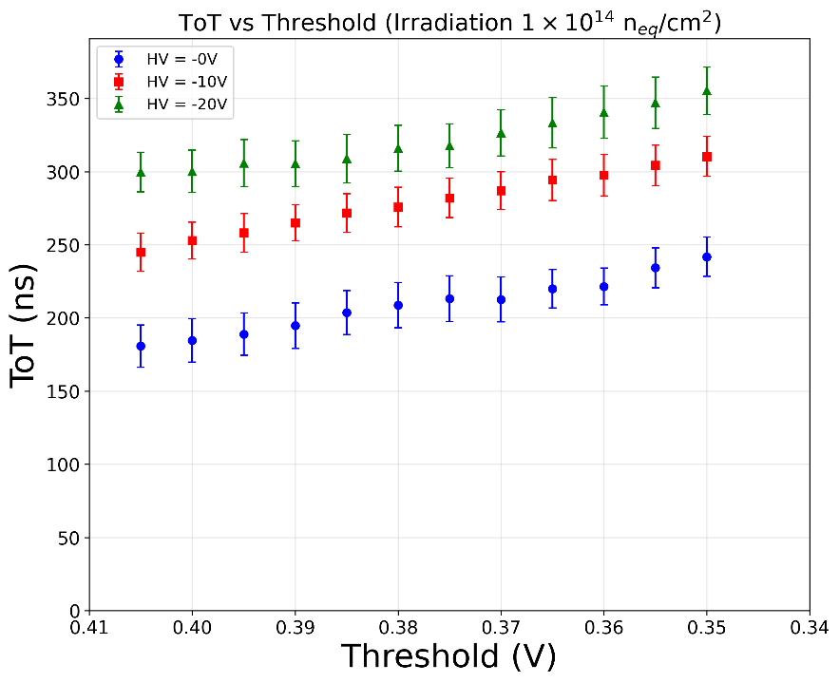
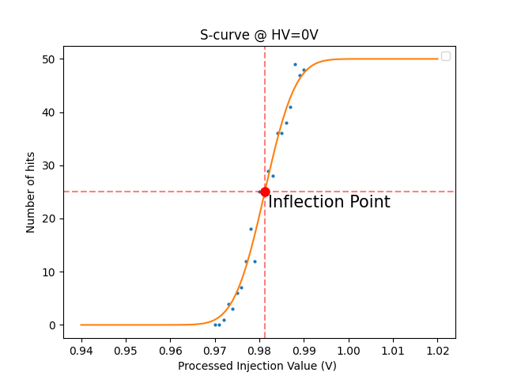
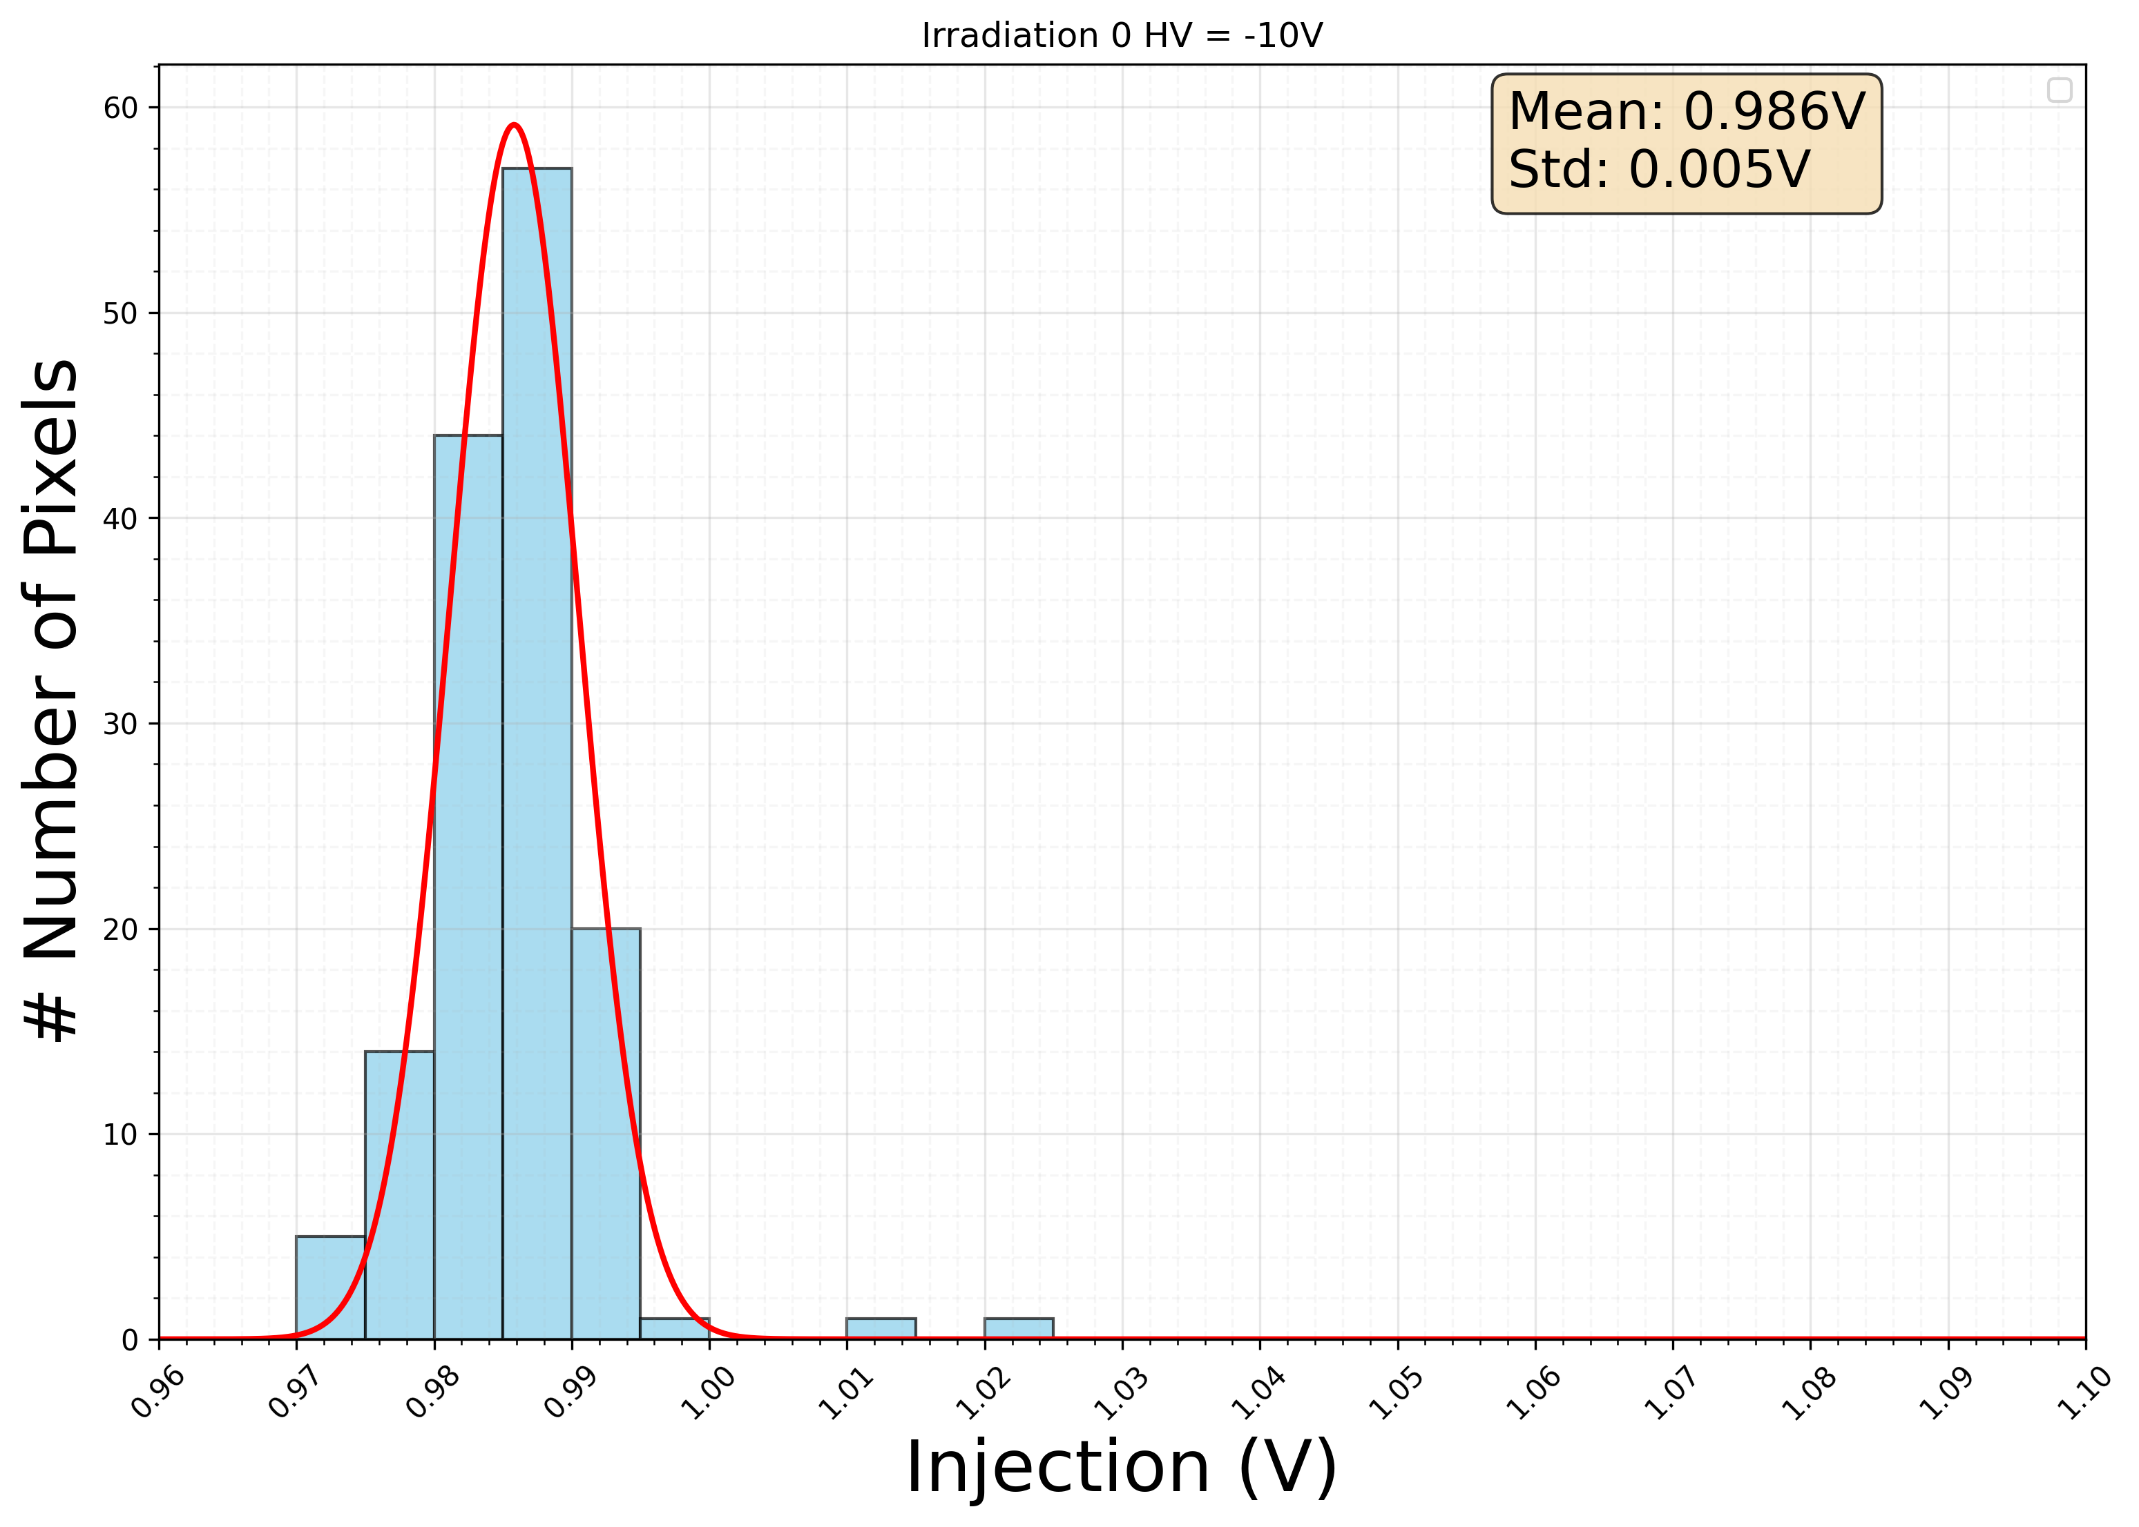
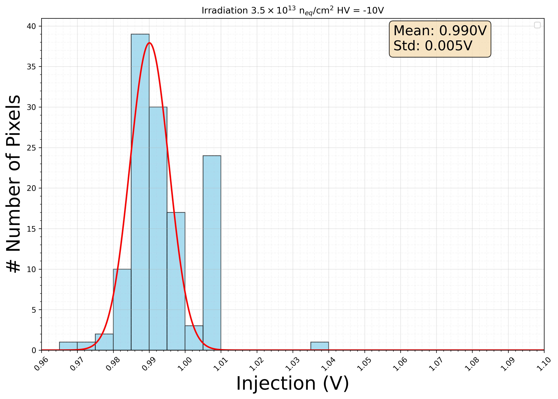
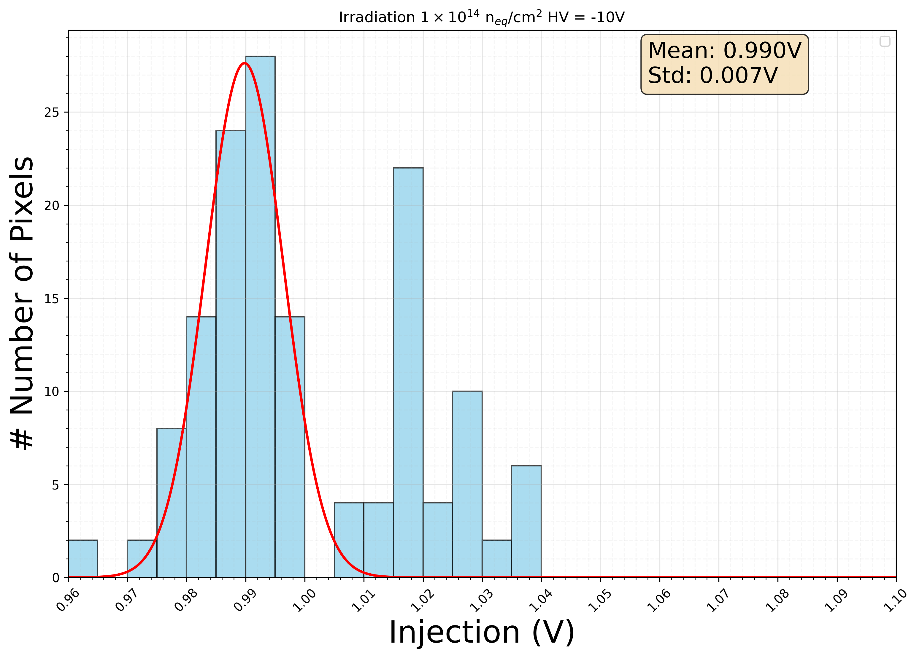
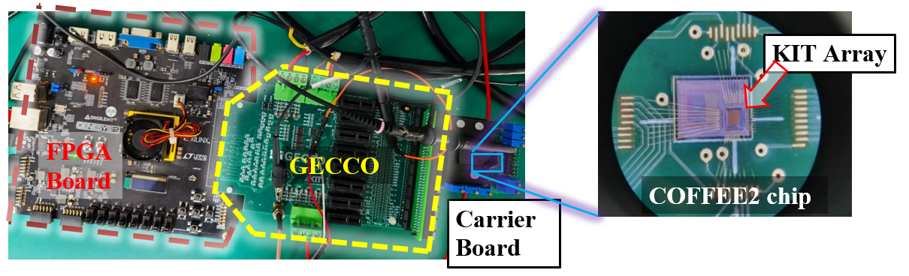


Irradiation study of COFFEE2, the first 55nm
High Voltage CMOS sensor prototype
Tianyu Shi^{1,2}, Mingjie Feng^{1,2}, Yiming Li¹, Jianchun Wang¹, Zhiyu Xiang³, Zijun Xu¹, Xuhao Yuan¹, Cheng Zeng^{1,2}, Hui Zhang¹
¹Institute of High Energy Physics, CAS, Beijing, China ²University of Chinese Academy of Sciences ³Central South University
Irradiation test setup @CSNS
Irradiated in 80 MeV proton beam at China Spallation Neutron Source (CSNS) in April 2024
2 sensors placed at each test point
  1 IV/CV tested + 1 new
Aluminum foil pieces placed at each point to calibrate irradiation fluence
Irradiated IV change
With bias of -50V, leakage current increases from ∼ 10 pA to ∼ 1nA after irradiated. The magnitude of leakage current is proportional to the irradiation fluence
Irradiation Tolerance Evaluation
Time over Threshold (ToT) versus Threshold
ToT and noise rate as a function of the threshold reference for all tested samples different voltages and irradiation fluence. Results are shown for chips settings at room temperature.
Time over Threshold (ToT) is correlated with the energy of a signal
An increase in ToT leads to an increase in the depletion voltage
Under an irradiation fluence of $1×{10}^{14}n_{eq}/{cm}^{−2}$, the chip can still maintain normal operation.
Inflection Point of S-curve for pixels
Inflection point of the S-curve as a function of charge injection for different irradiated chips. Results are shown for HV = -10V settings at room temperature
Show the noise level of the pixel
Systematic right-shift of inflection point distribution with increased fluence
An increase in the irradiation fluence leads to a reduction in pixel uniformity
The COFFEE2 chip demonstrated excellent irradiation tolerance, confirming the resilience of the 55nm HV-CMOS process. It remained fully functional with only minor performance degradation up to an accumulated fluence of 10¹⁴ 𝑛ₑq/cm². The observed degradation primarily manifested as a slight shift in the S-curve inflection point and a minor broadening of its distribution; nevertheless, the overall performance was well maintained. Furthermore, it was found that applying a higher bias voltage improved charge collection efficiency and increased the depletion depth, which consequently helped recover performance parameters.
Future work involves more detailed test including radioactive source test and test beam measurement.
Introduction
Irradiation Test
To meet the increasingly demanding requirements of future tracking detectors for the CEPC and LHCb Upgrade II, advanced detector technologies with enhanced hit density processing capabilities and enhanced radiation tolerance are essential. To study the sensor performance and electronic response in the next generation process of High Voltage CMOS (HV-CMOS), the sensor chip called COFFEE2, the first prototype for process and circuit module in a 55 nm
Fluence [n_{eq}/cm²] | 3.2 × 10¹¹ | 4.9× 10¹² | 5.7 × 10¹³ | 1.6 × 10¹⁴ | 1.3 × 10¹⁵
Temperature | Room temperature |  |  |  | -28°C
Main array
Passive
Sensor diode
KIT array
Dry air
Test box
Graphite
Sensor
sheets
Peltier
High-Voltage Technology, is designed and tested. A comprehensive irradiation tolerance testing campaign was conducted on the COFFEE2 chip. Utilizing the KIT pixel array, which boasts a fully integrated readout system, this work presents the first irradiation tolerance study of the 55 nm High-Voltage CMOS process.
Deep n-well - P substrate junction as collection electrode
Triple-well process: N-well/P-well/Deep n-well
P-type substrate resistivity: 10$Ω$·cm
Guard ring: one inner N-well ring, with two P-well outer rings
Substrate breakdown Voltage > 50V with frontside HV bias
More design details:
  Z. Chen et al., Feasibility study of CMOS sensors in 55 nm process for tracking, Nuclear Instruments and Methods in Physics Research A 1069 (2024) 169905.
  H. Zhang, et al., High voltage monolithic pixel sensor in 55 nm technology, JINST 20 (2025) 03, C03023
Pixel electronics (25 μm $×$ 25 μm )
  Sensor diode
  Charge Sensitive Amplifier (CSA)
  CR filter
  Comparator
  RAM and tune DAC
  Output stages
Work principle
  Charge collected by pixel n-well
  Converted to voltage signal by Charge Sensitive Amplifier
  Analog voltage pulse shaped and converted to digital signal by comparator
  Output stage generates current
  Current is sent via address line to the transimpedance amplifier outside matrix
  Address lines have constant potential – no cross talk
Genesys2 FPGA Board
  Translates commands from the PC into the precise low-level digital protocol
GECCO Control Readout Board
  It integrates power delivery and controls and supplies all required electrical potentials for testing the chip
Carrier Board (with wire-bonded COFFEE2 chip)
Signal Generator
  Provide charge injection to the chip through the GECCO board
Cooling water
Process Features
Main results
Laser response
AM-241 response
1.06 nA
0.57 nA
0.59 nA
0.65 nA
IV test results of COFFEE2 in different irradiation fluence
One pixel
KIT Pixel Electronics
Charge Injection
SFOut
Digital Output
ToT
(a)
(b)
(c)
Chip Response to Charge Injection(a); ToT vs. Thershold in different Irradiation fluence (b);
ToT vs. Threshold in different bias voltage(c)
H. Zhang, et al. High voltage monolithic pixel sensor in 55nm technology
JINST 20 (2025) 03, C03023
Bench test setup
(a)
(b)
(c)
(d)
The inflection Point of S-curve (a); The distribution of inflection point in bias voltage of -10V(b),-20V(c),-30V(d);
Summary & Outlook
The 2025 International Workshop on the High Energy Circular Electron Positron Collider (CEPC2025）
Email: shity@ihep.ac.cn

