Slide 1
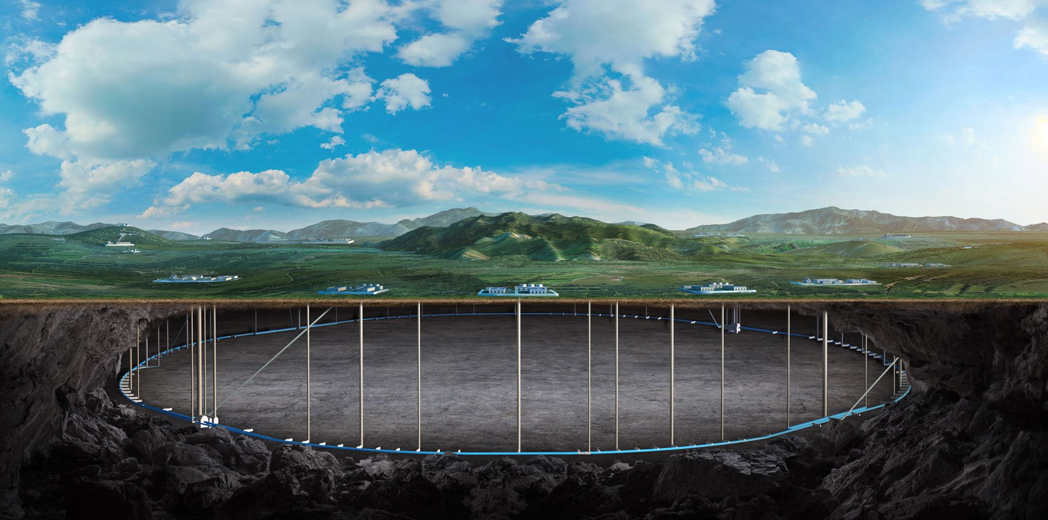


EDR Status of the CEPC collider ring
Beam dynamics
Yiwei Wang
on behalf of the accelerator physics team
6 Nov 2025, Guangzhou, CEPC Workshop 2025

Slide 2
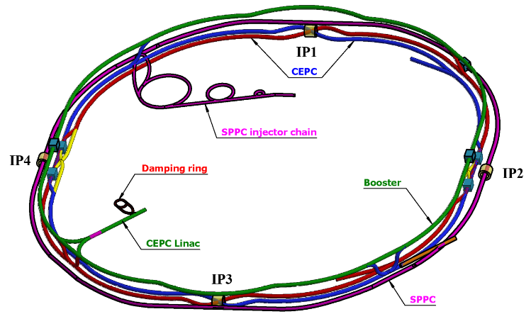
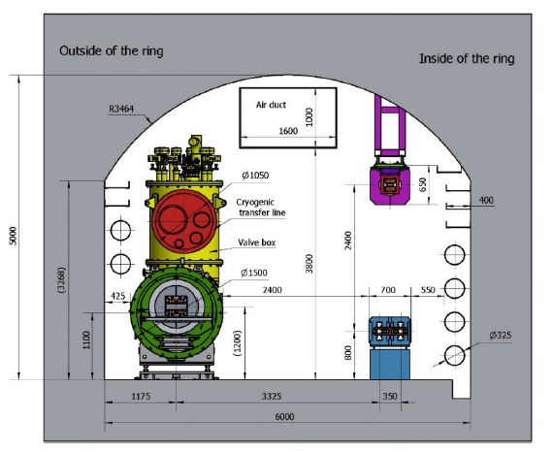
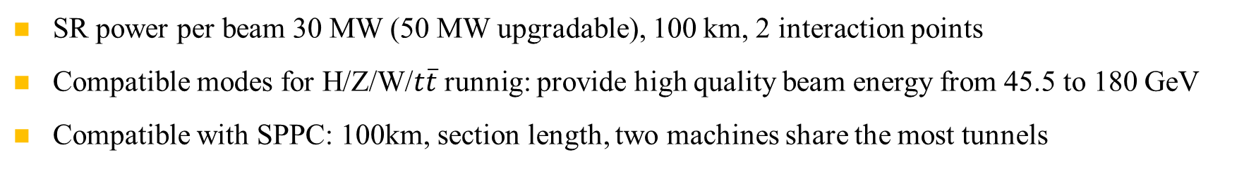
Overall design requirement of the CEPC collider ring
SR power per beam 30 MW (50 MW upgradable), 100 km, 2 interaction points
Compatible modes for H/Z/W/$t\overline{t}$runnig: provide high quality beam energy from 45.5 to 180 GeV
Compatible with SPPC: 100km, section length, two machines share the most tunnels
CEPC+SPPC complex
Tunnel in the arc regions
CEPC detectors

Slide 3
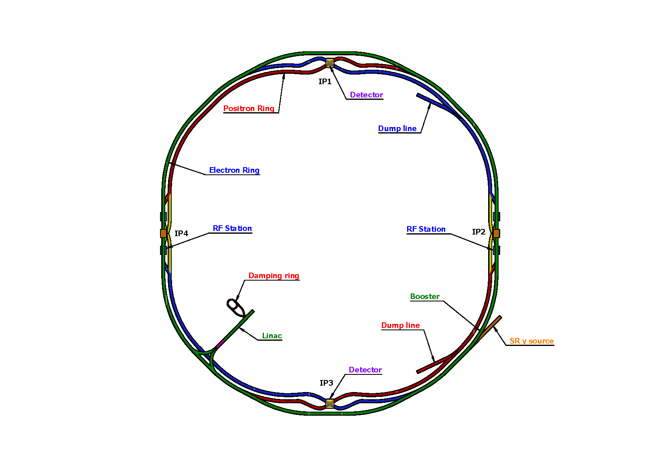
Lattice design requirement of the CEPC collider ring
Basically 2 folded symmetry
2 interaction regions @ IP1 and IP3
  crab waist collision
  local chromaticity correction for the interaction region
  asymmetric interaction region
2 RF acceleration regions @ IP2 and IP4
  shared cavities for two beam @ ttbar, Higgs
  flexible switching between compatible modes
8 arc sections
  dual aperture dipole and quadrupole magnets
4 short straight section
  on/off axis injection regions for different modes
  beam dumping
SS4
SS1
SS3
SS2
Ref: CEPC TDR; Radiation Detection Technology and Methods (2024) 8:1–1105, https://doi.org/10.1007/s41605-024-00463-y
SS: short straight section

Slide 4
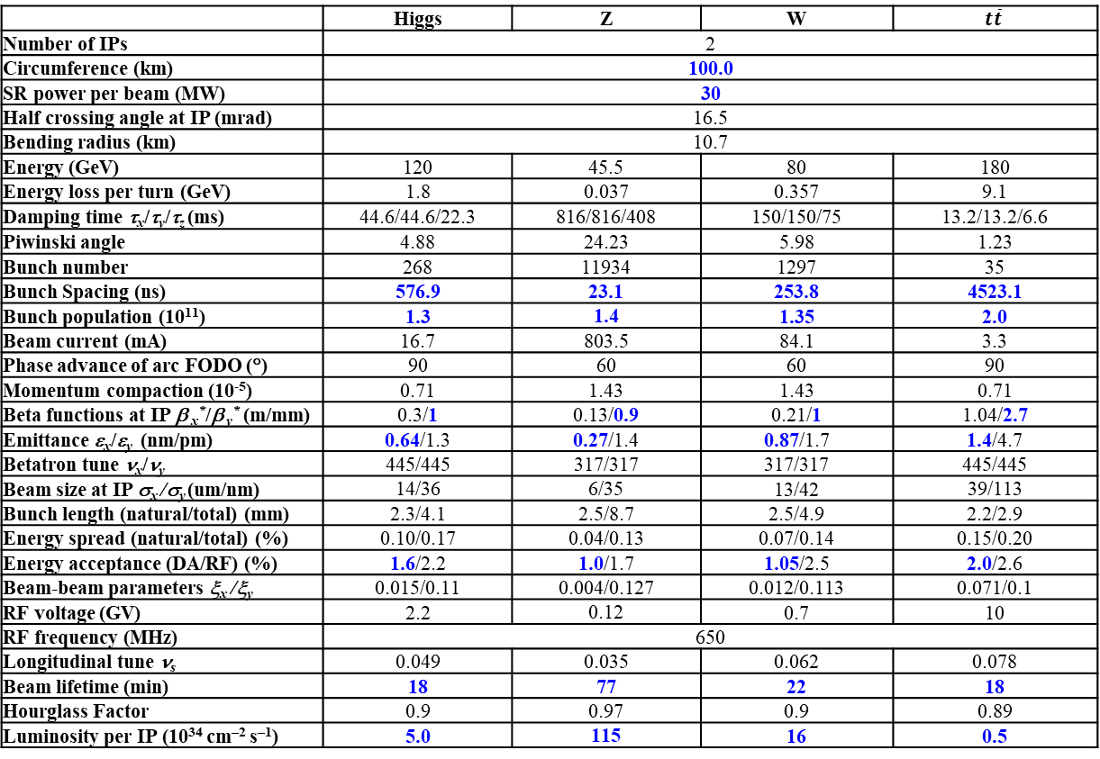
CEPC Design Parameters
 | Higgs | Z | W | $$t\overline{t}$$
Number of IPs | 2
Circumference (km) | 100.0
SR power per beam (MW) | 30
Half crossing angle at IP (mrad) | 16.5
Bending radius (km) | 10.7
Energy (GeV) | 120 | 45.5 | 80 | 180
Energy loss per turn (GeV) | 1.8 | 0.037 | 0.357 | 9.1
Damping time τ_{x}/τ_{y}/τ_{z} (ms) | 44.6/44.6/22.3 | 816/816/408 | 150/150/75 | 13.2/13.2/6.6
Piwinski angle | 4.88 | 24.23 | 5.98 | 1.23
Bunch number | 268 | 11934 | 1297 | 35
Bunch Spacing (ns) | 576.9 | 23.1 | 253.8 | 4523.1
Bunch population (10¹¹) | 1.3 | 1.4 | 1.35 | 2.0
Beam current (mA) | 16.7 | 803.5 | 84.1 | 3.3
Phase advance of arc FODO (°) | 90 | 60 | 60 | 90
Momentum compaction (10⁻⁵) | 0.71 | 1.43 | 1.43 | 0.71
Beta functions at IP β _{x}*/β _{y}* (m/mm) | 0.3/1 | 0.13/0.9 | 0.21/1 | 1.04/2.7
Emittance ε_{x}/ε_{y} (nm/pm) | 0.64/1.3 | 0.27/1.4 | 0.87/1.7 | 1.4/4.7
Betatron tune ν_{x}/ν_{y} | 445/445 | 317/317 | 317/317 | 445/445
Beam size at IP σ_{x} /σ_{y} (um/nm) | 14/36 | 6/35 | 13/42 | 39/113
Bunch length (natural/total) (mm) | 2.3/4.1 | 2.5/8.7 | 2.5/4.9 | 2.2/2.9
Energy spread (natural/total) (%) | 0.10/0.17 | 0.04/0.13 | 0.07/0.14 | 0.15/0.20
Energy acceptance (DA/RF) (%) | 1.6/2.2 | 1.0/1.7 | 1.05/2.5 | 2.0/2.6
Beam-beam parameters ξ_{x} /ξ_{y} | 0.015/0.11 | 0.004/0.127 | 0.012/0.113 | 0.071/0.1
RF voltage (GV) | 2.2 | 0.12 | 0.7 | 10
RF frequency (MHz) | 650
Longitudinal tune ν_{s} | 0.049 | 0.035 | 0.062 | 0.078
Beam lifetime (min) | 18 | 77 | 22 | 18
Hourglass Factor | 0.9 | 0.97 | 0.9 | 0.89
Luminosity per IP (10³⁴ cm^{–2} s^{–1}) | 5.0 | 115 | 16 | 0.5
𝛽y∗ and emittance chosen for luminosity
adequate bunch population Ne for the luminosity and the achievable energy acceptance for lattice design
Number of bunches Nb is adjusted to keep the beam current
Updated bunch spacing for the requirement from detector (D. Wang, Aug 2024, CEPC day)
Ref: CEPC TDR; Radiation Detection Technology and Methods (2024) 8:1–1105, https://doi.org/10.1007/s41605-024-00463-y;

Slide 5
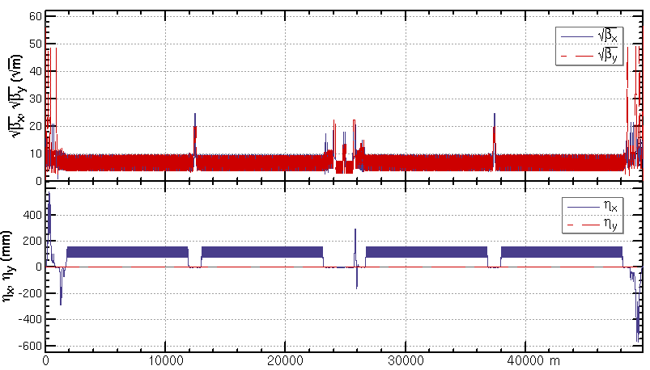
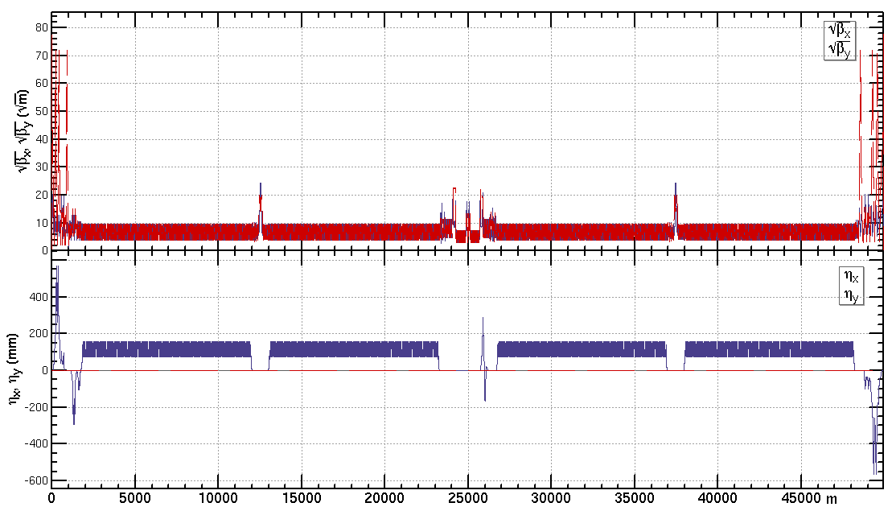
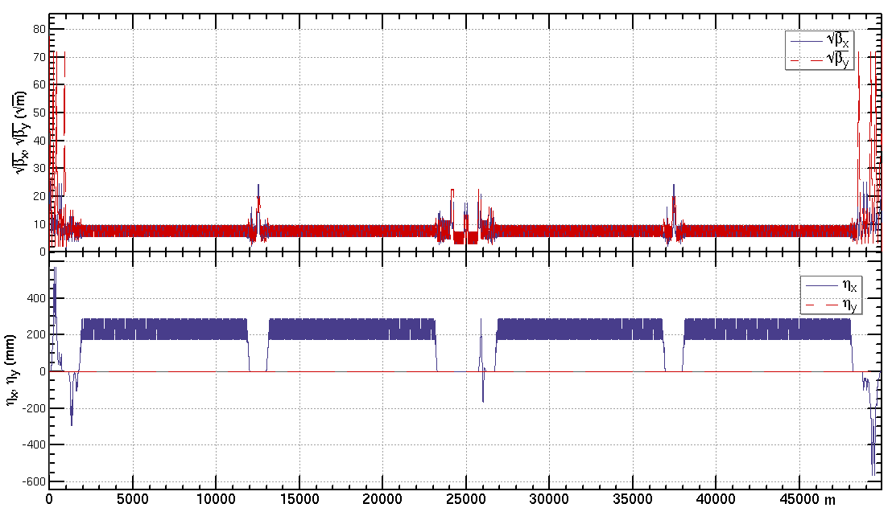
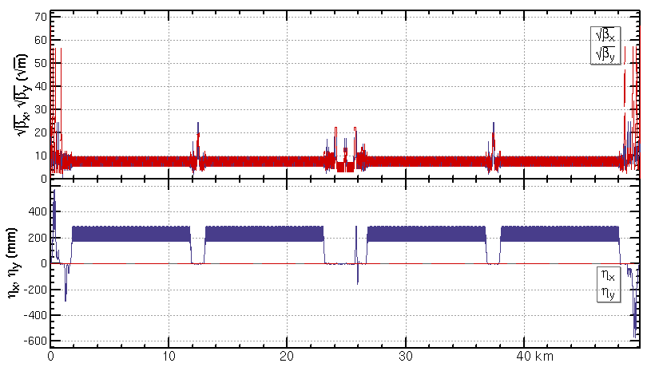
Lattice design of the CEPC half ring
ttbar: εx=1.4nm, β=1.04m/2.7mm
Higgs: εx=0.64nm, β=0.30m/1mm
W: εx=0.87nm, β=0.21m/1mm
Z: εx=0.27nm, β=0.13m/0.9mm

Slide 6
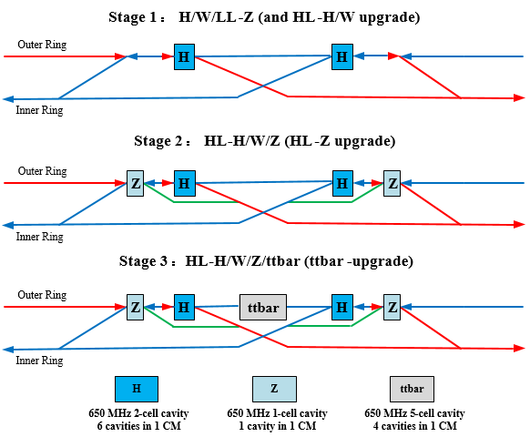
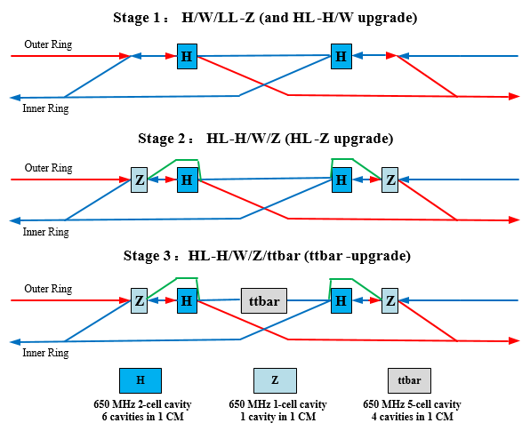
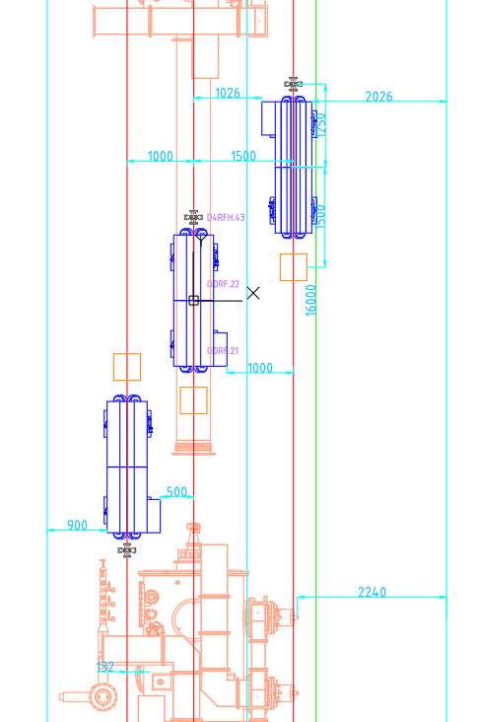
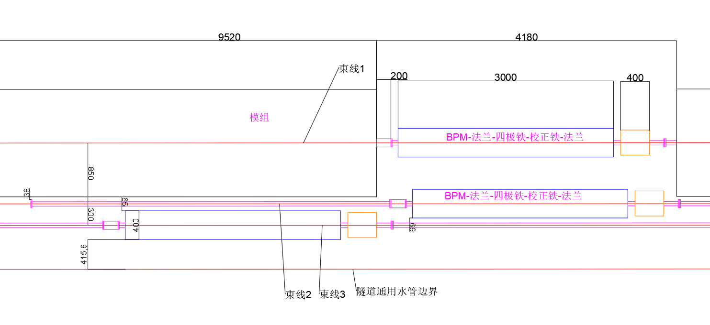
Modification of the RF region layout
Move the high-luminosity Z bypass beamline (green) to the outside, for the following reasons:
Placement on the inside is tight in the transverse space, and the low-luminosity Z (first phase) bypass beamline is very close to the wall-mounted water pipes.
Construction during 2nd stage, but not 1st stage
Line 1
Line 2
Line 3

Slide 7
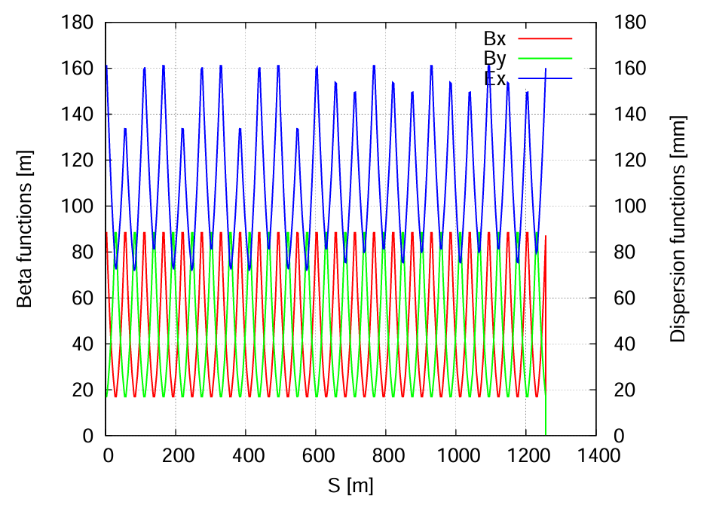
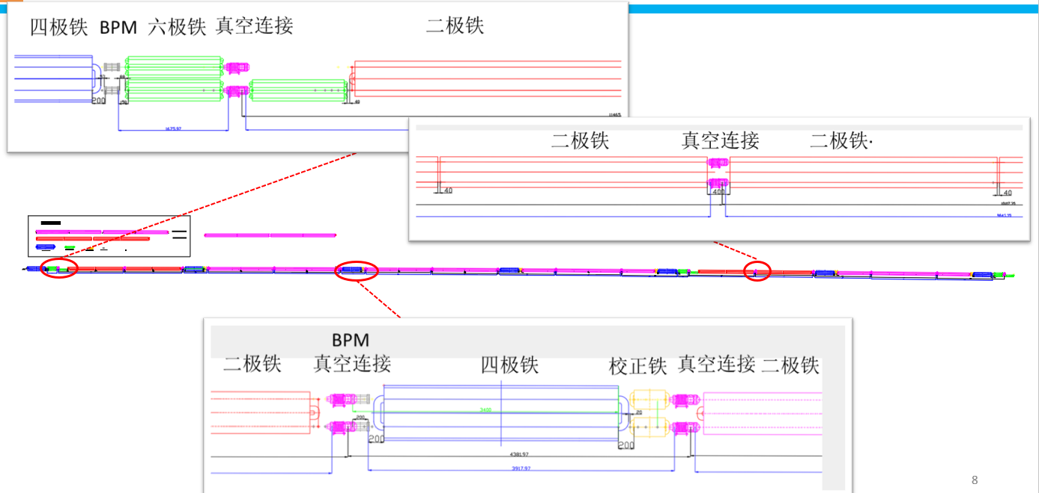
  Update of the ARC lattice
FODO cells in the arc to provide a large filling factor of dipole
  Dual-aperture dipoles and quadrupoles in the arc to save magnet power
  Single-aperture sextupoles for independent nonlinearity optimization of e+ e- rings
  Two kind of dipole length to use the space where no sextupoles
Single aperture magnets in the RF, injection and interaction regions
Correction of the energy sawtooth effects require adjusting range of magnets strength ±2.5% with the trim coils
Running at energy up to 180 GeV
The layout of the lattice in the arc area were updated based on the space required for vacuum, BPM, magnets, and mechanical equipment.
Qaud BPM Sext VCconection Dipole
Dipole VCconection Dipole
BPM
Dipole VCconection Quad Corr VCconection Dipole

Slide 8
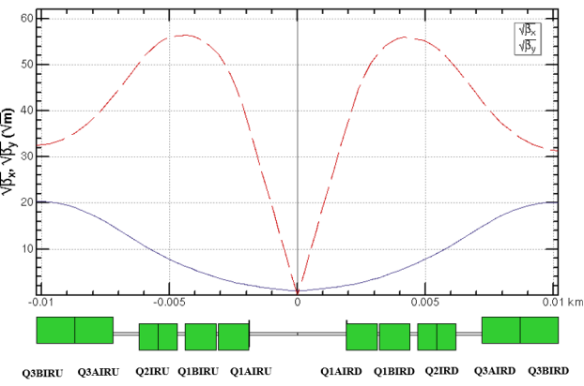
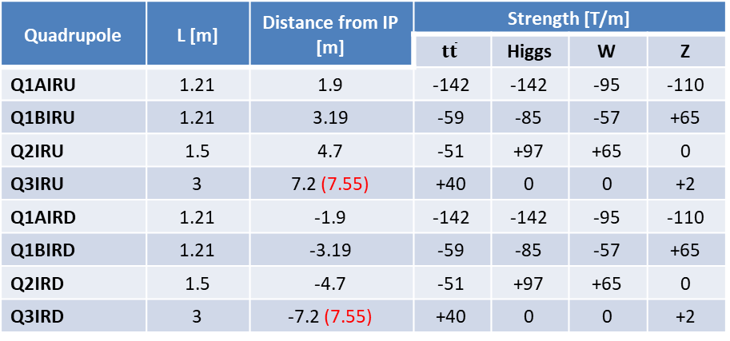
  Super conducting final quadrupoles for all modes
Dipole field aberration due to cross talk of the two aperture
  Three types of SCQ design were designed
  Beam dynamics: integrated dipole field should be corrected
  Radiation and particle loss: maximum 450/300/200/100 gs in the good field region along the SCQs for ttbar/Higgs/W/Z modes (the requirement will be updated with simulation of an integrated model of the quadrupoles, dipole error and solenoid)
    This is also the max field allowed for the correctors in SCQ
  The normal conducting quadrupole of Q3 for ttar running was moved outward (outer end from 7.2m to 7.55m) due to conflict between the cryomodule and the Q3
Layout of the dual aperture SCQ final quadrupoles
Parameters of the twin-aperture SCQs between the IP
Quadrupole | L [m] | Distance from IP [m] | Strength [T/m]
 |  |  | $$t\overline{t}$$ | Higgs | W | Z
Q1AIRU | 1.21 | 1.9 | -142 | -142 | -95 | -110
Q1BIRU | 1.21 | 3.19 | -59 | -85 | -57 | +65
Q2IRU | 1.5 | 4.7 | -51 | +97 | +65 | 0
Q3IRU | 3 | 7.2 (7.55) | +40 | 0 | 0 | +2
Q1AIRD | 1.21 | -1.9 | -142 | -142 | -95 | -110
Q1BIRD | 1.21 | -3.19 | -59 | -85 | -57 | +65
Q2IRD | 1.5 | -4.7 | -51 | +97 | +65 | 0
Q3IRD | 3 | -7.2 (7.55) | +40 | 0 | 0 | +2

Slide 9
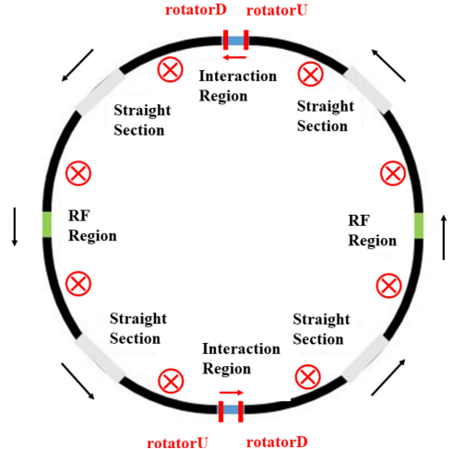
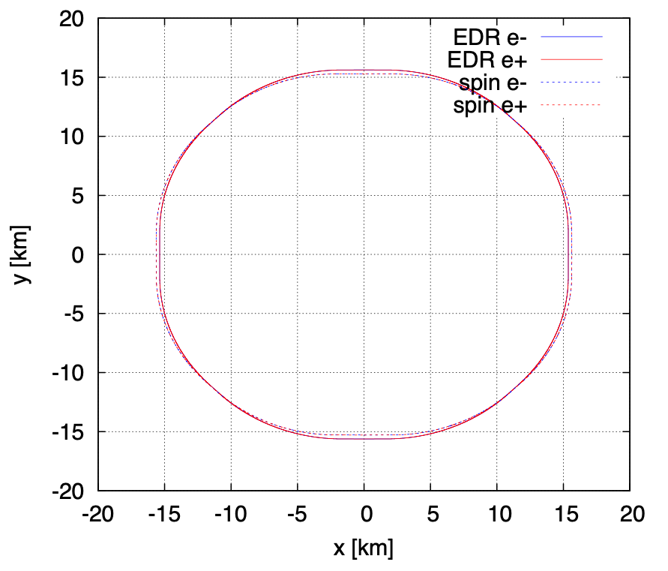
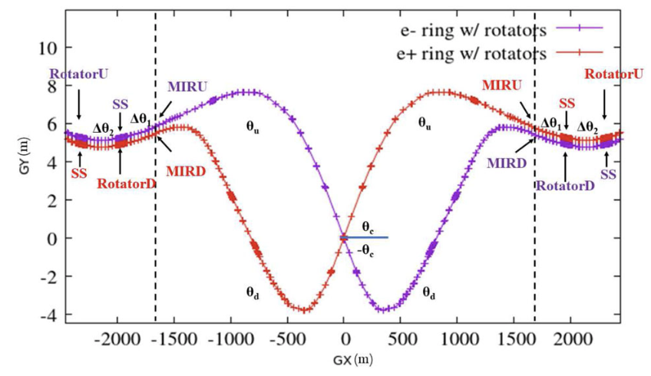
Spin rotator implementation in Colliders
Zhe DUAN, Yiwei WANG
Spin rotators have been implemented into the lattice
  Length of each spin rotator ~ 400m, total length of 4 rotators ~ 1.6 km (reduced from 2.8 km)
  The deflection angles and lengths of ARC dipoles are reduced
  The circumference of the whole ring is 99.913km
  More detailed optics optimization and performance evaluation is under way
relative difference:
~ 330m @IP1/3
~ 260m @IP2/4

Slide 10
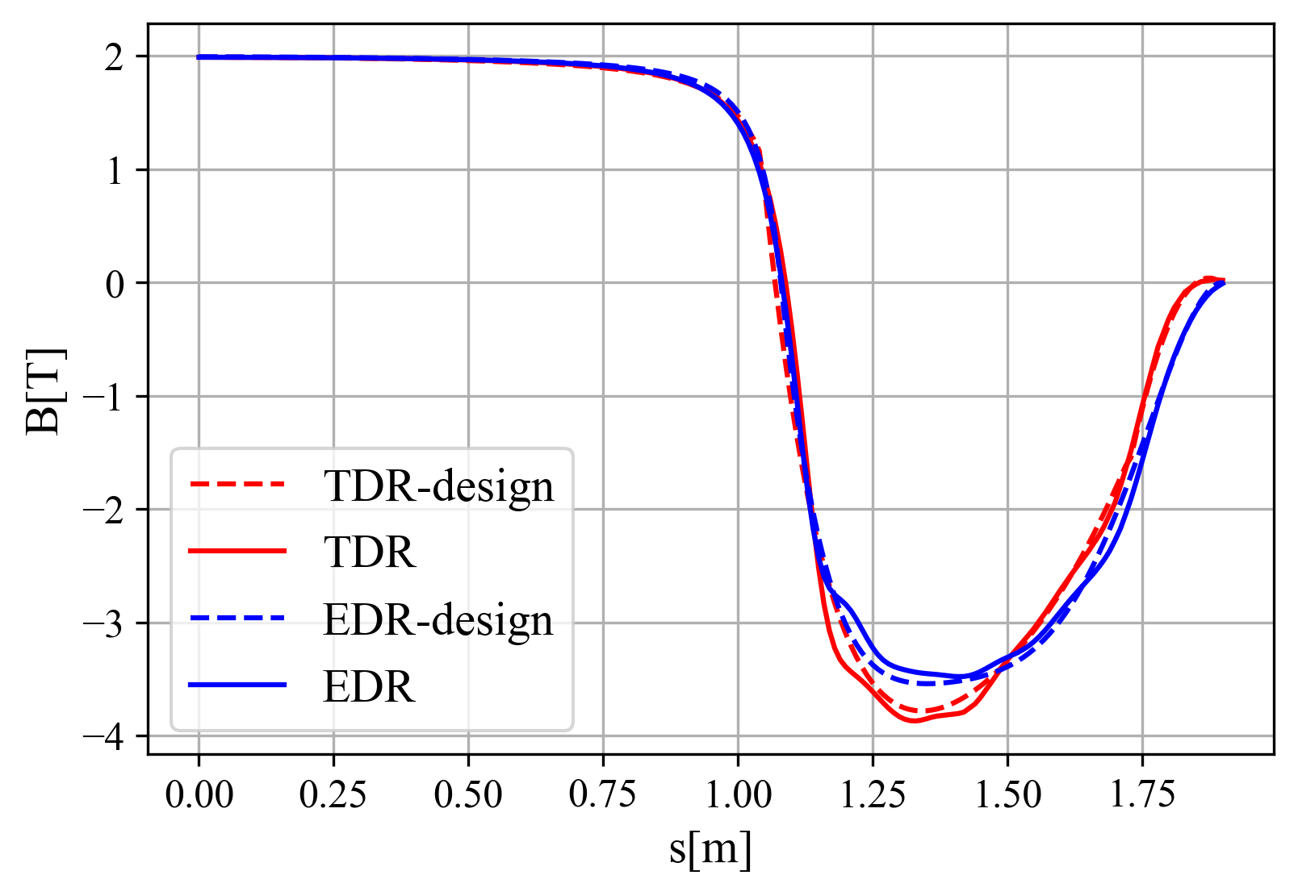
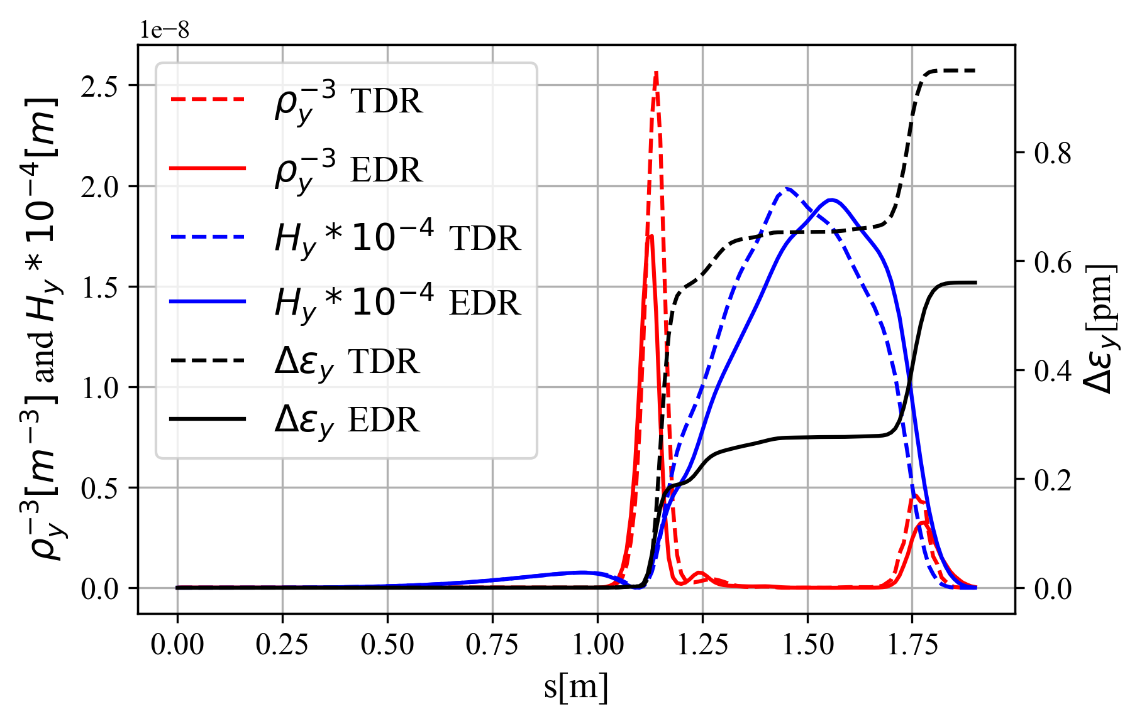
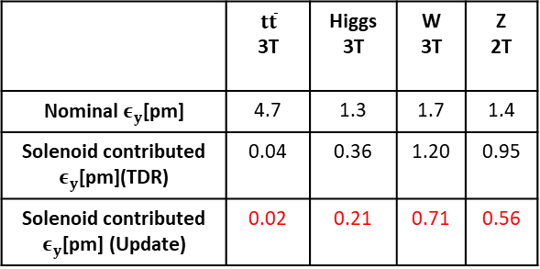
  Solenoid field compensation in CEPC TDR and update
Ande MA, Yiwei Wang, Yingshun Zhu et al
Detector solenoid field @ W/Higgs/ttbar
(Scaled to 2T at IP @ Z)
1.9m
The detector solenoid are compensated locally with anti-solenoids
From IP to the entrance of Q1A (0 to 1.9m):
  ∫Bzdz cancled between the IP and the entrance of final quadrupole with strong anti-solenoid field in 1.1m to 1.9m.
  Field configuration optimized to get emittance minimum and iterate with anti-solenoid technical constraints
From the entrance of Q1A to Q3(1.9m to 10.55m)
  Bz keep fully cancellation along this region
From the Q3 to the last bend (farer than 10.55m)
  ∫Bzdz from detector only < 0.5 T*m.
  Along beam line (not z), fully cancelation in Q3 and pre-cancelation in some extension region (with length of 1m) for the long tail of the detector solenoid field
Combined field @ Z
Data from Feipeng Ning
Z scaled to 2T
Emittance contribution from the from IP to the entrance of Q1A
 | $$t\overline{t}$$ 3T | Higgs 3T | W 3T | Z 2T
Nominal $ε_{y}$[pm] | 4.7 | 1.3 | 1.7 | 1.4
Solenoid contributed $ε_{y}$[pm](TDR) | 0.04 | 0.36 | 1.20 | 0.95
Solenoid contributed $ε_{y}$[pm] (Update) | 0.02 | 0.21 | 0.71 | 0.56

Slide 11
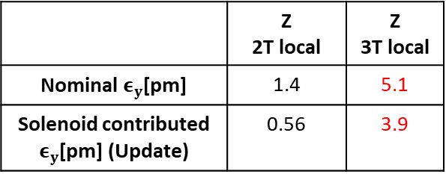
  3T solenoid detector field for CEPC Z pole operation
  (local compensation scheme)
Ande MA, Yiwei Wang, Yuan Zhang, D. Wang et al
Motivation: The TPC detector can run with much lower background when detector field is 3T comp. with 2T case.
With local compensation scheme
  Bz0 2 T=>3 T, vertical emittance 0.56 pm => 3.9 pm
  fulfill the nominal vertical emittance requirement of the 1st stage running ( assuming 5.1pm including error effects from other region )
 | Z (3T local, 1st stage running)
Number of Ips | 2
Circumference (km) | 99.955
SR power per beam (MW) | 12.1
Half crossing angle at IP (mrad) | 16.5
Bending radius (km) | 10.7
Energy (GeV) | 45.5
Energy loss per turn (GeV) | 0.037
Damping time τ_{x}/τ_{y}/τ_{z} (ms) | 816/816/408
Piwinski angle | 24
Bunch number | 3978
Bunch spacing (ns) | 69.2
Bunch population (10¹¹) | 1.7
Beam current (mA) | 325.0
Phase advance of arc FODO (°) | 60
Momentum compaction (10⁻⁵) | 1.43
Beta functions at IP β _{x}*/β _{y}* (m/mm) | 0.13/1.0
Emittance ε_{x}/ε_{y} (nm/pm) | 0.27/5.1
Betatron tune ν_{x}/ν_{y} | 317/317
Beam size at IP σ_{x} /σ_{y} (um/nm) | 6/72
Bunch length (natural/total) (mm) | 2.1/8.8
Energy spread (natural/total) (%) | 0.04/0.15
Energy acceptance (DA/RF) (%) | 1.0/2.2
Beam-beam parameters ξ_{x} /ξ_{y} | 0.0053/0.082
RF voltage (GV) | 0.16
RF frequency (MHz) | 650 (2 cell cavity)
Longitudinal tune ν_{s} | 0.041
Beam lifetime (Bhabha/beamstrahlung) (min) | 150/180
Beam lifetime requirement (min) | 68
Luminosity per IP (10³⁴ cm^{–2} s^{–1}) | 26
CEPC parameters with 3T detector for Z in the 1st stage running
The luminosity is limited by both the current (RF high order modes) and vertical emittance (solenoid field induced)
Luminosity goal 26E34/cm^2/s was accepted by the 1st stage running of CEPC detector
 | Z 2T local | Z 3T local
Nominal $ε_{y}$[pm] | 1.4 | 5.1
Solenoid contributed $ε_{y}$[pm] (Update) | 0.56 | 3.9

Slide 12
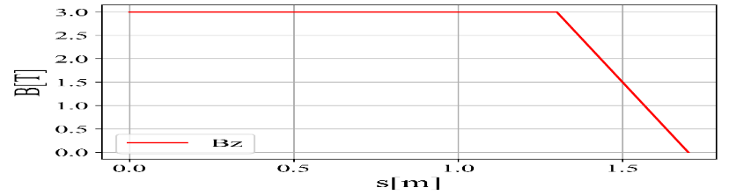
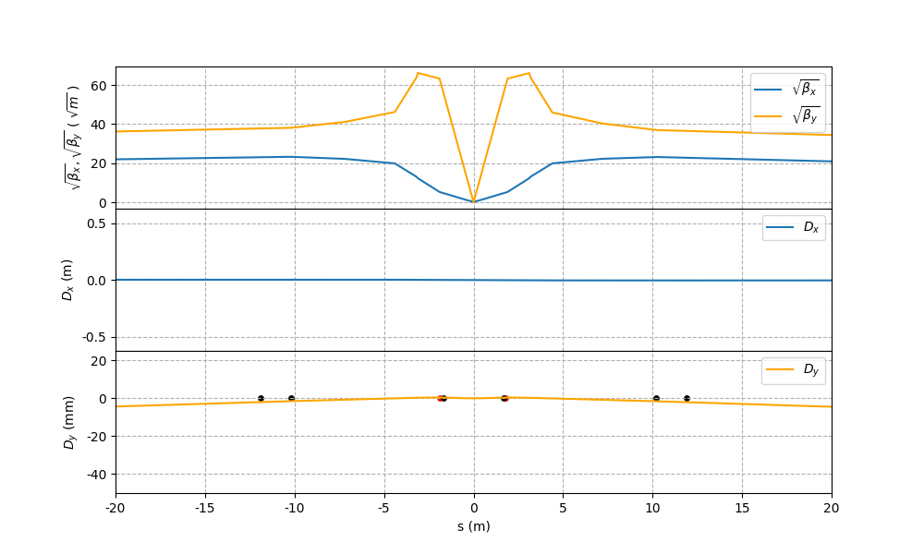
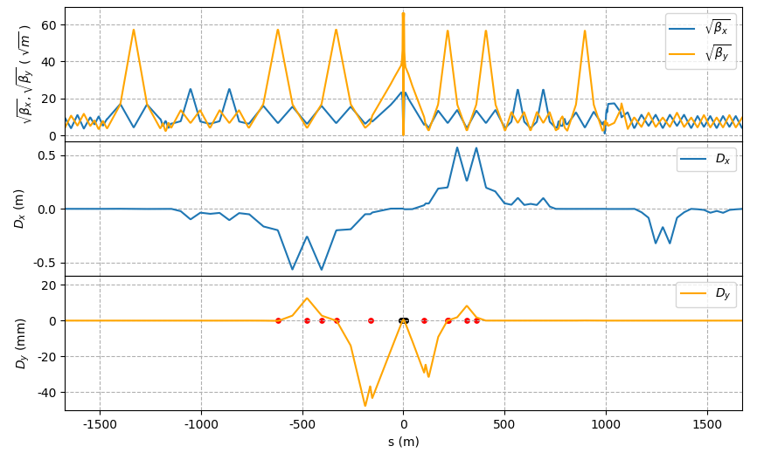
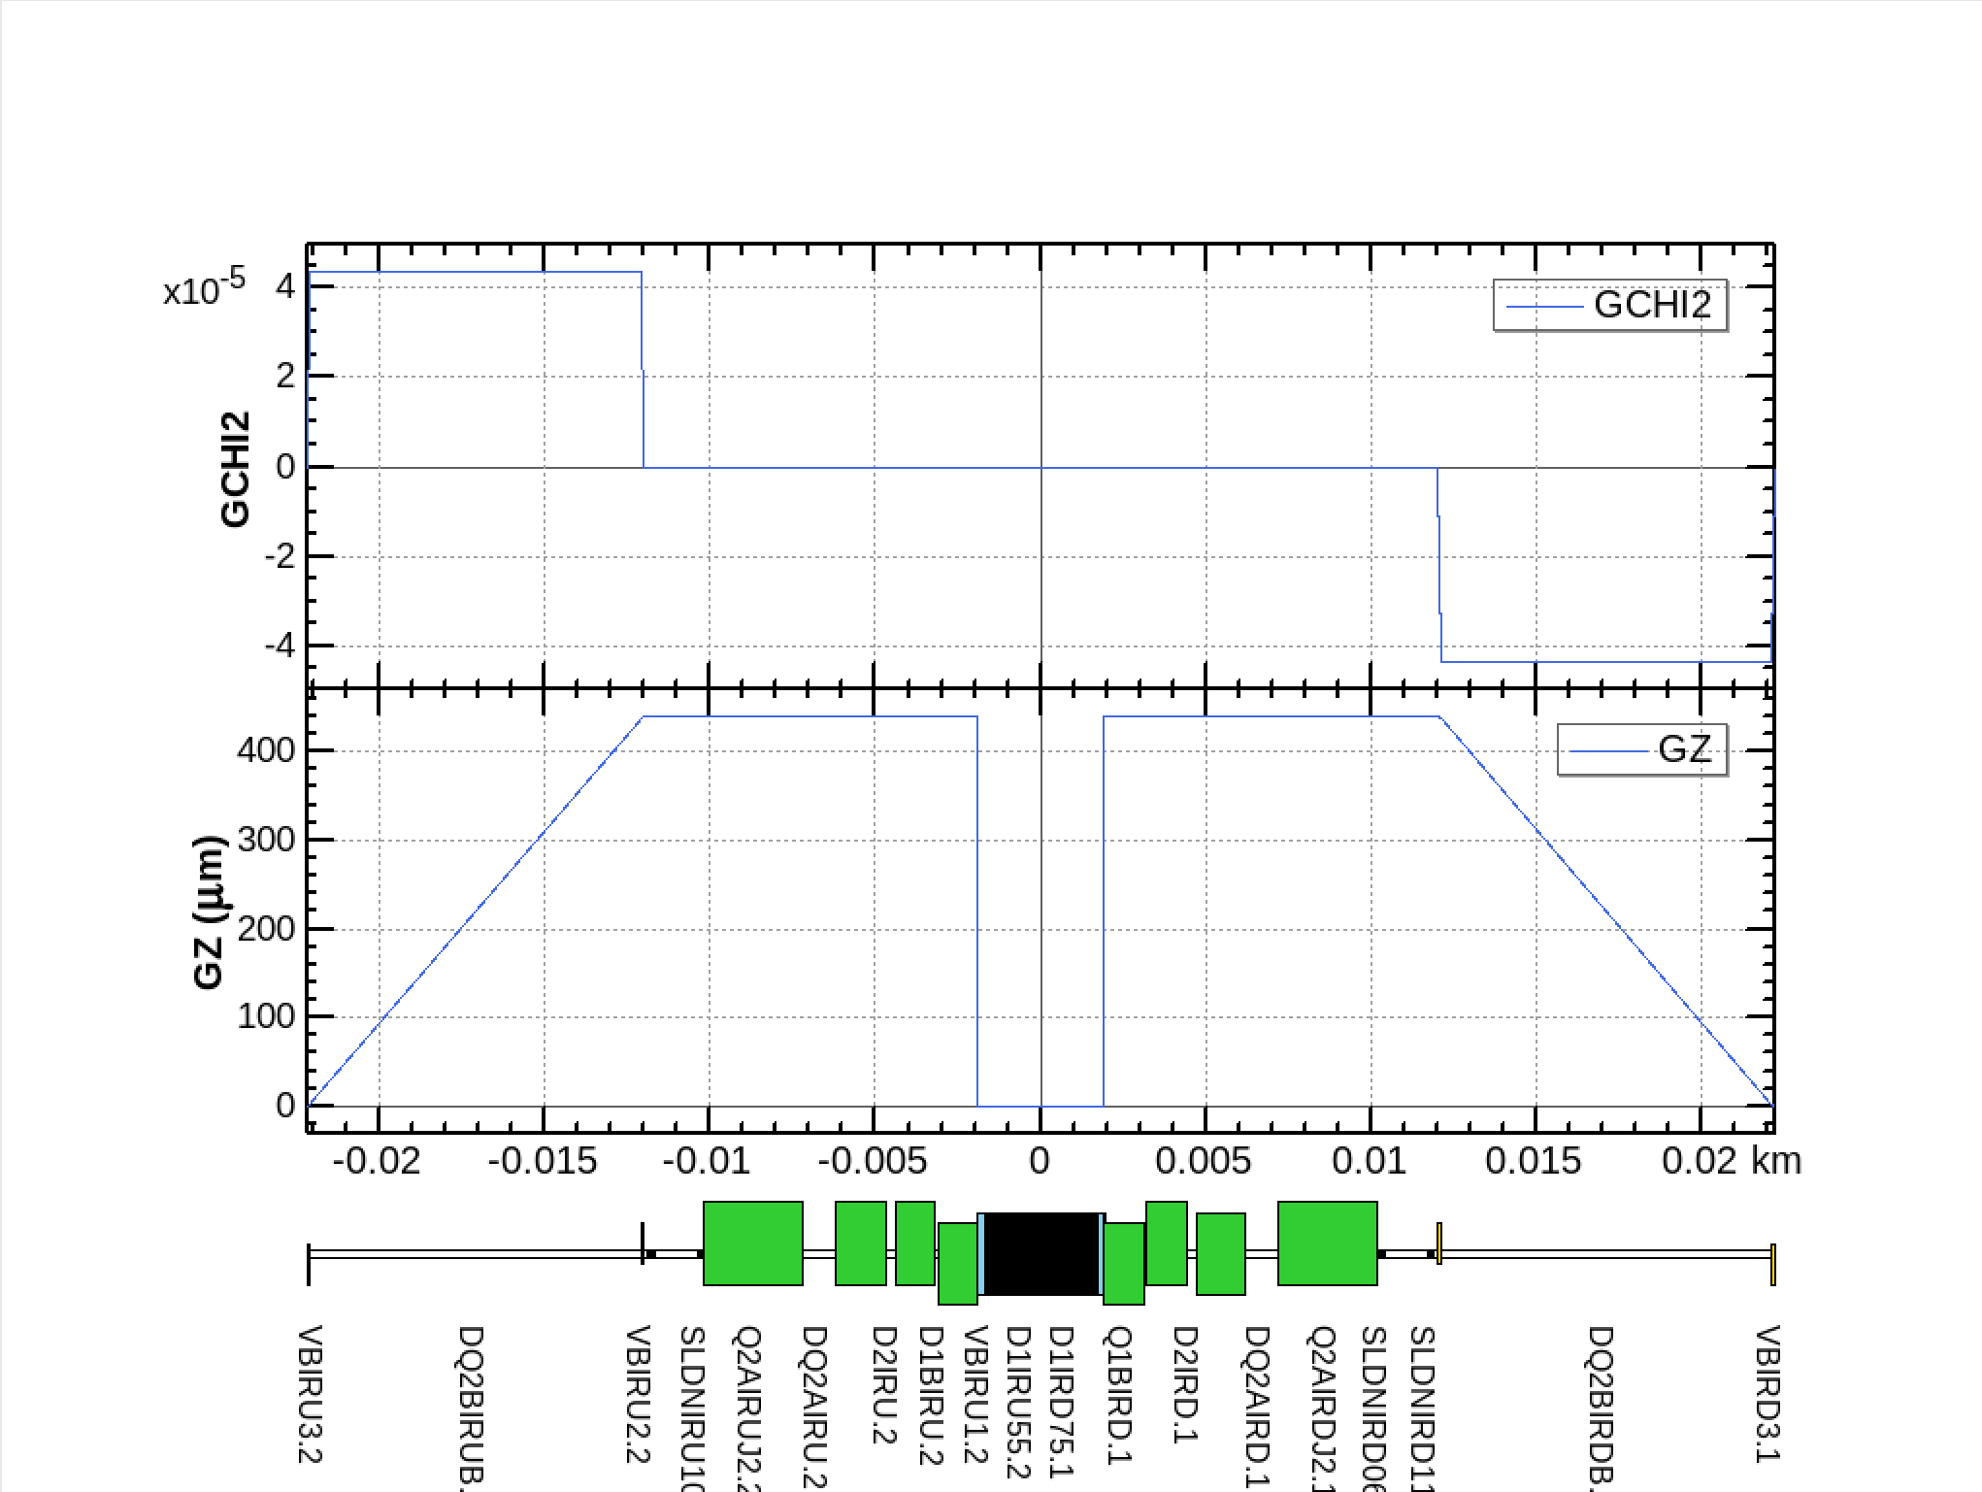
3T solenoid detector field for CEPC Z pole operation
(non local compensation scheme)
Yixian Dai, Yiwei Wang, Yuan Zhang
1.7m
    If non-local compensation scheme with Bz0=3 T
  Anti solenoid
    assuming anti-solenoid in front of the final quadrupoles from 1.3m to 1.7m to cancel the Bz to be zero and kept zero until the end of the final quadrupoles
  One bend in front of the final quadrupoles to partly correct the vertical angle
  Add Skew quadrupole coils on the final quadrupoles thus the beam will match the quadrupole
  Anti solenoid to cancel the ∫Bzdz to be zero right at down stream of the final quadrupole cryo-module
  5 more bends at the down stream to correct the orbit and dispersion y, y’, Dy, Dy’
Anti solenoids
Skew quad coils
Vertical bends
Anti solenoids
Vertical bend

Slide 13
Emittance comparison @ 3T Z
Vertical emittance can be reduced a lot though the optics and orbit correction is much more complicated.
  Peak luminosity potential is higher with non-local scheme.
Maximum of the compensation field can be reduced from 8.2T to 3T @ 3T Z running.
The space in front of the Q1A can be saved around 0.2 m which will be further check with MDI designs.
Z running with 3T detector solenoid | Local compensation | Non-local compensation
Potential peak luminosity [10^34/cm^2/s] | 26 (goal of the 1st stage running) | 115 (goal of the 2nd stage running )
Vertical emittance budget for ring [pm] | 5.1 | 1.4
Vertical emittance due to solenoid [pm] | 3.9 | 0.3
Maximum of the compensation field [T] | 8.2 | 3
Combined field @ Z with local scheme
Combined field @ Z with non local scheme
1.1-1.9m
1.3-1.7m

Slide 14
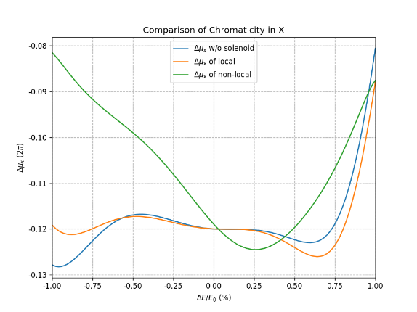
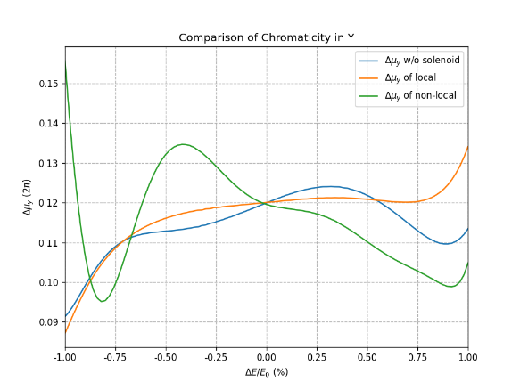
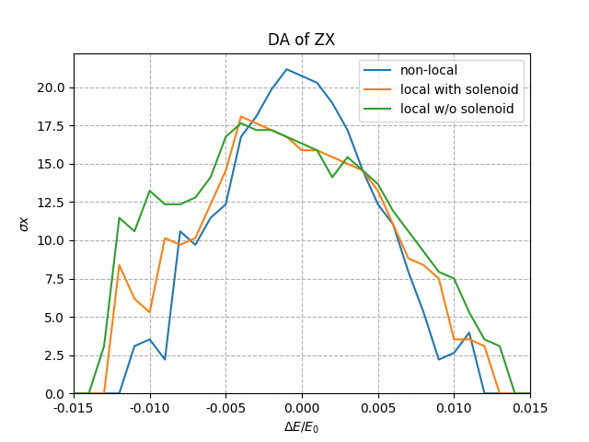
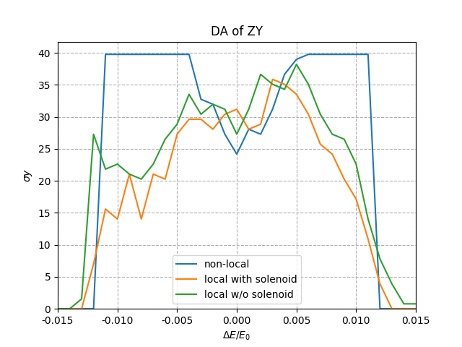
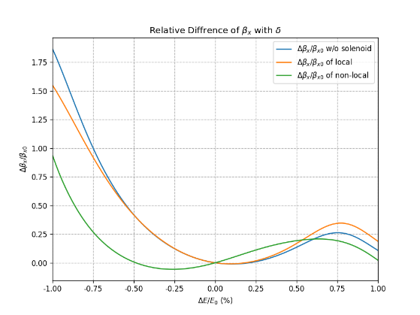
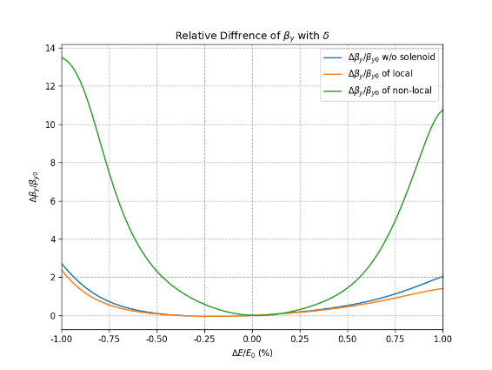
Nonlinear correction with non-local scheme @ 3T Z
Both dynamic aperture and beam blow-up without beam-beam were optimized with multi-objective optimization algorithm
  Dynamic aperture of non-local scheme is a bit smaller than the one of the local scheme which means similar beam lifetime (to be checked in next step)
  The energy dependent optics distortion due to the vertical dispersion and beta distortion were disturbed for non-local scheme (will be further optimized)
non local Qx=-4, to be further optimized

Slide 15
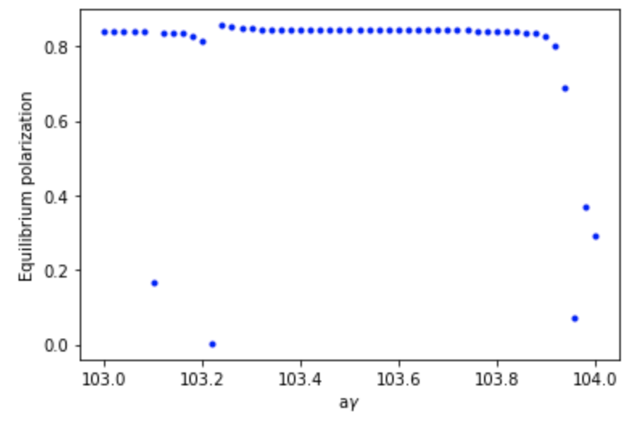
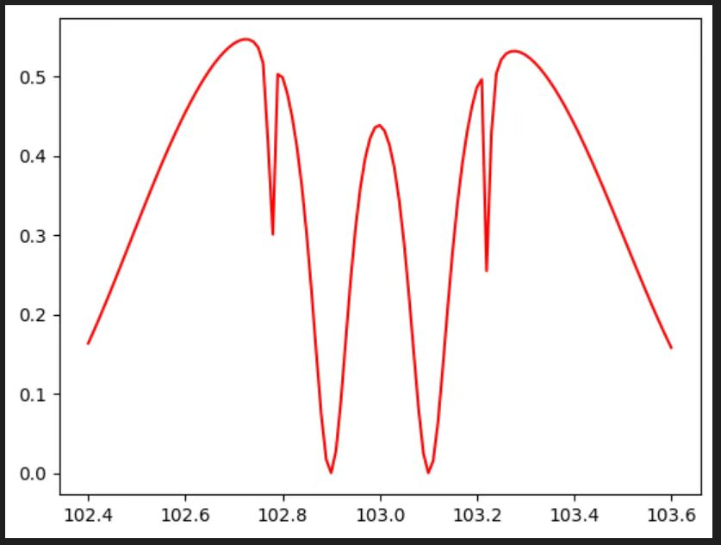
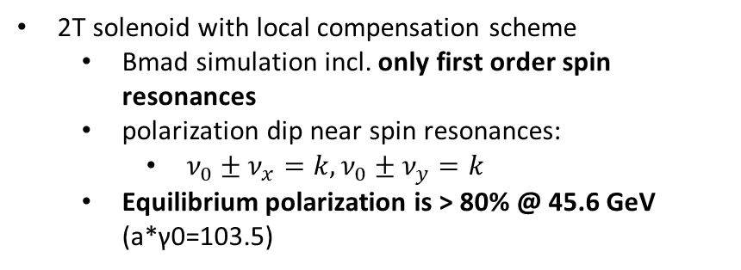
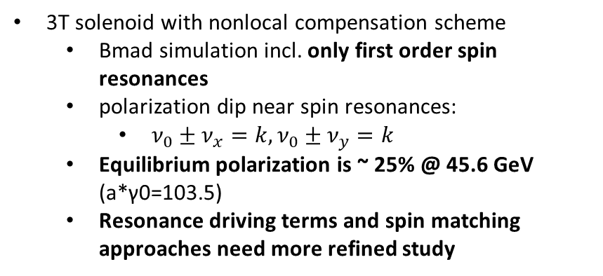
Polarization comparison @ 3T Z
Z. Duan
2T solenoid with local compensation scheme
  Bmad simulation incl. only first order spin resonances
  polarization dip near spin resonances:
    $ν_{0}±ν_{x}=k,ν_{0}±ν_{y}=k$
  Equilibrium polarization is > 80% @ 45.6 GeV (a*γ0=103.5)
3T solenoid with nonlocal compensation scheme
  Bmad simulation incl. only first order spin resonances
  polarization dip near spin resonances:
    $ν_{0}±ν_{x}=k,ν_{0}±ν_{y}=k$
  Equilibrium polarization is ~ 25% @ 45.6 GeV (a*γ0=103.5)
  Resonance driving terms and spin matching approaches need more refined study
Equilibrium polarization of local scheme
Equilibrium polarization of nonlocal scheme
From local to non-local scheme: equilibrium polarization is reduced from 80% to 25%.
45.6 GeV
45.6 GeV
a*γ₀
a*γ₀

Slide 16
Comparison of the local and non-local solenoid scheme
The local compensation schemes for solenoid were further optimized for TDR lattice.
The local compensation schemes for 3T solenoid fulfill the requirement of TPC detector in 1st stage running.
The non-local compensation scheme have potential to reach the high luminosity of 2nd stage running.
  Vertical emittance can be reduced from 3.9 to 0.3 pm @ 3T Z; Though the optics and orbit correction is much more complicated.
  Maximum of the compensation field can be reduced from 8.2T to 3T. The longitudinal space in front of the final quadrupoles can be saved around 0.2 m.
  DA of nonlocal scheme is a bit smaller than the one of the local scheme.
  The equilibrium polarization is reduced from 80% to 25%, which is similar to Oide san’s result.
Z running with 3T detector solenoid | Local compensation | Non-local compensation
Potential peak luminosity [10^34/cm^2/s] | 26 (goal of the 1st stage running) | 115 (goal of the 2nd stage running )
Vertical emittance budget for ring [pm] | 5.1 | 1.4
Vertical emittance due to solenoid [pm] | 3.9 | 0.3
Maximum of the compensation field [T] | 8.2 | 3
Dynamic aperture | slightly reduced from no solenoid | slightly reduced from no solenoid
Equilibrium polarization [%] | 80 | 25

Slide 17
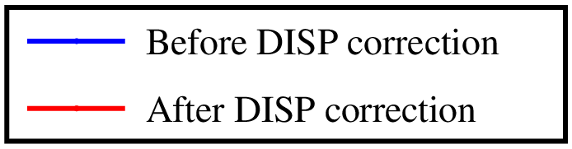
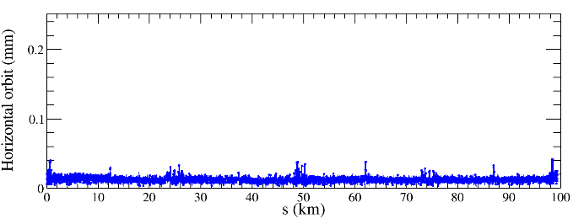
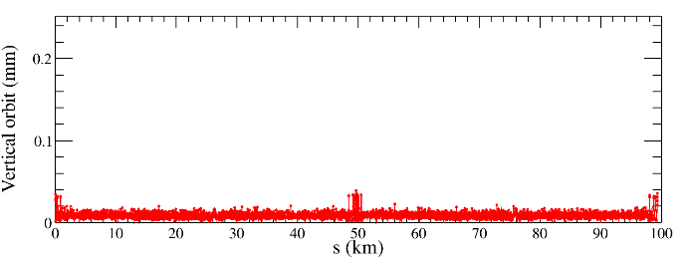
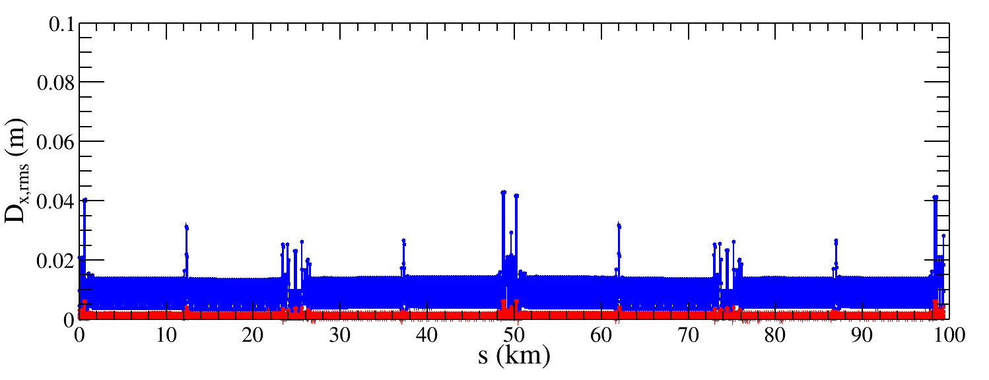
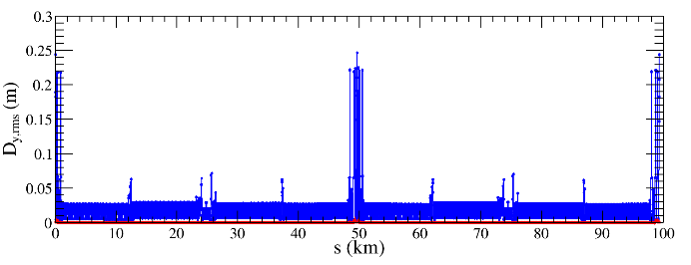
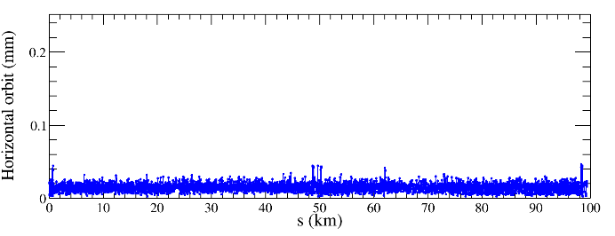
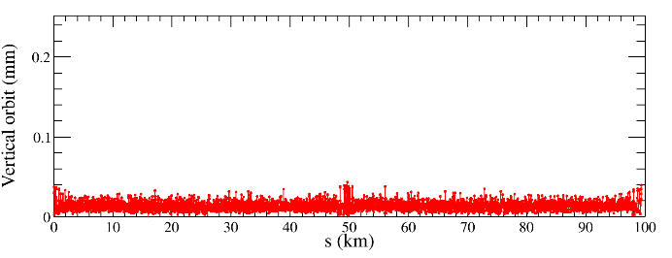
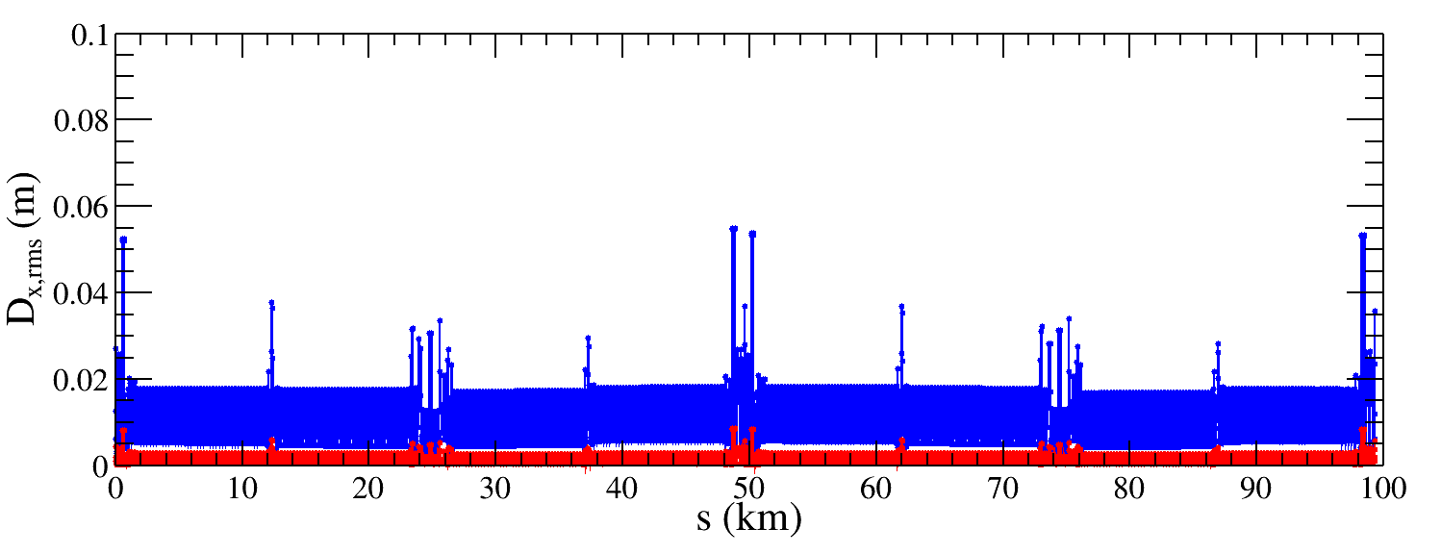
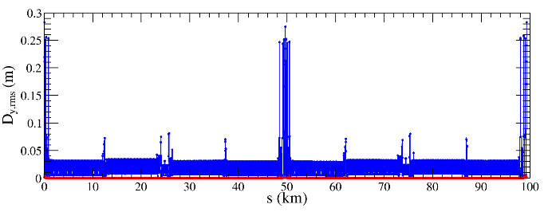
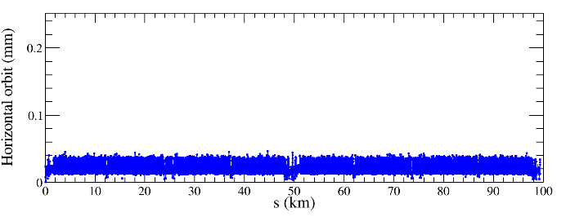
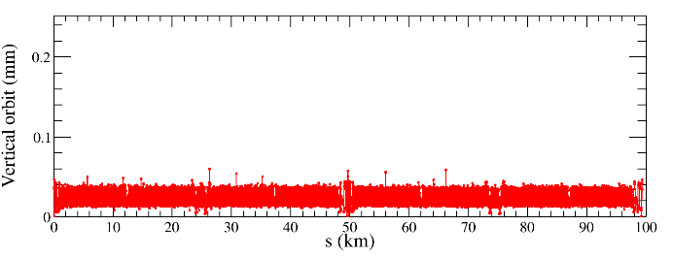










Alignment torlerance of the lattice
Bin WANG
Horizontal orbit
Vertical orbit
30 μm, 50 seeds converged
50 μm, 48 seeds converged
100 μm (TDR), 50 seeds converged with manual iteration.
150 μm, 21 seeds converged
150 μm, 11 seeds converged
As misalignment errors increase, the closed orbit exhibits growth while the convergence rate decreases, dispersion after correction remains comparable.

Slide 18




Error analysis of the solenoids misalignment
Offset
Tilt
Preliminary error requirements for the CEPC detector solenoid and compensating solenoid for Higgs mode
vertical emittance growth and the misalignment of anti-solenoid Δ𝑋2
vertical emittance growth and the misalignment of anti-solenoid Δθy

Slide 19
Requirements of the stabilities of
the magnet power supplies
Arc regions
  In principle, the dual-aperture dipoles and quadrupoles can be connected in series as same FODO cells in the arc. Actually powered by many power supplies due to the large scale of CEPC.
  Correctors, trim coils for the tapering, each pair of sextupoles for nonlinearity optimization should be powered independently (single-aperture)
RF, injection and interaction regions
  most magnets should be powered independently (single-aperture)
Stabilities
  The accuracy of the collision energy measurement from the HEP experiment would require better dipole stability)
  The working point and beta* stability would require better quadrupole stability
The stability requirement of magnet PS in TDR
Magnet Power Supplies | Quantity | Stability /8hours
Dipole-D-aperture | 32 | 10ppm
Dipole-S-aperture | 38 | 10ppm
Quadrupole-D-aperture | 328 | 10ppm
Quadrupole-S-aperture | 600 | 10ppm
Sextupole | 1096 | 20ppm
Corrector-H & V | 7088 | 100ppm
Trim | 11904 | 100ppm
Superconducting magnets | 88 | 10ppm
Total | 21174

Slide 20


Requirements of the stabilities of the magnet power supplies
Zifan Su
Assumptions for dipoles PS @ Higgs
  50% of the dynamic error effects
  ARC dipole: 16 families power supply
  IR, RF bypass: independent power supply
  Safety factor 3 included
Requirement
  ∆L/L(beam jitter)<0.1%
  ∆Ecm<2MeV
  ∆L/L(beam size blowup)<0.1%
Assumptions for quadtupoles PS @ Higgs
  50% of the dynamic error effects
  ARC dipole: 160 families power supply
  IR, RF, STR: independent power supply
  Safety factor 3 included
Requirement
  ∆Q<0.5E-4
  ∆L/L(beam size blowup)<0.1%
 | ARC | IR | RF bypass
$$I_{\text{stability}}(±ppm)$$ | 4.8 | 0.72 | 2.16
 | ARC | IR
$$I_{\text{stability}}(±ppm)$$ | 1.77 | 0.15
Requirement on power supply stability of the dipoles and quadrupoles in the IR will be less than 1ppm for some seconds @ Higgs.
Study on the other energies in on the way.

Slide 21


Vibration analysis with frequency-related coherence
Fang YAN et al
Constructed a vibration beam dynamics model related with frequency to study the vibration-induced beam orbit distortion at the IP.
Vibrations were introduced to all the quads within the arc section, across a range of frequencies.
The amplification factor indicates a strong coherence for vibrations at frequencies below 5Hz.

Slide 22

  Luminosity with local coupling error at IP
Yuanyuan WEI et al
Sensitivity study of the luminosity with local coupling error only in one beam (ring); for Higgs energy
The scaled coupling parameters R1/R2/R3/R4 have similar effects, where the scaled parameters should < ~1 to keep luminosity loss < 10%
Critical value — corresponding to 10% luminosity loss:
  R1 * =0.0022 (rad)
  R2 * =7.31*10⁻⁴ (m)
  R3 * =2.22 (m⁻¹)
  R4 * =0.61 ( rad)
Critical value — comparable to 1σ_{y} and 1σ’_{y} at IP
  D_{y} * =1.85*10⁻⁵ (m)
  D’_{y} * =3.65*10⁻⁵ (rad)
Luminosity with local coupling error at IP for Higgs energy (by Yuan Zhang)
R1, R2, R3 and R4 are the components of the x-y coupling matrix

Slide 23








Determine the coupling knobs for CEPC
Yuanyuan WEI et al
Suppose skew components at quadrupoles and sextupoles of IR
Calculate the response of { D_{y},D_{y}’,R1, R2, R3, R4} at IP to skew strength variations
Plot the 6 vectors and calculate the area enclosed by the 6 vectors for each magnet
Sort the area and find 6 magnets which are most sensitive to the parameters

Slide 24
Strength requirement of the IP coupling knobs
Specification for magnets design have been evaluated by applying a correction for 9 times of the RMS residual error at IP after global optics correction
Simulation with errors (3σ * 3 safety factor) after global optics correction
 | R1 | R2[m] | R3[m⁻¹] | R4 | Dy[m] | Dpy
rms(*10⁻³) | 0.87 | 0.89 | 49.77 | 31.11 | 0.0052 | 0.016
Strength requirement of the IP coupling knobs
 | Q1BIRU | QFV1IRU | VS2IRU | QFV3IRU | QDH1IRU | QDH2IRU
L(m) | 1.21 | 2.00 | 0.60 | 2.00 | 2.00 | 2.00
SK1(*10⁻³m⁻¹) | 1.13 | 1.00 | 0.20 | 0.25 | 1.00 | 1.00
G（T/m) | 0.37 | 0.20 | 0.14 | 0.05 | 0.20 | 0.20

Slide 25



Impedance and instabilities
Na WANG
The impedance model is updated considering the impedance contribution from the collimators and possible mitigations strategies. Their influence to the beam instabilities and luminosity is investigated.
Concerning the high intensity constraints in the Z operation mode, the impedance reduction, partially thanks to the decreased number of collimators, eases the requirements on the damping strategies.
Evaluate with rms bunch length of 3mm
TMCI stable with B-by-B feedback (damping rate ~0.05)
Design luminosity reached with feedback and positive chroma

Slide 26

Motivation
Accelerator Physics Emulation Studio (APES)
By the accelerator physics team of IHEP
Supported by IHEP Innovation Fund from 2022 to 2024
More accurate, powerful and faster
Meet the requirements of beam dynamics study in CEPC
Modeling complicated lattice easily
  IR, overlapped field, …
Combined effects should be studied self-consistently
  Beam-beam interaction + impedance/feedback/lattice, …
Application of new IT technology
  CPU, Openmp/MPI -> GPU, CUDA
…
Under active development

Slide 27



Simulation of Swap-out injection (Higgs)
Zhiyuan LI et al
Self-consistent simulation of injection
e+(inj.) / e-
w/o apert: 39/42(min)
w/ apert: 29/37(min)
Initial beams: e+ (collider SR equilibrium) vs e- (booster SR equilibrium)
Luminosity: same between symmetric and asymmetric collision
Clear lifetime reduction (e+) with physical aperture
  The aperture and location of collimators will be optimized

Slide 28





Modeling of SuperKEKB (LER)
Yuanyuan Wei, Weibin Liu，
Aug 25, 2025, SuperKEKB BEAM-BEAM Collaboration Meeting
Application to the SuperKEKB operation lattice which is very complicated
The comparison of the parameters between APES and SAD
  𝚫𝐆𝐗,𝚫𝐆𝐘 < 3.5 um
  𝚫𝐆𝐙 < 0.8 mm

Slide 29
Conclusions and further work
Progress of the collider beam dynamics toward EDR are presented.
The CEPC accelerator physics team has conducted extensive work to optimize the physical design in order to achieve high collision luminosity.
Currently, more rigorous and comprehensive performance evaluations of the physical design are underway, alongside software development specifically for the future high luminosity colliders.
We welcome exchanges and collaborations.

Slide 31

Remind of the RF region layout in TDR
1st priority of the Higgs running and switching between different modes
Shared cavities for two beam @ Higgs, ttbar; Bunches filled in each half rings
  Independent cavities; bunches filled in each whole rings for the W and Z
Maximize the performance and flexibility of future circular electron positron collider
Stage 1
H/W/LL
-
Z (and HL
-
：
H/W upgrade)
Outer Ring
H
H
Inner Ring
Stage 2
HL
-
H/W/Z (HL
-
：
Z upgrade)
Outer Ring
Z
H
H
Z
Inner Ring
Stage 3
HL
-
H/W/Z/ttbar (ttbar
-
：
upgrade)
Outer Ring
Z
H
ttbar
H
Z
Peak luminosity at different stages with SR power for 30/50MW per beam
Inner Ring
Luminosity/IP [10^34/cm^2/s] | Higgs | Z | W | ttbar
Stage 1 | 5/8.3 | 38 (2T solenoid, beam power limit) | 16/26.7 | -
Stage 2 | 5/8.3 | 115/192 | 16/26.7 | -
Stage 3 | - | 115/192 | 16/26.7 | 0.5/0.83
H
Z
ttbar
650 MHz 2
-
cell cavity
650 MHz 5
-
650 MHz 1
cell cavity
-
6 cavities in 1 CM
cell cavity
4 cavities in 1 CM
1 cavity in 1 CM

Slide 32




Solenoid effect on dynamic aperture
  The anti-solenoid cancel the ∫Bzdz between the IP and the faces of the final quadrupole.
The Twiss function distortion due to solenoid field was corrected with final quadrupoles.
The solenoid effect on the dynamic aperture is small.
Effects included in tracking
Synchrotron motion
Radiation loss in all magnets
Tapering
Crab waist sextupole
Maxwellian fringes
Kinematic terms
Finite length of sextupole
Solenoid
Higgs without solenoid
Higgs with
solenoid

Slide 33



Optics comparison @ 3T Z
Optics of non-local scheme was carefully re-matched due to the leak of the vertical dispersion and orbit deviation.
Several layout of the vertical bends tried and the optics generate vertical dispersion only on the 1st main IR sextuples was choosed to disturb the original optics as less as possible.
Vertical bends
Anti solenoids

