Slide 1


CEPC Magnets (both collider & booster)
Mei Yang, Wen Kang
On behalf of Magnet Group
2025.11.06
The 2025 International Workshop on the High Energy Circular Electron Positron Collider (CEPC2025)
November 6-10, 2025, Guangzhou, China

Slide 2
Content
Overview of magnet system in CEPC
Collider magnet progress in EDR
Review of magnet development in TDR
EDR status of collider magnets
Booster magnet progress in EDR
Summary

Slide 3
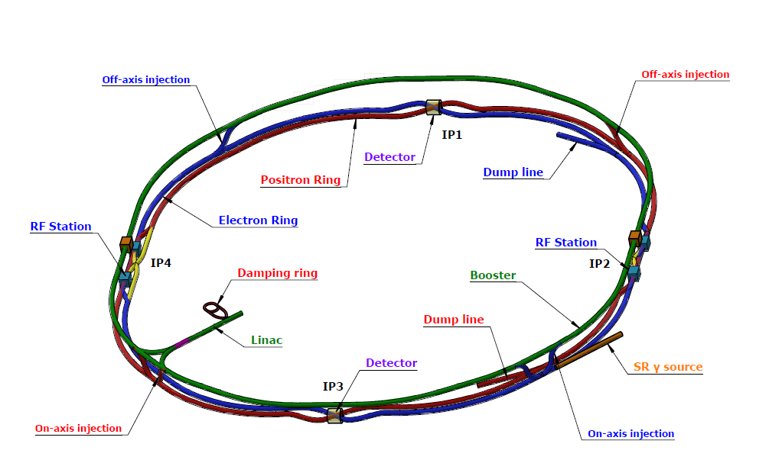
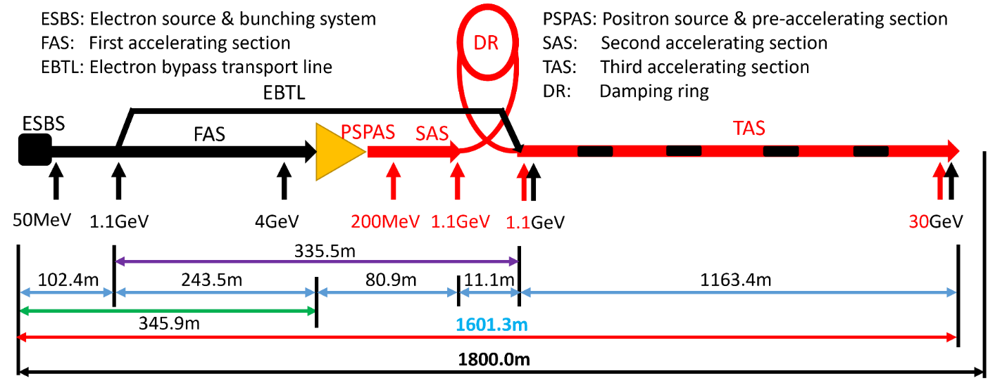
Overview of magnet system in CEPC
Lattice of CEPC
Injector：S+C-band 30GeV linac
Booster ring (C=100km)： ramped from 30~180GeV with a frequency of 0.1Hz
Collider double ring：shared a same tunnel with Booster
SR power per beam 30 MW (50 MW upgradable), 100 km, 2 interaction points
Higgs mode hold the 1st priority and compatible with the ttbar/W/Z modes.
Transport lines
As the low field in CEPC, all magnets are normal conducting magnets (except some in IR region).
Injector
Booster and Collider

Slide 4
Key specifications of CEPC main magnets
Booster | Number | Length | Min. field | Max. field
Dipole | 14866 | 4.7m/2.4m | 95Gs | 564Gs
Quad. | 3458 | 2m/1m | 2.0T/m | 15.9T/m
Sext. | 100 | 0.4m | 18T/m² | 217T/m²
Corr. | 1200 | 0.58m | 20Gs | 200Gs
Collider | Dipole | Quad. | Sext. | Corr.
Number of DA | 3008 | 3012 | - | -
Number of SA | 162 | 1128 | 3176 | 7088
Length(m) | 19.7/23.1 | 3 | 1.4 | 0.44
Max. field | 600Gs | 10.6T/m | 847T/m² | 300Gs
With a total magnet length of about 160 km, cost is a major consideration throughout the manufacturing and operational phases.
The magnetic field in the Booster magnets varies with the beam energy, necessitating the use of laminated cores instead of solid iron.
The main dipole and quadrupole magnets of the collider are dual aperture magnets with a 350 mm beam separation.
Lead blocks are guaranteed the coil from large radiation in Collider.
All magnets in Collider work at four energies (Higgs, W, Z and ttbar mode).

Slide 5
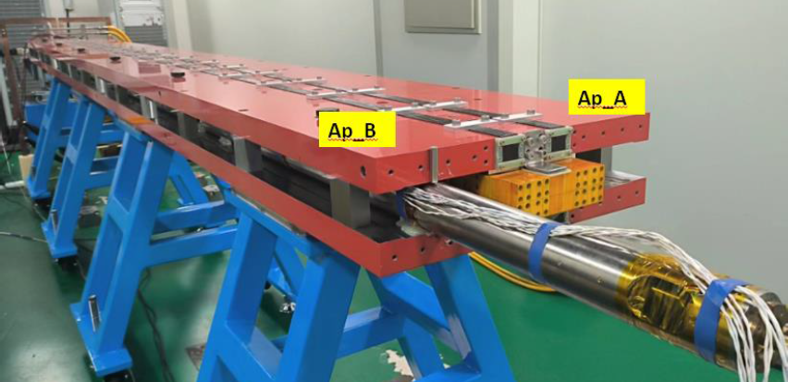
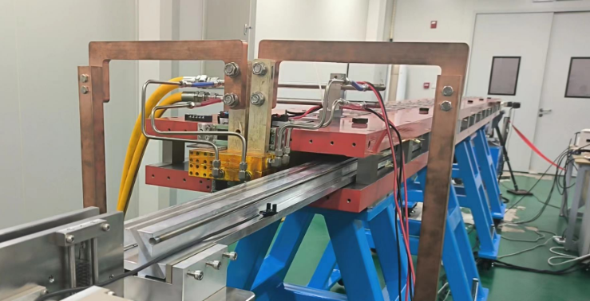
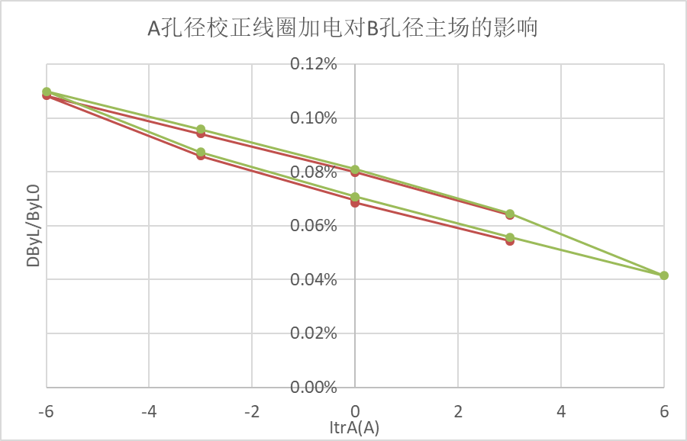
Review of Collider magnet development in TDR
Dual Aperture Dipole(DAD) prototype
Field harmonics meet the requirements.
Field distribution highly consistent over the working range.
Trim coils work with some hysteresis effect.
Item | Units | Value
Aperture diameter | mm | 70
Field strength | Gs | 150~600
Effective length | m | ~5.7
Trim coil adjustability |  | ±2.5%
Good field region | mm | 11.6
Harmonics |  | 5×10⁻⁴
Rotating coil
Hall probe
High harmonics @120GeV (units:1e-4)
n | bn_A | bn_B
2 | 0 | 0
3 | 3.92 | 3.88
4 | 1.03 | -1.22
5 | 0.47 | 0.54
6 | 0.08 | -0.46

Slide 6
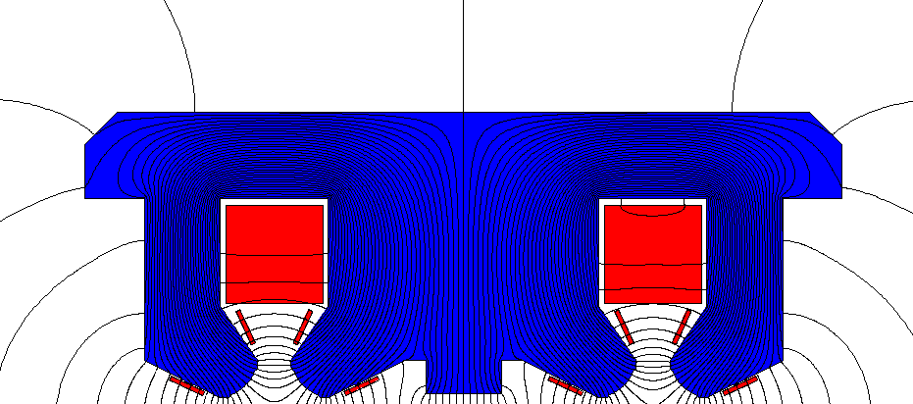
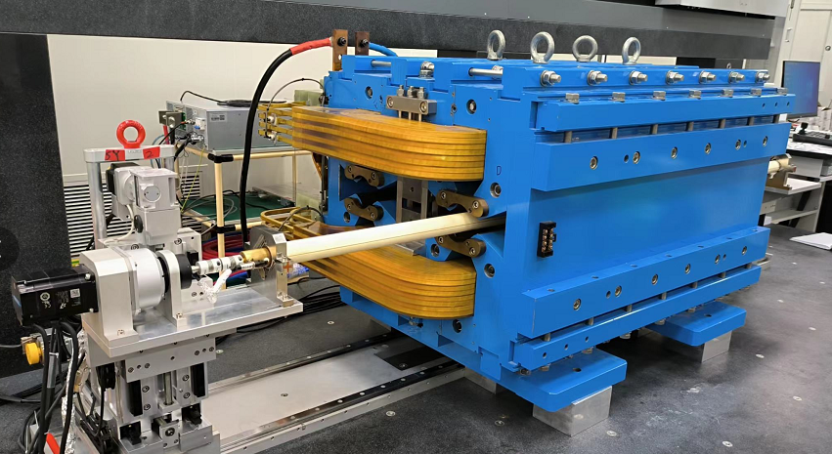
Review of Collider magnet development in TDR-2
Dual Aperture Quadrupole(DAQ) short prototype
Field measurement results
Harmonics meet the requirements with magic fingers compensation.
The field harmonics are changed a little with the gradient for the variations in magnetic materials which lead to asymmetry.
The dipole component mainly results from the shared coils between the two apertures.
Item | Units | Value
Aperture diameter | mm | 76
Gradient | T/m | 1.9~10.6
Effective length | m | 1
Trim coil adjustability |  | ±2.5%
Good field region | mm | 12.2
Harmonics |  | 5×10⁻⁴

Slide 7
EDR plan of CEPC magnet system
Further magnet optimization and iterative design
Prototypes to verify the field quality, mechanical structure, production process and alignment
Research and investigation of radiation resistant materials, the design of radiation resistant lead blocks, as well as interconnection of multi-cores in dipole magnet.
Further engineering design, compatibility with mechanics, mock up layouts, and utility facilities.
Research on efficient batch production and field measurement
Large scale manufacturing with more than 35000 magnet elements
Allow the magnet components production on flow lines, including the stacking process, welding, assembly, size checking, coil winding, machining, etc.
An automatic magnet production line for booster dipole magnets is under development. Refs. to J. Gao’s talk.
Field measurements are also hard tasks and time taking. Fixed measurement task and modular measurement process is very important.

Slide 8
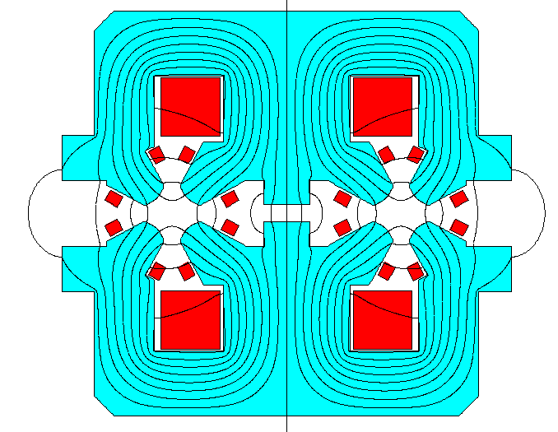
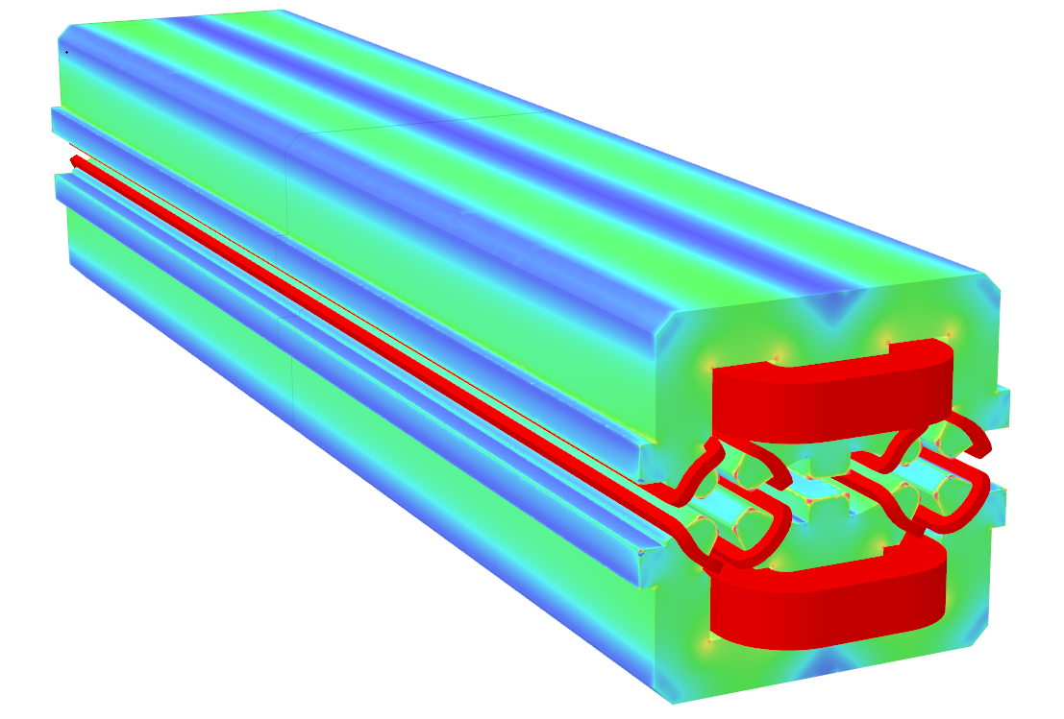
EDR status: full length DAQ design
A full length dual aperture quadrupole (DAQ) magnet is designed and will be developed.
D=66 mm, Leff=3 m, G=1.9~10.6 T/m, aluminum conductor for coils
Cross section updated and optimized to consist with the vacuum chamber and lead blocks.
Center yoke shim is still used for field interference compensation.
Trim coils (2.5% adjustability) are considered to taper the field gradient.
The field quality is verified by 3D simulation.
n | B_{n}/B₂ [10⁻⁴]
 | E=45.5GeV | E=80GeV | E=120GeV | E=180GeV
3 | -1.62 | -1.23 | -0.89 | -0.82
4 | -0.09 | -0.08 | -0.05 | -0.04
5 | 0.43 | 0.43 | 0.44 | 0.44
6 | -0.30 | -0.29 | -0.29 | -0.30
10 | -0.01 | -0.01 | -0.01 | -0.01

Slide 9
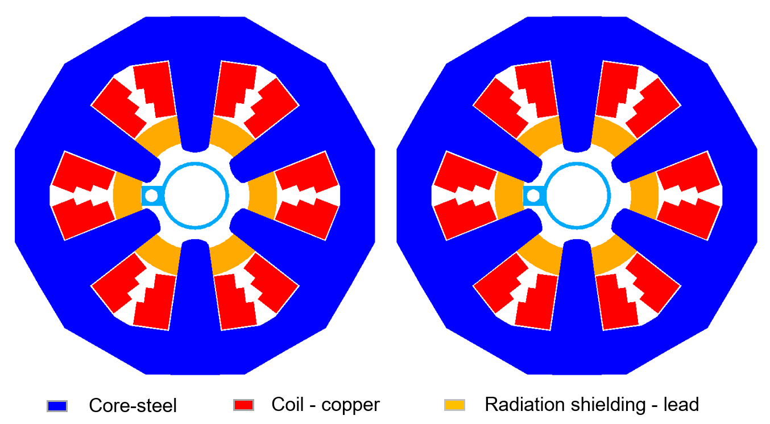
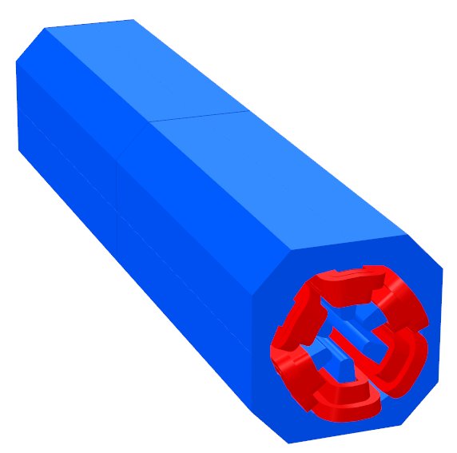
EDR status: full length sextupole design
Requirements of sextupole in CEPC collider
Two sextupoles installed side by side with a 350 mm beam separation
Narrow width for each magnet
Copper conductor is used for coils
21 turns/pole, 10.5 kW/magnet
Item | Units | Value
Effective length | M | 1.4
Aperture diameter | mm | 66
Gradient at 45.5GeV | T/m² | 209
Gradient at 180GeV | T/m² | 847
Effective length | m | 1.4
Good field region | mm | 11.6
Harmonics |  | 5×10⁻⁴

Slide 10
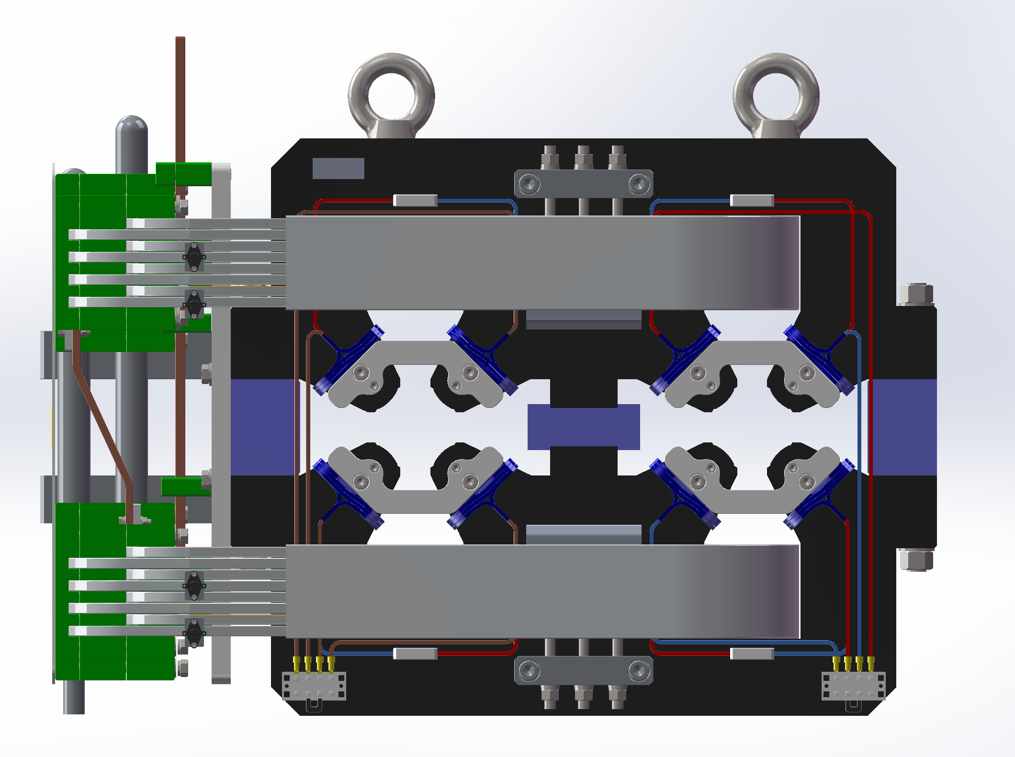
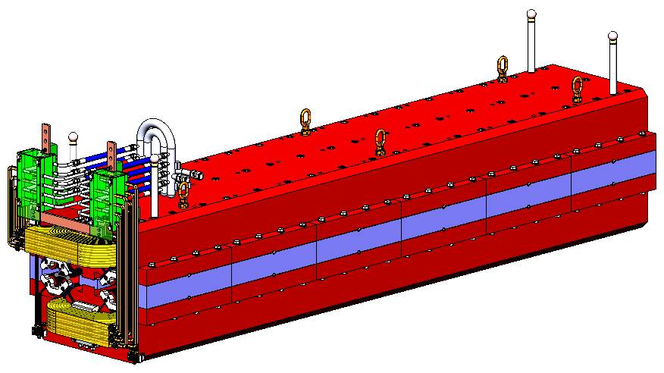
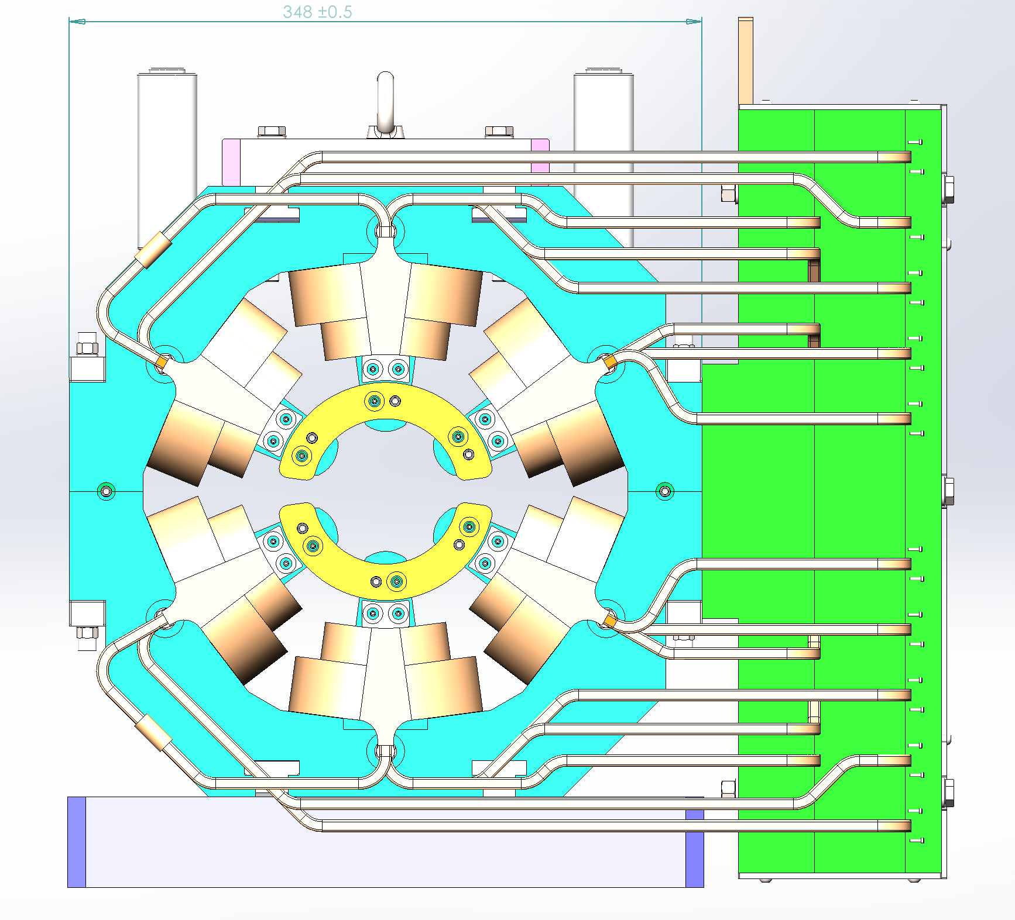
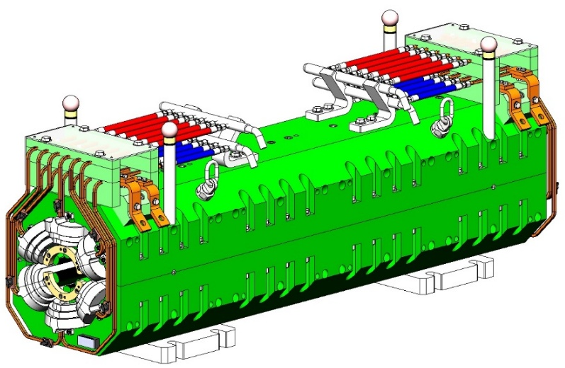
EDR status: mechanical design for DAQ and sextupole
To minimize the magnets’ transverse dimensions, the cooling and electrical connections are positioned at the top, which complicates the magnet disassembly and installation of the vacuum chamber.
DAQ
3m DAQ
Sextupole
1.4m Sextupole

Slide 11
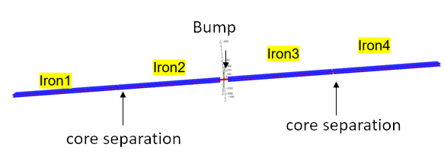
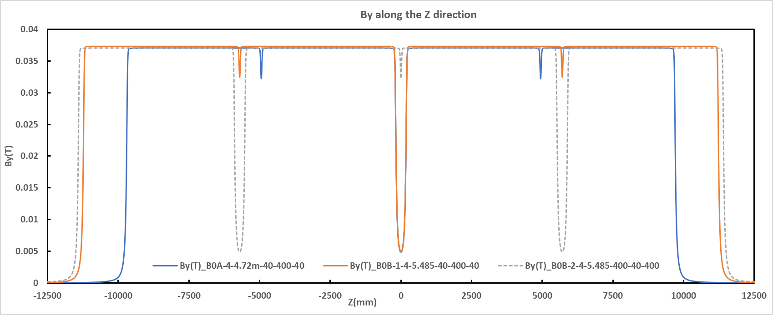
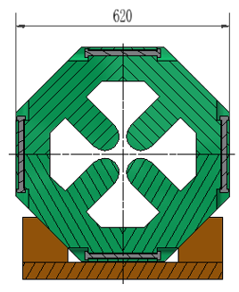
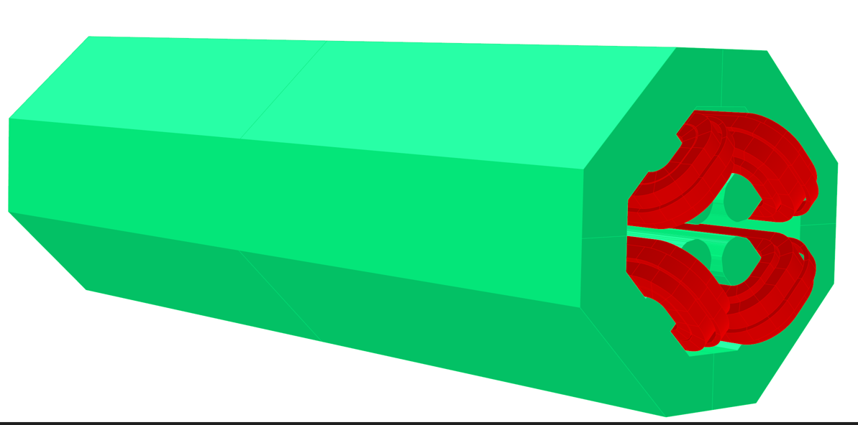
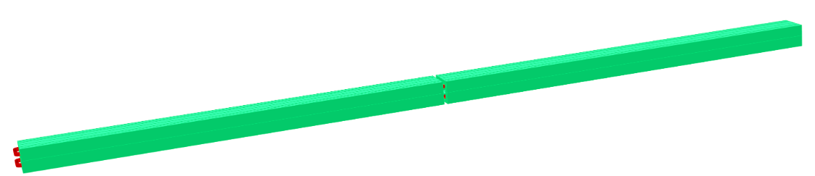
EDR status: other magnets design
Three layouts of main dipole magnets for vacuum chamber cutting
B0A: 4 cores, 4472-40-4472-400-4472-40-4472
B0B-1: 4 cores, 5485-400-5485-40-5485-400-5485
B0B-2: 4 cores, 5485-40-5485-400-5485-40-5485
Field distribution and effective lengths simulated for survey.
Magnets design at IR, RF or straight section
Magnets design for survey check
Some quad. width limitation (Dist=350 mm)
Narrow yokes with built in bolts
High current density with small coil windings
Bulit in bolts

Slide 12
EDR status: synchrotron radiation study in collider
Working environment requirements for magnets
Thermal environment control
Safe and stable temperature, control the magnetic material stability and suppress the thermal expansion.
Normally, deionized water is passed through the hollow conductor for cooling to reduce the temperature rise from joule heat, the temperature rise is usually controlled within 15 ℃.
Remove the huge heat generated from radiation absorption and beam energy deposition
Water cooling design to reduce the magnets’ temperature rise and reduce the pressure of the general ventilation system
Mechanical stability
Strong mechanical structure for magnets’ stiffness and strength
Radiation resistant design
Coil insulation material: polyimide(Kapton) or ceramic coating
Sensor and cable: radiation hardening type(such as mineral insulated cable)
Lead protection

Slide 13
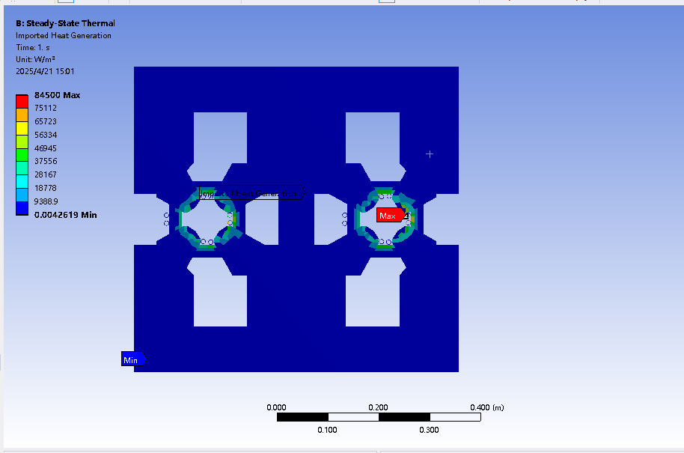
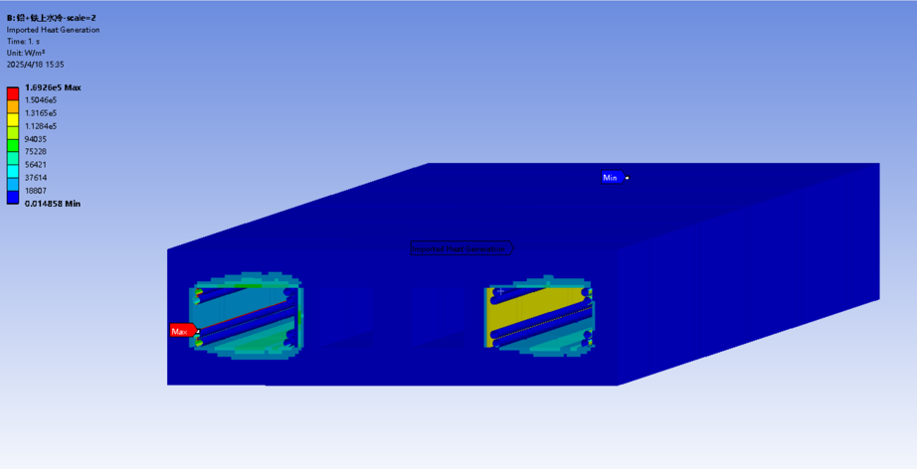
EDR status: synchrotron radiation study in collider-2
Distribution of synchrotron radiation deposition
Beam parameters design limits SR power to 50 MW per beam
Power deposition and total power absorbed are simulated @ttbar
~70% power deposited in vacuum chamber (removed by its own water cooling )
~19.4% power in lead and Iron of DAD (~2.14 kW for a 5.5 m DAD)
~2.4% power in lead and Iron of DAQ (~1.4 kW for a 3 m DAQ)
By G. Y. Tang
Deposited energy distribution in DAD
Deposited energy distribution in DAQ

Slide 14
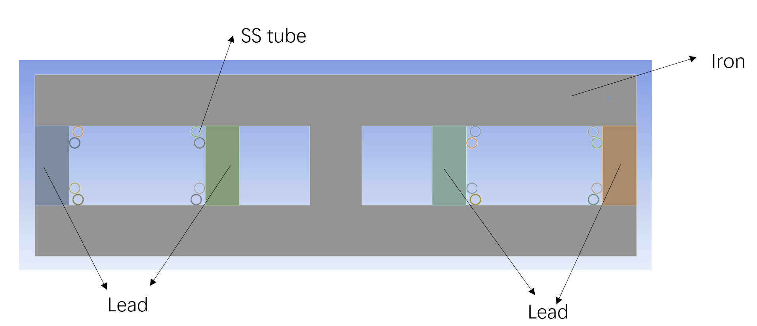
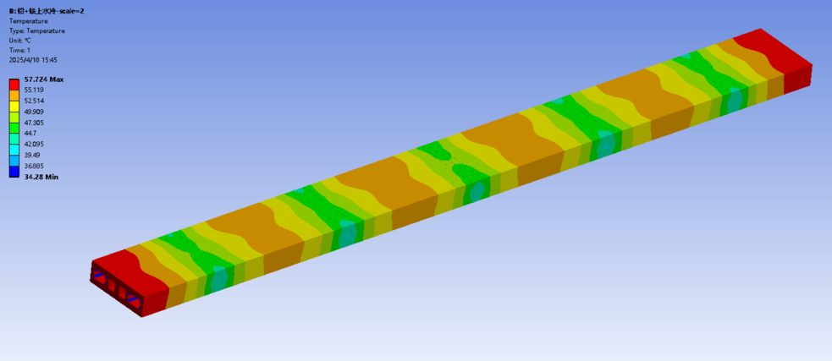
EDR status: synchrotron radiation study in collider-3
Water cooling design for DAD’s SR
With 16 stainless steel(SS) pipes to cool the SR deposition
8 mm inner diameter and 10 mm outer diameter SS pipes
Force convection coefficient of water: 2000 W/(m².℃)
Thermal conductivity: 15 W/(m.℃) for SS；Ambient temperature: 35 ℃
Considering the poor contact between stainless steel water-cooled tubes and iron cores / lead blocks, it is estimated that there is 0.1 m contact of every 1.1 m (conservative design)
Steady thermal analysis results
Temperature range: 35~57 ℃，average: 50 ℃
72% heat taken away by water cooling (~1.54 kW)
With 0.2 m contact of every 1.1 m, the temperature rise is less than 5 ℃.

Slide 15
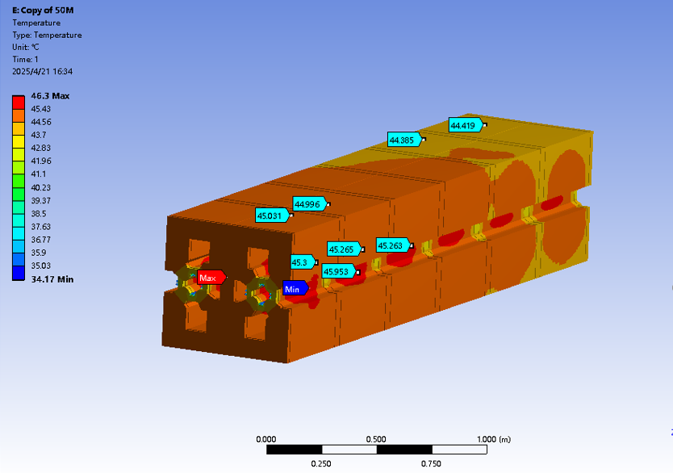
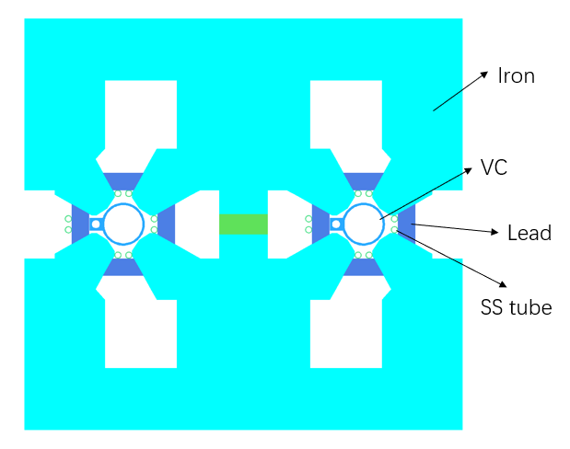
EDR status: synchrotron radiation study in collider-4
Water cooling design for DAQ’s SR
With 16 SS pipes to cool the SR deposition
Same parameters as in DAD
Steady thermal analysis results
Temperature range: 35~46.3 ℃，average temp: 44.6 ℃
72% heat taken away by water cooling (~1 kW)

Slide 16
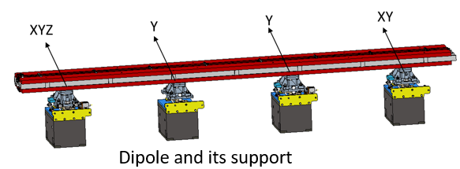
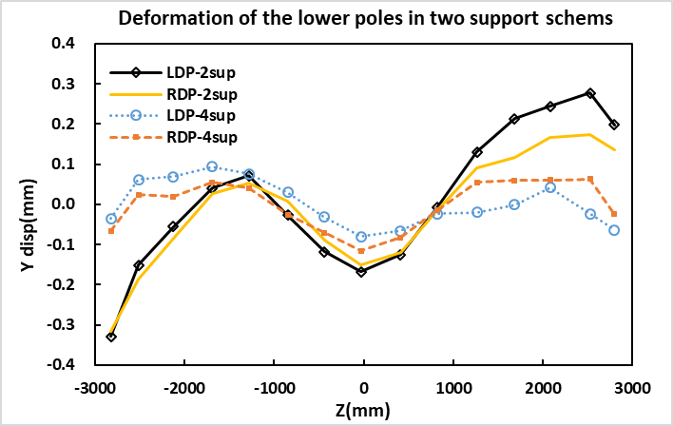
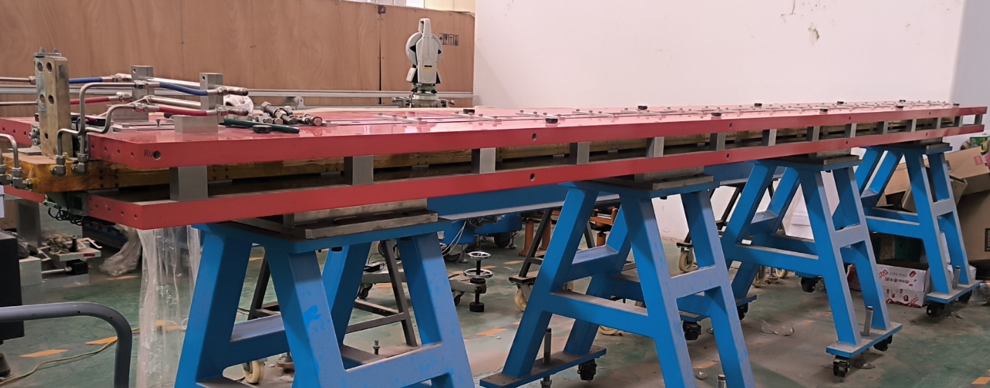
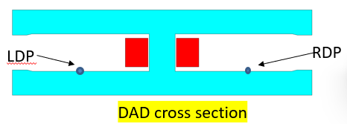
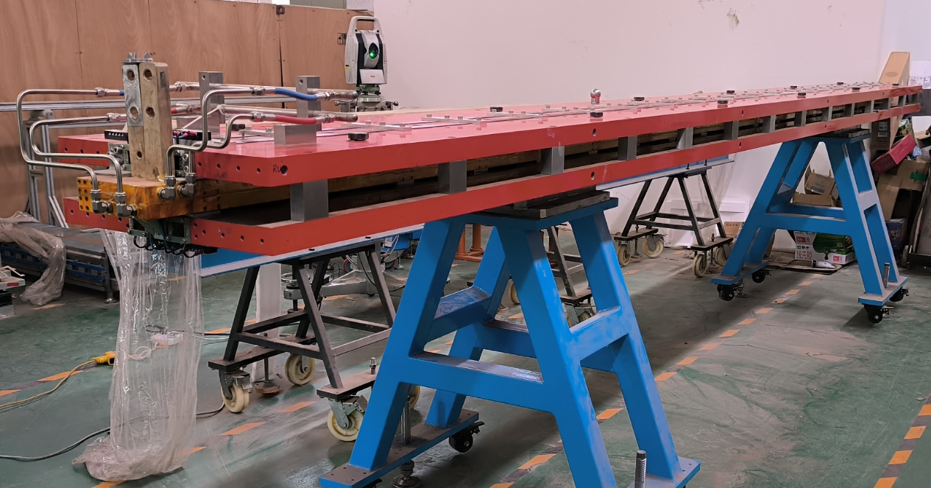
EDR status: DAD deformation study with a laser tracker
Deformation in long DAD prototype(5.67 m)
Simulated deformation in TDR support scheme is about 0.05 mm.
Four supports (in TDR) and two supports are compared.
The standard deviation of displacement for the two schemes are 0.055 mm (4 supports) and 0.17 mm (2 supports).
Difference in deformation between the upper and lower pole surfaces on one aperture are small and can be neglected.
Simulations will be done to evaluate the impact of deformation on magnetic field quality.
Similar simulation and test will be done on other long magnets.
In TDR
Four supports
15 points in Z direction
Two supports

Slide 17
Content
Overview of magnet system in CEPC
Collider magnet progress in EDR
Review of magnet development in TDR
EDR plan and design status
Booster magnet progress in EDR
Progress of dipole magnet with sextupole component
Summary

Slide 18
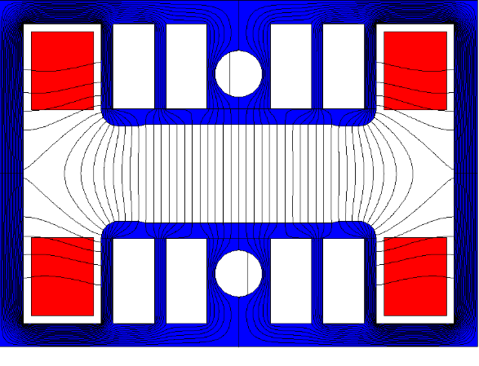
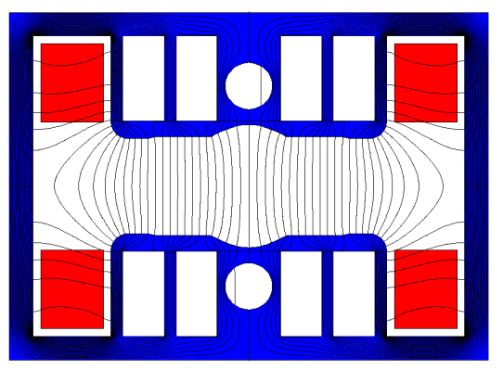
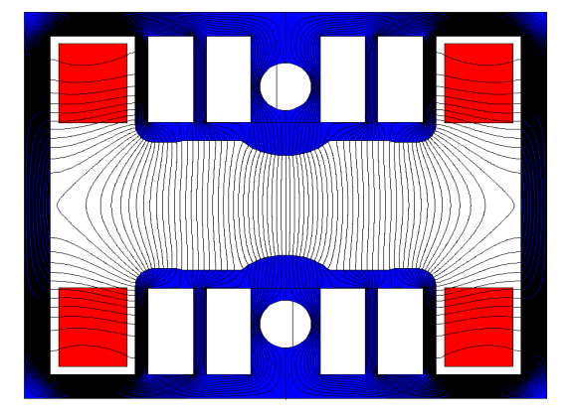
Dipole magnet in CEPC Booster
Booster dipole magnets are grouped into three families. One is the pure dipoles, the others are the dipole-sextupole combined magnets. The discussion focuses primarily on Dipole-SF combined magnet
In order to better shielding the earth field, a closed H-type core is selected for the dipole magnets.
To increase field strength in the yoke while reducing the magnet weight, the return yokes are designed to be as thin as possible and holes are punched in the pole regions of the laminations.
The magnetic flux distribution in the laminations matches prediction.
pure dipole magnet
dipole-SF combined magnet
dipole-SD combined magnet
The Cross-section of the Dipole Magnet
Notes:
To maximize the magnetic flux retained within the cores while reducing the magnet weight, the return yokes are designed to be as thin as possible,
and holes are punched in the pole regions of the laminations. The magnetic flux remains properly channeled through the laminations as intended.

Slide 19
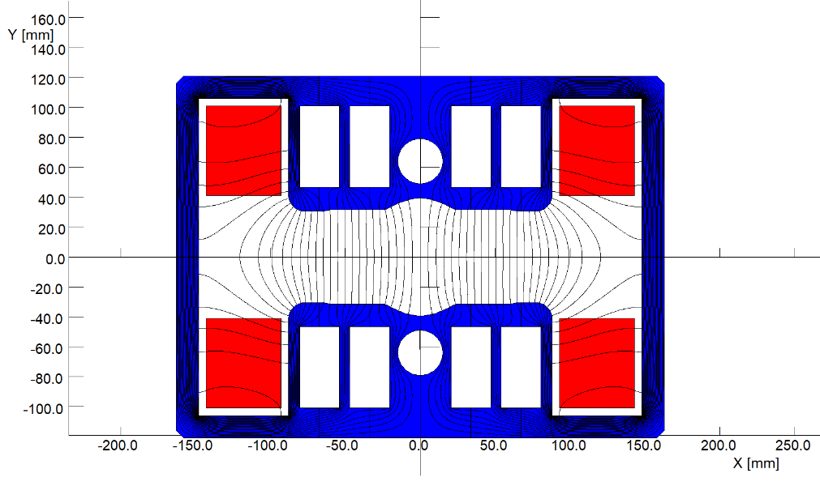
Booster dipole-sextuple combined magnet
Main parameters of dipole
B=95~564 Gs, Gap=63 mm, Leff=4.7, field uniformity<1×10⁻³
Core material selection
Plastic sheet (PET) and silicon steel sheet: 2 mm:1 mm
Increase field in the steel sheet
Reduce magnet weight
Coil material selection
4 turns of pure Aluminum busbars
Low weight and cost
Insulated with G10 sheets
 | Design Requirements | Simulation Results
B0[Gs] | 376 | 376.004
S[Gs/mm^2] | 0.106925 | 0.106928
h[mm] | ≥31.5 | 31.5

Slide 20
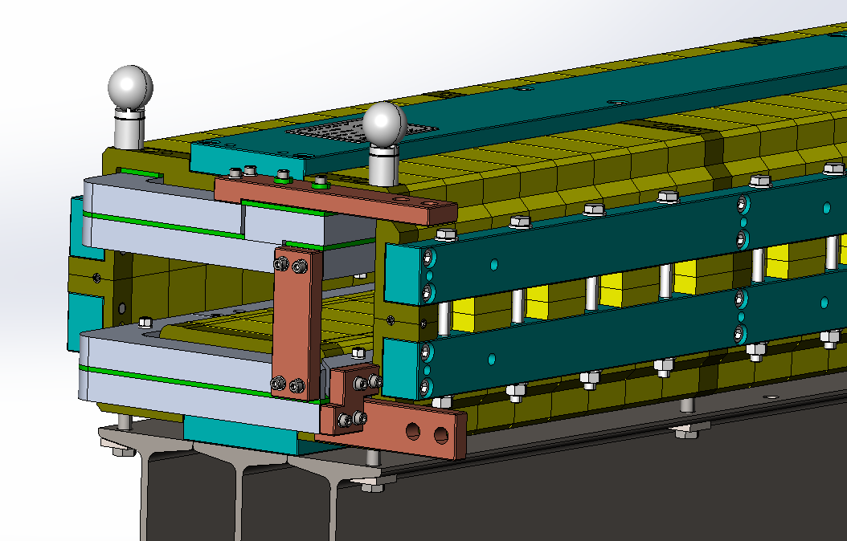
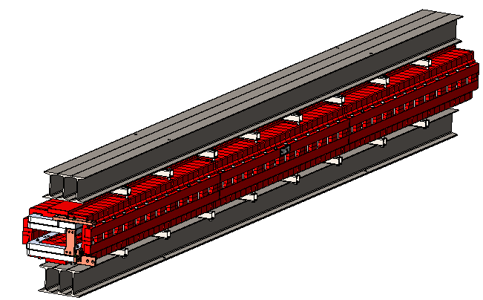
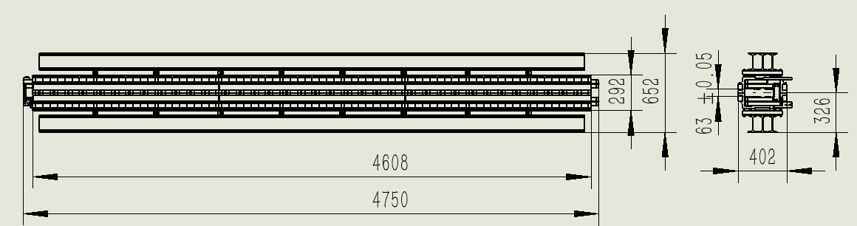
Booster dipole-sextuple combined magnet-2
Mechanical structure design should meet the physical design, related interface requirements and space limitations.
Composition: core, magnet holder, magnet hanger, coil assembly, connecting row, nameplate, etc.
Overall structure of the magnet
maximum external dimensions :
4750mm long * 402mm wide * 292mm high
the center height : 326mm
gap : 63 ± 0.05mm
total mass of about 1750g
Magnet hanger for magnet lifting and tunnel mounting magnets
Magnet holders for magnet transfer and testing.
63mm
nameplate
hanger
core
coil assembly
holder
connecting row

Slide 21
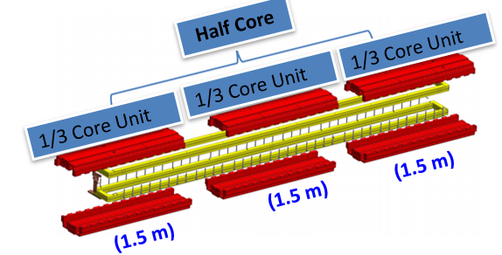
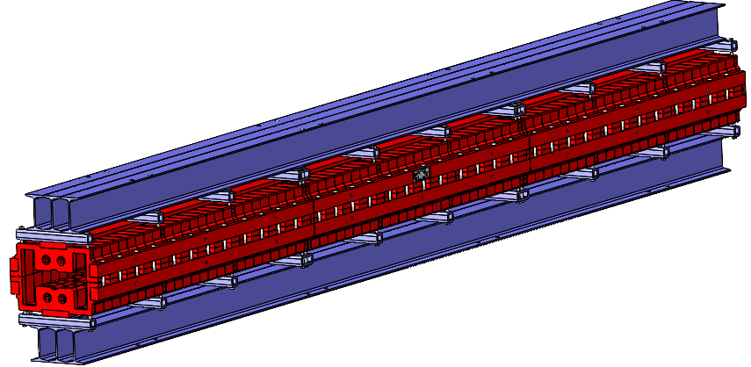
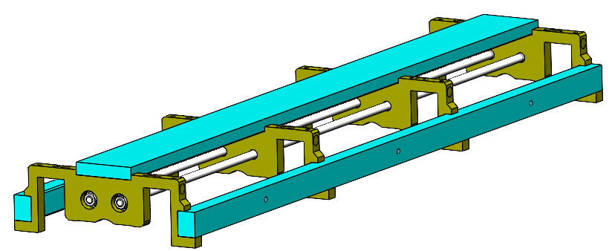
Booster dipole-sextuple combined magnet-3
DT4 spacer plates and three carbon steel pulling rods are used to form a cage structure for restrain the stamped laminations
Three parts in longitudinal direction are welded by the each part-endplates
The hang on tools are used to support the mechanical strength and convenient for transportation.
Cage structure for 1.5m-core
Magnet with hang on tools
Three parts structure

Slide 22
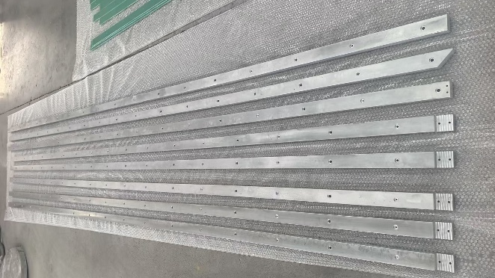
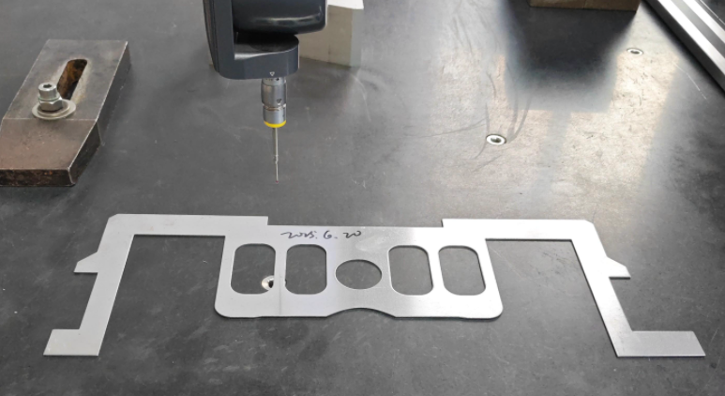
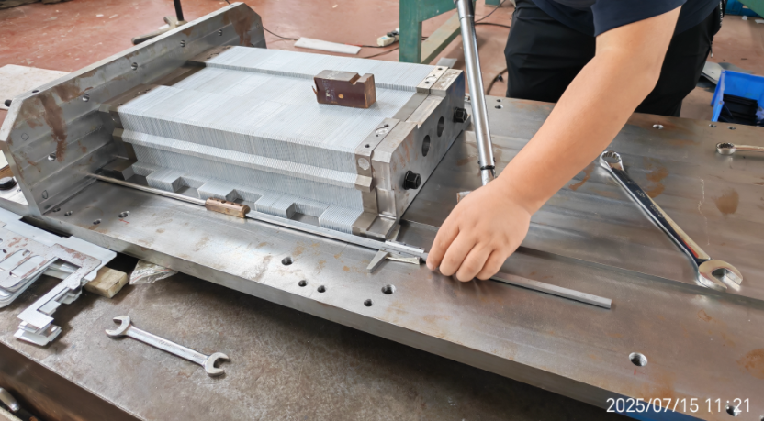
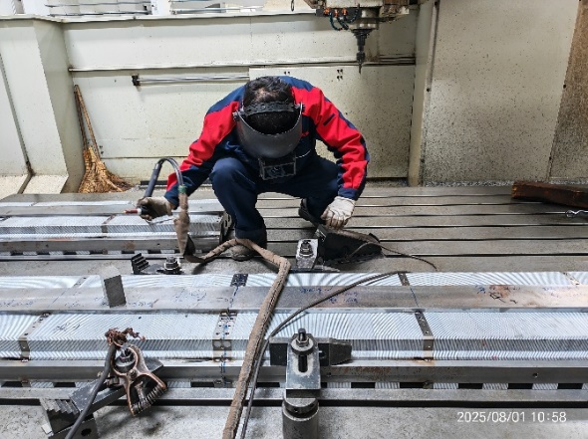
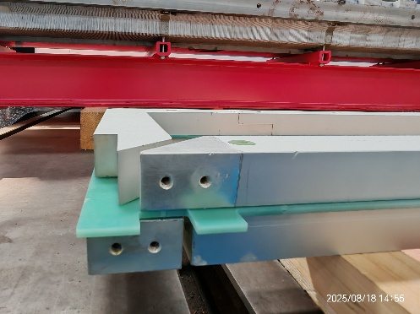
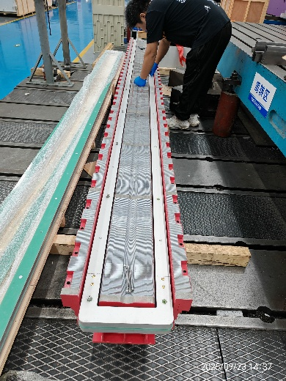
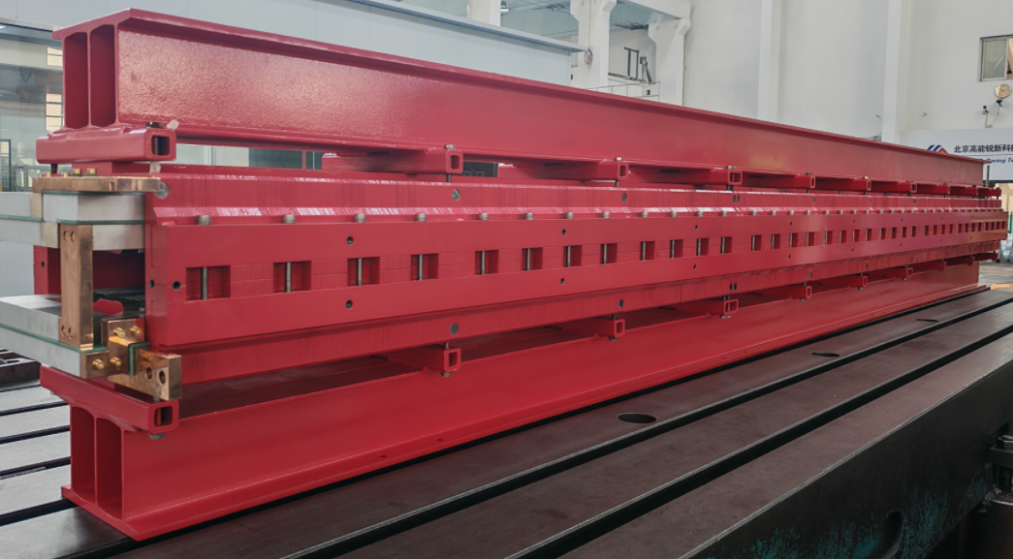
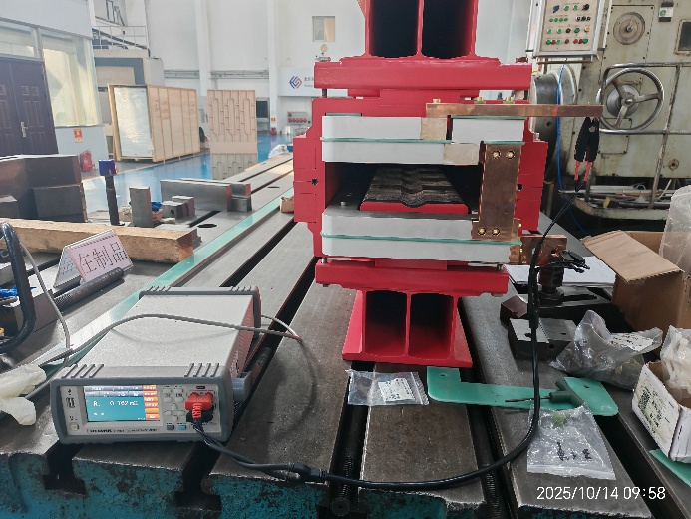
Booster dipole-sextuple combined magnet-4
Manufacturing process
This magnet is now under measurement.
Lamination sheet
upper core stacking
Welding
Aluminum Busbar
Coil
Coil assemble
Magnet assembly
resistance measurement

Slide 23
Summary
More detailed magnet design are done according to the updated lattice and survey adjustment.
The physical design and evaluation for the majority of magnets are completed.
The development of their respective mechanical designs is now in progress.
Some primary simulations on the synchrotron radiation heating effect on main dipole and quadrupoles are studied.
The lead blocks and water-cooling design are to be optimized and tested.
The mechanical and thermal study is under studying, so as the absorber scheme.
Booster dipole prototype will be measured and optimized.
Interaction studies between the magnet, the mechanical and alignment systems are ongoing.

Slide 24
Thank you very much for your attention!

