Slide 1


CEPC vacuum system EDR plan and status
Yongsheng Ma
Vacuum group, IHEP,CAS
Nov 7th 2025

Slide 2
Content
Preview of CEPC vacuum system
Discussion on vacuum chamber with photon absorber of collider ring
MDI vacuum progress
Production line development of NEG coating/ Spray for heating film in EDR
Possibility of AL alloy vacuum chamber in use of collider ring
Summary

Slide 3

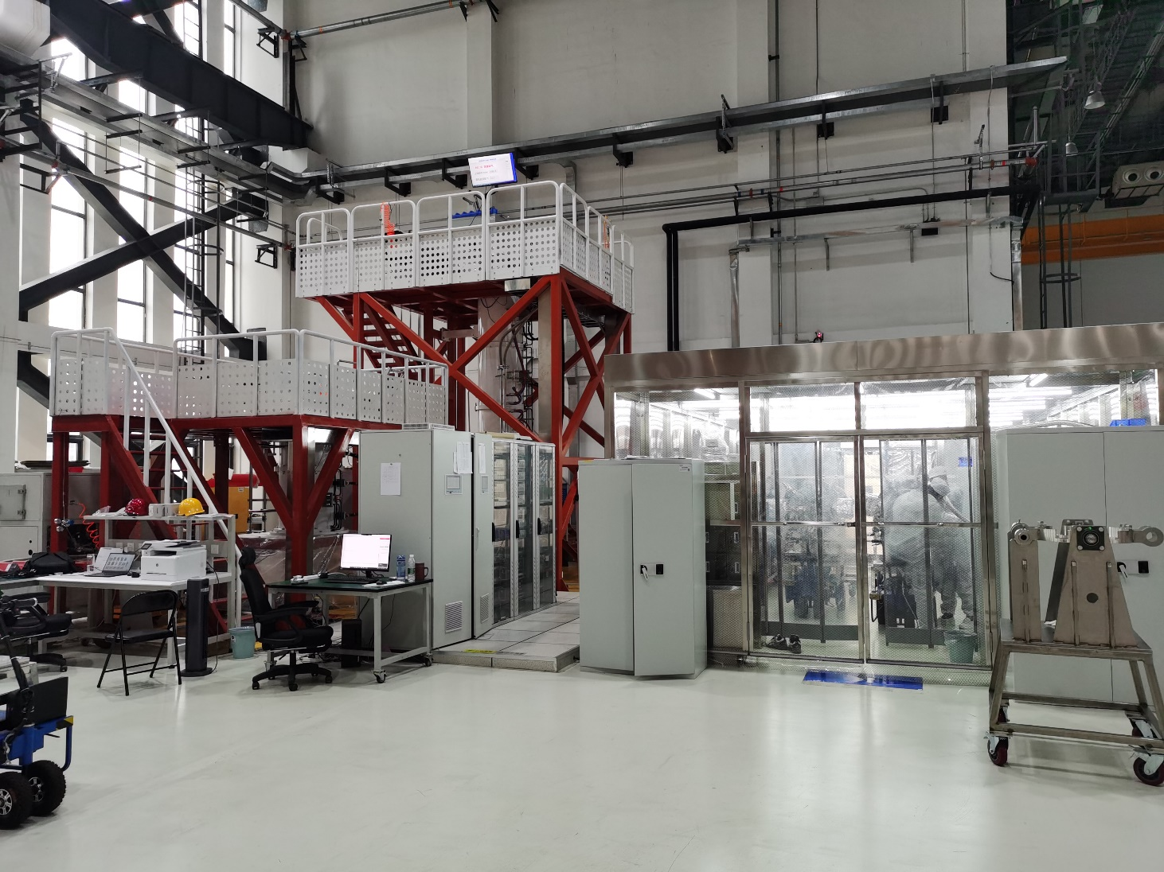
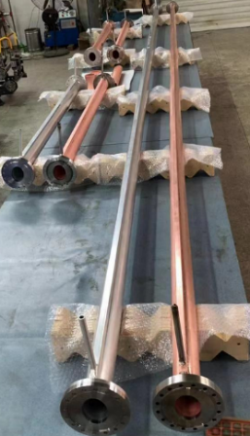
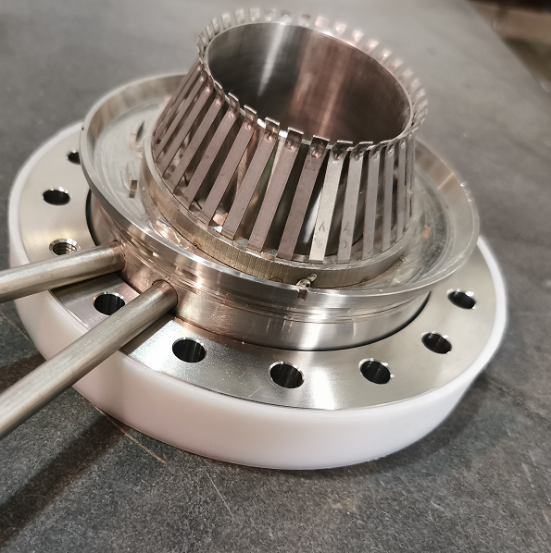
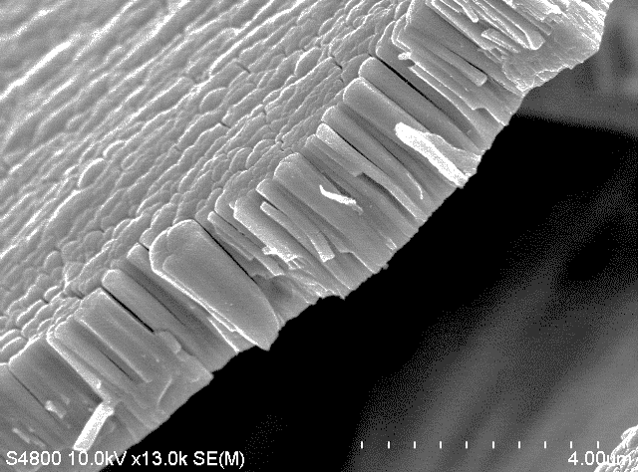
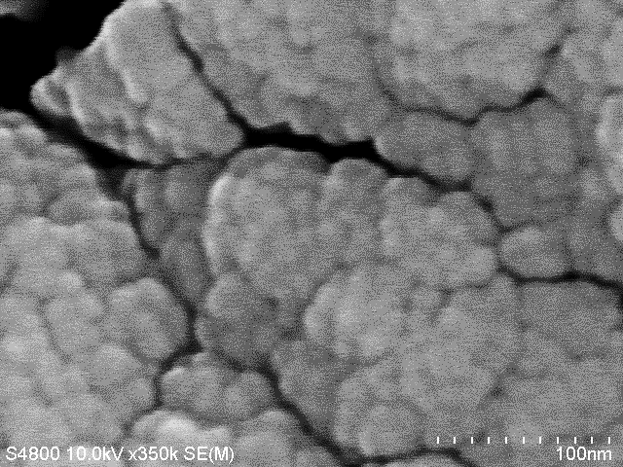
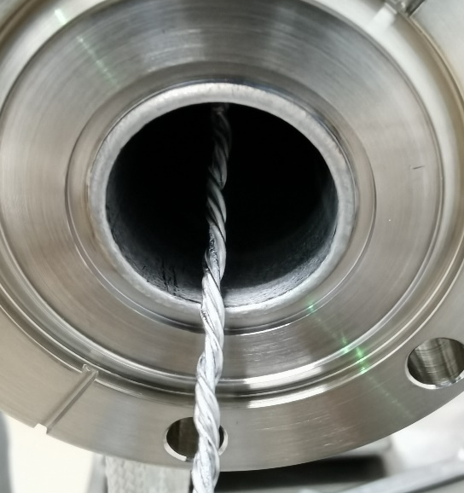
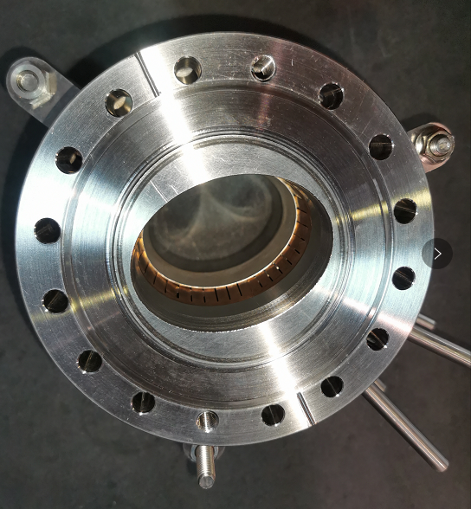
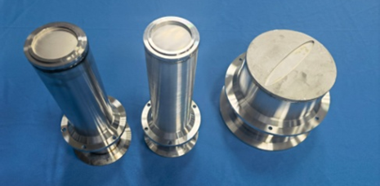
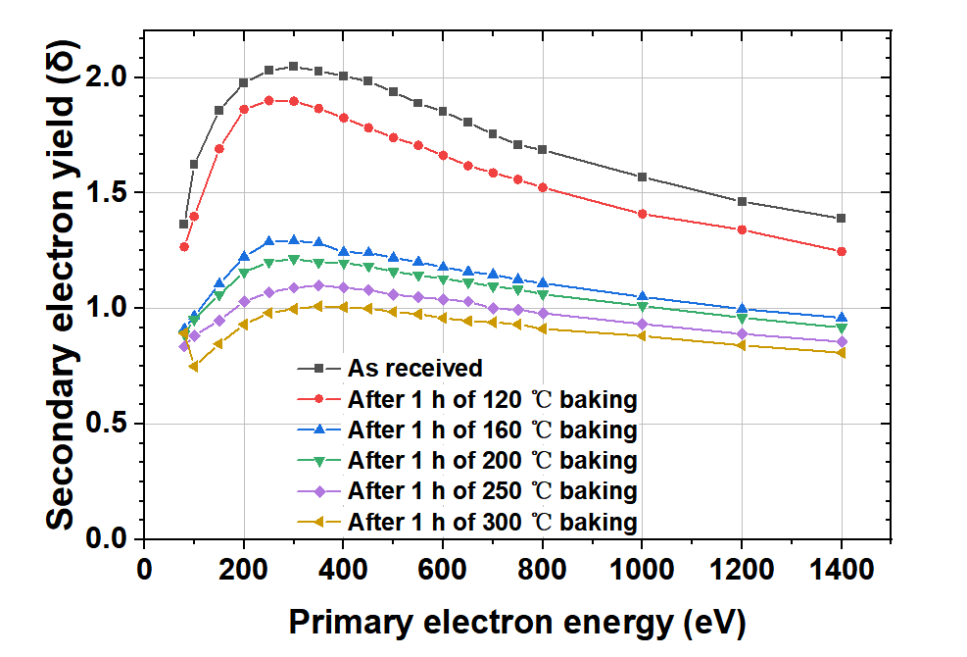
Preview of CEPC vacuum system
Technical developments in TDR
Machine and Vacuum Parameters
 | E | I | ρ
 | Gev | A | m
Higgs | 120 | 0.0167 | 10700
W | 80 | 0.084 | 10700
Z | 45.5 | 0.803 | 10700
tt | 180 | 0.0033 | 10700
Accelerator | length/m
LINAC | 1,601+335
Damping ring | 147
Booster | 100,000
Collider | 200,000
Transport line | 4,680
Total length/m | 306,763
Those prototypes have a good application in HEPS.

Slide 4
Vacuum requirements and configuration
 | Energy | Material | Cross Section/mm | Length/m | Dynamic pressure /Torr
LINAC | 30 GeV | Stainless steel, copper | Φ20~30 | 1,601+ 335 (BTL) | Acc <2×10⁻⁷ E-gun<2×10⁻⁸
Damping ring | 1.1 GeV | Extruded aluminum 6061 | Φ30/Al 6061, 2mm | 147 | <2×10⁻⁸
Booster | 30 to 180 GeV | Extruded aluminum 6061 | Φ56/thickness of 2mm | 100,000 | <3×10⁻⁸ tt<4×10⁻⁸
Collider | 45.5~180 GeV | Extruded copper, NEG film SEY<1.2 | Φ56/thickness of 2mm | 100,000×2 | Z<8×10⁻¹⁰ tt<1×10⁻⁸
MDI | 45.5~180 GeV | Copper/tungsten alloy, NEG film | Φ20 | 12 | <3×10⁻⁹
LTB | 30 GeV | Stainless steel | Φ56 | 3,000 | <1×10⁻⁷
BTC(CTB) | 6 GeV | Stainless steel | Φ56 | 240×6 | <1×10⁻⁷
DL | 1.1 GeV | Stainless steel | Φ30 | 240 | <1×10⁻⁷

Slide 5
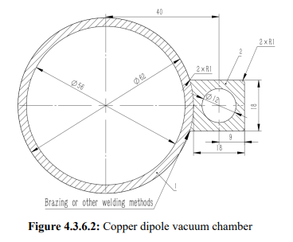
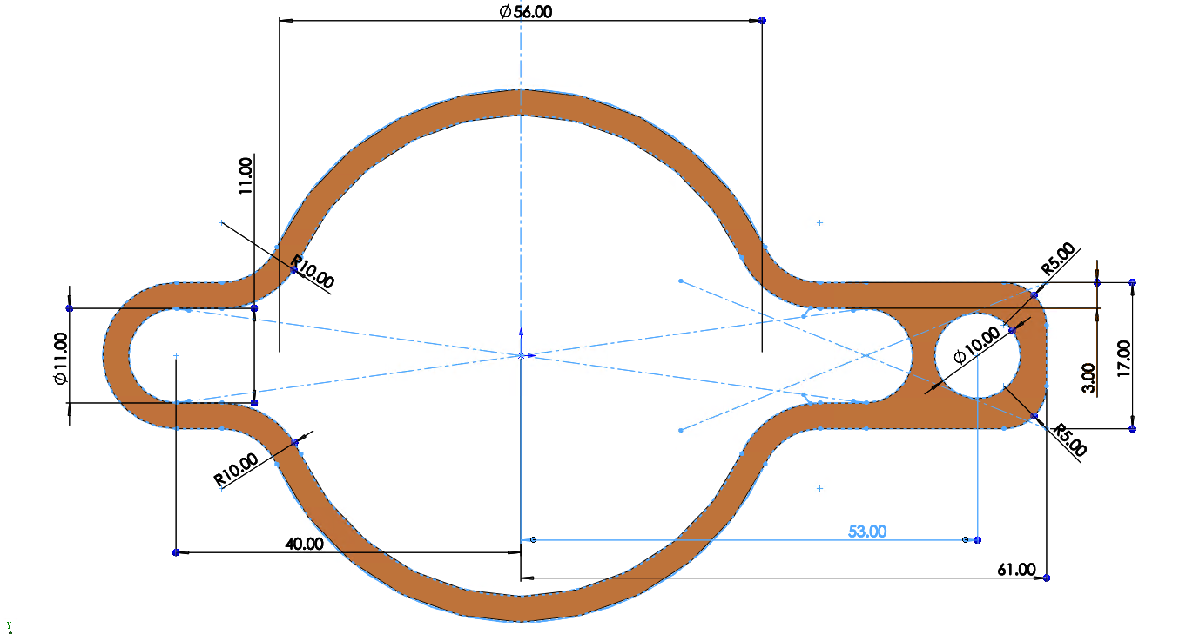
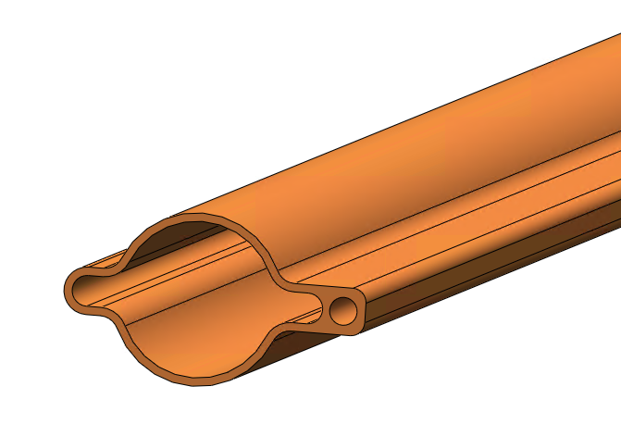
Discussion on vacuum chamber with photon absorber
First CEPC IARC EDR Review Report
A.9.2 Recommendations
1. A thorough comparison of the advantages and disadvantages of the proposed distributed approach versus
the photon stopper approach is necessary for effective management of synchrotron radiation;
Changes to vacuum chamber
The structure of vacuum chamber will be more complex.
The round vacuum chamber convert to antechamber;
Absorber will be welded together with vacuum chamber;
Colling pipe is necessary: the total heat load due to the resistive wall for collider single ring is about 2MW under 50 MW mode; SR reflection from absorber.
NEG coating , spraying heating layer will be more complex.
56
VC with photon absorber

Slide 6
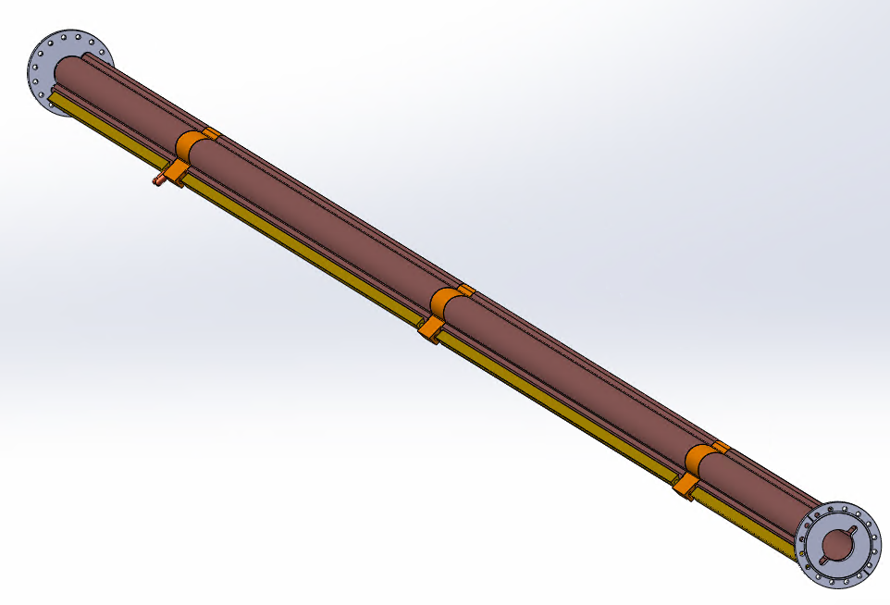
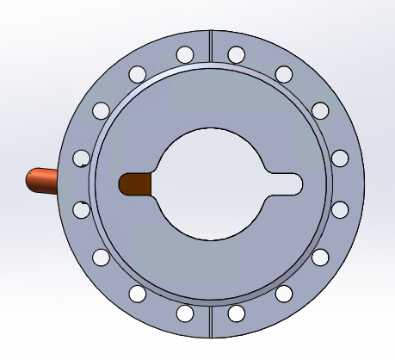
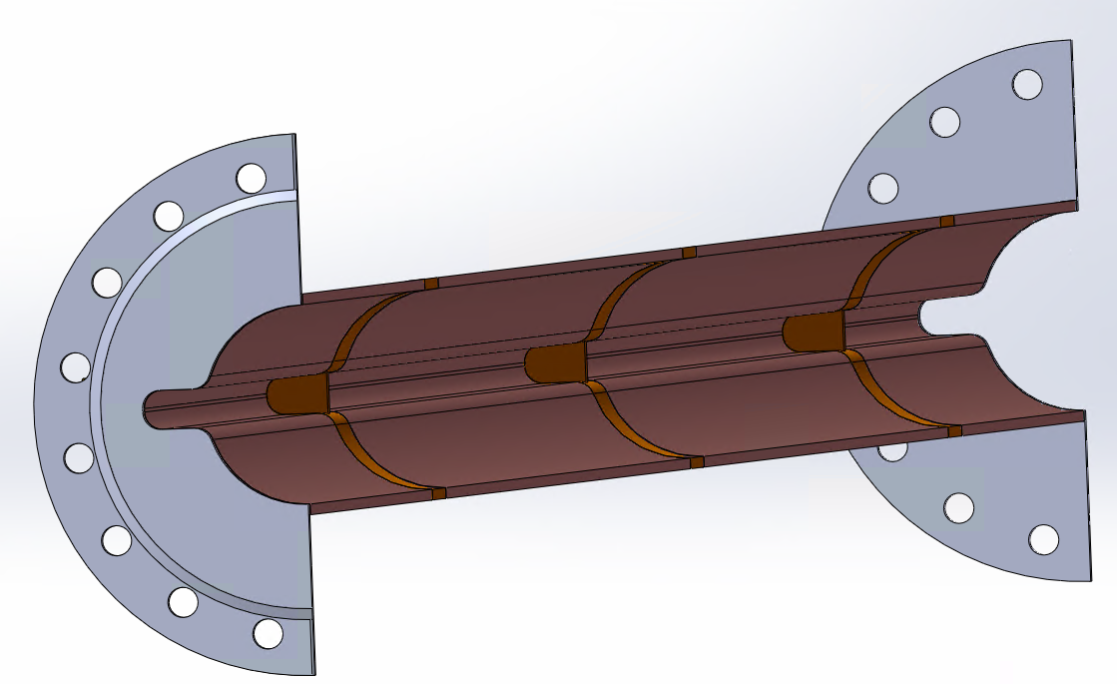
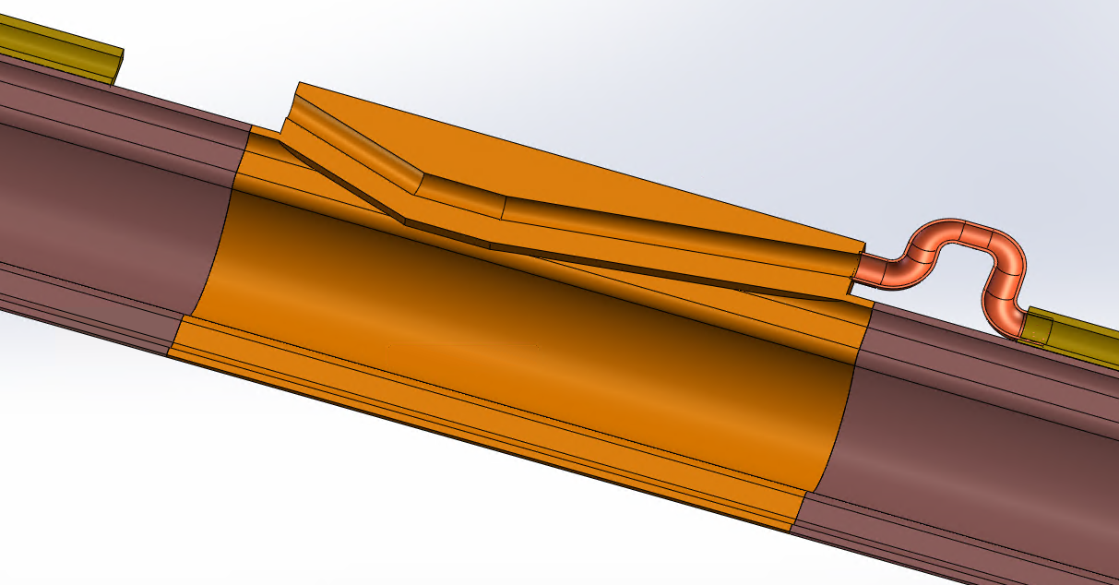
Structure of vacuum chamber with absorbers
There will be 2 or 3 absorbers in one vacuum chamber, if its length is still ~11meters.
The manufacture of absorber is very challenge;
The complex internal geometry of the SRAs calls for the use of additive manufacturing technology; (FCC)
Conventional dematerializing manufacturing (mechanical processing)
Lots risks of vacuum chamber with Absorbers due to the welding between beam pipe and absorbers
The risk of leakage has increased due to the large number of welding seals.(焊缝漏的风险)
Extra impedance due to mechanical Dimension error；
More outgassing due to outer welding;(外焊接带来夹气)
Prototypes should be taken out to test feasibility.

Slide 7
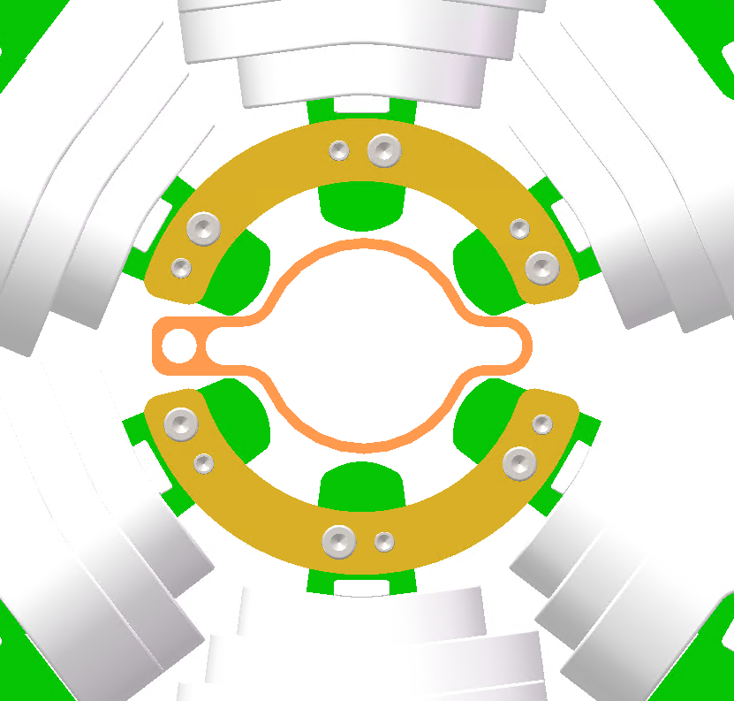
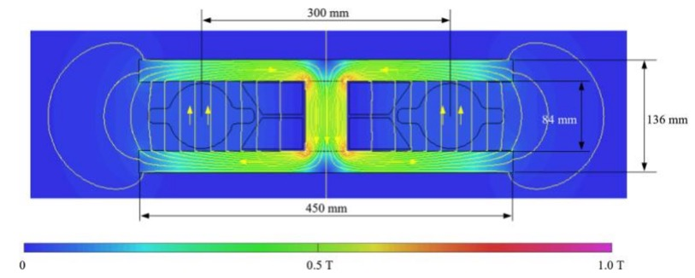
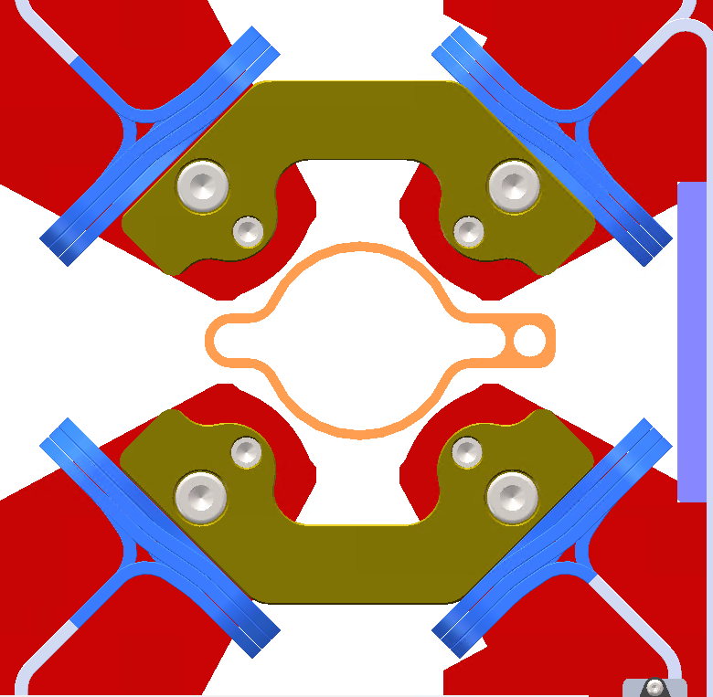
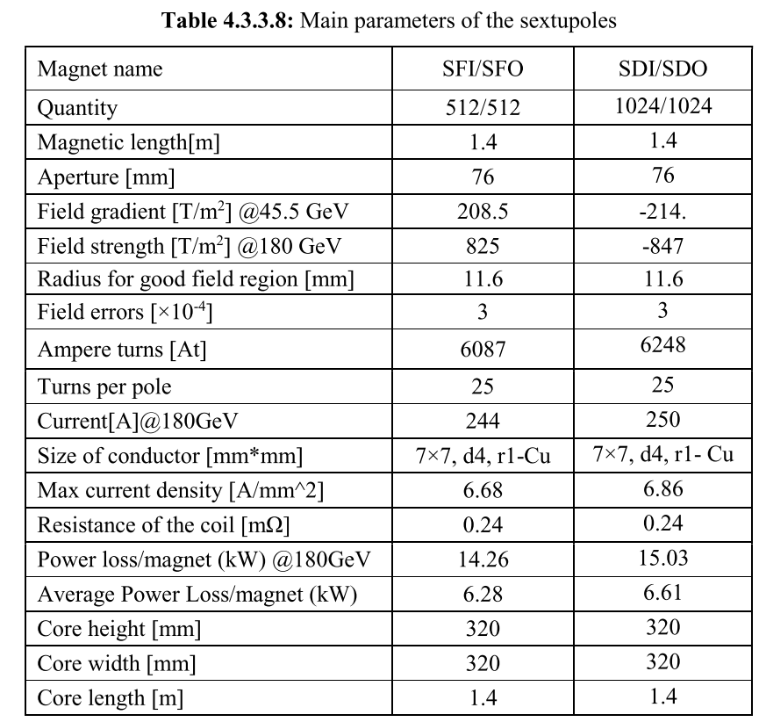
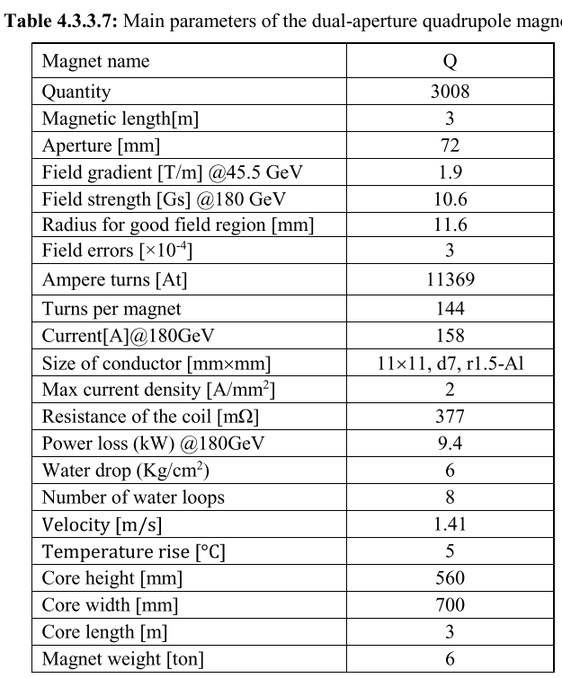
Mechanical adaption with magnets
[1]GAO J. CEPC Technical Design Report: Accelerator [J]. Radiation Detection Technology and Methods, 2024, 8(1): 1-1105.

Slide 8
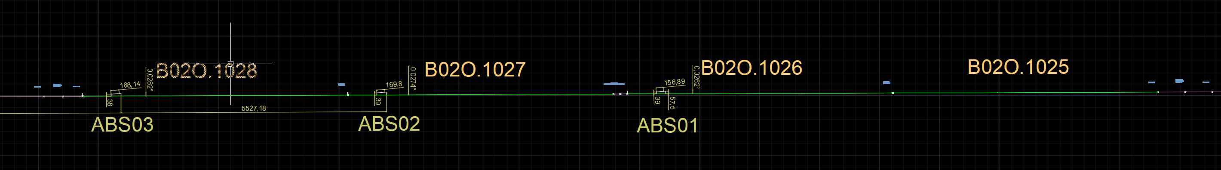
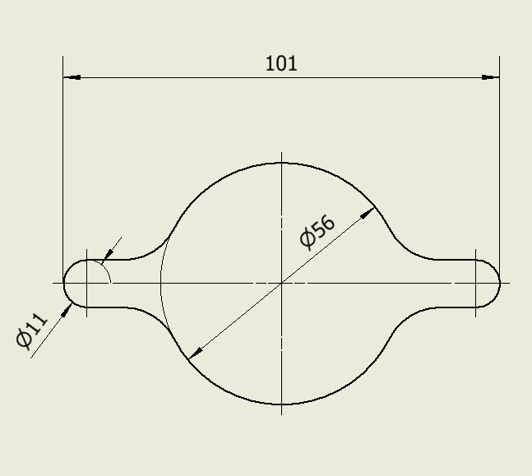
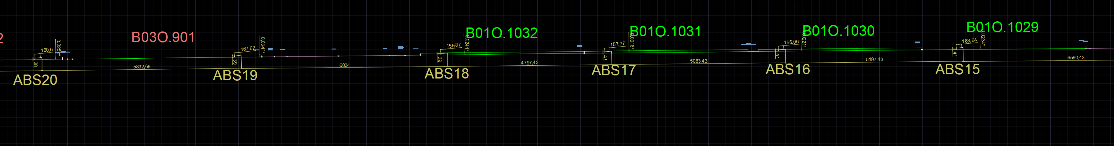
Preliminary design of absorbers power and distribution
Qi Li
The distance of absorbers is about 5.2~7m, corresponding deposited power varies from 3.9~ 4.4kw.
No. | SR Power (W) | Power density (W/mm²) | Distance(mm)
ABS_01 | 4311.53 | 101.31
ABS_02 | 4204.12 | 95.17 | 5893
ABS_03 | 4403.59 | 96.33 | 5697
ABS_04 | 4280.84 | 107.48 | 6100
ABS_05 | 4265.50 | 101.40 | 6675
ABS_06 | 3912.60 | 99.13 | 5247
ABS_07 | 4173.44 | 93.85 | 5793
ABS_08 | 4326.87 | 94.98 | 5547
ABS_09 | 4127.41 | 101.96 | 6334
ABS_10 | 4234.81 | 99.77 | 6093
ABS_11 | 4265.50 | 98.00 | 5686
ABS_12 | 4158.09 | 91.23 | 5693
ABS_13 | 4188.78 | 90.27 | 5590
ABS_14 | 4250.15 | 101.10 | 6601
ABS_15 | 4188.78 | 93.87 | 6688
ABS_16 | 4142.75 | 87.60 | 6263
ABS_17 | 4112.06 | 83.30 | 6128
ABS_18 | 4219.47 | 103.88 | 6674
ABS_19 | 4188.78 | 97.48 | 6993
ABS_20 | 4219.47 | 95.64 | 5646
ABS_21 | 4142.75 | 90.71 | 5693

Slide 9
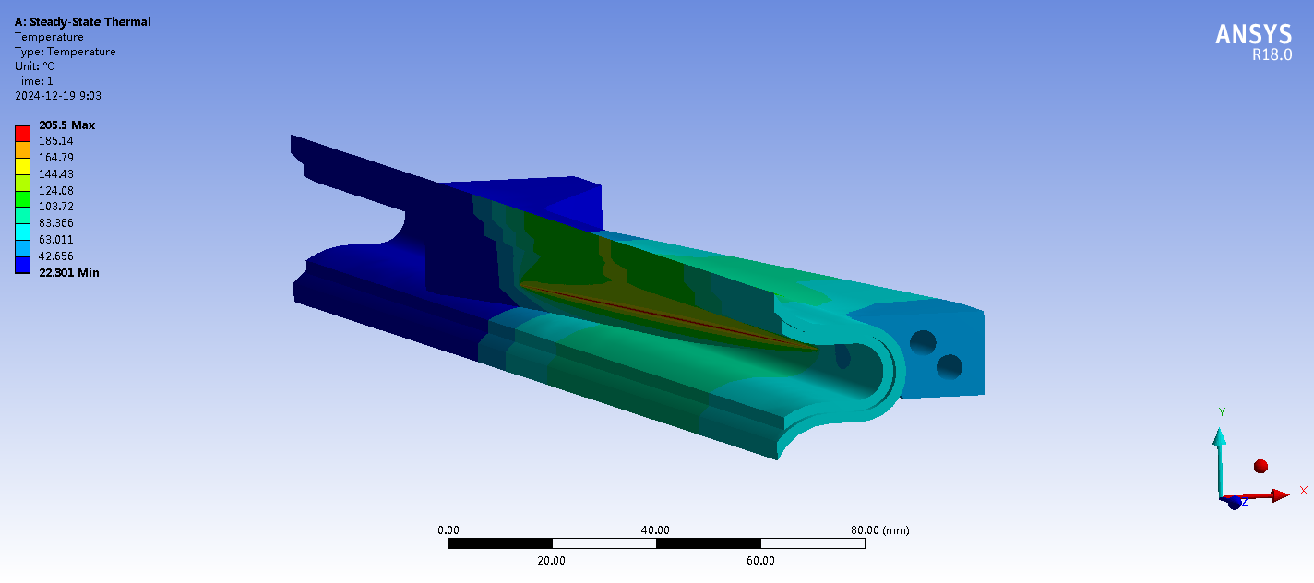
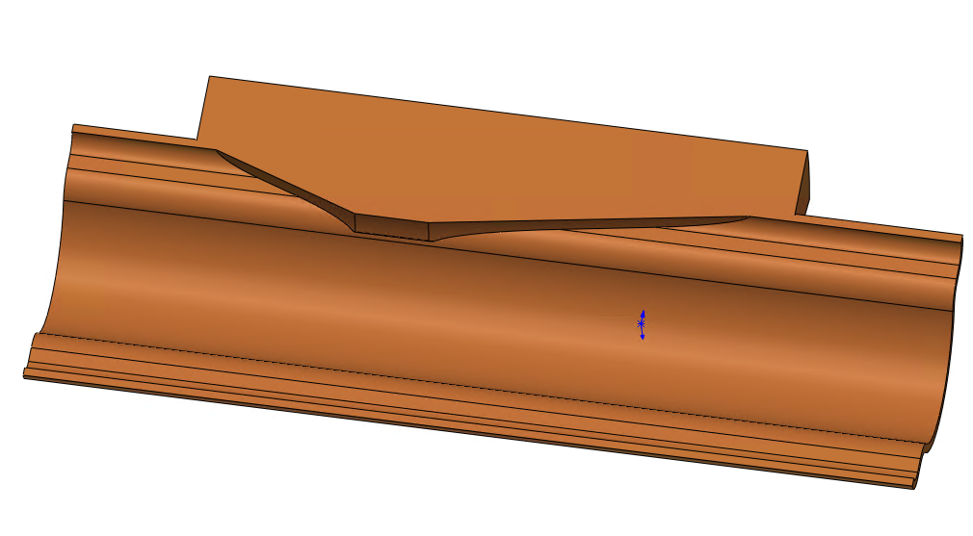
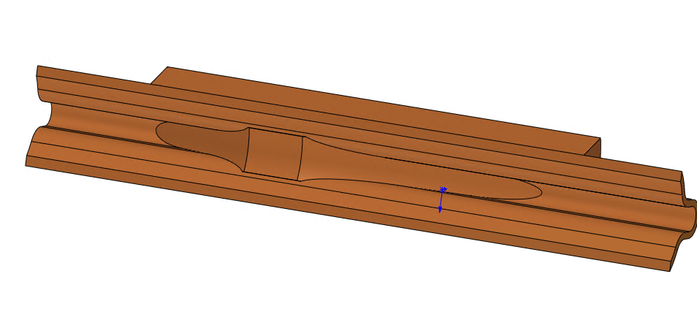
Design of Absorber
The layout of vacuum devices will be more complex.
Absorbers bear high power density synchronous light deposition, requiring good machining and installation accuracy.
Dipole magnet n+i
SR power 3660W
Heat exchange coefficient 10000W/m²-℃
Max temperature 206 ℃
Cooling surface temperature 128 ℃（ cooling water 22 ℃ ）
SR power from dipole magnet | Power density | Area of absorber | Length of absorber
W | W/mm² | mm² | mm
4071.01 | 15 | 271.4 | 407.10
Dipole magnet n
The manufacture of absorbers is very challenging.

Slide 10
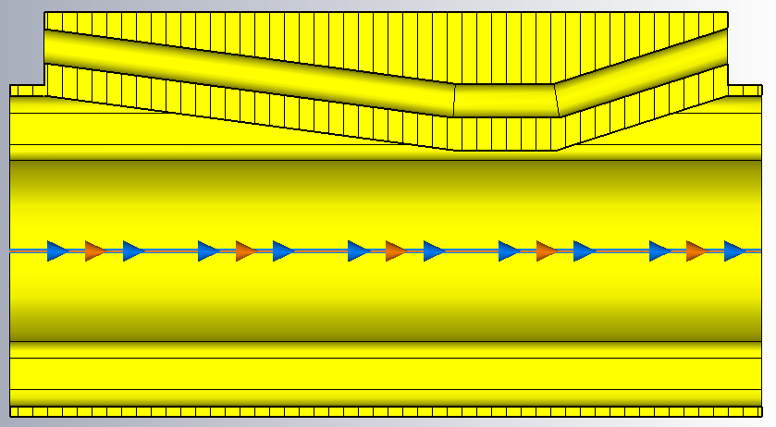
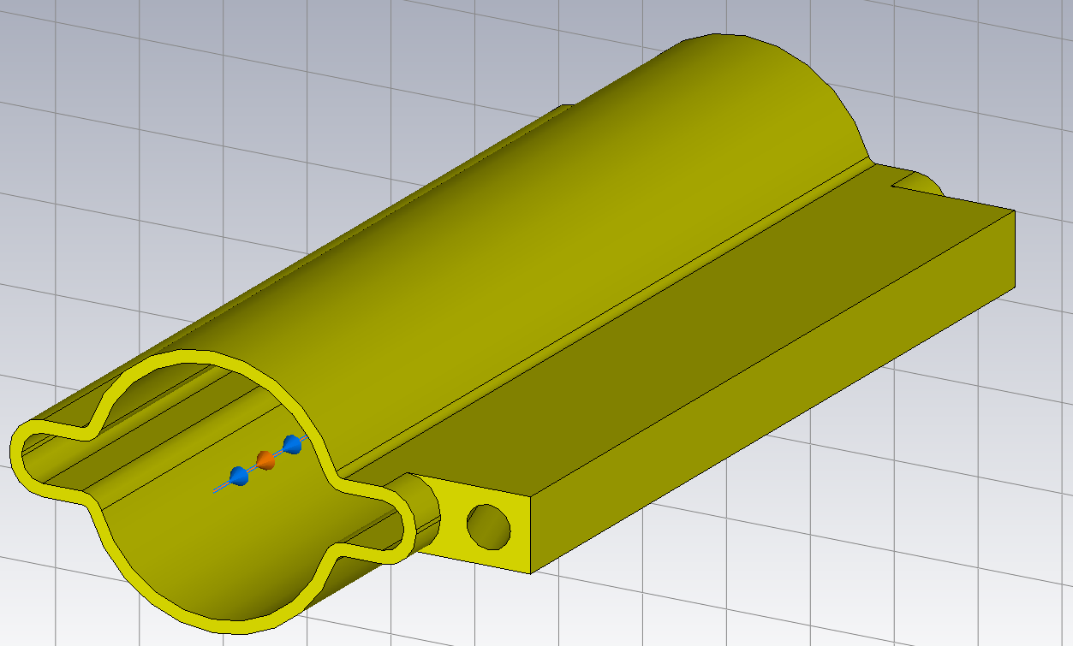
Impedance of absorbers
Wang Na
Main contribution to the ring impedance
  Resistive wall impedance ⇒ no significant change between circular and antechamber
  Longitudinal geometrical impedance
  Horizontal geometrical impedance
⇒ Mainly broadband, no narrowband resonances
Number per ring: 12217
Distance to the beam: 29.5mm
Length of top flat: 30mm
Taper angle upstream: 1/5
Taper angle downstream: 1/3

Slide 11
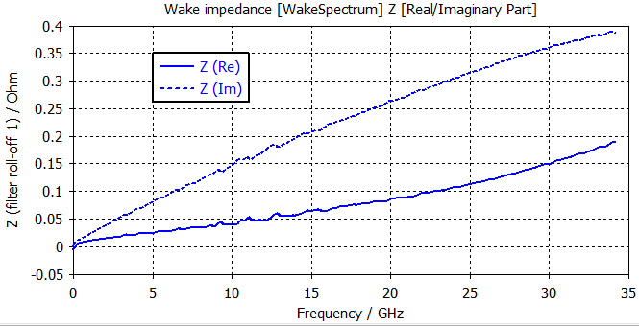
Impedance of absorbers
Na Wang
Main contribution to the ring impedance
  Resistive wall impedance ⇒ no significant change between circular and antechamber
  Longitudinal geometrical impedance
  Horizontal geometrical impedance
With bunch length of 3 mm, the broadband impedance contributions:
  Kloss=1.16E-3 V/pC
  ZL=4.1E-8 Ohm
  Kx=0.223 V/pC/m
Evaluate @σz=3mm
 | Z||/n [mΩ] | kloss [V/pC] | kx [kV/pC/m]
Absorbers | 0.5 | 14.2 | 3.4
Total | 16.5 | 819.8 | 65.5
Occupation | 3% | 2% | 5%
The impedance increase due to the absorbers are less than 5% of the total budget ⇒ acceptable from the instabilities

Slide 12
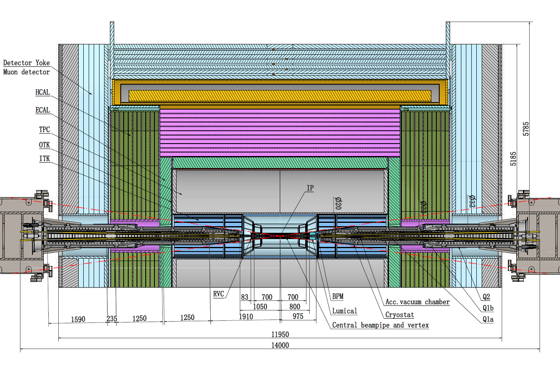
MDI vacuum progress
The total length of MDI vacuum system is about 14m, mainly composed of vacuum chamber, NEG coating, water cooling system, support system, etc.
The energy, beam life, and pressure indicators of the vacuum system at MDI are as the same as collider ring;
      The length of MDI vacuum chamber is about 14m.
      Central beam pipe：-700~700mm；
      RVC：700-783mm；
      Chamber：783-7000mm.
Crotch chamber
Z: 783~855mm
Φ20 chamber
Z: 855~4438mm
Φ20-30 chamber
Z: 4438~4653mm
Φ30 chamber
Z: 4653~7000mm

Slide 13
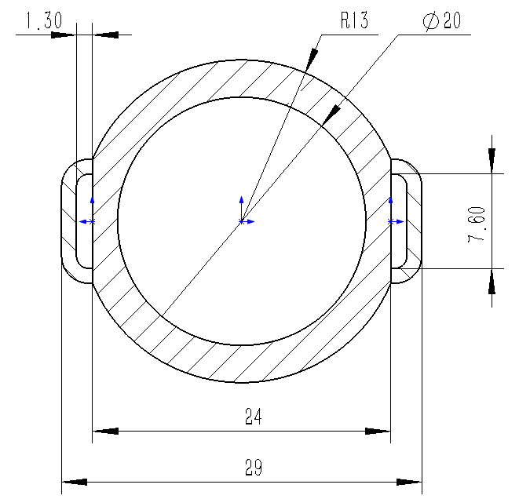
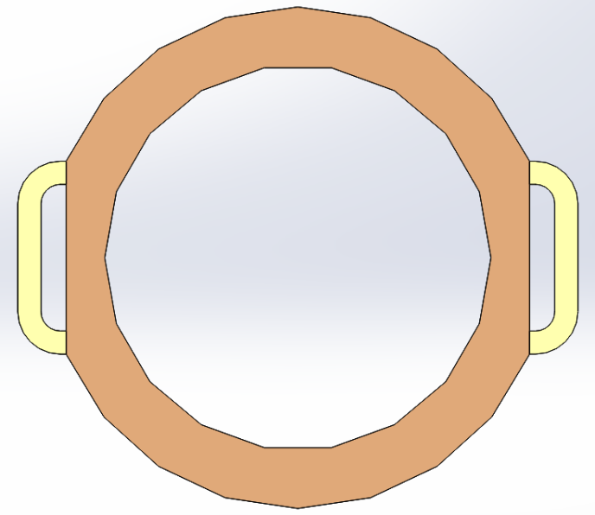
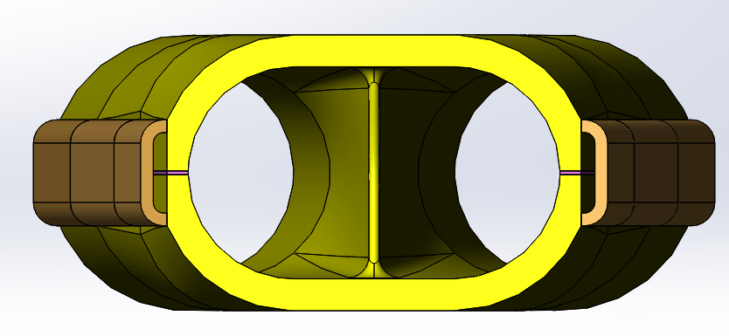
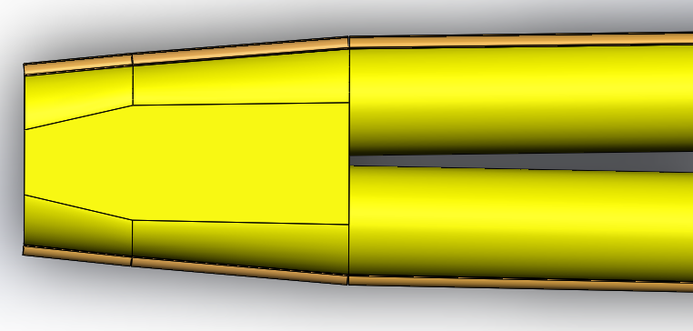
The structure of beam chamber
      The vacuum chamber is made of CuCrZr (C18150), with a cooling water pipe welded on the outer side. The cross-section of the circular pipe with a diameter of 20 is shown in the figure.
      Inner diameter φ20mm；
      Outer diameter φ26mm；
      Width 29mm；
      Multi-layer heating film：0.5mm.
      The length of MDI vacuum chamber is about 14m.
      Central beam pipe：-700~700mm；
      RVC：700-783mm；
      Chamber：783-7000mm.
15
R10
35
Notes:
Secondary Electron Yield

Slide 14
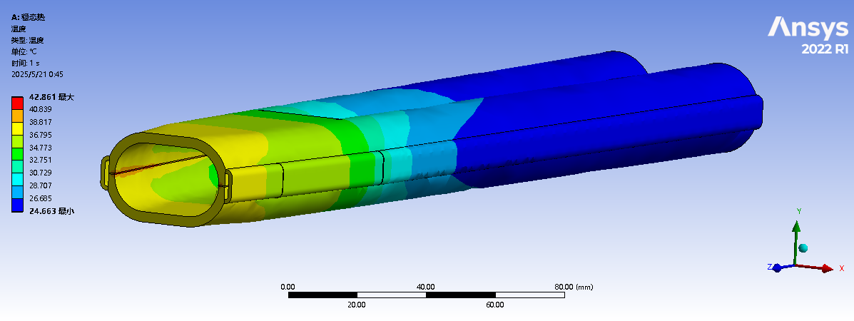
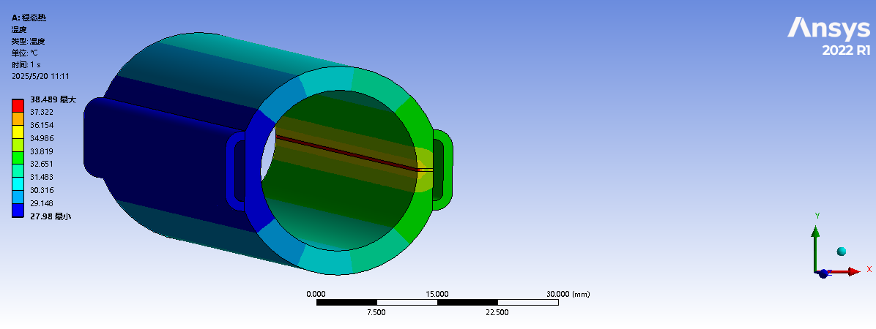
Thermal simulation
Lei Zhang
      Thermal analyses of chamber at cryostat @Higgs, 50MW. The highest temperature at crotch part is 42.9 ℃; The highest temperature at Masks is 38.5 ℃.
      Material ：C18150
      Cooling medium: water
      Inlet temperature：22℃
      Inlet velocity：1.5-2m/s (14.7-19.6 L/min)
Notes:
Secondary Electron Yield

Slide 15
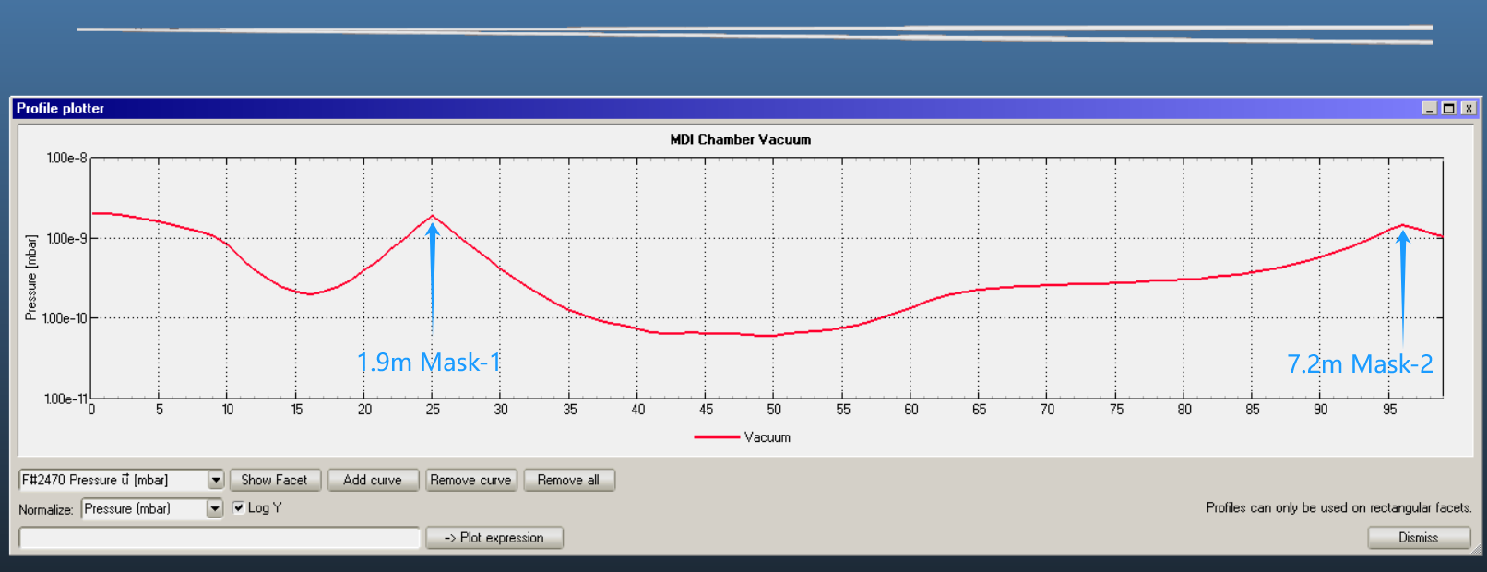
Vacuum pressure simulation
Lei Zhang
      The central beam pipe and luminal cannot be NEG-coated or baked.
      The worst vacuum pressure is 7.8E-9mbar. Most other part of vacuum chambers are better than 2E-9mbar.
      Sticking factor is 0.003；
      The out gassing rate of baked chamber is 1E-12 mabr·L/(s·cm²) , no baked part is 1E-11 mabr·L/(s·cm²) .
Central chamber without NEG coating.No baking.
7.2m, Mask-2
1.9m, Mask-1
Notes:
Secondary Electron Yield

Slide 16
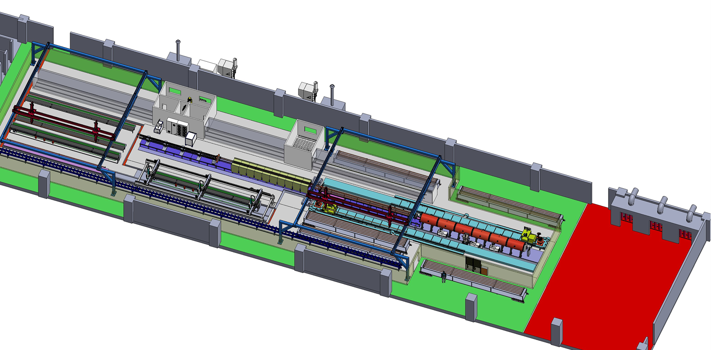
Preview of NEG coating/ Spray for heating film production line
Requirement
Due to the difference in length, two production lines will be used to complete the production of vacuum chambers for the CEPC collider. The quantity of NEG coating and spraying facilities for the two lines varies to match the production speed.
The full quantity of vacuum chambers for the collider will be manufactured within five years, utilizing two production lines operating at a combined capacity of 4,500 units per year.
Advantages
More stable process, less manpower, less NEG coating facility, more adaptive capacity in production, etc.
Heating layer spraying
Items | Specifications
Dimension | L 11400-d56-D62
Weight | 50~100kg
NEG coating | Thickness：200nm±30% SEY<1.1 S、Q、life-times
Spraying heating | Thickness<0.5mm Heating temperature <300℃
Cleaning
NEG coating

Slide 17
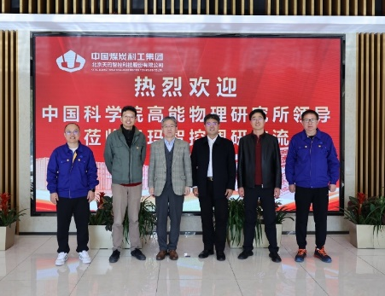
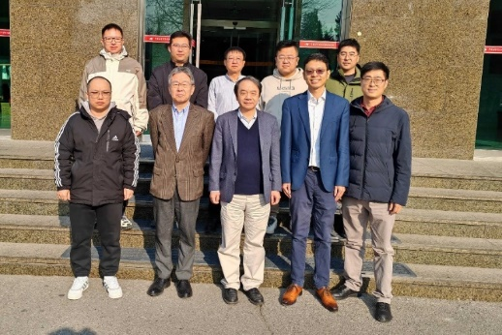
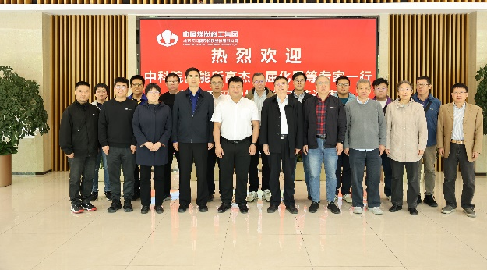
Critical Step in the Production Line
Important nodes and progresses
Technical scheme review
Procurement bidding
Process Review prior to Manufacturing
Most of components have been manufactured 2025.11
The production line will be conditioned 2026.3
2024.10
2024.12
2025.6
Manufacturer visit
Project kicker off
Process Review prior to Manufacturing

Slide 18
Production line composition
Classification | Sub-devices | Parameters | Note
Electron-beam welder | Electron-beam gun Power supply Vacuum chamber | Meets the Length of 11.4m vacuum chamber 6 working position | Design and manufacturing
Brazing | Mechanical holder Power supply | 350℃ 11.4m long | Low temperature brazing in air by conductivity heating, expecting stead by double hole copper tube
Heating film spraying facility | Electron-beam gun Power supply Controller Mechanical Structure | Meets the Length of 11.4m vacuum chamber Multilayer Spray Ceramic and conductivity layer | R&D
NEG coating tower | Pumping system Vacuum measurement Power supply Vacuum chambers Discharge Gas Cathode、controller | Meets the Length of 11.4m vacuum chamber 6 working position Background vacuum <5e-7Pa Baking temperature 200℃ | Developing to be more fitted the production line
Measurement and testing | Dimension measurement Leakage testing | Dimension measurement 11.5m/0.1mm Leakage testing 1e-10 mbar·L/s | Design and manufacturing
Cleaning | rinsing | deionized water rinsing | Design and manufacturing
Production line auxiliary equipment | Moving band robot arm system controller | Meets the Length of 11.4m vacuum chamber | Design and manufacturing

Slide 19
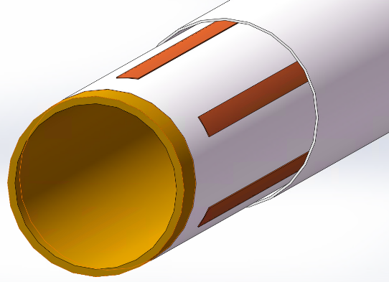
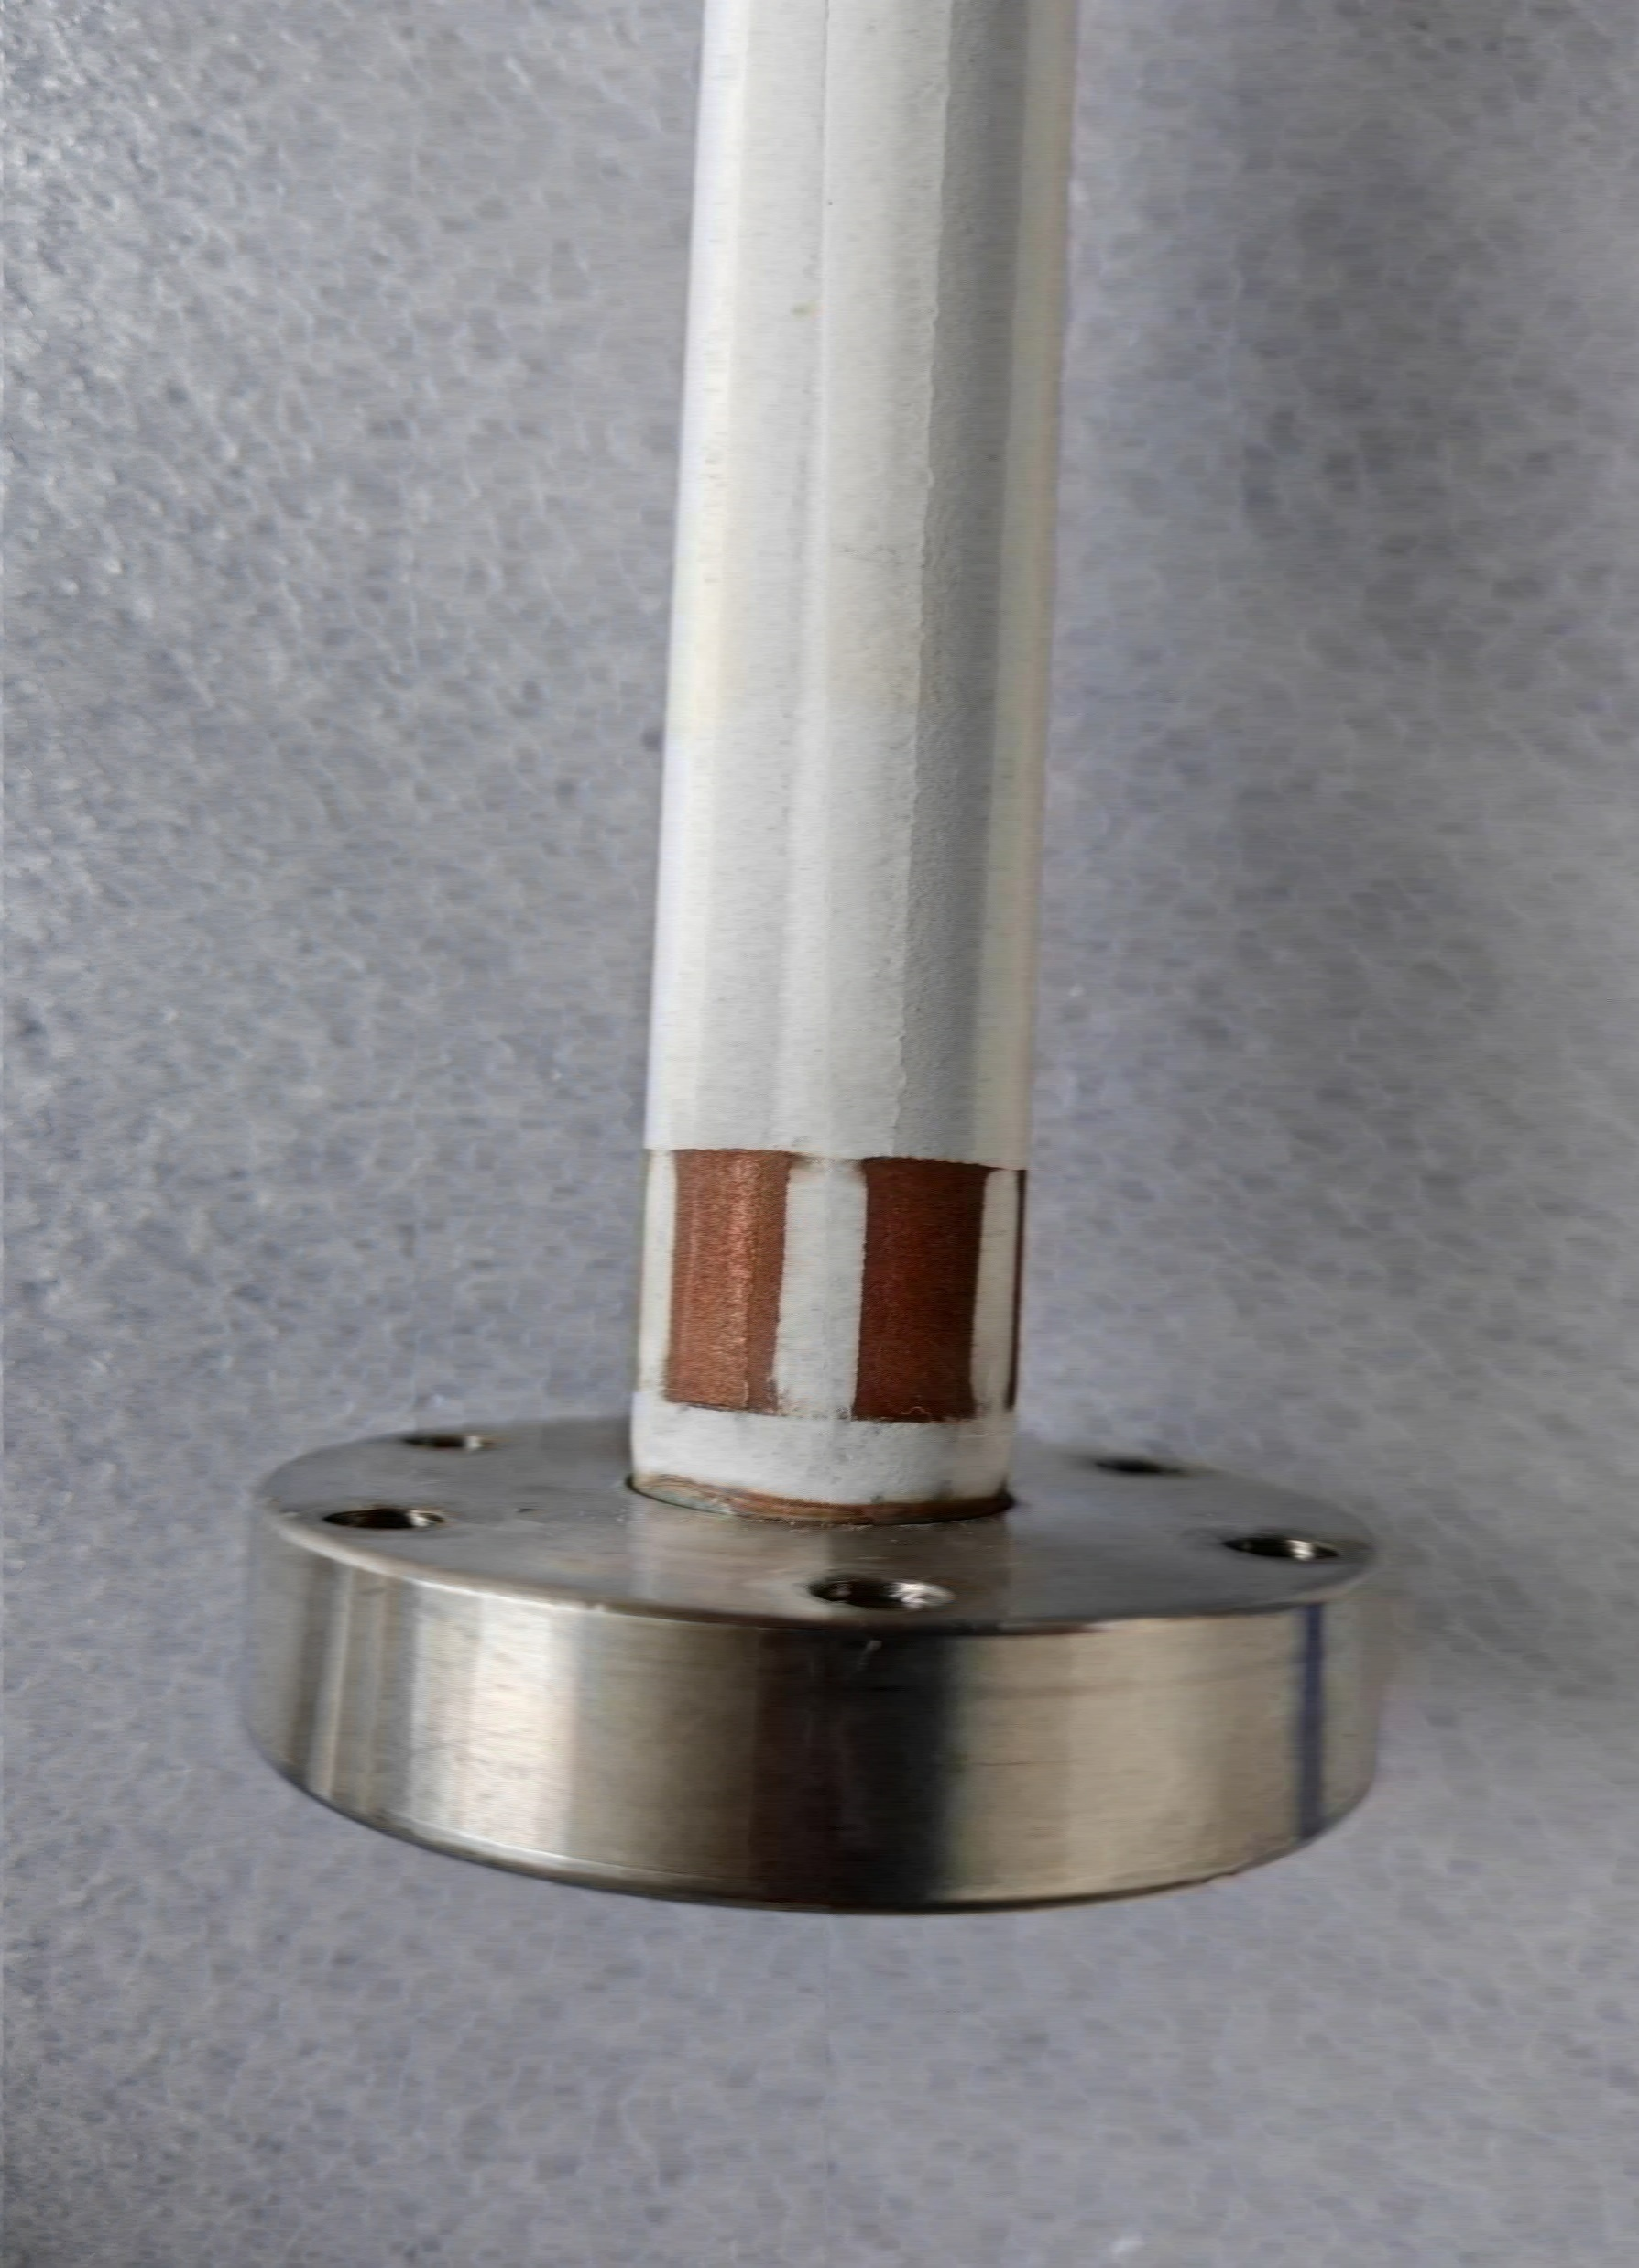
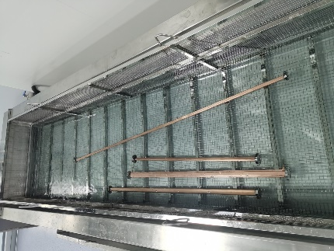
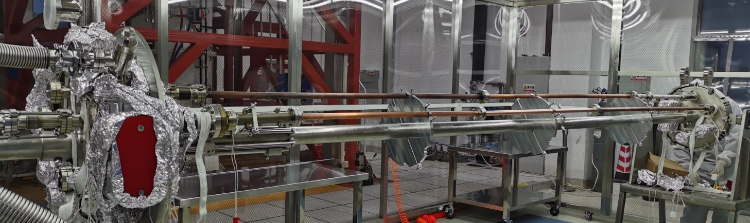
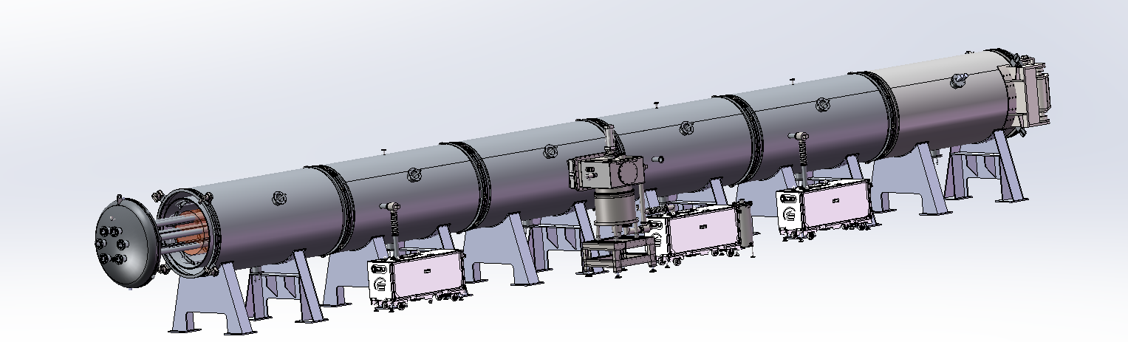
Procedure of NEG coating & spraying of production line
Spraying (Air plasma spraying)
Sandblasting
Spraying_Isolation_layer
Spraying_Conductivity-layer
Spraying_Isolation-layer
Spraying_Contactor-layer
Cleaning
Outside
Inside
NEG coating
vacuum chambers, cathodes assembling by mechanical arms (flanges sealing).
Leakage testing.
Deliver the assembles to vacuum oven/ baking/ NEG coating;
Disassembly the vacuum chambers
Function | Materials | Thichness/um
Transition-layer | MCrAlY alloy | 50~100
Isolation-layer | Al2O3 cermic | ~200
Conductivity-layer | NiCr alloy | 50~100
Isolation-layer | Al2O3 cermic | ~200
Contactor-layer | Copper | ~50
Notes:
Atmosphere plasma spray

Slide 20
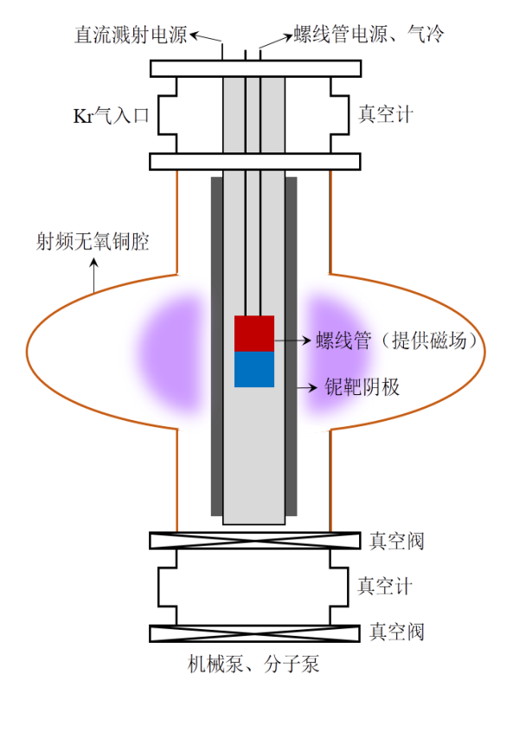
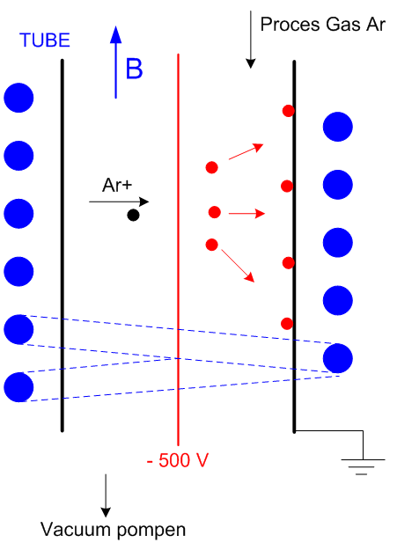
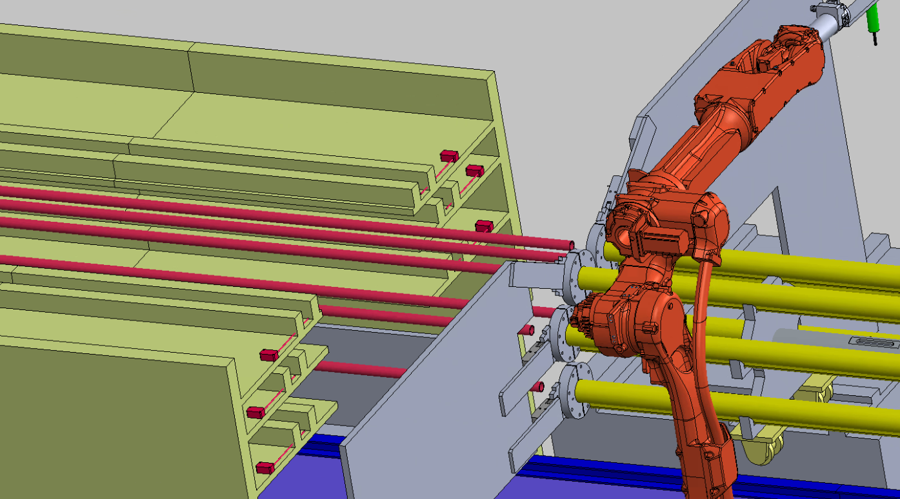

Layout & composition of NEG coating facility
NEG coating, VC assembly and disassembly with automatic robot arms.
DCMS for NEG coating
Kr+
磁环
Cathodes driven
Inside magnet
Cathodes
VC assembly
Vacuum oven

Slide 21








Vacuum chamber automatic assembly
z
X
Sealing gasket installation
Flanges fastening

Slide 22







Vacuum chamber automatic assembly
Due to the diameter of CEPC is D56, we plan to replace the cathode wire with a magnetron sputtering cathode
Permanent magnet instead of the solenoid which supplies magnetic field for DCMS;
By combining the low vacuum chamber outside of the vacuum chambers to be coated with NEG, the high vacuum process is simplified;
VC inserted into the oven
Safety insurence
VC & cathode support
UHV system for NEG coating

Slide 23






Prototype of cathode for NEG coating
Motor for magnets driven
23000mm(23 meters)
~12000mm(12 meters)
Magnetron Cathode
After testing and conditioning, the cathode achieves a stable DCMS plasma discharge under 367 V and 1.1 A.
23

Slide 24
















Manufacturing progress of production line
The oven for NEG coating, which provides a low vacuum environment and baking capabilities, is under manufacturing.
The 12-meter cathode prototype for NEG coating is under manufacturing.

Slide 25









Manufacturing progress of production line
The main components of vacuum oven for NEG coating have been manufactured and under are now being assembled.

Slide 26



VC baking & Why spray heating film
The baking is the most crucial procedure in achieving ultra-high vacuum
Necessity:
In order to meet the ultra-high vacuum requirement of achieving a dynamic vacuum level of 3.0E-10 mbar.
NEG coating reactivation
Too thick
Lifetime is very short under SR of CEPC
N₂
N₂
H₂
H₂
O₂
MO
O₂
Heat
O
High
vacuum
or
inert gas
H₂O
C
MC
CO
H₂O
CO₂
CO₂

Slide 27






Spraying for heating film
Multilayer heating film will be coated outside of the vacuum chamber which composited by ceramic and conductivity layer
The heating temperature could reach 250℃
Heating layer
Thickness： 0.5mm
Ceramic layer
Convection
Radiation
Conductivity layer
I
solution
Conduction
Ceramic layer
Cu/ceramic transition layer
Vacuum chamber
Related commercial products
Cu/Ag NW
Processing of spray
Plasma spraying
Electric heating circuit
De-icing for airplane

Slide 28




Plasma Spraying system
Plasma Spraying
& Laser etching room
Sandblasting room
The vacuum chamber will be transferred by motorized conveyance to the coating station, where a robotic arm will execute multi-layer deposition using an automated spray gun.
Notes:
Reciprocating motion

Slide 29









Heating coating spraying
The processing step for the heating coating spraying
Sandblasting
Plasma Spraying
Etching by laser
项目 | 参数
驱动方式 | 旋转气缸驱动
遮蔽材质 | 不锈钢
轴向可调节范围 | 100mm

Slide 30







Length of 1.5m prototype of Spraying
A 1.5-meter prototype has been developed to validate key process steps that will be implemented in the production line.
Installation
Sandblasting
Spraying
Spraying_Isolation-layer
Spraying_Conductivity-layer
Spraying_Isolation_layer

Slide 31



Elements and thickness testing
Ceramic layer
NiCr
Convection
Radiation
Conductivity layer
I
Conduction
Al₂O₃
Ceramic layer
Cu/ceramic transition layer
Vacuum chamber
Function | Materials | Thichness/um
Transition-layer | NiCr alloy | 47.6
Isolation-layer | Al2O3 cermic | 224
Conductivity-layer | NiCr alloy | 65.5
Isolation-layer | Al2O3 cermic | 174

Slide 32






Prototype spraying of a heating coating and tests
Reheating test more than 12 times
Adhesion test in ultrasonic resining
Dimension: L400*D24 Substrate: copper
Due to the strong natural convection formed inside the pipeline, the highest temperature point deviates from the center, and the temperature drop at both ends is significant.
Dimension: L1500*D60 Substrate: copper

Slide 33







Plasma spraying devices
The spraying system is similar to the system detailed in the following pictures.

Slide 34








All metal gate valve development with company
Under the demand traction of CEPC, two enterprises simultaneously carried out technological research and development, and the opened/closed times of CF63 gate valve are more than 2000 times.
日扬电子科技（上海）有限公司（HTC）
上海真空阀门制造有限公司（SHZK）
Gate Valve Evaluation Meeting 2025.2.20

Slide 35





Possibility of AL alloy vacuum chamber in use of collider ring
AL alloy (6000 series) vacuum chamber have been used in lots of accelerators, such as BEPCII, LEP, superKEKB (e+), and insertion devices of light source, under conditions where baking temperature is lower than180℃. However, their use is limited in NEG-coated vacuum chambers because the yield strength of the material undergoes a sharp decline when the baking temperature exceeds 180°C.
The 7000 series alloy exhibits superior high-temperature mechanical properties, with a yield strength of 200 MPa at 250°C compared to 150 MPa for the 6000 series—a 33% increase.

Slide 36
Conclusion
The impedance increase due to the absorbers are less than 5% of the total budget;
Lots risks of vacuum chamber with absorbers due to the welding between beam pipe and absorbers; The structure of vacuum chamber will be more complex, bad to NEG coating process;
Prototypes of absorbers should be taken out to access its feasibility.
Production line of vacuum chambers NEG coating and spraying heating has been carried out;
Prototype of Spraying heating film and tests have been carried out;
Feasibility study of AL alloy 7000 vacuum chamber in use of collider ring in next step;
NEG coating optimization for low impedance film will be carried out.

Slide 37
Thanks for your attention!

