Slide 1
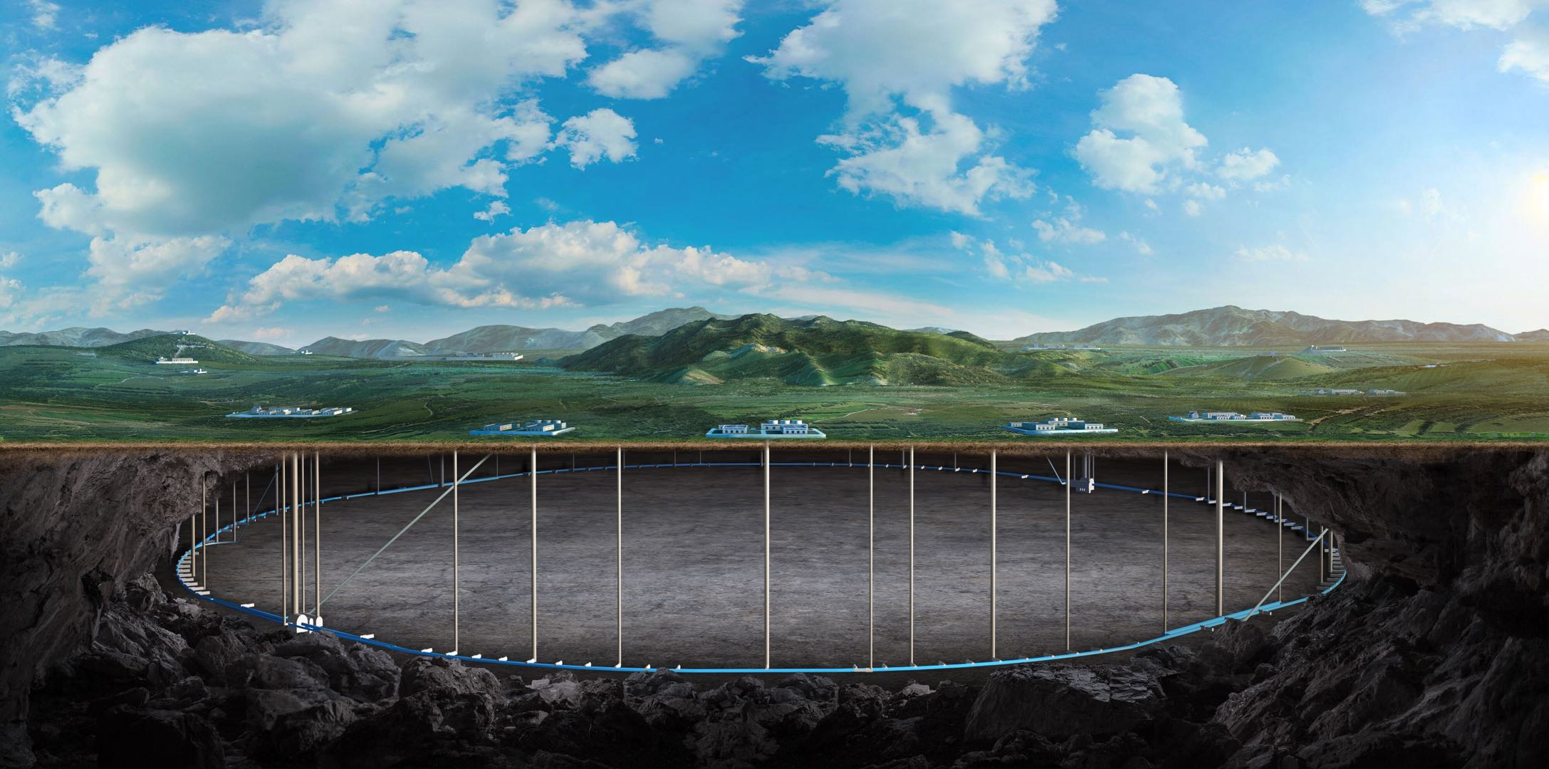


Radiation in the tunnel and its mitigation for CEPC EDR
Guangyi Tang
On behalf of CEPC RP Group
The 2025 International Workshop on the CEPC, Nov. 6, 2025, Guangzhou.

Slide 2
Content
Introduction
CEPC TDR shielding scheme
Prompt dose level in the tunnel for TDR scheme
Protection of radiation-sensitive equipment
Cables, electronics, optical fiber …
Induced dose level in the tunnel for TDR scheme
Conclusion

Slide 3
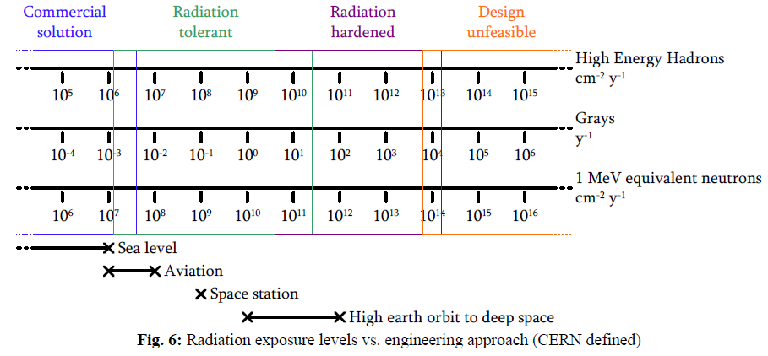

Upper limit of absorber dose for electronics
Radiation-sensitive equipment: electronics, optical fibers and cables/insulations.
In the collider tunnel, the radiation level is much higher than in the linac/transport line/damping ring. Electronics in the collider tunnel without shielding may be broken soon.
First priority to design shielding in collider tunnel.
Use absorbed dose, 1MeV-equivalent neutron fluence and high energy hadron fluence to assess the radiation exposure levels.
For electronics:
High Energy hadron fluence < $2×{10}^{10} cm^{−2}y^{−1}$
Absorbed dose < 20 Gy/y
1MeV equivalent neutron fluence < $2×{10}^{11} cm^{−2}y^{−1}$
CAS - CERN Accelerator School: Power Converters, 245-263
We set upper limits here.
Notes:
Upper limits changed to red color.

Slide 4
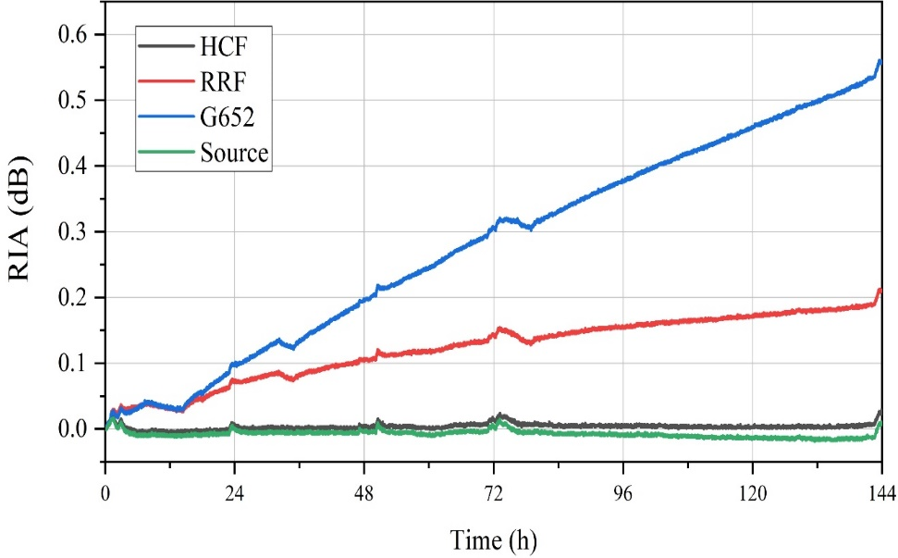
Upper limit of absorber dose for optical fiber and cable
Radiation-sensitive equipment: electronics, optical fibers and cables/insulations.
In the collider tunnel, the radiation level is much higher than in the linac/transport line/damping ring. Electronics in the collider tunnel without shielding may be broken soon.
First priority to design shielding in collider tunnel.
Use absorbed dose, 1MeV-equivalent neutron fluence and high energy hadron fluence to assess the radiation exposure levels.
For optical fibers:
Accumulated absorbed dose < 10 ~ 100 Gy for ordinary optical fiber
Accumulated absorbed dose < 10 kGy for radiation-resistant optical fiber
For cables/insulations:
Absorbed dose < 1 MGy considered for polyethylene, PVC, etc.
Total dose:
354Gy@HCF，268Gy@RRF，195Gy@G652
2025 European Edition of the International Workshop on the Circular Electron-Positron Collider (CEPC), Barcelona, Spain: CEPC large scale and precision control system study in EDR (remotely) · IFAE Indico
Radiation Induced Attenuation (dB)
RADIATION PROBLEMS IN THE DESIGN OF THE LARGE ELECTRON - POSITRON COLLIDER (LEP). (1984)

Slide 5
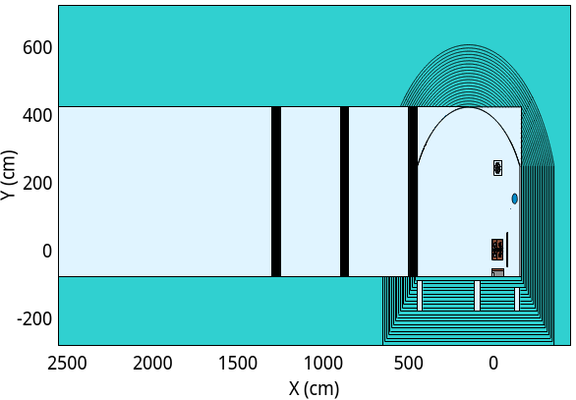
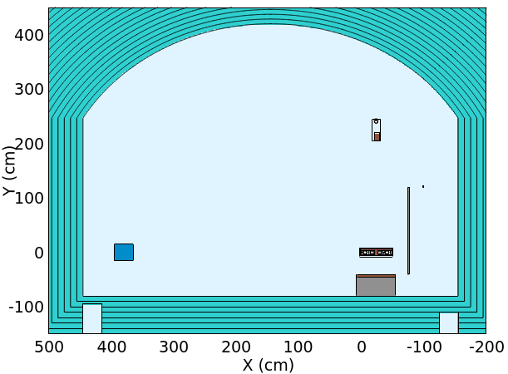
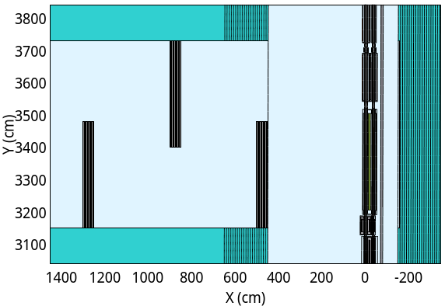
CEPC TDR scheme: collider tunnel and auxiliary tunnel maze
external
internal
The dose level in the tunnel is so high that would damage cables, fibers and electronics in the tunnel without shielding.
Add lead/concrete block to protect the cables on the cable trays. The cable trays are located in the inner wall.
Auxiliary tunnels with mazes are designed to contain all electronics.
booster
Auxiliary tunnel
collider
external
0.5m
internal
external
internal
5m
2.5m
2.5m
booster
5.8m
6m
Lead/concrete block
cable trays
3.5m
3.5m
collider
2.5m
collider
support
0.5m
0.5m

Slide 6
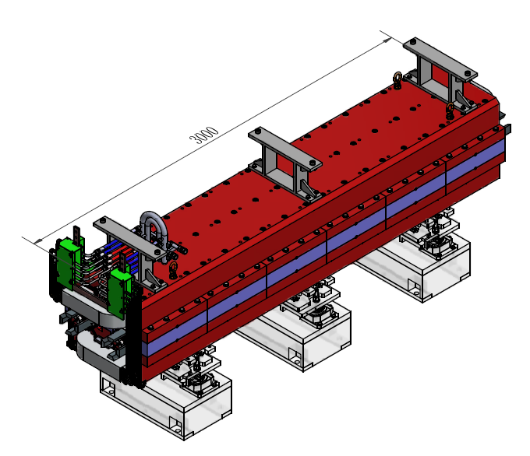
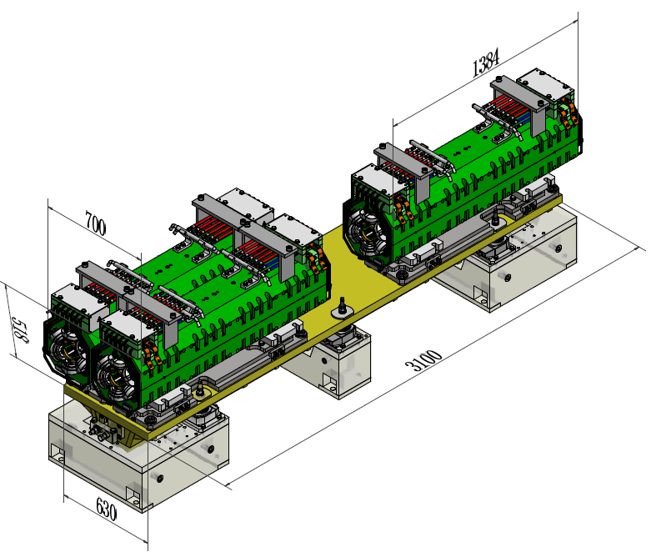
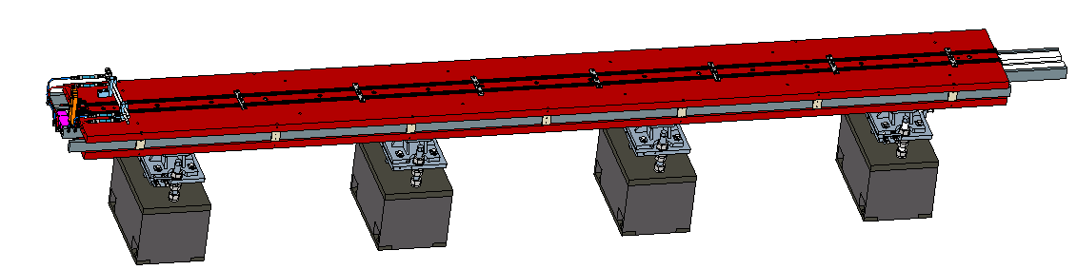
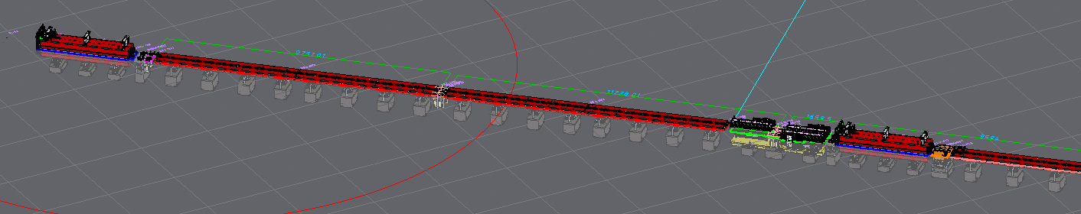
CEPC dipole, quadrupole and sextupole in CAD
Dipole typical length: 5m; quadrupole typical length: 3m; sextupole typical length: 1.5m;

Slide 7
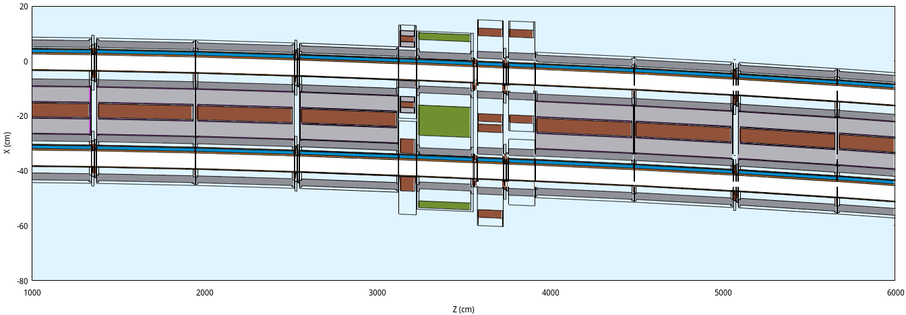
CEPC TDR scheme simulation setup: a typical collider arc region
According to mechanical arrangement, a beamline shows below
Dipoles with bellows and pumps -> Correctors -> Quadrupole -> BPMs -> Sextopoles -> Dipoles with bellows and pumps

Slide 8
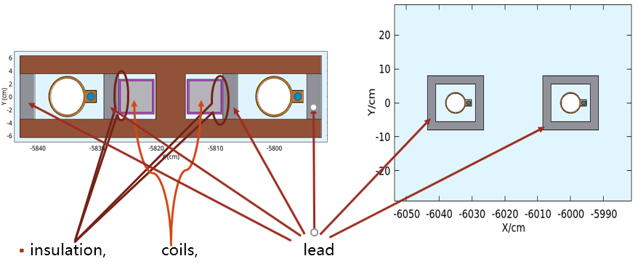


Lead in dipole and around vacuum chamber
dipole：2.5cm thick, 6.6cm high;
epoxy resin coil lead
Lead area: 66$cm^{2}$
Vacuum chamber：2.5cm thick, 11~17cm wide
Lead area: 70$cm^{2}$
2.5cm
2.5cm
2.5cm
2.5cm
12cm
6.6cm
11cm
16cm
17cm

Slide 9
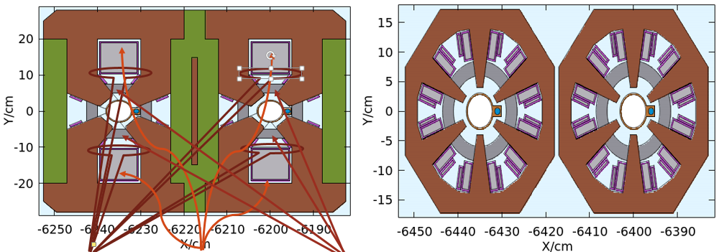


Lead in quadrupole and sextupole
Sextupole: 2.5cm thick
Lead area: 152$cm^{2}$
Quadrupole: 2.5cm thick
epoxy resin coil lead
Lead area: 97$cm^{2}$
2.5cm
2.5cm
2.5cm
2.5cm
2.5cm
2.5cm
2.5cm
2.5cm

Slide 10
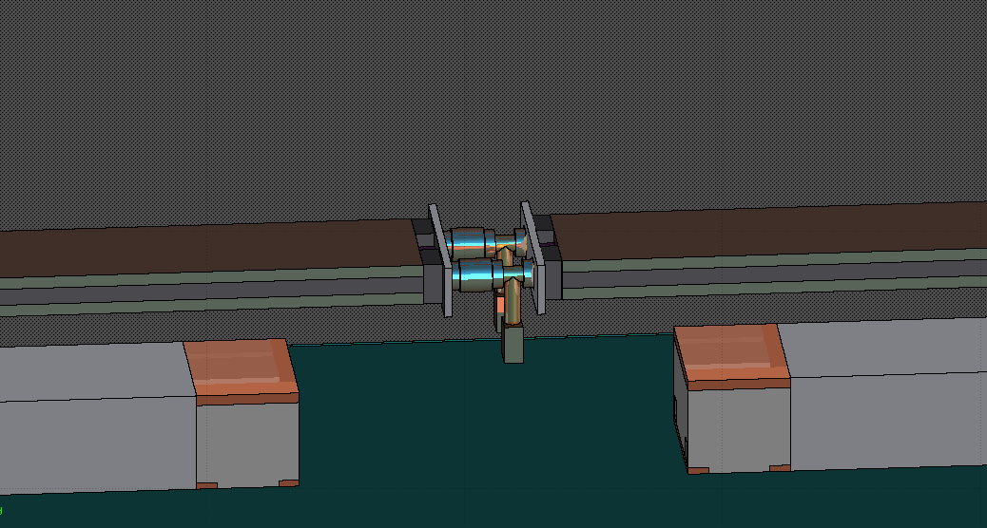
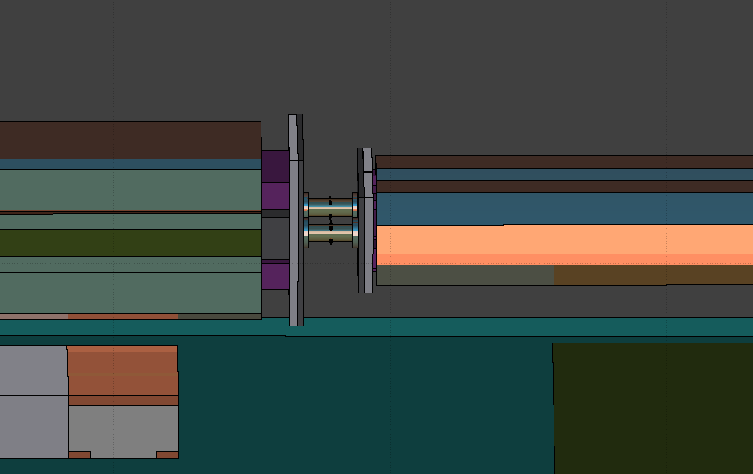

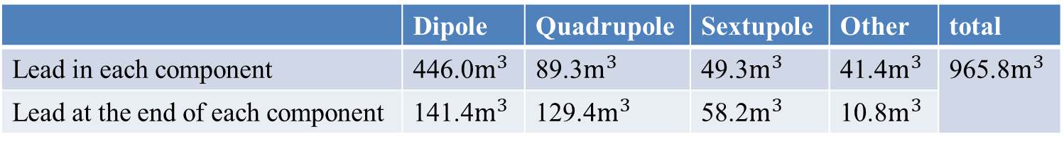
Lead shielding at the end of magnet
At dipole end: transvers area73cm x 20cm, 3~5cm thick
The volume and weight of lead used for the collider can be obtained, 996$m^{3}$ (10916 tons)
FCC: 11360 tons Pb94Sb6
At quadrupole end: transvers area 65cm x 62cm, 5cm thick
At sextupole end: transvers area 34cm x 36cm, 5cm thick
Pump and bellow
BPM
dipole
dipole
quadrupole
sextupole
Lead at the end of dipole
Lead at the end of quadrupole and sextupole
 | Dipole | Quadrupole | Sextupole | Other | total
Lead in each component | 446.0$m^{3}$ | 89.3$m^{3}$ | 49.3$m^{3}$ | 41.4$m^{3}$ | 965.8$m^{3}$
Lead at the end of each component | 141.4$m^{3}$ | 129.4$m^{3}$ | 58.2$m^{3}$ | 10.8$m^{3}$
From FCC Week 2025 talk

Slide 11
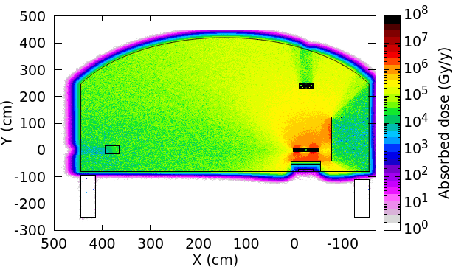
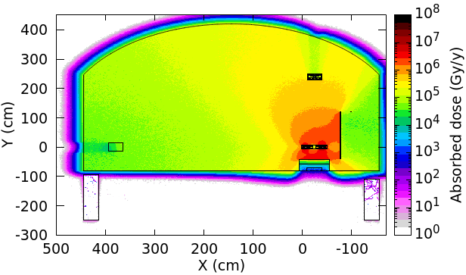
Prompt dose level for CEPC TDR scheme
@ttbar SR
Internal wall: 600kGy/y, external wall: 70kGy/y
Internal wall:50kGy/y,
Dose level caused by beam loss is much lower than that caused by SR. Dose rate @Z/WW can also be negligible.
@Higgs SR
Internal wall: 180kGy/y, external wall: 60kGy/y
Internal wall 30kGy/y,
After 18 years operation (10H+2Z+1W+5ttbar), the cumulative absorbed dose to the outer wall cable, 950 kGy, remains below the upper limit (1 MGy). By the lead/concrete shielding, the cumulative absorbed dose to the inner wall cables decrease from 4.8MGy to 550 kGy, lower than 1 MGy upper limit, so that the cables near inner wall and outter wall are both safe.
Without lead/concrete shielding
With lead/concrete shielding
external
internal
external
internal

Slide 12
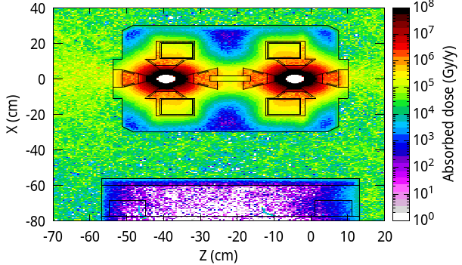
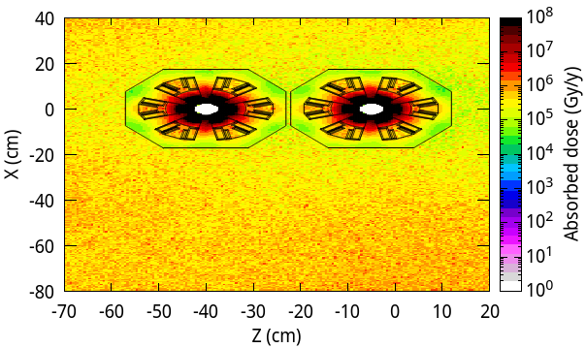
Radiation protection for cable insulation for CEPC TDR scheme
The cables next to quadrupoles and sextopoles are safe since the magnet cores are good shielding block.
Accumulated absorbed dose < 800 kGy, around quadrupoles < 8 MGy, around sextopoles
Safe for polyethylene or epoxy resin insulations, respectively.
And, cables next to other equipment needs radiation hardening.
Cables/connectors with SiO2/ceramic insulation
Multilayer insulations with wire meshing
Cost: assume 10k CNY per 10m radiation-hardening cable, 78160 cables signify 790M CNY
Plan to test the feasibility of cables.

Slide 13
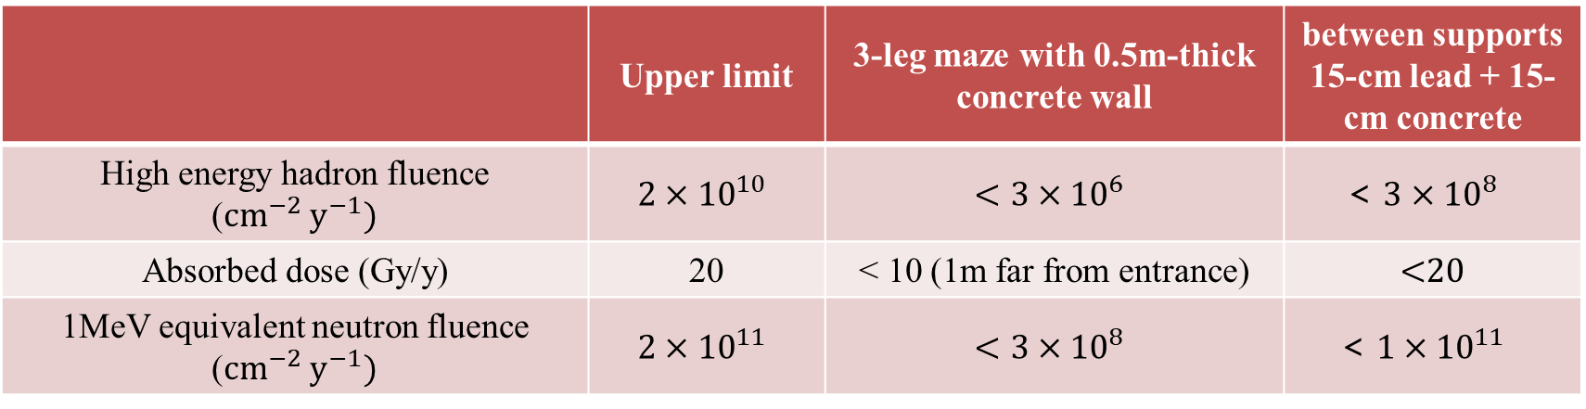
Radiation protection for electronics for CEPC TDR scheme
For electronics
With a 3-leg maze, radiation in the auxiliary tunnel decreases to a safe level
Number of electronics (power supply): ~ 26000 for magnets, ~ 30000 for vacuum system, ~ 12000 for BPM
198 auxiliary tunnels supply enough space to contain all electronics.
Alternatively, by shielding with 15cm lead and 15cm concrete, radiation in gaps between supports decreases to a safe level.
 | Upper limit | 3-leg maze with 0.5m-thick concrete wall | between supports 15-cm lead + 15-cm concrete
High energy hadron fluence (${cm}^{−2}{ y}^{−1})$ | $$2×{10}^{10}$$ | $$<3×{10}^{6}$$ | $$\text{< }3×{10}^{8}$$
Absorbed dose (Gy/y) | 20 | $\text{< }\text{1}\text{0}$ (1m far from entrance) | <20
1MeV equivalent neutron fluence (${cm}^{−2}{ y}^{−1})$ | $$2×{10}^{11}$$ | $$<3×{10}^{8}$$ | $$\text{< }1×{10}^{11}$$

Slide 14
Radiation protection for fiber/cables for CEPC TDR scheme
Upper limit for ordinary optical fiber: accumulated absorbed dose < 10 ~ 100 Gy Upper limit for radiation-resistant optical fiber: accumulated absorbed dose < 10 kGy
Radiation-resistant optical fibers are safe in the inner trench with 30cm concrete cover and in the outer trench with 10cm concrete cover.
Ordinary optical fibers are safe in outer trench with 30cm concrete cover.
For cable insulations (polyethylene, etc.) on the cable trays: accumulated absorbed dose <1 MGy
Use 2cm-thick 2m-high lead sheet, or 10cm-thick 2m-high concrete block to shield radiation. Cost: 830M CNY for lead, or 30M CNY for concrete
Cable aging test: polyethylene, SiO2, PEEK, etc.
 |  | Trench with 10-cm concrete cover | Trench with 30-cm concrete cover
Accumulated absorbed dose after 18y operation | internal trench | <72 kGy | <140 Gy
 | external trench | <7 kGy | <27 Gy
@Higgs
external
internal
@ttbar

Slide 15
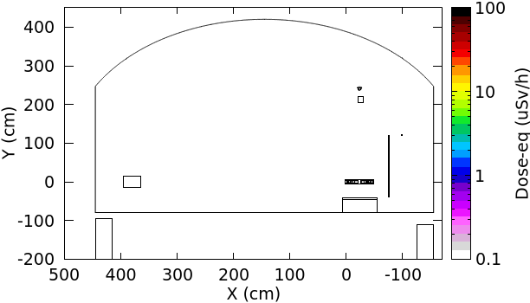
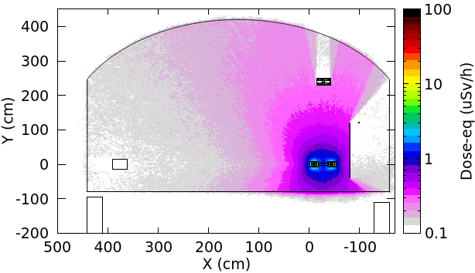
Induced dose-eq for CEPC TDR scheme, 10min after shutdown
For 4 operations (120/45.5/80/180 GeV), simulate the induced dose-eq caused by SR and random beam losses.
The dose-eq after 1-year running and 10-min shutdown is shown below
@Higgs operation：1m away from equipment <1 uSv/h，surface of equipment ~10 uSv/h
SR random beam loss
Similar radiation level @the end of BEPCII Linac (~10 uSv/h). Safe to work 500h per year

Slide 16
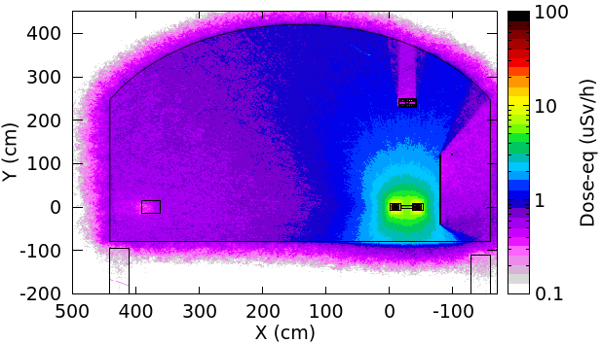
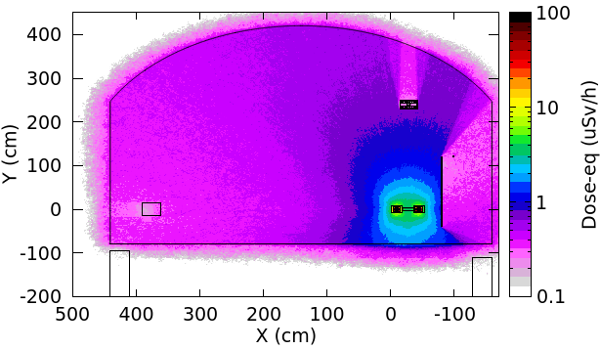
Induced dose-eq for CEPC TDR scheme, 10min after shutdown
@Z operation: 1m away from equipment <2 uSv/h， surface of equipment ~ 20 uSv/h
SR can be negligible
A little higher than radiation level around the end of BEPCII Linac (~10 uSv/h). Safe to work ~100h per year.
@ WW operation: 1m away from equipment <1 uSv/h， surface of equipment ~10 uSv/h
SR can be negligible

Slide 17
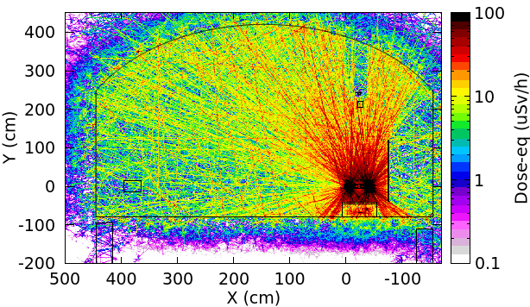
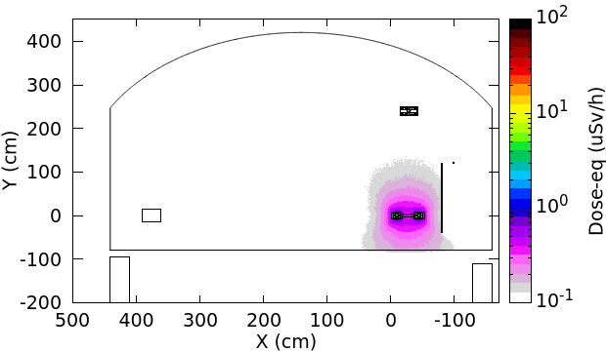
Induced dose-eq for CEPC TDR scheme, 10min after shutdown
@ttbar operation： 1m away from equipment <20 uSv/h， surface of equipment >100 uSv/h
SR random beam loss
Higher than the radiation level around BEPCII positron target. Considering 5mSv/y as the upper limit for workers, a short time (~10h per year) stay is permitted.

Slide 18
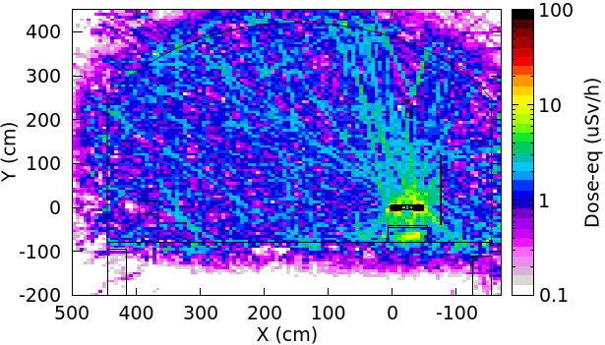
Induced dose-eq for CEPC TDR scheme, 1day after shutdown
@ttbar operation: 1m away from equipment <5 uSv/h, surface of equipment >10 uSv/h
SR
Considering 5mSv/y as the upper limit for workers, a long time (~100h per year) stay is permitted. So the induced radiation levels for all operations are acceptable.
Slightly higher than the dose-eq @Z/WW operation.

Slide 19
Conclusion
The induced dose-eq levels are safe for a long-time work in the tunnel, except the short-cooling-after-ttbar-operation case in which it is safe for a short-time work (10h).
Radiation level in the auxiliary tunnel is safe for electronics, radiation level around inner wall with shielding is safe for cables, radiation level in the trench is safe for optical fiber.
Further study on feasibility, shielding performance, operational complexity and maintainability. The engineering design for the lead fixing, cooling and cable tray shielding (aligns with our EDR plan).
Cable aging test, lead cooling test.
Thank you

Slide 20
backup

Slide 21
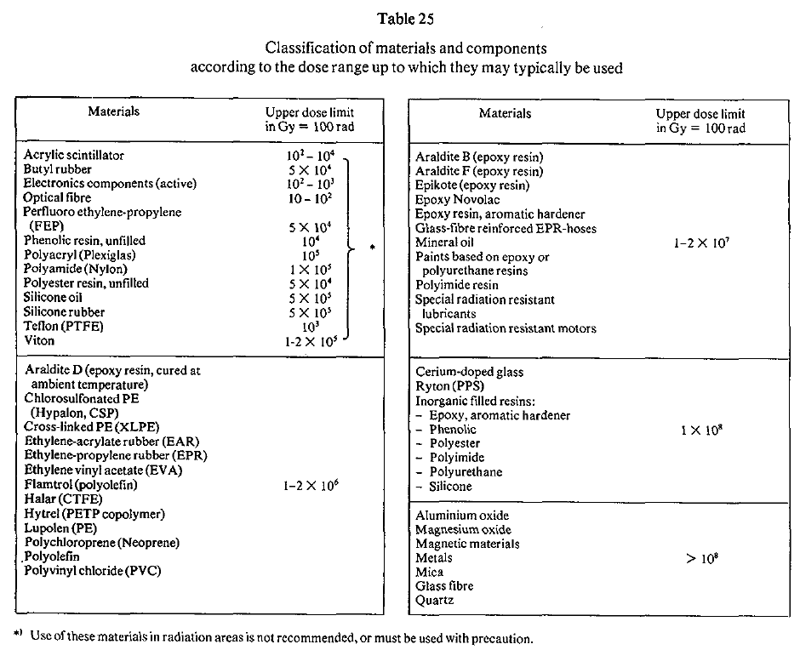

Slide 22
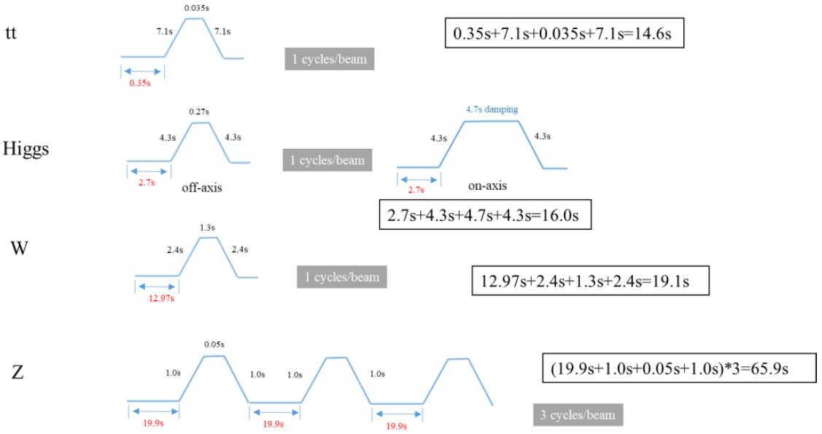
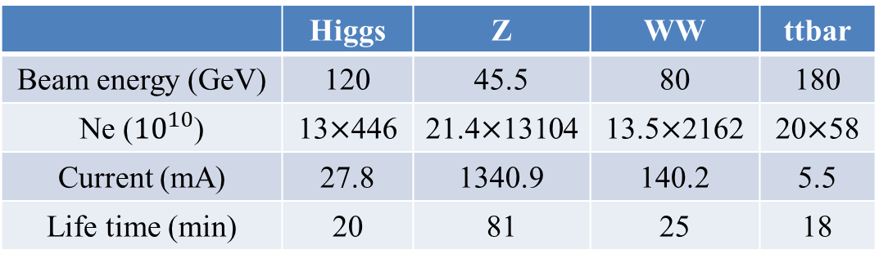

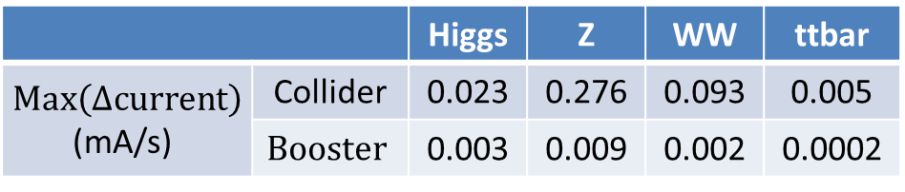
Random Beam Loss @50MW
Collider
Assuming beam losses are uniformly distributed along beampipe.
For collider, $N_{beam}=N_{e}×\text{Exp}\text{(}−\frac{t}{life time}\text{)}$, then $Max\left(N_{beamloss}\right)=\frac{Ne}{life time}$.
For booster, $N_{beamloss}=\frac{\left(1−90\%\right)×Ne}{injection interval}$
Beam losses from collider (1st row) and booster (2nd row)
Booster (transport efficiency 90%)
 | Higgs | Z | WW | ttbar
Beam energy (GeV) | 120 | 45.5 | 80 | 180
Ne (${10}^{10}$) | 13$×$446 | 21.4$×$13104 | 13.5$×$2162 | 20$×$58
Current (mA) | 27.8 | 1340.9 | 140.2 | 5.5
Life time (min) | 20 | 81 | 25 | 18
 | Higgs | Z | WW | ttbar
Current (mA) | 0.98 | 14.4 | 2.85 | 0.11
Time with beams (s) | 23.4 | 125.7 | 33.3 | 15.0
Injection interval (s) | 38.0 | 153.5 | 155.0 | 65.0
 |  | Higgs | Z | WW | ttbar
$Max\left(Δcurrent\right)$ (mA/s) | Collider | 0.023 | 0.276 | 0.093 | 0.005
 | $$Booster$$ | 0.003 | 0.009 | 0.002 | 0.0002
Prompt dose caused by beam loss is negligible, compared with prompt dose caused by SR.

Slide 23
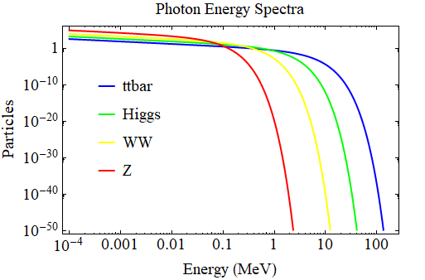
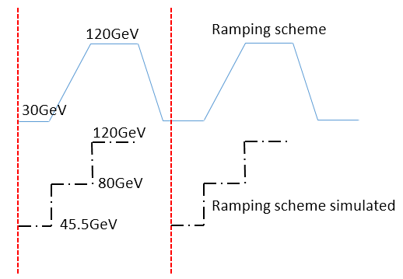
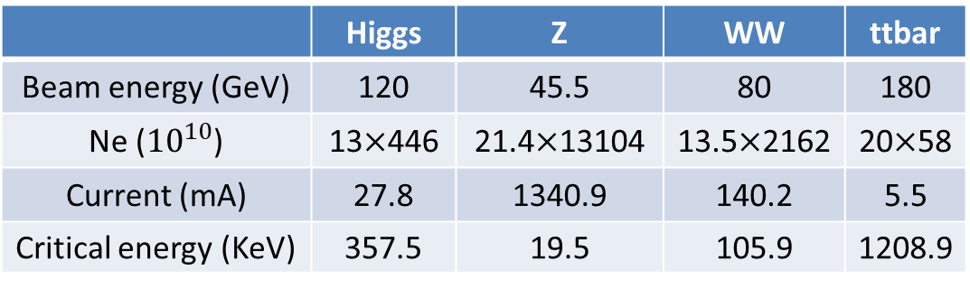
SR @50MW
Collider
With bending radius of 10.7km, SR can be simulated using parameters above in FLUKA.
SR photon spectrum
Booster (transport efficiency 90%)
Ramping simulation: example @Higgs
More smooth ramping simulation than TDR.
 | Higgs | Z | WW | ttbar
Beam energy (GeV) | 120 | 45.5 | 80 | 180
Ne (${10}^{10}$) | 13$×$446 | 21.4$×$13104 | 13.5$×$2162 | 20$×$58
Current (mA) | 27.8 | 1340.9 | 140.2 | 5.5
Critical energy (KeV) | 357.5 | 19.5 | 105.9 | 1208.9
 | Higgs | Z | WW | ttbar
Current(mA) | 0.98 | 14.4 | 2.85 | 0.11
Time with beams(s) | 23.4 | 125.7 | 33.3 | 15.0
Injection interval(s) | 38.0 | 153.5 | 155.0 | 65.0
In TDR
Now
120 GeV
120 GeV
Ramping scheme simulated
30 GeV
30 GeV

Slide 24
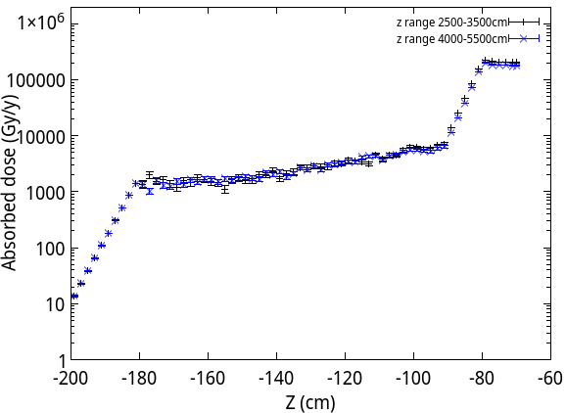
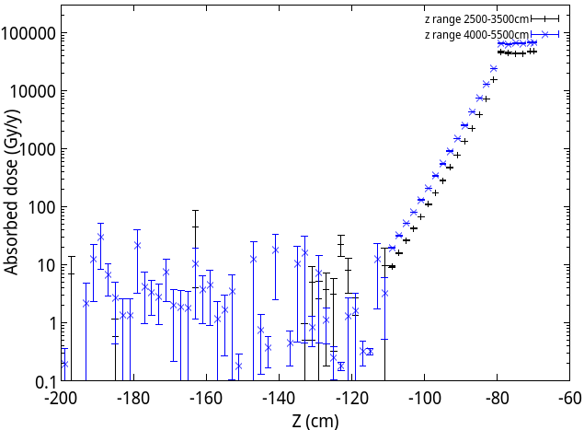
Radiation Protection for Fiber between TDR Scheme and Photon Absorber Scheme
For TDR scheme, ignoring dose decrease by1m-air, the dose under 30cm cover is 15Gy/y @ttbar. For photon absorber scheme, the dose under 30cm cover is 20Gy/y @ttbar.
Accumulated dose after 18y operation ~ 15Gy/y * 9 year (10y higgs ~ 4y ttbar, Z/WW negligible)
For TDR scheme, 135Gy; For photon absorber scheme, 180Gy.
20cm concrete
30cm cover
1m air
1m air
10cm cover

