Slide 1
IHEP-KEK collaboration on SuperKEKB beam-beam effects
Chuntao Lin, Yuan Zhang, Zhiyuan Li
IHEP
Many thanks to:
J. Gao, Y. Funakoshi, K.Ohmi
CEPC workshop, Guangzhou, Nov. 6-10,2025

Slide 2
Contents
Introduction
HER ring chromatic coupling
LER ring chromatic coupling
Preliminary beam-beam simulation with lattice using APES
Summary

Slide 3
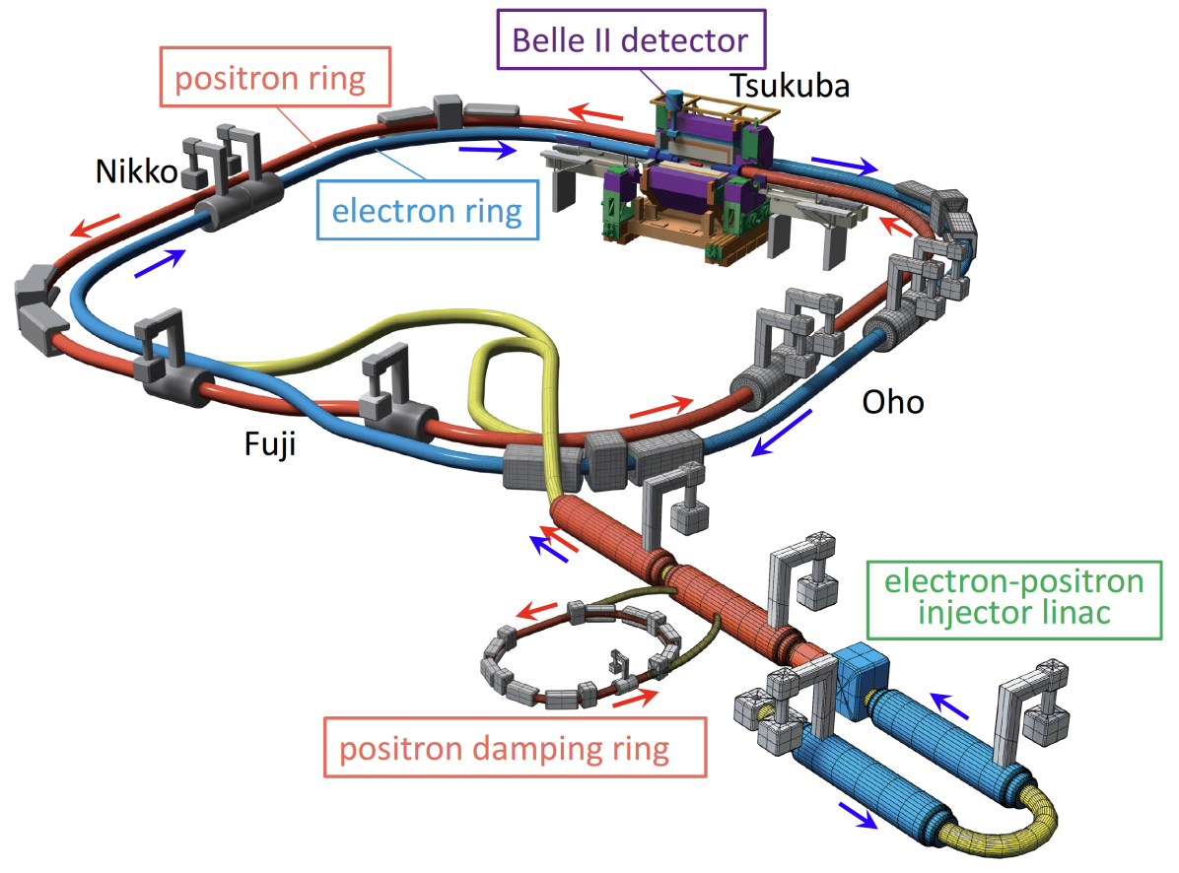
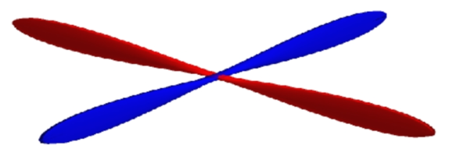
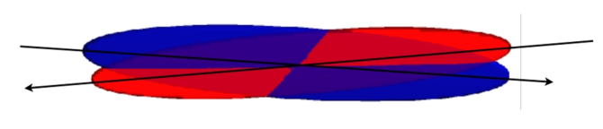

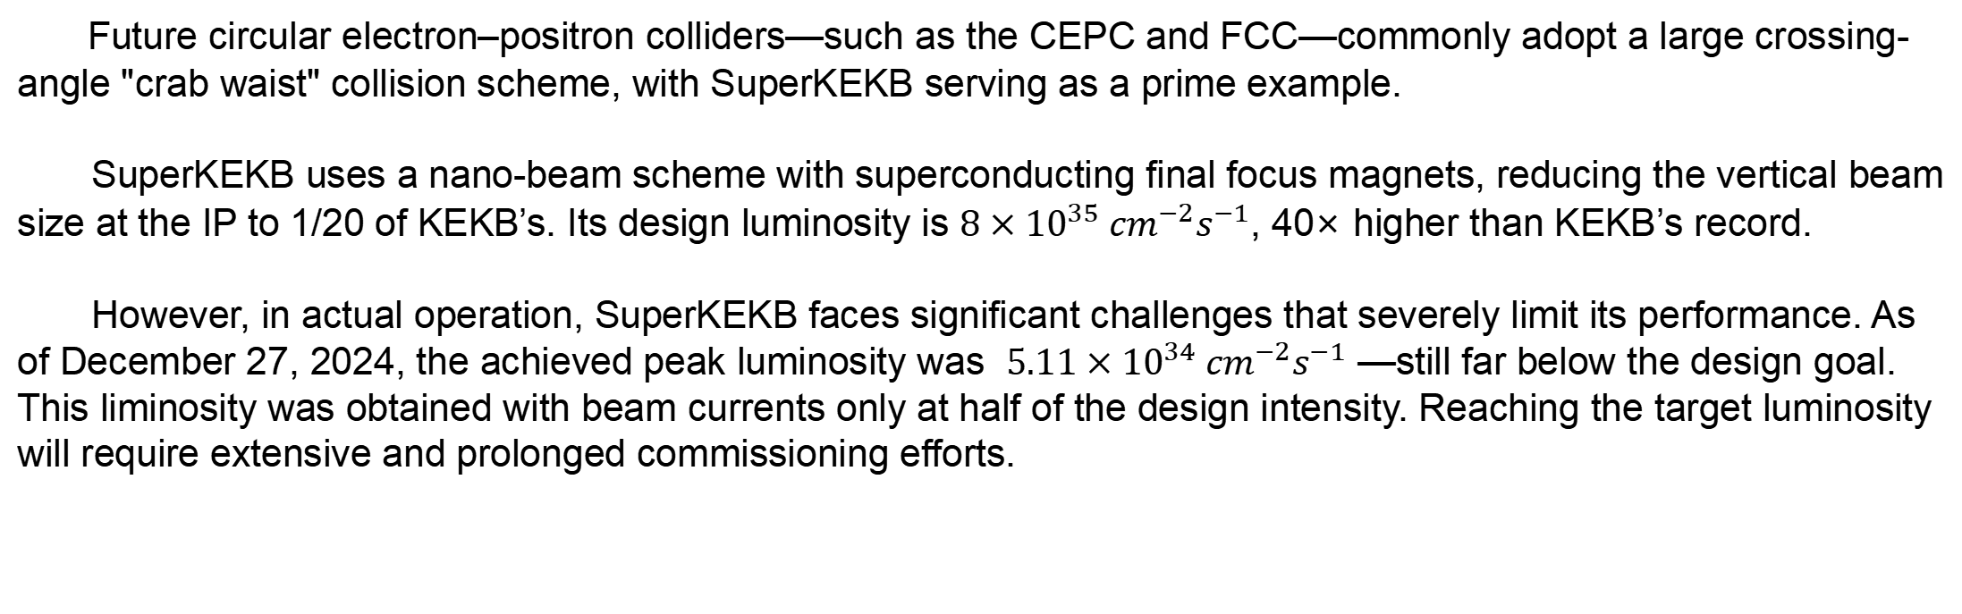
Introduction-SuperKEKB
Future circular electron–positron colliders—such as the CEPC and FCC—commonly adopt a large crossing-angle "crab waist" collision scheme, with SuperKEKB serving as a prime example.
SuperKEKB uses a nano-beam scheme with superconducting final focus magnets, reducing the vertical beam size at the IP to 1/20 of KEKB’s. Its design luminosity is $8×{10}^{35} {cm}^{−2}s^{−1}$, 40× higher than KEKB’s record.
However, in actual operation, SuperKEKB faces significant challenges that severely limit its performance. As of December 27, 2024, the achieved peak luminosity was $5.11×{10}^{34} {cm}^{−2}s^{−1}$ —still far below the design goal. This liminosity was obtained with beam currents only at half of the design intensity. Reaching the target luminosity will require extensive and prolonged commissioning efforts.
Beam squeezing :$×20$smaller at IR
KEKB crab crosing: small angle, high beam-beam parameter
SuperKEKB nano-beam scheme:
large angle, low emittance, low beta
Schematic view of SuperKEKB
https://arxiv.org/pdf/1809.01958

Slide 4
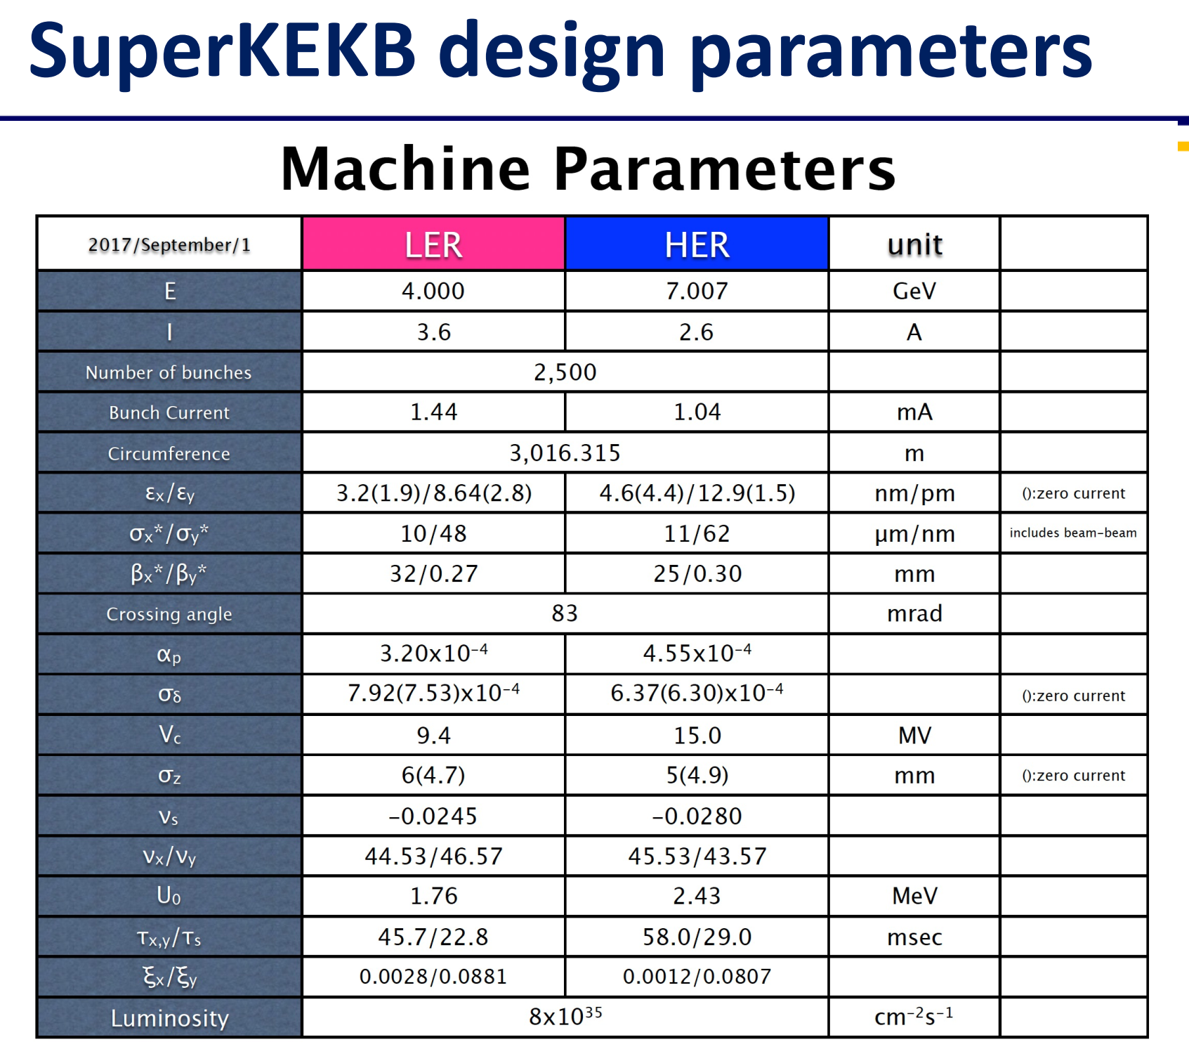
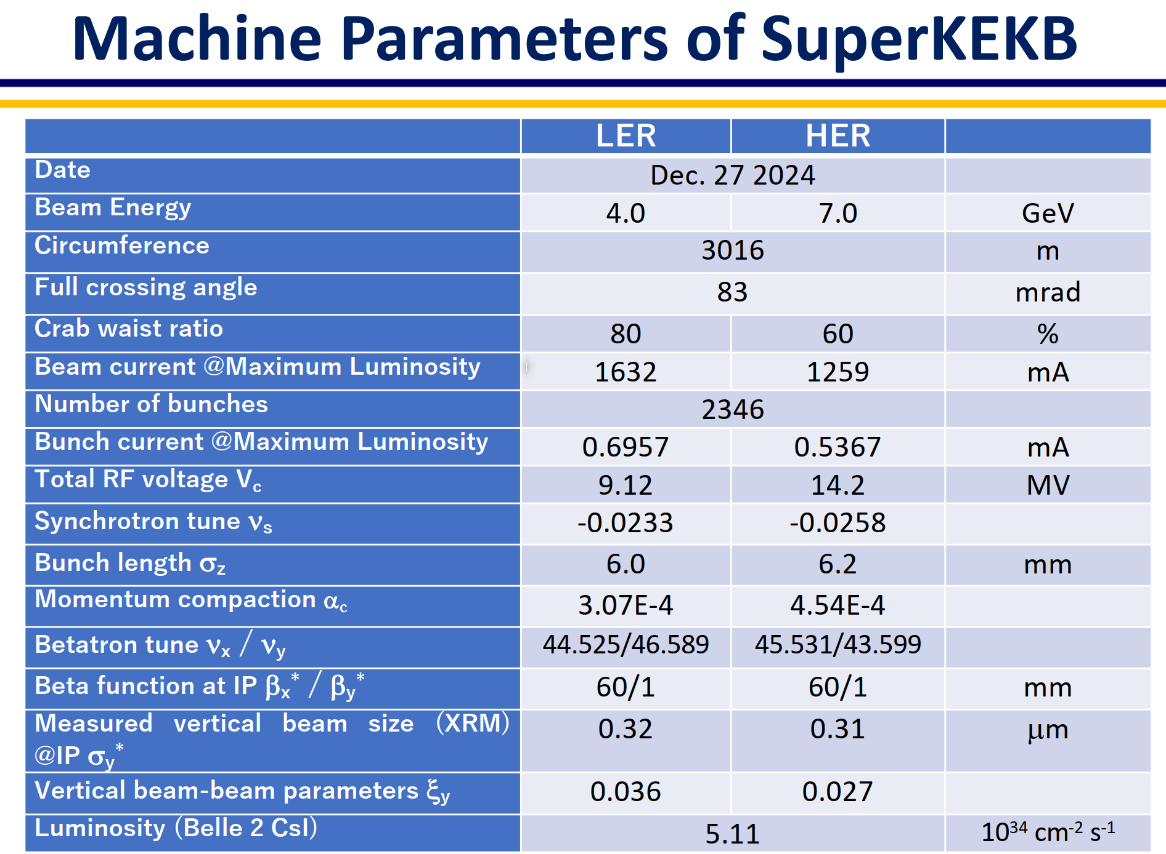
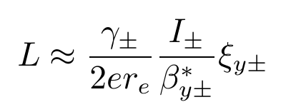
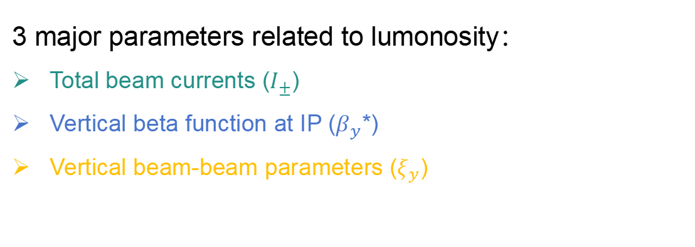
Luminosity limiting factors
LER beam injection largely affected by beam-beam interaction and betatron tunes
Dynamic aperture is largely reduced by CW sextupoles
Beam lifetime
Vertical beam-beam blowup
large vertical beta function
Chromatic coupling for both two rings
Manufacturing errors at IP in the HER beamline
...
3 major parameters related to lumonosity：
Total beam currents ($I_{±}$)
Vertical beta function at IP ($β_{y}$*)
Vertical beam-beam parameters ($ξ_{y}$)

Slide 5
HER ring chromatic coupling

Slide 6
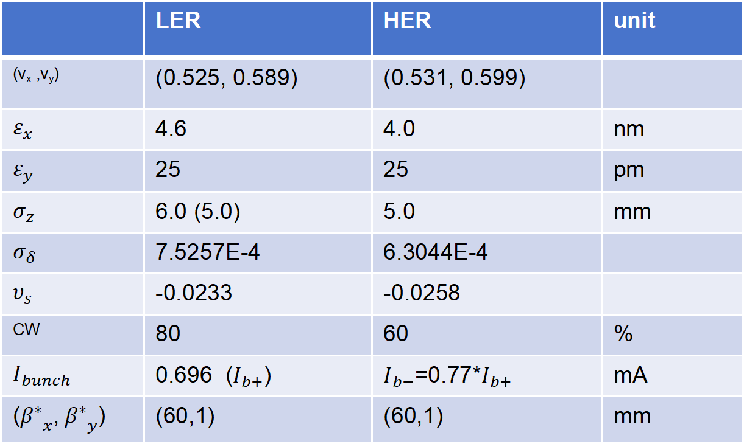
Simulation settings
Simulation parameters are base on 2024 c run.
Transverse impedance is not considered in the section.
Gaussian Strong-Strong Simulation
 | LER | HER | unit
(v_{x} ,v_{y}) | (0.525, 0.589) | (0.531, 0.599)
$$ε_{x}$$ | 4.6 | 4.0 | nm
$$ε_{y}$$ | 25 | 25 | pm
$$σ_{z}$$ | 6.0 (5.0) | 5.0 | mm
$$σ_{δ}$$ | 7.5257E-4 | 6.3044E-4
$$υ_{s}$$ | -0.0233 | -0.0258
CW | 80 | 60 | %
$$I_{bunch}$$ | 0.696 ($I_{b+}$) | $I_{b−}$=0.77*$I_{b+}$ | mA
(${β^{∗}}_{x}$,${{ β}^{∗}}_{y}$) | (60,1) | (60,1) | mm
1. Fix the HER horizontal tune at v_{x,HER}=0.531, and scan the HER vertial tune v_{y,HER}.
2. Fix the v_{y,HER}=0.599 and perfrom beam current scan

Slide 7
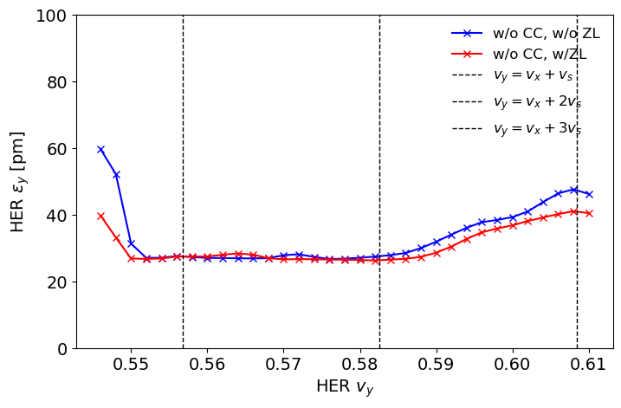
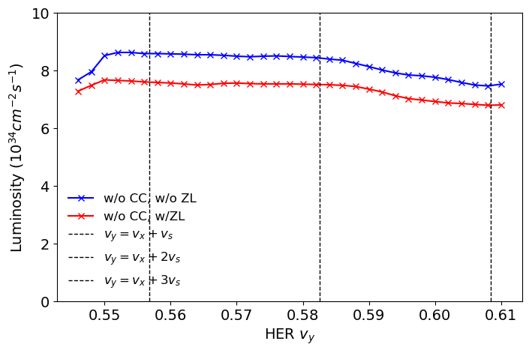
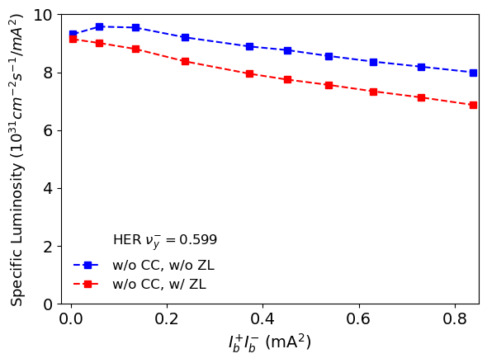
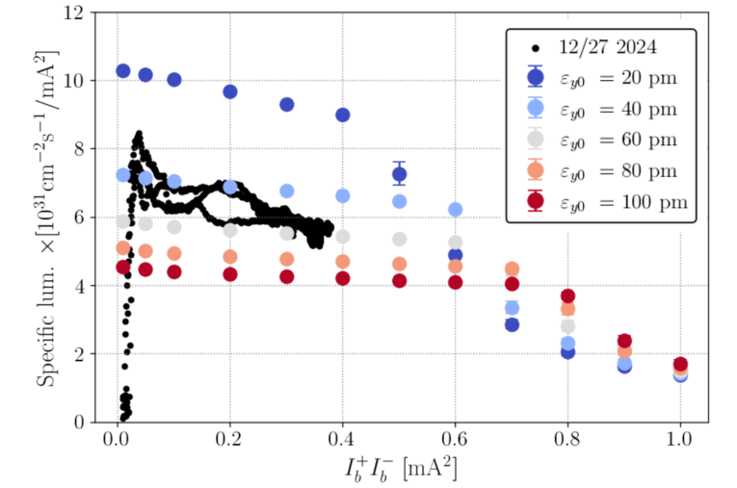
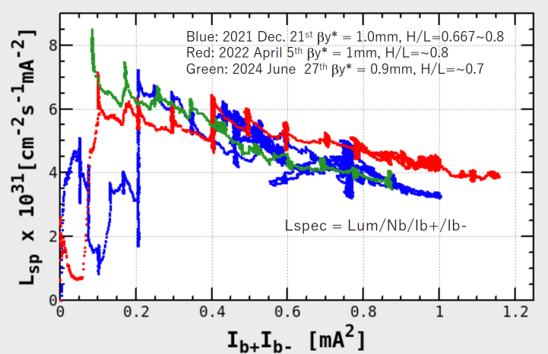
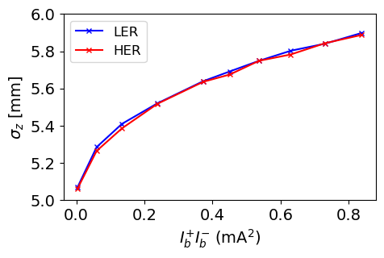
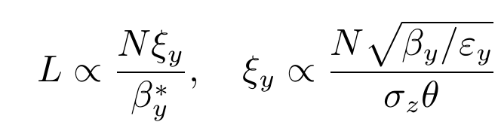

Longitudinal impedance
$$L_{sp}=\frac{ L}{N_{b}I_{b+}I_{b−}}$$
Luminosity degradation is mainly due to bunch lengthening from longitudinal impedance. However, the predicted slope is smaller than that observed in measurements.
H.Sugimoto
Y.Funakoshi
Measured vs. simulated luminosity

Slide 8
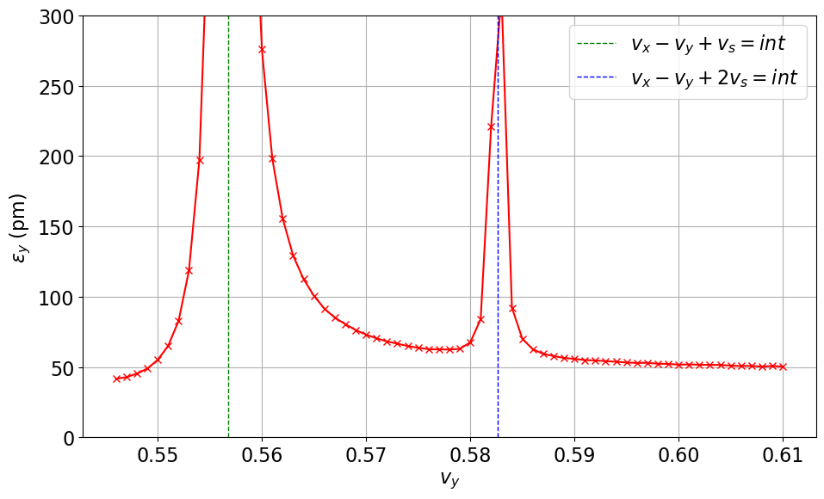
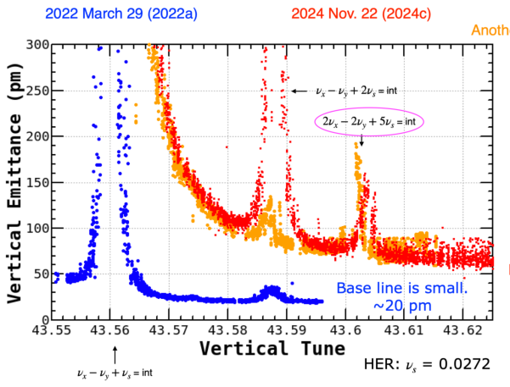
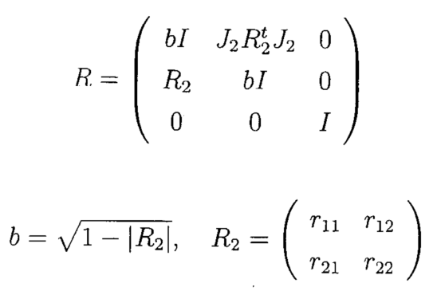
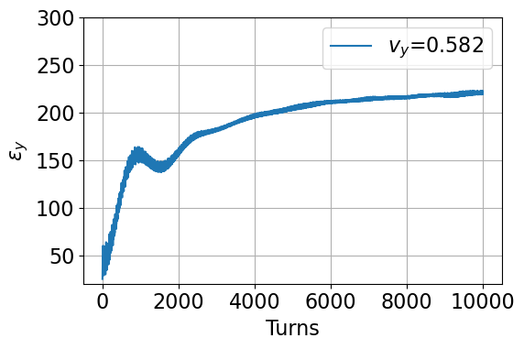
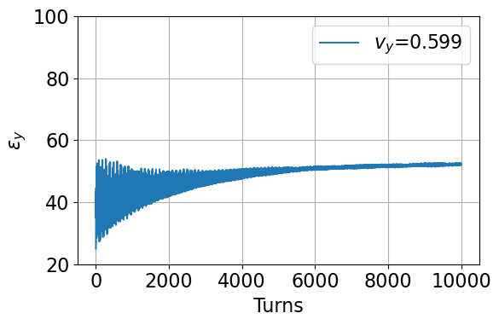
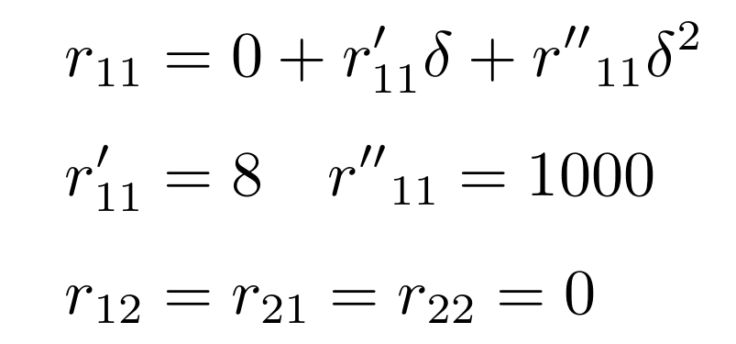
HER chromatic coupling reproduce
One -turn linear map with chromatic coupling including SR in the arc section.
Y.Funakoshi, International collaboration meeting on beam-beam effects at SuperKEKB (1)
HER single beam emittance with chromatic coupling
HER ring without collision, considering up to second order chromatic coupling, and only r₁₁ is non-zero.
HER
Without impedance
case 1: large emittance growth
case 2: small emittance growth

Slide 9
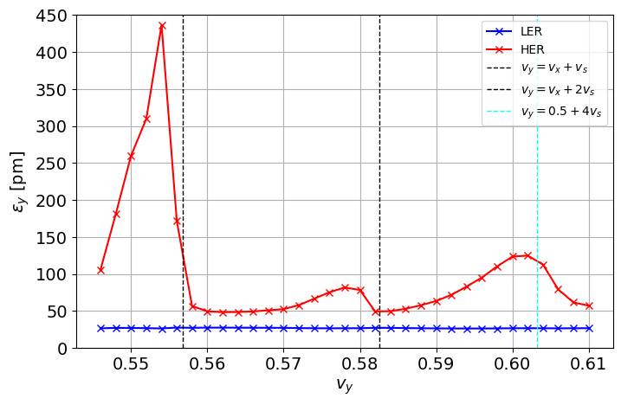
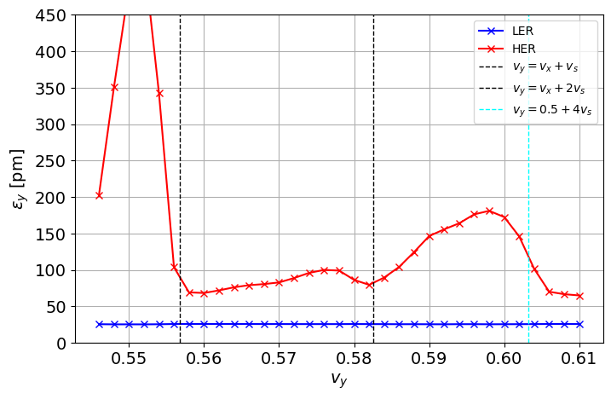
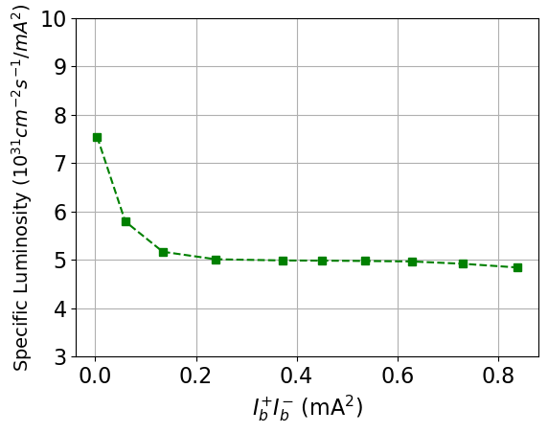
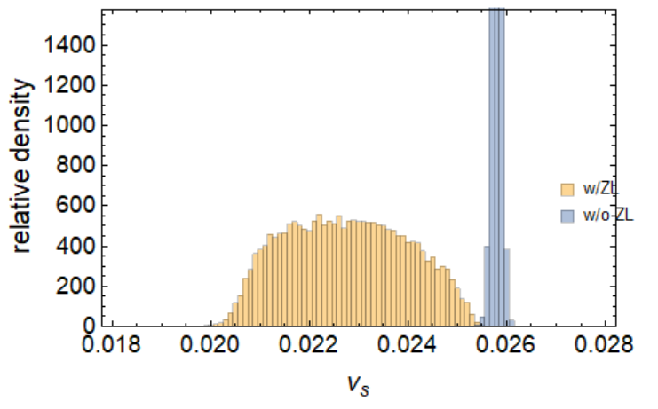
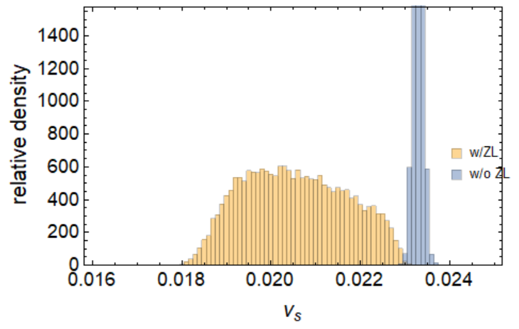
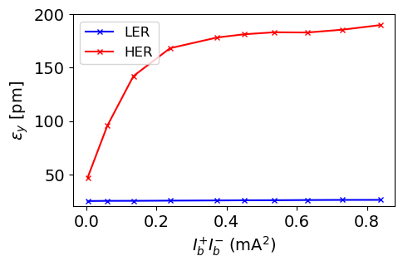


Effects of chromatic coupling
w/o ZL
w/ ZL
w/ ZL v_{y}=0.599
ZL induces a shift in the emittance vs. working point curve.This shift can be attributed to a reduction in the synchrotron tune .
The emittance near resonances increases significantly.One possible explanation is that synchrotron tune spread broadens the resonance lines
Sp. luminosity is nearly independent of beam current when beam current exceeds 0.2 ,although bunch lengthening persists.This behavior is likely due to the saturation of vertical emittance growth.
HER $ν_{S0}=0.0258$
LER $ν_{S0}=0.0233$
w/ ZL v_{y}=0.599
w/ ZL vy=0.599
ZL introduces an incoherent synchrotron tune spread. The central synchrotron tune of both rings is reduced by $∆ν_{s}≈$0.003, resulting in a significant tune spread.
Simulations suggest that the chosen coupling coefficients may be too large.

Slide 10
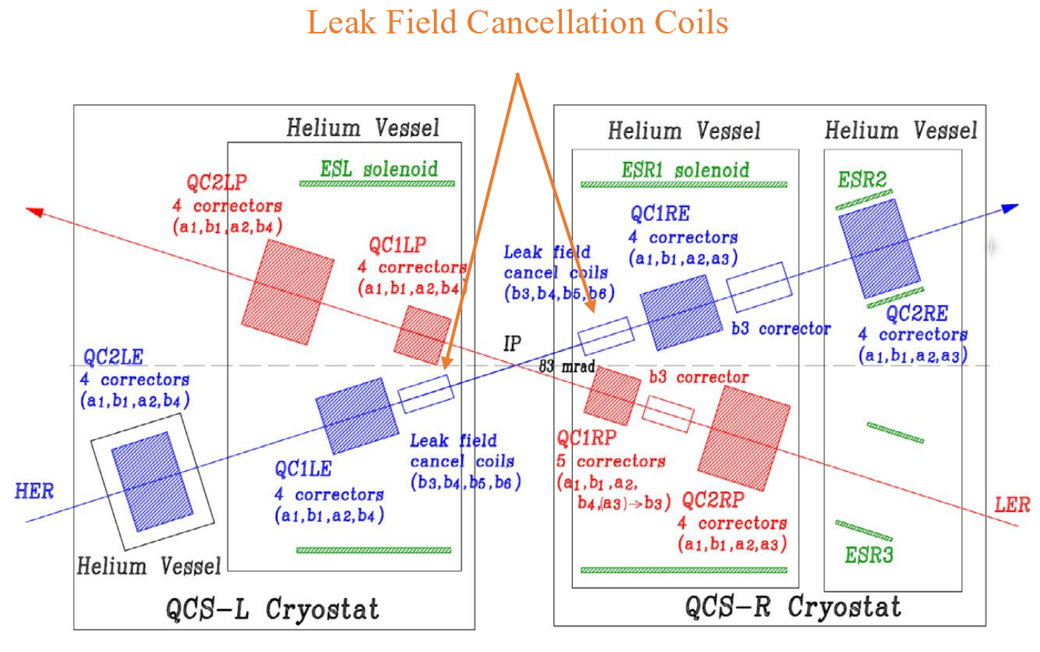
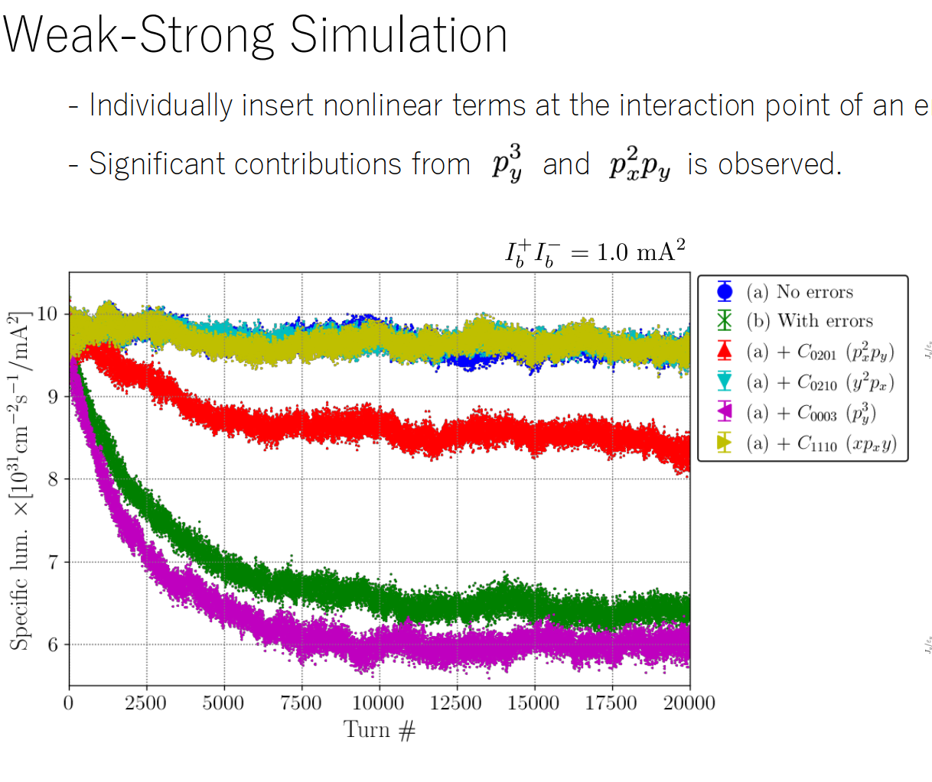
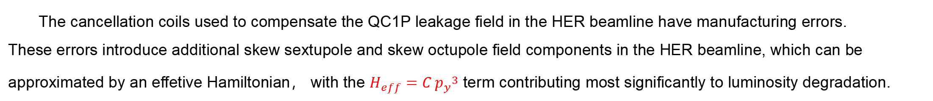
HER cancel coil manufacturing errors
The cancellation coils used to compensate the QC1P leakage field in the HER beamline have manufacturing errors.
These errors introduce additional skew sextupole and skew octupole field components in the HER beamline, which can be approximated by an effetive Hamiltonian， with the $H_{eff}=C {p_{y}}^{3}$ term contributing most significantly to luminosity degradation.
H.Sugimoto, 2025/4/28
International collaboration meeting on beam-beam effects at SuperKEKB (2)
The peturbation $H_{eff}=C {p_{y}}^{3}$(C = 0.06957) is inserted at the IP for HER ring

Slide 11
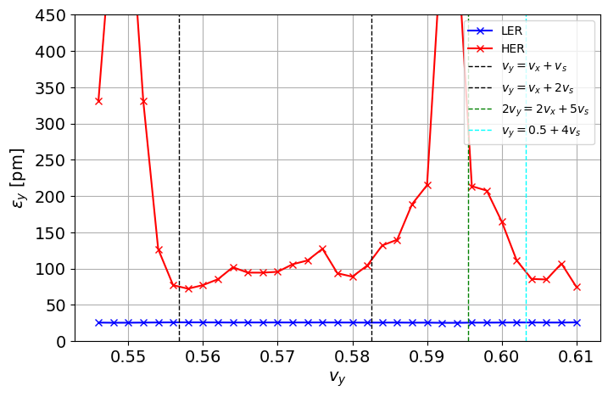
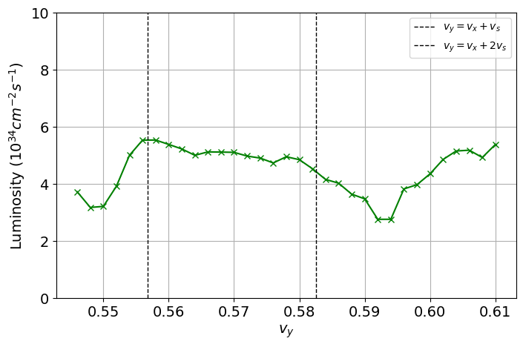
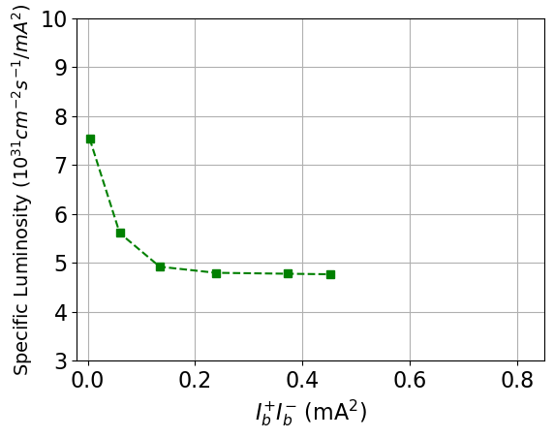
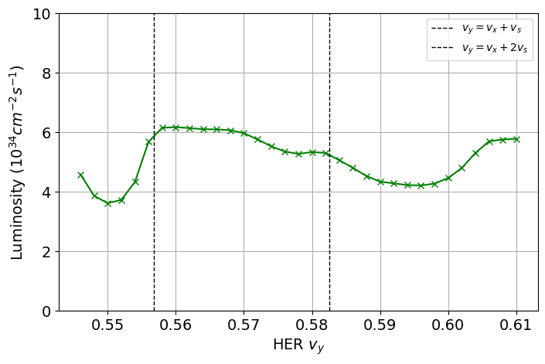
Combined of cancel coil errors and chromatic coupling
LER v_{y}=0.589
w/ py3
w/ py3
w/ py3, v_{y}=0.599
HER
HER
w/o py3
w/o py3
w/o py3, v_{y}=0.599
HER
p_{y}3 shift the curve towards 0.5 slightly, and increase the vertcial emittacce. But if the vertical emittance is already very strong at a specific working tune, the specific luminosity see no significant differences with and without p_{y}3 error.

Slide 12
LER ring chromatic coupling

Slide 13
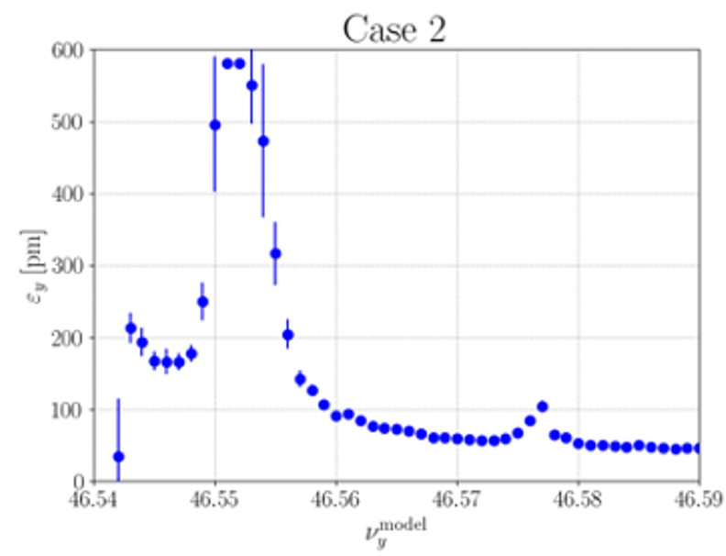
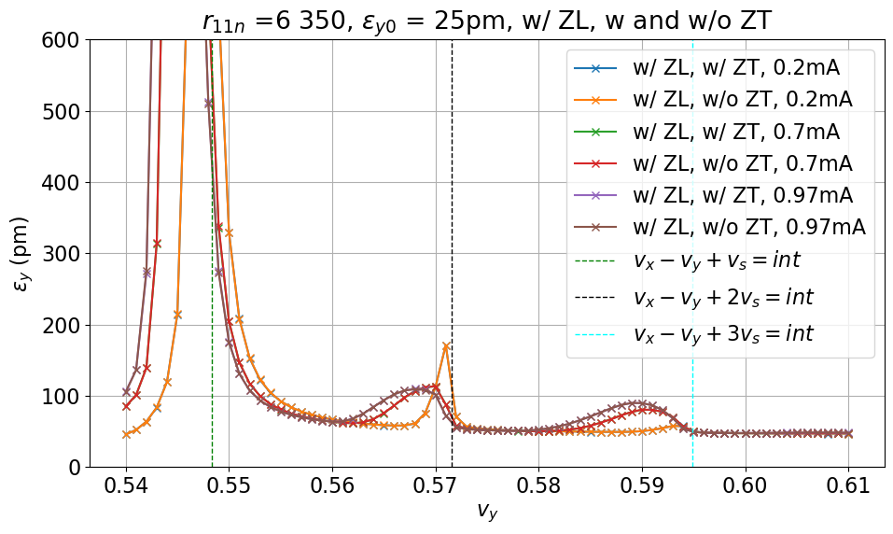
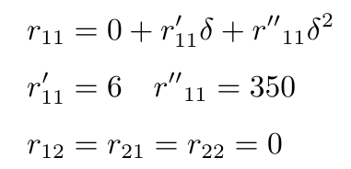
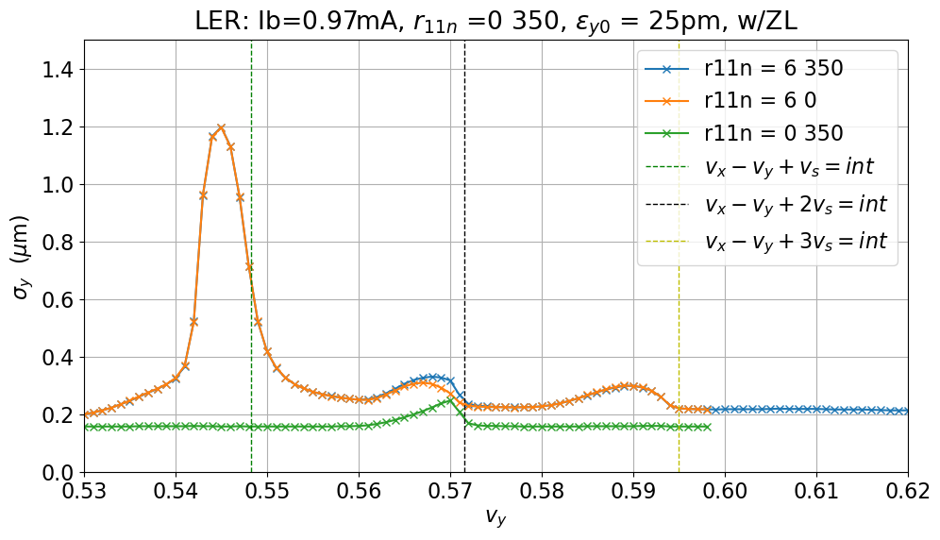
LER chromatic coupling
LER ring , no collsion, w/ ZL and w/ ZT for different beam intensity.
LER
Y.Funakoshi, measeured LER emittance vs. tune
ZL affects the emittance; as the beam current increases, third-order resonance appears, and no higher-order resonances exist.
ZT has almost no effect (even at high beam currents).
Has the emittance been measured at high beam currents ?
LER
With ZL, the first-order chromatic coupling could also lead to second and third order synchro-betatron resonance.

Slide 14
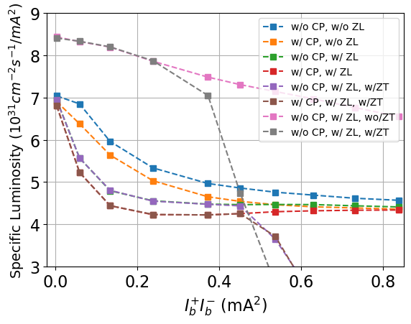

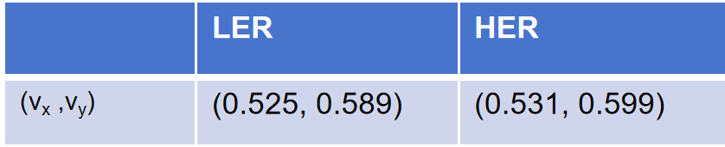
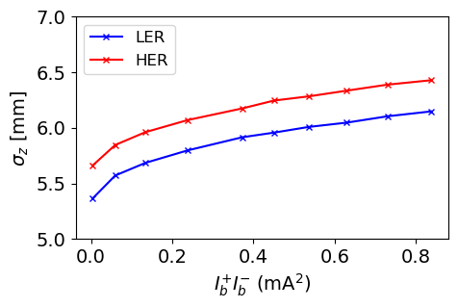
Effects of impedance and chromatic couping (CC)
LER CC is not considered but with HER CC in the first six cases.
The last two cases are totally CC free.
Operation current in 2024c run
At low beam currents, ZL and chromatic coupling cause a reduction in luminosity; ZT has negligible effect.
At high beam currents, the luminosity degradation is primarily caused by Y-Z instability.
While LER coupling degrades luminosity, its impact is much smaller than that of HER coupling.
Notes:
r11n 2 450

Slide 15
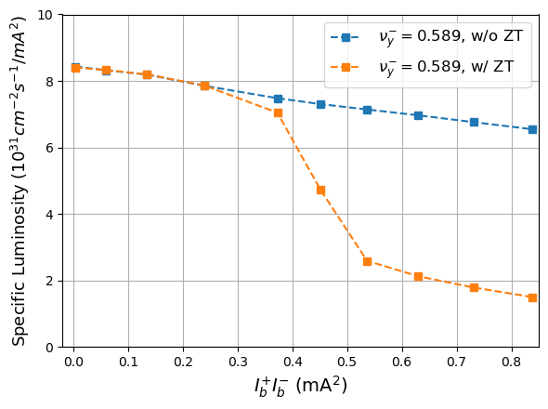
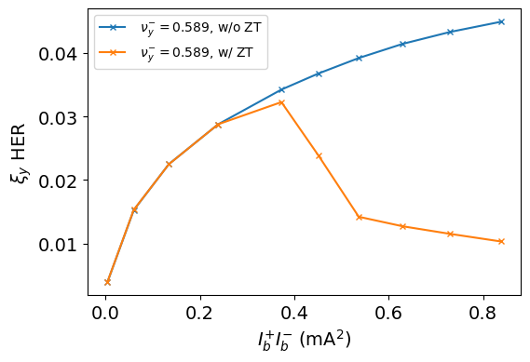
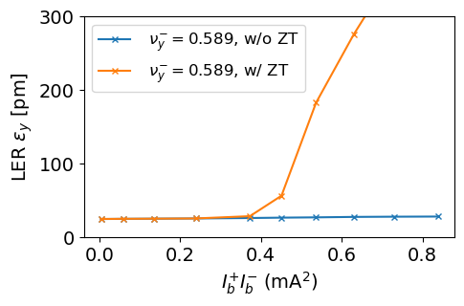
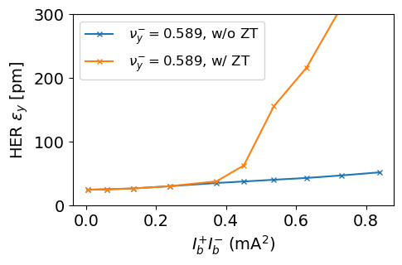
Instability induced by transverse impedance
TMCI-like instability can arise at currents much lower than the designed value.

Slide 16
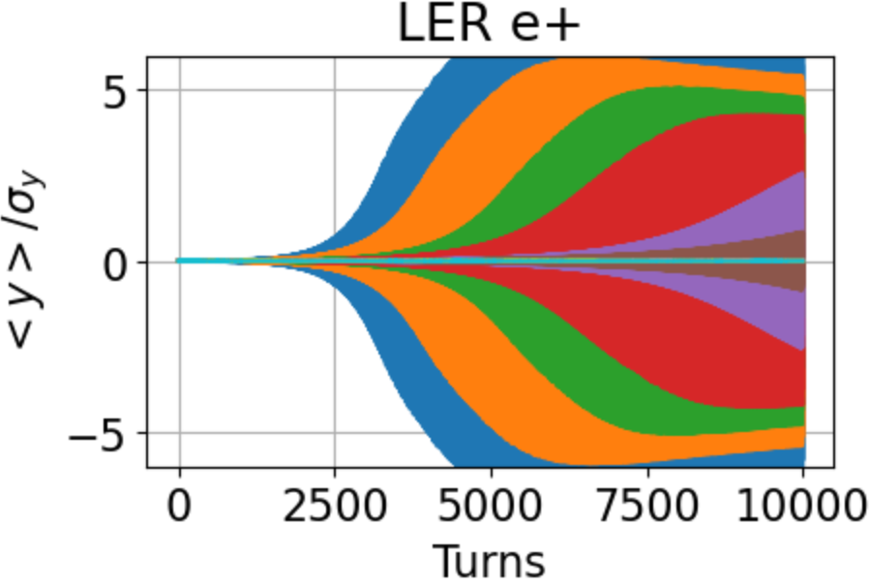
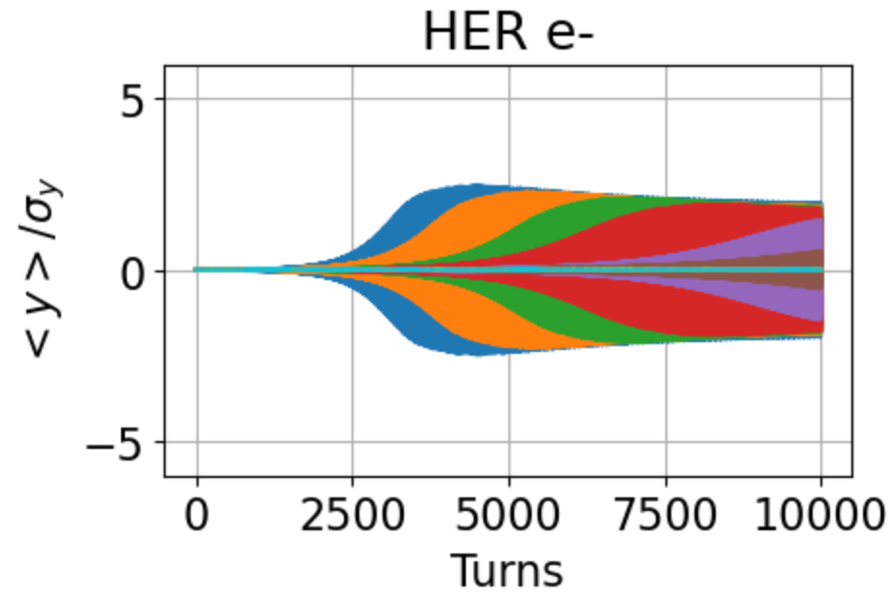
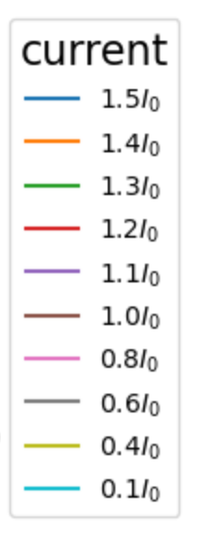
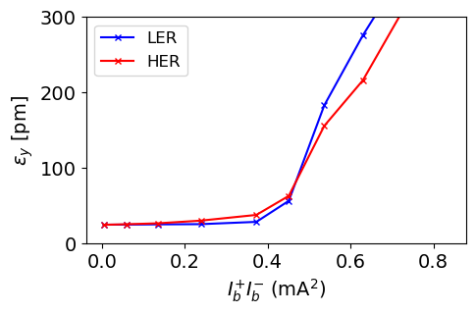




Coherent instabilty
Oscillation of dipole and skew moment in vertical direction.
w/o CP
w/ CP for both ring
HER chromatic coupling is larger than that of LER.
At low current, chromatic coupling only cause incoherent beam size blowup. However, if the chromatic coupling differs significantly between the two rings it can cause asymmetric emittance growth — one ring blows up while the other stays stable. Hence, coupling should be matched to preserve symmetric emittance evolution.
Notes:
ler25woCXwoCYwZLwZT

Slide 17








Instability mitigation
The instability exhibits coherent $σ$ mode,
in which the two bunch oscillate in phase.
Asymmetric tunes
Coherent $σ$ mode
The instability is head-tail tpye caused by the combination of transverse impedance and beam-beam. The chromaticity works.

Slide 18



Luminosity vs. tune in different chromatic configurations
At operation current （LER I_{b}=0.7mA)
w/ ZL and w/ ZT
Without coupling, when $v_{y,HER}≈v_{y,LER}$ the luminosity is low, since the instability excibits $σ$ mode. Different working points between colliding beams (asymmetric tunes) help mitigate the instability.
The LER chromatic couping will lower the luminosity. But if the $v_{y,LER}$ is far away from half integer, the influence become small.
While LER coupling degrades luminosity, its impact is much smaller than that of HER coupling.
Asymmetric tunes strategy remains effective when there are chromatic coupling.
Notes:
r11n 6 350

Slide 19
Preliminary beam-beam simulation with lattice using APES

Slide 20
Simulation settings
sler_1802_60_1_v2.sad
tune = [0.532,0.593,-.0237]
emit = [4.03e-9,5.52e-13,0.0046,0.00074]
beta = [0.06,0.001,6.19]
HER_5781_60_1_cw60.sad
tune = [0.531,0.598,-0.0272]
emit = [4.46e-9,5.67e-13,0.005,0.0006]
beta = [0.06,0.001,8.00]
Current：
ler: 0.70mA
her: 0.54mA
LER: emitx = 4.60e-9 emity = 25e-12 emit_couple = 0.0054
sigmaz = 6.00e-3 sigmap = 7.5e-4
HER: emitx = 4.00e-9 emity = 40e-12 emit_couple = 0.01
sigmaz = 6.20e-3 sigmap = 6.3e-4

Slide 21








Lattice without error
case1 : HER(linear) + LER(linear)
case2 : HER(linear) + LER(lattice)
case3 : HER(lattice) + LER(linear)
case4 : HER(lattice) + LER(lattice)
HER_5781_60_1_cw60.lat & sler_1802_60_1_v2.sad
case2:LER(lattice) Resulting in a luminosity decrease (-6.4%)
case3:HER(lattice)Causing a larger vertical size increase (>1.7×) and luminosity decrease (-26.9%)
case4: Luminosity decrease is approximately the superposition of the two lattices' effects (-32.3%)
5.22(-6.3%)
4.07(-26.9%)
3.77(-32.3%)
Zhiyuan Li
Notes:
look back：
To investigate the impact of the lattice on the collision simulation results, we configured the two rings into linear tracking mode and full lattice tracking mode respectively,
and conducted cross-combination simulations.
A total of 4 cases were designed for comparative analysis.
The simulation results show that:
case2: When we have LER with the lattice, it leads to a luminosity decrease of 6%.
Moving on to case3: HER with the lattice setup causes a more significant impact – a larger vertical size increase, over 1.7 times, along with a 27% drop in luminosity.
Then there’s case4: The luminosity decrease here, around 32%, is roughly the combined effect of both lattices acting together.
In short, these simulation results show HER has a more obvious impact, mainly by increasing the vertical size.

Slide 22








Lattice with error
case1 : HER(linear) + LER(linear)
case2 : HER(linear) + LER(lattice)
case3 : HER(lattice) + LER(linear)
case4 : HER(lattice) + LER(lattice)
HER_5781_60_1_cw60-can.lat & sler_1802_60_1_v2.sad
The imperfect HER lattice leads to enhanced vertical beam size growth and greater luminosity loss.
Zhiyuan Li
Notes:
模拟结果补充： 使用有误差的 her lattice重复Cross-combination simulations，结果显示该lattice会带来更大的σy-增长，与无误差lattice结果相比亮度下降
Supplementary simulation results:
Use the her lattice with errors to repeat the Cross-combination simulations,
the results show that this lattice brings greater σy- growth, and the luminosity decreases compared with the error-free lattice results.

Slide 23
Summary
HER chromatic coupling strongly drives vertical emittance growth and luminosity loss at low currents; In contrast, chromatic coupling in the LER has a much weaker effect
The luminosity impact of the p_{y}3 error is reduced when HER chromatic coupling is strong.
At low beam currents, ZL and coupling cause a noticeable reduction in luminosity; ZT has negligible effect.
At high beam currents, the luminosity degradation is primarily caused by ZT (Y-Z instability). The larger asymmetric-tune and chromaticity can recover the luminosity.
Including the lattice lowers luminosity by ~30%; with HER lattice errors, the loss is even larger.

Slide 24
Thank you for your attention!

