Slide 1
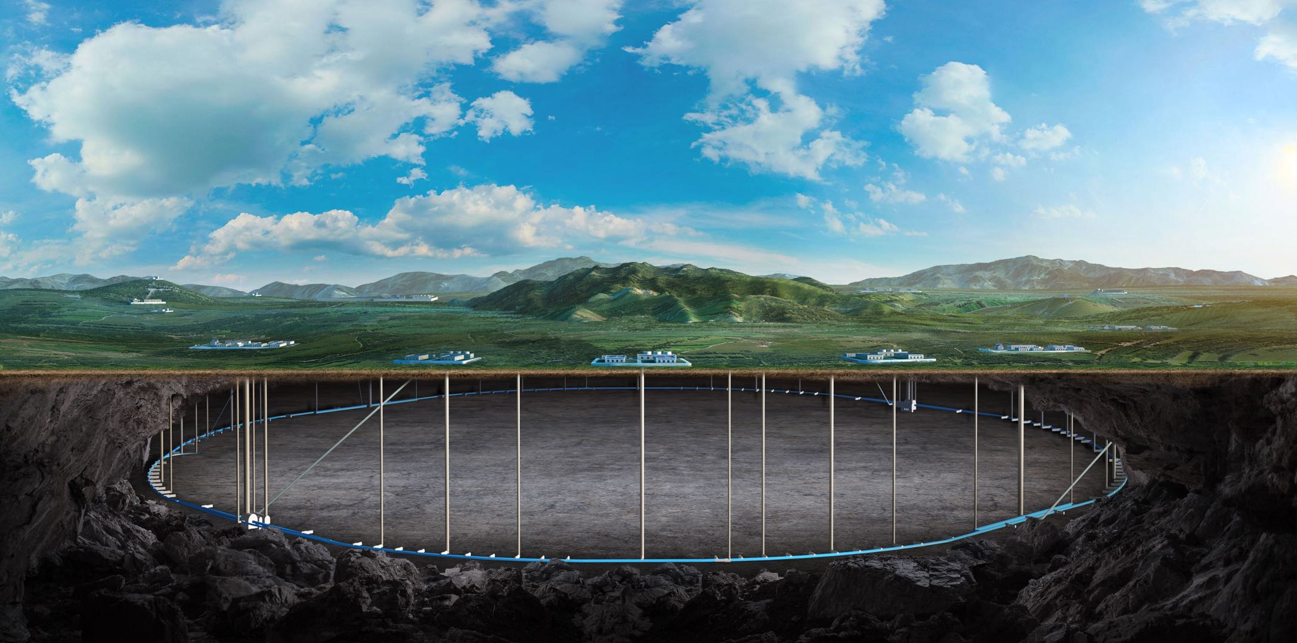


CEPC Linac EDR plan and status
Jingru Zhang, Cai Meng
On behalf of the linac group
5-10. November. 2025, Guangzhou, the CEPC international workshop

Slide 2
Content
Introduction
EDR progress status
Exploration of C-band cryogenic copper structures
Summary

Slide 3
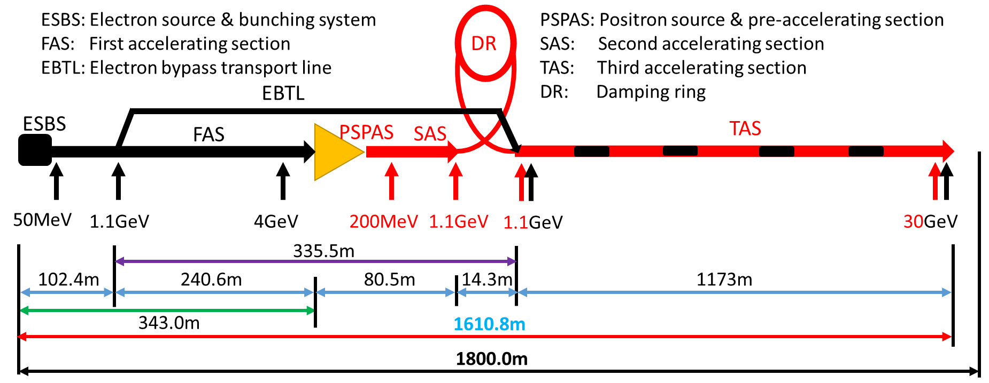
Introduction: CEPC Linac
The CEPC Linac is a normal-conducting linear accelerator that produces 30-GeV electron and positron beams, based on S-band and C-band RF technology
It is designed to function as a high-energy XFEL facility capable of producing photons with energies greater than 50 keV
An alternative linac scheme based on PWFA technology is currently under development
Parameter | Symbol | Unit | Baseline
Energy | E_{e-}/E_{e+} | GeV | 30
Repetition rate | f_{rep} | Hz | 100
Bunch number per pulse |  |  | 1 or 2
Bunch charge |  | nC | 1.5 (3)
Energy spread | σ_{E} |  | 1.5×10⁻³
Emittance | ε_{r} | nm | 6.5
Switch time for electron and positron |  | s | 3.0

Slide 4
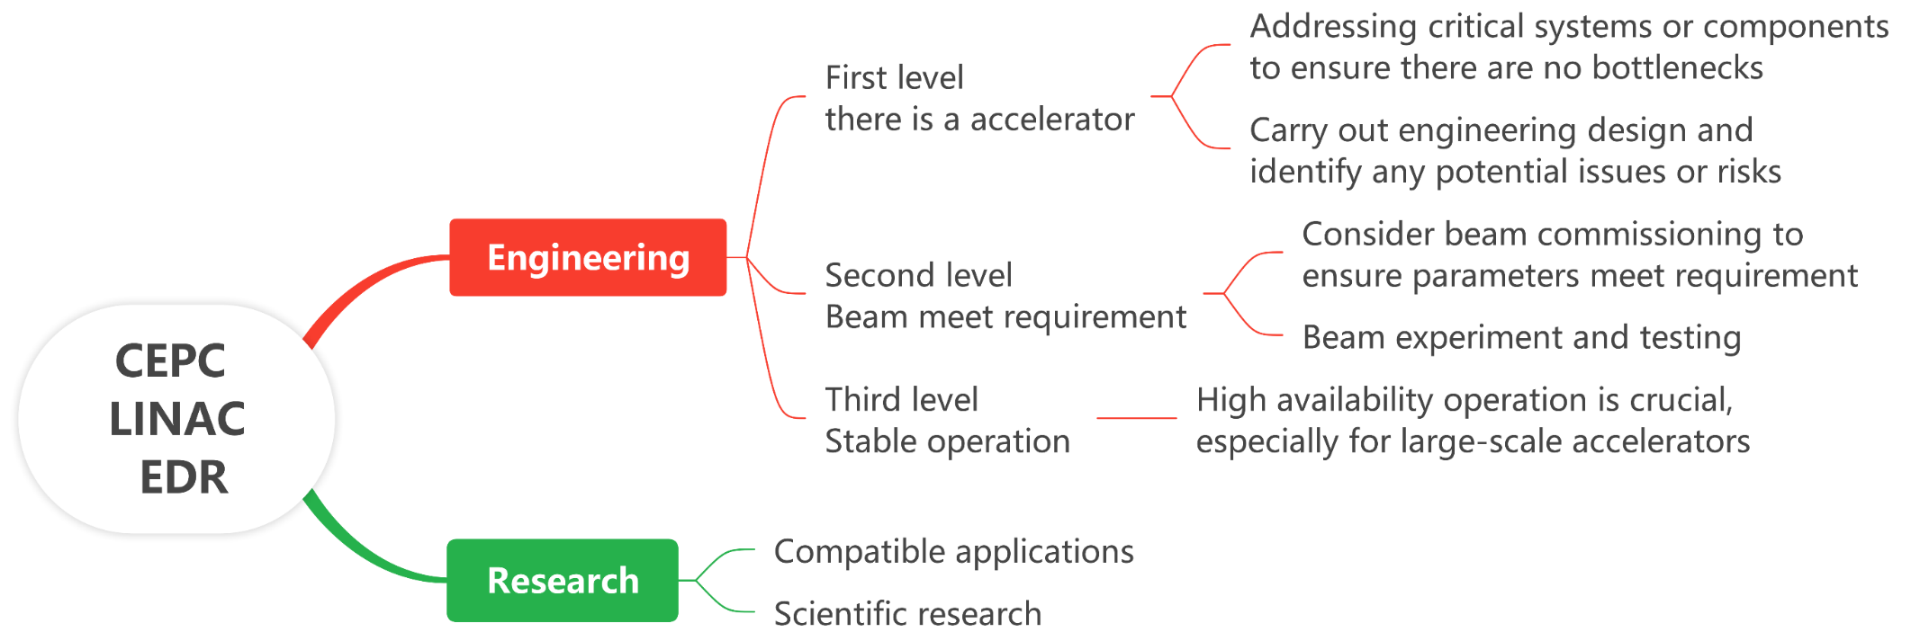
Introduction: EDR target of the CEPC LINAC
CEPC Linac, as the first-stage accelerator, needs to be constructed and commissioning first
The EDR target for the CEPC Linac is structured at two levels, as outlined below
  [Engineering] The top priority is to ensure readiness for construction and commissioning
  [Research] The secondary focus on having potential for upgradability and scalability

Slide 5
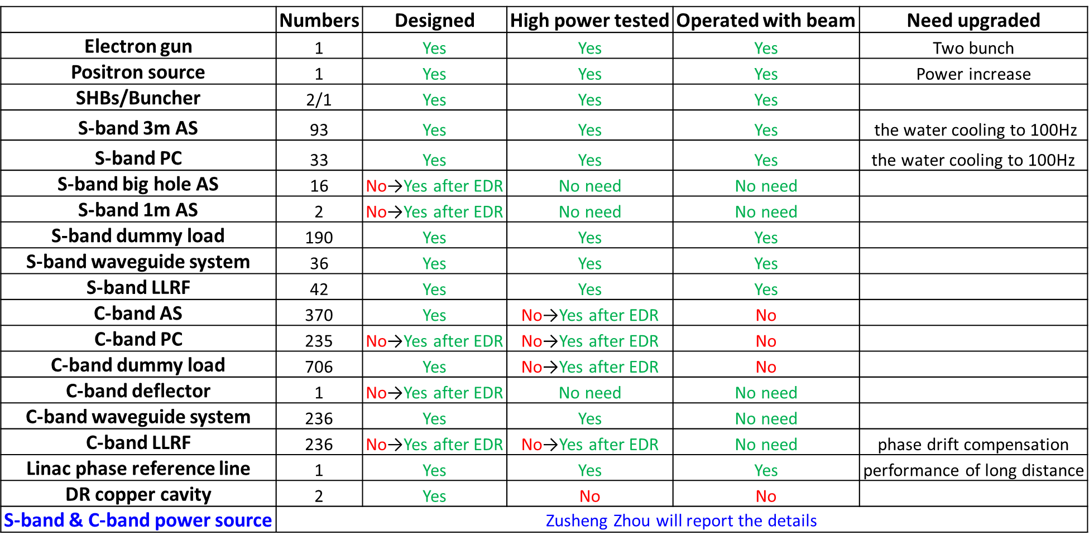
Introduction: EDR target of the CEPC LINAC
It comprises two key aspects
  software aspect, which focuses on physics design
  hardware aspect, which involves technical design and verification
Physics design
  Survey and plan
  High energy XFEL design
  Key physics issues in PWFA
Technical design and verification
  Equipment design
  High power test
  Double-bunch acceleration experiment

Slide 6
EDR progress status

Slide 7
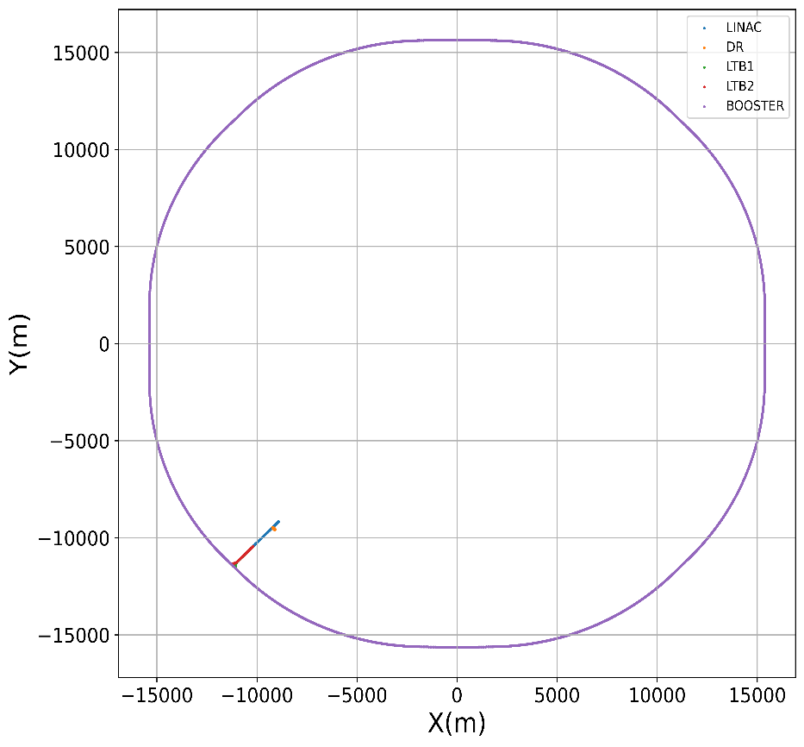
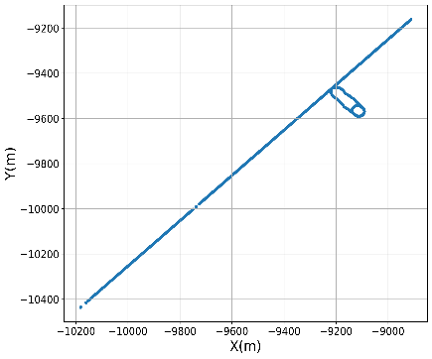
Physics design: Survey and plan
In accordance with the CEPC naming convention, we have provided the survey file, which has taken into consideration all accelerating sections, damping rings (DR), transfer lines, and beam dump lines.
A preliminary construction plan has been developed.
Major Task | Sub-task | Duration
Infrastructure | Infrastructure (including water, electricity, gas) | 4 years
Installation | Alignment Surveying & Control Network Establishment | 1 month | 2 years
 | Equipment Installation & Vacuum Sealing | 21 months
 | Linac Alignment Adjustment | 1 month
 | System Integration and debugging | 1 month
Commissioning | High-Power Conditioning, Troubleshooting & Maintenance | 5 months | 2 years
 | Beam Commissioning | 15 months
 | Fine Alignment | 1 month
 | Re-commissioning & Trial Operation | 3 months
Operation | Linac Beam Delivery to Booster | 2 years

Slide 8
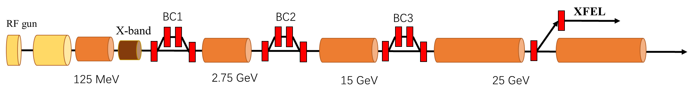
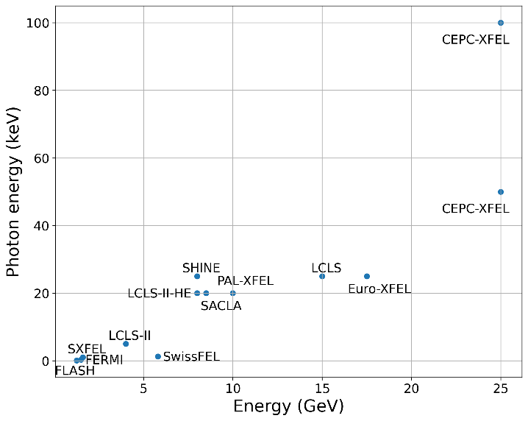
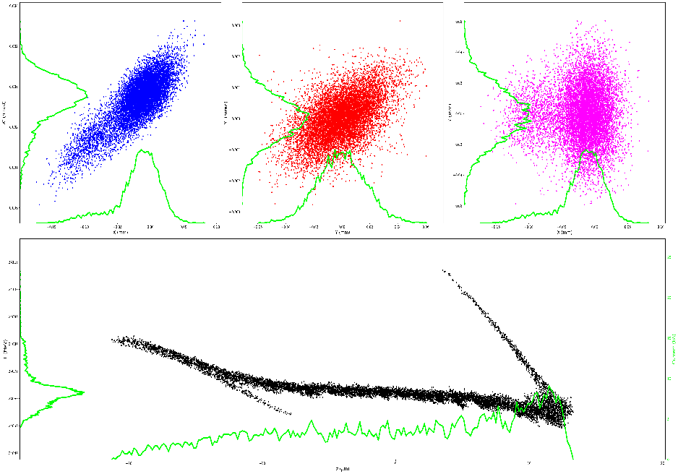
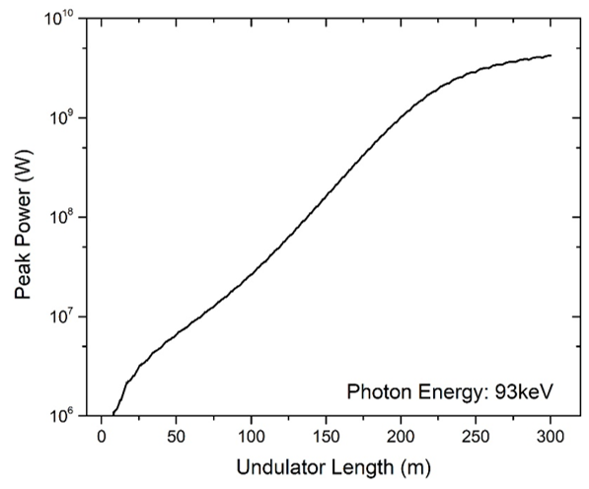
Physics design: High energy XFEL
The CEPC Linac can provide a high-energy beam, making it an excellent solution for XFELs with photon energies ranging from 50 keV to 100 keV
Except for the Z mode, it can generally be ensured that 50% of the time is available for XFEL operation in other modes
Time (s) | Higgs | W | Z | tt
T0 | 20 | 36 | 71 | 32
T1 | 3
T2 | 2.7 | 13 | 20 | 0.35
T3 | 3
T4 | 13.3 | 6.1 | 63.8 | 14.24
T5 | 11.3 | 17 | 1.2 | 25.6
XFEL duty | 57% | 47% | 2% | 80%

Slide 9
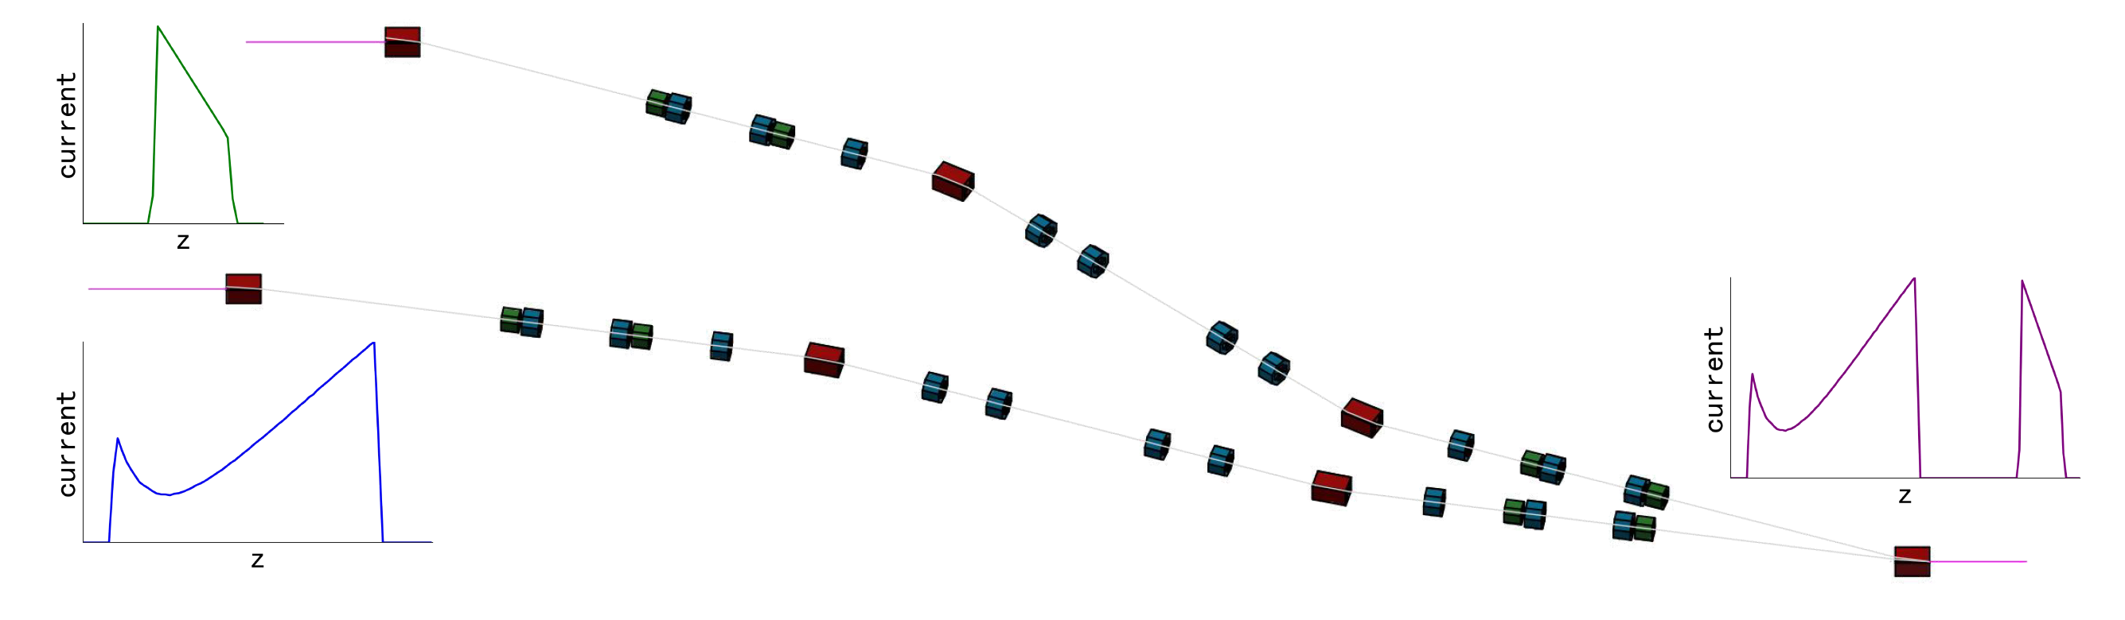
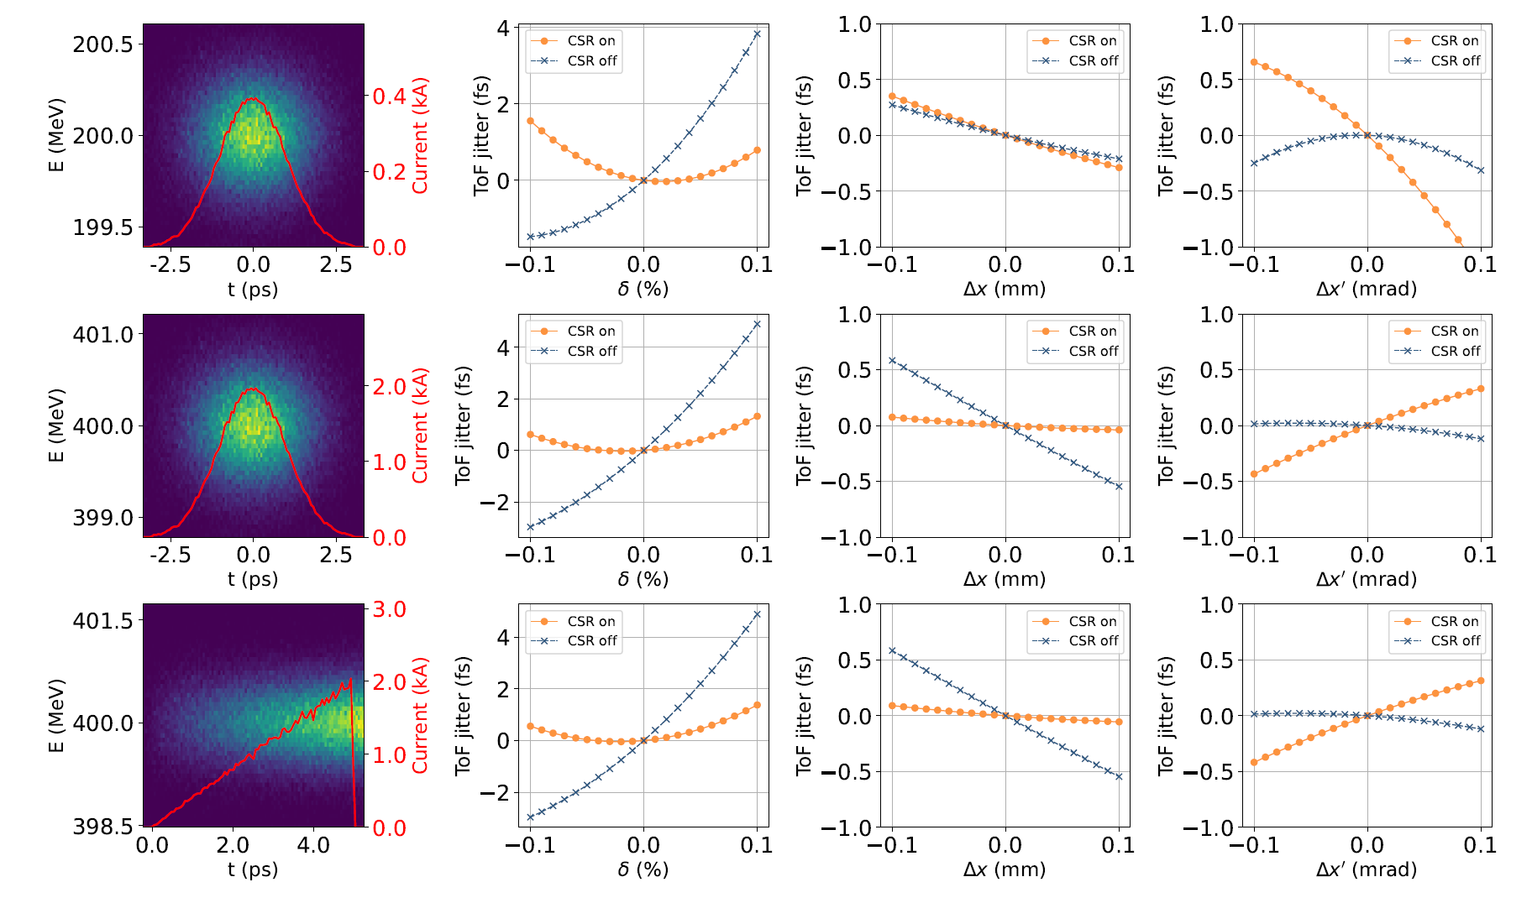
Physics design: Double-Bunch Beam Generation for PWFA
Ultra-Stable Double-Bunch Beam Generation for Plasma Wakefield Accelerators Via CSR-Tolerant Isochronous Beamlines
We propose a coherent synchrotron radiation (CSR)-free beam-merging scheme using twin isochronous beamlines that share a common dipole magnet to generate a high-charge double bunch with excellent stability
Numerical simulations indicate that the proposed scheme generates a 5 nC/1 nC electron double bunch with no charge loss, and an introduced inter-bunch timing jitter maintained below ±2 fs.

Slide 10
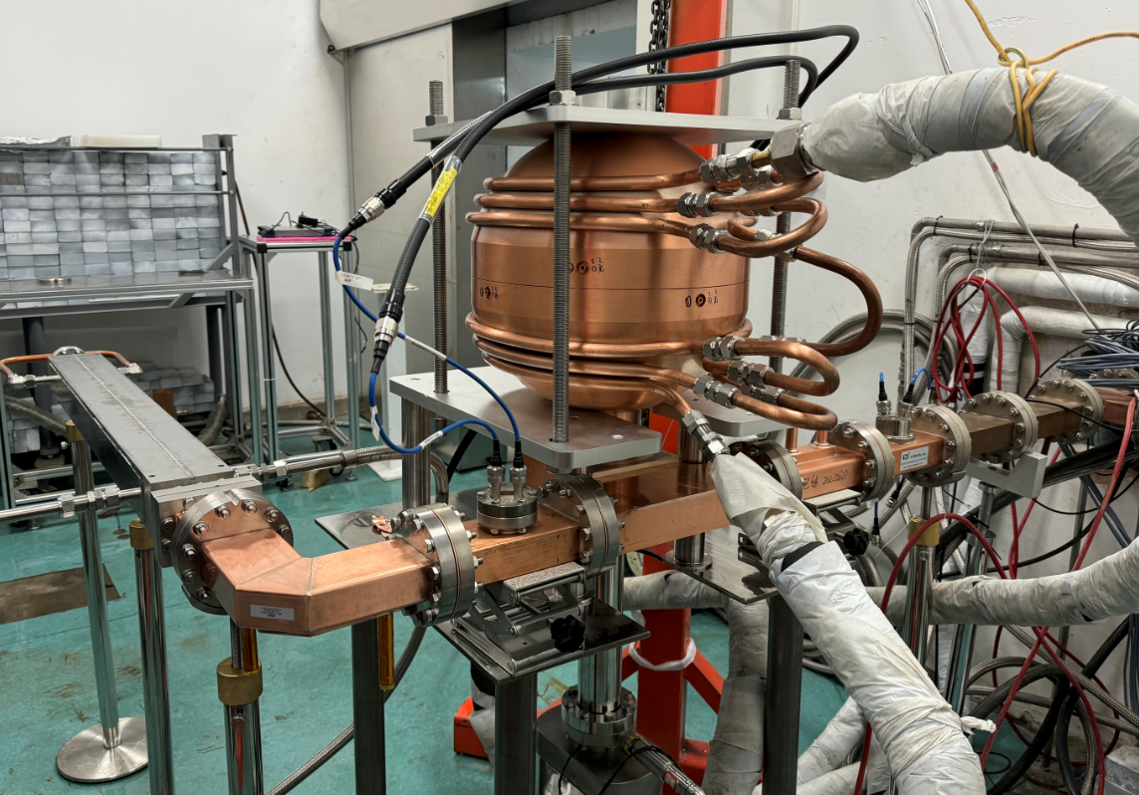
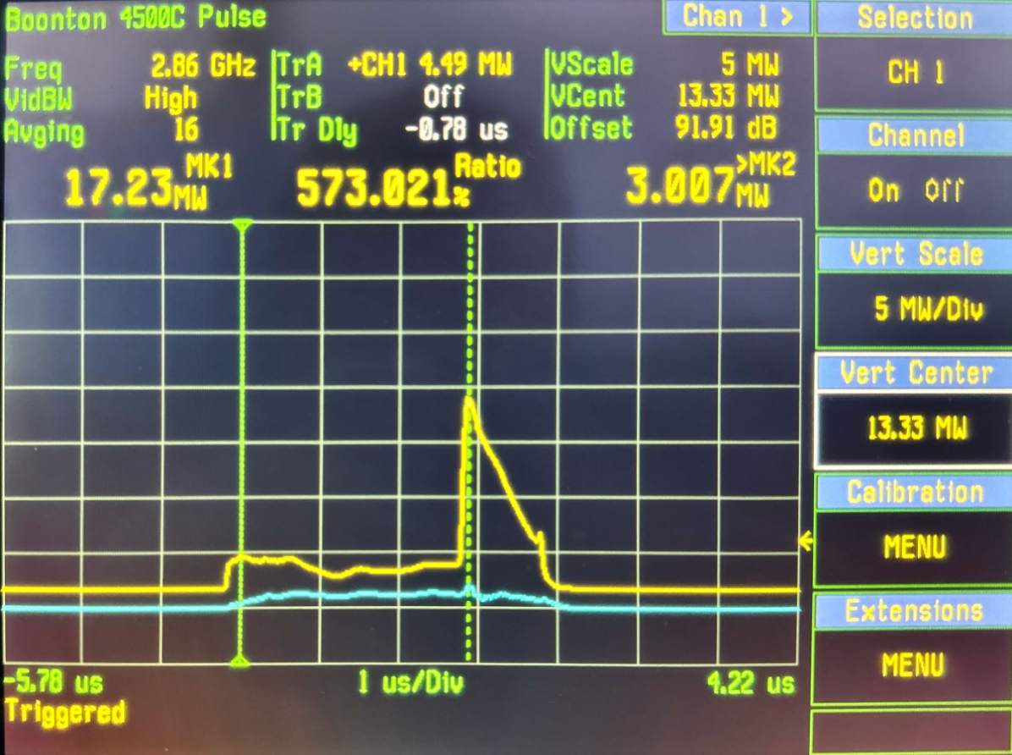
Technical design and verification:
S-band spherical cavity pusle compressor and metal load test
The high-power testing of the S-band spherical pulse compressor and metal load was completed
The input power to the pulse compressor is 66 MW (coresponding to 80MW power source), and the energy multiplication factor is 1.8
The maximum pulse power input the metal load is 205 MW (after pulse compressor), and the average power is 4.2 kW
They all will be used in RF system (80MW power source) of project PWFA at IHEP
High power test system
High power test waveform

Slide 11
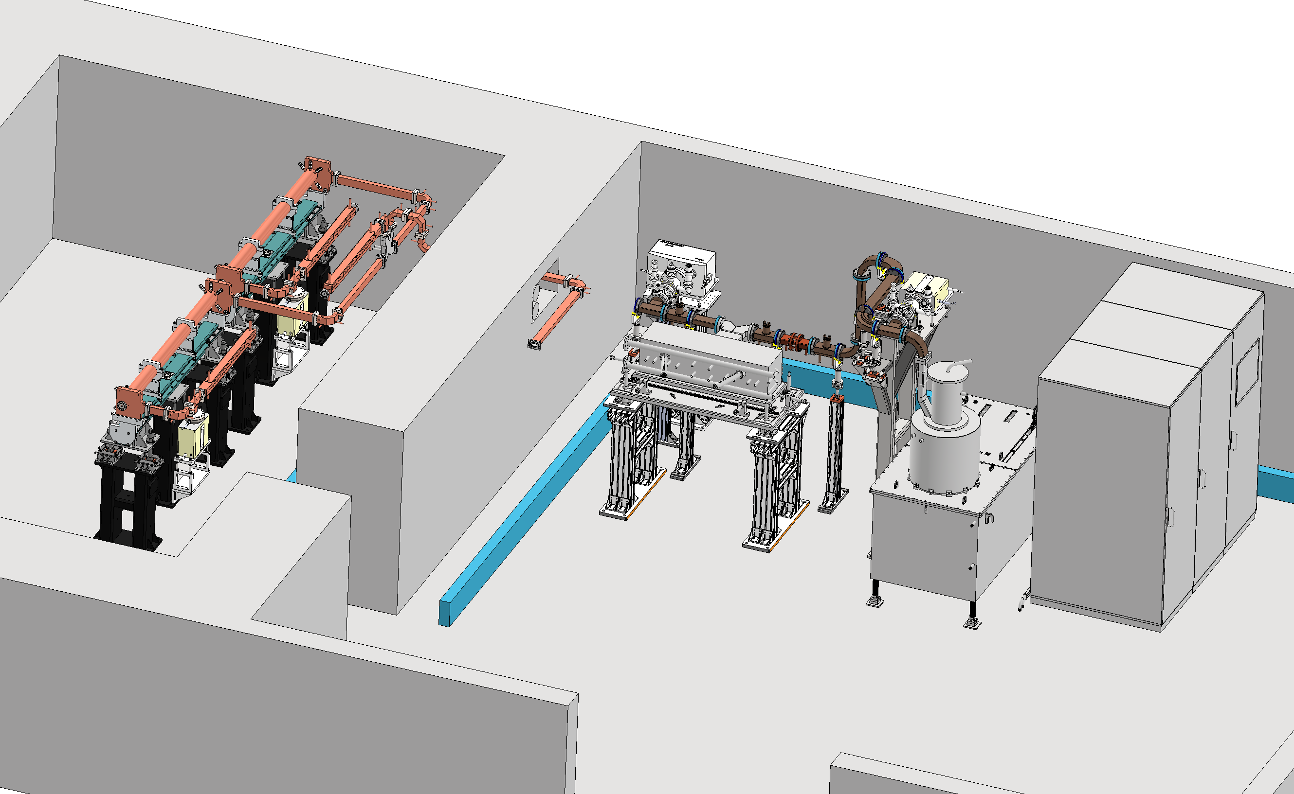
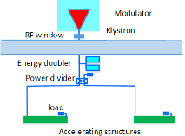
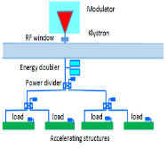
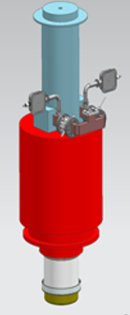
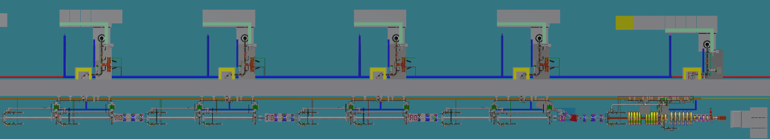
Technical design and verification:
C-band high power test platform plan
A C-band high-power test platform will be established in Huairou Park at IHEP
  2 accelerating structures
  Pulsed compressor, waveguides, directional couplers, loads, bend and straight waveguides, etc.
The C-band klystron will be completed in 2025. ( Zusheng Zhou will introduce)
3us, 100Hz
50MW
80MW
M≥1.7
M≥1.9
65MW
65MW
22MW (6.6kW)
40MV/m
40MV/m
10% attenuation in waveguide
10% attenuation in waveguide
Increase the energy multiplication factor of the pulse compressor or the shunt impedance of the accelerating structure, there is more margin of the energy gain.

Slide 12
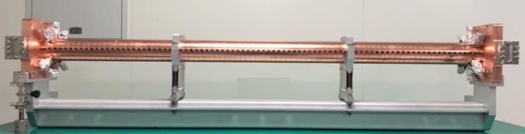
Technical design and verification:
C-band accelerating structure
The design parameters between different lab
  Mode :3π/4, 2π/3, 4π/5
  Length
  Disc thickness
Though the phase advance is deferent, the other key parameters is very similar
We will design and manufacture a new accelerating structure
 | IHEP | Spring8 | SINAP
Frequency: f（MHz） | 5712 | 5712 | 5712
No. of Cells | 87+2 | 100 regular cells +2 coupler | 77+2
Phase advance | 3π/4 | 2π/3 | 4π/5
Total length(m) | 1.8 | 1.8 | 1.784
Length of cell : d (mm) | 19.675 | 17.495 | 20.994
Disk thickness: t (mm) | 4.5 | 4 | 5
Average aperture: 2a (mm) | 14.04 | 15.938~12.107 | 15
Average diameter : 2b (mm) | 45.6 | 43.196~41.869 | -
Shunt impedance(average) : Rs (MΩ/m) | 66.05 | 66 | 62
Quality factor : Q | 11358~11186 | 9300/8900(measured) | 10470
Group velocity: Vg/c (%) | 2.8% ~ 0.96% | 2.3%(average) | 1.7%(average)
Filling time : t_{f} (ns) | 350 | 290 | 330
Attenuation factor : τ | 0.56 | 0.59 | 0.585
Espeak/E0 | 2.57 | 2.6 | 2.6

Slide 13
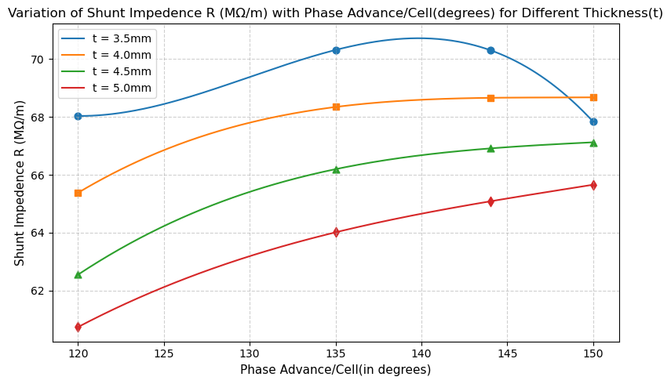
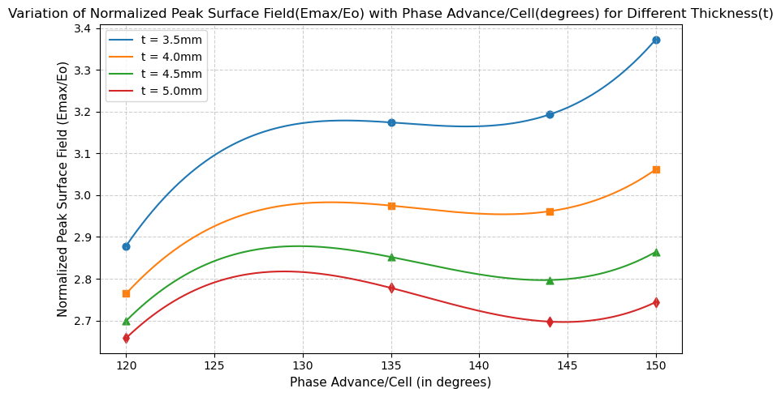
Technical design and verification:
C-band accelerating structure
In order to increase the shunt impedance, the first cell of the structure is optimized
The different modes and deferent thickness iris were compared. If the iris is thicker, the shunt impedance is increase. The surface electrical field is higher
Notes:
We try to find a group of values with clear advantages

Slide 14
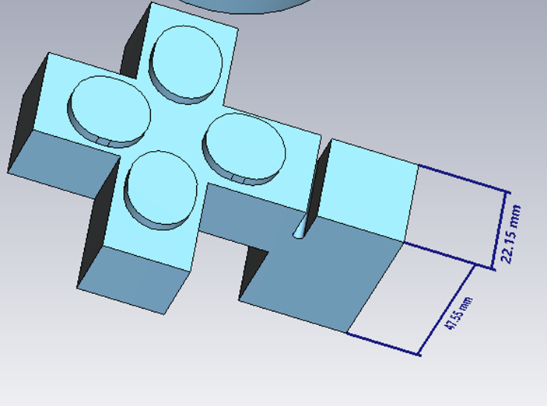
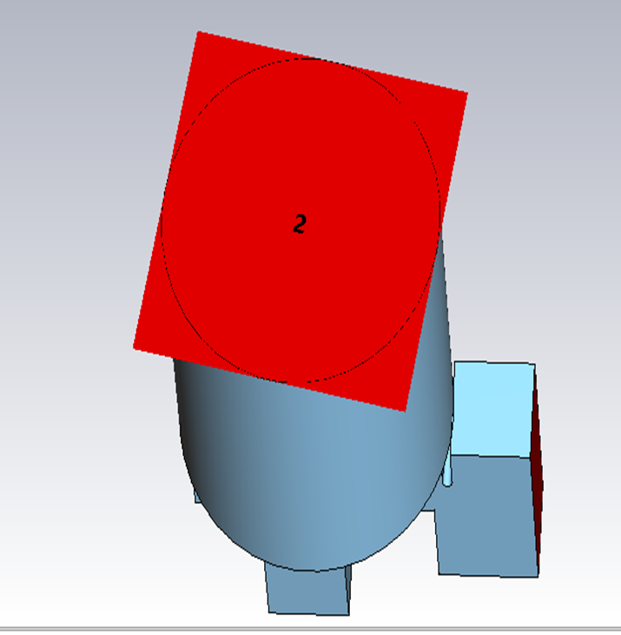
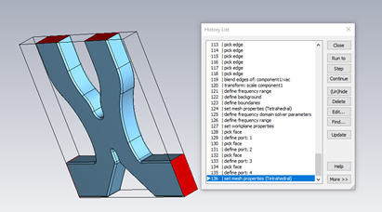
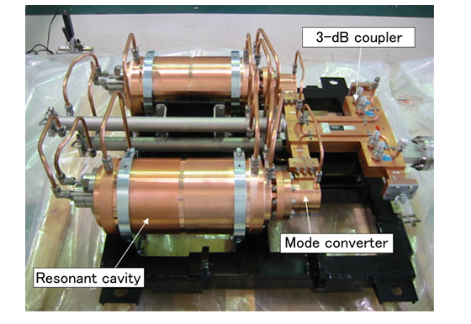
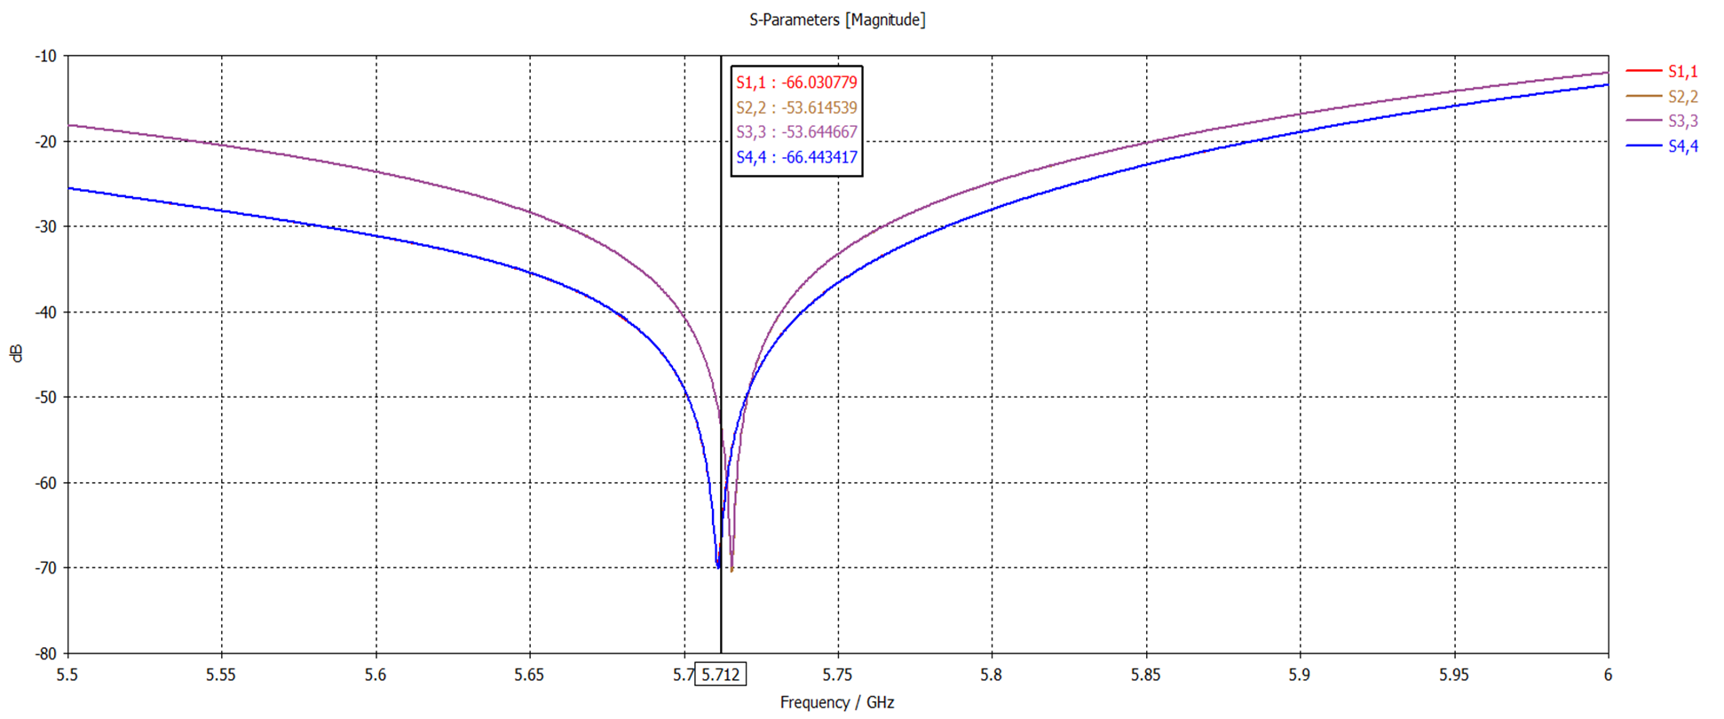
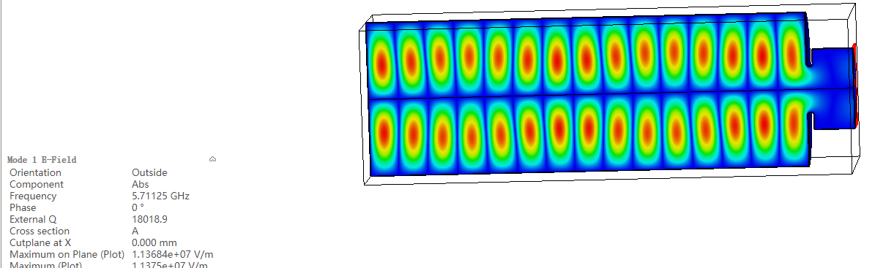
Technical design and verification:
C-band pulse compressor: Cylinder cavities type TE_{0,1,15}
Succesfully used in Spring8 and SINAP soft XFEL (50MW klystron), Our design targete is for 80MW
The 3-dB power divider has been successfully designed and validated with good simulation results
Currently focused on the mode converter design, aiming to optimize matching and reduce reflection losses
Further work will integrate the optimized converter with the complete system to evaluate overall efficiency and power multiplication
CST model showing mode converter geometry, port setup, and meshing
Appearance of the C-band RF pulse compressor of Spring8
Mode TE0,1,15 mode visualization in Cavity

Slide 15
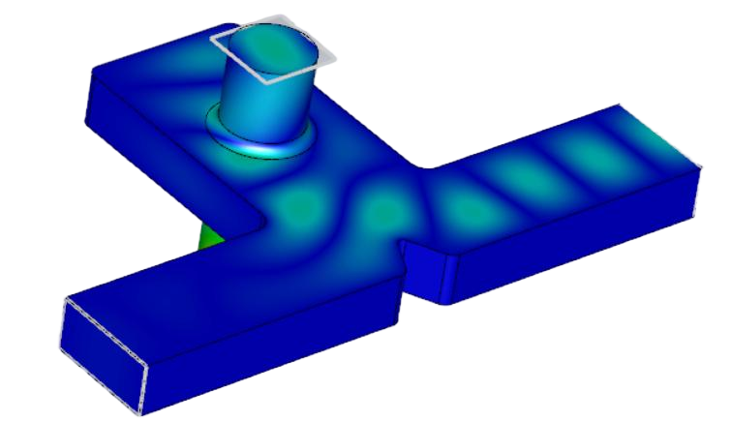
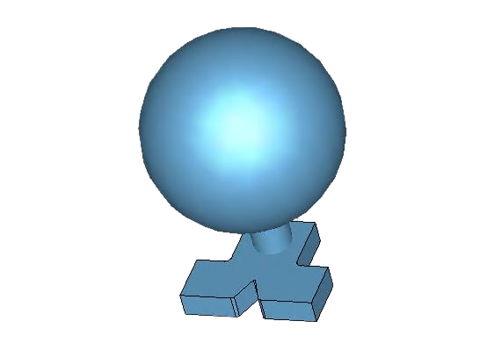
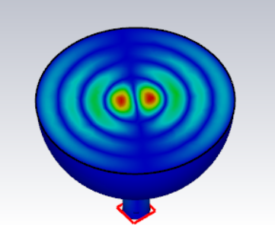
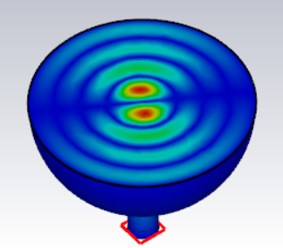
Technical design and verification:
C-band pulse compressor: Spherical cavity type TE_{1,1,4}
We simulated the design use CST program now
The TE₁₀ mode and TE₂₀ mode excite two polarization-degenerate TE₁₁ modes at the interface between the cylinder and the waveguide
When we select TE₁₁₄ mode in the cavity, the energy multiplication factor is 2
The diameter of the cavity is 117 mm
Parameters | Design values
Frequency（MHz） | 5712
Input power(MW) | 80
Working mode | TE₁₁₄
Input pulse length (μs) | 3
Compressed pulse length (μs) | 0.5
Coupling coefficient (β) | 5.43
Cavity Radius (mm) | 116.88
Unloaded Q | 126000
Energy multiplication factor | 2
Electric field diagram of the mode converter
Spherical resonant cavity (TE₁₁₄)

Slide 16
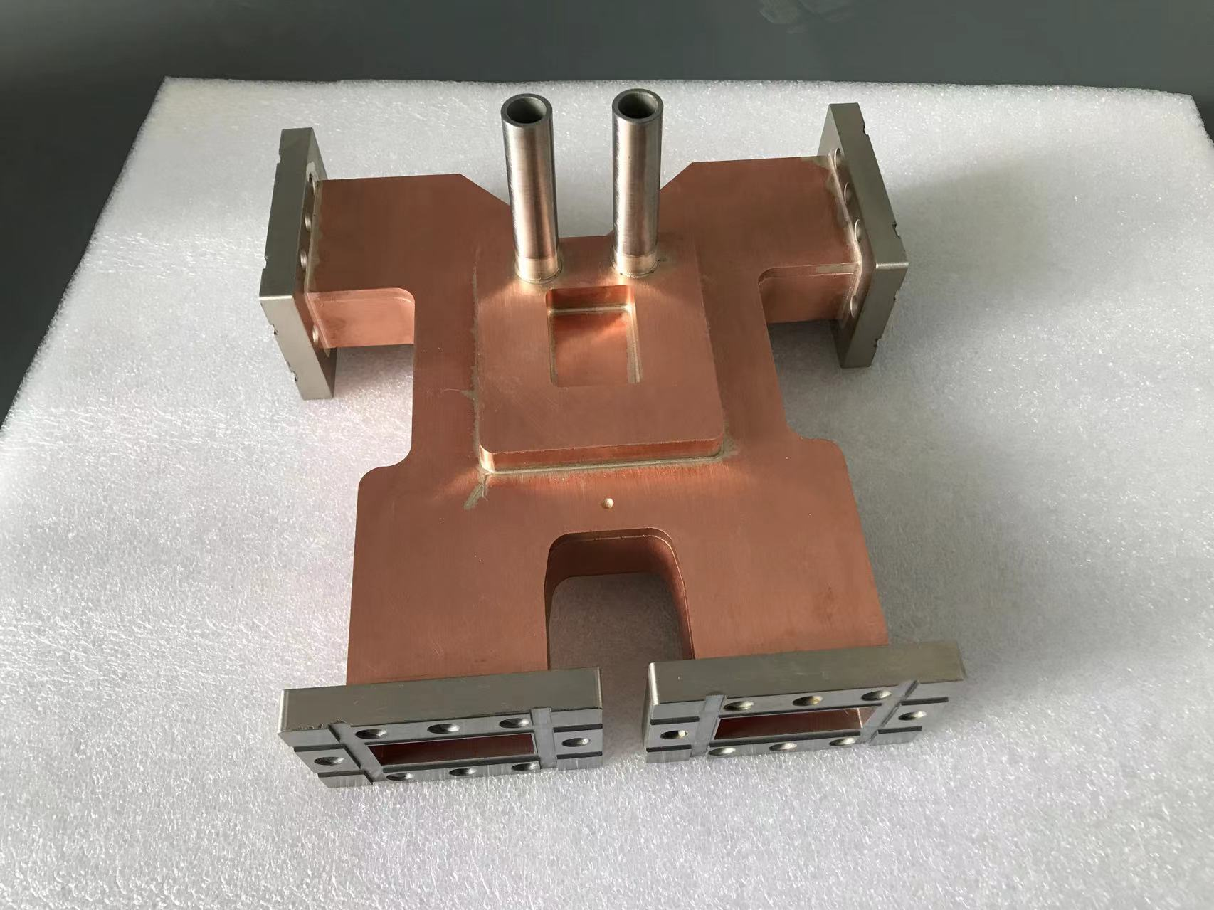
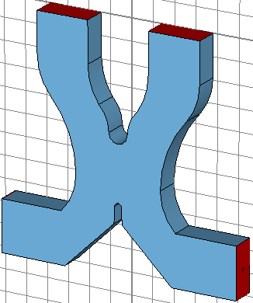
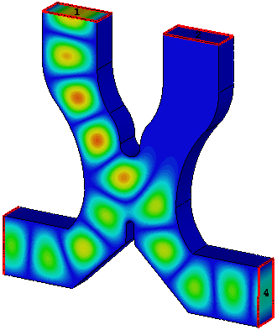
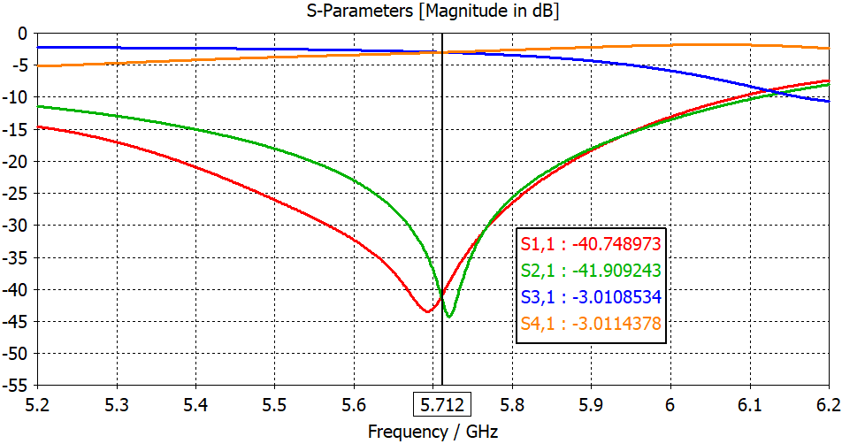
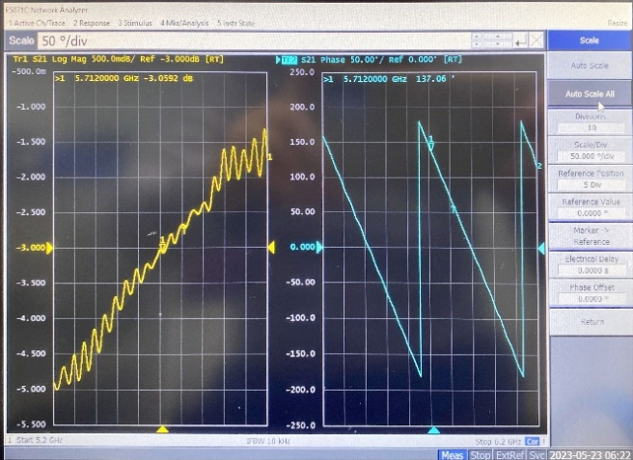
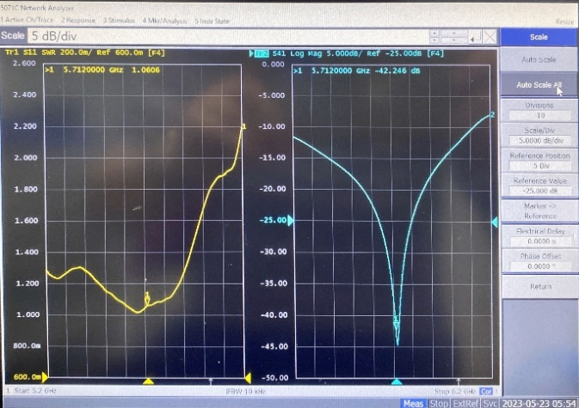
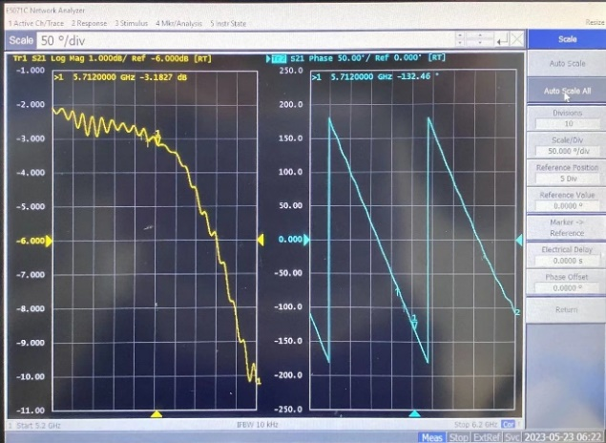
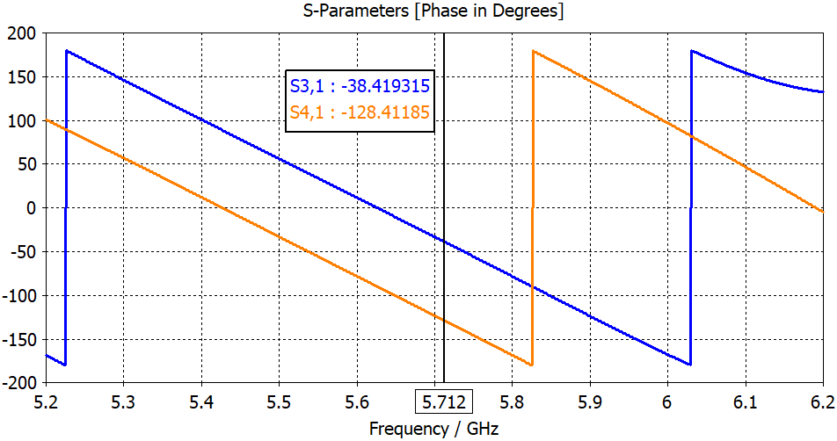
Technical design and verification:
C-band hybrid power divider design and test
Hybrid divider
  VSWR：1.06
  Amplitude imbalance: 0.13dB
  Phase imbalance degree: 0.48°
 | Amplitude |  |  |  | Phase
 | S11 | S21 | S31 | S41 | S31 | S41 | Phase difference
Designed | -40.7 | -41.9 | -3.01 | -3.01 | -30.4 | -120.4 | 90
Measured | -20.9 | -42.2 | -3.05 | -3.18 | 137 | -132.5 | 90.48

Slide 17
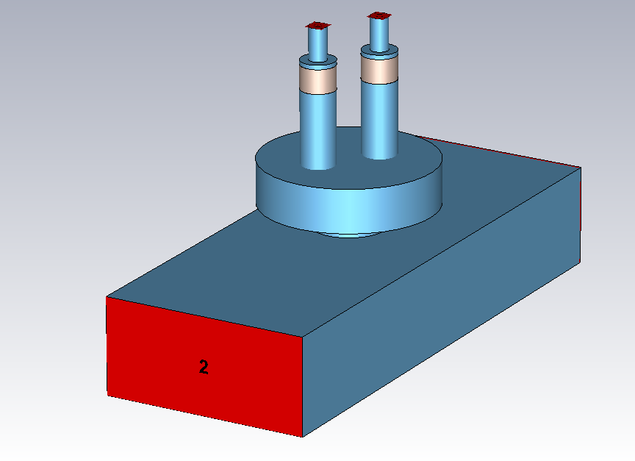
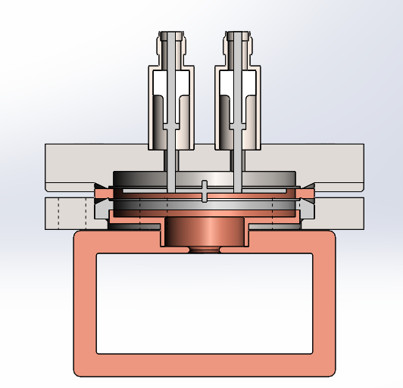
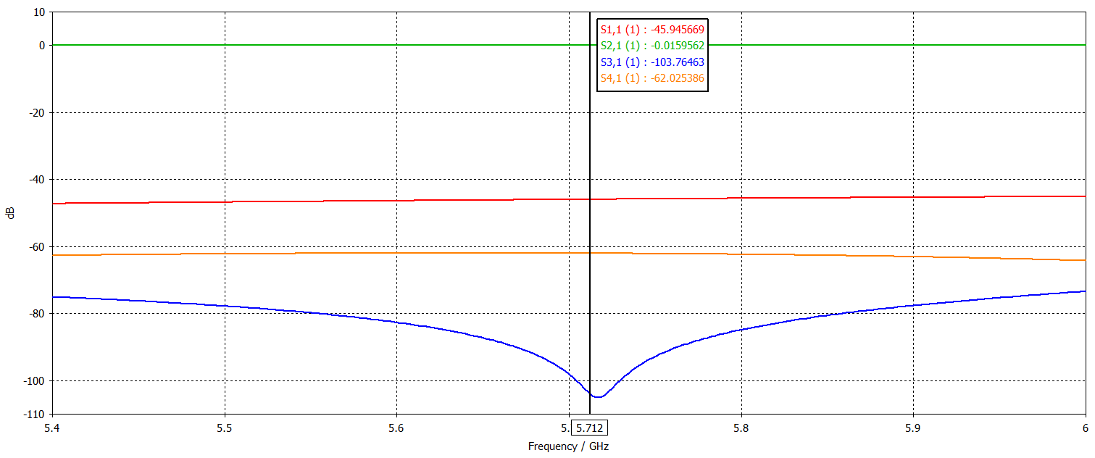
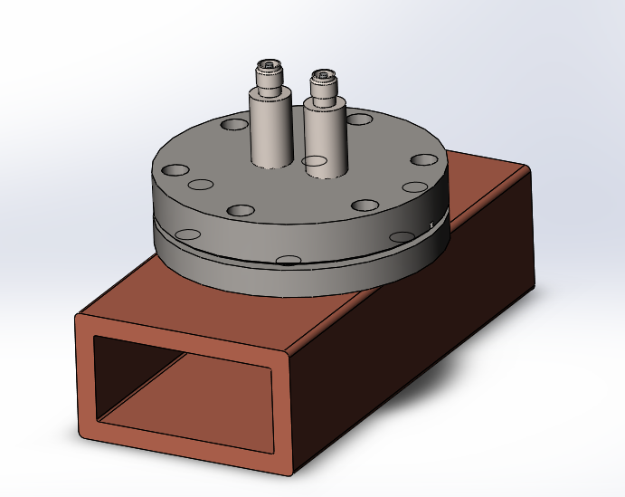
Technical design and verification:
C-band high directional coupler
The Bethy hole-type directional coupler has been selected
In the design, we utilize the CF35 flange and SMA feed-through
The coupling coefficient is 62 dB, while the directivity is 41.8 dB, it can effectively to differentiate between forward and backward waves
SMA feedthrough
CF35 flage
S11 (dB) | S12 (dB) | S13 (dB) | S14 (dB)
-45.9 | 0.016 | -103.8 | -62

Slide 18
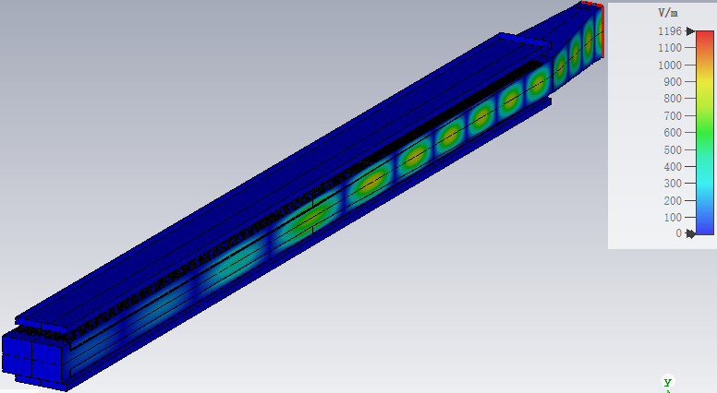
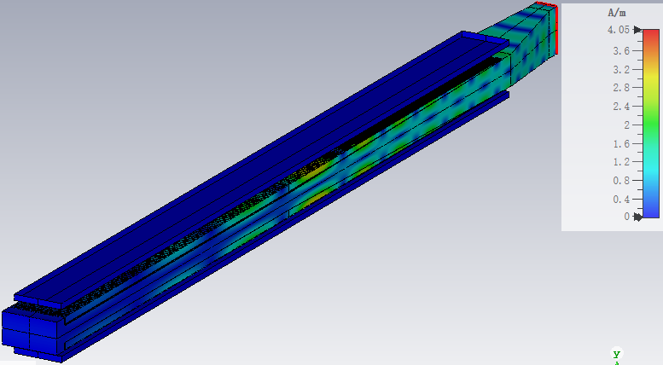
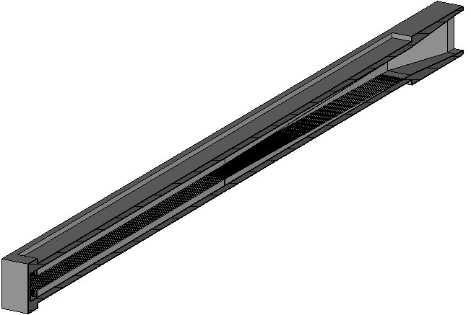
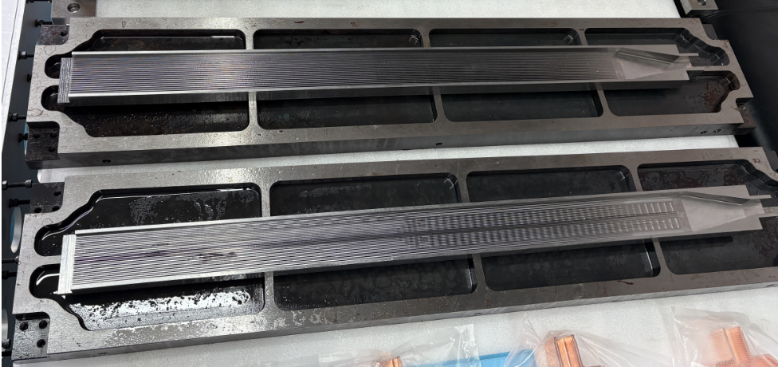
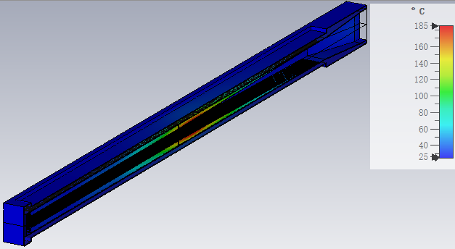
Technical design and verification:
C-band stainless steel metal load
Pure SS430 load with BJ48 input port, composed of waveguide taper, match section, regular section and end cavity. 1.02 VSWR in 5712 MHz working frequency, and >400 MHz bandwidth (S₁₁<-20 dB)
Distribution of the electric and magnetic field, Esmax ~ 30 MV/m with 300 MW peak power input
Waveguide taper
BJ48
Electric field
Magnetic field
The maximum temperature reaches approximately 185 °C, accompanied by an average input power of 10 kW and a cooling water flow rate of 30 L/min
End cavity
Match section
Regular section
Distribution of temperature

Slide 19
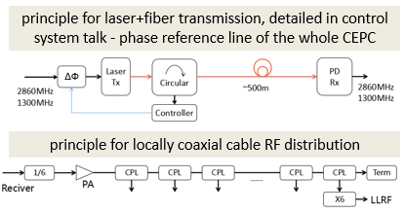

Technical design and verification:
Linac phase reference line & LLRF
The phase stability should be <0.2deg (rms) from beam physics
The phase reference line shall provide signals to LLRF as follows:
  Three laser+fiber based PRL for DR, transmitting 650MHz, FAS+SAS and TAS, transmitting 2860MHz, phase <0.02deg
  Two coaxial-cable based PRL for locally FAS+SAS and TAS:2860MHz divided to 476.67MHz, distributed along the cable to reduce signal attenuation, at the local LLRF receiver, multiplied back to 2860MHz and 5720MHz
  Phase reference coaxial cables will be placed in the temperature-controlled duct with stability <0.1K
  Standard 7/8 inch coaxial cables are used with temperature coefficient ~5ps/km/K, 1km phase will <0.5deg (peak-peak, 0.1deg rms)
Linac LLRF singals | Value
Phase stability | 0.3deg (rms)
Amplitude stability | 0.3% (rms)
2860MHz number | 33
5720MHz number | 236
650MHz @DR number | 2
Reference signal power | >0dBm
Reference signal jitter | <80fs(rms)

Slide 20



Technical design and verification:
Linac phase reference line & LLRF
Proven down-conversion LLRF architecture with high phase stability for CEPC Linac
  The LLRF system based on down-conversion architecture has already been widely applied at IHEP. There are 5 sets of 2998.8 MHz LLRF systems in the HEPS linac and 22 sets of 2856 MHz LLRF systems in the BEPCII linac
  The long-term online phase stability of is 0.08° RMS and 0.4° peak-to-peak, meets CEPC linac phase stability requirements
BEPCII LINAC LLRF System
HEPS LINAC LLRF System

Slide 21
Exploration of C-band cryogenic copper structures

Slide 22
R&D of C-band cryogenic copper accelerating structures
The aforementioned details pertain to the preparation of a C-band normal temperature test bench, specifically tailored for the baseline design requirements of the linac RF system
To achieve higher gradients, we have additionally developed cryogenic copper accelerating structures that operate within liquid nitrogen
We have designed two types of parallel coupling structures
  Type I: 20 cells，a=0.05*λ₀, 2a=5.25mm
  Type II: 40 cells，a=0.1*λ₀, 2a=10.5mm

Slide 23







C-band 20 cells parallel coupling structure design
It is a standing wave structure. This is the first model we examined. We completed cavity optimization, coupling design, and power distribution design
The shunt impedance has been determined to be 303 MΩ/m at 77K
Based on the experimental data, the Q₀ value increase by a factor of 2.8 attains 34079
The whole structure parameters
RF Parameter | value | Unit
Temp T | 77 | K
Frequency f₀ | 5712 | MHz
Working mode | π | ----
Cavity numbers n | 20 | ----
Total length L | 525 | mm
The gradient of the total cavity | 24.8
a=0.05*λ₀
Cavity optimization
Field distribution
Thermal analysis

Slide 24






Cold test results after tuning
Brazing serves as the process for soldering
The frequency error for each cell is within ±15 kHz, and the field distribution exhibits a flatness of over 90%
The structure has been installed within the cryostat
Room temperature measured s-parameters
20 cells structure
Electric field distribution after tuning
The structure installed in the cryostat

Slide 25




Preparation for high power test
In the Dongguan branch of the IHEP, there is a C-band test platform
Before connecting to the power source, VNA is utilized for measuring the S-parameters
Subsequent to cooling to 77 K, the resonant frequency is 5711.907 MHz (The difference from the theoretical value of 5712 is 93 kHz). The VSWR is 1.13. The measured Q-value is approximately 77% of the theoretical one
Measured here
window
Frequency after the cooling
Waveguide layout design

Slide 26



High power test results
March 27, 2025, completed the first round of high-power test. The experiment was halted after three hours of operation at 20 MW input power to the cavity because a window was broken
Considering fill time and the measured Q-values and theoretical values, the maximum acceleration gradient of this test is up to 90.3MV/m
High-power testing will continue in Nov. 2025
Signal source frequency is 2855.9537*2=5711.9074MHz

Slide 27






Wakefield simulation
Structural modeling was completed and the short-range wakefield was calculated
For application in a CEPC injector, with a bunch charge ranging from 1.5 to 3 nC, a radius of at least 5.25 mm is necessitated (Bunch length: 0.3 mm)
C3: r=2.62mm
C3: r=5.25mm
C-band: r=7.24mm
Transverse Wake Max. = 3503 V/pC/m
Loss factor = -14.8 V/pC
Transverse Wake Max. = 873 V/pC/m
Loss factor = -7.2 V/pC
Transverse Wake Max. = 378 V/pC/m
Loss factor = -5.1 V/pC

Slide 28




40 cells cryogenic accelerating structure design
Type II: a=0.1*λ₀ (2a=10.5mm)
The increase of the beam aperture leads to coupling between neighboring cells. Subsequently, the field distribution of the pi-mode is flattened after resizing the edge cells (reduce about 3um)
The shunt impedance and E_{Smax}/E₀ both decrease when compared to the TypeI

Slide 29


High power test bench at Huairou testing platform
Based on the C-band klystron, another C-band test bench is currently under development, with high-power testing scheduled in 2025
It will reach 144MV/m with 80MW input theoretically, taking into account the actual operating power of the klystron (typically 80% of the design value), waveguide attenuation and other factors, our phase one target gradient is 80 MV/m
Beam tests will be conducted in 2026
Beam test bench

Slide 30
Summary
According to the booster and collider time line, the construction time for the linac is provided
A C-band nornmal temperature test bench is currently being designed
We are also researching on low-temperature copper C-band accelerating structures and now is doing the second time high power test in Donguan branch

Slide 31
Thank you

