Slide 1
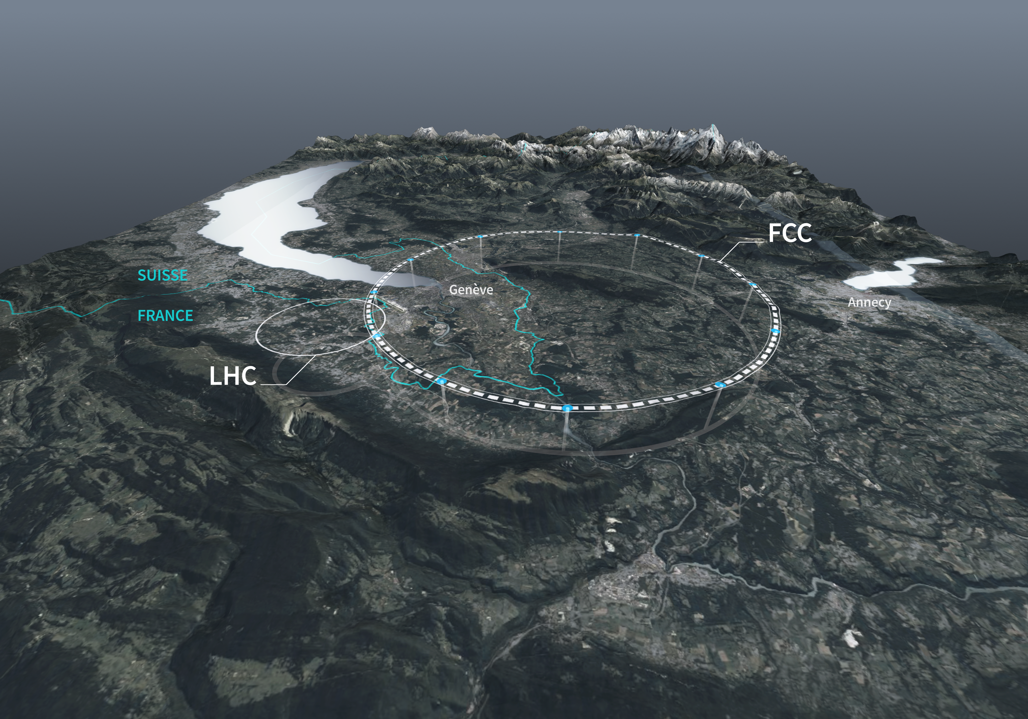












ipac24_logo.png
Monochromatization a new operation mode for e⁺e⁻ circular colliders
A. Faus-Golfe (IJCLab)
Z. Zhang (IJCLab & IHEP), P. Raimondi (FNAL)
Notes:
Thanks for the invitation to present this topic.
I am doing this talk on behalf of Pantaleo Raimondi and Zhandong Zhang.

Slide 2
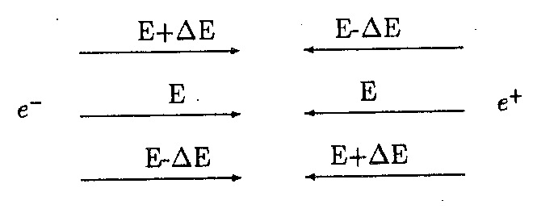
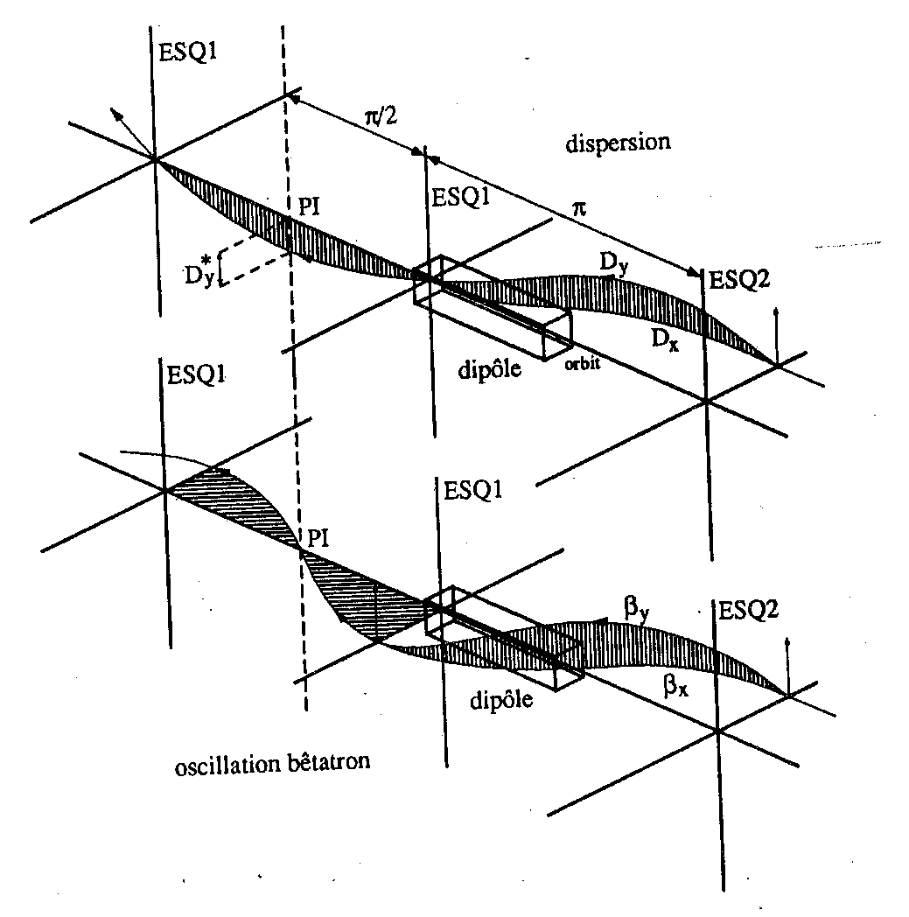
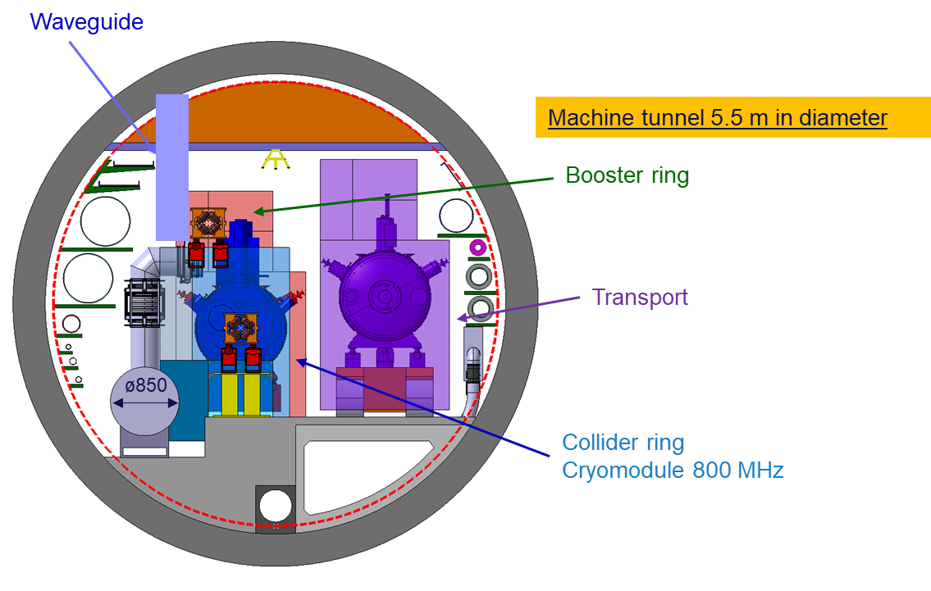
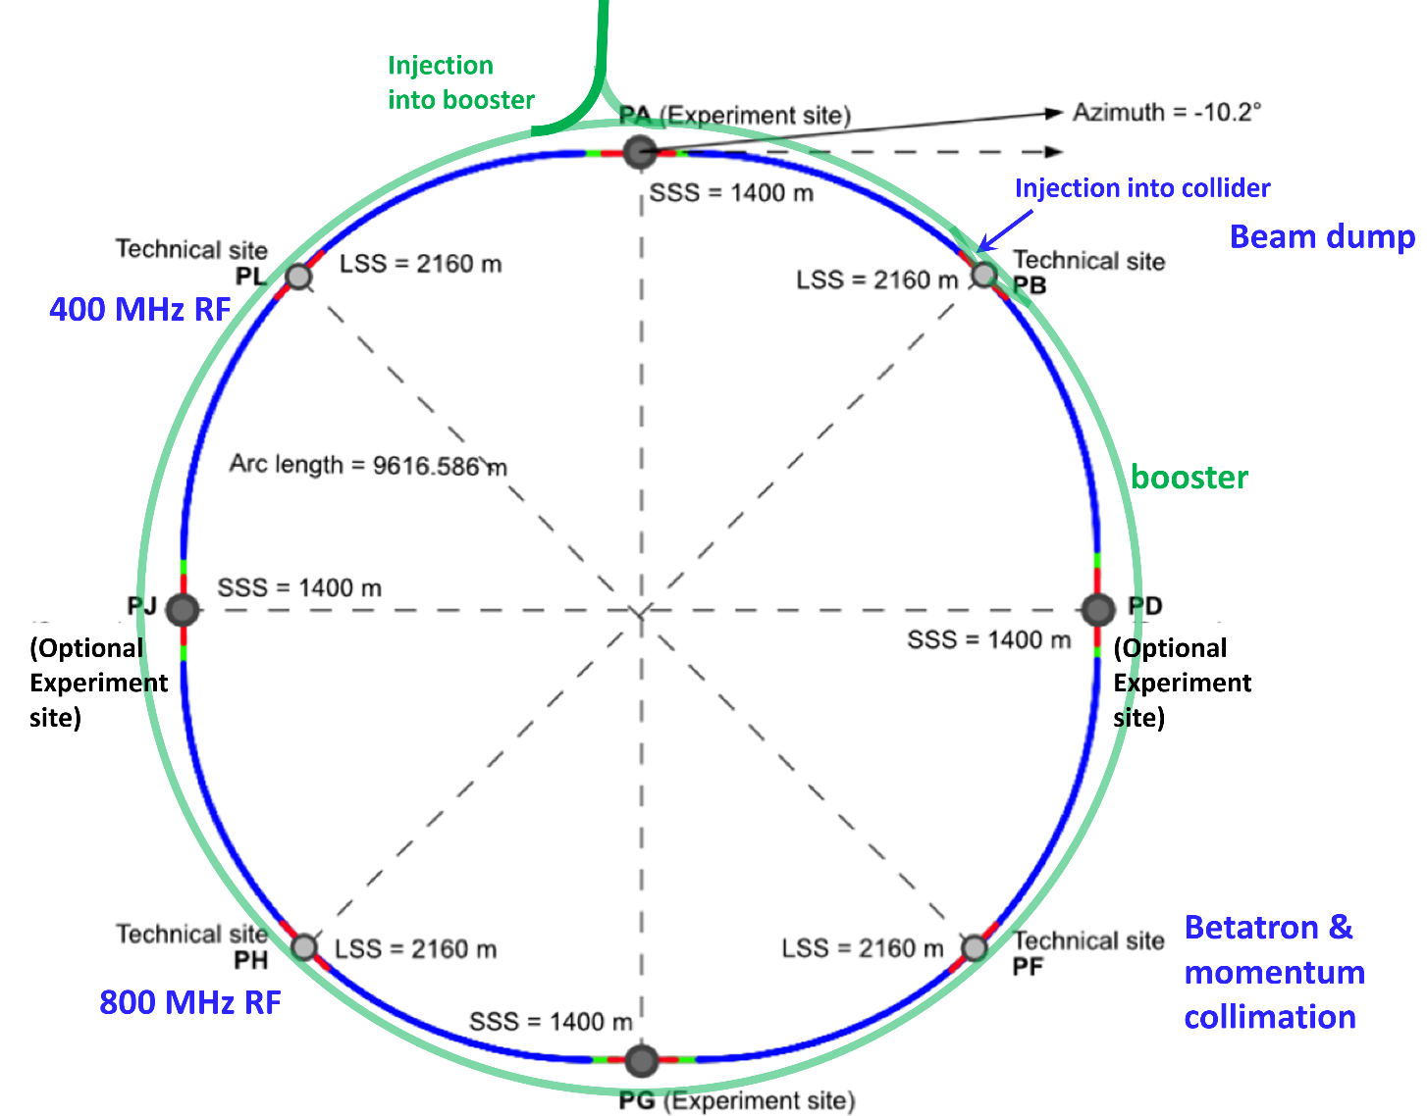

ipac24_logo.png
Outline
Monochromatization
Monochromatization concept in e⁺e⁻ colliders
  Low-energy
  High-energy: FCC-ee
FCC-ee monochrom physics motivation and performance studies
FCC-ee monochrom schemes and implementation studies
Summary and Perspectives
E₀ + ΔE
E₀- ΔE
E₀ + ΔE
E₀- ΔE
E₀ + ΔE
E₀- ΔE
E₀ + ΔE
E₀- ΔE
E₀ + ΔE
E₀- ΔE
E₀
E₀
E₀
E₀
E₀
E₀
E₀
E₀
E₀
E₀
E₀ - ΔE
E₀+ ΔE
E₀ - ΔE
E₀+ ΔE
E₀ - ΔE
E₀+ ΔE
E₀ - ΔE
E₀+ ΔE
E₀ - ΔE
E₀+ ΔE
Notes:
I will introduce first the concept of monochromatization, for low and high-energy colliders . I will focus in the Future e+e- high-energy Circular Collider at CERN.
I will explain the physics motivation for these new mode of operation, how we have implemented in the FCC-ee, and some perspectives

Slide 3
CM Energy Resolution in Colliders
Reducing the spread of the centre-of mass (CM) energies (σ_{ω}) of colliding beams is a way to increase the collision energy resolution, that is of particular interest when operating the collider on a narrow particle resonance or at the threshold of its pair production.
spread of the CM energies
beam energy
bending radius
usual way
⇊
longitudinal partition number
relative beam energy spread
alternative way
Relative energy spread is mainly due to Synchrotron Radiation (SR) emitted when a ultra-relativistic particle passes trough a bending magnet (ρ)
Monochromatization consists in reducing the spread of the CM energies, without necessarily reducing the inherent energy spread of the two individual beams
Monochromatization
Notes:
Reducing the CM energy spread is one way to in crease the energy resolution of a collider, that it is interesting when the collider is running close to a narrow particle resonance or when we are in the threshold of its pair production.
For a given energy in a circular collider, the CM energy spread is inversely proportional to the square of bending radius and the longitudinal partition number. If we would like to reduce the the CM energy spread the usual way is to increase the bending radius and push to the max the longitudinal partition number or to use an alternative way consisting in a monochromatization of the beams.
varepsilon = E-E_0/E_0 relative energy deviation
sigma_varepsilon = relative energy dispersion or energy spread
J_varepsilon = longitudinal partition number
J_x = horizontal partition number
I_3/I_2 =1/pho
The spread of CM energy resolution (sigma_w) in colliders is determined by the relative energy spread of the beams (sigma_varepsilon). This relative energy spread is mainly determined by the Synchrotron Radiation emitted when a ultra-relativistic particle passes through a bending magnet dipole.
The usual way to decrease the relative energy spread is to increase the bending radius or to vary the longitudinal partition number. Another alternative way is monochromatization. This monochromatization consists in reducing the spread of the centre-of mass (CM) energies, without necessarily reducing the inherent energy spread of the two individual beams, which is of particular interest when operating on a narrow resonance or at the threshold of its pair production.

Slide 4



Monochromatization Principle
Standard
  Monochromatization
D*_{x,y}=0
D*_{x+} = - D*_{x-}= D*_{x}
D*_{y+} = - D*_{y-}= D*_{y}
IP
IP
correlation between transverse spatial position and energy deviation
e⁺
e⁻
e⁺
e⁻
Opposite correlations between transverse spatial position and energy deviation
$$w=2(E_{b}+∆E)$$
CM energy
$$w=2E_{b}+O{(∆E)}^{2}$$
Spread of the CM energies
$$λ=1$$
Monochromatization factor
Luminosity
betatronic beam sizes at the IP
  Enhancement of energy resolution, and sometimes increase of the relative frequency of the events at the center of of the distribution but luminosity loss !!!!
  σ*_{x,y}$=$ $\sqrt{ {β_{x,y}^{∗}ε_{x,y}+\left(D_{x,y}^{∗}σ_{δ}\right)}^{2}}$
dispersive beam size at the IP
Notes:
To understand what is the monochromatization, we will make a comparison between the standard and the monochromatization modes of collision.
In a standard collision mode, the two colliding beams have a correlation between the transverse spatial position and the energy deviation as illustrated in the top left figure.
The CM energy, the CM energy spread and and the Luminosity are given but the very well known formulas.
In the case of the monochromatization we have opposite correlations between the transverse spatial position and the energy deviation as sketched in the right top Figure.
In beam-optics terms, this will require generating a dispersion function of opposite signs for the two beams, at the Interaction Point (IP).
This will have an impact in the CM energy that now it is depending in the energy deviation at second order and in a direct reduction of the CM energy spread, by a factor that is proportional to the enlargement of the beam size of the IP due to the non-zero dispersion at the IP. But due to the nonzero dispersion function at the IP, that will contribute to enlarge the IP transverse beam size (σ*_{x} or σ*_{y}), we have a reduction in the Luminosity by the same factor.
Luminosity is not always the most important factor, indeed we have methods to mitigate this reduction. Consequently the design of a monochromatization scheme has to consider not only the IR beam optics design, but the optimization of the rest of collider parameters to keep luminosity as high as possible.
Opposite dispersions at the IP enhance energy resolution without detriment of the differential luminosity while dispersion which have the same sign degrade both differential and total luminosity

Slide 5
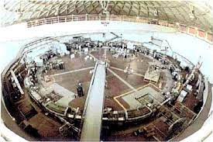

Monochromatization Principle
Standard
  Monochromatization
D*_{x,y}=0
D*_{x+} = - D*_{x-}= D*_{x}
D*_{y+} = - D*_{y-}= D*_{y}
IP
IP
e⁻
correlation between transverse spatial position and energy deviation
e⁺
e⁺
e⁻
Opposite correlations between transverse spatial position and energy deviation
$$w=2(E_{b}+∆E)$$
CM energy
$$w=2E_{b}+O{(∆E)}^{2}$$
Proposed by A. Renieri in 1975 for ADONE.
Smart idea, conceptually very simple, but never tested experimentally !!!!!!
Spread of the CM energies
$$λ=1$$
Monochromatization factor
Luminosity
betatronic beam sizes at the IP
  Enhancement of energy resolution, and sometimes increase of the relative frequency of the events at the centre of of the distribution but luminosity loss !!!!
  σ*_{x,y}$=$ $\sqrt{ {β_{x,y}^{∗}ε_{x,y}+\left(D_{x,y}^{∗}σ_{δ}\right)}^{2}}$
dispersive beam size at the IP
Notes:
This smart idea was proposed by Aldo Renieri in 1975 for being implemented in ADONE. But never tested experimentally.

Slide 6
Monochromatization in Low-energy Colliders
At low-energy e⁺e⁻ colliders, with flat beam schemes (σ*_{y}<<<σ*_{x}) and where the energy spread is meanly due to SR (“beamstrahlung” (BS) is not important), we could optimize this scheme by playing with the beam-beam parameters and the emittances to avoid luminosity losses:
we could gain in energy resolution keeping the luminosity constant and the beam-beam in the standard limits !!!!!!
σ∗_{y}<<<σ∗_{x}
D*_{x+}= D*_{x-} = 0
D*_{y+} = - D*_{y-}= D*_{y}
β∗_{y}<<<β∗_{x}
Vertical dispersion different from zero
beam-beam parameter
with
ε∗_{y}<<<ε∗_{x}
beam emittances
Monocromatization Design Studies for low-energy e⁺e⁻ colliders:
VEPP4: one ring, electrostatic quads (τ−charm)
SPEAR: one ring, electrostatic quads, λ~8
LEP: one ring, electrostatic quads (limited strength) and alternative RF magnetic quads, λ~3 (optics limitations)
B-factory: Superconducting RF resonators
τ−charm factory: two rings, vertical dipoles, λ~7.5
with low-horizontal emittance
τ−charm factory with monocromatization scheme
A. Faus-Golfe, J. Le Duff, Versatile DBA and TBA lattices for a tau charm factory with and without beam monochromatization. Nucl. Instrum. Methods A 372, 6–18 (1996)
Notes:
At low-energies with flat vertical beams and where energy spread is mainly given by the SR, the scheme could optimized to avoid the luminosity losses.
In these conditions is more efficient to create the dispersion in the vertical plane, the vertical beam size is mainly given by the dispersive part.
Consequently both the influence of the beam-beam and the luminosity decreases. To compensate we have to act in the horizontal plane by decreasing the horizontal emittance. This is the pay-off of the monochromatization.
Different studies have been made for different e+e- colliders as: Tau-charm factories, VEPP4, SPEAR, LEP and B factories...

Slide 7
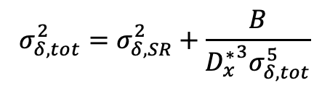
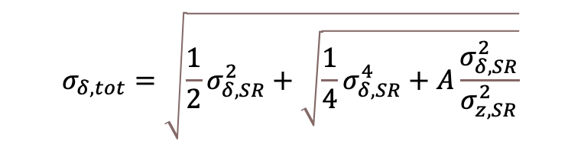
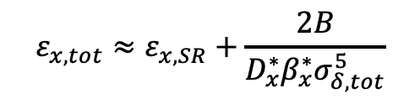
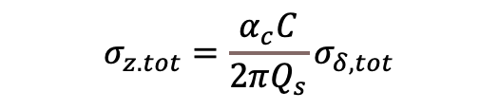

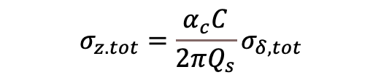
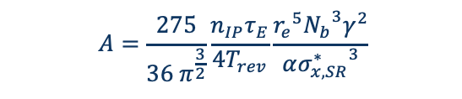
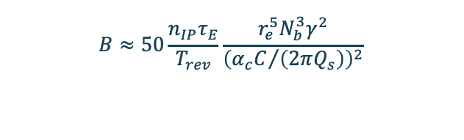
Monochromatization in High-energy Colliders
In the previous case for low-energy e⁺e⁻ colliders, the relative energy spread is mainly given by SR in the colliders arcs (σ_{δ}=σ_{δ,SR}). Alternatively in high-energy e⁺e⁻, we have to take into account also the SR created by the strong opposing EM field during collision or “beamstrahlung”(BS) (Nγ ∝ 1/ σ_{z} (σ*_{x}+ σ*_{y}), with σ_{z} the bunch length).
Standard BS
D*_{x,y}=0
  Monochromatization BS
D*_{x+} = - D*_{x-}= D*_{x}
D*_{y+} = - D*_{y-}= D*_{y}
$$σ_{δ,tot}=\sqrt{\frac{1}{2}σ_{δ, SR}^{2}+\sqrt{\frac{1}{4}σ_{δ, SR}^{4}+A\frac{σ_{δ, SR}^{2}}{σ_{z, SR}^{2}}}}$$
Energy spread
$$σ_{δ, tot}^{2}=σ_{δ, SR}^{2}+\frac{B}{{D_{x}^{∗}}^{3}σ_{δ, tot}^{5}}$$
Coupled system to be solved numerically
$$A=\frac{275}{36 π^{\frac{3}{2}}}\frac{n_{IP}τ_{E}}{4T_{rev}}\frac{{r_{e}}^{5}{N_{b}}^{3}γ^{2}}{α{σ_{x,SR}^{∗}}^{3}}$$
$$B≈50\frac{n_{IP}τ_{E}}{T_{rev}}\frac{r_{e}^{5}N_{b}^{3}γ^{2}}{{\left({α_{c}C}/{\left(2πQ_{s}\right)}\right)}^{2}}$$
$$ε_{x, tot}≈ε_{x, SR}$$
$$ε_{x, tot}≈ε_{x, SR}+\frac{2B}{D_{x}^{∗}β_{x}^{∗}σ_{δ, tot}^{5}}$$
Horizontal emittance
$$σ_{z.tot}=\frac{α_{c}C}{2πQ_{s}}σ_{δ,tot}$$
Bunch length
$$σ_{z.tot}=\frac{α_{c}C}{2πQ_{s}}σ_{δ,tot}$$
BS at high-energy with D_{x}*=0, has more impact on energy spread in standard mode than in monochromatization mode.
BS with monochromatization at high-energy, avoids the blow up of the relative beam energy spread, which is significant in standard mode with D_{x}*=0.
M. A. Valdivia García, F. Zimmermann, Towards an optimized monochromatization for direct Higgs production in future circular e+ e- Colliders, in CERN-BINP Workshop for Young Scientists in e+e- Colliders, pp. 1–12 (2017)
Notes:
What happens with high-energy colliders....
In this case the relative energy spread has an important contribution from the Beamstrahlung (radiation due to the strong opposing EM field created by the other beam).
More in detail and recalculating the impact of the BS (all details in the paper of Marco Alan and Frank) in: the energy spread, the emittance and the bunch length:
- the energy spread and the bunch length are impacted by the BS
- the horizontal emittance is not impacted in the standard but is impacted on the monochromatiztion case.
We could conclude that the BS in the monochrom case is avoiding the blow-up of the relative energy spread that it is significant in the standard case.
We have now all the tools on hand to study the monochromatization in FCC-ee

Slide 8
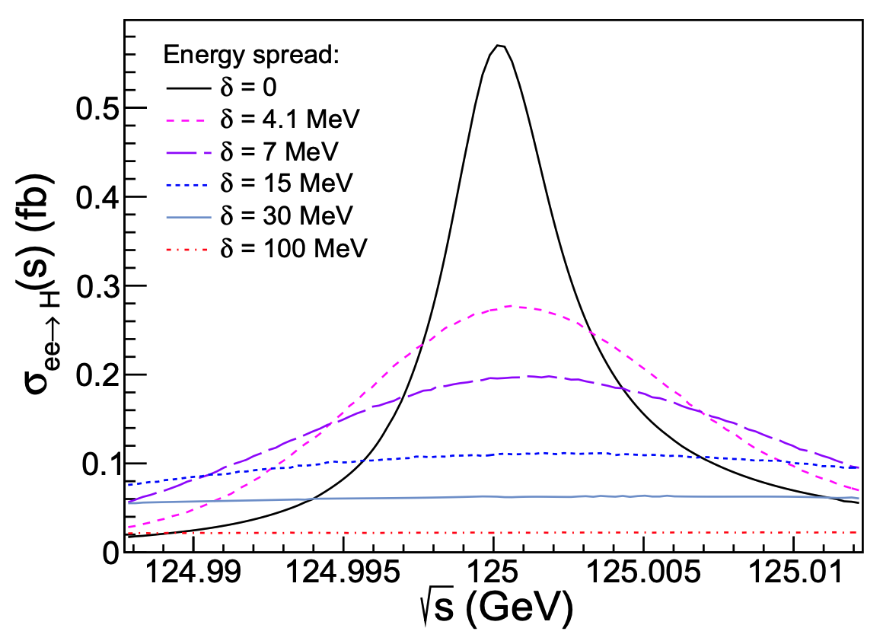
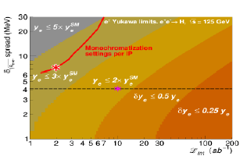
FCC-ee Monochrom Physics Motivation and Performance
In recent years interest in monochromatization has been renewed, as FCC-ee could directly produce the Higgs boson in s-channel annihilation e⁺e⁻ → H at 125 GeV. This production mode is only possible if the default collision energy spread (~ 50 MeV) can be reduced to a level comparable with the natural width of the Higgs boson Γ_{H} = 4.2 MeV, offering the only known path to measuring the electron-Yukawa coupling (y_{e}).
Resonant Higgs production cross section e⁺e⁻ CM energy spread
S. Jadach, R.A. Kycia, Phys. Lett. B 755, 58 (2016. DOI: 10.1016/j.physletb.2016.01.065
FCC-ee self-consistent parametric studies at 125 GeV has been realized to identify the best scenario with D*_{x} $≠$0.
A. Faus-Golfe, M. Valdivia Garcia, F. Zimmermann, The challenge of monochromatization Direct s-channel Higgs production: e+e− → H, Eur. Phys. J. Plus (2022) 137:31, DOI: 10.1140/epjp/s13360-021-02151-y
Associated upper limits contours (95% CL) on the electron Yukawa coupling (y_{e}) has been calculated.
Red curves show the range of parameters presently reached in self-parametric FCC-ee monochromatization studies. The red star indicates the best signal strength monochromatization point in the plane (the pink star over the δ√s = ΓH = 4.2 MeV dashed line, indicates the ideal baseline point assumed in default analysis). All results are given per IP and per year.
D. d'Enterria, A. Poldaru, G. Wojcik, Measuring the electron Yukawa coupling via resonant s-channel Higgs production at FCC-ee, arXiv:2107.02686v1 [hep-ex] 6 Jul 2021
Notes:
Why we would like to implement monochromatization in FCC-ee?
There is a way to produce directly the Higgs boson in the s-channel at 125 GeV (62.5 energy per beam) and offering the possibility to measure the electron Yukawa coupling, if the collision energy spread is reduced from 50 MeV (SR) to 4.1 MeV.
A comprehensive optimization parametric study has been made for FCC-ee (summary in the table). With these ideal parameters, we have calculated the associated upper limiting contours of the electron Yukawa coupling and the results are the red curve. The best case is the red star and the ideal is the pink one.

Slide 9
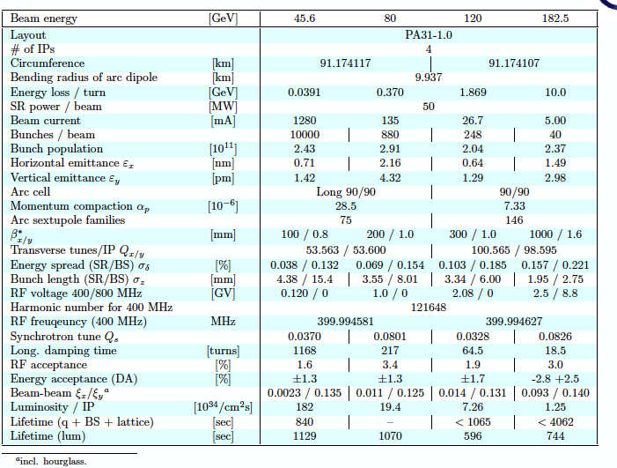
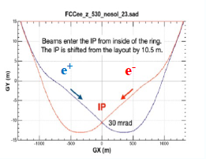
The FCC-ee GHC Standard Lattice & Performances
(Global Hybrid Correction)
4 operation modes: Z, WW, ZH, ttbar
FCC-ee GHC Performance Table for V22
4 IPs
Long week dipoles and antisymmetric IR to avoid SR
Large crossing angle (θ_{c}=30 mrad) at IP are required to separate the two beams to harmful effects of parasitic collisions
E₀ + ΔE
E₀- ΔE
E₀ + ΔE
E₀- ΔE
E₀ + ΔE
E₀- ΔE
E₀ + ΔE
E₀- ΔE
E₀ + ΔE
E₀- ΔE
E₀
E₀
E₀
E₀
E₀
E₀
E₀
E₀
E₀
E₀
E₀ - ΔE
E₀+ ΔE
E₀ - ΔE
E₀+ ΔE
E₀ - ΔE
E₀+ ΔE
E₀ - ΔE
E₀+ ΔE
E₀ - ΔE
E₀+ ΔE
Notes:
A first implementation of this operation mode has been made for the FCC-ee Global Hybrid correction lattice.
This lattice has four modes of operation, ranging from 45 to 182.5 Gev per beam.
4 IRs, featuring a large crossing angle of 30 mrads, and long weak dipoles and antisymmetric by respect to the IP to avoid the impact of the SR.

Slide 10
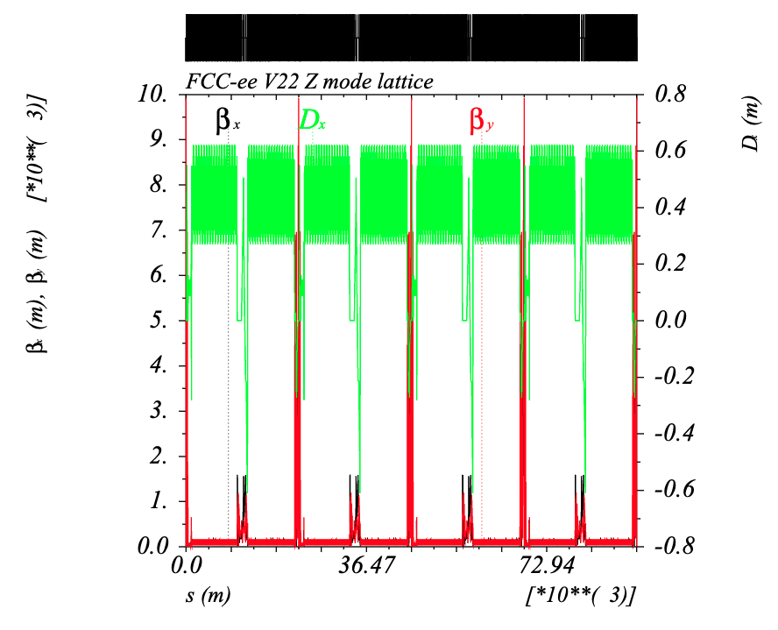
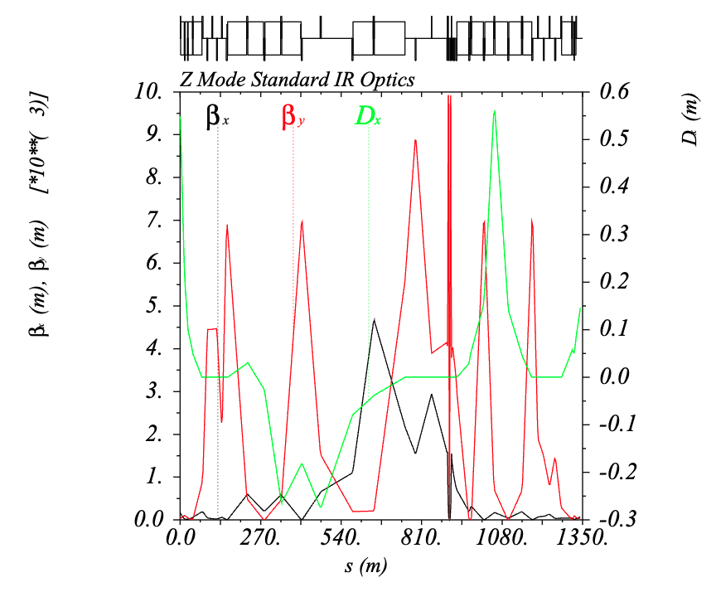
FCC-ee GHC V22 Standard Optics
Z mode lattice with Long 90/90 arc cells
IR Crab waist type Z mode Lattice
Highly asymmetric IR lattice around the IP to mitigate the SR impact
IP
Energy: 45.6 GeV, E_{x}=0.71 nm, E_{y}=1.42 pm
𝛽*_{x}= 100 mm 𝛽*_{y}= 0.8 mm D*_{x}= 0 D*_{y}= 0
J. Keintzel, A. Abramov, M. Benedikt, M.Hofer, K.Oide et al. ”FCC-ee lattice design”, eeFACT2022, doi:10.18429/JACoW-eeFACT2022-TUYAT0102
Notes:
The new operation mode being at 62.5 GeV, we have taken as starting point the Z mode lattice at 45 Gev per beam.
In the left figure we could see the entire ring optics and in the left a zoom of the IR optics where I signal in yellow the place of the IP without dispersion in order to get the highest luminosity.

Slide 11
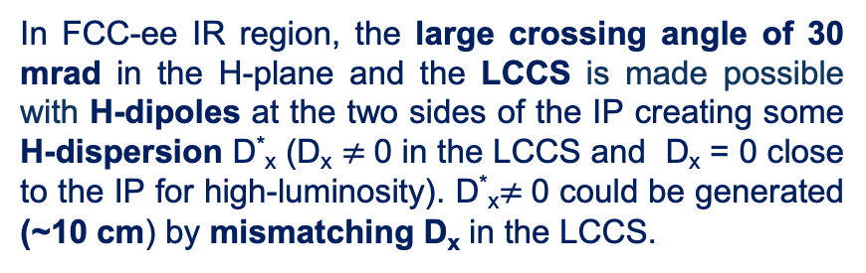
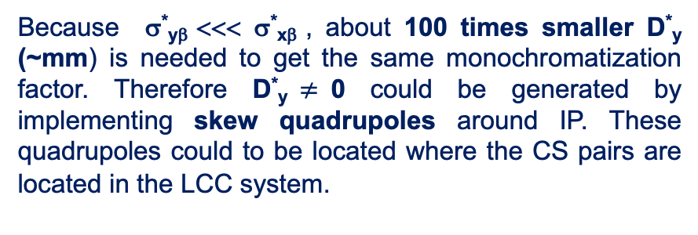
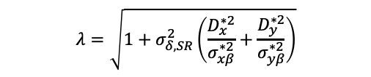


Monochrom Implementation in FCC-ee GHC IR
Despite the simplicity of the monochromatization concept, the creation and the control of the necessary H/V dispersion function of opposite signs at the IP could be rather difficult to implement.
e⁺
Monochromatization factor
IR GHC: Local Chromaticity Correction Section (LCCS) with Crab Sextupoles (CS) in the vertical to produce a crab waist collision
$$λ=\sqrt{1+σ_{δ, SR}^{2}\left(\frac{D_{x}^{∗2}}{σ_{xβ}^{∗2}}+\frac{D_{y}^{∗2}}{σ_{yβ}^{∗2}}\right)}$$
D*_{x} $≠$0 generation at the IP
D*_{y} $≠$0 generation at the IP
In FCC-ee IR region, the large crossing angle of 30 mrad in the H-plane and the LCCS is made possible with H-dipoles at the two sides of the IP creating some H-dispersion D*_{x} (D_{x} $≠$0 in the LCCS and D_{x} = 0 close to the IP for high-luminosity). D*_{x}$≠$0 could be generated (~10 cm) by mismatching D_{x} in the LCCS.
Because σ*_{yβ} <<< σ*_{xβ} , about 100 times smaller D*_{y} (~mm) is needed to get the same monochromatization factor. Therefore D*_{y}$≠$0 could be generated by implementing skew quadrupoles around IP. These quadrupoles could to be located where the CS pairs are located in the LCC system.
WEPR21
Notes:
How to implement the monchrom in this lattice FCC-ee??
In the case of the horizontal dispersion, is rather direct. We have H-dipoles for crossing angle and local chromaticity correction, Let’s used them: lets mismatch the dispersion. From the parametric study we know we need around 10 cm
In the case of the vertical, given the fact that the vertical beam size is smaller than the horizontal size, 100 times smaller dispersion is needed, this means mm. This means we could use for instance the skew quads around IP located in the Local chromaticity correction system.

Slide 12
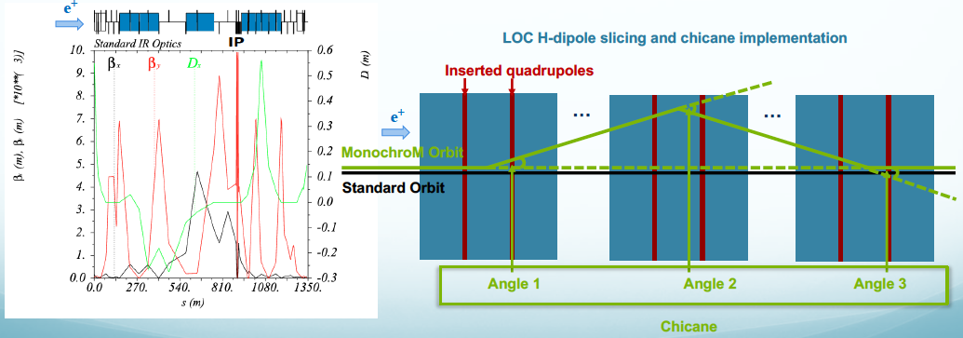
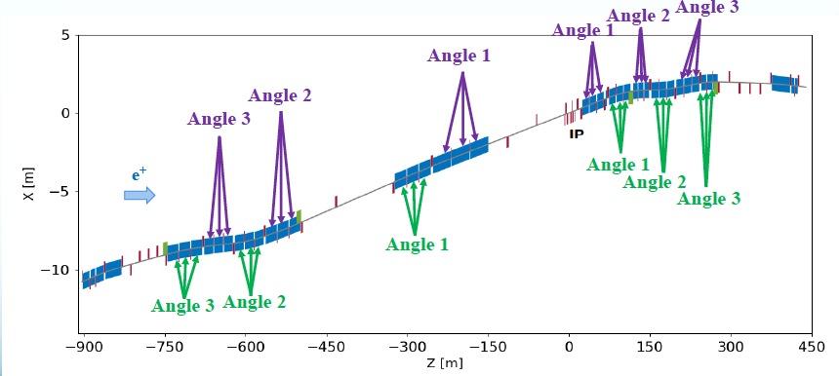
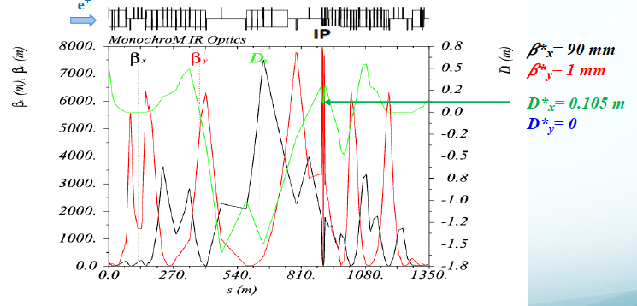
H-Monochrom Implementation in FCC-ee GHC IR (I)
Step 1: All LCCS H-dipoles (blue) are cut into three pieces and quadrupoles (red) are inserted between them for matching flexibility. Additional chicanes are implemented in each upstream and downstream LCCS H-dipole to create the dispersion at the IP while keeping the orbit.
Step 2: To mitigate the horizontal emittance blowup, two long chicanes are implemented to each upstream and downstream. And each angle of chicane is equally distributed to all the three pieces of each LCCS H-dipole.
Step 3: The IP beam parameters are matched to FCC-ee Monochrom self-consistent parameters* while keeping the beam parameters at the entrance and exit of the IR similar to those of standard mode, including phase advances between sextupoles and crab sextupoles.
* A. Faus-Golfe, M. Valdivia Garcia, F. Zimmermann, The challenge of monochromatization Direct s-channel Higgs production: e+e− → H, Eur. Phys. J. Plus (2022) 137:31, https://doi.org/10.1140/epjp/s13360-021-02151-y
Notes:
For the horizontal case a procedure in 5 steps have been optimized:
Adding flexibility by more freedom in the dipoles and quadrupoles, and additional chicanes at each upstream and downstream of the IP dispersive region.
smothering process to avoid the emiitance blow-up
Matching the LCCS sextupoles and exit and entrance of the IR to the standard values.

Slide 13
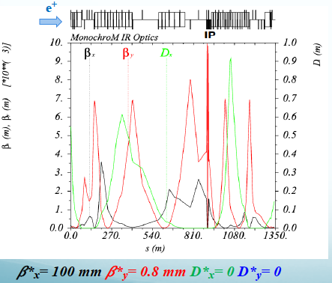
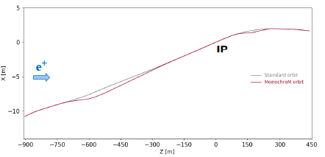
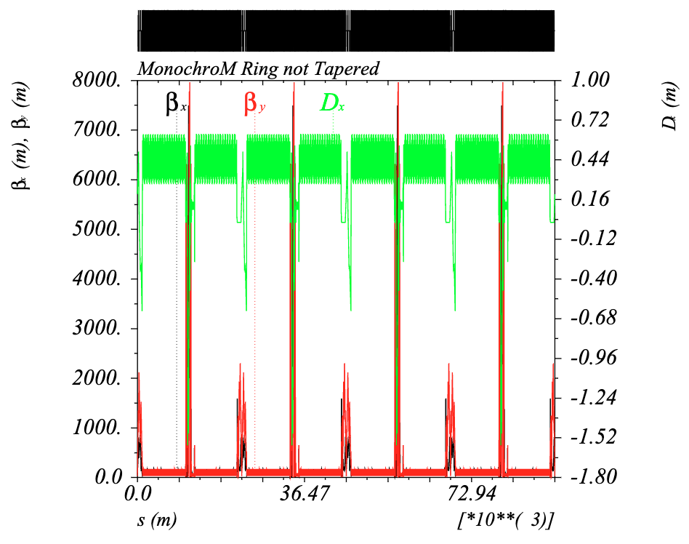
H-Monochrom Implementation in FCC-ee GHC IR (II)
Step 4: Compatibility orbit checking for the standard mode with D_{x} = 0.
e⁺
Step 5: IR Monochrom is implemented in the four IPs and global matching:
    LCCS chromaticity correction
    Global arc chromaticity correction
    Tune correction
    Emittance checks and SR-RF strategy compensation
    Preliminary Tracking and DA calculations
WEPR21
Notes:
4) Compatibility with the orbit of a standard case without dispersion of the IP
5) Integration in the main ring in the 4 IPs, LCCS chromaticity correction, arc correction, tune, emittance checking and RF strategy (saw tooth effect) and tracking and DA calculations
All the details in the poster tomorrow afternoon.

Slide 14
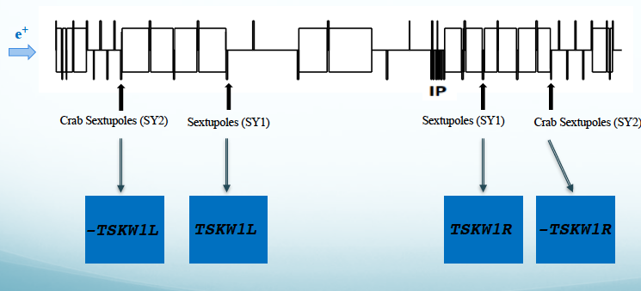
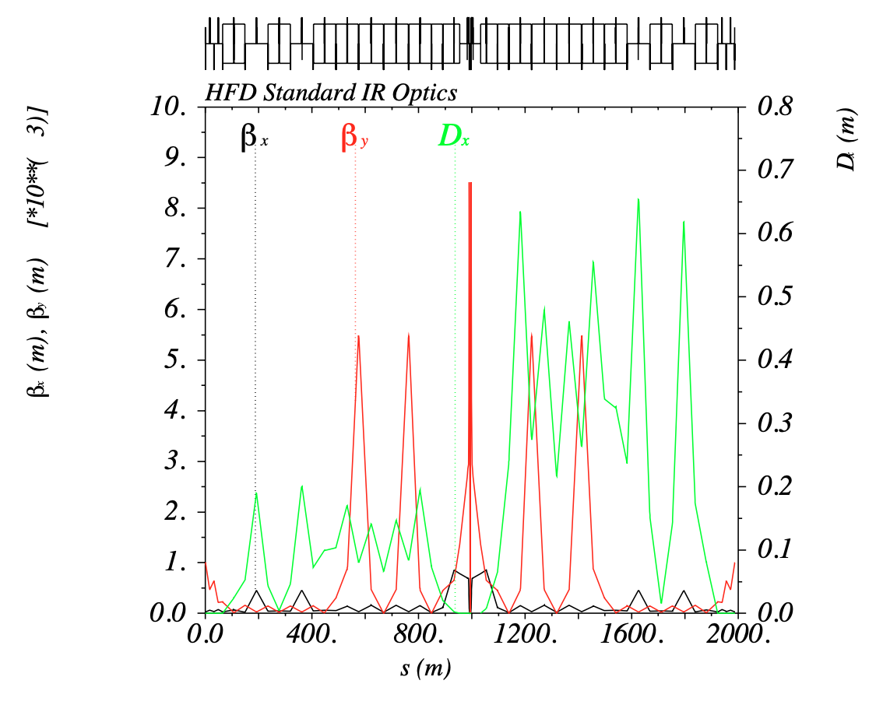
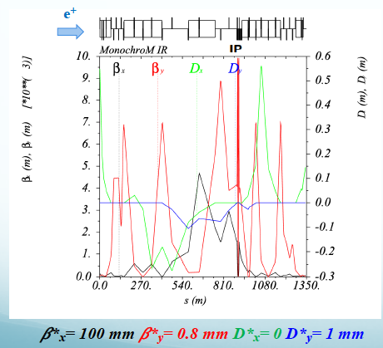
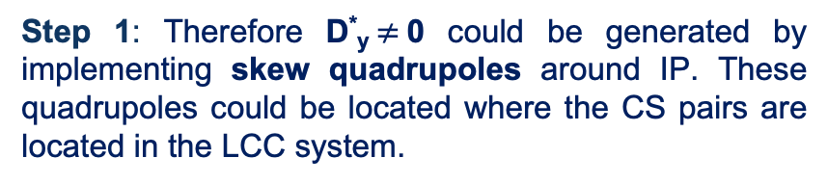
V-Monochrom Implementation in FCC-ee GHC IR
Step 1: Therefore D*_{y}$≠$0 could be generated by implementing skew quadrupoles around IP. These quadrupoles could be located where the CS pairs are located in the LCC system.
Inspired in Local Chromaticity Correction (LCC) IR optics solenoid compensation scheme
Step 2: IR Monochrom is implemented in the four IPs and global matching:
    LCCS chromaticity correction
    Global arc chromaticity correction
    Tune correction
    Emittance checks and SR-RF strategy compensation
    Preliminary Tracking and DA calculations
WEPR21
Notes:
In the case of the of vertical dispersion, the procedure is easier given the fact we only need mm. Taking inspiration in the way the solenoidal impact is compensated in the Local chromaticity correction type of lattice, we have added skew quadrupoles in the Global Hybrid Correction Lattice “a la LCC” and created the necessary vertical dispersion.
Note that we don’t have orbit change in this case!!!
The second step is equivalent to the fifth step of the other case.

Slide 15
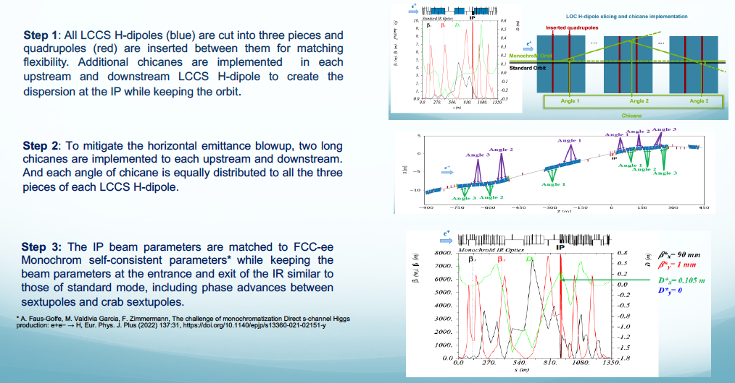
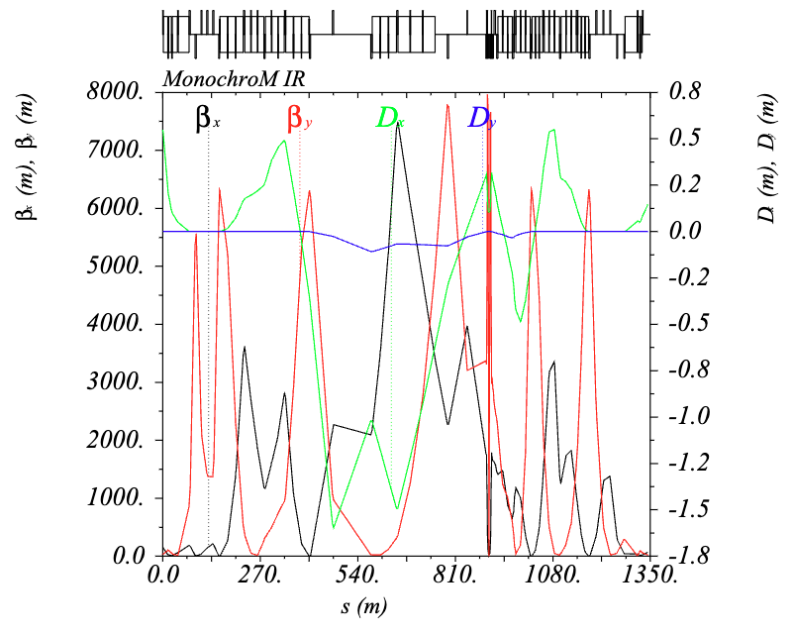
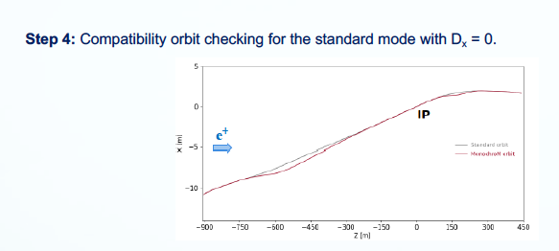
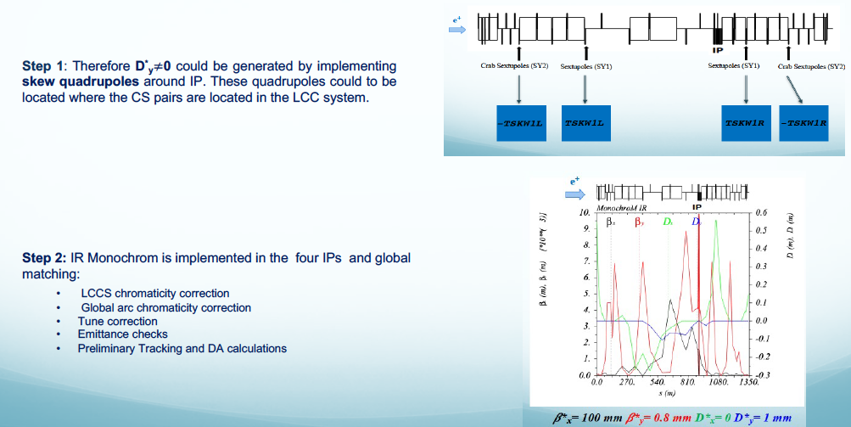
HV-Monochrom Implementation in FCC-ee GHC IR
e⁺
𝛽*_{x}= 90 mm
𝛽*_{y}= 1 mm
D*_{x}
D*_{x}= 0.105 m
D*_{y}= 0.001 m
D*_{y}
WEPR21
Notes:
We have also combined the two methods by matchind a complete lattice with horizontal and vertical dispersion.

Slide 16
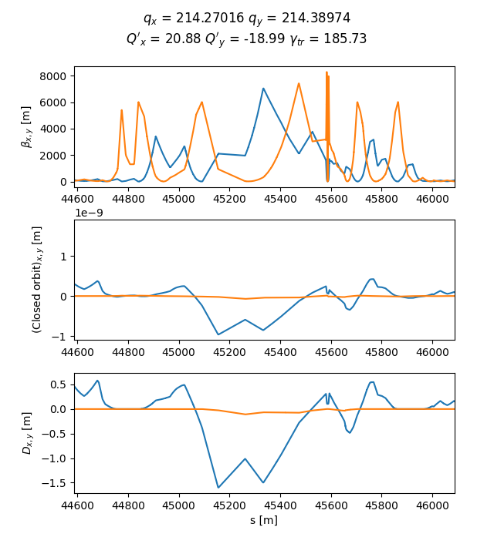
FCC-ee GHC Monochrom Lattices
7 kinds of FCC-ee GHC V22 Monochrom optics design based on Z mode and 7 lattices based on ttbar mode has been completed with different possible combination of H, V, H/V dispersions and number of IPs.
FCC-ee GHC | Orbit changed or not | Dx* | Dy*
standard_625 | No | 0 | 0
monochrom_h_4ip | Yes | 0.105 m | 0
monochrom_h_2ip | Yes | 0.105 m | 0
monochrom_h_d0 | Yes | 0 | 0
monochrom_v_1 | No | 0 | 0.001 m
monochrom_v_2 | No | 0 | 0.002 m
monochrom_mix | Yes | 0.105 m | 0.001 m
MADX - Methodical Accelerator Design. http://madx.web.cern.ch/madx/
Xsuite. https://xsuite.readthedocs.io/
Xsuite Monochrom mixed based on Z mode lattice.
Notes:
In summary 7 lattices taking for the Z mode based and 7 lattices for the ttbar mode has been completed and bench marked with MADx Ans Xsuite codes.

Slide 17
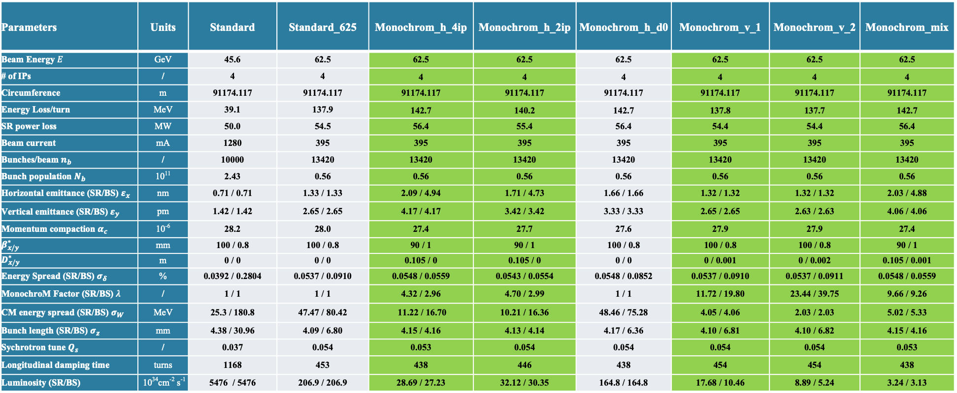
FCC-ee GHC Monochrom Performance (I)
FCC-ee GHC Monochrom Optics Performance based on Z mode lattice (w/o BS effect)
Parameters | Units | Standard | Standard_625 | Monochrom_h_4ip | Monochrom_h_2ip | Monochrom_h_d0 | Monochrom_v_1 | Monochrom_v_2 | Monochrom_mix
Beam Energy $E$ | GeV | 45.6 | 62.5 | 62.5 | 62.5 | 62.5 | 62.5 | 62.5 | 62.5
# of IPs | / | 4 | 4 | 4 | 4 | 4 | 4 | 4 | 4
Circumference | m | 91174.117 | 91174.117 | 91174.117 | 91174.117 | 91174.117 | 91174.117 | 91174.117 | 91174.117
Energy Loss/turn | MeV | 39.1 | 137.9 | 142.7 | 140.2 | 142.7 | 137.8 | 137.7 | 142.7
SR power loss | MW | 50.0 | 54.5 | 56.4 | 55.4 | 56.4 | 54.4 | 54.4 | 56.4
Beam current | mA | 1280 | 395 | 395 | 395 | 395 | 395 | 395 | 395
Bunches/beam $n_{b}$ | / | 10000 | 13420 | 13420 | 13420 | 13420 | 13420 | 13420 | 13420
Bunch population $N_{b}$ | 10¹¹ | 2.43 | 0.56 | 0.56 | 0.56 | 0.56 | 0.56 | 0.56 | 0.56
Horizontal emittance (SR/BS) $ε_{x}$ | nm | 0.71 / 0.71 | 1.33 / 1.33 | 2.09 / 4.94 | 1.71 / 4.73 | 1.66 / 1.66 | 1.32 / 1.32 | 1.32 / 1.32 | 2.03 / 4.88
Vertical emittance (SR/BS) $ε_{y}$ | pm | 1.42 / 1.42 | 2.65 / 2.65 | 4.17 / 4.17 | 3.42 / 3.42 | 3.33 / 3.33 | 2.65 / 2.65 | 2.63 / 2.63 | 4.06 / 4.06
Momentum compaction $α_{c}$ | 10⁻⁶ | 28.2 | 28.0 | 27.4 | 27.7 | 27.6 | 27.9 | 27.9 | 27.4
$$β_{x/y}^{∗}$$ | mm | 100 / 0.8 | 100 / 0.8 | 90 / 1 | 90 / 1 | 100 / 0.8 | 100 / 0.8 | 100 / 0.8 | 90 / 1
$$D_{x/y}^{∗}$$ | m | 0 / 0 | 0 / 0 | 0.105 / 0 | 0.105 / 0 | 0 / 0 | 0 / 0.001 | 0 / 0.002 | 0.105 / 0.001
Energy Spread (SR/BS) $σ_{δ}$ | % | 0.0392 / 0.2804 | 0.0537 / 0.0910 | 0.0548 / 0.0559 | 0.0543 / 0.0554 | 0.0548 / 0.0852 | 0.0537 / 0.0910 | 0.0537 / 0.0911 | 0.0548 / 0.0559
MonochroM Factor (SR/BS) $λ$ | / | 1 / 1 | 1 / 1 | 4.32 / 2.96 | 4.70 / 2.99 | 1 / 1 | 11.72 / 19.80 | 23.44 / 39.75 | 9.66 / 9.26
CM energy spread (SR/BS) $σ_{W }$ | MeV | 25.3 / 180.8 | 47.47 / 80.42 | 11.22 / 16.70 | 10.21 / 16.36 | 48.46 / 75.28 | 4.05 / 4.06 | 2.03 / 2.03 | 5.02 / 5.33
Bunch length (SR/BS) $σ_{z }$ | mm | 4.38 / 30.96 | 4.09 / 6.80 | 4.15 / 4.16 | 4.13 / 4.14 | 4.17 / 6.36 | 4.10 / 6.81 | 4.10 / 6.82 | 4.15 / 4.16
Sychrotron tune $Q_{s}$ | / | 0.037 | 0.054 | 0.053 | 0.054 | 0.054 | 0.054 | 0.054 | 0.053
Longitudinal damping time | turns | 1168 | 453 | 438 | 446 | 438 | 454 | 454 | 438
Luminosity (SR/BS) | 10³⁴cm⁻² s⁻¹ | 5476 / 5476 | 206.9 / 206.9 | 28.69 / 27.23 | 32.12 / 30.35 | 164.8 / 164.8 | 17.68 / 10.46 | 8.89 / 5.24 | 3.24 / 3.13
Notes:
A performance calculation has been completed for all the cases with and without BS.
In the 2 first columns we found for comparison the 45.6 case in the first one and the scaling in energy not optimized in the second. The green are the monochrom and the grey the standard.
In the red boxes the CM energy spread and the monochrome factor achieved.

Slide 18
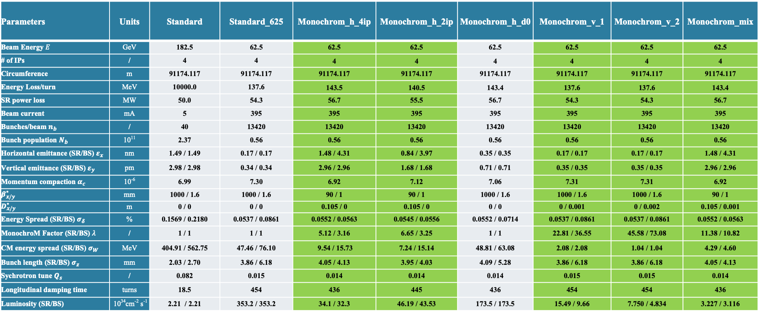
FCC-ee GHC Monochrom Performance (II)
FCC-ee GHC Monochrom Optics Performance based on ttbar mode lattice (w/o BS effect)
Parameters | Units | Standard | Standard_625 | Monochrom_h_4ip | Monochrom_h_2ip | Monochrom_h_d0 | Monochrom_v_1 | Monochrom_v_2 | Monochrom_mix
Beam Energy $E$ | GeV | 182.5 | 62.5 | 62.5 | 62.5 | 62.5 | 62.5 | 62.5 | 62.5
# of IPs | / | 4 | 4 | 4 | 4 | 4 | 4 | 4 | 4
Circumference | m | 91174.117 | 91174.117 | 91174.117 | 91174.117 | 91174.117 | 91174.117 | 91174.117 | 91174.117
Energy Loss/turn | MeV | 10000.0 | 137.6 | 143.5 | 140.5 | 143.4 | 137.6 | 137.6 | 143.4
SR power loss | MW | 50.0 | 54.3 | 56.7 | 55.5 | 56.7 | 54.3 | 54.3 | 56.7
Beam current | mA | 5 | 395 | 395 | 395 | 395 | 395 | 395 | 395
Bunches/beam $n_{b}$ | / | 40 | 13420 | 13420 | 13420 | 13420 | 13420 | 13420 | 13420
Bunch population $N_{b}$ | 10¹¹ | 2.37 | 0.56 | 0.56 | 0.56 | 0.56 | 0.56 | 0.56 | 0.56
Horizontal emittance (SR/BS) $ε_{x}$ | nm | 1.49 / 1.49 | 0.17 / 0.17 | 1.48 / 4.31 | 0.84 / 3.97 | 0.35 / 0.35 | 0.17 / 0.17 | 0.17 / 0.17 | 1.48 / 4.31
Vertical emittance (SR/BS) $ε_{y}$ | pm | 2.98 / 2.98 | 0.34 / 0.34 | 2.96 / 2.96 | 1.68 / 1.68 | 0.71 / 0.71 | 0.35 / 0.35 | 0.35 / 0.35 | 2.96 / 2.96
Momentum compaction $α_{c}$ | 10⁻⁶ | 6.99 | 7.30 | 6.92 | 7.12 | 7.06 | 7.31 | 7.31 | 6.92
$$β_{x/y}^{∗}$$ | mm | 1000 / 1.6 | 1000 / 1.6 | 90 / 1 | 90 / 1 | 1000 / 1.6 | 1000 / 1.6 | 1000 / 1.6 | 90 / 1
$$D_{x/y}^{∗}$$ | m | 0 / 0 | 0 / 0 | 0.105 / 0 | 0.105 / 0 | 0 / 0 | 0 / 0.001 | 0 / 0.002 | 0.105 / 0.001
Energy Spread (SR/BS) $σ_{δ}$ | % | 0.1569 / 0.2180 | 0.0537 / 0.0861 | 0.0552 / 0.0563 | 0.0545 / 0.0556 | 0.0552 / 0.0714 | 0.0537 / 0.0861 | 0.0537 / 0.0861 | 0.0552 / 0.0563
MonochroM Factor (SR/BS) $λ$ | / | 1 / 1 | 1 / 1 | 5.12 / 3.16 | 6.65 / 3.25 | 1 / 1 | 22.81 / 36.55 | 45.58 / 73.08 | 11.38 / 10.82
CM energy spread (SR/BS) $σ_{W }$ | MeV | 404.91 / 562.75 | 47.46 / 76.10 | 9.54 / 15.73 | 7.24 / 15.14 | 48.81 / 63.08 | 2.08 / 2.08 | 1.04 / 1.04 | 4.29 / 4.60
Bunch length (SR/BS) $σ_{z }$ | mm | 2.03 / 2.70 | 3.86 / 6.18 | 4.05 / 4.13 | 3.95 / 4.03 | 4.09 / 5.28 | 3.86 / 6.18 | 3.86 / 6.18 | 4.05 / 4.13
Sychrotron tune $Q_{s}$ | / | 0.082 | 0.015 | 0.014 | 0.014 | 0.014 | 0.015 | 0.015 | 0.014
Longitudinal damping time | turns | 18.5 | 454 | 436 | 445 | 436 | 454 | 454 | 436
Luminosity (SR/BS) | 10³⁴cm⁻² s⁻¹ | 2.21 / 2.21 | 353.2 / 353.2 | 34.1 / 32.3 | 46.19 / 43.53 | 173.5 / 173.5 | 15.49 / 9.66 | 7.750 / 4.834 | 3.227 / 3.116
Lower CM energy spread compared to Z mode
Notes:
Similar for the ttbar lattice, main difference is the vertical emittance in the arcs!!!
We obtain in this case lower CM energy spread!!!

Slide 19
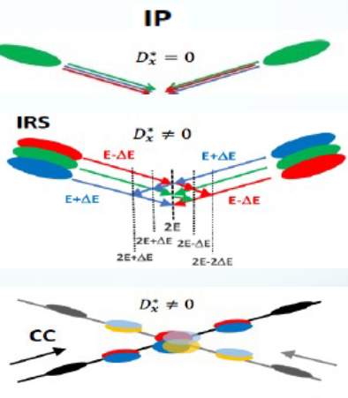
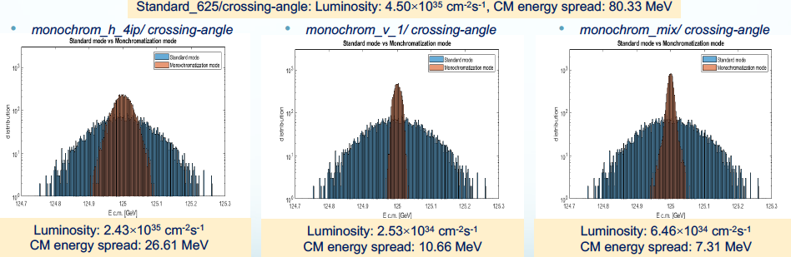
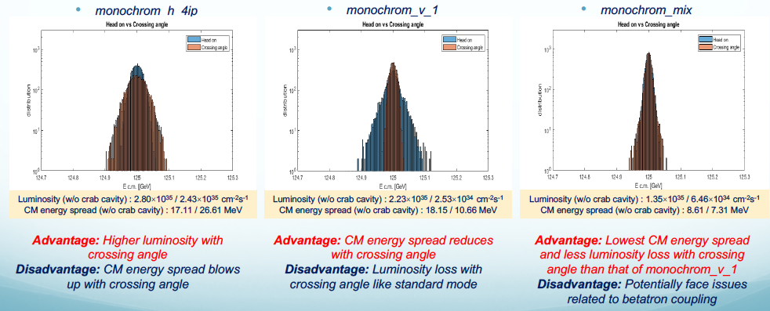
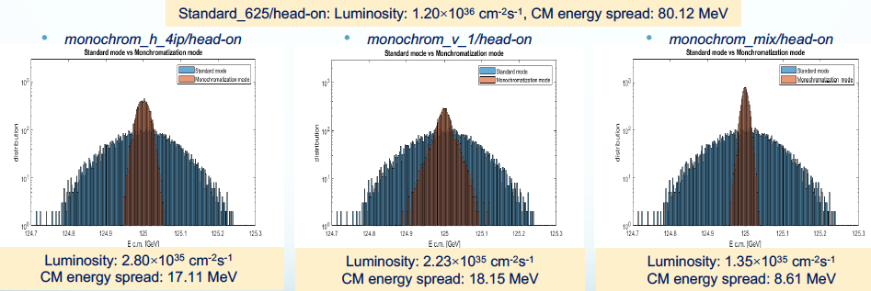
FCC-ee GHC Monochrom Luminosity and CM Energy Spread (I)
Luminosity and CM Energy Spread (with BS) calculated with Guinea-pig for FCC-ee GHC monochom based on Z mode lattice for: monochrom crab cavities (CC) and monochrom (crossing or Integrated Resonances Scan IRS) compared to standard (crossing)
Monochrom CC vs Standard
Monochrom CC vs IRS
Monochrom IRS vs Standard
Notes:
The Luminosity and the CM energy spread has also been calculated with Guinea Pig in the Z mode based lattice
In that case we have also calculated with and without Crab cavities, this means head-on or with crossing angle., as illustrated in the top right figure.
The plots show the comparison between the monochrom in red and the standard in blue in the left. The right bottom shows the comparison between the two monochrome modes w/wo crab cavities.

Slide 20
FCC-ee GHC Monochrom Luminosity and CM Energy Spread (II)
FCC-ee GHC Monochrom Optics based on Z mode lattice
WEPR21
Parameters | Units | Standard | Standard_625 | Monochrom_h_4ip | Monochrom_h_2ip | Monochrom_h_d0 | Monochrom_v_1 | Monochrom_v_2 | Monochrom_mix
Luminosity (w/o crab cavity) | 10³⁴cm⁻² s⁻¹ | 449 / 99.3 | 120 / 45.0 | 28.0 / 24.3 | 31.2 / 27.8 | 99.8 / 42.7 | 22.3 / 2.53 | 9.92 / 1.28 | 13.5 / 6.46
CM energy spread (w/o crab cavity) | MeV | 180.38 / 182.85 | 80.12 / 80.33 | 17.11 / 26.61 | 16.31 / 26.18 | 76.65 / 75.52 | 18.15 / 10.66 | 9.12 / 9.66 | 8.61 / 7.31
FCC-ee GHC Monochrom Optics based on ttbar mode lattice
Parameters | Units | Standard | Standard_625 | Monochrom_h_4ip | Monochrom_h_2ip | Monochrom_h_d0 | Monochrom_v_1 | Monochrom_v_2 | Monochrom_mix
Luminosity (w/o crab cavity) | 10³⁴cm⁻² s⁻¹ | 1.83 / 1.52 | 399 / 122 | 33.7 / 29.4 | 45.3 / 40.6 | 210 / 91.2 | 21.2 / 2.98 | 9.08 / 1.45 | 14.8 / 6.43
CM energy spread (w/o crab cavity) | MeV | 547.02 / 542.7 | 75.94 / 76.65 | 15.86 / 25.88 | 15.32 / 25.10 | 63.43 / 64.39 | 9.10 / 4.94 | 5.94 / 4.51 | 7.64 / 6.36
Monochrom optics based on ttbar mode lattice has lower CM energy spread than the one based on Z mode lattice
Notes:
Tables summarize all the values. Confirming that the ttbar lattice achieve better performances.

Slide 21
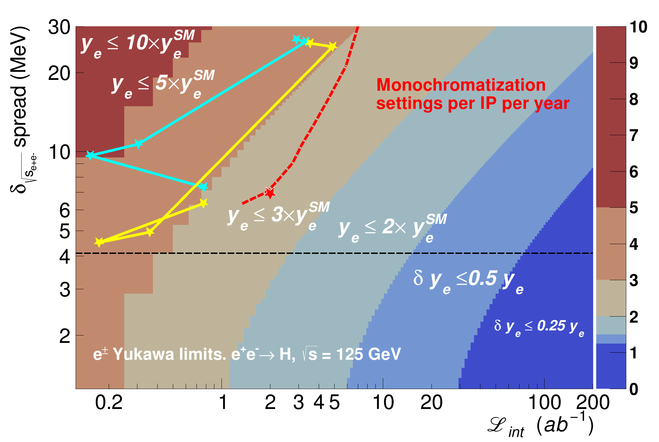
FCC-ee Monochrom Physics Performance
Associated upper limits contours (95% CL) on the electron Yukawa (y_{e})
D. d'Enterria, A. Poldaru, G. Wojcik, Measuring the electron Yukawa coupling via resonant s-channel Higgs production at FCC-ee, arXiv:2107.02686v1 [hep-ex] 6 Jul 2021
FCC-ee monochrom parametric studies (red line*), Z mode lattice based monochrom perfomance (light blue), ttbar mode lattice based monochrom performance (yellow).
h_4ip
h_4ip
h_2ip
h_2ip
v_1
v_2
mix
The best performance is obtained with the ttbar lattice based “mix” mode, which reaches an upper limit of y_{e}< 2.9*y_{e}(SM) in the Higgs-electron coupling.
mix
FCC-ee self consistent parameters
v_2
v_1
Re-optimization of the beam parameters should give better performances.
* A. Faus-Golfe, M. Valdivia Garcia, F. Zimmermann, The challenge of monochromatization Direct s-channel Higgs production: e+e− → H, Eur. Phys. J. Plus (2022) 137:31, https://doi.org/10.1140/epjp/s13360-021-02151-y
Notes:
With these new parameters we have re-calculated the associated upper limits contours of the electron Yukawa coupling.
Obtaining the light blue curve for the Z mode and the yellow for the ttbar mde.
Best performance is for the mixed ttbar mode.
Re-optimization with this more realistic parameters is in progress to obtain better performances.

Slide 22
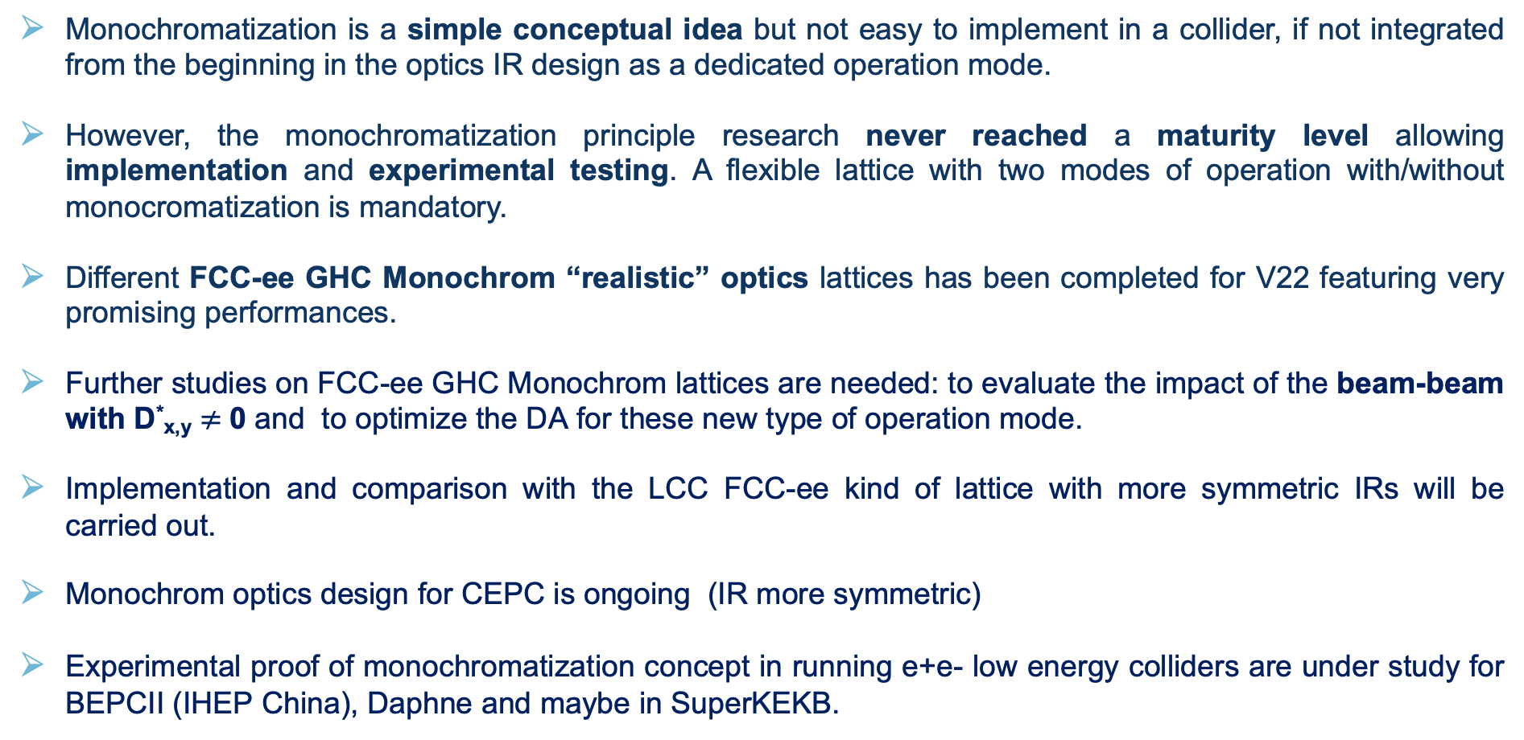
Summary and Perspectives
Monochromatization is a simple conceptual idea but not easy to implement in a collider, if not integrated from the beginning in the optics IR design as a dedicated operation mode.
However, the monochromatization principle research never reached a maturity level allowing implementation and experimental testing. A flexible lattice with two modes of operation with/without monocromatization is mandatory.
Different FCC-ee GHC Monochrom “realistic” optics lattices has been completed for V22 featuring very promising performances.
Further studies on FCC-ee GHC Monochrom lattices are needed: to evaluate the impact of the beam-beam with D*_{x,y} $≠$0 and to optimize the DA for these new type of operation mode.
Implementation and comparison with the LCC FCC-ee kind of lattice with more symmetric IRs will be carried out.
Monochrom optics design for CEPC is ongoing (IR more symmetric)
Experimental proof of monochromatization concept in running e+e- low energy colliders are under study for BEPCII (IHEP China), Daphne and maybe in SuperKEKB.

Slide 23


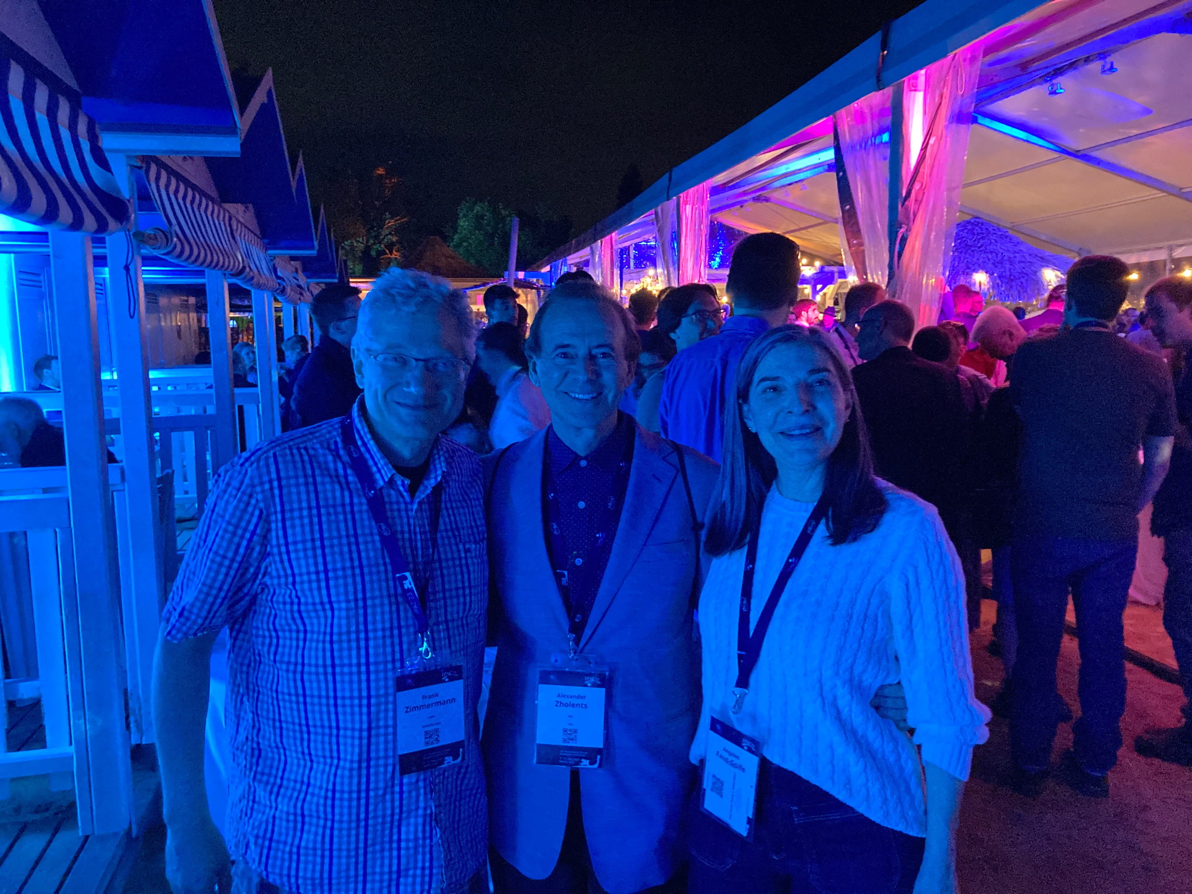
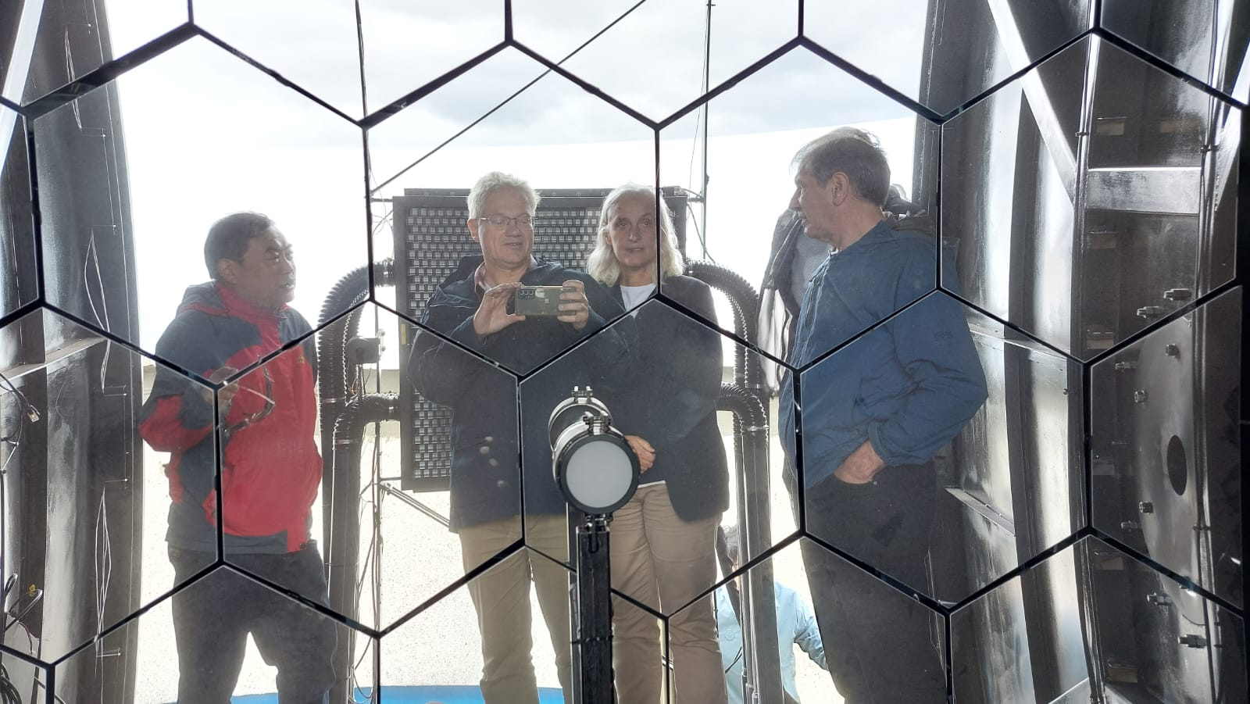


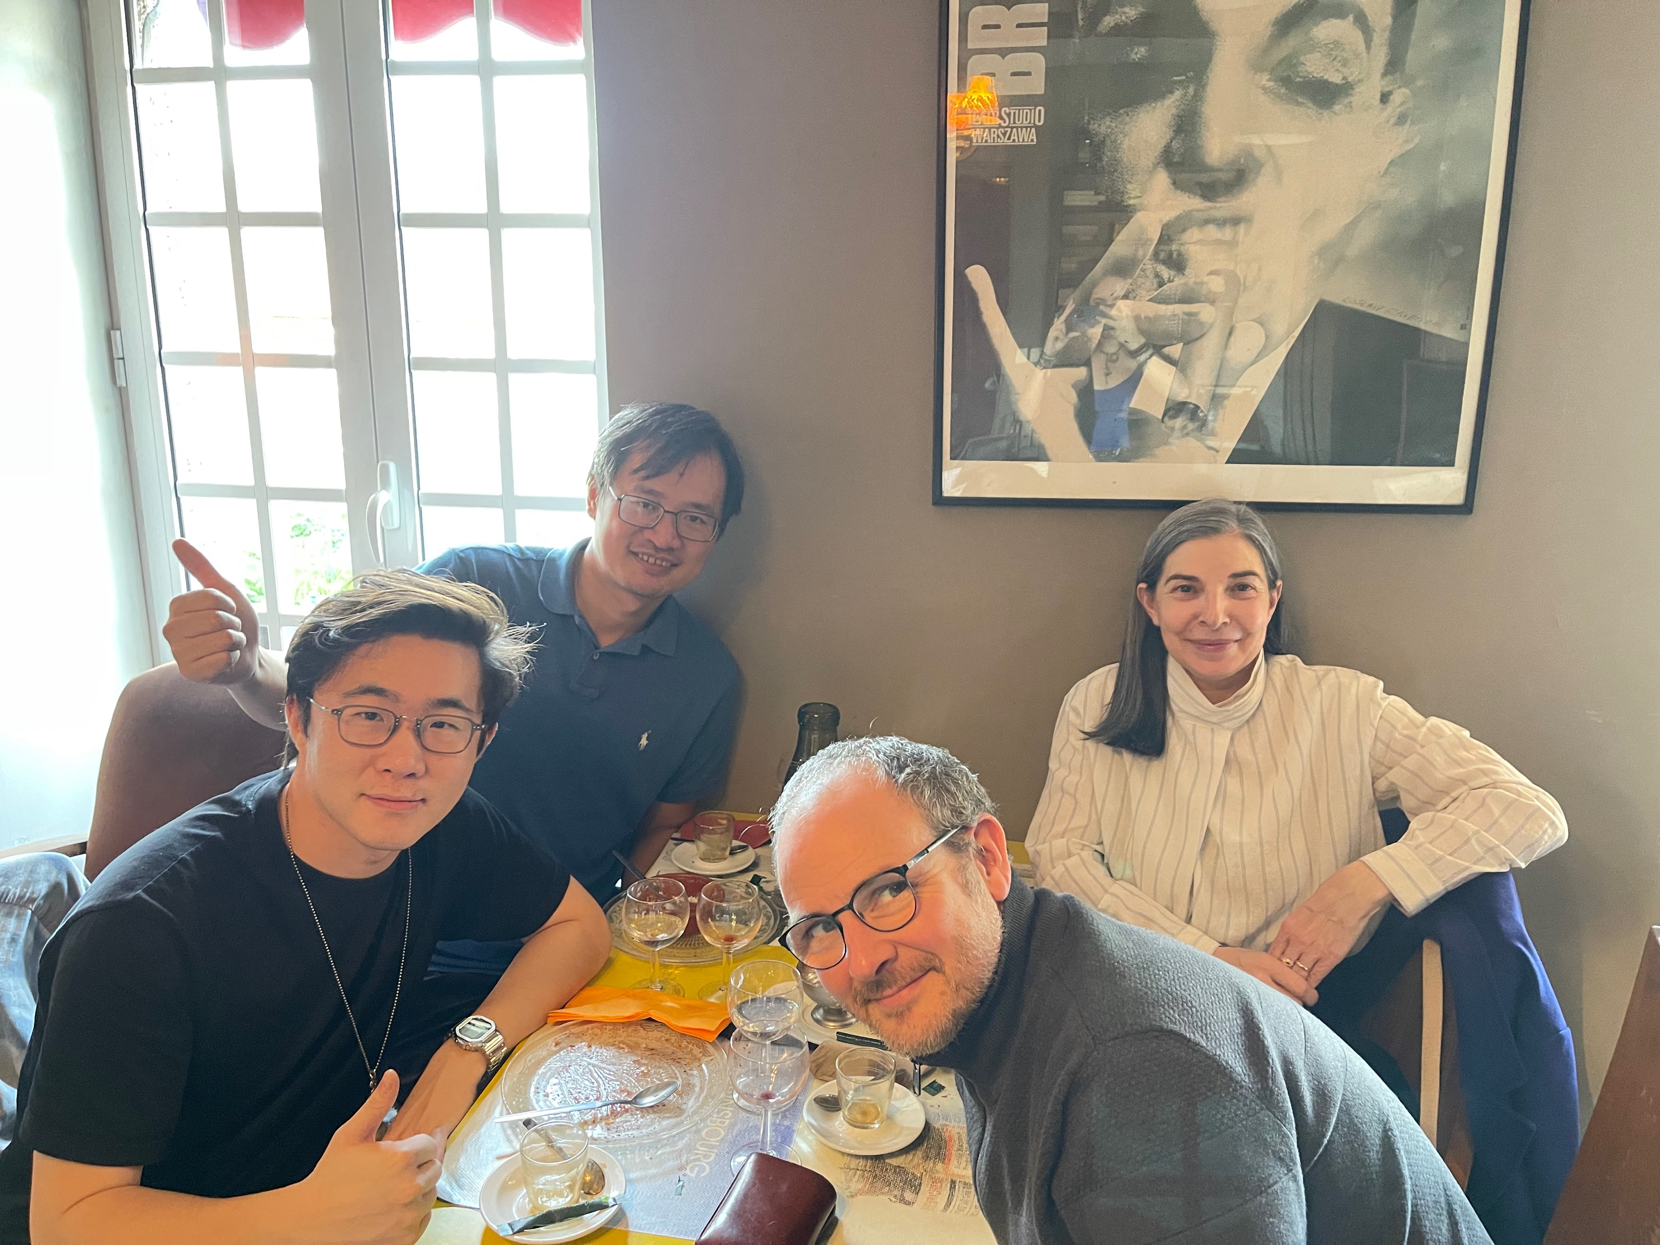


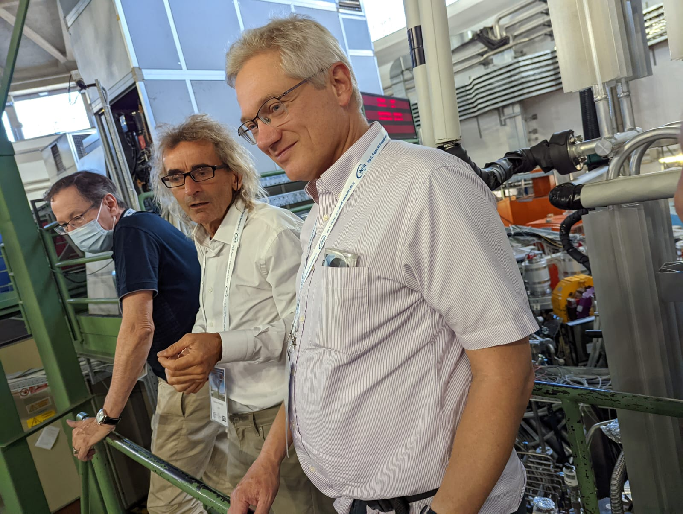
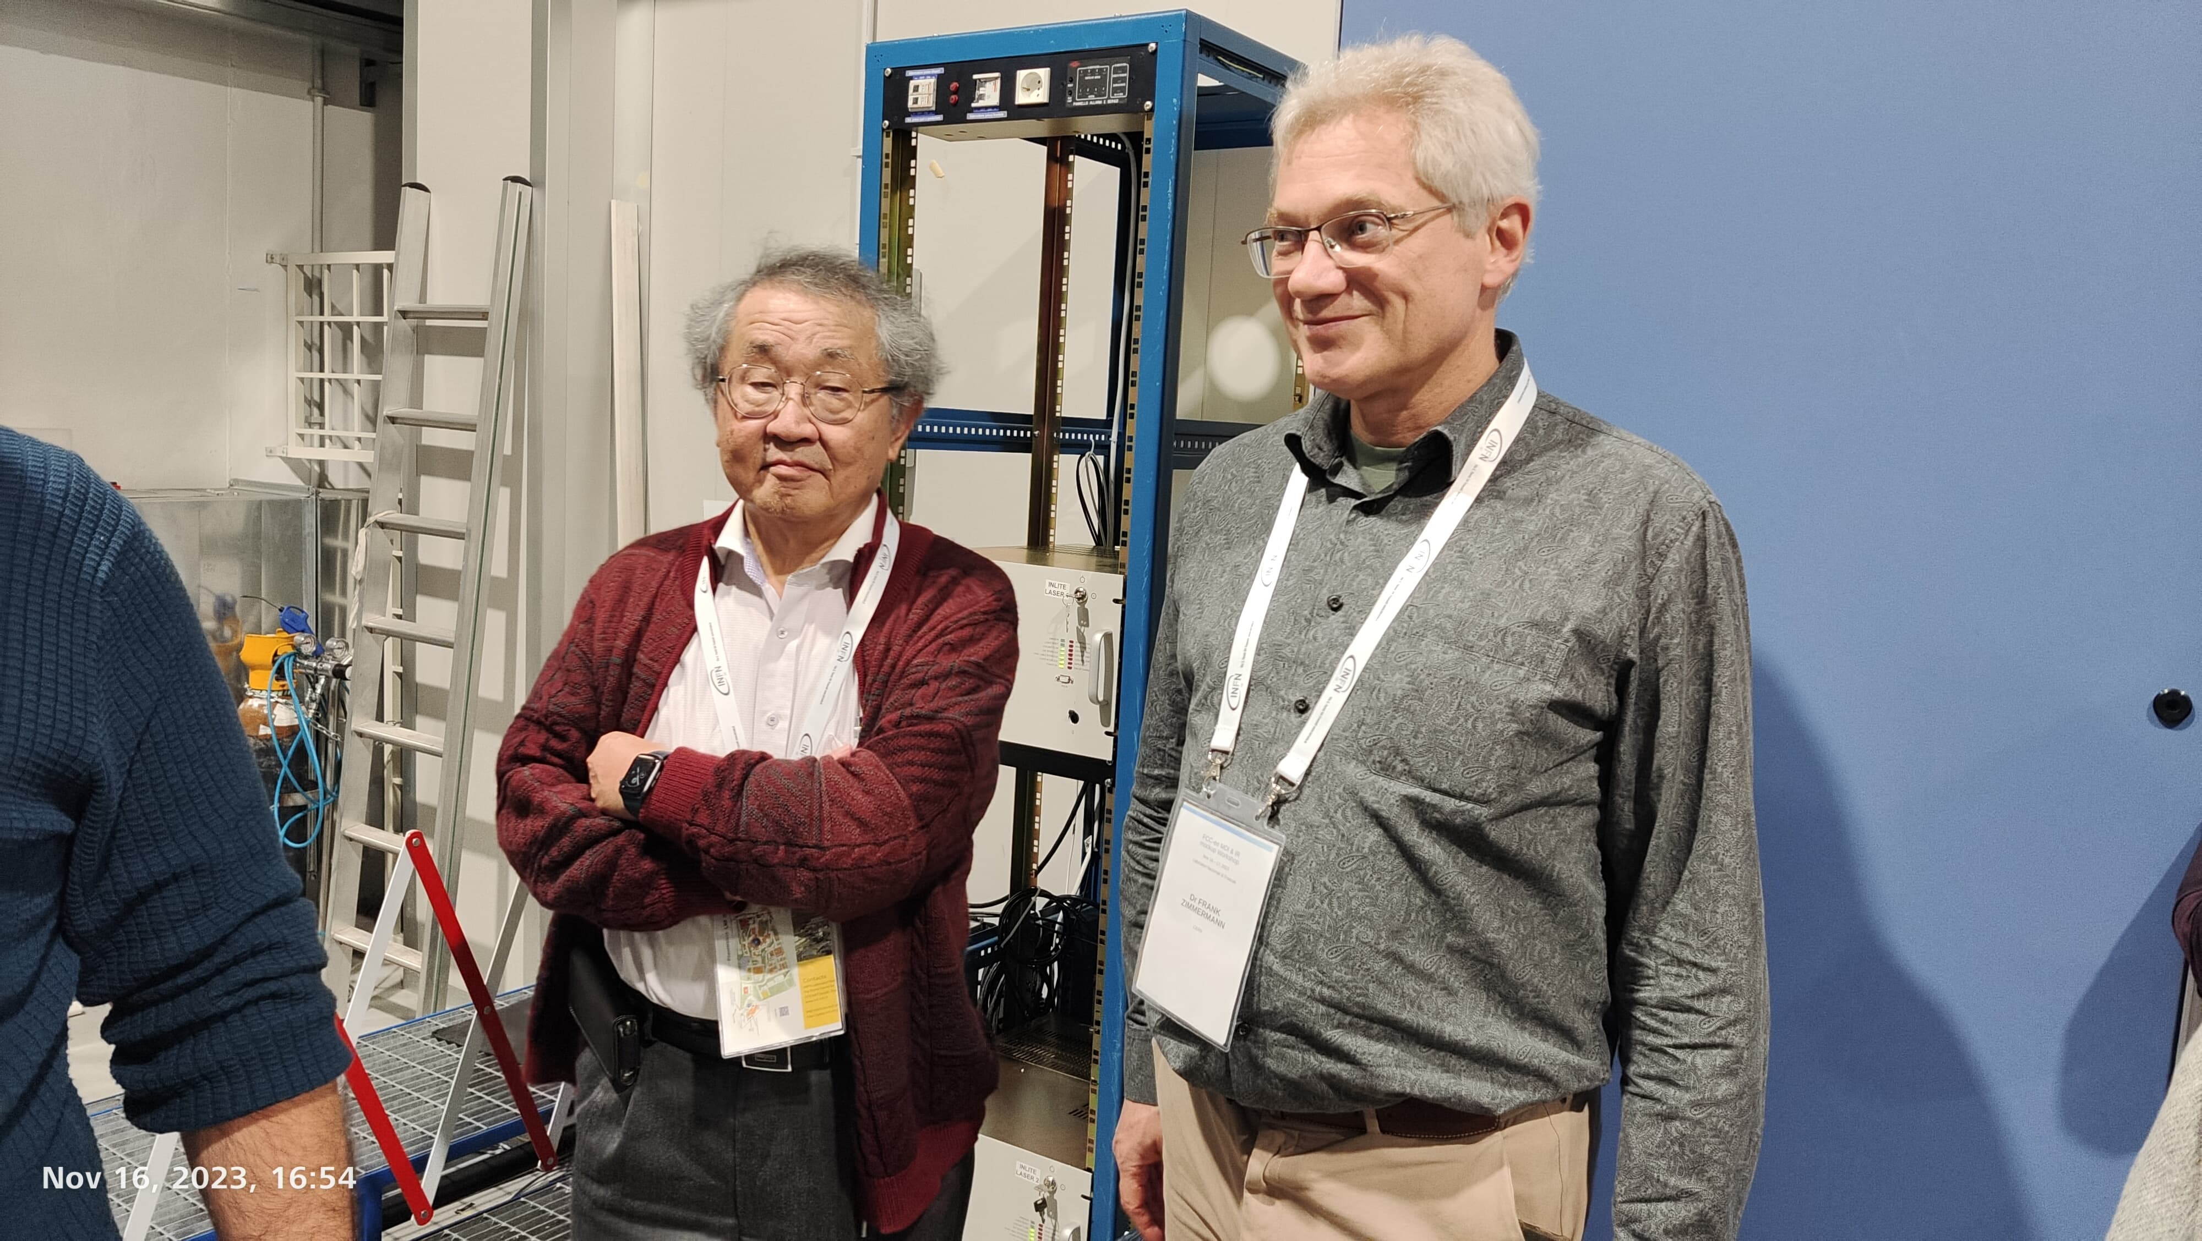




THE BRAVE COLLABORATORS
MonochroM team
A. Faus-Golfe, Z. Zhang, B. Bai, H. Jiang, M. A. Valdivia García, J. Jowett,
F. Zimmermann, K. Oide, A. Blondel, P. Raimondi, D. Shatilov, D. d’Enterria, P. Janot, U. Bassler
A. Zholents, J. Keintzel, G. Wilkinson, C. Milardi, A. Ciarma
Notes:
This work is the result of multiple discussions with the brave monochrome collaborators during these last 3 years.

Slide 24
ipac24_logo.png
Back-up slides

Slide 25


Monochromatization principle
Standard
  Monochromatization
D*_{x,y}=0
D*_{x+} = - D*_{x-}= D*_{x}
D*_{y+} = - D*_{y-}= D*_{y}
IP
IP
e⁻
correlation between transverse spatial position and energy deviation
e⁺
e⁺
e⁻
Opposite correlations between transverse spatial position and energy deviation
$$w=2(E_{b}+∆E)$$
CM energy
$$w=2E_{b}+O{(∆E)}^{2}$$
Relative energy spread
Spread of the CM energies
$$λ=1$$
Monochromatization factor
Number of bunches
Revolution frequency
Particles per bunch
Luminosity
betatronic beam sizes at the IP
  σ*_{x,y}$=$ $\sqrt{ {β_{x,y}^{∗}ε_{x,y}+\left(D_{x,y}^{∗}σ_{δ}\right)}^{2}}$
  Enhancement of energy resolution, and sometimes increase of the relative frequency of the events at the center of of the distribution but luminosity loss !!!!
dispersive beam size at the IP
Notes:
To achieve this monochromatization, opposite correlations between the transverse spatial position and the energy deviation are induced in the colliding beams as sketched in right Figure. In beam-optics terms, this requires generating a dispersion function of opposite signs for the two beams, at the Interaction Point (IP). Nonzero dispersion function at the IP will contribute to enlarge the IP transverse beam size (σ*_{x} or σ*_{y}) and could also have an impact in the luminosity (L$∝$ 1/ (σ_{x} σ_{y})). Consequently the design of a monochromatization scheme has to consider not only the IR beam optics design, but the optimization of the rest of collider parameters to keep luminosity as high as possible.
Opposite dispersions at the IP enhance energy resolution without detriment of the differential luminosity while dispersion which have the same sign degrade both differential and total luminosity

Slide 26
Monochromatization in high-energy colliders
In the previous case for low-energy e⁺e⁻ colliders, the relative energy spread is mainly given by SR in the colliders arcs (σ_{δ}=σ_{δ,SR}). Alternatively in high-energy e⁺e⁻, we have to take into account also the SR created by the strong opposing EM field during collision or “beamstrahlung”(BS) (Nγ ∝ 1/ σ_{z} (σ*_{x}+ σ*_{y}), with σ_{z} the bunch length).
Standard BS
D*_{x,y}=0
  Monochromatization BS
D*_{x+} = - D*_{x-}= D*_{x}
D*_{y+} = - D*_{y-}= D*_{y}
$$σ_{δ,tot}=\sqrt{\frac{1}{2}σ_{δ, SR}^{2}+\sqrt{\frac{1}{4}σ_{δ, SR}^{4}+A\frac{σ_{δ, SR}^{2}}{σ_{z, SR}^{2}}}}$$
Energy spread w/o BS
Energy spread
Coupled system to be solved numerically
$$σ_{δ, tot}^{2}=σ_{δ, SR}^{2}+\frac{B}{{D_{x}^{∗}}^{3}σ_{δ, tot}^{5}}$$
Bunch length w/o BS
$$A=\frac{275}{36 π^{\frac{3}{2}}}\frac{n_{IP}τ_{E}}{4T_{rev}}\frac{{r_{e}}^{5}{N_{b}}^{3}γ^{2}}{α{σ_{x,SR}^{∗}}^{3}}$$
$$B≈50\frac{n_{IP}τ_{E}}{T_{rev}}\frac{r_{e}^{5}N_{b}^{3}γ^{2}}{{\left({α_{c}C}/{\left(2πQ_{s}\right)}\right)}^{2}}$$
Beam size w/o BS
Revolution time
$$ε_{x, tot}≈ε_{x, SR}$$
$$ε_{x, tot}≈ε_{x, SR}+\frac{2B}{D_{x}^{∗}β_{x}^{∗}σ_{δ, tot}^{5}}$$
Horizontal emittance without BS
Horizontal emittance
Momentum compaction factor
$$σ_{z.tot}=\frac{α_{c}C}{2πQ_{s}}σ_{δ,tot}$$
$$σ_{z.tot}=\frac{α_{c}C}{2πQ_{s}}σ_{δ,tot}$$
Circumference
Bunch length
Synchrotron tune
BS at high-energy with D_{x}*=0, has more impact on energy spread in standard mode than in monochromatization mode.
BS with monochromatization at high-energy, avoids the blow up of the relative beam energy spread, which is significant in standard mode with D_{x}*=0.
M. A. Valdivia García, F. Zimmermann, Towards an optimized monochromatization for direct Higgs production in future circular e+ e- Colliders, in CERN-BINP Workshop for Young Scientists in e+e- Colliders, pp. 1–12 (2017)
Notes:
We have now all the tools on hand to study the monochromatization in FCC-ee

Slide 27

Monochromatization could be obtained by operating with a residual nonzero local vertical chromaticity (RLC). This enables the focal length of the final quadrupoles to change with the momentum deviation of a beam particle, and establishes a dependence between the vertical beam size waist and momentum offset. An effective monochromatization could be obtained, without adding any new hardware. The resulting monochromatization factor will be enhanced for smaller β_{y}*, but limited λ possible.
Waist location for beam 1 with momentum offset δ, can be made to coincide with the waist location for beam 2 with momentum offset -δ, leading to an effective monochromatization, without adding any new hardware.
P. Raimondi, F. Zimmermann, private communication

Slide 28



Monochromatization with dispersion inside the deflecting RF cavities (SCRF-D) on either side of the collision point.
A.A. Zholents, Sophisticated accelerator techniques for colliding beam experiments. Nucl. Instrum. Methods A 265, 179–185 (1988)
Notes:
Proposed by Sasha Zholets for the b-factory.

Slide 29


Monochromatization IR Global Implementation
Local Chromaticity Correction
Load monochromatization ring lattice, and extract sequence from IP to crab sextupoles.
Turned off all the sextupoles including crab sextupoles SY2.
Match the vertical chromaticity from IP to crab sextupoles to 0 using the sextupoles SY1.
Calculate the strength of crab sextupoles (SY2) with the following formula ^{[6]}:
$$K2SY2=K2SY1 ±crab_{factor}・crab_{strength}$$
The crab strength is given by:
$$crab_{strength}=\frac{1}{L_{SY2}∗θ_{CROSS}∗{BY}_{IP}∗BY_{CS}}∗\sqrt{\frac{BX_{IP}}{BX_{CS}}}$$
The crab factor is determined from Beam-beam studies, at Z it's 97%, W 87%, so ~90% for Higgs mode seems a good starting guess.
e⁺
Crab Sextupoles (SY2)
Sextupoles (SY1)
Sextupoles (SY1)
Crab Sextupoles (SY2)
[6] K. Oide, M. Aiba, S. Aumon, M. Benedikt, A. Blondel et al. ”Design of beam optics for the future circular collider e⁺e⁻ collider rings”, Physical Review Accelerators and Beams, 19, 111005 (2016)

Slide 30
Monochromatization IR Global Implementation
Global Chromaticity Correction
With the matched strength of the SY1 and the strength of SY2 calculated by the formula, the global chromaticity correction is done by matching the strength of all the sextupoles in the arc.
There are two kinds of sextupoles in the arc, focus sextupoles and defocus sextupoles. The strength of all the focus sextupoles is multiplied by the coefficient kn_sf, while the strength of all the defocus sextupoles is multiplied by the coefficient kn_sd.
The horizontal chromaticity (DQ1) and vertical chromaticity (DQ2) are matched to 5 with the two coefficient, because positive chromaticity is benefit for the beam stability.
Tune Correction
By varying the strength of quadrupoles around the RF cavities in the arc, the horizontal tune Q1 and vertical tune Q2 are matched to be same with the standard mode while keeping the beam parameters at the IRs.
Emittance Check
Switching on the RF cavities and considering the energy loss due to synchrotron radiation, the longitudinal energy difference (pt) are matched to zero by varying the voltage and the phase of the RF cavities in tapering twiss model.

Slide 31



Monochromatization IR Performance Check
Preliminary Single Particle Tracking in MADX-PTC
1000-turn single particle tracking (4D) calculated with MADX-PTC (FCC-ee monochromatization optics base on Z mode lattice)
monochrom_h_4ip
monochrom_v_1
monochrom_mix

Slide 32




Monochromatization IR Performance Check
Preliminary Dynamic Aperture Particle Tracking in MADX-PTC
1000-turn dynamic aperture particle tracking (4D) calculated with MADX-PTC taking 100 particles without family sextupole optimization in the arc (FCC monochromatization optics base on Z mode lattice)
monochrom_h_4ip
monochrom_v_1
monochrom_mix
Input Particles
Input Particles
Input Particles
Stable Cloud
Stable Cloud
Stable Cloud
100% particles survive after 1000 turns
100% particles survive after 1000 turns
70% particles survive after 1000 turns

Slide 33



Monochromatization IR Performance Check
Preliminary Dynamic Aperture Particle Tracking in Xsuite
1000-turn dynamic aperture particle tracking (4D) calculated with Xsuite without family sextupole optimization in the arc (FCC-ee monochromatization optics base on Z mode lattice).
monochrom_h_4ip
monochrom_v_1
monochrom_mix

Slide 34



Monochromatization IR Performance Check
Preliminary Single Particle Tracking in MADX-PTC
1000-turn single particle tracking (4D) calculated with MADX-PTC (FCC-ee monochromatization optics base on ttbar mode lattice)
monochrom_h_4ip
monochrom_v_1
monochrom_mix

Slide 35



Monochromatization IR Performance Check
Preliminary Dynamic Aperture Particle Tracking in MADX-PTC
1000-turn dynamic aperture particle tracking (4D) calculated with MADX-PTC taking 100 particles without family sextupole optimization in the arc (FCC monochromatization optics base on ttbar mode lattice)
monochrom_h_4ip
monochrom_v_1
monochrom_mix
Input Particles
Input Particles
Input Particles
Stable Cloud
Stable Cloud
Stable Cloud
82% particles survive after 1000 turns
100% particles survive after 1000 turns
78% particles survive after 1000 turns

Slide 36



Monochromatization IR Performance Check
Preliminary Dynamic Aperture Particle Tracking in Xsuite
1000-turn dynamic aperture particle tracking (4D) calculated with Xsuite without family sextupole optimization in the arc (FCC-ee monochromatization optics base on ttbar mode lattice).
monochrom_h_4ip
monochrom_v_1
monochrom_mix

Slide 37



Monochromatization IR Performance Check
Luminosity and CM Energy Spread (with BS effect)
The following figures show the Guinea-pig calculation result of FCC-ee monochromatization optics base on Z mode lattice with crab cavities (head-on) compared with that of the scaled standard mode.
Standard_625/head-on: Luminosity: 1.20×10³⁶ cm⁻²s⁻¹, CM energy spread: 80.12 MeV
monochrom_h_4ip/head-on
monochrom_v_1/head-on
monochrom_mix/head-on
Luminosity: 2.80×10³⁵ cm⁻²s⁻¹
CM energy spread: 17.11 MeV
Luminosity: 2.23×10³⁵ cm⁻²s⁻¹
CM energy spread: 18.15 MeV
Luminosity: 1.35×10³⁵ cm⁻²s⁻¹
CM energy spread: 8.61 MeV

Slide 38



Monochromatization IR Performance Check
Luminosity and CM Energy Spread (with BS effect)
The following figures show the Guinea-pig calculation result of FCC-ee monochromatization optics base on Z mode lattice without crab cavities (crossing-angle) compared with that of the scaled standard mode.
Standard_625/crossing-angle: Luminosity: 4.50×10³⁵ cm⁻²s⁻¹, CM energy spread: 80.33 MeV
monochrom_h_4ip/crossing-angle
monochrom_v_1/crossing-angle
monochrom_mix/crossing-angle
Luminosity: 2.43×10³⁵ cm⁻²s⁻¹
CM energy spread: 26.61 MeV
Luminosity: 2.53×10³⁴ cm⁻²s⁻¹
CM energy spread: 10.66 MeV
Luminosity: 6.46×10³⁴ cm⁻²s⁻¹
CM energy spread: 7.31 MeV

Slide 39



Monochromatization IR Performance Check
Luminosity and CM Energy Spread (with BS effect)
The following figures show the comparison of the Guinea-pig calculation result with/without crab cavities of FCC-ee monochromatization optics design base on Z mode lattice.
monochrom_h_4ip
monochrom_v_1
monochrom_mix
Luminosity (w/o crab cavity) : 2.80×10³⁵ / 2.43×10³⁵ cm⁻²s⁻¹
CM energy spread (w/o crab cavity) : 17.11 / 26.61 MeV
Luminosity (w/o crab cavity) : 2.23×10³⁵ / 2.53×10³⁴ cm⁻²s⁻¹
CM energy spread (w/o crab cavity) : 18.15 / 10.66 MeV
Luminosity (w/o crab cavity) : 1.35×10³⁵ / 6.46×10³⁴ cm⁻²s⁻¹
CM energy spread (w/o crab cavity) : 8.61 / 7.31 MeV
Advantage: Higher luminosity with crossing angle
Disadvantage: CM energy spread blows up with crossing angle
Advantage: CM energy spread reduces with crossing angle
Disadvantage: Luminosity loss with crossing angle like standard mode
Advantage: Lowest CM energy spread and less luminosity loss with crossing angle than that of monochrom_v_1
Disadvantage: Potentially face issues related to betatron coupling

Slide 40
Status
The monochromatization IR optics design
Chromaticity correction, tune correction and emittance check of monochromatization optics
Luminosity and CM energy calculation in Guinea-Pig
Single particle tracking and dynamic aperture particle tracking
Dynamic aperture optimization is in progress
Beam-beam calculation is in progress
Monochromatization optics design for CEPC
Experimental proof of monochromatization concept in running e⁺e⁻ low energy colliders

