Slide 1
Studies on CEPC IP tuning
Wei Yuanyuan, Wang Yiwei, Zhang Yuan,
Wang Bin, Bai Sha
IHEP, China
CEPC workshop，7 Nov. ，2025

Slide 2
Content
CEPC baseline lattice
Introduction of IP tuning
IP beta and waist knobs
IP coupling knobs
Summary and To-do list

Slide 3
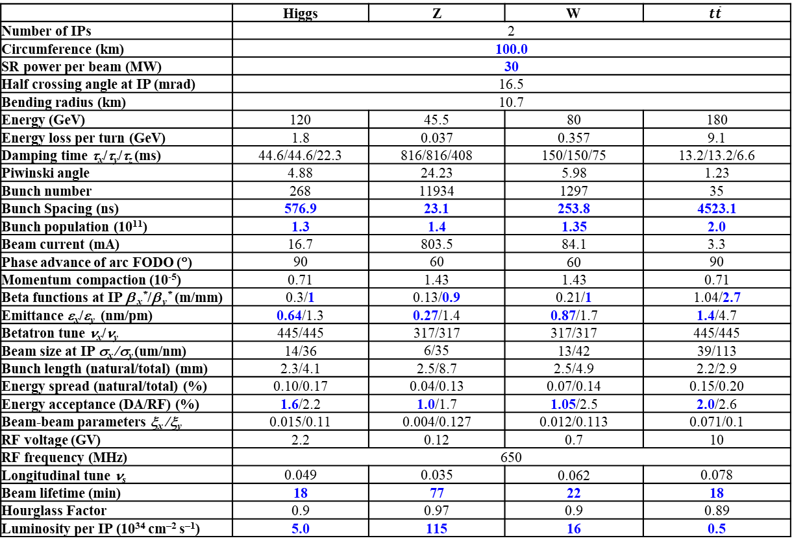
CEPC Design Parameters
 | Higgs | Z | W | $$t\overline{t}$$
Number of IPs | 2
Circumference (km) | 100.0
SR power per beam (MW) | 30
Half crossing angle at IP (mrad) | 16.5
Bending radius (km) | 10.7
Energy (GeV) | 120 | 45.5 | 80 | 180
Energy loss per turn (GeV) | 1.8 | 0.037 | 0.357 | 9.1
Damping time τ_{x}/τ_{y}/τ_{z} (ms) | 44.6/44.6/22.3 | 816/816/408 | 150/150/75 | 13.2/13.2/6.6
Piwinski angle | 4.88 | 24.23 | 5.98 | 1.23
Bunch number | 268 | 11934 | 1297 | 35
Bunch Spacing (ns) | 576.9 | 23.1 | 253.8 | 4523.1
Bunch population (10¹¹) | 1.3 | 1.4 | 1.35 | 2.0
Beam current (mA) | 16.7 | 803.5 | 84.1 | 3.3
Phase advance of arc FODO (°) | 90 | 60 | 60 | 90
Momentum compaction (10⁻⁵) | 0.71 | 1.43 | 1.43 | 0.71
Beta functions at IP β _{x}*/β _{y}* (m/mm) | 0.3/1 | 0.13/0.9 | 0.21/1 | 1.04/2.7
Emittance ε_{x}/ε_{y} (nm/pm) | 0.64/1.3 | 0.27/1.4 | 0.87/1.7 | 1.4/4.7
Betatron tune ν_{x}/ν_{y} | 445/445 | 317/317 | 317/317 | 445/445
Beam size at IP σ_{x} /σ_{y} (um/nm) | 14/36 | 6/35 | 13/42 | 39/113
Bunch length (natural/total) (mm) | 2.3/4.1 | 2.5/8.7 | 2.5/4.9 | 2.2/2.9
Energy spread (natural/total) (%) | 0.10/0.17 | 0.04/0.13 | 0.07/0.14 | 0.15/0.20
Energy acceptance (DA/RF) (%) | 1.6/2.2 | 1.0/1.7 | 1.05/2.5 | 2.0/2.6
Beam-beam parameters ξ_{x} /ξ_{y} | 0.015/0.11 | 0.004/0.127 | 0.012/0.113 | 0.071/0.1
RF voltage (GV) | 2.2 | 0.12 | 0.7 | 10
RF frequency (MHz) | 650
Longitudinal tune ν_{s} | 0.049 | 0.035 | 0.062 | 0.078
Beam lifetime (min) | 18 | 77 | 22 | 18
Hourglass Factor | 0.9 | 0.97 | 0.9 | 0.89
Luminosity per IP (10³⁴ cm^{–2} s^{–1}) | 5.0 | 115 | 16 | 0.5
𝛽y∗ and emittance chosen for luminosity
adequate bunch population Ne for the luminosity and the achievable energy acceptance for lattice design
Number of bunches Nb is adjusted to keep the beam current
Updated bunch spacing for the requirement from detector
Ref: CEPC TDR; Radiation Detection Technology and Methods (2024) 8:1–1105, https://doi.org/10.1007/s41605-024-00463-y;

Slide 4
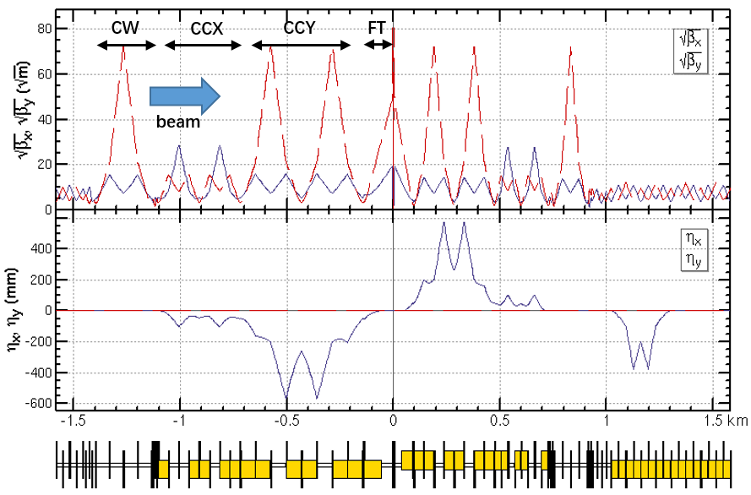
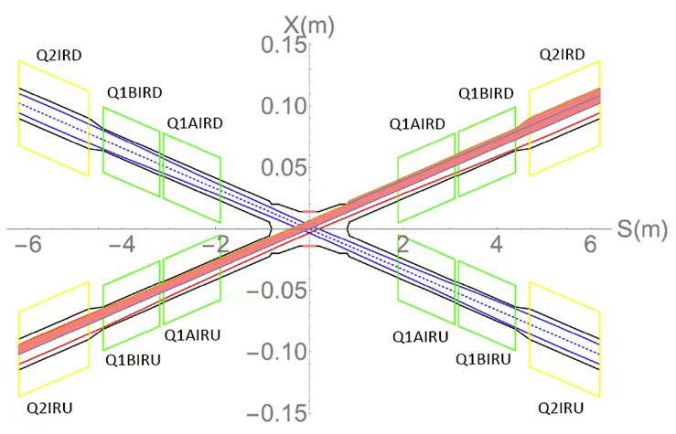
CEPC baseline lattice
CEPC baseline lattice— TDR lattice for Higgs energy w/o solenoid
Layout of IR
Layout of IP

Slide 5
What is “IP tuning”
IP tuning is a process adjusting and optimizing some important optics properties at IP by some knobs
Including knobs of local orbit, orbit angle, β * , waist shift, coupling, dispersion
One knob is to tune specific parameters at IP locally using a set of magnets
The magnets are localized in IR region and the distortion of beam parameters should be closed in this area
Parameters at IP can be tuned linearly by changing the strengths of the sets of magnets
Notes:
….

Slide 6
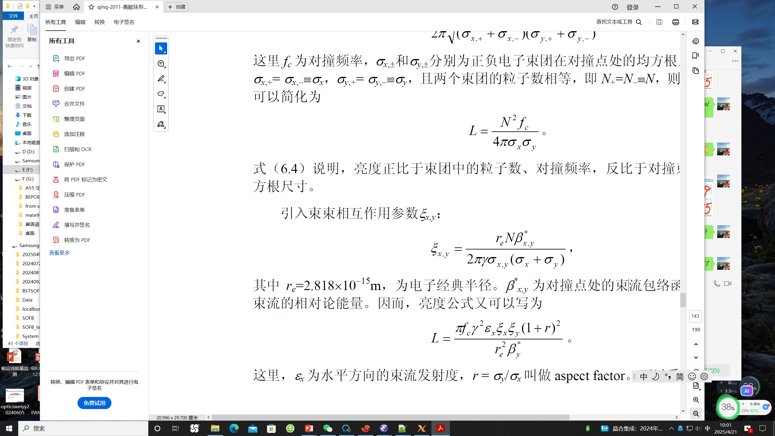
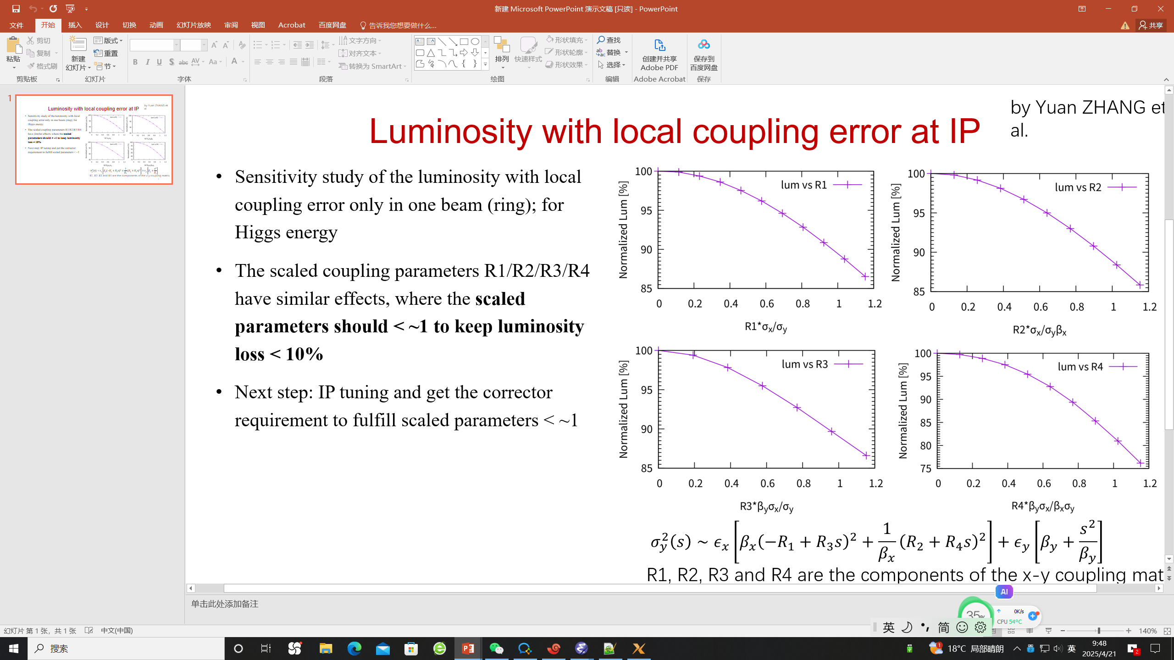
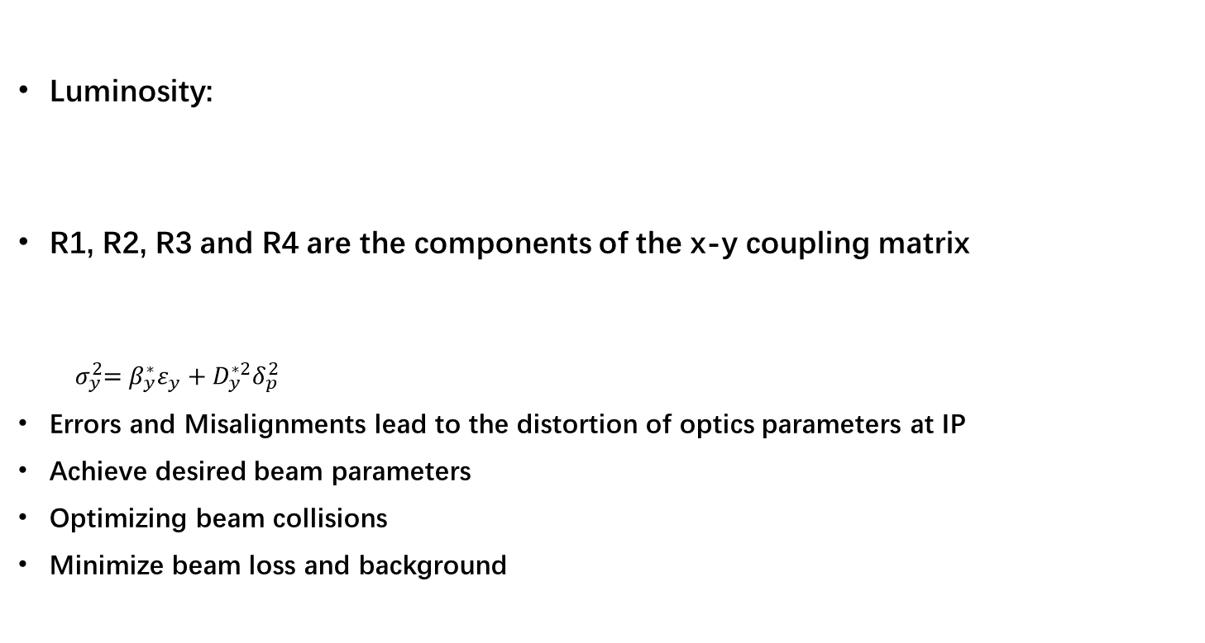
Why is IP tuning important
Luminosity:
R1, R2, R3 and R4 are the components of the x-y coupling matrix
$${ σ}_{y}^{2}=β_{y}^{∗}ε_{y}+D_{y}^{∗2}δ_{p}^{2}$$
Errors and Misalignments lead to the distortion of optics parameters at IP
Achieve desired beam parameters
Optimizing beam collisions
Minimize beam loss and background

Slide 7
Why is IP tuning important
ϵ_{x}=6.6478e-10 (m*rad)
Β_{x IP}=0.33 (m)
Β_{y IP}=0.001 (m)
Critical value — corresponding to 10% luminosity loss:
R1 * =0.0022 (rad)
R2 * =7.31e⁻⁴ (m)
R3 * =2.22 (m⁻¹)
R4 * =0.61 （rad)
Critical value — comparable to 1σ_{y} and 1σ’_{y} at IP
D_{y} * =1.85e⁻⁵ (m)
D’_{y} * =3.65e⁻⁵ (rad)
Luminosity with local coupling error at IP for Higgs energy from Zhang Yuan’s simulation

Slide 8
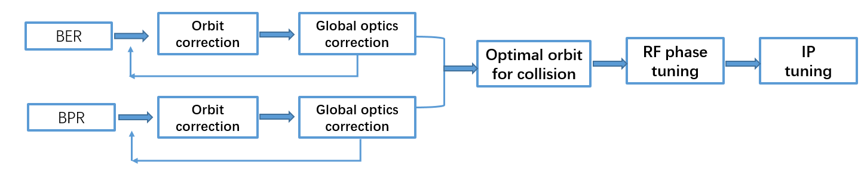
When is IP tuning performed
Whenever optimization of collisions:
During Initial Beam Commissioning
During Routine Operation:
When Beam quality degrades
Maintaining Beam Stability
The typical of beam tuning to achieve a good luminosity:

Slide 9
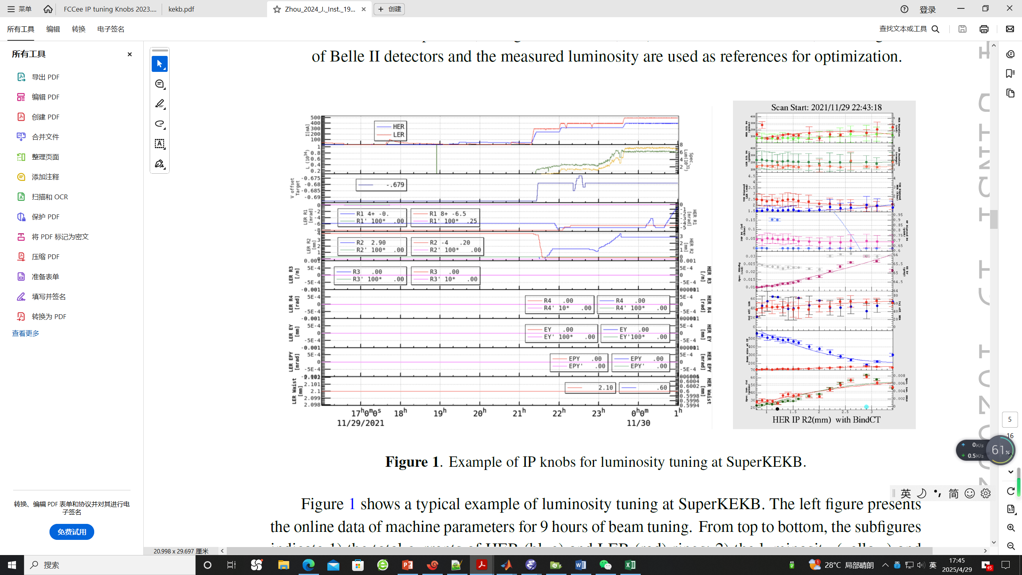
How is IP tuning performed
Determine the knobs according to the simulation
IP orbit knob , waist shift knob, IP coupling knob, IP dispersion knob
During the IP tuning
Input the desired parameters at IP，calculate the strength of knob magnets by fitting using SAD online
Record the luminosity corresponding to the specific parameters
Scan the parameters to maximize the luminosity
Example of IP knobs for luminosity tuning at SuperKEKB
D. Zhou et al 2024 JINST 19 T02002

Slide 10
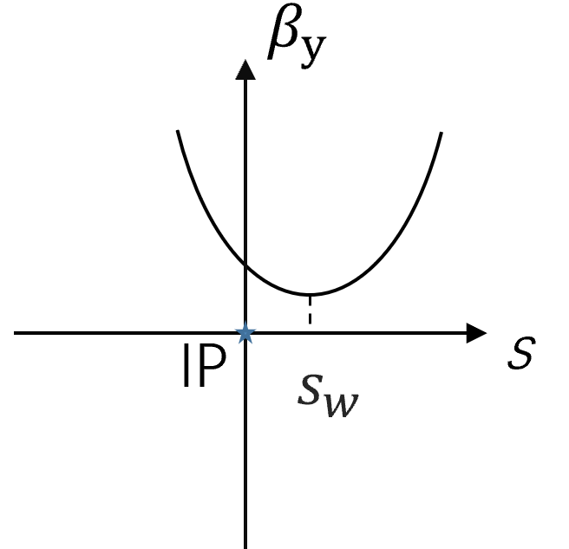
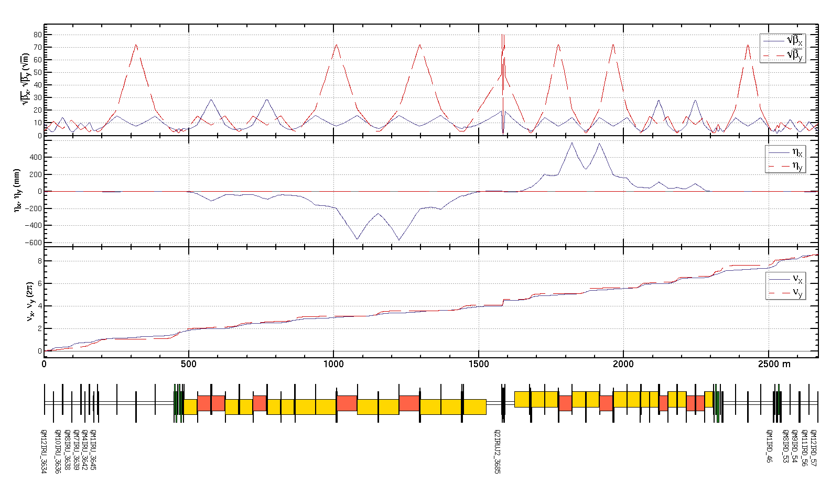

Determine beta and waist knobs
IP beta and waist knobs:
Constrains in fitting:
β*, α*at IP
optics (β, α and tunes not disturbed
outside the IR region)
For one side of IP including:
2 Quadrupoles of FF
dispersion free
6 Quadrupoles in matching section
16 Quadrupoles in total
Dispersion free region
$$α^{∗}=\frac{s_{w}}{β_{w}}$$
$${ β}^{∗}=β_{w}+\frac{s_{w}^{2}}{β_{w}}$$
$$γ^{∗}=\frac{1}{β_{w}}$$

Slide 11
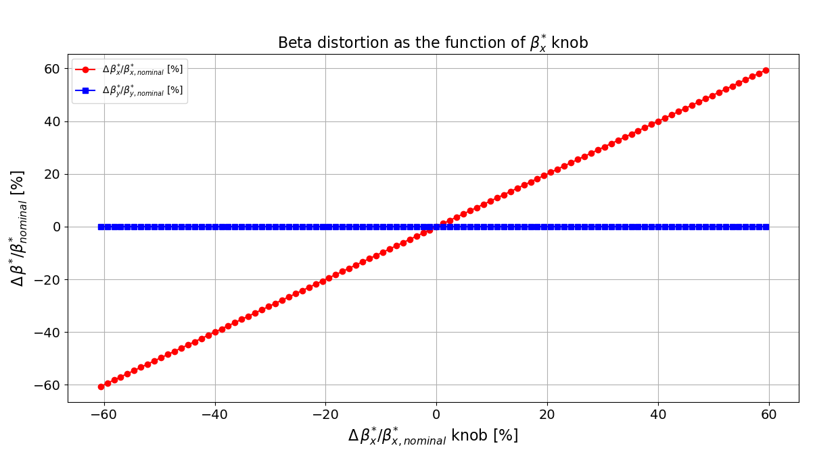
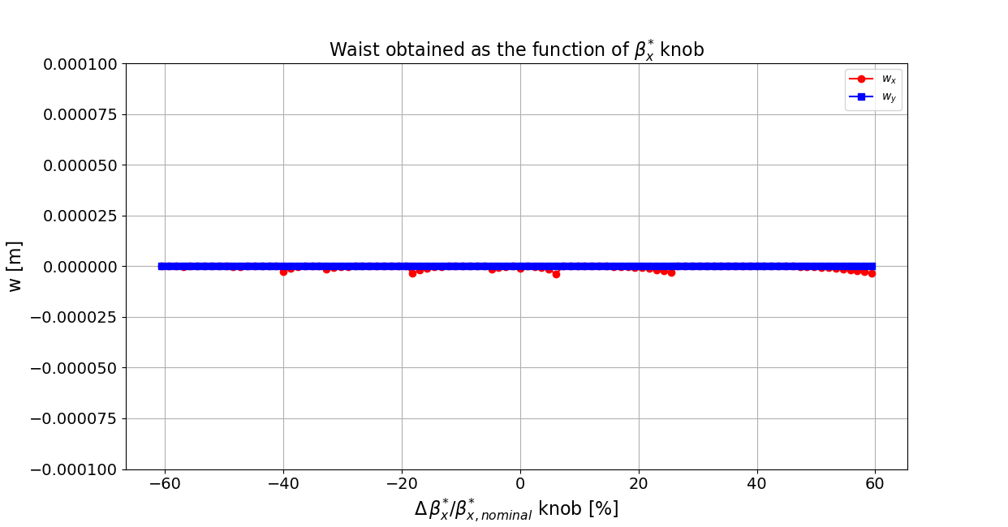
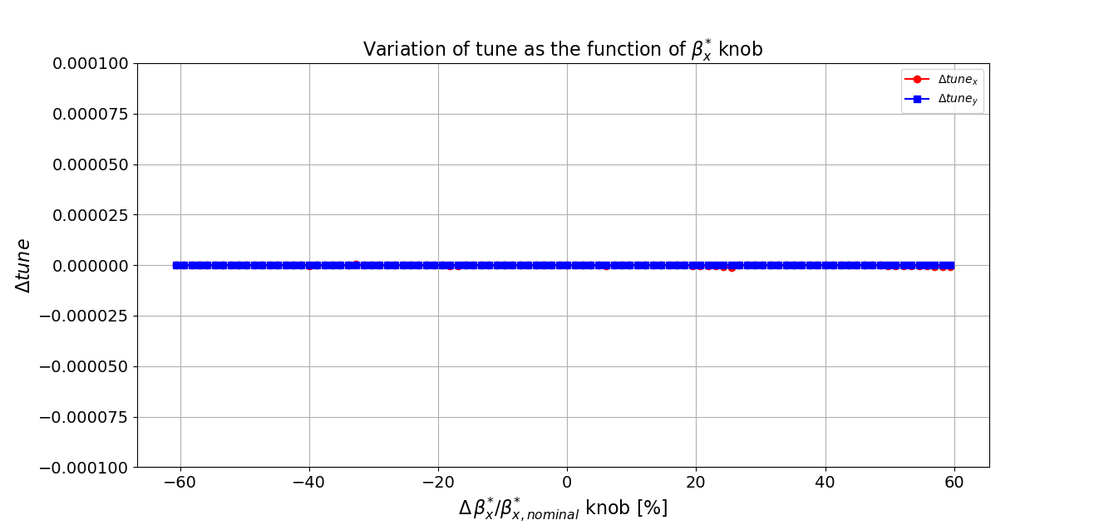
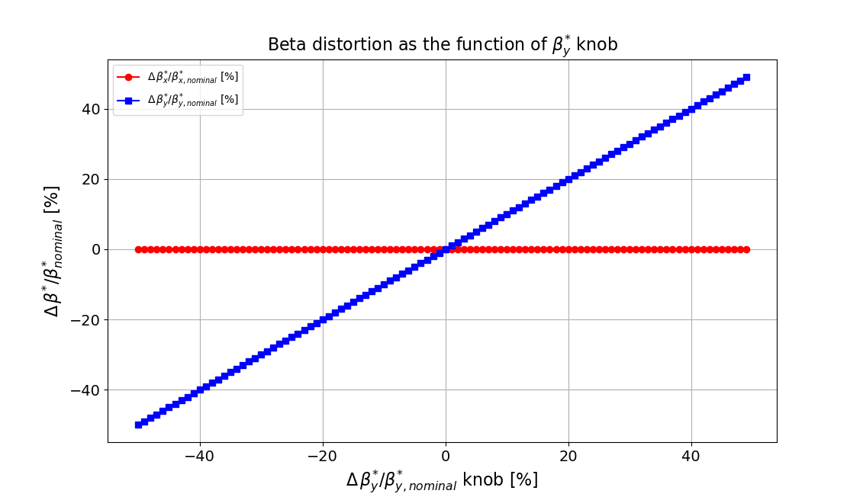
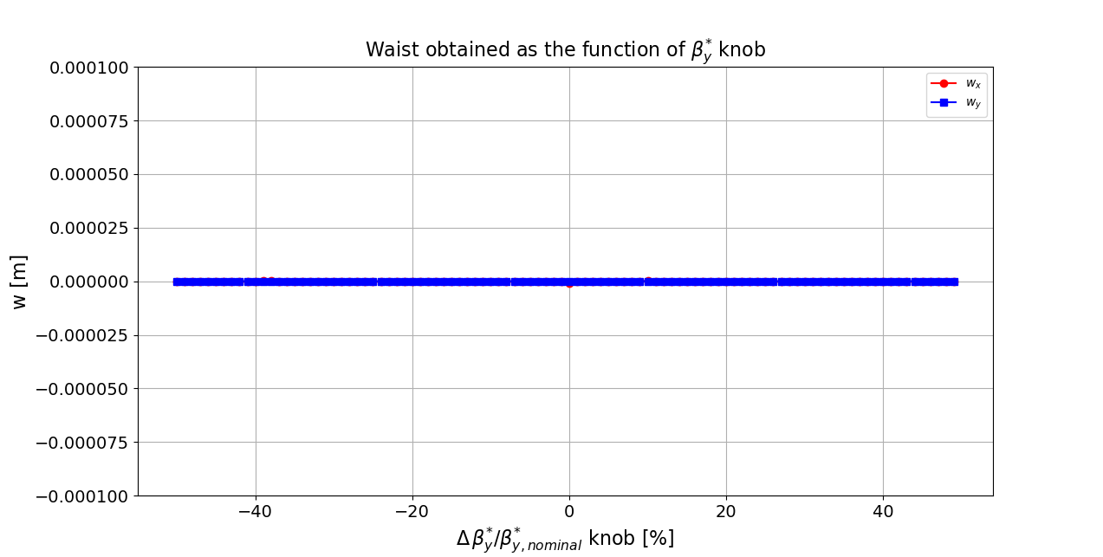
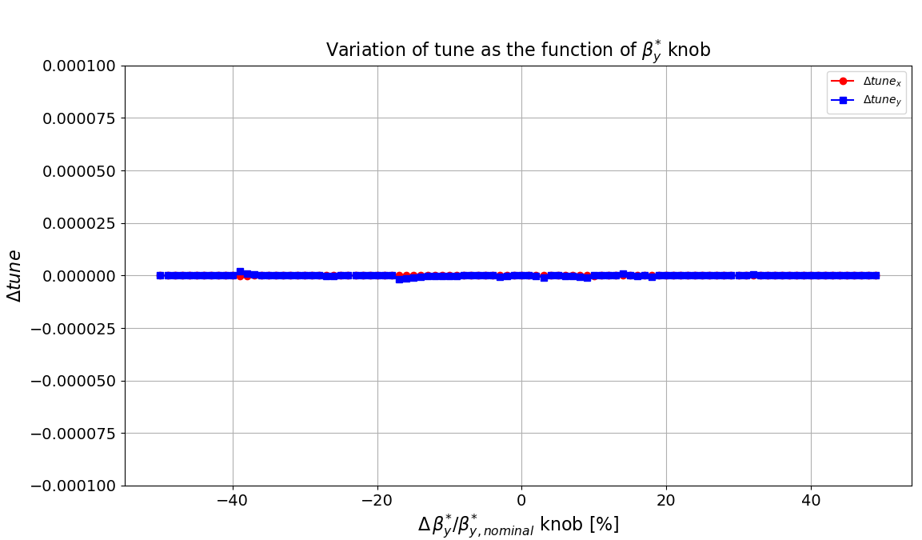
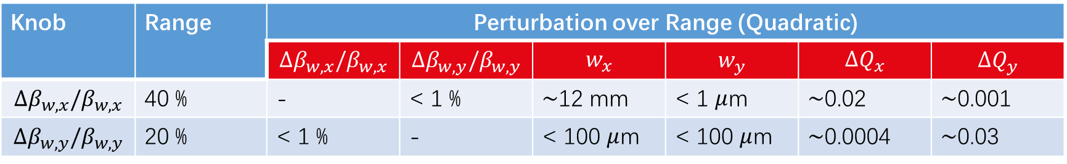
IP beta knobs
Knob | Range | Perturbation over Range (Quadratic)
 |  | $${Δβ}_{w,x}/β_{w,x}$$ | $$Δβ_{w,y}/β_{w,y}$$ | $$w_{x}$$ | $$w_{y}$$ | $$ΔQ_{x}$$ | $${ΔQ}_{y}$$
$${Δβ}_{w,x}/β_{w,x}$$ | 40 % | - | < 1 % | $\sim$12 mm | < 1 $μ$m | $\sim$0.02 | $\sim$0.001
$$Δβ_{w,y}/β_{w,y}$$ | 20 % | < 1 % | - | < 100 $μ$m | < 100 $μ$m | $\sim$0.0004 | $\sim$0.03

Slide 12
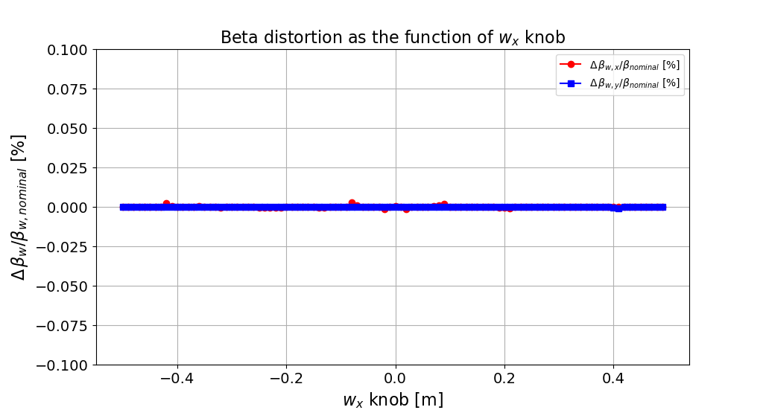
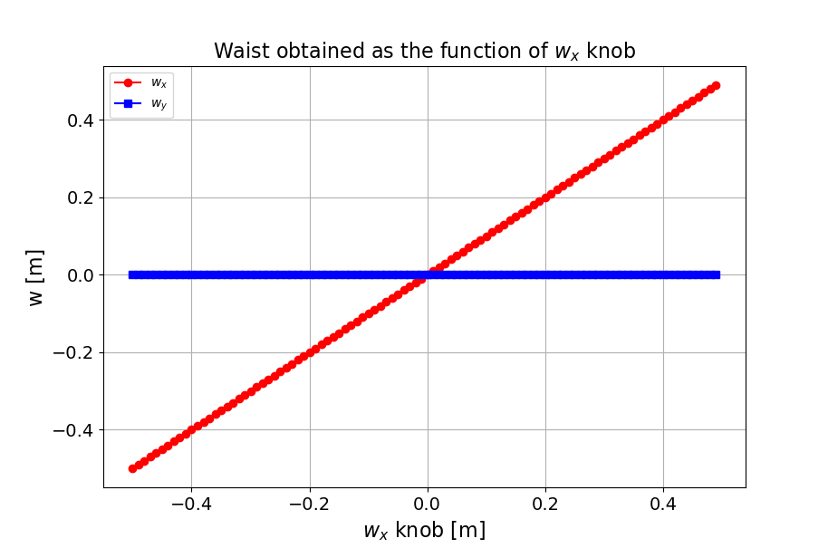
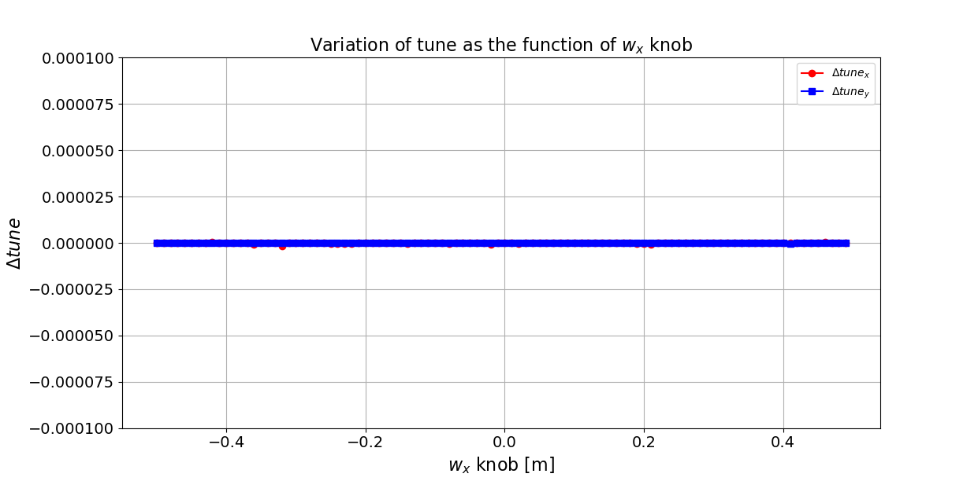
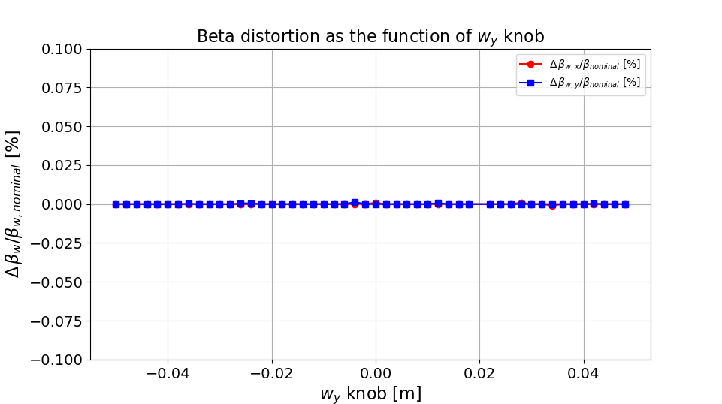
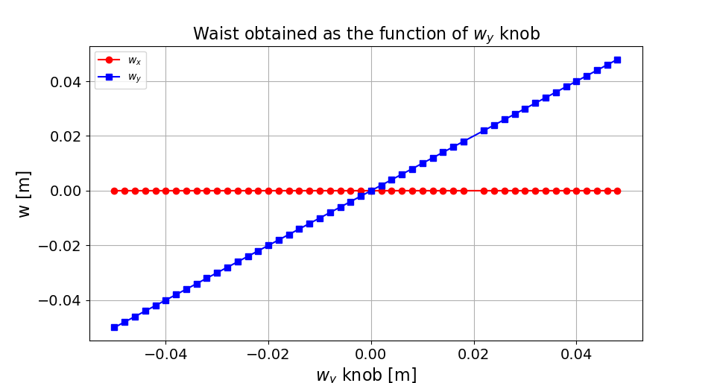
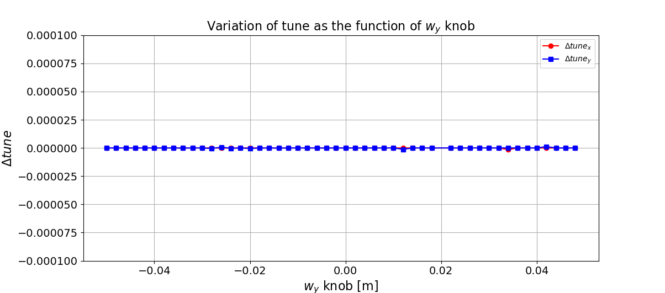
IP waist knobs
Knob | Range | Perturbation over Range (Quadratic)
 |  | $${Δβ}_{w,x}/β_{w,x}$$ | $$Δβ_{w,y}/β_{w,y}$$ | $$w_{x}$$ | $$w_{y}$$ | $$ΔQ_{x}$$ | $${ΔQ}_{y}$$
$${Δβ}_{w,x}/β_{w,x}$$ | 40 % | - | < 1 % | $\sim$12 mm | < 1 $μ$m | $\sim$0.02 | $\sim$0.001
$$Δβ_{w,y}/β_{w,y}$$ | 20 % | < 1 % | - | < 100 $μ$m | < 100 $μ$m | $\sim$0.0004 | $\sim$0.03

Slide 13
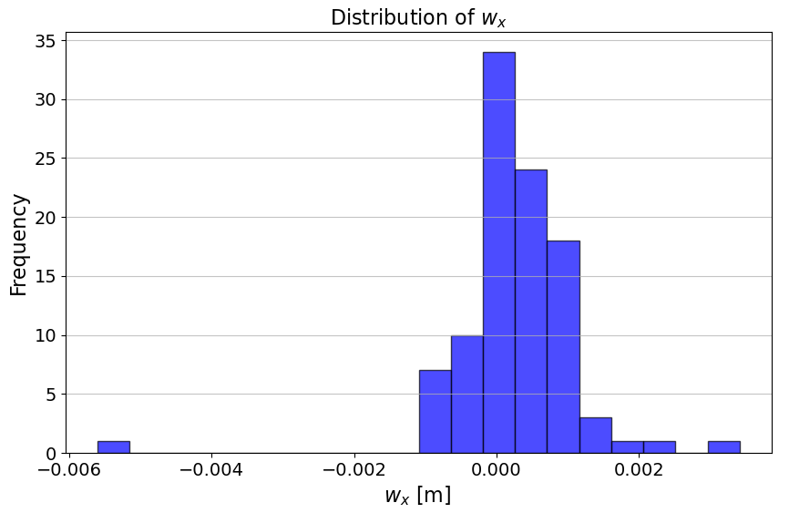
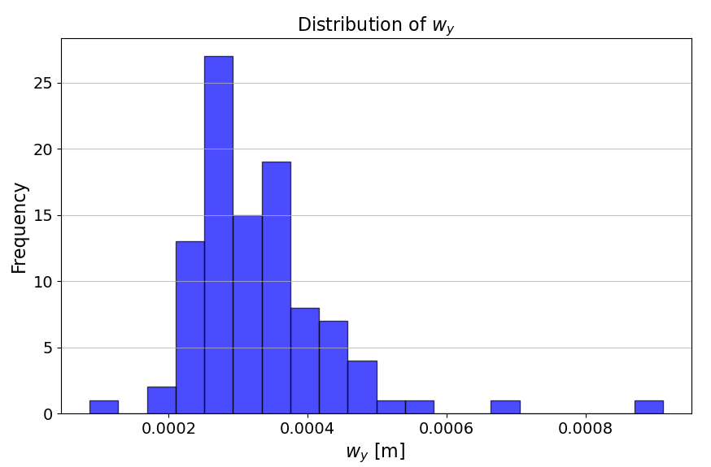
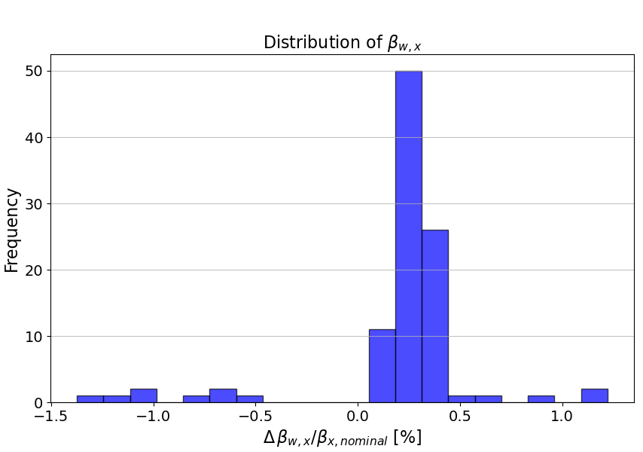
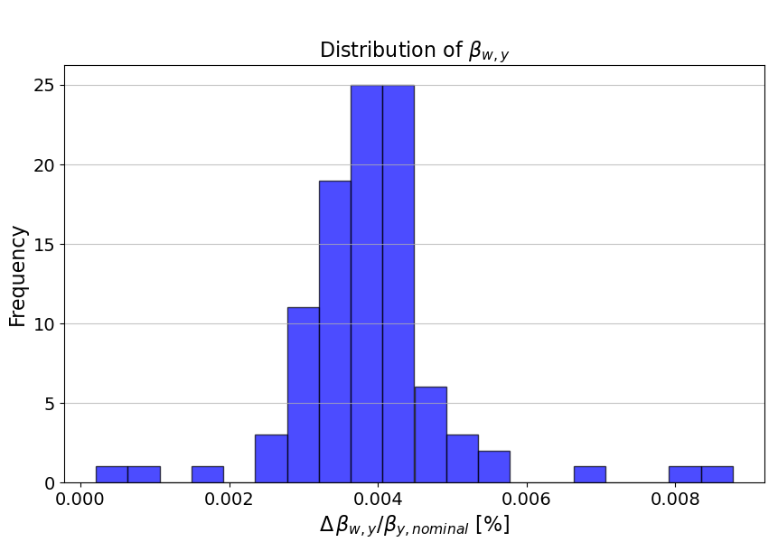
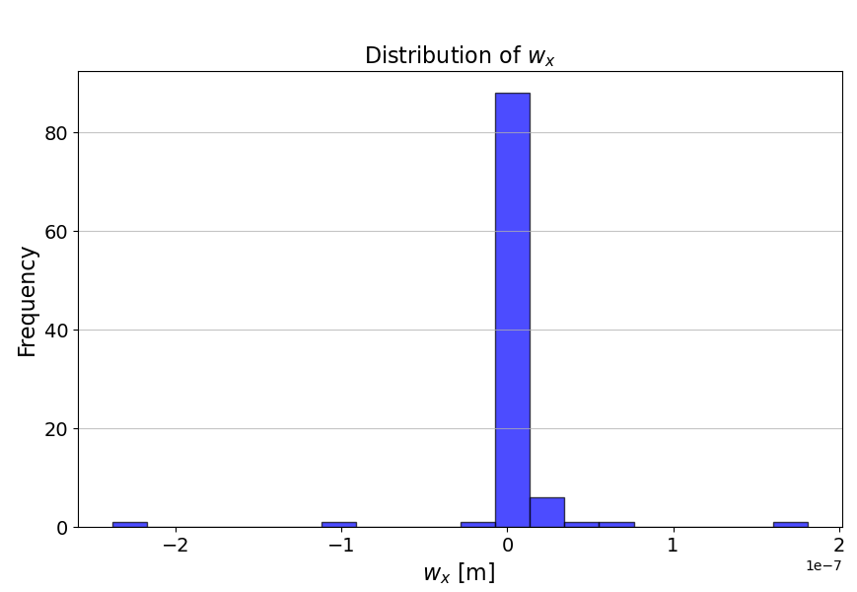
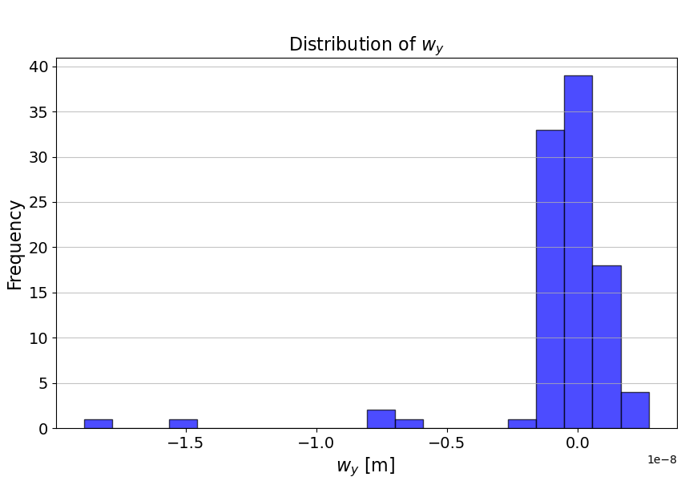
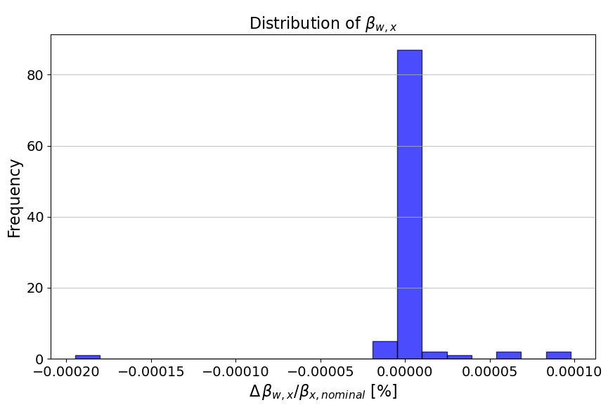
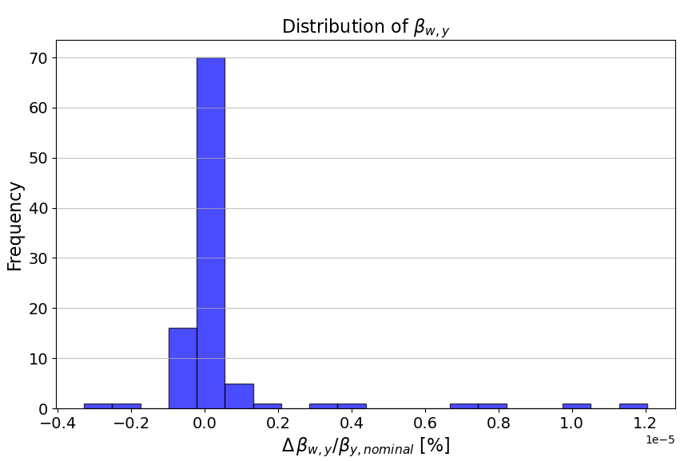
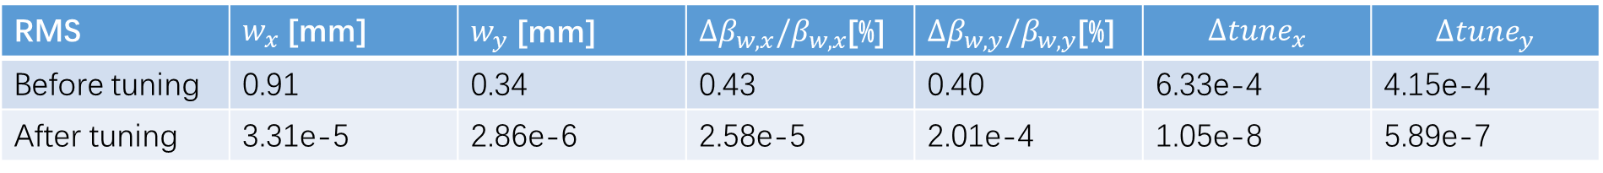
IP beta and waist knobs
Perform IP beta and waist knobs for 100 seeds after global optics correction
RMS | $w_{x}$ [mm] | $w_{y}$ [mm] | ${Δβ}_{w,x}/β_{w,x}$[%] | $Δβ_{w,y}/β_{w,y}$[%] | $$Δ{tune}_{x}$$ | $${Δtune}_{y}$$
Before tuning | 0.91 | 0.34 | 0.43 | 0.40 | 6.33e-4 | 4.15e-4
After tuning | 3.31e-5 | 2.86e-6 | 2.58e-5 | 2.01e-4 | 1.05e-8 | 5.89e-7
Knob | Range | Perturbation over Range (Quadratic)
 |  | $${Δβ}_{w,x}/β_{w,x}$$ | $$Δβ_{w,y}/β_{w,y}$$ | $$w_{x}$$ | $$w_{y}$$ | $$ΔQ_{x}$$ | $${ΔQ}_{y}$$
$${Δβ}_{w,x}/β_{w,x}$$ | 40 % | - | < 1 % | $\sim$12 mm | < 1 $μ$m | $\sim$0.02 | $\sim$0.001
$$Δβ_{w,y}/β_{w,y}$$ | 20 % | < 1 % | - | < 100 $μ$m | < 100 $μ$m | $\sim$0.0004 | $\sim$0.03

Slide 14
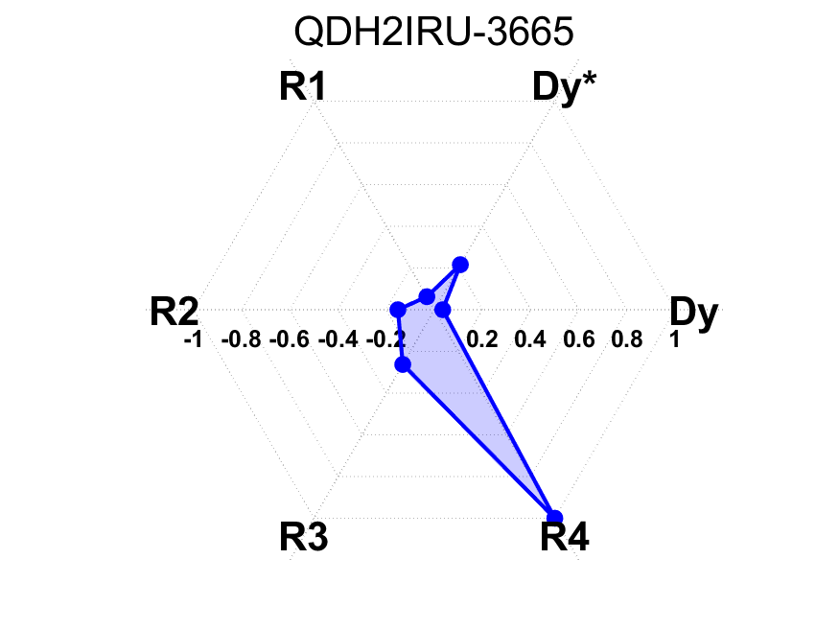
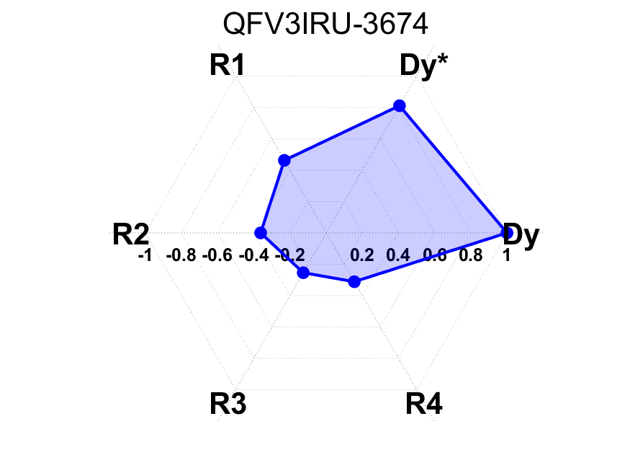

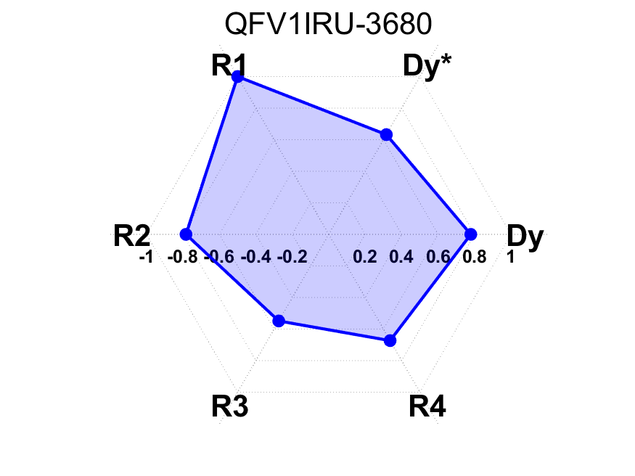
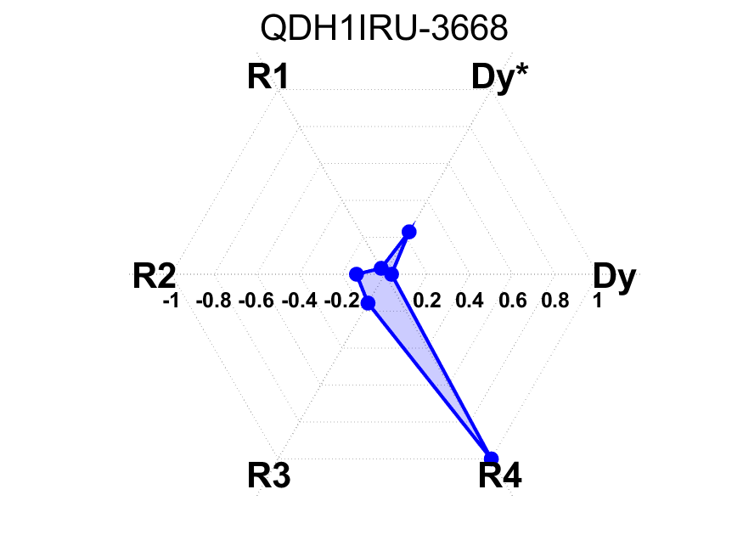
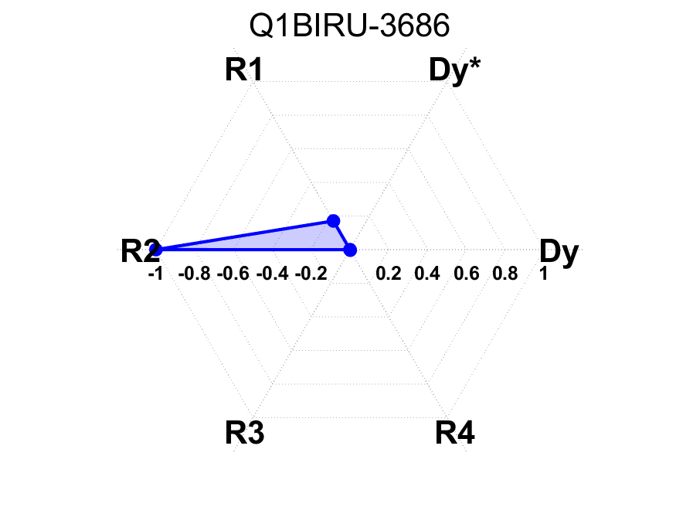
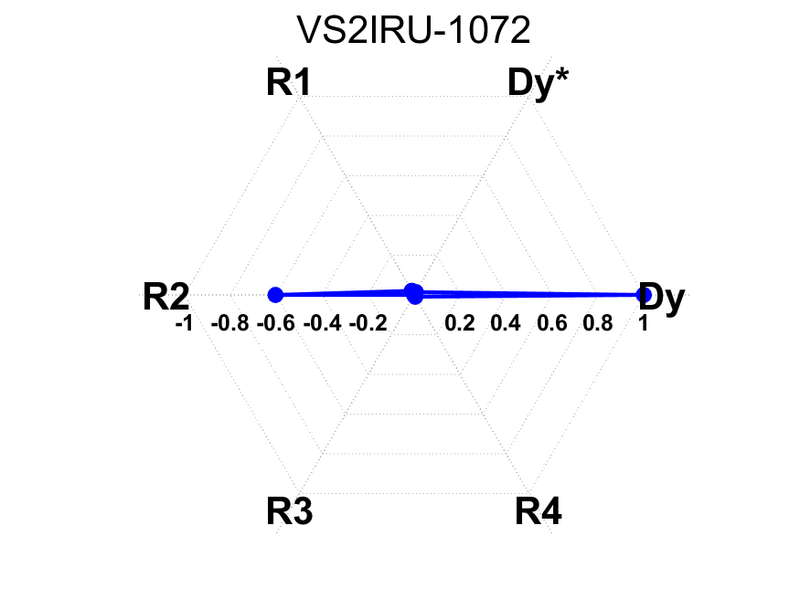
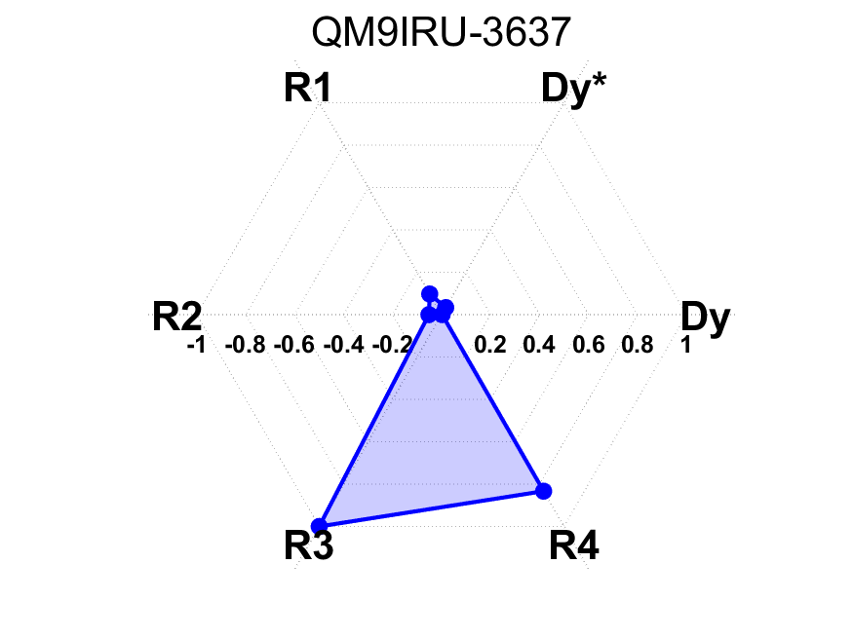
Determine the coupling knobs for CEPC
Suppose skew components at quadrupoles and sextupoles of IR
Calculate the response of { D_{y},D_{y}’,R1, R2, R3, R4} at IP to skew strength variations
Plot the 6 vectors and calculate the area enclosed by the 6 vectors for each magnet
Sort the area and find 6 magnets which are most sensitive to the parameters

Slide 15
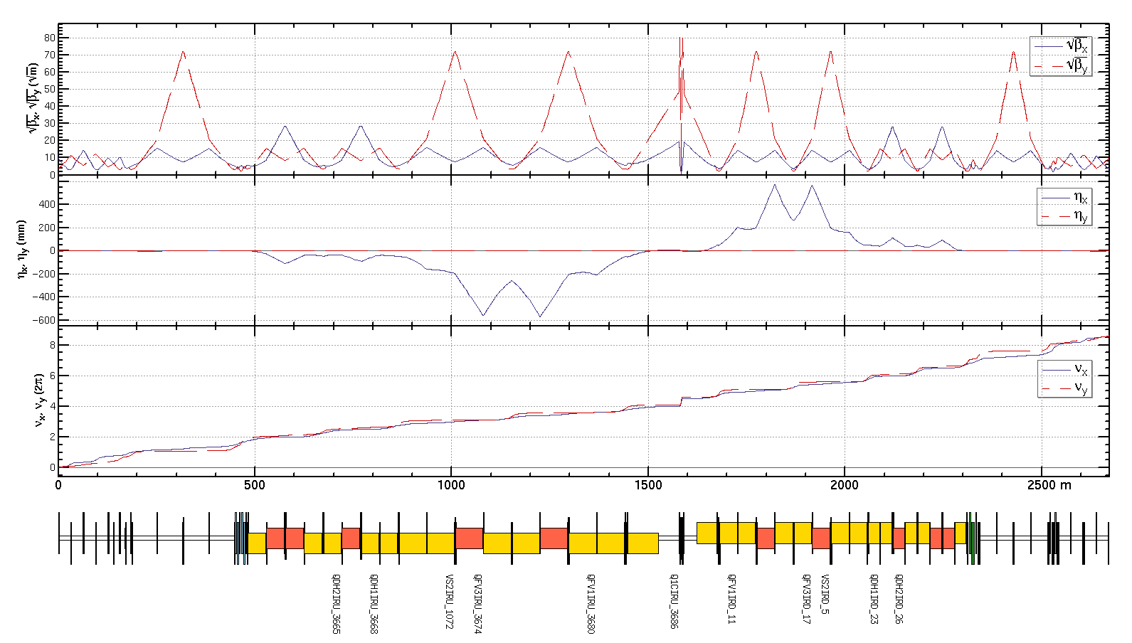
Determine the coupling knobs
Coupling knobs:
For one side of IP including:
1 skew coil on FF quadrupole
dispersion free
1 skew coil on sextuple
4 skew coils on quadrupoles
dispersive region
12 skew components in total
Constrains in fitting:
R1，R2，R3，R4
D_{y}, D’_{y} at IP
optics not disturbed
outside the knob region

Slide 16
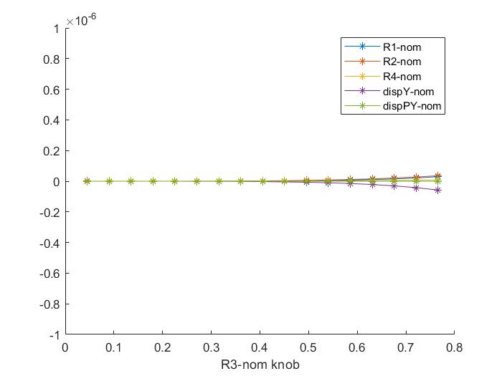
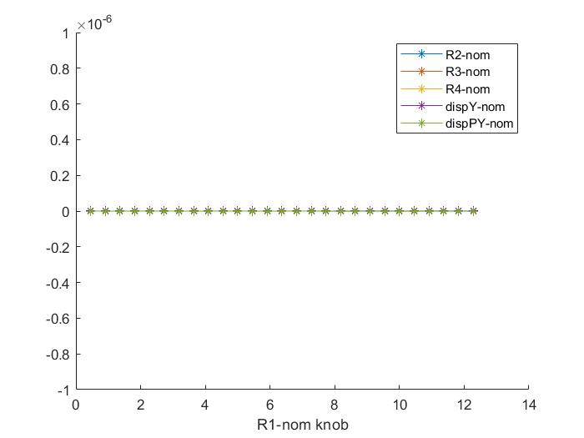
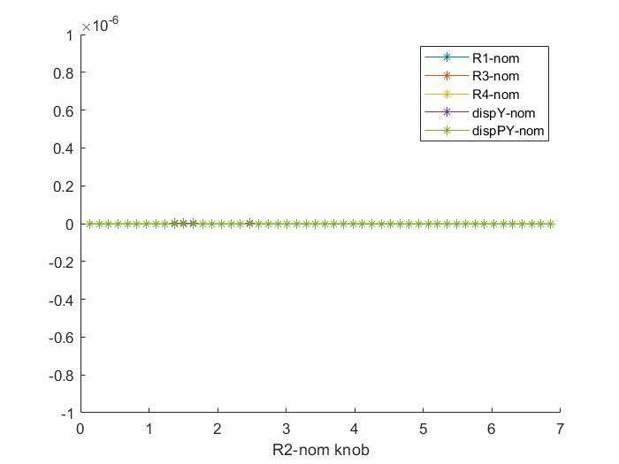
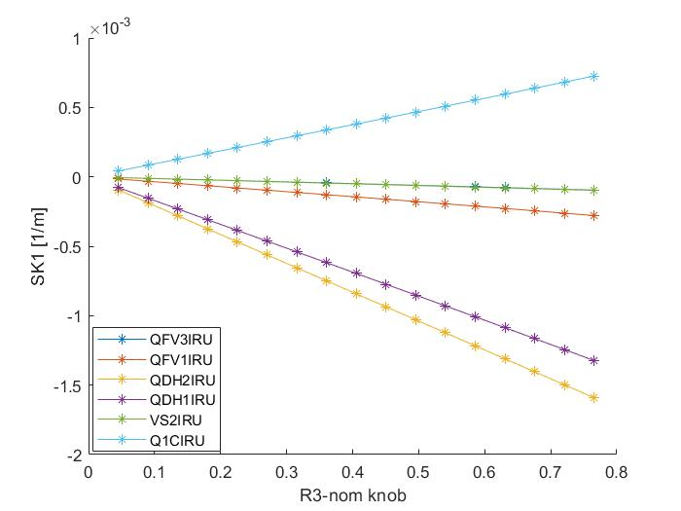
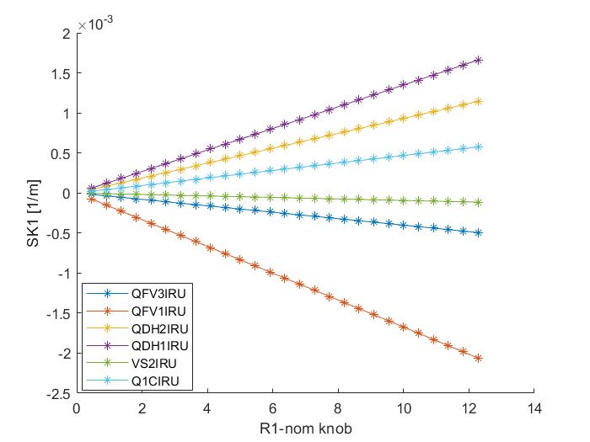
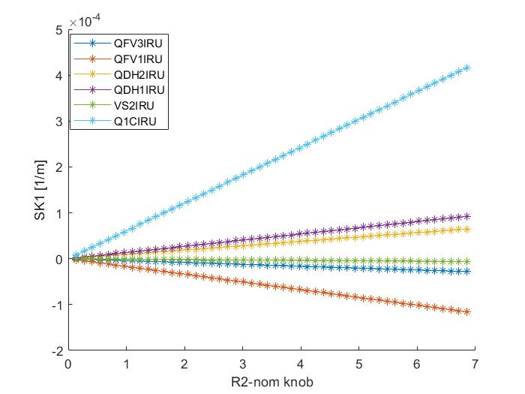
Scans of each knob and the corresponding skew strengths
Coupling parameters are normalized by the values corresponding to 10% luminosity loss (R1* ,R2* ,R3* ,R4*)
D_{y} and D’_{y} are normalized by the values comparable to 1 σ_{y} and 1σ’_{y} at IP (D_{y} * , D’_{y} * )
Scan of R1 knob (normalized by R1*)
Scan of R2 knob (normalized by R2*)
Scan of R3 knob (normalized by R3*)

Slide 17
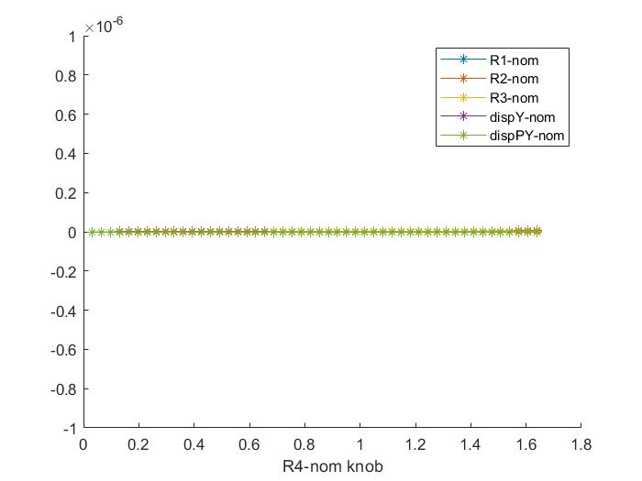
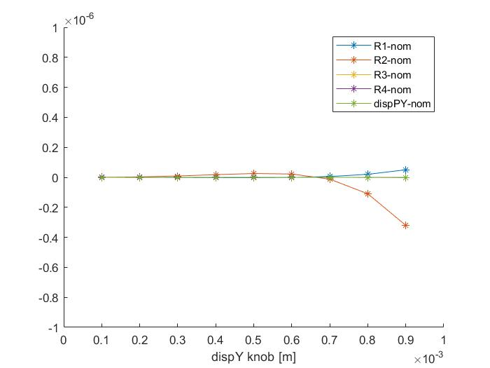
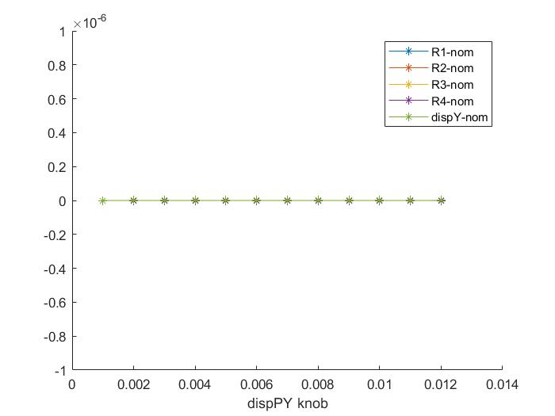



Scans of each knob and the corresponding skew strengths
Coupling parameters are normalized by the value corresponding to 10% luminosity loss (R1* ,R2* ,R3* ,R4*)
D_{y} and D’_{y} are normalized by the value comparable to 1 σ_{y} and 1σ’_{y} at IP (D_{y} * , D’_{y} * )
Scan of R4 knob (normalized by R4*)
Scan of D_{y} knob
Scan of D’_{y} knob

Slide 18


Results of IP coupling tuning
Vertical dispersion knob for D_{y,IP}=0.1（mm）*
Coupling knob for R1_{IP}=0.002 *

Slide 19
Results of IP coupling tuning
●
Assumed errors (3σ*3)
Perform coupling tuning and calculate the strength of skew quadrupoles
Provide specifications for magnet design
 | R1* | R2*[m] | R3*[m⁻¹] | R4* | Dy*[m] | Dpy*
rms(*10⁻³) | 0.87 | 0.89 | 49.77 | 31.11 | 0.0052 | 0.016
 | Q1BIRU | QFV1IRU | VS2IRU | QFV3IRU | QDH1IRU | QDH2IRU
L(m) | 1.21 | 2.00 | 0.60 | 2.00 | 2.00 | 2.00
SK1(*10⁻³m⁻¹) | 1.13 | 1.00 | 0.20 | 0.25 | 1.00 | 1.00
G（T/m) | 0.37 | 0.20 | 0.14 | 0.05 | 0.20 | 0.20

Slide 20






Results of IP coupling tuning
Statistic of strength of skew components (Simulation with assumed errors (3σ*3) )

Slide 21
Summary
Knobs for IP beta、waist and coupling have been determined at CEPC
IP beta and waist tuning are performed for lattices with errors after global optics correction
Parameters D_{y},D_{y}’,R1, R2, R3, R4 at IP can be tuned independently in the range corresponding to
10% luminosity loss
Specification for magnets design have been evaluated by applying a correction for 10 times of
the RMS residual error at IP after global optics correction
To-do list
Develop other knobs
Investigate the effects of tuning on other dynamic parameters
Perform all the tunings using lattices with errors after global optics correction and study the luminosity
performance before and after IP tuning
Tuning simulations with APES
Ref: CEPC TDR; Radiation Detection Technology and Methods (2024) 8:1–1105, https://doi.org/10.1007/s41605-024-00463-y;

Slide 22
Thanks for your attention

Slide 23
Results of IP coupling tuning
●
Errors applied for global optics correction
Component | Δx (µm) | Δy (µm) | Δθ_{z} (µrad)
Dipole | 100 | 100 | 100
Quadrupole | 100 | 100 | 100
Sextupole | 100 | 100 | 100
Component | Field error (RMS)
Dipole | 0.01%
Quadrupole | 0.02%
Sextupole | 0.02%

