Slide 1
A Study on the Influence of the Vibrations on Beam Stability at the CEPC IPs
YAN Fang, TAN Xiangyu, WANG Yiwei, Haijing Wang
Accelerator center, IHEP, Beijing, China
2025.11.07
CEPC workshop Nov. 6-11, 2025 Guangzhou

Slide 2
Outlines
1
Background introduction
2
Simulating results with incoherent vibrations
3
Frequency-related vibration beam dynamics model
4
Vibration analysis with frequency-dependent coherence
5
The vibration parameters necessitate definition for the CEPC site
6
Summary

Slide 3
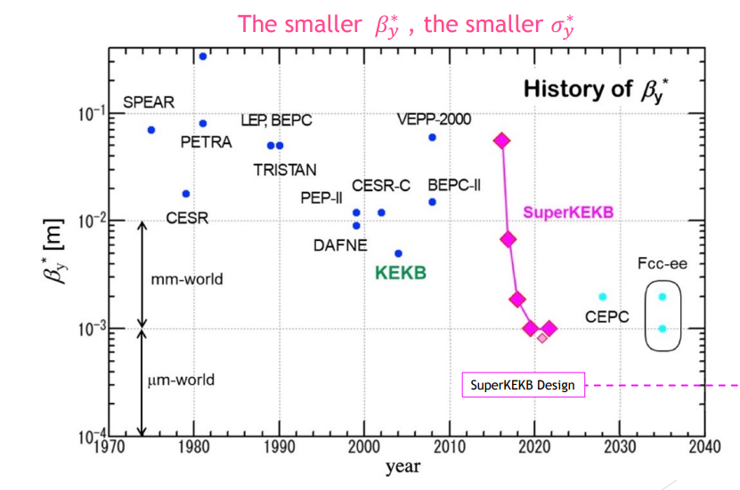
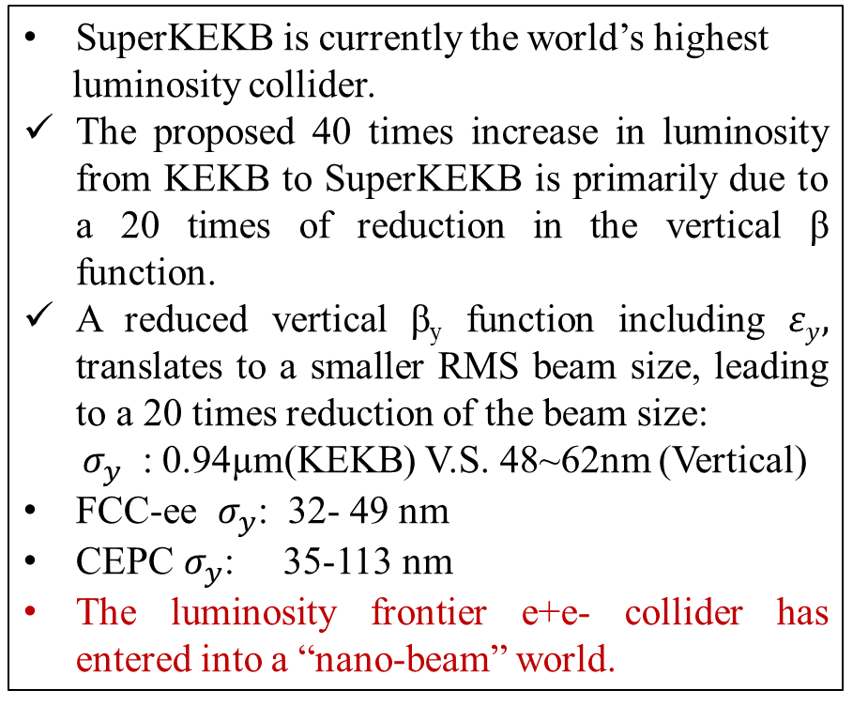
1. Background introduction
The Luminosity frontier e+e- collider has entered into a “nano-beam” world
SuperKEKB is currently the world’s highest
luminosity collider.
The proposed 40 times increase in luminosity from KEKB to SuperKEKB is primarily due to a 20 times of reduction in the vertical β function.
A reduced vertical β_{y} function including $εy,$ translates to a smaller RMS beam size, leading to a 20 times reduction of the beam size:
$σ_{y}$ : 0.94µm(KEKB) V.S. 48~62nm (Vertical)
FCC-ee $σ_{y}$: 32- 49 nm
CEPC $σ_{y}$: 35-113 nm
The luminosity frontier e+e- collider has entered into a “nano-beam” world.
36nm
0.94um
48-62nm
Courtesy of Mika Masuzawa from KEK

Slide 4
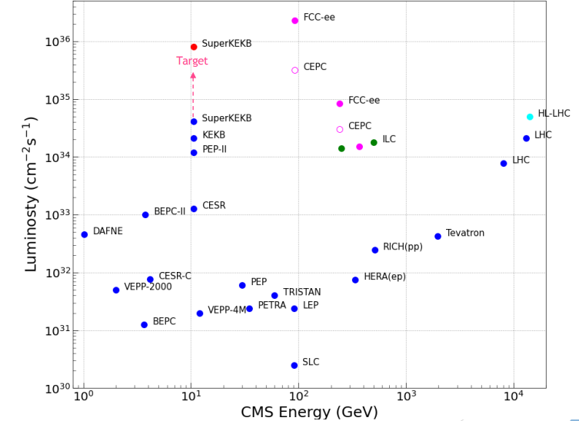
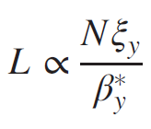


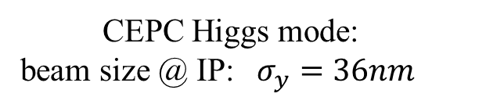
1. Background introduction
Vibration is crucial for colliders pursuing nanometer scale beam stability at IPs
The significant decrease in beam's dimensions lead to high sensitivity of the final focus system to vibrations and degrading the beam interaction efficiency at the IP.
CEPC Higgs mode:
beam size @ IP: $σ_{y}=36nm$
$$\frac{ΔL}{L}≈−\frac{{Δy}^{2}}{4σ_{y}^{2}}$$
Courtesy of Mika Masuzawa from KEK
$∆y @$IR: 10nm $\text{L}\text{: 2\%}$
→

Slide 5
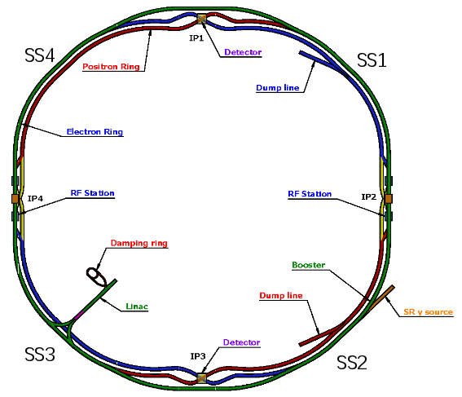
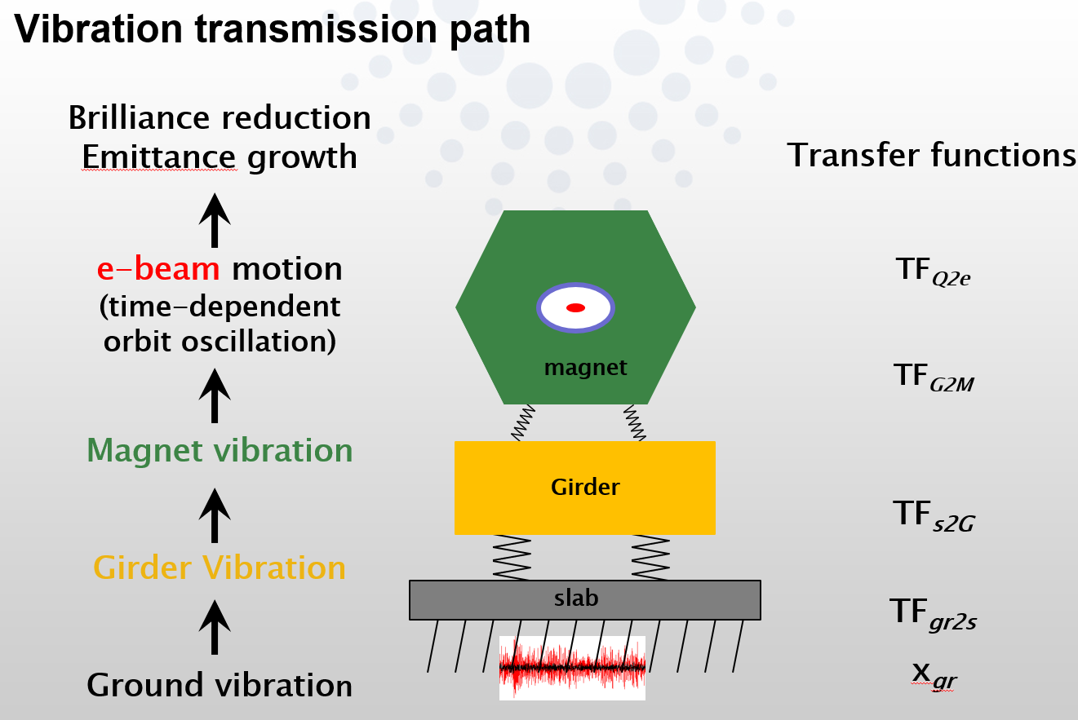
1. Background introduction
Where do the vibrations come from?
Ground motions are the major vibration sources of CEPC.
It transmitted through the slab, girder-magnet assembly propagate to the beam, leading to an emittance growth and brilliance reduction at IP.
Interaction Region
Courtesy of Lin Zhang, GM2017
Arc section
Arc section
Interaction Region

Slide 6
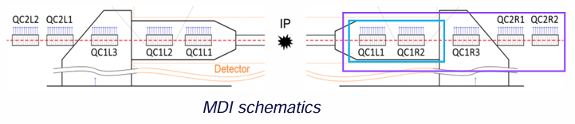
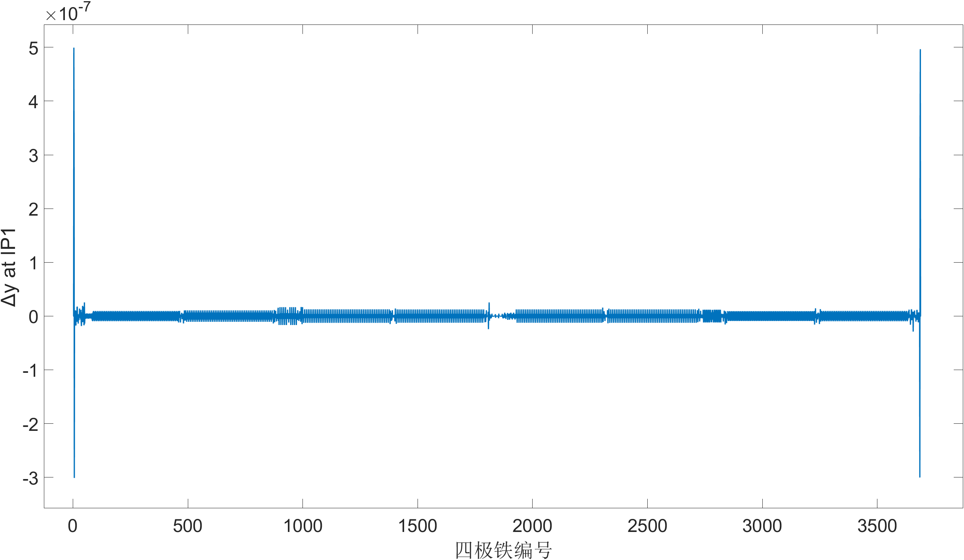
2. Simulating results with incoherent vibrations
Which part of the vibrations contribute more significantly to orbit distortion at IPs?
Introducing vertical displacement of 1µm to each Quad. of CEPC Higgs mode lattice.
The vibrational levels at IP1 caused by the Quad. at the IR are approximately two orders of magnitude greater than those at the arc section.
IP1
Interaction Region
Arc section
IP2
Vertical contribution to the IP1 of the quadrupoles
along CEPC with displacement error of 1µm

Slide 7
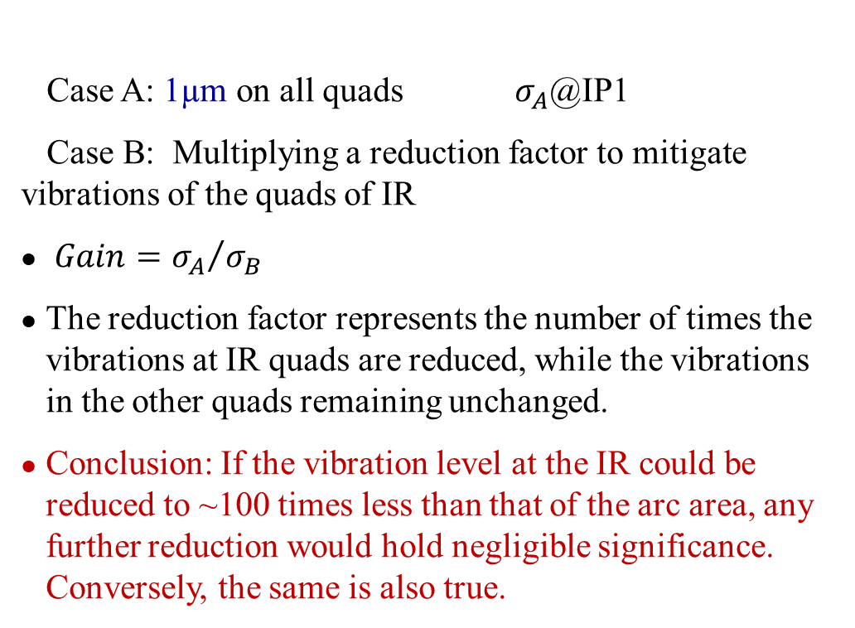

2. Simulating results with incoherent vibrations
To what extent can the reduction in vibration levels at the IR be deemed reasonable?
Random vertical vibrations are introduced:
The concept was gracefully introduced by Gaël BALIK from the CNRS during the 7th FCC Physics Workshop.
IP1
Case A: 1µm on all quads $σ_{A}$@IP1
Case B: Multiplying a reduction factor to mitigate vibrations of the quads of IR
$Gain={σ_{A}}/{σ_{B}}$
The reduction factor represents the number of times the vibrations at IR quads are reduced, while the vibrations in the other quads remaining unchanged.
Conclusion: If the vibration level at the IR could be reduced to ~100 times less than that of the arc area, any further reduction would hold negligible significance. Conversely, the same is also true.
IP2
$σ_{B}$@IP1
25nm/4nm
To be noted: all the simulation is based on an
uncorrelated errors. vibrations.

Slide 8
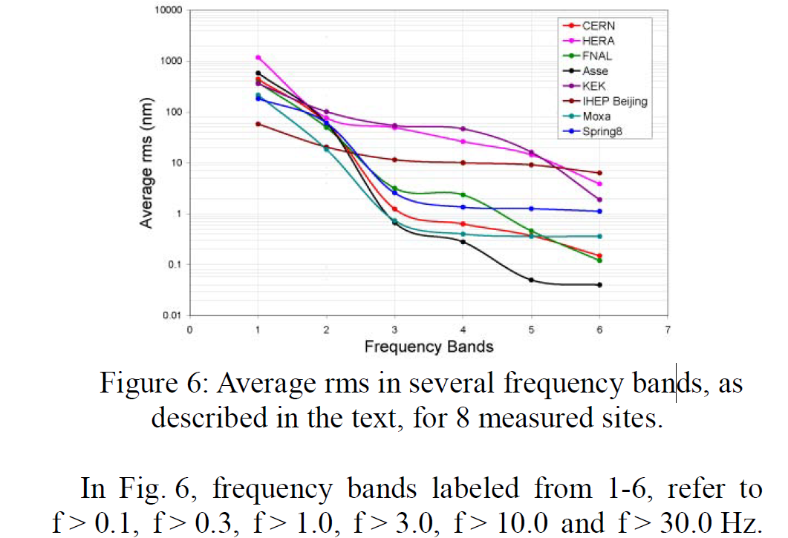
2. Simulating results with incoherent vibrations
The distribution of ground vibration requirements across the IR and arc sections.
RMS 4nm vibrations from the ground of IPs is assumed, based on the vibration levels (1-100Hz) at the IP of CERN tunnel which situated 100 meters underground.
Combined with RMS 25 nm vibrations from the ground in the arc region — not 4nm all along the 100km ring due to the inevitable presence of mined-out areas even at a depth of 100 meters.
Random vibrations, no magnification by girder assembling.
The cumulative effect of these vibrations on the IP position is 10 nm, resulting in a 2% decrease in luminosity.
RMS vibration induced in IR | RMS vibration induced in ARC region | RMS Orbit deviation @ IP1/IP2
4nm | 25nm | 10/10nm
Courtesy of Wilhelm Bialowons, MEASUREMENT OF GROUND MOTION IN VARIOUS SITES, EPAC2006 proceedings.

Slide 9
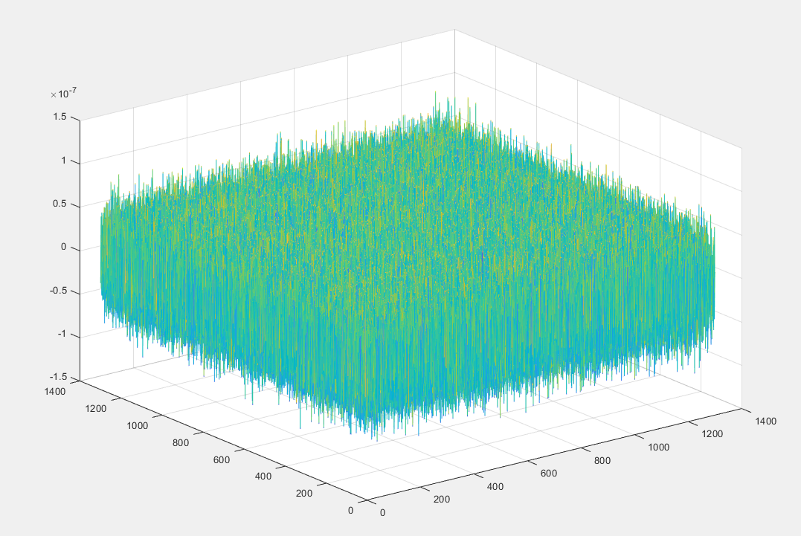
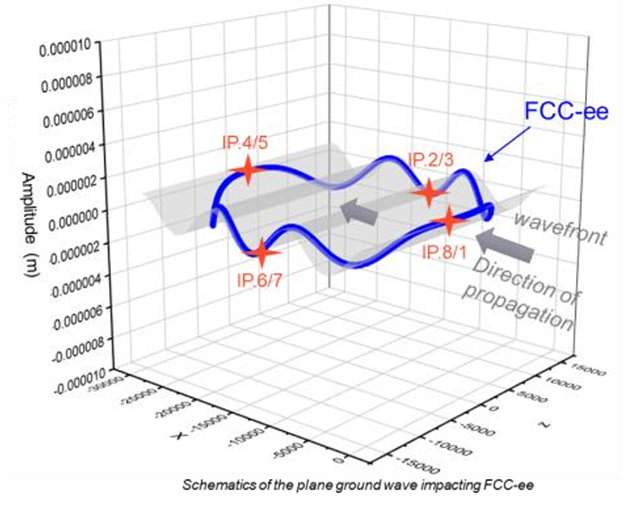




3. Frequency-related vibration beam dynamics model
A vibration beam dynamics model with f-dependent coherence length is needed
Courtesy of Gaël BALIK of CNRS
Model on basis of random vibrations
Model with a infinite coherence length
Coherence length：
$$L_{c}→0$$
$$L_{c}=L\left(f\right)$$
$$L_{c}→∞$$

Slide 10
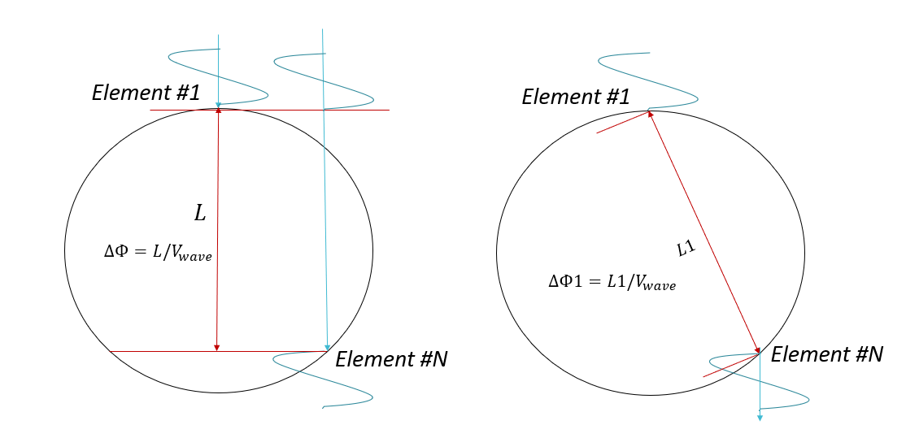


3. Simulating with frequency related correlation
3. Frequency-related vibration beam dynamics model
For nm scale vibration controlling requirement, special cares are mandatory in developing site vibration specifications. To reasonably evaluate the vibration response, a frequency related beam dynamics model
has to be established.
Plane wave model is developed for simulating vibrations far away. Point wave model is developed for
simulating vibrations close by. Wave velocity and wave decay are considered.
$$A\cos\left[ωt+φ\left(θ\right)\right]$$
Plane wave model
Point wave model
*$2πf$
*$2πf$

Slide 11
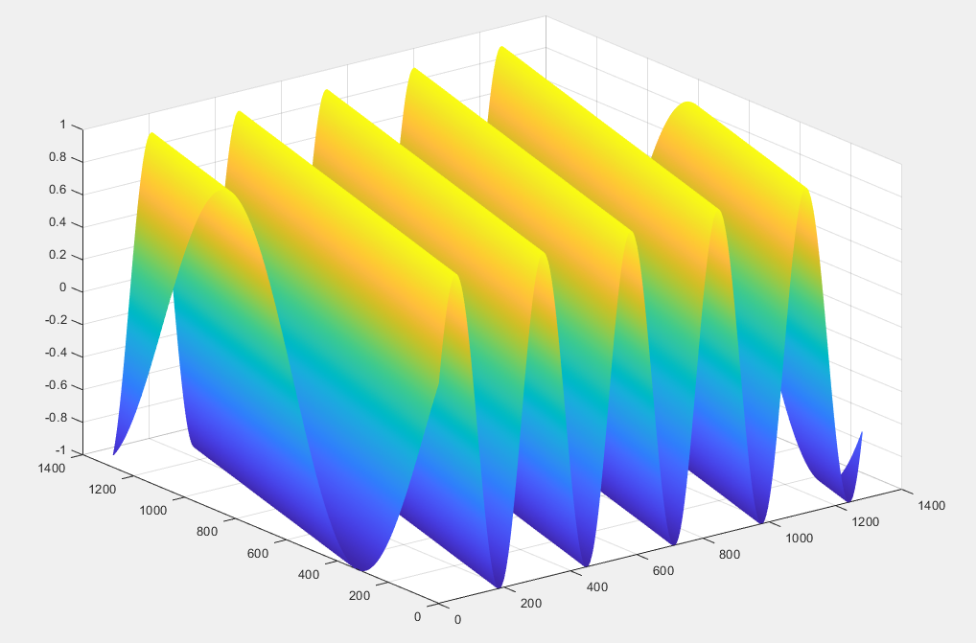
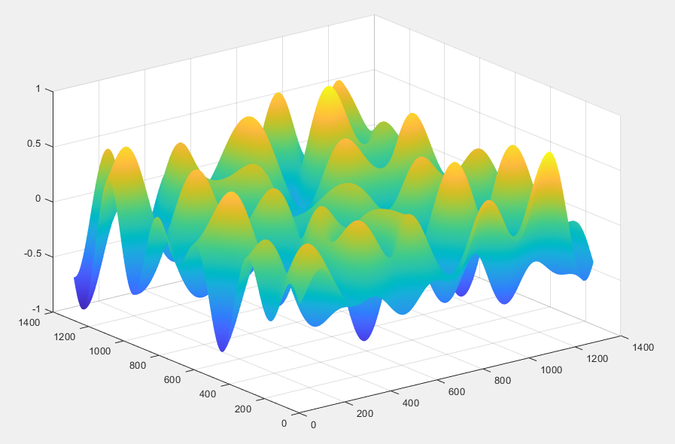

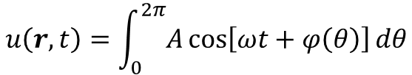
3. Frequency-related vibration beam dynamics model
与频率相关的相干模型：振动的叠加
Establishing vibration fields basing on plane wave model
Random superposition of plane waves in different directions.
A monochromatic plane wave
propagating along the θ direction
the vibration field After superposition
$$u\left(r,t\right)=\int_{0}^{2π}{A\cos\left[ωt+φ\left(θ\right)\right]dθ}$$
$$A\cos\left[ωt+φ\left(θ\right)\right]$$
The random direction
was superimposed hundreds times.

Slide 12
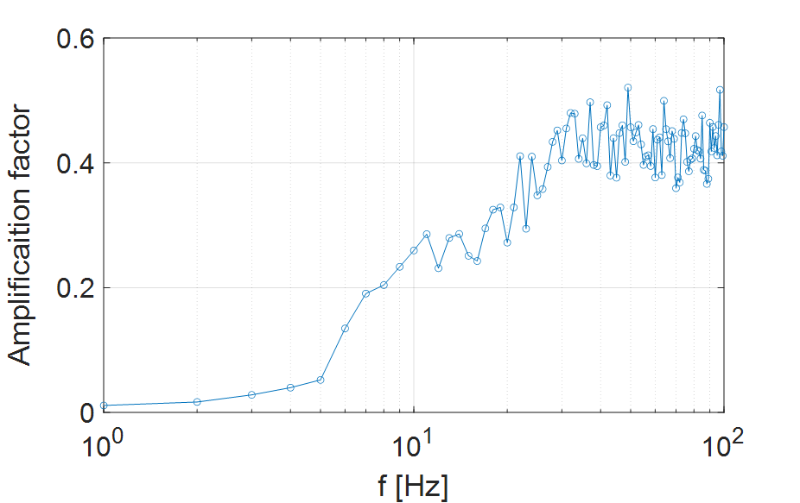
4. Vibration analysis with frequency-dependent coherence
The lower frequency limit for the requirement of ground vibrations
Plane waves model is used for the amplification factor study of different frequencies.
Since the ground vibrations are typically travel from great distances, often spanning kilometres or more, resulting in a minimal decay slope of the vibrations. So the wave’s decay is omitted to simplify the model.
Assuming the wave velocity of the CEPC site
is 2000m/s for all frequencies.
Vibrations with 10nm (RMS) were introduced to all the Quads within the arc section, across a
range of frequencies.
The amplification factor indicates a strong coherence for vibrations at frequencies below 5Hz.
The lower frequency limit for the ground vibration specification of arc region could be extended to 5Hz.

Slide 13
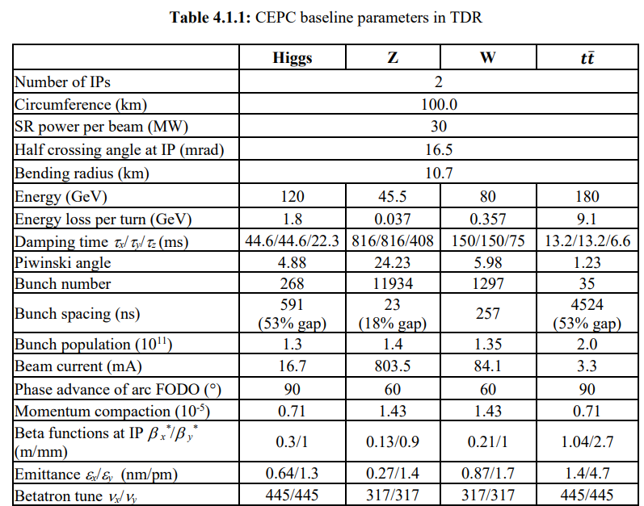
4. Vibration analysis with frequency-dependent coherence
The lower frequency limit for the requirement of ground vibrations
The characteristic wavelengths of slow ground motions are far greater than betatron wavelength, the dynamic effects to the beam can be neglected：[courtesy of June-Rong Chen/NSRRC MEDSI2014]
--CEPC Betatron wavelength:
λ_{βy}= C / ν_{y}= 100km / 445(Higgs mode) = 224.7 m
--Assume the wave velocity of CEPC site is: ν_{y}=2000 m/s
--Consider vibrations with wavelength one magnitude higher than
the betatron wavelength, the characteristic frequency is:
f_{βy} = ν_{βy1} / λ_{βy}= 2000 / 2247 = 0.89Hz ≈ 1Hz
For characteristic frequency of ground vibrations smaller than 1Hz, the dynamic effect to the beam can be neglected. Therefore, 1Hz is treated as the lower limit of the ground motion Spec.

Slide 14
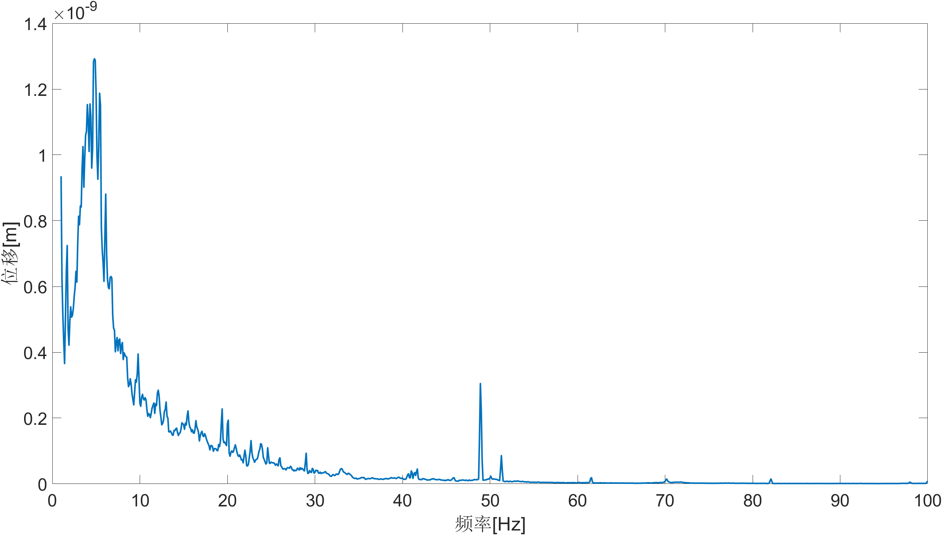
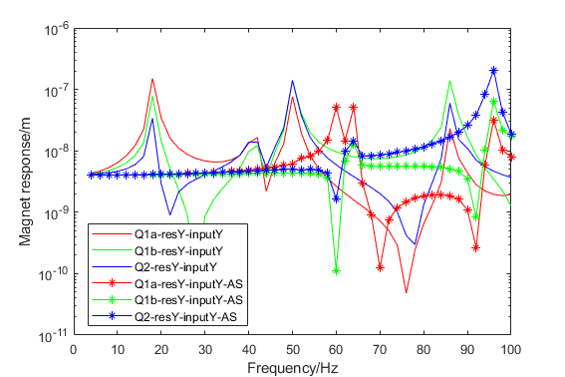
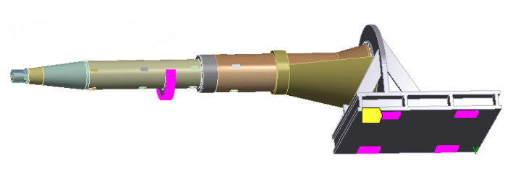
4. Vibration analysis with frequency-dependent coherence
CEPC对撞区磁铁支架的稳定性研究
HEPS night vibration as input on magnet ground
RMS: 4.2nm
Dominated f: 4.8Hz
Frequency Response Function
of a Cantilever Structure
 | Displacement @IP1 | Amplification factor
No support | 5.72nm | 1.43
With support | 3.59nm | 1
Support position
The auxiliary support design can effectively improve the amplification of ground vibrations comparing with design without support: under the assumption that the detector connecting with the auxiliary support does not amplify the ground vibrations. It could be designed with eigen frequency greater than 54Hz or it falls within a frequency range characterized by strong coherence.

Slide 15
5. The vibration parameters necessitate definition for the CPEC site
Actual wave velocity of the site (Currently 2 km/s is assumed) → Complete the vibration beam dynamics model, assess the influence of vibration sources outside CEPC site
Wave attenuation relationship on the site → Complete the vibration beam dynamics model, assess the influence of vibration sources inside of the CEPC site
Vibration level on collision zone (4nm is assumed) → Complete the vibration assessment on collision position
Vibration level on arc area (25nm is assumed)→ Complete the vibration influence on collision position

Slide 16
6. Summary
Vibrations are crucial for luminosity frontier colliders which pursue nanometer scale beam stability at the interaction points.
Ground motion is the usually the major vibrations.
These disturbances originate from both the ground of the interaction region and the arc sections, and the former contributing more substantially to orbit distortion at the IPs. So deducing the vibration levels at the IR could decrease the vibration impact at IP effectively. But there is a limit.
To investigate these vibrations reasonably, a frequency-related vibration beam dynamics model is developed considering coherences at different distances.
The vibration amplification factor at IP has been obtained by introducing vibrations within arc region under the assumption of a 2km/s wave velocity. This could provide as a basis for defining the lower frequency limit for the requirement of ground vibrations in conjunction with the the betatron wavelength of the beam.
The auxiliary support design of the Cantilever Structure at the MDI has been shown to effectively improve the amplifications of ground vibration comparing to structure design without support.

