Slide 1
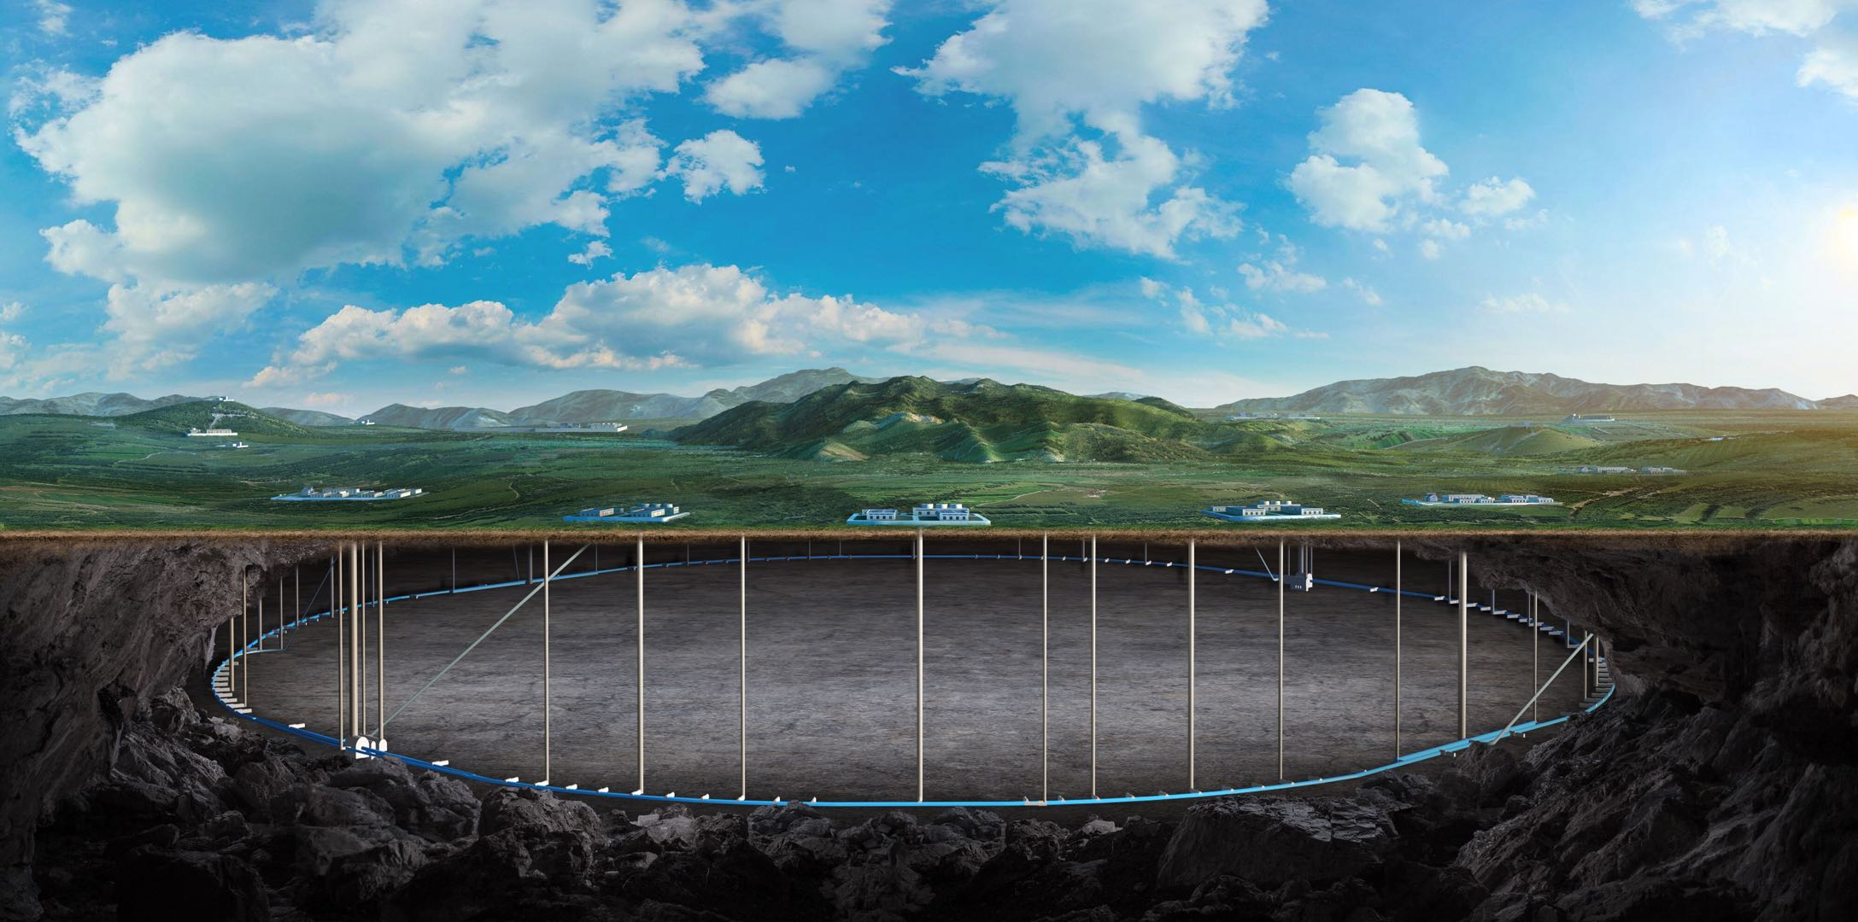


CEPC accelerator instrumentation EDR plan and status
Yanfeng Sui
On behalf of CEPC BI team

Slide 2
Content
The introduction of CEPC beam instrumentation
Booster and collider ring beam instrumentation
Linac and damping ring beam instrumentation
EDR scope goal and plan
EDR progress
Beam position monitor （BPM）system
Beam feedback system
Luminosity tuning system
Industrialization preparation
Summary

Slide 3
Beam instrumentation of linac & damping ring
 | Item | Method | Parameter | Amounts
Linac | Beam position | Stripline BPM | Resolution ：30um | 150
 | Beam current | ICT | 2.5%@1nC-10nC | 63
 | Beam profile | YAG/OTR | Resolution: 30um | 30
 | Beam emittance | Q+PR | 10% | 3
 | Beam energy & spread | AM+PR | 0.1% | 3
Damping ring | Average current | DCCT | Resolution :50uA@0.1mA-30mA | 1
 | Beam position | Button BPM | Resolution : 20um @ 5mA TBT | 40
 | Tune measurement | Frequency sweeping | Resolution:0.001 | 1

Slide 4
Beam instrumentation of the booster
Item | Method | Parameter | Amounts
Beam position monitor | 4 Button pickups | Measurement area (x × y)：±20mm×±10mm Resolution：<20um(turn by turn) | 2408
Bunch current | BCM | Measurement range：10mA / per bunch Relatively precision：1/4095 | 2
Average current | DCCT | Dynamic measurement range：0.0~1A Resolution:50uA@0.6-8mA Linearity：0.1 % Zero drift: <0.05mA | 2
Beam size | Double slit interferometer x ray pin hole | Resolution:0.2 µm | 2
Bunch length | Streak camera Two photon intensity interferometer | Resolution:1 ps | 2
Tune measurement | Frequency sweeping method | Resolution:0.001 | 2
 | DDD | Resolution:0.001
Beam loss monitor | Optical fiber | Space resolution:0.6m | 670
Feedback system | TFB/LFB | Damping time<=3ms/Damping time<=35ms（50ms） | 2/4

Slide 5
Beam instrumentation of the storage ring
Item |  | Method | Parameter | Amounts
Beam position monitor | Closed orbit | 4 Button pickups | Measurement area (x × y)：±20mm×±10mm Resolution：<1um Measurement time of COD：< 4 s | 4252
 | Bunch by bunch | 4 Button pickups | Measurement area (x × y)：±40mm×±20mm Resolution：0.1mm
Bunch current |  | BCM | Measurement range：10mA / per bunch Relatively precision：1/4095 | 2
Average current |  | DCCT | Dynamic measurement range：0.0~1A Linearity：0.1 % Zero drift: <0.05mA | 2
Beam size |  | Double slit interferometer x ray pin hole | Resolution:0.2 µm | 4
Bunch length |  | Streak camera Two photon intensity interferometer | Resolution:1ps@10ps | 2
Tune measurement |  | Frequency sweeping method | Resolution:0.001 | 2
 |  | DDD | Resolution:0.001
Beam loss monitor |  | PIN-diode | Dynamic range:120 dB Maximum counting rates≥10 MHz | 5800
Feedback system |  | TFB/LFB | Damping time<=1ms / <=12ms | 4/ 4

Slide 6
EDR scope and goal of beam instrumentation
Finalize the EDR design of the beam instrumentation, specifically focusing on the luminosity tuning system, and refine the sub-systems.
Key technologies under research and development include the feedback system, luminosity tuning system, key components of the synchrotron radiation system, and more.
Preparing for industrialization：BPM blocks and electronics，beam loss monitors and data acquisition，or other related

Slide 7
EDR plan
2025
Carry out research on the industrialization of BPM electronics and beam loss monitor systems with CIPC member or other potential vendors
CEPC proposal preparation
2026
Complete detail the beam instrumentation engineering design report of sub-systems.
Prepare the EDR of beam instrumentation.
2027
Local fast beam orbit feedback system test logic of whole system.
The whole system cost updates.

Slide 8
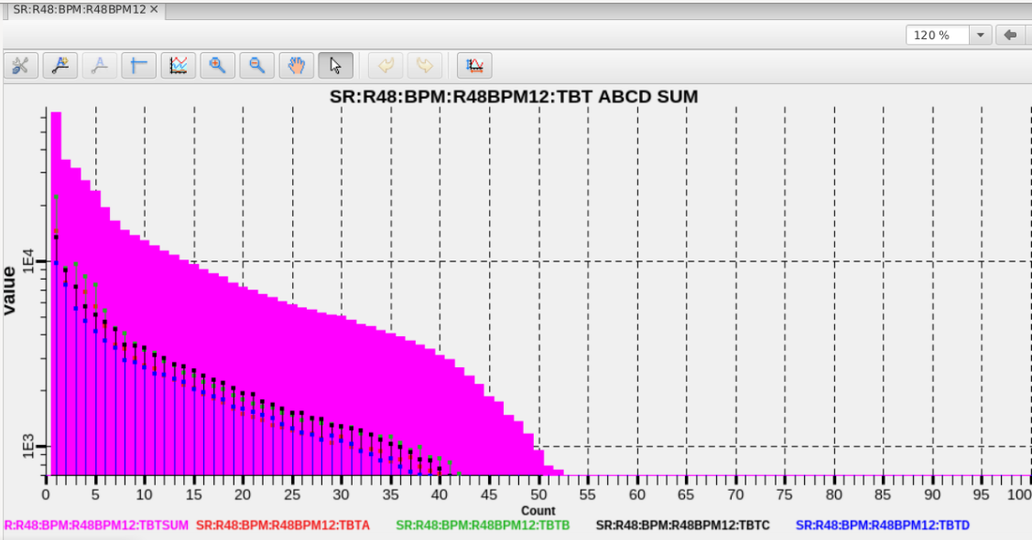
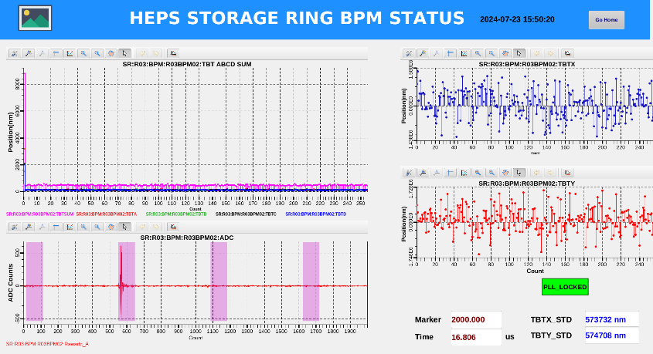
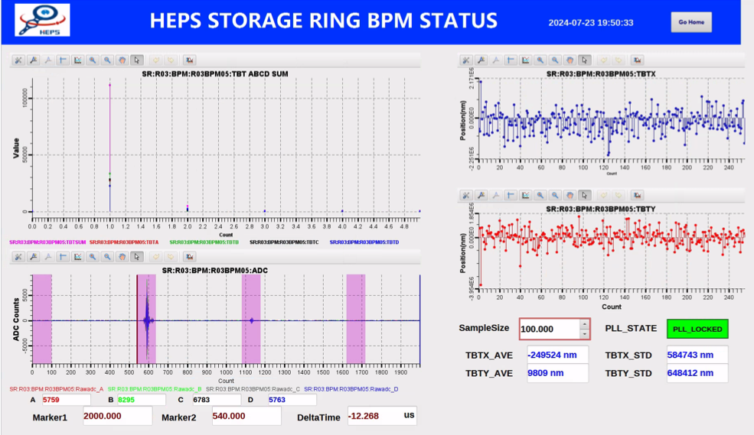
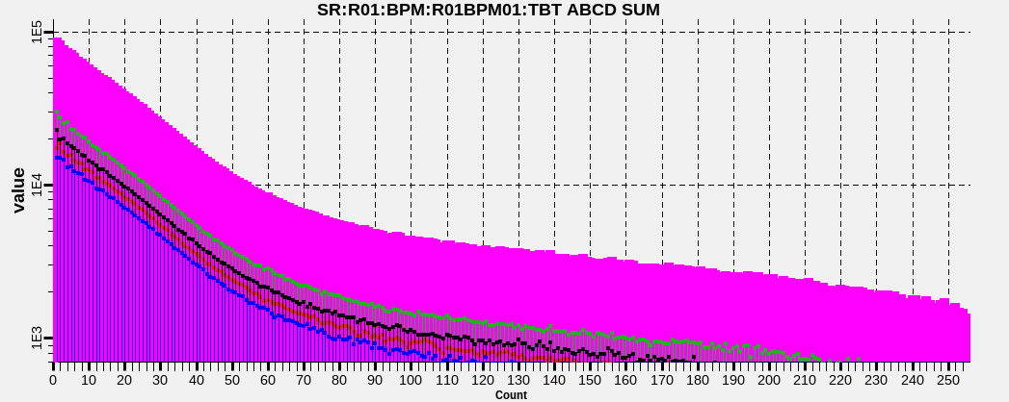
BPM electronics commissioning in HEPS
First injection
The 2nd turn

Slide 9
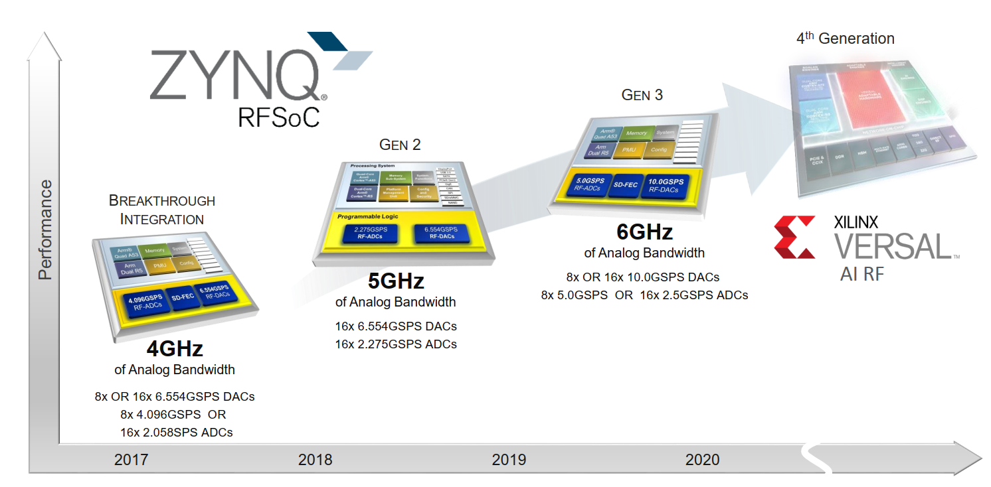
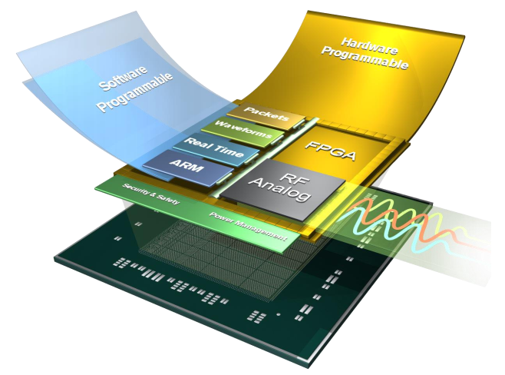
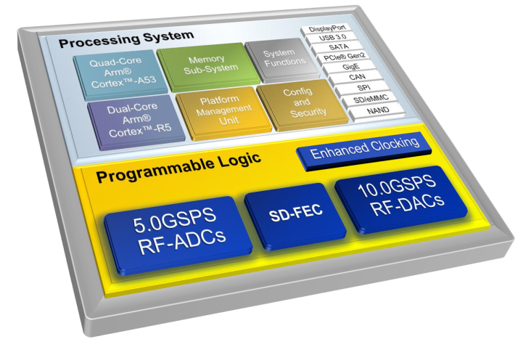
5G direct-RF Sampling in next generator BPM processor
New platforms give rise to new BPM processor

Slide 10
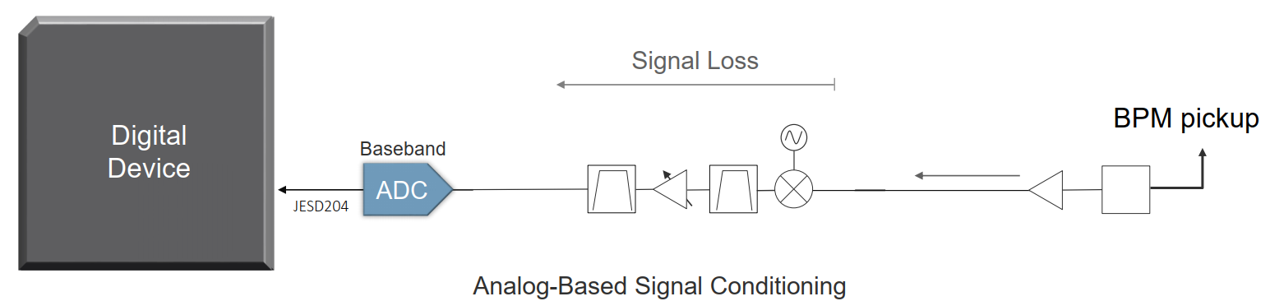
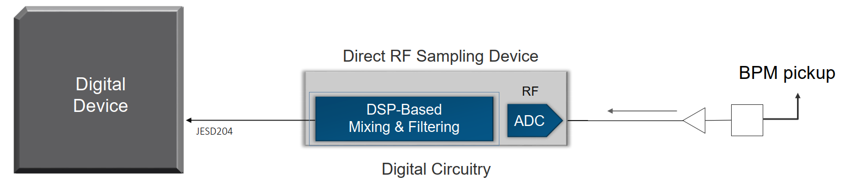
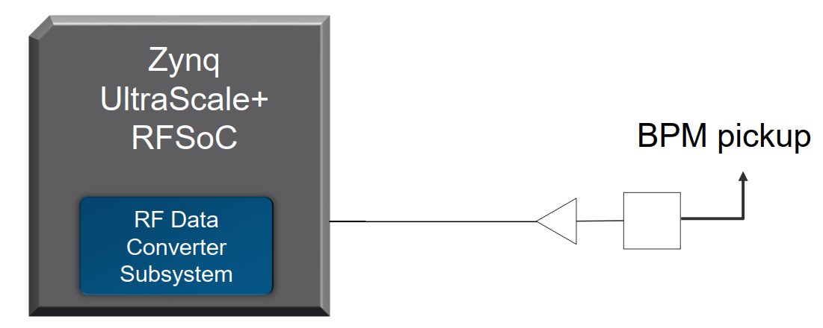
Platform Flexibility with Direct RF-Sampling
Traditional IF (Intermediate Frequency) Sampling before ADC sampling using analog components
✓ Power efficient  Greater footprint due to multiple components  Greater design effort due to BOM complexity  Limited flexibility due to fixed components
Direct RF Sampling Gen2 Signal conditioning after ADC sampling, in the digital domain
 Higher power → higher sample rate
 Significant footprint → discrete component
 BOM complexity → discrete component
✓ Flexibility in the digital domain
Direct RF Sampling Gen3 Signal conditioning after ADC sampling, in the digital domain
✓ Lower power through integration
✓ Smaller footprint through integration
✓ Faster design cycle with less BOM complexity
✓ Flexibility in the digital domain

Slide 11
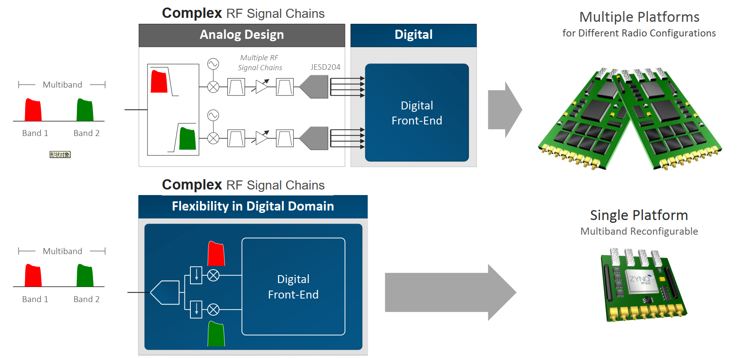
Multi-Standard Reconfigurable Platform for different Accelerator BPM

Slide 12
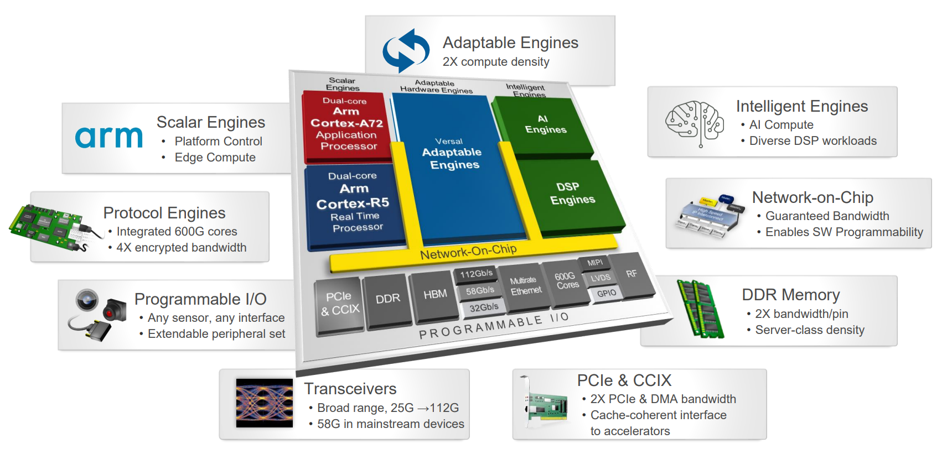
AI FPGA in new generator BPM system
How to correlate multi-dimensional beam data in real time and accurately predict beam evolutionary trends？
Focuses on improving beam prediction accuracy and timeliness by optimizing machine learning models based on AI FPGA
Unlike computer-based machine learning, it also explores extracting key information from massive beam data to optimize model parameters
AI FPGA latency(us) && GPU/CPU latency(ms)
AI FPGA is “hardware tailored and modified for specific AI tasks”, e.g.: BPM
Xilinx AI FPGA

Slide 13
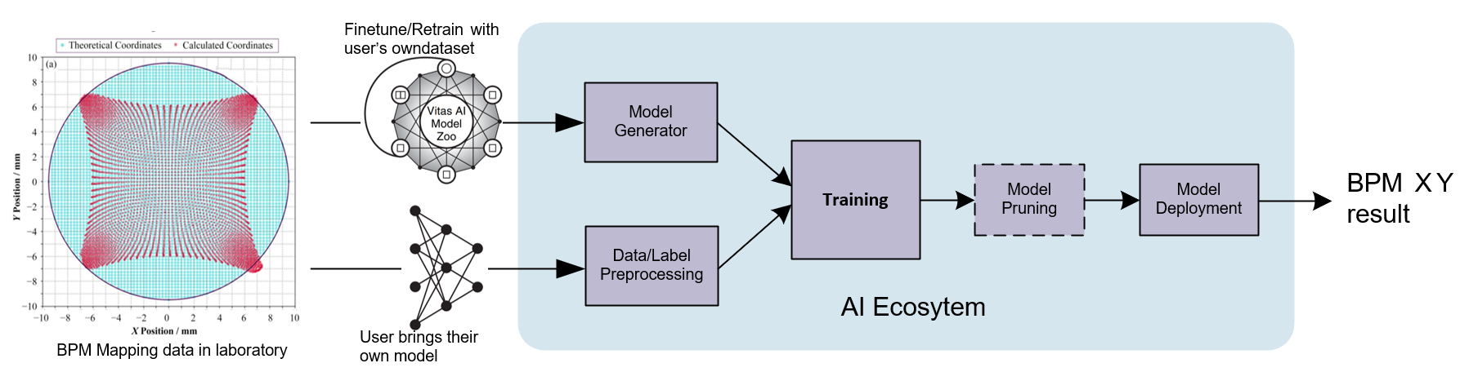
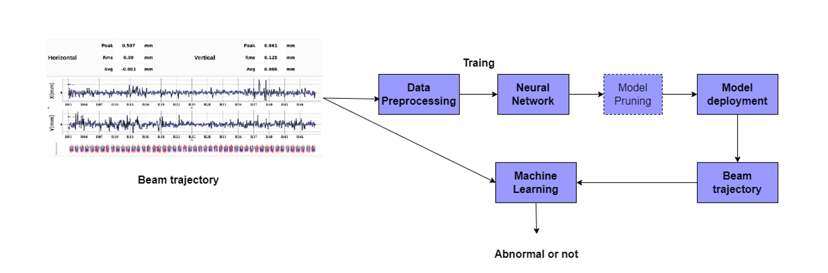
AI FPGA in new generator BPM system
Machine Learning Process Flow Diagram for BPM-based Mapping Data
Machine Learning Process Flow Diagram for Anomaly Monitoring Based on Beam Trajectory

Slide 14
The integration of feedback system with machine learning
The damping time must be shorter than the growth time of the instability.
The data acquisition time (multi-turn oscillation) and processing by the feedback system will occupy a large part of the damping time,for rings with larger circumferences such as the CEPC.
Therefore, machine learning will be applied to the acquisition of beam oscillation signals in the feedback system of CEPC to address the issues above.
Using traditional feedback methods, the time taken for data acquisition will occupy at most 2/3 of the damping time.
0.33ms/turn
2 turns
0.66ms
CEPC Damping Time 1ms

Slide 15
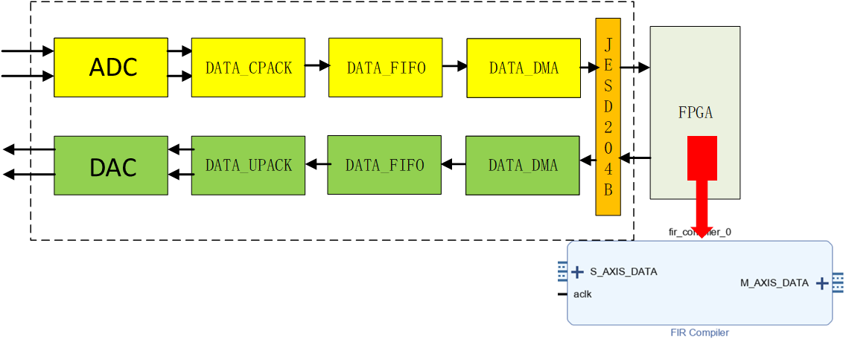
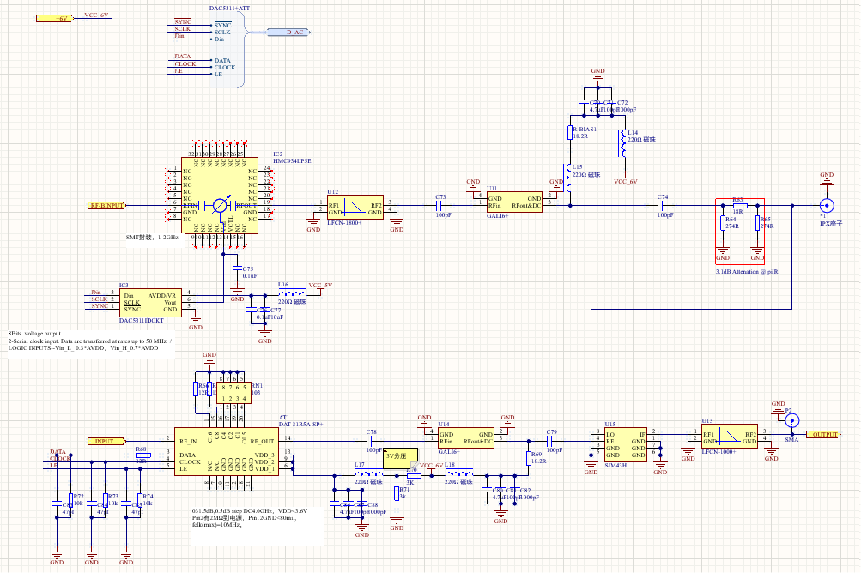
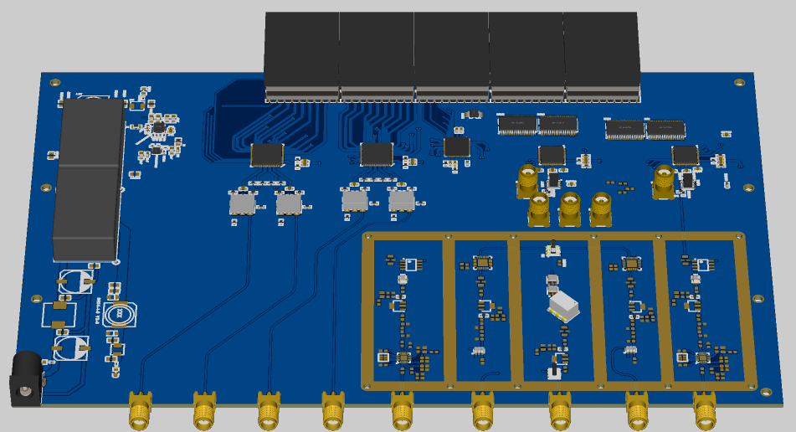
Progress of Front-End Electronics Design
Chip selection and schematic drawing have been completed, along with the implementation of each module's functions.
Front-End Circuit: The signal has an adjustable attenuator (ATT) of 31.5 dB, an LNA gain of 21.8 dB, and a down-conversion phase shifter with an adjustable phase from 0 to 400°.
A/D and D/A Circuit: LVDS, 500 MSPS
Clock Module and Power Module Design
Design FIR Filter Algorithm Using ISE
Front-End Schematic Design
PCB Layout and Routing

Slide 16
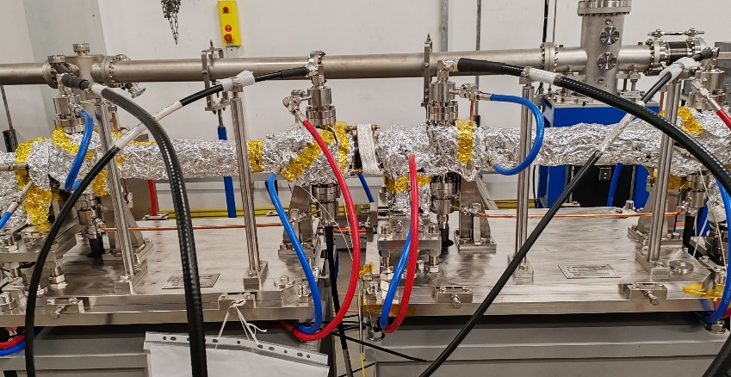
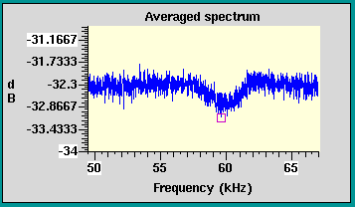
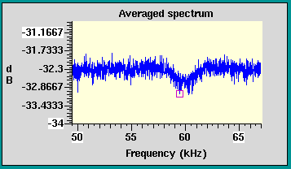
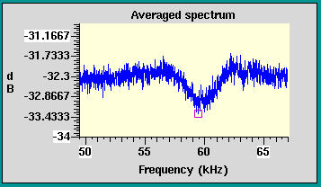
Validate the feasibility of multiple feedback at HEPS
For a large accelerator like CEPC, with strong coupling instabilities, the shunt impedance provided by a single feedback kicker is limited by factors such as the dynamic aperture. Therefore, multiple kickers are required to enhance the damping capability.
At HEPS, the Y-direction feedback system employs two kickers in series. We observed phenomena using two kickers separately at approximately 100 mA. As shown in the figure below, the notch tune in the spectrum of data using a single kicker is similar, while the notch tune using two kickers is significantly deeper. This demonstrates that this method has enhanced the damping effectiveness..
The Y-direction feedback at HEPS uses two kickers in series
Only use kicker1
Only use kicker2
Use both kicker1 and kicker2

Slide 17
Design of luminosity tuning system for CEPC
BPM sub-system
BPM pick-up
PT module
Digital BPM electronics
Luminosity monitor sub-system
Luminosity detector
Front-end electronics
DAS electronics
Interaction Point fast orbit feedback control system of CEPC
BPM interface logic
Luminosity monitor interface logic
TDC logic
FOC, Fast Orbit Controller
Power Supply Controller Interface
……

Slide 18
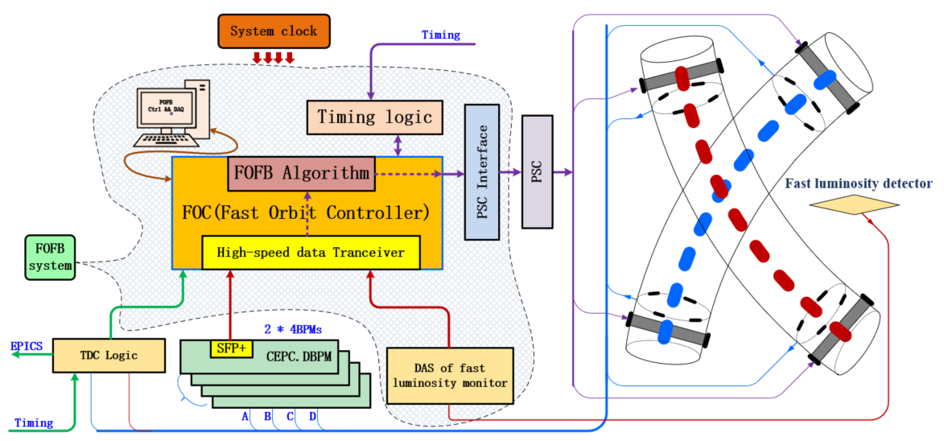
Design of the fast orbit feedback system at IP
Fast Orbit Feedback Controller
BPMs
Luminosity Monitor
TDC logic
Interface to Power Supply Controller
……

Slide 19
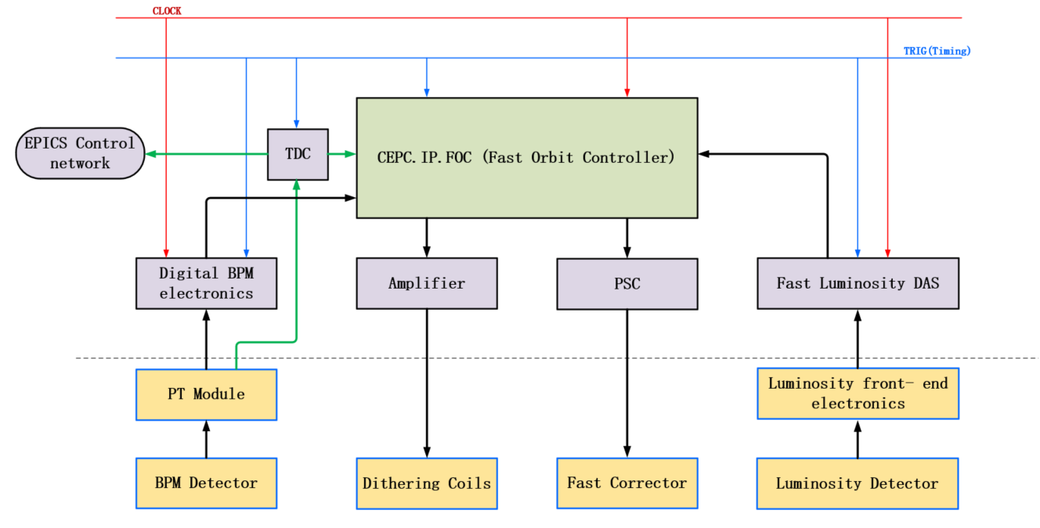
Fast Orbit Controller electronics
FOC Input signals
Digital BPMs data
Luminosity monitor data
Electron and positron beam arriving time
Clock and Timing signal
FOC output signals
Fast corrector power supply setting
Dithering controlling information

Slide 20
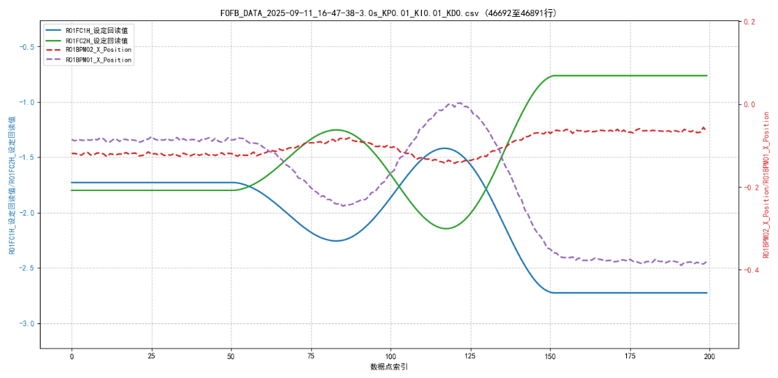
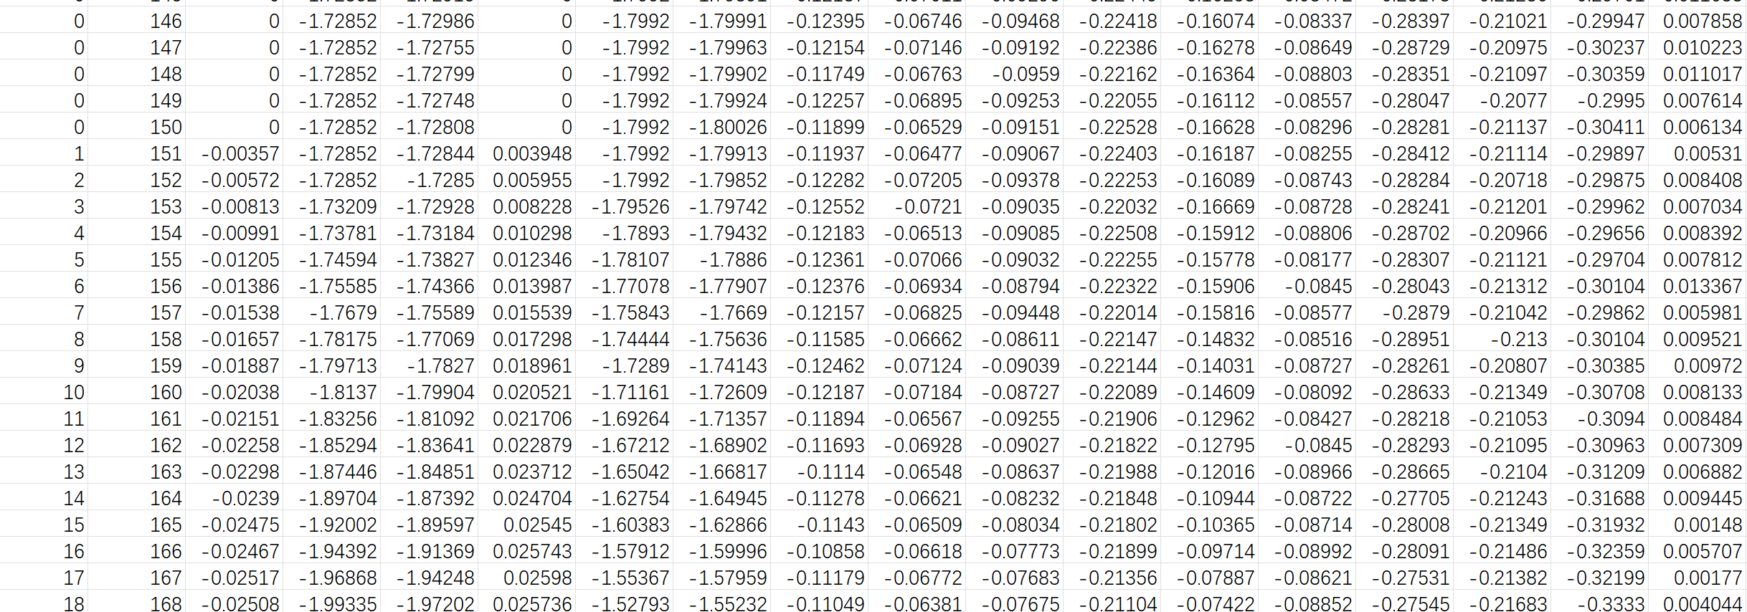
FOFB system commissioning in HEPS
Commissioning with beam(2025.09.11)
Beam current: 15mA; BPM selected: R01BPM01 and R01BPM02; FC selected: R01FC1H \ R01FC2H \ R48FC3H \ R48FC4H.
Fixed 100 steps running mode; the limit of PSC amplitude setting is ± 6A; and save FOFB data synchronously during each test running.
A few sets of PID parameters are testing, and expected results not obtained, more experiments are needed.
Based on the results of FOFB testing, the FOFB algorithm and the correct FC current setting values are verified.

Slide 21
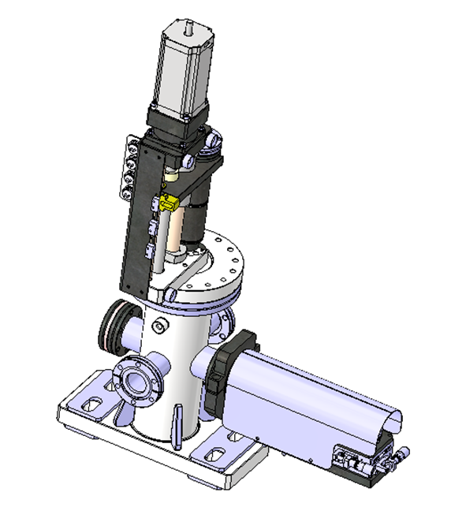
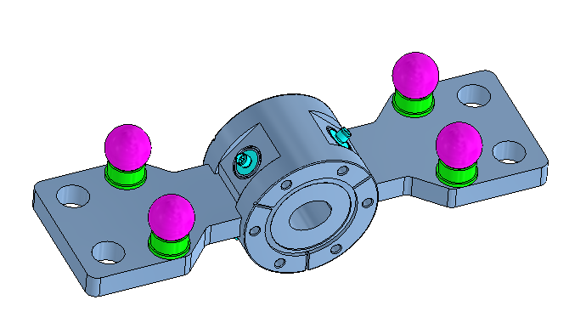
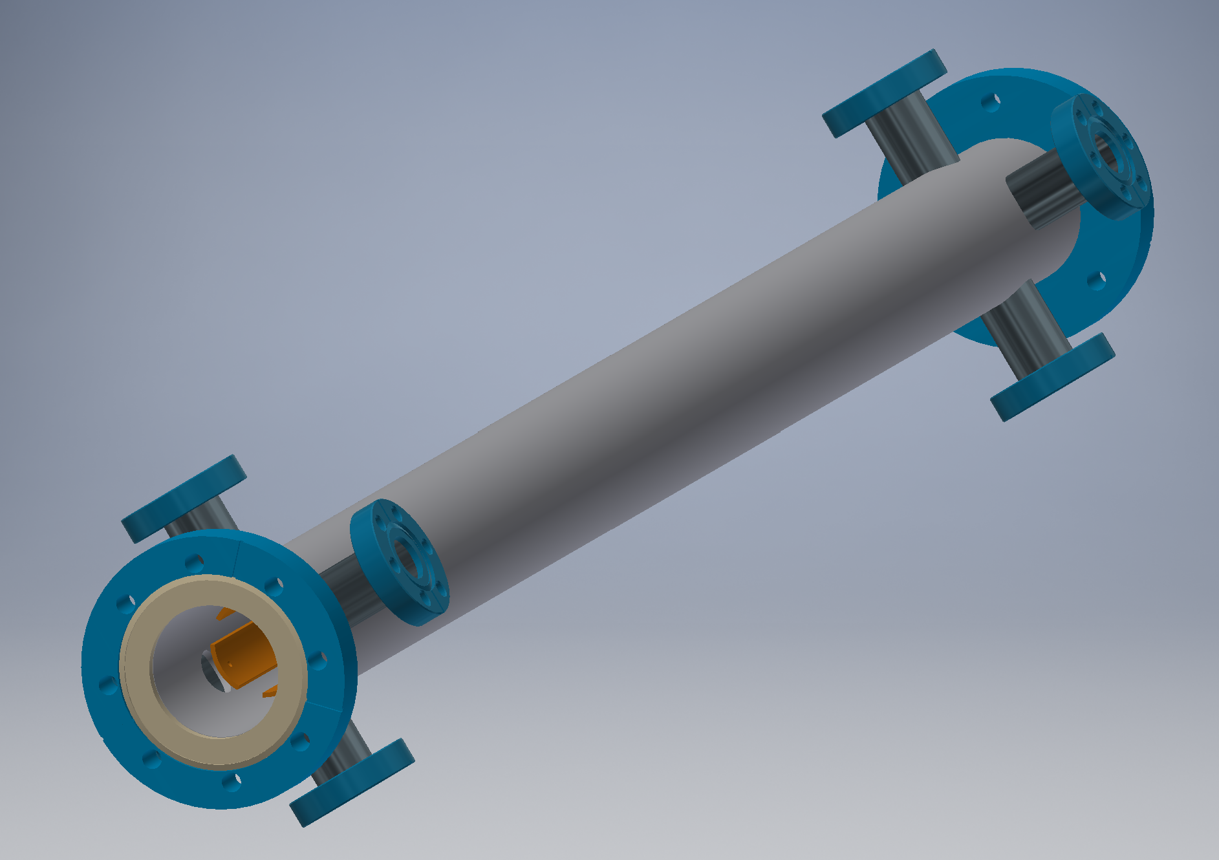
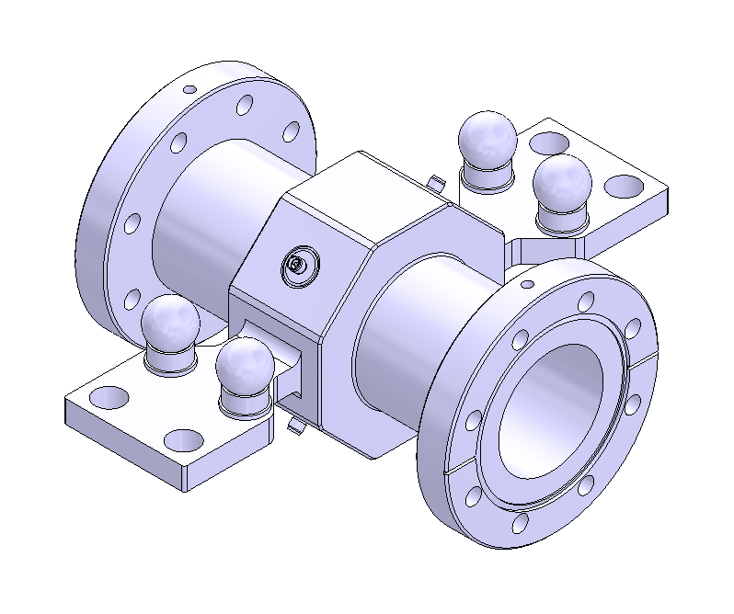
BI component-types and quantities
Location | Hardware types | Quantity
Linac | 10 | 244
Booster | 6 | 2418
Collider | 7 | 7134
Transport lines | 5 | 86

Slide 22
Industrialzation preparation
Components | Quantity | Vendors
BPM electronics | ~10000 | Beijing DAQ Technology Co., Ltd.(迪爱科) Beijing Conveyi Limited（科维泰信）
BPM feedthrough | ~40000 | East China Optical Technology Research Co., Ltd.(华东光电）、Anhui High Tech Co., Ltd.(安徽海泰科电子） Kyocera（京瓷）
BPM block | ~10000 | Liaoning SEALTECH Technology Co., LTD. (辽宁希泰) Hefei Keye Co., Ltd.(合肥科烨） East China Optical Technology Research Co., Ltd.(华东光电）
Beam loss monitor | ~6000 | North Night View Technology Co., Ltd(北方夜视） HAMAMTSU（滨松）
Cable | ~50000 | Jiangsu Anshengda Aerospace Technology Co., Ltd（安胜达）

Slide 23

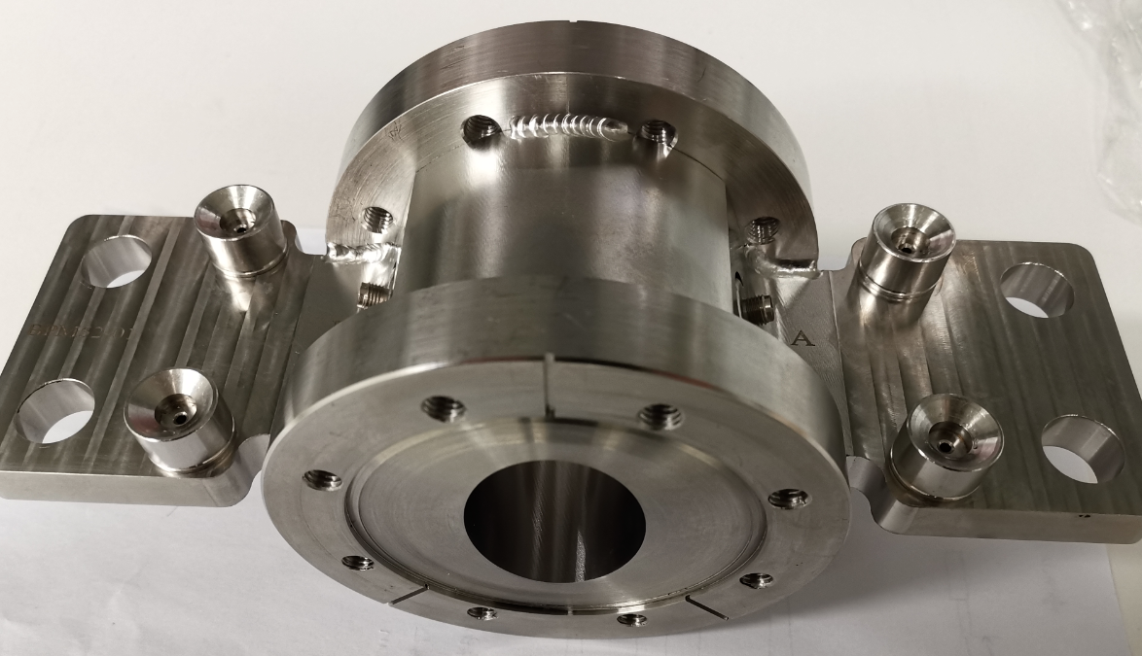

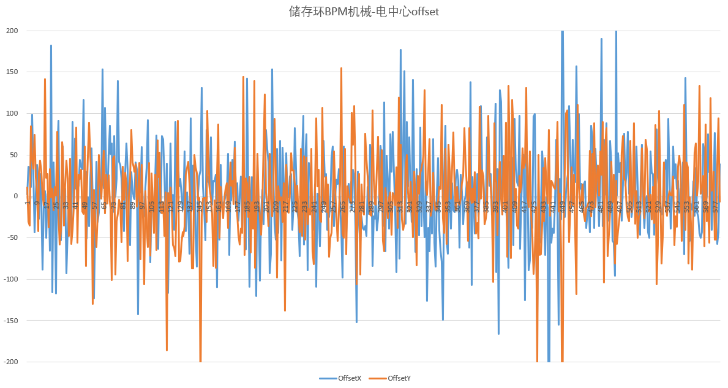
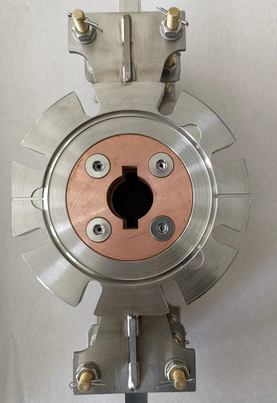
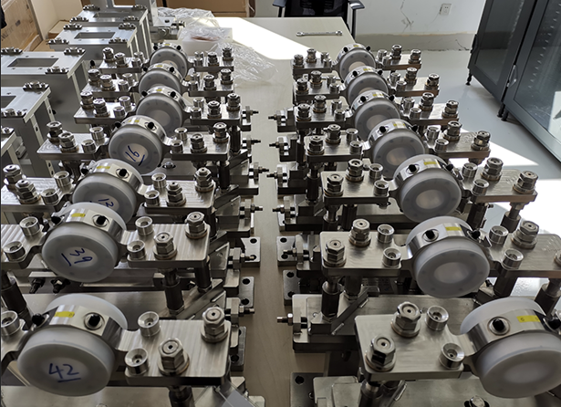

The vendor of BPM blocks
The fabrication capabilities, process standards, and detection capacity of the collaborating manufacturers have all been significantly improved by HEPS BPM.
The electro‑mechanical(geometry) offset are controlled within 80um(RMS), which is the target we set to complete the beam commissioning of the first turn of the 4th-generation light source before BBA.
can meet the requirements of CEPC, for which the value is about 100 um.
Offset between M&E centre | Value
The 3rd Generation light source | ~100um
The 4th Generation light source | ~80um
CEPC1 | ~100um
Electrical offset distribution for HEPS SR BPMS.

Slide 24
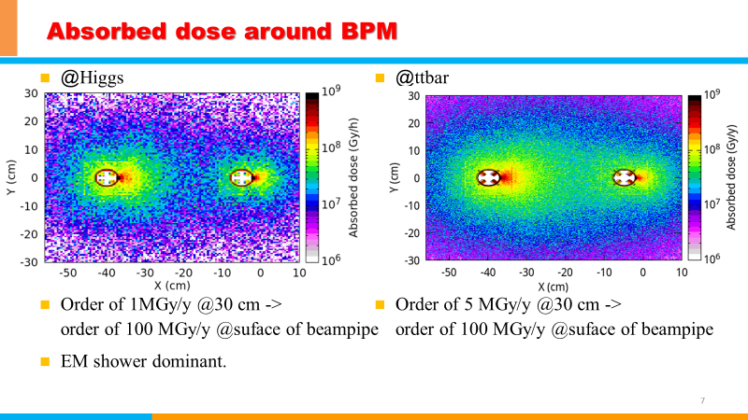
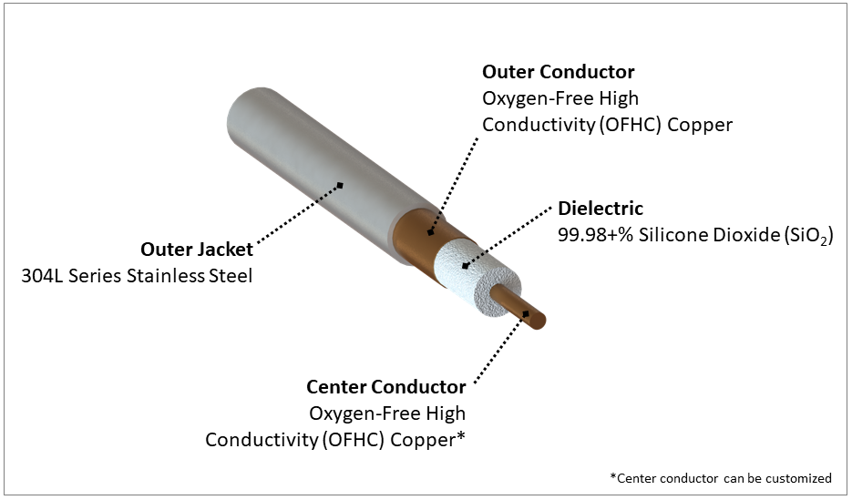
Potential vendor of cable
Courtesy of Guangyi Tang
SiO2 RF cable Assemblies By AMT（安胜达）

Slide 25
Summary
During the EDR phase, studies will be conducted on the industrialization of BPM and BLM sub-systems, beam feedback system, luminosity tuning system and R&D of key components for synchrotron light.
Building upon the beam tuning of HEPS, optimize beam diagnostics devices and develop the next generation of beam instrumentation.
The beam instrumentation system has finalized the CEPC proposal in this year and be prepared for construction after the EDR phase.
Thank you for attention！

