Slide 1

The Electron Cloud and SEY measurents for CEPC
Yudong Liu
CEPC’ 2025, Guangzhou, November 6-10

Slide 2
Outline
The Electron Cloud simulation
The parameters of CEPC TDR
Sources and Model of Ecloud
Density of Ecloud and Instability Threshold
A new source of Ecloud in collimator
Experimental measurements on SEY of NEG coating
Experimental apparatus
Measurements & results
Summary & Conclusions

Slide 3
The Parameters of CEPC TDR(30MW)
Parameters | H | Z
Circumference (km) | 100
Bunch population (10¹⁰) | 13 | 14
Bunch spacing (ns) | 550 | 23
Beam energy (GeV) | 120 | 45.5
Emittance x/y (nm) | 0.64/0.0013 | 0.27/0.0014
Pipe radius (mm) | 28
Bunch number | 268 | 11934
Betatron tune | 445.1/445.22 | 317.11/317.22
Synchrotron tune | 0.049 | 0.035
Luminosity per IP (10³⁴ cm^{–2} s^{–1}) | 5.0 | 115

Slide 4
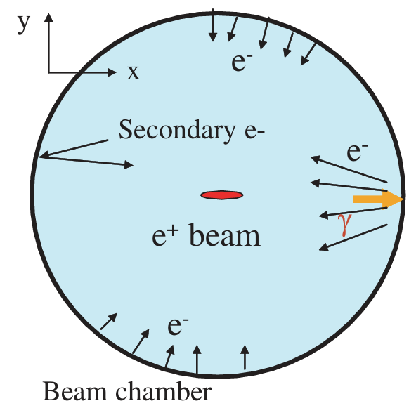
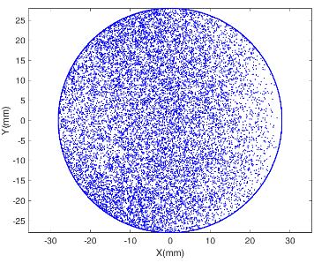
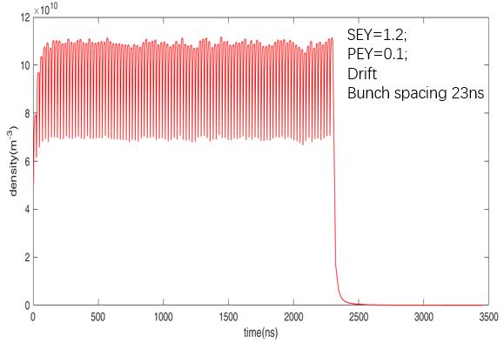
Source of ECLOUD
(1) Synchrotron radiation on wall=>photon electron
(2)Photon electron on wall=> secondary electron(SEY>1)
All the electrons trapped by the beam and accumulation to produce the cloud. With the action between the beam and space charge of Ecloud, the EC will be in an status of balance with density, ρ.

Slide 5
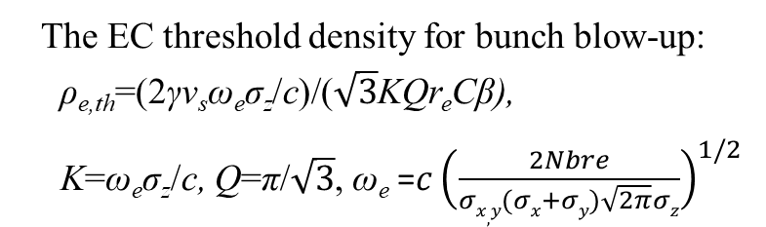
Density of Ecloud and Instability Threshold
Action of EC on bunches, treated as an wake, can induce coupled bunch instabilities and emittance blow-up , which lead to luminosity degradation.
The balanced neutralization density of Ecloud:
ρ_{e,neutr}≈λ_{e}/πab,
Wake field :
W_{ec,x,y}/L=4πρ_{e,neutr}/n_{b},
The growth rate for coupled bunch instability :
1/τ_{e,CB} =(2r_{e}n_{b}c²)/(γω_{β}abL_{sep})
Parameters | H | Z
Circumference (km) | 100
Bunch population (10¹⁰) | 13 | 14
Bunch spacing (ns) | 10/25/50/100 | 20/23
Beam energy (GeV) | 120 | 45.5
Emittance x/y (nm) | 0.64/0.0013 | 0.27/0.0014
Pipe radius (mm) | 28
Bunch number | 268 | 11934
Betatron tune | 445.1/445.22 | 317.11/317.22
Synchrotron tune | 0.049 | 0.035
Neutralization volume density (10¹²/m³) | 17.6/7.04/3.52/1.76 | 9.48/8.24
Simulated electron cloud density (10¹¹/m³) (SEY~1.2) | 5.17/1.31/0.242/0.0392 | 1.21/1.16
Simulated wake field W/L (/m³) | 49.97/12.66/2.33/0.37 | 10.86/10.41
Growth time (ms) | 2.4/9.4/51.1/315 | 2.8/2.9
Threshold electron density (10¹¹/m³) | 7.27 | 1.4
The EC threshold density for bunch blow-up:
ρ_{e,th}=(2γν_{s}ω_{e}σ_{z}/c)/($\sqrt{3}$KQr_{e}Cβ),
K=ω_{e}σ_{z}/c, Q=π/$\sqrt{3}$, ω_{e} =$c{\left(\frac{2Nbre}{σx,y(σx+σy)\sqrt{2π}σz}\right)}^{1/2}$
ω_{e} : oscillation frequency of electrons in the bunch
For Z mode operation, the Ecloud will be most serious.
Bunch spacing choice(shortest): ~ 20ns
A transvers feedback system with a damping time at scale of millisecond is required to suppress coupled bunch instability.
5

Slide 6
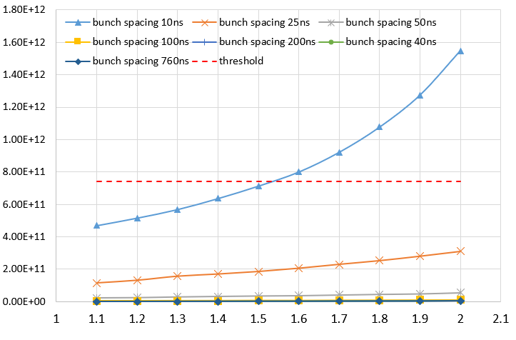
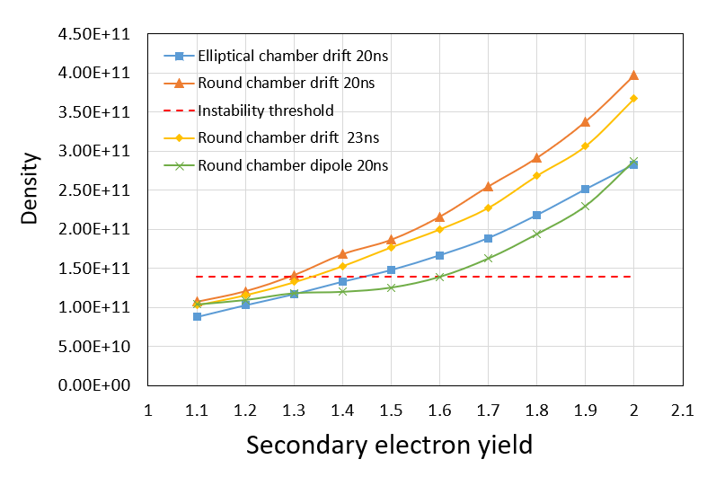
Simulation on ecloud density with various SEY
Higgs mode
Z mode
The coating to SEY<1.3 is necessary for the restriction on ECI.
The NEG coating have been used in positron ring of CEPC!

Slide 7
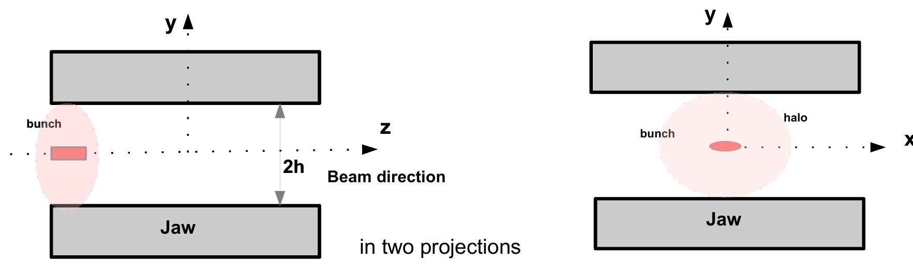
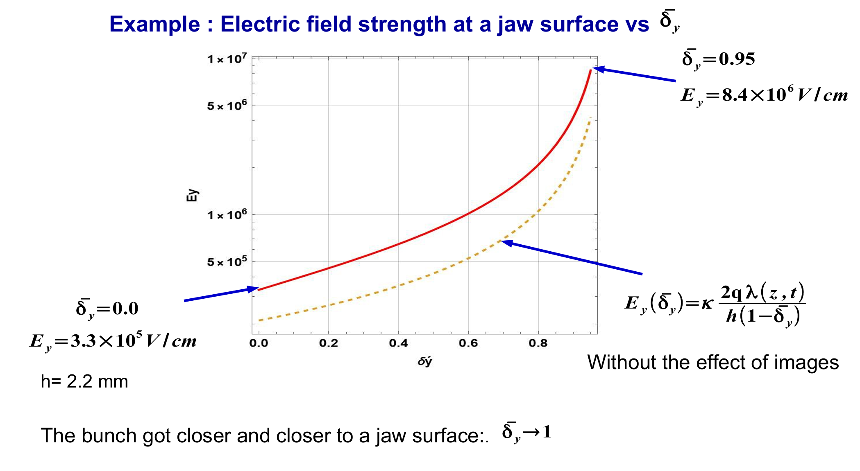
New source of Ecloud
(Boris Levchenko, The XXV International Workshop-School High Energy Physics and Quantum Field Theory, in SINP MSU)
Field Emission Effects in collimators
When the beam is close to the jaw of collimator. Beam field may lead to the emission of electrons from the mental surface.
Beam closer to the surface of the jaw
The electrons may escape the potential well of mental surface!
Beam in center

Slide 8
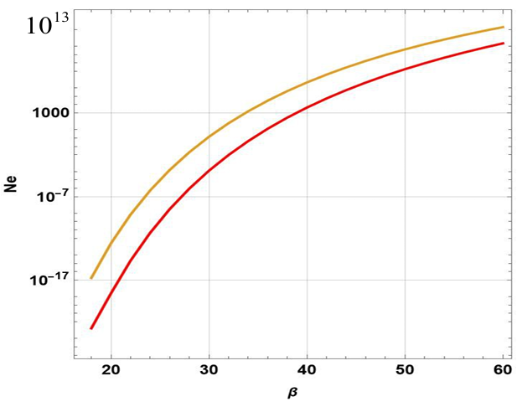
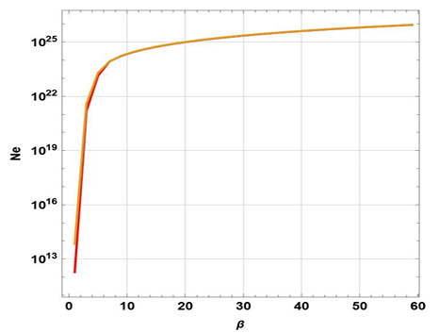
Estimation from Boris Levchenko for CEPC collimators
Number of extracted electrons
Number of electrons emitted per second
Yellow line: beam deviation the center by 10%
Red line: beam in center
half gap of collimator: h = 2.2mm
The minimum gap of the removable collimator :
h = 0.03 mm
Due to the field emission effect, the number escaped electrons may exceeds the number of particles in the beam at the minimum collimator .
β is the morphology of the surface

Slide 9
Aperture of CEPC collimator and method to weaken electron field emission
Name | Distance to IP (m) | Xgap(mm) | Ygap(mm)
APT_2771 | 11748.52435 | 3 | 28
APT_2810 | 12027.70841 | 3 | 28
APT_2833 | 12370.10786 | 28 | 3
APT_4283 | 21038.99896 | 28 | 3
APT_4293 | 21093.61577 | 28 | 3
APT_6865 | 36969.84323 | 3 | 28
APT_6890 | 37316.24267 | 28 | 3
APT_6956 | 38038.18305 | 3 | 28
APT_11521 | 49655.66327 | 28 | 3
APT_11532 | 49655.77327 | 28 | 3
APT_29852 | 62007.06708 | 3 | 28
APT_29876 | 62348.69421 | 28 | 3
APT_29931 | 62911.56091 | 3 | 28
APT_30782 | 67797.96566 | 28 | 3
APT_30792 | 67856.38248 | 28 | 3
APT_33860 | 86513.96962 | 3 | 28
APT_33896 | 86787.35146 | 3 | 28
APT_33921 | 87133.7509 | 28 | 3
APT_35712 | 97743.06639 | 28 | 3
APT_35722 | 97821.18938 | 28 | 3
APT_38002 | 99466.68453 | 28 | 3
APT_38013 | 99466.79453 | 28 | 3
APT_4267 | 20931.26533 | 4 | 28
APT_4275 | 20984.38214 | 4 | 28
APT_11495 | 49655.40327 | 4 | 28
APT_11507 | 49655.52327 | 4 | 28
APT_30756 | 67639.71523 | 4 | 28
APT_30764 | 67694.33204 | 4 | 28
APT_37978 | 99466.44453 | 4 | 28
APT_37988 | 99466.54453 | 4 | 28
APT_51046 | 99602.02646 | 4 | 28
Collimator surface treatments maybe necessary to restrict the electron field emission!
More smooth surface to be treated for lower β!

Slide 10
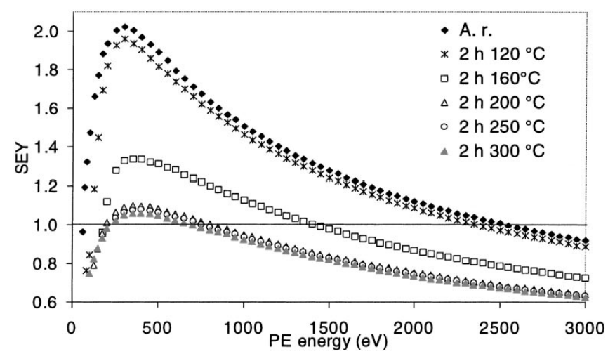
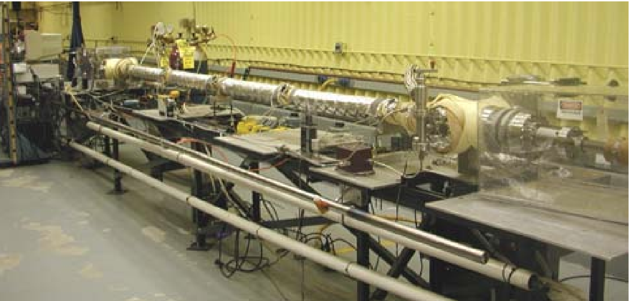
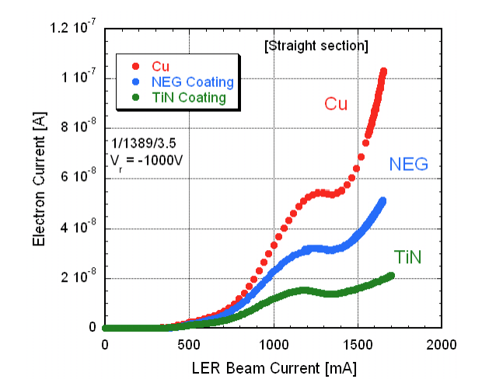
Lower SEY : NEG coating for suppression on SEY
NEG coating have been proved to be one of the most effective methods for SEY restriction
CERN, LHC
NEG Coating in RHIC
Applied Surface Science 172 (2001)95-102, B. Henrist, N. Hilleret, C. Scheuerlein* , M. Taborelli
PAC2005,Knoxville, Tennessee, D. Weiss , P. He, H.C. Hseuh, R. Todd
KEK, LER
For CEPC positron rings the SEY is <1.3, NEG films are necessary!
NIM A 578 (2007) 470–479, Y. Suetsugu, K. Kanazawa, K. Shibata, H. Hisamatsu

Slide 11
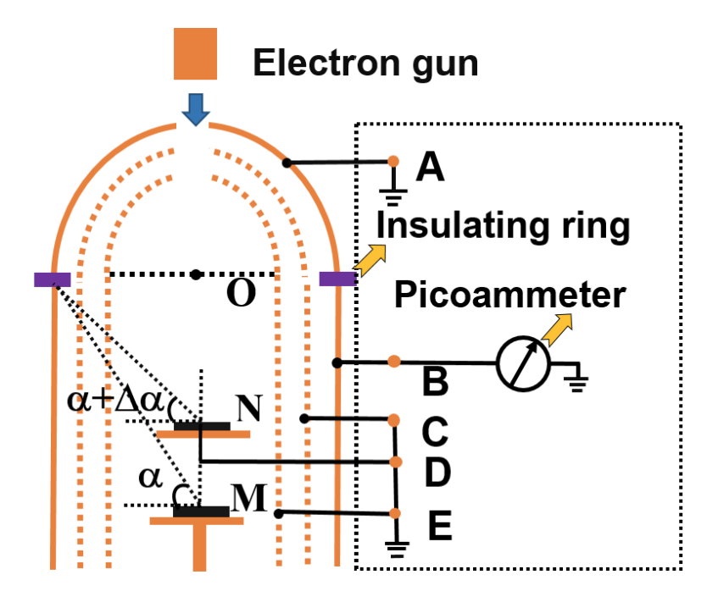
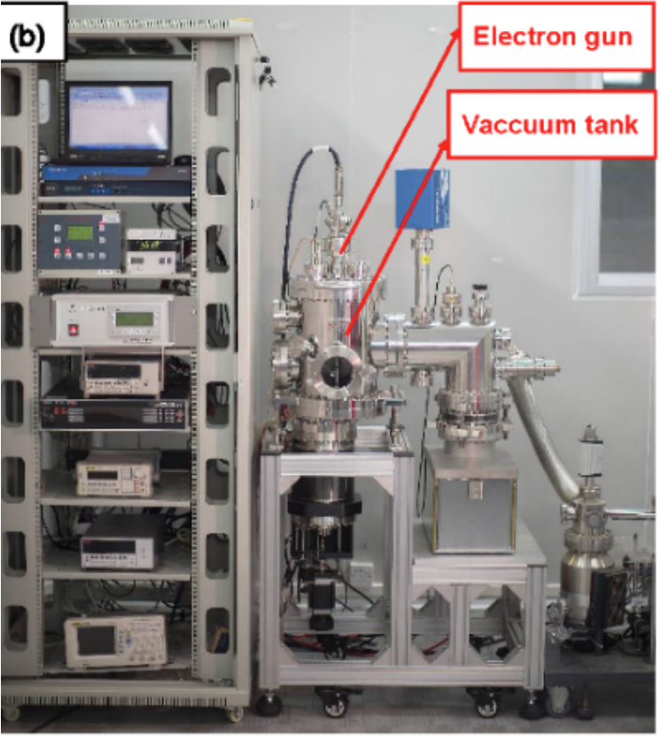
Experimental apparatus and its upgrade
The apparatus have been set up and get some results.
For the past several years, this apparatus was updated to make measurements in cryogenic environment!

Slide 12
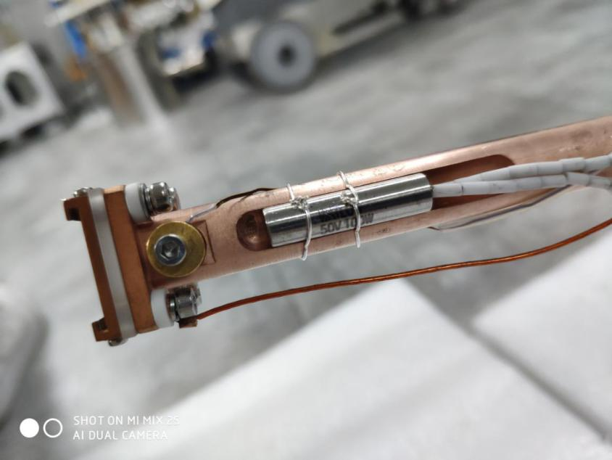
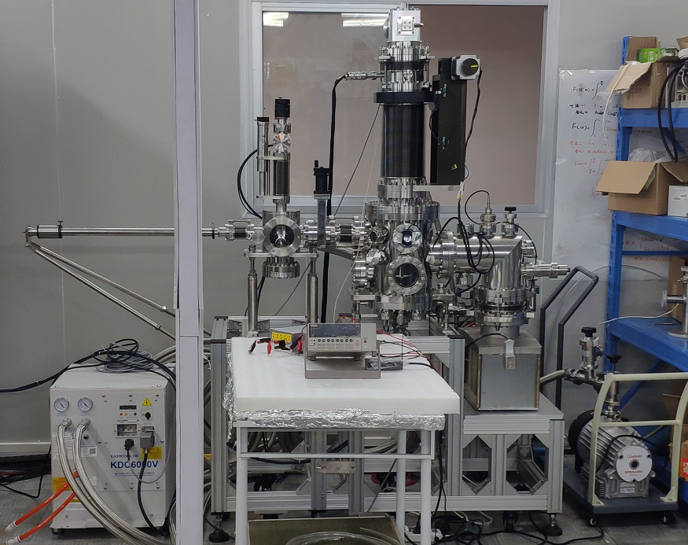
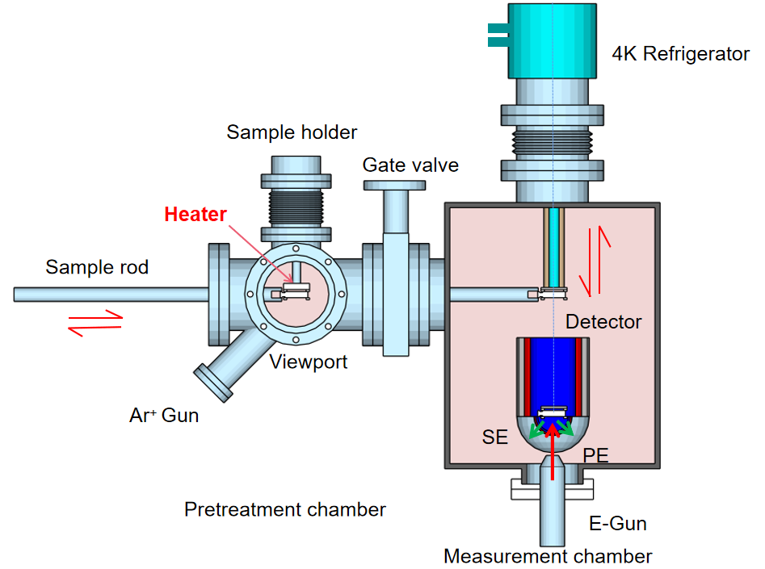
The Updated Experimental apparatus
A refrigerator was used to cooling the sample to 4K.
Considering the length of refrigerator, the E-Gun and detector was upside down.
The sample can be treated in pretreatment chamber.

Slide 13
Experiments results : mental materials
A few mental materials such as Nb,Nb/Cu，Nb₃Sn、SS are used in cryogenic environment of accelerators.
Without baking and clearing
With baking and clearing
Surface treatment is more important to SEY than temperature!

Slide 14
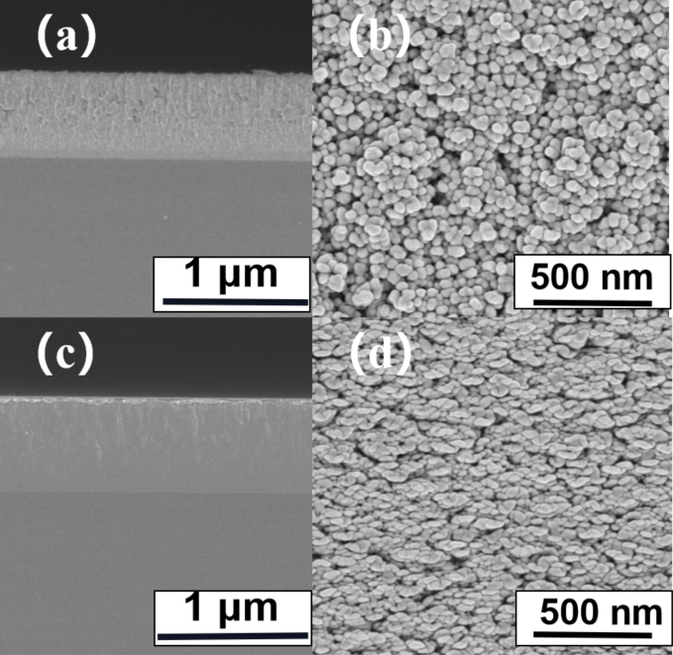
Experiments results : NEG(TiZrV &TiZrHfV )
Ternary TiZrV and quaternary TiZrHfV films with thickness 1um were deposited on OFC by DC magnetron sputtering.
TiZrV
TiZrHfV
Cross-sectional and surface morphologies
The TiZrV and TiZrHfV films possess an average surface roughness of 32.2 nm and 29.2 nm, respectively

Slide 15
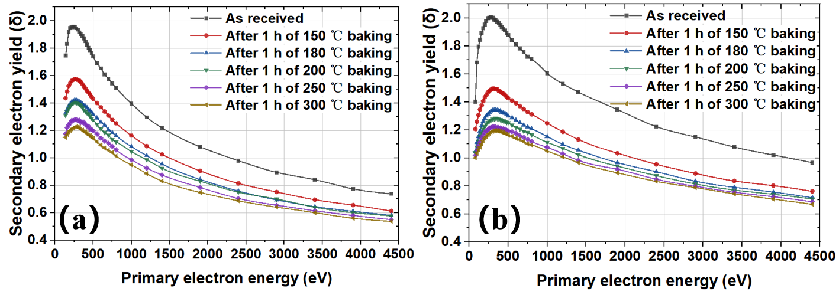
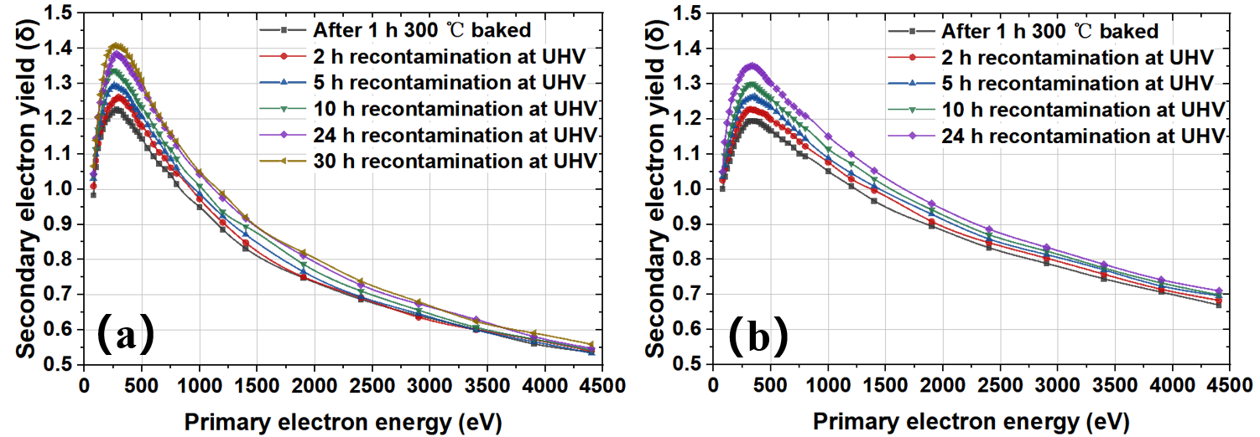
SEY results for NEG film with heating treatment & recontamination
TiZrHfV
TiZrV
The SEY of NEG film can be decreased to 1.2 by heating treatments to 300℃ for an hour.
TiZrV
TiZrHfV
Gas molecules absorption in UHV, SEY: increase

Slide 16
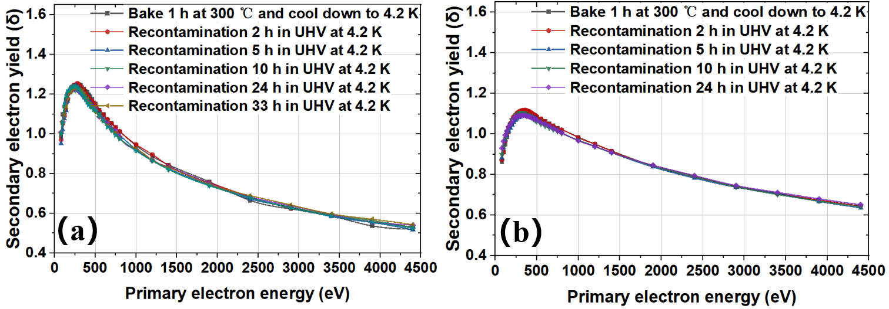
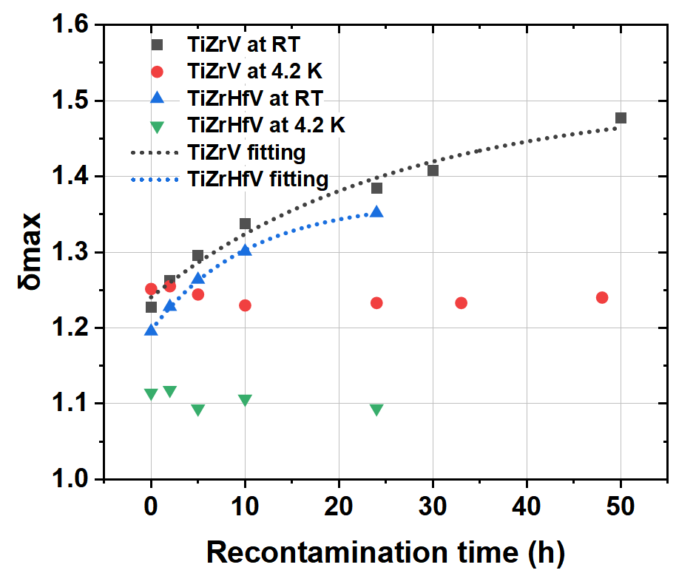
SEY in 4.2K
TiZrHfV
TiZrV
The SEY is almost same with recontamination in cryogenic environment。

Slide 17
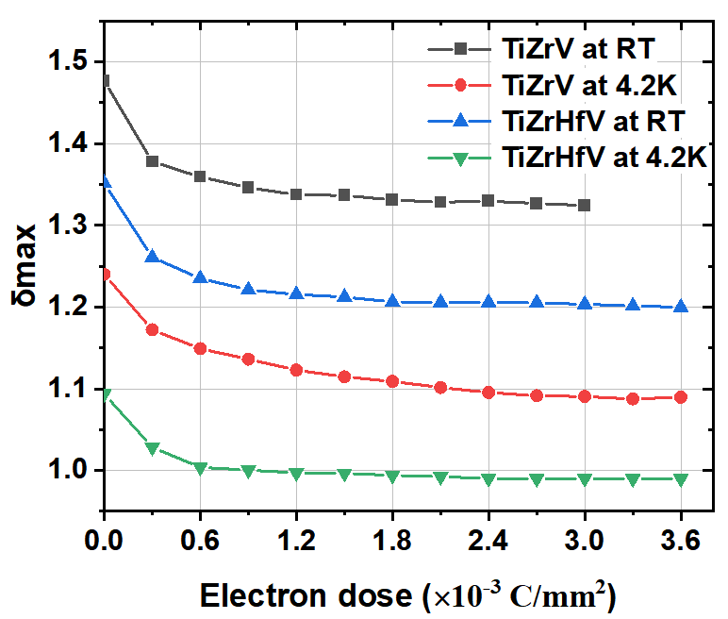
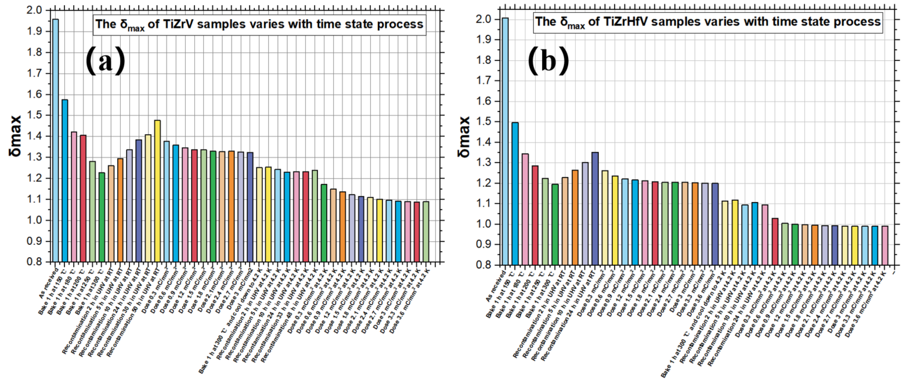
Variation of δ_{max} as a function of electron dose on activated TiZrV and TiZrHfV
SEY of the NEG film in a similar accelerator condition

Slide 18
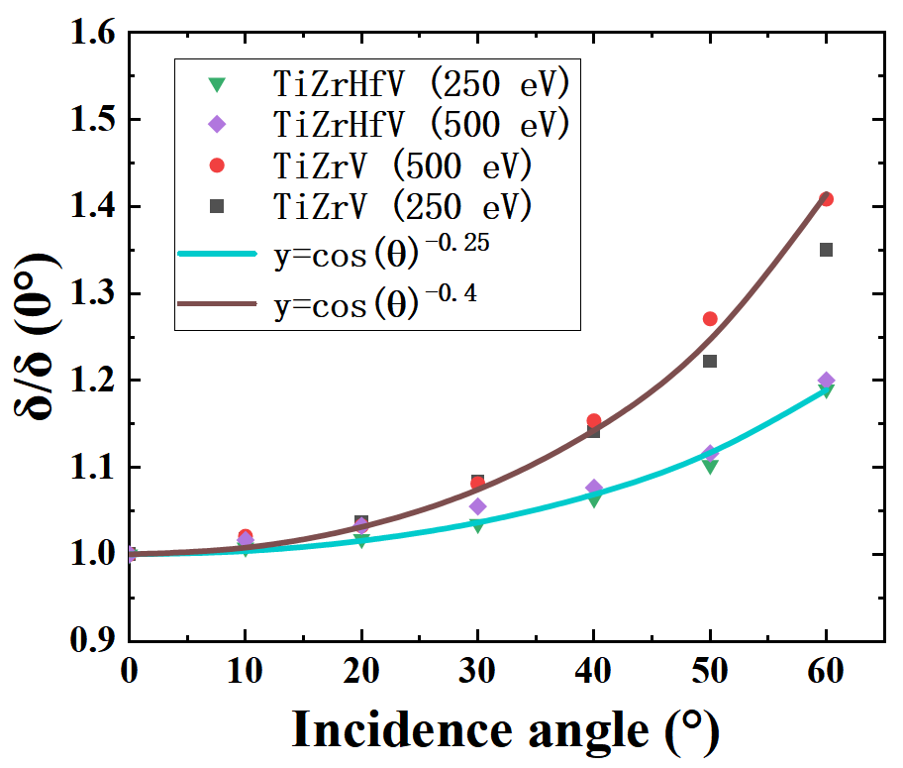
SEY dependence on incident angle
The sample holder can be rotated from 0° to 60° to obtain the dependence of the SEY on the incident angle

Slide 19
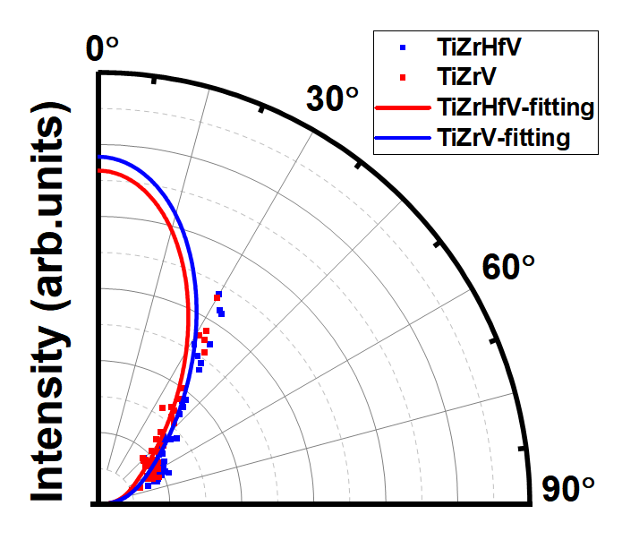
Spatial distribution of secondary electrons
$f(φ)=\cos{φ}(1+m(\sin{φ})^{2}+n(\sin{φ})^{4}+⋯)$,
TiZrV：m = −1.84761, n = 1.14928,
TiZrHfV：m = −1.65213, n = 0.98579
the approximate distribution

Slide 20
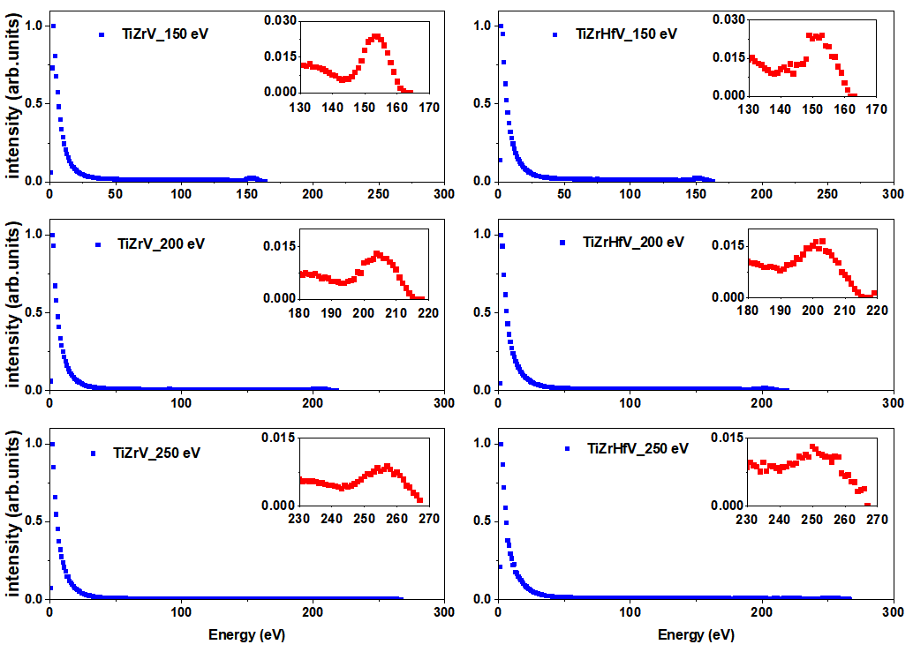
Energy spectrum of secondary emission electrons
The elastic scattering energy changes with incident electron energy.
The percentage for elastic electrons: ~ 8% of the total emission electrons

Slide 21
Summary & Conclusions
A transvers feedback system with a damping time at scale of millisecond is necessary to suppress coupled bunch instability!
SEY lower than 1.3 is adequate to mitigate the density of electron cloud below the threshold in Z mode.
With the application of NEG coating on the inner surface of the beam pipe, the surface treatments is important for lower SEY.
The contribution from electrons of field emission (new source of EC) need to be further verified.
Thank your attention!

