Slide 1

CEPC SRF EDR Plan and Status
Jiyuan Zhai (IHEP)
On behalf of CEPC SRF Team
2025 International Workshop on High Energy Circular Electron Positron Collider (CEPC2025)
Guangzhou, November 6-10, 2025

Slide 2
Content
CEPC SRF EDR plan
CEPC SRF R&D status
Summary and outlook

Slide 3
EDR Plan of CEPC SRF System
EDR major goal is to prepare for the first stage construction of the CEPC SRF system (30 MW H/W & low-lumi Z):
Complete engineering design of the Collider 650 MHz and Booster 1.3 GHz cryomodule for Higgs 30/50 MW & Z 10 MW (3.8×10³⁵ cm⁻²s⁻¹).
Complete Higgs 650 MHz full-scale cryomodule prototyping to achieve TDR specification.
High Q high gradient cavity and high power RF components R&D.
Collider Higgs 650 MHz Cryomodule Parameters | Spec.
Module operating temperature | 2 K
Cavity vertical test gradient | 28 MV/m
Cavity vertical test Q₀ at 25 MV/m | 3.3E10
Module RF voltage (six 2-cell cavities) | 70 MV
Module average cavity gradient | 25 MV/m
Module average cavity Q₀ at 25 MV/m | 3.0E10
Module total 2 K heat load at 70 MV | 160 W
Input coupler conditioning power | 300 kW
Input coupler Q_{e} adjusting range | 1E5 ~ 1E7
HOM coupler power (cryogenic test) | 1 kW
HOM absorber power (test stand) | 5 kW
CEPC SRF EDR | Preliminary Design | Engineering Design | Full-scale Prototyping | Industrial Preparation
Collider H/W/LL-Z (high Q / G 650 M) |  | √ | √ | √
Collider HL-Z (high current 650 M) | √
Collider ttbar (high G / Q 650 M) | √
Booster H/W/ttbar (high Q / G 1.3 G) |  | √ | √ | √
Booster Z (high current 1.3 G) | √ | ERL | ERL

Slide 4
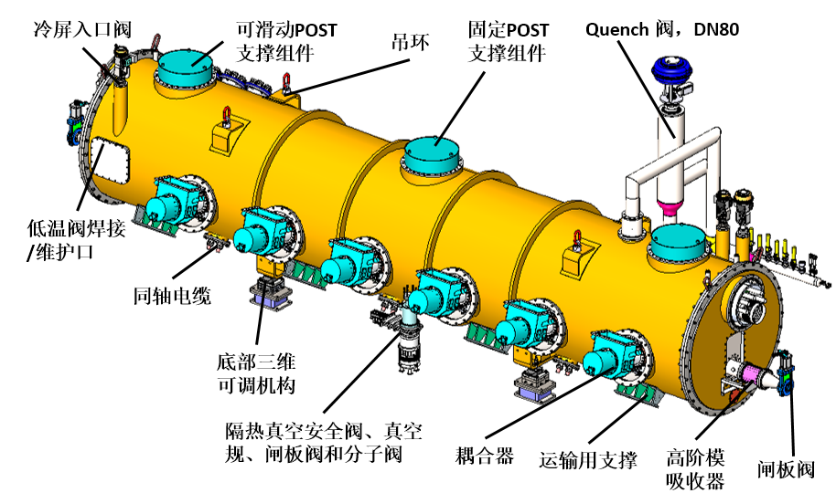
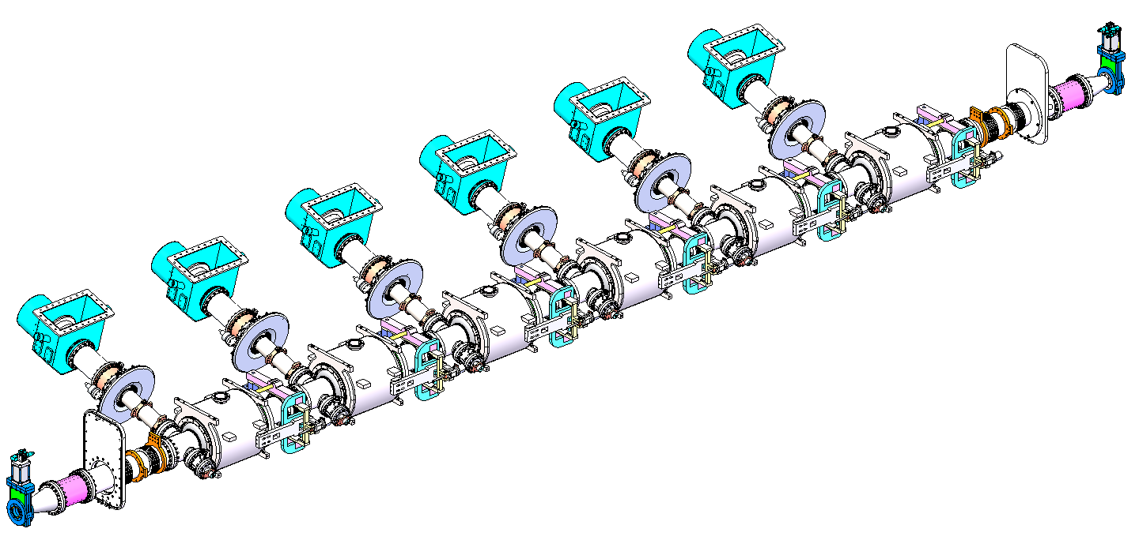
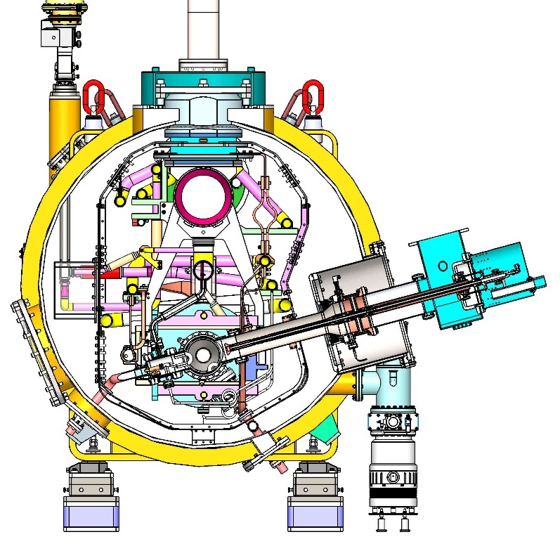
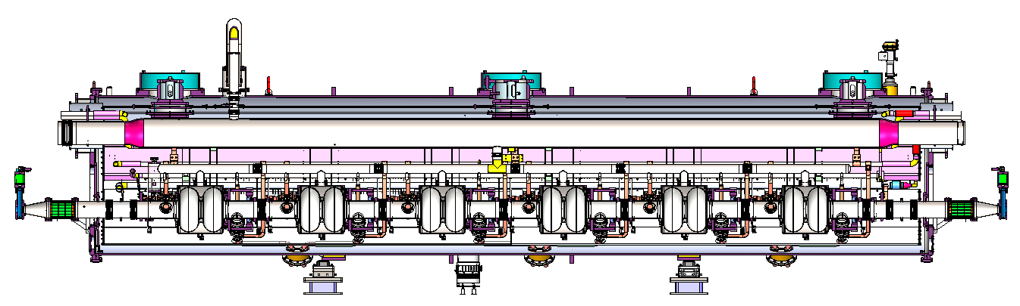
650 MHz Full-Scale Cryomodule Design
Miaofu Xu,
Mei Li …

Slide 5
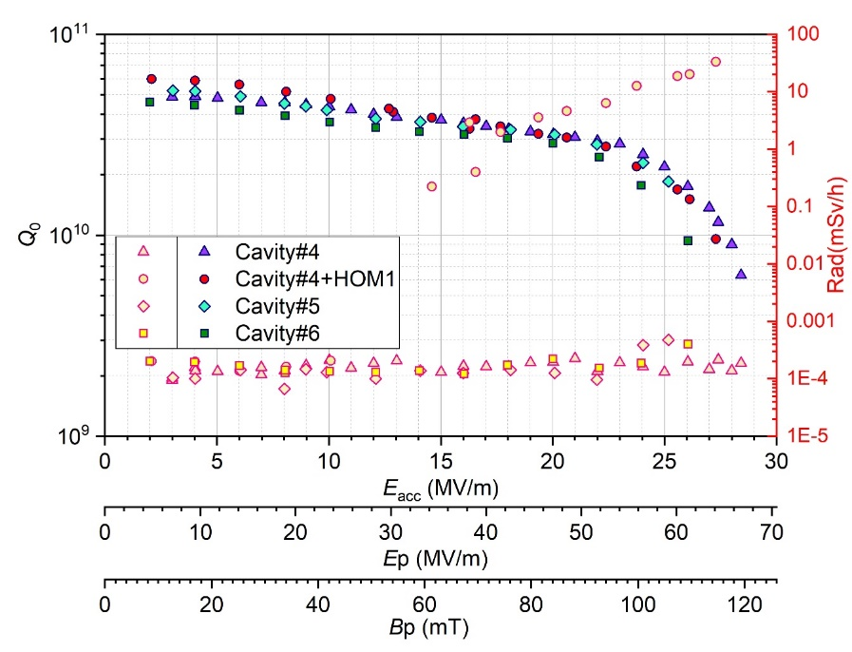
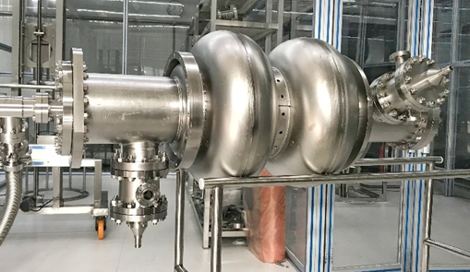
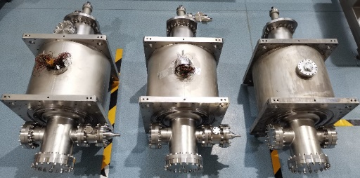
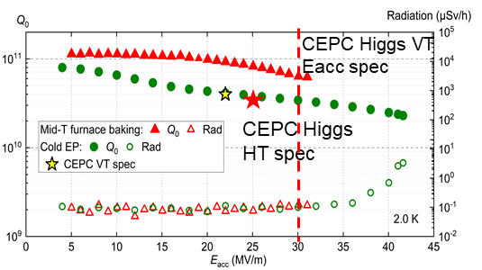
650 MHz 2-cell Cavity
Peng Sha
CEPC 650 MHz CM |  | EDR Specification
650 MHz 2-cell cavity vertical test | E_{acc.max} | 30 MV/m
 | Q₀ | 3.6E10 @ 25 MV/m
Module horizontal test acceptance | E_{acc.max} | 28 MV/m
 | Q₀ | 3.3E10 @ 25 MV/m
Module long term operation | E_{acc.max} | 28 MV/m
 | Q₀ | 3.0E10 @ 25 MV/m
650 MHz 2-cell BCP
20 % margin from vertical test to operation spec.
BCP dressed 2-cell VT: 2E10 @ 25 MV/m, max ~ 26.5 MV/m
BCP 2-cell module test: 2E10 @ 8 MV/m (coupler cooling limited?)
EP + mid-T 1-cell VT: 8E10 @ 25 MV/m, max 31.5 MV/m
Apply 1-cell recipe to 2-cell
650 MHz 1-cell EP mid-T
5

Slide 6
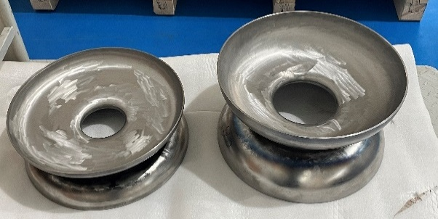
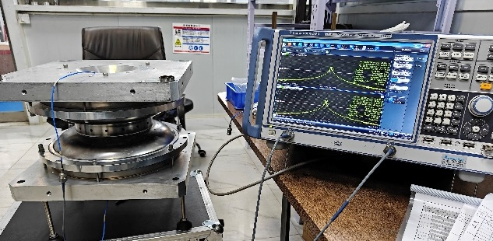
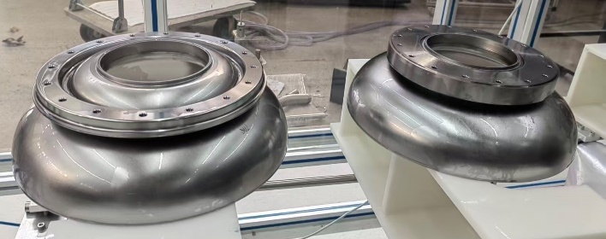
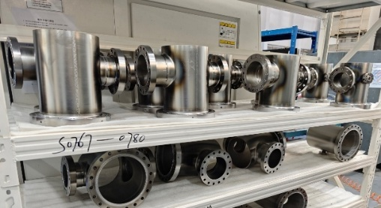
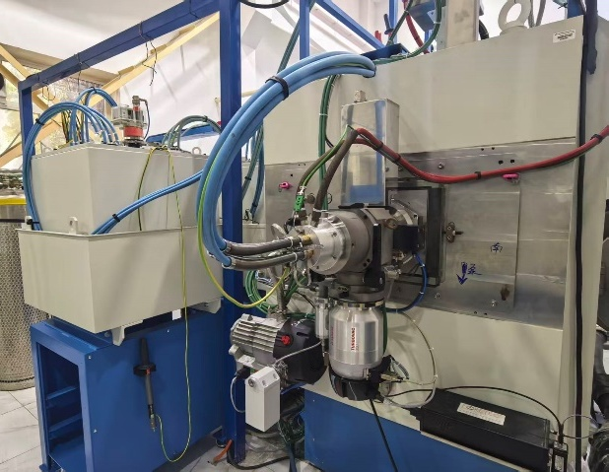
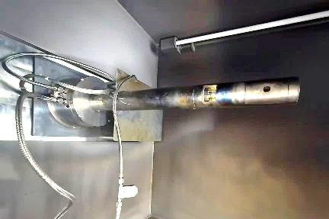
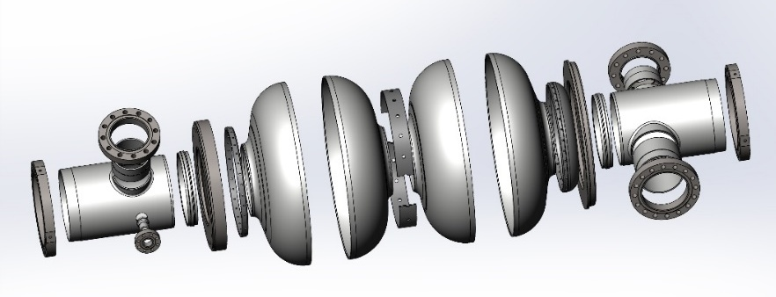
650 MHz 2-cell Cavity Fabrication
Peng Sha
HERT
Will complete EBW of two 2-cell cavities in November and other six cavities in 2026.
Processing (EP + improved mid-T) and vertical test to start soon.
Inside EBW system installed and in commissioning
Advantages:
still cylindrical and homogeneous beam after bending
extremely smooth weld seam for high performance cavity
welding of unreachable seam for design flexibility
Equator welding:
outside back-forming
two-side (now)
inside (next step)

Slide 7
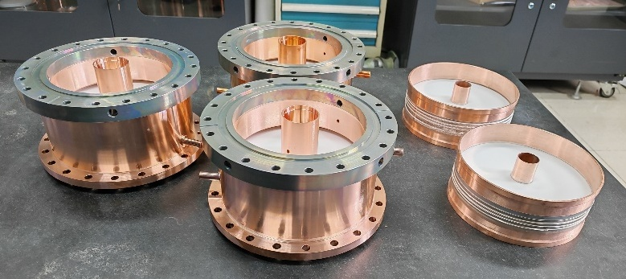
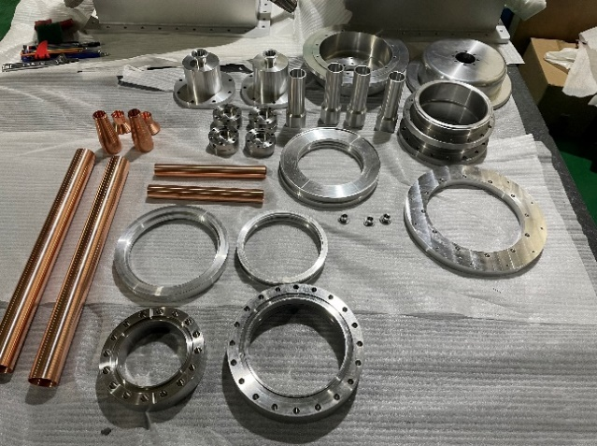
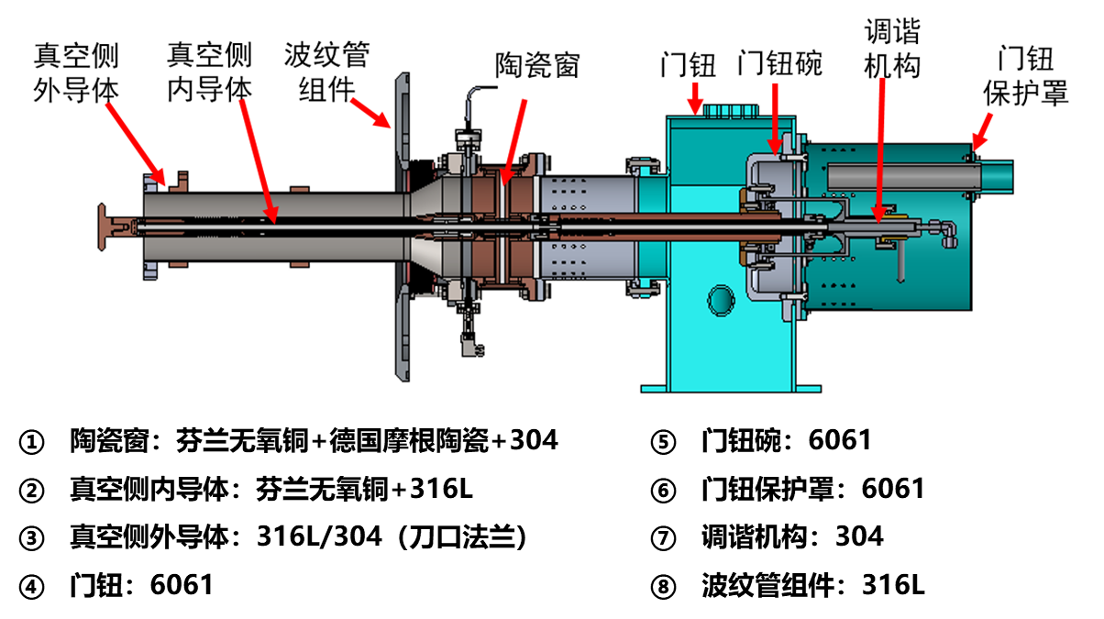
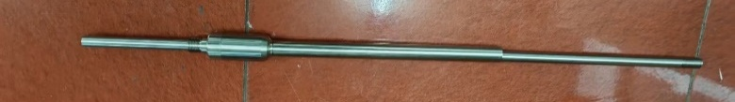
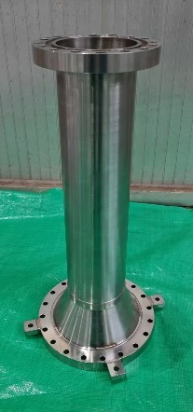
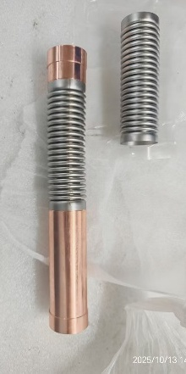
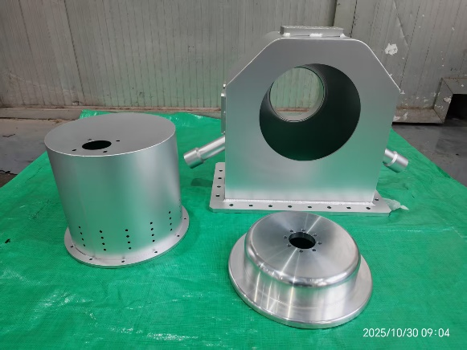
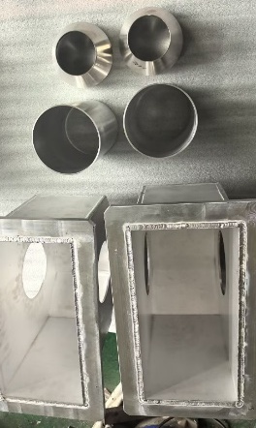
650 MHz High Power Input Coupler
Xu Chen, Tongming Huang, Qiang Ma
HERT
Six variable 300 kW CW 650 MHz input couplers for the full-size module. In TDR phase, both fixed and variable couplers are tested to CW TW 150 kW (SSA power limit), SW 100 kW. Two fixed couplers in test cryomodule.
Two variable couplers will be delivered in November. High power tested (> 300 kW) with 800 kW CW klystron .
The other four variable couplers in 2026.

Slide 8
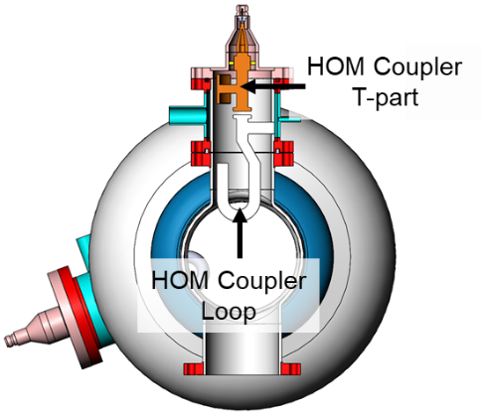
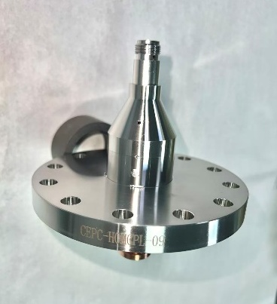
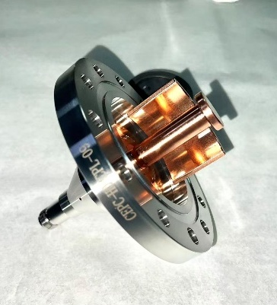
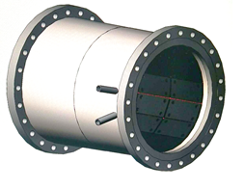
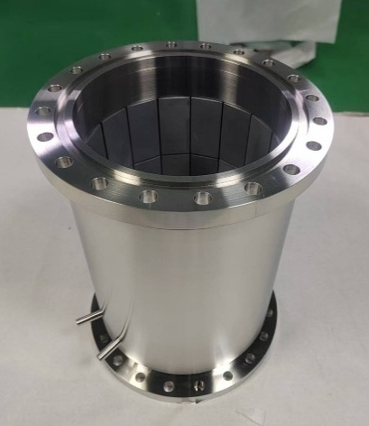
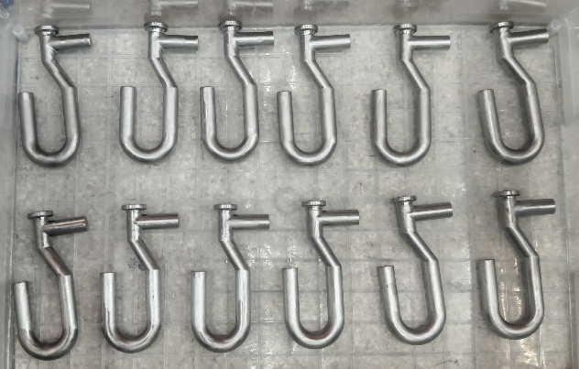
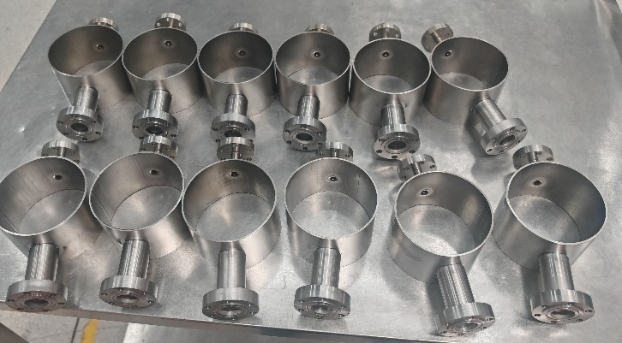
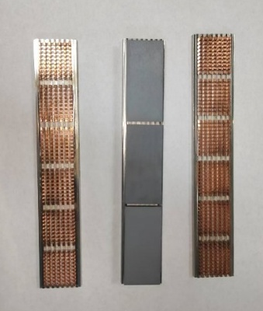
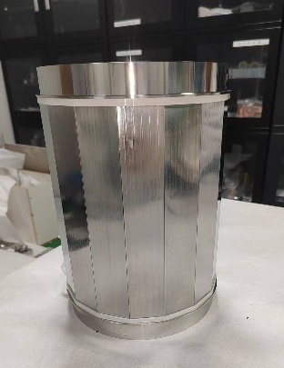
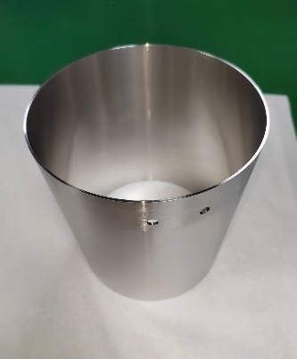
650 MHz HOM Coupler and Absorber
Hongjuan Zheng, Fanbo Meng
OTIC, HAITEC
12 HOM couplers and two HOM absorbers in fabrication.
1 kW HOM coupler
Free of notch-tuning
HOM absorber with
SiC + AlN material

Slide 9
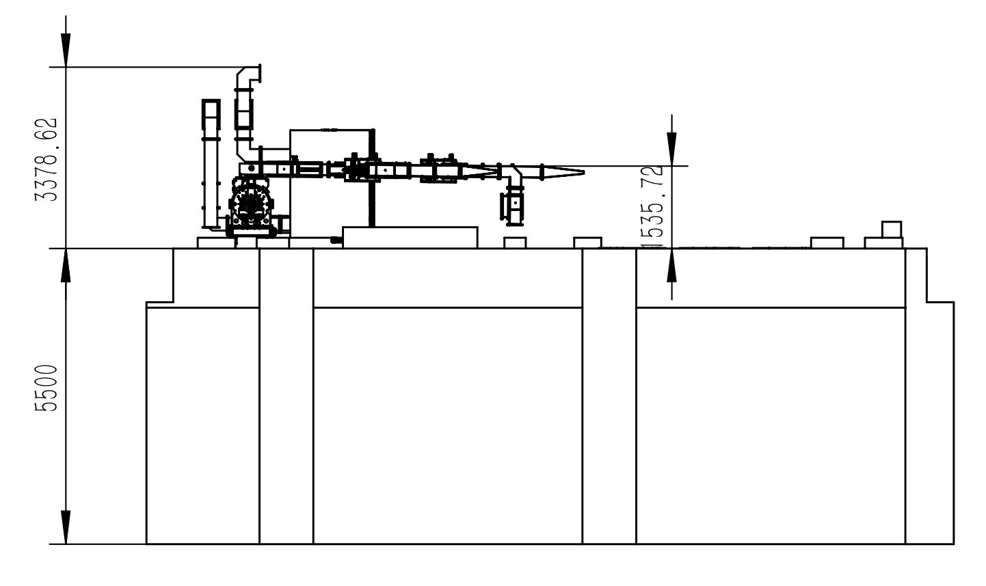
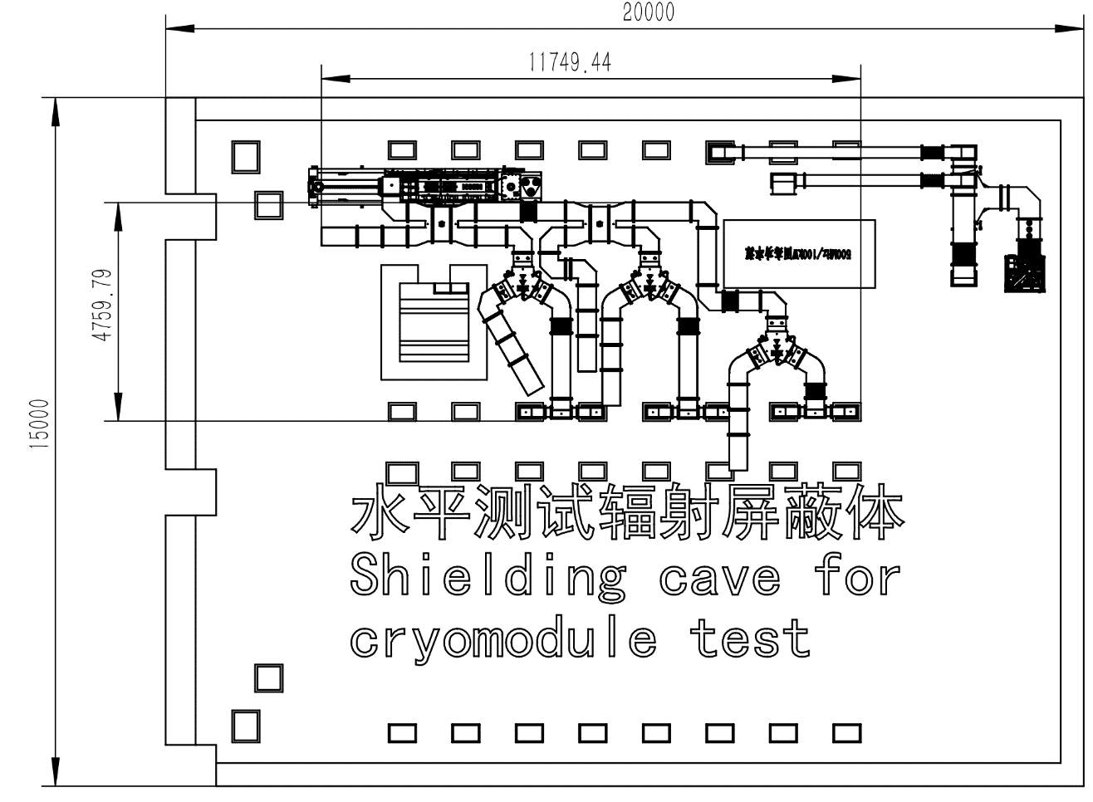
HLRF System for 650 MHz Module Test
Zusheng Zhou
CEPC 800 kW high efficiency 650 MHz klystron to feed six 2-cell cavities (150 kW SSA as backup).
RF distribution under design for the six 2-cell cavities.

Slide 10
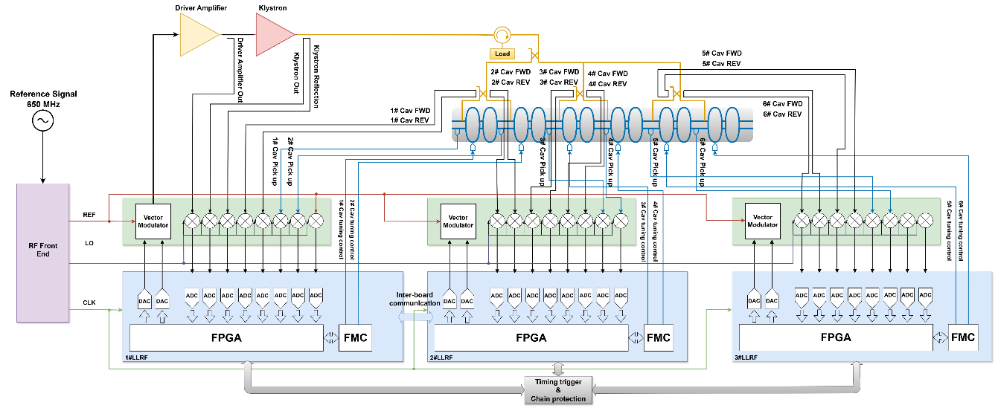
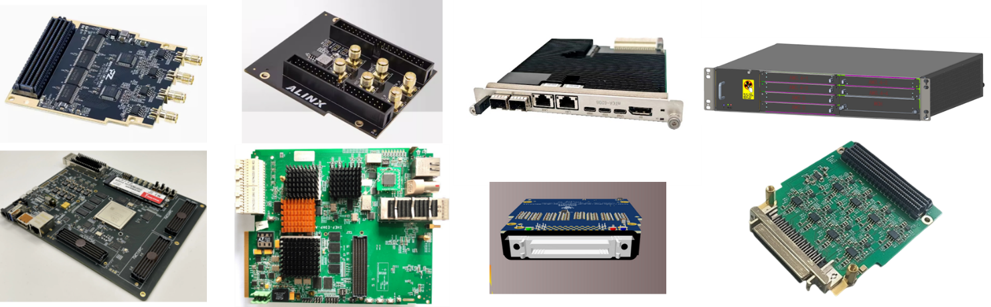
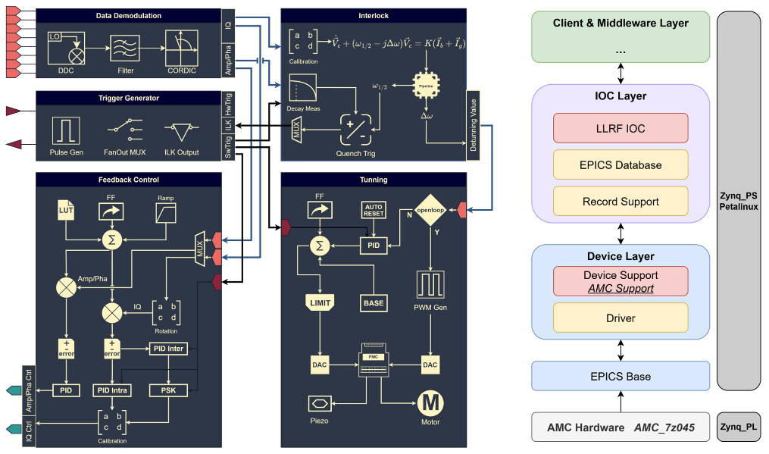
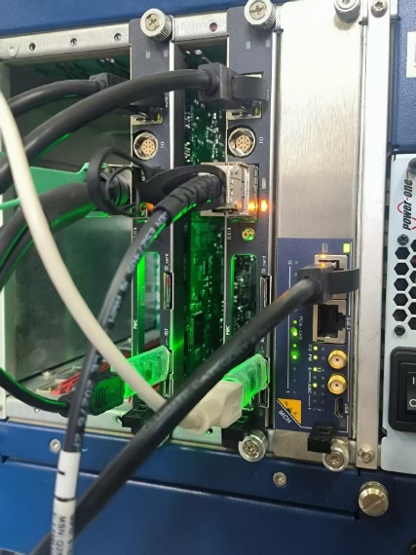
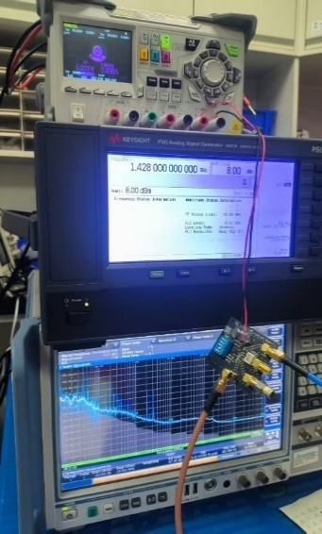
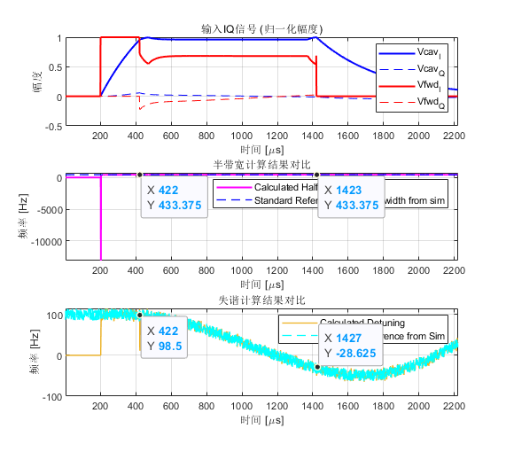
LLRF System for 650 MHz Module Test
Wenbin Gao
Nan Gan
Zusheng Zhou
LLRF system design scheme
Control boards and other hardware (domestic MicroTCA platform)
FPGA firmware and EPICS software architecture
Integration and testing

Slide 11
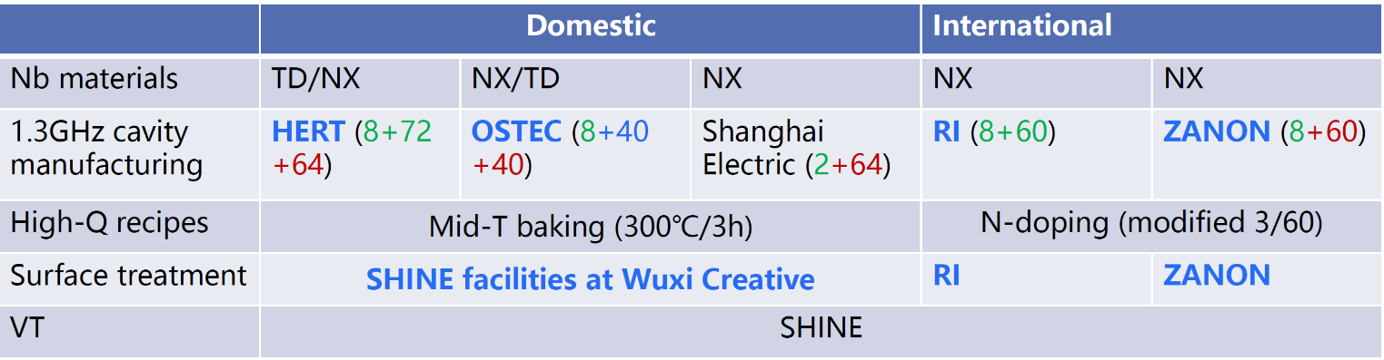
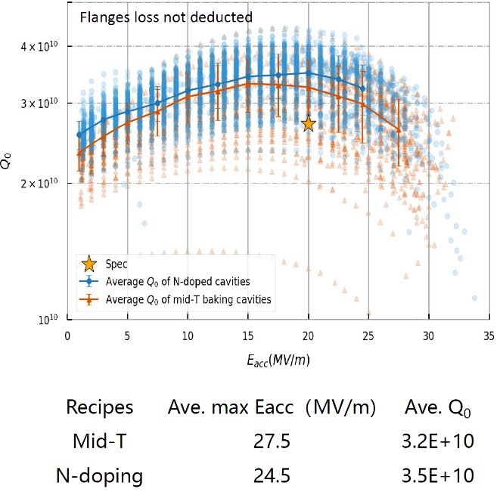
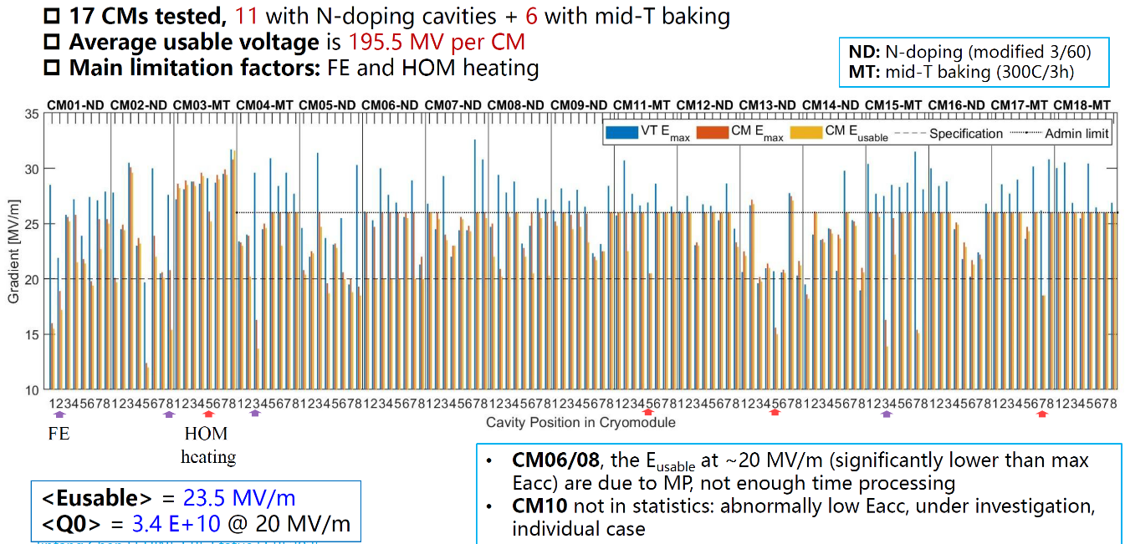
1.3 GHz High Q Cavity and Module
IHEP and SARI significantly advanced high Q mid-T bake application [PRAB 27, 092003 (2024) & NST 36,25 (2025)]
SHINE mass production of high Q cavity / module (as of Sept. 2025) : 126 mid-T cavities and 6 mid-T modules tested
HERT (IHEP) 1/3 of the total 432 cavities (54 CMs) for SHINE
Jinfang Chen, Hongtao Hou, SRF2025

Slide 12
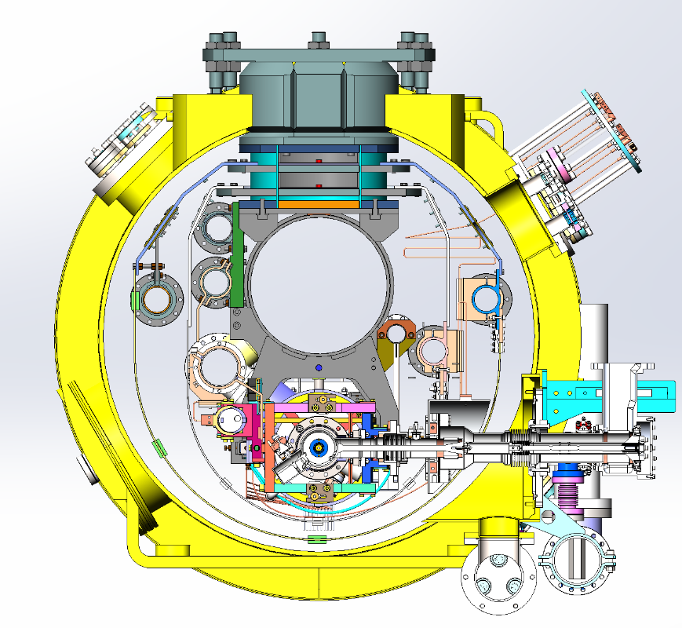
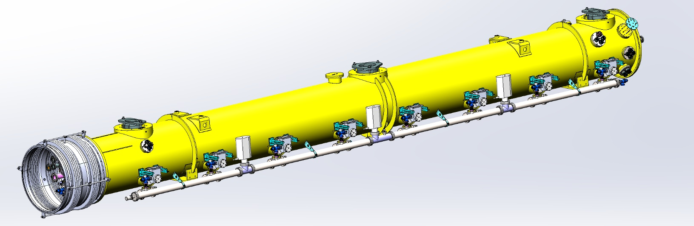
1.3 GHz High Gradient Module
1.3 GHz high gradient cavity and cryomodule R&D, aiming for 40 MV/m operation (pulsed). Module to be assembled and tested in 2026.
Module structure similar to TESLA/XFEL/ILC:
Two layers of thermal shields (add 5 K shield).
No JT and CD valves on the module, one helium vessel pre-cooling inlet (no fast cool down requirement)
1.3 GHz 5 MW klystron and power distribution system to feed eight 9-cell cavities
Lorentz force detuning compensation for eight cavities operation

Slide 13
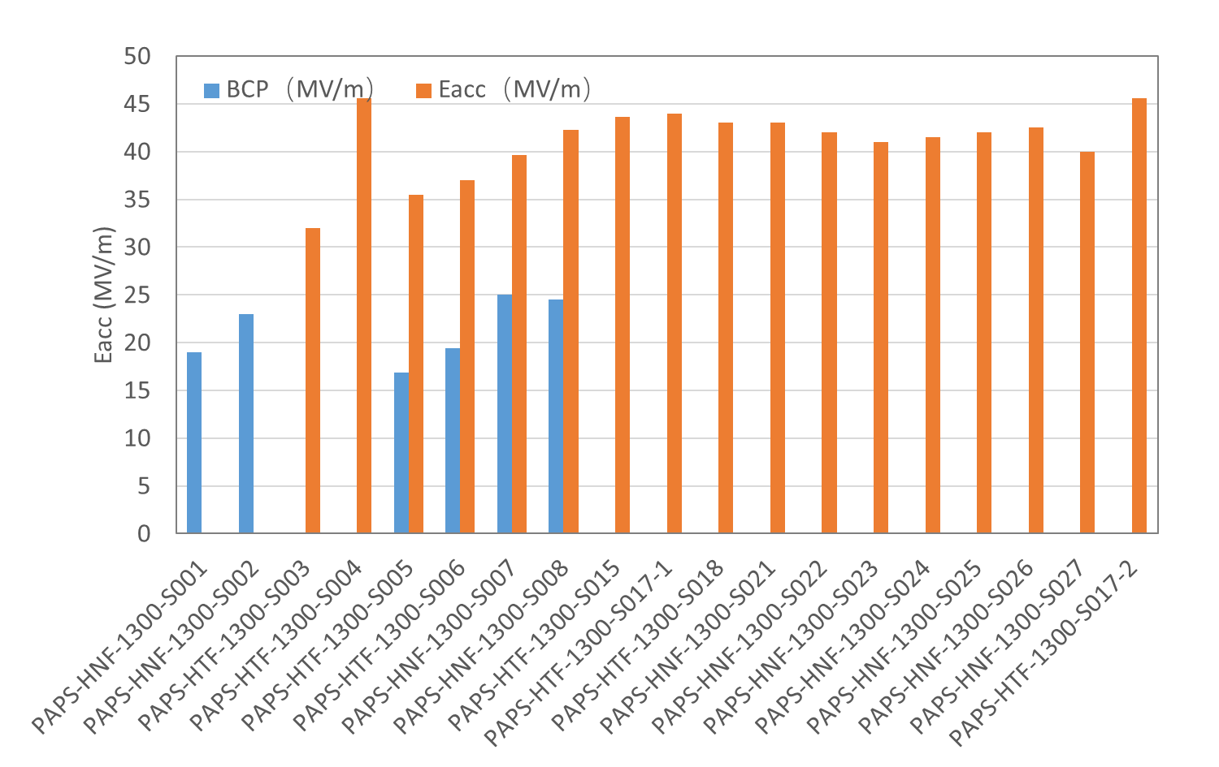
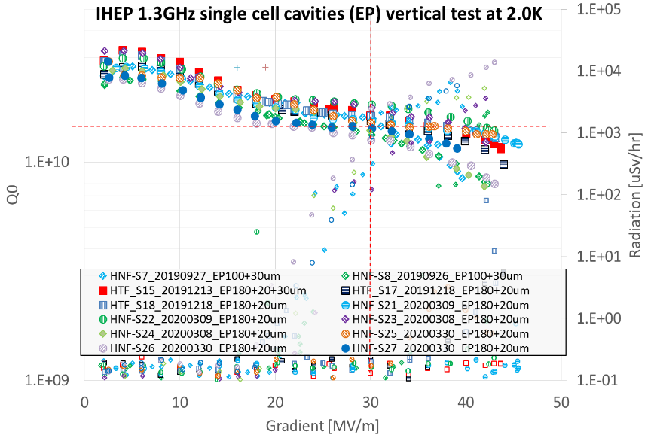
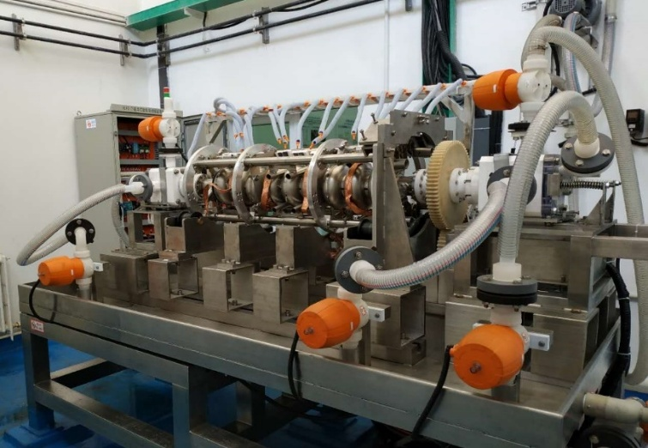
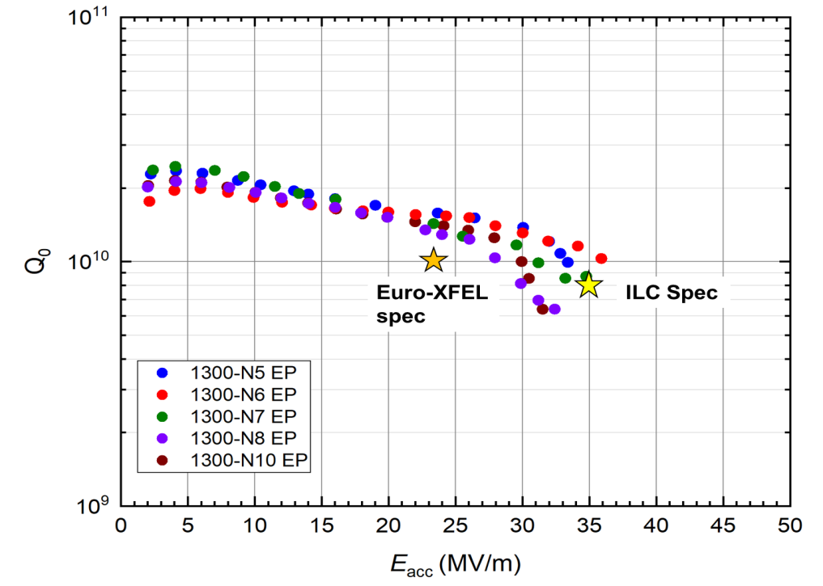

1.3 GHz High Gradient Cavity
Established China’s first EP system and demonstrated high gradient 1-cell and 9-cell results in 2019-2020
Troubleshooting with field emission to recover and improve performance
Developing T-mapping and second sound system for defect diagnostics
1-cell (2019-2020)
1-cell (2019-2020)
9-cell (2020)
1-cell (2025)

Slide 14



EP System Maintenance
Song Jin
EP system aging and maintenance: abrasion and erosion of parts and devices. Sulfur and carbon contaminations inside pipes and pumps. Clean or replace most of the parts and devices.
System tests with 1.3 GHz 1-cell cavities. One of them achieved 40 MV/m, but with considerable field emission.
EP tooling modification for new flanges of 650 MHz 2-cell cavity
650 MHz 2-cell cavity EP optimization and mid-T for high Q and high gradient

Slide 15



T-mapping System
Tongxian Zhao
9-cell T-mapping system in commissioning. X-ray mapping to be installed soon.
Temperature sensor: film-type carbon resistance thermometer
Sensitivity: 0.05 K @ 2~10 K
Amount: 96 temperature sensors per cell, 864 in total.
Sample time: 100 ms

Slide 16










1.3 GHz High Gradient Module Components
HERT
WXCX …

Slide 17




1.3 GHz RF Power Source
Jindong Liu
Zusheng Zhou
Facheng Zhao
1.3 GHz 5 MW (5 Hz, 1.5 ms) klystron (Thales TH2104) and Marx solid state modulator (Leike)
Power distribution system with variable power dividers (-2.2 dB ~ -4 dB), circulators, loads, etc.
Integration and test on the bunker.

Slide 18
Summary and Outlook
CEPC SRF EDR R&D is focused on a full-size Higgs 650 MHz cryomodule, targeting high Q, high gradient, and high power handling. This prototype can also be used for future advanced test facilities.
Our 1.3 GHz module development continues to leverage synergies: ttbar booster high-gradient module aligns with national pulsed XFEL R&D, Z booster high-current module is with the planned ERL facility.
For high-luminosity Z operation, we are re-evaluating the RF configuration by comparing three options:
TDR baseline (H/W/LL-Z 2-cell + HL-Z 1-cell with bypass lines and duplicate RF power sources)
all 2-cell compact and efficient system (FCC-ee, RPO and large HOM power extraction …)
all 1-cell system (CEPC alternative, high gradient high Q 650 MHz cavity…requiring further study)

