Slide 1
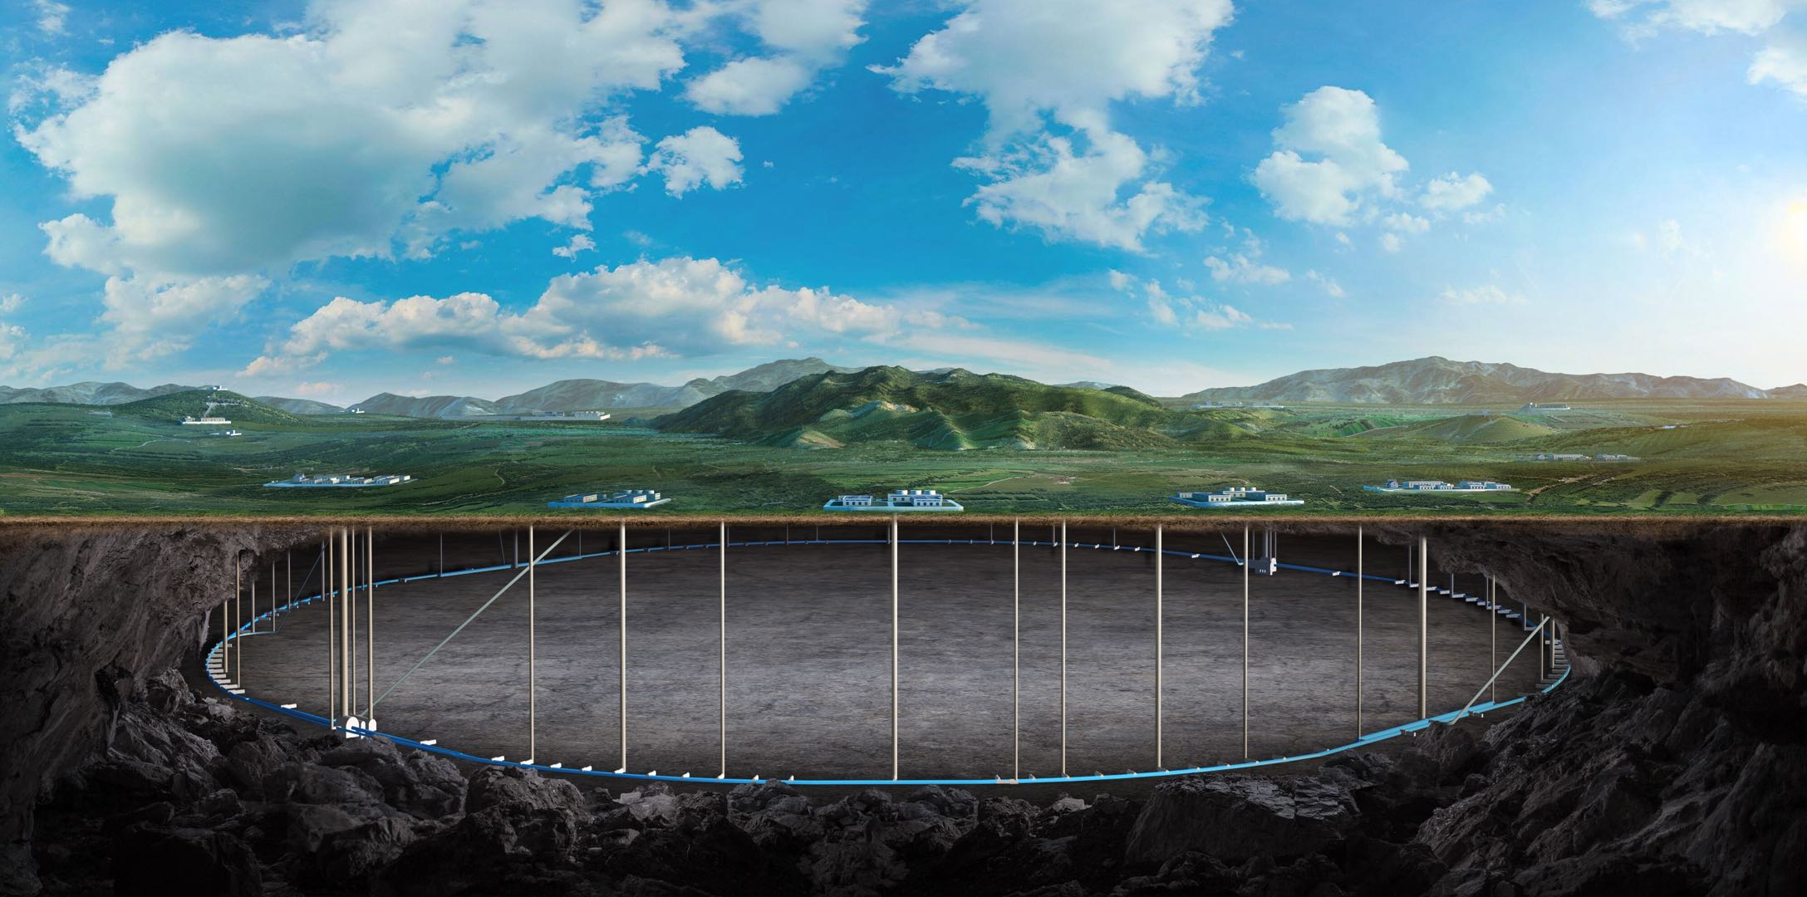


CEPC Cryogenic System EDR Plan and Status
Rui Ge, Mei Li
On behalf of CEPC cryogenic system
2025 International Workshop on CEPC, Guangzhou, China, November 6-10, 2025
Notes:
Good afternoon, everyone. My name is Mei Li, on behalf of the CEPC cryogenic team, I am pleased to present: a summary of CEPC Cryogenic System EDR Plan and Status

Slide 2
Content
1. CEPC Cryogenic System Overview
1.1 CEPC Project Brief Introduction
1.2 General Layout of Cryogenic System
1.3 2025 Mini-Review
2. CEPC SRF Cryogenic System Scheme Design
2.1 Process Design & Calculation
2.2 Large Helium Refrigerator
3. Cryomodule R&D Status
3.1 Collider 650MHz Cryomodule R&D
3.2 Booster 1.3GHz Cryomodule R&D
4. Summary and Outlook
Notes:
My presentation will be structured around four key sections. First, I will talk about CEPC Cryogenic System Overview. Then, I will introduce CEPC SRF Cryogenic System Scheme Design. Following that, I will discuss the Cryomodule R&D Status. Finally, I will conclude with a summary and outlook.

Slide 3
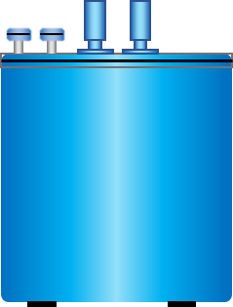
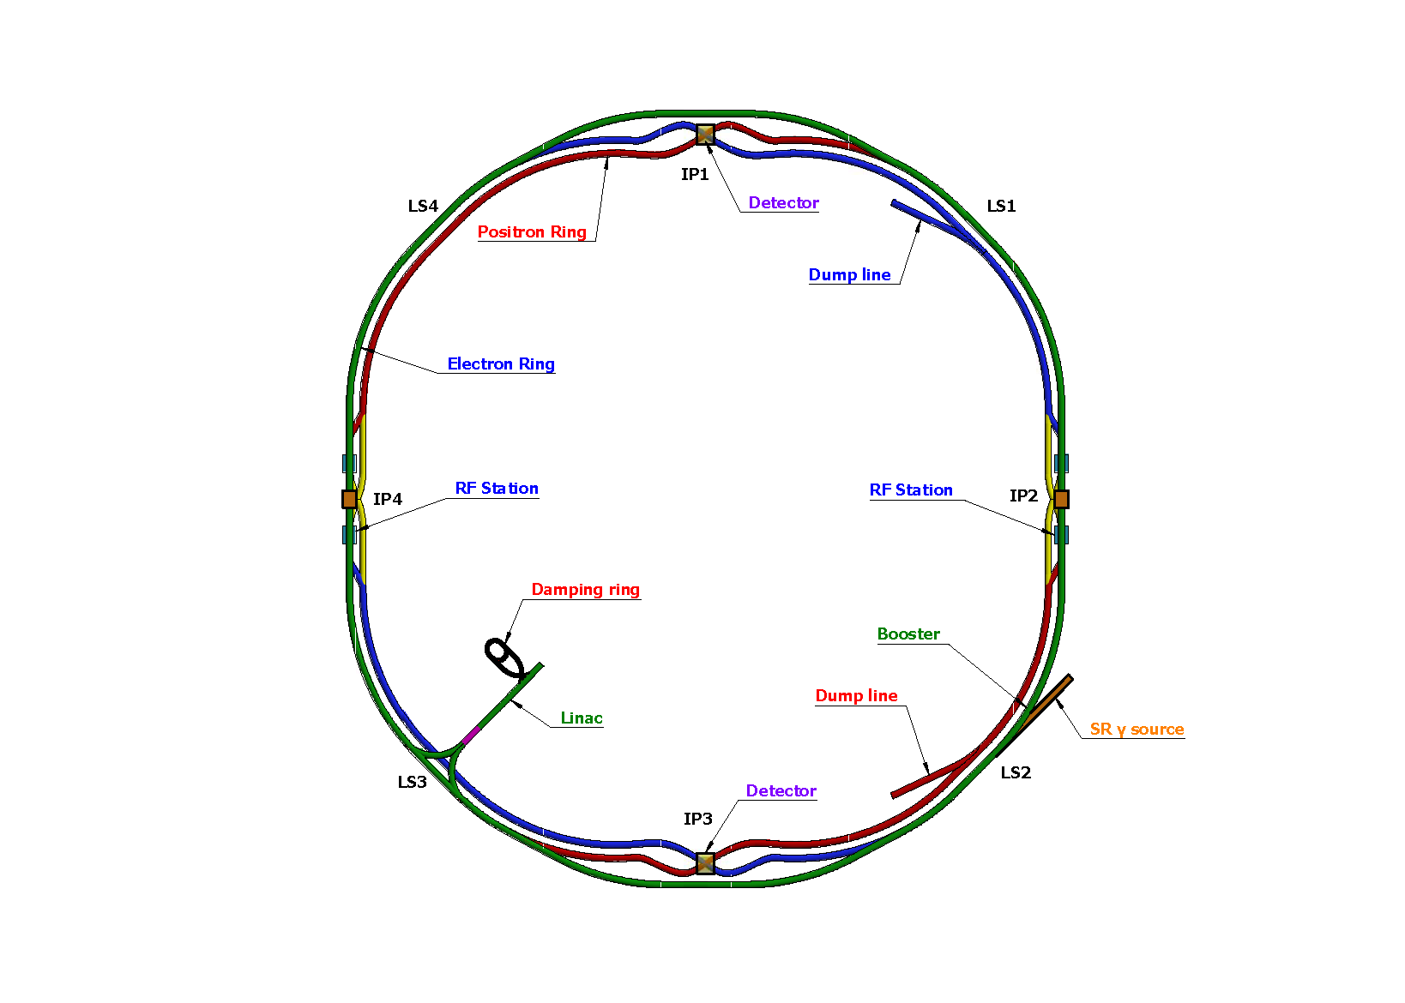
CEPC Cryogenic System Brief Introduction
CEPC is a positron and electron collider, and the beam is accelerated to 30 GeV by linear acceleration section, and then further accelerated to 120 GeV by RF cavities in the Booster and Collider ring.
Cryogenic system is designed to provide a reliable and stable cooling environment (4.5K or 2K) for RF cavities and magnets.
SC magnets Cryo-station
Booster ring:
1.3 GHz 9-cell cavities, 96 cavities
12 cryomodules
3 cryomodules/each station
Temperature: 2K
Collider ring:
650MHz 2-cell cavities, 240 cavities
32 cryomodules for Higgs 30MW, 56 for Higgs 50MW
8 or 14 cryomodules/each station
Temperature: 2K
MDI IR magnets:
4 IR magnets, 4 cryostats
Temperature: 4.5K/2K
Detectors:
2 detector magnets
HeI/Thermosiphon cooling
SRF cryomodule: 4×15kW@4.5K
IR MDI magnets: 2×1kW@4.5K
Detectors: 2×1kW@4.5K
RF
Cryo-station
RF
Cryo-station
SC magnets Cryo-station
Overview of the CEPC cryogenic system
1. | OVERVIEW | OVERALL CRYO LAYOUT | 2024 IARC COMMENT | 2025 MINI REVIEW |
Notes:
As you may be aware, CEPC is a positron and electron collider. The beam can be further accelerated to higher energy levels through RF cavities. The primary function of the cryogenic system is to provide a reliable and stable cooling environment (4.5K or 2K) for RF cavities and magnets.
The entire circumference of CEPC is about 100km, with four cryo-stations located at the west and east points, namely IP 2 and IP 4. Each cryo-station has a cooling capacity of 12kW@4.5K. The Booster Ring, with 12 cryomodules each containing eight 1.3 GHz 9-cell cavities operating at 2 K. The Collider Ring, with 56 cryomodules each containing six 650 MHz 2-cell cavities, also at 2 K. Additionally, at the north and south points (IP1 and IP3), there are four MDI IR magnets and two detectors, cryo-stations are located in these two points. Our report today will focus on the SRF systems.

Slide 4
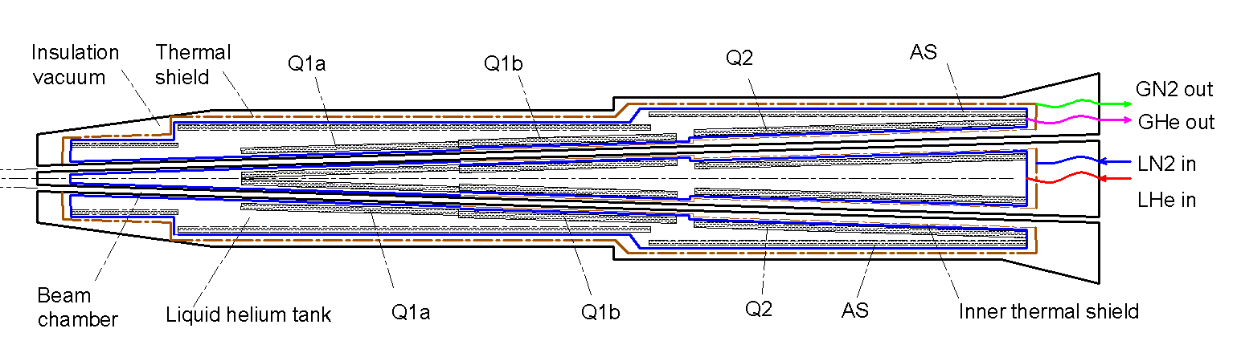
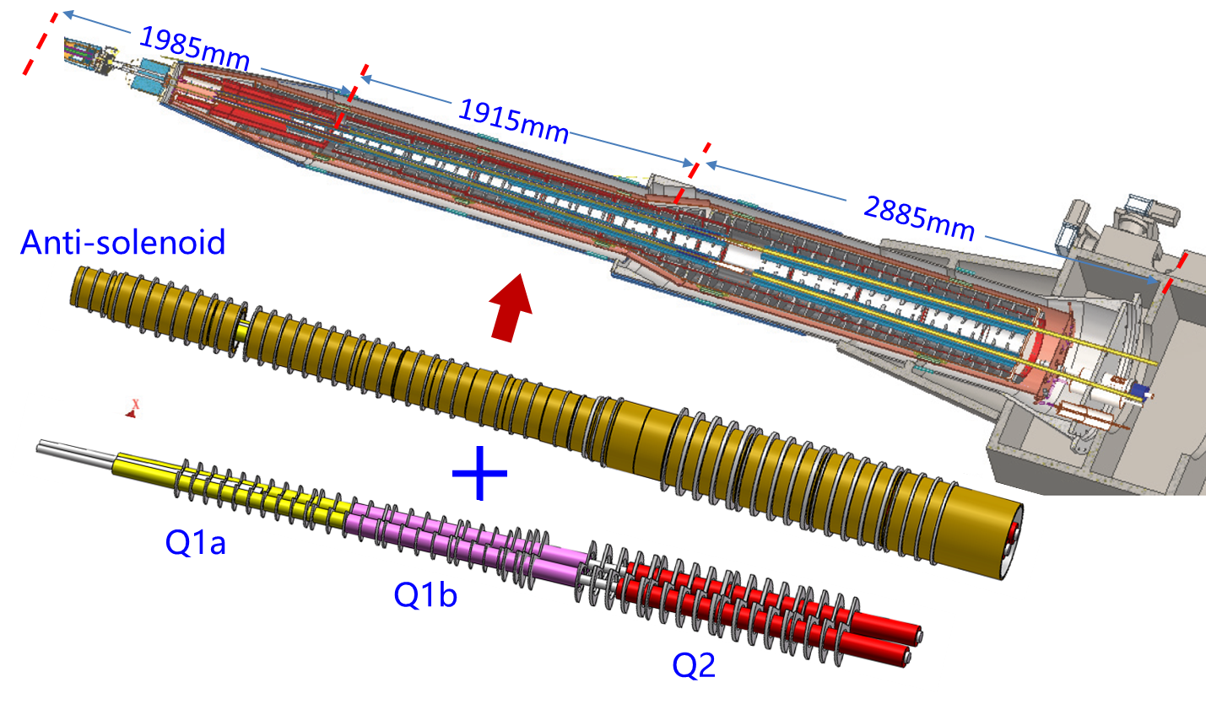
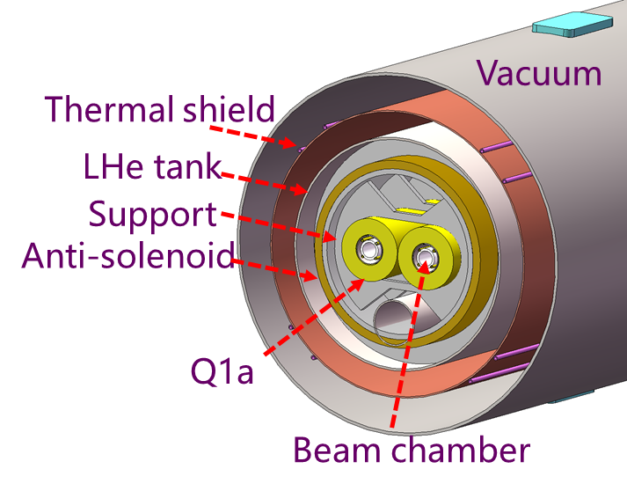
MDI IR Magnets Cryogenic System Brief Introduction
Zhang Xiangzhen, Yang Xiaochen
IR MDI magnets Cryogenic System : 2×1 kW@4.5K
Cryostat scheme
4 K cooling system
Structural design of the cryostat
2 K cooling system
1. | OVERVIEW | OVERALL CRYO LAYOUT | 2024 IARC COMMENT | 2025 MINI REVIEW |

Slide 5
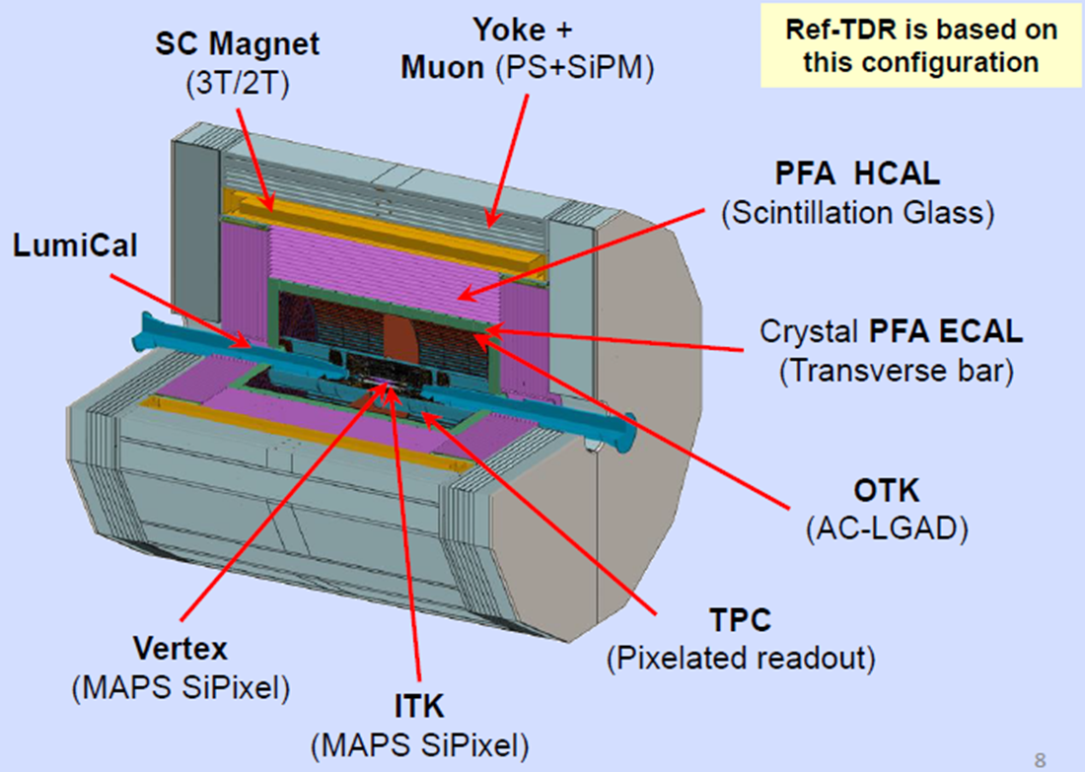
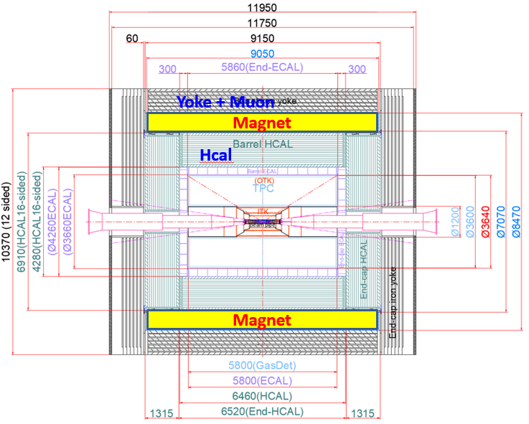
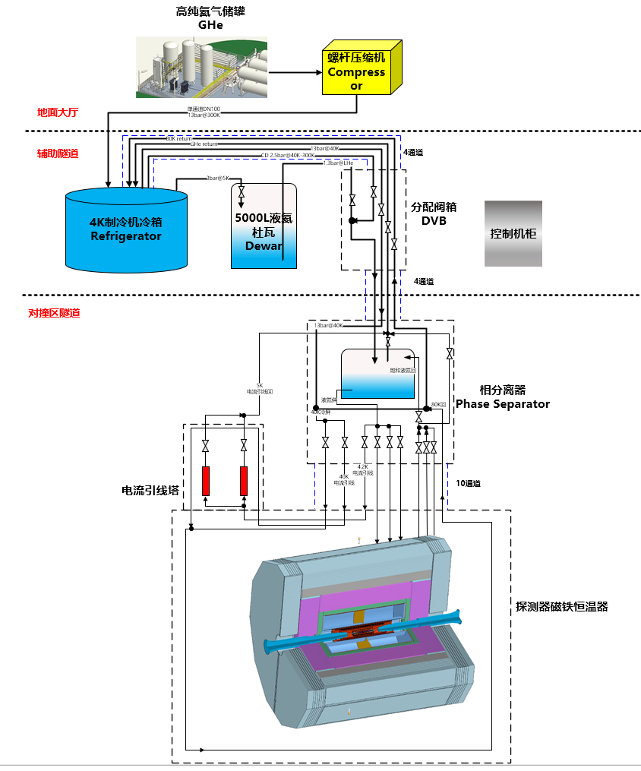
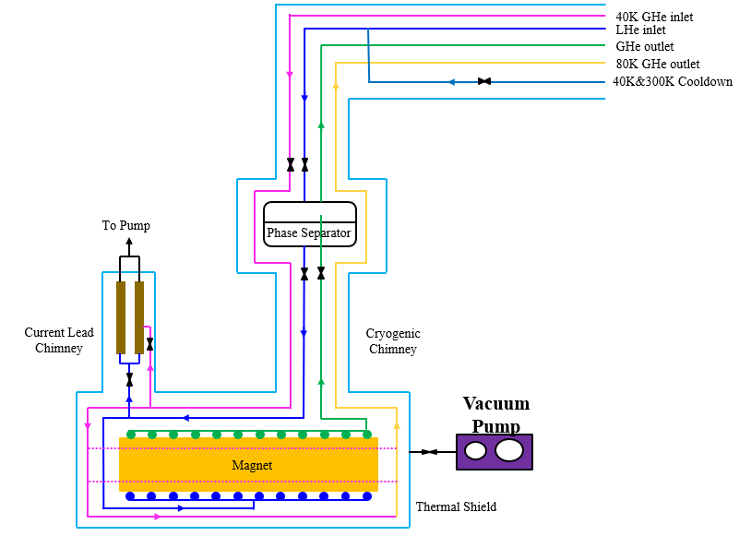
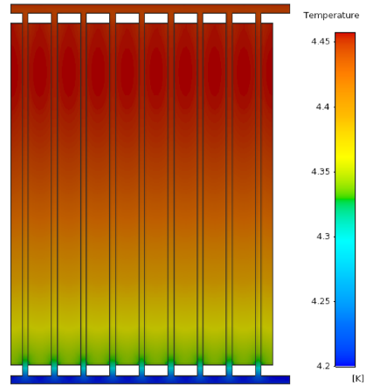
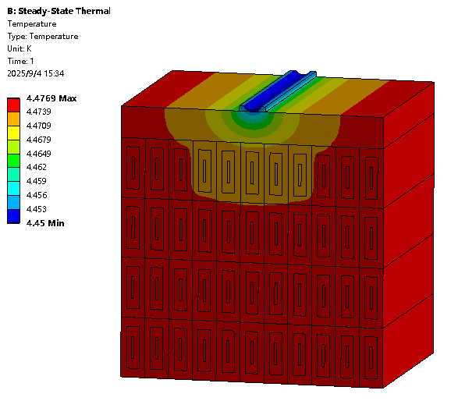
Detectors Cryogenic System Brief Introduction
Chang Zhengze, Zhu Keyu
Thermosiphon Cooling Solution
Detectors Cryogenic System: 2×1kW@4.5K
1. | OVERVIEW | OVERALL CRYO LAYOUT | 2024 IARC COMMENT | 2025 MINI REVIEW |

Slide 6
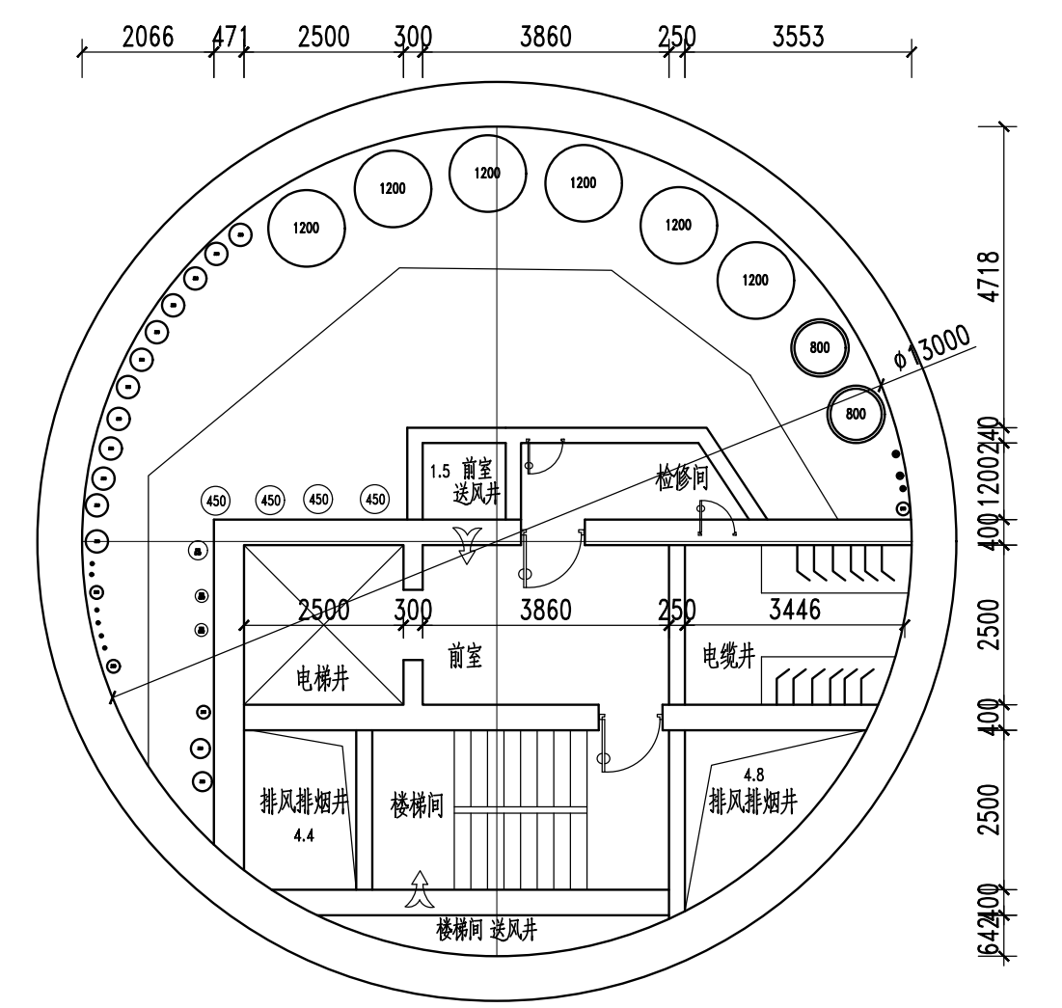
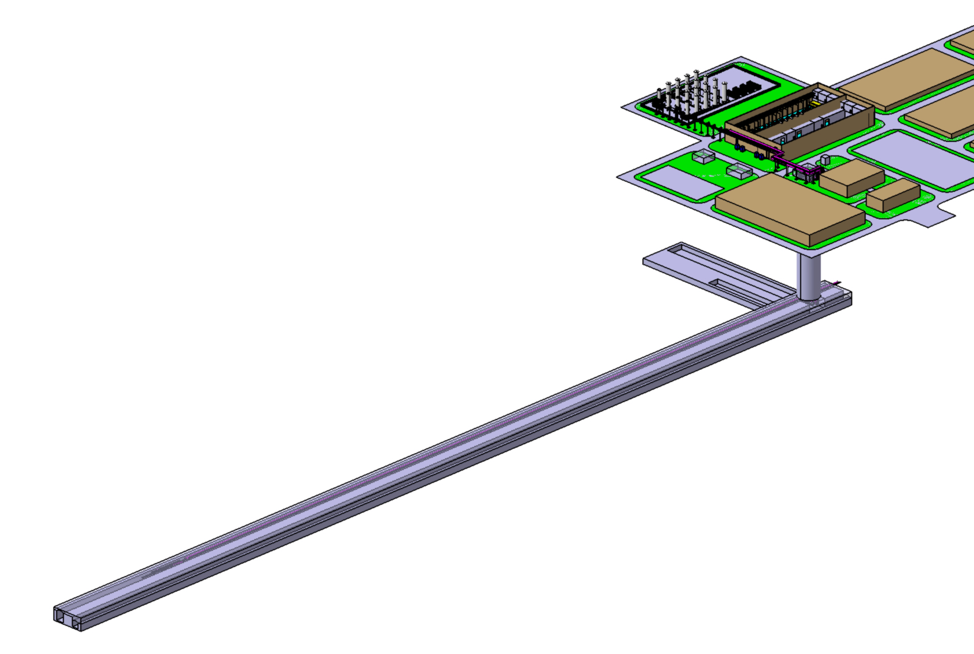
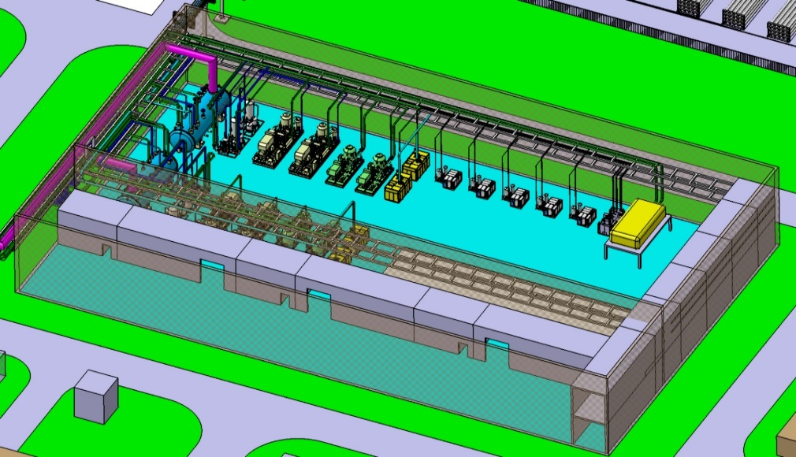
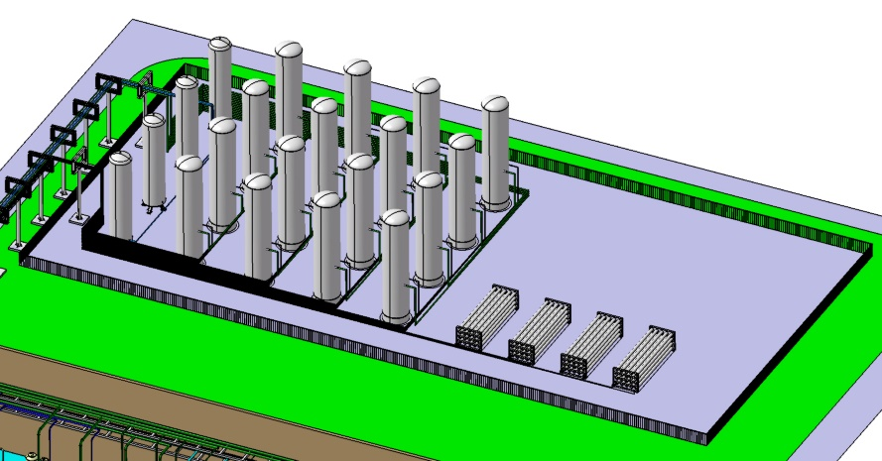
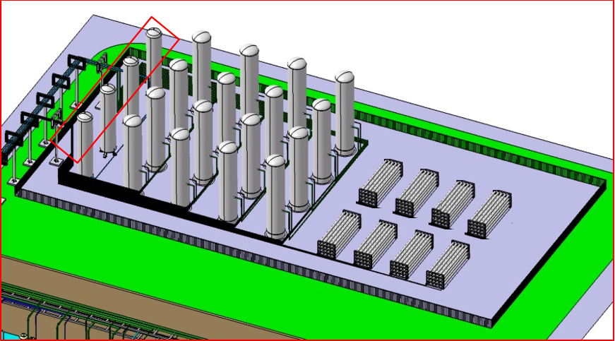
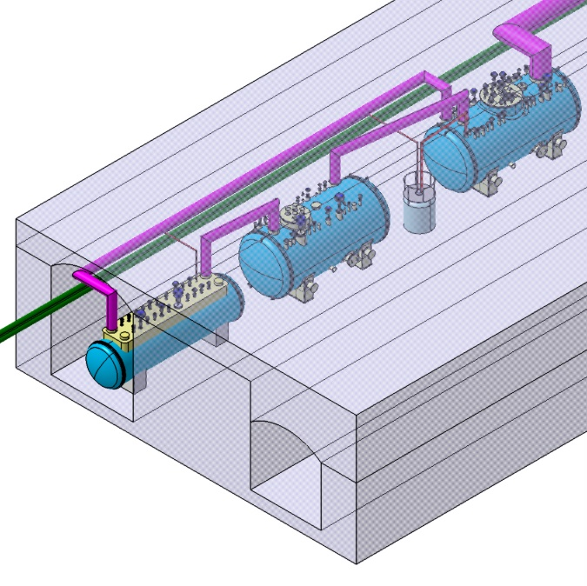
CEPC SRF Civil Engineering Cryo-Layout
SRF Cryogenic System: 4×15kW@4.5K
100m
Tanks zone
Cryogenic hall
UCB (300K-40K)
60m
shaft
Cryogenic hall-ground surface
Tanks zone
660m
LCB (40K-4.5K)
~50m
2K CB
The inclined shaft (width 7m*height 6m) is used for cryogenic equipment transportation；
Cryogenic transfer line and cable through vertical RF shaft (diameter 13m)
The size of 1.3 GHz 9-cell cavity cryomodule: OD1160-11500mm
The size of 650 MHz 2-cell cavity cryomodule: OD1650-9293.6mm
MDVB
Auxiliary gallery
Beam Tunnel
1. | OVERVIEW | OVERALL CRYO LAYOUT | 2024 IARC COMMENT | 2025 MINI REVIEW |
Notes:
This slide outlines the significant civil engineering cryo-layout for the cryogenic system. The design includes a cryogenic hall and tanks zone on the ground surface, the underground Auxiliary gallery and beam tunnel. An inclined shaft is used for cryogenic equipment transportation；Cryogenic transfer line and cable through vertical RF shaft (diameter 13m). In order to reduce the inclined shaft sizes, the coldbox is divided into two separated small coldboxes, the UCB (300K-40K) locates on the ground surface, and the LCB (40K-4.5K) locates underground, as close as possible to the CMs.
The auxiliary gallery houses the lower coldbox (LCB), 2K coldbox (2K CB), and the main distribution valve box (MDVB). The distance between the shaft and cryo-equipment section is about 660m. In this section, we need to reserve the spaces for the the ttbar klystron and Higgs LLRF and klystron.

Slide 7
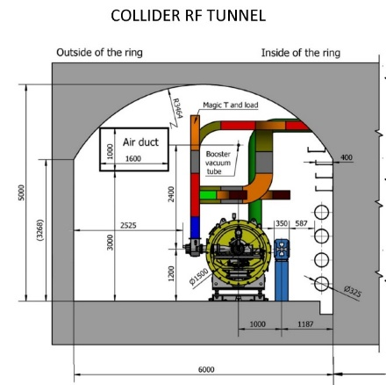
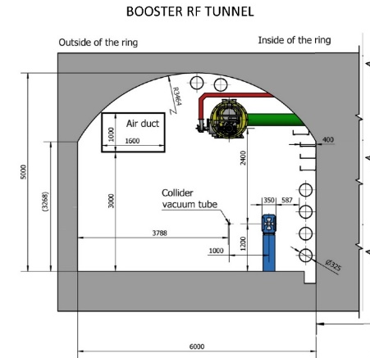
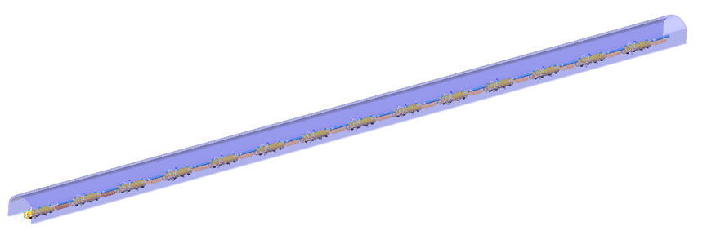
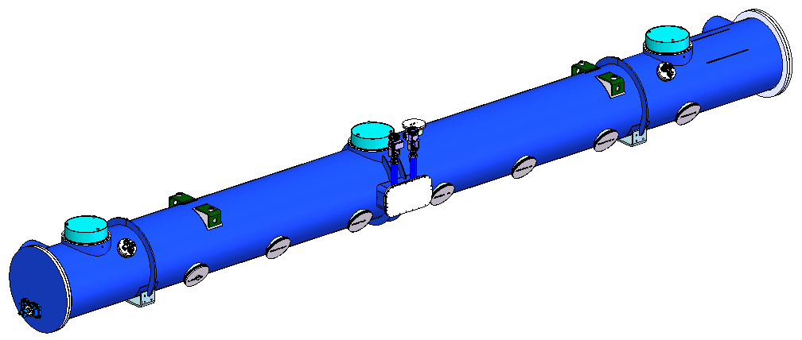
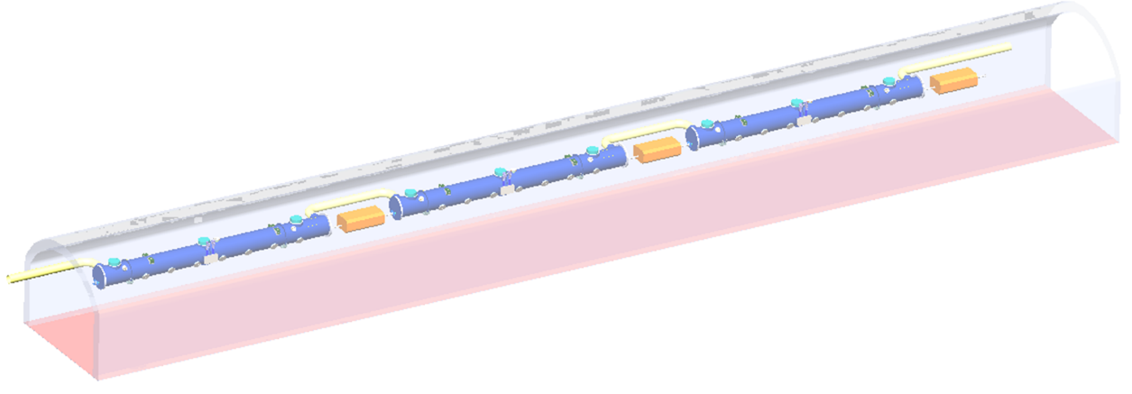
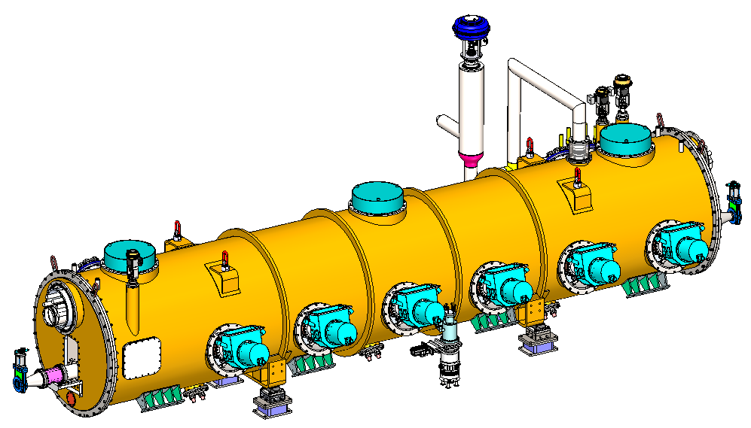
CEPC SRF Beam Tunnel Cryomodule Layout
Ground: tanks zone to shaft: 150m
Shaft length: 300m~400m
Auxiliary gallery: shaft to cryo-section: 660m
Beam tunnel:
Cryo-section in Auxiliary gallery →Collider 14th CM: 304m；
Cryo-section in Auxiliary gallery → Booster 3th CM: 52m;
Total 3.0km transfer is challenging for achieving an efficient design.
224m
Beam Tunnel Collider 650MHz CMs layout
14 650MHz cryomodules
Set a vacuum barrier per two cryomodules
80m
32m
20m
Beam Tunnel Booster 1.3GHz CMs layout
3 1.3GHz 9-cell SRF cavities cryomodules
Set a vacuum barrier per cryomodule
1. | OVERVIEW | OVERALL CRYO LAYOUT | 2024 IARC COMMENT | 2025 MINI REVIEW |
Notes:
Here we see the Beam Tunnel Cryomodule Layout. The Collider ring section equips 14 cryomodules. A vacuum barrier is set per two cryomodules, while the Booster section equips 3 CMs in each cryo-station. The total distance from the cryogenic hall to the farthest cryomodule is very long, approximately 3 kilometers. Fulfilling this long-distance transfer is crucial for achieving an efficient cryogenic system design.

Slide 8
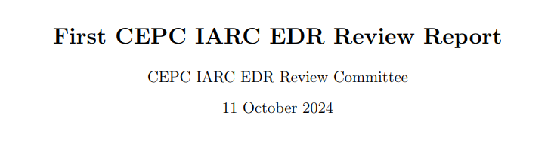
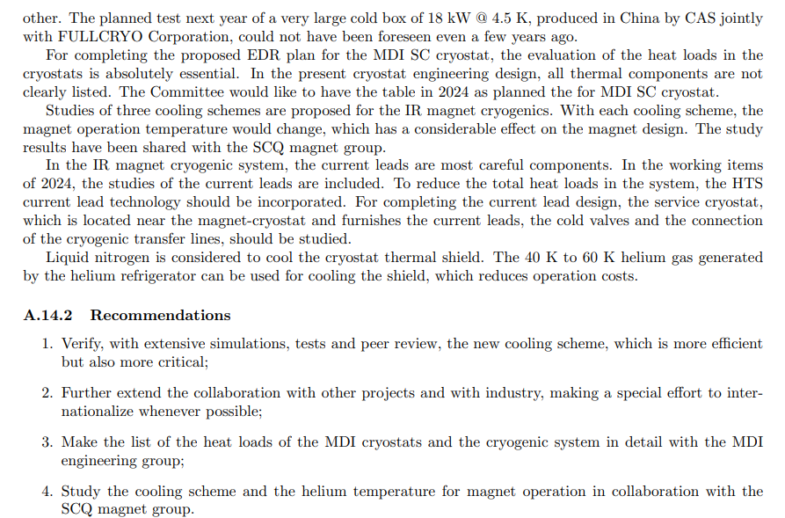
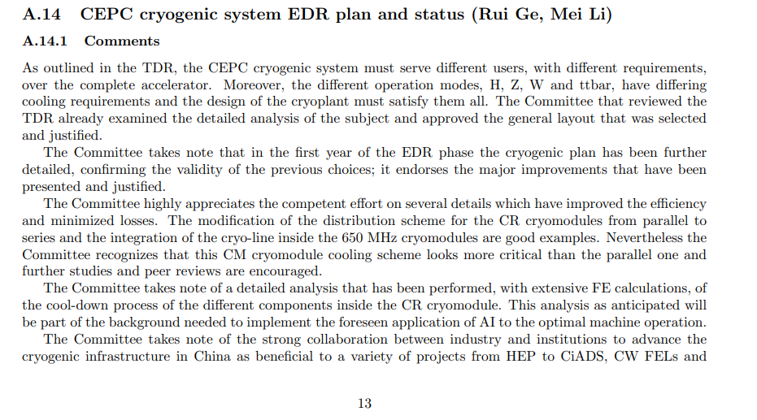
2024 IARC comment
1. | OVERVIEW | OVERALL CRYO LAYOUT | 2024 IARC COMMENT | 2025 MINI REVIEW |
Notes:
Now we move to the 2024 IARC comment. Firstly, we want to express our many thanks to the committee for the valuable comments. Those recommendations have been instrumental in guiding our work this past year. Committee suggested that we need to hold a mini-review to evaluate the works we have done.

Slide 9

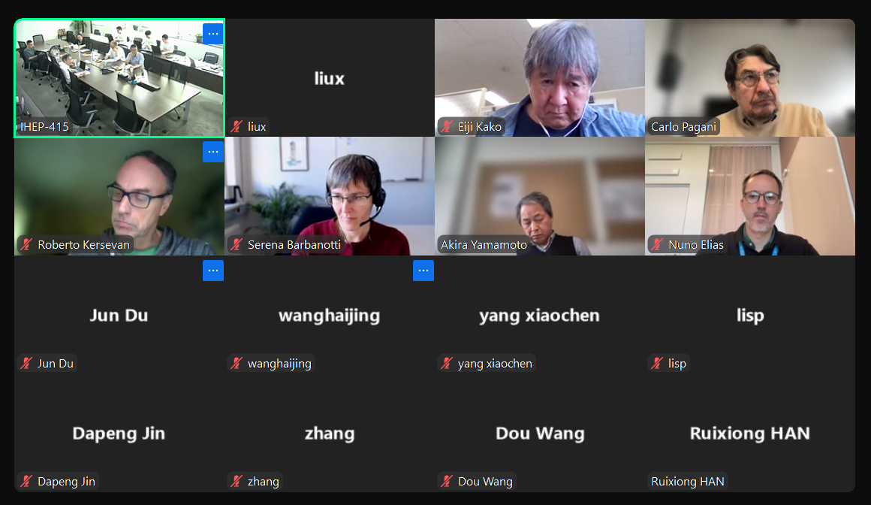
2025 SRF Cryogenic System Peer Review
Successfully Held CEPC SRF Cryogenic System Peer Review, May 13, 2025
1. | OVERVIEW | OVERALL CRYO LAYOUT | 2024 IARC COMMENT | 2025 MINI REVIEW |
Notes:
The mini-review was successfully held on May 13th, 2025. These are photos and screenshots.

Slide 10
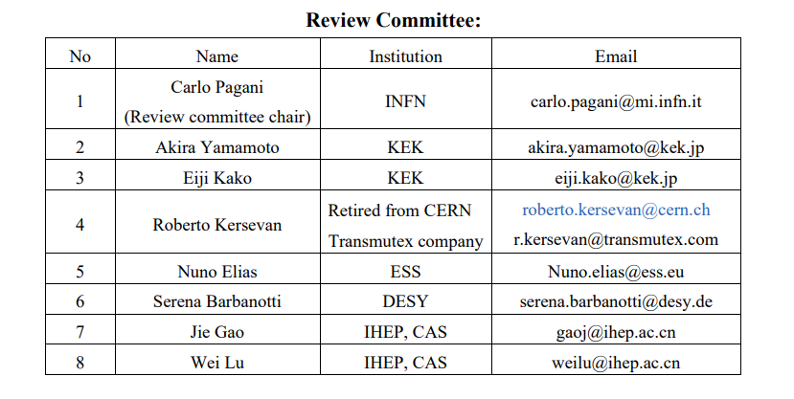
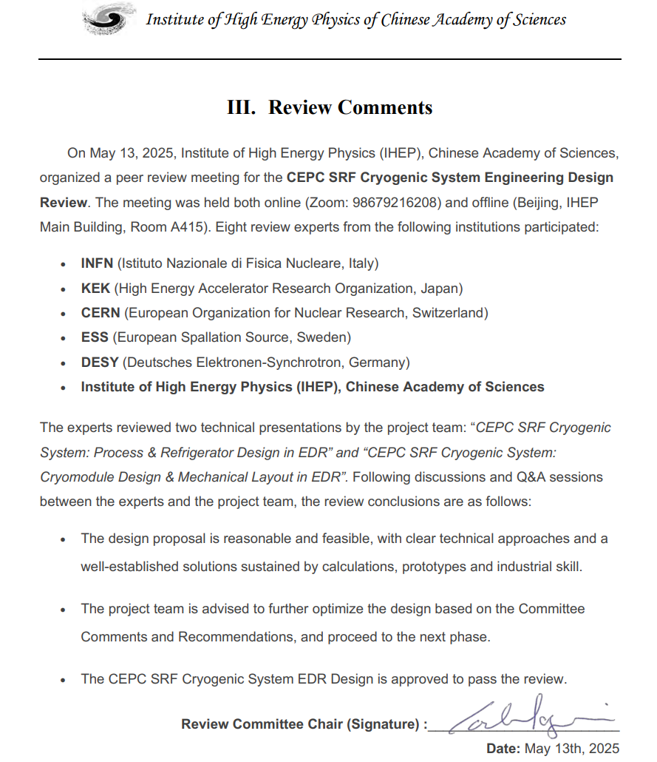
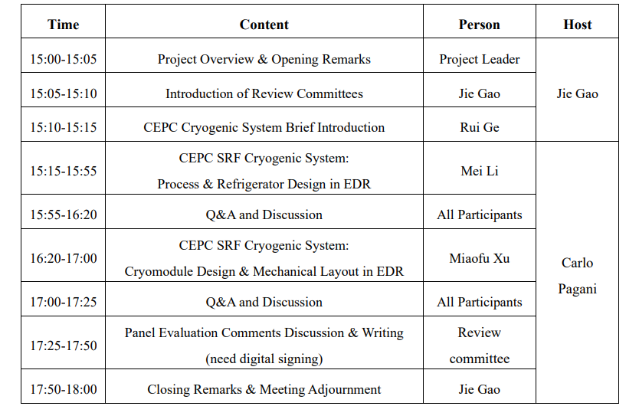
2025 SRF Cryogenic System Peer Review
1. | OVERVIEW | OVERALL CRYO LAYOUT | 2024 IARC COMMENT | 2025 MINI REVIEW |
Notes:
We have received the valuable review comments, which can be acted as the guidance to our future research works.

Slide 11
Content
1. CEPC Cryogenic System Overview
1.1 CEPC Project Brief Introduction
1.2 General Layout of Cryogenic System
1.3 2025 Mini-Review
2. CEPC SRF Cryogenic System Scheme Design
2.1 Process Design & Calculation
2.2 Large Helium Refrigerator
3. Cryomodule R&D Status
3.1 Collider 650MHz Cryomodule R&D
3.2 Booster 1.3GHz Cryomodule R&D
4. Summary and Outlook

Slide 12
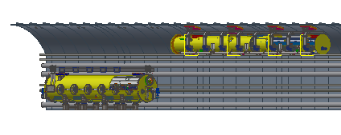
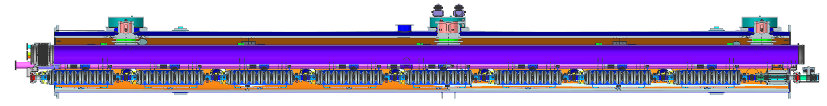
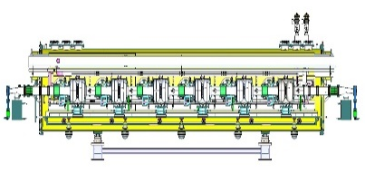
Process Flow Block Diagram of SRF Cryogenic System
Ground equipment
Process flow block diagram is essential in comprehending the interaction of various cryogenic equip, and designing the CM cooling process.
Tanks zone
Upper Cold Box
（300K-40K）
5 K @ 3 bara supercritical helium is subcooled to 4.5 K in the lower coldbox, and then further be cooled to 2.4 K @ 3 bara by a large heat exchanger ( ~ 90 g/s of each, total four HX)
2.4 K @ 3 bara helium is transferred to the beam tunnel, then is throttled by JT valve inside CM to produce the 2 K superfluid helium
Return GHe goes through 2 K HX and cold compressors to recover the cold quantity, then returns to CB and compressors LP side to finalize the whole cycle
RF shaft
Compressor group
Auxiliary tunnel
Lower Cold Box
（40K-4.5K）
2K coldbox
10m
MDVB
12kW@4.5K
Beam tunnel
10m
20m
11000
11000
32m
11000
8000
3 cryomodules, 8 × 1.3 GHz 9-cell cavities each
Booster Ring
12
Cryomodules
Phase seperator
Higgs 50MW
80m
9500
8000
224m
95000
14 cryomodules, 6 × 650 MHz 2-cell cavities each
Collider Ring
2 | EDR PROCESS FLOW DIAGRAM | PROCESS CALCULATION | LARGE HELIUM REFRIGERATOR|
Notes:
This block diagram is essential for understanding the key thermodynamic process of the 2K system. Supercritical helium at 5K is subcooled and then further cooled by large heat exchangers before being transferred to the cryomodules. Inside the CM, a JT valve throttles the flow to produce the superfluid helium bath at 2K. The return gas passes through a heat exchanger and cold compressors to recover its cooling potential before returning to the main compressors, completing the cycle.

Slide 13
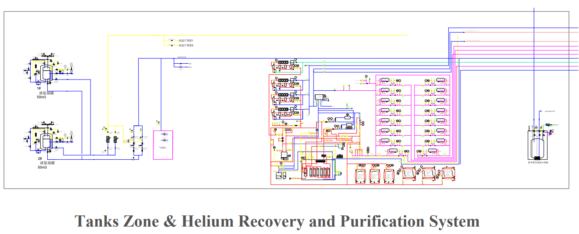
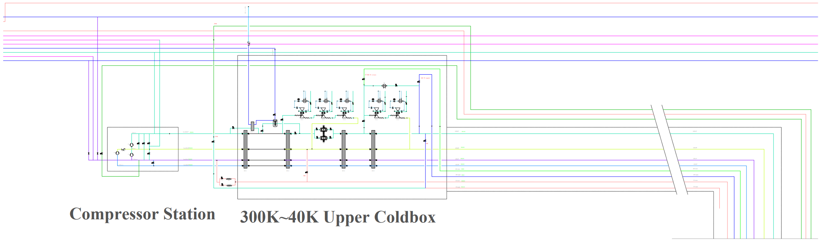
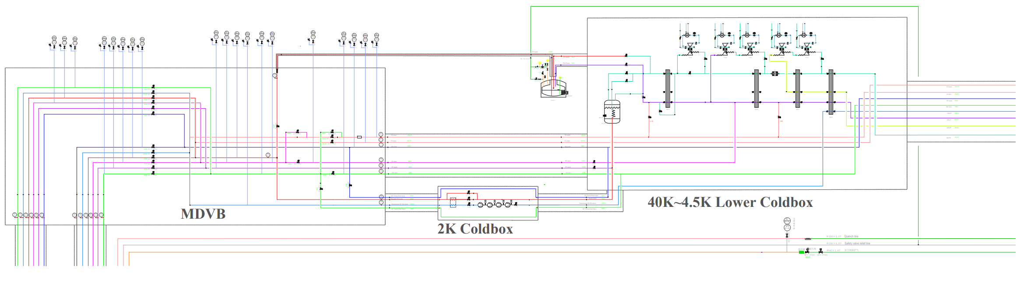
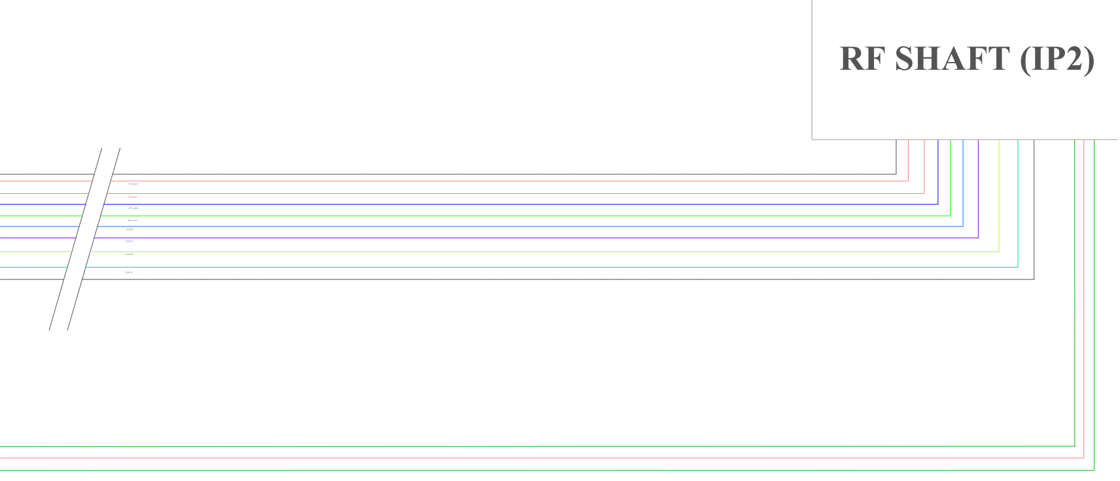
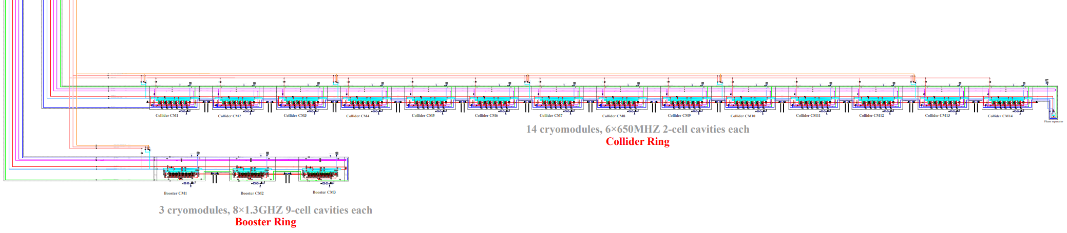
SRF Cryogenic system process flow diagram / IP2 RF1 Section
Tanks Zone & Helium Recovery and Purification System
Compressor station
300K~40K Upper Coldbox
40K~4.5K Lower Coldbox
Main Distribution Valve Box
2K Coldbox
(cold compressor+ 2K HX)
Cryomodules
2 | EDR PROCESS FLOW DIAGRAM | PROCESS CALCULATION | LARGE HELIUM REFRIGERATOR|
Notes:
The EDR—Flow chart of SRF Scheme provides a visual representation of the entire process flow diagram of the SRF cryogenic system. This is ***, This is ***. In the subsequent slides, I will present an enlarged view of each section for a more detailed examination.

Slide 14
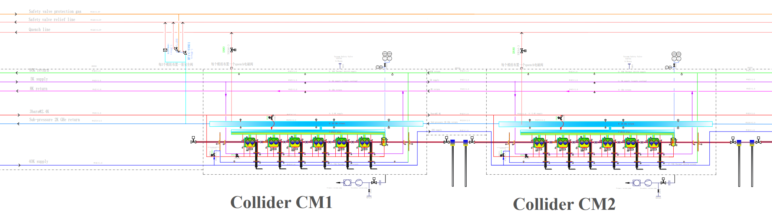
Individual CM Warmup Consideration When Abnormal Conditions
Condition 1
Condition 2
When one CM has problem, it can be bypassed(closed CD valve, GHe goes through quench valve) without influence other CMs operation;
It occurs the accident (leakage, vacuum becoming bad, cavities damage, etc. ),we have set the vacuum barrier, to prevent vacuum deterioration spreading to all CMs;
Because of the series connection, all CMs need be warmed up together.
Cavities or one CM performance is not well, we can warm up this CM to 40K using the thin-filmed electrical heater which is attached in the bottom of the helium vessel, then fast cooldown to cross the transition temperature 9.2K → 4.5K directly, following that accumulated the required LHe level, and pump 2K
2 | EDR PROCESS FLOW DIAGRAM | PROCESS CALCULATION | LARGE HELIUM REFRIGERATOR|
Notes:
A very important process function design is to handle one of abnormal or faulty cryomodule. We have designed a procedure to warm up a single faulty cryomodule to 40K using integrated electrical heaters. Besides, when one CM has problem, it can be bypassed(closed CD valve, GHe goes through quench valve) without disturbing the entire string. Vacuum barriers are set to prevent a local vacuum deterioration spreading to all CMs.

Slide 15
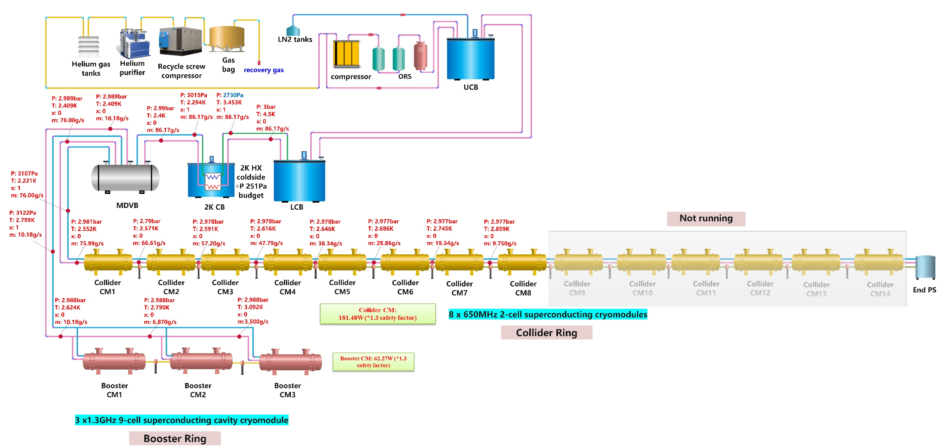
Higgs30MW--2K process calculation and optimization
Item | Higgs 30MW | Higgs 50MW
Heat load per CM (contains 1.2 times margin) | Collider 181.48W Booster 62.27W | Collider 73.45W Booster 63.31W
CM number per Cryo-station | Collider 8 CMs Booster 3 CMs | Collider 14 CMs Booster 3 CMs
2K TL length per Cryo-station/m | Collider: 228m Booster: 72m | Collider: 324m Booster: 72m
Total Mass flow rate 3bara@4.5K/(g/s) | 86.37 | 66.04
Helium gas return pipe (HGRP) diameter | DN250 | DN250
2K HX coldside budget | 251Pa | 286Pa
Total △P from CM to 2K CB Cold-compressor inlet | 400Pa | 400Pa
Not running
Collider: 3bara@2.4K Supply (Φ45*1.6) 2K return (DN250, Φ273*2.0) Booster: 3bara@2.4K Supply (Φ34*1.6) 2K return (DN250, Φ114*2.0) | Supply TL heat loss-0.3W/m (round) Return TL heat loss-0.6W/m (round)
2 | EDR PROCESS FLOW DIAGRAM | PROCESS CALCULATION | LARGE HELIUM REFRIGERATOR|
Notes:
This slide references the detailed process calculation and optimization for the Higgs 30MW mode. While the specific results will not be explained in detail here. This part of works are the foundation for system sizing and performance prediction.
The Higgs30MW--2K process calculation and optimization shows the details about the calculation. The mass flow rate is approximately 86g/s. The total pressure drop (△P) from the CM to the 2K CB cold-compressor inlet is 400Pa, and we have selected a helium gas return pipe diameter of DN250. Under these conditions, the 2K HX coldside budget is 251Pa, ensuring efficient heat exchange and minimizing pressure losses.

Slide 16
EDR- CEPC Cryo-layout at RF section- Higgs 30/50MW
Compressor system
Compressor system
① Collider Multiple TL to CMs
He Gas Tanks
Operating parameters | A | B | C | D | E | F
Pressure / [bara] | 3 | 0.031 | 3 | 2.5 | 13 | 10
Temperature / [K] | 2.4 | 2 | 5 | 8 | 40 | 70
Nominal Pipe Size Do × Thick. / [mm] | Φ45×1.6 | Φ273×3.5 | Φ45×1.6 | Φ45×1.6 | Φ45×1.6 | Φ45×1.6
Upper coldbox
LN2 system
LN2 system
Upper coldbox
Ground surface
RF Shaft, Φ16 m
② Booster Multiple TL to CMs
LHe
Dewar
Lower coldbox
Lower coldbox
LHe
Dewar
Operating parameters | A | B | C | D | E | F
Pressure / [bara] | 3 | 0.031 | 3 | 2.5 | 13 | 10
Temperature / [K] | 2.2 | 2 | 5 | 8 | 40 | 70
Nominal Pipe Size Do × Thick. / [mm] | Φ34×1.6 | Φ114×2 | Φ34×1.6 | Φ42×1.6 | Φ34×1.6 | Φ42×1.6
2K valve box
MDVB
MDVB
2K valve box
Auxiliary tunnel
Beam tunnel
10m
10m
DN500
DN420
Phase seperator
Phase seperator
Collider CM
(14 cryomodules, 6×650MHZ 2-cell/CM)
Collider CM
(14 cryomodules, 6×650MHZ 2-cell/CM)
C
A
C
①
②
②
①
B
B
A
D
①
D
②
224m
90m
90m
224m
E
F
E
F
Booster CM
(3 cryomodules, 8×1.3GHZ 9-cell/CM)
Booster CM
(3 cryomodules, 8×1.3GHZ 9-cell/CM)
The design results can well illustrate the tunnel-based cryomodule distribution with their associated transfer line operating parameters (pressure, temperature, pipe dimensions).
32m
30m
30m
32m
2 | EDR PROCESS FLOW DIAGRAM | PROCESS CALCULATION | LARGE HELIUM REFRIGERATOR|
Notes:
This slide shows the CEPC Cryo-layout at RF section. It illustrates the location of surface equipment like compressors and upper cold boxes, and the underground installation of the LCB, valve boxes, and the Multiple TL sizes to collider CMs and to the Booster CMs. The design results can well illustrate the tunnel-based cryomodule distribution with their associated transfer line operating parameters (pressure, temperature, pipe dimensions).

Slide 17

EDR-Higgs 30MW Heat Loads
Cavity RF voltage 11.5MV
Higgs Mode 30MW | Unit | Collider |  |  | Booster
 |  | 40-80K | 5-8K | 2K | 40-80K | 5-8K | 2K
Predicted module static heat load | (W/module) | 300 | 60 | 25 | 140 | 20 | 20
Predicted module HOM static heat load | (W/module) | 2.4 | 1.2 | 0.1 | 0 | 0 | 0
Predicted module Input coupler static heat load | (W/module) | 6 | 3 | 0.3 | 16 | 8 | 0.8
Predicted module dynamic heat load (RF) | (W/module) | 0 | 0 | 123.2 | 0 | 0 | 40.9
Predicted module HOM dynamic heat load | (W/module) | 2.9 | 1.4 | 0.2 | 7.1 | 3.6 | 0.6
Predicted module Input coupler dynamic heat load | (W/module) | 90.1 | 22.5 | 3.8 | 208 | 20.8 | 2.6
Cryomodule number | - | 32 | 32 | 32 | 12 | 12 | 12
Total module static heat | (kW) | 9.87 | 2.05 | 0.81 | 1.87 | 0.34 | 0.25
Total module dynamic heat | (kW) | 2.98 | 0.76 | 4.07 | 2.58 | 0.29 | 0.53
Each Module total heat load | W | 401.4 | 88.1 | 152.6 | 371.1 | 52.4 | 64.9
MDVB heat loss | W | 50 | 30 | 10 | 50 | 30 | 10
MDVB number | - | 4 | 4 | 4 | 4 | 4 | 4
Total cryogenic transfer line length | m | 2232 | 2232 | 912 | 1608 | 1608 | 288
cryogenic transfer line heat loss per meter | W/m | 2 | 0.5 | 0.3 | 2 | 0.5 | 0.3
Total cryogenic transfer line heat loss | W | 4464 | 1116 | 273.6 | 3216 | 804 | 86.4
Non-module heat load | (kW) | 4.664 | 1.236 | 0.314 | 3.416 | 0.924 | 0.126
Total predicted heat | (kW) | 17.509 | 4.055 | 5.197 | 7.869 | 1.553 | 0.905
Total predicted mass flow | (g/s) | 83.903 | 126.527 | 245.259 | 37.709 | 48.449 | 42.720
Ideal power based on total estimated heat | (kW) | 80.628 | 192.644 | 800.480 | 36.238 | 73.766 | 139.431
Heat uncertainty factor on static heat (Fus) |  | 1.000 | 1.000 | 1.000 | 1.000 | 1.000 | 1.000
Heat uncertainty factor on dynamic heat (Fud) |  | 1.000 | 1.000 | 1.000 | 1.000 | 1.000 | 1.000
Heat load per cryogenic unit including uncertainty | (kW) | 17.509 | 4.055 | 5.197 | 7.869 | 1.553 | 0.905
Mass flow per cryogenic unit including uncertainty | (g/s) | 83.903 | 126.527 | 245.259 | 37.709 | 48.449 | 42.720
Weighted ideal power | (kW) | 80.628 | 192.644 | 800.480 | 36.238 | 73.766 | 139.431
4.5 K equiv weighted power | (kW) | 1.228 | 2.934 | 12.191 | 0.552 | 1.123 | 2.124
Efficiency (fraction Carnot) |  | 0.280 | 0.240 | 0.220 | 0.280 | 0.240 | 0.220
Operating power based on predicted heat | (kW) | 287.956 | 802.684 | 3638.546 | 129.420 | 307.360 | 633.777
Operating power including uncertainty | (kW) | 287.956 | 802.684 | 3638.546 | 129.420 | 307.360 | 633.777
Overall net cryogenic capacity multiplier |  | 1.540 | 1.540 | 1.540 | 1.540 | 1.540 | 1.540
Heat load per cryogenic unit (Fus, Fud, and Fo) | (kW) | 26.964 | 6.245 | 8.003 | 12.119 | 2.391 | 1.394
Installed 4.5 K equivalent heat loads (1.54 margin) | (kW) | 2.026 | 5.648 | 25.602 | 0.911 | 2.163 | 4.459
Total installed 4.5 K equivalent power (kW) |  | 33.276 |  |  | 7.533
Total 4.5K equiv. heat load with multiplier | kW | 40.808
Installed power (COP(219W/1W)) | MW | 7.287 |  |  | 1.650
2 | EDR PROCESS FLOW DIAGRAM | PROCESS CALCULATION | LARGE HELIUM REFRIGERATOR|
Notes:
After detailed process calculation, we summarized the Higgs 30MW Heat Loads for the Collider and Booster. These precise calculations are necessary in sizing the refrigerator selection. For the Higgs 30MW mode, with a cavity voltage of 11.5 MV, the total calculated heat load at 4.5K is 41 kW. This leads to the specification of four 12 kW cryo-plants to handle this load with a 17% margin.

Slide 18
EDR-Higgs 50MW Heat Loads
Cavity RF voltage 6.5MV
Higgs Mode 50MW | Unit | Collider |  |  | Booster
 |  | 40-80K | 5-8K | 2K | 40-80K | 5-8K | 2K
Predicted module static heat load | (W/module) | 300 | 60 | 25 | 140 | 20 | 20
Predicted module HOM static heat load | (W/module) | 2.4 | 1.2 | 0.1 | 0 | 0 | 0
Predicted module Input coupler static heat load | (W/module) | 6 | 3 | 0.3 | 16 | 8 | 0.8
Predicted module dynamic heat load (RF) | (W/module) | 0 | 0 | 40.1 | 0 | 0 | 40.9
Predicted module HOM dynamic heat load | (W/module) | 4.8 | 2.4 | 0.4 | 9.6 | 4.8 | 0.8
Predicted module Input coupler dynamic heat load | (W/module) | 85.8 | 21.5 | 3.6 | 256 | 25.6 | 3.2
Cryomodule number | - | 56 | 56 | 56 | 12 | 12 | 12
Total module static heat | (kW) | 17.27 | 3.60 | 1.42 | 1.87 | 0.34 | 0.25
Total module dynamic heat | (kW) | 5.07 | 1.34 | 2.47 | 3.19 | 0.36 | 0.54
Each Module total heat load | W | 399 | 88.1 | 69.5 | 421.6 | 58.4 | 65.7
MDVB heat loss | W | 50 | 30 | 10 | 50 | 30 | 10
MDVB number | - | 4 | 4 | 4 | 4 | 4 | 4
Total cryogenic transfer line length | m | 2616 | 2616 | 1296 | 1608 | 1608 | 288
cryogenic transfer line heat loss per meter | W/m | 2 | 0.5 | 0.3 | 2 | 0.5 | 0.3
Total cryogenic transfer line heat loss | W | 5232 | 1308 | 388.8 | 3216 | 804 | 86.4
Non-module heat load | (kW) | 5.432 | 1.428 | 0.429 | 3.416 | 0.924 | 0.126
Total predicted heat | (kW) | 27.776 | 6.362 | 4.321 | 8.475 | 1.625 | 0.915
Total predicted mass flow | (g/s) | 133.103 | 198.490 | 203.917 | 40.613 | 50.696 | 43.173
Ideal power based on total estimated heat | (kW) | 127.908 | 302.211 | 665.547 | 39.028 | 77.187 | 140.910
Heat uncertainty factor on static heat (Fus) |  | 1.000 | 1.000 | 1.000 | 1.000 | 1.000 | 1.000
Heat uncertainty factor on dynamic heat (Fud) |  | 1.000 | 1.000 | 1.000 | 1.000 | 1.000 | 1.000
Heat load per cryogenic unit including uncertainty | (kW) | 27.776 | 6.362 | 4.321 | 8.475 | 1.625 | 0.915
Mass flow per cryogenic unit including uncertainty | (g/s) | 133.103 | 198.490 | 203.917 | 40.613 | 50.696 | 43.173
Weighted ideal power | (kW) | 127.908 | 302.211 | 665.547 | 39.028 | 77.187 | 140.910
4.5 K equiv weighted power | (kW) | 1.948 | 4.603 | 10.136 | 0.594 | 1.176 | 2.146
Efficiency (fraction Carnot) |  | 0.280 | 0.240 | 0.220 | 0.280 | 0.240 | 0.220
Operating power based on predicted heat | (kW) | 456.815 | 1259.211 | 3025.213 | 139.386 | 321.612 | 640.498
Operating power including uncertainty | (kW) | 456.815 | 1259.211 | 3025.213 | 139.386 | 321.612 | 640.498
Overall net cryogenic capacity multiplier |  | 1.540 | 1.540 | 1.540 | 1.540 | 1.540 | 1.540
Heat load per cryogenic unit (Fus, Fud, and Fo) | (kW) | 42.775 | 9.797 | 6.654 | 13.052 | 2.502 | 1.409
Installed 4.5 K equivalent heat loads (1.54 margin) | (kW) | 3.214 | 8.860 | 21.286 | 0.981 | 2.263 | 4.507
Total installed 4.5 K equivalent power (kW) |  | 33.361 |  |  | 7.750
Total 4.5K equiv. heat load with multiplier | kW | 41.111
Installed power (COP(219W/1W)) | MW | 7.306 |  |  | 1.697
2 | EDR PROCESS FLOW DIAGRAM | PROCESS CALCULATION | LARGE HELIUM REFRIGERATOR|
Notes:
Similarly, for the 50MW mode, with a lower cavity voltage of 6.5 MV, the heat load is also managed by four 12 kW plants. This optimized load calculation compared to the TDR is a significant achievement in efficiency.

Slide 19
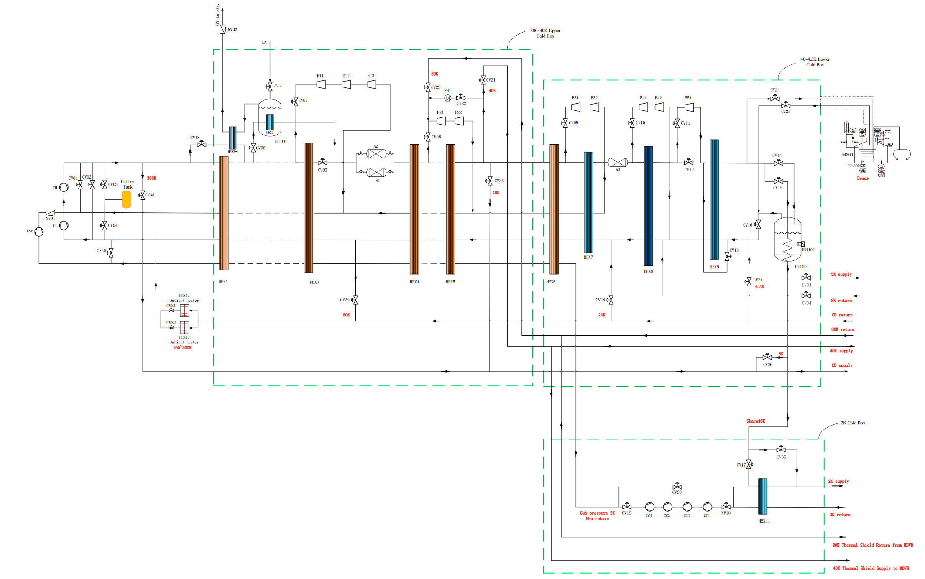
Large Refrigerator PFD diagram
This PFD diagram provides a comprehensive overview of the refrigeration cycle and the interactions between various components, serving as a blueprint for the system's operation and performance.
Cryo-plants Design value (performance test) 4×15kW@4.5K
300K~40K Upper Coldbox
中国科学院理化技术研究所
Technical Institute of Physics and Chemistry
40K~4.5K Lower Coldbox
Compressor station
3000L Dewar
2.0K ≥ 2200W
40~80K ≥13000W
5~8K ≥2200W
>15kW@4.5K
>3000 L/h
2K Coldbox
(cold compressor+ 2K HX)
Maximum capacity
Refrigeration capacity
Liquefaction rate
2 | EDR PROCESS FLOW DIAGRAM | PROCESS CALCULATION | LARGE HELIUM REFRIGERATOR|
Notes:
For the large refrigerator design, we prefer the design value or performance test is selected to 15kW for each, because it can provide the relative greater margin for the CEPC cryogenic system design. This Process Flow Diagram provides a comprehensive overview of the entire refrigeration cycle, from the compressor station and buffer dewar, through the stages of cooling in the upper and lower cold boxes, down to the 2K cold box containing the cold compressors and heat exchangers. It serves as the master blueprint for the system.

Slide 20
Main Design Results of refrigerator
These parameters are seriously determined to ensure that the refrigerator meets the required cooling capacity and efficiency standards, providing a reliable foundation for CEPC cryogenic system.
Overall design parameters for single refrigerator
中国科学院理化技术研究所
Technical Institute of Physics and Chemistry
Working temperature | Design requirement |  | Design results
 | Pressure（bar） | Heat load（W） | Pressure（bar） | Temperature（K） | Heat load（W） | Equivalent Heat load (@1.8K)
2.0K | 0.03 | ≥2200 | 0.03 | 1.986 | 2242 | 2031.24
40~80K | 18~16 | ≥13000 | 18.66~16.66 | 39~78K | 13400 | 380.22
5~8K | 5~4 | ≥2200 | 5~4 | 5~8K | 2200 | 630.87
Total equivalent heat load （@1.8K） |  |  |  |  |  | 3042.33
Other parameters | Design target
Liquid nitrogen consumption | 0g/s
Precooling helium gas flow | 60g/s
Overall UA value | 943.9kJ/K·s
Helium gas flow | 1032g/s
Predication power consumption（KW） | 2599
Equivalent energy efficiency ratio for 1.8K: 857.60W/W*
2 | EDR PROCESS FLOW DIAGRAM | PROCESS CALCULATION | LARGE HELIUM REFRIGERATOR|
Notes:
We have established the overall design parameters for a single refrigerator. These parameters ensure the plant meets the stringent performance requirements for CEPC.

Slide 21
Main Design Results of refrigerator
The cold compressor plays a vital role in the low-temperature stages of the refrigeration cycle, and its design and performance significantly impact the system's ability to achieve and maintain 2K for superconductivity.
Main equipment parameters - cold compressor
中国科学院理化技术研究所
Technical Institute of Physics and Chemistry
Parameter name | 1st stage | 2nd stage | 3rd stage | 4th stage
Mass flow rate (g/s) | 120 | 120 | 120 | 120
Inlet temperature（K） | 3.55 | 6.54 | 10.30 | 14.84
Inlet pressure（kPa，static pressure） | 2.90 | 8.12 | 17.10 | 30.80
Outlet temperature（K） | 6.54 | 10.30 | 14.84 | 20.12
outlet pressure（kPa） | 8.12 | 17.10 | 30.80 | 50.00
Predicated efficiency（%） | 60 | 60 | 60 | 60
Predication power consumption（kW） | 1.86 | 2.34 | 2.83 | 3.29
*：Expected value, internally adjustable
2 | EDR PROCESS FLOW DIAGRAM | PROCESS CALCULATION | LARGE HELIUM REFRIGERATOR|
Notes:
We also established the cold compressors parameters table. The cold compressors are vital for maintaining the low pressure required for 2K operation. This slide lists their main design parameters, including mass flow rate, suction and discharge pressures, and adiabatic efficiency. Their performance is crucial for the stability of the entire cryogenic system.

Slide 22
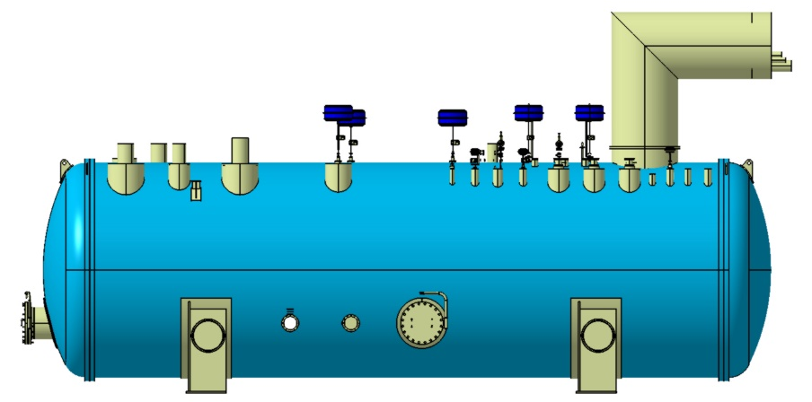
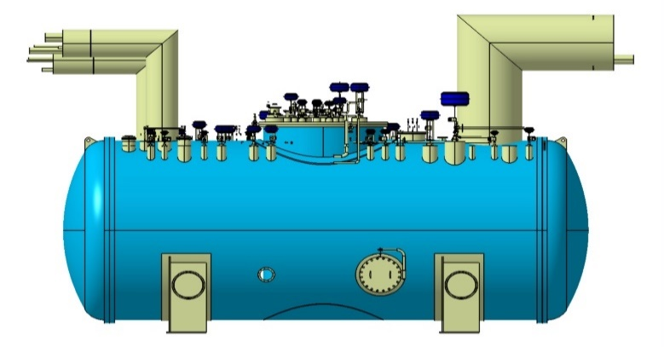
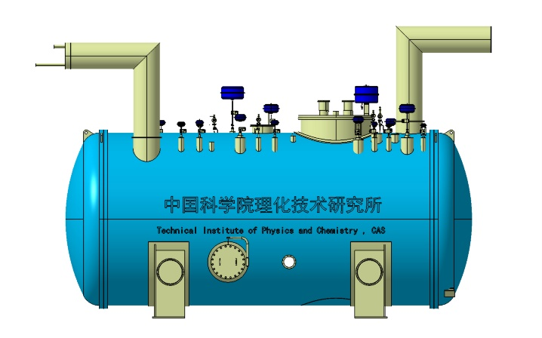
Preliminary design and optimization of cold box integration
Item | Number
Diameter/ m | 4
Length/ m | 15
Width / m | 5
Height / m | 6
Weight / tons | 95
300K~40K Upper ColdBox
Ground surface
Item | Number
Diameter/ m | 4
Length/ m | 10.5
Width / m | 5
Height / m | 6
Weight / tons | 80
40K~4.5K Lower ColdBox
Auxiliary Tunnel
Item | Number
Diameter/ m | 4
Length/ m | 10
Width / m | 5
Height / m | 6
Weight / tons | 80
2K Coldbox
Auxiliary Tunnel
2 | EDR PROCESS FLOW DIAGRAM | PROCESS CALCULATION | LARGE HELIUM REFRIGERATOR|
Notes:
This slide shows the mechanical integration of the major cold boxes – the Upper, Lower, and 2K units – within the surface cryogenic hall and their connection points to the transfer lines running down to the tunnel.

Slide 23
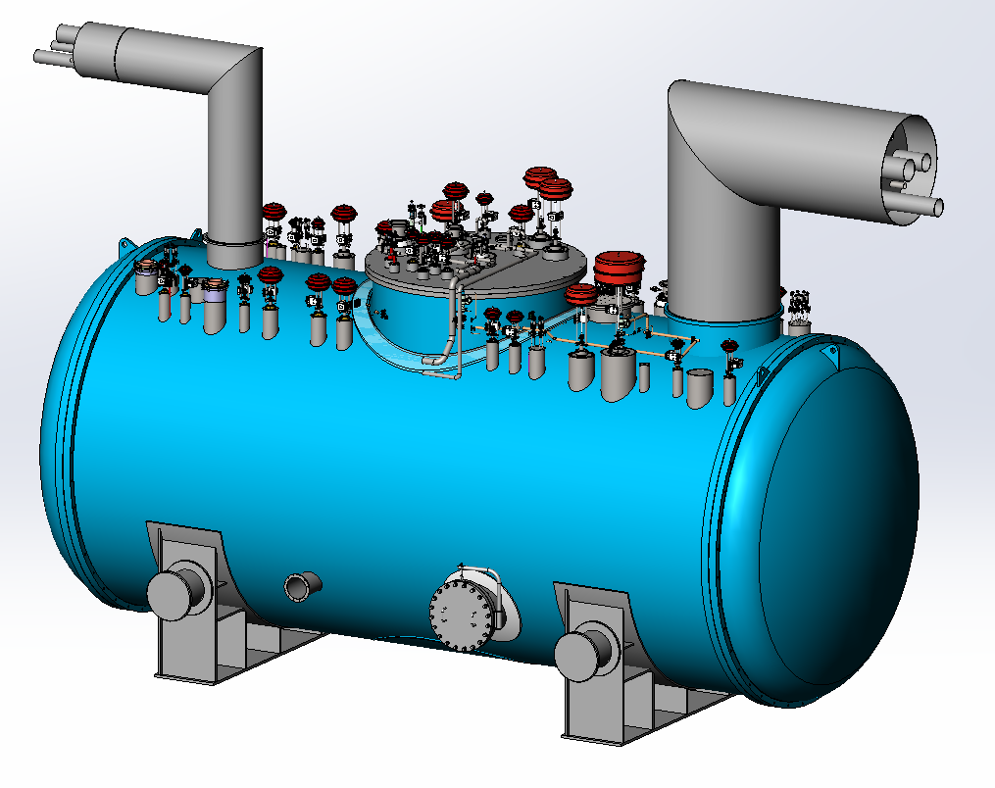
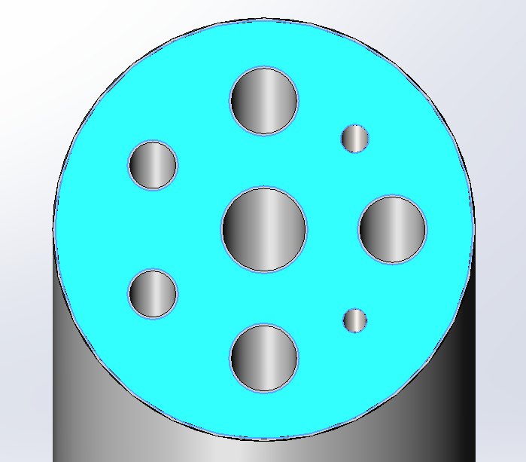
Preliminary design and optimization of cold box integration
40K~4.5K Lower ColdBox
From Upper ColdBox
DN200
DN250
负压通道
Sub-atmosphere
低压通道
Low pressure
To 2K
DN150
DN80
CD supply
80KReturn
DN200
中压通道
Medium pressure
DN150
高压通道
High pressure
6000
40K Supply
DN65
5000
CD Return
DN200
DN650
10500
中国科学院理化技术研究所
Technical Institute of Physics and Chemistry
40K~4.5K Lower ColdBox: multiple Transfer line (TL) layout （connection with Upper ColdBox）
2 | EDR PROCESS FLOW DIAGRAM | PROCESS CALCULATION | LARGE HELIUM REFRIGERATOR|
Notes:
Focusing on the Lower Cold Box, this slide details the complex arrangement of multiple transfer lines connecting it to the Upper Cold Box.

Slide 24
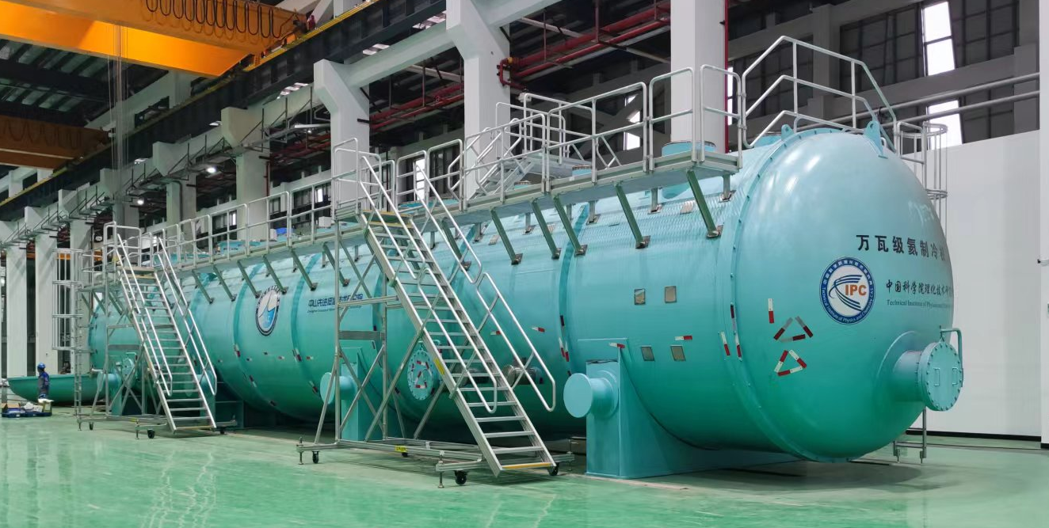
Mega-watts (18kW) Large refrigerator R&D status
TIPC, CAS & Zhongshan Institute of Advanced Cryogenic Technology
18kW@4.5K large refrigerator, reached liquefaction rate >3000L/h
2 | EDR PROCESS FLOW DIAGRAM | PROCESS CALCULATION | LARGE HELIUM REFRIGERATOR|
Notes:
For the mega-watts (18kW) Large refrigerator R&D status, our collaborators at TIPC CAS and Zhongshan Institute have developed an 18kW @ 4.5K large refrigerator, which has already achieved a liquefaction rate of greater than 3000 liters per hour. This is a tremendous achievement and a good foundation for the final plant design. Now this plant has been installed in the CiADS project onsite in Huizhou, Guangdong Provinces, and started the whole system commissioning test.

Slide 25
Content
1. CEPC Cryogenic System Overview
1.1 CEPC Project Brief Introduction
1.2 General Layout of Cryogenic System
1.3 2025 Mini-Review
2. CEPC SRF Cryogenic System Scheme Design
2.1 Process Design & Calculation
2.2 Large Helium Refrigerator
3. Cryomodule R&D Status
3.1 Collider 650MHz Cryomodule R&D
3.2 Booster 1.3GHz Cryomodule R&D
4. Summary and Outlook

Slide 26
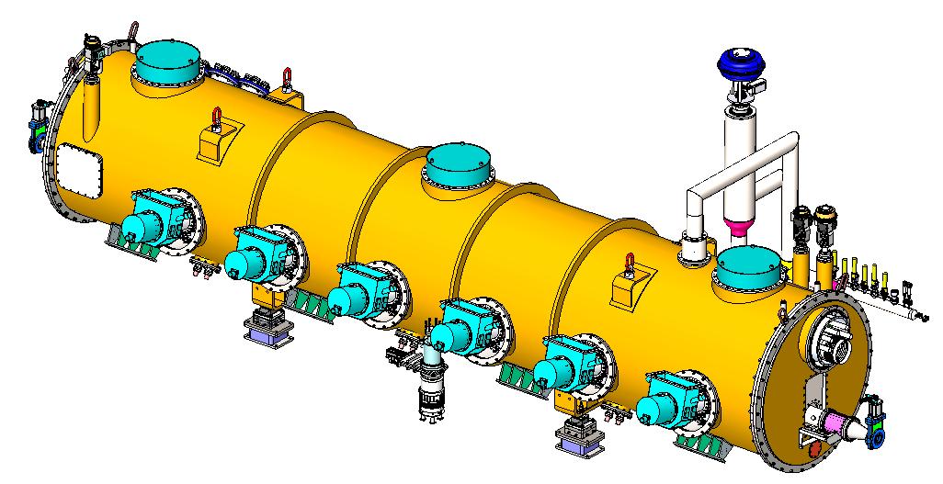
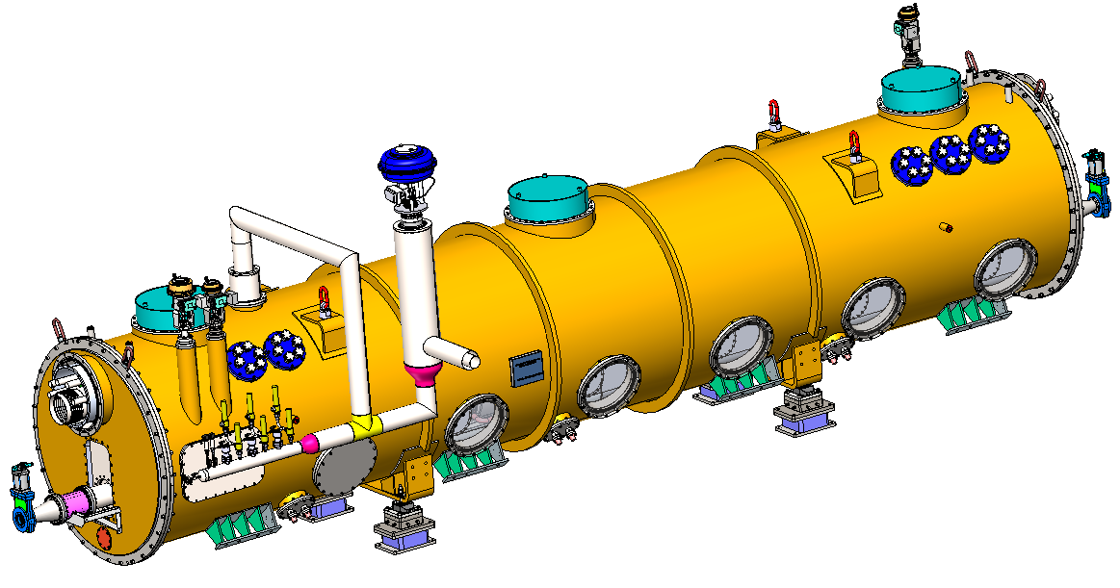
650 MHz full-size Cryomodule Design (Top Suspension)
Details can be referred to Prof. Jiyuan Zhai’s talk
Main material:
Thermal shield
inlet valve,DN15
Slide POST
Support
component
Fix POST
Support
component
Rings
Quench valve,DN80
Vacuum house：Q345R;
Thermal shield：Aluminum6061-T6+AL1050-A；
Cryogenic pipe：316L；
POST:G10
Copper hoop + copper braided strap：copper，RRR>100。
Gate valve
Welding/
maintenance
Coaxial line
Cryogenic pipeline connectors
CD valve,DN25
JT valve,DN15
Bottom adjustive
component
Vacuum relief valve/vacuum
gauge/Gate valve/
molecular pump
HOM absorber
Coupler
Support for
transportation
Size of vacuum chamber:Φ1500*14-7747.6mm
Total length of beam tube:9293.6mm
Total weight:10334Kg
Beamline height ：800mm
Height of cryomodule：3223.8mm(with quench valve)/2958mm
Alignment
FEEDTHROUGH，
6*CF35
Nameplate
Tuner maintenance
Pressure relief valve
Quench pipe：
Outer pipe Φ141/inner pipe Φ89
Vacuumize/Conditioning
Bursting disc
3. | COLLIDER 650MHz CM R&D STATUS | BOOSTER 1.3GHz CM R&D STATUS
Notes:
This slide details the mechanical design of the full-size 650 MHz cryomodule, which uses a top-suspension scheme. It lists key materials, the overall size and weight, and identifies all major external components, including couplers and cryogenic valves, etc.

Slide 27



650 MHz full-size Cryomodule Design(Top Suspension)
Two 5 ~ 8 K Ø45 pipes for coupler
Two 40 ~ 70 K Ø45 pipes for thermal shield
One 2 K Ø273 (inside CM) Ø219 (outside CM) GRP
One 3 Bara @ 2.4 K Ø45 pipe for subcooled supply.
Coupler change from horizontal to 15 deg tilt due to off-axis (move downward) and cold mass-vacuum chamber assembly requirement. Coupler length also reduced.
12 coaxial cables for power extraction of 12 HOM couplers (1 kW each).
Set RF shielded bellow between cavities.
Impedance and heat load of cavity flange seal gap to be evaluated.
Two layers of magnetic shielding
slide support
Quench valve
DN80
Fix support
slide support
3. | COLLIDER 650MHz CM R&D STATUS | BOOSTER 1.3GHz CM R&D STATUS
Notes:
Focusing on the internal mechanical design, the slide shows the different temperature circuit pipes for the coupler, thermal shield, and helium GRP. It also highlights the RF shielded bellows are set between cavities and two layers of magnetic shielding are also equipped.

Slide 28


Horizontal test R&D status
North HTS of PAPS SRF lab. New 2 K valve box and CTL.
Waveguide ports
Transport
path
Old 4K valve box for 166MHz cryomodule
New 2 K valve box for 650MHz cryomodule
3. | COLLIDER 650MHz CM R&D STATUS | BOOSTER 1.3GHz CM R&D STATUS
Notes:
The photo shows the North Horizontal Test Stand at the PAPS SRF lab, which is being prepared for the 650 MHz module tests. A new 2K valve box and cryogenic transfer line will be installed.

Slide 29

650 MHz Module Horizontal Test PID Diagram
3. | COLLIDER 650MHz CM R&D STATUS | BOOSTER 1.3GHz CM R&D STATUS
Notes:
This Piping and Instrumentation Diagram for the CM horizontal test has been decided, which will be used to validate the performance of this types of CM at 2K.

Slide 30


Flow chart for Booster 1.3GHz CM
Magnet
Series connection，modified TESLA CM
Three 1.3 GHz cryomodules hung from ceiling at a different beamline
Working temperature:2K
Two-phase flow
300 mm OD helium gas return pipe (GRP) is used as support backbone
Shared thermal insulating vacuum
No external parallel transfer cryogenic pipeline
3. | COLLIDER 650MHz CM R&D STATUS | BOOSTER 1.3GHz CM R&D STATUS
Notes:
The Booster cryomodules, based on a modified TESLA-type design, use a series connection scheme. A key feature is the use of a large 300mm OD gas return pipe acting as the structural backbone, which eliminates the need for external parallel transfer lines, simplifying the tunnel layout.

Slide 31







IHEP High Q 1.3GHz TESLA Type Cryomodules
Details can be referred to Prof. Jiyuan Zhai’s talk
World’s first Mid-T Bake High Q 1.3 GHz Cryomodule, Developed for High-repetition-rate FEL project of DALS.
Key criteria for stable and reliable operation include a dependable cryogenic refrigeration system and process design, good thermal insulation, pressure control, temperature uniformity, and quench protection, etc.
3. | COLLIDER 650MHz CM R&D STATUS | BOOSTER 1.3GHz CM R&D STATUS
Notes:
This slide highlights our experience base, showcasing the world's first Mid-T Bake High Q 1.3 GHz cryomodules developed for a FEL project. This experience is directly applicable to the Booster ring design and underscores the importance of a reliable cryogenic system for stable operation.

Slide 32
Content
1. CEPC Cryogenic System Overview
1.1 CEPC Project Brief Introduction
1.2 General Layout of Cryogenic System
1.3 2025 Mini-Review
2. CEPC SRF Cryogenic System Scheme Design
2.1 Process Design & Calculation
2.2 Large Helium Refrigerator
3. Cryomodule R&D Status
3.1 Collider 650MHz Cryomodule R&D
3.2 Booster 1.3GHz Cryomodule R&D
4. Summary and Outlook

Slide 33
Summary & Outlook
Comprehensive Design addresses nearly all critical aspects of the CEPC SRF cryogenic system.
Key R&D Milestones:
Completed 650 MHz cryomodule 2K Horizontal test in 2026 or 2027, depends on when the construction fees are in place.
Completed CEPC Cryogenic System Proposal in 2026.
Completed CEPC Cryogenic System EDR Documentation in June, 2027.
Collaboration & Scalability:
Collaboration with other projects (e.g., SHINE, Ci-ADS, S3FEL, HALF, etc.) and institutions will be maintained to leverage existing experience and expertise.
Develop AI-driven monitoring for real-time tracking of safety parameters (pressure, temperature).
Long-Term Goals:
The cryogenic system design aims to support the long-term operation of the CEPC SRF project, with considerations for potential upgrades and future expansion. The system is designed to be flexible and adaptable to evolving requirements.
Safety and reliability of the cryogenic system will remain a top priority. Continuous monitoring, testing, and validation of safety systems will be conducted to ensure the protection of personnel and equipment.
Thanks for your attention!

