Slide 1
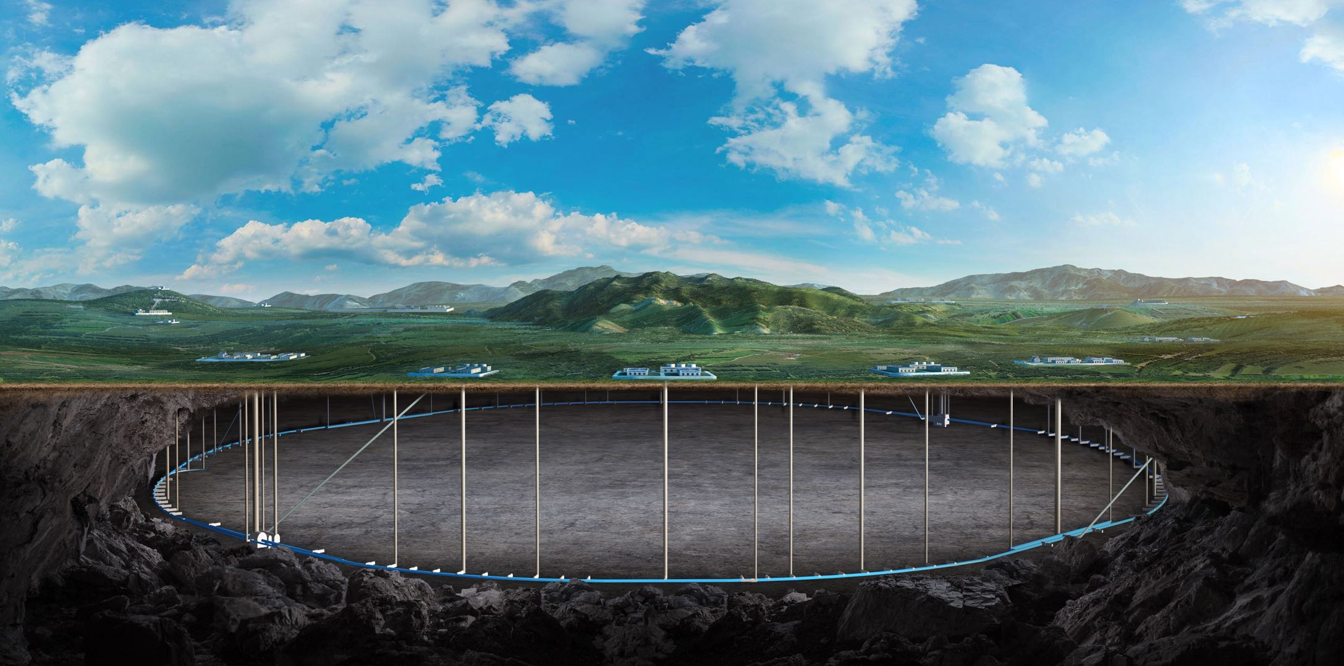

CEPC dumps and the dump experimental hall
Guangyi TANG, Zhongjian MA
On behalf of RP team of IHEP
2025 International Workshop on the High Energy Circular Electron Positron Collider (CEPC2025), 6-10 Nov, 2025, Guangzhou

Slide 2
Outline
Introduction to dumps in CEPC
Functional design for dumps
Dumps used for machine protection
Summary

Slide 3
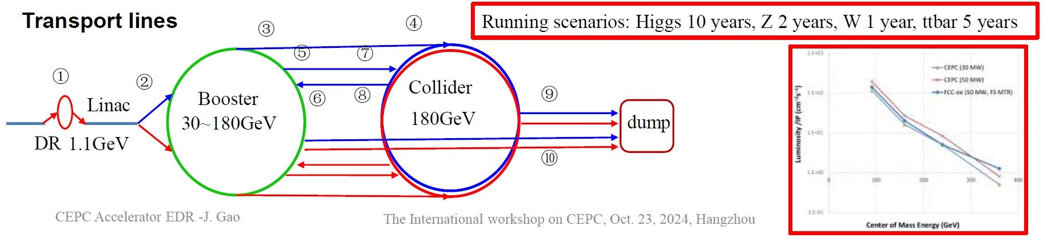
Introduction to dumps in CEPC
Dumps in the CPEC is used for machine commissioning/unwanted beam collection/collect beam in abnormal situation/sudden beam loss for machine protection
In the Linac, there are 6 Beam energy analysis stations used for beam characteristic analysis, 1 dump in the end for commissioning, 1 collimation station
In the Booster and Collider, there are now 2 dumps, more can be added according to design

Slide 4
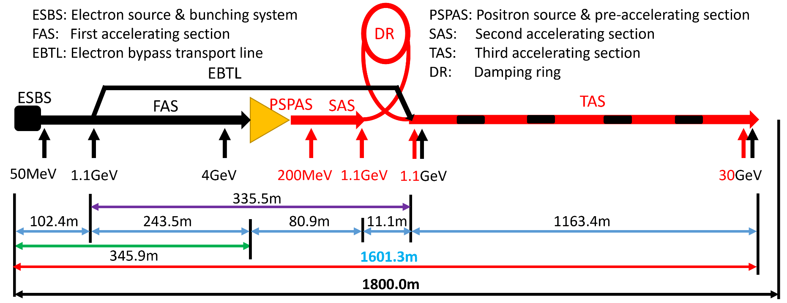
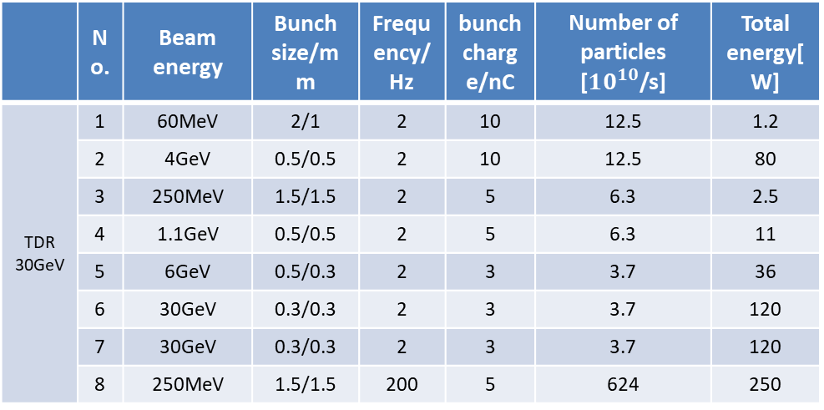
Functional design in TDR- Linac dumps Intro
Electron energy in the Linac is increased step by step
Radiation dose induced by hot points(beam energy analysis station or dumps) is higher
Shielding thickness for the Linac tunnel is determined by the random beam loss alone the beam line
 | No. | Beam energy | Bunch size/mm | Frequency/Hz | bunch charge/nC | Number of particles [$10^{10}$/s] | Total energy[W]
TDR 30GeV | 1 | 60MeV | 2/1 | 2 | 10 | 12.5 | 1.2
 | 2 | 4GeV | 0.5/0.5 | 2 | 10 | 12.5 | 80
 | 3 | 250MeV | 1.5/1.5 | 2 | 5 | 6.3 | 2.5
 | 4 | 1.1GeV | 0.5/0.5 | 2 | 5 | 6.3 | 11
 | 5 | 6GeV | 0.5/0.3 | 2 | 3 | 3.7 | 36
 | 6 | 30GeV | 0.3/0.3 | 2 | 3 | 3.7 | 120
 | 7 | 30GeV | 0.3/0.3 | 2 | 3 | 3.7 | 120
 | 8 | 250MeV | 1.5/1.5 | 200 | 5 | 624 | 250

Slide 5
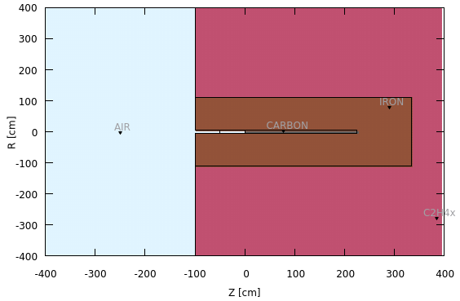
Functional design in TDR- Design principle
3 layers cylindrical structure is used for dump design
Carbon and iron is selected as the absorber material, surrounded by the polyethylene as local shielding.
5.5mSv/h is set as upper limit to decide the thickness of local shielding.
To suppress the back scattering radiation, extra iron and polyethylene was designed on the left part from the negative side of z position.
Radiation level nearby each energy analysis station was figured out, and then, roughly specified the space for the local shielding.

Slide 6
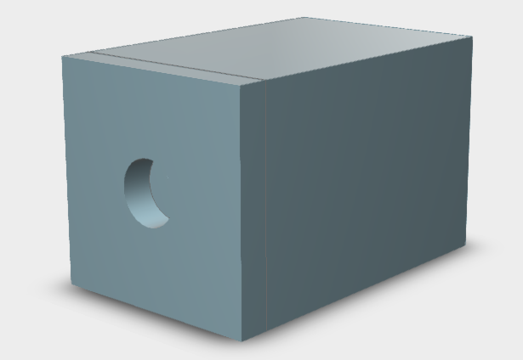
Functional design in TDR- Design results
No. | Beam energy | C |  | C+Fe |  | C+Fe+Polyethylene
 |  | R/m | Length/m | R/m | Length/m | R/m | Length/m
Dump_1 | 60MeV | 0.05 | 0.15 | 0.7 | 1 | --- | ---
Dump_2 | 4GeV |  | 1.25 | 1.1 | 2.4 | 1.2 | 2.6
Dump_3 | 250MeV |  | 0.4 | 0.5 | 0.95 | 0.55 | 1
Dump_4 | 1.1GeV |  | 0.75 | 0.75 | 1.6 | 0.85 | 1.7
Dump_5 | 6GeV |  | 1.45 | 0.92 | 2.4 | 1 | 2.5
Dump_6/7 | 30GeV |  | 2.6 | 1.2 | 3.7 | 1.3 | 3.8
Collimator | 250MeV | R=1.3m L=1.8m (outer dimension)
Outline of external dimensions for each dumps were designed
Thickness of local shielding can be further optimized, considering the beam loss optimization process and the Linac tunnel thickness

Slide 7
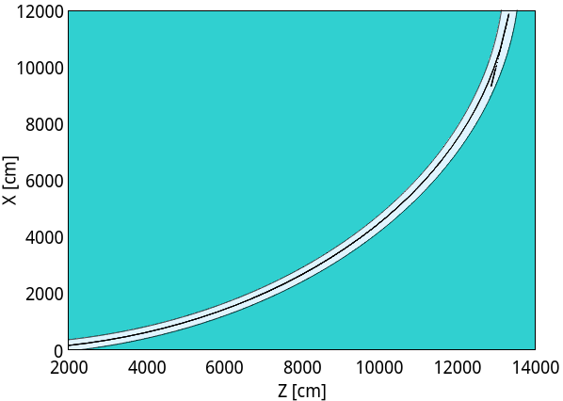
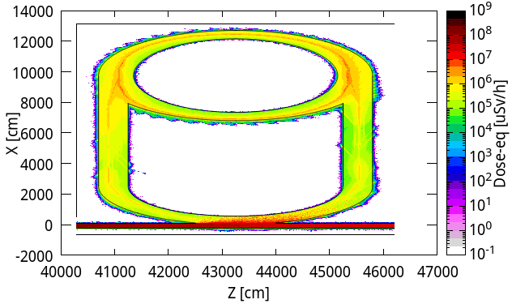
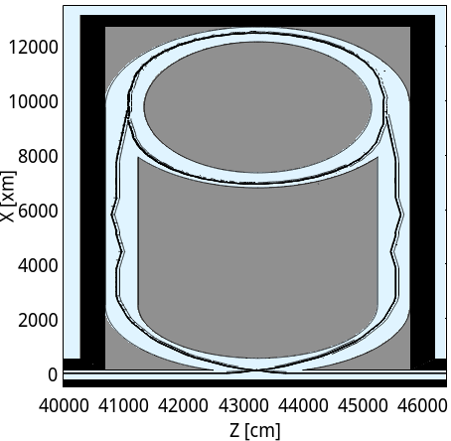
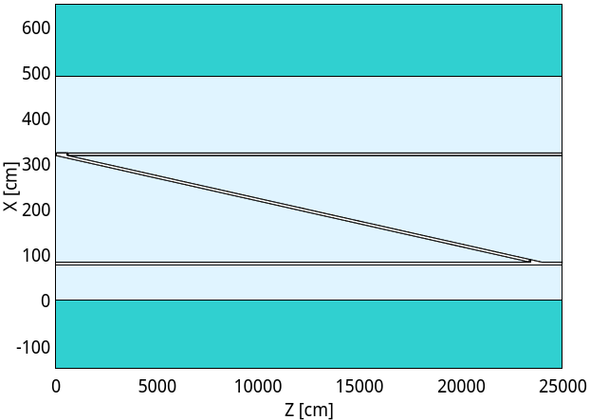
Linac-Damping ring & Linac-DR transport lines
Random beam losses are simulated along damping ring and transport lines;
since the SR critical energy is around 1 keV and power of SR is low.
The linac-to-booster and booster-to-collider transport line are simulated also.
Rock
FLUKA setup
Transport line
Concrete
Rock
Concrete
booster
Transport line
collider

Slide 8
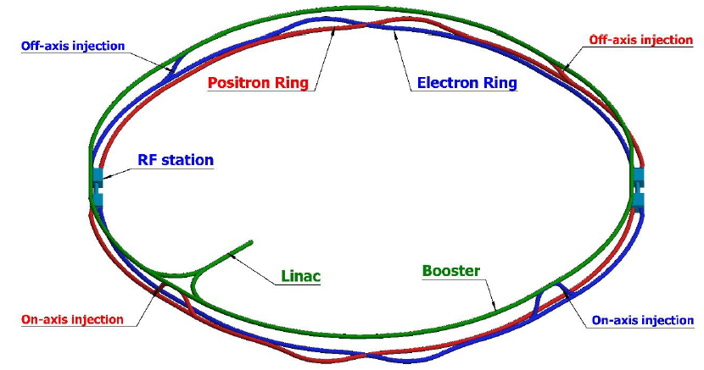
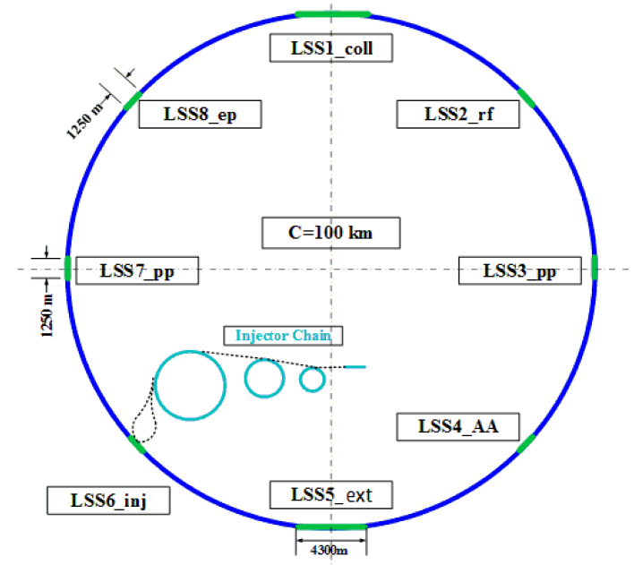
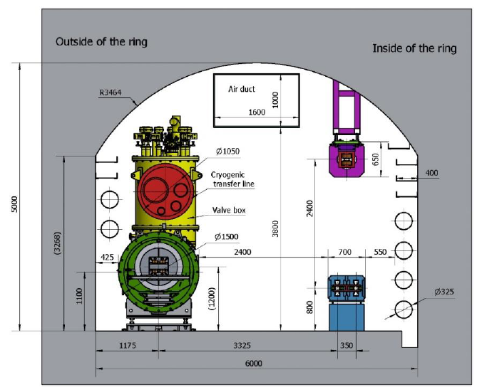
Functional design in TDR- Dumps for Booster/Ring
Dumping system for collider ring
Not necessary to be close to IP
Active machine protection for the beam loss with time larger than multi turns
Located at STR1 and STR2
At least one dump for each collider ring
STR4 for future option of ep collision
Inner side of tunnel
SPPC will locates outer side of CEPC
Maintenance of the dump
Dumping system for booster ring
Low charge bunches can be dumped by collimator
Dumping for bunches can share the dump with collider ring
STR4
STR1
STR3
STR2

Slide 9
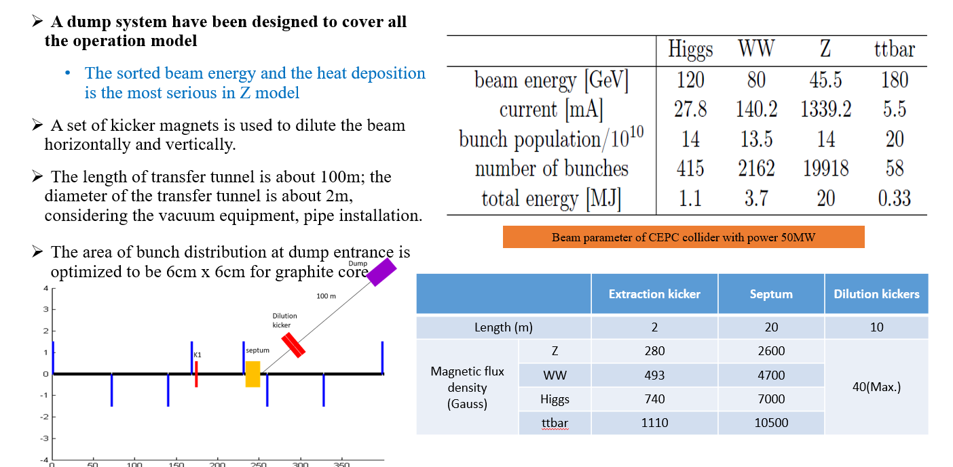
Functional design in TDR- Design scheme

Slide 10
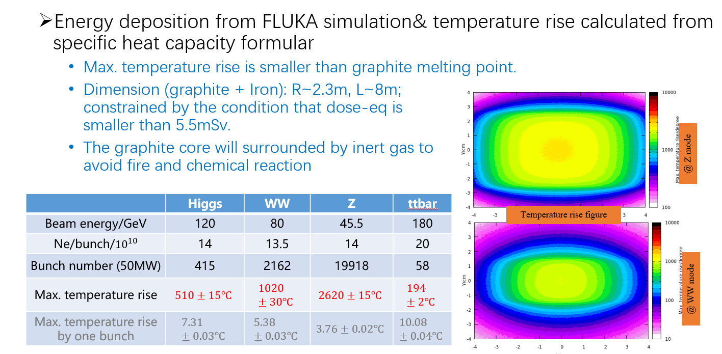
Functional design in TDR- Design results

Slide 11
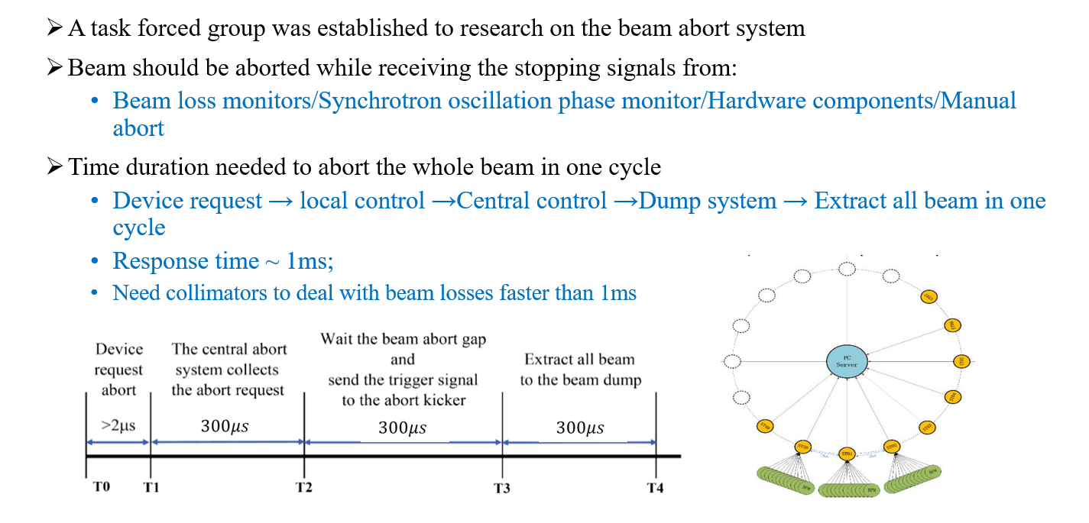
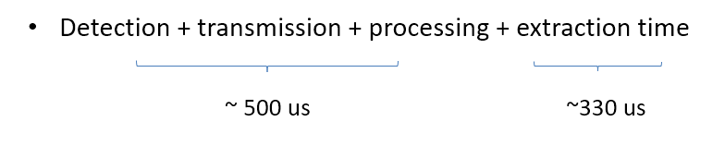
Dumps used for machine protection

Slide 12
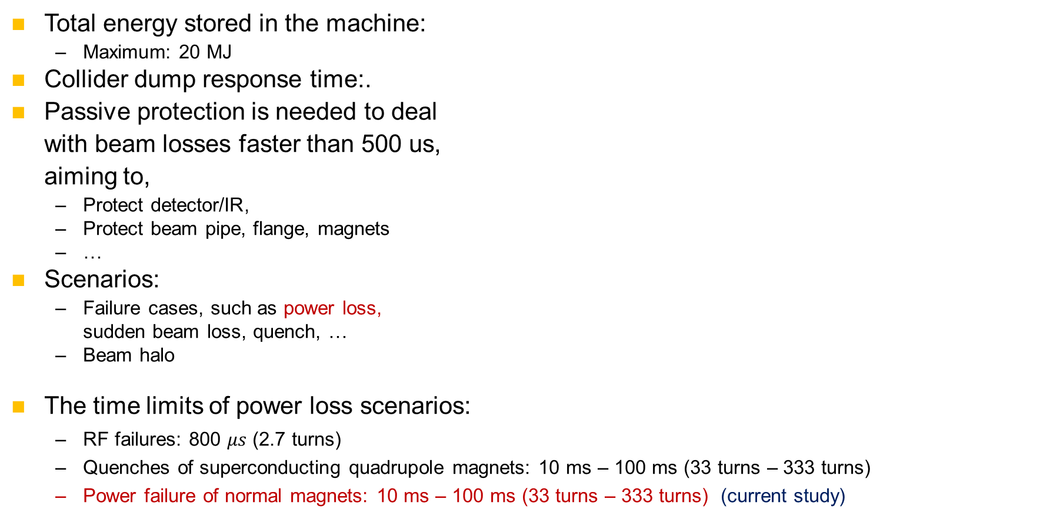
Dumps used for machine protection- Main issues
Total energy stored in the machine:
Maximum: 20 MJ
Collider dump response time:.
Passive protection is needed to deal with beam losses faster than 500 us, aiming to,
Protect detector/IR,
Protect beam pipe, flange, magnets
…
Scenarios:
Failure cases, such as power loss, sudden beam loss, quench, …
Beam halo
The time limits of power loss scenarios:
RF failures: 800 $μs$ (2.7 turns)
Quenches of superconducting quadrupole magnets: 10 ms – 100 ms (33 turns – 333 turns)
Power failure of normal magnets: 10 ms – 100 ms (33 turns – 333 turns) (current study)
 | Higgs | Z | WW | ttbar
Beam energy/GeV | 120 | 45.5 | 80 | 180
Energy stored in the machine/MJ | 1.1 | 20 | 3.7 | 0.33

Slide 13
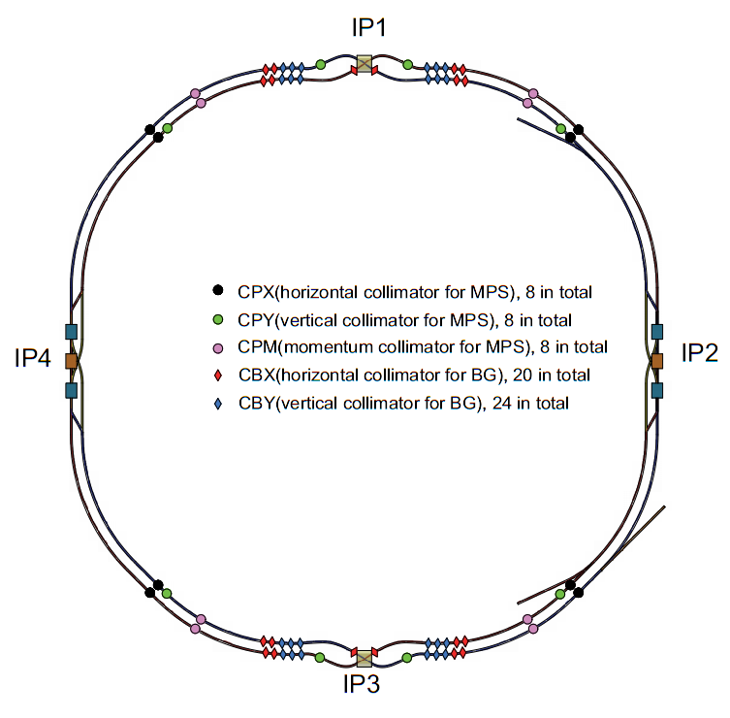
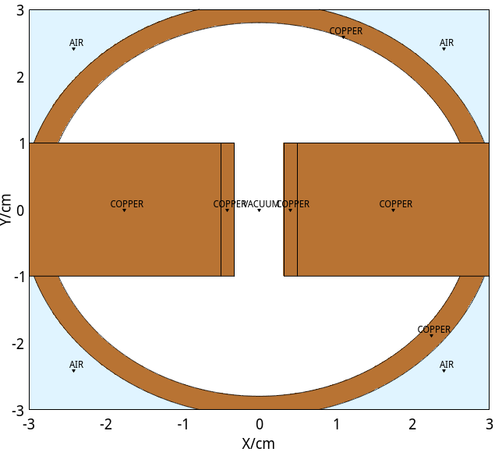
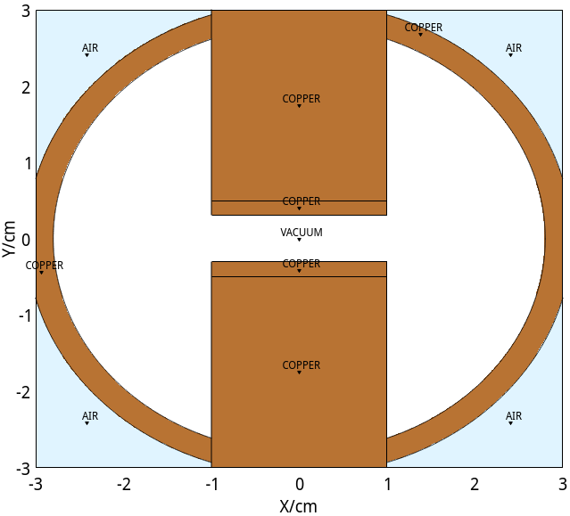
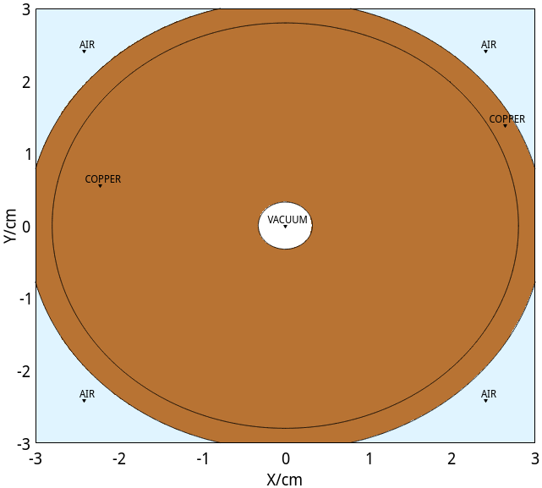
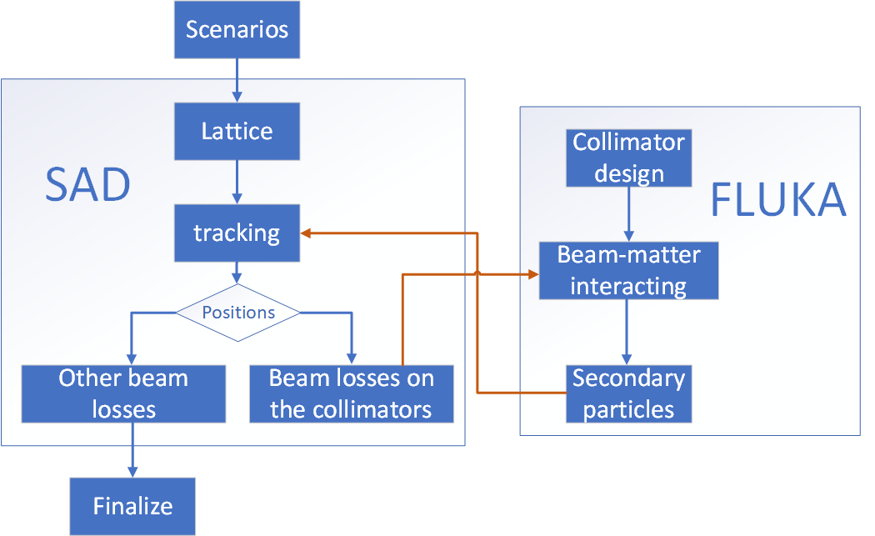
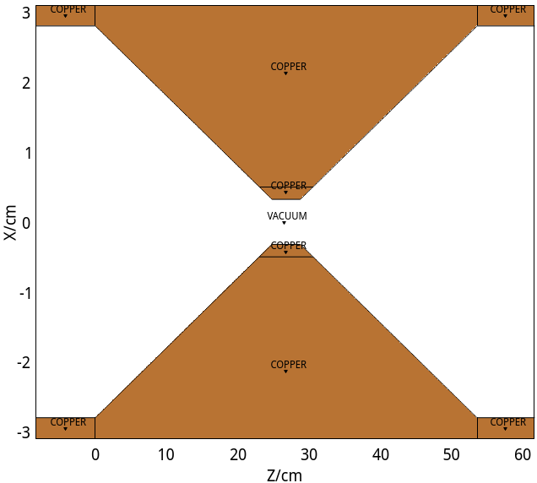
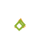
Dumps used for machine protection- Add passive devices
Offered by Xiaohao Cui and Guangyi Tang
We add collimators for each ring
located at positions where the beta function or dispersion is larger than at other position.
Three types:
horizontal collimator, vertical collimator and circular collimator
All types have 1:10 tapers.
Aperture > 2.5 mm.
Material:
Copper, or
Molybdenum – Carbon composite

Slide 14
Summary
Dump design for Linac and main ring had been finished, can be further optimized or detailed.
Dumps used for machine protection have been studied and combined by the passive devices as collimators, now in iterative design stage.

Slide 15
Thank you for your attention!

Slide 16
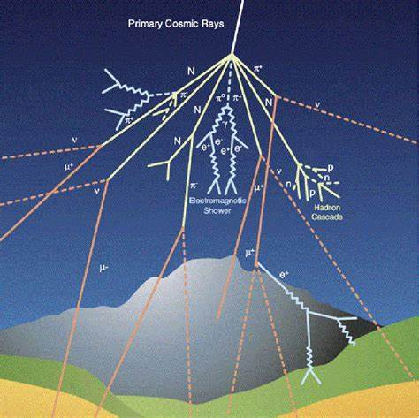
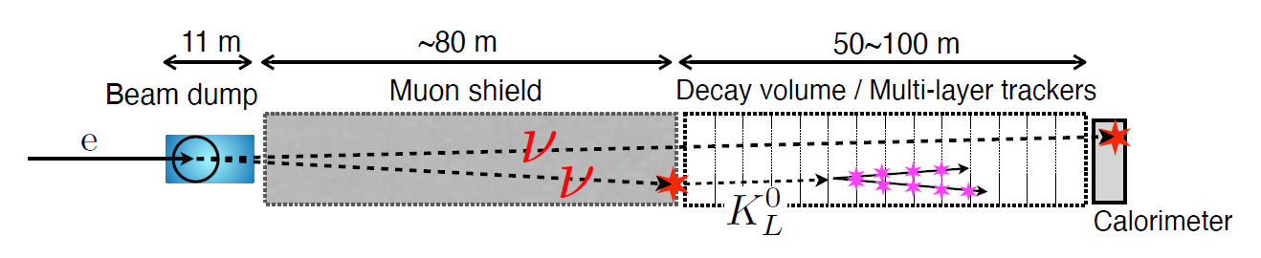
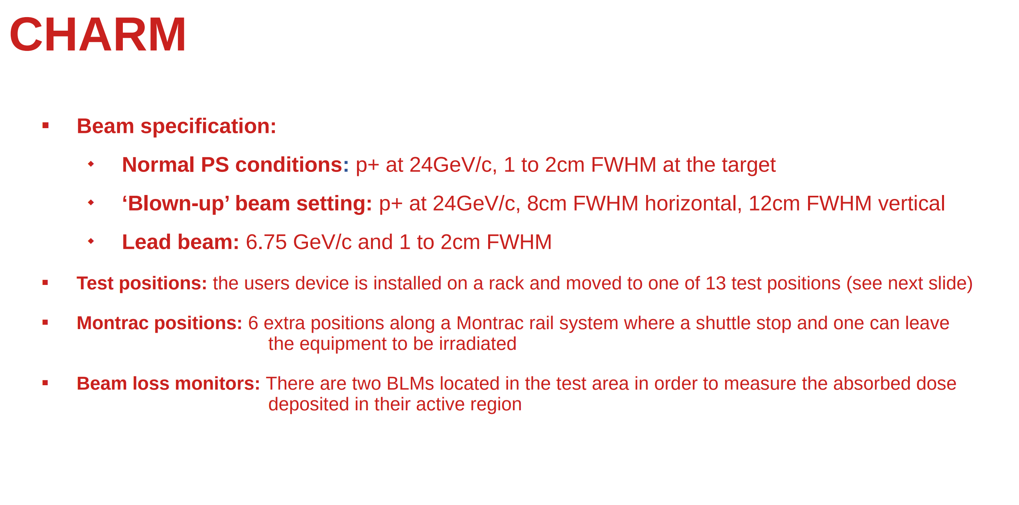
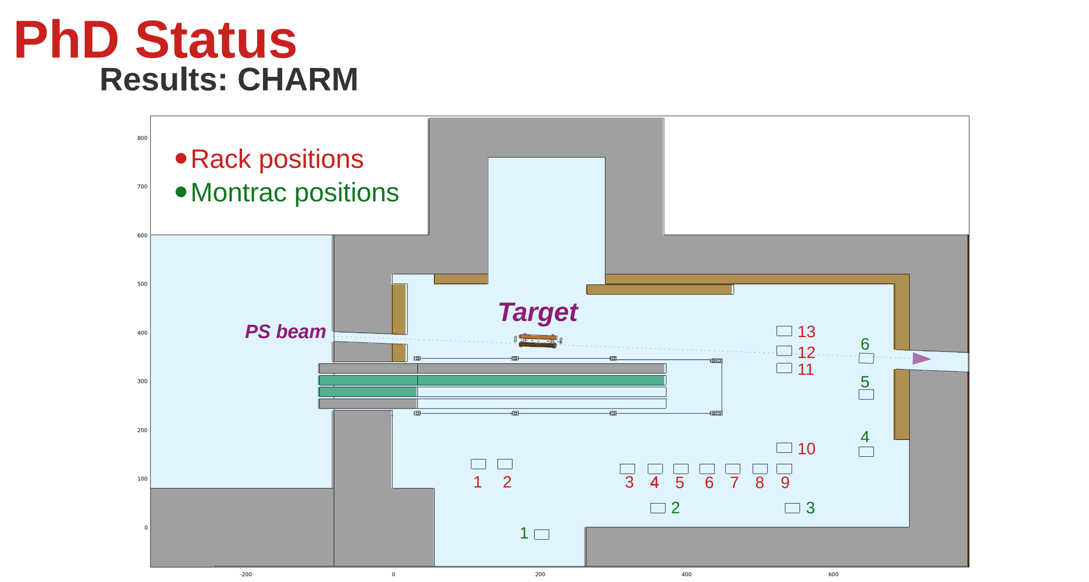
Other possible application for the wasted beam
Electromagnetic cascade shower similar to cosmic rays
Rich of secondary particles，neutrons and muons have atmospheric-like spectra
high-intensity, large-area, Irradiation field are favored
Physics Beyond Colliders (PBC)
Heavy Neutral Leptons (HNLs), New particles from electromagnetic showers, Searches for Long-Lived Particles, etc
Ref:Yasuhito Sakaki @LCWS2024 talk
Ref:https://r2e.web.cern.ch/about-radiation/test-facilities/charm

