Slide 1
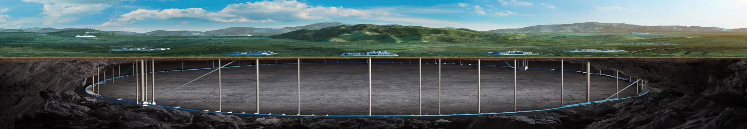


CEPC Mechanical system EDR plan and status
Haijing Wang
The 2025 International Workshop on the High Energy Circular Electron Positron Collider
Nov 5 – 10, 2025, Guangzhou

Slide 2
Content
Introduction
CEPC EDR layout progress
Tunnel mockup progress
MDI mechanics progress
Vibration test scheme
Summary

Slide 3
Introduction
The mechanical system is engaging to make progress in EDR stage.
  CEPC survey and layout
  CEPC tunnel mockup and high accuracy automatic adjusting and alignment system
  MDI mechanics
  Vibration test

Slide 4
Introduction--EDR goal, scope and plans
Items | 2024 | 2025 | 2026 | 2027
CEPC equipment layout | Determine layout software and method Version 1 in arc section | Version 1 in other sections | Refinement and updating | Wrap up the unfinished work. Prepare the EDR report.
CEPC tunnel mockup | Finish the design, development and installation
High accuracy automatic adjusting and alignment system | Finish the design, development and the tests to fulfill the main requirements |  | Optimize the alignment method and support structure
Vibration test | Finish the design Follow the geological exploration to do the tests
MDI layout | More detailed layout, identify the MDI interface dimensions The locations for additional BPMs
Cryostat support design | More detailed support structure and FEA Design of auxiliary support |  | Vibration decreasing methods, eg. damping material
RVC design | Mechanical design Prototype development and leak rate experiment |  | Structure optimization Finish the leak rate experiment
Majority finished
Design finished
Design finished
Design finished
Finished
Optimize →mini review
Design finished

Slide 5
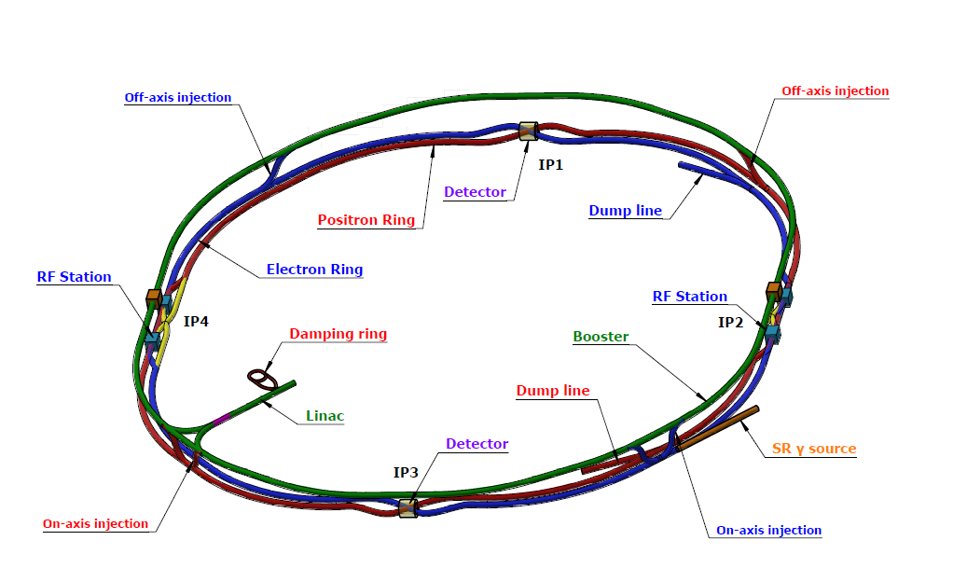
CEPC EDR layout progress
CEPC layout is one of the key tasks for CEPC this year
  It makes the geometry of the accelerator physics to engineering layouts.
  It serves as a bridge for communication and discussion between the mechanical system, accelerator physics system and multiple hardware systems, brings CEPC towards a more systematic and optimized direction.
Survey design
(the coordinates of each elements)
Hardware model design
Layout design
(place hardware on drawing according to survey)

Slide 6
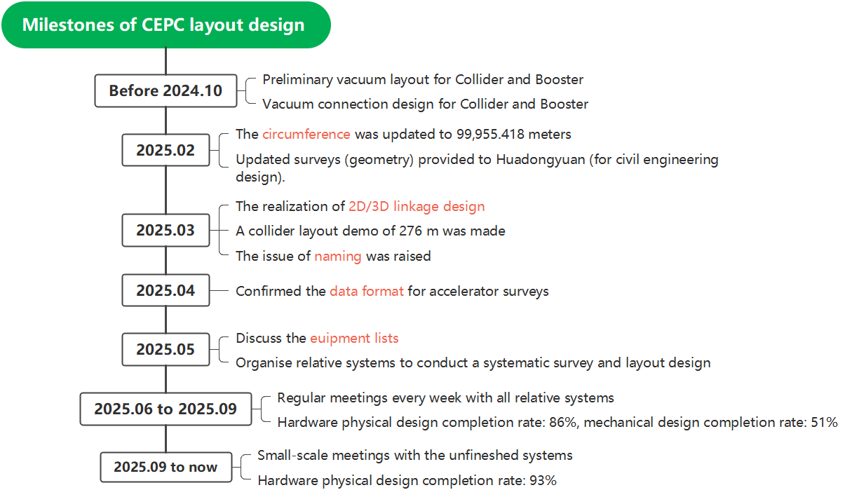
CEPC EDR layout progress

Slide 7
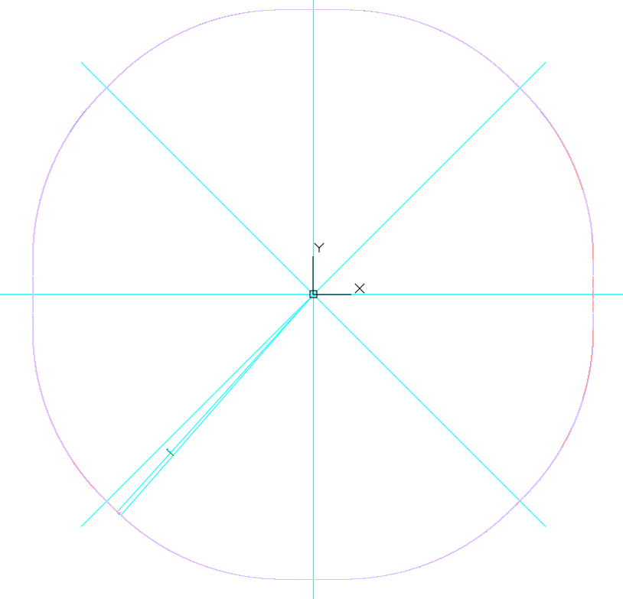
CEPC EDR layout progress-overall
CEPC is composed by Linac with the length of 1.6 km, damping ring with the circumference of 147 m, booster and collider with the same circumference of 99955.418 m*, 2 dumps and 14 transport lines.
The coordinate origins of all the accelerator has been unified. The (0,0) point is at the symmetric center of the Collider.
The survey position accuracy reaches the micrometer level.
Accelerator | Have EDR survey data? | Finish EDR survey design? | Have layout demo? | Complete survey naming?
Collider | √ | × note 1 | √ | ×
Booster | √ | √ | √ | ×
Linac | √ | √ | √ | √
Damping Ring | √ | √ | √ | ×
Transport lines | √ | × note 2 | × | ×
(0,0)
  note 1&2: are scheduled ~ Jan, 2026
*, Dou Wang, Jie Gao, Jianchun Wang, et al., The CEPC Clock Issue and Finetuning of the Circumference. CEPC note.

Slide 8
CEPC EDR layout progress-hardware
Accelerator | Hardware types * note1 | Hardware quantities | Progress (completed hardware types and completion rate)
 |  |  | Have survey design | Have 3D physics design | Have 3D mechanical design
Collider | 53 (66) | 51756 | 46, 87% | 56, 85% | 31, 47%
Booster | 22 (30) | 40466 | 22, 100% | 29, 97% | 24, 80%
Linac | 66 (69) | 9690 | 66, 100% | 65, 94% | 18, 26%
Damping Ring | 10 (15) | 498 | 10, 100% | 15, 100% | 5, 33%
Transport lines | 46 (25) | 2758 | 44, 95% | 23, 92% | 14, 56%
INJ & EXT | 50 (27) | 186 | 32, 64% | 27, 100% | 27, 100%
  note 1, No1. (No.2), the item numbers need survey (the total item types along beamline). The vacuum chambers are not included, because the detailed vacuum chambers design must be after the vacuum segmentation and layout definition.
Physics design progress from May to November, 2025

Slide 9
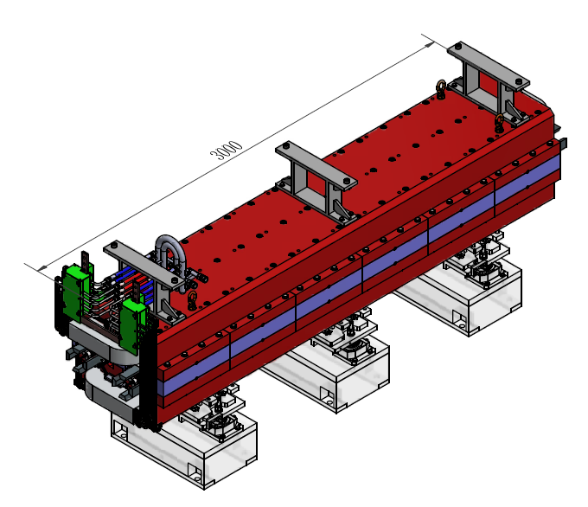
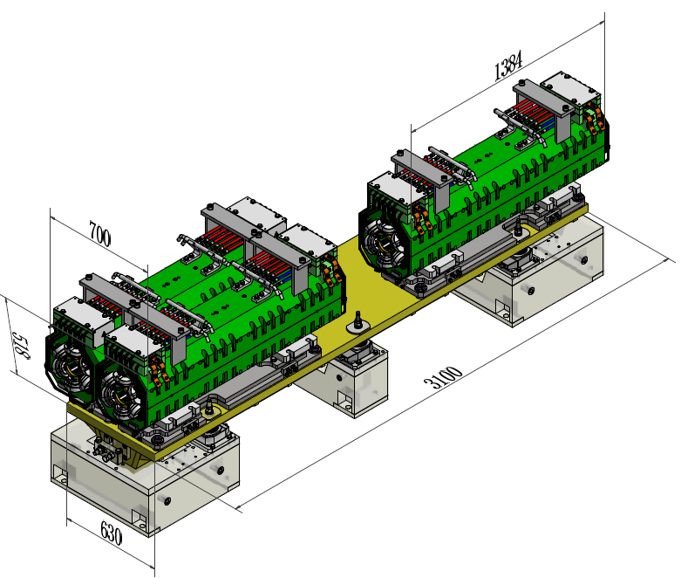
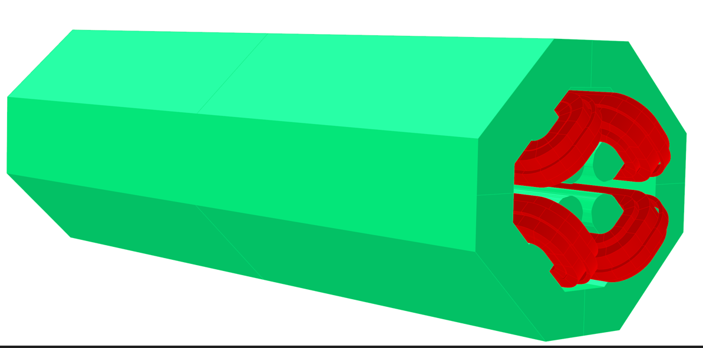
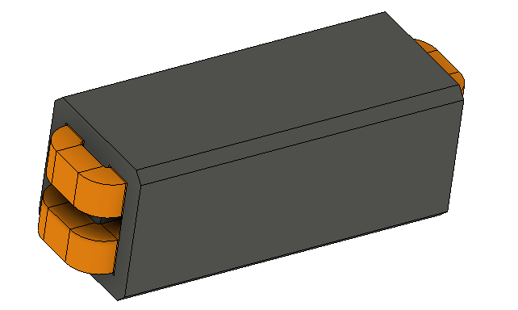
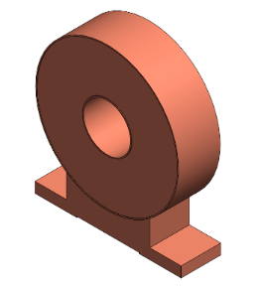
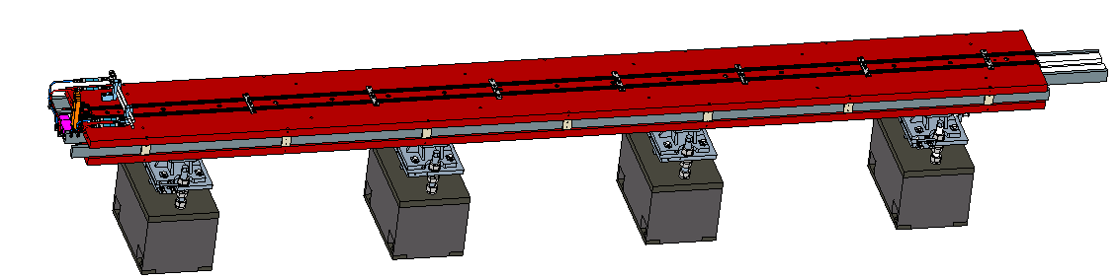
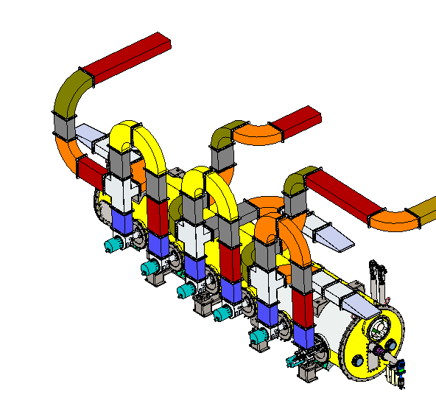
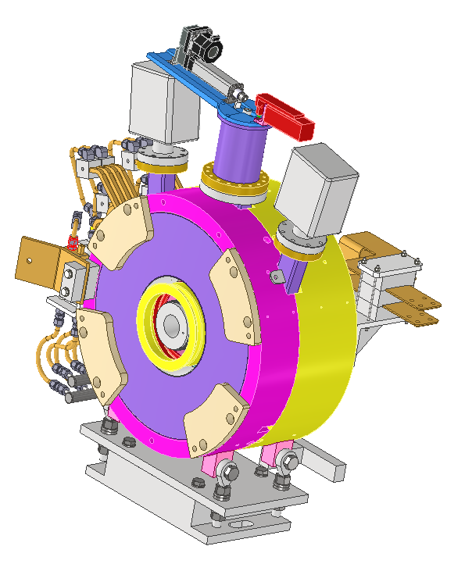
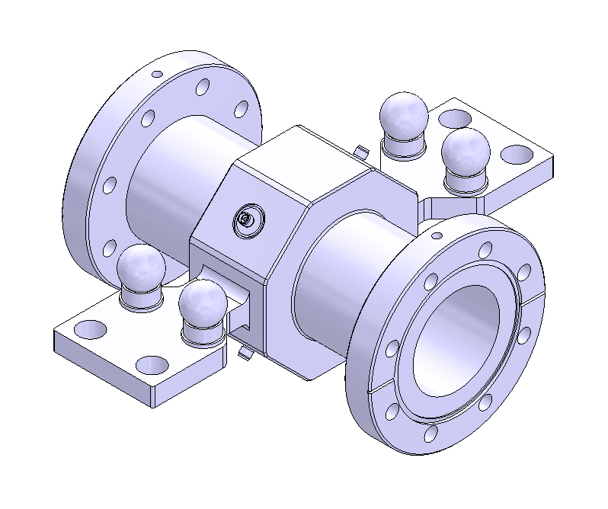
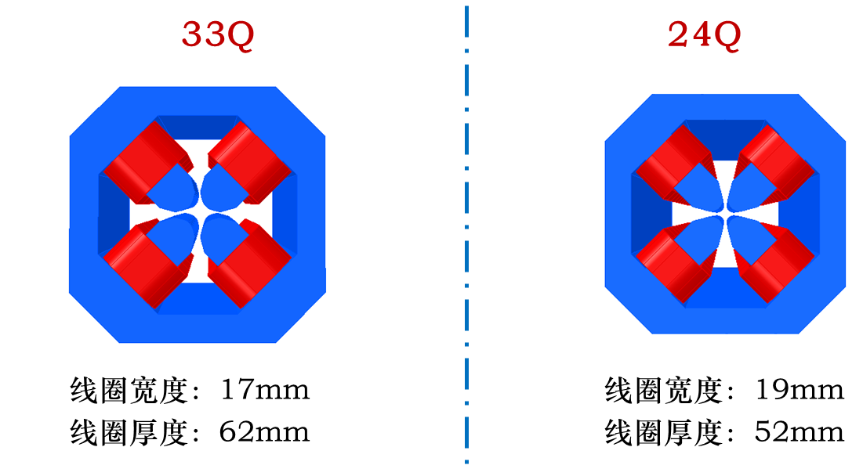
CEPC EDR layout progress-hardware
We are mainly focusing on hardware physics design at this stage, and when resources permit or necessity arises, we also undertake some mechanical design.
Physics design for some magnets
Mechanical design for some equipment

Slide 10
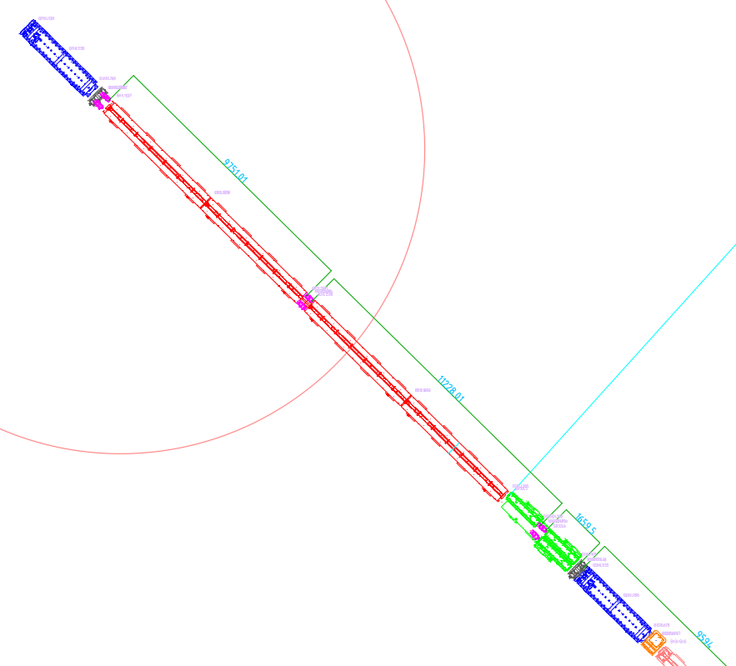
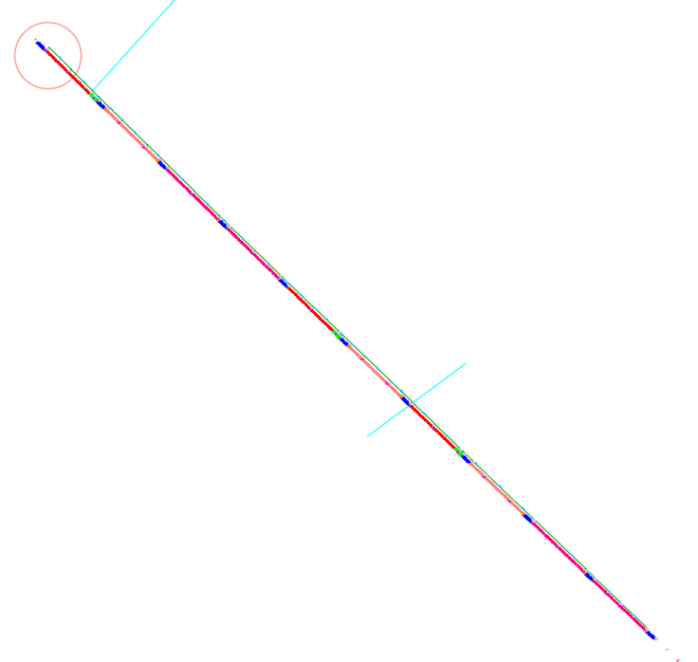
CEPC EDR layout progress-Collider demo
Collider layout demo (2D, arc section, 276 m)
Q
BPM
B01
Tunnel inside
Vacuum connection
Vacuum connection
Vacuum connection
Tunnel outside
BPM
S
Q
CH&CV

Slide 11
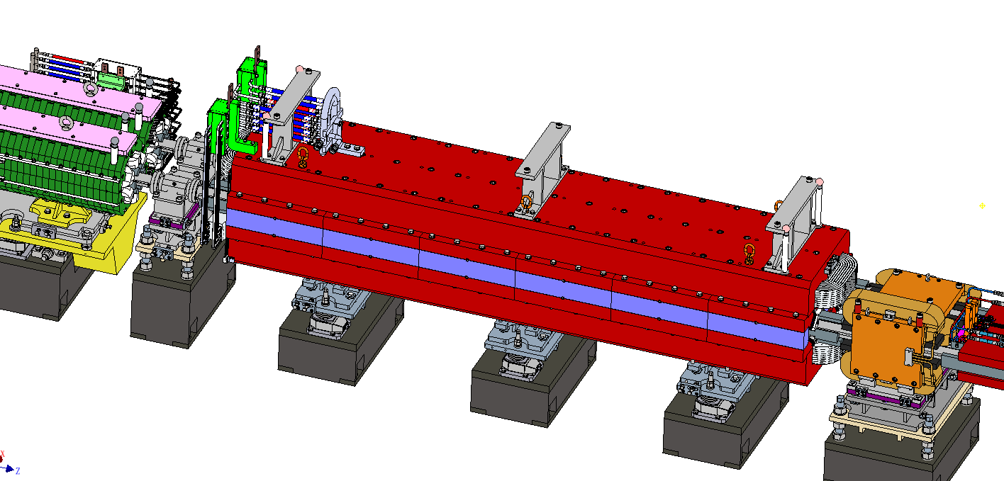
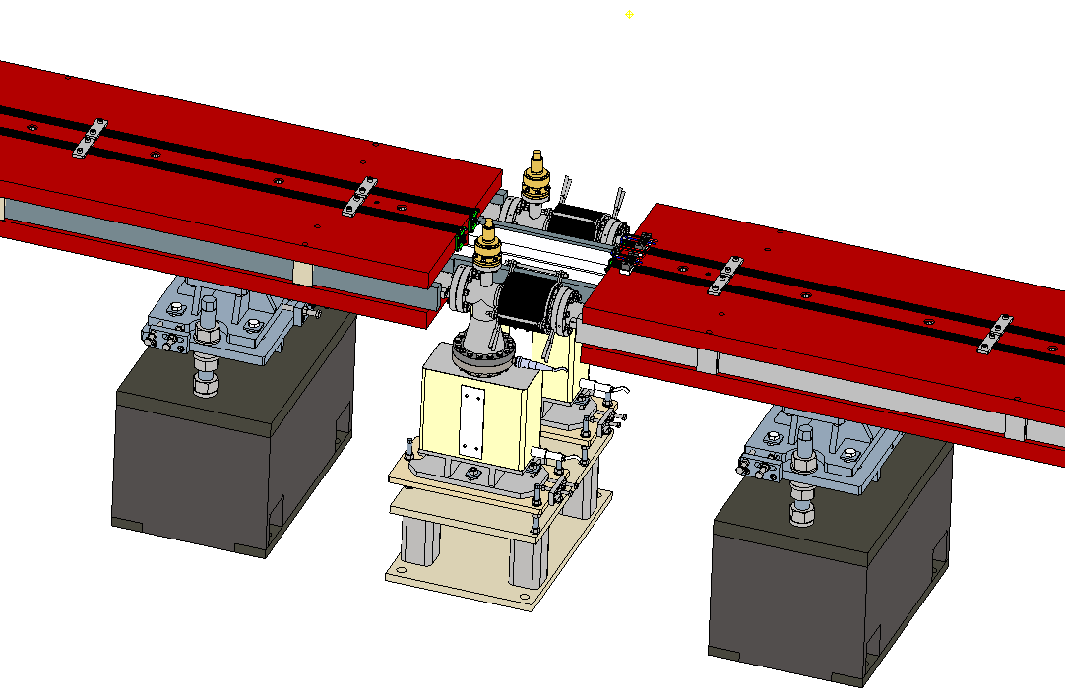
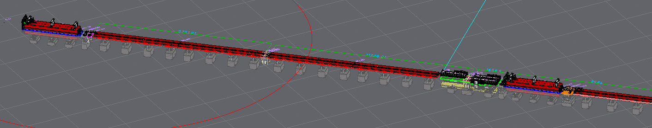
CEPC EDR layout progress-Collider demo
Collider layout demo (3D, arc section, 276 m)

Slide 12
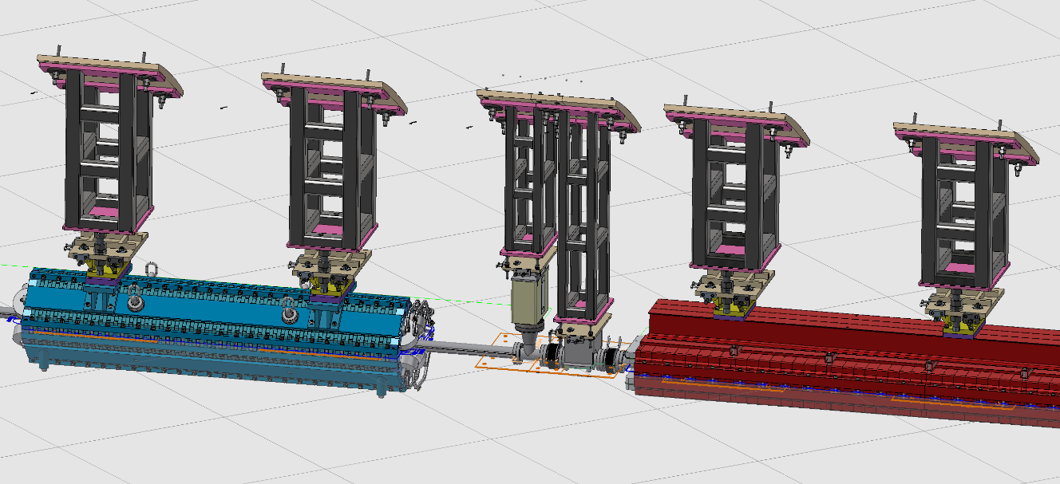
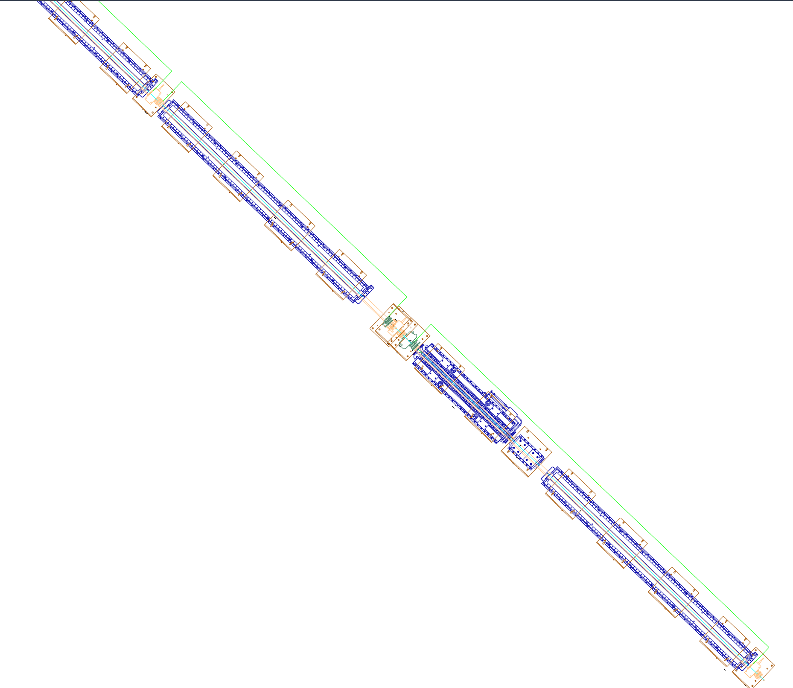
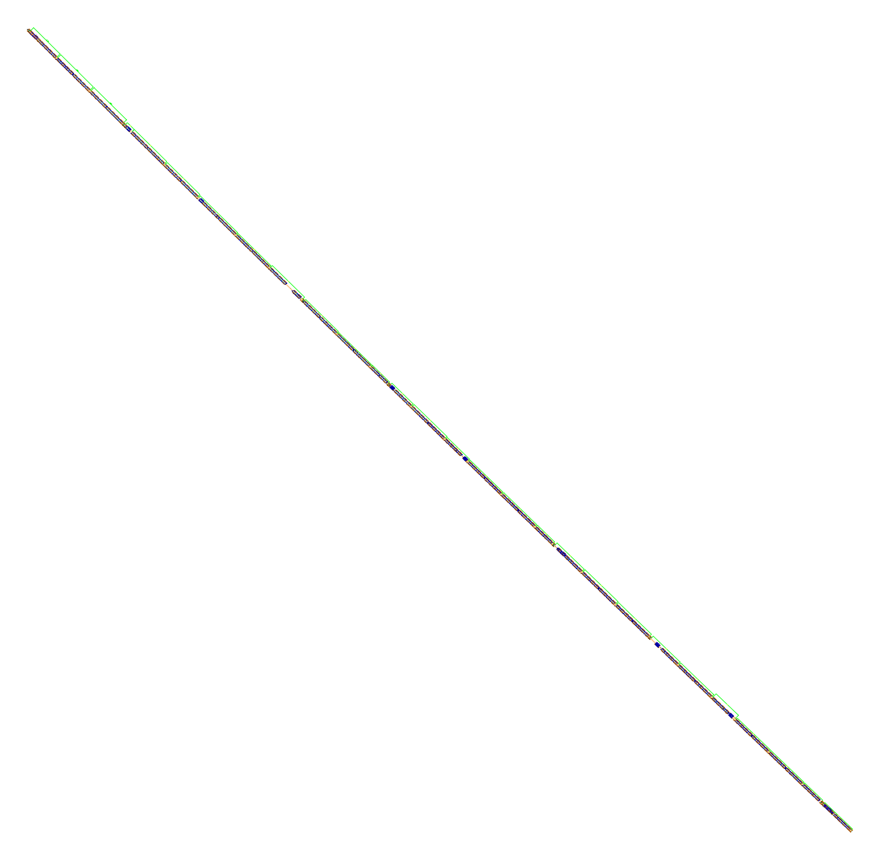
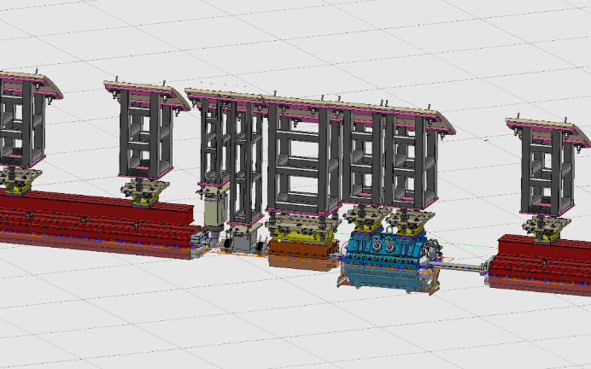
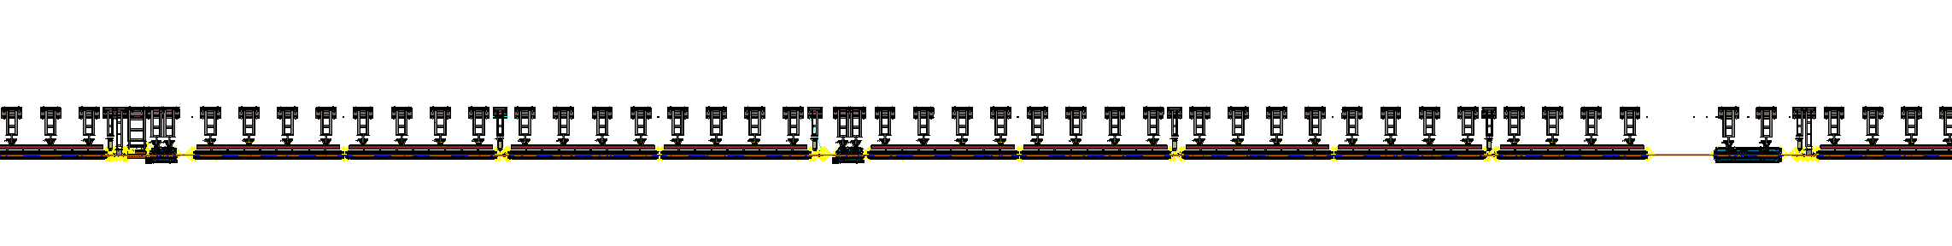
CEPC EDR layout progress-Booster demo
Booster layout demo (2D/3D, arc section, 230 m)
B01
Tunnel inside
Vacuum connection
Q
Vacuum connection
Vacuum connection
Tunnel outside
CH

Slide 13
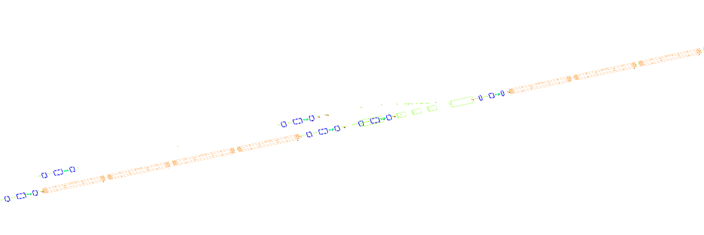
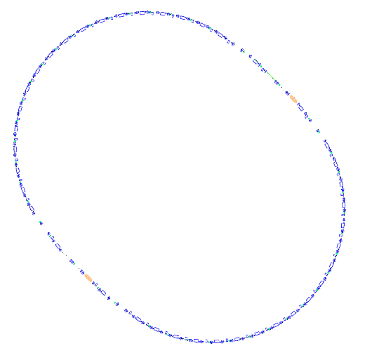
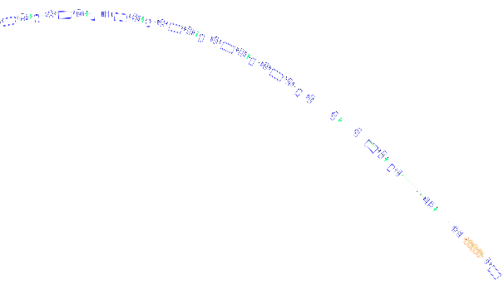
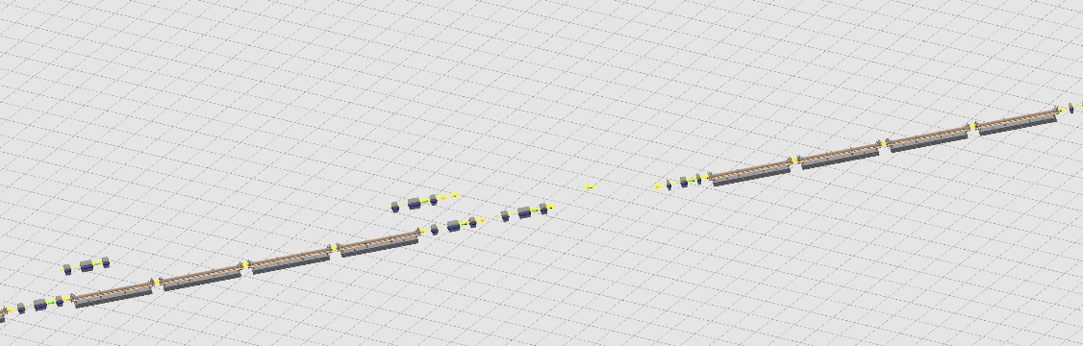
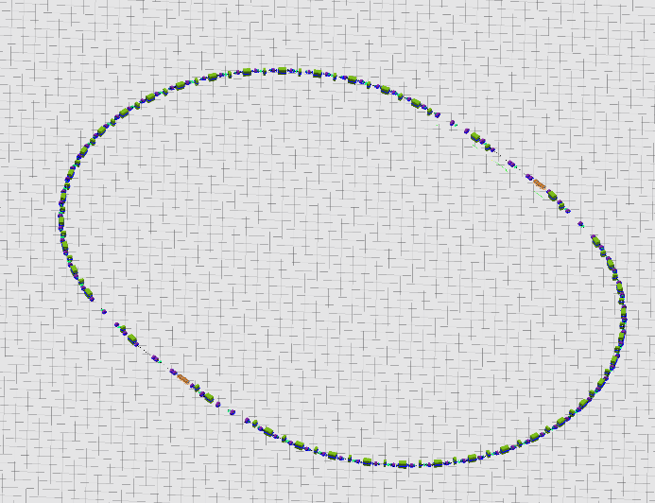
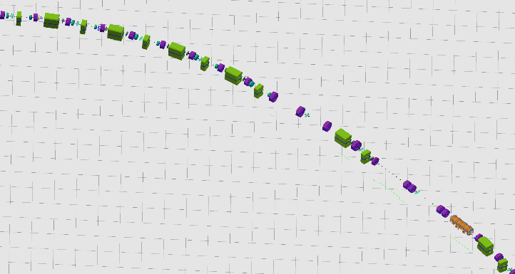

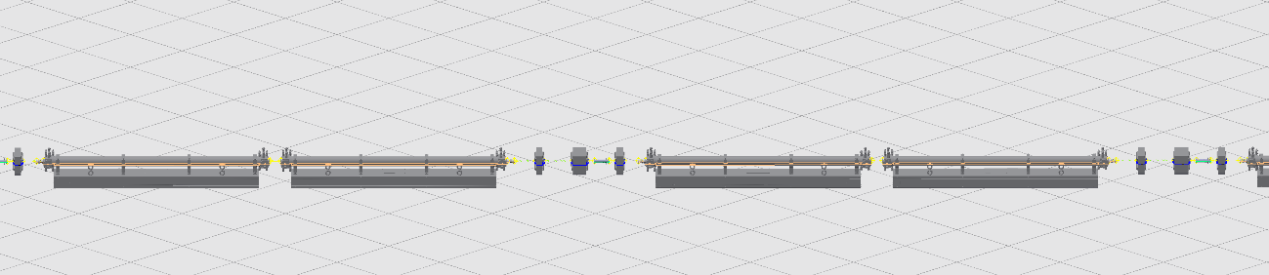
CEPC EDR layout progress-Linac and DR demos
Linac layout demo
Damping ring layout demo
EBTL (Electron bypass transport line)
Up: 2D layout; Down: 3D layout
2D layout
FAS (first accelerator section)
Up: 2D layout; Down: 3D layout
3D layout

Slide 14
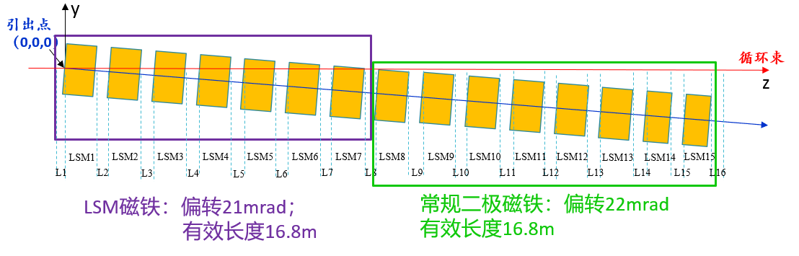
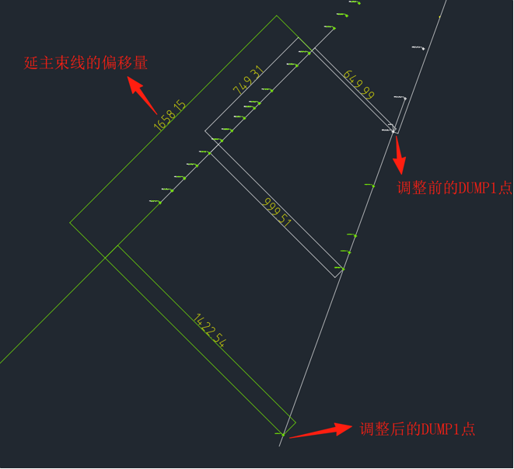
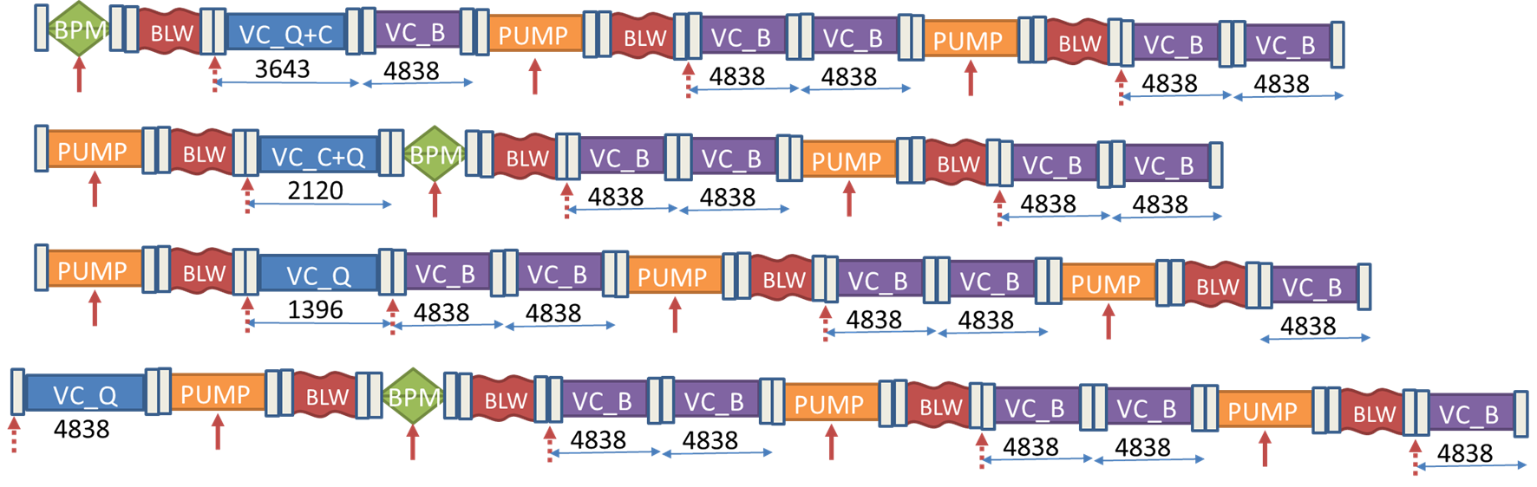
CEPC EDR layout progress-Main issues addressed
1: LSM or dipole?
    Changed part of LSMs to regular dipoles
2: DUMP space interference in Linac and update
3: Different vacuum layout considering installation requirements
    Three vacuum layout for Collider
    3 vacuum layout for Booster, optimizing the installation method
Haijing Wang, CEPC DAY, 25.5.23, https://indico.ihep.ac.cn/event/25992/
Will be presented by X. Wang, next report

Slide 15
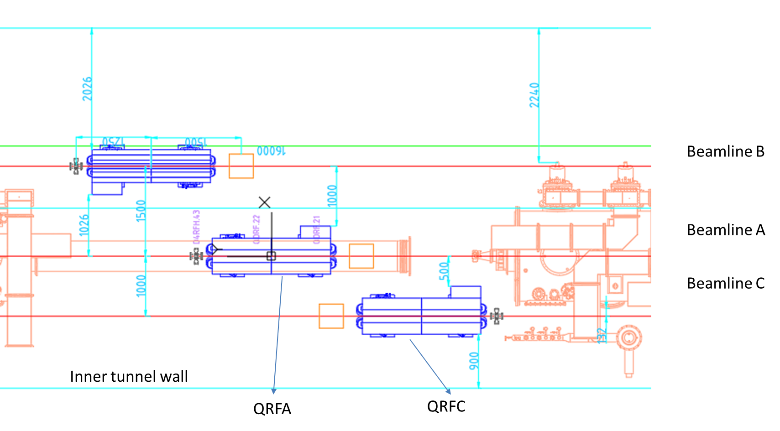
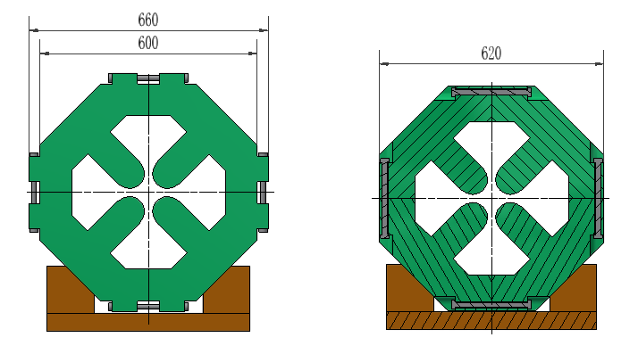
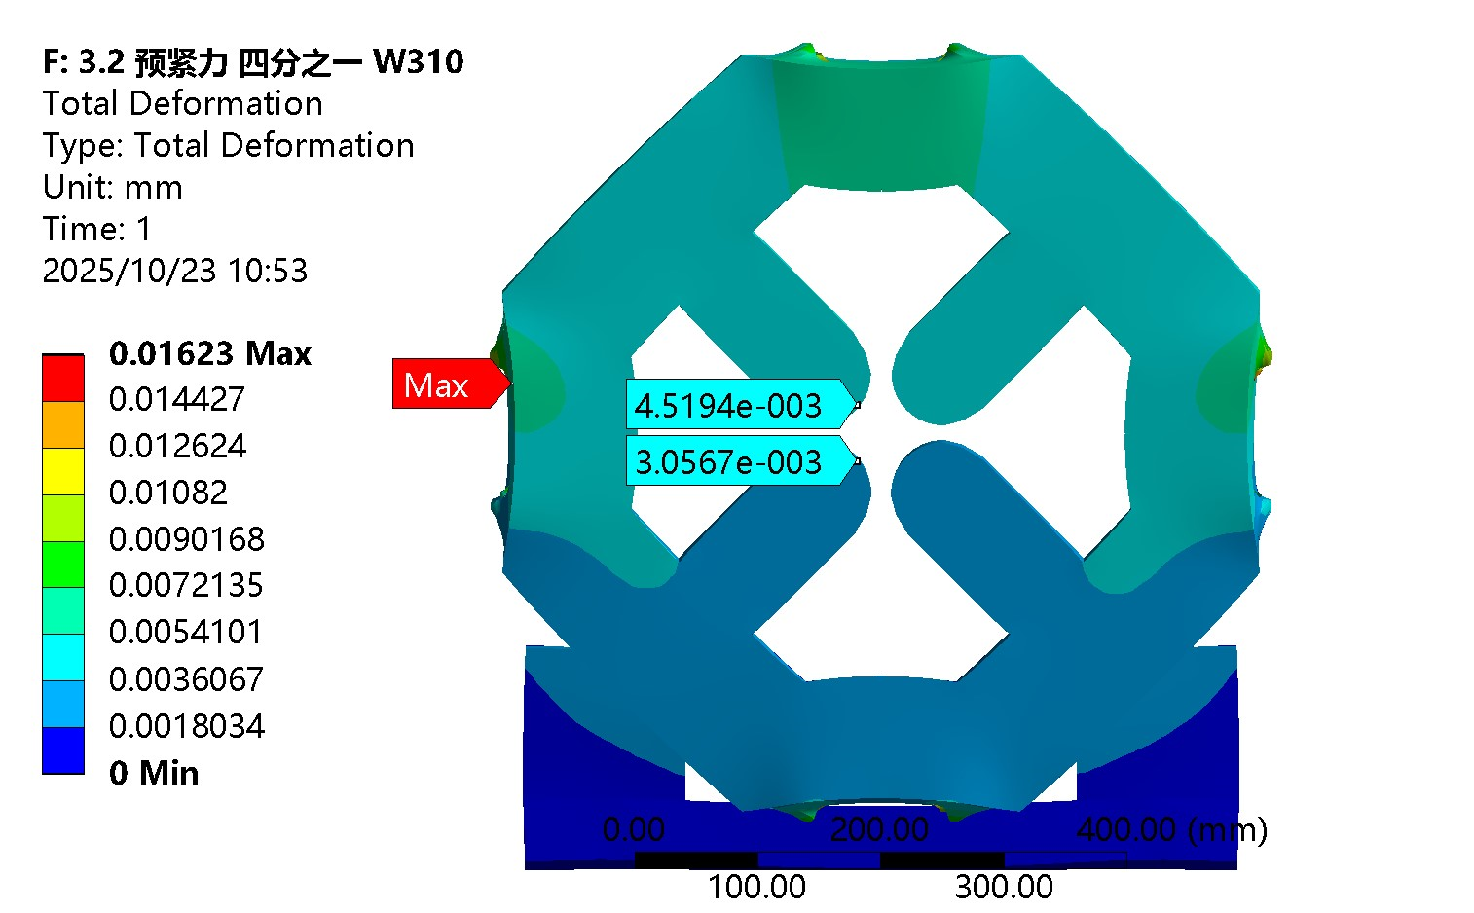
CEPC EDR layout progress-Main issues addressed
4. Quadrupole cross section optimization based on limited space.
  Comparison on the deformation of magnet pole tip.
5. Space arrangement at RF section, 3 beam lines

Slide 16
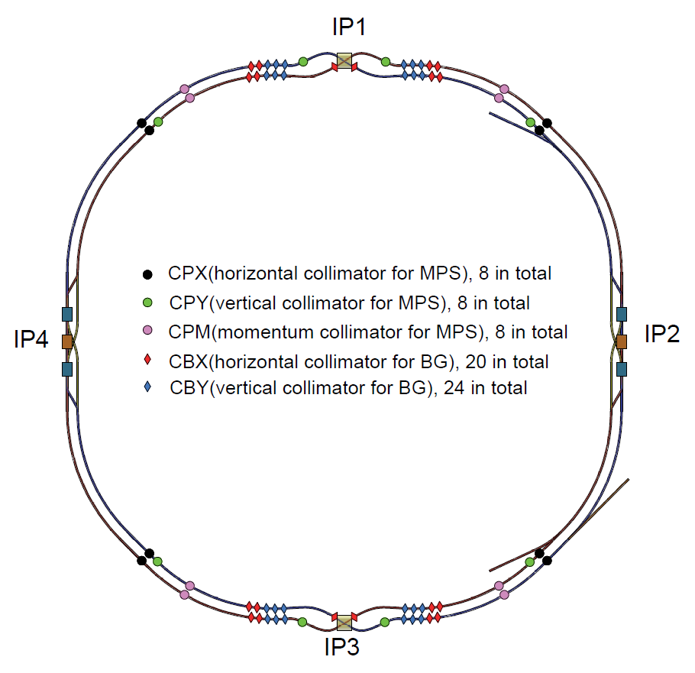
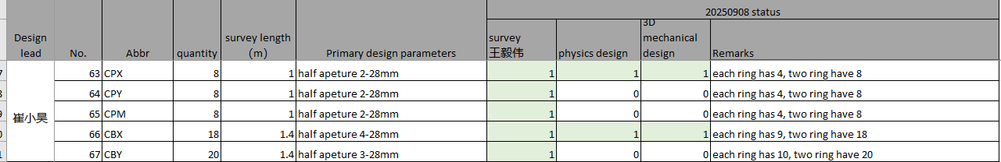
CEPC EDR layout progress-Main issues addressed
6: Collimators
    Optimize design according to new lattice, update data formats
    All collimators are located beside sextupoles (1.4 m available)
7: IP sextupoles
    Two kinds of sextupoles are changed to SC magnets, from TDR to EDR, with a quantity of 32.
We have a working group and regular meetings to propose the design and solve the problems like vacuum layout and installation methods, collimators and other issues.

Slide 17
CEPC EDR layout progress-Integration method
2D and 3D layouts of CEPC are being built synchronized.
  Less workloads
  The 2D and 3D layouts are interconnected, reducing the possibility of inconsistencies between them.
After numerous iterations of collider layout demo, we have essentially get the design process.
Computer lag reduces work efficiency, as the layout is too big for such a huge project!
  Discuss with Autodesk and Huadongyuan. Some suggestions like BIM (Building Information Modeling), Navisworks, and external interfaces are considered as candidate methods.
  Better workstations.
  Sub-layouts
Preliminary survey and magnet design
Preliminary 2D layout and vacuum segmentation
Detailed survey design
Detailed 3D magnet design
Detailed 2D layout design
Publish resource library
Automatic
Automatic
Manual
Detailed 3D layout
Manual
Survey design change
Model design change

Slide 18
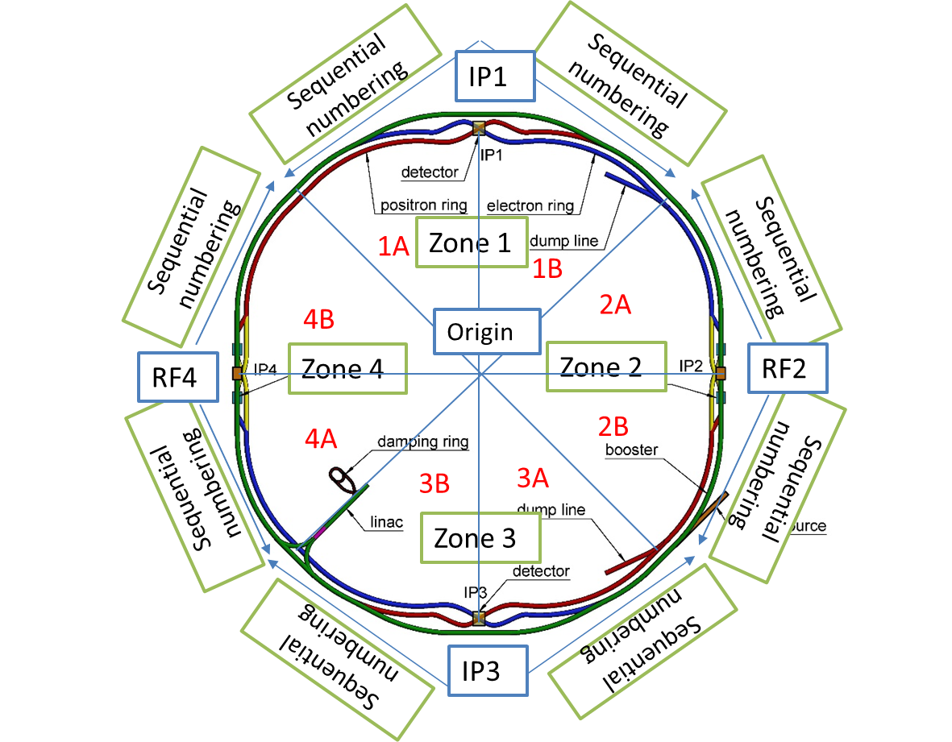
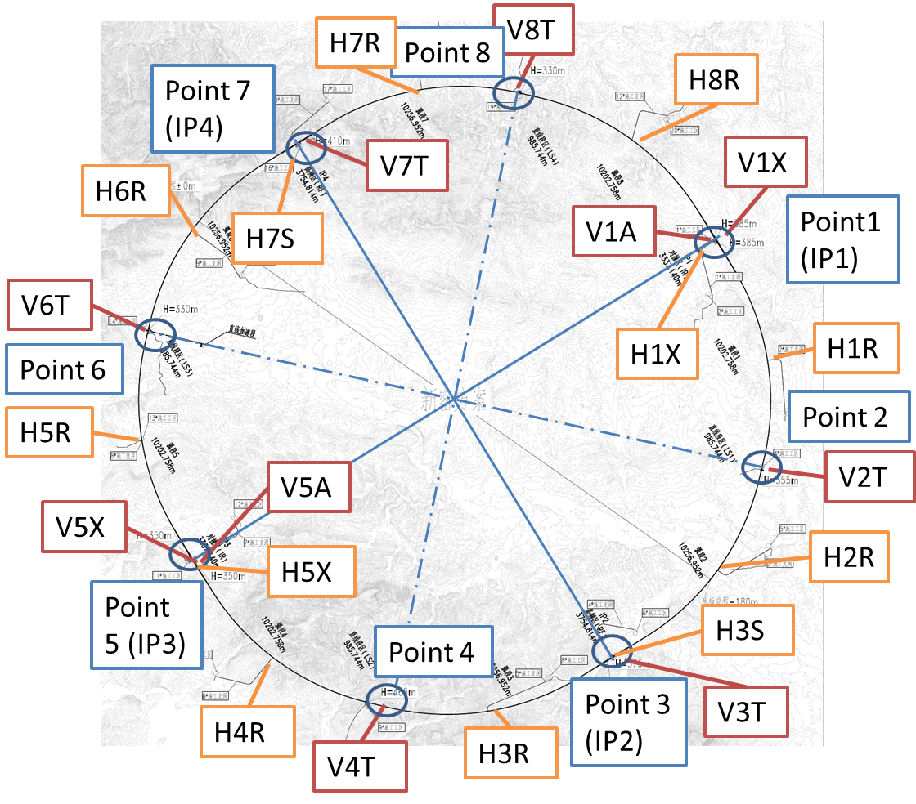
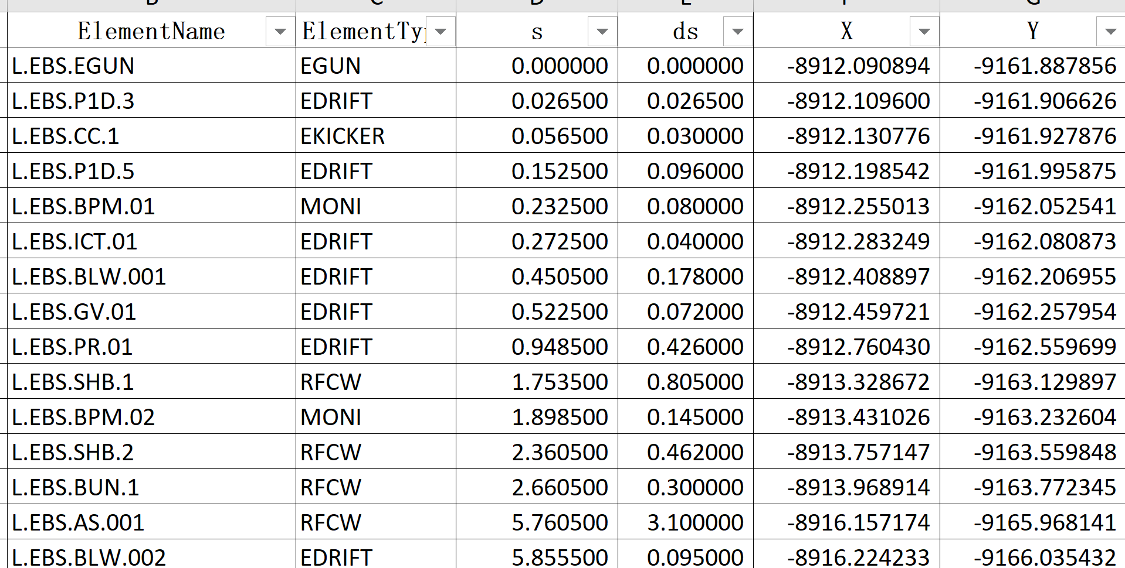
CEPC EDR layout progress-Hardware naming
When working on the layout, we realized the naming should be expedited.
We have formulated preliminary opinions on equipment along the beam and the shafts.
The naming has been applied in Linac survey, that on other accelerators are on-going
Zoning for collider and booster
Shafts naming

Slide 19
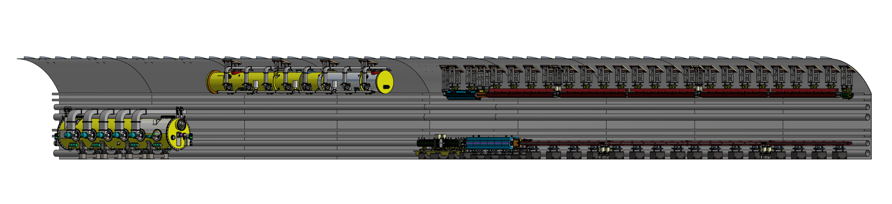
Tunnel mockup progress
A 60-meter tunnel with typical arc section and RF section
  Arc section：one FODO cell in both Collider and Booster（including dipole, quadrupole, sextupole, corrector and BPM）
  RF section：one RF module in both Collider and Booster
  Technical verification of installation and alignment for the above-mentioned equipment.
Development progress
  Design review: 24.8.16
  Now: waiting for bidding for the displaying models, under machining for the supports.

Slide 20
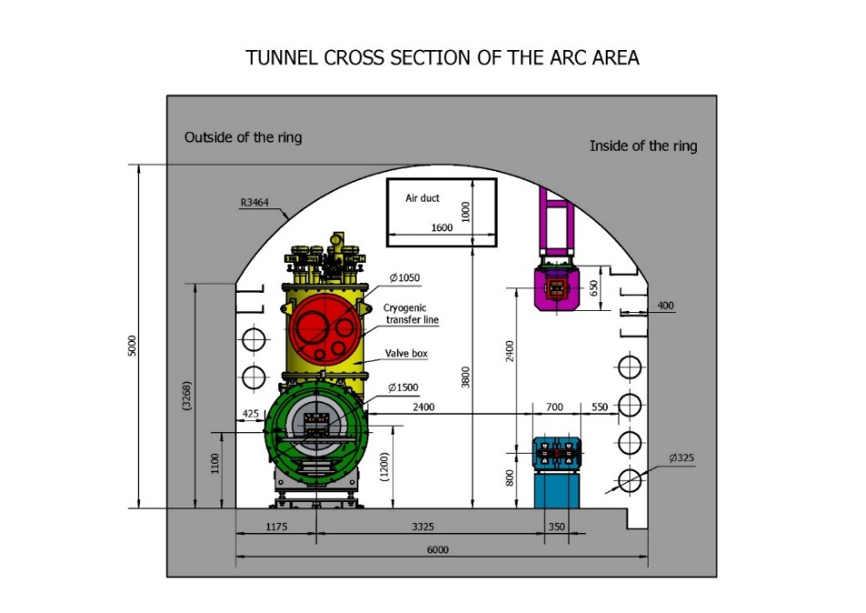
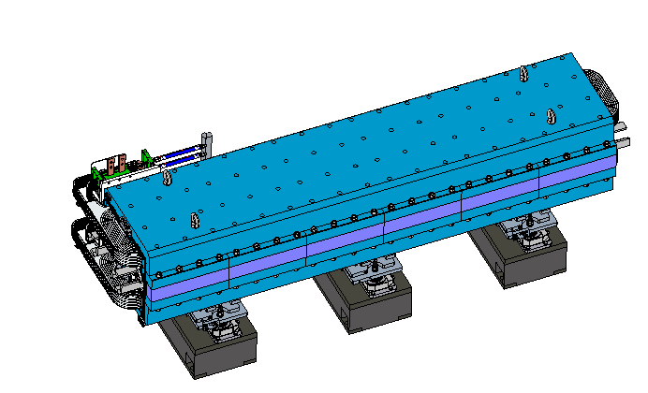
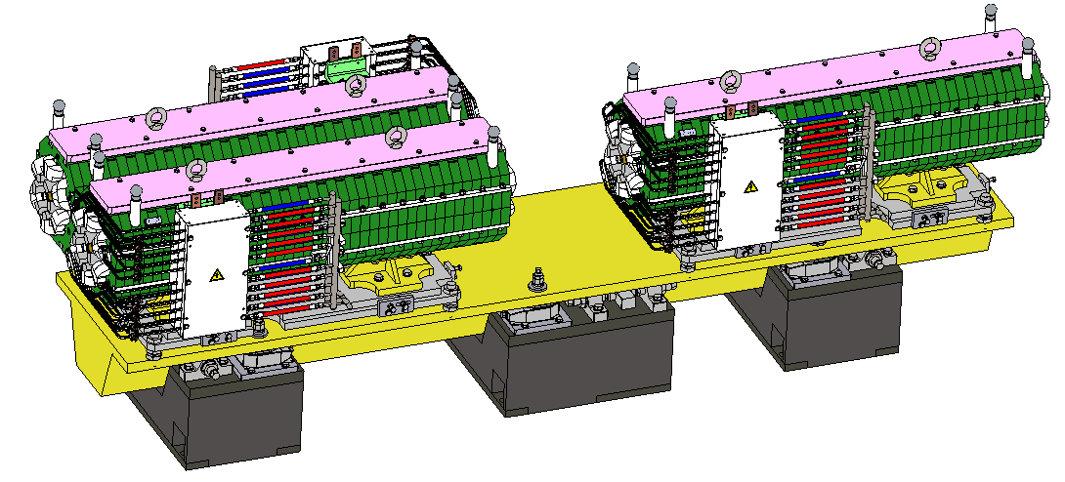
Tunnel mockup progress-dimension optimization
Optimizing dimensions to fulfill the space arrangement of TDR tunnel design.
  The water and electricity connections for quadrupole and sextupoles have relocated to the upper side.
  Cryomodule design update: bottom support→ top suspension
Collider quadrupole and sextupole optimization
Miaofu Xu, CEPC SRF Cryogenic System EDR Design Peer Review, May, 2025

Slide 21
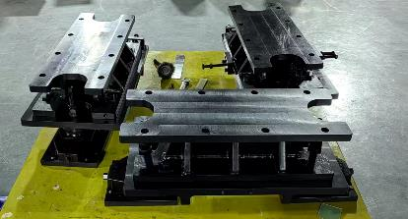
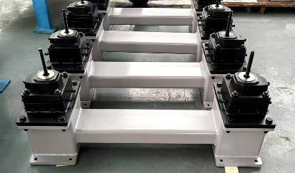
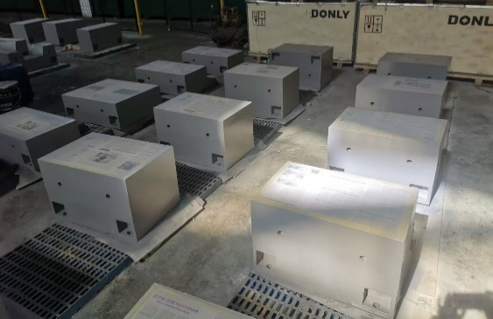
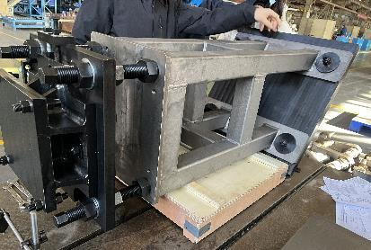



Tunnel mockup progress-developing
The site construction design of the tunnel mockup is under-going.
The devices of the mockup is under developing.
The deformation has been analyzed for the real magnet in Booster, the max. deformation by gravity is 20µm, which is small enough for lifting and operating.
Wen Kang, Zhihui Mu, Design and production tolerance analysis of the CEPC Booster dipole-sextuple combined magnets. Mini-Review for CEPC Booster Combined Magnets. May, 2025

Slide 22




Tunnel mockup progress-automatic adjusting mechanism
The amount of CEPC equipment is huge. Therefore, improving alignment and adjusting efficiency while ensuring accuracy is one of the important aspects in EDR stage.
The high accuracy automatic adjusting and alignment system of CEPC
  High-accuracy measurement field (alignment): multi-camera photogrammetry, multi-point synchronous monitoring, high efficiency
  Automatic adjusting mechanism (adjustment): movable drive, unified quick plug-and-play interface
  The prototypes are designed and waiting developing
Output shafts at the aisle side
Dipole and its support
Adjusting mechanism for dipole (screw)
Adjusting mechanism for quadrupole (wedge)
Quadrupole and its support

Slide 23




MDI mechanics progress-layout
MDI layout
  Detective angle: acos0.99
  IP chamber：±700mm
  Yoke length：11950mm
Distance to detective angle
  IP chamber flange: 5.3mm
  RVC: 14.9mm
Mechanical interface between accelerator and detector
MDI layout

Slide 24


MDI mechanics progress-mechanical analyses
Mechanics and vibration analyses
  Static structure: max. deformation and displacement change with/wo Lorentz force
  Vibration analyses: natural frequency & harmonic response
  Structure optimization
 | Related requirements | Response now*
Position accuracy (X/Y) of SC quadrupoles ≤100μm | Adjusting resolution≤5μm Adjusting accuracy≤30μm | ≤5μm ≤30μm from HEPS experience
 | Max. def. and disp. change, ＜ 50μm | FEA，＜40μm
Small vibration, 1-100Hz RMS ≤4nm | High natural frequency | FEA, ~50Hz and 1 (same level to HEPS, and arc section of CEPC)
 | Low amplification factor
Designed model
Analyses model
* The response now only considers the mechanics aspect.

Slide 25
MDI mechanics progress-mechanical analyses
We made detailed analyses and presented on the MDI mini-review in June 2025.
  Iron-free quadrupole and optimized skeleton has benefits (Max. disp. of SC quadrupoles/cryostat decreased)
  Material optimization，no obvious effect
  Auxiliary support，significant effect (max. disp. change from 2 mm to 84 um, max. def. smaller than 15 um, natural frequency from 17.7Hz to 49.2 Hz)
  Thicker vacuum vessel: significant effect (max. disp. change from 84 um to 33 um)→can be considered comprehensively with radiation.
  Support rods: significant effect→ can be optimized further
  It seems there is no sudden positional jitter caused by the disappearance of the Lorentz force. Either for the Von mises stress. We are checking on it.
Works to be done
  Further optimization with collaboration with other colleagues: compromise solution with other aspects of optimization such as cryogenic.
  After above analyses converged, we will taking into account all the relative components and make a whole FEA.

Slide 26






MDI mechanics progress-mechanical analyses
Simulation results, with Lorentz force and gravity
Z disp. of SC quadrupoles, 4.2 K
SC quadrupole displacement
Y disp. of vacuum vessel, 4.2 K
1st order of mode, 4.2 K
Displacement of SC quadrupoles when quenching
Harmonic response, 1-100Hz

Slide 27




MDI mechanics progress-RVC
    RVC
  Leak rate requirement: 2.7 ×10–11 Pa·m3/s
  Leak rate: $Q=C∙∆P$
  Decrease $∆P$ (experience from CSNS)
    Single-layer → double layer, leak rate can be improved from 1e-6 Pa.m3/s to 8.5e-10 Pa.m3/s.
  Decrease C
    We are engaging on it
  A prototype will be developed
Inflatable seal
$$\left.C=34A^{2}（L/w）exp{[}−3F/(LwR)\right]$$
More details of MDI in: Haijing Wang, CEPC Interaction Region engineering design status, this workshop

Slide 28


Vibration test scheme
 | Ground motion requirements, RMS, 1-100 Hz displacement integral
MDI | ≤4 nm
Arc and straight section, and RF section in Collider | ≤24 nm
Linac | ≤50 nm
Mechanical dynamic stability (vibration)
  Ground vibration:
  Magnet-support assembly: natural frequency? Amplification factor?
  Damping devices: damping material? active vibration technology?
Enhancing the natural frequency is an effective method to decrease vibration.
HEPS site

Slide 29





Vibration test scheme
Test scheme
  The test sites has been identified.
  The vibration sensors have been tested and identified.
Test contents |  | Site requirements
Ground motion test | Amplitude of ground vibration | Close to a real tunnel site
 | Wave velocity and vertical attenuation.
Modal test on magnet & support assembly | Collider magnet & support | Good vibration performance, to validate the rationality of the design
 | Booster magnet & support
Ground motion test sites
Modal test sites, at JUNO
Sensor testing at PAPS and HEPS

Slide 30
Summary
We are dedicated to the detailed layout design during the EDR phase while simultaneously advancing the progress of various hardware equipment. By now, most of survey and hardware physics design have been completed. The 2D and 3D layouts of CEPC are being built synchronized. The naming of hardware along beam and shafts have been made as well.
The design of tunnel mockup has been completed, during which we have optimized some hardware design. The development is on-going.
The cryostat and its supports at MDI have been analyzed detailly, after optimization, it has little effect on alignment, and no re-alignment is needed after having Lorentz force. The RVC has been designed and waiting for developing.
The vibration test scheme has been identified, and the test sites are determined.

Slide 31
Thanks for your attention!
Thanks to the contributors!
  Haijing Wang, Siyu Chen, Minxian Li, Lei Wu, Zihao Wang, Jianli Wang, Jie Gao, Yiwei Wang, Dou Wang, Cai Meng, Xiaohao Cui, Wen Kang, Mei Yang, Yafeng Wu, Xianjing Sun, Qing Li, Yingshun Zhu, Jinhui Chen, Lihua Huo, Lei Wang, Bin Chen, Yongsheng Ma, Qi Yang, Yanfeng Sui, Jingru Zhang, Jiyuan Zhai, Guangyi Tang, Zusheng Zhou, Miaofu Xu, Sha Bai, Haoyu Shi, Huamin Qu, Min Zhou, Dapeng Jin, Guoping Lin

