Slide 1



CEPC RF power sources and power distribution EDR plan and status
ZHOU Zusheng
On behalf of High power & high efficiency klystron team
The 2025 International Workshop on the High Energy Circular Electron Positron Collider, Nov 5-10, 2025, Guangzhou China

Slide 2
Outline
Introduction
EDR goal, scope and plan
EDR progress
Industrialization preparation progress and status
Key milestones from 2025-2027
Conclusion
Acknowledgement

Slide 3
Introduction
This talk is about RF power sources and power distribution for CEPC collider ring, booster ring, damping ring and linac injector.
This talk relates to the EDR goal, scope and plan and also includes recent progress of EDR.
The content relates to the item “key technology research and development”.

Slide 4
Design consideration for Collider RF sources
Considering klystron lifetime, power redundancy, and cost, the two cavities will be powered by a single CW klystron capable of delivering more than 800 kW.
A high-voltage DC power supply will be implemented to support the operation of the high-power and high-efficiency klystron.
The RF power will be distributed to the cavities through a transmission system composed of waveguides, a power divider, phase shifters, circulators, and loads. In addition to the main RF chain, the system also includes auxiliary power supplies, interlocks and controls, an LLRF system, and a pre-amplifier to ensure reliable and stable RF power delivery.

Slide 5
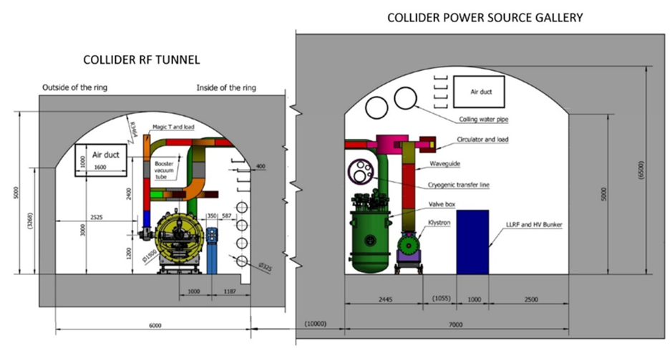
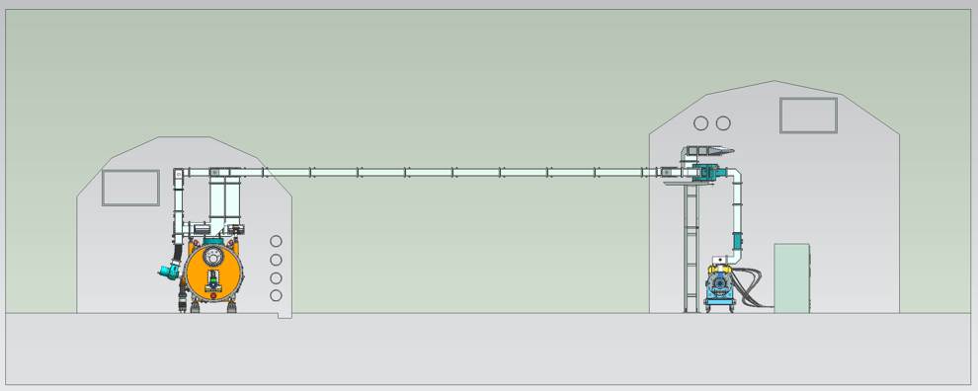
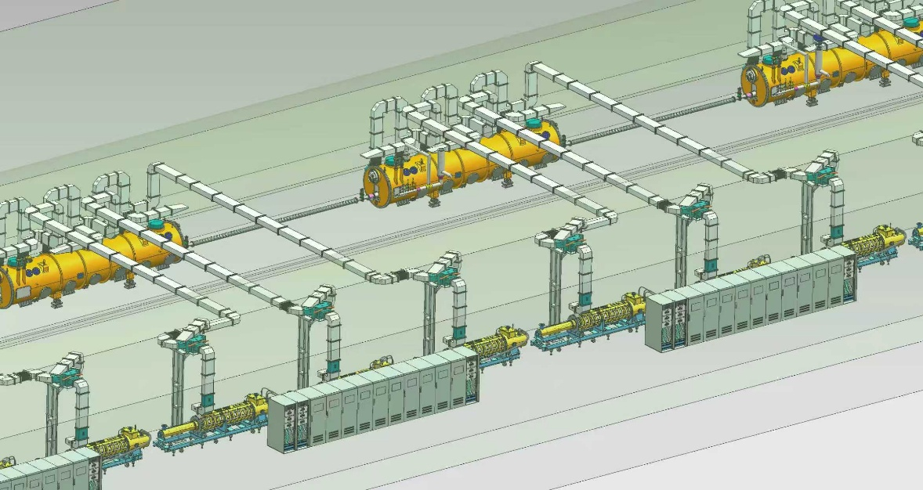
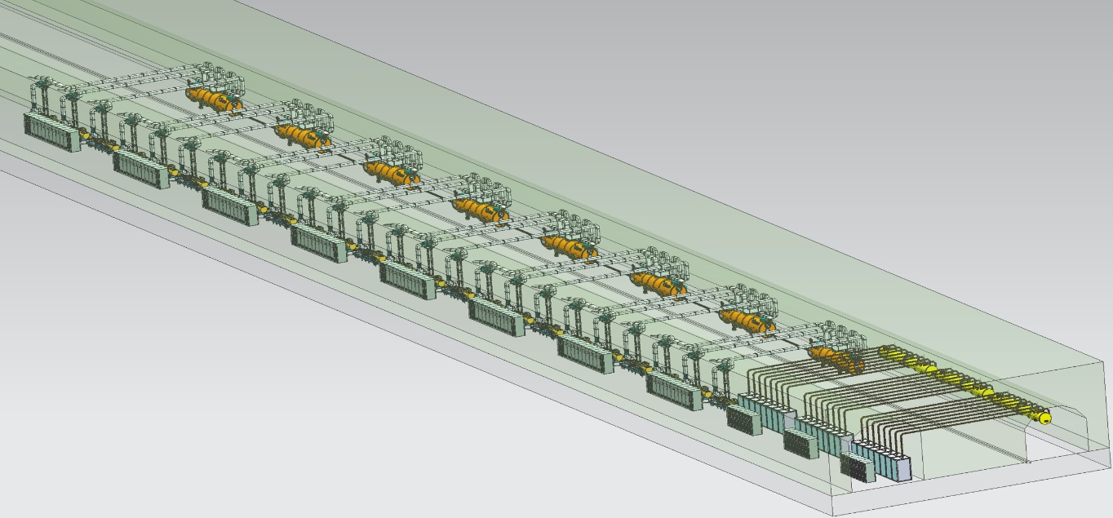
Design consideration for Collider RF sources
TDR
EDR

Slide 6
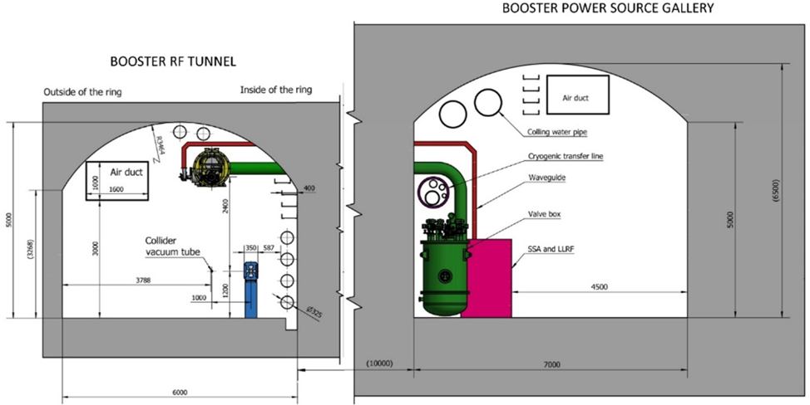
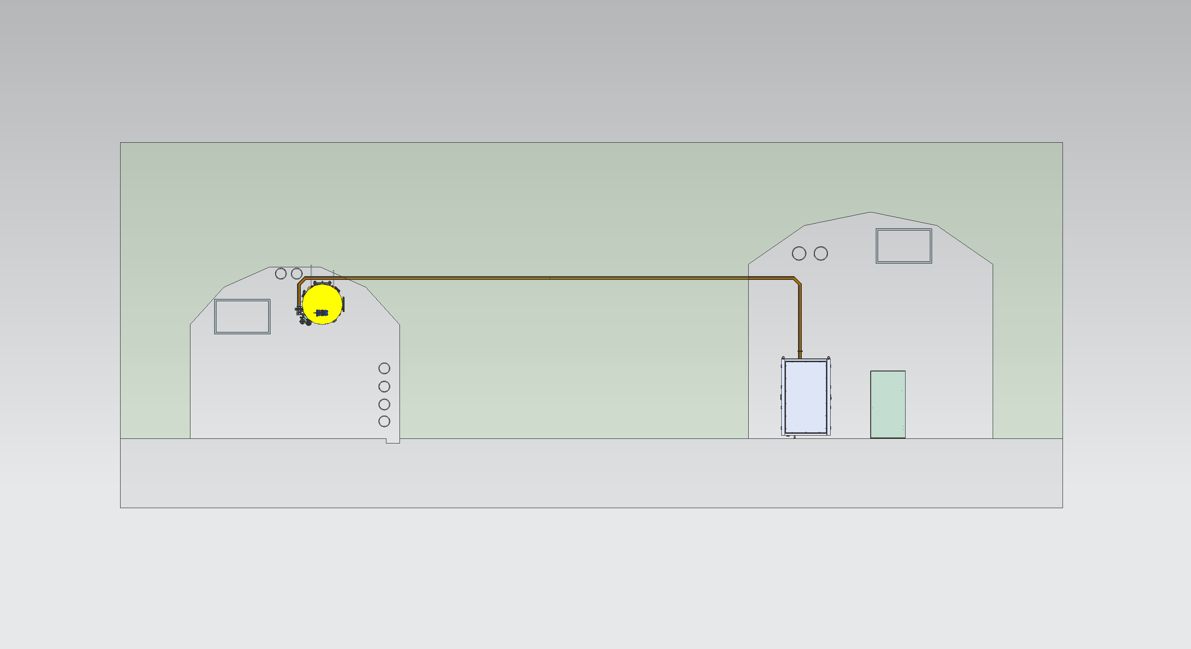
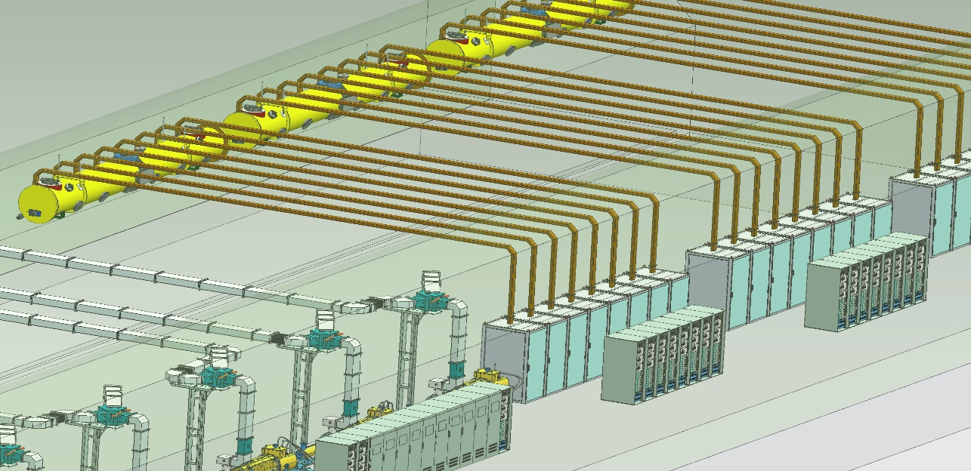
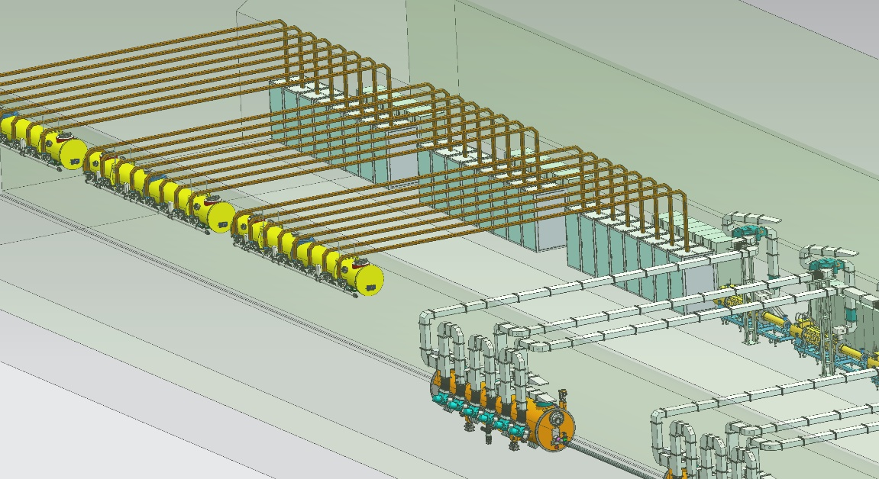
Design consideration for Booster RF sources
TDR
EDR

Slide 7

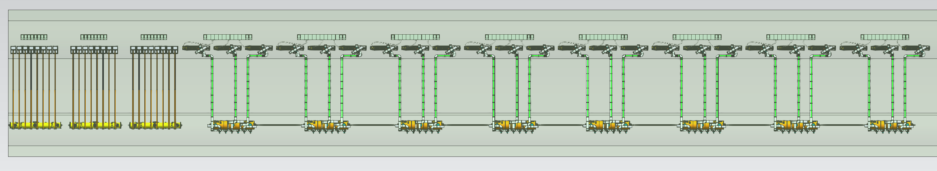
Design consideration for Ring RF sources
EDR

Slide 8
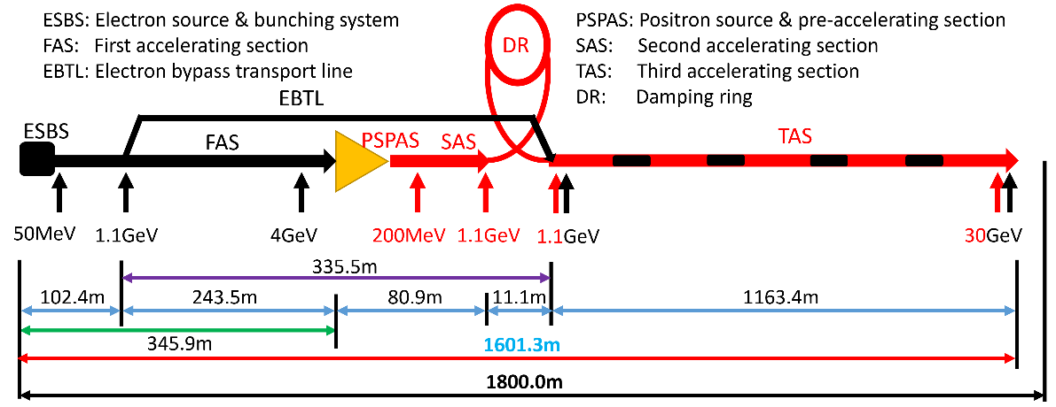
Design consideration for Linac RF sources
The primary high-power RF sources for Linac consist of 33 units of 80 MW S-band klystrons and 236 units of 50 MW C-band klystrons, along with the corresponding high-voltage modulators and associated subsystems.
Type | QTY | Freq.(MHz) | Structure type
S-band klystron | 33 | 2860 | 1 1-to-1，standard-bunch 3 1-to-2，standard acc. structure. 8 1-to-2，large aperture acc. structure 21 1-to-4, standard acc. structure.
C-band klystron | 236 | 5720 | 1-to-2，standard acc. structure.

Slide 9
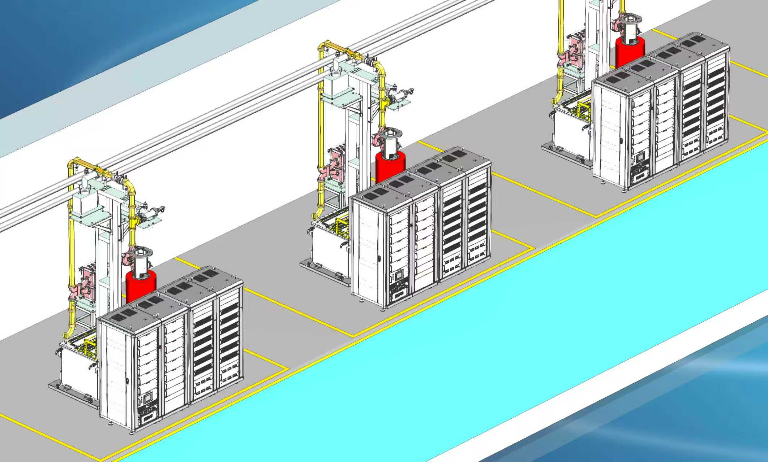
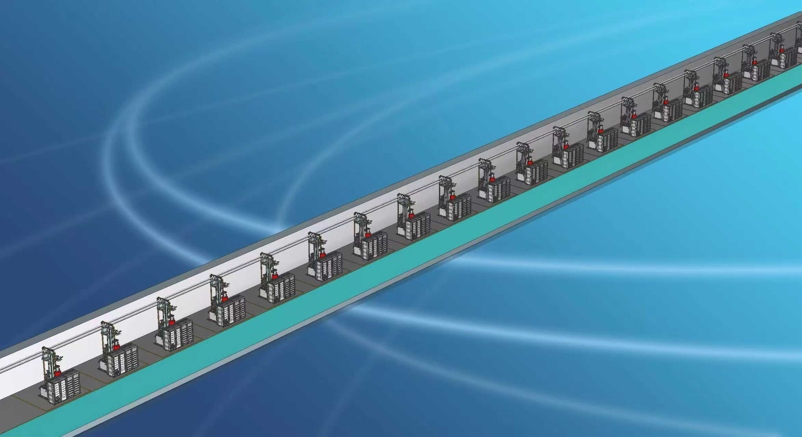
Design consideration for Linac RF sources
EDR

Slide 10
EDR goal, scope and plan
Accomplishment of high-power test for high efficiency klystron prototype (single beam klystron and multi-beam klystron)
R&D
C band 80MW klystron(80MW/100Hz/3us)
S band 80MW high efficiency klystron(80MW/55%)
S band high efficiency PPM klystron
P band resonant ring(1.2MW CW power)
Energy recovery klystron
LLRF system

Slide 11
EDR Progress

Slide 12
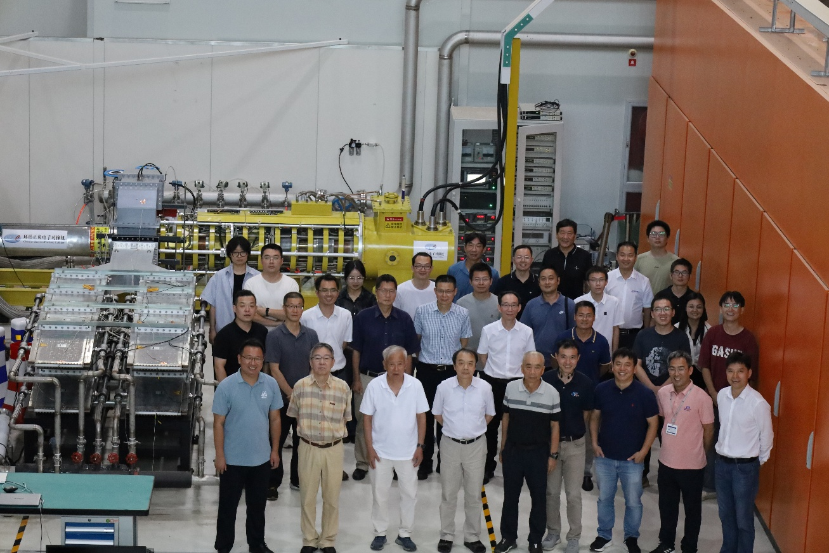
1. High power test of high efficiency klystron
Milestone(2024)
Jan.11 Klystron shipped to PAPS site；
Feb.2, 1‰ duty factor, 800kW
Jun.18, 10% duty factor, 800kW
Jul.10, 50% duty factor, 800kW
Jul.15, CW 600kW
Jul.16, CW 700kW
Jul.23, CW 800kW（max. 809kW）
Aug.18, CW 803kW, Eff. 78.5%

Slide 13
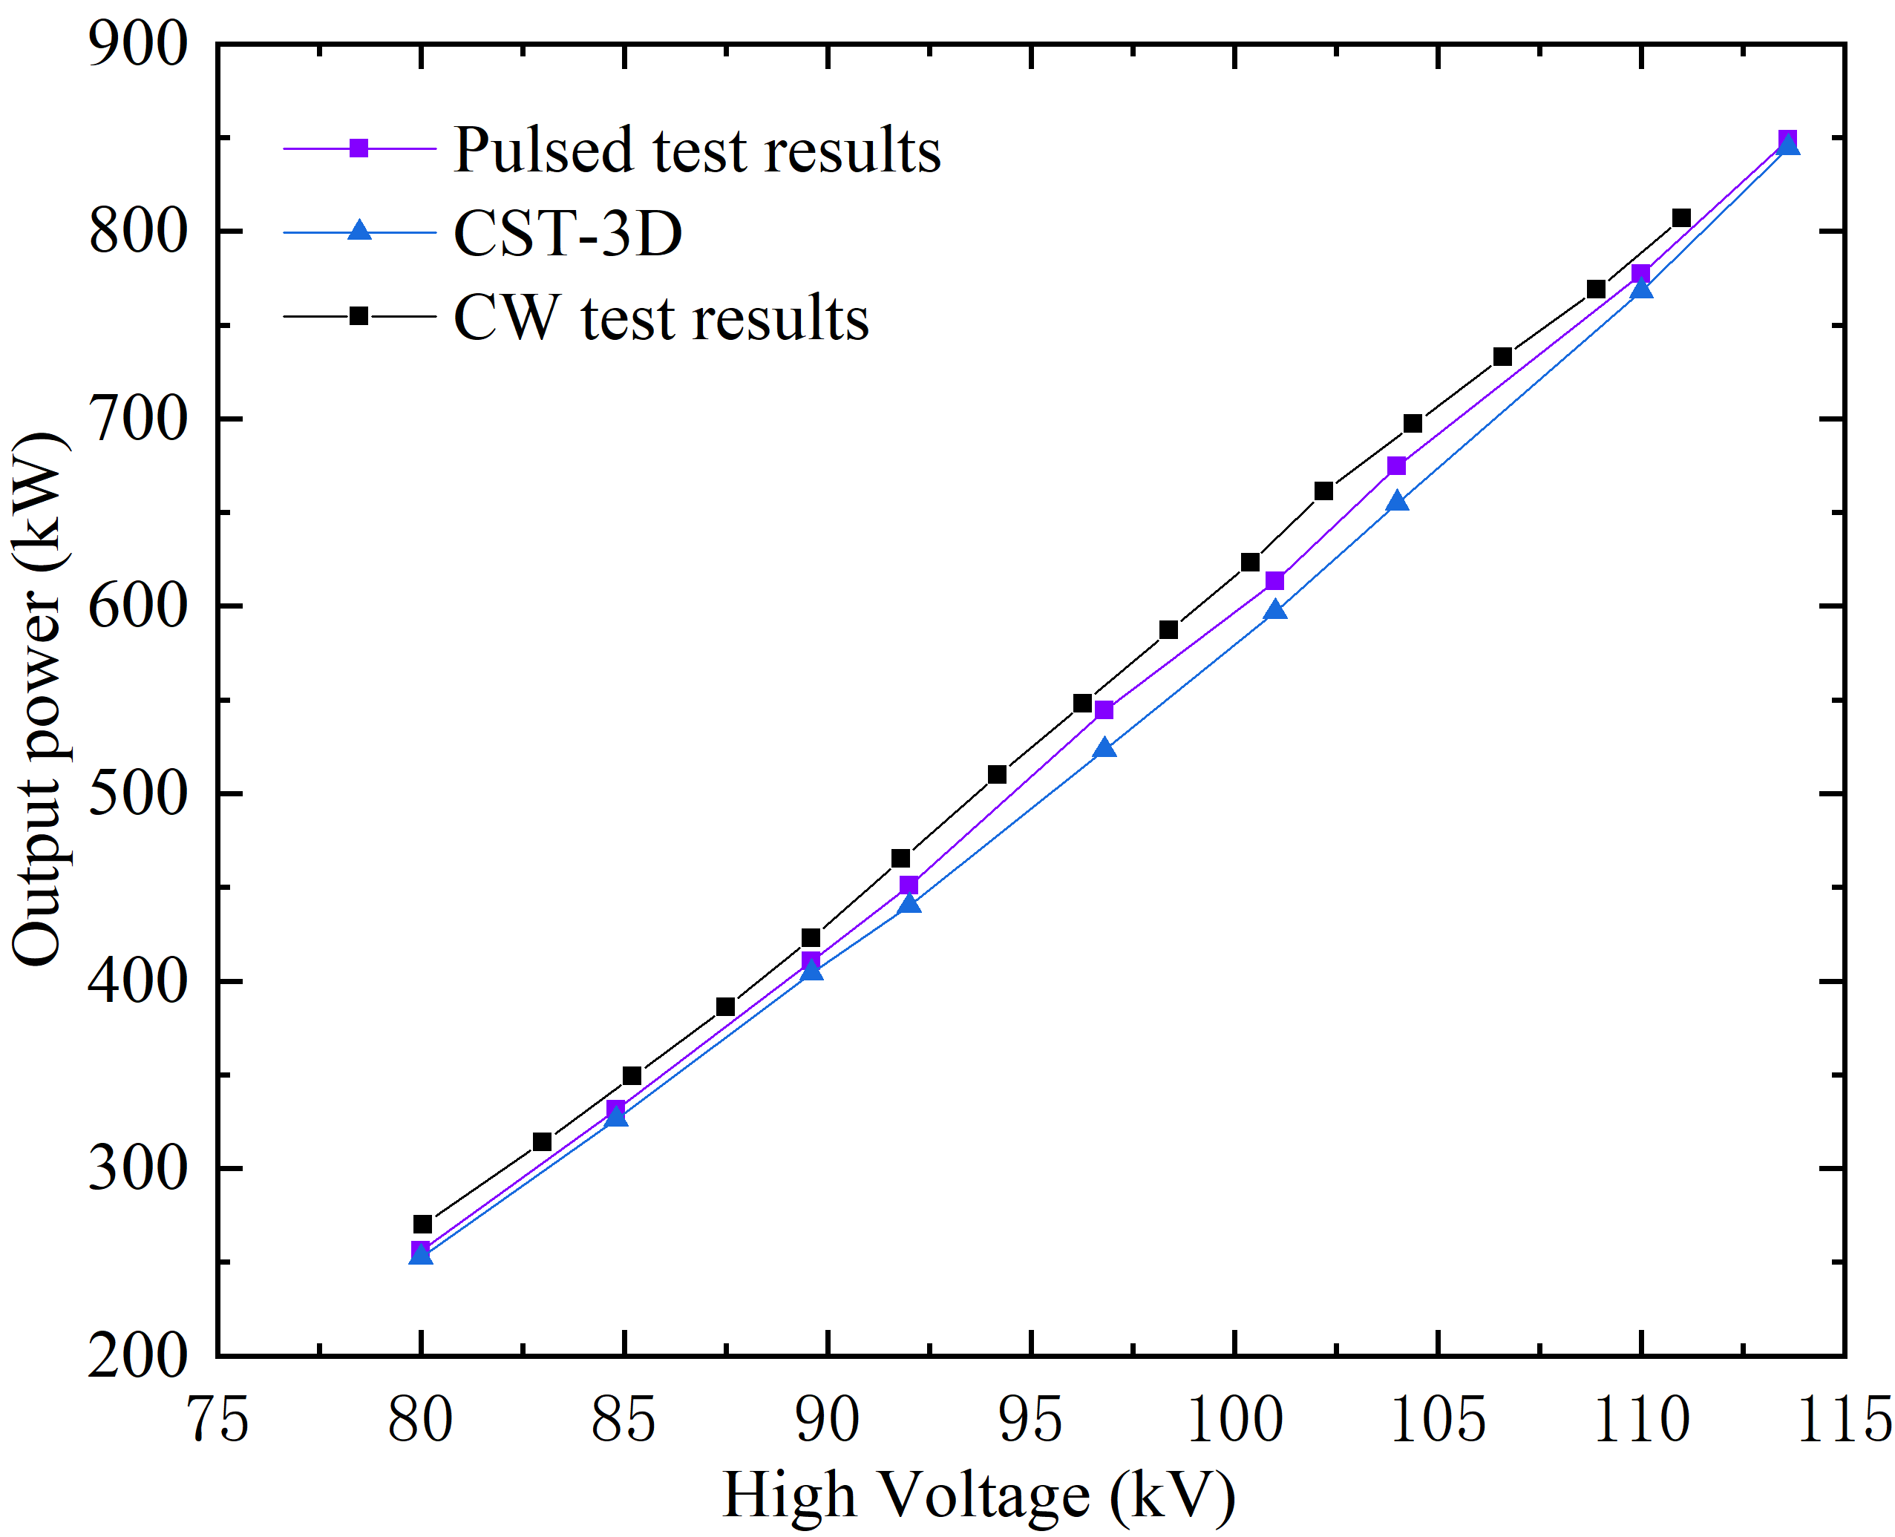
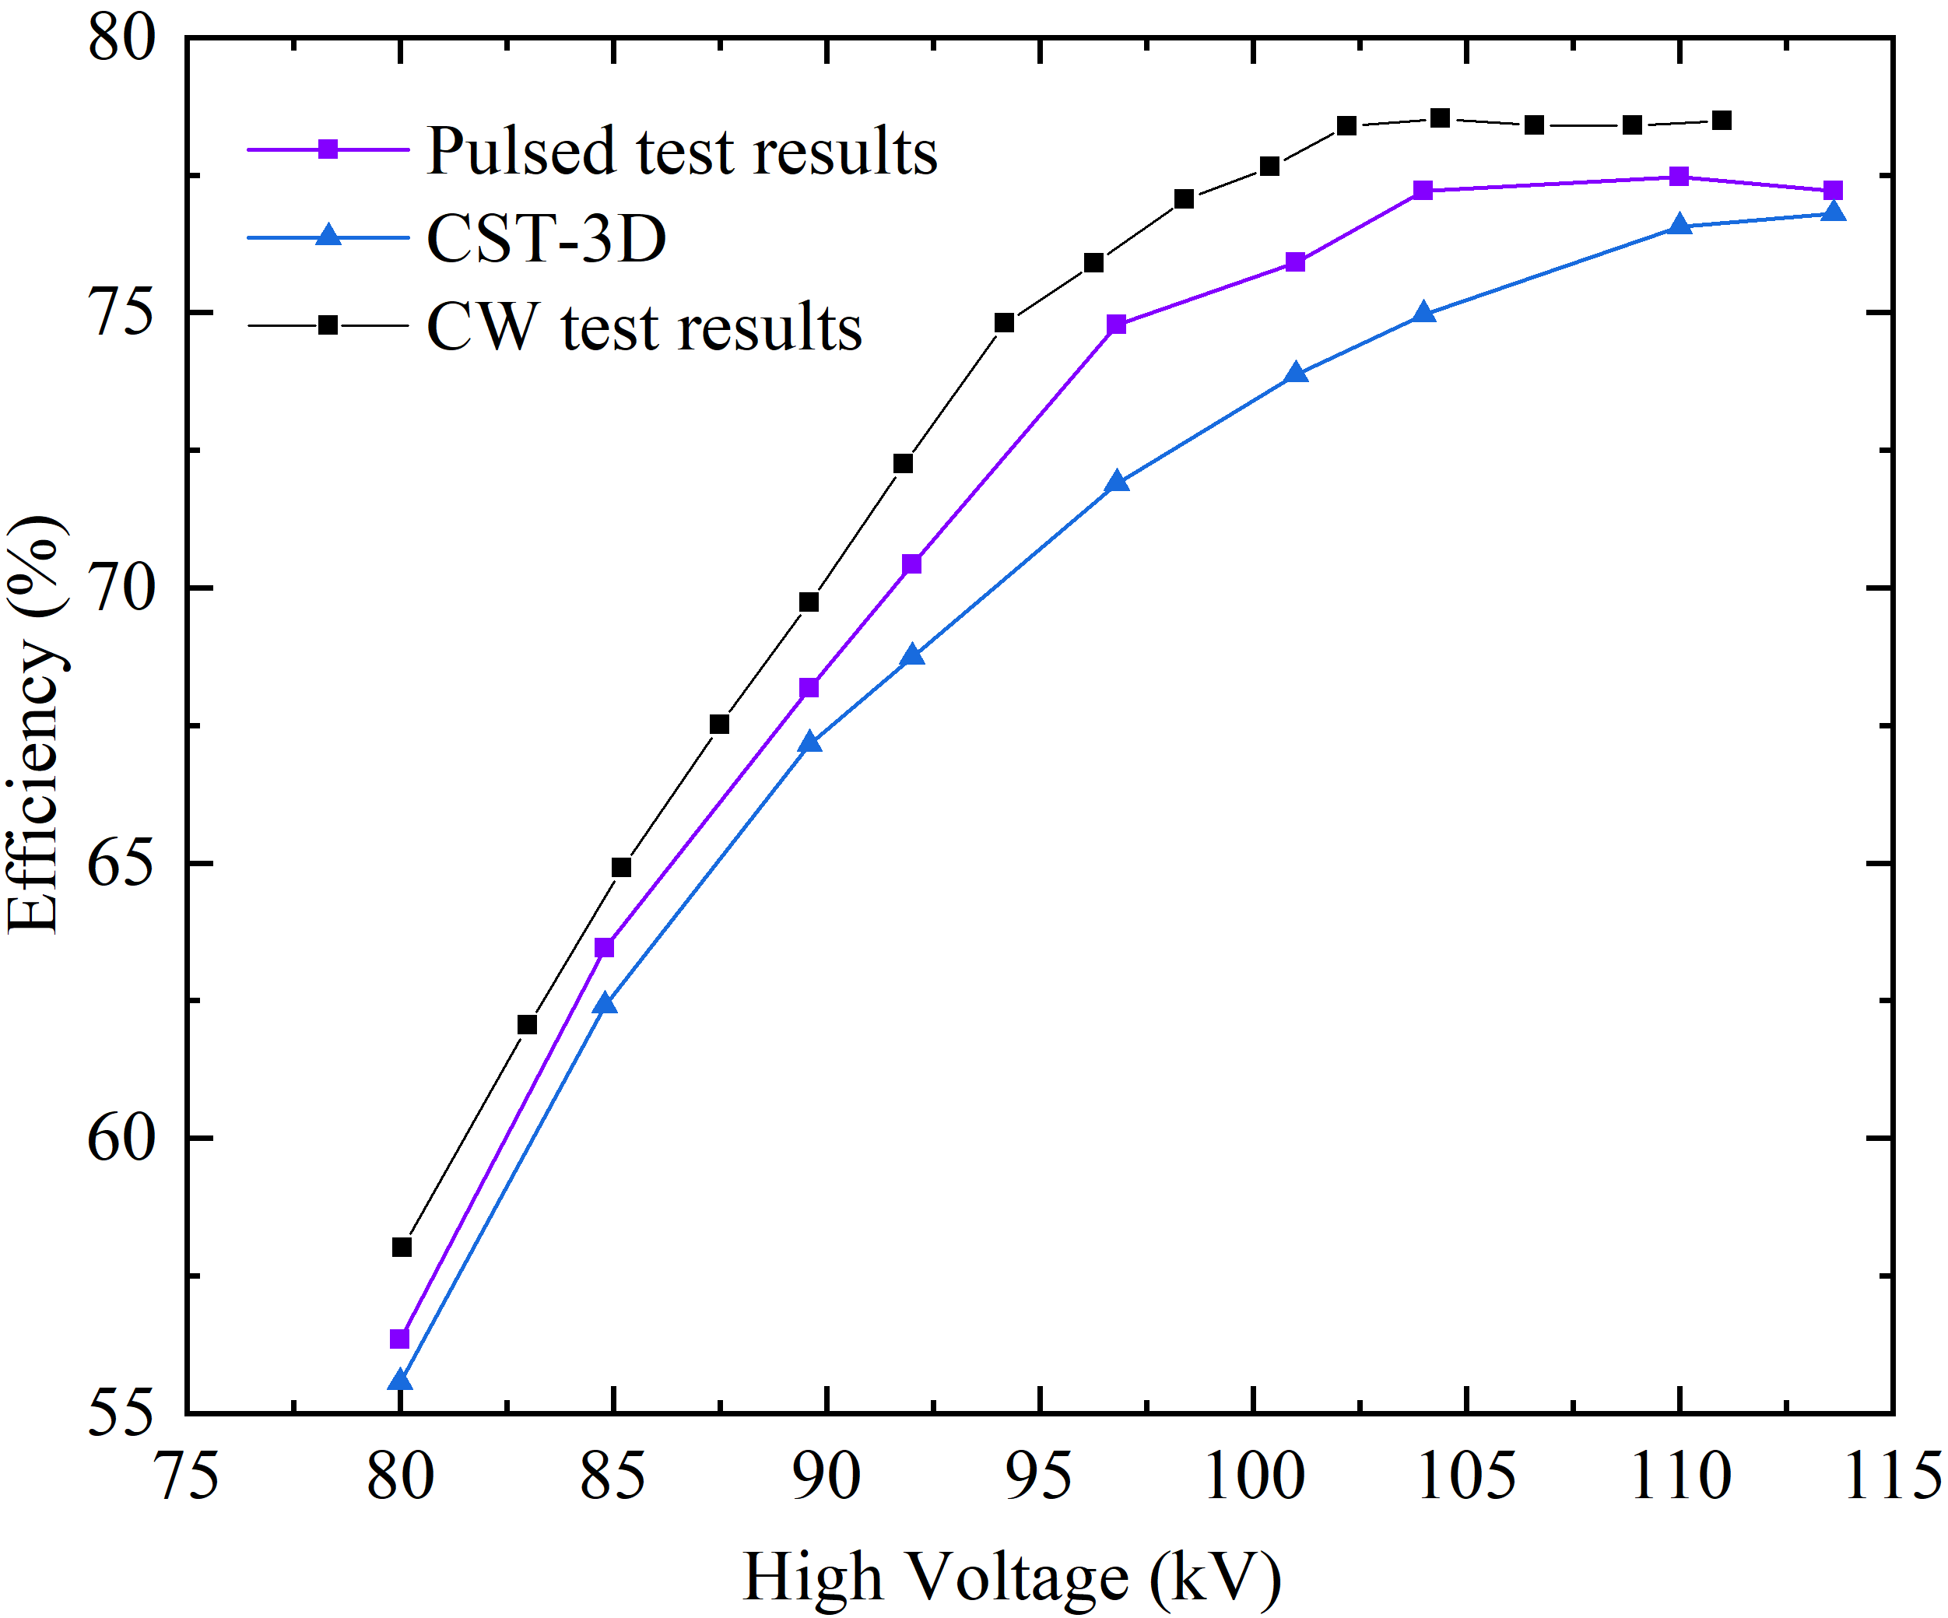
650MHz/800kW CW klystron test results

Slide 14
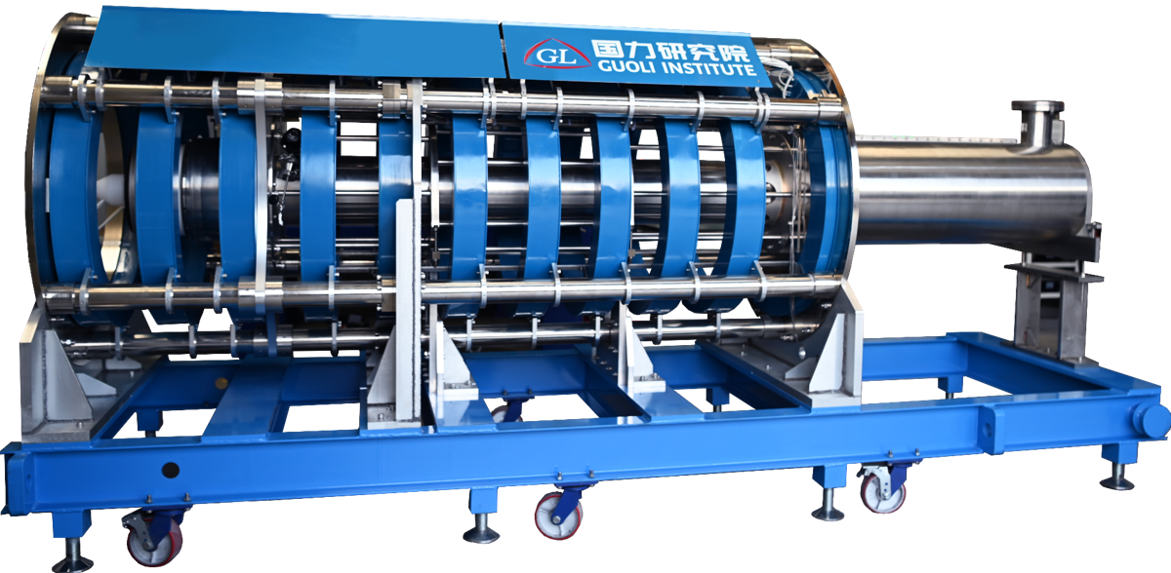
2. Multi-beam klystron Fabrication
Milestone
July, 2021, Physical design review；
Sep. 2021, Mechanical design review(beam tester and prototype)
Mar. 2023, High power test of beam tester

Slide 15
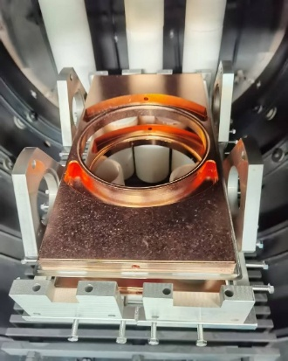
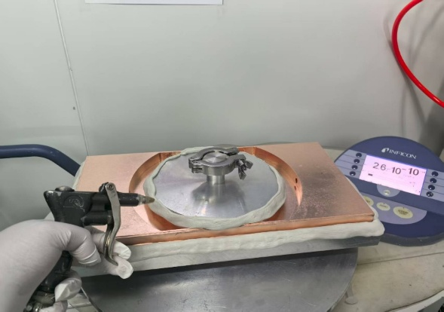
Multi-beam klystron Fabrication
Klystron prototype manufacture is in progress.
Cavity cold test
Cathode preprocessing
Focusing magnet
The new window fabrication was completed and klystron baking are expected to begin at the end of this year.
Window re-fabrication
Klystron body

Slide 16
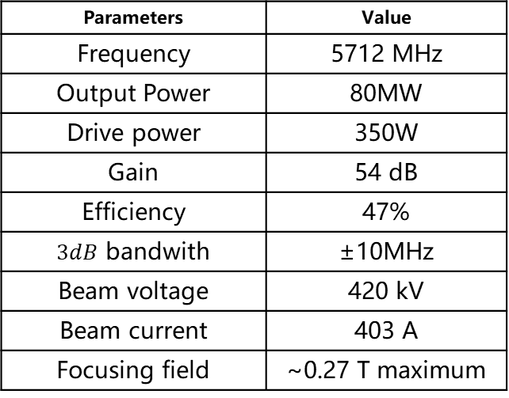
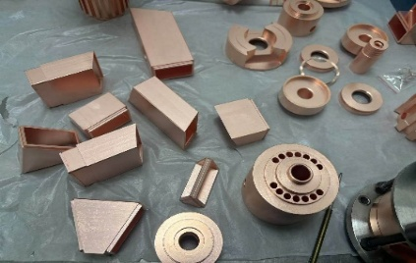
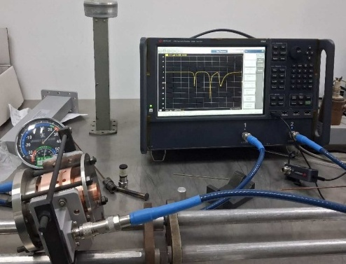
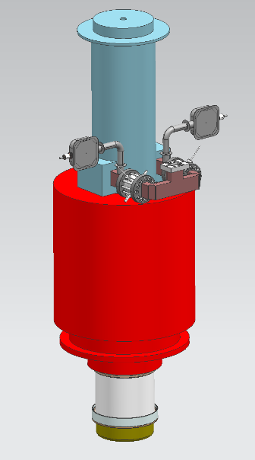
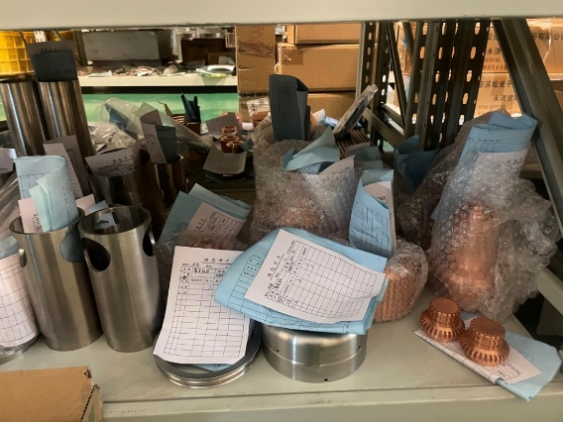
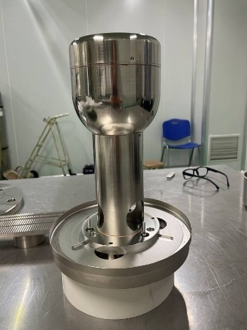
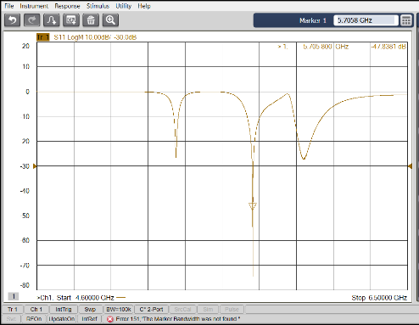
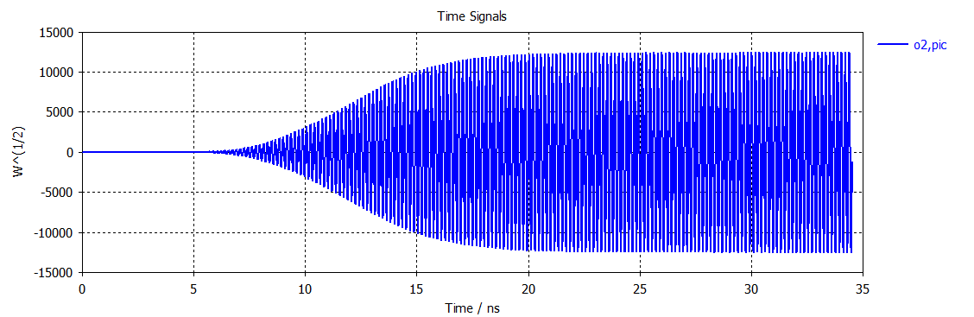
3. C band 80MW klystron(Li Fei’s Poster)
Physics design review
May.12 2024
Part manufacturing
Oct. 15 2024
Cavity cold test
Apr. 14 2025
Mechanical design review
Aug. 12 2024
Gun and cavity manufacturing
Feb. 28 2025
Mechanical processing and manufacturing are in progress.
High-power test is expected to be carried out in Dec. 2025.

Slide 17
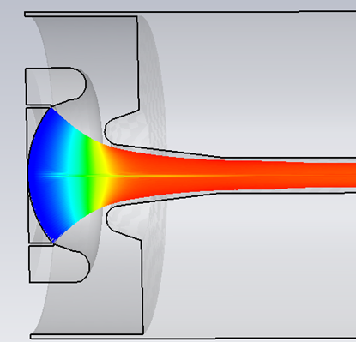
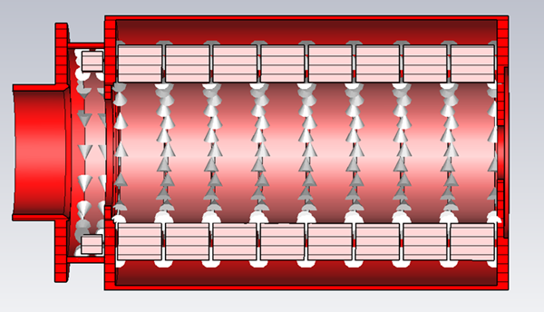
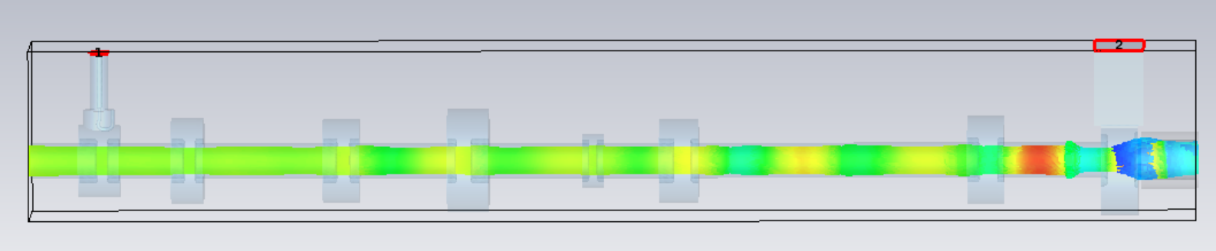
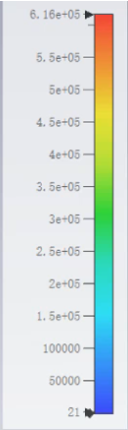
4. S band 80MW high efficiency klystron(Wang Yiao’s Poster)
Aiming at 80 MW peak power and 55% RF efficiency with high-efficiency design approaches, the optical design of the electron gun, the electromagnetic focusing coil, and the beam dynamics design have all been completed.
Electron GUN
Voltage: 350 kV
Current: 415A
Beam dynamics simulation
Num of cavity: 8
RF conversion efficiency: 55%
Output power: 80MW

Slide 18
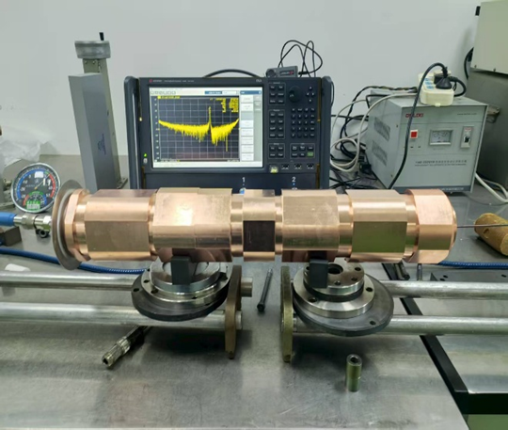
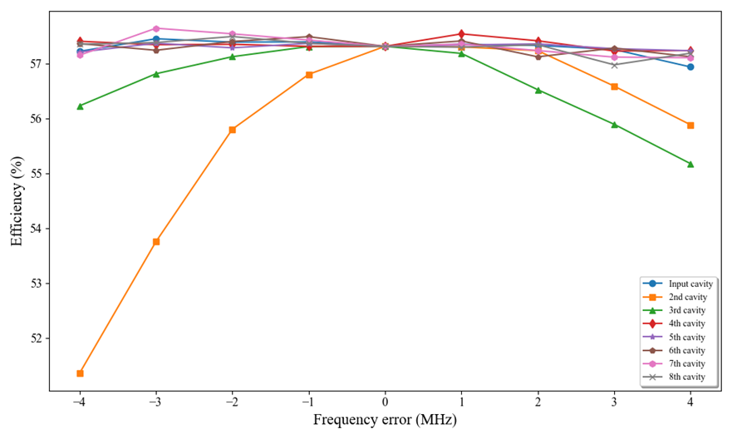
4. S band 80MW high efficiency klystron(Wang Yiao’s Poster)
Machining has begun, and part machining is complete.
The cavity machining met design requirements through frequency error analysis and error control during welding and cold tests.
Assembly will now move forward, with high-power testing expected by year-end.
Num | Design value(MHz) | Measure value(MHz)
1 | 2859 | 2857
2 | 2853 | 2853
3 | 2870 | 2871
4 | 2326 | 2328
5 | 5558 | 5559
6 | 3010 | 3010
7 | 3065 | 3065
8 | 2852 | 2853

Slide 19
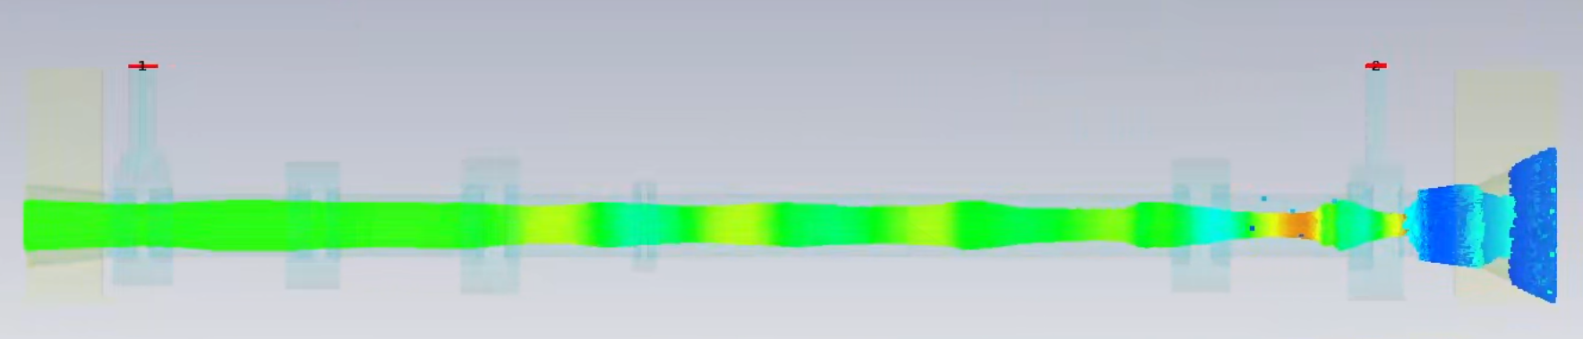
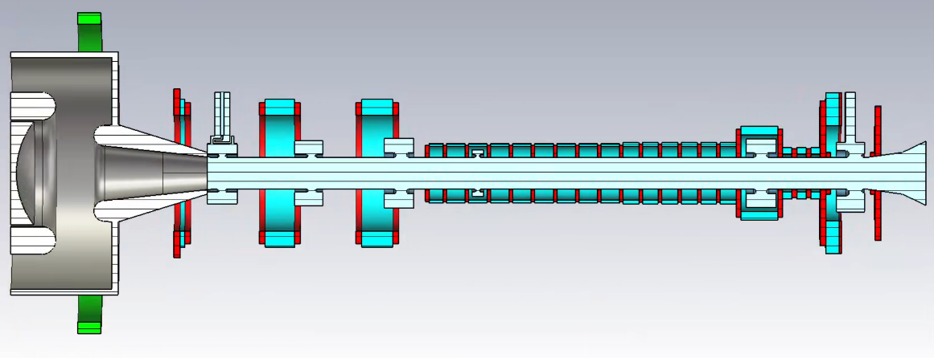
5. S band PPM klystron(Xiao Han’s Poster)
To improve efficiency, reduce system size, and support localization, we are developing an S-band 50 MW PPM klystron. CST Particle Studio simulations indicate 51.2 MW output power and 53.8% efficiency.
Fabrication is expected to begin at the start of next year.
S-band 50MW PPM Klystron | Design Specifications
Beam Voltage | 350kV
Beam Current | 272A
Frequency | 2856MHz
Tube Radius | 13.8mm
Beam Radius | 9mm
Output Power | 50MW
Efficiency | 53%
Beam dynamic
Klystron structure

Slide 20
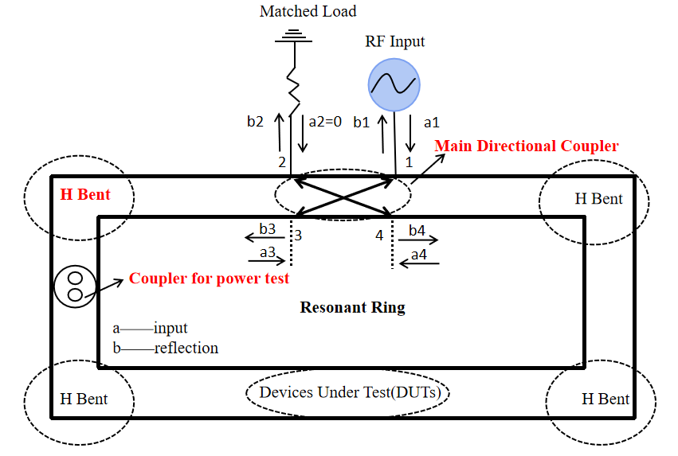
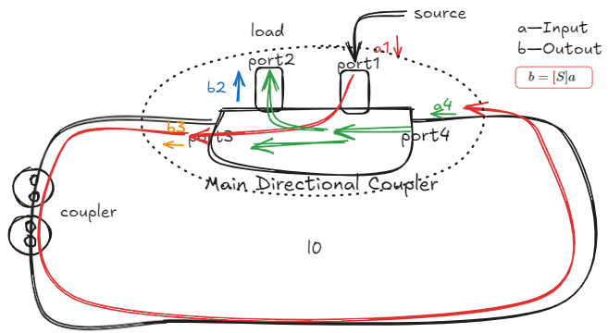
6. P band resonant ring(Wang Fanyu’s Poster)
Ensures reliable high-power testing of RF components such as klystron ceramic windows and coupler of cavity.
System components: main directional coupler, power detection coupler, four H-bends, observation window, three-stub tuner, phase shifter.
Capable of 1.2 MW testing power (1.5 × the rated output of an 800-kW klystron)
Traveling-wave resonator schematic
Power Build-up Process

Slide 21
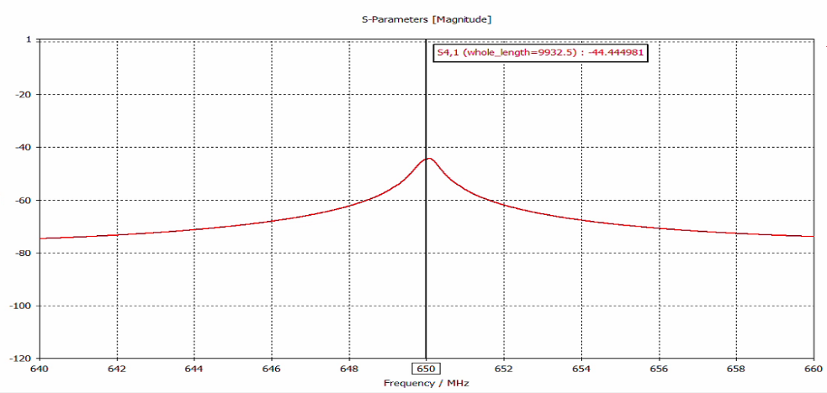
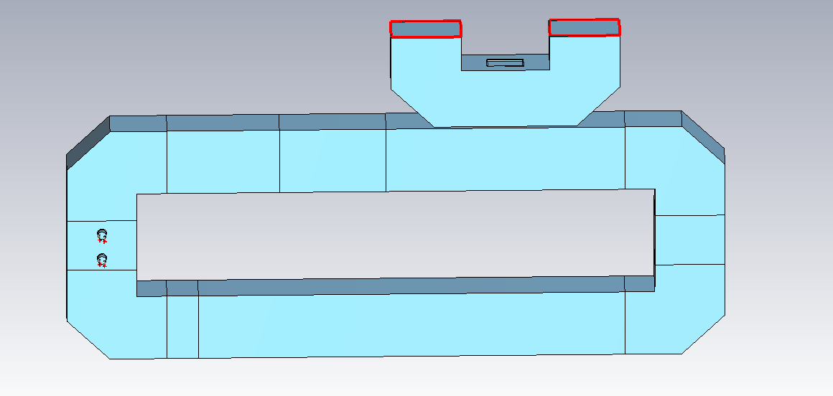
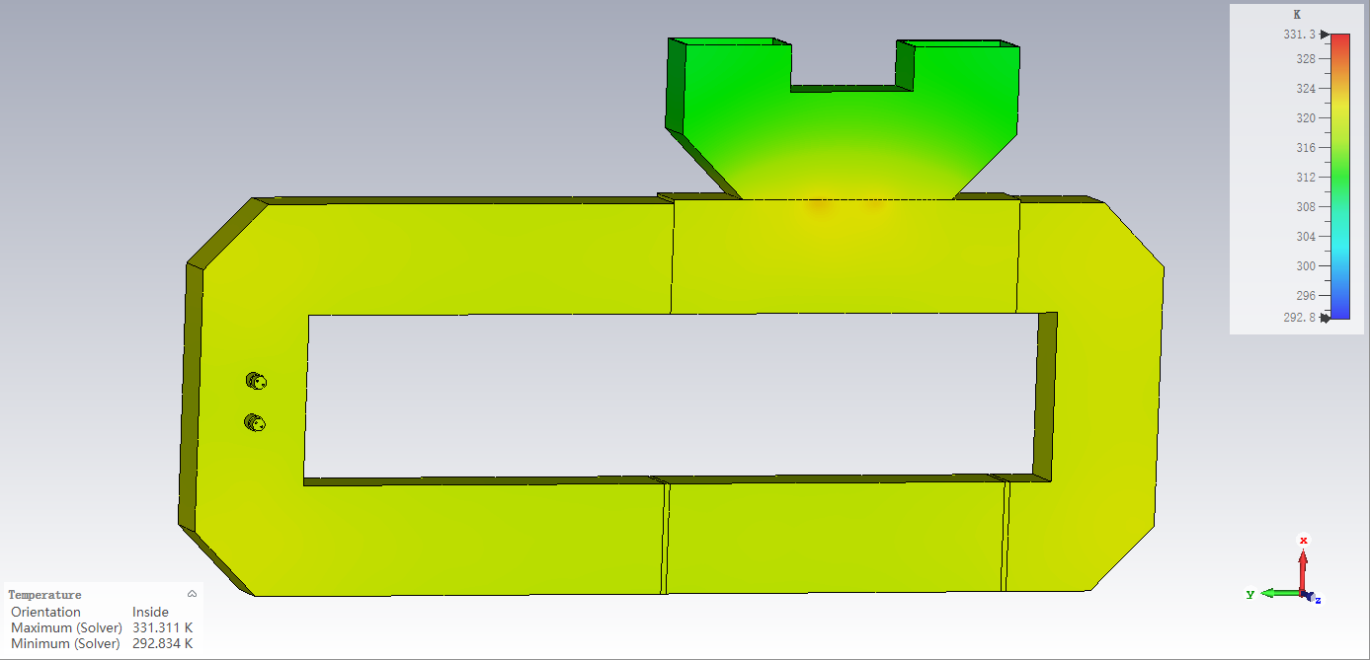
6. P band resonant ring(Wang Fanyu’s Poster)
Waveguide | WR1500
Length of the ring | 9.28m
Coupling coeficeent | –10dB
Power Gain_{therectical} | 36.7
Max. power gain | 15.56 dB
Max.temperature rise | 38℃
port2
port1
P-band TWRR power gain is 15.56dB@650MHz（35.9）
port2
port1
port4
port3
port4
port3
P-band TWRR model
Temperature rise of P-band TWRR
P-band TWRR fabrication planned for early next year.

Slide 22
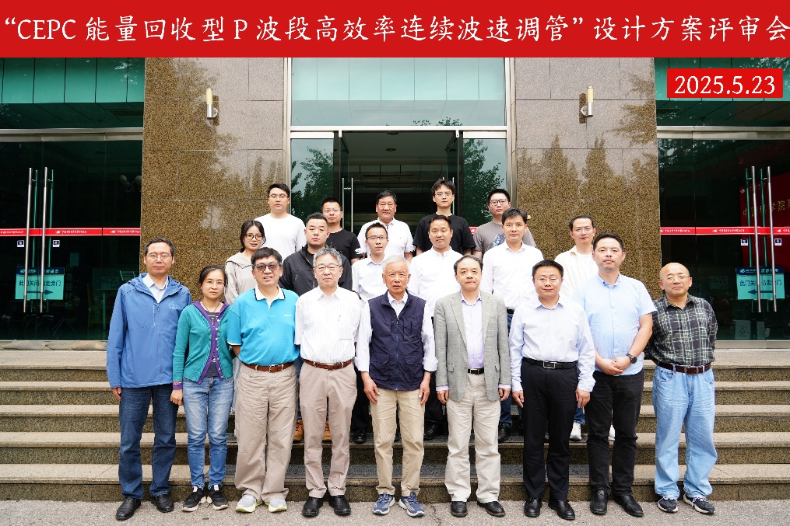
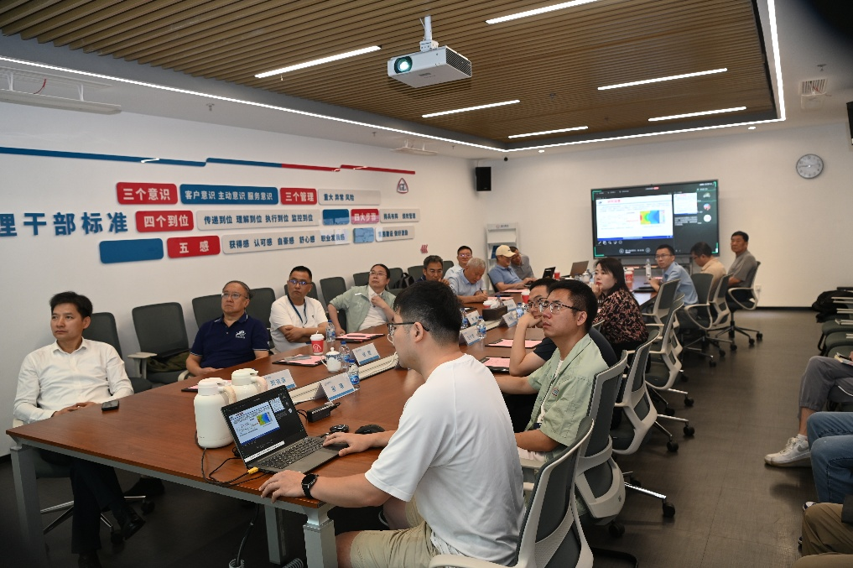
7. Energy recovery klystron (Liu Yu’s Poster)
Milestone
May, 2025, Physical design review；
Jul. 2025, Mechanical design review
Parameters | Value
Frequency | 650 MHz
Beam voltage | 113 kV
Output power | 800 kW
Pervence | 0.25 μP
Efficiency (with 1 stage depressed collector) | 85%

Slide 23
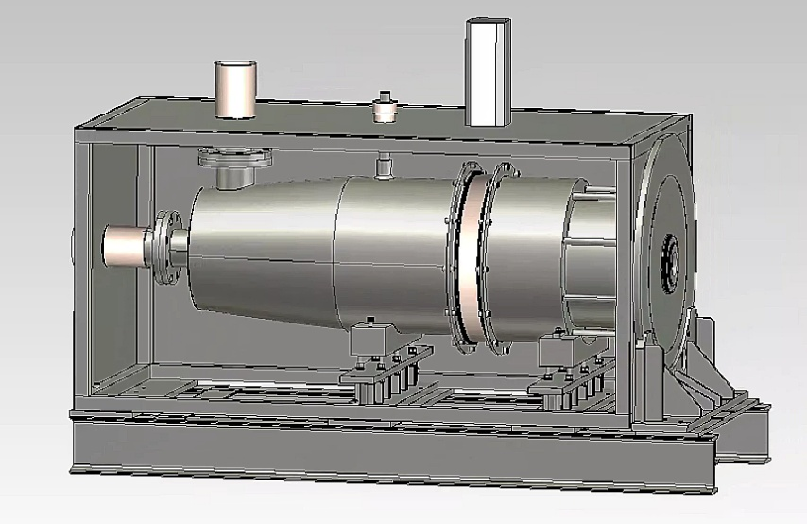
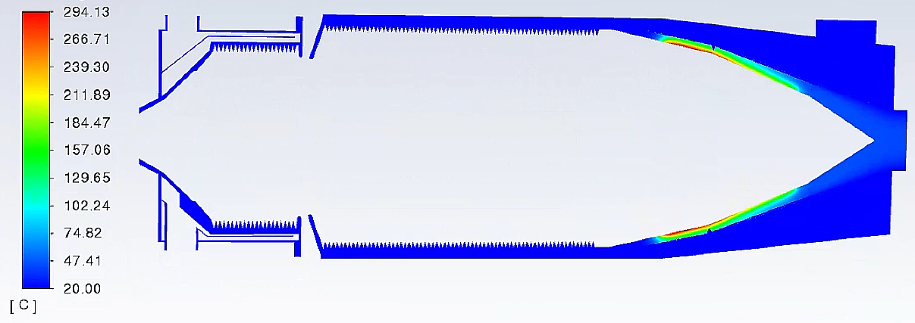
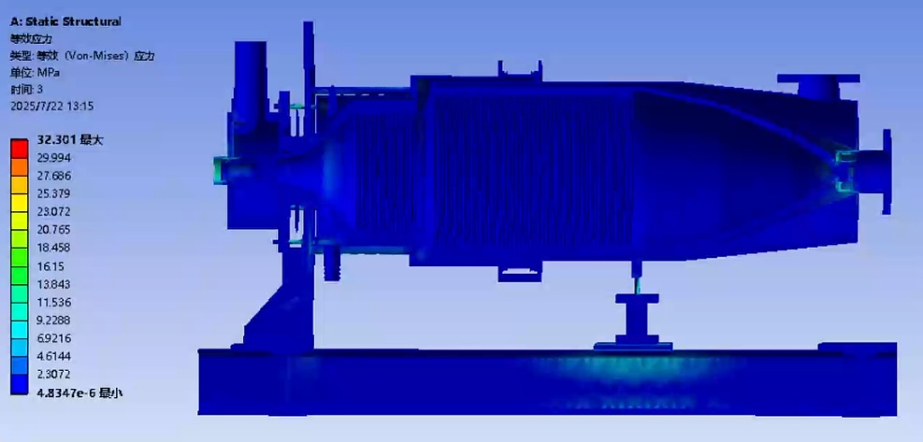
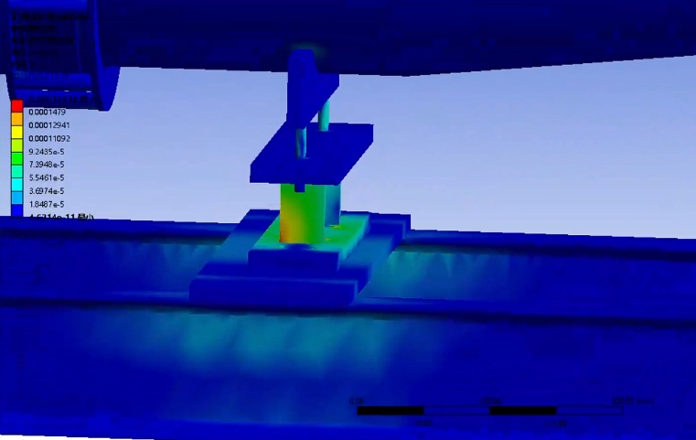
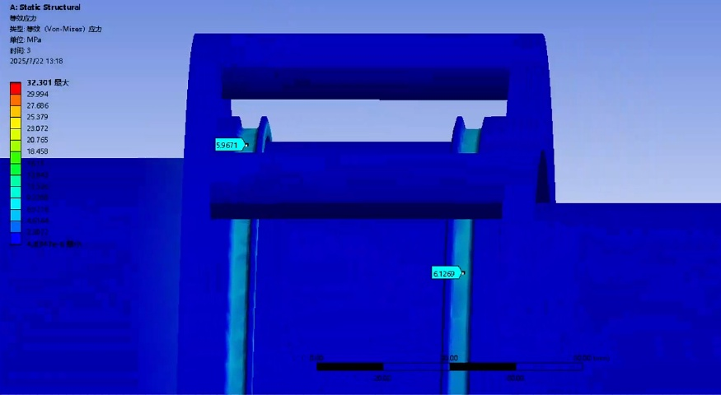
Collector design
294℃
Thermal analysis
32MPa
Mechanical analysis

Slide 24
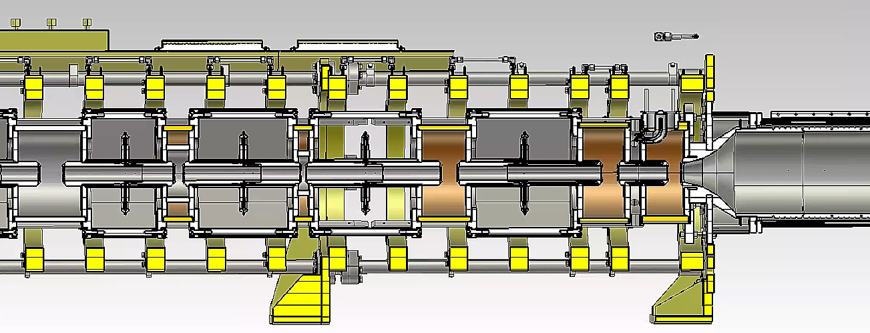
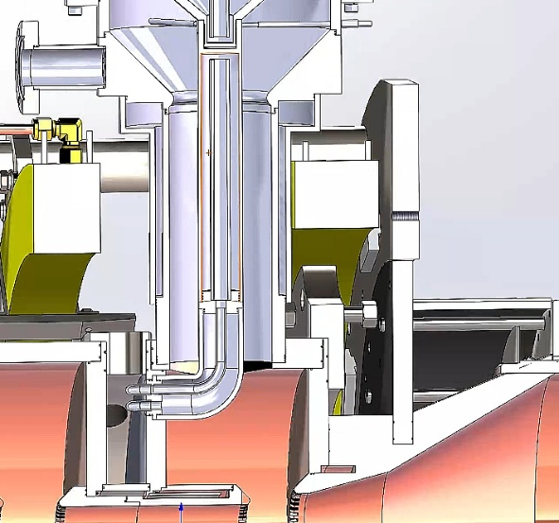

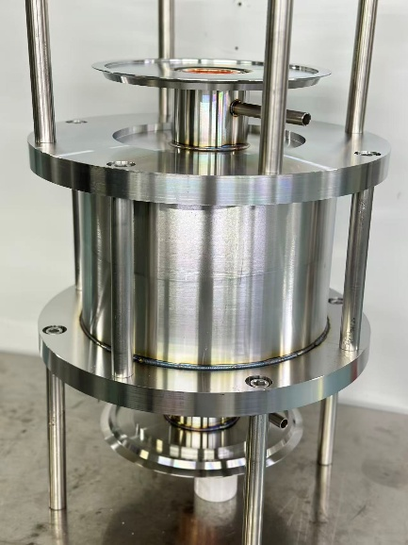
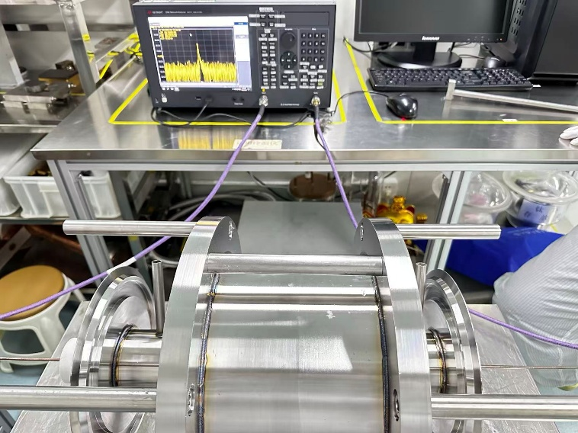
Klystron body optimization
Magnet
Coil 15
Window
Mechanical processing and manufacturing are in progress.
High-power test is expected to be carried out in Sep. 2026.

Slide 25



8. LLRF system(Gao Wenbin’s Poster)
Design consideration：
The system is based on a domestic MicroTCA platform and includes three control boards.
A vector-sum-based multi-cavity control algorithm is used to achieve synchronous control of the amplitude, phase, and frequency of the six cavities.

Slide 26


LLRF progress
Software
Completed development of the domestic FPGA control board firmware and EPICS software
Developed model-based superconducting cavity tuning algorithms, including detuning calculation and quench detection
Vector-sum–based multi-cavity control algorithms are currently under development

Slide 27




LLRF progress
Hardware
Developed a multi-channel piezo and motor control FMC module
Designed inter-board communication for multiple superconducting cavities using a 40 Gbps optical transceiver and fiber link
Inter-board loopback testing completed
Hardware procurement and testing finalized
Plan to set up a test platform for integrated debugging and testing of:
Tuning algorithms
Tuning control FMC
Inter-board communication

Slide 28
Industrialization preparation progress and status
650MHz/800kW high efficiency klystron R&D
Close collaboration with GUOLI company at Jiangsu province）
S band, C band 80MW high power klystron R&D
Close collaboration with HANGUANG company at Hubei province
650MHz, 2860MHz, 5720MHz and 1.3GHz solid state amplifier
Close collaboration with HUAKANG company at Jiangsu province

Slide 29








Slide 30
Key milestones from 2025-2027
Mass production preparation for high efficiency klystron.(2025-2027)
S band and C band klystron for BEPCII, BEPCII-U and other facilities in China.
26-set P band klystron for CSNSII project
LLRF, klystron protection system and power distribution system will be implemented for horizontal test of superconducting cavity.(2025-2026)
Development of energy recovery klystron is for exploration of a much higher efficiency klystron.(2025-2026)

Slide 31
Conclusion
The high power test of high-efficiency klystron prototype has been successfully completed, achieving a continuous wave (CW) output of 803 kW and an efficiency of 78.5%.
Mass production preparations are underway for high efficiency klystron and high power klystron.
Processing and high-power test of the MBK will be conducted this year.
Development of S band PPM klystron and energy recovery klystron is progressing.
Efforts are also being made in the development of P-band resonant ring.
An auxiliary system for the horizontal test of superconducting cavities will encompass LLRF, klystron energy dissipation protection, power distribution and transmission systems.

Slide 32
Acknowledgement
We would like to express our sincere gratitude to Yifang Wang for his leadership and support through the Ten Thousand Talents Program, which has been instrumental to the success of this work.
We also acknowledge the CEPC study group, GuoLi, Hanguang, and Huakang for their excellent cooperation.
Additionally, we extend our appreciation to colleagues and students who contributed their time, expertise, and resources to this effort.

Slide 33








33

