Slide 1
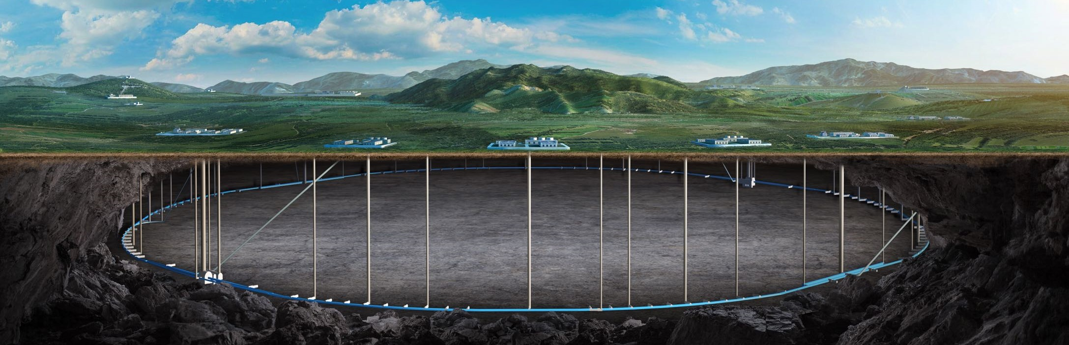


CEPC injection and extraction system
(Latest progress in EDR phase)
Jinhui Chen, Xiaohao Cui, Lei Wang , Huo Lihua , Guanjian Wu
2025 International Workshop on the CEPC (Nov. 6-10，2025，Guangzhou, China)

Slide 2
Content
Overview of CEPC Injection & extraction system
Inj. & ext. system layout and survey design
EDR design update of kickers
EDR design update of septa
New inj. & ext. tech. demonstration in HEPS beam commissioning
Summary

Slide 3
1 Overview of CEPC Injection & extraction system

Slide 4
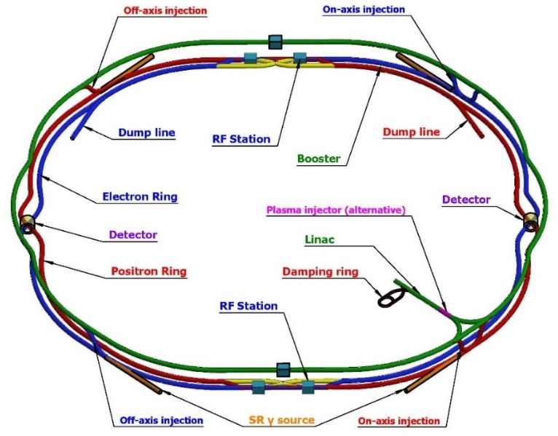
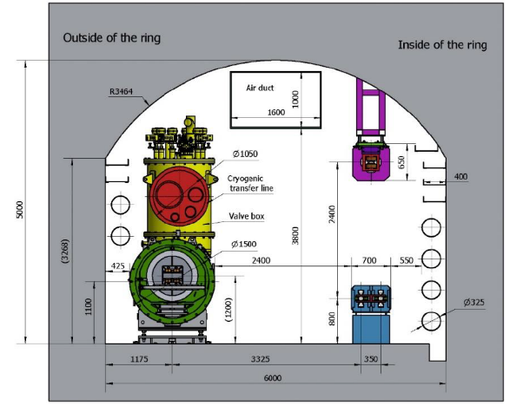
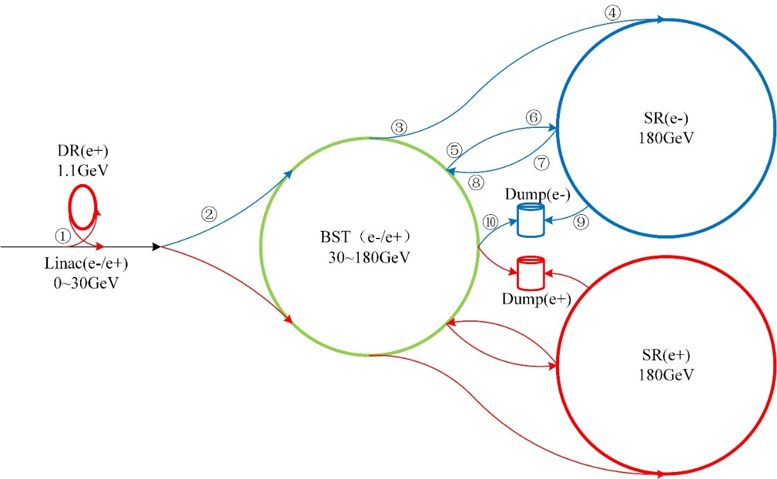

Overview of the inj.&ext. system in CEPC
The CEPC complex consists of 4 circular accelerators：
A damping ring (1.1GeV/147m)
A booster ring (30~120/180GeV/100km)
2 storage rings (120/180GeV/100km)
The 4 rings being linked with 14 transport lines and 10 injection & extraction sub-systems :
DR injection and Extraction system(e+)
Booster LE injection system (e+,e-)
Booster Extraction system1 (e+,e-)
Collider off-axis injection system (e+,e-)
Booster Extraction system2 (e+,e-)
Collider swap out injection system (e+,e-)
Collider swap out extraction system (e+,e-)
Booster HE injection system (e+,e-)
Collider beam dump system(e+,e-)
Booster beam dump system(e+,e-)
Off-axis injection
(in W, Z and $t\overline{t}$ mode)
On-axis injection
(only in Higgs mode)

Slide 5
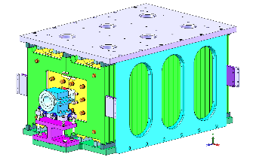
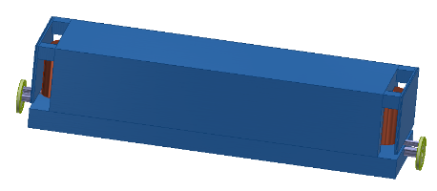
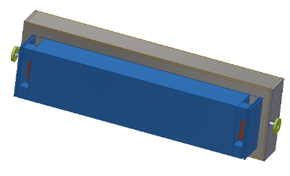
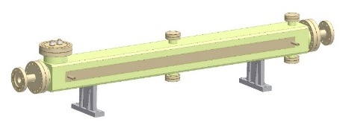
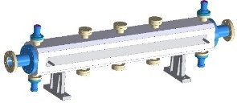
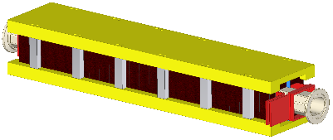
List of the types of inj. & ext. hardware
 | Sub-system | Kicker |  | Septa
 |  | Kicker Type | Kicker waveform | Septum Type | Stored beam pipe aperture /Thickness of septum
1 | DR inj./ext. | Slotted-pipe kicker | Half-sine /245ns | Horizontal LMS in air | ф30/6mm
2 | BST LE inj. | Strip-line kicker | Half-sine/50ns | Horizontal LMS in air | ф56/10mm
3 | BST ext. for CR off-axis inj. | Delay-line dipole kicker | Trapezoid /440-2420ns | Vertical LMS in air | Ф56/10mm
4 | CR off-axis inj. | Delay-line dipole kicker | Trapezoid /440-2420ns | Vertical LMS in vac.&air | Ф56/2mm&3.5mm
5 | BST ext. for CR on-axis inj. | Ferrite core dipole kicker | Half-sine/1360ns | Vertical LMS in air | Ф56/6mm
6 | BST HE inj. for CR on-axis inj. | Ferrite core dipole kicker | Half-sine/0.333ms | Vertical LMS in air | Ф56/10mm
7 | CR swap out inj. | Ferrite core dipole kicker | Half-sine/1360ns | Vertical LMS in vac.&air | Ф56/2mm&3.5mm
8 | CR swap out ext. | Ferrite core dipole kicker | Half-sine/1360ns | Vertical LMS in vac.&air | Ф56/2mm&3.5mm
9 | CR beam dump | Delay-line dipole kicker | Trapezoid /0.333ms | Horizontal LMS in air | Ф56/5mm
10 | BST beam dump | Delay-line dipole kicker | Trapezoid /0.333ms | Horizontal LMS in air | Ф56/5mm
Slotted-pipe kicker
Strip-line kicker
Delay-line kicker
Lumped ferrite-core kicker
H LSM in air
V LSM half in vac.

Slide 6
2 Layout and survey design progress status
Contributed by Xiaohao Cui, Lihua Huo, Lei Wang etc.

Slide 7
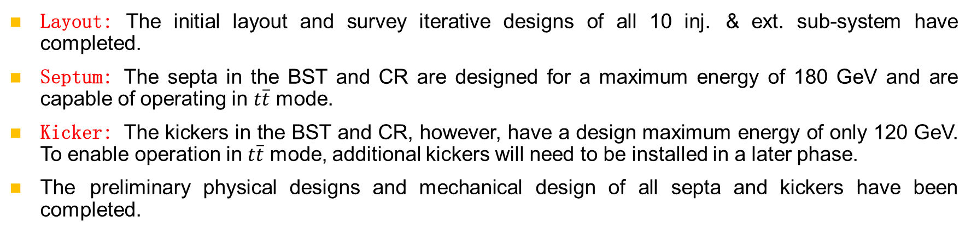
Overall progress status of CEPC EDR
Layout: The initial layout and survey iterative designs of all 10 inj. & ext. sub-system have completed.
Septum: The septa in the BST and CR are designed for a maximum energy of 180 GeV and are capable of operating in $t\overline{t}$ mode.
Kicker: The kickers in the BST and CR, however, have a design maximum energy of only 120 GeV. To enable operation in $t\overline{t}$ mode, additional kickers will need to be installed in a later phase.
The preliminary physical designs and mechanical design of all septa and kickers have been completed.
Due to time constraints, this presentation will focus only on the layout design of the CR on-axis swap-out injection subsystem dedicated for Higgs energy mode operation.

Slide 8
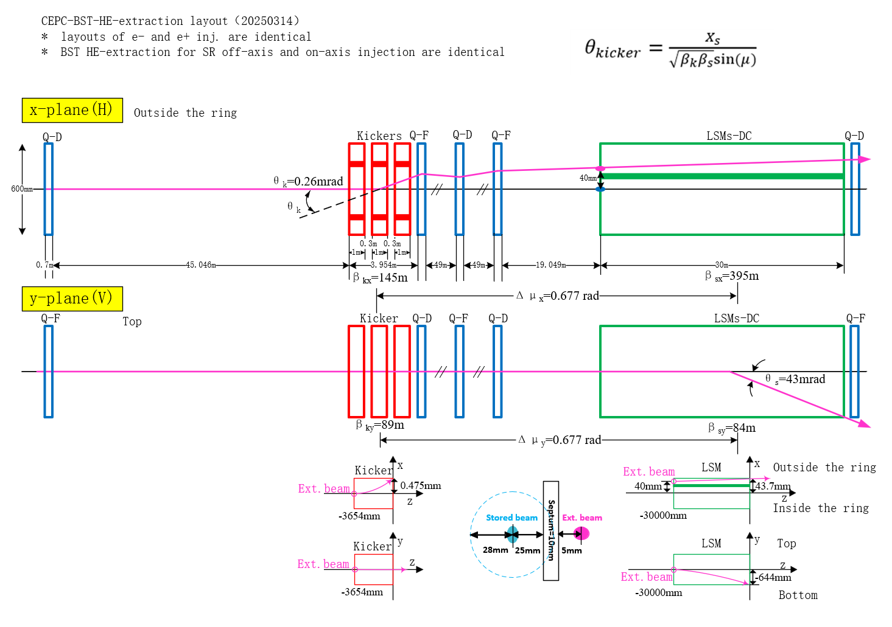
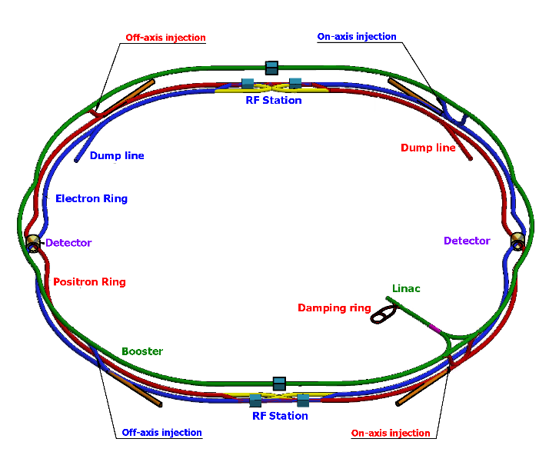
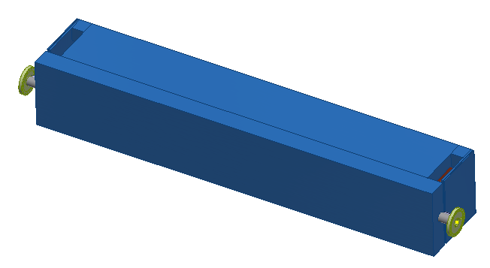
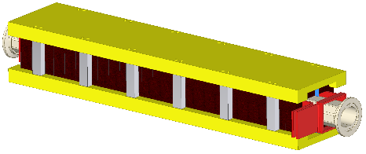
Booster extraction for CR on-axis injection

Slide 9
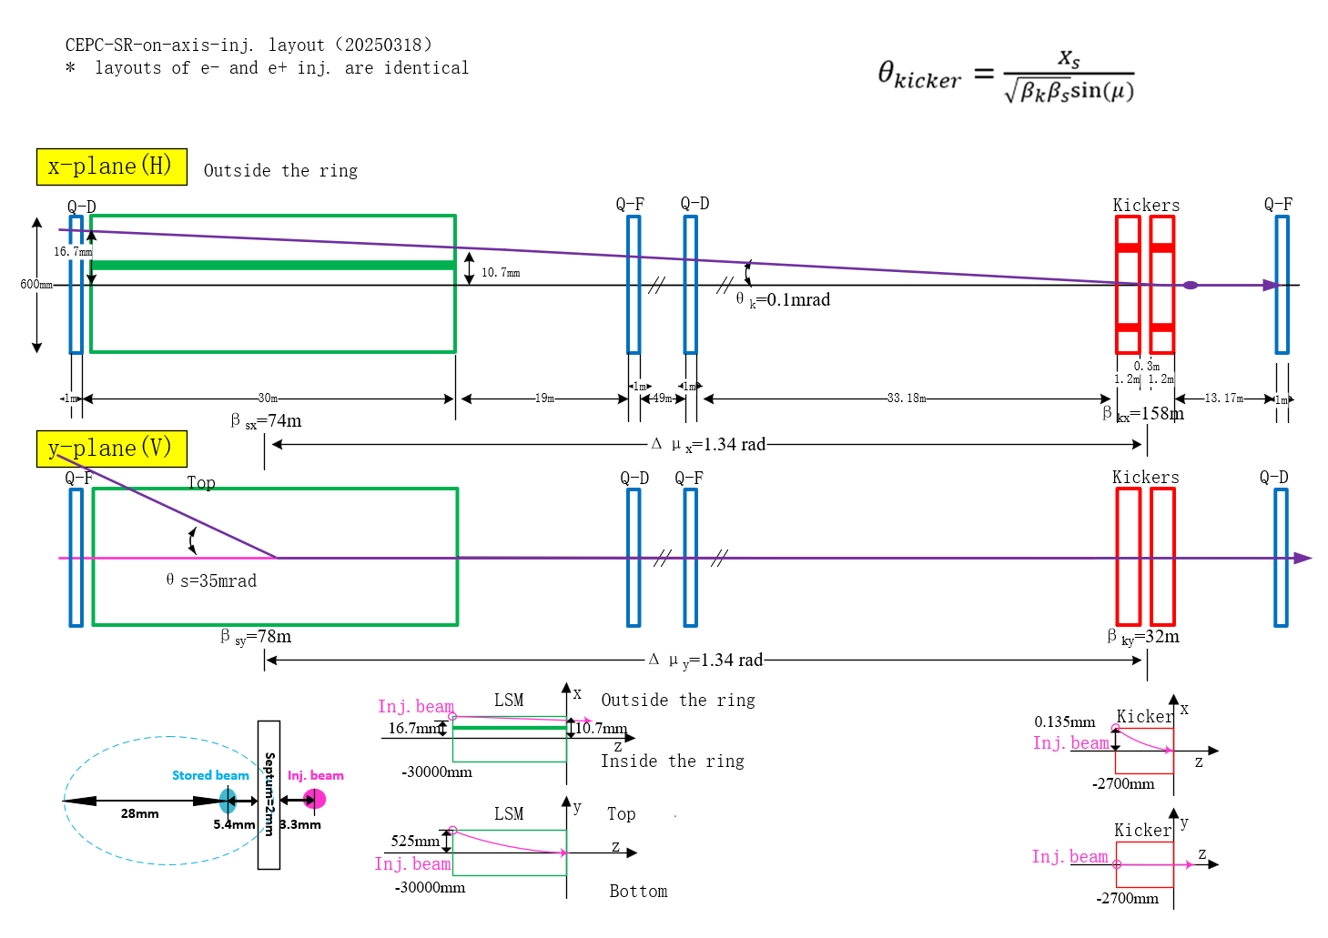

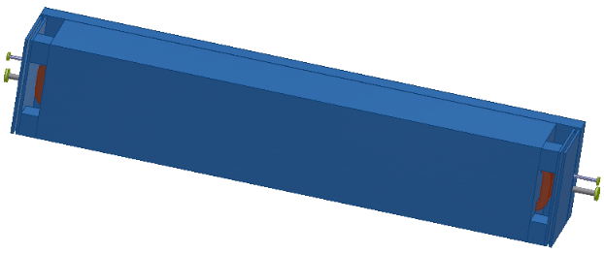
Collider on-axis injection

Slide 10
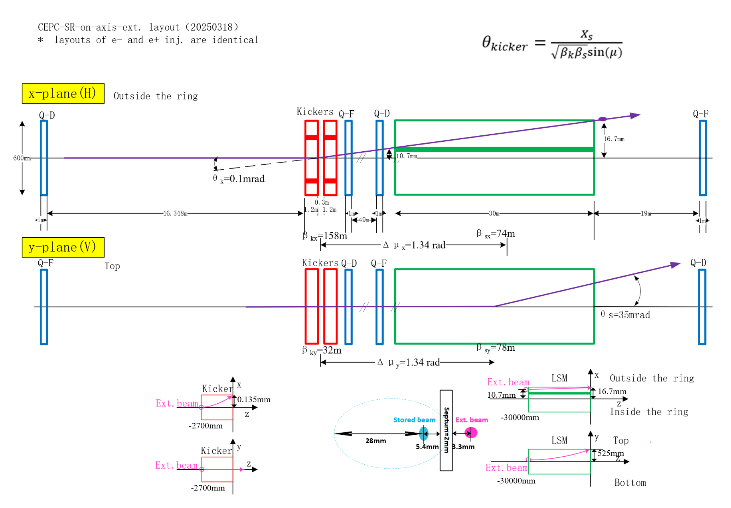
Collider on-axis extraction

Slide 11
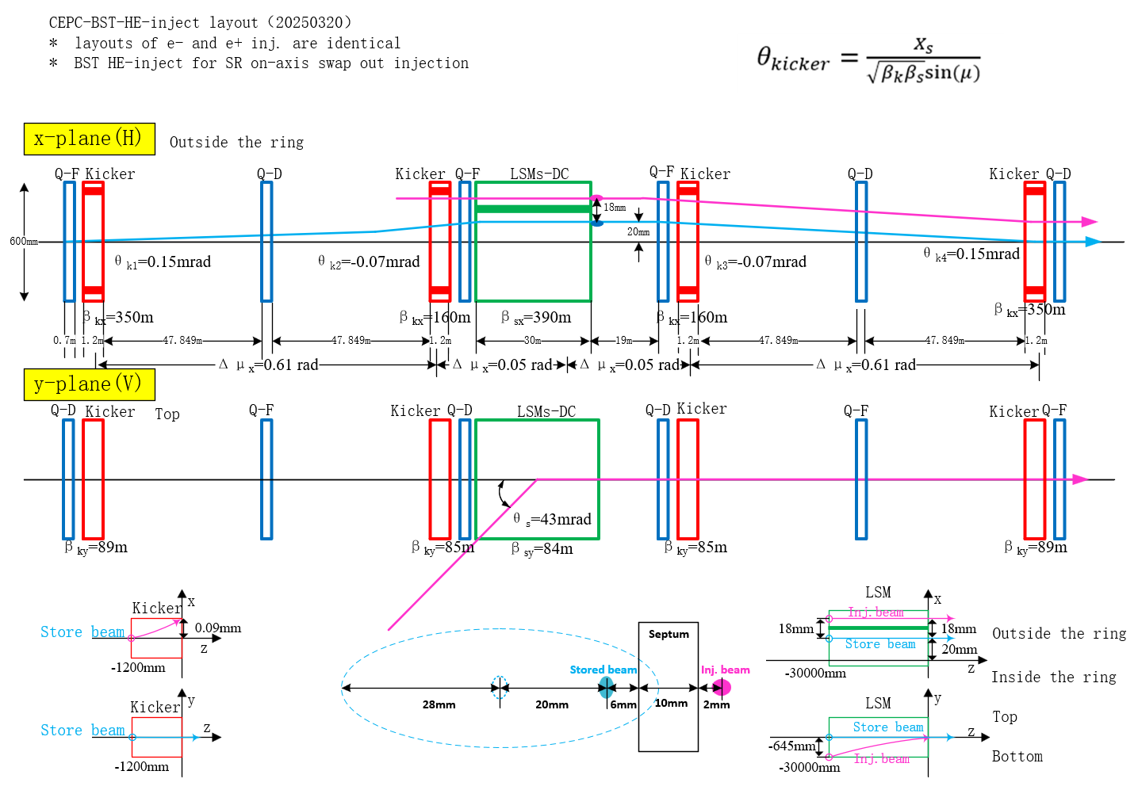
Booster re-injection from SR

Slide 12
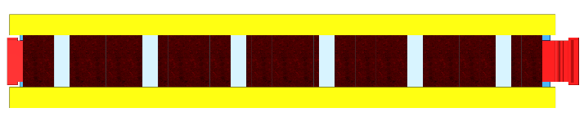

Kickers for BST extraction
1200mm
300mm
1200mm
300mm
1200mm
4.2m
Ext. point
LSMs for BST extraction
400mm
Stored beam
510mm
110mm
Ext. beam
2600mm
620mm
22.94m
LSMs for CR on-axis injection
Inj. point
Inj beam
110mm
400mm
400mm
130mm
150mm
400mm
Stored beam
2200mm
620mm
1940mm
410mm
300mm
23.58m
Kickers for CR on-axis injection
1200mm
300mm
1200mm
2.7m

Slide 13
3 Kicker system EDR design update
Contributed by Lei Wang，Hua Shi and Guanjian Wu

Slide 14
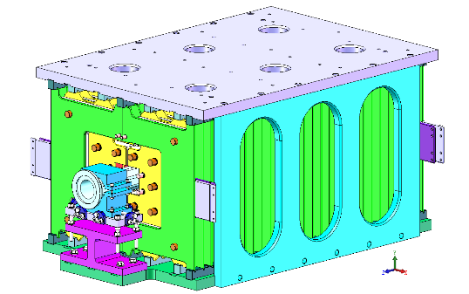

Kickers for CEPC injection & extraction
Type | Magnetic strength（T） | Quantity(e+/e-)
Slotted-pipe kicker | 0.02095 | 2
Strip-line kicker | / | 6
In-air delay-line dipole kicker | 0.04 | 10
 | 0.02 | 12
In-air lumped parameter dipole kicker | 0.035 | 10
 | 0.02 | 12
Total |  | 52
Slotted-pipe kicker
Strip-line kicker
Delay-line kicker
Lumped ferrite-core kicker

Slide 15
1）Slotted-pipe kicker for DR inj. & ext. system
parameter | Unit | CEPC-DR-kicker | HEPS-BST-kicker
Quantity | - | 1+1 | 1+3
Type | - | Slotted-pipe kicker | Slotted-pipe kicker
Deflect direction | - | Vertical | Vertical
Beam Energy | GeV | 1.1 | 0.5/6
Deflect angle | mrad | 8 | 9.104/1.75
Magnetic effective length | m | 1.4 | 0.8/1.4
Magnetic strength | T | 0.02095 | 0.02/0.025
Integral magnetic strength | T·m | 0.0293 | 0.016/0.035
Clearance region(H×V) | mm | 30×20 | 22×28/30×28
Good field region(H×V) | mm | 19.8×16 | 12×16/12×10
Field uniformity in good field region | - | ±1.5% | ±1%
Repetition rate | Hz | 100 | 50
Amplitude repeatability | - | ±0.5% | ±0.5%
Pulse jitter | ns | ≤5 | ≤5
Bottom width of pulse(5%-5%) | ns | < 250 | < 300
The slotted-pipe kicker for CEPC DR is very similar to HEPS booster injection kicker.

Slide 16
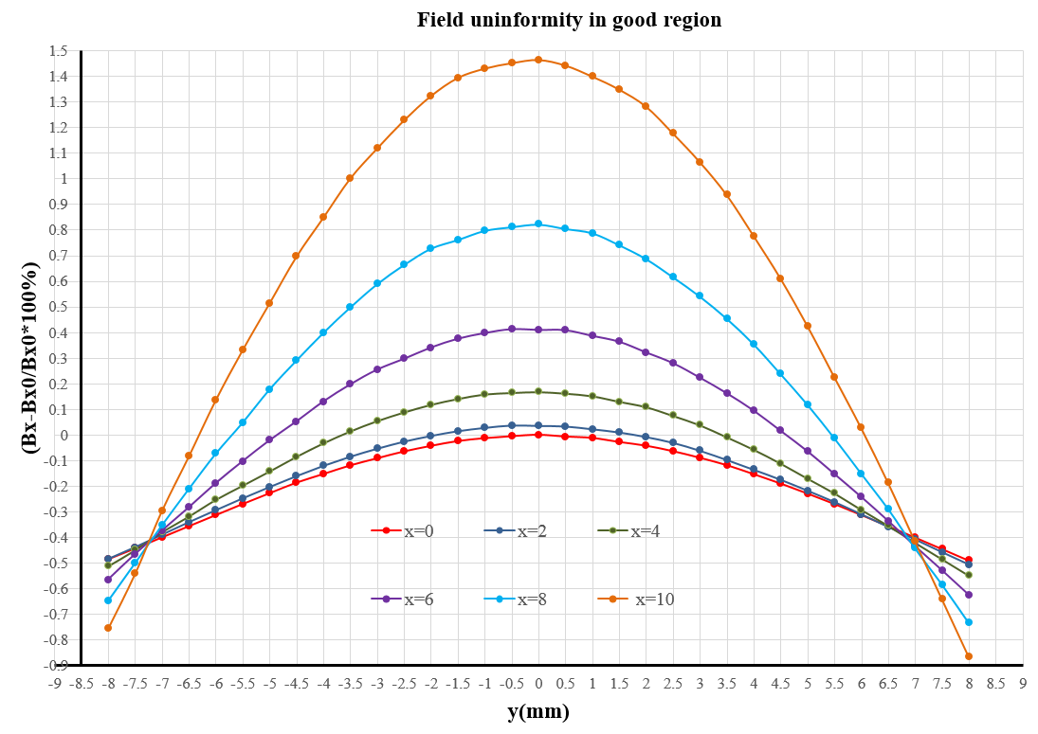
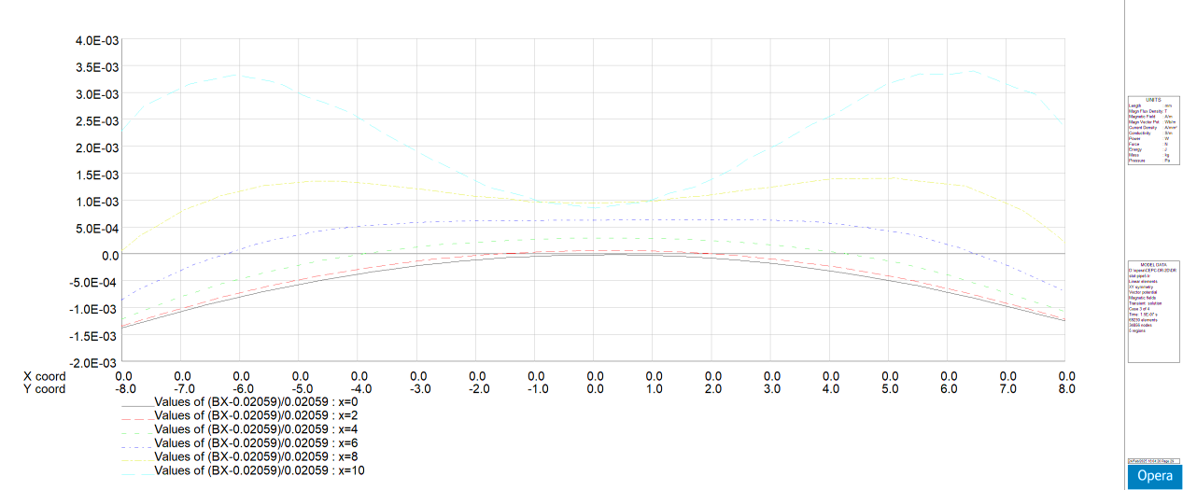
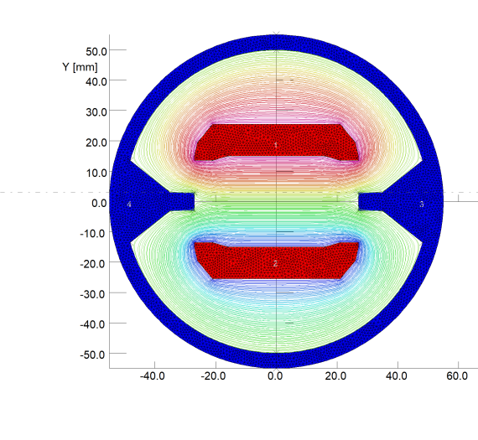
Physics design of slotted-pipe kicker for CEPC DR
Un.= -0.9%~1.5%
Range：x=±10mm, y=±8mm
TDR
Good field region
19.8×16mm
Un.= -0.5%~0.5%
Range: x=±10mm, y=±8mm
EDR
Good field region
19.8×16mm
2D simulation model

Slide 17
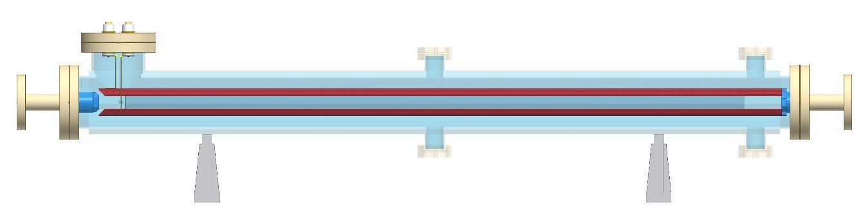
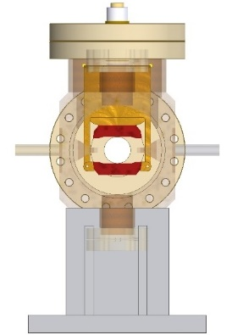
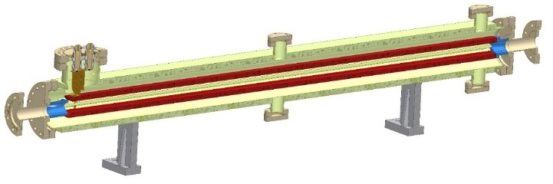
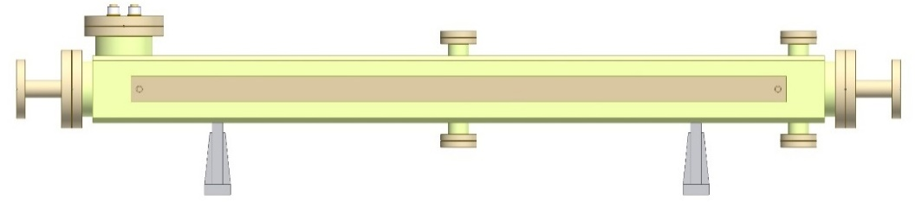
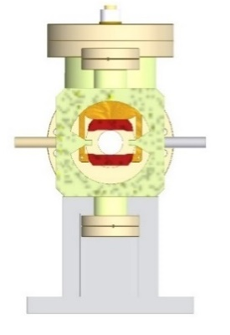

Engineer design of slotted-pipe kicker for CEPC DR
Features：the both electrodes are electrical connected to the vacuum chamber at up-stream end, which is at ground potential. This feature is good for beam impedance. However, the kicker must be excited by a bipolar pulsed power supply.
Design parameters | unit | value
Maximum voltage of coil | kV | 10.8
Maximum exciting current | kA | 2.45
Inductance of magnet coil | nH | 350
Good field region（H×V） | mm | 19.8×16
Field uniformity | - | -0.9%~1.5%
Magnetic effective length | mm | 1400
Total length | mm | 1700
- +
1700 mm
200 mm
buses
400 mm
feedthrough

Slide 18
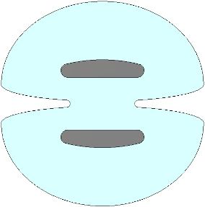
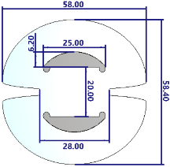
2) Strip-line kicker for BST LE injection
parameter | Unit | CEPC-BSTLEIK | HEPS-TF kicker prototype | HEPS-SR-kicker
Quantity | - | 3 ×2 | - | 5×2
Type | - | Strip-line kicker | Strip-line kicker | Strip-line kicker
Deflect direction | - | Vertical | Vertical | Vertical
Beam Energy | GeV | 30 | 6 | 6
Deflect angle of each magnet | mrad | 0.0366(total 0.11) | - | 0.32
Effective Length of Strip-line kicker electrode | mm | 1000 | 750 | 300
Gap between two electrodes | mm | 20 | 10 | 8
Odd mode impedance | Ω | 50±1 | 50±1 | 50±1
Even mode impedance | Ω | <65 | <65 | <65
Clearance region(H×V) | mm | 20×13 | - | -
Good field region(H×V) | mm | 10×12 | x=±2.3，y= ±1 | x=±1.1，y= (-0.85, 2.1)
Integral field uniformity | - | ±1.5% | <±1% | <±1%
Amplitude of electrical pulse（into 50Ω） | kV | ±10 | ±18 | ±15
Repetition rate | Hz | 100 | 50 | 50
Amplitude repeatability | - | <2% (RMS) | <2% (RMS) | <2% (RMS)
Pulse jitter | ns | ≤1 | ≤0.1 | ≤0.1
Bottom width of electrical pulse（3%-3%） | ns | < 43.3 | < 10 | < 10
More flexible bunch filing patterns are achieved by using faster pulse kickers.
The strip-line kicker for CEPC BST LE injection is very similar to HEPS-TF kicker prototype.
The gap between 2 electrodes decreased in EDR from 44mm to 20mm.
44mm
20mm
TDR
EDR

Slide 19
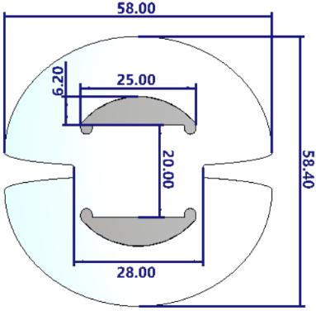
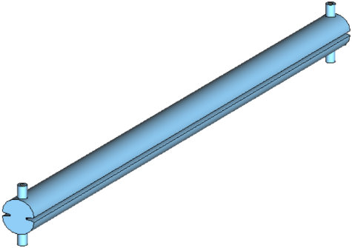
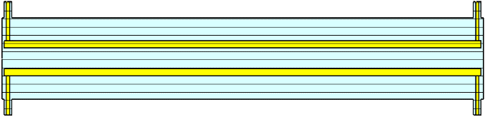
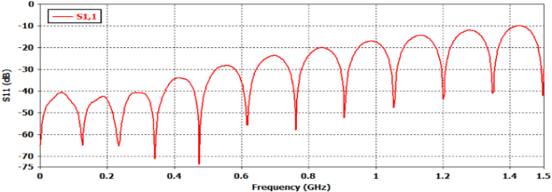
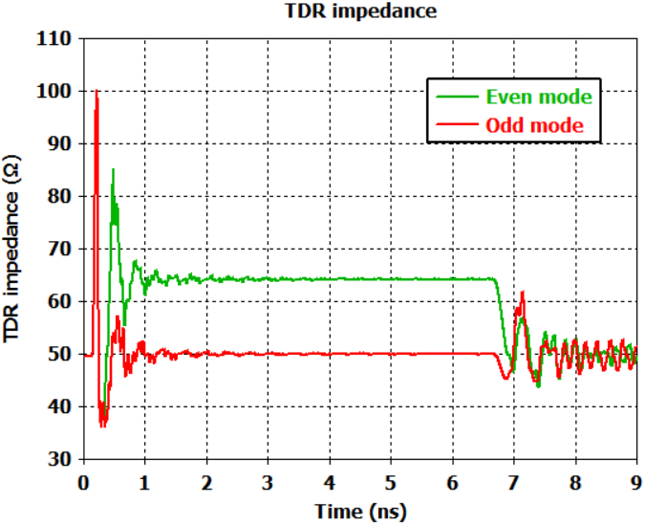
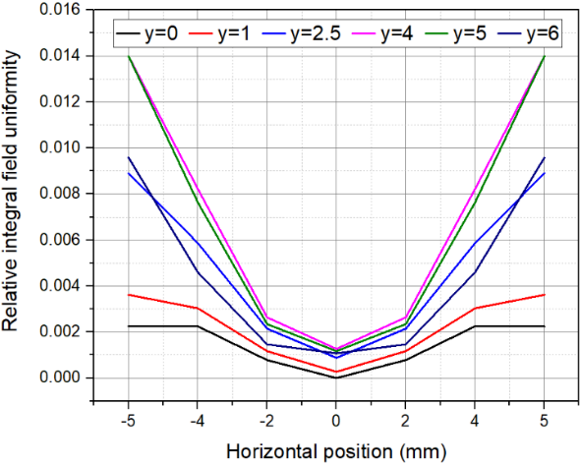
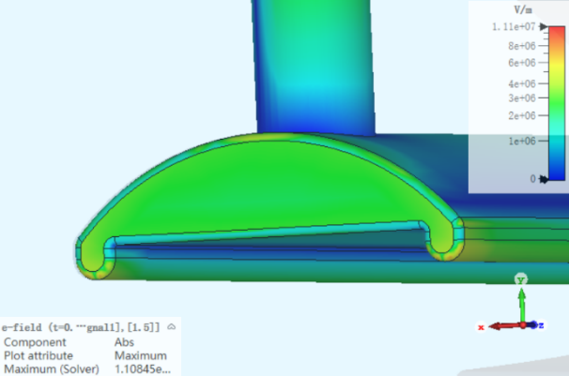
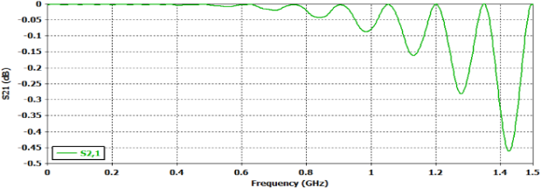
Physics design of Strip-line kicker for CEPC
Length：To realize injection bunch by bunch(τ=25ns), the strip-line electrode length=1m, electrical pulse width 6.7ns< t_{p} <43.3ns（Flat-top t_{top} >6.7ns ，Rise/fall Time t_{r}/t_{f} <18.3ns）
Distance: Minimum distanced of blades is d=20mm, which determined by beam clearance. Voltage between blades=10kV.
Blades：To achieve highest geometric factor(g=0.966) the blade width should be w=25mm. Blade thickness=6.2mm.
Outer body: distance between vanes =28mm
Impedance: Odd-mode impedance Z_{odd}=50Ω, even-mode impedance Z_{even}=64.3Ω
50Ω co-axis feedthrough，d/D=7/16mm
7mm
16mm
2D-geometry
Unit : mm
CST-3D
1000mm
1010mm
8mm
S11
TDR
Field distribution
E_{max}=11.1MV/m @ excited pulse peak=±10kV
S-parameter
Impedance mismatching
（from feedthrough to blade）
S21
Pulse bandwidth：300MHz

Slide 20
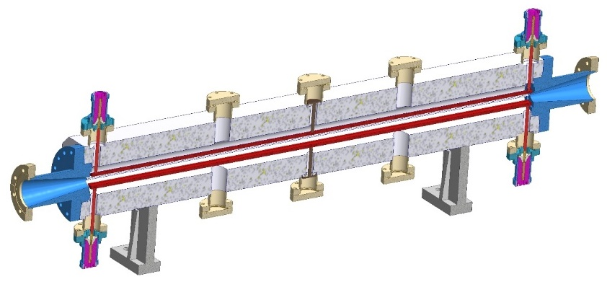
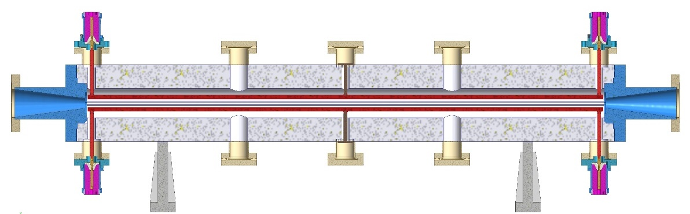
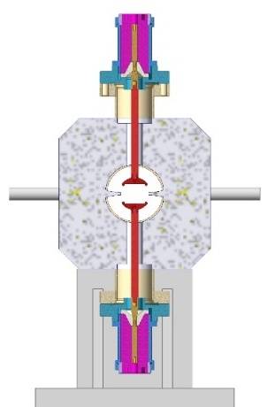

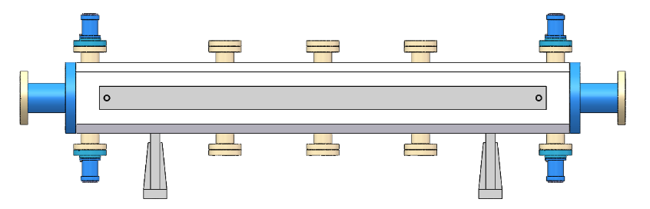
Engineer design of strip-line kicker
1300 mm
460 mm
1000 mm
260 mm
1300 mm
300 mm
4500 mm

Slide 21
3) Delay-line kickers for CR off-axis inj. and ext. to dump
parameter | Unit | BST-ext-kicker1 （for CR off-axis inj.） | BST-dump kicker | CR-inj-kicker1 （for CR off-axis inj.） | CR-dump kicker
Type | - | In-air delay-line dipole kicker
Deflect direction | - | Horizontal | Vertical | Horizontal | Vertical
Quantity(e+/e-) |  | 3×2 | 2×2 | 4×2 | 2×2
Beam Energy | GeV | 120 | 120 | 120 | 120
Deflect angle of each magnet | mrad | 0.0866× 3 | 0.05×2 | 0.1×2+0.024×2 | 0.05×2
Magnetic effective length | m | 1 | 1 | 1 | 1
Magnetic strength | T | 0.035 | 0.02 | 0.04 | 0.02
Integral magnetic strength | T·m | 0.035 | 0.02 | 0.04 | 0.02
Clearance region(H×V) | mm | 20×13 | 20×13 | 50×15 | 13×10
Good field region(H×V) | mm | 20×13 | 20×13 | 20×13 | 13×10
Field uniformity in good field region | - | ±1.5% | ±1.5% | ±1.5% | ±1.5%
Repetition rate | Hz | 1k | - | 1k | -
Amplitude repeatability | - | ±0.5% | ±0.5% | ±0.5% | ±0.5%
Pulse jitter | ns | ≤5 | ≤5 | ≤5 | ≤5
Bottom width of pulse(5%-5%) | ns | Trapezoid：440~2420 | Trapezoid：330000 | Trapezoid：440~2420 | Trapezoid：330000
Tr/Tf(5%-95%) | ns | <200 | <200 | <200 | <200
40~2000ns
1kHz
200ns
200ns
200ns
0.33ms

Slide 22

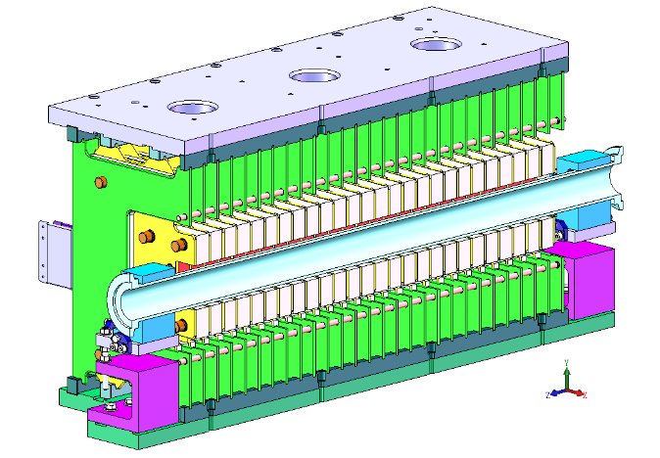
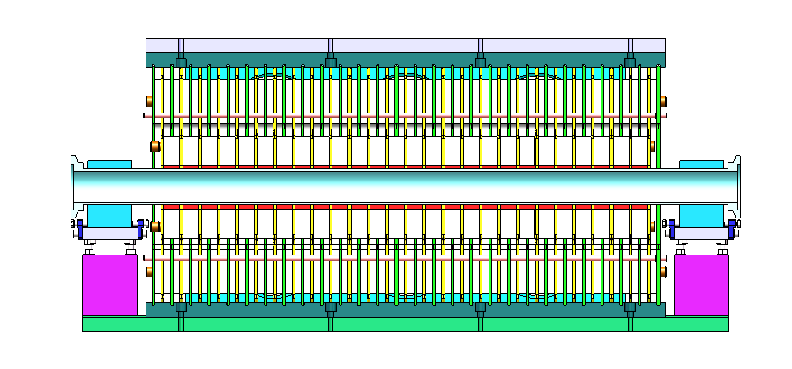
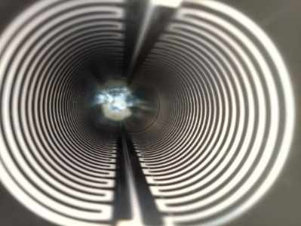
Delay-line kicker design for BST HE ext. and CR off-axis inj.
For trapezoid kicker system, a delay-line dipole kicker is preferred, because it can helps to achieve ideal trapezoid waveform. While, its structure is complicated.
Dual-C type magnet structure is adopted for CEPC.
Ceramic vacuum chamber with TiN-Ag ladder pattern film is applied due to in-air magnet structure.
Update: design a new delay-line kicker with ceramic dielectric to reduce the volume of magnet.
1kHz
440~2420ns
200ns
200ns
Delay-line dipole kicker and pulser Parameter | Value
Aperture of magnet (mm) | 100 × 80
Longitudinal length of magnet cell (mm) | 36
Cell number of magnet | 26
Differential impedance of magnet (Ω) | 12.5
Length of magnet (mm) | 942
Total mechanical Length of magnet (mm) | 1018
Inductance of magnet cell (nH) | 56.6
Total inductance of magnet (nH) | 1471.6
Capacitance of magnet cell (pF) | 362
Total capacitance of magnet (nF) | 9.412
Magnetic strength (Gs) | 425
Exciting current of magnet (A) | 2703
Differential voltage of magnet (V) | +/-16895.5
Pulse waveform | trapezoid
Rise/fall time (ns) | 200
Flat-top width of pulse (ns) | 40~2000 adjustable
Filling time of magnet (ns) | 117.728
Rise/fall time of pulser (ns) | 80
Repetition rate (kHz) | 1
ceramic

Slide 23
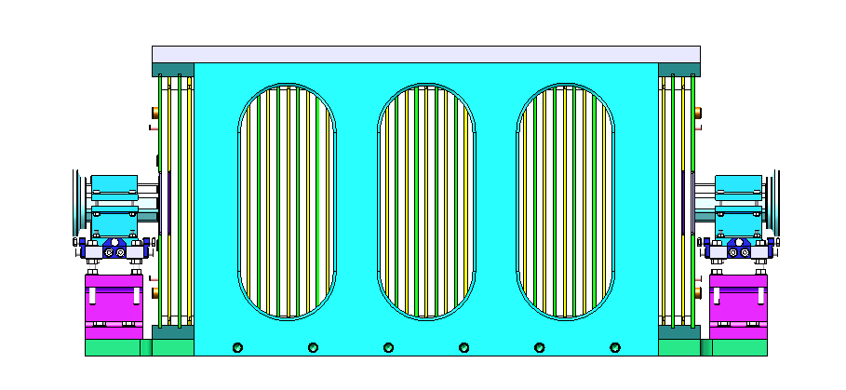
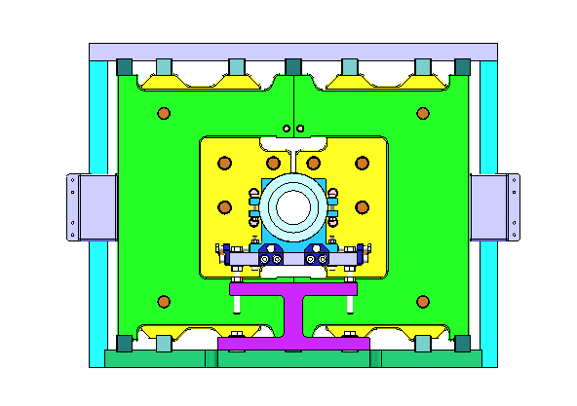
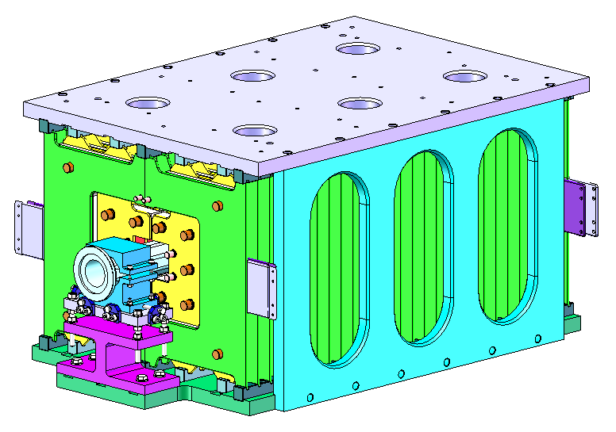

Engineer design of delay-line kicker
945.1mm
535mm
1216mm
1216mm
1216mm
1216mm
300mm
300mm
4.25m
*Graphene heat dissipation film is considered to adopted for the vacuum chamber cooling.

Slide 24
4) Lumped parameter kickers for CR on-axis inj.
parameter | Unit | BST-EXT-kicker2 （for CR on-axis inj.） | BST-HE-inj-kicker2 （for CR on-axis inj.） | CR-inj-kicker2 （for CR on-axis inj.） | CR-ext-kicker1 （for CR on-axis inj.）
Type | - | In-air lumped parameter dipole kicker
Deflect direction | - | Horizontal |  | Horizontal
Quantity(e+/e-) |  | 2×2 | 5(4)×2 | 2×2 | 2×2
Beam Energy | GeV | 120 | 120 | 120 | 120
Deflect angle of each magnet | mrad | 0.05×2 | 0.087+0.068×2+0.065×2 | 0.05×2 | 0.05×2
Magnetic effective length | m | 1 | 1 | 1 | 1
Magnetic strength | T | 0.02 | 0.035 | 0.02 | 0.02
Integral magnetic strength | T·m | 0.02 | 0.035 | 0.02 | 0.02
Clearance region(H×V) | mm | 20×13 | 50×15 | 13×10 | 13×10
Good field region(H×V) | mm | 20×13 | 20×13 | 13×10 | 13×10
Field uniformity in good field region | - | ±1.5% | ±1.5% | ±1.5% | ±1.5%
Repetition rate | Hz | 1k | 1k | 1k | 1k
Amplitude repeatability | - | ±0.5% | ±0.5% | ±0.5% | ±0.5%
Pulse jitter | ns | ≤5 | ≤5 | ≤5 | ≤5
Bottom width of pulse(5%-5%) | ns | Half-sine：1360 | Half-sine：1360 | Half-sine：1360 | Half-sine：1360
Tr/Tf(5%-95%) | ns | <680 | <680 | <680 | <680
1360ns,1kHz

Slide 25



lumped parameter kicker design for BST HE ext/reinj. & CR on-axis inj.
As for 1.3us half-sine wave kicker system, the lumped parameter type kicker is adopted, because of its simpler structure and lower cost.
The kicker magnet with ferrite core is preferred due to its higher exciting efficiency.
Ceramic vacuum chamber with TiN-Ag continuous film is applied due to in-air magnet structure.
Lumped dipole kicker Parameter | Value
Magnetic field B (T) | 0.04
Inner aperture of ceramic vacuum chamber (mm×mm) | 56×56
Ceramic vacuum chamber outer aperture (mm×mm) | 85×66
Magnet aperture w × h (mm×mm) | 100×80
Length of magnet l (m) | 1
Inductance of magnet L (μH) | 1.6
Magnet exercitation current I (kA) | 2.6
Impedance Z (Ω) | 3.7
Voltage of magnet U (kV) | 9.62
Pules bottom width τ (ns) | 1360
Repetition rate（Hz） | 1000
HV conductor
Ferrite core
Ceramic vacuum chamber
Ceramic support components
x=±15, y=±15
Un.= -0.2%~0.2%
<1360ns,1kHz

Slide 26


Engineer design of lumped-parameter kicker
250 mm
1200 mm
320 mm
1200mm
300mm
1200mm
300mm
1200mm
4.2m
*Graphene heat dissipation film is considered to adopted for the vacuum chamber cooling.

Slide 27
4 Septum magnets EDR design update
Contributed by Lihua Huo

Slide 28

Transport lines and septa for inj.&ext. system
Transport line：14
Inj&ext sub-system：10×2=20
Type of LSMs：in-air and half-in-vacuum
Total quantity of septa: 134
EDR Design progress:
physical models: 23
Mechanical models: 102
Transport line |  | Inj.&ext sub-systems |  | Septa model | Quantity
[1] | Lianc to DR e+ (LD） | 1 | Damping ring inj and ext | LSM (in-air) | 1
[2] | DR to Linac e+(DL) | 2 |  |  | 1
[3] | Linac to BST e+(LBP ) | 3 | Booster Low energy inj | LSM (in-air) | 3
[4] | Linca to BST e-(LBE) | 4 |  |  | 3
[5] | BST to CR e+ off-axis inj (BCFP) | 5 | Booster e+ ext (off-axis) | LSM (in-air) | 7
 |  | 6 | Collider e+ inj（off-axis） | LSM1 (in-vac) | 4
 |  |  |  | LSM2 (in-air) | 4
[6] | BST to CR e- off-axis inj (BCFE) | 7 | Booster e- ext（off-axis） | LSM (in-air) | 7
 |  | 8 | Collider e- inj（off-axis） | LSM1 (in-vac) | 4
 |  |  |  | LSM2 (in-air) | 4
[7] | BST to CR e+ on-axis inj (BCNP) | 9 | Booster e+ ext（on-axis） | LSM (in-air) | 7
 |  | 10 | Collider e+ inj（on-axis） | LSM1 (in-vac) | 5
 |  |  |  | LSM2 (in-air) | 4
[8] | BST to CR e- on-axis inj (BCNE) | 11 | Booster e- ext（on-axis） | LSM (in-air) | 7
 |  | 12 | Collider e- inj（on-axis） | LSM1 (in-vac) | 5
 |  |  |  | LSM2 (in-air) | 4
[9] | CR to BST e+ (CBP) | 13 | Booster e+ high energy inj（on-axis） | LSM (in-air) | 8
 |  | 14 | Collider e+ ext to Booster（on-axis） | LSM1 (in-vac) | 5
 |  |  |  | LSM2 (in-air) | 4
[10] | CR to BST e- (CBE) | 15 | Booster e- high energy inj（on-axis） | LSM (in-air) | 8
 |  | 16 | Collider e- ext to Booster（on-axis） | LSM1 (in-vac) | 5
 |  |  |  | LSM2 (in-air) | 4
[11] | BST to Dump e+ (BDPP) | 17 | Booster ext to dump | LSM (in-air) | 7
[12] | BST to Dump e- (BDPE) | 18 |  |  | 7
[13] | CR to Dump e+ (CDPP) | 19 | Collider ext to dump | LSM (in-air) | 8
[14] | CR to Dump e- (CDPE) | 20 |  |  | 8
 |  |  |  | Total: | 134

Slide 29
Physical requirements of all LSMs for CEPC
Subsystem | DR inj&ext | BST LE inj | BST HE ext. (off-axis) | BST HE ext. (on-axis) | BST HE re-injection | BST ext. to dump | CR off-axis injection | CR on-axis injection | CR on-axis extraction | CR ext. to dump
Operation mode | Z, W, Higgs, tt | Z, W, Higgs, tt | Z, W, Higgs, tt |  | Higgs, tt | Z, W, Higgs, tt | Z, W, Higgs, tt | Higgs, tt |  | Z, W, Higgs, tt
Max Energy （GeV） | 1.1 | 30 | 180 |  | 180 | 180 | 180 | 180 |  | 180
Deflection direction | Horizontal | Horizontal | Vertical |  | Vertical | Horizontal | Vertical | Vertical |  | Horizontal
Total Integral field strength of septa (T-m) | 0.44 | 4.5 | 12.6 |  | 12 | 12.6 | 11.68 | 11.6 |  | 12
Total deflection angle (m rad) | 120 | 45 | 21 |  | 20 | 21 | 20 | 20 |  | 20
Deflection Radium (m) | 4.167 | 133.333 | 800 |  | 800 | 800 | 800 | 800 |  | 800
Magnetic field strength for injected/extracted beam (T) | 0.88 | 0.75 | 0.75 |  | 0.75 | 0.75 | 0.7/0.75 | 0.7/0.75 |  | 0.75
Total magnetic length (m) | 0.5 | 6 | 16.8 |  | 16 | 16.8 | 16 | 16 |  | 16
Septum thickness (incl. septum board, inj./ext. beam pipe wall, installation gap) (mm) | 6 | 10 | 10 |  | 10 | 5 | 2/3.5 | 2/3.5 |  | 5
Clearance of inj. & ext. beam at Lambertson (H×V) (w.r.t. inj. & ext. beam orbit) (mm) | 30 × 22 | 30 ×30 | 10×5 |  | 10×5 | 10×10 | 9.2×4 | 6.6×4 |  | 7×6
Field uniformity in clearance of inj. & ext. beam | < ±0.05% | < ±0.05% | < ±0.05% |  | < ±0.05% | < ±0.05% | < ±0.05% | < ±0.05% |  | < ±0.05%
Clearance of stored beam at Lambertson (H×V) (w.r.t. stored beam orbit) (mm) | 22 × 11 | 30 ×50 | 50 × 50 |  | 50 × 50 | 30 × 20 | 50 × 10 | 20 × 10 |  | 20 × 10
Integral leakage magnetic field / Integral main magnetic field | ≤ 1×10-3 | ≤ 1×10-3 | ≤ 1×10-3 |  | ≤ 1×10-3 | ≤ 1×10-3 | ≤ 1×10-3 | ≤ 1×10-3 |  | ≤ 1×10-3
The leakage magnetic field position from septum plate in circulating tube (mm) | 11 | 25 | 25 |  | 25 | 25 | 20 | 5.4 |  | 25
Magnet pole
Magnet pole
Magnet pole
Wall of stored beam pipe
+
Wall of injected beam pipe
+
Iron septum
+
installation margins
Installation margin
Installation margin
Installation margin
Injected bunch
Injected bunch
Injected bunch
Septum
thickness
SS
=
Installation margin
Yoke
Yoke
Yoke
Stored bunch
Stored bunch
Stored bunch
Iron or VP(FeCoV，1J22)
SS
In-air（septum≥3.5mm）
Half in-vacuum（septum=2mm）
Traditional LSM

Slide 30


Preliminary magnet physical design of LSMs
2D simulation model with total thickness of septum ：5.5mm
Wall thickness of injected beam pipe：1mm
Iron septum（DT4）：3mm
Installation margin of stored beam pipe：0.5mm
Wall thickness of stored beam pipe：1mm
Conclusions：
If main field=1T，the shielding structure don’t meet requirements with any materials
If main field=0.9T， the shielding structure do meet requirements with DT4 vacuum chamber
If main field=0.8T， the shielding structure do meet requirements with any materials
1mm
3mm
5.5mm
0.5mm
1mm
down stream
up stream
The main field strength is preferred less than 0.8T
 | Material of stored beam pipe | Air (Stainless Steel or copper) |  |  | 1J77A |  |  | DT4 |  |  | 1J22
Down stream | Main field By (T) | 0.80 | 0.89 | 0.999 | 0.8007 | 0.900 | 1.011 | 0.8010 | 0.903 | 1.023 | 1.027
 | Leakage field By (T） | 5.06E-04 | 4.69E-03 | 1.51E-02 | 1.07E-06 | 1.53E-03 | 1.10E-02 | 2.52E-05 | 2.76E-04 | 5.94E-03 | 4.46E-03
 | Leakage field Bx (T） | 3.03E-07 | -1.99E-06 | -1.76E-05 | 2.57E-10 | -5.76E-06 | 6.33E-04 | 4.89E-09 | 6.06E-04 | 6.66E-04 | 6.78E-04
 | Leakage field By/main field By | 6.33E-04 | 5.25E-03 | 1.51E-02 | 1.34E-06 | 1.70E-03 | 1.08E-02 | 3.15E-05 | 2.76E-04 | 5.94E-03 | 4.46E-03
Up stream | Main field By (T) | 0.80 | 0.905 | 1.037 | 0.8007 | 0.905 | 1.039 | 0.8010 | 0.905 | 1.040 | 1.040
 | Leakage field By (T） | 5.06E-04 | 8.39E-04 | 5.89E-03 | 1.07E-06 | 3.63E-06 | 1.58E-03 | 2.52E-05 | 2.99E-05 | 4.27E-04 | 2.63E-04
 | Leakage field Bx (T） | 3.03E-07 | 2.45E-04 | -5.83E-03 | 2.57E-10 | 2.13E-06 | -2.22E-03 | 4.89E-09 | -3.37E-04 | -1.25E-03 | -1.10E-03
 | Leakage field By/main field By | 6.33E-04 | 9.26E-04 | 5.68E-03 | 1.34E-06 | 4.01E-06 | 1.52E-03 | 3.15E-05 | 3.30E-05 | 4.11E-04 | 2.53E-04
Data In red represent not meeting requirements

Slide 31




Preliminary mechanical design of LSM
400mm
The mechanical length of a single magnet is must less than 2.7 meters, mainly considering the following points:
Machining and manufacturing capability of the magnet core(solid iron + deep hole drilling)
Assembly and alignment errors of the magnet
Weight considerations for individual magnets
Processing, assembly and vacuum achievement of beam pipes
Measurement of the magnetic field (Hall point measurement)
injected beam pipe：Idφ=30mm/
Thickness=0.7mm
360mm
stored beam pipe:
Idφ=56mm
Thickness=1mm
down stream of LSM
2500mm
down stream flange
2700mm
2940mm
up stream flange

Slide 32
Magnet designs of all of LSMs for CEPC
Sub-system | DR inj&ext | BST LE inj | BST ext. (on-axis) | BST ext. (off-axis) | BST HE re-inj. | BST ext. to dump | CR off-axis inj. |  | CR on-axis inj. |  | CR on-axis ext. |  | CR ext. to dump
Type | H-in air | H-in air | V-in air | V-in air | V-in air | H-in air | V-in vac | V-in air | V-in vac | V-in air | V-in vac | V-in air | H-in air
Thickness of septum(mm) | 6 | 10 | 10 | 10 | 10 | 5 | 2 | 3.5 | 2 | 3.5 | 2 | 3.5 | 5
Quantity per group | 1 | 3 | 7 | 7 | 8 | 7 | 4 | 4 | 5 | 4 | 5 | 4 | 8
Deflection angle (m rad) | 120 | 15 | 3 | 3 | 2.5 | 3 | 2 | 3 | 2 | 2.5 | 2 | 2.5 | 2.5
Gap of magnet(mm) | 20 | 36 | 20 | 20 | 15 | 20 | 20 | 20 | 15 | 15 | 15 | 15 | 15
Integral main field strength (T*mm) | 440 | 1500 | 1800 | 1800 | 1500 | 1800 | 1120 | 1800 | 1120 | 1500 | 1120 | 1500 | 1500
Field strength of magnet (T) | 0.88 | 0.75 | 0.75 | 0.75 | 0.75 | 0.75 | 0.7 | 0.75 | 0.7 | 0.75 | 0.7 | 0.75 | 0.75
Magnetic effective length (mm) | 500 | 2000 | 2400 | 2400 | 2000 | 2400 | 1600 | 2400 | 1600 | 2000 | 1600 | 2000 | 2000
Main field uniformity | ≤±0.05% | ≤±0.05% | ≤±0.05% | ≤±0.05% | ≤±0.05% | ≤±0.05% | ≤±0.05% | ≤±0.05% | ≤±0.05% | ≤±0.05% | ≤±0.05% | ≤±0.05% | ≤±0.05%
Integral leakage field/main field | ≤0.1% | ≤0.1% | ≤0.1% | ≤0.1% | ≤0.1% | ≤0.1% | ≤0.1% | ≤0.1% | ≤0.1% | ≤0.1% | ≤0.1% | ≤0.1% | ≤0.1%
Size of coil wire (mm) | 7x7 Ø4 | 7x7 Ø4 | 7x7 Ø4 | 7x7 Ø4 | 7x7 Ø4 | 7x7 Ø4 | 7x7 Ø4 | 7x7 Ø4 | 7x7 Ø4 | 7x7 Ø4 | 7x7 Ø4 | 7x7 Ø4 | 7x7 Ø4
Turn number of coil | 96 | 224 | 144 | 144 | 80 | 144 | 108 | 144 | 56 | 80 | 56 | 80 | 80
Resistance of coil (m Ω) | 68.25 | 519.73 | 519.73 | 519.73 | 170.69 | 375.8 | 195.78 | 375.8 | 99.55 | 173.69 | 99.55 | 173.69 | 170.69
Inductance of magnet(H) | 0.06 | 0.73 | 0.65 | 0.65 | 0.22 | 0.65 | 0.24 | 0.65 | 0.09 | 0.22 | 0.09 | 0.22 | 0.22
Voltage drop (V) | 10.04 | 50.12 | 31.94 | 31.94 | 19.54 | 31.32 | 20.3 | 31.32 | 14.93 | 19.54 | 14.93 | 19.54 | 19.54
Exciting current (A) | 147.17 | 96.43 | 85 | 85 | 112.5 | 83.33 | 103.7 | 83.33 | 150 | 112.5 | 150 | 112.5 | 112.5
Power consumption (kW) | 1.48 | 4.83 | 2.72 | 2.72 | 2.2 | 2.61 | 2.11 | 2.61 | 2.24 | 2.2 | 2.24 | 2.2 | 2.2
Current density of coil (A/mm²) | 4.14 | 2.71 | 2.39 | 2.39 | 3.16 | 2.34 | 2.92 | 2.34 | 4.22 | 3.16 | 4.22 | 3.16 | 3.16
Pressure of cooling water (kg/cm2） | 6 | 6 | 6 | 6 | 6 | 6 | 6 | 6 | 6 | 6 | 6 | 6 | 6
Number of water channel | 4 | 14 | 12 | 12 | 10 | 12 | 9 | 12 | 7 | 10 | 7 | 10 | 10
Velocity of water flow (m/sec) | 3.1 | 1.34 | 1.47 | 1.47 | 2.07 | 1.47 | 1.82 | 1.47 | 2.32 | 2.07 | 2.32 | 2.07 | 2.07
Flow of water (ml/sec) | 0.31 | 0.23 | 0.22 | 0.22 | 0.26 | 0.22 | 0.21 | 0.22 | 0.2 | 0.26 | 0.2 | 0.26 | 0.26
Temperature rise (°C) | 2.26 | 4.91 | 2.92 | 2.92 | 2.02 | 2.8 | 2.45 | 2.8 | 2.62 | 2.02 | 2.62 | 2.02 | 2.02
Length of magnet (mm) | 700 | 2240 | 2600 | 2600 | 2200 | 2600 | 1940 | 2600 | 1940 | 2200 | 1940 | 2200 | 2200
Width of magnet (mm) | 440 | 580 | 450 | 450 | 410 | 440 | 481 | 450 | 444 | 380 | 444 | 380 | 400
Height of magnet (mm) | 340 | 500 | 440 | 440 | 400 | 450 | 580 | 440 | 580 | 400 | 580 | 400 | 410

Slide 33

Design example: LSMs for CR on-axis injection system
e+ inj region：9 sets of LSM
LSM1~LSM5：half-in-vac (septum=2mm)
LSM6~LSM8：in-air(septum=3.5mm)
Inj. beam
Stored beam
Length of straight section of inj. beam （mm）
L10 | LSM8 | L9 | LSM8 | L8 | LSM7 | L7 | LSM6 | L6 | LSM5 | L5 | LSM4 | L4 | LSM3 | L3 | LSM2 | L2 | LSM1 | L1
610 | 2000 | 820 | 2000 | 820 | 2000 | 820 | 2000 | 910 | 1600 | 750 | 1600 | 750 | 1600 | 750 | 1600 | 750 | 1600 | 600
Mode | Higgs | tt
Energy （GeV） | 120 | 180
Deflection direction | Vertical
Total Integral field strength of septa (T-m) | 7.733333 | 11.6
Total deflection angle (m rad) | 20
Deflection Radium (m) | 800
Magnetic field strength for injected/extracted beam (T) | 0.46667/0.5 | 0.7/0.75
Total magnetic length (m) | 16
Septum thickness (incl. septum board, inj./ext. beam pipe wall, installation gap) (mm) | 2/3.5
Clearance of inj. beam at Lambertson (H×V) (w.r.t. inj. beam orbit) (mm) | 6.6 x 4
Field uniformity in clearance of inj. beam | < ±0.05%
Clearance of stored beam at Lambertson (H×V) (w.r.t. stored beam orbit) (mm) | 20 x 10
Integral leakage magnetic field / Integral main magnetic field | ≤ 1×10⁻³
The leakage magnetic field position from septum plate in circulating tube (mm) | 5.4

Slide 34





The LSMs for CR on-axis injection
LSM1~LSM5: half-in-vacuum, septum=2mm
LSM6~LSM9: in-air, septum=3.5mm
Stored beam pipe(1J22)
LSM1-inj. point
LSM6 export
Inj. beam pipe
Wall thickness=0.7mm
316LSST
Coil
Vacuum chamber
LSM5-export
polar
Stored beam pipe
Wall thickness=0.7mm
316LSST

Slide 35










Physical design of the LSMs for CR on-axis injection
LSM8
LSM6
LSM5
LSM1
Half-in-vacuum
import
In-air
export
2D model in Opera
3D model in Opera

Slide 36









Mechanical design of LSMs for CR on-axis injection
Quantity per group | 5 | 4
Thickness of septum (mm) | 2 | 3.5
Deflection angle (m rad) | 2 | 2.5
Gap of magnet(mm) | 15 | 15
Integral main field strength (T*mm) | 1120 | 1500
Field strength of magnet (T) | 0.7 | 0.75
Magnetic effective length (mm) | 1600 | 2000
Main field uniformity | ≤±0.05% | ≤±0.05%
Integral leakage field/main field | ≤0.1% | ≤0.1%
Size of coil wire (mm) | 7x7 Ø4 | 7x7 Ø4
Turn number of coil | 56 | 80
Resistance of coil (m Ω) | 99.55 | 173.69
Inductance of magnet(H) | 0.09 | 0.22
Voltage drop (V) | 14.93 | 19.54
Exciting current (A) | 150 | 112.5
Power consumption (kW) | 2.24 | 2.20
Current density of coil (A/mm2) | 4.22 | 3.16
Pressure of cooling water (kg/cm2） | 6 | 6
Number of water channel | 7 | 10
Velocity of water flow (m/sec) | 2.32 | 2.07
Flow of water (ml/sec) | 0.20 | 0.26
Temperature rise (°C) | 2.62 | 2.02
Length of magnet (mm) | 1940 | 2200
Width of magnet (mm) | 444 | 380
Height of magnet (mm) | 580 | 400
LSM5
LSM6
LSM4
LSM7
LSM3
LSM8
LSM2
LSM1
LSM9
e+ injection

Slide 37
Layout of 9 LSMs in CR on-axis injection region
e+ inj region
Injection point
LSM9
LSM8
LSM7
LSM6
LSM5
LSM4
LSM3
LSM2
LSM1
Inj beam
Stored beam
3-400
4-2200
5-1940
400
4-150
400
300
≈23580mm
Injection point
e- injection
Inj beam
Stored beam

Slide 38

5 Inj. & ext. tech. demonstration in HEPS beam commissioning
High Energy Photon Source

Slide 39






Overview of injection & extraction system of HEPS
BTS: SR 6GeV injection system/WBS:AB-0102
(Bunch by bunch/for on-axis swap-out or longitudinal injection)
SR injection
STB: SR 6GeV extraction system/WBS:AB-0101
(Bunch by bunch/for on-axis swap-out injection)
SR extraction
STB: BST 6GeV injection system/WBS:AB-0203
(Pulsed local bump injection with 2 kickers )
BTS: BST 6GeV extraction system/WBS:AB-0201
(Bunch by bunch/fast extraction with 4 slow bumpers assisted)
BST re-injection
LTB: BST 0.5GeV injection system/WBS:AB-0202
(Bunch by bunch/on-axis /one turn injection )
BST extraction
Highlight feature:
SR on-axis swap-out top-up injection based on beam accumulating in the full-energy booster.
BST injection

Slide 40




Challenges of HEPS inj. & ext. system
Top-up injection physics solutions（due to small DA）:
short-term goal: on-axis swap-out injection with the full-energy BST as accumulating ring. (baseline)
Long-term goal: on-axis longitudinal injection with harmonic cavities.
SR injection & extraction system:
2 straight sections with length of only 6 meters applied to accommodate inj.&ext. components for 6 GeV beam manipulation.
Fast kicker system: 5-cell 300mm long strip-line kicker module with 8mm gap and super fast pulser with pulse bottom width of 10ns/4ns (3%-3%) ，±15kV peak voltage into 50Ω allowing to charge all the buckets.
Thin septum: Half-in-vacuum Lambertson magnet with septum as thin as 2mm，high vacuum achievement with small beam physic aperture.
BST injection & extraction system:
kicker system: slotted-pipe kicker with large physic aperture and fast pulser with pulse bottom width of 300ns (at least 600ns，10%-10%)，2.8kA peak current into 0.7μH to inject 10 (at least 5) bunches into the BST ring in a cycling period.
Thin septum: Lambertson magnet with thickness septum of 3.5mm
Slow bumper: half-sine wave pulse with bottom width of 1ms and consistent waveform (only for extraction subsystem)
RF=166MHz
6ns
6ns
10ns
4ns
On-axis swap-out injection
On-axis long. injection
Electrical pulse for fast kicker

Slide 41
Hardware for HEPS injection & extraction system
Hardware | Type | Quantity | Typical parameters | Features | Status
BST kicker magnet | Slotted-pipe kicker | 4+1 | 300ns/450ns/1us | In-vacuum | On-line operation
BST kicker pulser | Thyratron based | 4+1 | 300ns/450ns/1us | Made in house | On-line operation
BST bump magnet | Laminated core | 4 | 1ms | In-air | On-line operation
BST bumper pulser | IGBT based | 4 | 1ms | Made in house | On-line operation
BST septum magnet | Lambertson | 3 | Septum=3.5mm | In-air/DC | On-line operation
SR septum magnet | Lambertson | 2+1 | Septum=2mm | Half in-vacuum/DC | On-line operation
SR kicker | Strip-line kicker | 2 | 300mm/8mm/±15kV/V | 5-cell module | On-line operation
SR pre-ext. kicker | Strip-line kicker | 1 | 300mm/16mm/±8.4kV/H | In-vacuum | On-line operation
SR fast kicker pulser | DSRD+MOSFET based | 22 | 10ns/±17kV | Made in house | On-line operation
SR fast kicker pulser | FID based | 5 | 4ns/±20kV | Commercial | On-line operation
SR pre-dump kicker | Slotted-pipe kicker | 2 | 4.5us/half sine/H+V | In-vacuum | On-line
SR pre-dump kicker pulser | IGBT based | 2 | 4.5us/half sine | Made in house | Off-line test
Most of the hardware technologies are applied in the CEPC.

Slide 42






Milestone of inj. & ext. system installation and commissioning
2023/02/09: To complete 4 bumpers,BS1LSM,BS1K,BS2k,BS3K,BS4K installation
2023/06/06: To complete BS1K pulser installation and commissioning
2023/07/23: Success in BST 1st phase beam commissioning with BST LE injection system
2023/10/23: To complete BS2K,BS3K,BS4K,4 bumpers pulsers installation and commissioning
2023/12/18: To complete BS3LSM,BS4LSM installation
2024/05/17: Success in BST beam extraction commissioning
2024/05/29: To accept all hardware of SR inj.&ext. and enter final installation stage
2024/07/01: To complete vacuum connection of all SR devices
2024/07/23: Success in SR 1st phase beam commissioning with the backup kicker(450ns)
2024/08/24: Success in SR extraction to dump with fast kickers (10ns)
2024/09/12: Success in SR 2nd phase beam commissioning with the final kickers(10ns)
2024/12/25: Success in SR extraction to BST with fast kickers (4ns)
2024/12/28: Success in BST full-energy re-injection
2025/01/02: Success in on-axis swap-out injection with beam accumulating by full-energy BST
2025/09/26: HEPS accelerator passing national acceptance testing successfully
2024/05/17
2024/05/29
2024/07/01
2024/07/23
2024/08/24
2025/01/02

Slide 43







HEPS IAC review report 2025
HEPS IAC review report in Jan.2025
Strip-line kickers
10ns
15.17kV @DC=400V.
Fast pulsers
with kicker & cables
FeCoV
2mm
DT4
Cu
Half-in-vacuum LSMs

Slide 44
Summary
The inj. & ext. system layout designs and hardware designs for the CEPC were discussed.
The layout and hardware design iteration of CEPC inj.&ext. system has be updated, including kickers and Lambertson magnets. The preliminary mechanical designs of the most magnets with dimensions were presented.
Most key inj. & ext. technologies applied in the CEPC were demonstrated in the HEPS beam commissioning.

Slide 45
END
Thank you for attentions!

