Slide 1
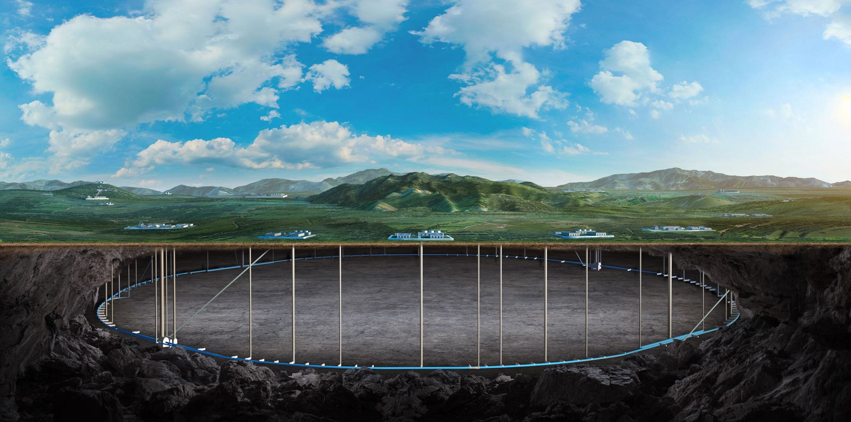


CEPC Control System
Dapeng Jin
5-10. Nov. 2025, CEPC Workshop, Guangzhou

Slide 2
Outline
System overview & progress
Next to do
Summary

Slide 3
System overview & progress

Slide 4
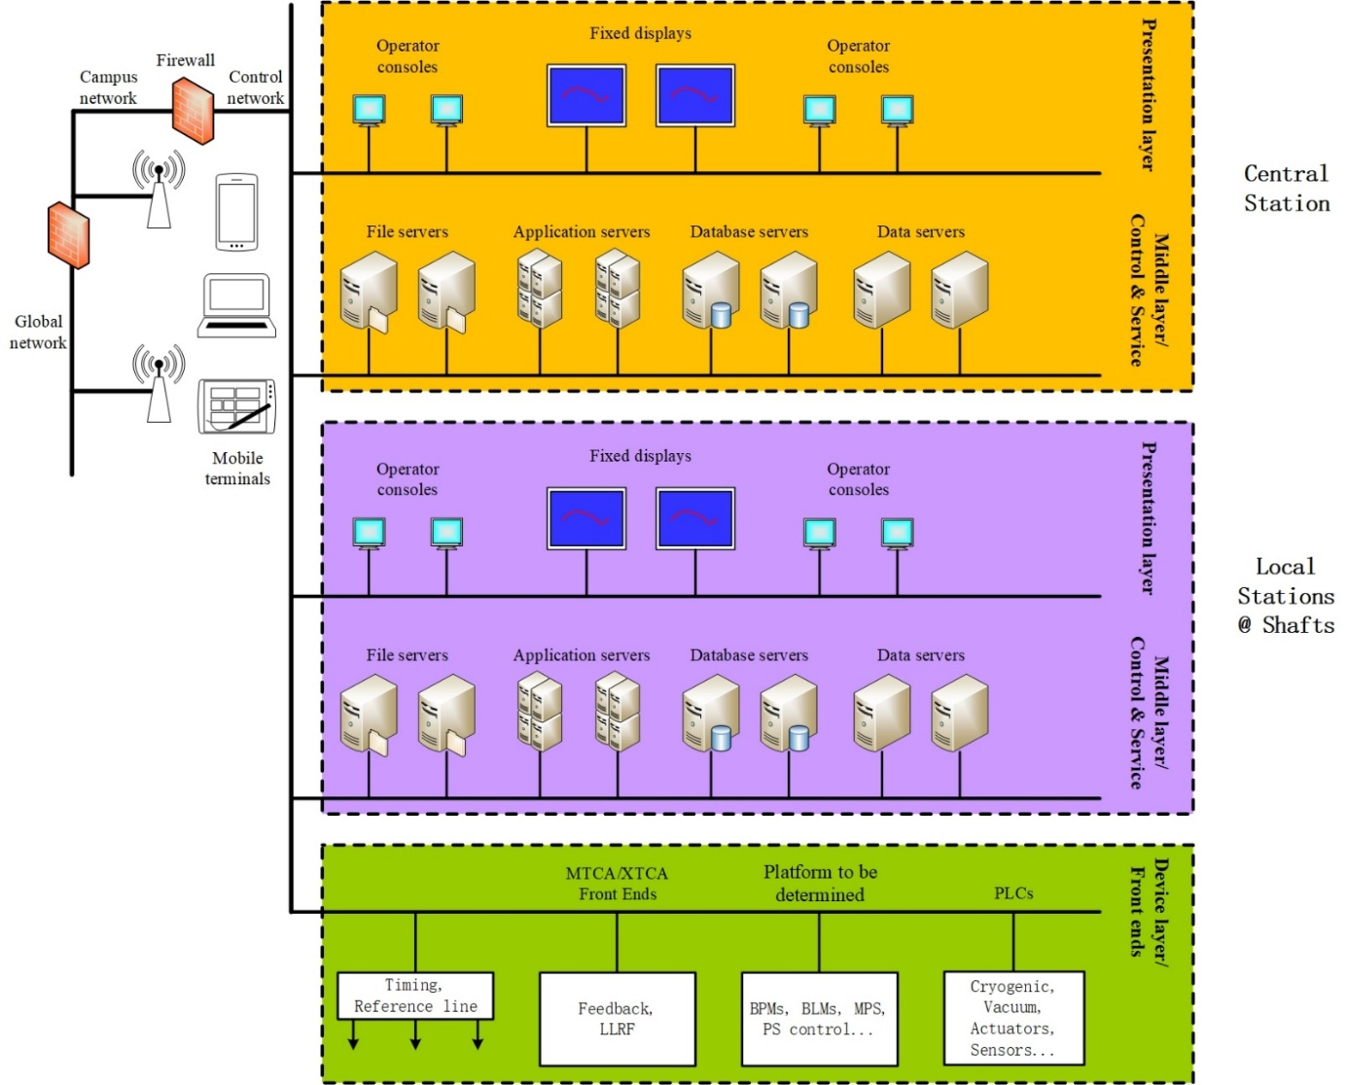
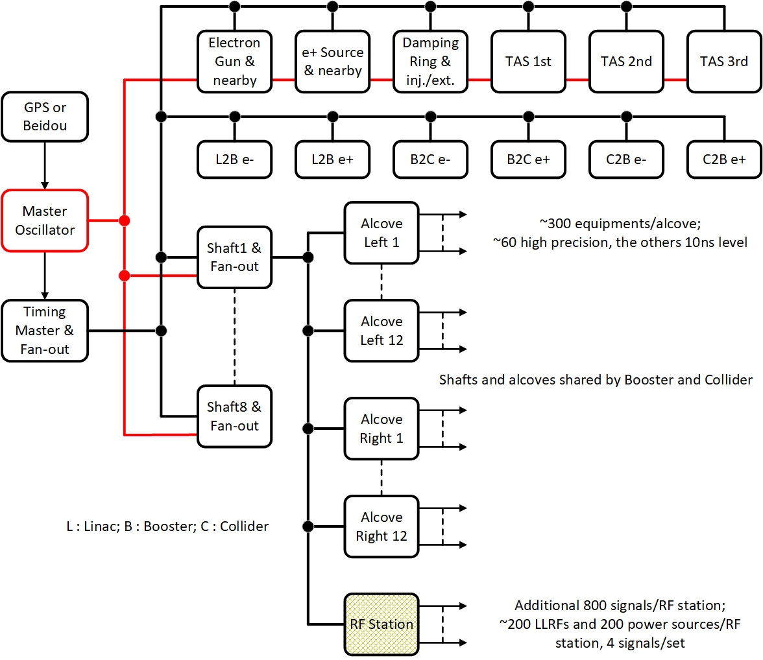
Overall of the control system
IP3 as main station
Network structure on p21
Booster & Collider
Clock jitter < 100fs
Timing jitter < 30ps
Overall structure of the control system
Preliminary design of the clock & timing system

Slide 5
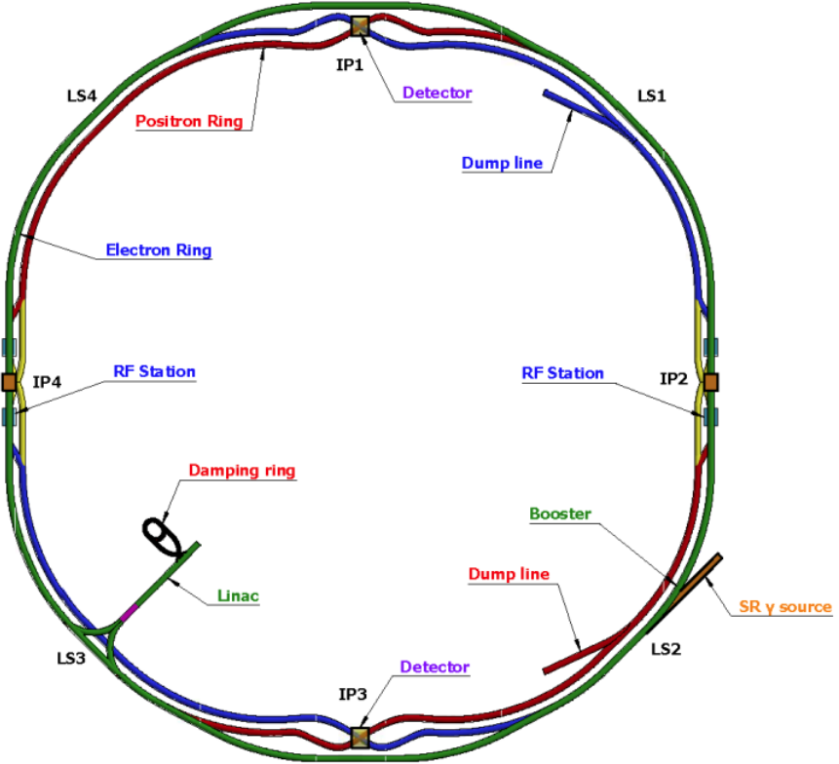
Number of devices to be controlled : Overall
Controlled devices distribution
Linac, damping ring, main ring & transfer lines
Main controlled systems
Radio frequencies
Power supplies
Environment : temperatures, water leakage…
Particle physics
Beam instrumentations
Vacuum
>80,000 devices to be controlled,
~40,000 to do data acquisition
 | Radio Frequencies | Beam Instrumentations | Power Supplies | Vacuum & others | Particle Physics
Network | √ | √ | √ | √ | ---
Timing | √ | √ | √ | --- | √
Reference Line | √ | √(Partly) | --- | --- | √

Slide 6
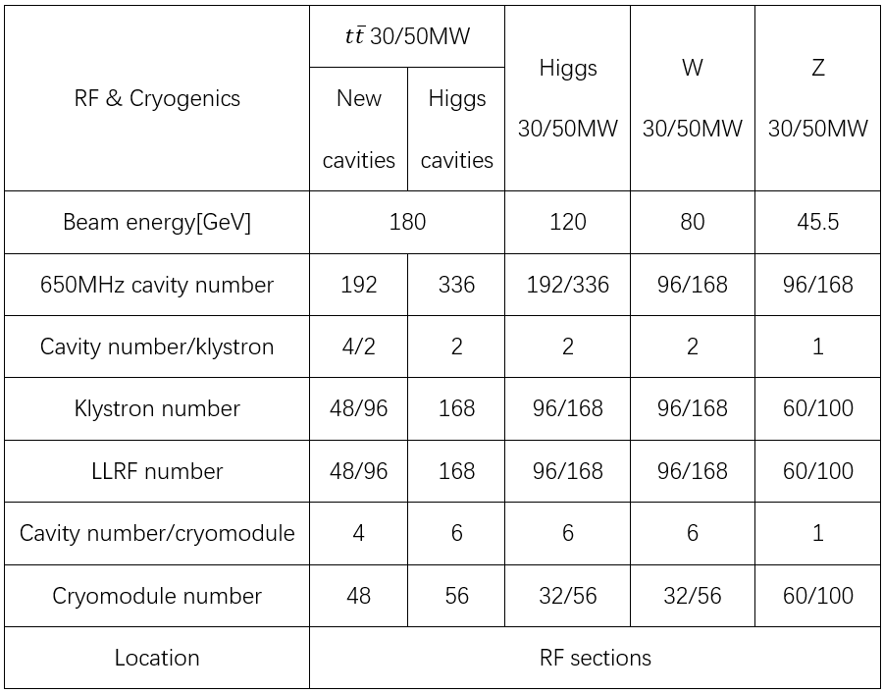
Number of devices to be controlled : Collider
LLRF 96, cryomodule 32.
Reference line and timing for LLRF.
Network to all.

Slide 7
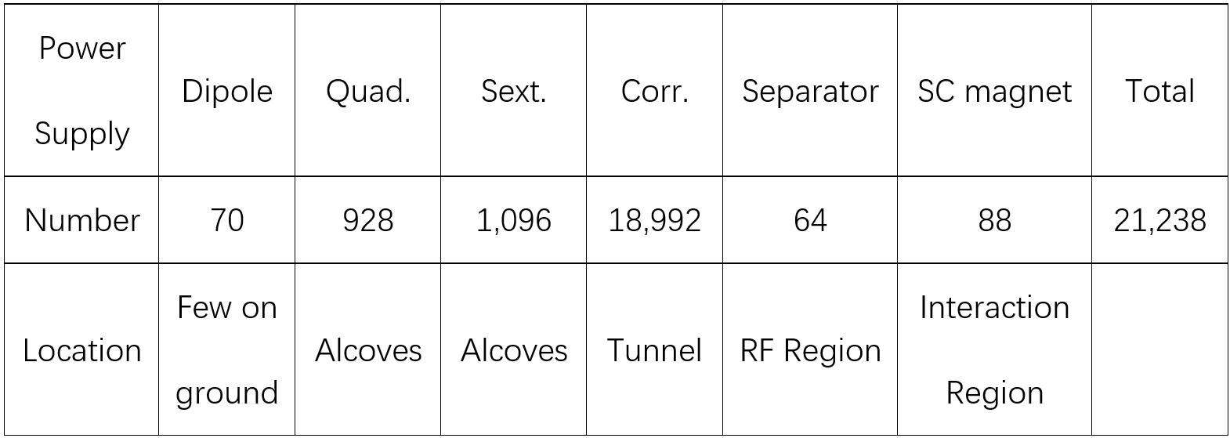
Number of devices to be controlled : Collider
Timing to all power supplies.
Timing uncertainty to be clarified and proper technique to be used.
~192 alcoves, ~110 power supplies/alcove.
Network to all.

Slide 8
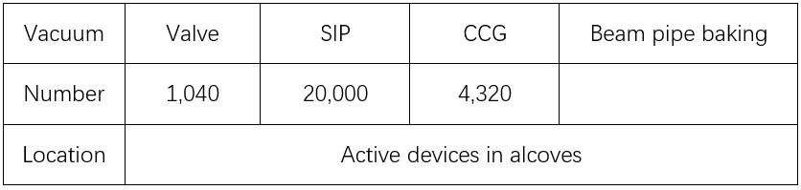
Number of devices to be controlled : Collider
Control of valves and shutdown of the valves according to the neighbored CCGs’ interlock signals.
Readout and monitoring of values from CCGs and SIPs.
~192 alcoves, ~5 valves & 100 SIPs & 23 CCGs/alcove. One control cabinet for valve-control. ~8 serial-port servers and one industrial computer for readout and monitoring. (One station for 3 neighbored alcoves considered)
Network to all controllers.

Slide 9
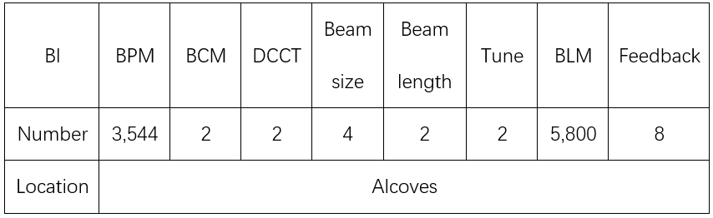
Number of devices to be controlled : Collider
Timing to all.
Reference line maybe to BPMs and to few others.
~192 alcoves, ~18 BPMs & 30 BLMs/alcove.
Network to all.

Slide 10
Number of devices to be controlled : Collider
Movable collimators.
Vacuum chamber temperature monitoring …
Network to all.

Slide 11
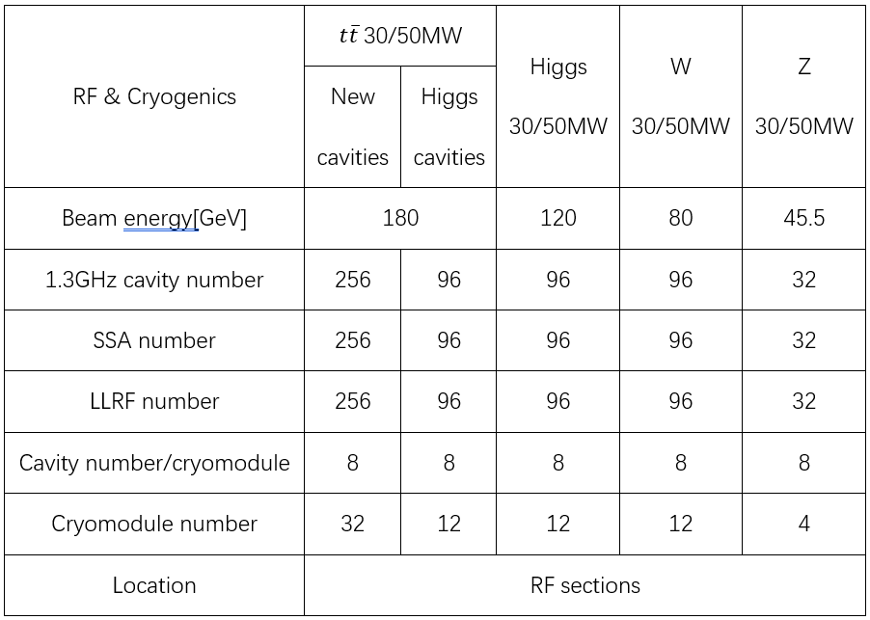
Number of devices to be controlled : Booster
LLRF 96, cryomodule 12.
Reference line and timing for LLRF.
Network to all.

Slide 12
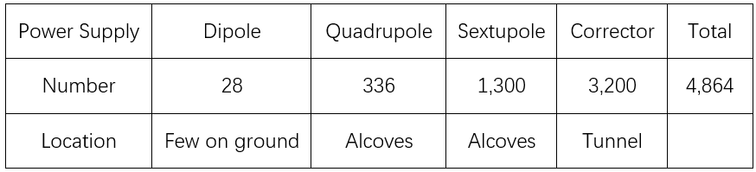
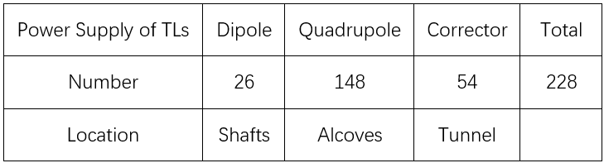
Number of devices to be controlled : Booster
Timing to all power supplies.
Timing uncertainty to be clarified and proper technique to be used.
~192 alcoves, ~25
power supplies/alcove.
Network to all.

Slide 13
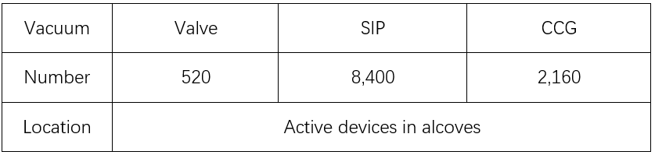
Number of devices to be controlled : Booster
Controlled together with the storage ring.
Network to all controllers.

Slide 14
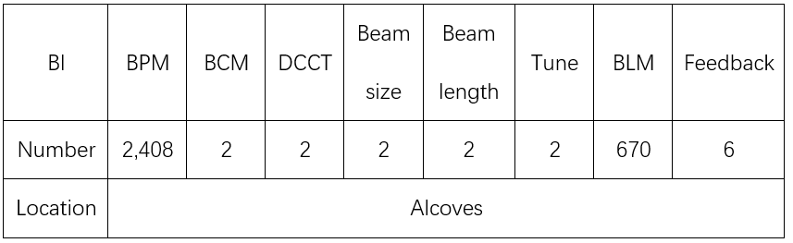
Number of devices to be controlled : Booster
Booster to storage rings
32 BPMs
Timing to all.
Reference line maybe to BPMs and to few others.
~192 alcoves, ~12 BPMs & 4 BLMs/alcove.
Network to all.

Slide 15
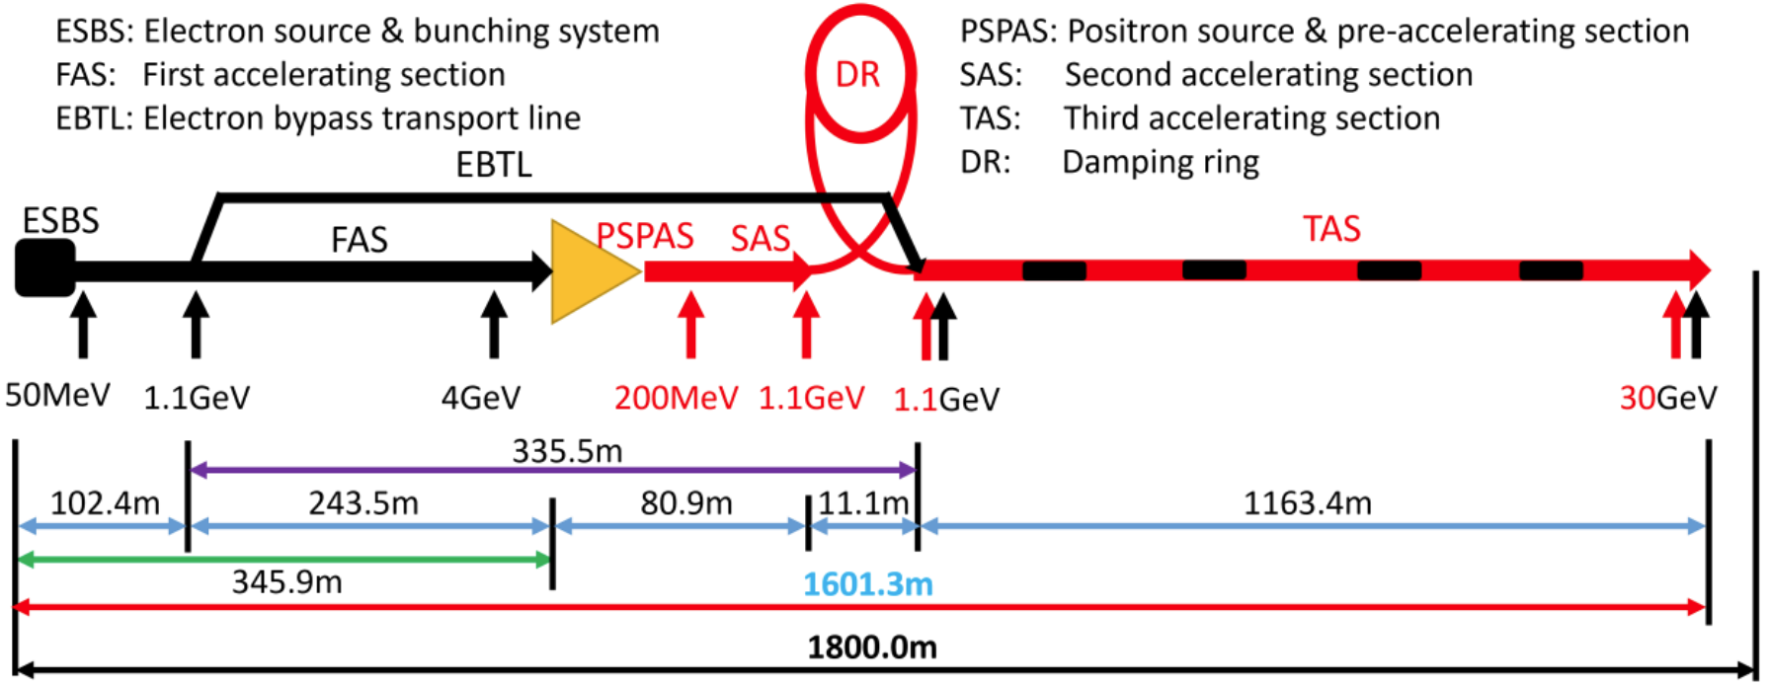
Number of devices to be controlled : LN, DR, TLs
Total 272(LN) + 2 (DR) LLRFs, reference line and timing to all.
Network to all.

Slide 16
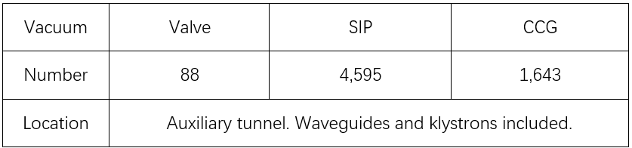
Number of devices to be controlled : LN, DR, TLs
Total 789 power supplies with 583 of LINAC, 206 of damping ring & its TLs.
Timing to all.
Network to all.
Controlled together with vacuum stations, valve control cabinets as less as possible.
Network to all controllers.

Slide 17
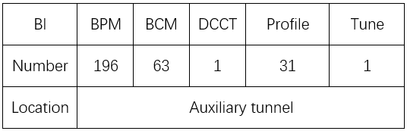
Number of devices to be controlled : LN, DR, TLs
LINAC to booster
28 BPMs & 2 PRs
Timing to all.
Network to all.
Injection & extraction of whole CEPC: 190 equipment in 5 stations. Timing to all. Network to all.

Slide 18
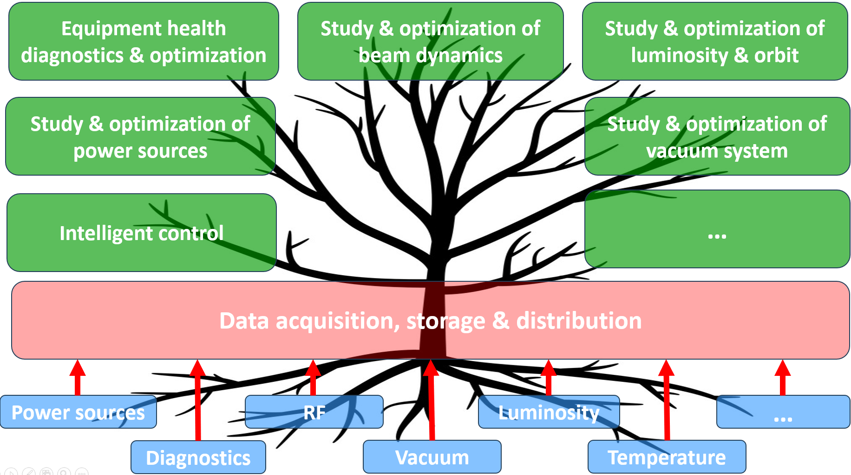
Accelerator data acquisition & applications
High quality data
High speed DAQ
Open loop applications
High perform. computing
Closed loop applications
High perform. actuator
High Performance applications
High bandwidth
Digital twin
Slow control & monitoring
Other applications
…

Slide 19
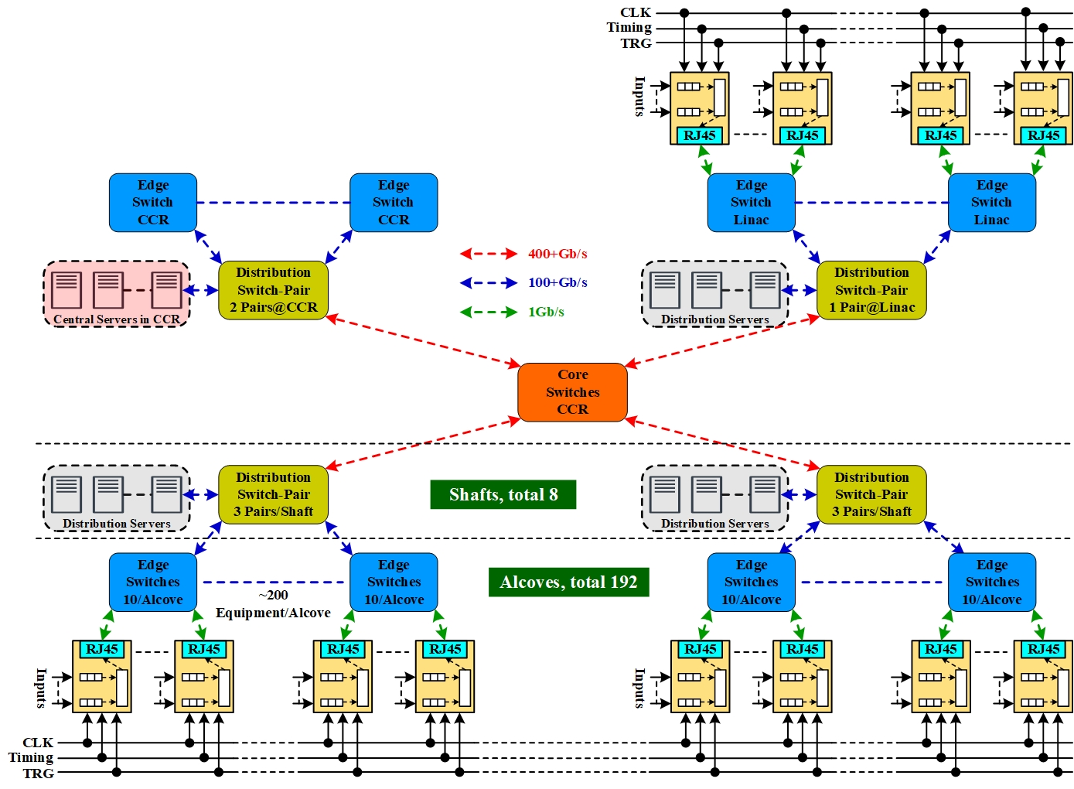
Accelerator data acquisition & applications
Services with multi-region data deployed on central servers .
Services with only local data deployed on distribution servers.
Distributed data acquisition, storage & services.
Physical separation of control & DAQ network.

Slide 20
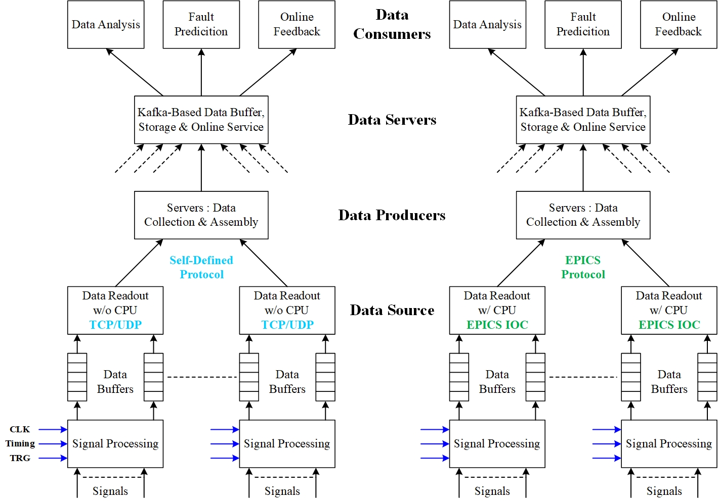
Accelerator data acquisition & applications
Fault tolerance & recovery.
Total data for one trigger:
5MB * 40,000 = 200GB/10s
Total data rate for continuous trigger & readout: 160Gb/s
To be applied on BEPCII with the implementation of the “BEPCII digital & intelligent upgrade” project.
Note: Referenced to documents of Sinong Cheng, from APS-U and Apache Software Foundation.
Overall structure of the whole data flow

Slide 21
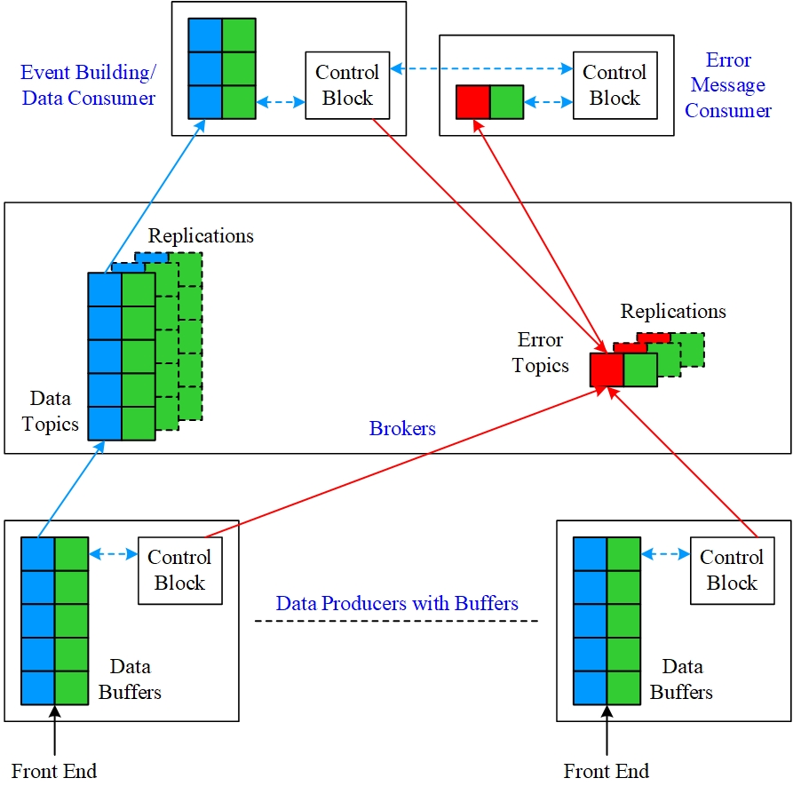
Accelerator data acquisition & applications
To be applied on BEPCII with the implementation of the “BEPCII digital & intelligent upgrade” project.
Data & message flow of DAQ with & without event building for accelerator physics

Slide 22
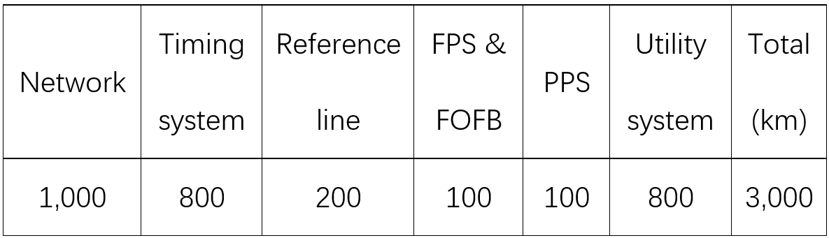
Fiber routing & radiation experiment
Fiber routing in tunnel with IP3 as the center.
G.652 single-mode fiber attenuation: ~0.2dB/km @1550nm
Radiation hardness & cost.
~3000km 48-core opt. fiber needed.
IP3

Slide 23
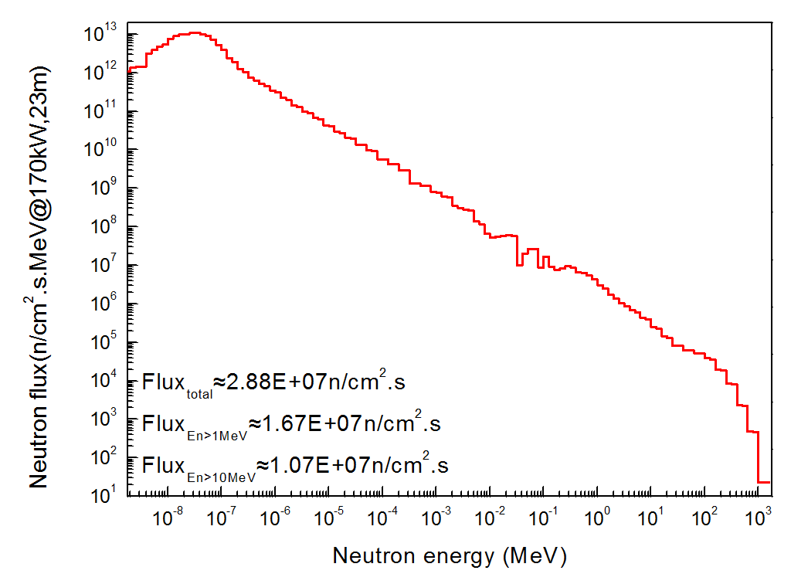
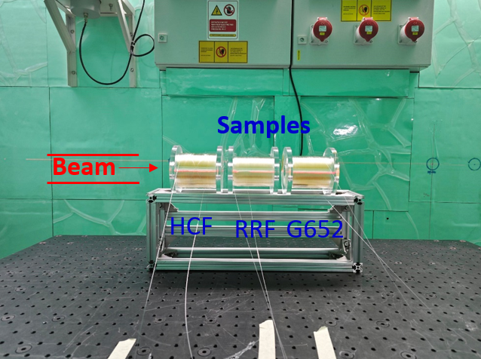
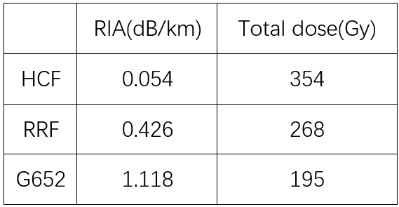
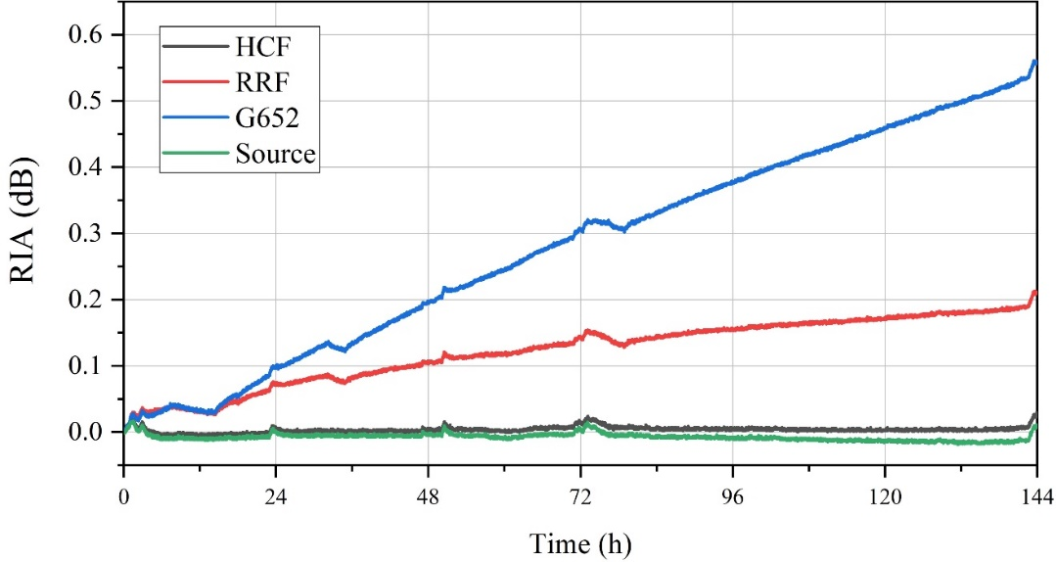
Fiber routing & radiation experiment
Neutron radiation experiment done at ANIS of CSNS.
Ge doped fiber is very radiation sensitive.
Even F doped fiber is not suitable for accelerator.
HCF is much better with a price ~50RMB/core/m at present.
Further experiment planned.
Total dose:
354Gy@HCF，268Gy@RRF，195Gy@G652
1550nm
Joint fiber radiation experiment among YOFC, CSNS & IHEP.

Slide 24
Fast protection system
Loop structure in the ring.
Heart-beat function from the front end electronics & along the loop for both real-time health monitoring & protection.
Redundant loops for both reliability & availability.
Delay of transmission & electronics < 500us
Normal
Fault

Slide 25
Fast orbit feedback system
Loop structure.
Bi-direction transmission loops for both reliability & availability.
A bandwidth of tens of Hz is expected mainly determined by the response time of BPMs & power supplies together with the magnets.
Data driven & fast computation with DSPs in FPGA

Slide 26
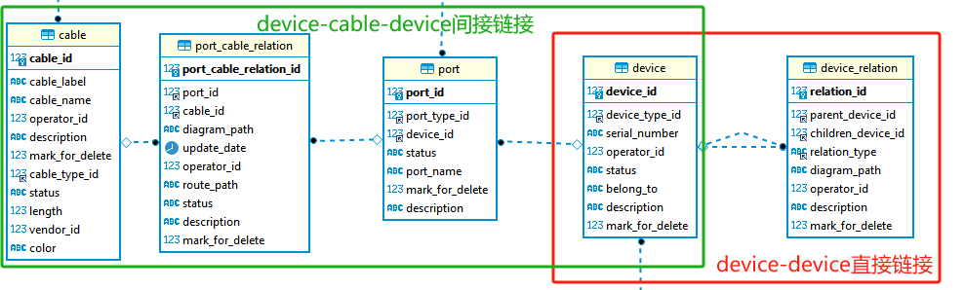
Component & cable database
Indirect connection of devices through cable
Direct connection of devices : housing
Note: Referenced to APS-U design with key modifications.

Slide 27
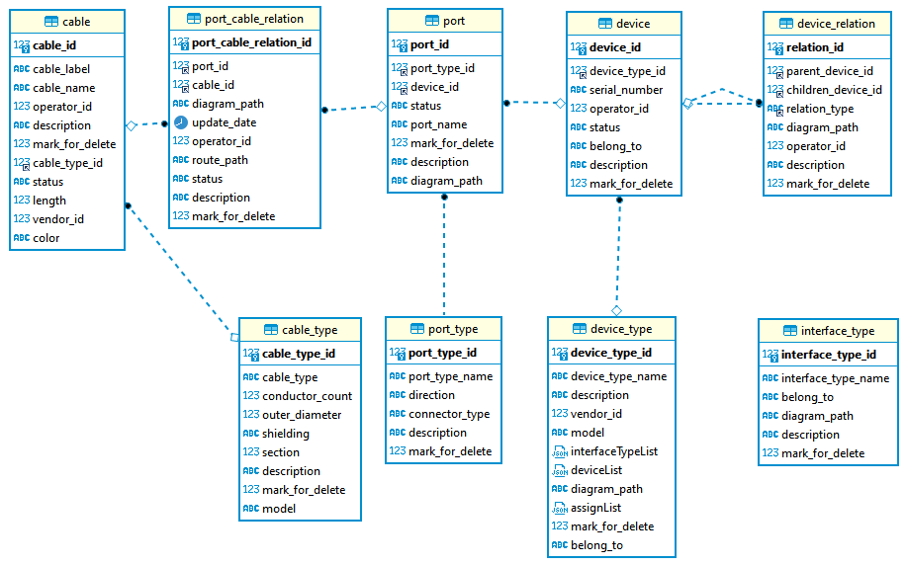
Component & cable database
Data from users
Sub-million cables
Dictionary data managed by administrator
Note: Referenced to APS-U design with key modifications.

Slide 28
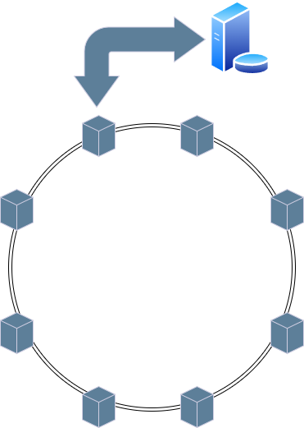
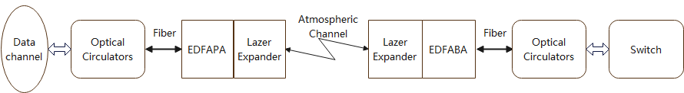
Timing system with wireless transmission
Motivation: To achieve high-precision global clock transmission, and timing synchronization
Within a 100 km range through wireless transmission
Reducing the need of radiation-hard optical fibers
Providing a backup technical solution.
Research
Long-distance free space optical wireless transmission system
Data transmission and clock synchronization technology
Large scale, multi-cascaded clock synchronization technology
Main node
Structure of cascaded clock synchronization system
Schematic of long-distance FSO transmission

Slide 29
Timing system with wireless transmission
Progress (jitter well below 30ps)
Long-distance Free Space Optical wireless transmission system.
A 1 km distance laser wireless transmission system has been designed and tested.
Data transmission and clock synchronization tests have been conducted with a bit error rate of less than 1E-13 and a synchronization accuracy of 20 ps (without optimizition).
Point-to-point data transmission and clock synchronization technology
A new high-precision clock synchronization hardware node has been designed and tested.
With fiber, the TIE jitter of receive clock is 2.28 ps, the clock synchronization accuracy is 3.33 ps.
Large scale, multi-cascaded clock synchronization technology
A machine learning-based approach is proposed to gather multi-node information and dynamically adjust the phase of all nodes to alleviate long-term clock drift caused by cascading.
A small system with 7 nodes is scheduled, aiming for a timing accuracy of better than 10 ps across all nodes.

Slide 30
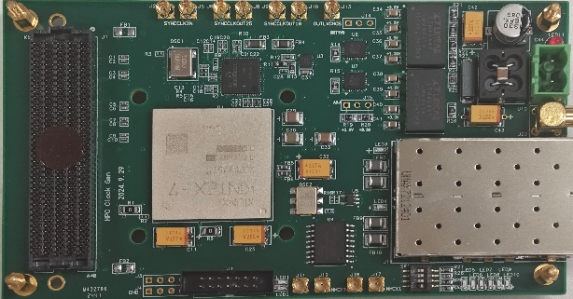
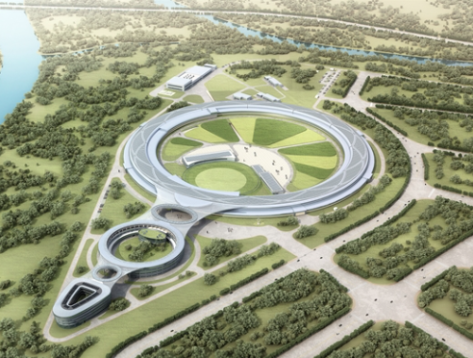
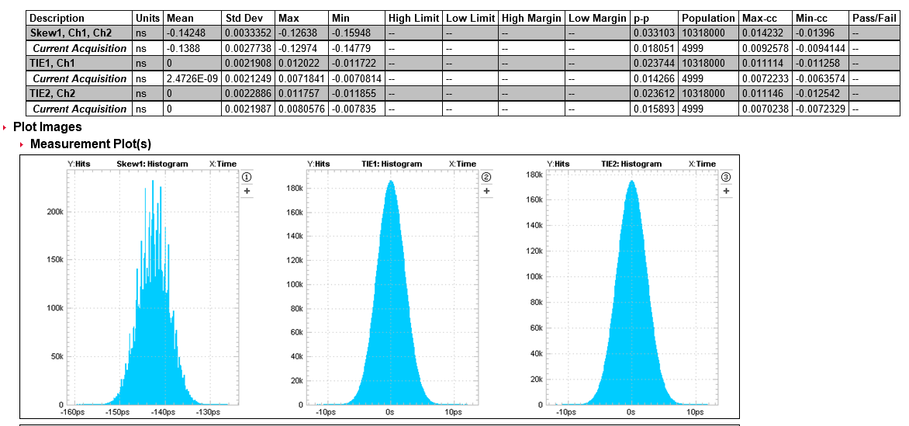
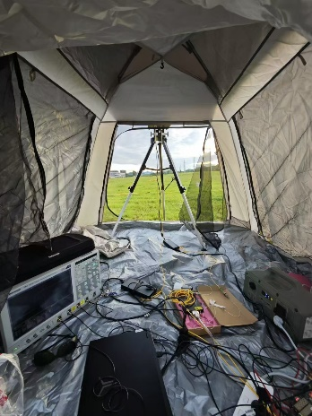
Timing system with wireless transmission
RMS=2.28ps
RMS=3.33ps
High-precision clock synchronization hardware node
Test setup of 1 km FSO Equipment in HEPS
TIE jitter of receive clock
Clock synchronization

Slide 31
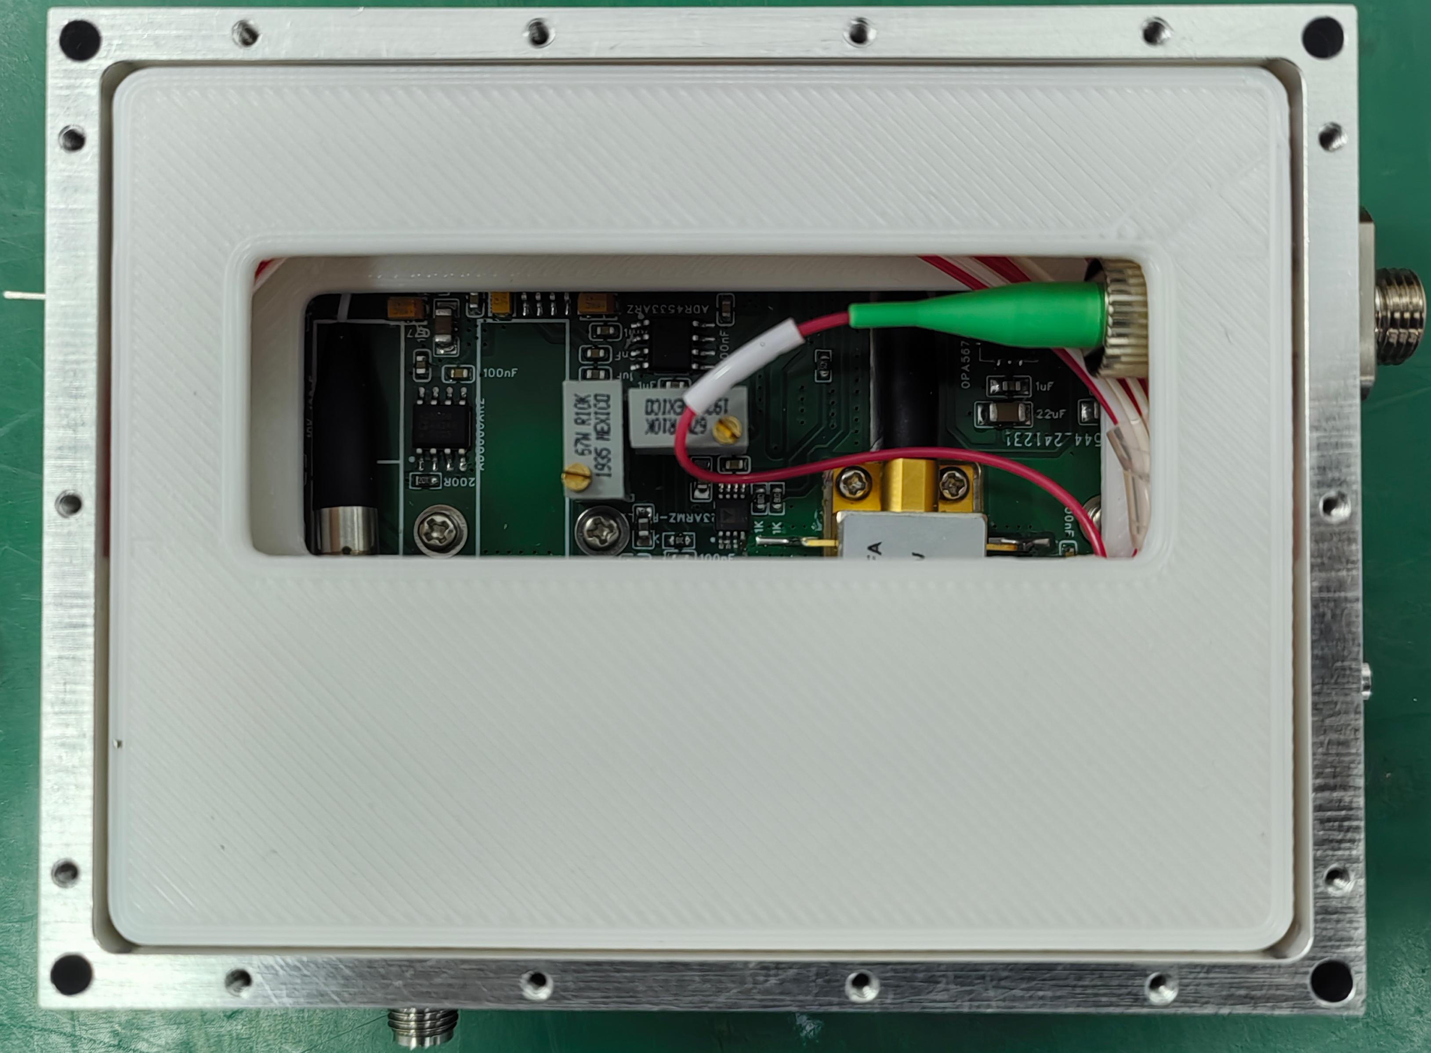

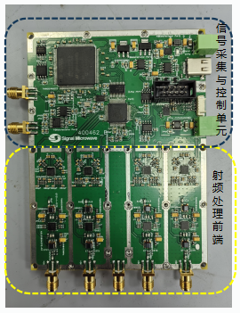
Reference line
Reference line
Hardwares are fully updated from HEPS/BEPCII-U 499.8MHz version, better lasers are meausred and used for higher frequency 1300MHz/650MHz
Digitally I/Q modulator phase shifter is used for multiple period phase (>360°) compensation
DAQ and analog circuits are seperated for clean noise on the PCB board
RF front-end
Laser module
DAQ and control
PCB circuits
RF_monitor
RF_IN
phase shifter
RF_OUT

Slide 32
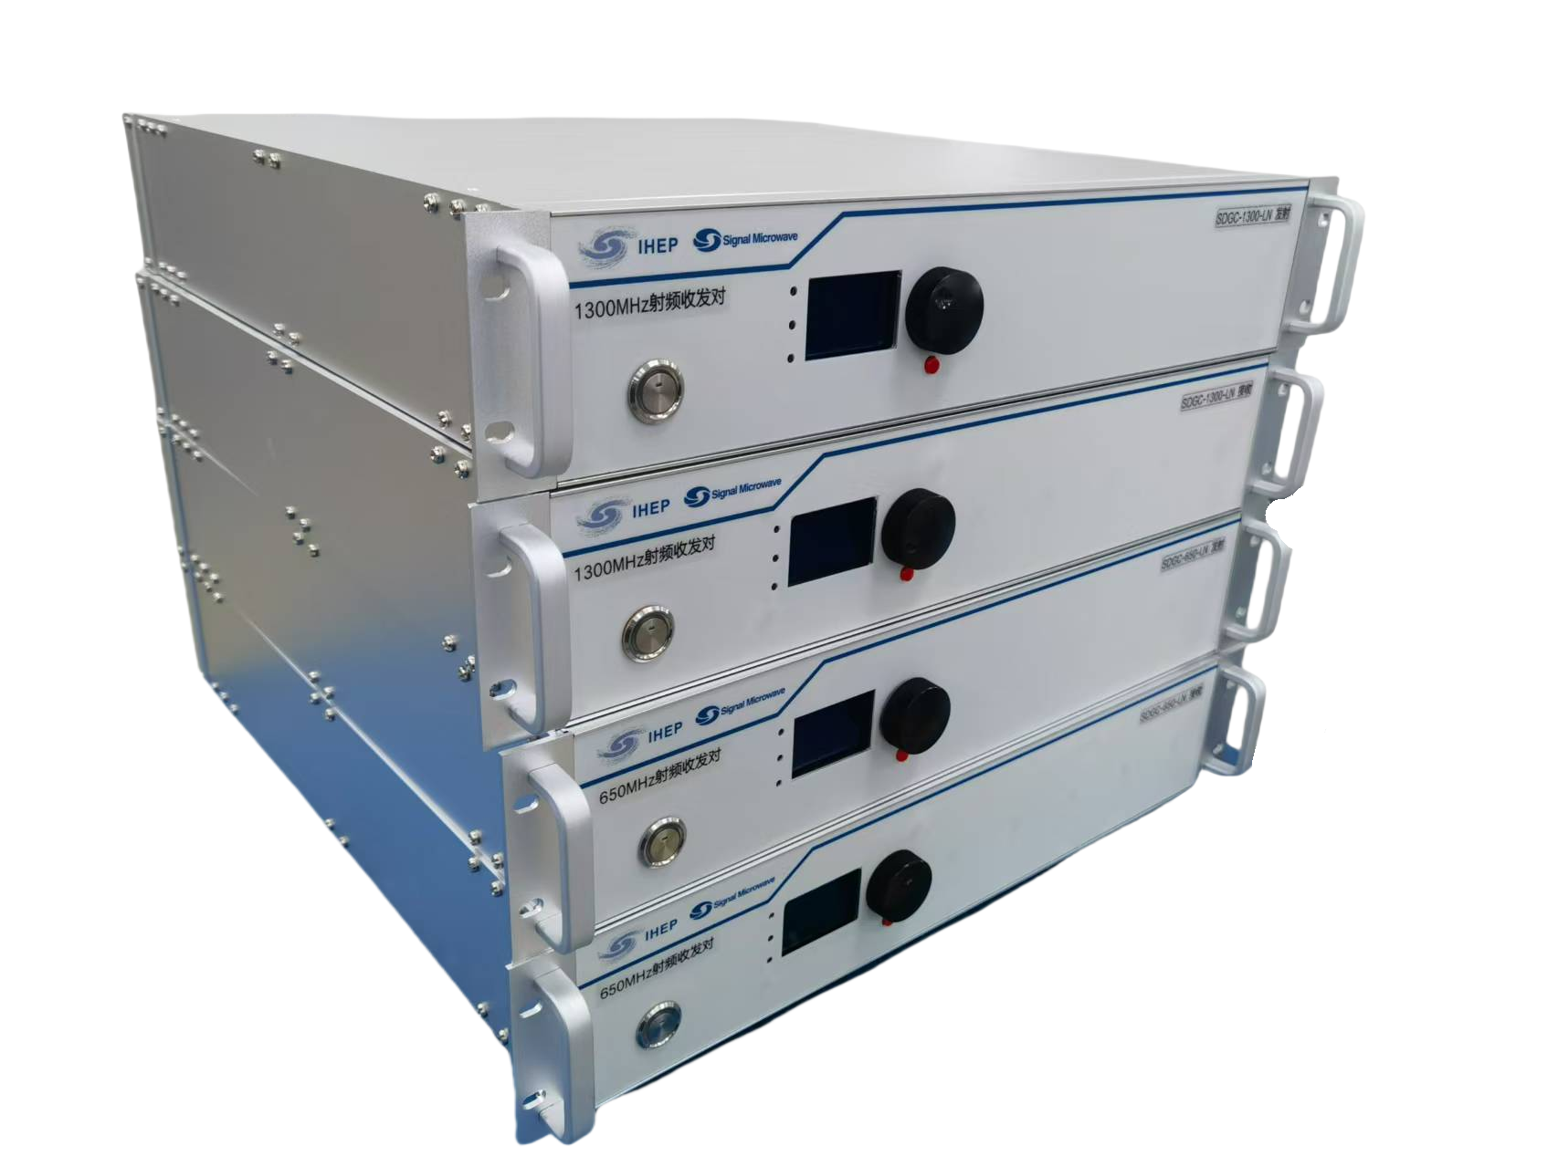
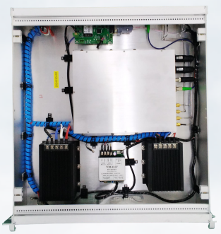
Reference line
Reference line
Self developed module prototype: SDGC-1300M-LN and SDGC-650M-LN, each pair: one Tx and one Rx module
Transfer 1300MHz/650MHz from master oscillator to Linac/shafts/... with ultra-low additive jitter of RF reference signals
RF is modulated on the low-noise laser, wavelengths are 1550nm, phase can be stablized by measuring the return laser and Tx laser phases error, with digital PID contoller in the FPGA and MCU, phase stabilized within 0.01deg, or ~20fs for 1300MHz signal
Temperature of the module is also stabilized within 0.01degC, to keep the system stable
All the data are accessed by LAN and EPICS

Slide 33
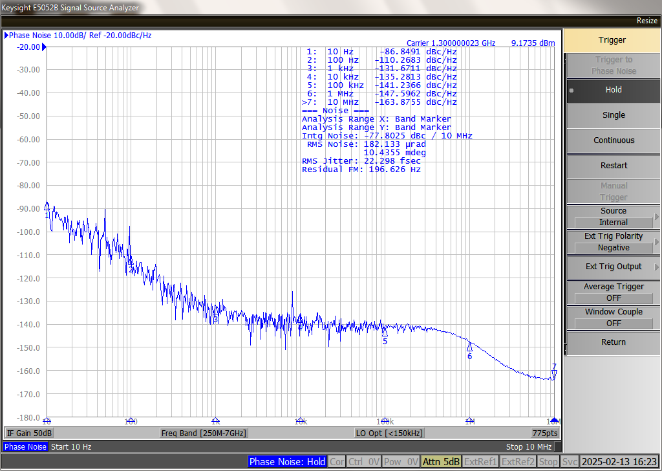
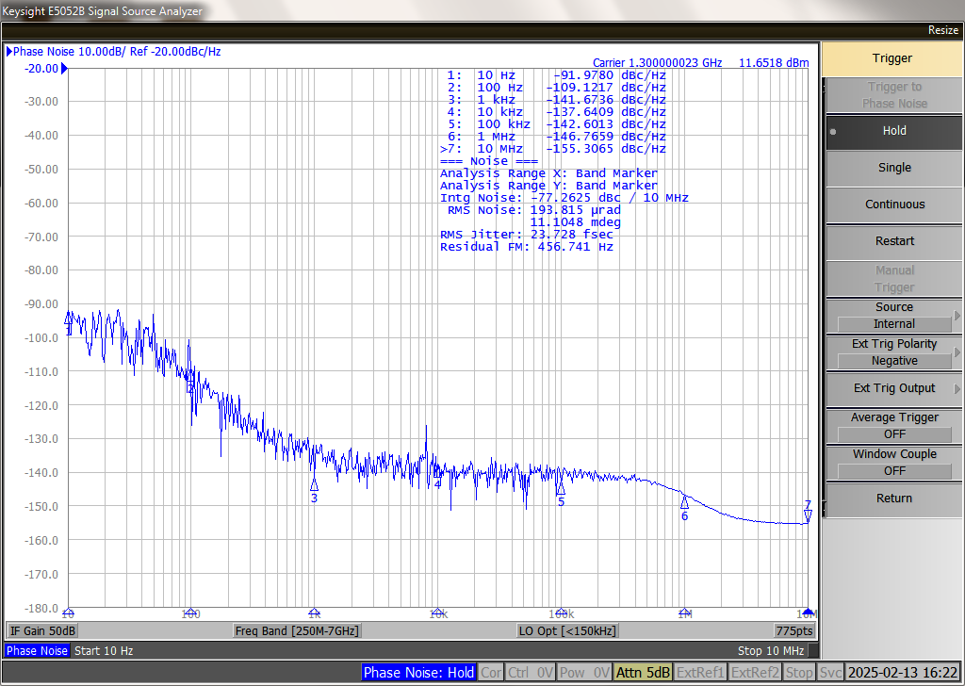
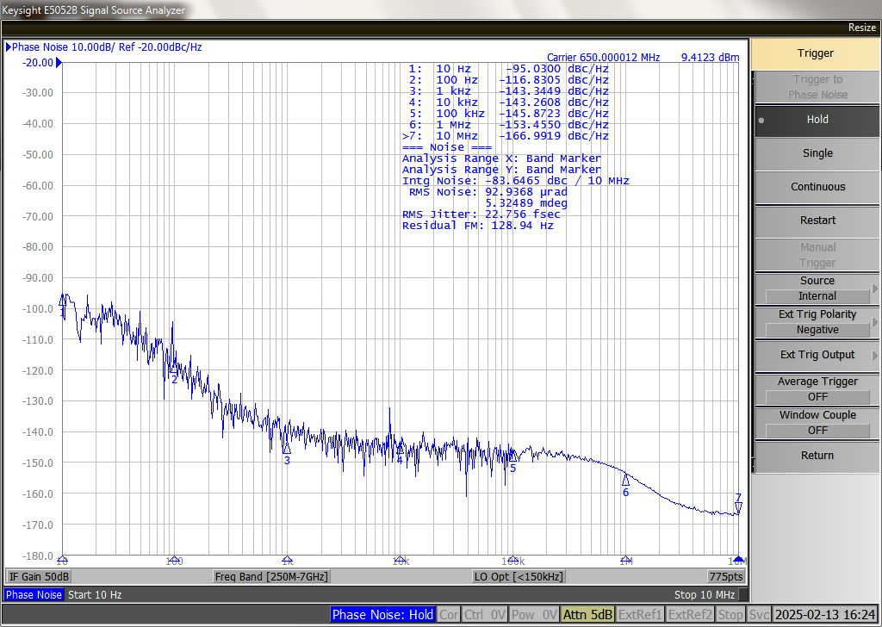
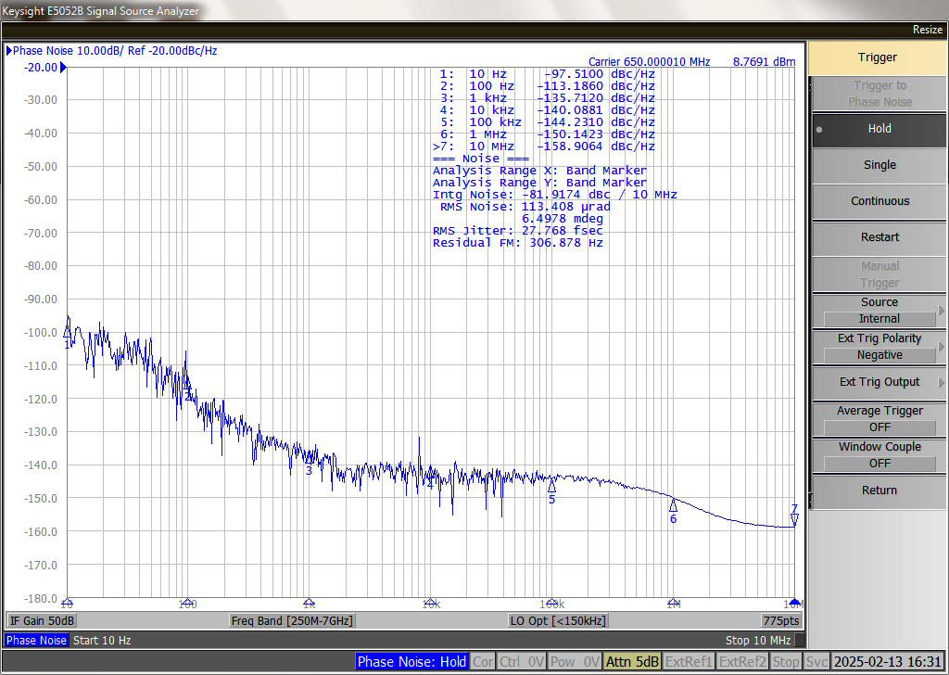
Reference line
Measurement (preliminary result， jitter well below 100fs)
signal generator：SMA100B
phase noise analyzer：E5052B
signal remains good after transmission, even better than HEPS version
software / remote control / close loop performance are still under test, because lack of measurement condition, very long distance(>10km) and phase compensation is under study, later system will be totally tested
Experiences in BEPC, CSNS & HEPS。
1300MHz
input signal jitter：22.29fs
output signal jitter：23.72fs
650MHz
input signal jitter：22.75fs
output signal jitter：27.77fs

Slide 34
Next to do

Slide 35
Next to do
Further radiation experiment of optical fibers focusing on HCF including optical lens between HCF & SMF ends, fusion splice points. Radiation induced attenuation < 0.1dB/km with a dose ~20kGy in 20 years.
Further DAQ design and implementation, applied first in BEPCII.
Further development of component-cable database and application in BEPCII & PWFA.
Long-distance & long time test of reference line.
Larger system integration & test of wireless transmission based timing system.
Further design of fast orbit feedback system & fast protection system.
Further design of network.

Slide 36
Next to do
Management of millions of variables effectively & efficiently, design first, then develop whenever manpower available.
Effective use of the variables.
Monitoring & alarm. Fault prediction to solve before failure.
To present customized UIs conveniently, such as through voice.
To present non-customized UIs automatically whenever needed.
To present useful information automatically & effectively when fault or error.
Periodic & fault logs.
Fault tolerance & redundancy.
Self-health monitoring…

Slide 37
Summary
Key issues of control system go forward steadily.
Much work will be done with manpower limited.
Thanks for your attention!

