Slide 1
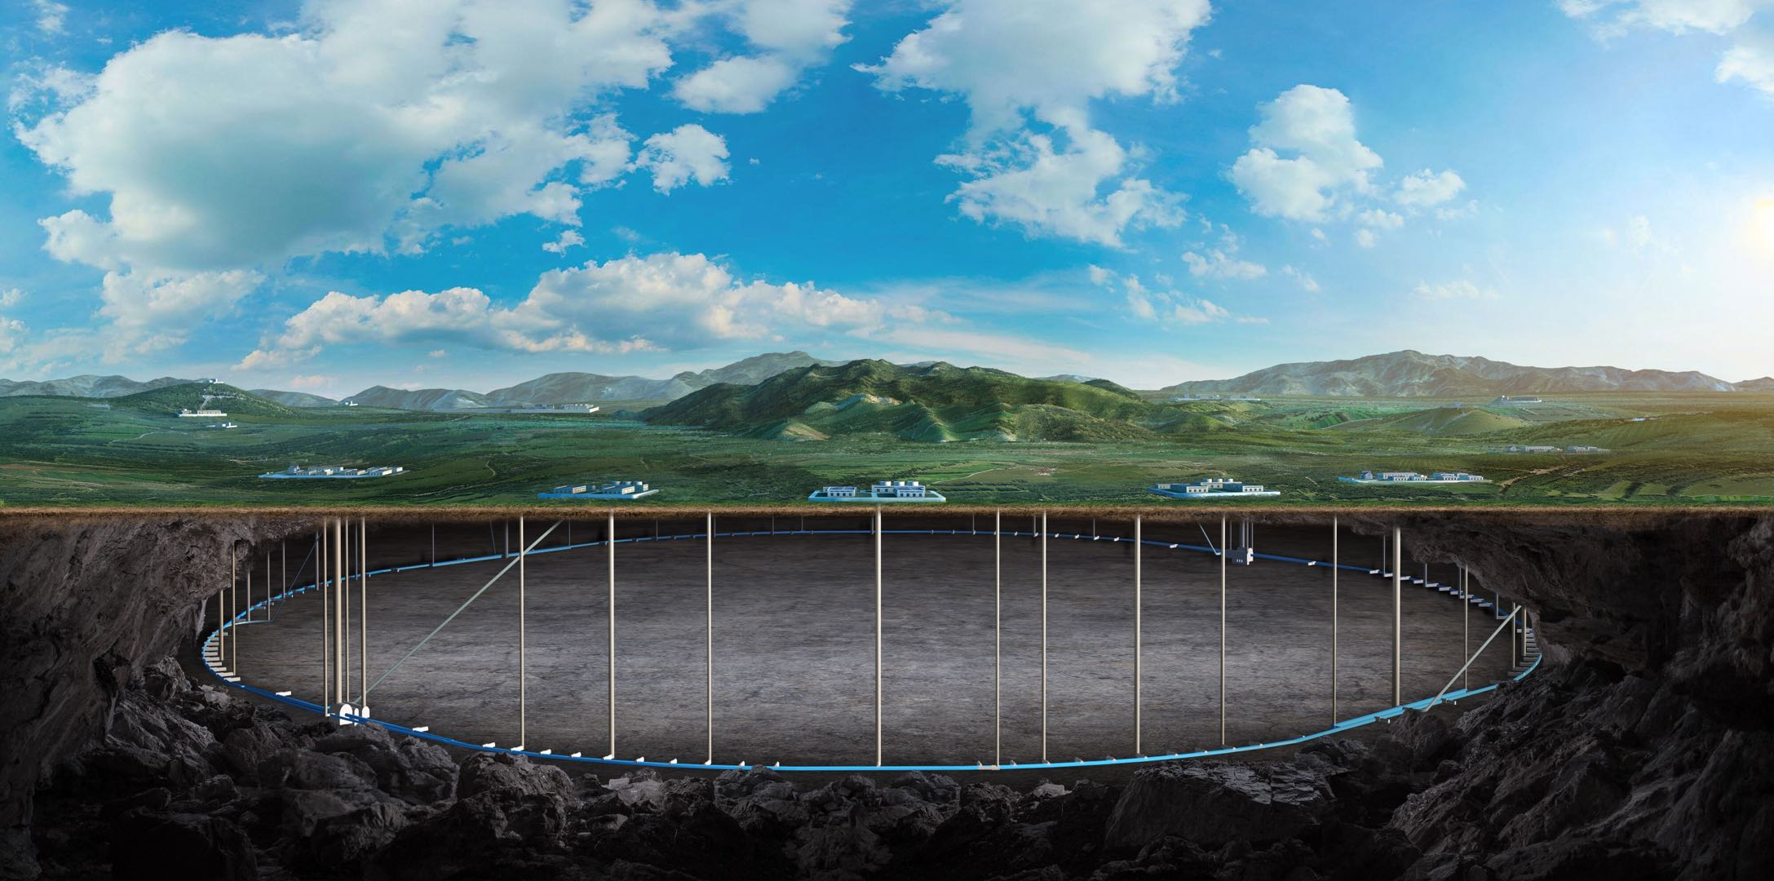

Circular Electron Positron Collider
CEPC Polarization Study Status
Zhe Duan
On behalf of the CEPC Polarization Working Group
Nov 9, 2025, CEPC Workshop 2025, Guangzhou email: duanz@ihep.ac.cn

Slide 2
Outline
Overview of beam polarization issues for CEPC
R&D in the Engineering Design Phase
Concepts of longitudinal polarization at BEPCII
Summary

Slide 3
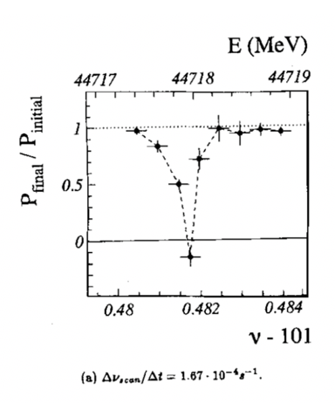
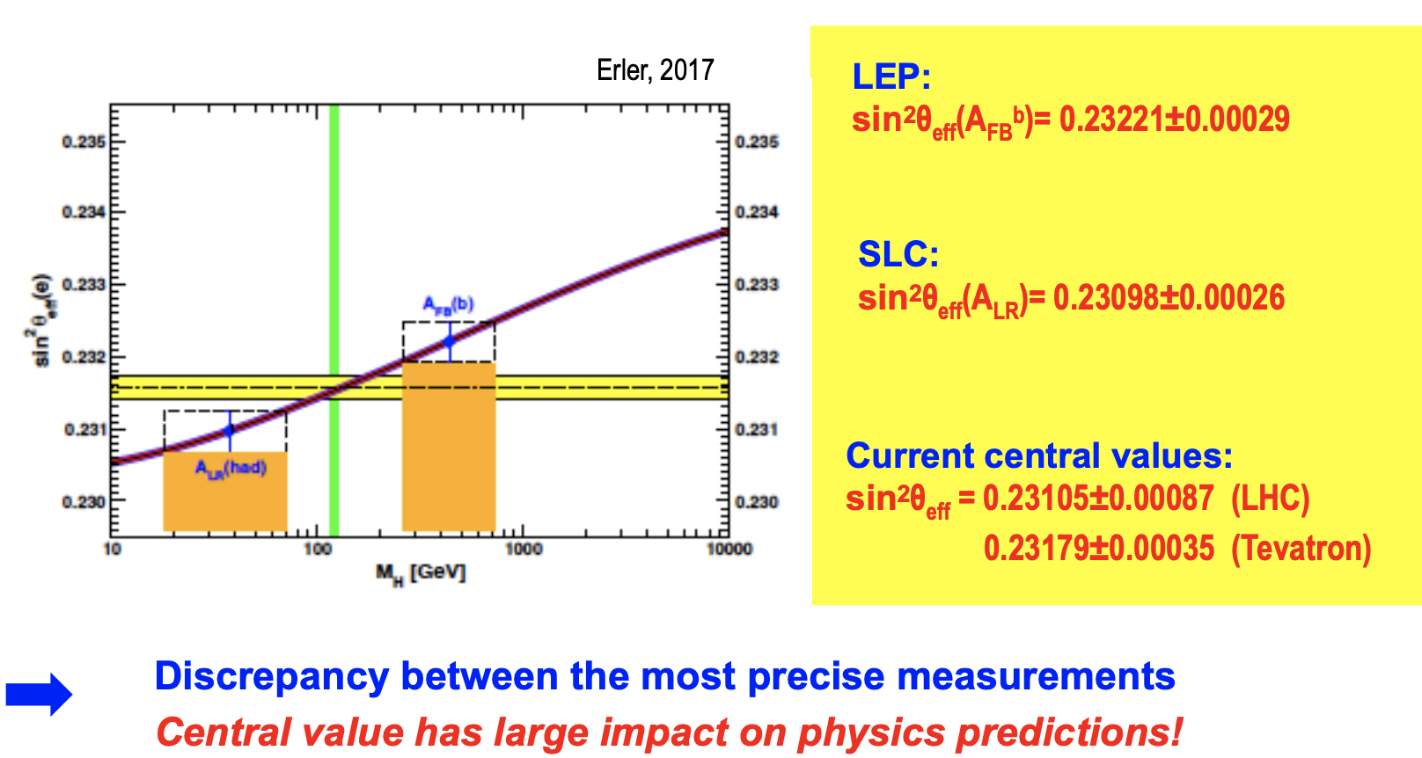
Physics motivation of polarized beams @ CEPC
Precision beam energy calibration @ Z, W (~100keV)
resonant depolarization with vertically polarized beams
Precision measurement of weak mixing angle @ Z
Longitudinally polarized colliding beams for measuring A_{LR}
could resolve the tension between A_{FB} & A_{LR}, by measuring both in the same experiement
CPV with polarized beams in e+e- → HZ. H → ττ etc
ECFA meeting on e+e- to ZH angular measurements
Polarized beam applications @ ILC,
arXiv:2105.09691, 2111.06687, 2202.07385
L. Arnaudon, et al., Z. Phys. C 66, 45-62 (1995).
G. Moortgat-Pick’s talk on CEPC Workshop EU @ Marseille, 2024 April

Slide 4
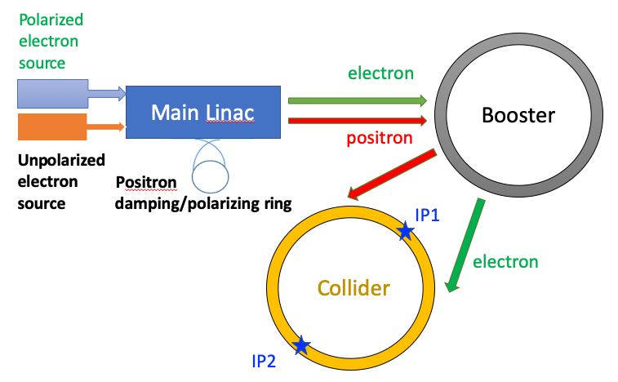
Injecting polarized beams
Polarized source
Polarized electron gun w/ superlattice GaAs cathode (>85% polarization)
Positron damping/polarizing ring(>20% polarization, sufficient for RD)
Linac & Transport lines
no interleaved H & V bendings
polarization loss is negligible
Booster
free from intrinsic spin resonances
polarization can be well maintained for Z & W
T. Chen, Z. Duan, D. H. Ji, D. Wang, Phys. Rev. Accel. Beams, 26, 051003 (2023).
Collider
polarization for Higgs under investigation
W. Xia, Z. Duan, D. P. Barber, Y. Wang, B. Wang and J. Gao, Phys. Rev. Accel. Beams, 26, 091001 (2023).
Similar approach is now being studied for FCC-ee
J. Wenninger, Injecting polarized beams , FCC Week 2025, FCC-FS EPOL group meeting 40

Slide 5
Injecting polarized beams
Polarized source
Polarized electron gun w/ superlattice GaAs cathode (>85% polarization)
Positron damping/polarizing ring(>20% polarization, sufficient for RD)
Linac & Transport lines
no interleaved H & V bendings
polarization loss is negligible
Booster
free from intrinsic spin resonances
polarization can be well maintained for Z & W
T. Chen, Z. Duan, D. H. Ji, D. Wang, Phys. Rev. Accel. Beams, 26, 051003 (2023).
Collider
solenoid spin rotators @ 45.6 GeV
~70% longitudinal polarization for e-
W. Xia et al., Investigation of spin rotators in CEPC at the Z-pole,
Radiat. Det. Tech. Meth. 6:490 (2022).

Slide 6
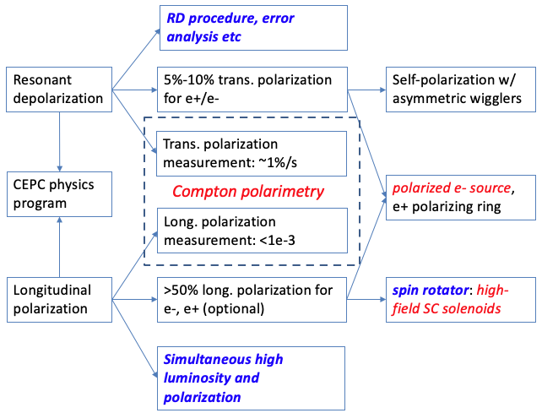
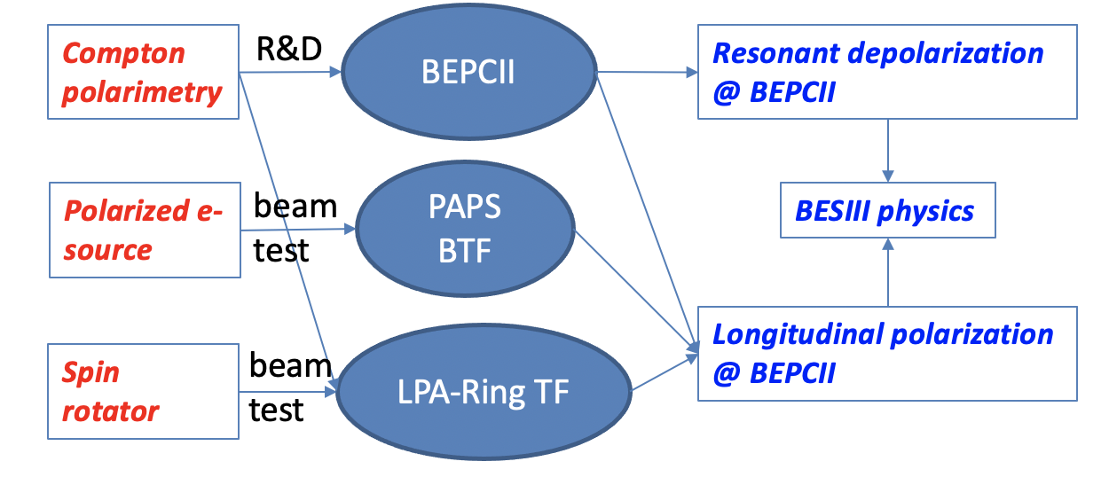
Beam polarization R&D in the EDR phase
CEPC requirements, R&D items,
and required experiment demonstration
R&D, beam tests, and foreseen experimental demonstration at IHEP accelerator facilities
These activities will set the basis for polarized beam applications @ CEPC.

Slide 7
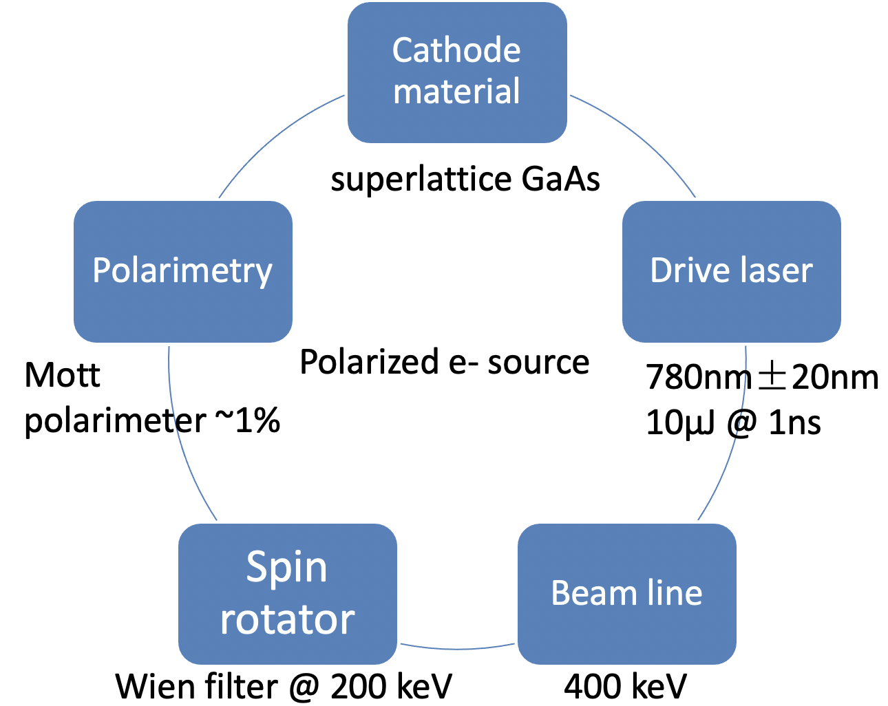
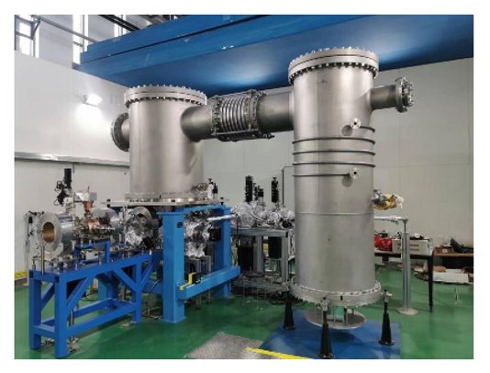
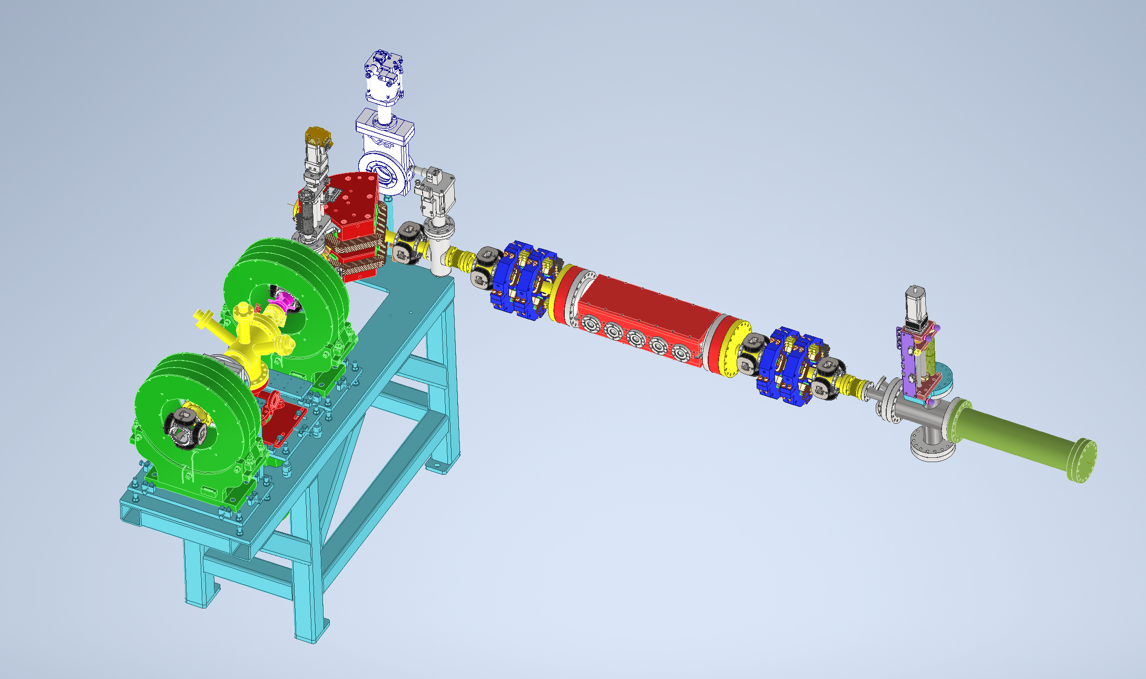
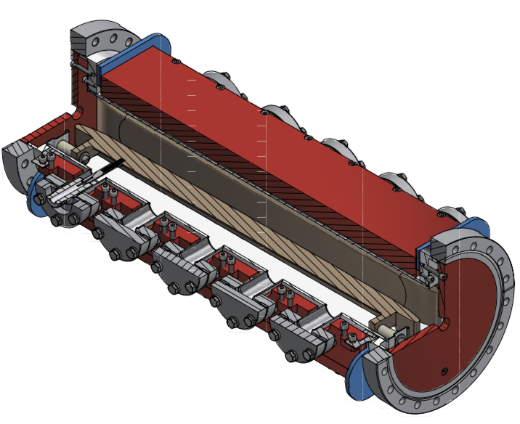
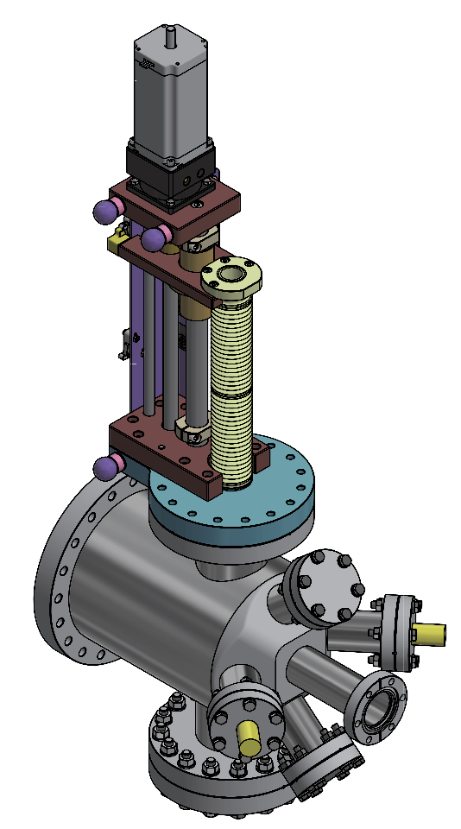
A test facility for polarized electron source
R&D on superlattice GaAs cathode
Convert a HV DC gun to a polarized electron source
Details in LI Xiaoping’s presentation
500kV photocathode DC gun @ PAPS
Beamline for polarization measurement
Wien filter
Mott polarimeter
Li Xiaoping, V. Tyukin, Liu Wei, Meng Cai, Wang Jianli, Wang Haijing, Liu Jindong, Liang Zhijun, Liu Zhongtian etc

Slide 8
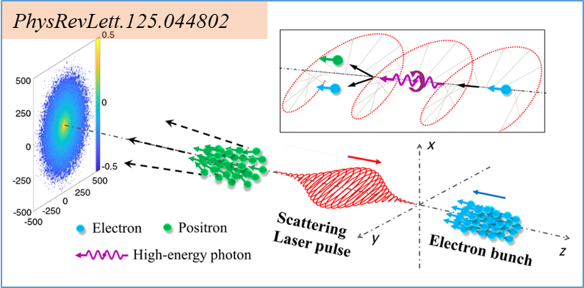
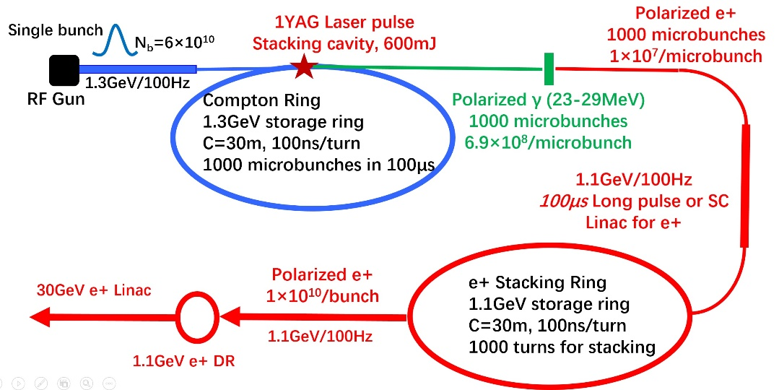
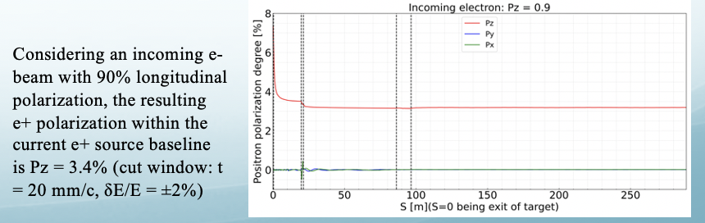
Collaborative study on polarized e+ source
Polarized e+ source is challenging to deliver high pol & flux for colliding beams at future colliders
Circular colliders like CEPC requires ~1/50 flux compared to ILC
Collaboration with IJCLab (w/ support from FCPPN) to investigate various schemes
e+ polarization converted from pol. e- (Yuting Wang, I. Chaikovska, IJCLab)
all optical scheme – nonlinear Compton + nonear Breit-Wheeler (Yanfei Li, Xi’an Jiaotong University)
e+ polarizing ring (Xiaoping Li etc, IHEP)
Yuting Wang, I. Chaikovska, IJCLab
Yangfei Li, XJU
Xiaoping Li

Slide 9
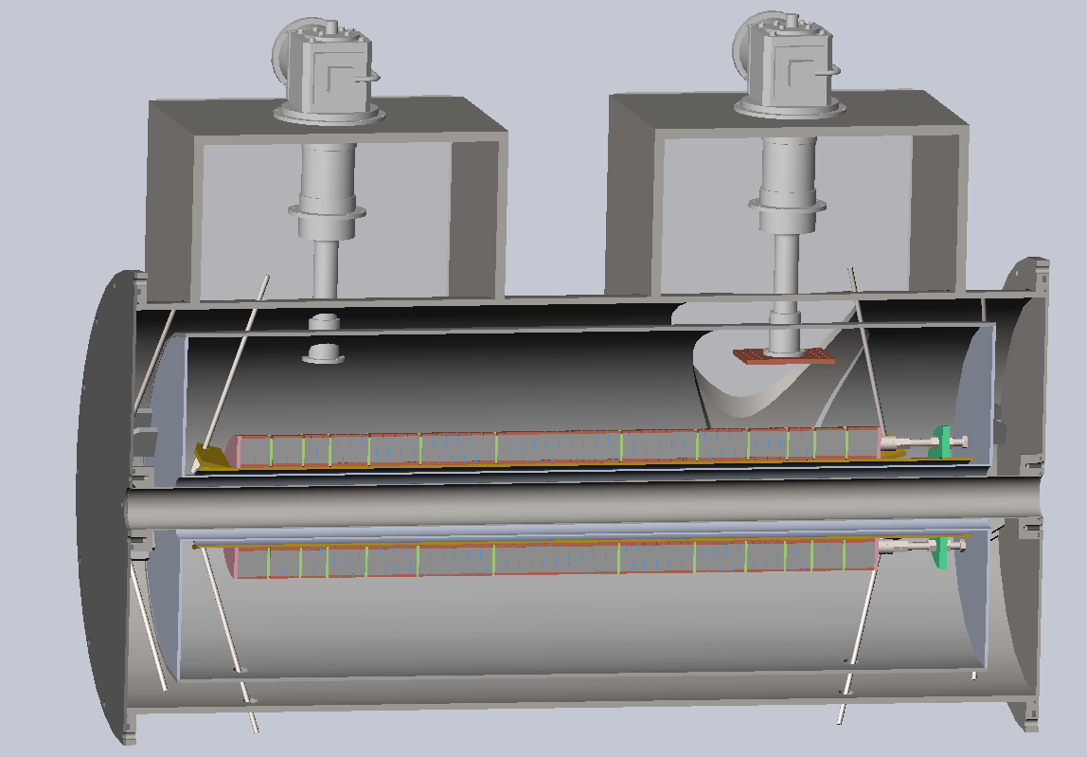
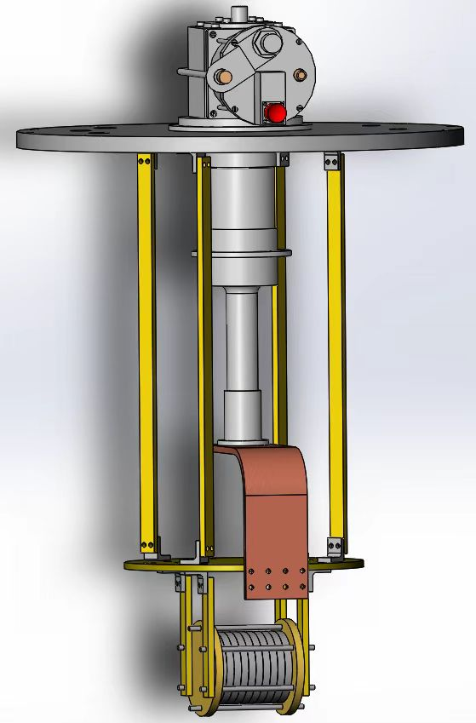
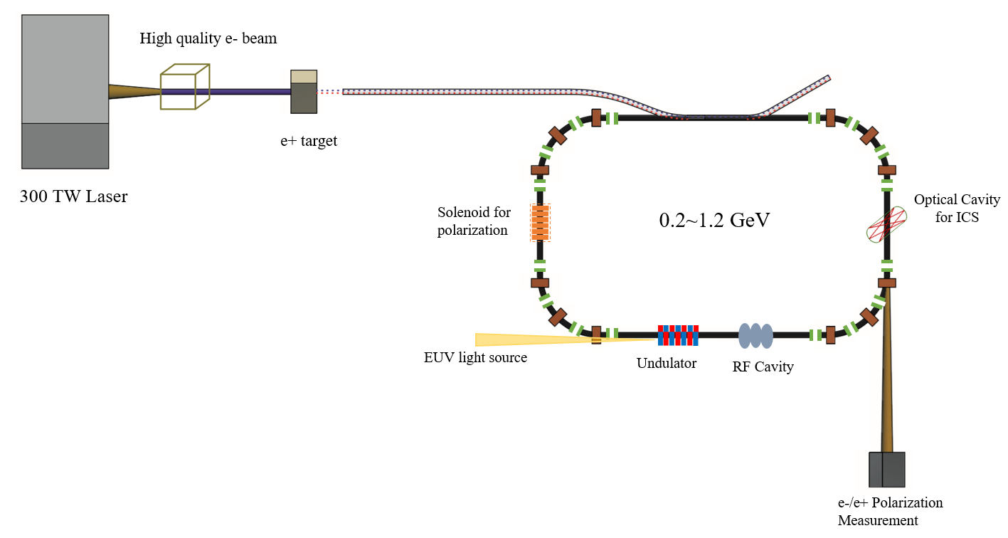
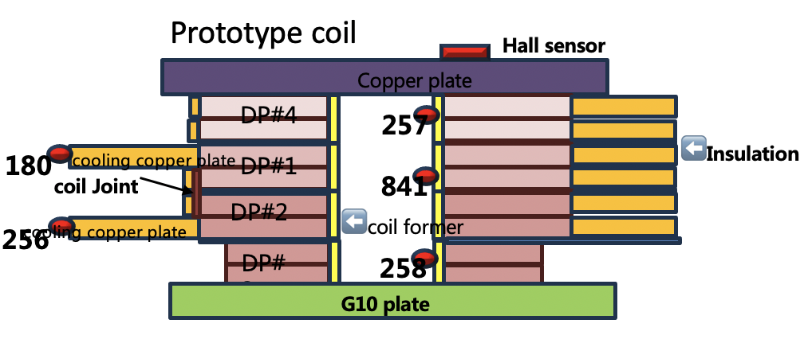

YBCO Superconducting solenoid spin rotator R&D
Concept
HTS with conduction-cooling
Coil design and optimization
integral field meets spec
max stress within limit
Experiment studies
Temperature homogeniety
Stability of YBCO coils
Measurements in 2027 followed by beam tests at LPA-Ring TF
Cryo-cooler
Design specs：
Peak field: 12 T
Integral field：10.34T.m
Length：1.018m
Working current：300A
Coil aperture：140mm
magnet aperture > 64mm
Vacuum Dewar
Solenoid
10.5 T$∙$m Solenoid as a Siberian snake
Longitudinal polarization
LPA-Ring TF
Zhao Ling, Xu Qingjin, Hou Zhilong, Zhou Jin, Liu Zhongxiu etc

Slide 10
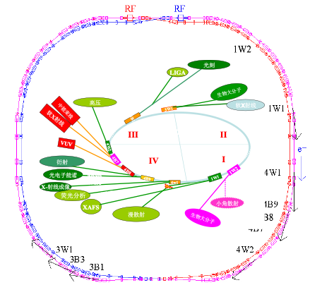
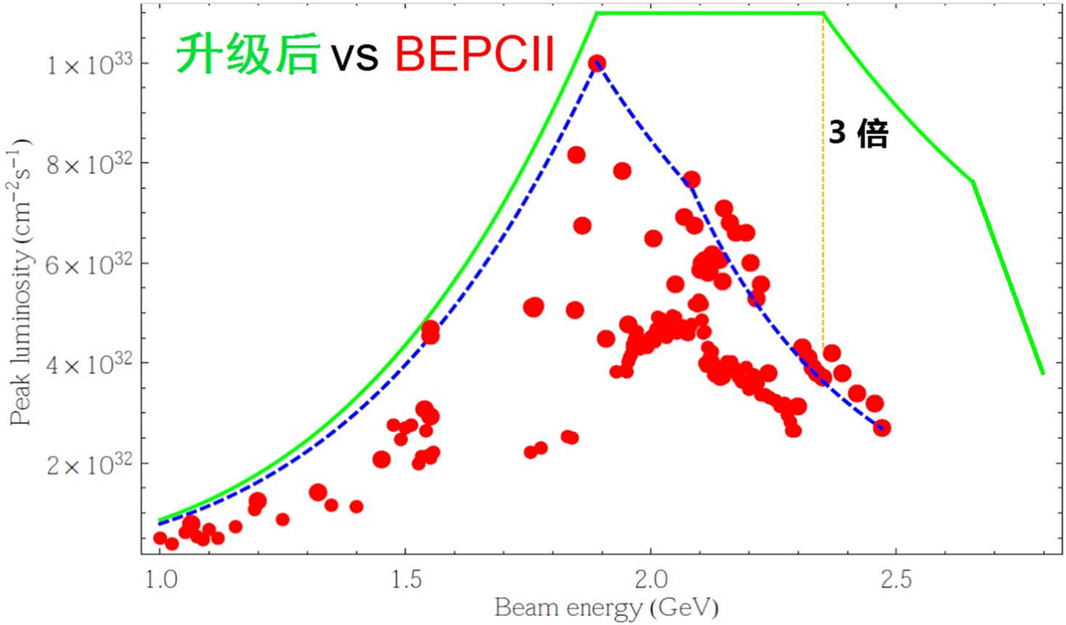
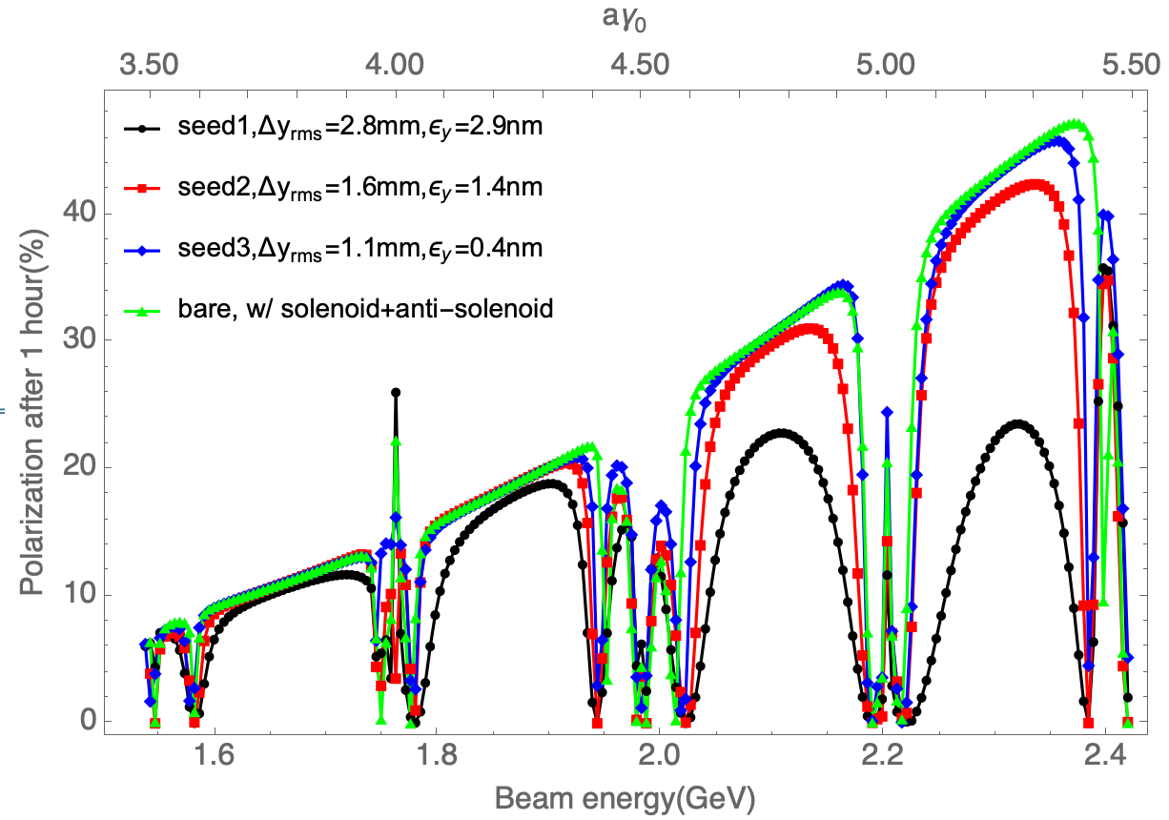
BEPCII upgrade project and beam polarization
BEPCII upgrade project (2025-2030): higher luminosity (x3 @ 2.35 GeV) & higher energy (up to 2.8 GeV)
Home-developed SCQ, SRF; CGEM detector (Italy)
e- beam is spontaneously vertical polarized due to spin flip in synchrotron radiation
Simulations show a sizable polarization in routine operation conditions
Vertical polarization 1 hour after injection
SR commissioning
Colliding beams at 1.84 GeV
Start tunnel installation
2024.7
2025.1
2025.5
Linac resumes operation

Slide 11
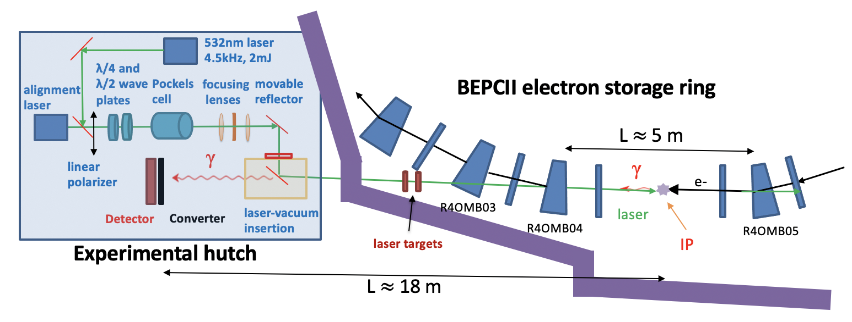
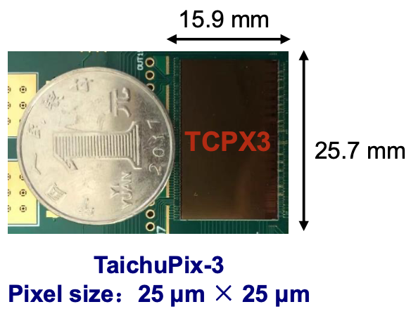
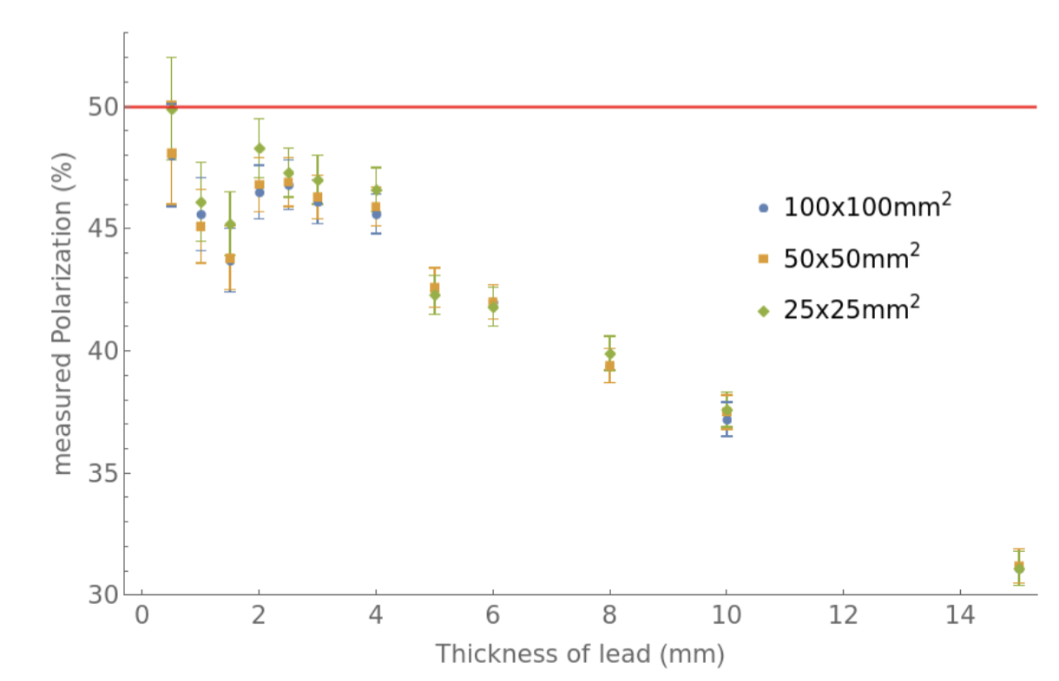
Compton polarimeter @ BEPCII
CEPC vertex detector prototype
Location | beamline and experimental hall of 4W2 wiggler
Laser | 532nm, 4.5 kHz, 2 mJ, 1 ns, flippable circular polarization
Observable | Vertical asymmetry of backscattered γ (up to 180 MeV)
Detector | lead preshower + silicon pixel detector
Signal | backscattered γ ~ 20kHz/mA/W
Background | bremsstruhlung γ ~ 1kHz/mA
Assume 50% vertical polarization
MC simulation
Measured polarization (%)
~1% stats uncertainty in ~ 20 sec
Thickness of lead (mm)
11
Su Mengyu, Duan Zhe, A. Martens (IJClab), Liang Zhijun, Tang Guangyi, Wang Jianli etc
11

Slide 12
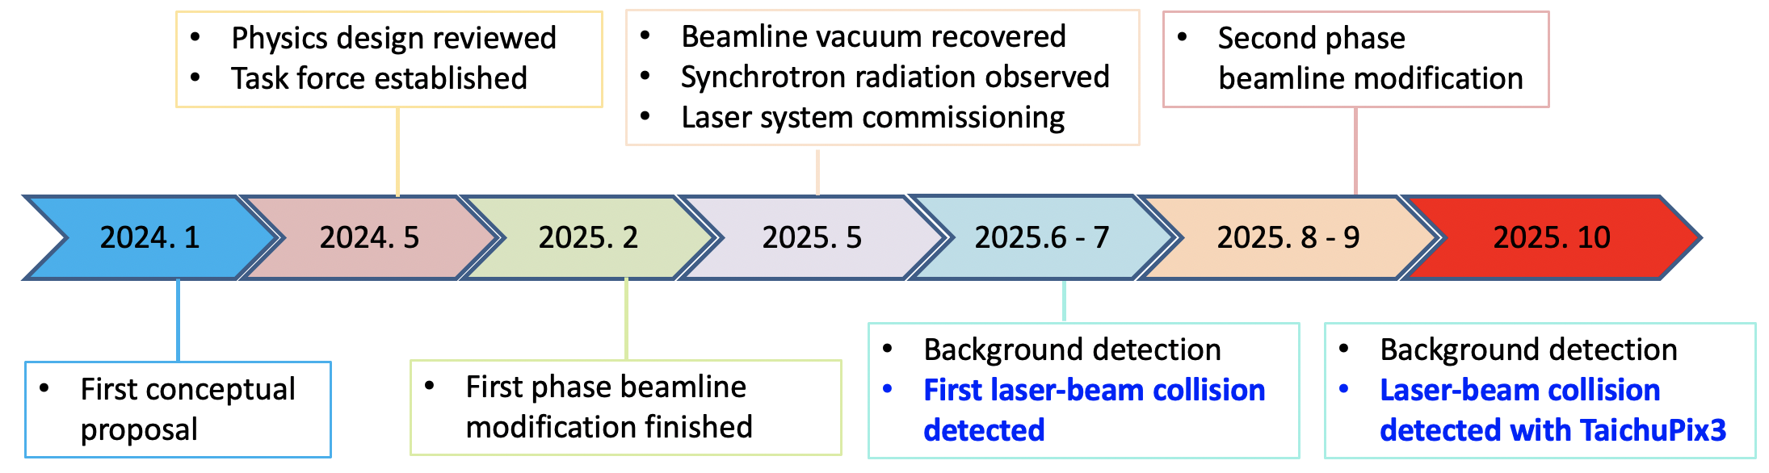
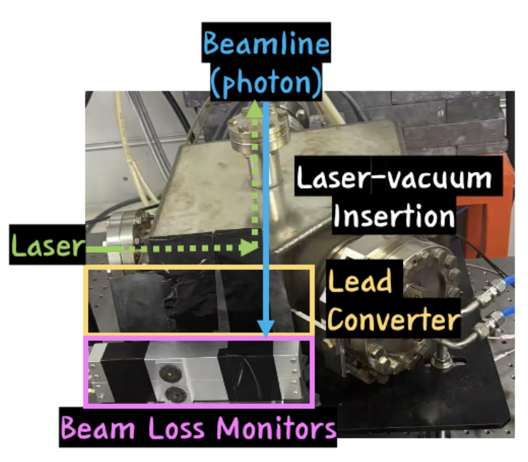
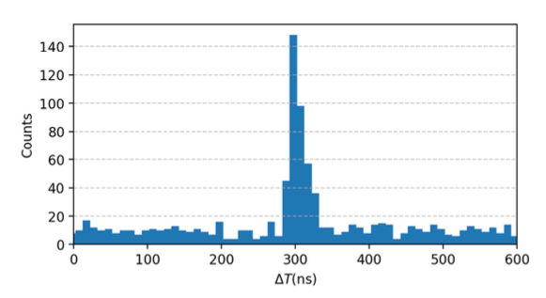
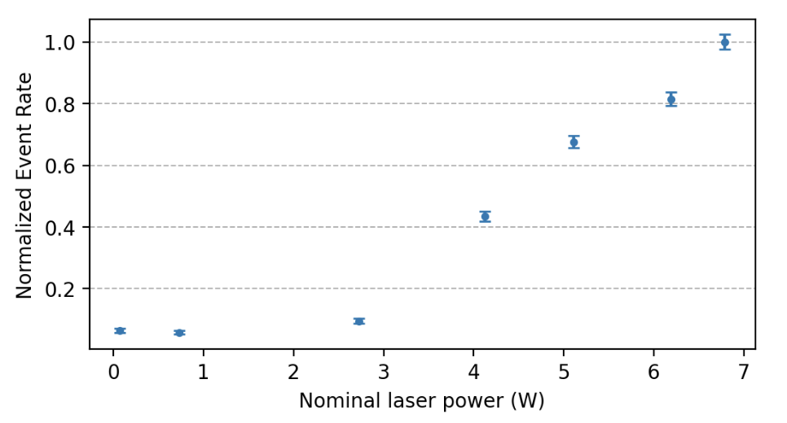
Progress and status
First polarization measurement?
2025.11
Causality between laser & signal
Correlation between signal intensity and laser power
plastic scintiliator + PMT
Status report to be submitted to RDTM

Slide 13
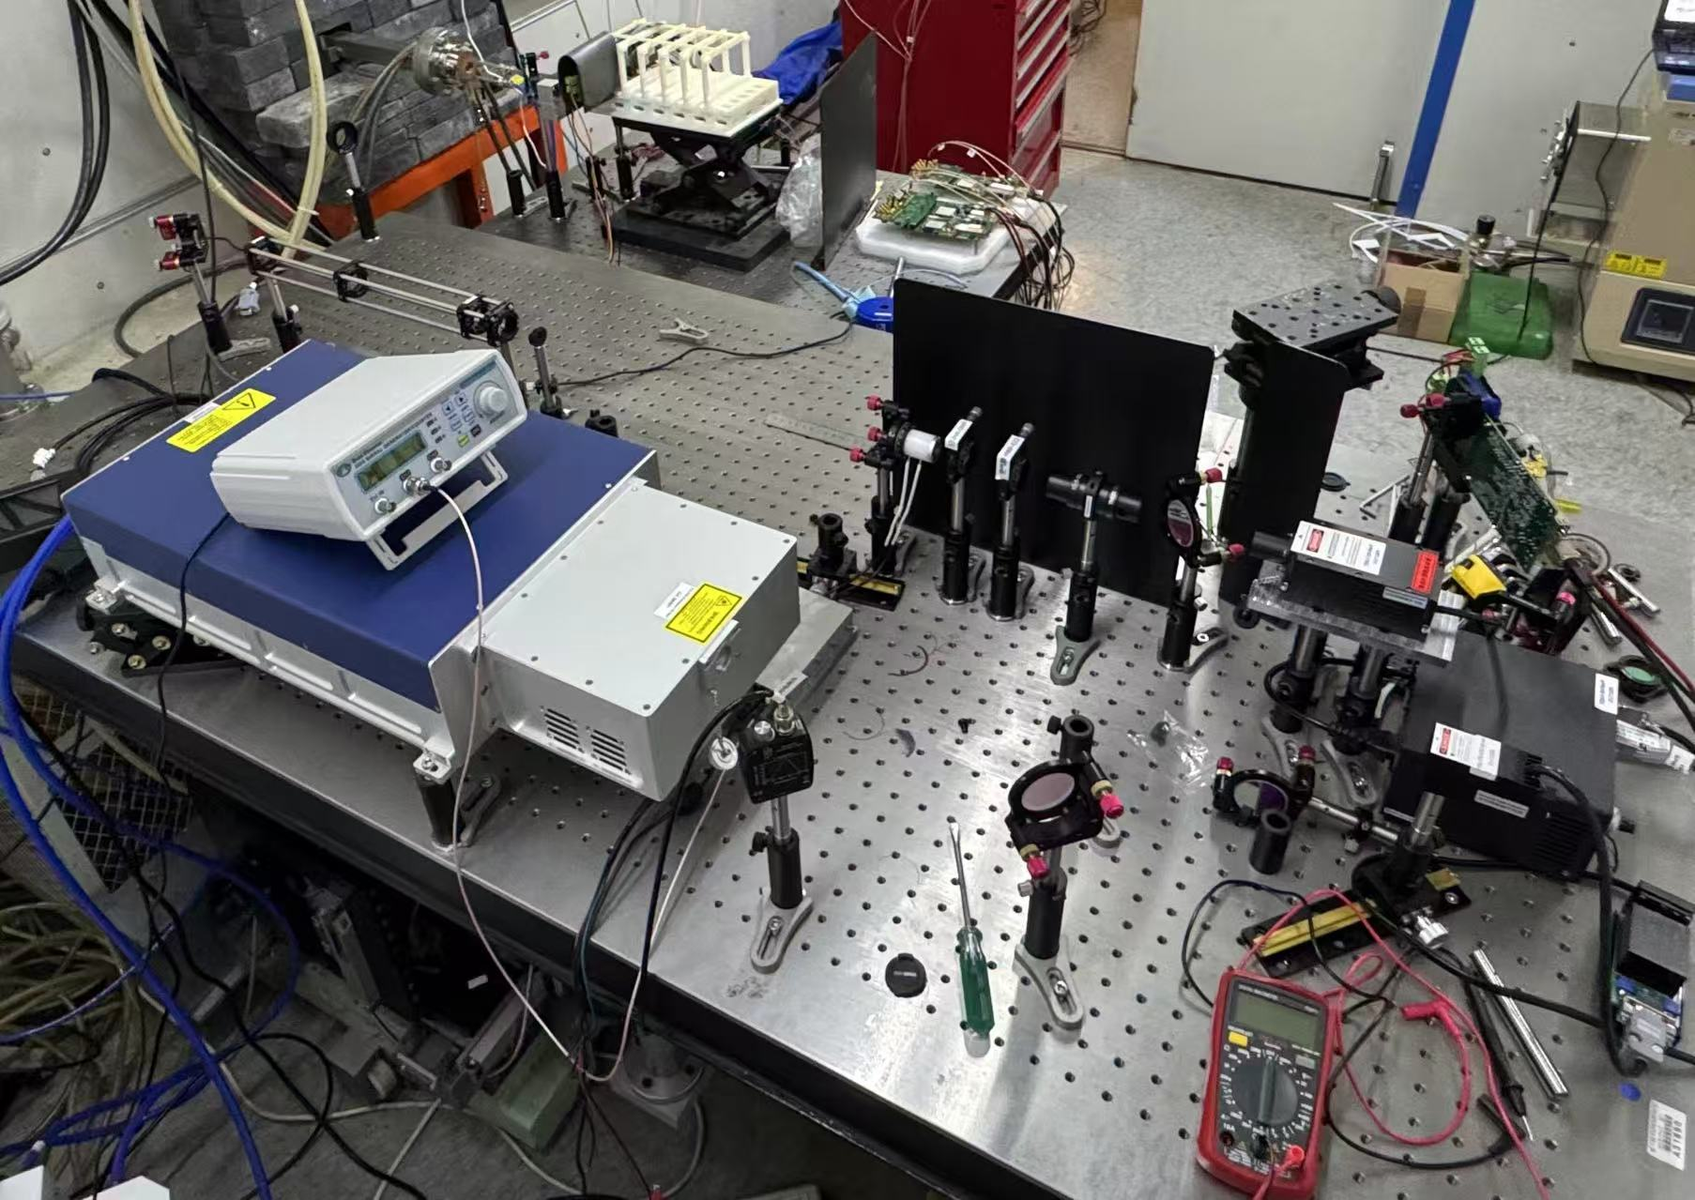
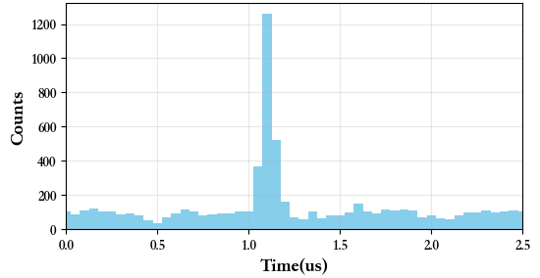
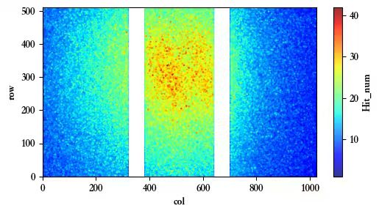
Recent experiments with TaichuPix3
Commissioning of TaichuPix-3
Laser-to-Taichu as trigger
Laser-signal causality observed
Offline analysis of beam polarization is underway
TaichuPix3

Slide 14
Prospects of a Compton polarimeter @ BEPCII
Experimental studies to address
How to precisely measure beam polarization?
How to precisely calibrate beam energy?
How to mitigate depolarization effects in storage ring?
Aspects | R&D item
Compton polarimeter | laser polarization measurement/control, silicon pixel detector
Resonant depolarization | Operation scenarios, error analysis, colliding bunches & pilot bunches
Depolarization mechanism | Rich data of parameter dependence, beam-beam depolarization
Polarization tuning/optimization | spin matching, machine learning techniques

Slide 15
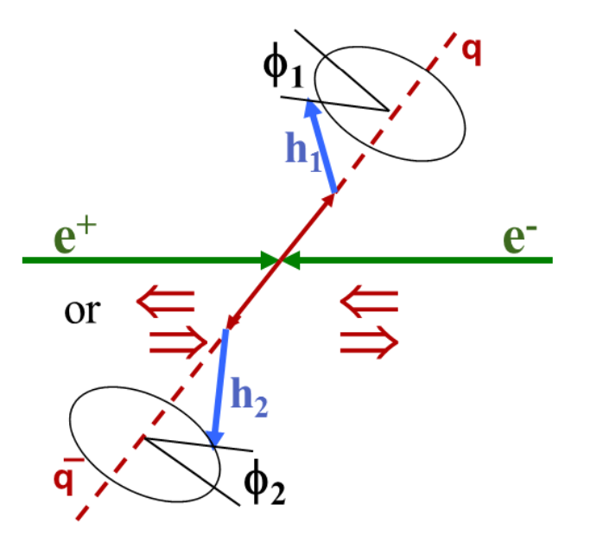
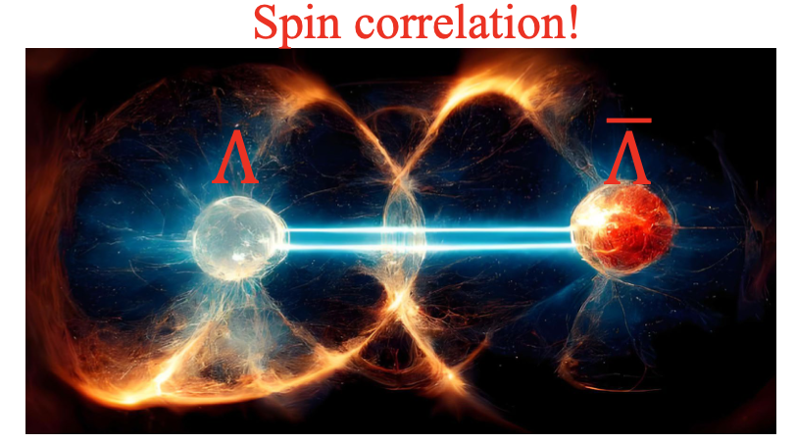
Motivation for longitudinal polarization at BEPCII
BESIII spin physics has flourishes, focusing on polarization of final products of e+e- collisions
Nature,606,64-69,2022; PRL 116,042001, 2016; PRL 130, 231901, 2023; arXiv:2502.16084
e- longitudinal polarization will greatly enhance the spin physics potential at BESIII
Entangled hyperon-antihyperon pairs for CP tests;
Spin dependent fragmentation function
Nucleon form factor etc.
Refer to LI Haibo, “Spin physics at BESIII”, SPIN 2025, Qingdao, Sep 2025

Slide 16
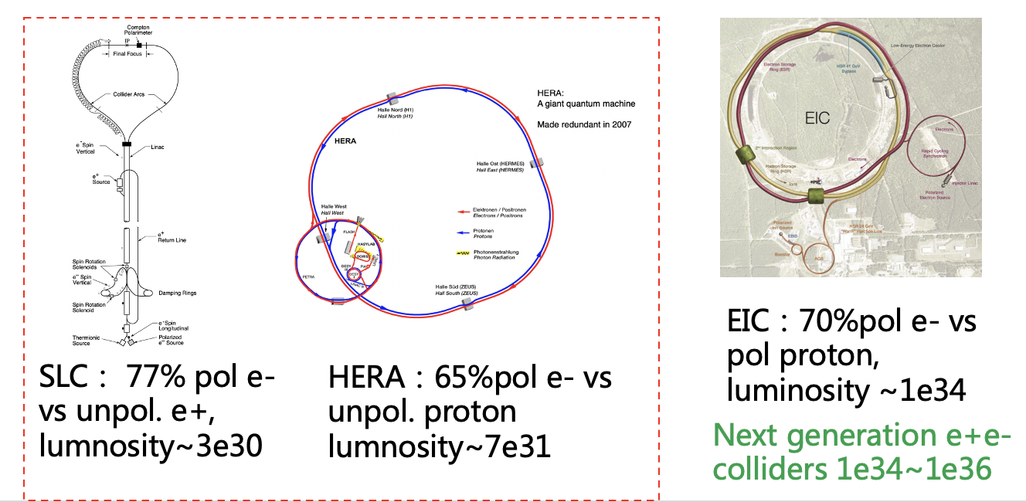
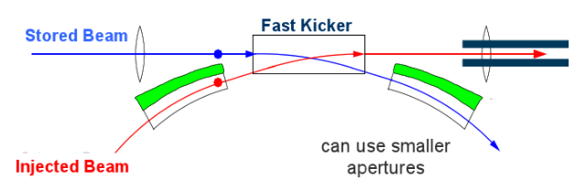
Motivation for longitudinal polarization at BEPCII
e- longitudinal polarization at BEPCII: a demonstrator for future colliders including CEPC
simultaneous achievement of high luminosity and high longitudinal polarization
swap-out injection applied to e+e- collider, already demonstrated at APS-U & HEPS
Long-term operation of polarized electron source
Precision Compton polarimetry
swap-out injection
Courtesy of C. Steier

Slide 17
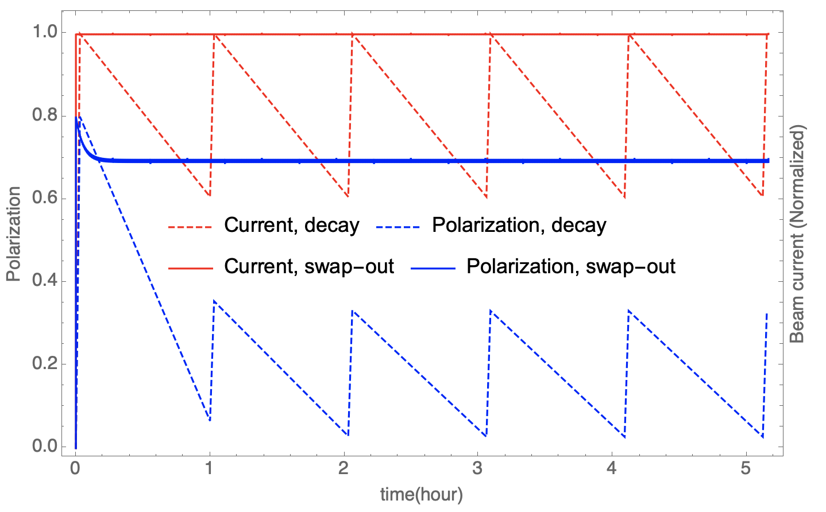
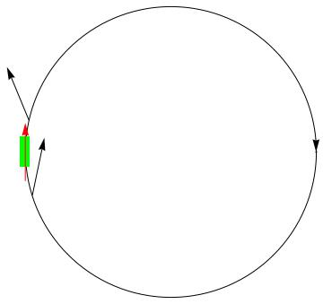
Polarization issues at 1.55 GeV
Sokolov-Ternov time is 10.5 hour, beam lifetime is 1~2 hour
Inserting a Siberian snake to attain longitudinal polarization at IP
Depolarization time is 24 min for a spin matched snake (requirements on lattice design)
Frequent extraction of depolarized bunches & injection of fresh polarized bunches
e.g. replace 1/12 of all 120 bunches every 20 seconds
for an injected beam polarization 80%, time-averaged polarization ~ 70%
A single full snake

Slide 18
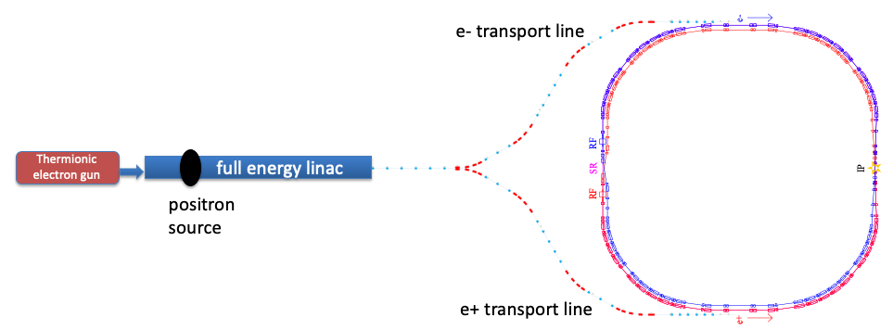
Layout of BEPCII

Slide 19
Modified layout for longitudinal polarization
Key issue 3: injection
injection
Key issue1： polarized e- source
Key issue 5: polarimetry
spin rotator
Compton polarimeter
Siberian
snake
150kV polarized DC gun
wien filter
Mott polarimeter
Key issue 2: spin manipulation
extraction to beam dump
Detailed design study is under way.
Key issue 4: extraction

Slide 20
International collaborators
Spin dynamics studies
D. Barber (DESY), E. Forest (KEK), S. Nikitin (BINP)
contribute to FCC-ee EPOL collaboration
Compton polarimeter
A. Martens (IJCLab, supported by FCPPN)
Instructive discussions with I. Nikolaev, V. Kaminskiy (BINP)
A laser-vacuum insertion was borrowed from BEMS @ BESIII for early commissioning, granted by N. Muchnoi and M. Achasov (BINP)
Polarized electron source
V. Tyukin (JGU Mainz, supported by PIFI program of CAS)
Polarized positron source
I. Chaikovska, Yuting Wang etc (IJCLab, supported by FCPPN )

Slide 21
Summary
Potential of polarized beam at CEPC is reviewed
R&D of key technologies in progress
Longitudinal polarization option is being studied for BEPCII
These activities will set the basis for polarization applications at CEPC
Thank you for your attention!

