Slide 1
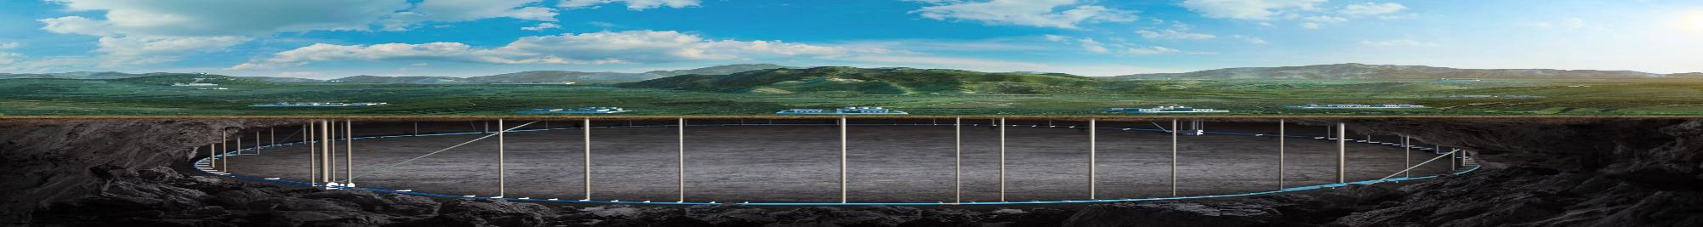



CEPC DeepC Status
Reporter: Song Jin (IHEP)/ Lei Ye (HDEC)
For CEPC accelerator group
CEPC workshop 2025, November 6-10 2025， Guangzhou, China
Notes:
Hello everyone，I am songjin from IHEP。 My topic is deepc status。 It is documentation system。

Slide 2
Contents
1
Introduction
2
DeepC electronic documentation system
3
Pilot application on CEPC
4
Market application and Future Prospects
Notes:
There are 4 parts。1st brief background introduction. 2nd is software development. 3rd is about pilot applications on CEPC. Last is some other applications and future porspects.

Slide 3
Contents
1
Introduction
2
DeepC electronic documentation system
3
Pilot application on CEPC
4
Market application and Future Prospects

Slide 4
1. Introduction
CEPC is one of most advanced future colliders with a large-scale accelerator complex.
A 1.8 km 30GeV Linac
Two 100 km circular accelerators, booster and collider
A dozen of subjects
A large amount of devices or components
~40,000 magnets; ~38,000 magnet power supplies;
~80,000 mechanical supporters; ~300 km vacuum system;
~300 superconducting RF cavities; ~200 klystron; etc.;
A software tool will be very helpful to manage parameters and documents, provide a cooperative working environment , follow-up progress and so on.
CEPC accelerator involves over a dozen systems with more than 800k components
Superconducting RF
linac
Radiation protection
Collider Magnet
Superconducting magnet
Booster Magnet
Beam instrument
Survey and Alignment
Cryogenic system
Power supply
Control
Accelerator physics
Vacuum system
Mechanical system
Injection and Extraction
MDI

Slide 5
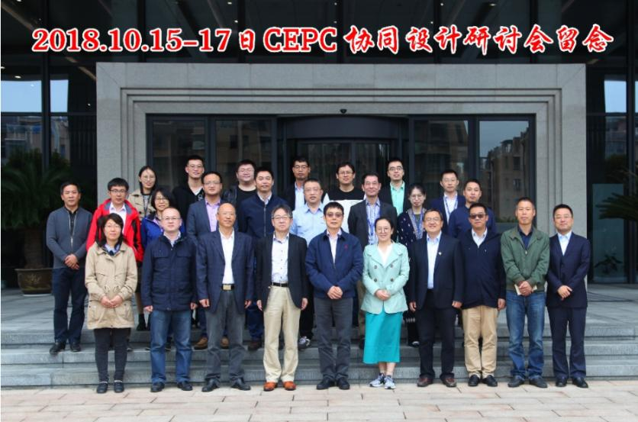
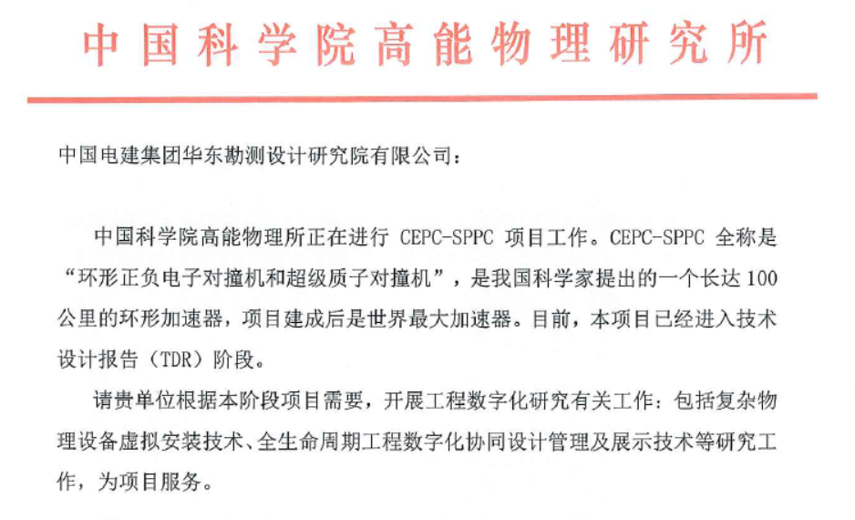
This work started in cooperation with HDEC
We started this work in 2018, mainly based on the cooperation with one of CIPC members, Huadong Engineering Company (HDEC) .

Slide 6
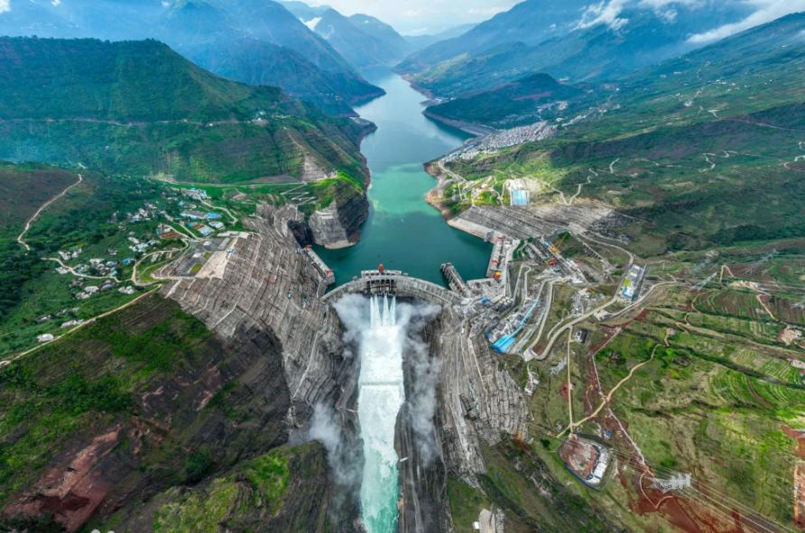
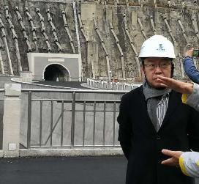
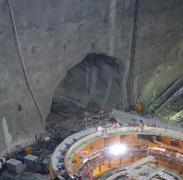
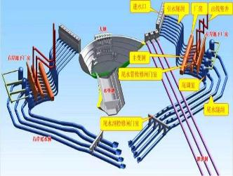
Work experience of HDEC
HDEC has extensive engineering experience.
It has undertaken more than 300 hydropower projects alone, including the second largest dam in the world, Baihetan Dam, ~178 Billion in 2017-2021.
HDEC is also famous for its digital design capability.
Since 2004, HDEC has taken the lead in developing China's first 3D digital design platform enabling full-lifecycle management.
In partnership with Bentley, advanced the application of BIM in hydropower projects.
Baihetan Dam（2017-2021）
The second largest dam in the world， ~178 Billion RMB

Slide 7
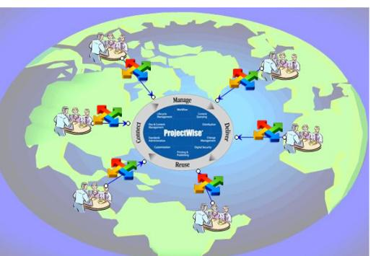
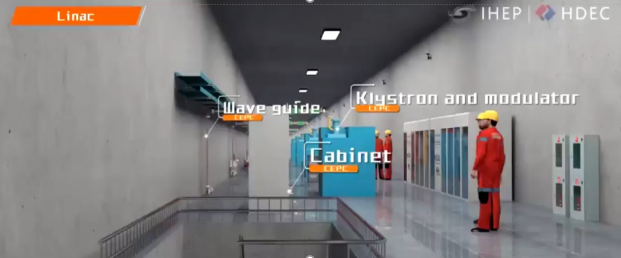
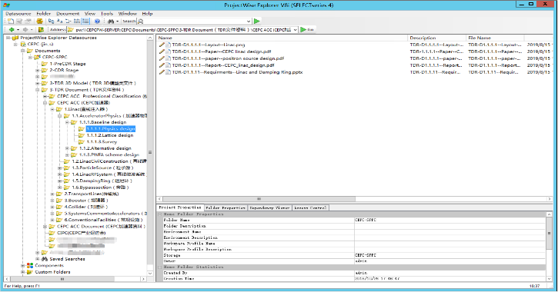
Preliminary works based on ProjectWise
Initial works are based on a software called ProjectWise by Bentley. A 3d video was made according to CEPC CDR design.
Several key-factors to well use the software were learnt including: Clear positioning, systematic management planning, and effective promotion.

Slide 8
Contents
1
Introduction
2
DeepC: An electronic documentation system
3
Pilot application on CEPC
4
Current Adoption and Future Prospects

Slide 9
The problems we met in former work
During the use of ProjectWise we met several problems due to complexity of CEPC.
 | Traditional projects | CEPC
1 | Such as Hydropower station | Large scientific projects /Modern large-scale engineering projects.
2 | Few domains, mainly focusing on infrastructure and electromechanical systems. A single type of data center can meet the needs. | Convergence point for science, technology and engineering. It requires multi-center management with strong interdependencies.
3 | Professional barriers are not very high. | More specialized fields and higher professional barriers. The multiple dimensions is of great importance.
4 | The demand for interdisciplinary talent is moderate. | Besides multi-center, multi-dimensional, the deeply integration also important to ease the cross-disciplinary management.

Slide 10
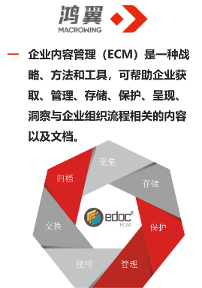


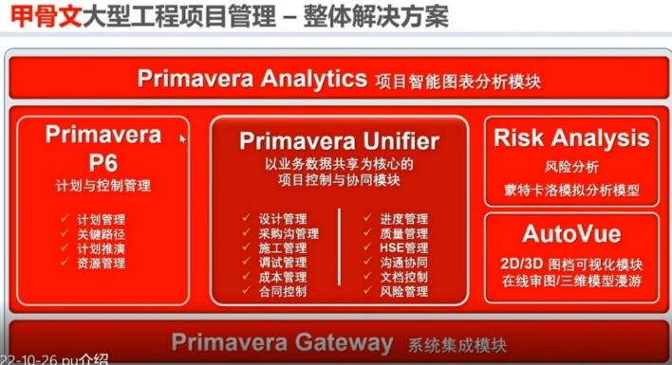
Survey for commercial software
After extensive market survey, we have not identified commercial software well-suited to our needs.
Potential Competitors & Representative Products | Data Production & Application | Data Governance
 |  | Data standards | Engineering Algorithm
Macrowing Emphasis on the management of unstructured data | weak | unstructured data | can be integrated with Primavera P6
DTSTACK, DTWAVE… Provide data warehousing services | weak | Good | weak
Primavera Unifier Provide solutions for managing projects and facilities | flexible module configuration functionality | weak | Can be integrated with Primavera P6
Data Management
Data Governance
Oracle's Project Management Solutions
Project and Asset Management

Slide 11

Development Goals
So, we decide to develop a new software for electronic documentation.
Preserve the advantages of the existing solution: standardization, process orientation, integration, security, and real-time capability.
Through a shared data foundation, rebuild the underlying architecture to enable:
Multi-dimensional project breakdown
Seamless file metadata exchange
Unified government of multi-source data
Align with evolving trends by using AI-driven enhancements to develop more flexible applications.

Slide 12
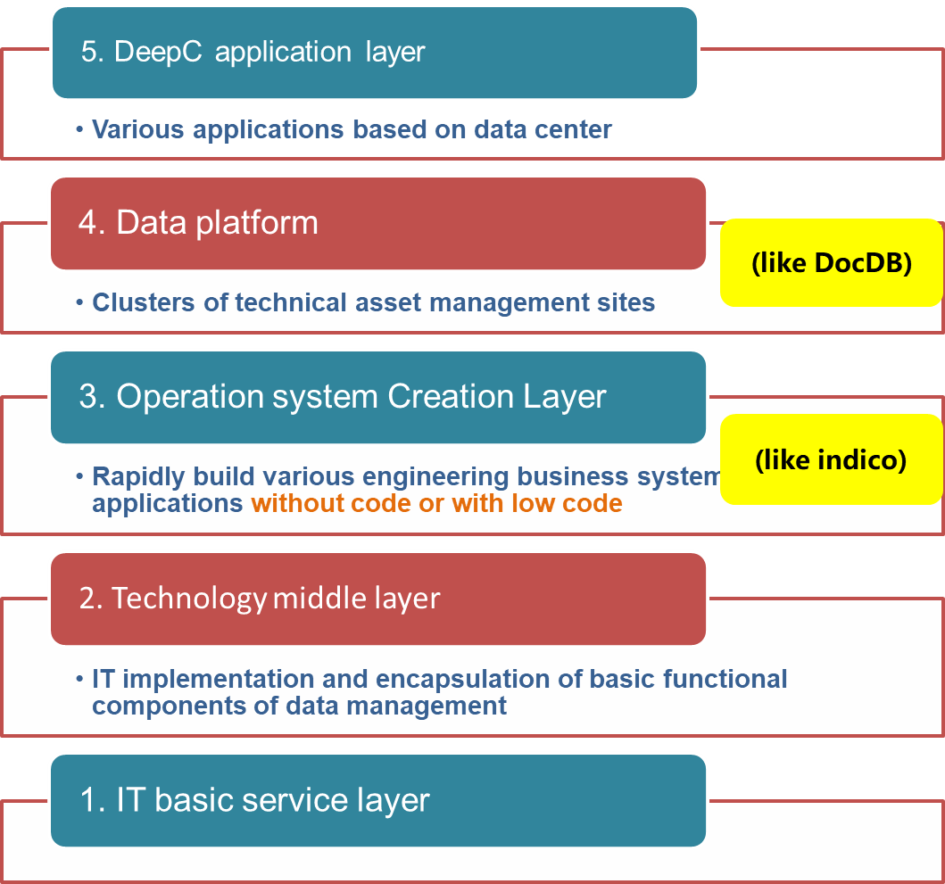




Development Principle for the DeepC
Data Production
APP
DKE
Graph Database
DLE
DeepC Data Governance Engine Driven Data Flywheel
Base data
for interaction
Data Application
Various layers of DeepC development

Slide 13
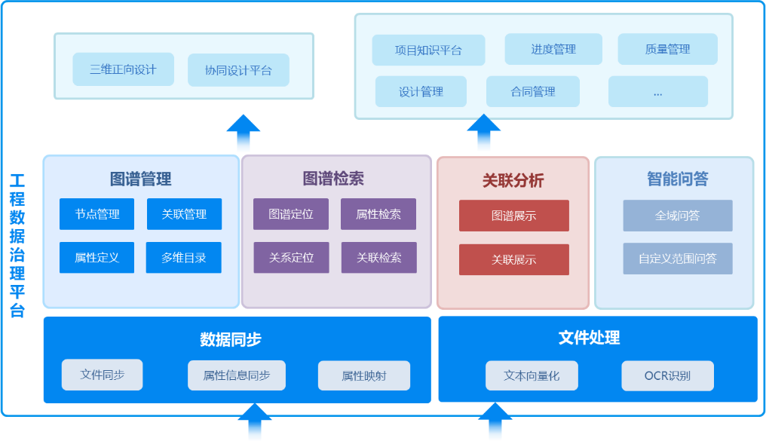
Architecture of DeepC
The main idea is to form an architecture called “one-graph, one-database and one-platform”.
Database for the digital knowledge storage.
Graph means Knowledge graph for developing data relationships.
Platform is mainly for customizing applications.
Application Platform
Knowledge Graph
Database
一图、一库、一平台
Data resources
Notes:
目前

Slide 14

DeepC completed after 6 years of dedicated effort
After ~6 years of dedicated effort, the DeepC was finally completed.
2024
Subsidiary established for promotion
成立子公司浙江迪普数据科技有限公司
2023
Technical perfection
进入华东院双创项目
2019
Basic function research
集团科研课题开展相关技术研究工作
Form an overall architecture of one graph, one database, and N application platforms
形成一图一库一平台的格局
Integrate data governance and AI capabilities for multi-project applications
融入数据治理和AI功能，多项目应用：
CEPC试点；华东院数字档案馆试点；形成大坝案例库V1.0产品；形成制度通、数据通等系列产品。
Research, development, and iteration of basic file and structured data management functions
以CEPC需求为牵引，完成基础功能并迭代；多维度的文件管理基础功能；结构化数据管理基础功能；在渝西、华东院科技管理资料收集等项目进行工程文件管理试点。

Slide 15
Main functions for data governance
 | Description
Two data categories | 1. Structured data: parameters: Physical, Technical, and Project related parameters
 | 2. Non-Structured data: documents: Technical, Engineering, Meetings and Publicity
Four primary functions (with visualization) | 1. Relationships between device parameters and engineering documents;
 | 2. Browse project progress in a data-driven way along multiple dimensions;
 | 3. 3D visualization；
 | 4. Intelligent （AI）enhanced tools built on the overall data model.

Slide 16
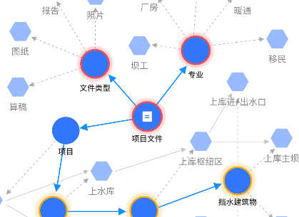
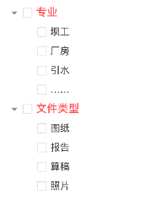
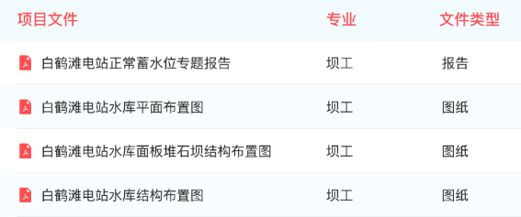
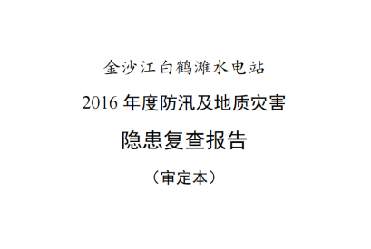
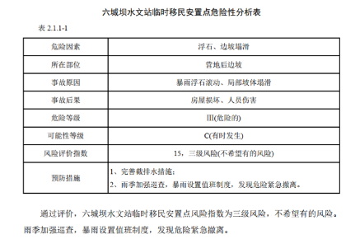
一、DeepC Key Functions: Document Management--Automated Document Processing
主要功能-文件管理-文件自动处理
1、文件上传 Document upload
4、工程数据自动治理
Automatic analyses and management
2、文件内容自动识别
Automatic identification
3、文件内容提取
Content extract
目录
表格
一般文本（规范、报告等）
开源+自研优化工具-全自动处理
原始文档
识别
OCR识别
版面分割
公式识别
表格识别
语义分割
生成问答对&摘要
图数据库存储
数据向量化

Slide 17

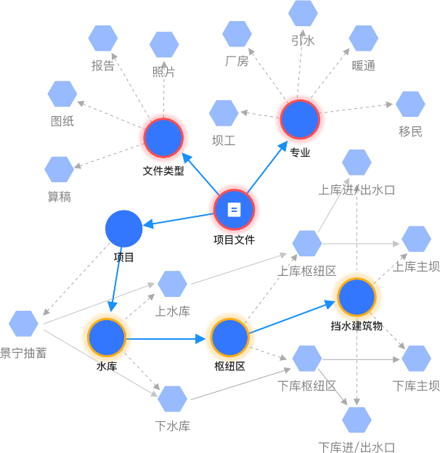
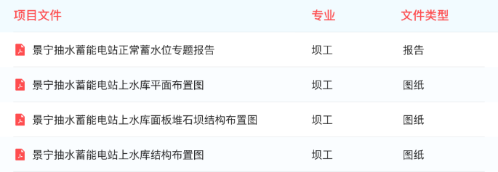
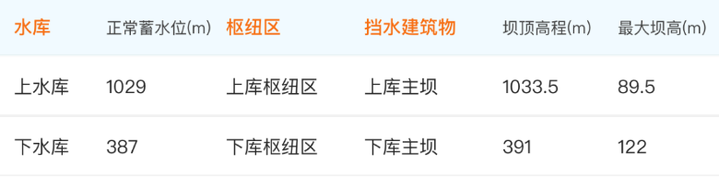
二、DeepC Key Functions- Data Management
Relationship building and elements selecting
Document classification (Unstructured data)
Engineering data extraction (Structured data)

Slide 18
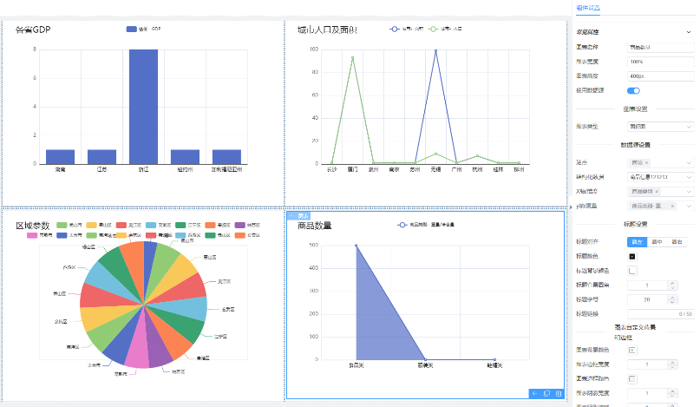
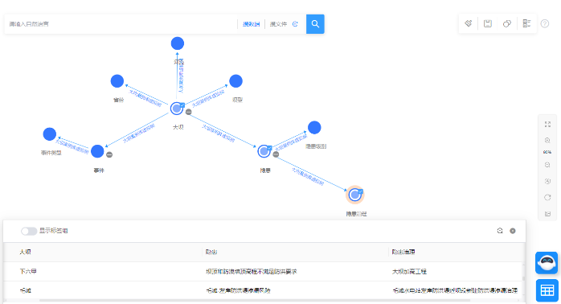
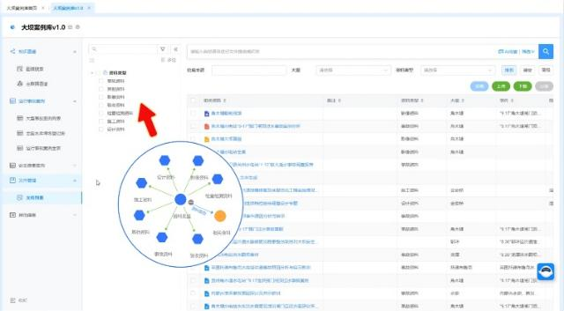
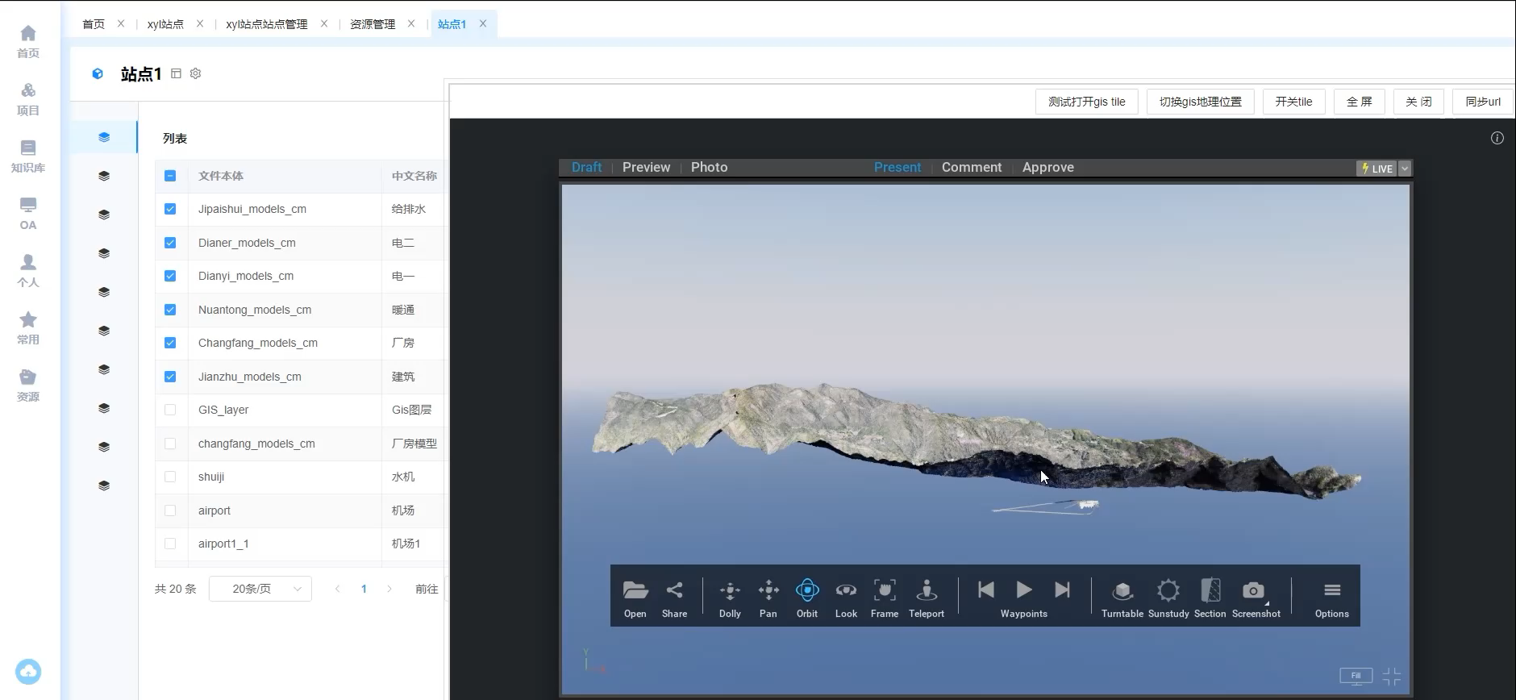
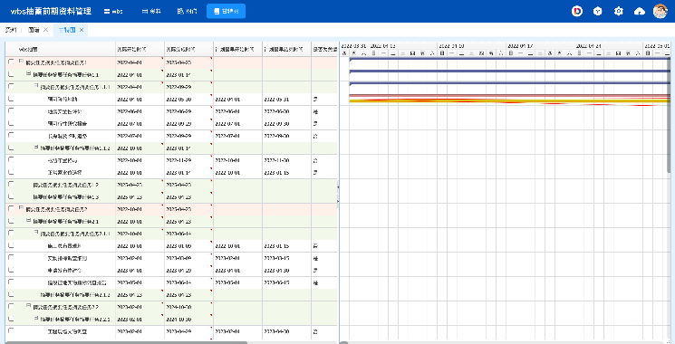
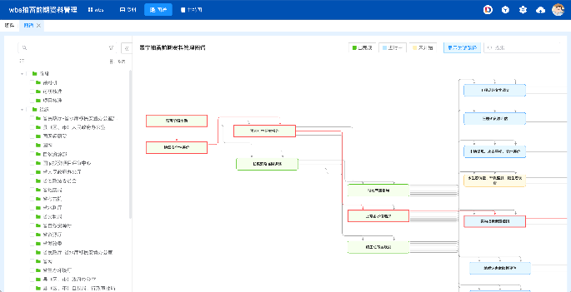
三、DeepC Key Functions – Data visualization
主要功能-数据可视化
Knowledge graph
Parameters
Workflow
3 Demonstration

Slide 19
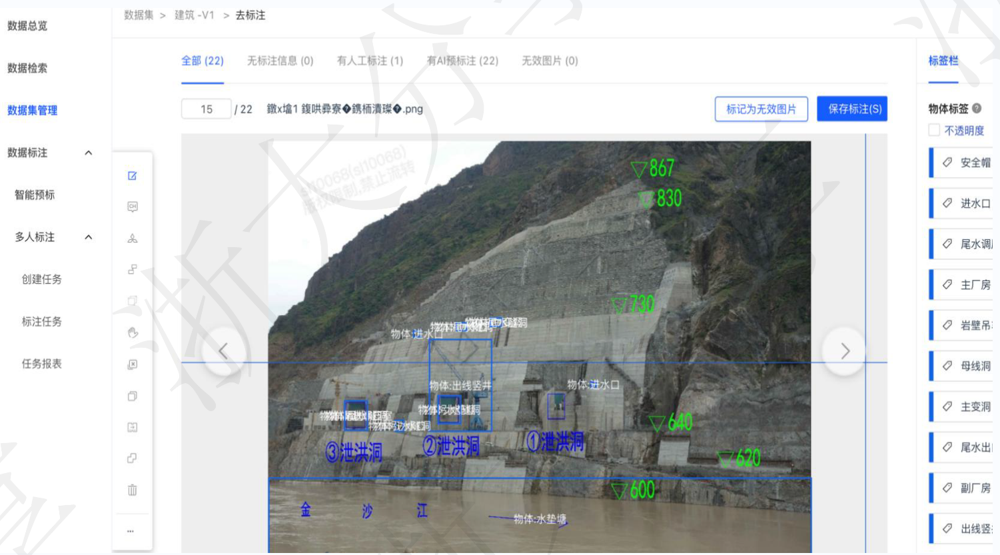
四、Intelligent Knowledge Base example
智能知识库
AI加强：工程图片识别
AI development for image training
AI-Pre-labeling
Provide pre-labeling services for multi-modal, open-vocabulary, and large-vocabulary object detection; tasks run automatically to cut labor costs.
Full-process support
Support both SFT and RLHF annotation modes, and offer diverse tools such as image–text chat and bounding-box selection to meet every assignment quickly and conveniently.
Quality inspection
Enable single-pass and double-pass quality inspection to guarantee accuracy and reliability, while real-time visual dashboards track progress and team status, boosting overall labeling efficiency.

Slide 20
Contents
1
Introduction
2
DeepC electronic documentation system
3
Pilot application on CEPC
4
Current Adoption and Future Prospects

Slide 21
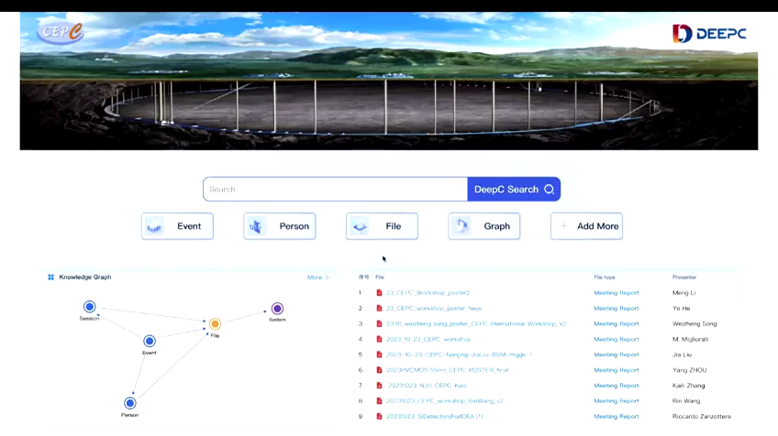
Pilot 1: Documents management for conferences and news（video）

Slide 22
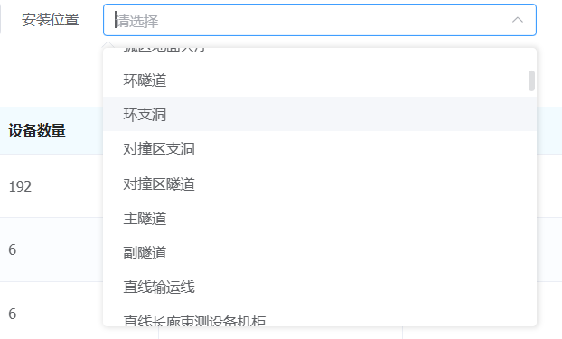
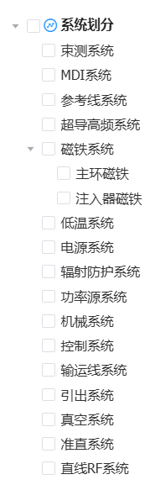

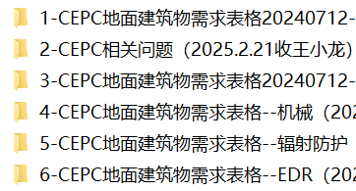
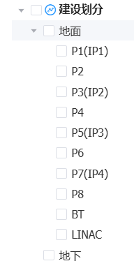
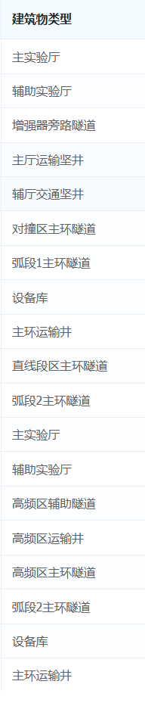
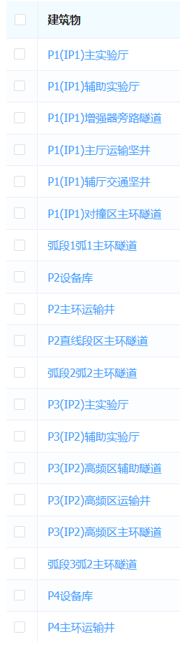
Pilot 2: CEPC Henan Site Selection, Survey and Design Project (河南选址勘测设计)
基本结构的初始搭建：CEPC机电基建需求参数
Initial Parameters of Electrical and Mechanical Infrastructure Demand
建筑部位/安装位置/工程部位
Building Components / Installation Points / Work Faces
建筑物按空间划分
Spatial Zoning of Buildings
原始资料及版本
Original Data & Version
具体建筑物
Individual Buildings
系统划分
System Architecture
建筑物按类型划分
Categorization by Building Type
Notes:
通过对已有参数的录入，完成对CEPC一个层面的数据建模

Slide 23
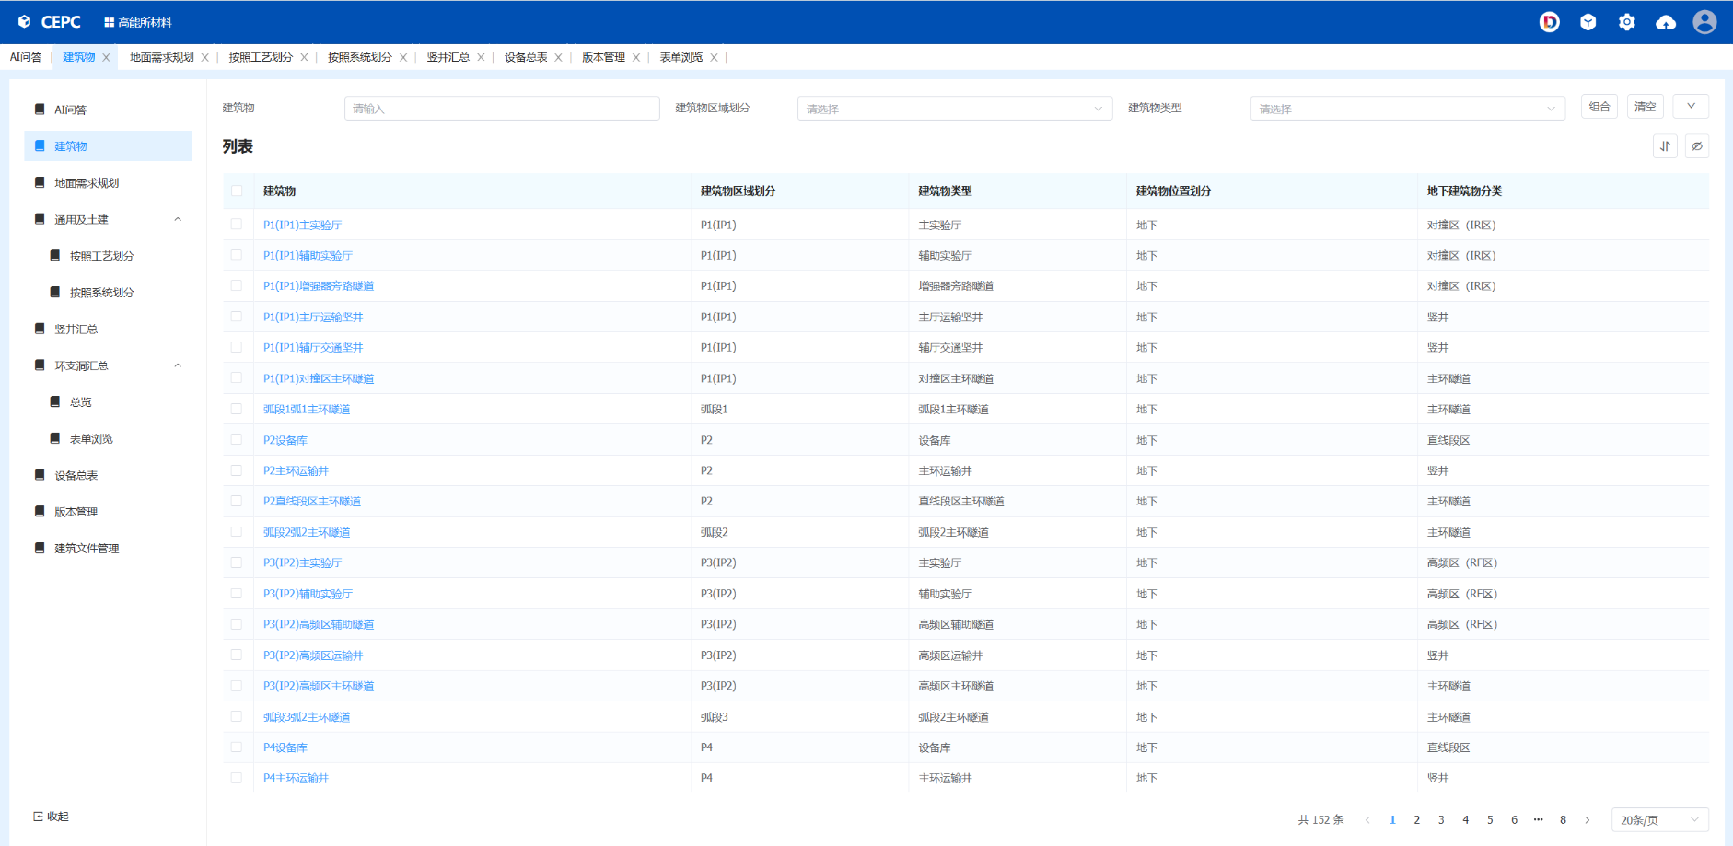
The formed dynamic set of building data requirements
形成的协同建筑数据需求集
Notes:
我们系统管理所有的Excel表。在这个层面上和IHEPdoc

Slide 24
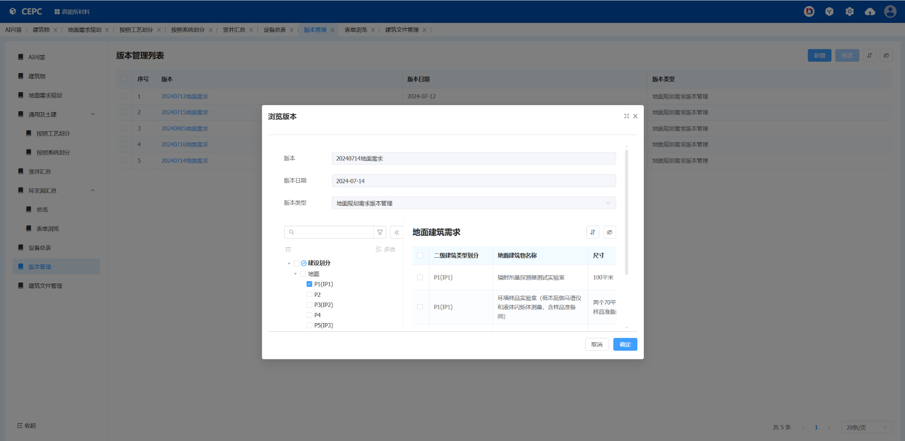
File version management
文件版本管理

Slide 25
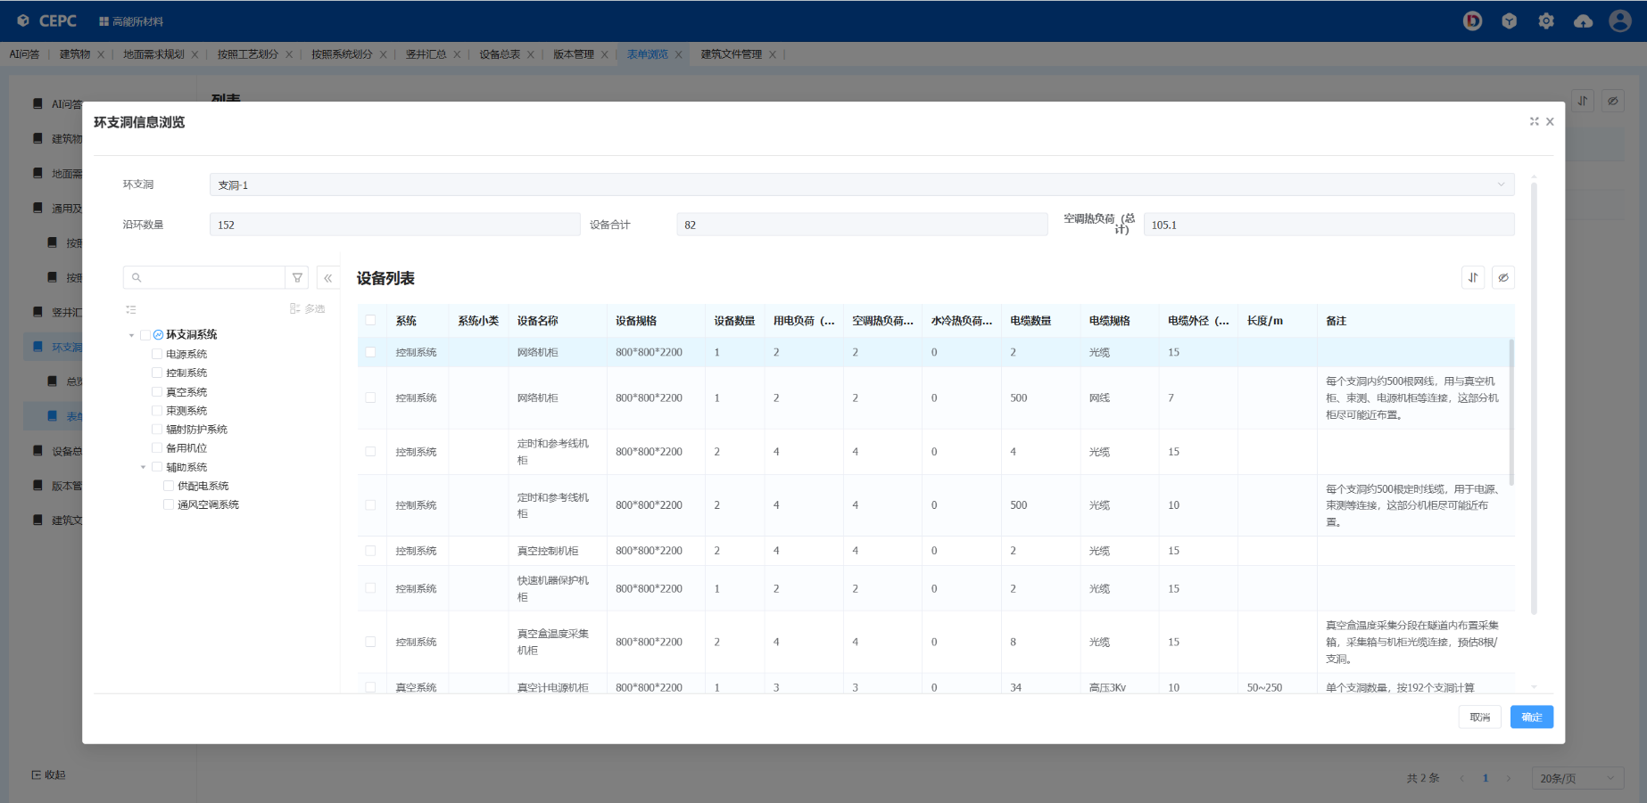
Table data management
表格数据管理

Slide 26
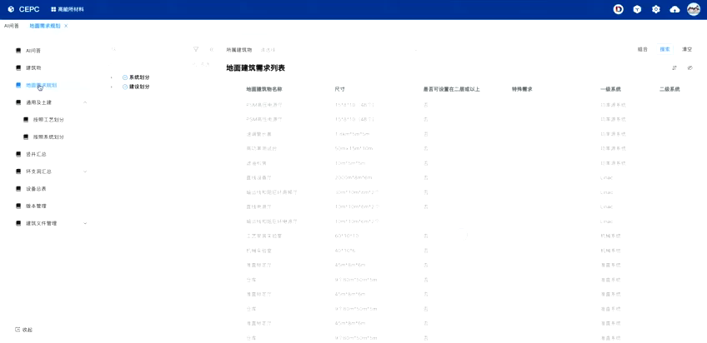
Data Utilization : Multi-Dimensional Combined Query
数据利用：多维度组合查询（video ）
Notes:
Through multi-dimensional queries, we can flexibly obtain the desired data.

Slide 27
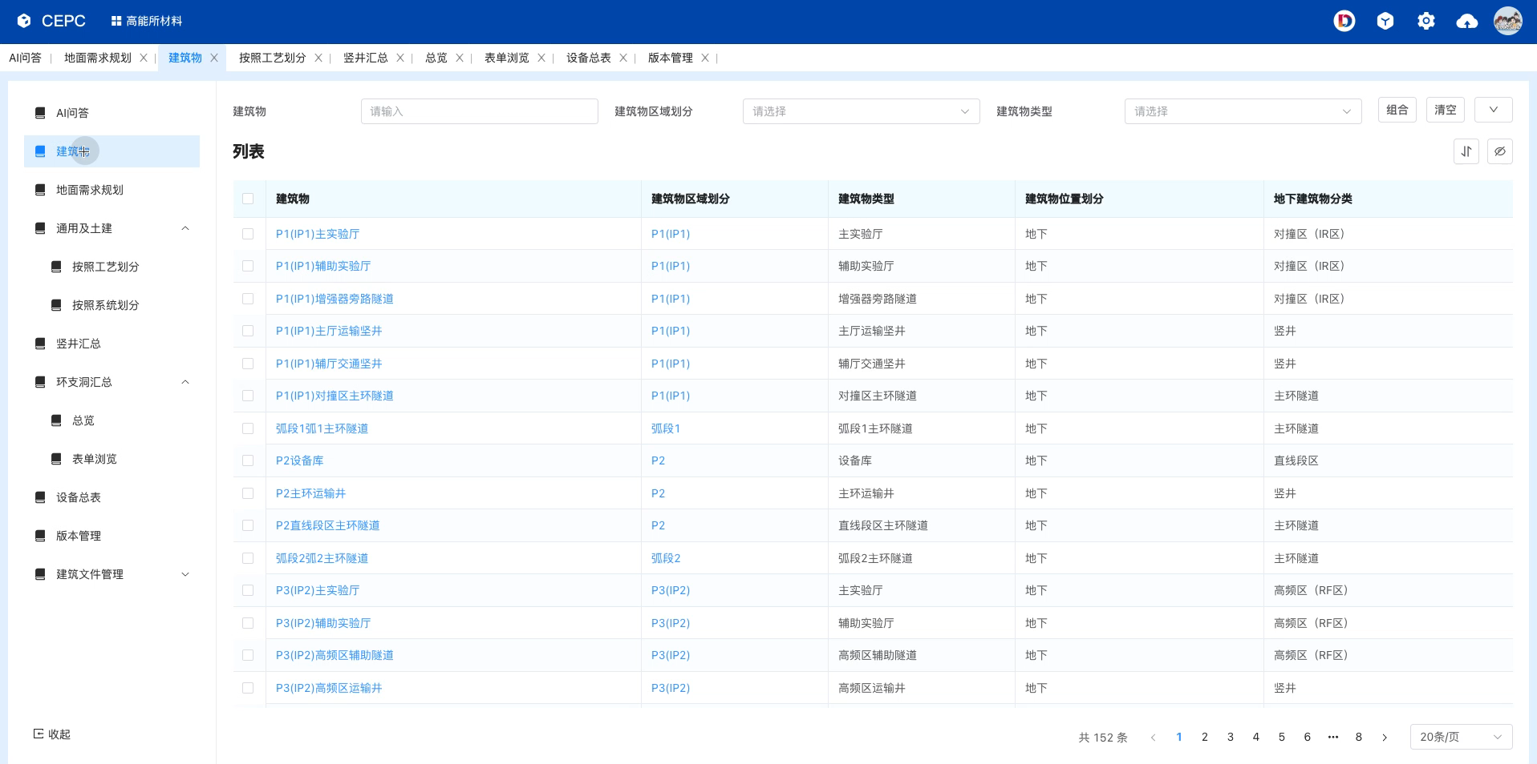
Data growth (survey design output result management)
数据生长（产出成果管理：勘测设计图纸等工程文件）

Slide 28
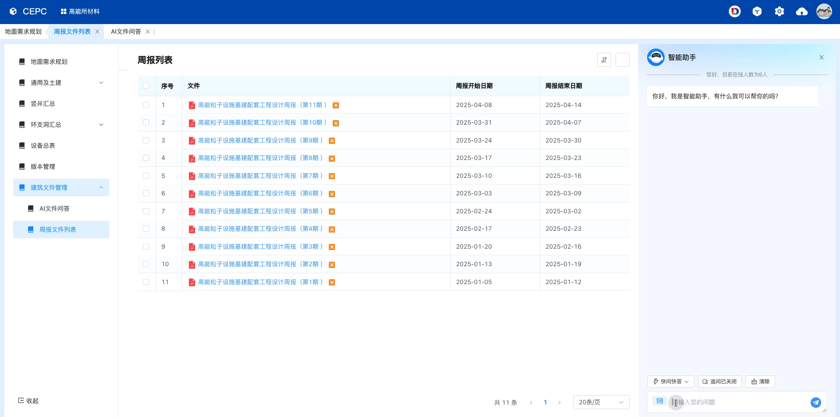
Data growth (output result management: weekly reports)
数据生长（产出成果管理：周报等管理文件）

Slide 29
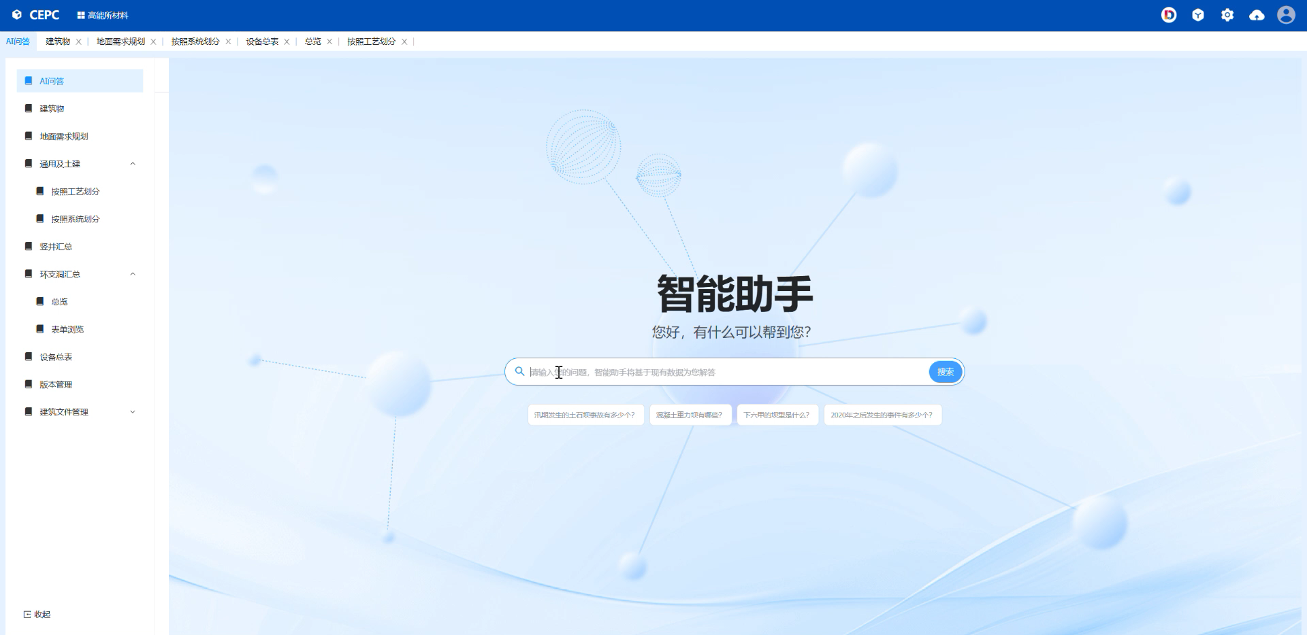
AI-enhanced data governance question-answer retrieval
数据利用：AI增强数据治理问答检索（video ）

Slide 30
Contents
1
Introduction
2
DeepC electronic documentation system
3
Pilot application on CEPC
4
Market application and Future Prospects

Slide 31
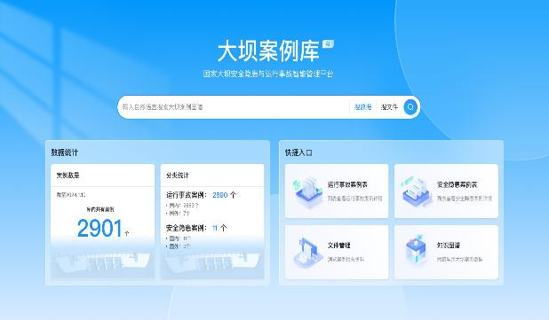
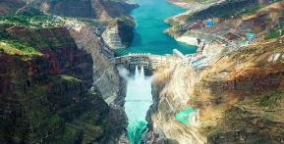
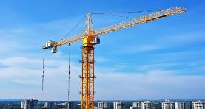
Other market applications
In addition to the CEPC, there are also several applications to industry.
Dam Case Library
大坝案例库
Hydroelectricity Knowledge Library
水电水利知识库
Baihetan Dam Project（2017-2021）
The second largest dam in the world， ~178 Billion RMB

Slide 32
Prospects
Currently, DeepC could work for project construction. However it still falls short of full-lifecycle management, such as accelerator operations as noted by the IARC committee.
Continuous improvements should be necessary.
Meanwhile, through improvements, greater commercial value could be generated for industry.
Management and data processing methods could be more suitable for the modern large-scale engineering projects.
In-depth developed of AI logic could serve modern engineering projects.

Slide 33




Thanks！
Let data drive engineering, and let engineering advance toward intelligence!
让数据驱动工程，让工程走向智能!

Slide 34
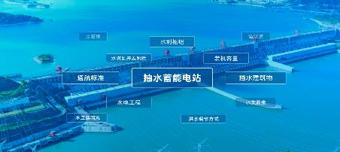

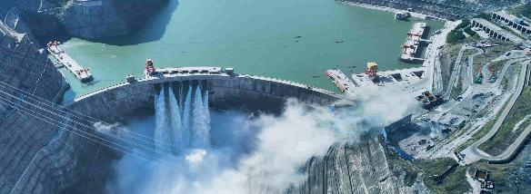

Future woks following project approval
A set of engineering standards needs to be established as the foundation for engineering data management.
Engineering Vocabulary
Procedures and Standards
AI-enhanced Knowledge Base
A set of standards used to guide the construction and management projects, ensuring project quality, safety, and environmental protection.
Data collections that support retrieval and reuse, empowering intelligent decision-making and services.
Classification & Coding

Slide 35
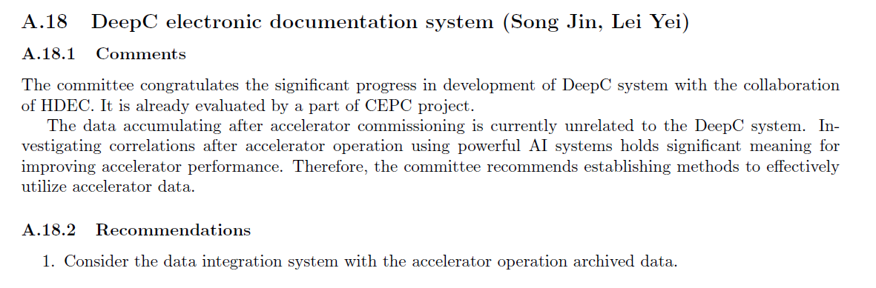
IARC review
It is reviewed in the IARC meeting in September 16-19, 2025.

