Slide 1
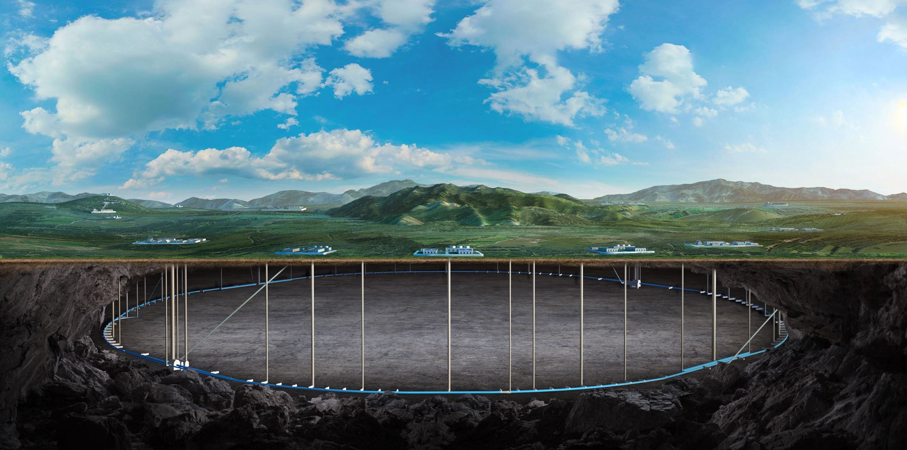


Operation experiences of BEPCII and HEPS
Daheng Ji
BEPCII-U & HEPS commissioning team
2025.11.10

Slide 2
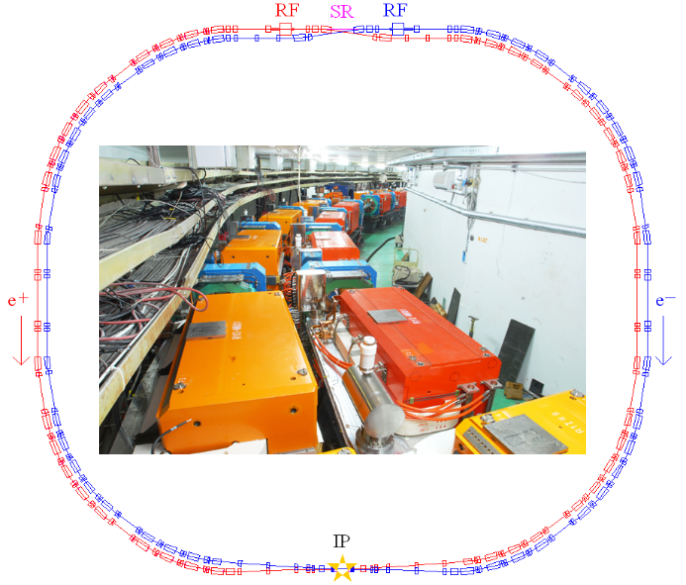
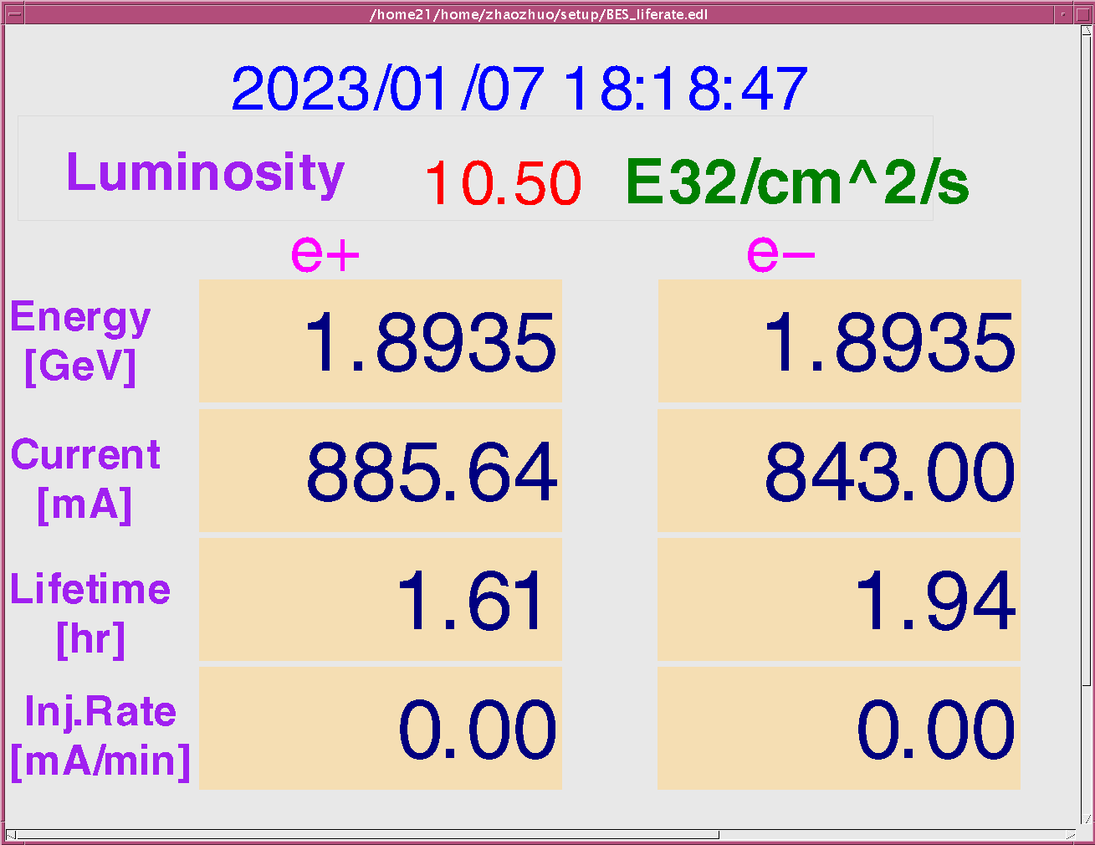
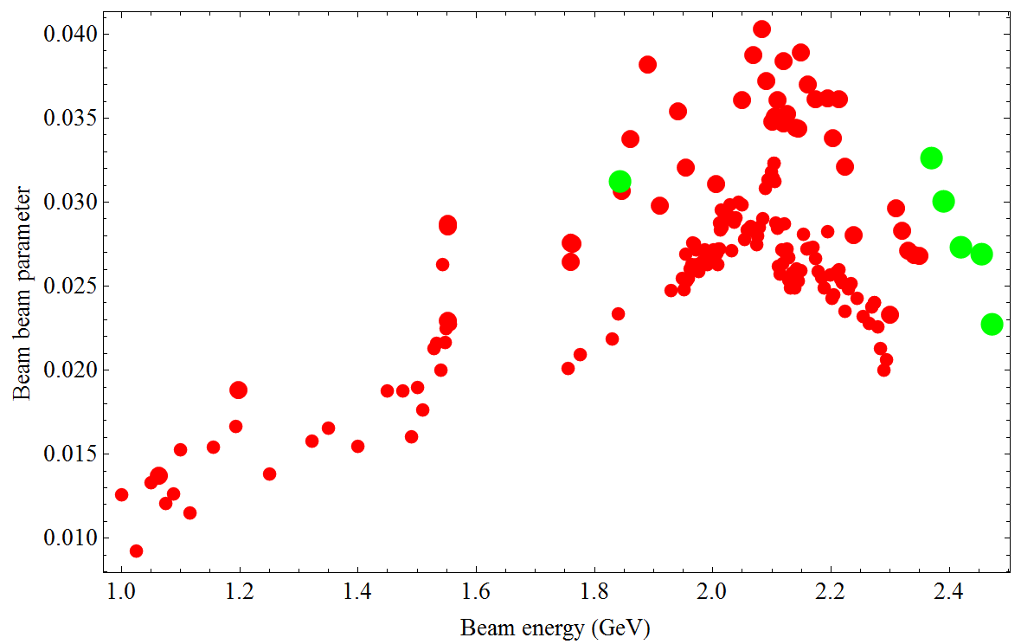
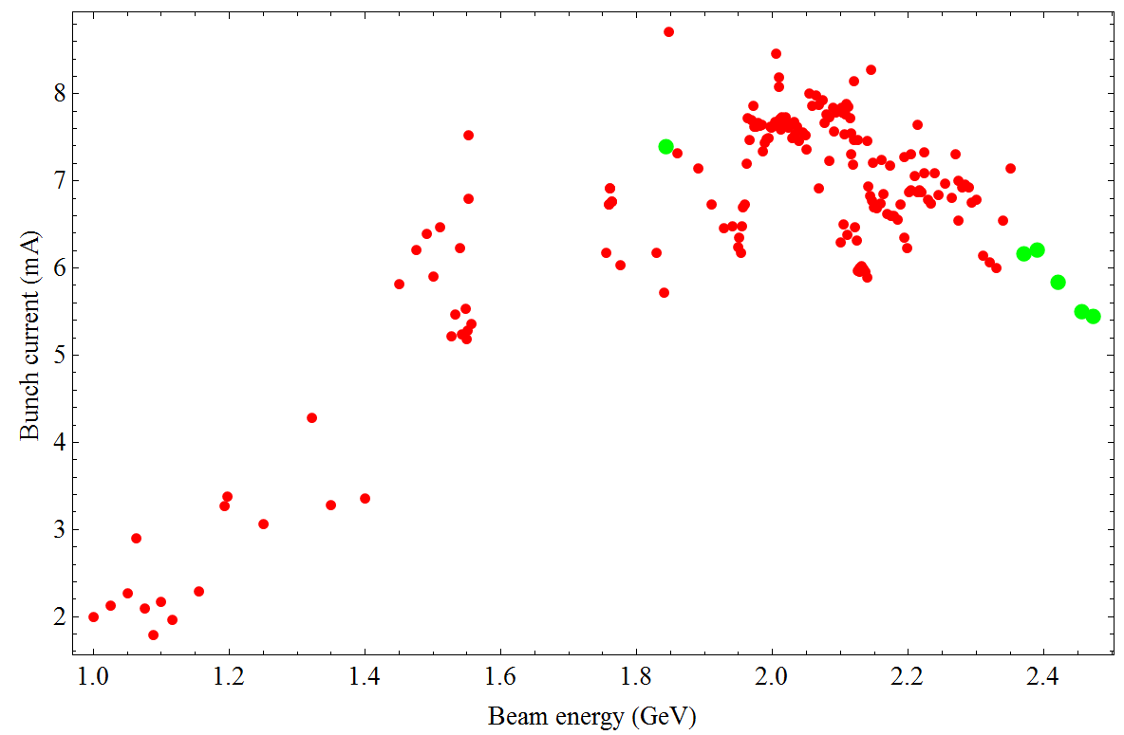
BEPCII-U：upgrade program of BEPCII
BEPCII：
  HEP
    Beam energy range 1-2.1 GeV
    Optimized beam energy 1.89 GeV
    Beam current 910 mA
    Luminosity 1×10³³cm⁻²s⁻¹ @1.89 GeV
  Synchrotron radiation
    Beam energy 2.5 GeV
    Beam current 250 mA
BEPCII-U: Increase luminosity at higher Energy
  Squeeze bunch length and 𝛽_{𝑦}∗ by increasing RF voltage + Increase beam current

Slide 3
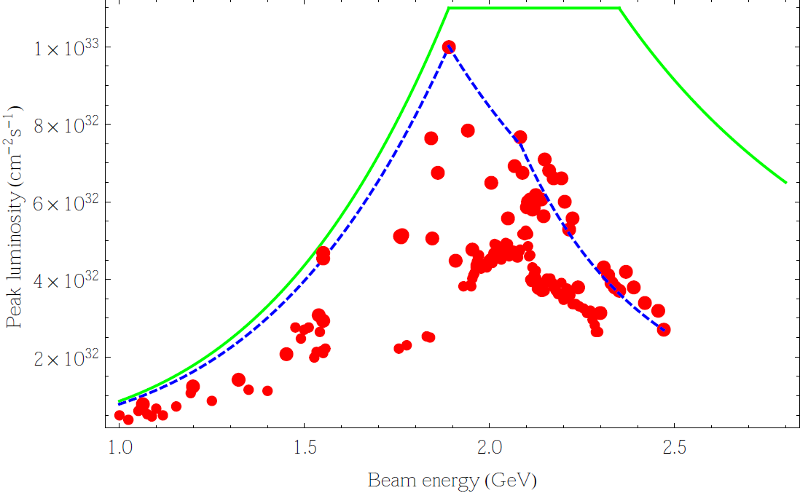
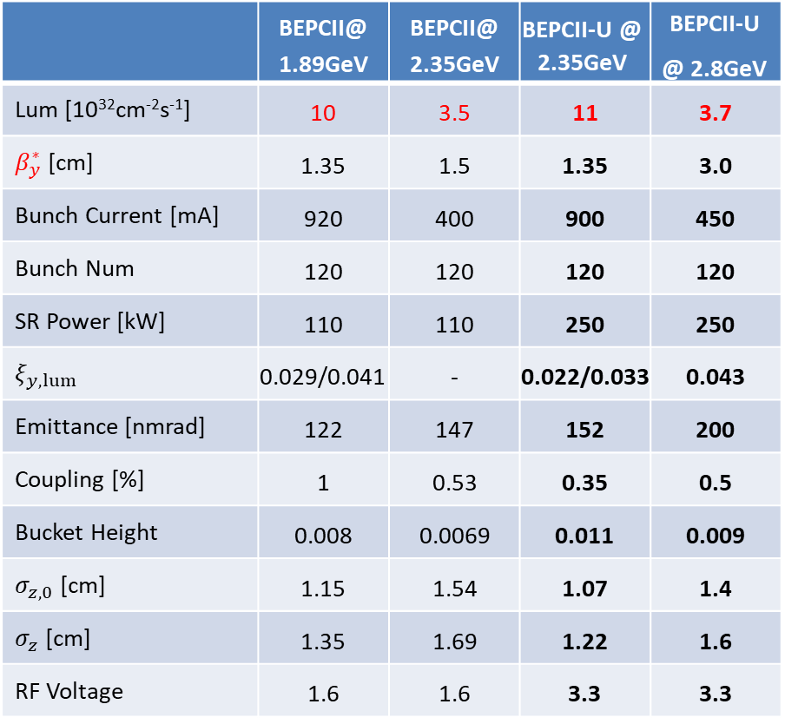
Design Parameters before / after Upgrade
Beam Energy：2.35GeV
BEPCII-U vs BEPCII
 | BEPCII@ 1.89GeV | BEPCII@ 2.35GeV | BEPCII-U @ 2.35GeV | BEPCII-U @ 2.8GeV
Lum [10³²cm⁻²s⁻¹] | 10 | 3.5 | 11 | 3.7
$β_{y}^{∗}$ [cm] | 1.35 | 1.5 | 1.35 | 3.0
Bunch Current [mA] | 920 | 400 | 900 | 450
Bunch Num | 120 | 120 | 120 | 120
SR Power [kW] | 110 | 110 | 250 | 250
$$ξ_{y,lum}$$ | 0.029/0.041 | - | 0.022/0.033 | 0.043
Emittance [nmrad] | 122 | 147 | 152 | 200
Coupling [%] | 1 | 0.53 | 0.35 | 0.5
Bucket Height | 0.008 | 0.0069 | 0.011 | 0.009
$σ_{z,0}$ [cm] | 1.15 | 1.54 | 1.07 | 1.4
$σ_{z}$ [cm] | 1.35 | 1.69 | 1.22 | 1.6
RF Voltage | 1.6 | 1.6 | 3.3 | 3.3
3 times
Luminosity is increased by a factor of 3 @2.35GeV
Maximum beam energy is increased from 2.1GeV to 2.8GeV.

Slide 4
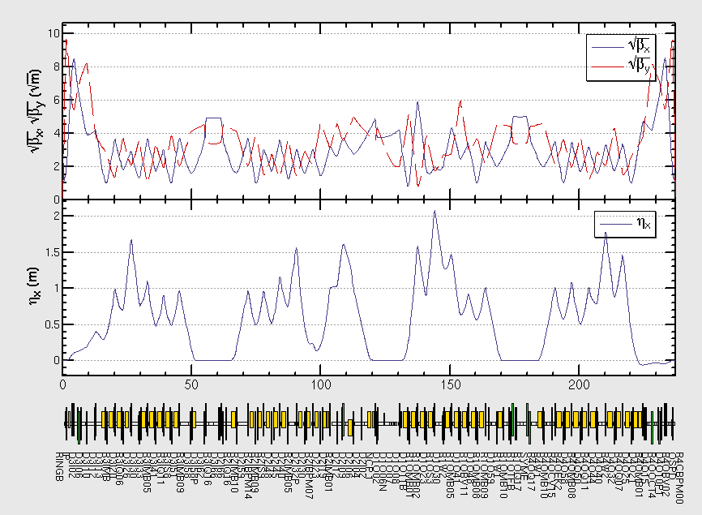
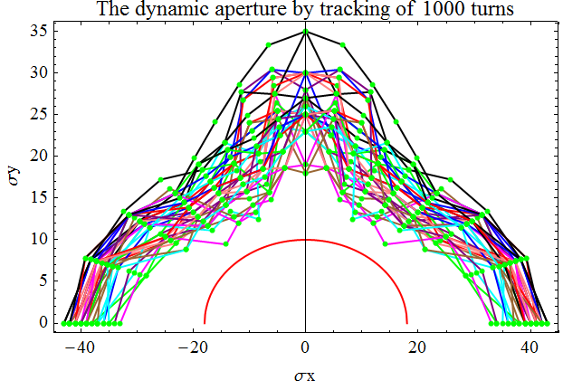
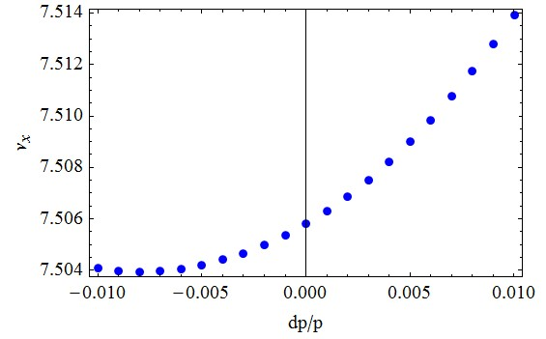
Lattice Modified @ 2.35GeV
Local optics redesigned at the RF region
Global tuning has been done to minimize the emittance
Dynamic aperture is optimized to ensure enough beam lifetime
Intensive multiparticle tracking has been done to make sure the luminosity performance

Slide 5
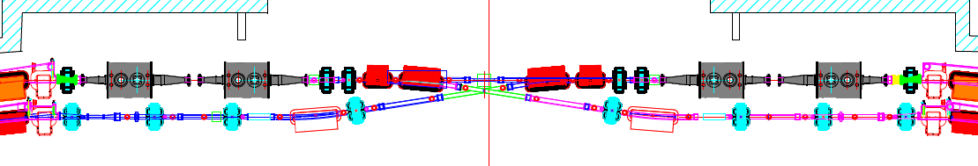
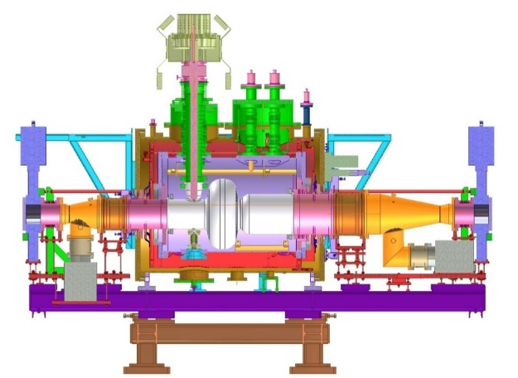
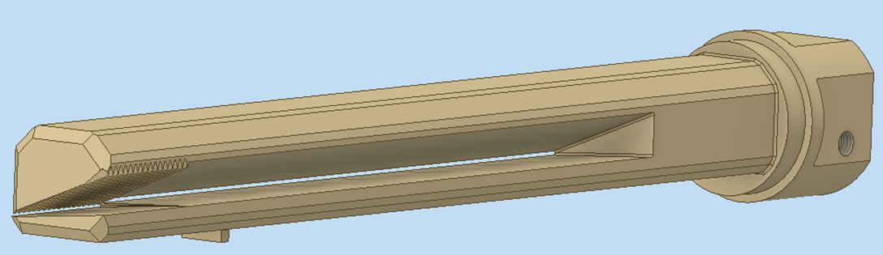
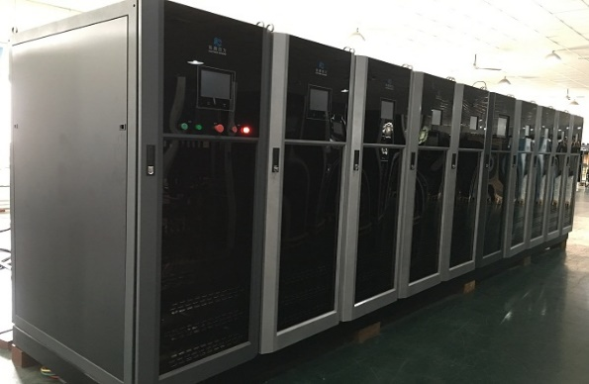
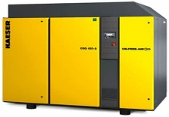
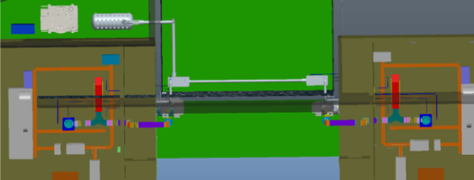
Hardware upgrade: RF
new cavity
BEPCII-U RF region
new cavity
1 existing + 1 new RF Cavity/ per ring
  2 old cavities; 1 backup cavity; 1 new cavity
  Survey will be kept exactly the same as BEPCII
  Two sets of 500MHz, 200kW solid state power source are installed
Cryogenic system: upgraded with a new refrigerator
Photon absorber capacity upgraded from 110 kW to 250 kW

Slide 6
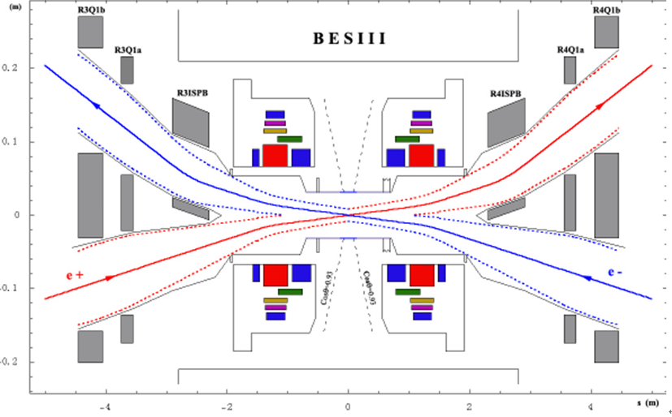
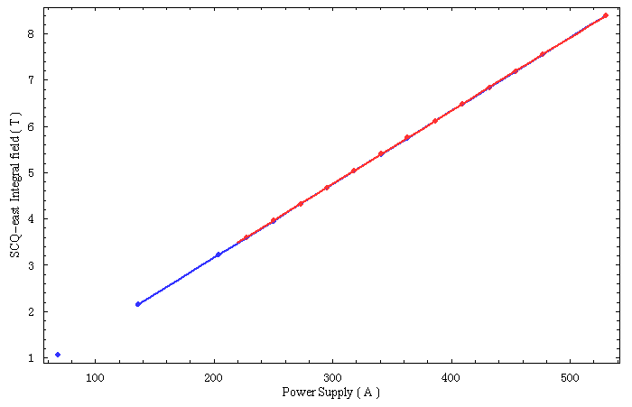
Hardware upgrade ----SCQ
530A
The strength of SCQ(Superconducting Quadrupole) is critical for high luminosity at 2.8 GeV (current SCQs exceed quench current limit).
New SCQs replace existing ones for 2.8 GeV operation.

Slide 7
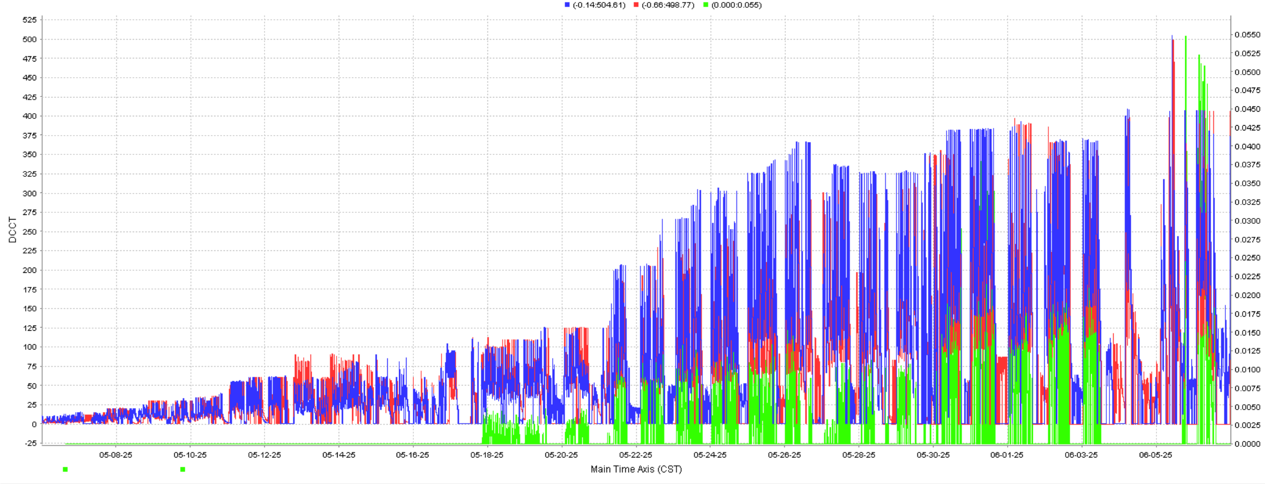
Schedule
2024 .7-12, Shut down for hardware dismantling and installation
2025-2028, Operation at 1.89~2.5GeV, and prepare for energy upgrade
  Current status: Commissioning at 1.89 GeV
2028.6-9, Energy upgrade to 2.8GeV
2028.9~2030, Operation at 2.5~2.8GeV
e+, e-, Lum.

Slide 8
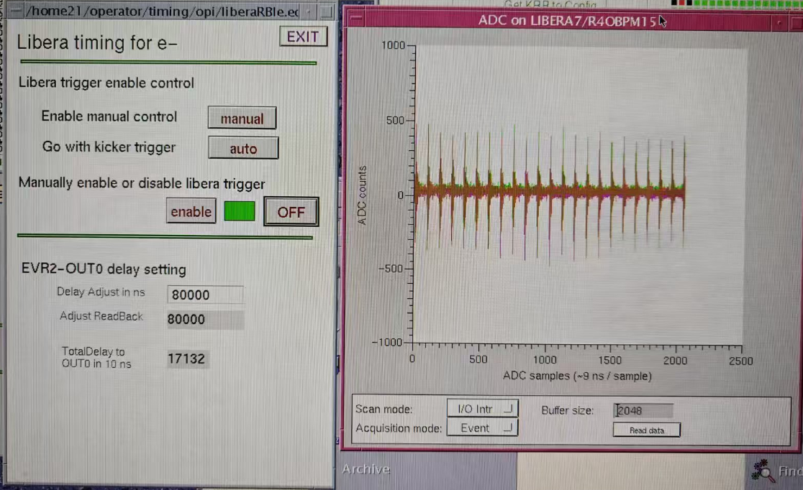
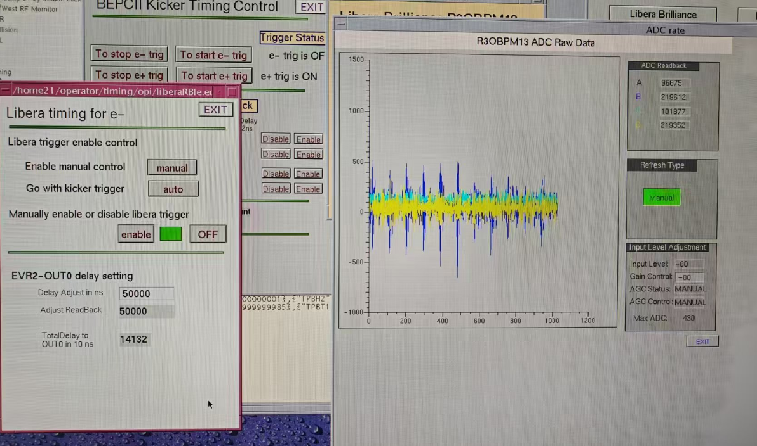
Beam Commissioning w/o RF
The cryogenic system was ready at May 2nd.
In March and April, commissioning of injection beams at 1.89GeV was conducted without the RF system, with the BPR and BER obtaining beam signals of 80 turns and 100 turns respectively.
BER 120 turns
BPR 80 turns

Slide 9
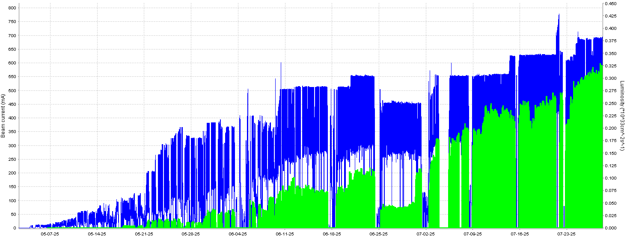
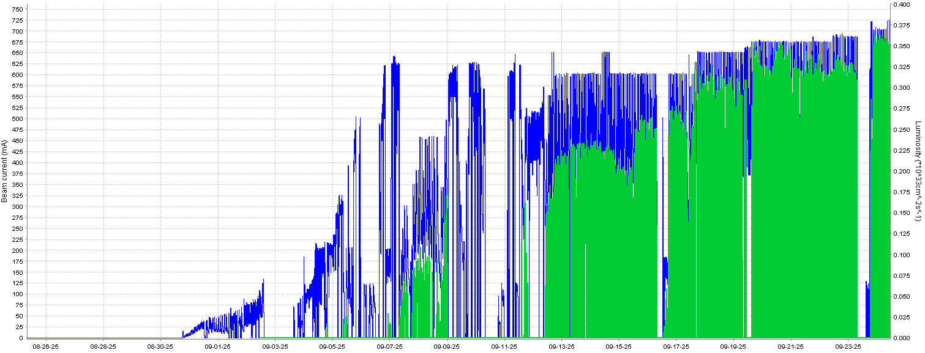
Status of BEPCII-U operation
May.2 – Sep.30
BEPCII upgrade operates stably & beam current and luminosity increasing steadily
◆ Beam current ◆ Luminosity
◆ Beam current ◆ Luminosity
May.2– July.29
Aug.25– Sep.30
Beam current 720mA/720mA & Peak luminosity 3.8×10³²cm⁻²s⁻¹
Data taking with 8 beam lines for BSRF parasitic experiments

Slide 10
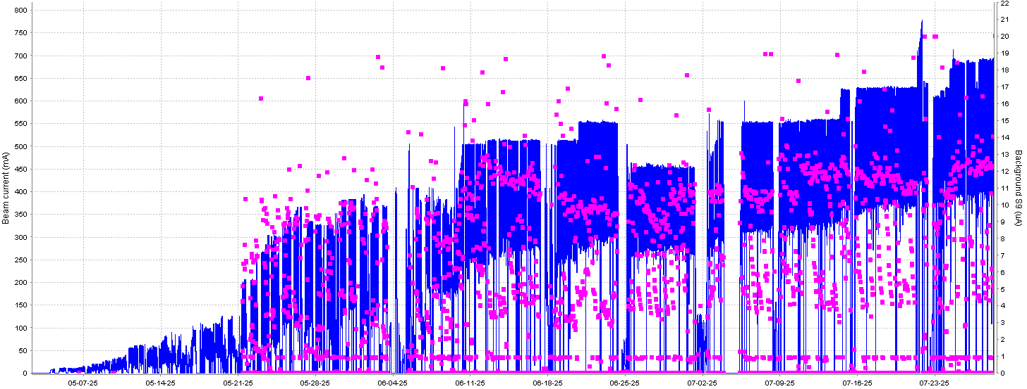
Status of BEPCII-U operation
◆ Beam current ◆ Dark current
Vacuum recovery of a new machine by monitoring the background limitation of BES (<12uA)
Current vacuum of BER(5×10⁻⁹ torr@720mA) is better than BPR(1×10⁻⁸ torr@720mA)

Slide 11
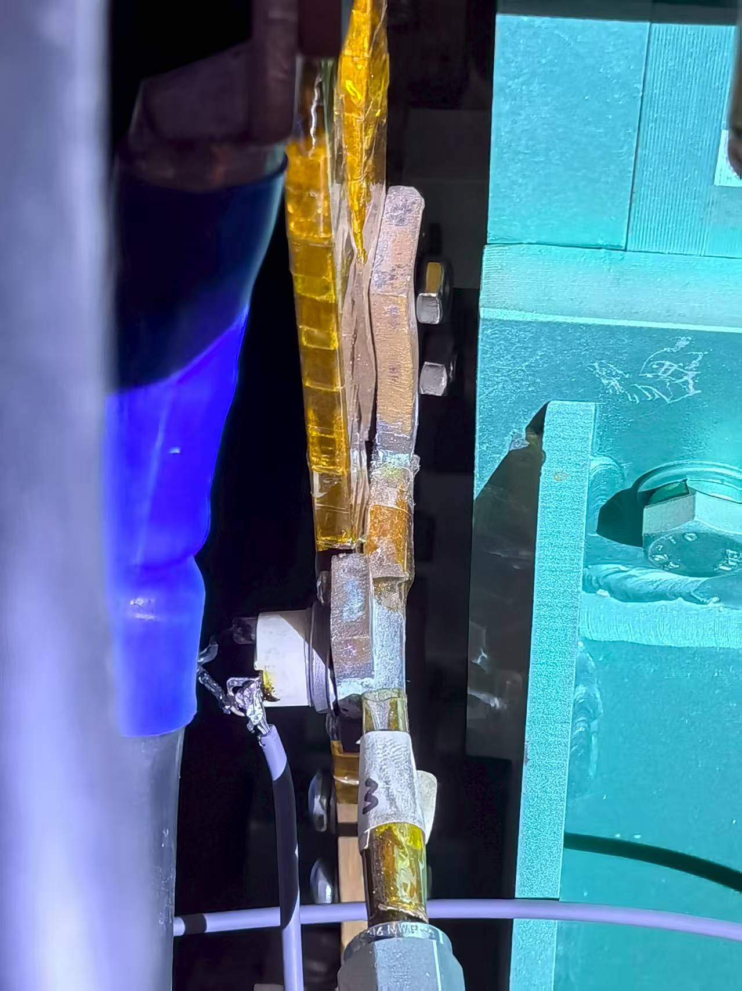
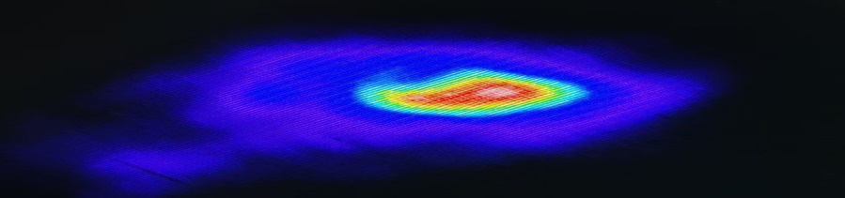
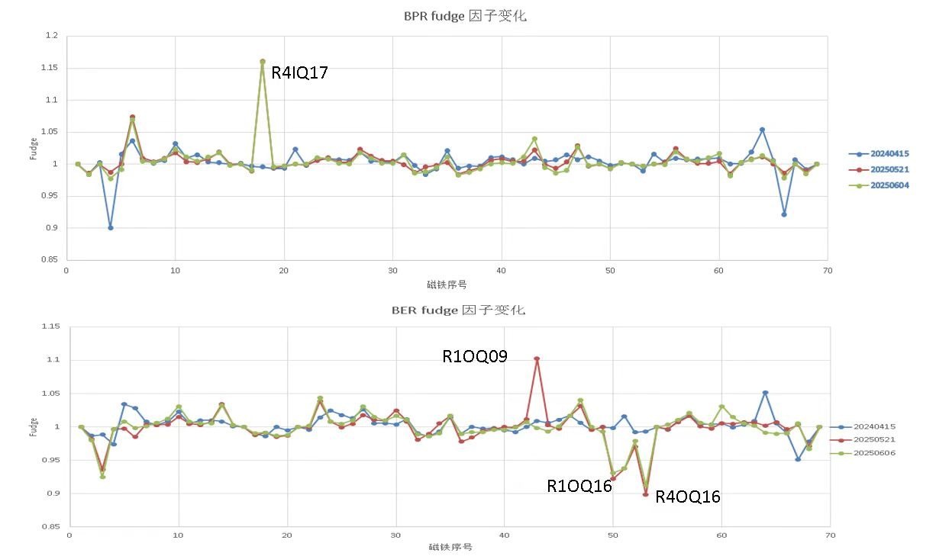
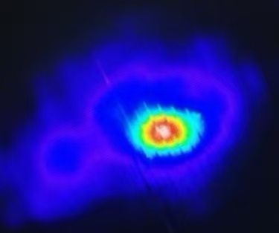
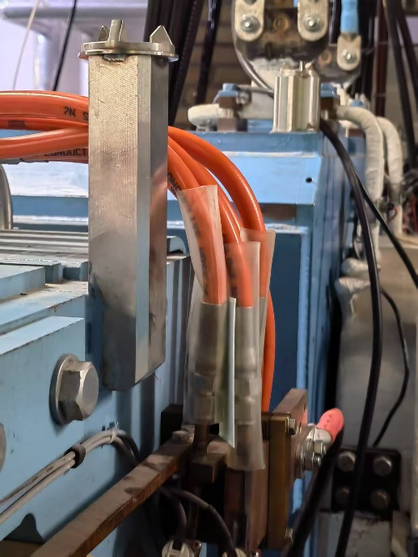
Status of BEPCII-U operation
Hardware issues identified during operation
Imperfect compensation between the solenoid and the anti-solenoid. Imperfect compensation for the vertical focusing effect of the solenoid.
Magnet short circut
Sextupole R3OS4, Jul.22
Magnet short circut
Quadrupole R4IQ17, Jun.17

Slide 12
Current Status of BEPCII-U
As of September 30th, during the past 73 HEP operation days, the maximum beam current and peak luminosity reached 720mA and 3.8×10³²cm⁻²s⁻¹ respectively. The dark current is controlled under 12μA. The integral luminosity reached 420.4 pb⁻¹ and 183 user experiments were finished by BSRF 8 parasitic beam lines.
BEPCII is an operational facility with a scheduled BESIII data-taking task and urgent BSRF beam usage demands, resulting in a severe shortage of dedicated beam commissioning time for the accelerator after the upgrade project and its restart.

Slide 13
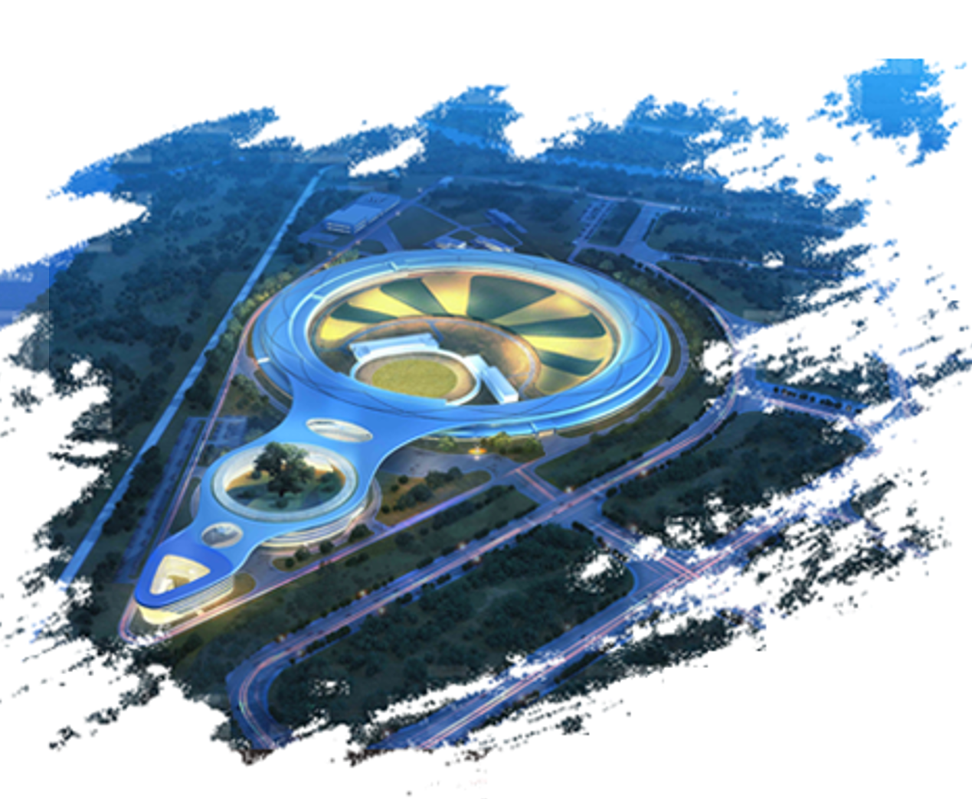
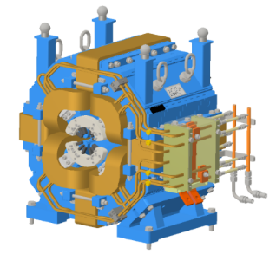
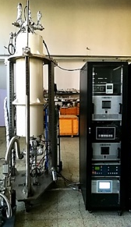
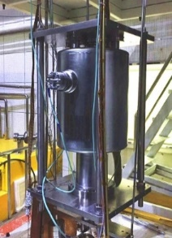
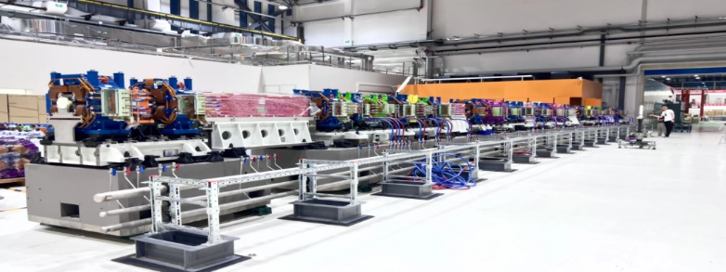
High Energy Photon Source
(HEPS)
4th-generation synchrotron radiation light source
Circumference | 1360.4 | m
Energy | 6 | GeV
Emittance | ≤0.06 | nm·rad
Brightness | >1×10²² | phs/s/mm²/mrad²/0.1%BW
Beam Line | ≥90 | Initially: 14
Photon Energy | 0.1-300 | keV

Slide 14
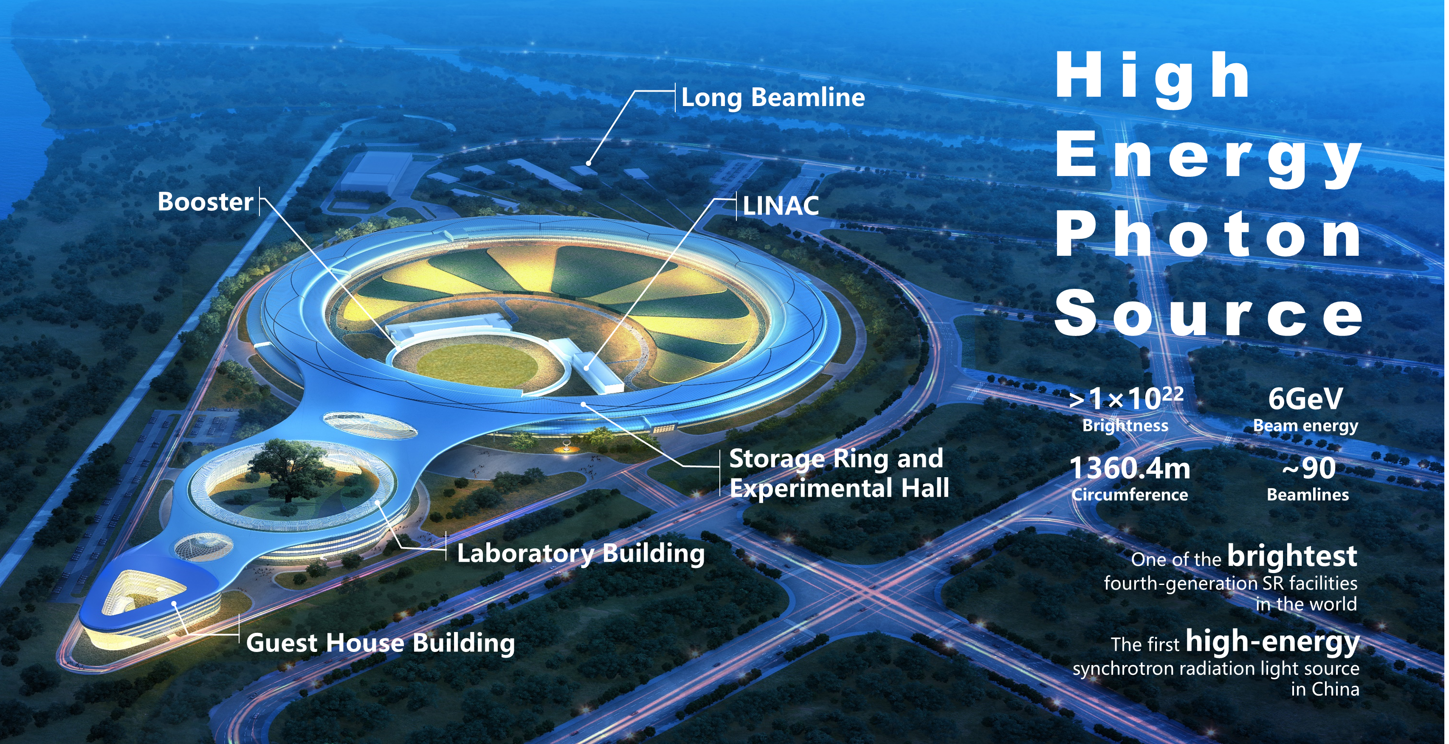
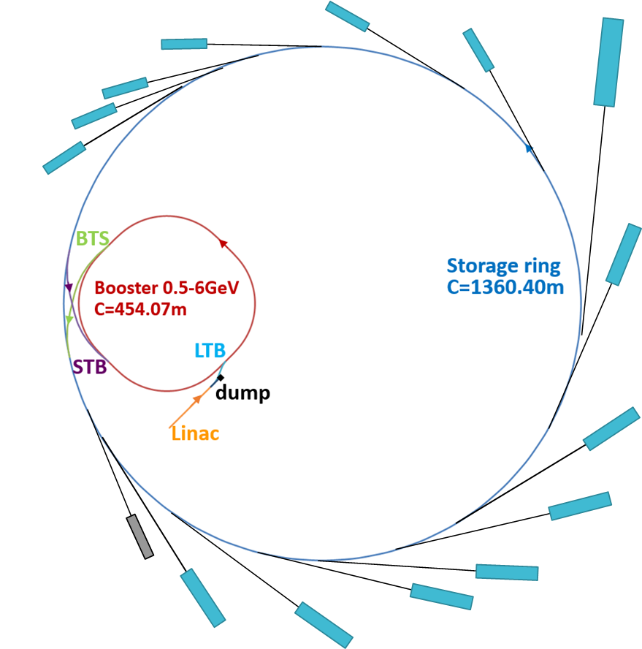
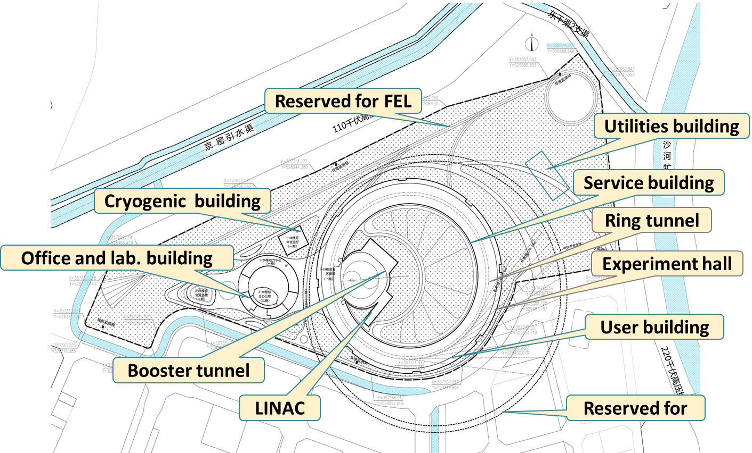

High Energy Photon Source (HEPS)
High Energy Photon Source (HEPS) is a 6-GeV synchrotron light source in Beijing, China.
Main parameters | Unit | Value
Beam energy | GeV | 6
Circumference | m | 1360.4
Emittance | pm∙rad | < 60
Brightness | phs/s/mm²/mrad²/0.1%BW | >10²²
Beam current | mA | 200

Slide 15
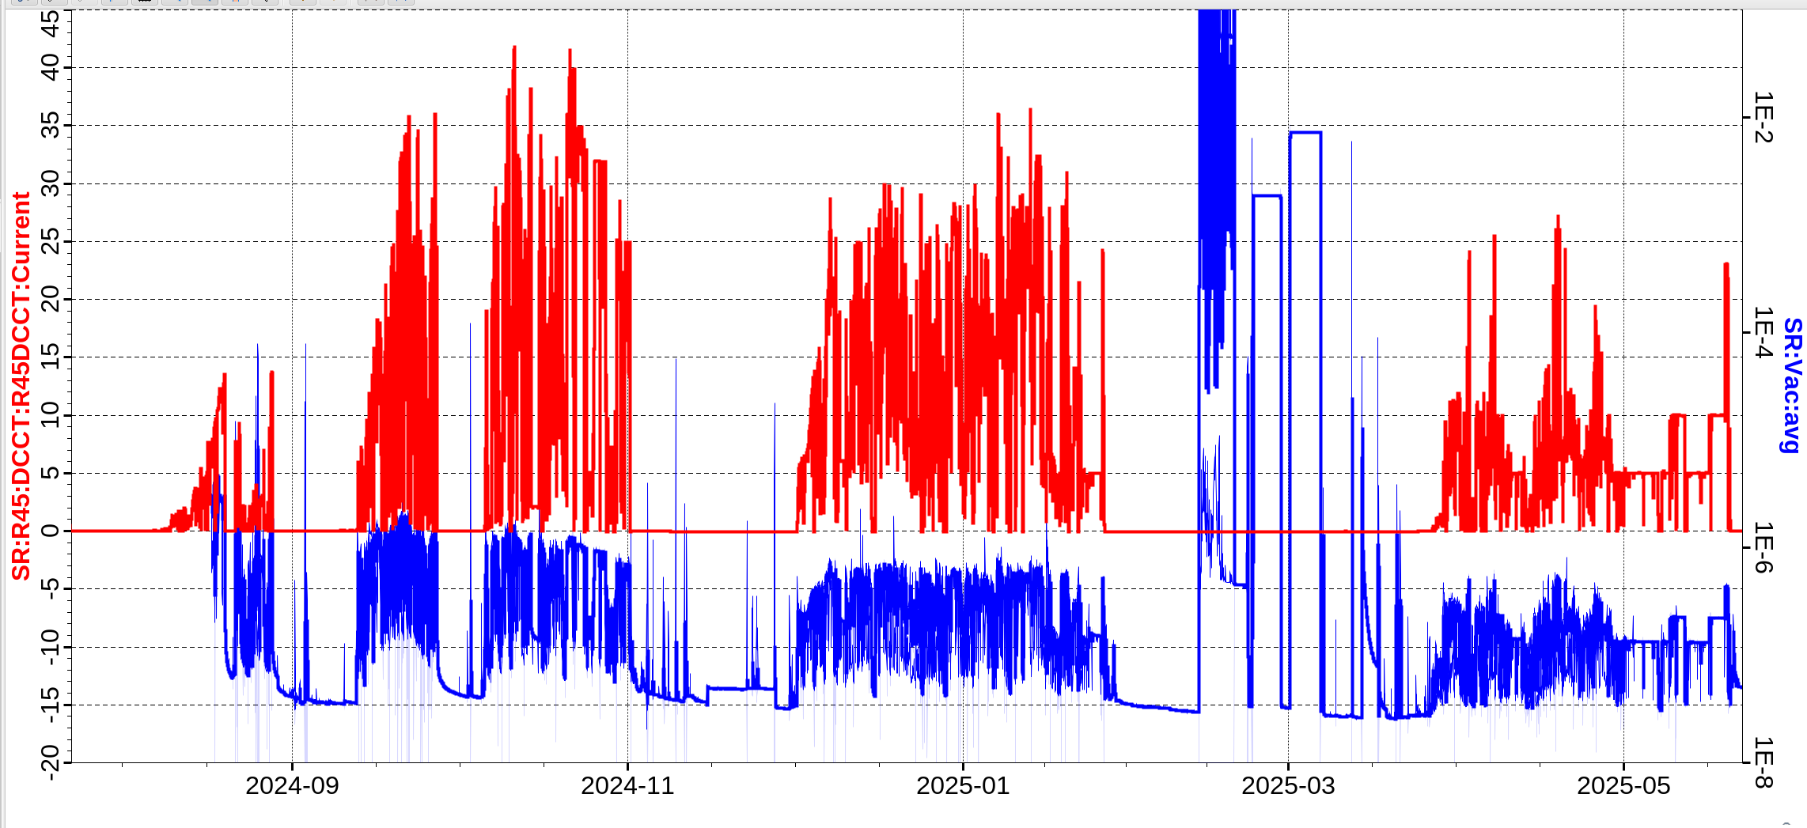
HEPS Storage Ring Commissioning
Phase 1
Phase 2
Phase 3
Phase 4
Phase 5
Shut down#1
Shut down#2
Shut down#3
Shut down#4

Slide 16
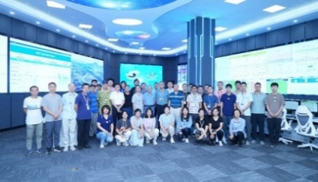
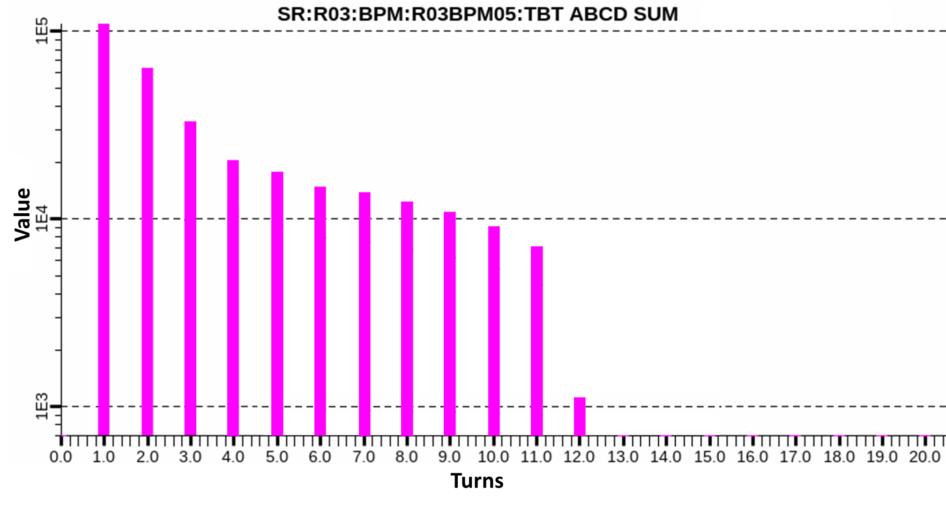
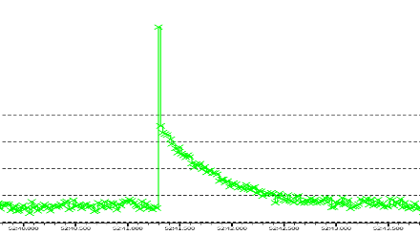
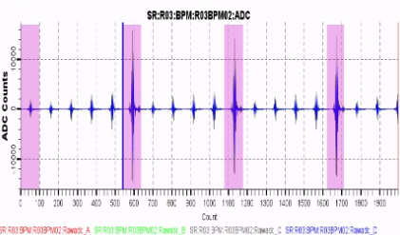
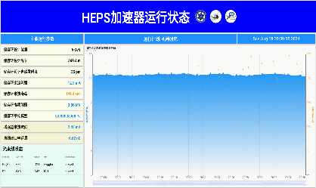
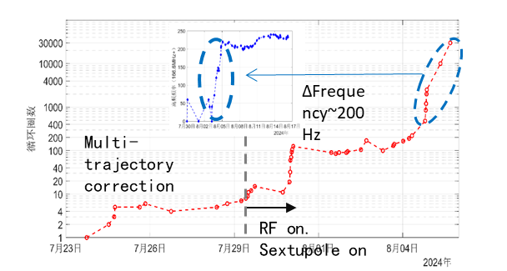
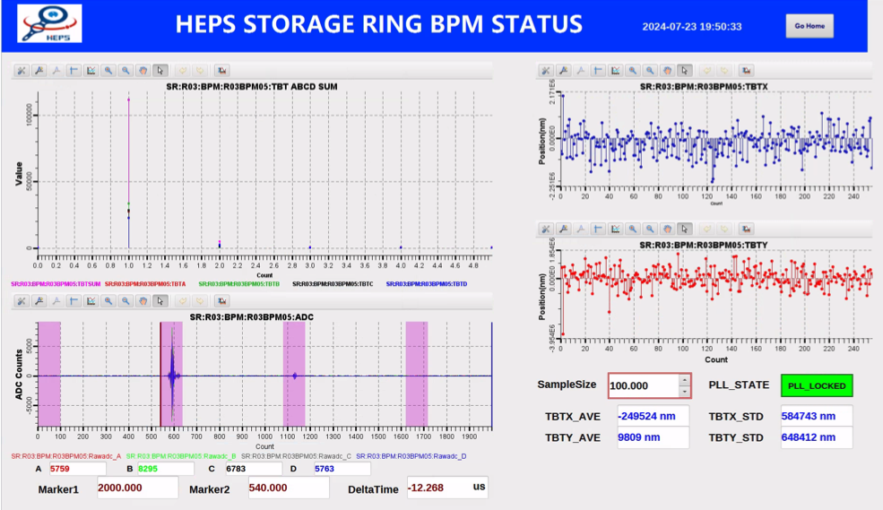
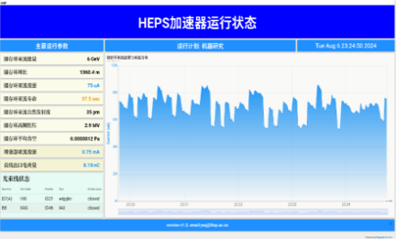
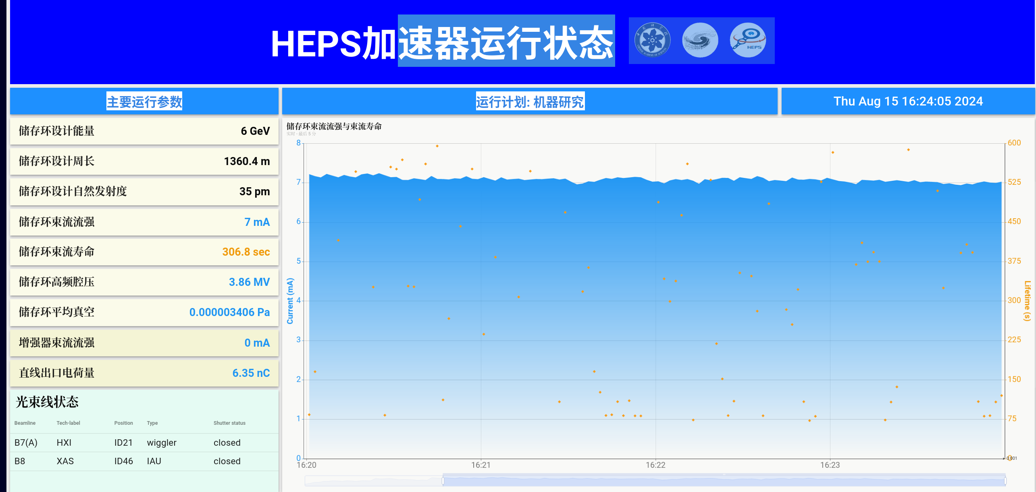

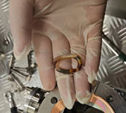
Phase 1: Achieved beam storage with current >10 mA.
(7.23-8.27)
第11圈束流信号
12th turn singal
~1.3sec
Current~ 0.4 mA
Life time~ 1 mins
Current~ 12 mA
Life time~ 2 mins
Commissioning begin
10 turns
Beam Accumulation
Multi Bunch
Current 12mA
07.23
08.04
08.06
08.15
07.23
07.29
08.06
08.08
08.18
1st-turn
1000 turns
Life time 1 min
7mA
>1000 turns
current~ 60 uA
Life time~ 1 min
Current~ 7 mA
Life time~ 2 mins
2nd turn signal
Shut down #1:
Replace injection kicker and power supply;
Replace R20VC14 vacuum chamber.

Slide 17
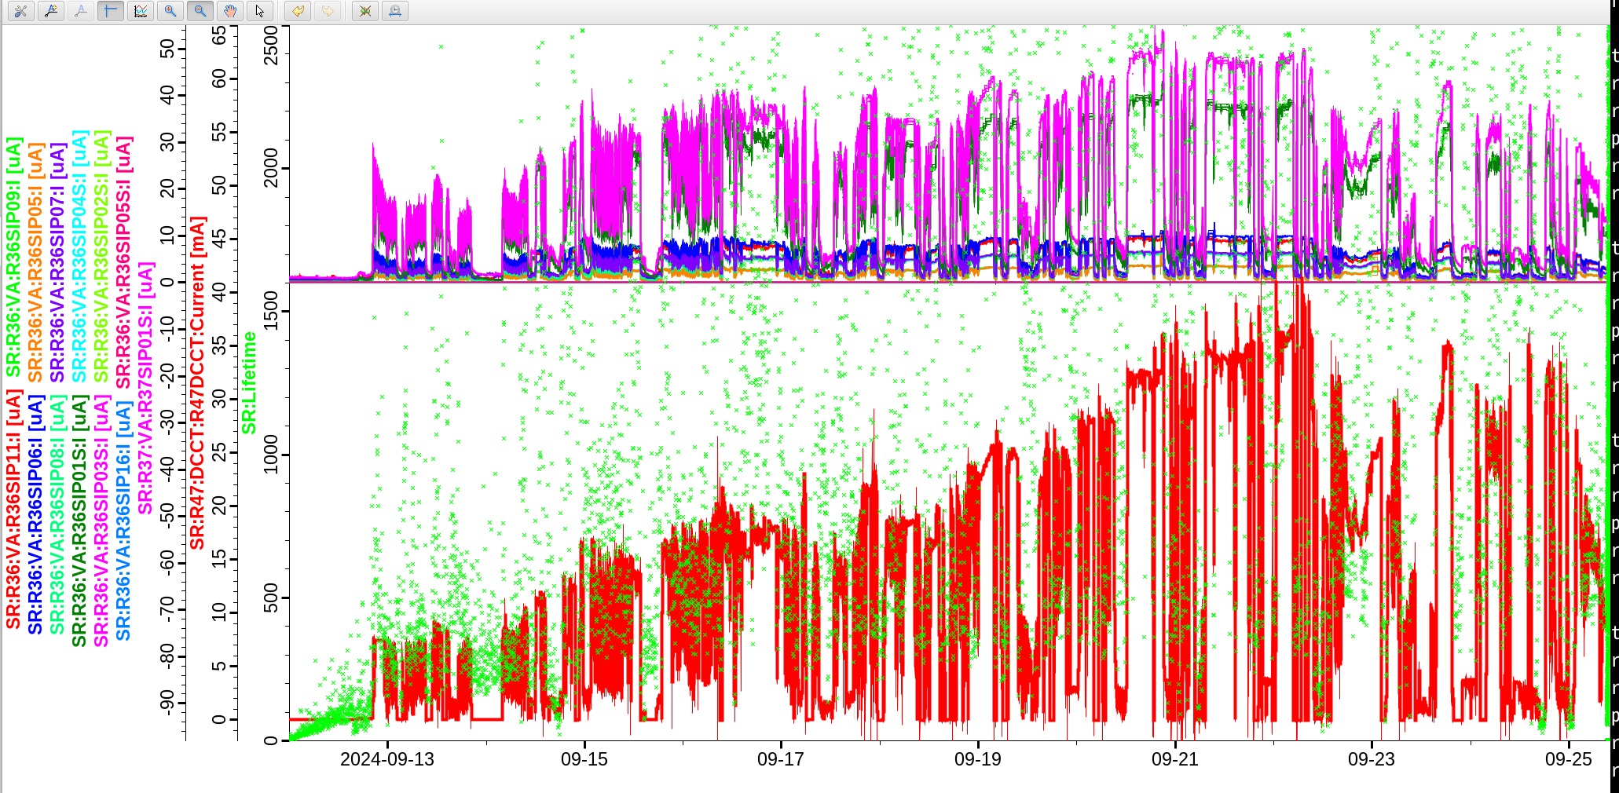
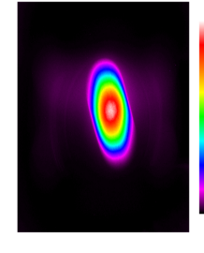
Phase 2: Current increased to ~40 mA.(9.12-9.26)
R20 vacuum chamber replaced to address vacuum limitations.
Injection kicker replaced to resolve current limitations.
Beam cleaning performed.
9-23 SR from Bend
Monochromatic light near the focal point
Experimental station
Shutdown #2:
Replace ID21/42/46 vacuum chambers.

Slide 18


Phase 3: First light, beamline experiments. (10.5-11.1)
Accelerator recovery
B7 beamline tuning
(low corrent)
Accelerator tuning
B7 optimization
(high corrent)
First Light
Shutdown #3:
  Install ID09 ID;
  Replace ID08 and ID30 vacuum chambers;
  Install three collimators;
  Replace superconducting cavity.
Other beamlines tuning

Slide 19



Phase 4: Preliminary beam dynamics optimization completed.(11.30-1.26)
Verified swap-out injection with high-energy accumulation in the booster.
Beam emittance reduced to <100 pm·rad at 27 mA.
COD(rms): ~100/100 mm.
Beta beating (rms): ~3%/3%.
Dispersion deviation (std): ~4/3 mm.
Shutdown #4:
  Install most ID;
  Perform full-ring precise alignment;
  Install pre-kicker.

Slide 20

Phase 5:Optimization of storage ring current, lifetime, and vacuum. (3.23-5.20)
Accelerator recovery
BBA, Optics correction
Beamline tuning
Pre-kicker and collimator tuning
SOFB on
Shutdown #5 (5.20-8.10):
  Install all 166 MHz cavity;
  Replace collimator.

Slide 21



Phase 6: Further optimize the beam with the acceptance indicators as the target. (08.06-10.29)
Source and suppression of low-frequency beam oscillations and testing of fast and slow feedback systems
  Beam oscillation is less than 20% of the beam size.
Resume beam operation with 166 MHz superconducting cavity as fundamental frequency and stretch bunch length with harmonic cavity
  increase current to 100 mA.
Optics correction based on sextupole magnet movers
  The beam emittance is reduced to 56 pm.rad.
On September 30th, the accelerator passed the performance and process test
On October 29th, the beamline passed the performance and process test.
The HEPS is scheduled to begin trial operation by the end of 2025.

Slide 22
Thanks to BEPCII-U & HEPS Commissioning Team
Thank you !

