Slide 1


Prospect for Measurement of CKM Angle 𝛾
in $B_{s}^{0}→ D_{s}^{∓}K^{±}$ Decays at CEPC
JHEP06(2025)212
Yulong Tang
Institute of High Energy Physics
CEPC Workshop
Nov 07, 2025 ·Guangzhou

Slide 2
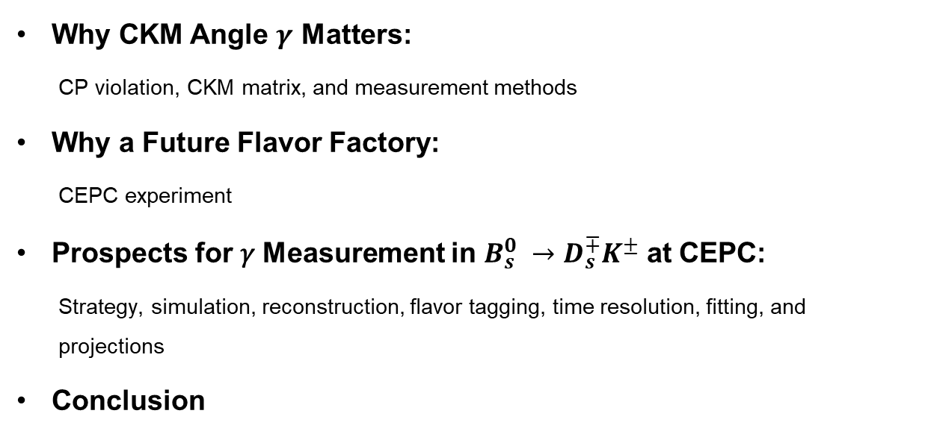
Outline
Why CKM Angle $γ$ Matters:
  CP violation, CKM matrix, and measurement methods
Why a Future Flavor Factory:
  CEPC experiment
Prospects for 𝛾 Measurement in $B_{s}^{0} →D_{s}^{∓}K^{±}$ at CEPC:
  Strategy, simulation, reconstruction, flavor tagging, time resolution, fitting, and projections
Conclusion

Slide 3
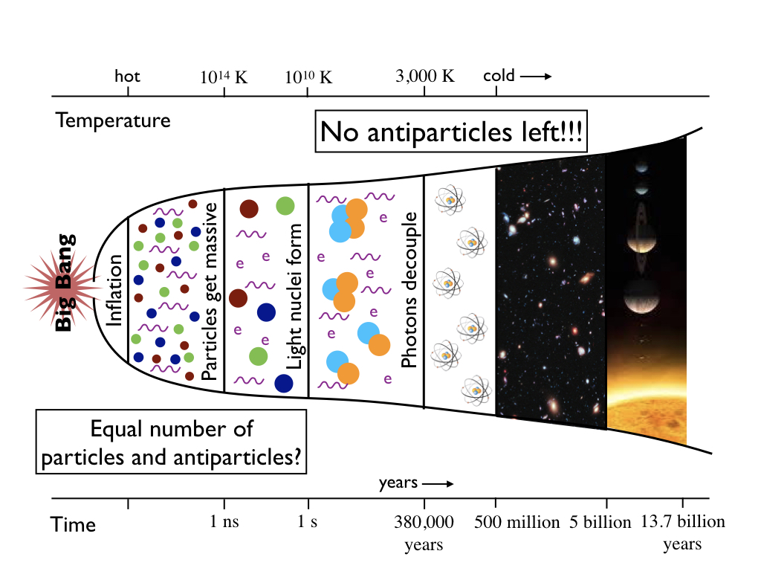
Why matter dominates the universe?
Big Bang: matter = antimatter
Today: matter ≫ antimatter
Sakharov conditions (1967)：
  Baryon number violation
  C /CP violation
  Departure from thermal equilibrium
CP violation in the SM is too small
New source of CP violation ⇒ new physics
[Sakharov, JETP Lett. 5 (1967) 24]

Slide 4
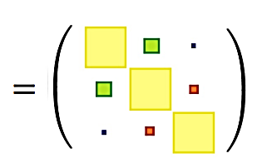
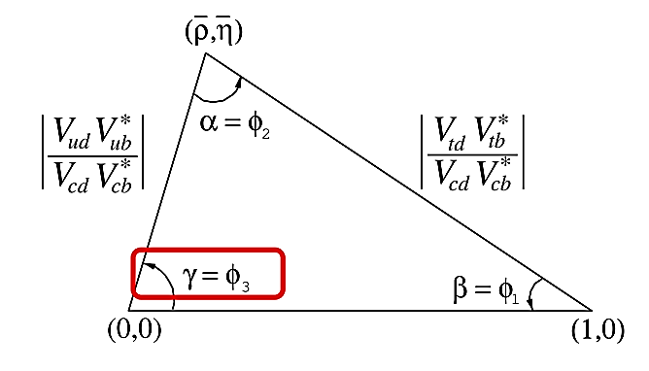

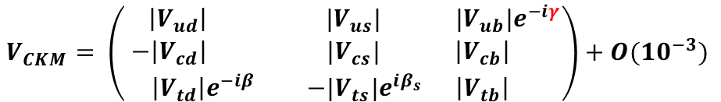
CKM matrix
CKM matrix describes quark mixing in the SM
  The complex phase is the only established source of CPV in the SM
Unitarity of the CKM matrix
⇒ the unitarity triangles (UTs)
  Indirect search of BSM physics
$$V_{CKM}= \left(\begin{matrix} \left|V_{ud}\right| & |V_{us}| & |V_{ub}|e^{−iγ} \\ −\left|V_{cd}\right| & |V_{cs}| & \left|V_{cb}\right| \\ \left|V_{td}\right|e^{−iβ} & −|V_{ts}|e^{iβ_{s}} & \left|V_{tb}\right| \end{matrix}\right)+O({10}^{−3})$$

Slide 5
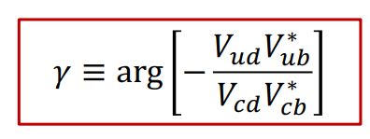
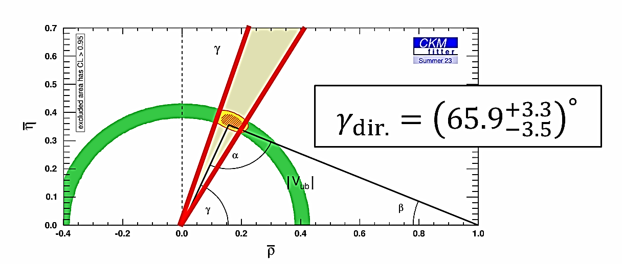
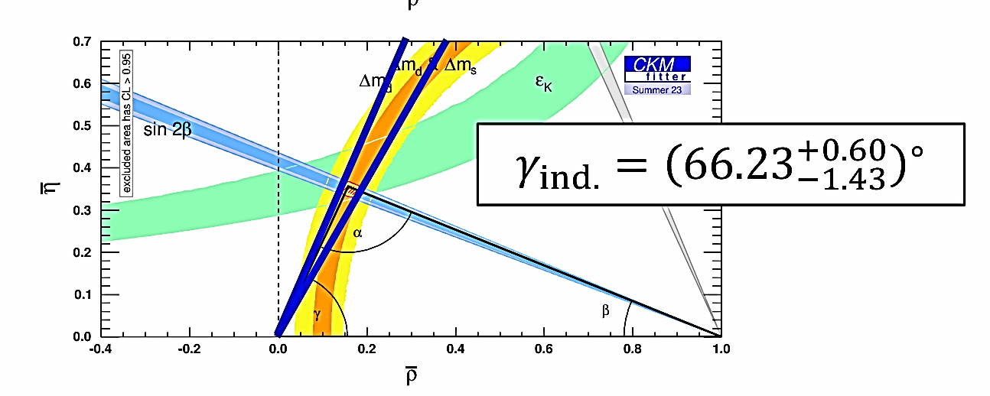

CKM angle $γ$
Free of top quark by definition ⇒ accessible via tree-level
Negligible theoretical uncertainty ⇒ SM benchmark
Search for new physics：direct vs. indirect measurement
  Direct: measure 𝛾 from tree-level decays
  Indirect: assume UT is closed and infer 𝛾 from other processes
Experimental approaches: Time-integrated method vs. Time dependent method
[JHEP 01 (2014) 051]
[CKMfitter-2023]

Slide 6
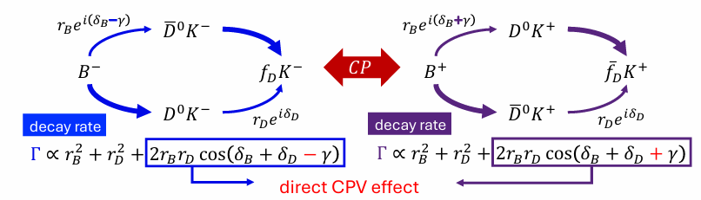
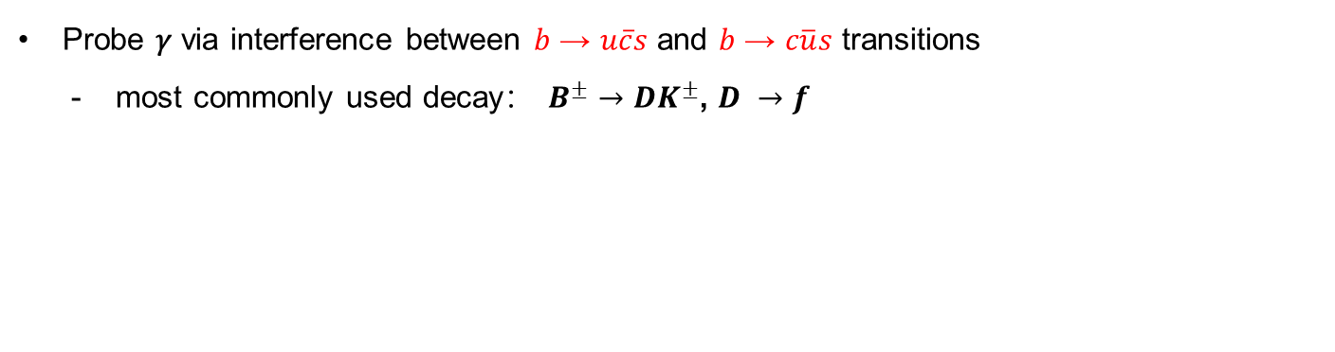
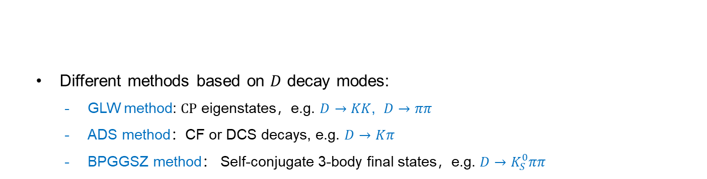
Time integrated method
Probe 𝛾 via interference between 𝑏 → 𝑢$\overline{c}$𝑠 and 𝑏 → 𝑐$\overline{u}$𝑠 transitions
  most commonly used decay： $B^{±}→DK^{±}$, $D →f$
  Different methods based on $D$ decay modes:
    GLW method: $CP$ eigenstates，e.g. $D→KK$, $D→ππ$
    ADS method：CF or DCS decays, e.g. $D→K$𝜋
    BPGGSZ method： Self-conjugate 3-body final states，e.g. $D→K_{S}^{0}ππ$
[Phys. Lett. B 253 (1991) 483]
[Phys. Lett. B 265 (1991) 172]
[Phys. Rev. Lett. 78 (1997) 3257]
[Phys. Rev. D 63 (2001) 036005]
[Phys. Rev. D 68 (2003) 054018]

Slide 7
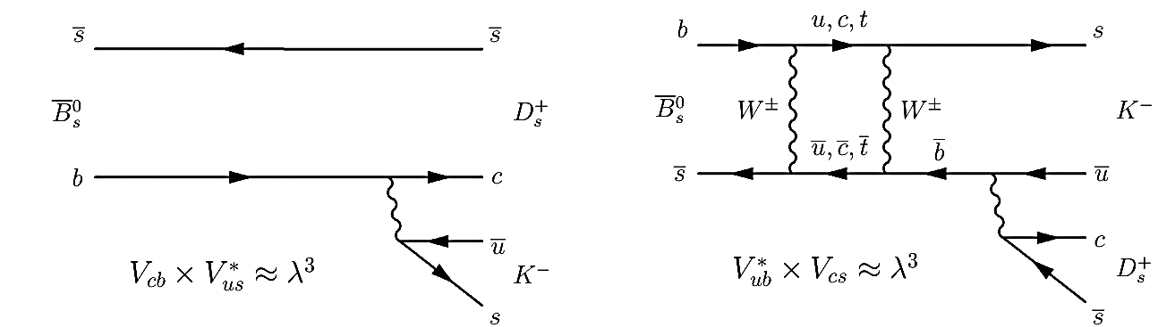
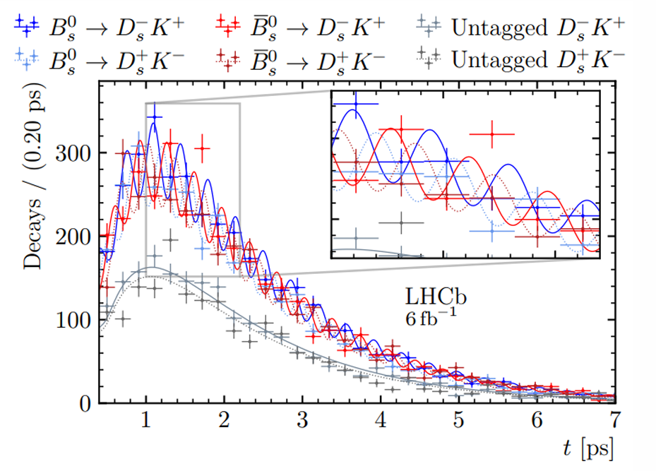
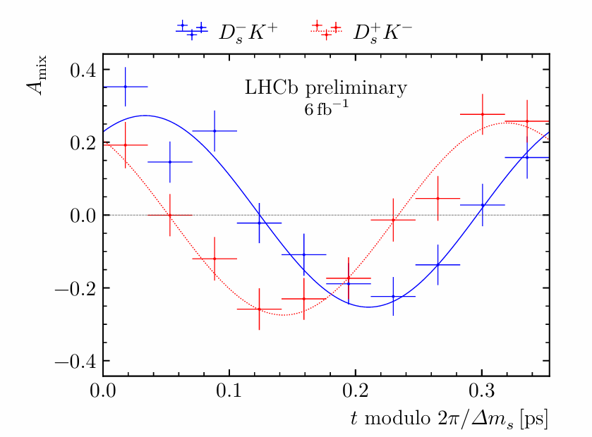
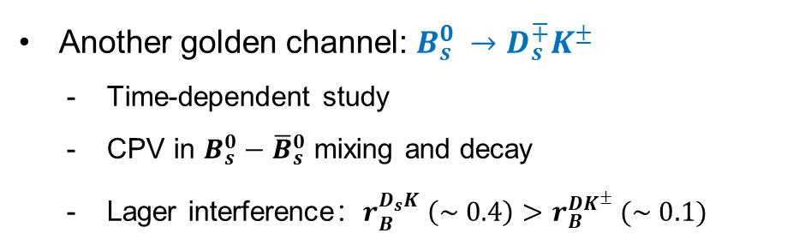
Time dependent method
Another golden channel: $B_{s}^{0} →D_{s}^{∓}K^{±}$
  Time-dependent study
  CPV in $B_{s}^{0}−{\overline{B}}_{s}^{0}$ mixing and decay
  Lager interference：$r_{B}^{D_{s}K} （\sim 0.4）>r_{B}^{DK^{±}} (\sim 0.1)$
Mixing asymmetry in one mixing period shift
[LHCb-PAPER-2024-020]
decay-time-dependent decay rate
Notes:
图注需要写

Slide 8
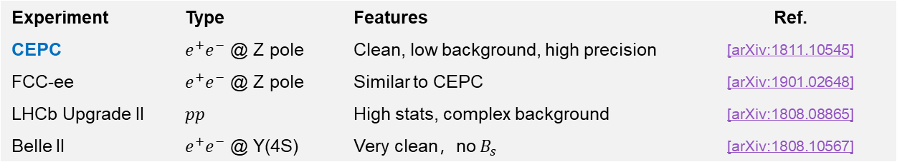
Why a future flavor factory?
Current 𝛾 measurements limited by:
  Statistics
  Systematics
  Decay modes
Future high-luminosity colliders ⇒ much better precision
Experiment | Type | Features | Ref.
CEPC | $e^{+}e^{−}$ @ Z pole | Clean, low background, high precision | [arXiv:1811.10545]
FCC-ee | $e^{+}e^{−}$ @ Z pole | Similar to CEPC | [arXiv:1901.02648]
LHCb Upgrade II | $$pp$$ | High stats, complex background | [arXiv:1808.08865]
Belle II | $e^{+}e^{−}$ @ Υ(4S) | Very clean，no $B_{s}$ | [arXiv:1808.10567]

Slide 9
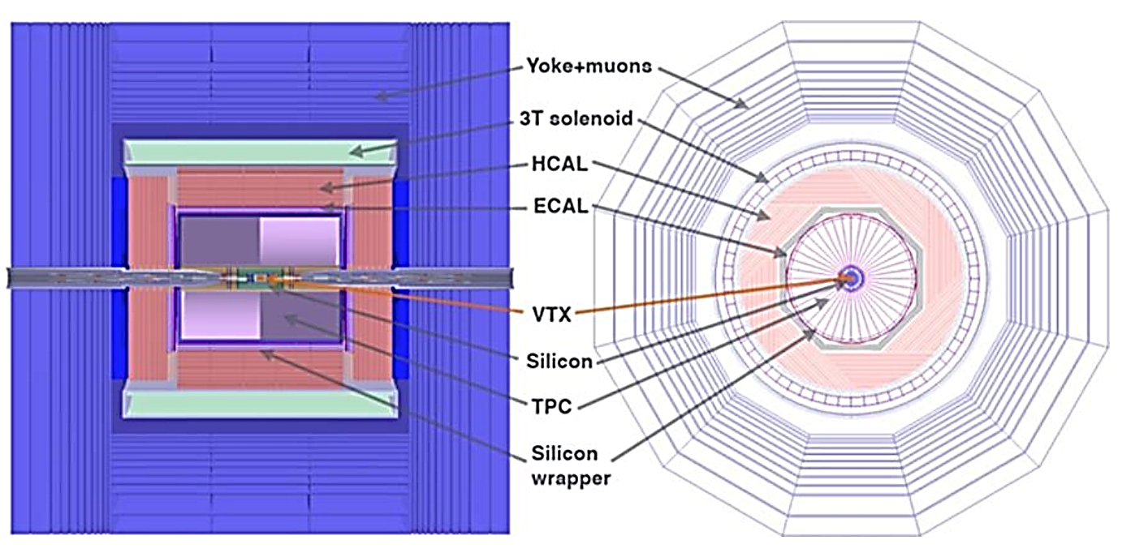
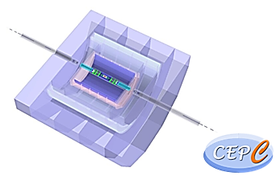
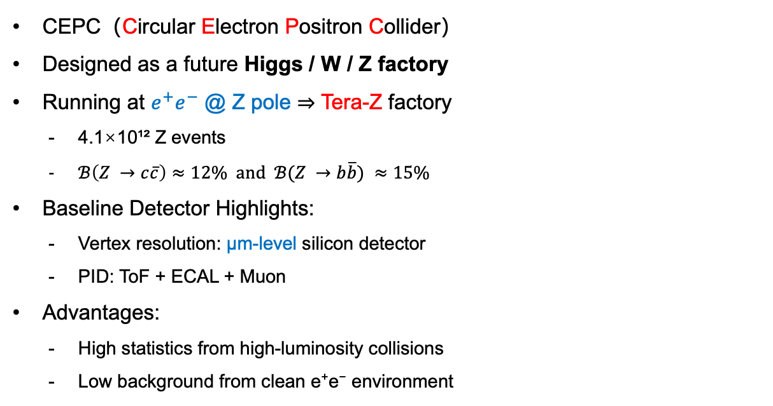
CEPC experiment
CEPC（Circular Electron Positron Collider）
Designed as a future Higgs / W / Z factory
Running at $e^{+}e^{−}$ @ Z pole ⇒ Tera-Z factory
  4.1×10¹² Z events
  $ℬ\left(Z →c\overline{c}\right)≈12\% and ℬ(Z →b\overline{b}) ≈15\%$
Baseline Detector Highlights:
  Vertex resolution: μm-level silicon detector
  PID: ToF + ECAL + Muon
Advantages:
  High statistics from high-luminosity collisions
  Low background from clean e⁺e⁻ environment

Slide 10
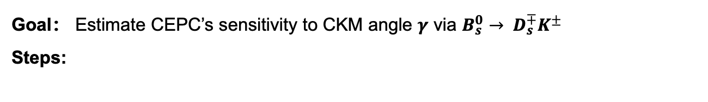
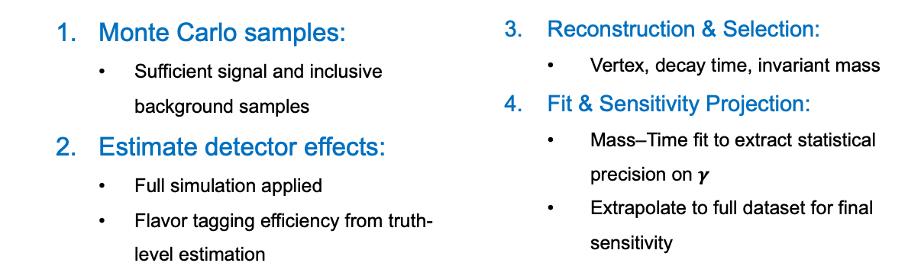
Strategies
Goal： Estimate CEPC’s sensitivity to CKM angle $γ$ via $B_{s}^{0}→ D_{s}^{∓}K^{±}$
Steps:
  Monte Carlo samples:
    Sufficient signal and inclusive background samples
  Estimate detector effects:
    Full simulation applied
    Flavor tagging efficiency from truth-level estimation
  Reconstruction & Selection:
    Vertex, decay time, invariant mass
  Fit & Sensitivity Projection:
    Mass–Time fit to extract statistical precision on $γ$
    Extrapolate to full dataset for final sensitivity

Slide 11
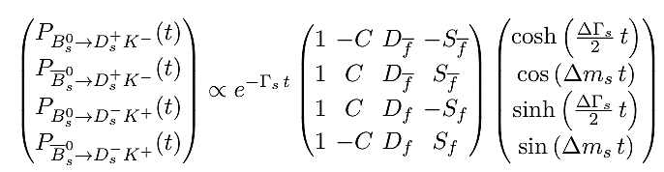
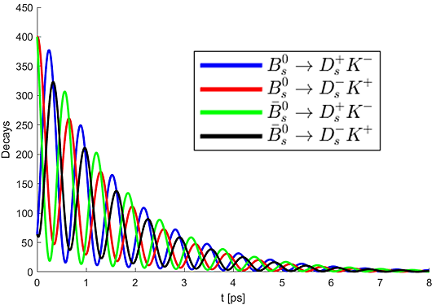
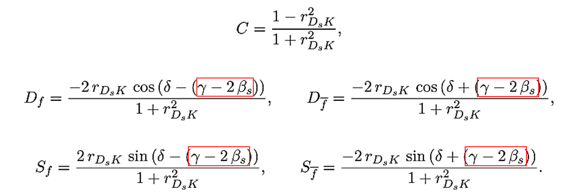
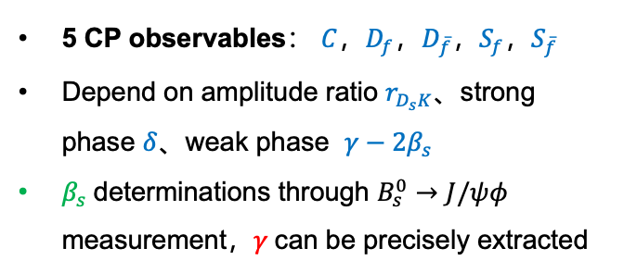
Decay rates
5 CP observables： $C$，$D_{f}$，$D_{\overline{f}}$，$S_{f}$，$S_{\overline{f}}$
Depend on amplitude ratio $r_{D_{s}K}$、strong phase $δ$、weak phase ​ $γ−2β_{s}$
$β_{s}$​determinations through $B_{s}^{0}→J/ψφ$ measurement，$γ$can be precisely extracted

Slide 12
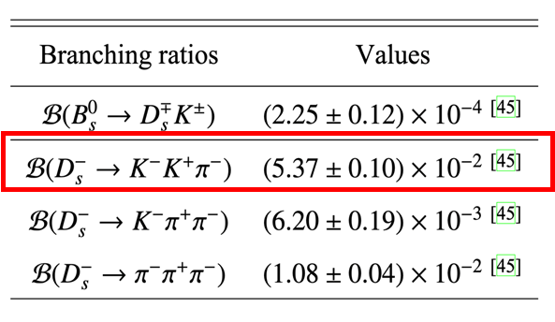
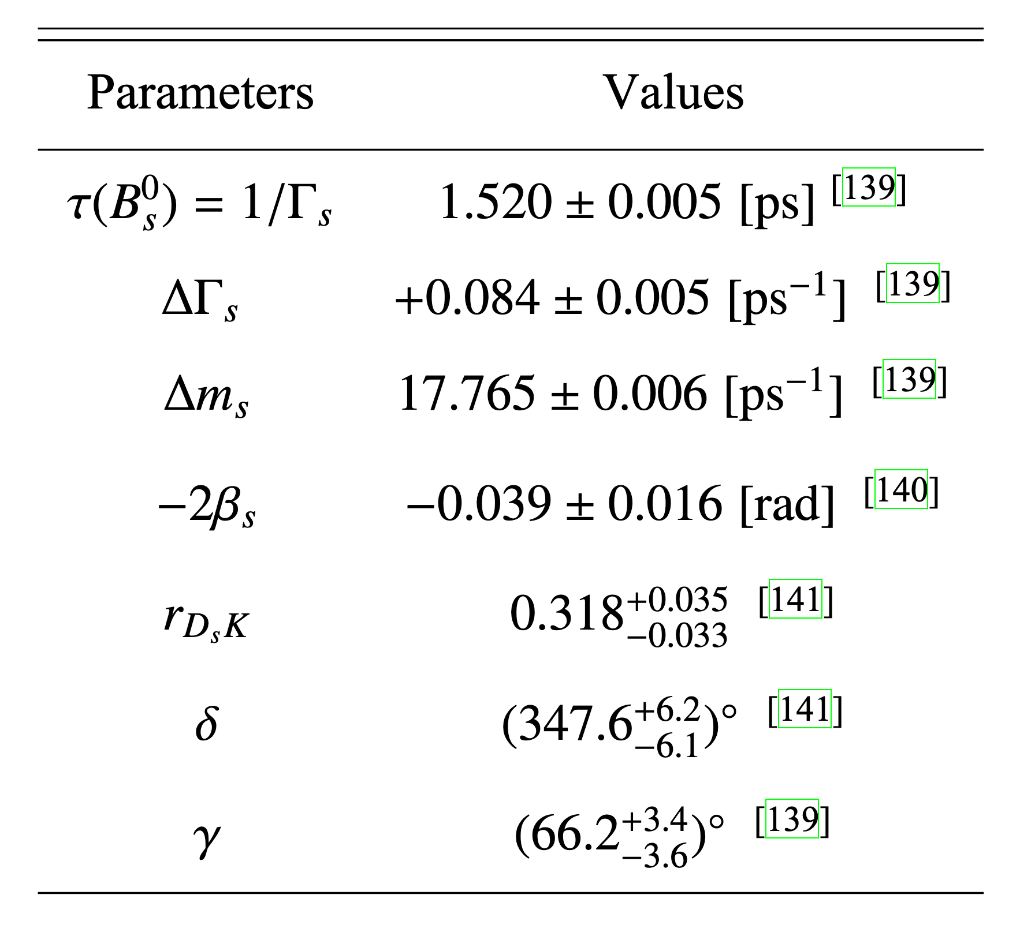
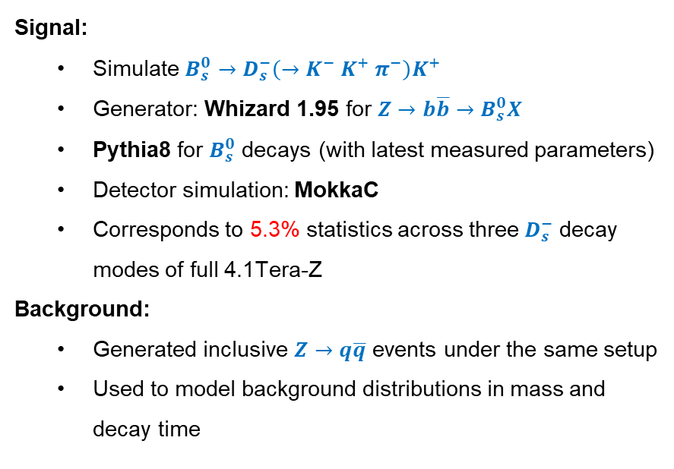
Full MC simulation
Signal:
  Simulate $B_{s}^{0}→D_{s}^{−}\left(→K^{−} K^{+} π^{−}\right)K^{+}$
  Generator: Whizard 1.95 for $Z→b\overline{b}→B_{s}^{0}X$
  Pythia8 for $B_{s}^{0}$ decays (with latest measured parameters)
  Detector simulation: MokkaC
  Corresponds to 5.3% statistics across three$D_{s}^{−}$ decay modes of full 4.1Tera-Z
Background:
  Generated inclusive $Z→q\overline{q}$ events under the same setup
  Used to model background distributions in mass and decay time

Slide 13









Reconstruction & Selection
Vertex Reconstruction:
  TV: Reconstruct $D_{s}^{−}→K^{−}K^{+ }π^{−}$with mass-constrained fit
  SV: Combine $D_{s}^{−}$ pseudo-track with $K^{+ }$ to reconstruct $B_{s}^{0}$ vertex
Selection Cuts:
  Mass windows:
    M($D_{s}^{−}$) ∈ [1.96,1.98]GeV/$c^{2}$
    M($B_{s}^{0}$) ∈ [5.28,5.46]GeV/$c^{2}$
  Vertex fit： $χ_{TV}^{2}<9$
  PV - TV > 0.1 mm, PV - SV > 0.5 mm
Efficiencies:
  Signal selection efficiency: 80%
  PID efficiency: $K$: 98.5%, $π$: 97.7%
$K^{−}$
$π^{−}$
$K^{+}$
$K^{+}$
$$TV$$
$$D_{s}^{−}$$
$$SV$$
$$B_{s}^{0}$$
$$PV$$
[arxiv:2411.06939]
(PV: Primary Vertex, SV: Secondary, TV: Tertiary)

Slide 14
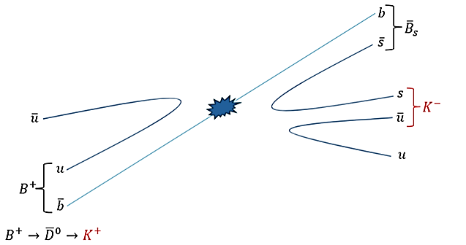
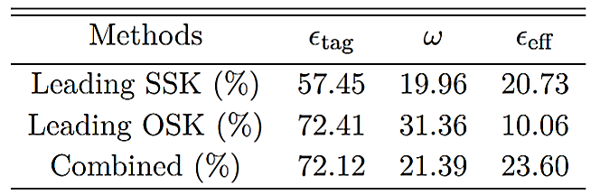
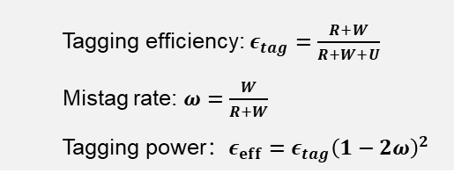
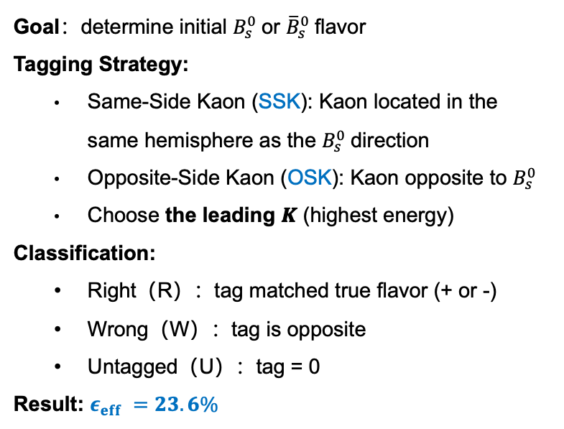
Flavor tagging
Goal：determine initial $B_{s}^{0}$​or ${\overline{B}}_{s}^{0}$​flavor
Tagging Strategy:
  Same-Side Kaon (SSK): Kaon located in the same hemisphere as the $B_{s}^{0}$direction
  Opposite-Side Kaon (OSK): Kaon opposite to $B_{s}^{0}$
  Choose the leading 𝑲 (highest energy)
Classification:
  Right（R）：tag matched true flavor (+ or -)
  Wrong（W）：tag is opposite
  Untagged（U）：tag = 0
Result: $ε_{eff} =23.6\%$
  Tagging efficiency: $ε_{tag}=\frac{R+W}{R+W+U}$
  Mistag rate: $ω=\frac{W}{R+W}$
  Tagging power：$ε_{eff}=ε_{tag}{\left(1−2ω\right)}^{2}$

Slide 15
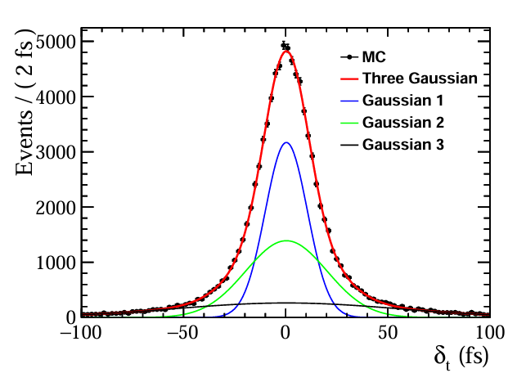

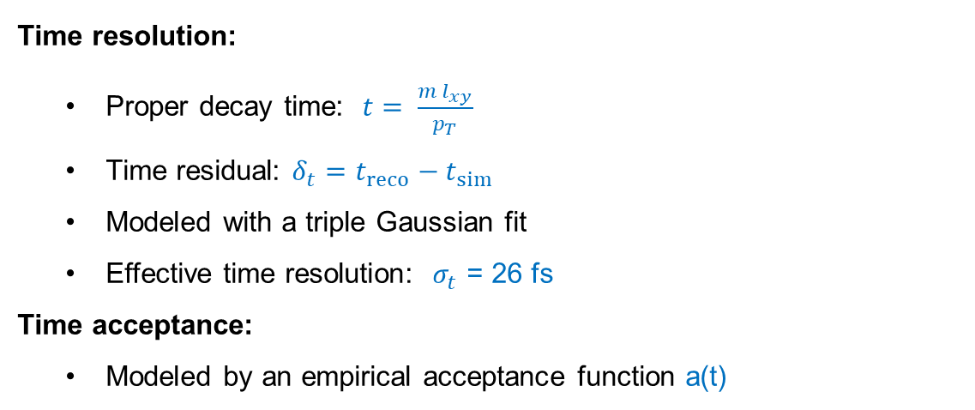
Time resolution and acceptance
Time resolution:
  Proper decay time: $t= \frac{m l_{xy}}{p_{T}}$
  Time residual: $δ_{t}=t_{reco}−t_{sim}$
  Modeled with a triple Gaussian fit
  Effective time resolution: $σ_{t}$ = 26 fs
Time acceptance:
  Modeled by an empirical acceptance function a(t)

Slide 16
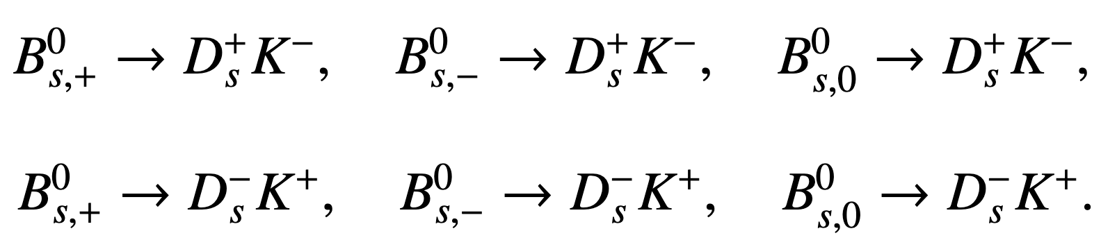
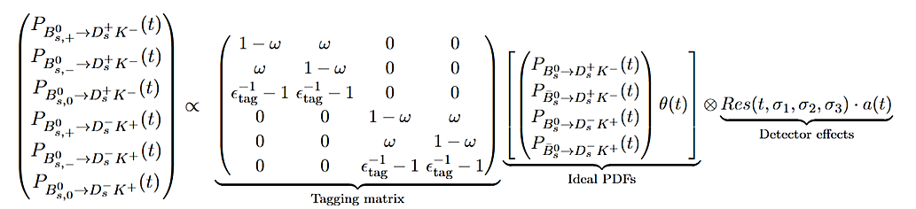
Signal parameterization
Flavor tagging divides the samples into 6 categories:
Mass distribution modeled by a Double-Sided Crystal Ball (DSCB) function
Time distribution based on the ideal model with corrections for:
  Flavor tagging effects, time resolution, time acceptance
Detector effects
Ideal PDF
Tagging matrix

Slide 17
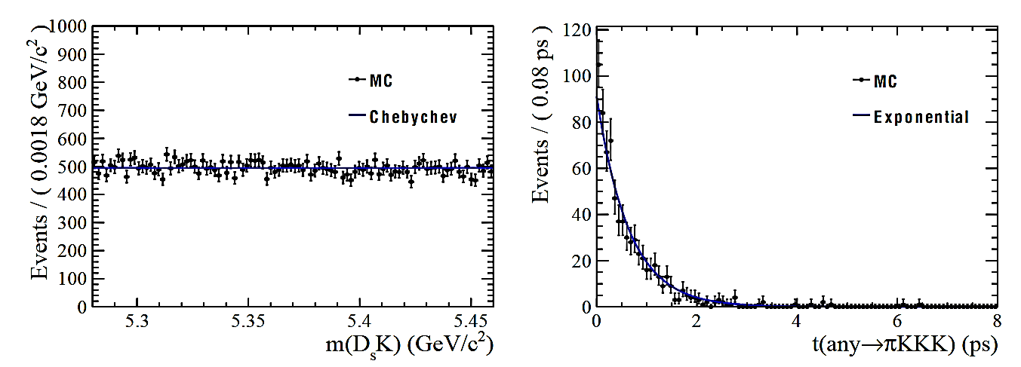
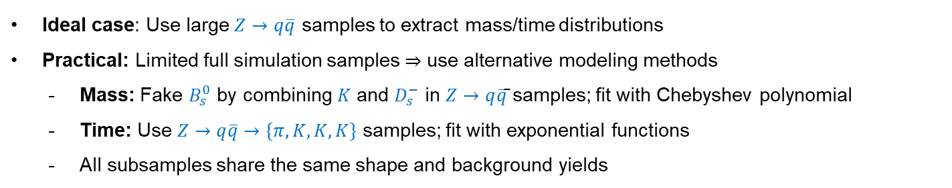
Background treatment
Ideal case: Use large $Z→q\overline{q}$ samples to extract mass/time distributions
Practical: Limited full simulation samples ⇒ use alternative modeling methods
  Mass: Fake $B_{s}^{0}$ by combining $K$ and $D_{s}^{−}$ in $Z→q\overline{q}$̄ samples; fit with Chebyshev polynomial
  Time: Use $Z→q\overline{q}→\{π, K, K, K\}$ samples; fit with exponential functions
  All subsamples share the same shape and background yields

Slide 18
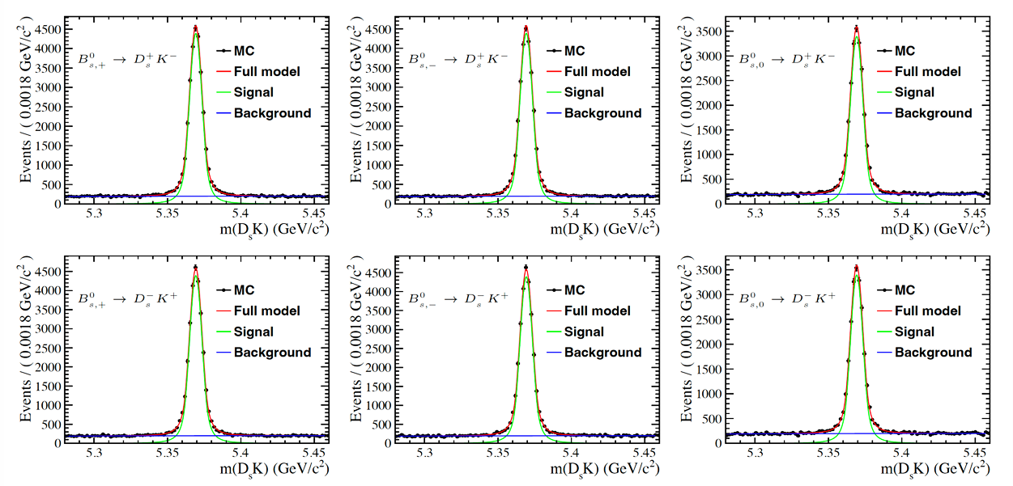
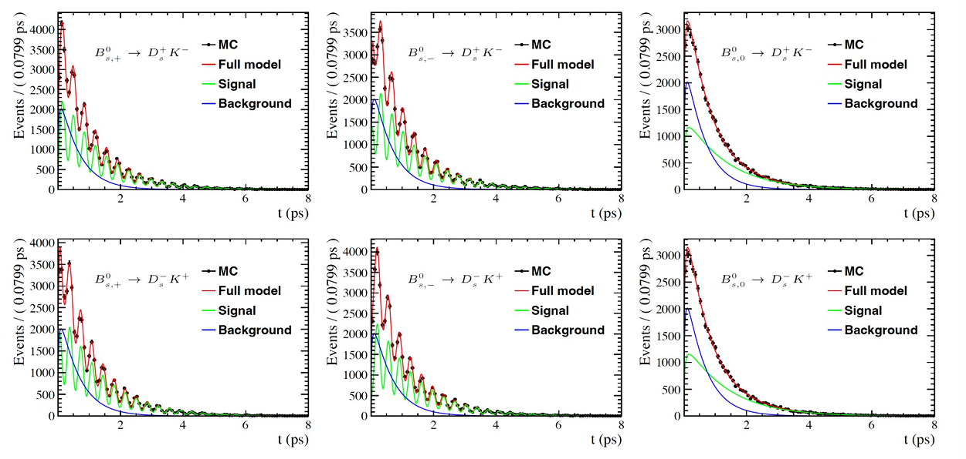
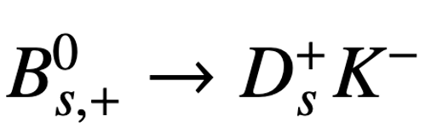
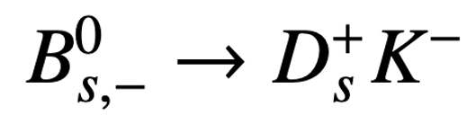
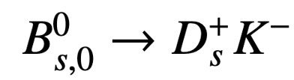
Mass-Time fit
Parameters fixed: $Γ_{s}$, $ΔΓ_{s}$, $Δm_{s}$ and $−2β_{s}$

Slide 19

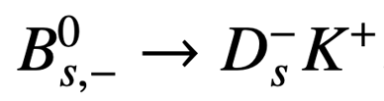
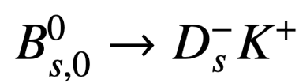
Mass-Time fit
Parameters fixed: $Γ_{s}$, $ΔΓ_{s}$, $Δm_{s}$ and $−2β_{s}$

Slide 20
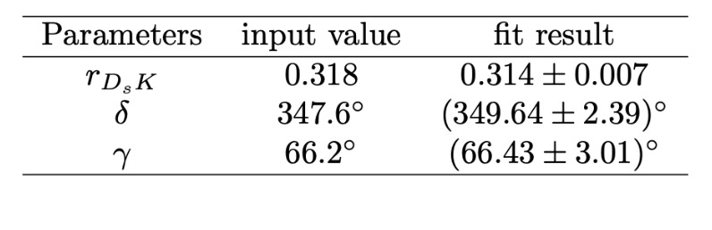

Fit results
Fit result:
  $γ$ = (66.43 ± 3.01)° (Statistical uncertainty only, based on 5.3% of full dataset, input $γ$ = 66.2°)
Projected final precision:
  σ($γ$) = 0.69° (Using all three $D_{s}^{−}$ decay modes, 4.1 Tera-Z)

Slide 21
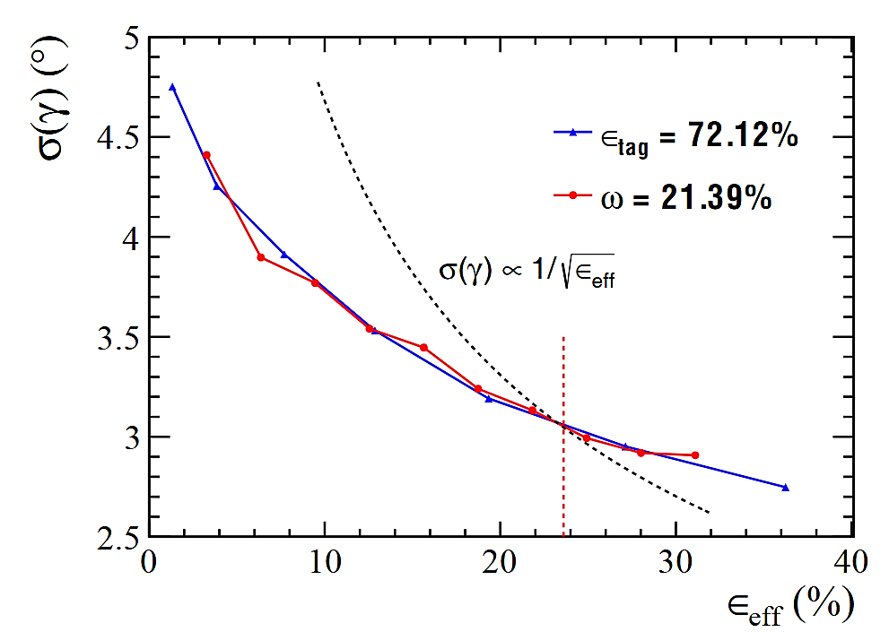
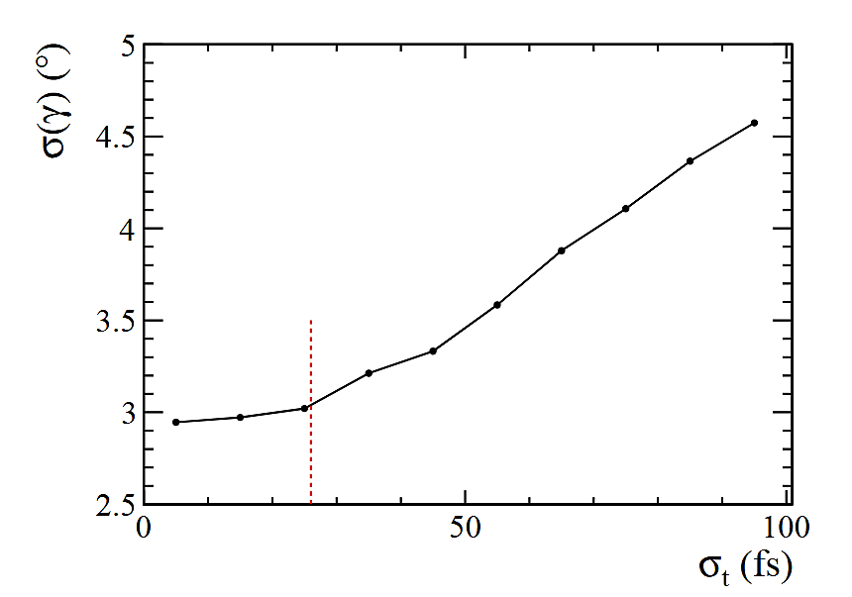

Discussion
σ($γ$) vs. $ε_{eff}$：
  Red & blue curves overlap: $ε_{eff}$ effectively summarizes tagging performance
  Clear deviation from $1/\sqrt{ε_{eff}}$ : Untagged events also carry $γ$ information
σ($γ$) vs. $σ_{t}$：
  Current $σ_{t}$ = 26 fs is sufficient for high-precision $γ$ measurement

Slide 22


Future optimization directions
A scale factor encapsulates all contributions affecting the $γ$ resolution:
Effective Statistics: Include additional $D_{s}^{−}$decay modes, e.g. with $π^{0}$
Selection Efficiency: Use machine learning to further improve selection
Tagging Power: Apply advanced tagging algorithms, e.g. ParticleNet
Time resolution: Optimize vertex reconstruction methods

Slide 23

Conclusion
Based on the CEPC Baseline detector，under 4.1 Tera-Z conditions，the projected statistical precision on the CKM angle $γ$ from $B_{s}^{0}→ D_{s}^{∓}K^{±}$ decay is σ($γ$) = 0.69°
  In comparison, LHCb Upgrade I / II expects: 2.5°/1.0° precision for the same decay channel
CEPC shows competitive performance for gamma measurement in this channel.
[arXiv:1808.08865]
Thanks

