Slide 1
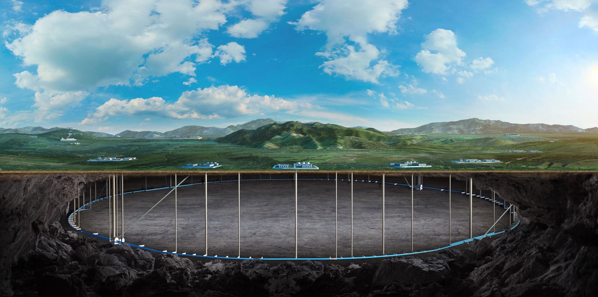


CEPC MDI EDR status and plan
Sha Bai
On behalf of CEPC MDI group
05-10. Nov. 2025, Guangzhou, The 2025 International Workshop on the High Energy Circular Electron Positron Collider

Slide 2
Content
Introduction
CEPC MDI EDR status
CEPC EDR work plan
Summary

Slide 3
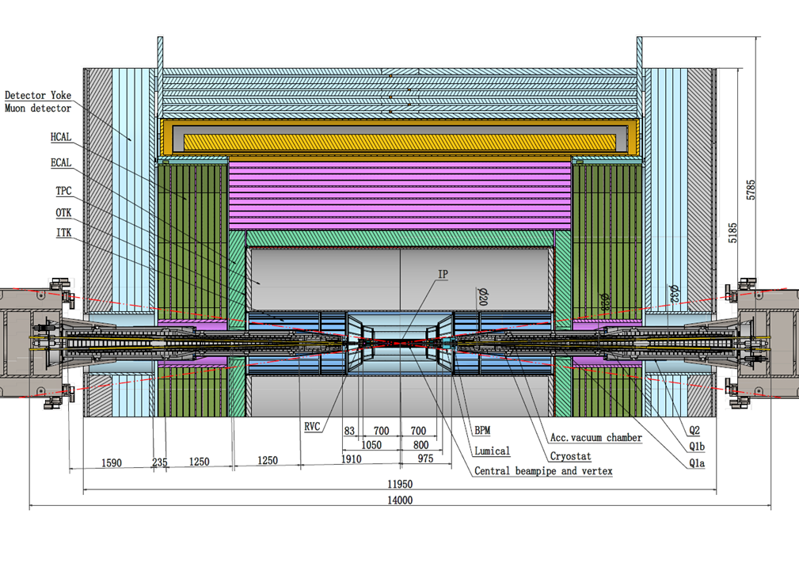
Introduction - MDI layout and IR design
The Machine Detector Interface (MDI) of CEPC double ring scheme is about ±7m long from the IP.
The CEPC detector superconducting solenoid with 3T magnetic field.
The accelerator components inside the detector are within a conical space with an opening angle: acos0.99
The e+e- beams collide at the IP with a horizontal angle of 33mrad and the final focusing length is to 1.9m.
Lumical is between 800mm~950mm from IP, while IP BPM at 950~1050mm.
Cryostat start point at 1050mm from IP, while anti-solenoid starts at 1130mm to 6200mm from IP.

Slide 4
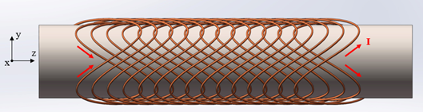
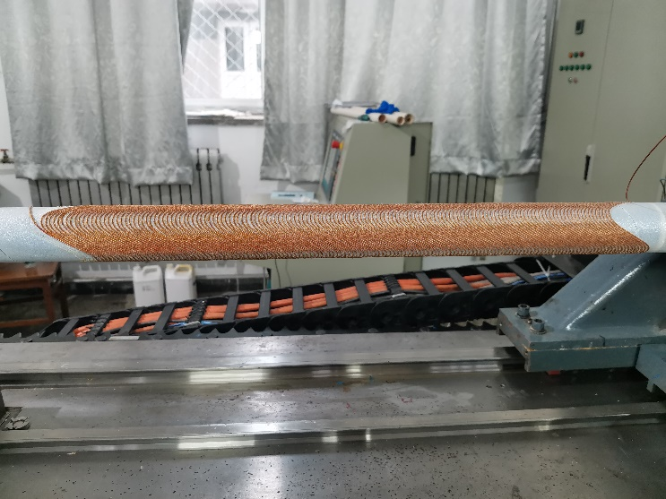
Acc. Superconducting magnets
SC quadrupole design adopted CCT type
1) CEPC Interaction Region quadrupole magnets meet basic requirement.
2) Ratio of multipole field to quadrupole field <2×10⁻⁴
3) Integral dipole field at the center of one aperture is zero
Local dipole field at each longitudinal position ≤ 300Gs
The total weight of each set of SC magnets is ~ 0.4 tons.
ITEM | Q1a | Q1b | Q2 | Anti-solenoid
Central field gradient (T/m) | 142.3 | 85.4 | 96.7
Cooling type | LHe | LHe | LHe | LHe
Operating current (A) | 720 | 640 | 760 | 1300
Magnetic storage energy (KJ) | 16.7 | 15.2 | 36.1 | 740
Cross section parameter (mm) | Φ40~61 | Φ52~78 | Φ62~88 | 70 sections
Magnet mechanical length (m) | 1.23 | 1.23 | 1.53 | 5.1
Net weight (Kg) | 25 | 32 | 43 | 302
Total weight of magnets (Kg) |  |  |  | 402
CCT coil
Peak field in coil Q1a/Q1b/Q2: 4.0T/3.7T/4.1T
Within the aperture of anti-solenoid, the maximum magnetic field is 8.2T, and the maximum magnetic field on anti-solenoid coil is 10.9T.
SC magnets corrector coil：dipole coil(Q1a/Q1b/Q2）≤300Gs
Skew quadrupole coil：
 | Q1b | Q2
L(m) | 1.21 | 1.5
G（T/m) | 0.44 | 0.36

Slide 5
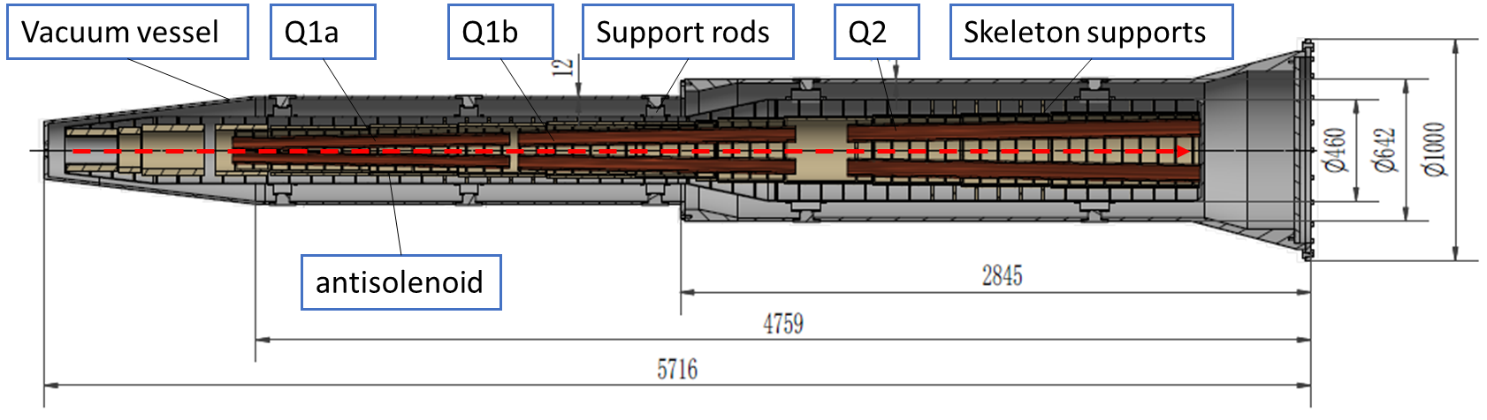
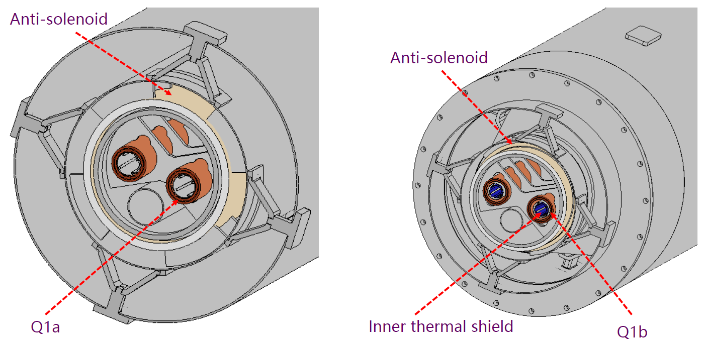
Cryostat
The cryostat is used to provide the cryogenic environment for SC magnets, which is below 5.0 K.
Working temperature: 2K is the baseline, 4.2K is alternative.
Cryostat: a total weight of ~ 2.4 tons and a total length of ~ 5.7m.
Items | Weight (kg) | Main materials
Vacuum vessel | 869 | SS
Helium Vessel | 510 | SS
Thermal shield and pipes | 43 | Aluminum
SC quadrupoles | 100 | Copper & Aluminum
Anti-solenoids | 302 | Copper & Aluminum
Skeleton supports | 92 | Aluminum
Liquid Helium | 504 | Liquid Helium
Total weight | 2420

Slide 6
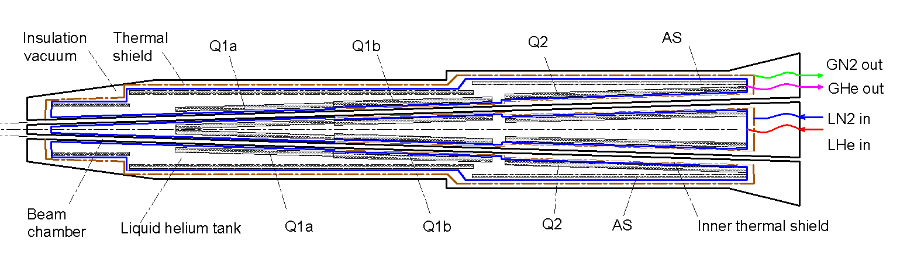
Cryogenic scheme of the cryostat
Cryostat scheme
Superconducting magnets are immersed in the helium tank for the low temperature.
One thermal shield is set for the heat interruption from the ambient temperature.
The shield is extended between the helium tank and the beam chamber.
The cold mass can be cooled by supercritical, subcooled, or superfluid liquid helium, and the shield is by liquid nitrogen.
4 K cooling system(alternative)
2 K cooling system（baseline)

Slide 7
Thermal analyses – Sychrotron radiaton
SR heat load without Masks
Region | ttbar |  | Higgs |  | Z
 | SR heat load | SR average power density | SR heat load | SR average power density | SR heat load | SR average power density
0~780mm | 0 | 0 | 0 | 0 | 0 | 0
780mm~805mm | 11.88W | 132W/cm² | 23.04W | 256W/cm² | 11.8W | 131.1W/cm²
805mm~855mm | 27.53W | 152.9W/cm² | 53.39W | 296.6W/cm² | 27.4W | 152.2W/cm²
855mm~1.9m(Q1a entrance） | 2.22W | 0.59W/cm² | 4.32W | 1.15W/cm² | 2.2W | 0.59W/cm²
Q1a（1900-3110）1210 | 1.69W | 0.38Wcm² | 3.28W | 0.75W/cm² | 1.68W | 0.38W/cm²
Q1a~Q1b（3110-3190） | 11.8W | 40.97W/cm² | 22.92W | 79.58W/cm² | 11.75W | 40.8W/cm²
Q1b（3190-4400） | 2.04W | 0.47W/cm² | 3.96W | 0.91W/cm² | 2.03W | 0.47W/cm²
Q1b~Q2(4400-4700) | 36.6W | 33.9W/cm² | 71.04W | 65.8W/cm² | 36.4W | 33.7W/cm²
Q2(4700-6200) | 3.74W | 0.69W/cm² | 7.26W | 1.34W/cm² | 3.72W | 0.69W/cm²

Slide 8
Thermal analyses – HOM & Resistance wall
HOM & Resistance wall
Position | Position Start-end（mm） | material | Length (mm) | Higgs (w)&(w/cm²) | W (w)&(w/cm²) | Z (w)&(w/cm²) | ttbar (w)&(w/cm²)
Be pipe (w&w/cm²) | 0-110 | Be | 110 | 1.46 & 0.021 | 7.230 & 0.105 | 71.558 & 1.035 | 0.401 & 0.005
Be pipe transition(w&w/cm²) | 110-180 | Al | 70 | 0.45 & 0.01 | 2.173 & 0.049 | 21.574 & 0.491 | 0.127 & 0.007
Transition pipe (w&w/cm²) | 180-655 | Al | 475 | 6.99 & 0.017 | 34.48 & 0.085 | 341.562 & 0.83 | 1.958 & 0.005
Transition （w&w/cm²） | 655-700 | Al | 45 | 0.62 & 0.015 | 2.95 & 0.071 | 29.28 & 0.701 | 0.172 & 0.004
RVC bellow（w&w/cm²） | 700-780 | Cu | 80 | 0.52 & 0.007 | 2.532 & 0.034 | 25.002 & 0.337 | 0.14 & 0.002
Transition on Y-crotch(w&w/cm²) | 780-805 | Cu | 25 | 0.16 & 0.007 | 0.785 & 0.032 | 7.822 & 0.316 | 0.05 & 0.002
Y- crotch (w&w/cm²) | 805-855 | Cu | 50 | 0.33 & 0.005 | 1.572 & 0.024 | 15.626 & 0.241 | 0.091 & 0.002
Quadrupole pipe(w&w/cm²) | 855-1100 | Cu | 245 | 1.58 & 0.005 | 7.735 & 0.024 | 75.594& 0.24 | 0.434 & 0.002
Total | 0-1100 | - | 1100 | 12.11 &0.011 | 59.457 &0.056 | 588.018 & 0.56 | 3.373 & 0.003

Slide 9
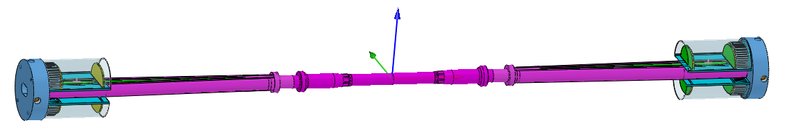
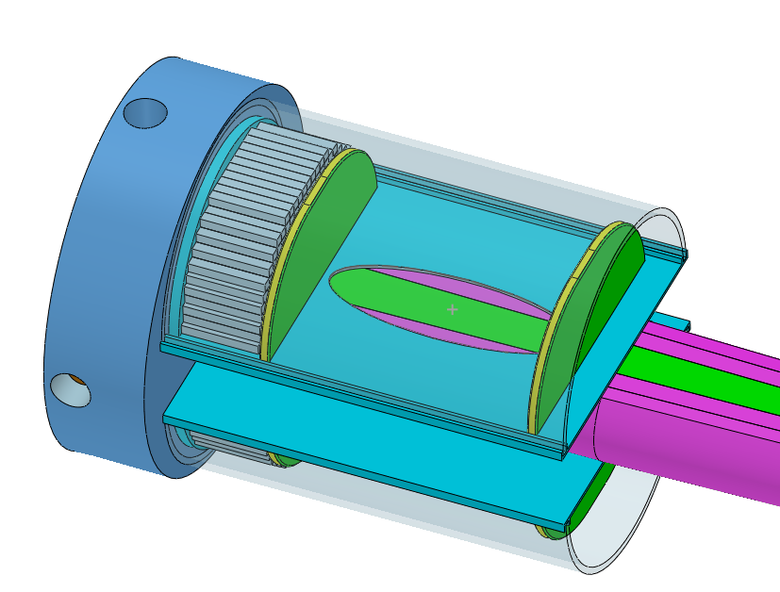
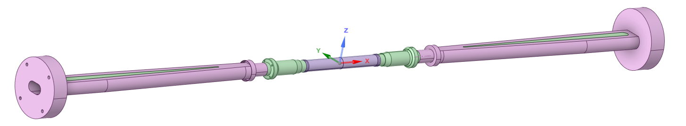
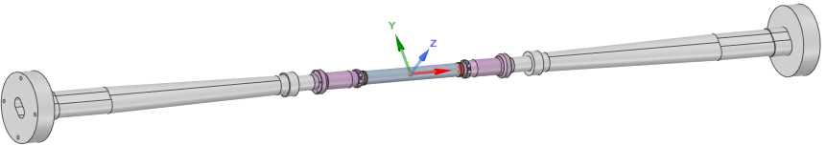
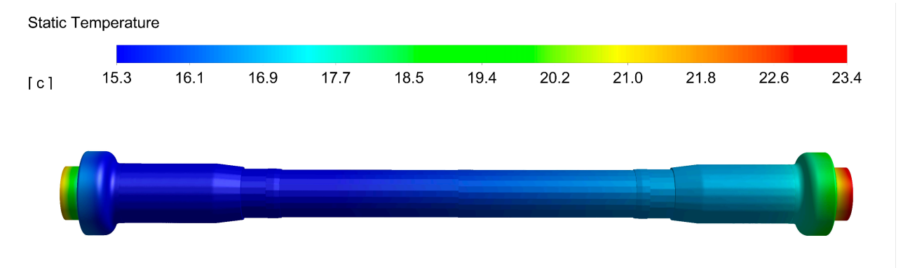
The central beam pipe design
Central Be pipe segment: 380mm, the inner diameter: 20mm
The inner Be layer: 0.2mm
Outer Be layer: 0.15mm (to improve the accuracy of vertex)
the cooling gap: 0.3 mm, Paraffin
0.2 mm, Water
Si wafer
LYSO bars
Highest temperature position
Water is the basic design and Paraffin is alternative choice.
Dynamic temperature/pressure could meet the requirements.
Highest temperature: 23.4℃

Slide 10
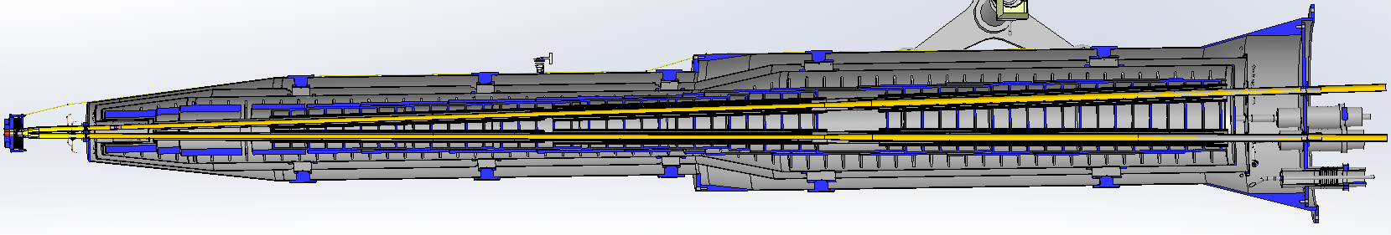
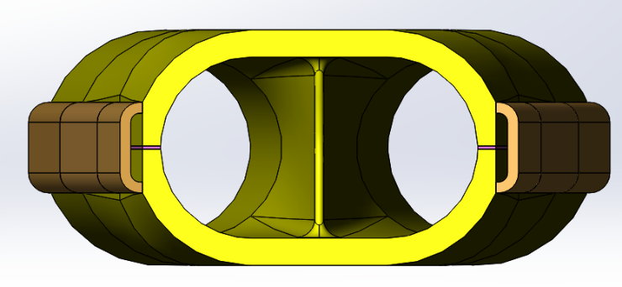
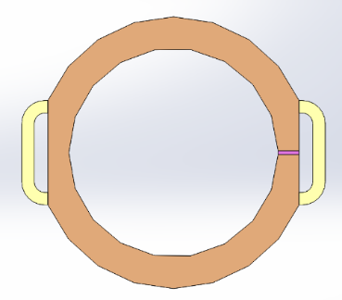
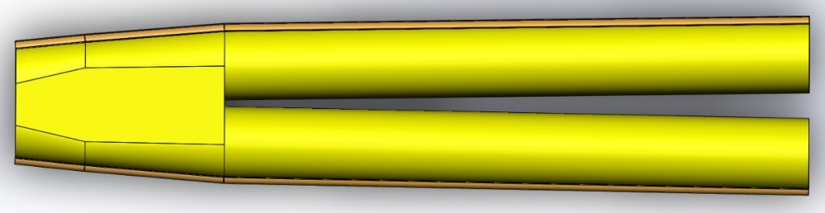
IR vacuum chamber
The total length of MDI vacuum system is about 14m, mainly composed of vacuum chamber, bellows, beryllium pipe, cooling system, support system, etc.
Due to limited space at MDI region, not possible to install a vacuum pump, and NEG coating is chosen.
From IP(mm) | Shape | Inner diameter(mm) | Material | Marker
0-110 | Circular | 20 | Be
110-180 | Circular | 20 | Al
180-655 | Race-track | 20~35 | Al | Taper: 1:70
655-700 | Race-track | 35 | Al
700-780 | Race-track | 35 | Cu
780-805 | Race-track | 35~39 | Cu
805-855 | Race-track | 39~20 double pipe | Cu
Q1a-Q1b-Q2：20mm-23mm-32mm
Cone+circular beam pipe structure with gradually increasing aperture
mode | E (Gev) | Beam lifetime (hours) | Vacuum pressure (Torr)
Higgs | 120 | 10 | 2 × 10⁻⁹
W | 80 | 5 | 1.5 × 10⁻⁹
Z | 45.5 | 3 | 8 × 10⁻¹⁰
tt | 180 | 15 | 1 × 10⁻⁸
The beam pipe is made of chromium zirconium copper material (Cr-Zr-Cu) C18150.
Water channels welded on the outside for cooling the SR heat load.
Cr-Zr-Cu has low photon desorption capacity, high thermal conductivity, and can effectively prevent photons from penetrating the vacuum chamber and damaging magnets and other hardware.
Bellows was installed at the connection of vacuum chamber which can compensate for the thermal expansion, contraction, and offset of the vacuum chamber, and provide continuous RF shielding between two connected vacuum chambers to reduce the impedance.

Slide 11
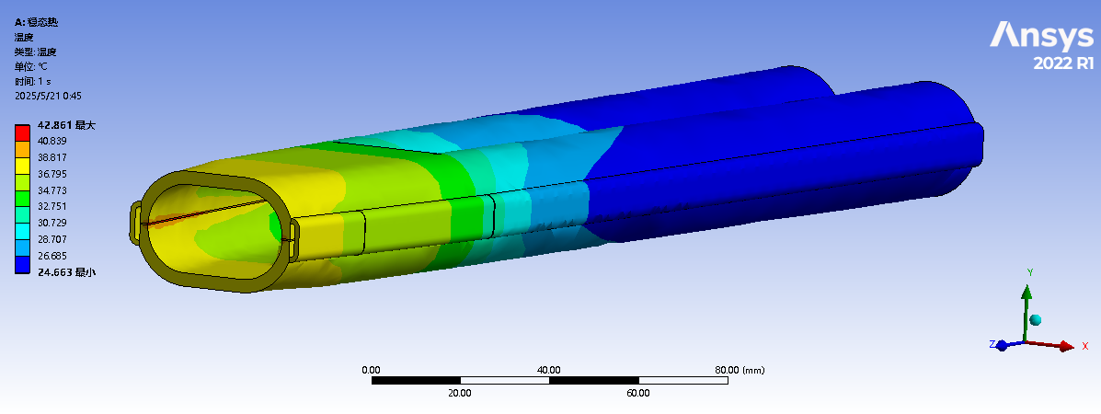
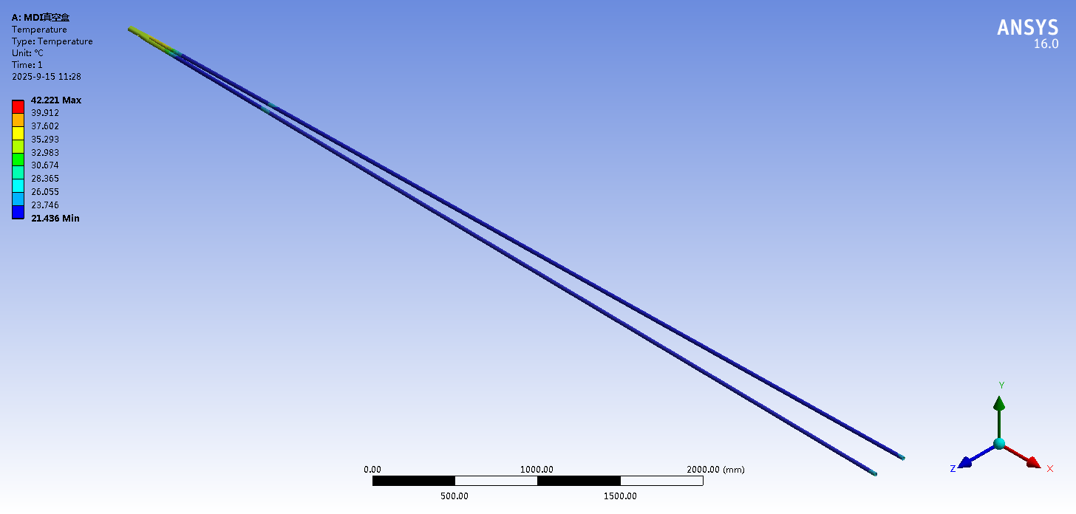
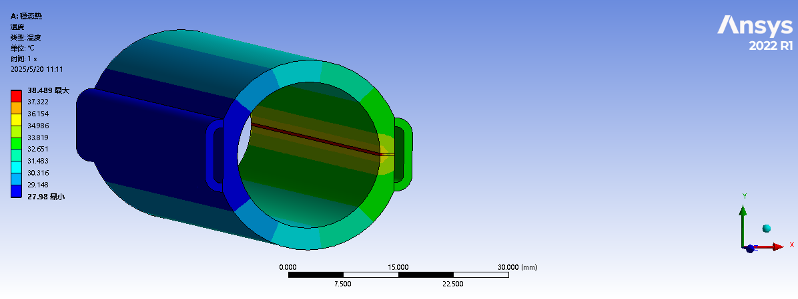
Thermal analysis of IR beam pipe
Thermal analyses of beam pipe at cryostat @Higgs, 50MW
Two masks at 1.9m and 7.2m respectively, and the power density is highest at masks.
The power density of SR at Mask1 is ~ 2.966 W/mm², and at Mask2 is ~3.2 W/mm².
The power density at the crotch part is 2.97 W/mm², while at other positions is less than 0.8 W/mm² ;
The highest temperature at crotch part is 42.86 ℃, and at Masks is 38.5 ℃. The other part is the cooling water temperature.

Slide 12
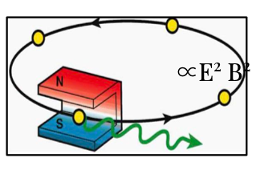
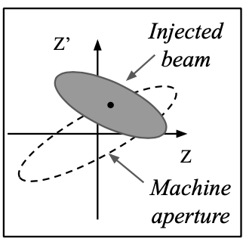
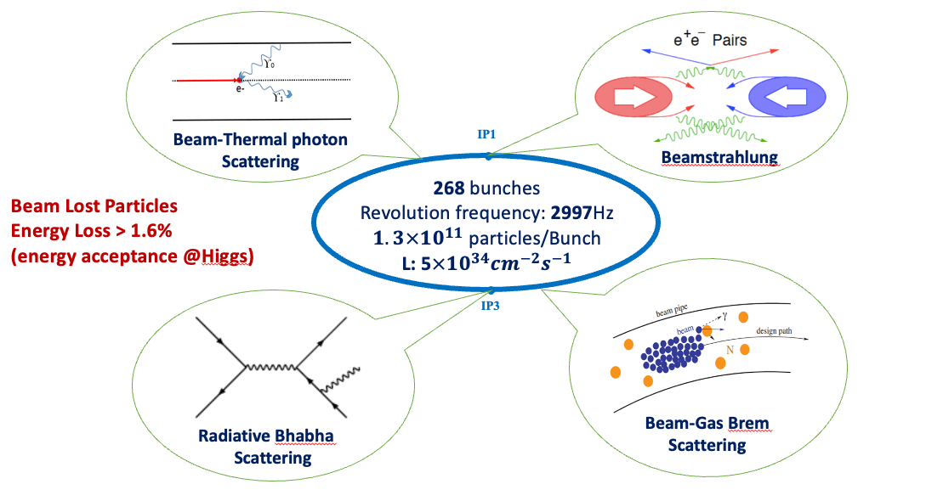
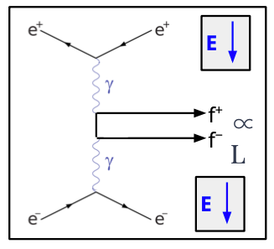

Beam Background Sources and Simulation Steps
Single Beam
  Touschek Scattering
  Beam Gas Scattering(Elastic/inelastic)
  Beam Thermal Photon Scattering
  Synchrotron Radiation
Luminosity Related
  Beamstrahlung
  Radiative Bhabha Scattering
Injection(Will be considered future)
A. Natochii
SR
A. Natochii
468 bunches
$$1.3×{10}^{11} particles/bunch$$
$$L:8.3×{10}^{34}{cm}^{−2}s^{−1}$$
Pair Production
Photon BG
Beam Loss BG
Injection BG
Background | Generation | Tracking | Detector Simu.
Synchrotron Radiation | BDSim/Geant4 | BDSim/Geant4 | CEPCSW/FLUKA
Beamstrahlung/Pair Production | Guinea-Pig++ | SAD
Beam-Thermal Photon | PyBTH[Ref]
Beam-Gas Bremsstrahlung | PyBGB[Ref]
Beam-Gas Coulomb | BGC in SAD
Radiative Bhabha | BBBREM
Touschek | TSC with SAD
Simulate each background separately
Whole-Ring generation for single beam BGs
Multi-turn tracking(150 turns)
  Using built-in LOSSMAP
  SR emitting/RF on
  Radtaper on
  No detector solenoid yet

Slide 13
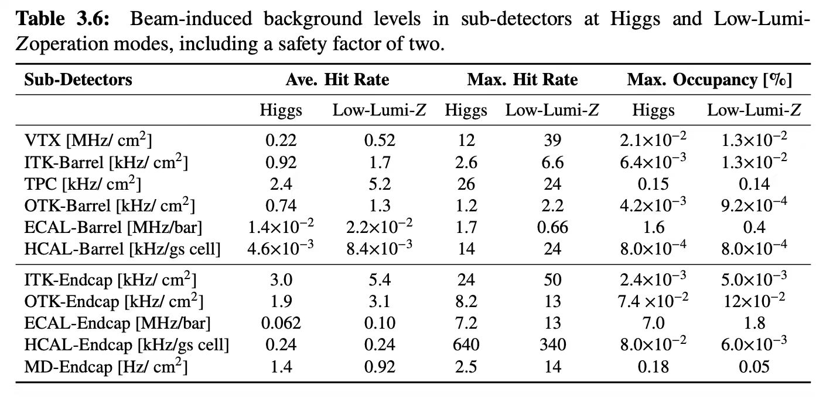
BG Level at Higgs/Z with mitigation
We have obtained an estimation of the beam-induced background levels at Higgs and 12.1-MW Z mode(Low-Luminosity-Z mode) based on current design including a safety factor of two.
  The results in High-Luminosity-Z mode will be much higher than these two, 10~100 times higher than Higgs on hit rate.
  The average means the average over the whole detector volume. Eg, the VTX has 6 layers, the average it count by the total hit number in 6 layers / the sum of areas of the 6 layers.
  The maximum is the highest number of the basic unit, like per cm² or per cell.
13

Slide 14
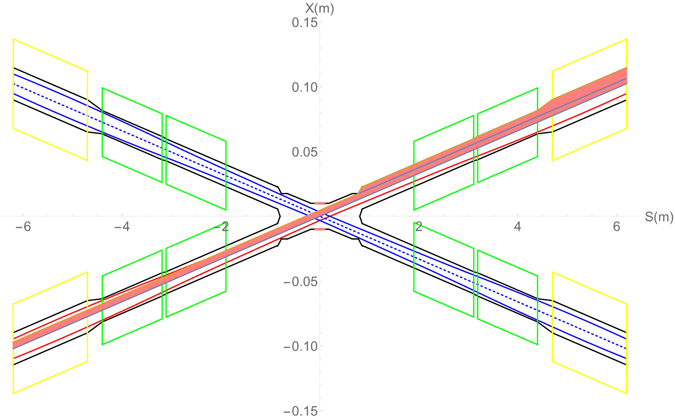
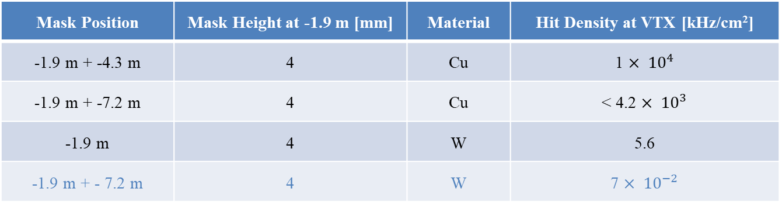
SR BG & Mitigation
The central beam pipe was carefully designed to avoid the direct hitting of the SR photons.
The masks are implemented to further mitigate the secondaries, the design is still on going.
  Several ways has been attempted, including different position/material/design of the mask, parts of them are listed here in the table. (We simulated 1e⁹~1e¹² electrons, then scale to 1s)
Mask Position | Mask Height at -1.9 m [mm] | Material | Hit Density at VTX [kHz/cm²]
-1.9 m + -4.3 m | 4 | Cu | 1 $× {10}^{4}$
-1.9 m + -7.2 m | 4 | Cu | < 4.2 $× {10}^{3}$
-1.9 m | 4 | W | 5.6
-1.9 m + - 7.2 m | 4 | W | 7 $× {10}^{−2}$

Slide 15
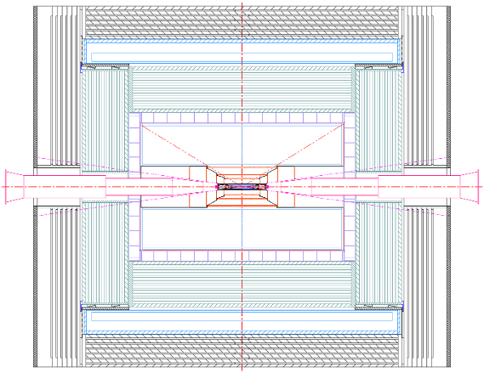
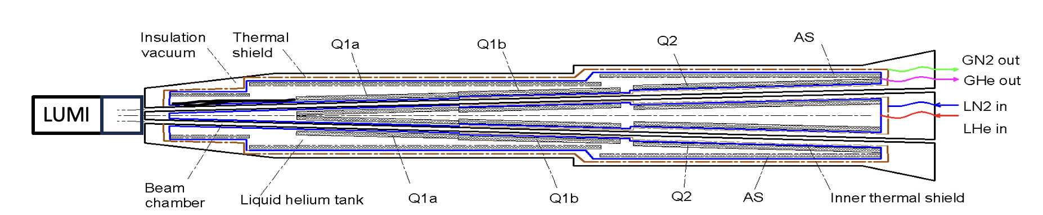
Shielding
Shielding is designed to prevent beam background from damaging detector.
Shielding has been implemented at both ends of the yoke using the 10 cm of paraffin, and also 10mm W outside of the LumiCal-LYSO. The shell of cryo-module also used as shielding. The shielding has reduced the ~20%-50% of the BG level.
10cm Paraffin
15mm Stainless Steel Shell and Shielding
10mm Tungsten
15

Slide 16
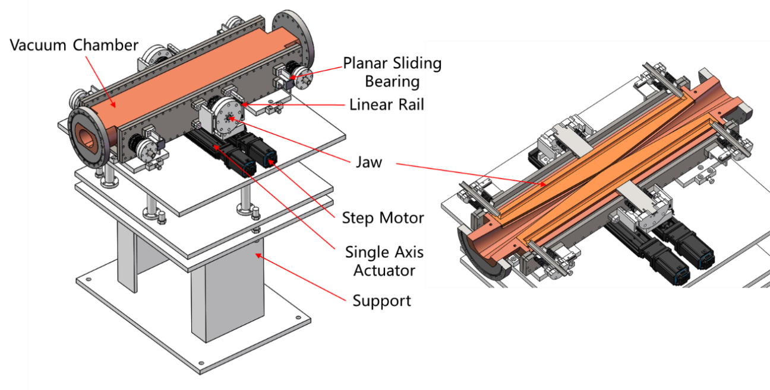
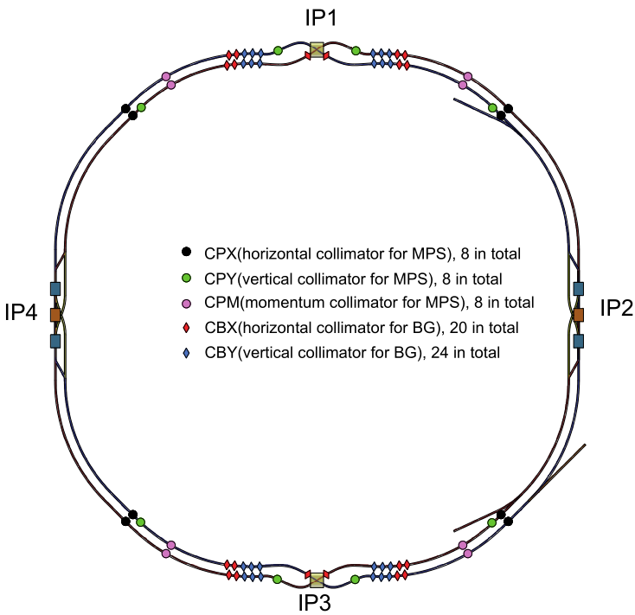
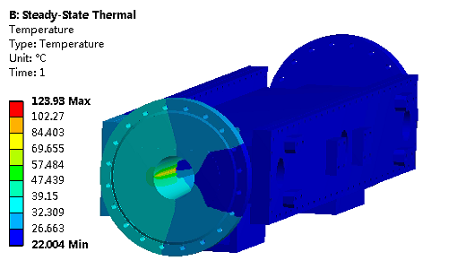
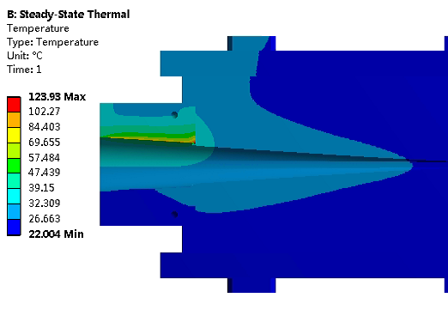
Background collimators
  Movable collimators are designed for beam background mitigation(totally 44 for two rings).
  Jaw and vacuum vessel material: Glidcop Al-15, can endure the SR and HOM power in normal operation.
Highest temperature: 124 ℃

Slide 17
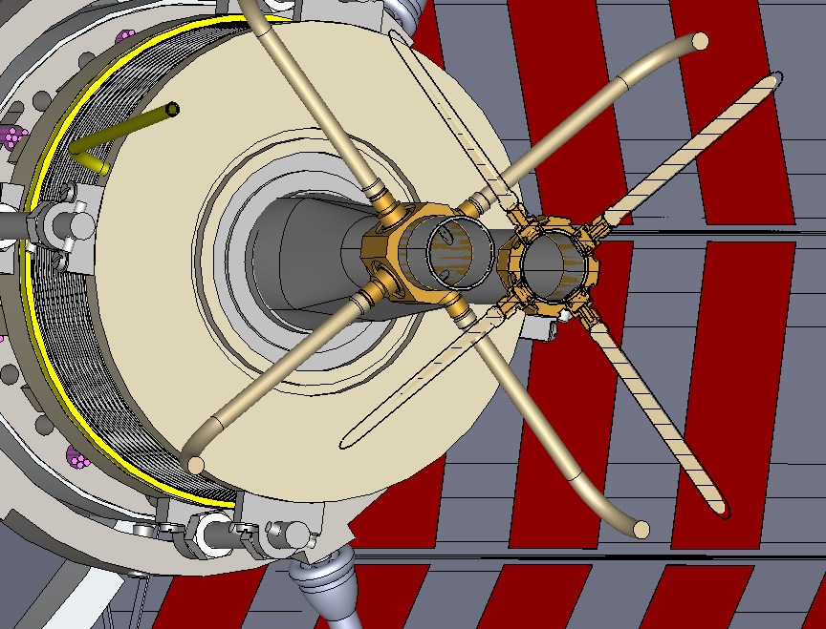
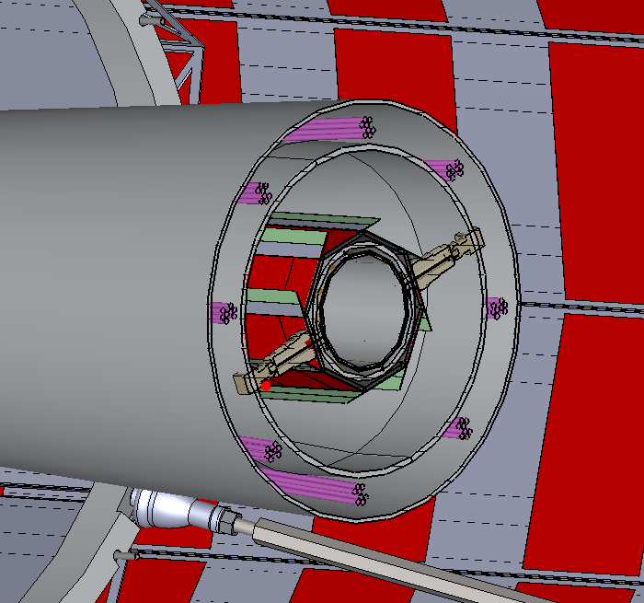
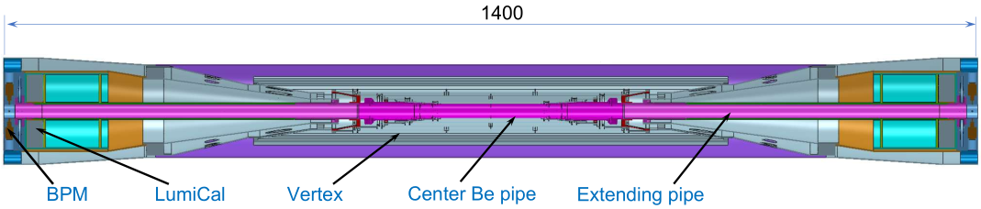
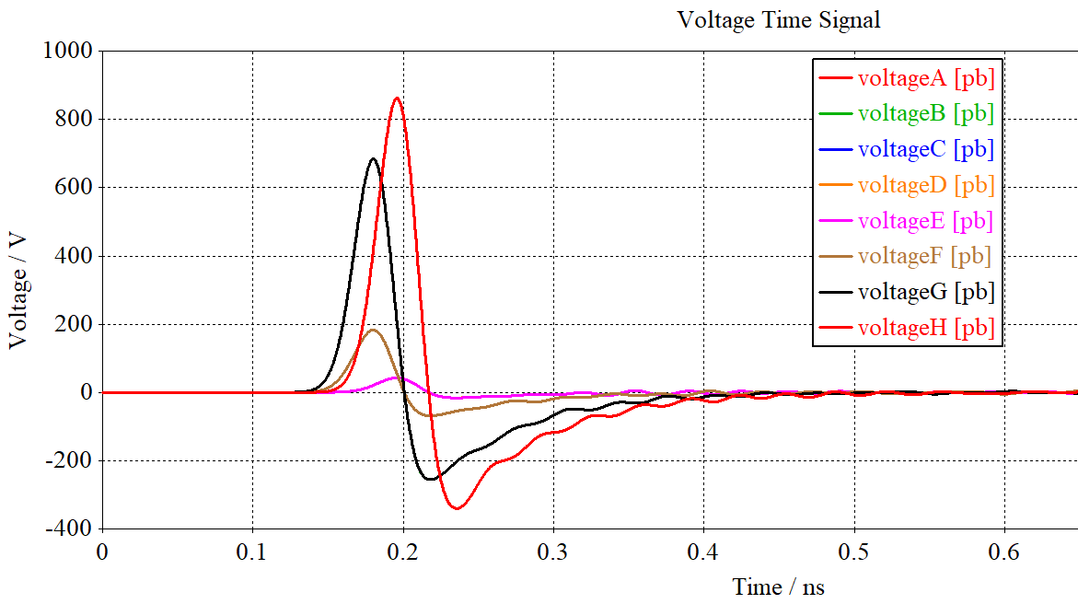
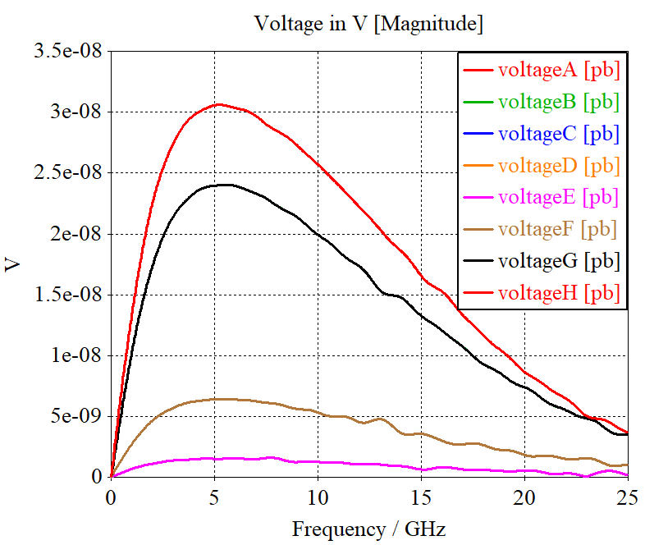
IR BPMs
Considering response time and calibration difficulty, two 4 button electrodes BPM in double pipe and one 2 button electrodes BPM in single pipe at each side of CEPC IR are adopted.
2 button electrodes BPM for measuring the arrival time.
Utilize a pair of BPMs for vertical beam orbit feedback (fast lumi monitor for horizontal), placed at symmetric positions on each side of the IP, located at 950mm~1050mm from IP.
BPM
 | Bunch charge | Bunch length | Current peak | Current average | 650MHz | K_{loss}
 | nC | mm | A | A | dBm | mV/pC
Higgs | 20.8 | 4.1 | 607 | 0.208 | -11.9 (-20.2) | 6.76 (0.16)
Z | 22.4 | 8.7 | 308 | 0.974 | 1.5 (-6.8) | 0.30 (0.15)
W | 21.6 | 4.9 | 527 | 0.216 | -11.5 (-19.8) | 3.4 (0.25)
ttbar | 32.0 | 2.9 | 1315 | 0.320 | -20.2 (-16.4) | 15.1 (0.017)

Slide 18
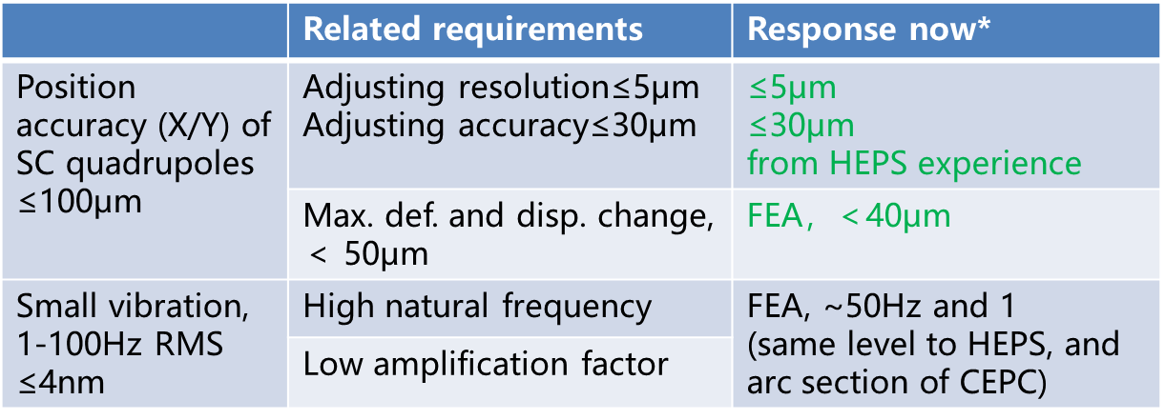
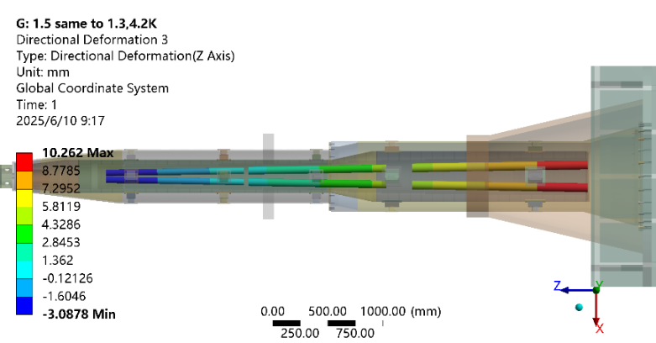
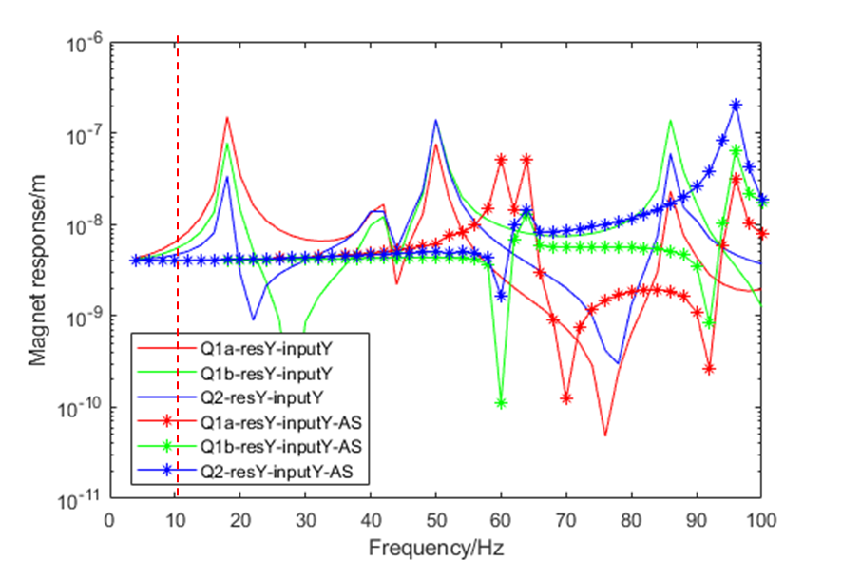
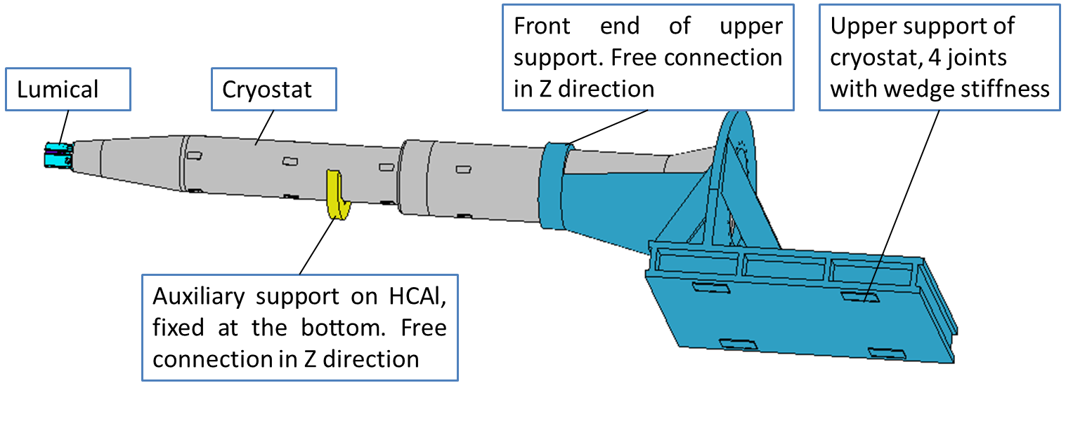
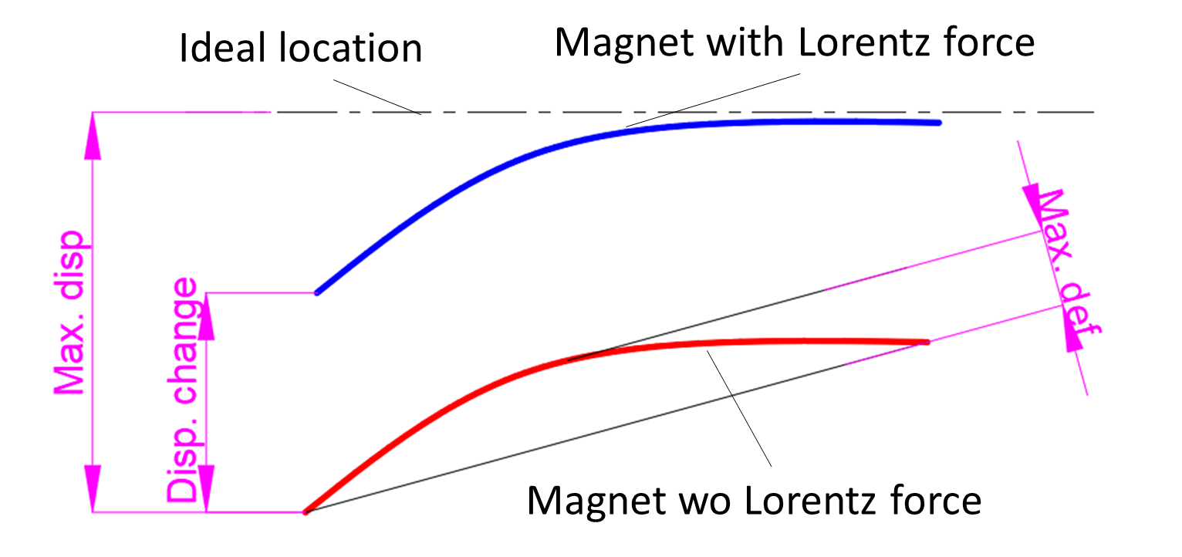
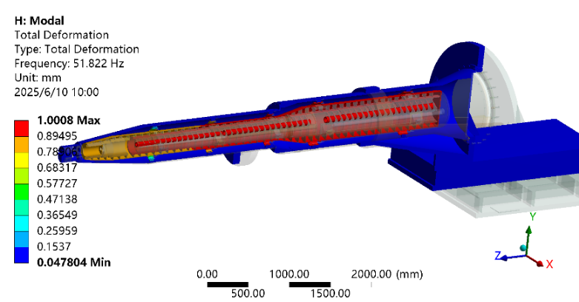
SC magnet support system
Mechanics and vibration analyses
  The cryostat and its supports at MDI have been optimized.
  The first natural frequency has been enhanced 3 times, from 17.7Hz to 49.2 Hz.
  The Max. def. and disp. Change is smaller than 40 um, which means it has little effect on alignment, and no re-alignment is needed after having Lorentz force.
Analyses model
Z disp. of SC quadrupoles, 4.2 K
Harmonic response, 1-100Hz
Details in: Haijing Wang, Mini-Review of CEPC MDI (9-June 10, 2025), https://indico.ihep.ac.cn/event/26255/
Primary concerned metrics
1st order of mode, 4.2 K

Slide 19
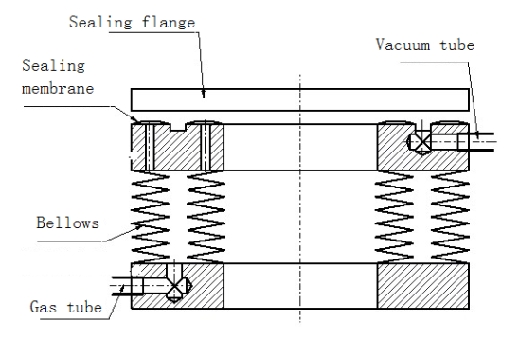
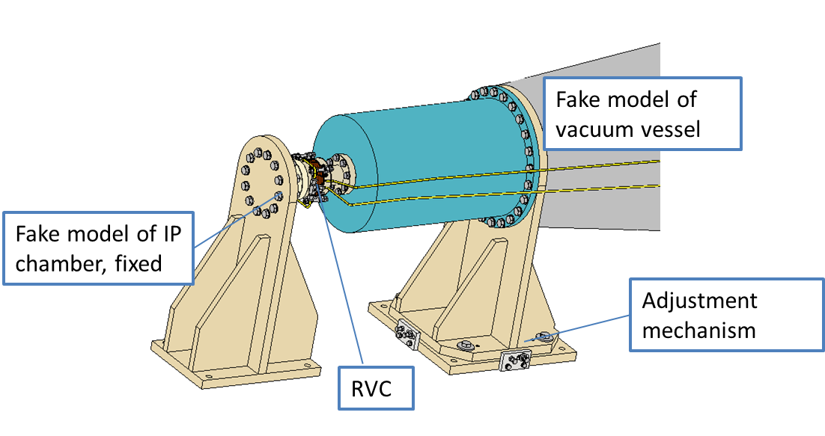
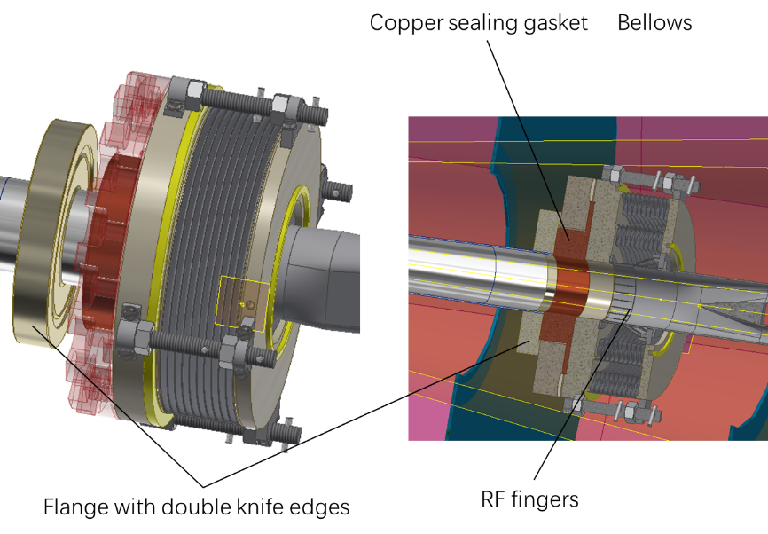
Remote Vacuum Chamber(RVC)
    RVC
  The RVC design has been completed.
  A prototype will be developed (quotation finished, and the 1st engineering drawings are prepared).
  The influence of RVC displacement on the leakage rate will be simulated through an adjustment mechanism.
Inflatable seal

Slide 20
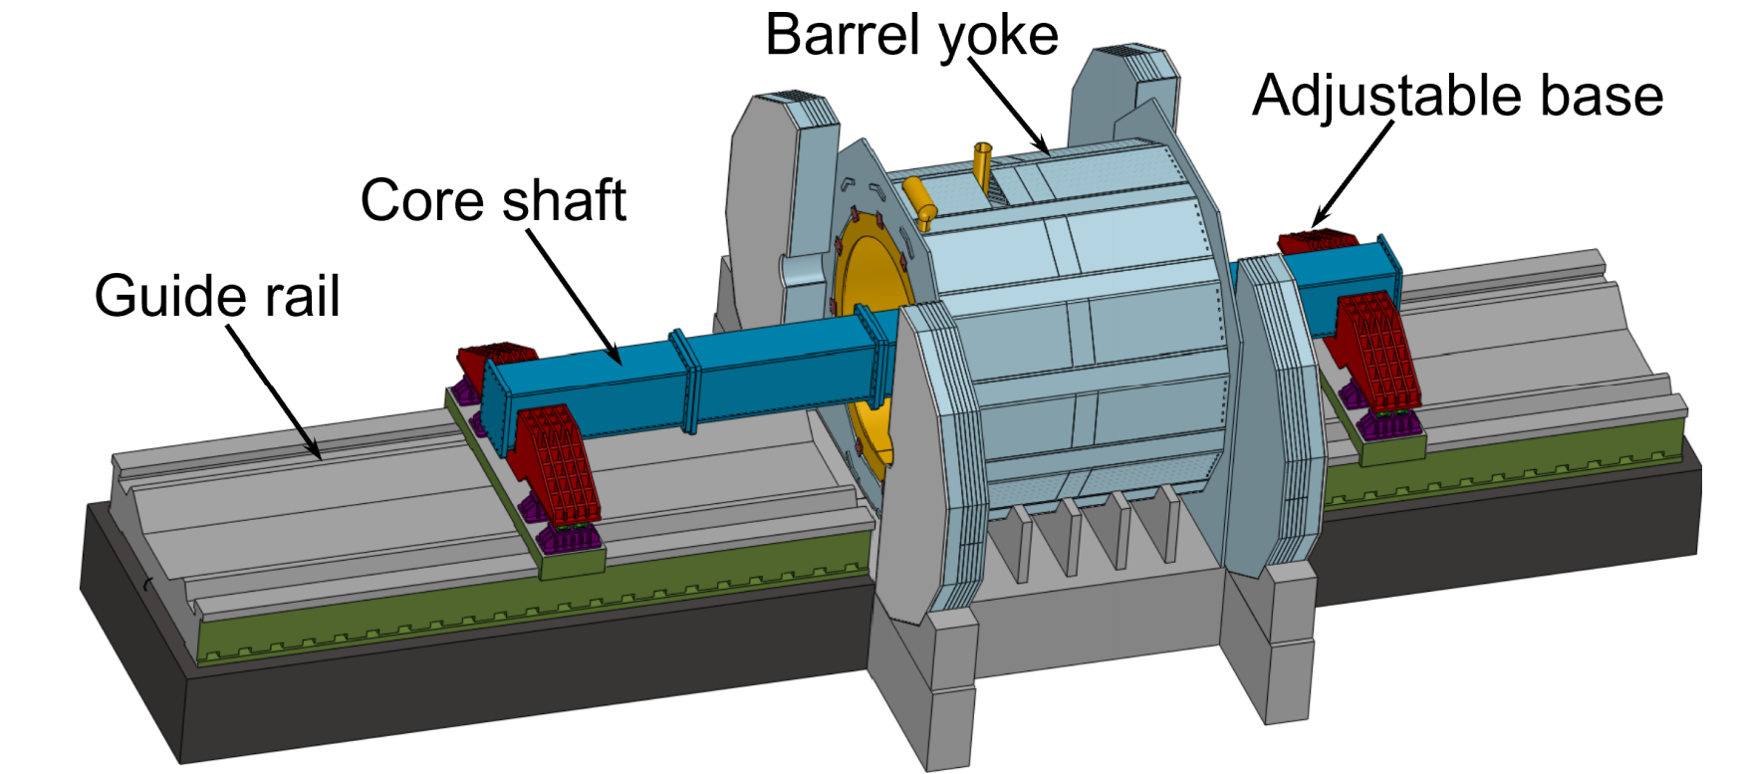
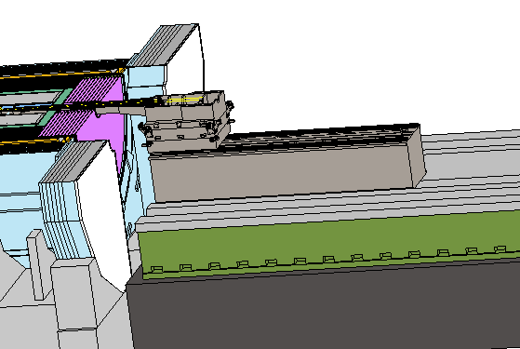
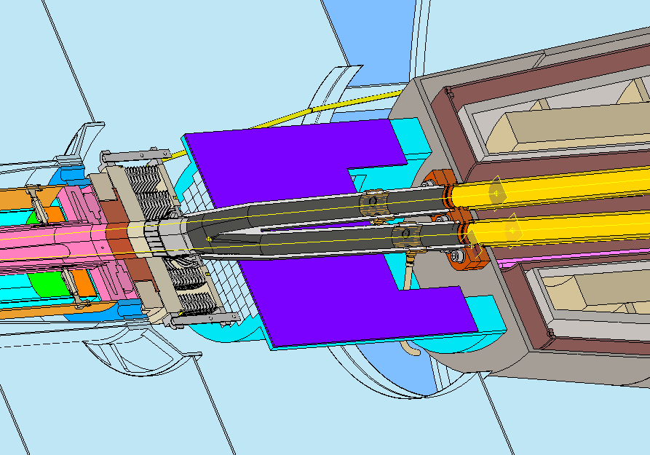
Integration and Assembly
Detector installation in the underground experimental hall
Mechanical interface between accelerator and detector
Central beampipe
Lumical
Accelerator
cryostat support
RVC
Y chamber
IP BPM
Detector guide rail
20

Slide 21
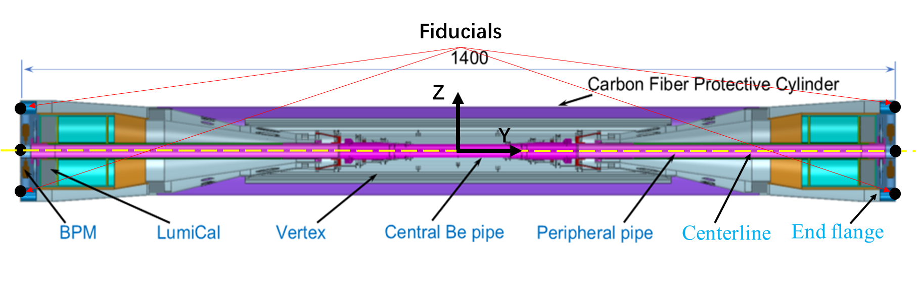

MDI alignment
  Components in MDI need to be aligned mainly include Beam pipe, LumiCal, BPM and Cryostat (final focusing magnets).
  Beam pipe assembly integrates beam pipe, vertex detector, LumiCal, and BPM.
  Beam pipe assembly installed in ITK, its finally alignment accuracy is 100um.
Beam pipe assembly
ITK
Cryostat internal structure
Cryostat alignment scheme
  LHe-tank module fiducialization
  Cryostat pre-alignment
  Cryostat installation alignment
Alignment accuracy of the SCQs on both sides ≤ 100μm

Slide 22
EDR work plan
  Study on key technologies on Direct winding Q1a CCT quadrupole model with 0.5m length
  Manufacture and test of CCT type Q1a short model quadrupole
  Optimization of the cryostat; Consideration of processing and manufacturing technology
  Improve beam background simulation; optimize the design of suppression methods. Deliver an estimation of BIB level in detector and whole interaction region with the optimization of the shield and the safety margin considered.
  Research on corrosion prevention, gold plating, beryllium-aluminum welding, etc.
  In terms of Lumical, further design the system, assemble module-level prototypes, and conduct beam experiments, etc
  The mechanics and vibration analyses and the structure optimization is basically converged, comprehensive considered with the deformation and vibration performance, alignment requirements, radiation and quench. More detailed analyses including all the relative components are planned next stage.
  The engineering design of RVC has been started. We have made an experiment scheme, based on which the quotation is finished, and the engineering drawings are under process.
  For the alignment, a series of test will be carried out, including consistency inspection of the magnetic center and the mechanical center, deformation measurement under different support forms, the impact of temperature changes on alignment; Continue the high-efficiency and high-precision measuring instrument R&D. etc on.

Slide 23
Summary
Progress has been made across several areas of study, including impedance and thermal load simulations, background analysis, and cryo-magnet design etc on. However, detailed investigations and further optimizations are still needed.
Prototype is necessary and will be in progress.
Work plan will be carried out in reference to the IARC recommendations.

Slide 24
Thanks for your attention

