Slide 1
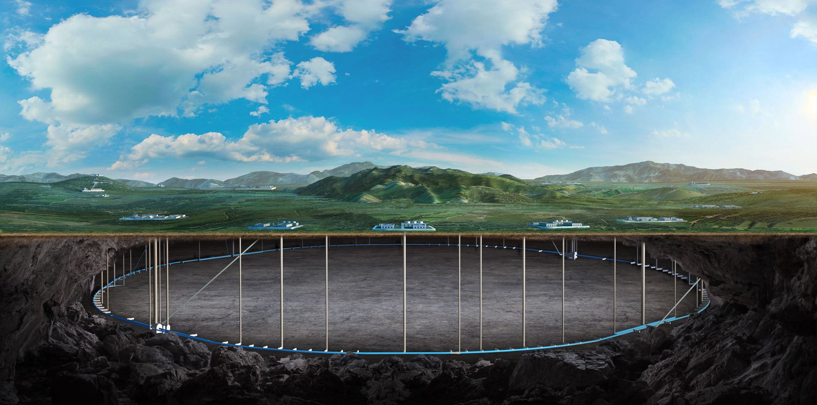


CEPC MDI VACUUM
Lei Zhang, Yongsheng Ma
On behalf of CEPC Vacuum System
Haijing Wang, Haoyu Shi, Sha Bai, Haiyi Dong, Huamin Qu
2025 International Workshop on CEPC, Guangzhou, China, November 6-10, 2025
Notes:
With the help of some other colleagues

Slide 2
Content
Introduction
The structure of beam chamber
Vacuum system
Thermal simulation
Summary and outlook

Slide 3

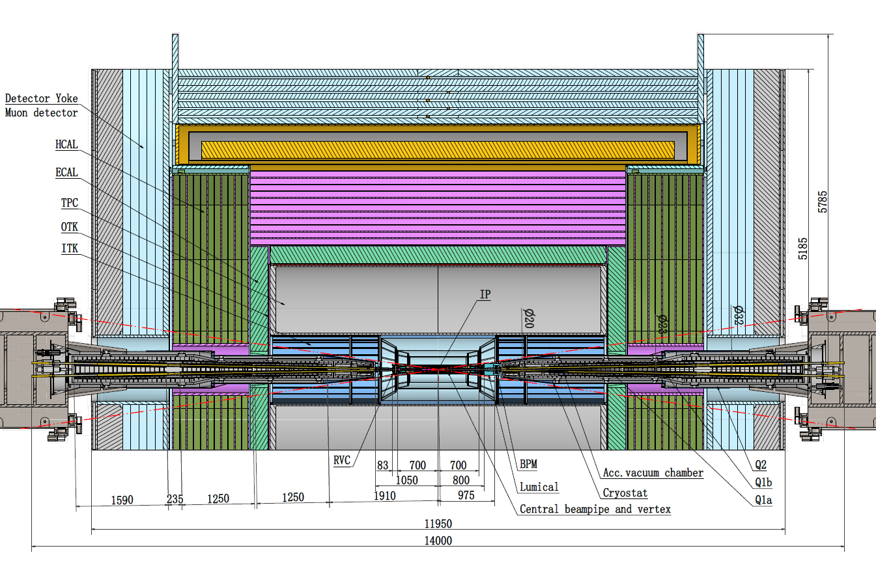
Introduction
The total length of MDI vacuum system is about 14m, mainly composed of vacuum chamber, NEG coating, water cooling system, support system, etc.
The energy, beam life, and vacuum pressure requirements at MDI are shown in the following table:
Modes | E (Gev) | Beam gas scattering lifetime (h) | Vacuum requirement (Torr)
Higgs | 120 GeV | 10 | <2×10⁻⁹
W | 80 GeV | 5 | <1.5×10⁻⁹
Z | 45.5 GeV | 3 | <8×10⁻¹⁰
Tt | 180 GeV | 15 | <1×10⁻⁸

Slide 4
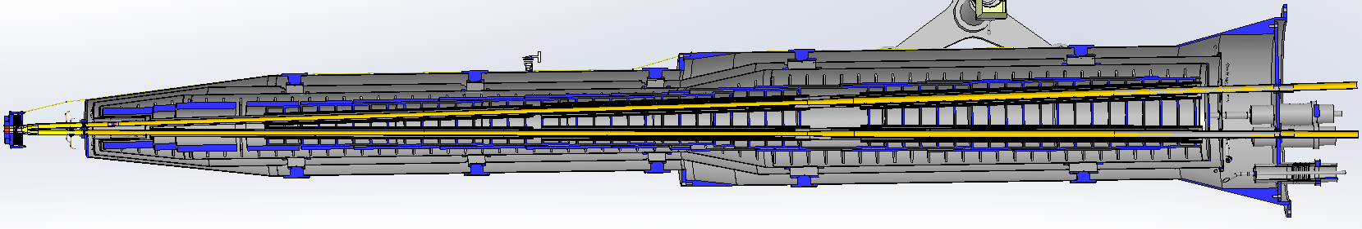
The structure of beam chamber
      The length of MDI vacuum chamber is about 14m.
      Central beam pipe：-700~700mm (other colleagues)；
      RVC：700-783mm；
      Chamber：783-7000mm (MDI vacuum system).
      Most of the chambers are in the cryostat and the smallest gap between the vacuum chamber and the cold screen is only 3mm. So it poses significant challenges for the support and alignment of chambers.
Crotch chamber
Z: 783~855mm
Φ20 chamber
Z: 855~4438mm
Φ20-30 chamber
Z: 4438~4653mm
Φ30 chamber
Z: 4653~7000mm

Slide 5
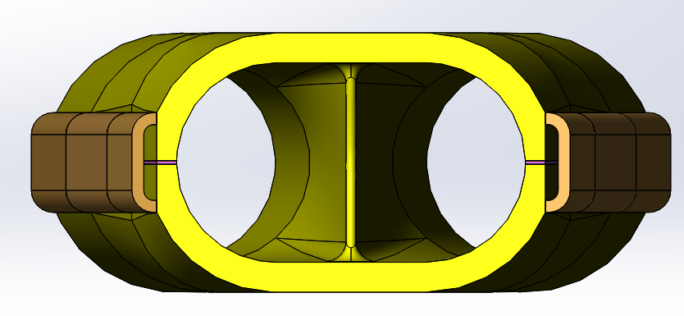
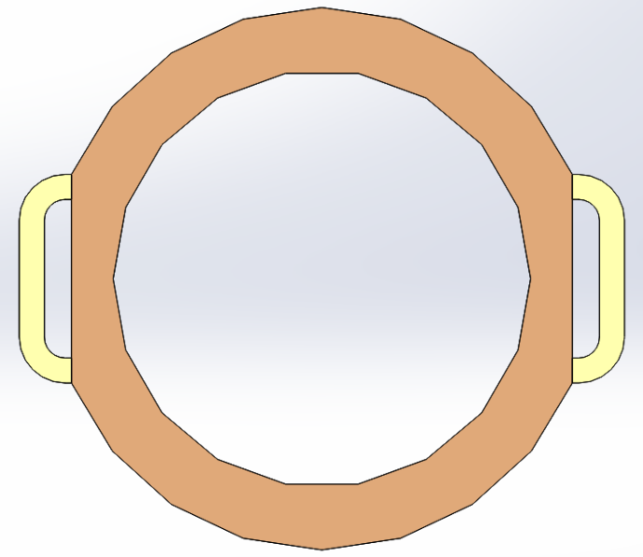
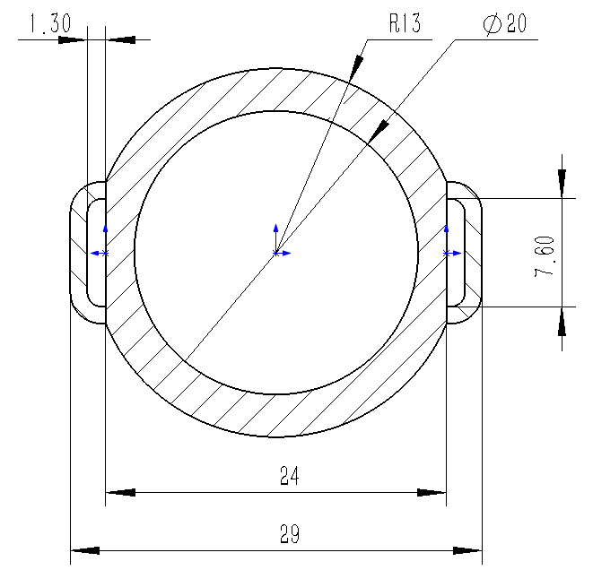
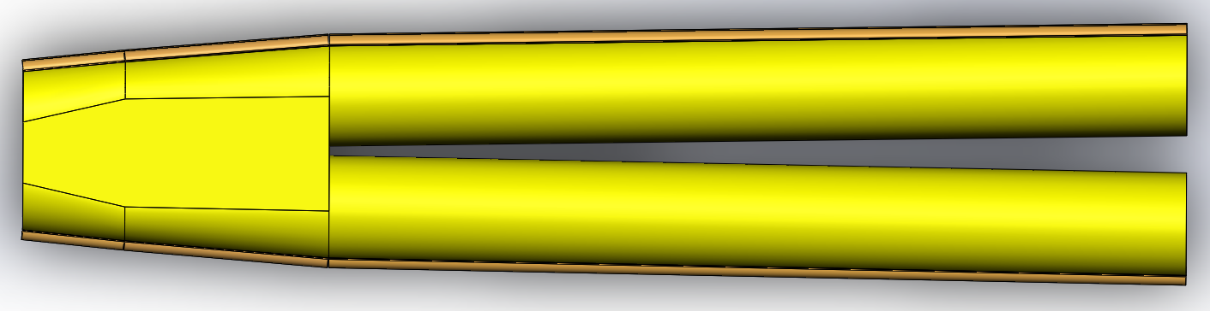
The structure of beam chamber
      The vacuum chamber is made of CuCrZr (C18150), with a cooling water pipe welded on the outside. The cross-section of the circular pipe with a diameter of 20mm is shown in the figure.
      Inner diameter φ20mm；
      Outer diameter φ26mm；
      The two circular tubes merge into a single duct with a racetrack-shaped , which is shown below.
      Width 29mm；
      Multi-layer heating film：0.5mm.
15
R10
35
Notes:
Chromium Zirconium copper

Slide 6
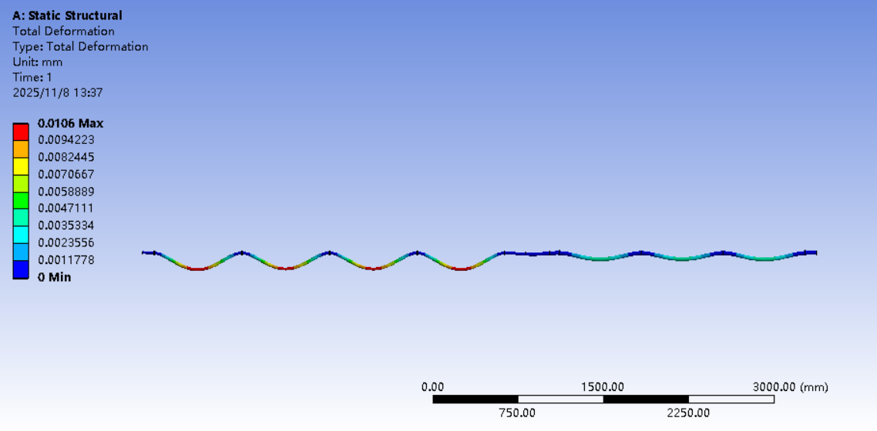
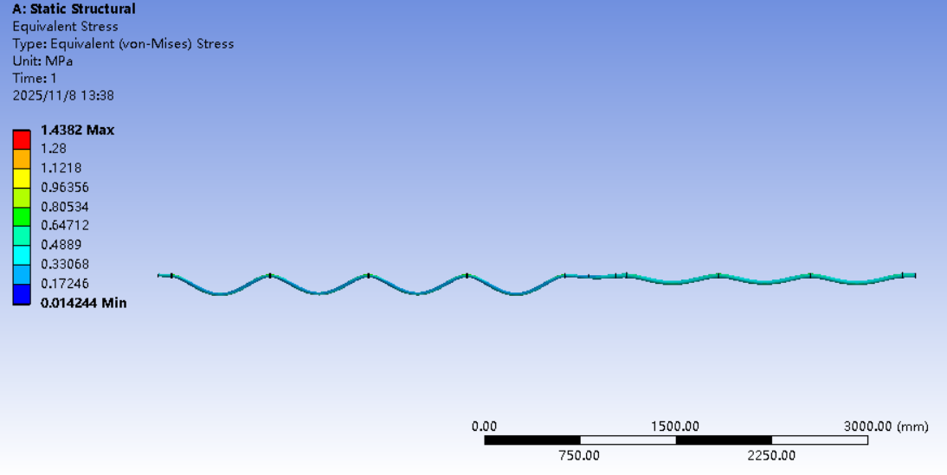
The structure of beam chamber
      The vacuum chamber has two masks, that are 1.9m and 7.2m away from the center respectively. And the masks can block the synchrotron radiation of the upstream magnet and protect the downstream equipments.
      The material is CuCrZr (C18150), nine supports are set on the vacuum chamber, with an interval of about 750mm. The maximum stress is 1.4MPa, the maximum deformation ＜0.1mm.
Mask-1, 1.9m
Mask-2, 7.2m
Notes:
Chromium Zirconium copper

Slide 7

Vacuum system
To design the MDI vacuum system, the main gas load of the vacuum system must be analyzed first：
Estimating the gas load of the MDI vacuum system：
(1) Outgassing of materials;
(2) Beam induced gas load:
A. Thermal outgassing of materials
B. Photon stimulated outgassing
(3) Leakage.
Evaluate the photon stimulated gas desorption（dynamic, main）
$$Q_{gas}=24.2EIη$$
[Torr⋅L/s]

Slide 8
Vacuum system
      The photon stimulated desorption outgas caused by synchrotron radiation is analyzed in the following table.
      The desorption outgassing rate on the surface of the vacuum chamber is approximately 4.46E-9 mbar·L/s/m （ Higgs mode, 50MW）.
Mode | E [GeV] | I [A] | PSD [molecules/photon] | Q_{gas} [Torr⋅L/s] | Q_{L} [Torr⋅L/s/m] | Dynamic pressure [Torr]
Higgs | 120 | 0.029 | 2.0 E-5 | 1.68E-3 | 4.46E-9 | 2.0 E-9
W | 80 | 0.147 | 1.0 E-5 | 2.85E-03 | 7.57E-9 | 1.5 E-9
Z | 45.5 | 1.39 | 2.0 E-6 | 3.06E-03 | 8.13E-9 | 8.0 E-10
tt | 180 | 0.0054 | 1.35 E-3 | 3.18E-02 | 8.45E-8 | 1.0 E-8
Notes:
Power megawatt

Slide 9
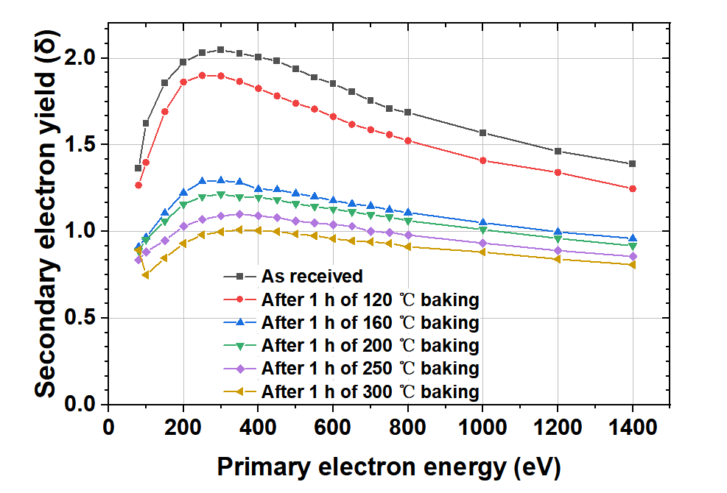
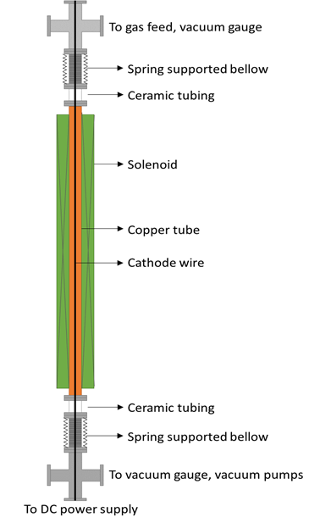
Vacuum system
      Good beam lifetime must be achieved soon after the initial start-up with a stored beam.
      The vacuum system must be capable of quick recovery after sections are exposed to air for maintenance or repairs.
      The chamber wall must be as smooth as possible to minimize electromagnetic fields induced by the beam.
      NEG coating of 200nm is used to suppress e-cloud of positron ring while absorbing residual gases. After 24 hours of activation at 180 ℃, SEY is 1.2, which can be reduced at higher activation temperature.
Outside magnet （solenoid）
9

Slide 10
Vacuum system
By Yongsheng Ma
      Due to the limited space at the MDI, it is not possible to install a vacuum pump. So a Non-Evaporable-Getters (NEG) film must be coated on the inner wall of the vacuum chamber. Usually, after NEG coating, hydrogen (H₂) accounts for over 80% of the residual gas, while the total concentration of carbon monoxide (CO) and carbon dioxide (CO₂) is less than 20%.
      Generally, the temperature of activation is about 180-200 ℃.

Slide 11
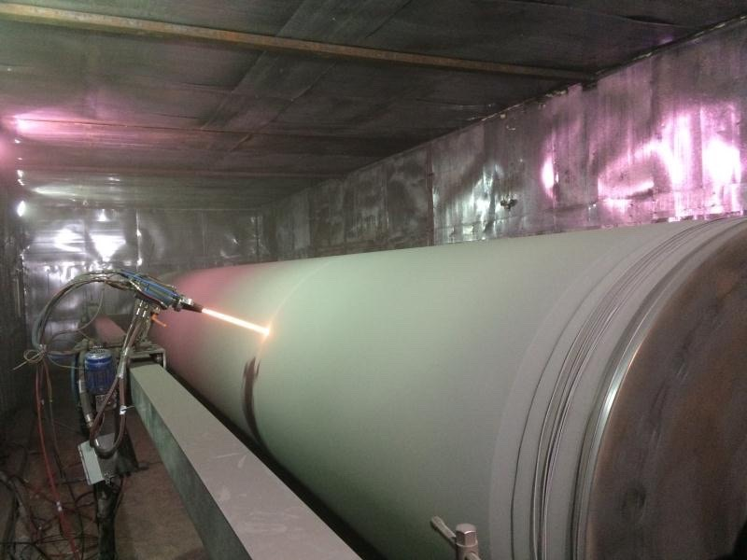
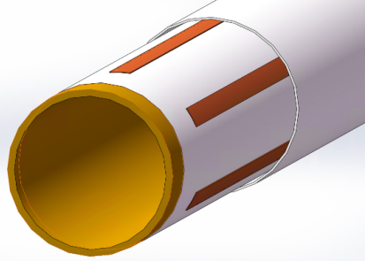
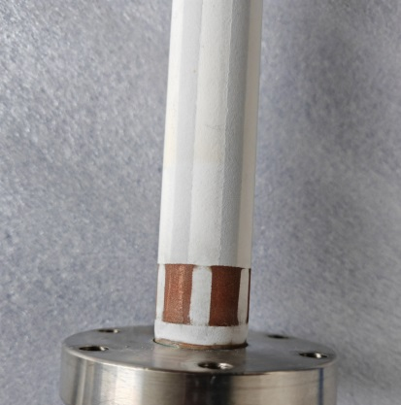
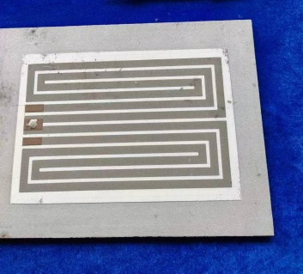
Vacuum system
By Yongsheng Ma
      Multi-layer heating film composed of ceramic and conductive layer will be sprayed outside the vacuum chamber.
      The heating temperature can reach 250-300℃.
Ceramic layer
Heating layer
Thickness： 0.5mm
Convection
Radiation
Current I
Conductivity layer
Conduction
Ceramic layer
Cu/ceramic transition layer
Vacuum chamber
Electric heating circuit
11

Slide 12
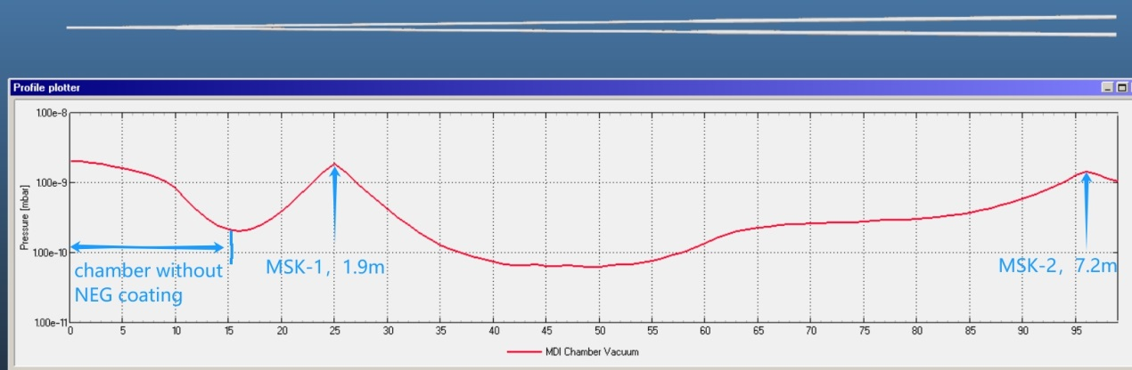
Vacuum system
      The central beam pipe and luminal can not be NEG-coated or baked.
      The worst vacuum pressure is 2.1E-9mbar. Most of other parts of chamber are better than 1E-9mbar.
      Sticking factor is 0.003, which is conservative；
      The out gassing rate of baked chamber is 1E-12 mabr·L/(s·cm²) , no baked part is 1E-11 mabr·L/(s·cm²) .
Notes:
The simulation conditions are:

Slide 13
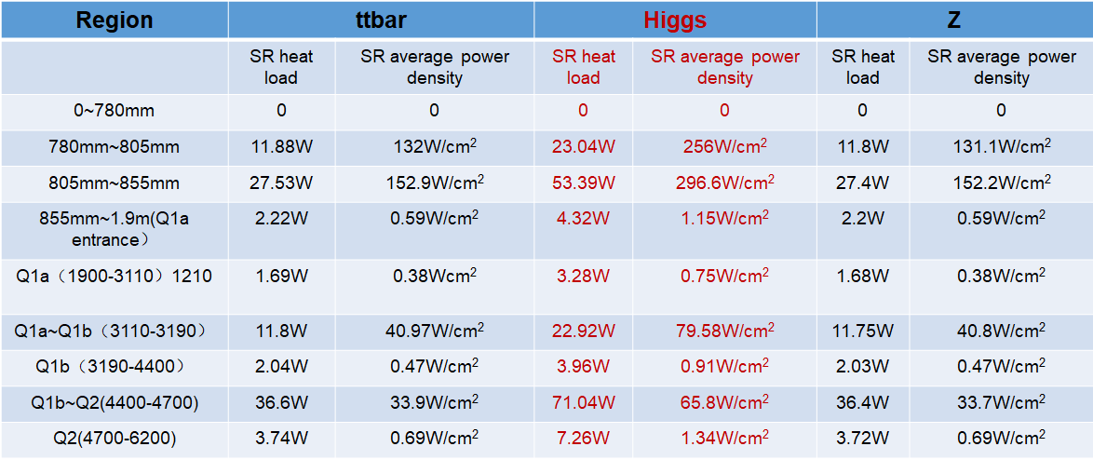
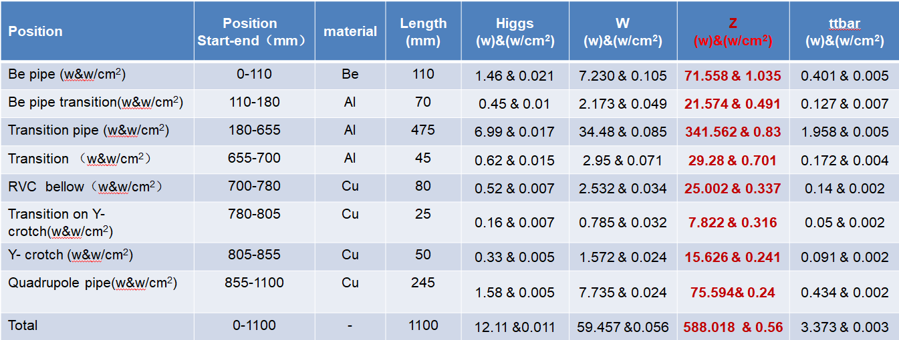
Thermal simulation
From Sha Bai
      The main sources of thermal power of vacuum chamber are:
      The synchrotron radiation(SR) heat load;
      High order mode(HOM) & Resistance wall.
Notes:
The width of the light is about 0.36mm values are shown in the table

Slide 14
Thermal simulation
      The material used for the vacuum chamber is CuCrZr （C18150）, with a coefficient of thermal conductivity of 320 W/(m·K).
      The vacuum chamber has a block mask at 1.9m and 7.2m respectively, and the power density is highest at the block mask. The power density of the synchronous radiation at Mask-1 is about 2.966 W/mm², and the power density of the synchronous radiation at Mask-2 is about 3.2 W/mm².
      The power density at the Crotch chamber is 2.97 W/mm², while the power density at other positions is less than 0.8 W/mm².
      The the cooling water channels are connected by electron beam welding.
Notes:
Zero point eight watts per square millimetre

Slide 15
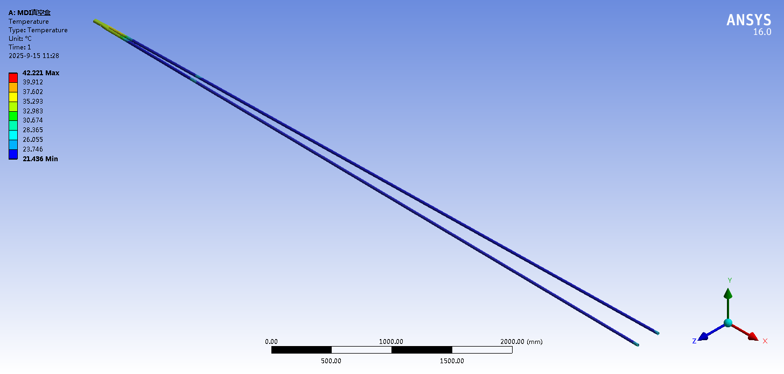
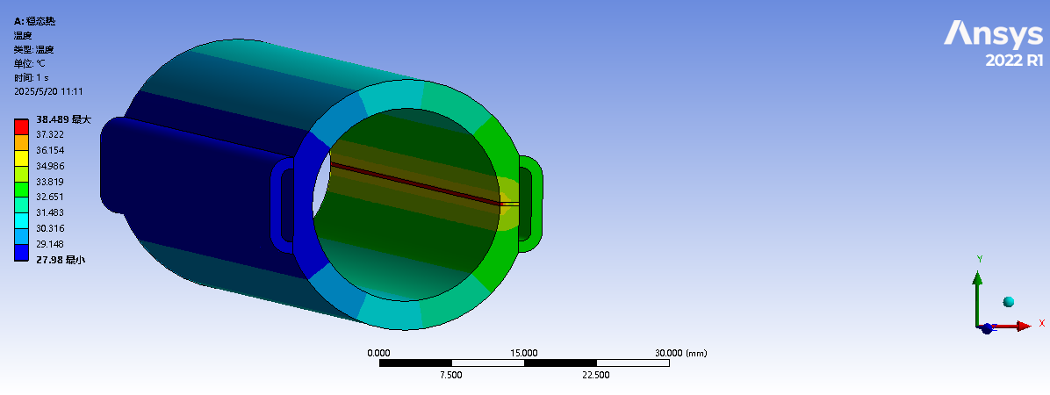
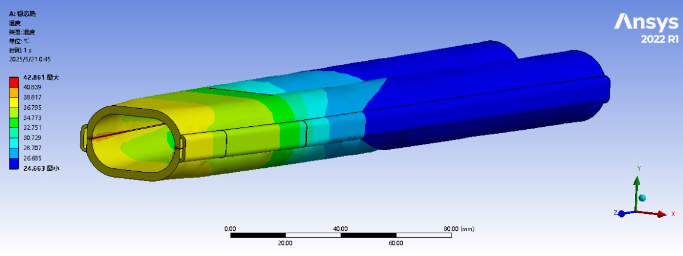
Thermal simulation
      Thermal analyses of chamber at cryostat @Higgs, 50MW. The highest temperature at crotch part is 42.86 ℃; The highest temperature at Masks is 38.5 ℃. The width at the highest temperature is less than 1mm.
      Material ：C18150
      Cooling medium: water
      Inlet temperature：22℃
      Inlet velocity：1.5-2m/s (14.7-19.6 L/min)
Notes:
The simulation conditions are:

Slide 16
Summary and outlook
The inner surface of the vacuum chamber needs to be coated with NEG film to ensure vacuum requirements. Spray a ceramic heating film layer on the outer surface of the vacuum chamber to activate the NEG film.
The position, size, material and manufacturing process of the mask are continuously optimized.
The installation and alignment of the vacuum chamber will be one of the next steps of the work.
Safety and reliability of the MDI vacuum system will remain a priority. Temperature sensors and other monitoring equipment will ensure the safety of chambers and people.

Slide 17
Thanks for your attention!

