Slide 1
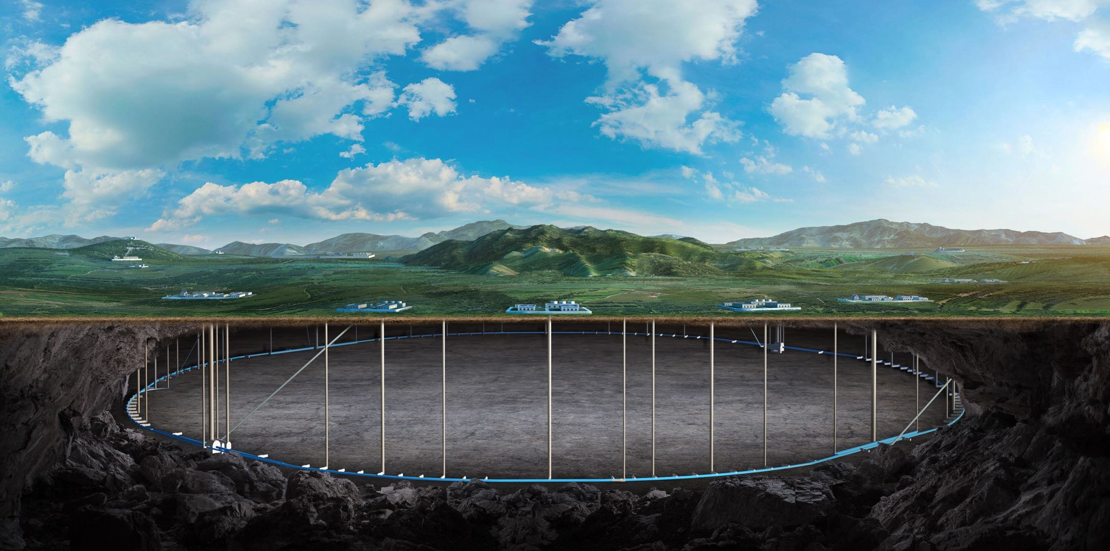

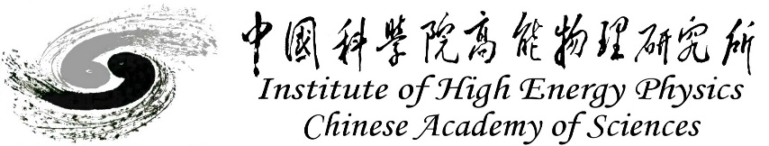
CEPC Interaction Region engineering design status
Haijing Wang, on behalf of the MDI colleagues
The 2025 International Workshop on the High Energy Circular Electron Positron Collider
Nov 5 – 10, 2025, Guangzhou

Slide 2
Content
Introduction
MDI layout
SC magnet, cryostat and support design
RVC
MDI alignment scheme
Conclusion

Slide 3
Introduction
This report is about the CEPC MDI accelerator engineering design, mainly focusing on the MDI layout, mechanics and vibration analyses, RVC design and alignment scheme.
The updates from TDR:
MDI layout: Q3 and anti solenoid next to Q3 (2024).
SC quadrupoles: iron → iron free (2024).
Cryostat updates
Cryostat support updates
Structure optimization and analyses (always on the way before finalized)
RVC engineering updates

Slide 4
Introduction--EDR goal, scope and plans
EDR plans and current status
Itemsalmost | 2024 | 2025 | 2026 | 2027
MDI layout | More detailed layout, identify the MDI interface dimensions The locations for additional BPMs |  | Continuously updating according to the physical and technical design Detailed installation and alignment schedule | Wrap up the unfinished work. Prepare the EDR report.
Cryostat design | More detailed structure design Cryogenic design and analyses |  | Design updating according to layout design
Cryostat support design | More detailed support structure and FEA Design of auxiliary support |  | Vibration decreasing methods, eg. damping material
RVC design | Mechanical design Prototype development and leak rate experiment |  | Structure optimization Finish the leak rate experiment
SC magnets design | Finish magnet design, and summarize parameters |  | Finish magnet engineering design
Alignment | Identify the alignment and installation scheme |  | Key technology study
Vacuum | Finish the vacuum evaluation and vacuum chambers design |  | Key technology study
Finished
Almost individually finished, needs joint design
Design finished
Finished
Finished
Almost finished

Slide 5
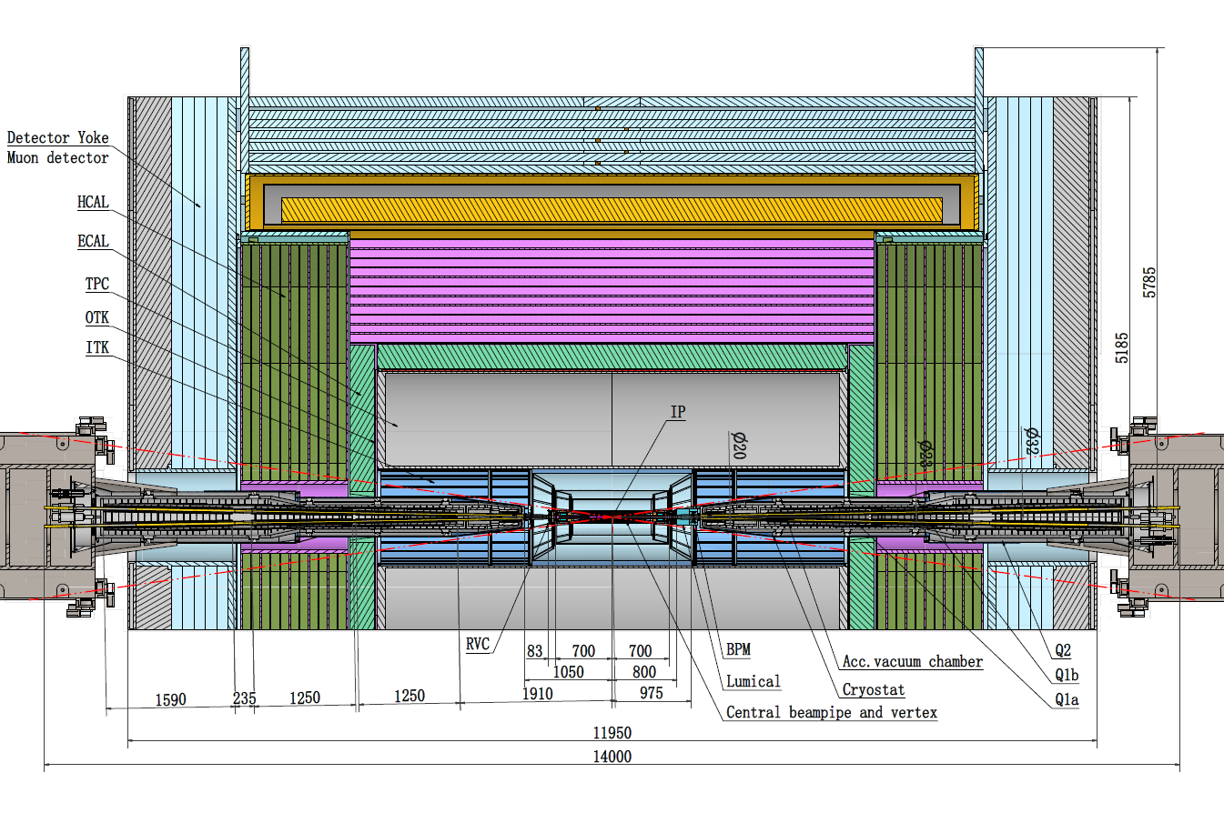
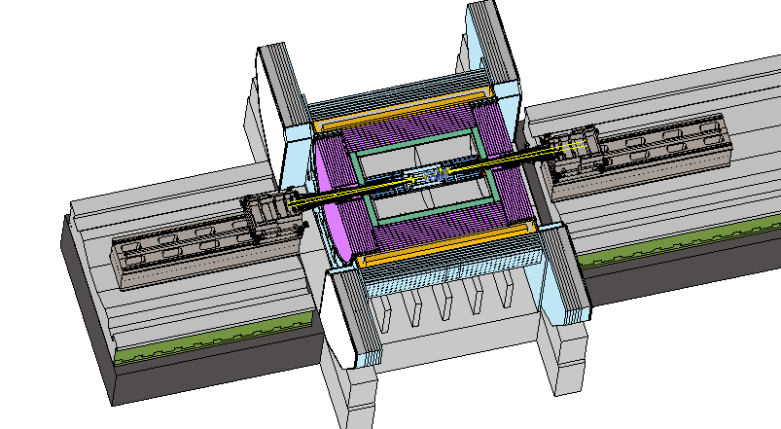
MDI layout
Detective angle: acos0.99
IP chamber：±700mm
Yoke length：11950mm

Slide 6
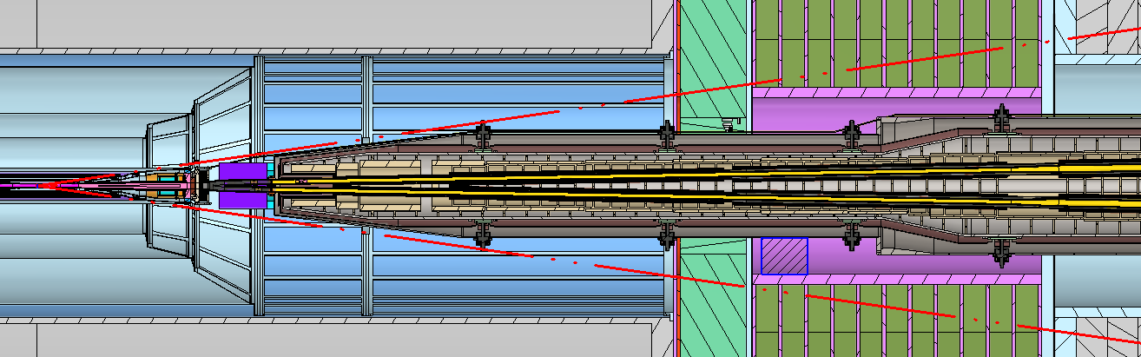
MDI layout
Central beampipe
Z: -700~700mm
Y chamber
Z: 783~1050mm
Lumical
Z: 800-950mm
IP
RVC
Z: 700~783mm
IP BPMs
Z: 950~1050mm
Auxiliary support
Z: 3300~3700 mm
Q1a Q1b &Q2
Z: 1880~6245mm
Distance to detective angle
IP chamber flange: 5.3mm RVC: 14.9mm (pressure tube)

Slide 7
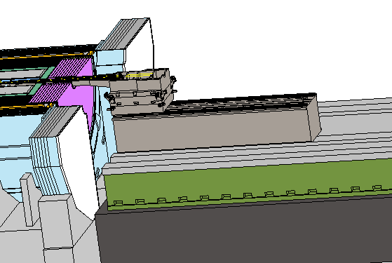
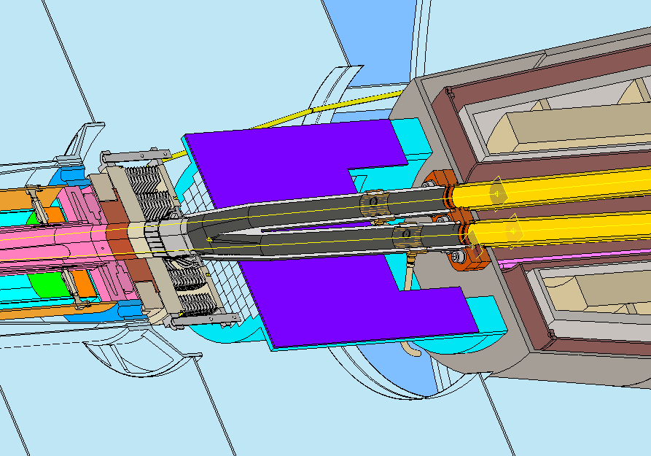
MDI layout
Mechanical interface between accelerator and detector
Accelerator
cryostat support
Central beampipe
Lumical
RVC
Y chamber
IP BPM
Detector guide rail

Slide 8
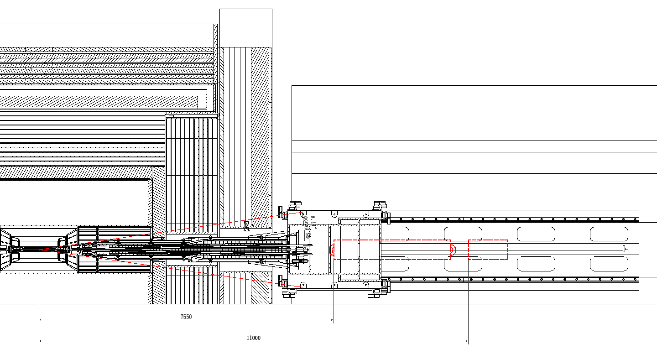
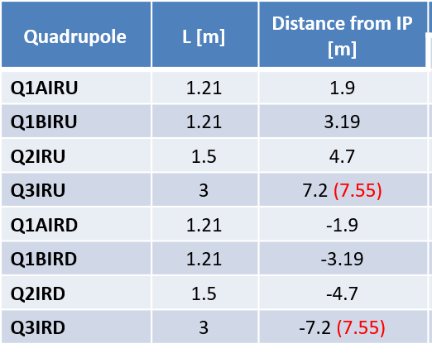
MDI layout
Q3 and anti-solenoid are at the support bed of cryostat, should be removed first once the cryostat be pulled out.
Q3: 7.55~10.55m
Anti-solenoid: 11~12m
Detector components
Accelerator cryostat
Detector guide rail
Yiwei Wang，CEPC Lattice with Energy Switch, Ground Motion，IAS Program on Fundamental Physics，January 13-17, 2025.
7550
Q3
11000
Anti-solenoid

Slide 9
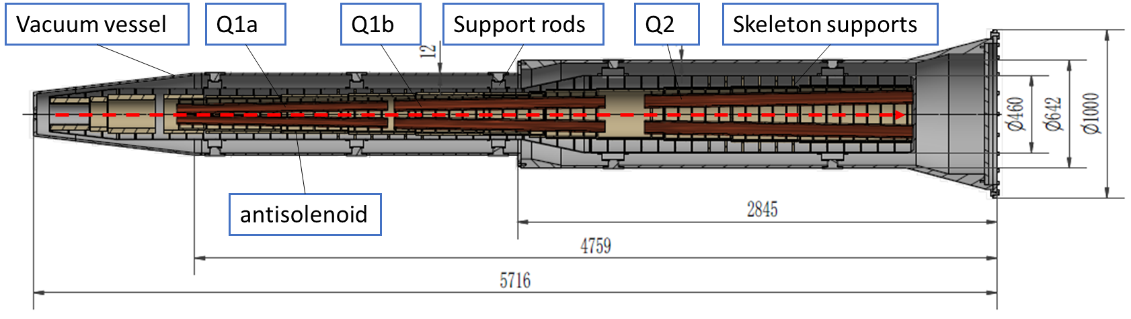
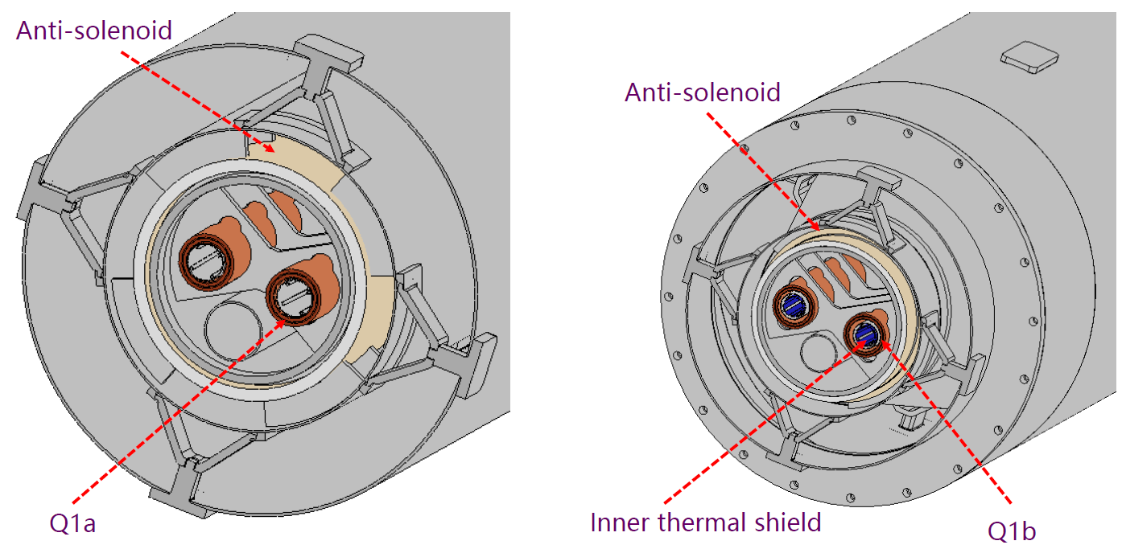
SC magnet, cryostat and support design
SC quadrupoles
iron → iron free (2024), the weight decreased from 400kg to 100 kg (very small compared to the total weight of cryostat)
Cryostat design
2K is the baseline, 4.2K is alternative.
No thermal shielding at Q1a according to space limitation
Details of SC magnets: Yingshun Zhu, this workshop
Details of cryostat: Xiangzhen Zhang, this workshop

Slide 10
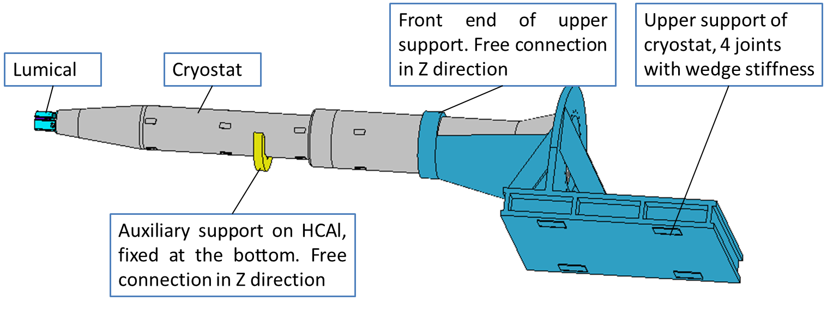
SC magnet, cryostat and support design
The mechanical analyses mainly include
Static structure: the displacement of quadrupoles, and their uneven deformation
Vibration analyses: modal, harmonic responses
Structure optimization: to decrease deformation and enhance natural frequencies
Quench analyses: the response when all the Lorentz forces vanished in 0.2 s
Load used in analyses:
Gravity
Lorentz forces*
Cryogenic temperature
* 2.7e5 N in total in TDR, 1.48e5 N in total now. To facilitate a single-variable comparison and maintain a certain safety factor, the calculations still employ the former value. A unified update will be implemented once the design converges.

Slide 11
SC magnet, cryostat and support design
The analyses model (Cryostat)
Model | TDR | IARC 24 | Thinner | Thicker | Thicker II
Cryostat length /mm | 5613 | 5716 | 5599 | 5716 | 5577
Vacuum vessel thickness /mm | 4/8 | 4/8 | 3/3 | 12/16 | 6/6
Helium vessel thickness/mm | 3 | 3 | 2 | 3 | 10/10
End diameter/mm | 1000 | 1000 | 1000 | 1000 | 1000
Cryostat weight/kg | 2.7 | 2.4 | 1.3 | 2.7 | 2.2
Cross section of “Thicker”
TDR: iron quadrupoles
IARC 24: iron-free quadrupoles
Thinner: Thinner cryostat walls
Thicker: Thicker cryostat walls
Thicker II: another thicker version with adjustable support rods
Bonded
Frictional in Z direction

Slide 12
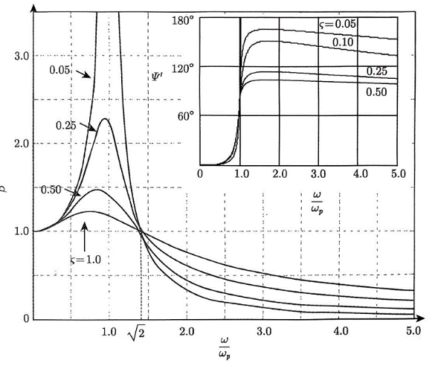
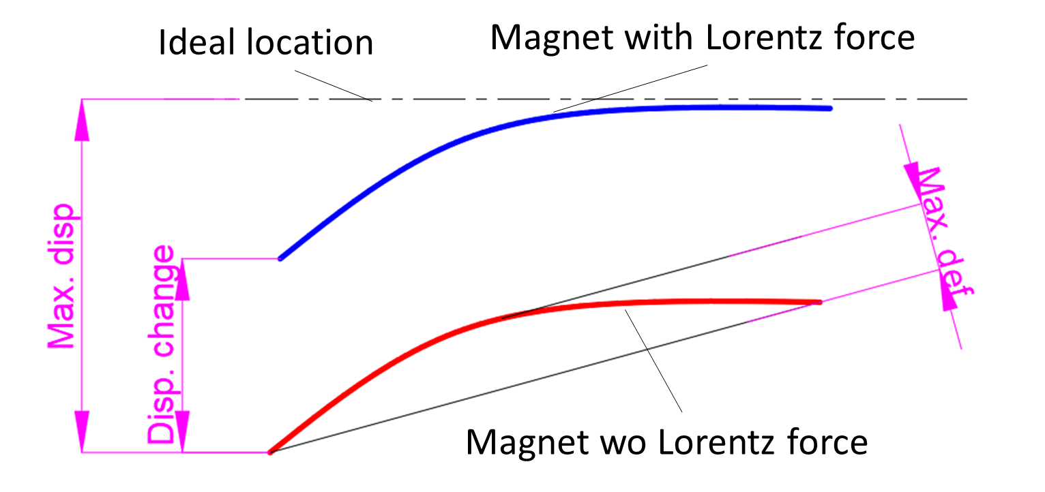
SC magnet, cryostat and support design
Primary concerned metrics
Max. def: the maximum uneven deformation in Y (vertical) direction of quadrupole, difficult be adjusted by alignment.
Length/diameter, CEPC Q1a: 20 vs BEPCII SCQ: 4.5, the uneven deformation of quadrupoles should be considered
Disp. change: Displacement change in Y direction before and after Lorentz force
If the change is small enough, re-alignment can be neglect after having Lorentz force.
BEPCII also concerned this metric before installation
Natural frequencies
Relates to vibration response. The higher the better.
Ref.
HEPS ≥54Hz
Quadrupole of arc section of CEPC: ~45 Hz

Slide 13
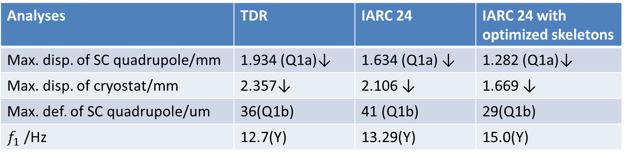

Mechanics and vibration analyses
Quadrupole design & skeleton optimization
Iron → iron free, decrease load factor $q$.
Skeleton optimization, mainly decrease load factor $q$ and increase equivalent $E$/$ρ$.
For all the cases, only gravity applied.
Good effect.
Analyses | TDR | IARC 24 | IARC 24 with optimized skeletons
Max. disp. of SC quadrupole/mm | 1.934 (Q1a)↓ | 1.634 (Q1a) ↓ | 1.282 (Q1a)↓
Max. disp. of cryostat/mm | 2.357↓ | 2.106 ↓ | 1.669 ↓
Max. def. of SC quadrupole/um | 36(Q1b) | 41 (Q1b) | 29(Q1b)
$f_{1}$ /Hz | 12.7(Y) | 13.29(Y) | 15.0(Y)

Slide 14
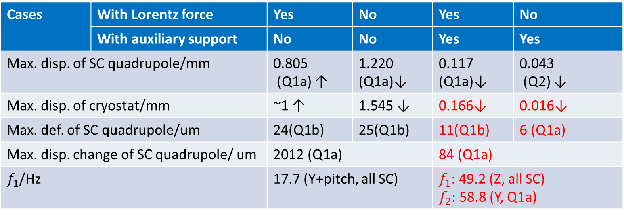
Mechanics and vibration analyses
Auxiliary support (IARC 24 model)
Significant effect on improving the deformation and stability performance
The Max. disp. change of SC quadrupoles about 2mm without auxiliary support but 0.084mm with it
The natural frequency can be improved to about 3 times
Cases | With Lorentz force | Yes | No | Yes | No
 | With auxiliary support | No | No | Yes | Yes
Max. disp. of SC quadrupole/mm |  | 0.805 (Q1a) ↑ | 1.220 (Q1a)↓ | 0.117 (Q1a)↓ | 0.043 (Q2) ↓
Max. disp. of cryostat/mm |  | ~1 ↑ | 1.545 ↓ | 0.166↓ | 0.016↓
Max. def. of SC quadrupole/um |  | 24(Q1b) | 25(Q1b) | 11(Q1b) | 6 (Q1a)
Max. disp. change of SC quadrupole/ um |  | 2012 (Q1a) |  | 84 (Q1a)
$f_{1}$/Hz |  | 17.7 (Y+pitch, all SC) |  | $f_{1}$: 49.2 (Z, all SC) $f_{2}$: 58.8 (Y, Q1a)

Slide 15
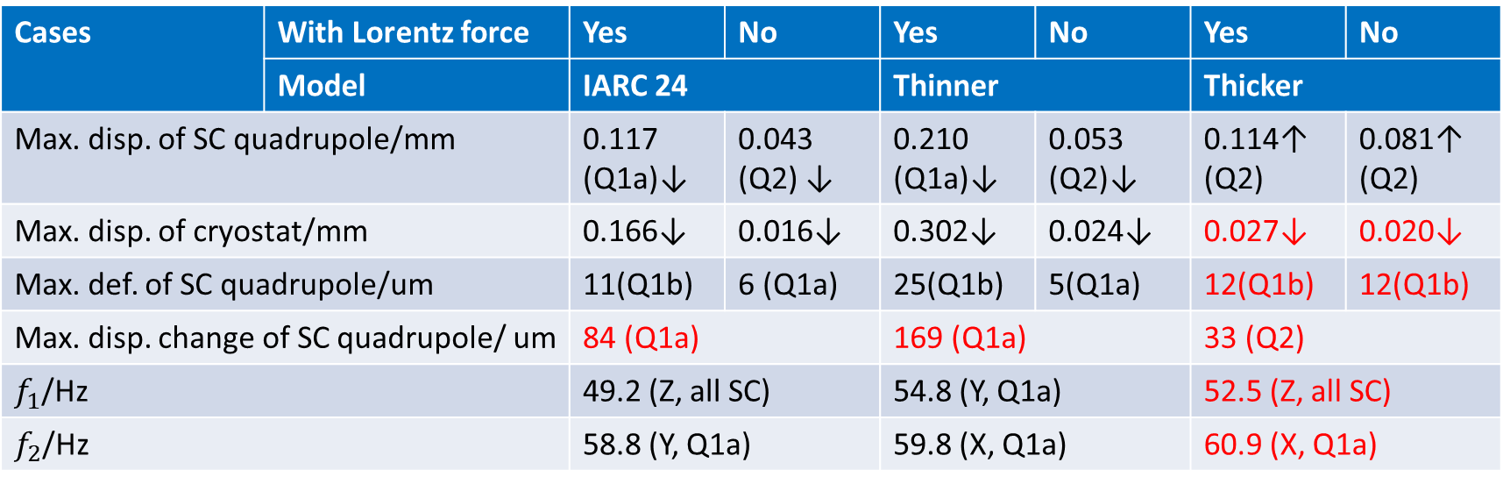
Mechanics and vibration analyses
Cryostat wall thickness
The thinner model has worse deformation and stability performance than the thicker one, even has worse deformation than the IARC 24 version.
Cases | With Lorentz force | Yes | No | Yes | No | Yes | No
 | Model | IARC 24 |  | Thinner |  | Thicker
Max. disp. of SC quadrupole/mm |  | 0.117 (Q1a)↓ | 0.043 (Q2) ↓ | 0.210 (Q1a)↓ | 0.053 (Q2)↓ | 0.114↑ (Q2) | 0.081↑ (Q2)
Max. disp. of cryostat/mm |  | 0.166↓ | 0.016↓ | 0.302↓ | 0.024↓ | 0.027↓ | 0.020↓
Max. def. of SC quadrupole/um |  | 11(Q1b) | 6 (Q1a) | 25(Q1b) | 5(Q1a) | 12(Q1b) | 12(Q1b)
Max. disp. change of SC quadrupole/ um |  | 84 (Q1a) |  | 169 (Q1a) |  | 33 (Q2)
$f_{1}$/Hz |  | 49.2 (Z, all SC) |  | 54.8 (Y, Q1a) |  | 52.5 (Z, all SC)
$f_{2}$/Hz |  | 58.8 (Y, Q1a) |  | 59.8 (X, Q1a) |  | 60.9 (X, Q1a)

Slide 16
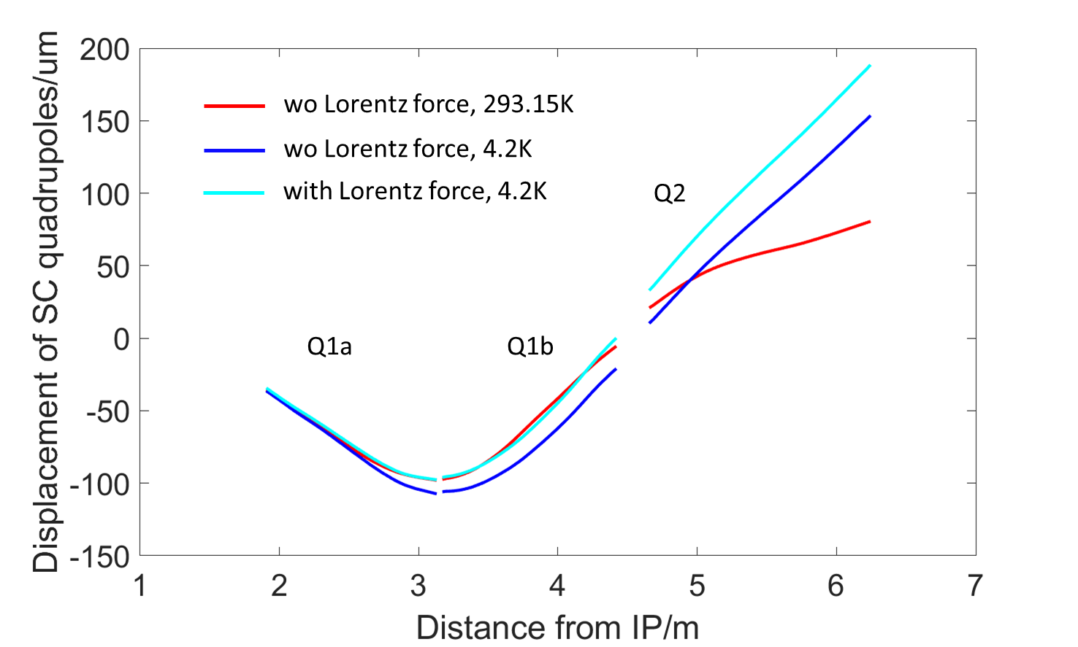
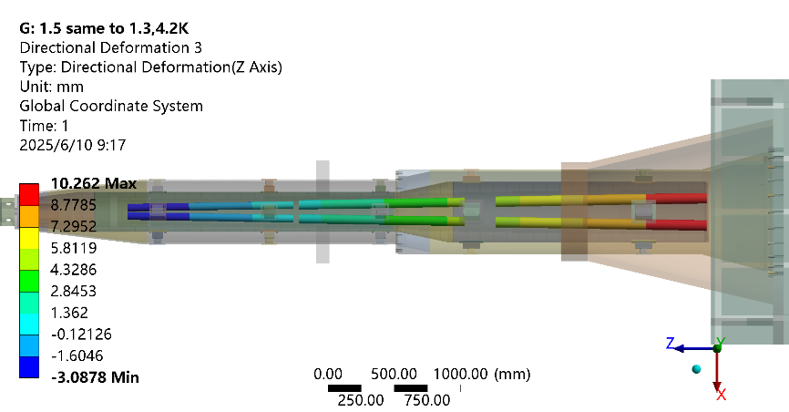
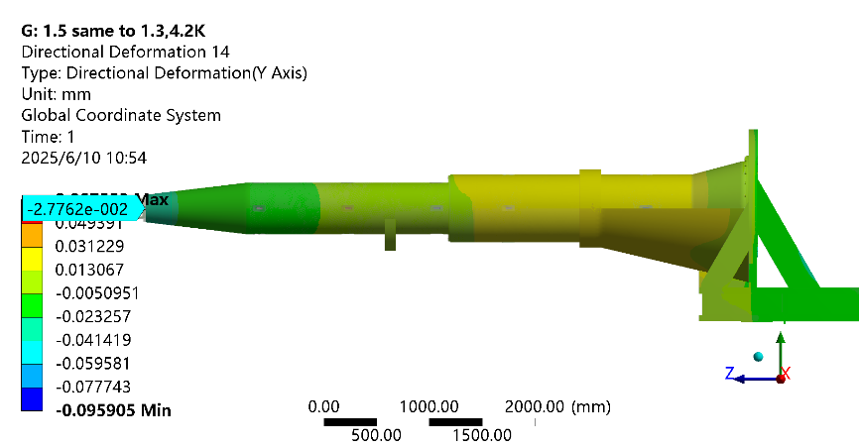
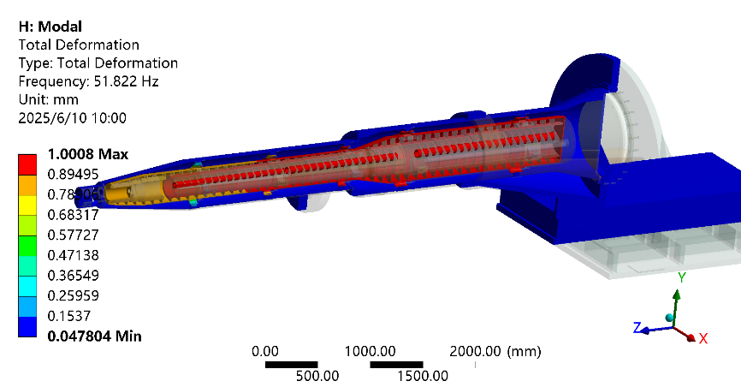
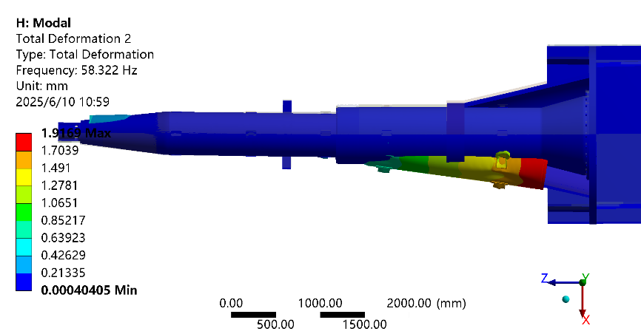
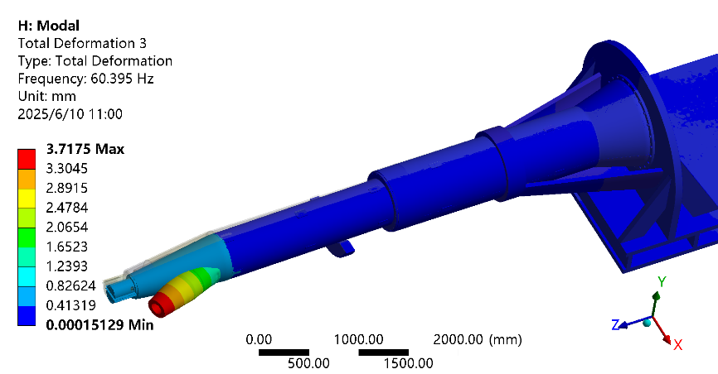
Mechanics and vibration analyses
Simulation results for “Thicker” model, with Lorentz force and gravity
Z disp. of SC quadrupoles, 4.2 K
SC quadrupole displacement
Y disp. of vacuum vessel, 4.2 K
1st order of mode, 4.2 K
2nd order of mode, 4.2 K
3rd order of mode, 4.2 K

Slide 17
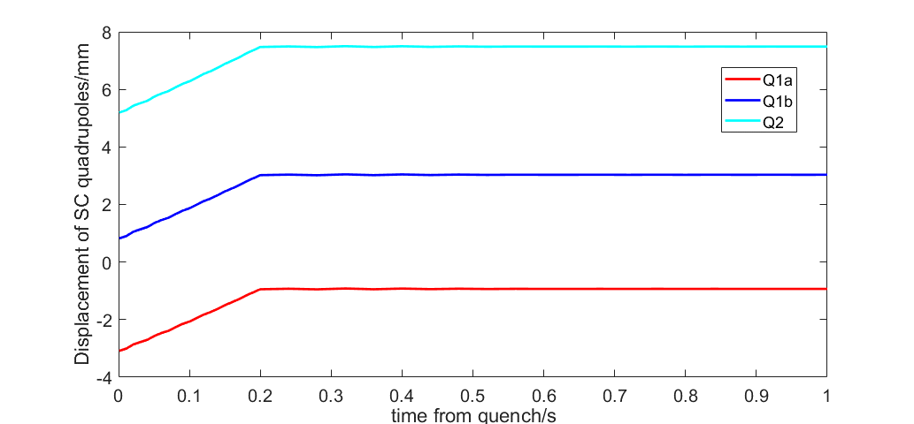
Mechanics and vibration analyses
Quench analyses
When quenching, the Lorentz forces vanish in 0.2 s. All the other loads remains the same in short period.
Three timesteps have been set.
It seems there is no sudden positional jitter caused by the disappearance of the Lorentz force. Either for the Von mises stress.
Displacement of SC quadrupoles when quenching
Time
1e-3 | Original Lorentz force
0.2 | Lorentz force decrease to 0, ramping
1 | Lorentz force: 0

Slide 18
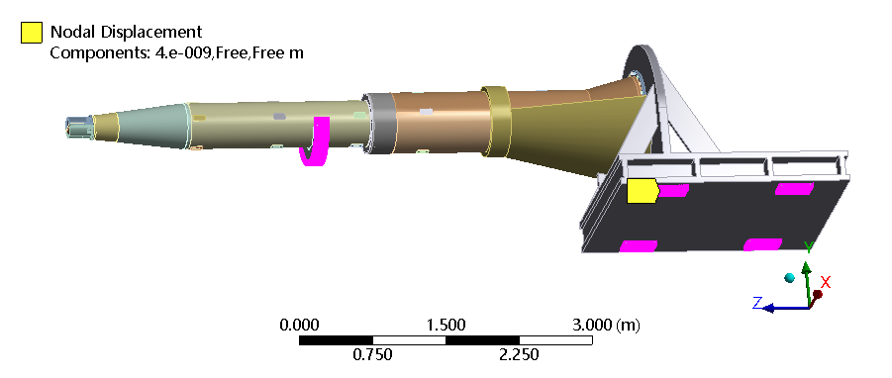
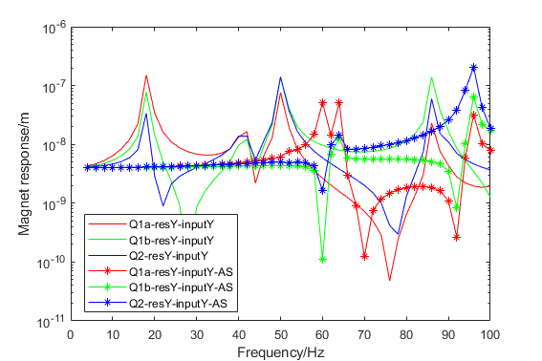
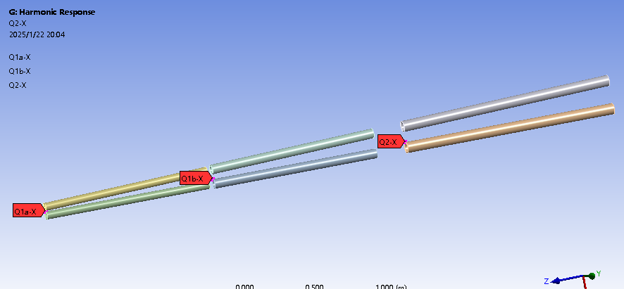
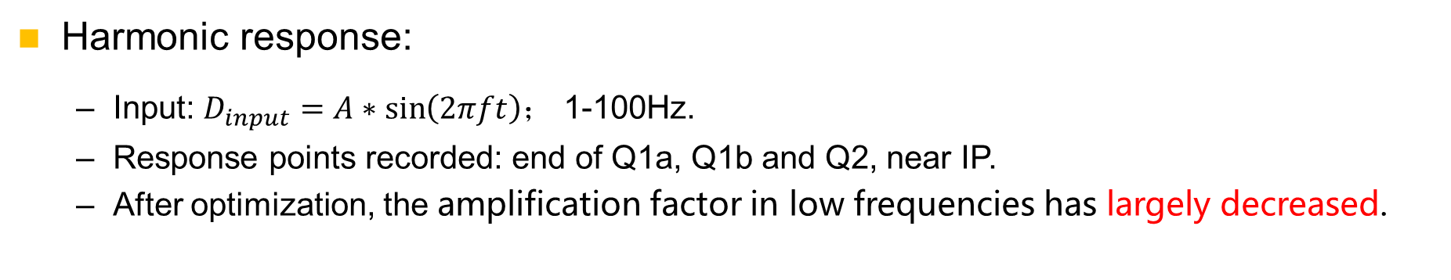
Mechanics and vibration analyses
Harmonic response:
Input: $D_{input}=A∗\sin\left(2πft\right)$； 1-100Hz.
Response points recorded: end of Q1a, Q1b and Q2, near IP.
After optimization, the amplification factor in low frequencies has largely decreased.
Input locations
Response points recorded

Slide 19
Mechanics and vibration analyses
Conclusions on mechanical FEA
Iron-free quadrupole and optimized skeleton has benefits (Max. disp. of SC quadrupoles/cryostat decreased)
Material optimization，no obvious effect
Auxiliary support，significant effect (max. change from 2 mm to 84 um, 1st natural frequency from 17.7Hz to 49.2 Hz)
Thicker vacuum vessel: significant effect (max. change from 84 um to 33 um)→can be considered comprehensively with radiation.
Support rods: significant effect→ can be optimized further
Works to be done
Further optimization with collaboration with other colleagues: compromise solution with other aspects of optimization, updated loads (radiation shielding, Lorentz force)
After above analyses converged, we will taking into account all the relative components and make a whole FEA.

Slide 20
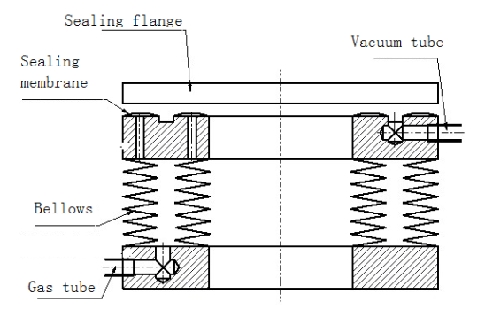
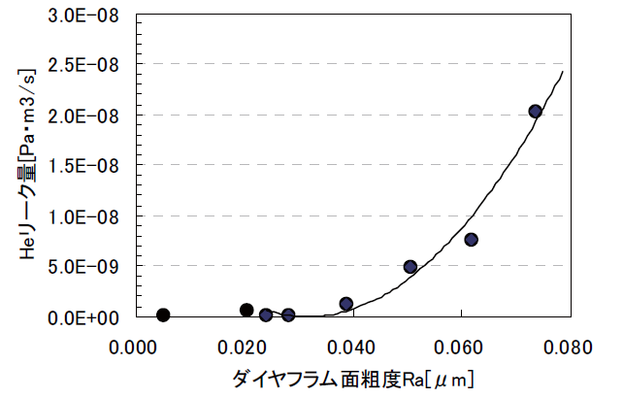
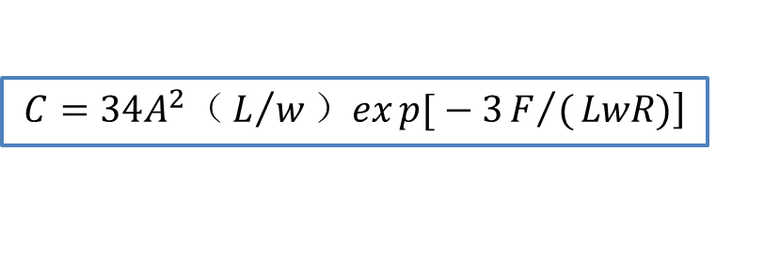
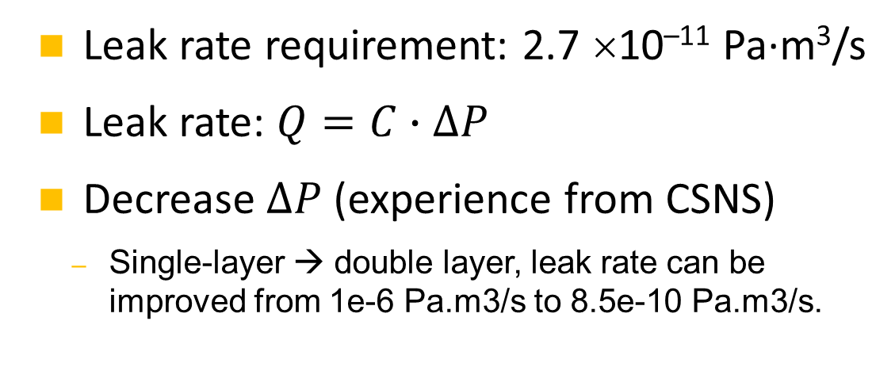
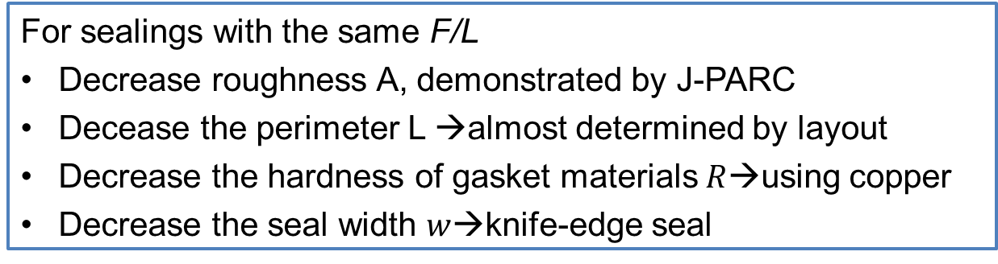
RVC
Leak rate requirement: 2.7 ×10^{–11} Pa·m³/s
Leak rate: $Q=C∙∆P$
Decrease $∆P$ (experience from CSNS)
Single-layer → double layer, leak rate can be improved from 1e-6 Pa.m3/s to 8.5e-10 Pa.m3/s.
Inflatable seal
$$\left.C=34A^{2}（L/w）exp{[}−3F/(LwR)\right]$$
For sealings with the same F/L
Decrease roughness A, demonstrated by J-PARC
Decease the perimeter L →almost determined by layout
Decrease the hardness of gasket materials$R$→using copper
Decrease the seal width $w$→knife-edge seal
Roughness and conductance, J-PARC

Slide 21
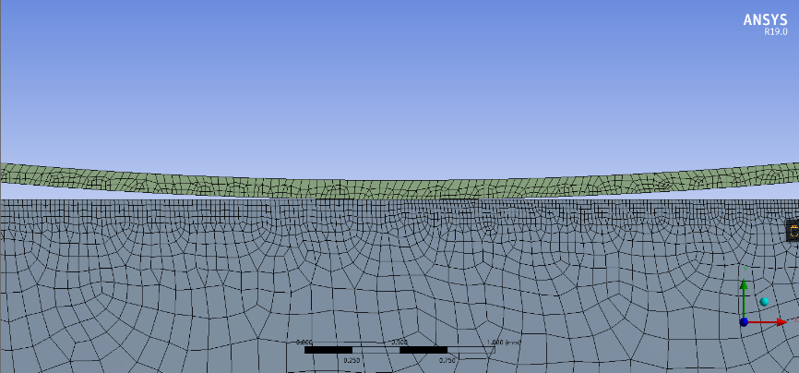
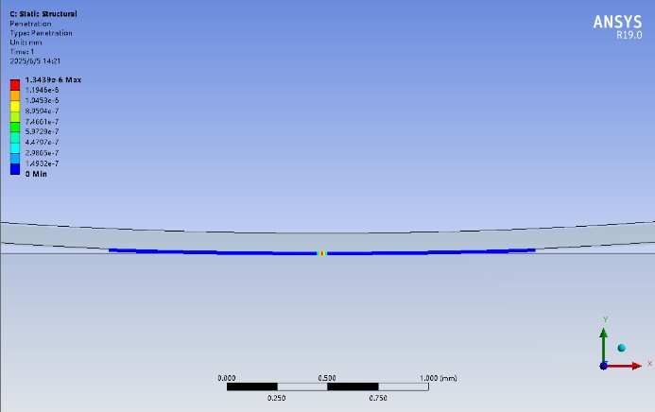
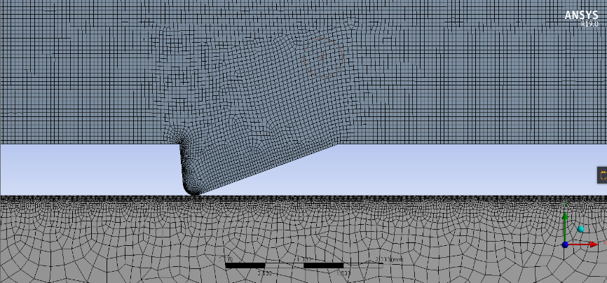
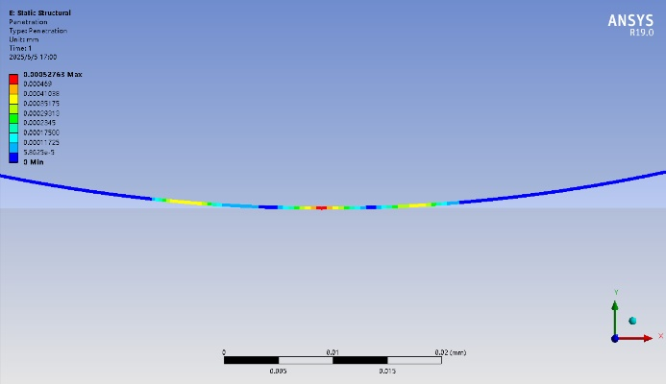
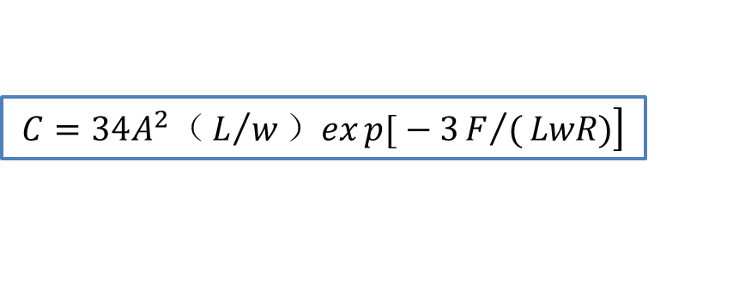
RVC
FEA estimation
Two FEA cases has been made, for membrane inflatable seal and knife-edge inflatable seal, separately.
$$\left.C=34A^{2}（L/w）exp{[}−3F/(LwR)\right]$$
Membrane inflatable seal
The preliminary FEA result shows both method can obtain the leak rate at the level of 10^{–11} Pa·m³/s.
Knife-egde inflatable seal

Slide 22
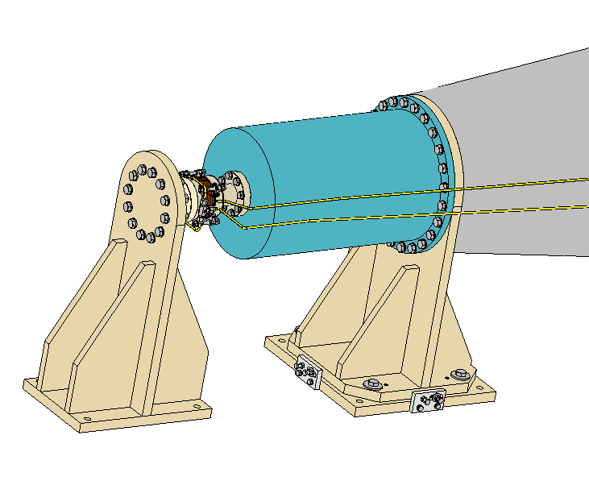
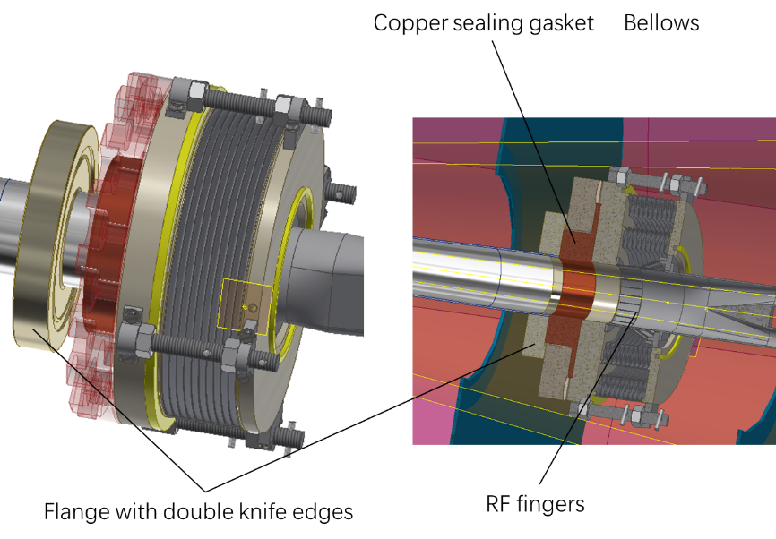
RVC
A prototype will be developed (quotation finished, 1st version engineering drawings finished).
The influence of RVC displacement on the leakage rate will be simulated through an adjustment mechanism.
Fake model of vacuum vessel
Fake model of IP chamber, fixed
Adjustment mechanism
RVC

Slide 23
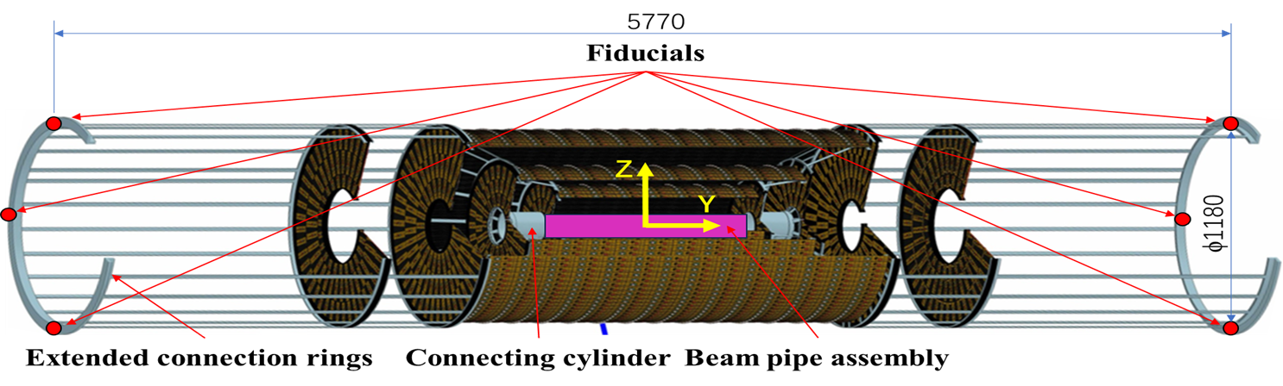
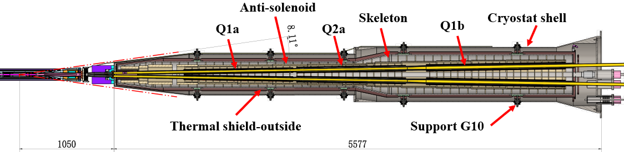
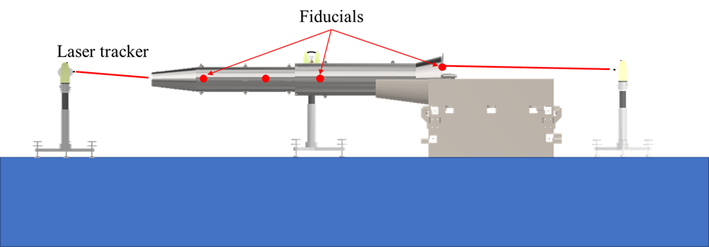
MDI alignment scheme
Alignment of IP beam pipe assembly, about 100 μm for the assembly centerline.
Secure the SC quadrupoles inside the helium vessel, and do the fiducialization
Assemble the helium vessel to the vacuum vessel and perform pre-alignment in the lab.
Assemble the vacuum chambers inside the cryostat, the Lumical crystal, Y chamber with IP BPM, and perform alignment in the lab.
ITK
More details in: Xiaolong Wang, Summary of CEPC alignment EDR status mini review. CEPC IARC meeting, 2025

Slide 24
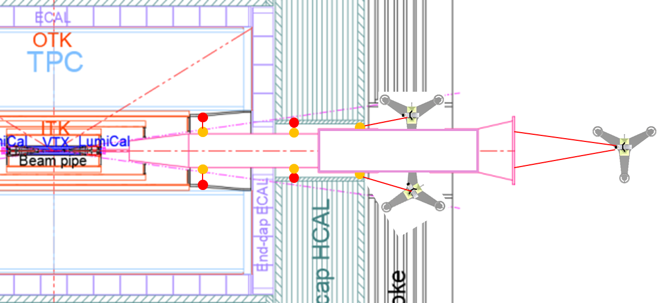
MDI alignment scheme
Assemble the cryostat, RVC and the cryostat support system on-site, perform the alignment by adjusting the adjusting mechanism of the support.
Move the cryostat into the detector to its designated location, connecting the Y chamber with the IP chamber using the RVC.
Perform the final alignment, 100 μm for SC quadrupoles.
Error item | Error /μm
SCQs installation in skeleton | 50
LHe-tank module fiducialization | 30
Superconducting magnets pre-alignment | 50
Laser alignment system | 20
Multiline & Laser tracker measurement | 30
Superconducting magnets installation adjustment | 30
Total | 90

Slide 25
Conclusion
We have finished a relatively detailed MDI layout with all the components coherent, based on which the preliminary installation and alignment scheme has been made.
The mechanics and vibration analyses and the structure optimization is basically converged, comprehensive considered with the deformation and vibration performance, alignment requirements, radiation and quench. More detailed analyses including all the relative components are planned next stage.
The engineering design of RVC has been started. We have made a experiment scheme, based on which the quotation is finished, and the engineering drawings are under cross-checking.

Slide 26
Thank you for your attention!

