Slide 1
Overview of BESIII installation
Xiaoping Jing
Nov. 8, 2025

Slide 2
contents
Structure
Procedure
Upgrade
Summary

Slide 3
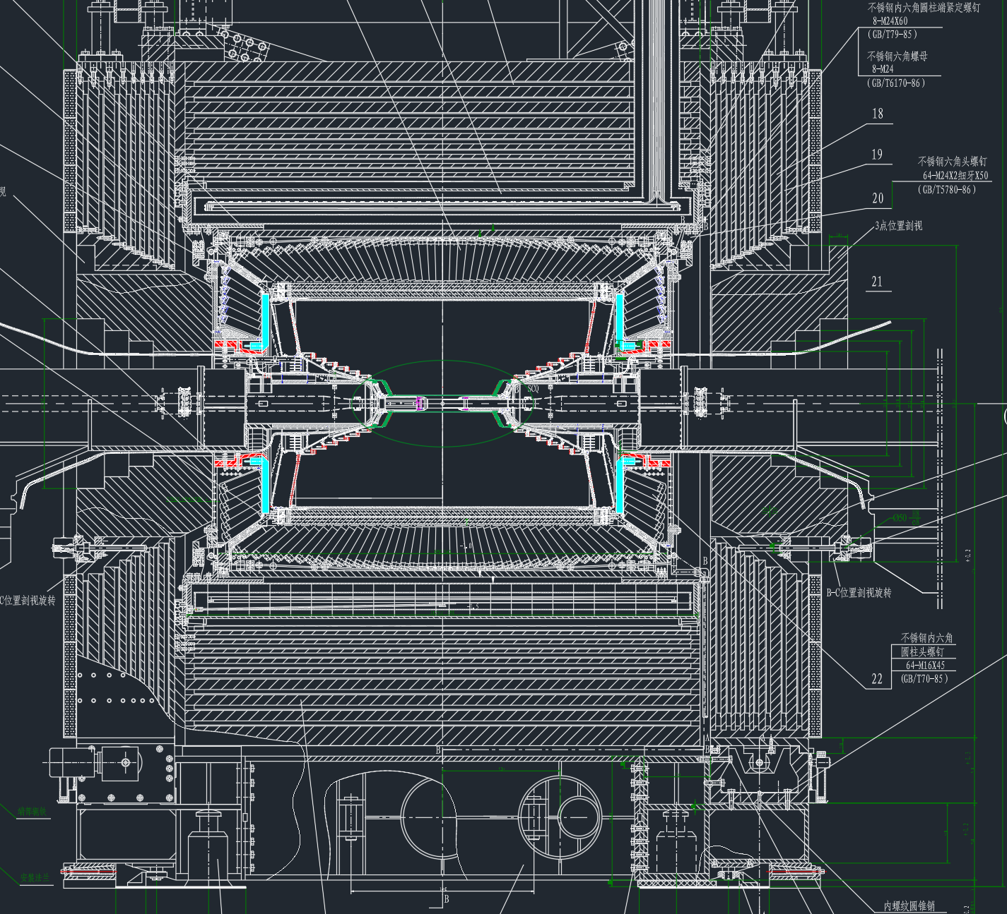
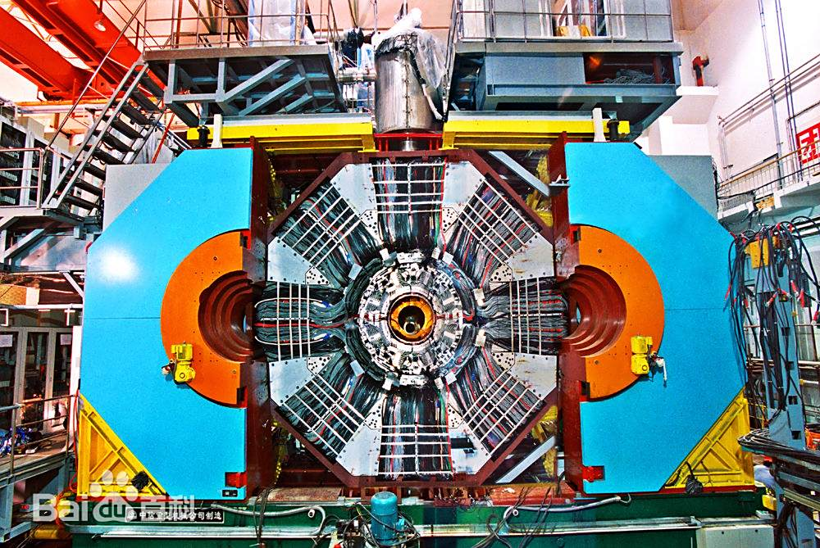
Structure
BESⅢ: Beijing Spectrometer Ⅲ
SSM: superconducting solenoid magnet
BEMC: barrel electromagnetic calorimeter
TOF:time of flight counter
MDC:main drift chamber
BP: beam pipe
EEMC: end electromagnetic calorimeter
SCQ: super-conducting quadrupole magnet
Multi-layer octagonal structure with 4 doors
11m × 6m × 6.5m，Weight 750t
Component: from inside to outside BP, MDC,TOF etc.
Gap(mm): Flange > 20 < EMC > 10 < MDC +TOF > 2 < BP
8 blocks fixed on barrel iron yoke, flange on blocks, flange bear weight of all detectors
Cable routing: recessed region between blocks
Iron yoke + muon
door
SSM
Flange
BEMC
Flange
Cable
MDC+TOF
EEMC
Pole
BP
SCQ
Door
Block
Base
Rail
1

Slide 4
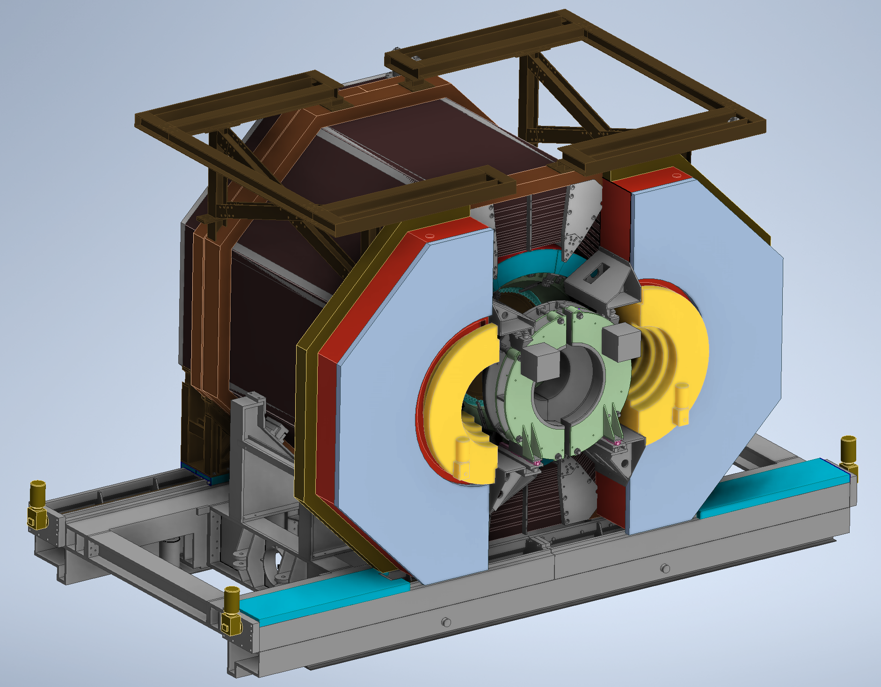
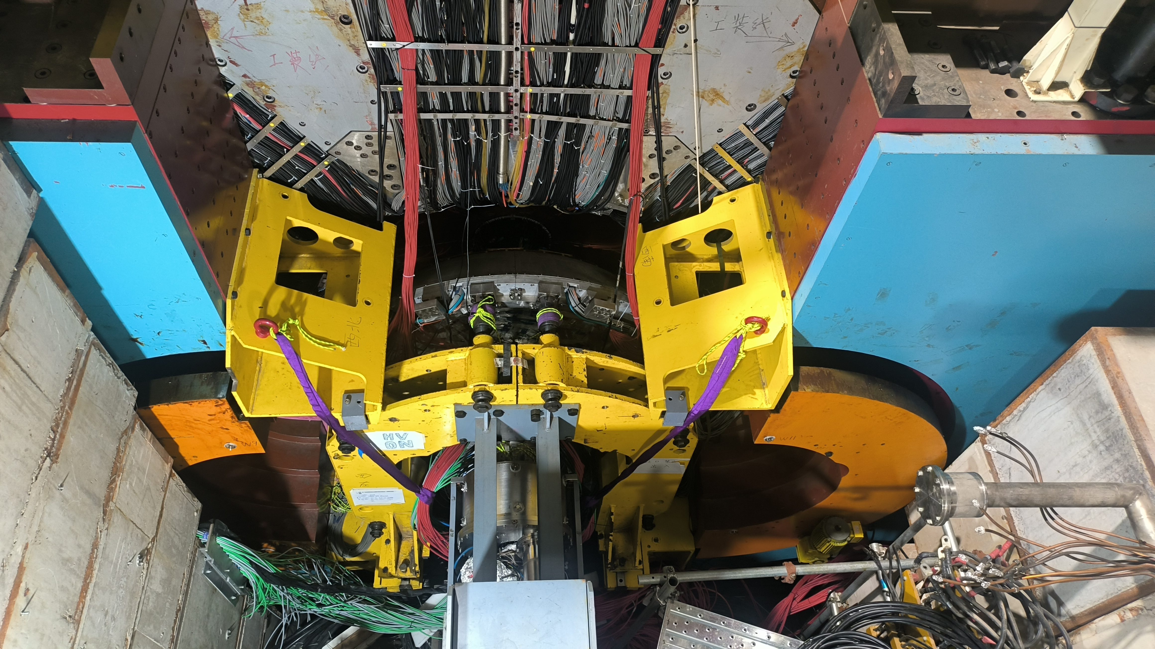
Structure - Detector Maintenance
In order to maintain conveniently, sliding doors designed
EEMC pulling device fixed on door
Pull out Pole → open doors → install EEMC pulling device → connect EEMC→ pull out EEMC by the device
→ person enter BES3 and perform maintenance
Pulling device
2

Slide 5
General Procedure
Mechanical Structure → detectors and components from outside to inside
→ entire BESⅢ to final position → connect with SCQ → sheilding → close doors
Mech + muon
SSM
Flange
BEMC
Push BESIII
BP
EEMC
MDC + TOF
Connect SCQ
Shielding wall
Close door
3

Slide 6
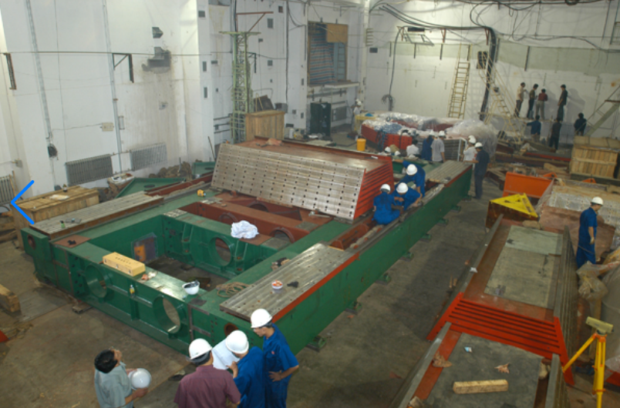
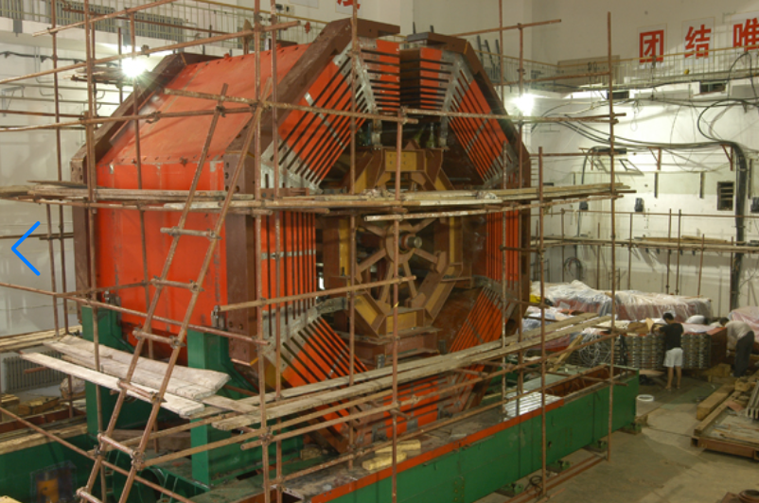
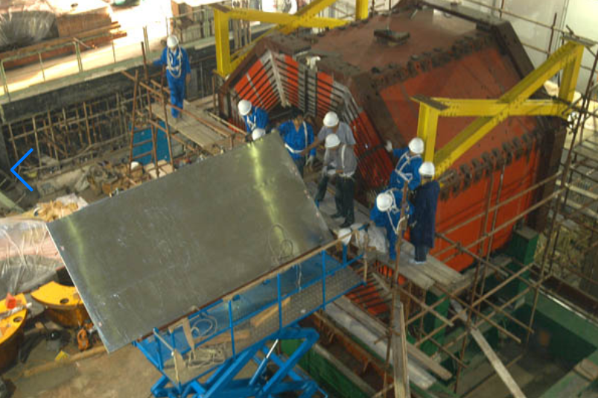
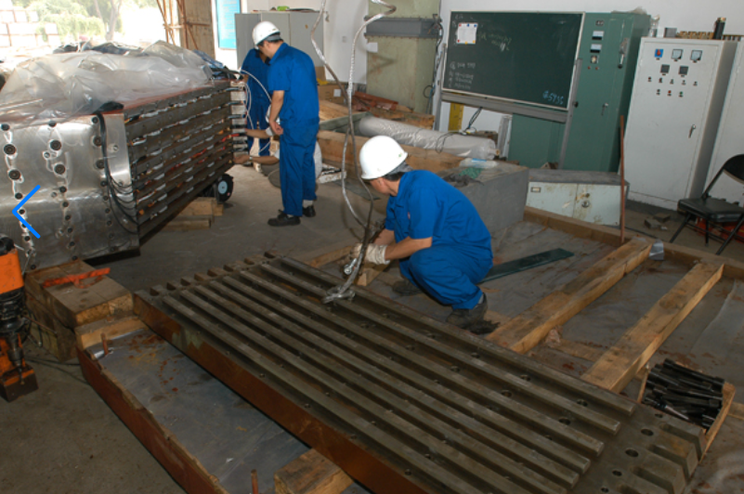
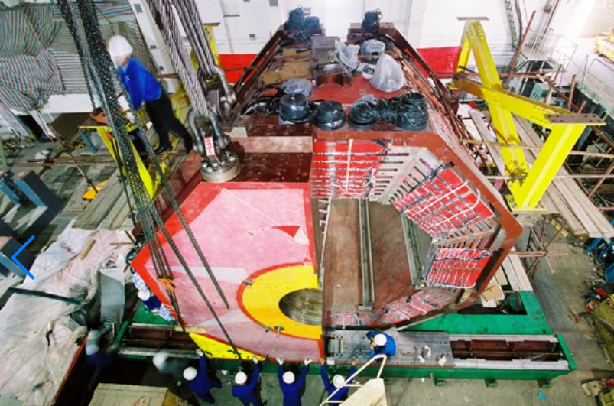
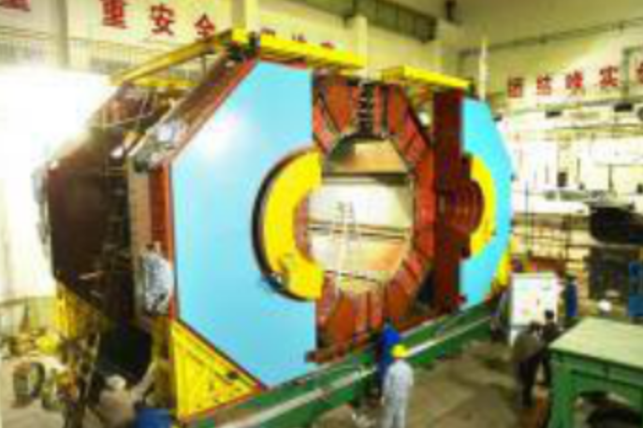
Procedure - Mechanical Structure and muon detector（2005.03~2005.11）
Base + sliding rail → barrel yoke (inner mounting frame) → muon detector inserted → door(end yoke)
Muon detector and end yoke assembled to be door then lifted on rail
4

Slide 7
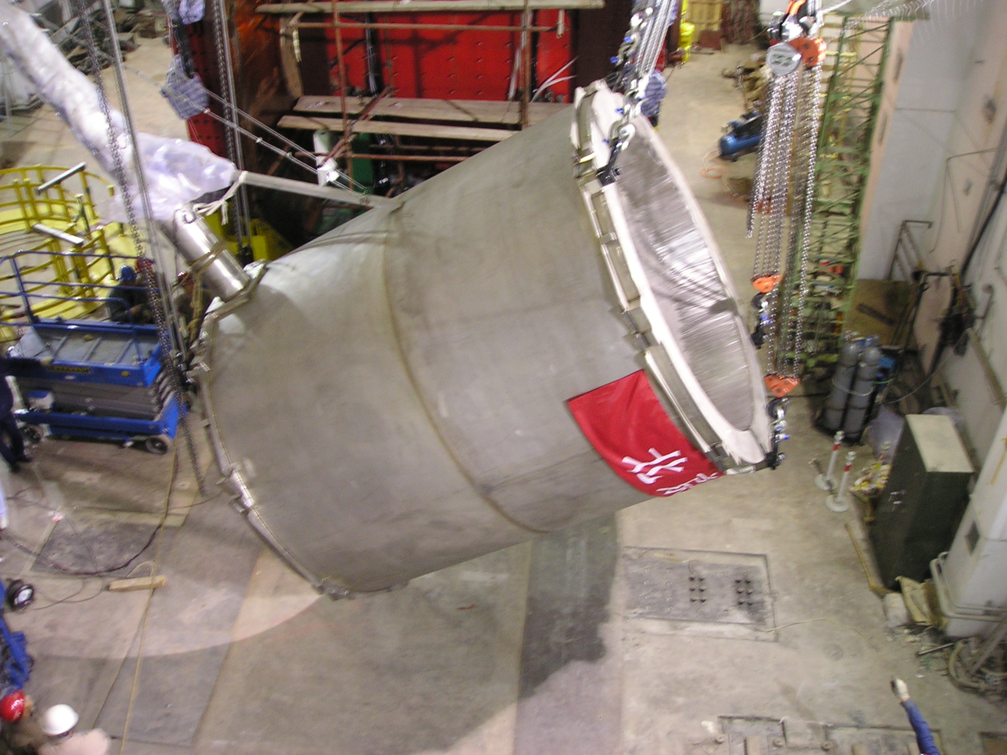
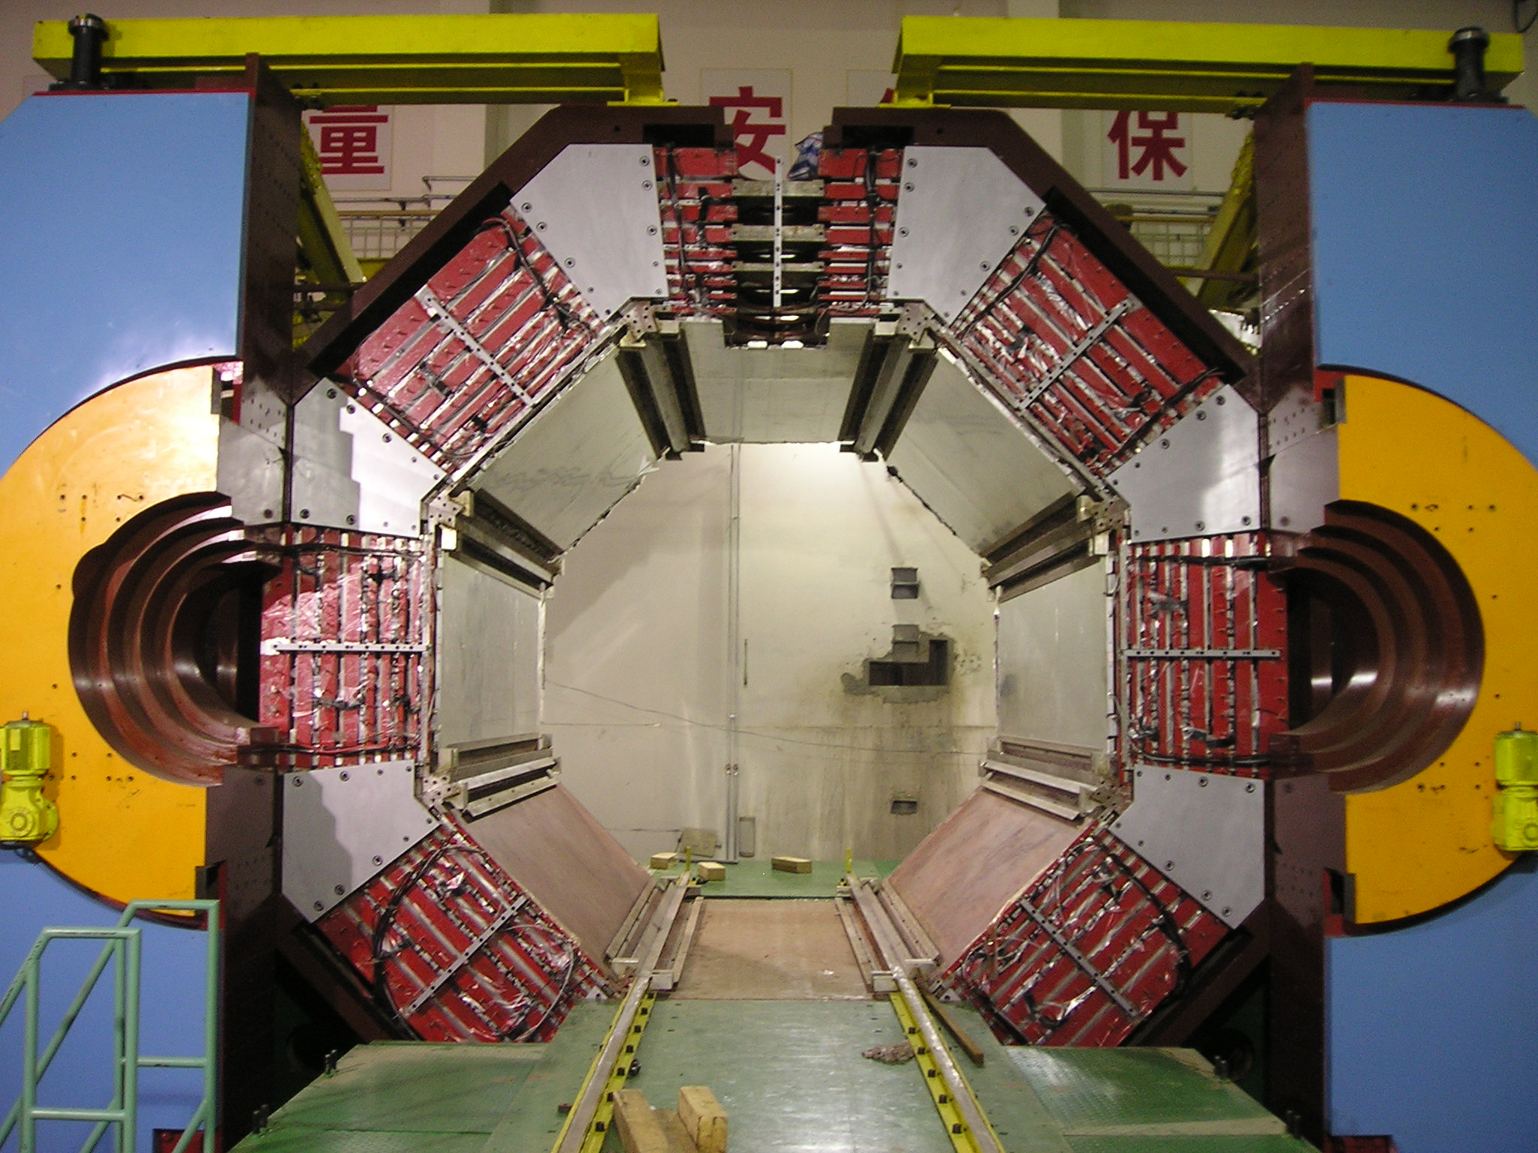
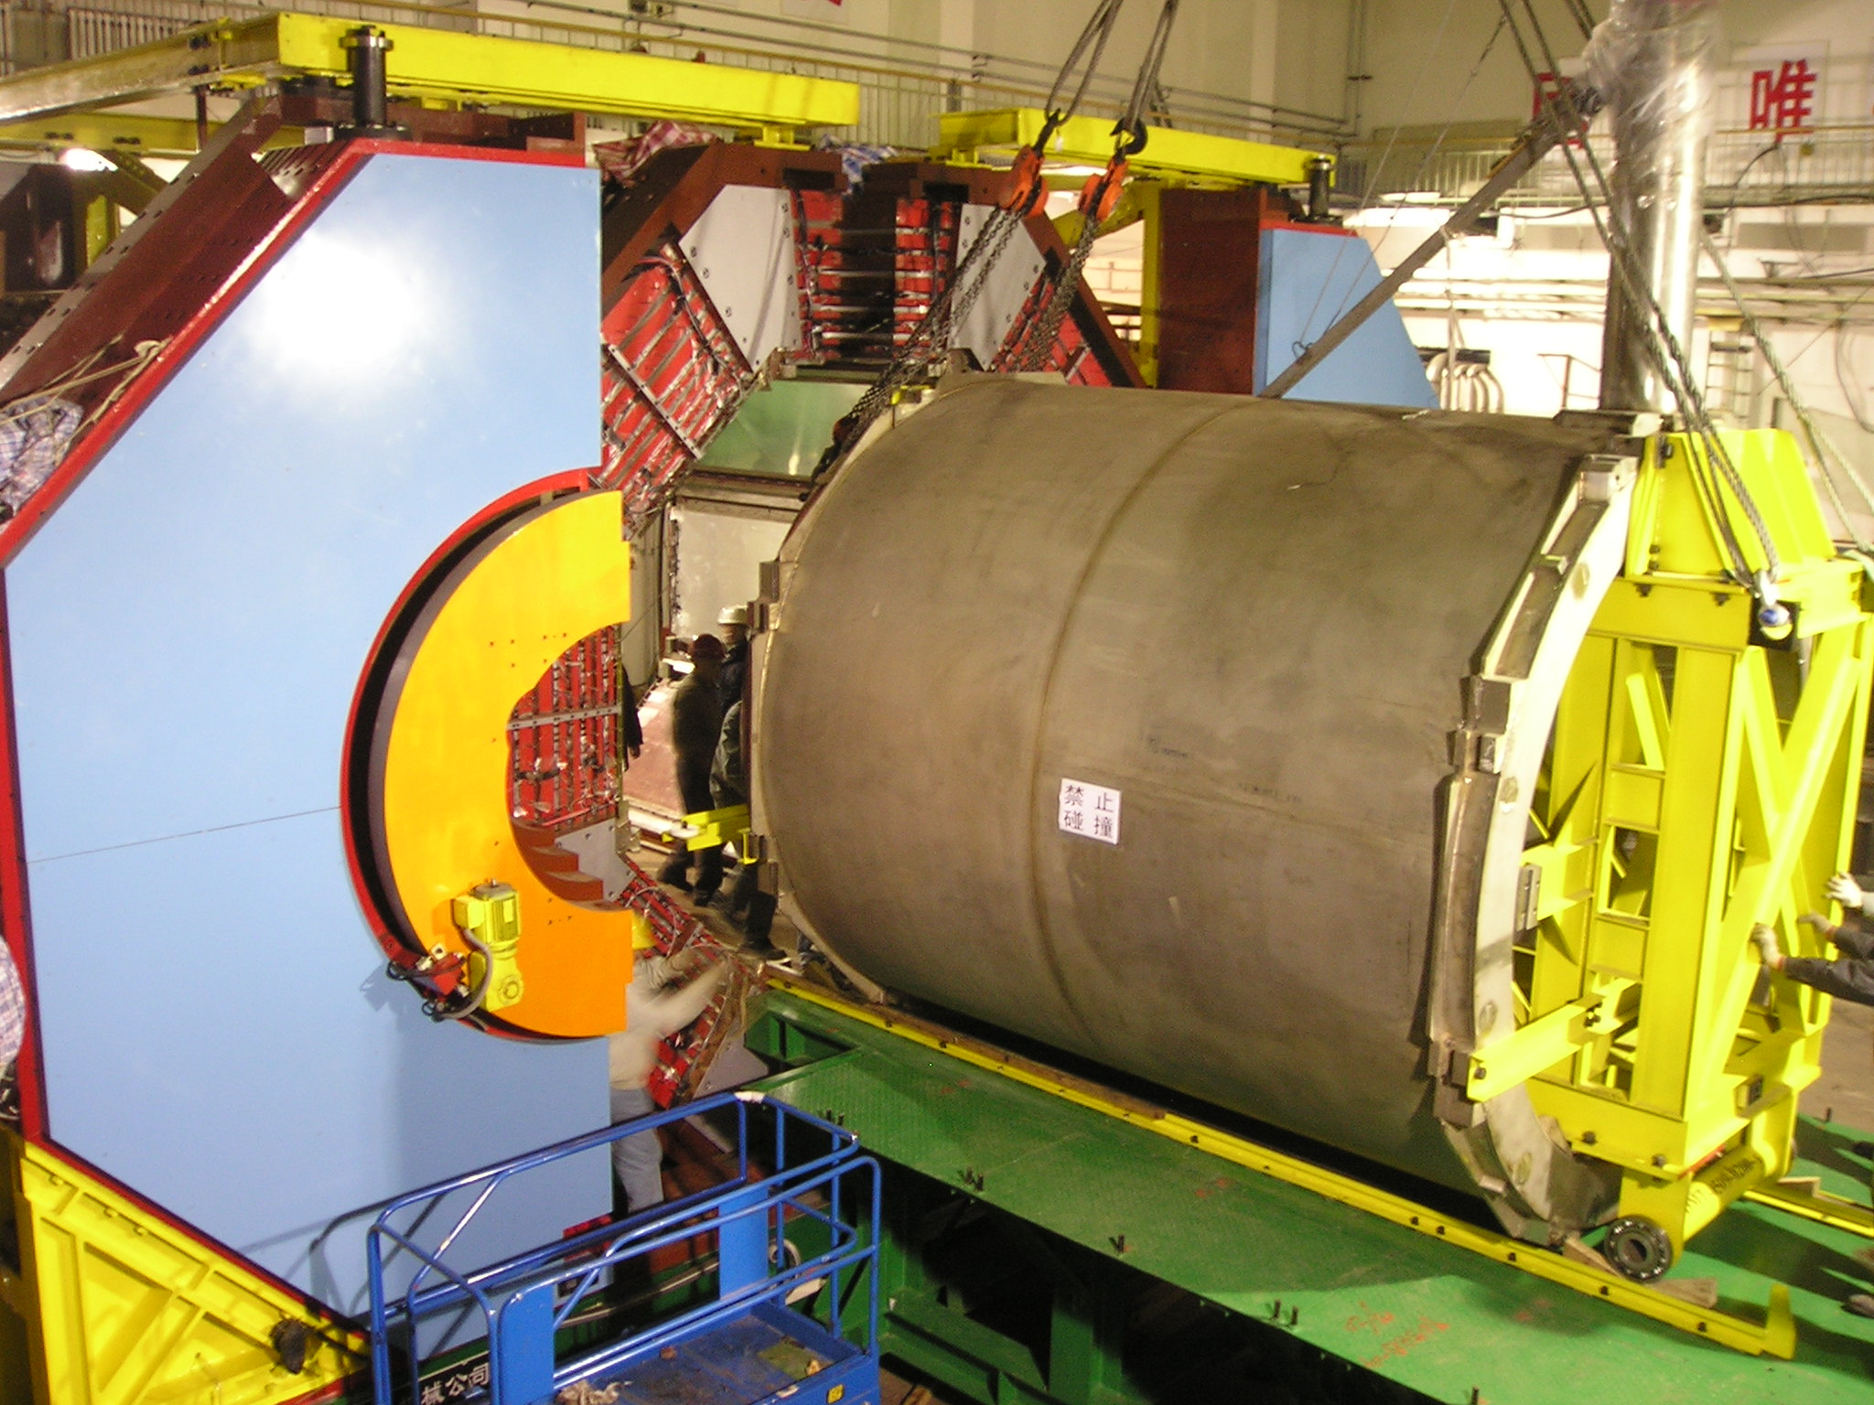
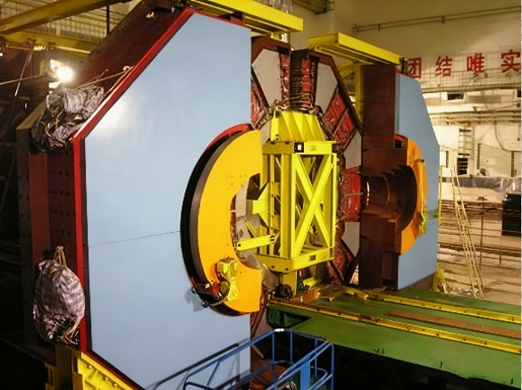
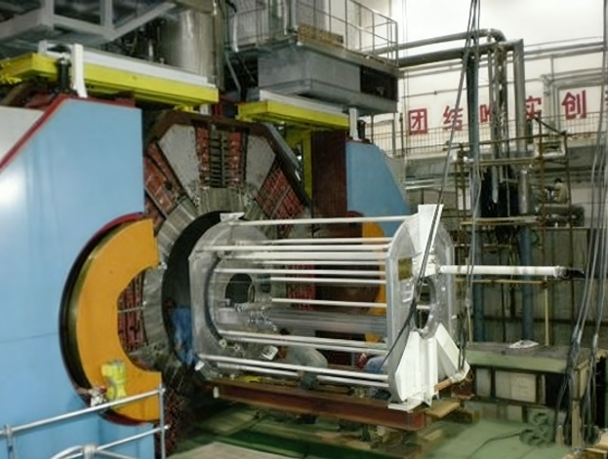
Procedure - SSM (2005.12~2006.07)
Enough space between SSM and yoke, rail structure reserved on yoke, external rail installed on the platform
Rotate to horizontal → insert mounting frame with wheel → lift on rail → adjust coaxial then insert into BESⅢ → fix → remove frame → in order to measure magnetic field, install and remove Magnetometer →remove rail
5

Slide 8
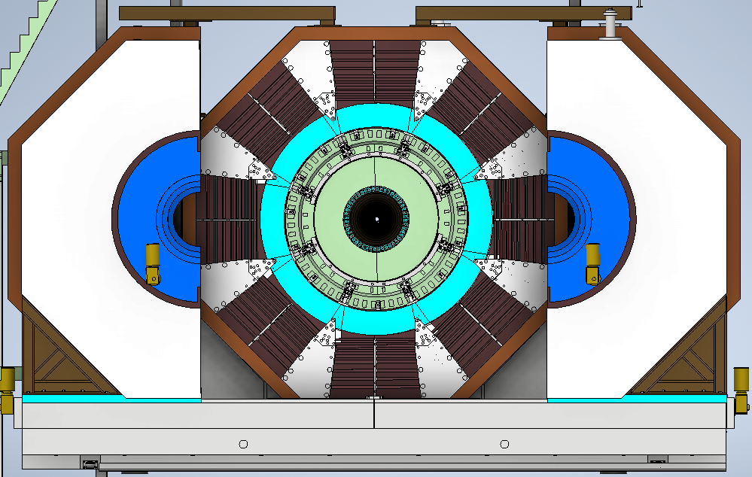
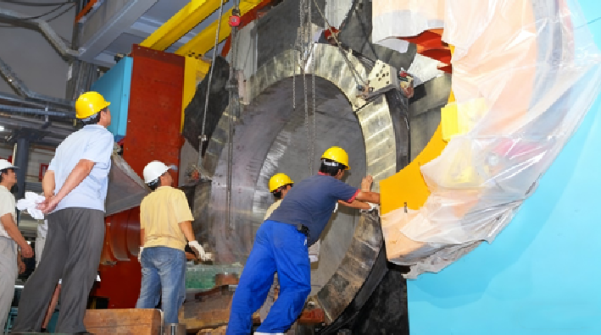
Procedure - Flange (2006.08)
Lift flange and fix it on 8 blocks
6

Slide 9
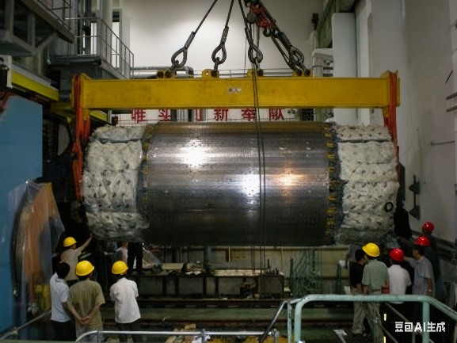
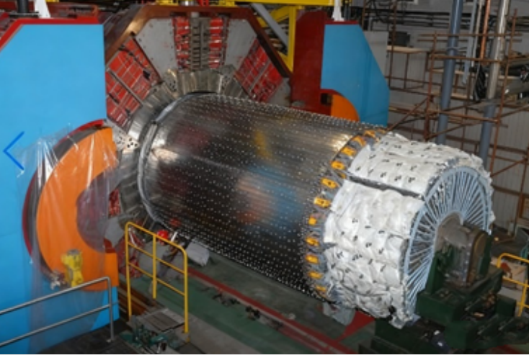
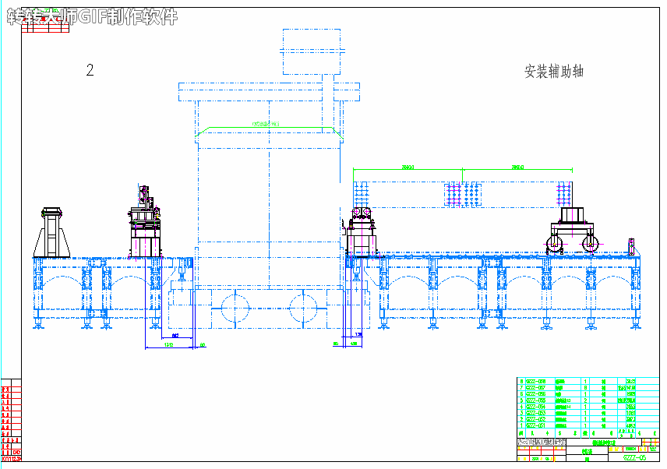
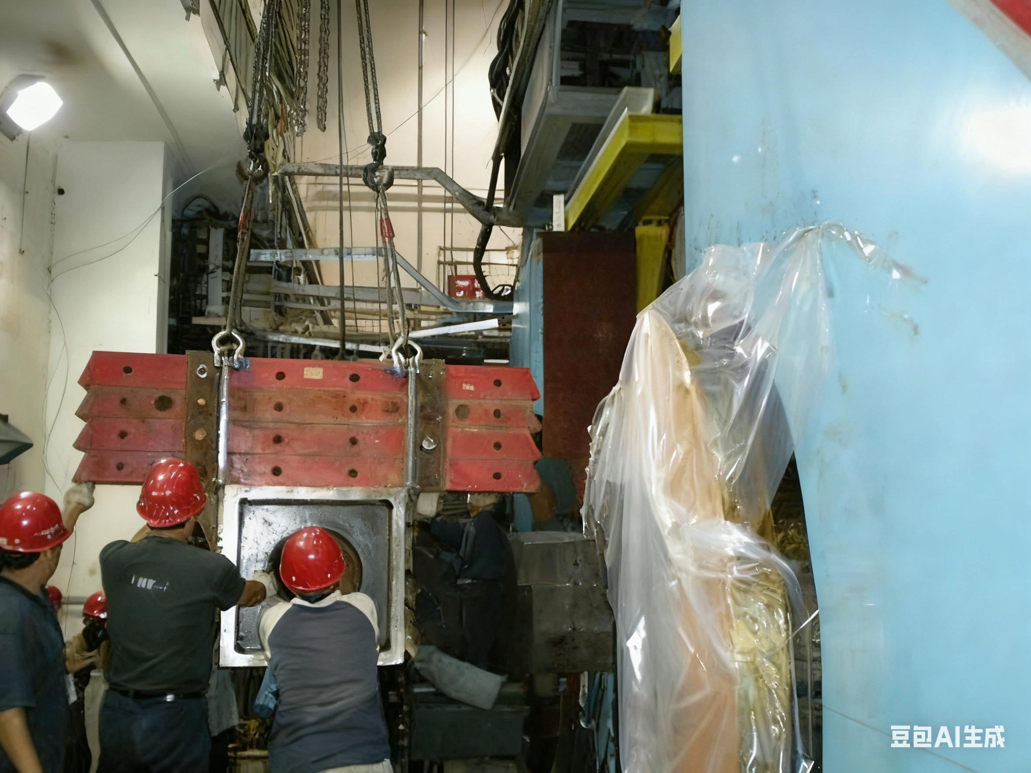
Procedure - BEMC (2007.09)
Simply supported beam：Rail, Multi-segment rectangular beam
West: fixed bracket，east: movable bracket + temp bracket
No enough space on the west side lead to complicate procedure, install
and remove parts of beam many times
7

Slide 10
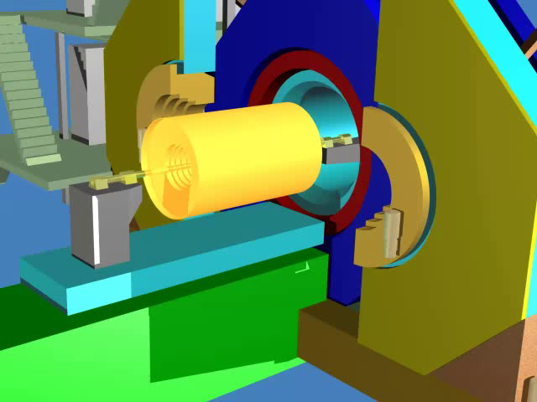
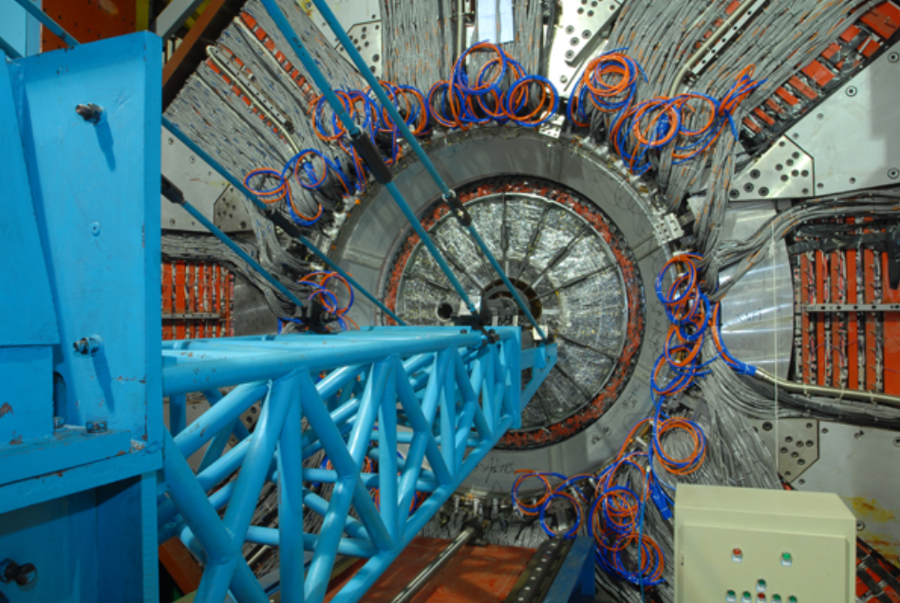
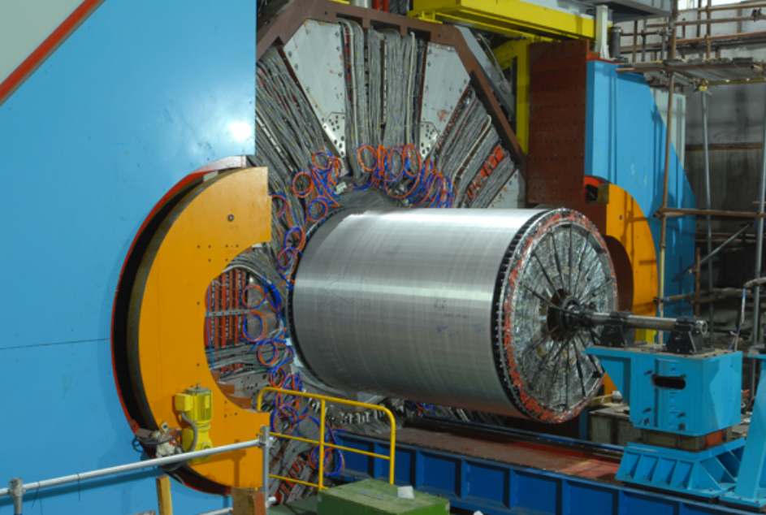
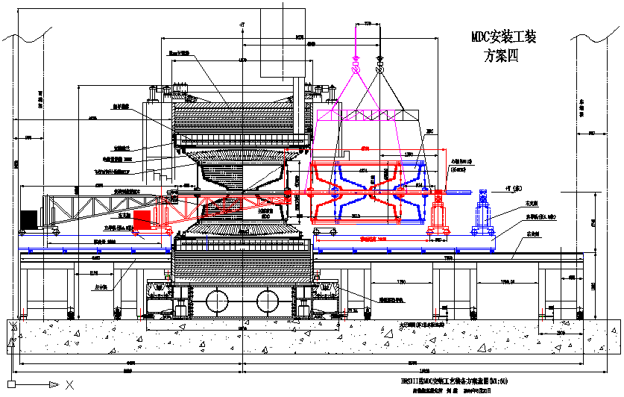
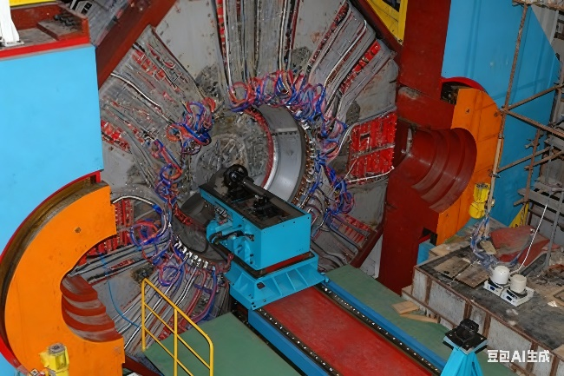
Procedure - MDC + TOF (2007.11)
Simply supported beam, different, brackets on sliding rail withstand moments, west moveable cantilever bracket
West bracket move throuth BESⅢ → east bracket to the far end → MDC lifted → Connect → adjust then move 300mm to west → disconnect → west bracket move 300mm to east (otherwise MDC will not reach final postion) → reconnect → adjust → move to final position → fixed → remove mounting device
Due to insufficient stroke, not reach final position, west bracket move and reconect with shaft
8

Slide 11
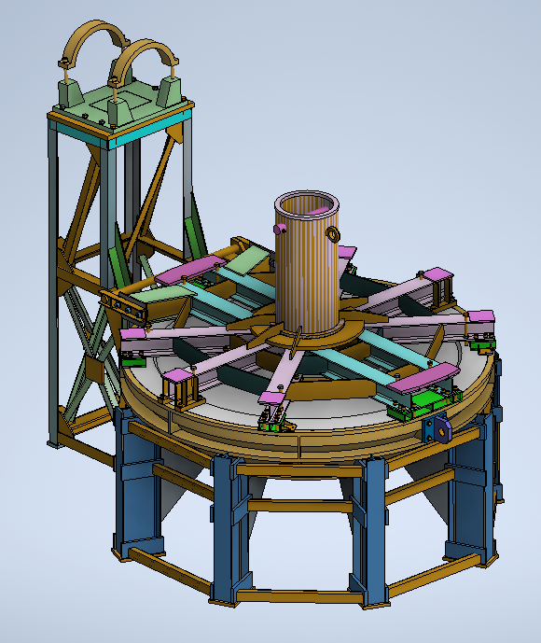
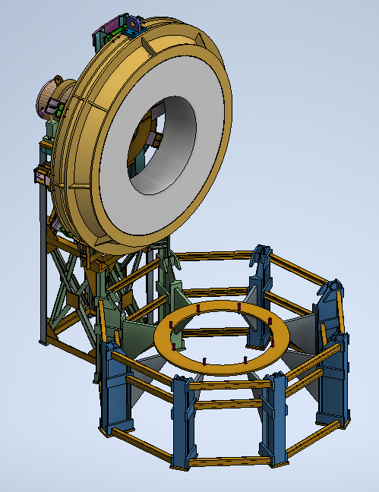
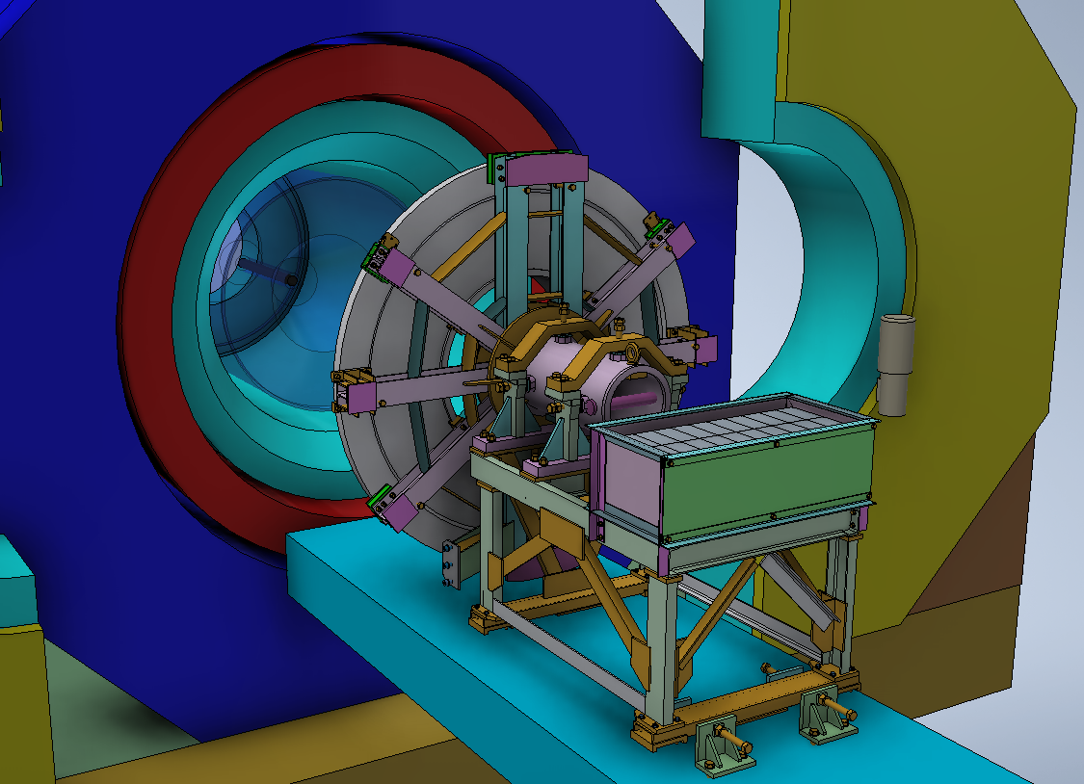
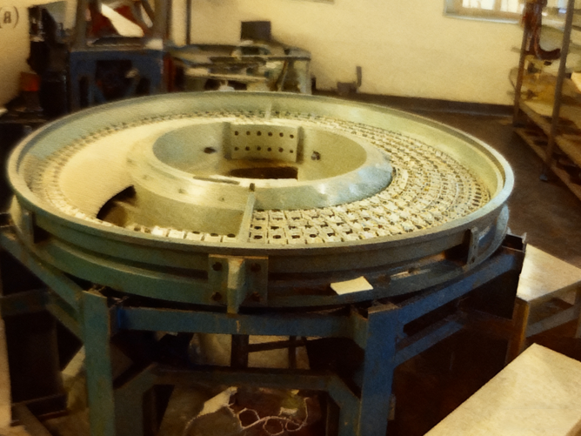
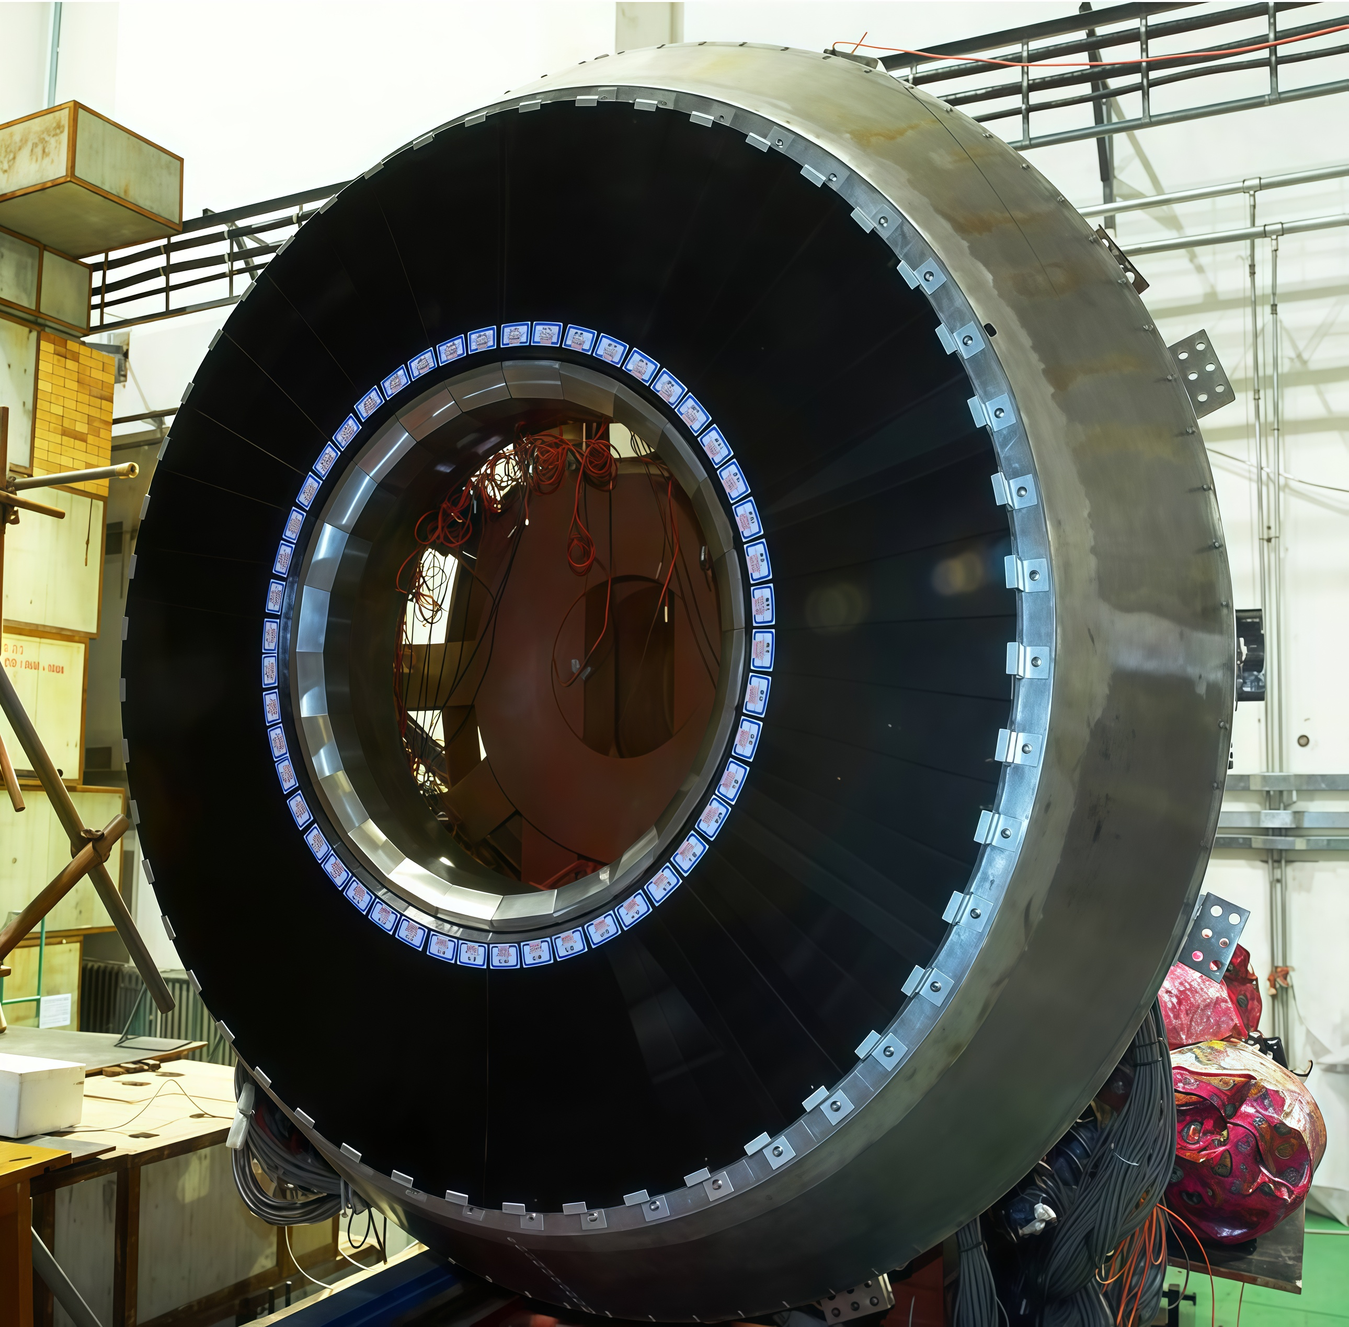
Procedure - EEMC (2008.01)
Assemble on frame → transport with frame → rotate → lift to movable frame on MDC sliding rail → adjust → move to final position→ connect EEMC with flange → remove all mounting device
9

Slide 12
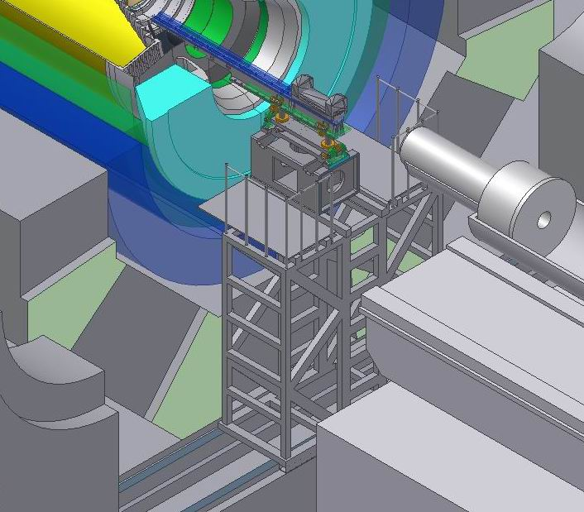
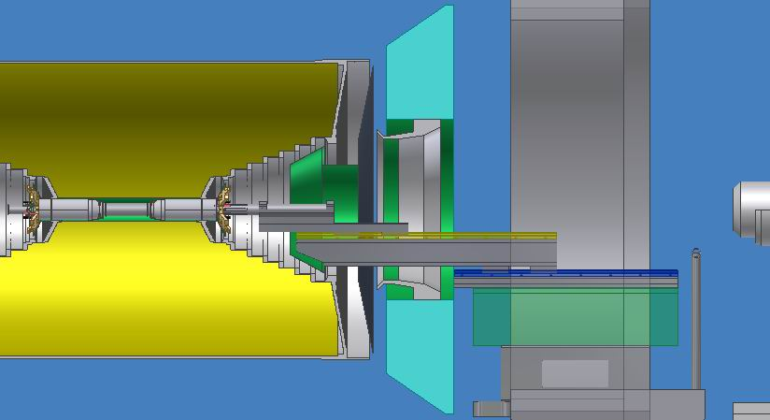
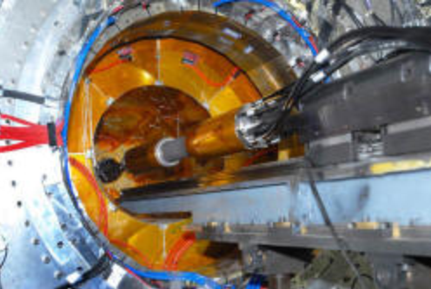
Procedure - Beam pipe (2008.03)
Cantilever beam: sliding rail, shaft, east movable cantilever bracket
Gap 2mm, and the middle section is thin Beryllium tube, need shaft to strength beam pipe during installation
Install platform on rail of door → install bracket → lift beam pipe with shaft → adjust → insert
→ disconnect and fixed → extract bracket
The beam pipe is clamped by 4 jacking screws from the top, bottom, left, and right directions
10

Slide 13
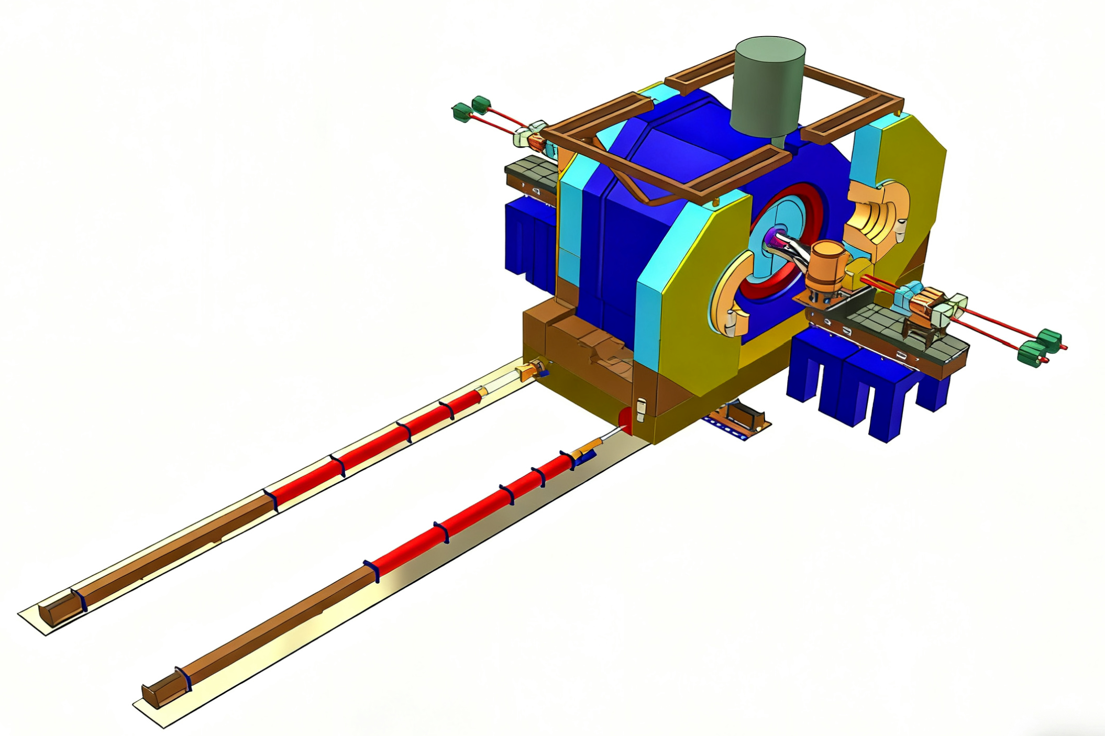
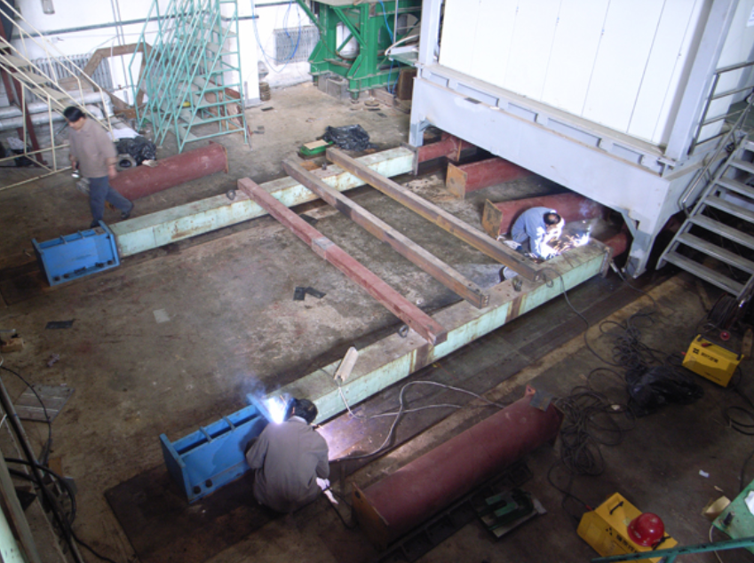
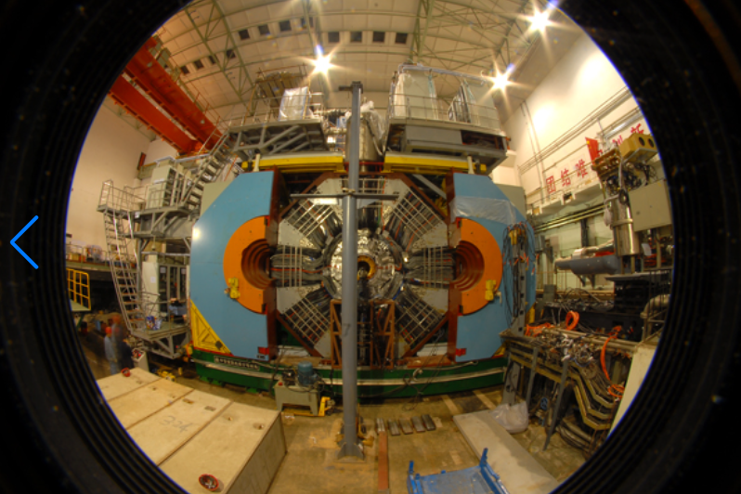
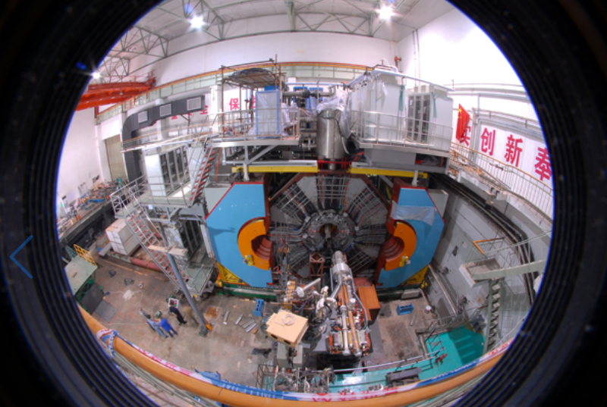
Procedure - push BESⅢ (2008.4)
After all detectors insatlled, entire BESⅢ pushed to collision point
Distance from install point to collision point: >11m, positioning accuracy XYZ ±1.5mm
Put PTFE (polytetrafluoroethylene) sliding blocks under BESⅢ, static friction coefficient 0.05, reduce force < 40T
Long distance: hydraulic cylinder(push 40T & pull 30T) , 1m stroke,accuracy 1mm, sensor for dispalcement and force
Accurate adjustment: ordinary hydraulic cylinder, 50T & 300T, in other direction including up and down
Anchor: south original steel plate, east and west: new steel plate with chemical anchor bolt,
Diffrent distance: 1×5m & 2×2m & 2×1m combine 1 to 11 m
11

Slide 14
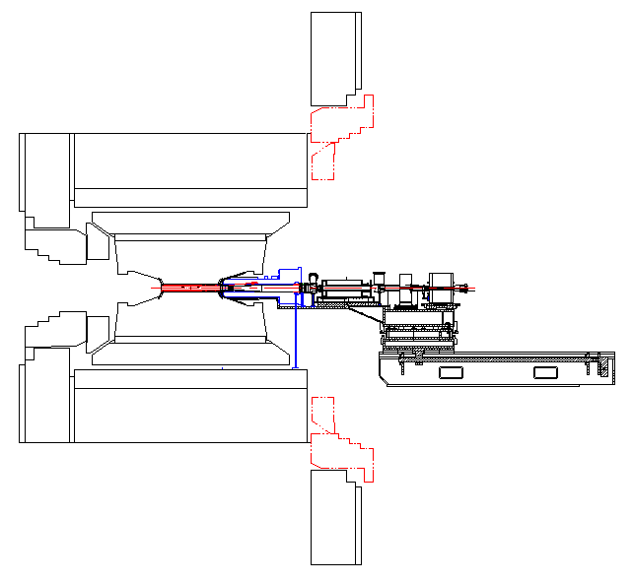
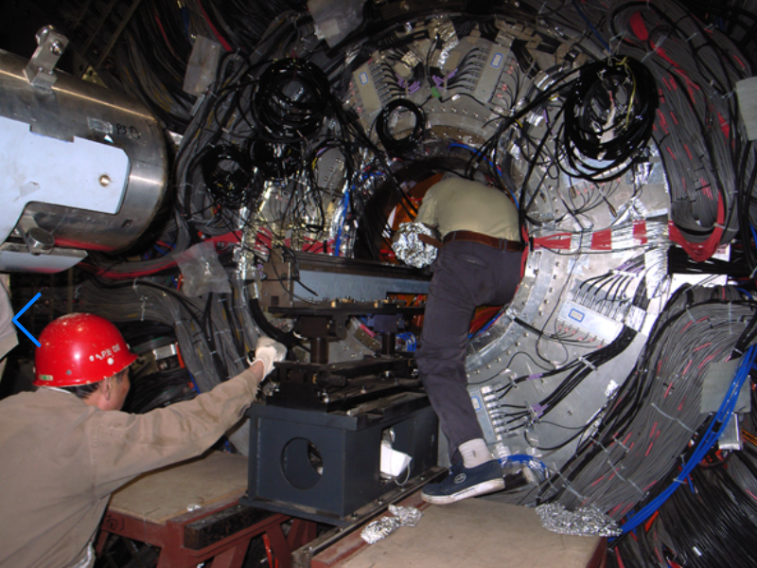
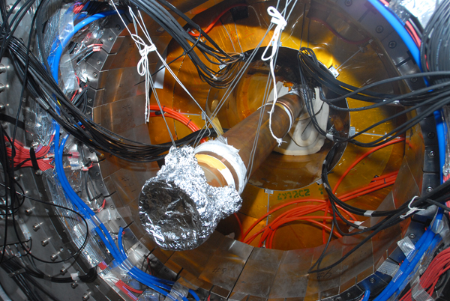
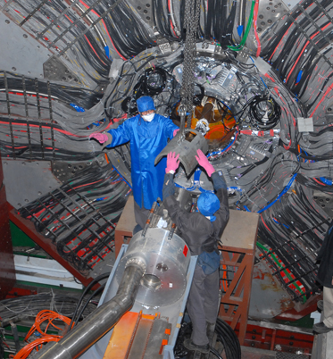
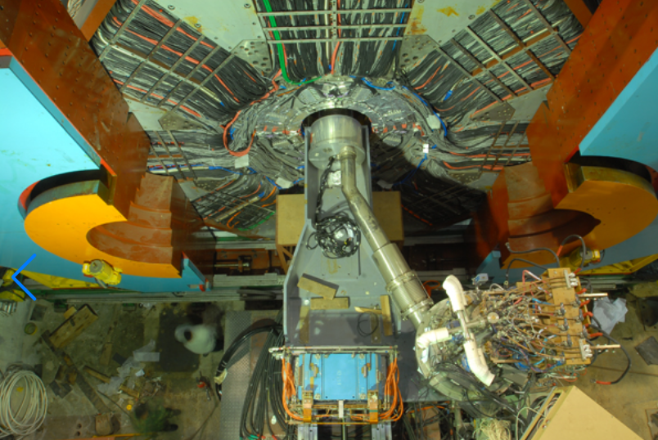
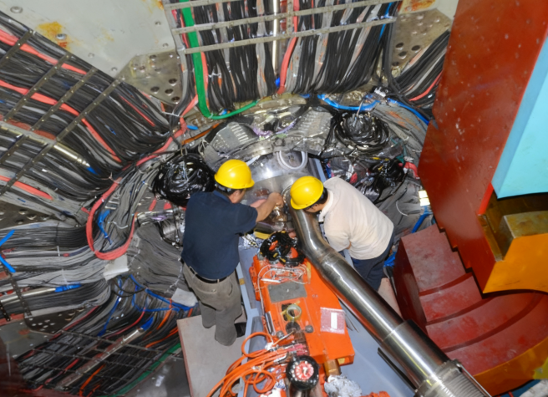
Procedure - Connect SCQ （2008.06）
SCQ installed, upper parts move to end on rail before pushing BESⅢ
After accurate adjustment of BESⅢ, SCQ vacuum chambers are inserted and connected to the beam pipe.
Depleted uranium shielding layer cover SCQ
SCQ inserted into the BESⅢ
12

Slide 15
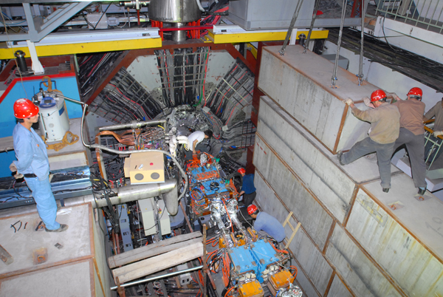
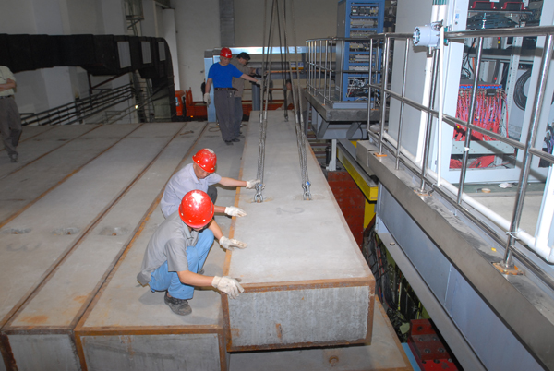
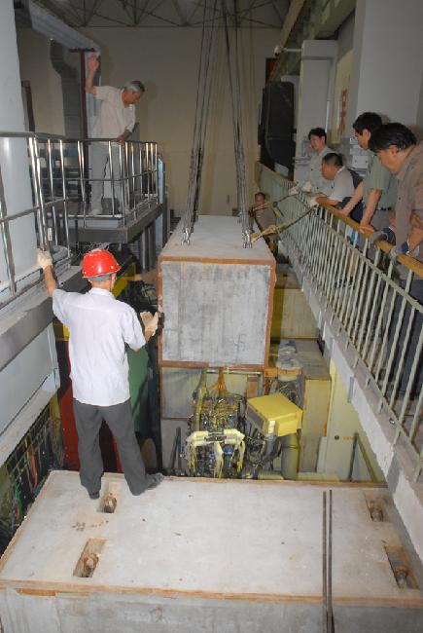
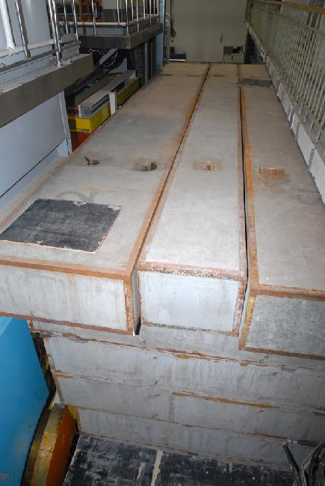
Procedure - Shielding wall （2008.07）
Lots of difficulties
Concrete block large and heavy, ＞3m × 1m × 1m, top block 8m× 1m × 0.5m，about 10T
Close to BESⅢ,＜500mm
Narrow space on west side
Surface uneven, add thin shims in gaps to stabilize
13

Slide 16
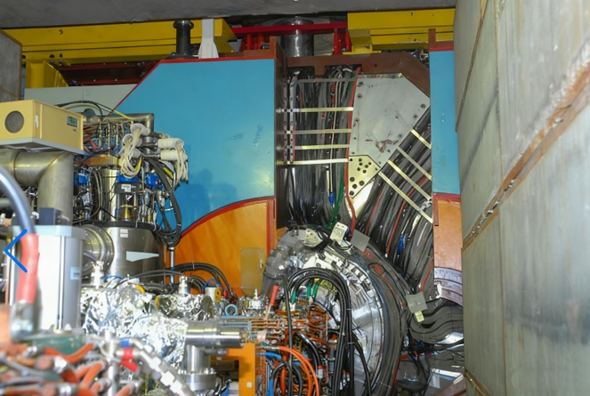
Procedure - Close door （2008.07）
After all detectors and components are installed, confirm all dectors work normally
Check space of closing door，ensure no any interference
Check cable routing confirm no scratch during closing door
14

Slide 17
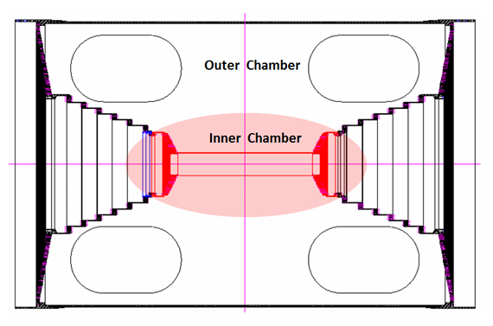



Upgrade (2024.07.08 ~ 2025.02.28)
Main task remove inner drift chamber, Install CGEM by Italian
Outer chamber and other detectors must not be damaged
Small clearance fit; sealing glue and scratch lead to unpredictable force
3+2 legs, shaft, pulling struture, inner drift chamber and CGEM slide on the shaft
15

Slide 18











Upgrade
Installation test on mock-up and improve pulling struture, add tension meter ensure force balance,
cooling ring enlarge clearance, adopt structure restrict first step of outer chamber to protect it
Pull out inner chamber successfully
Install carbon fiber cylinder
Italians install the CGEM by using the legs and shaft of the inner chamber
16

Slide 19
Summary
BESⅢ work normally after installation and upgrade
The installation becomes more complicate due to space constraints.
It is necessary to test installation procedure in advance
It is difficult to install concrete shielding wall
Thanks for your attention!
17

