Slide 1

Simulation Study for CEPC Fast Luminosity Detector based on 4H-SiC
Yanpeng Li^{1,2}, Meng Li^{2,3}, Qiming Ye⁴, Xiyuan Zhang², Haoyu Shi², Dou Wang², Philip Bambade³, Weimin Song¹, Xin Shi²
CEPC Workshop 2025
Guangzhou Nov.8 2025
1.Jilin University
2.Institute of High Energy Physics, CAS
3.Laboratoire de l'Accélérateur Linéaire (LAL),Centre Scientifique d’Orsay
4.Lanzhou University

Slide 2
OUTLINE
Description for CEPC Fast Luminosity Monitor System
Introduction for 4H-SiC detector
Simulation Discussion for CEPC Fast Luminosity Detector
Beam-Beam Deflection and Background Concerns for CEPC Fast Luminosity Detector
Conclusion and Next to do

Slide 3
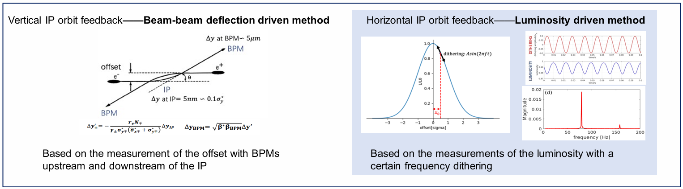
Description for CEPC Fast Luminosity Monitor System
Crab-waist scheme for CEPC to achieve high luminosity
  Beam size very small (horizontal: 14 𝜇m; vertical: 36 nm)
  Luminosity sensitive to the stability of beam jitter(like ground motion)
Orbit feedback system at IP to maintain an optimum collision and maximize the luminosity
Two possible methods for IP orbit feedback system

Slide 4
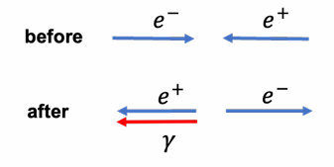
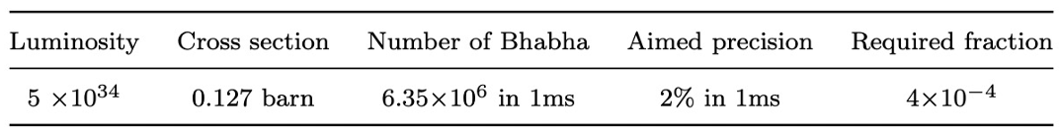
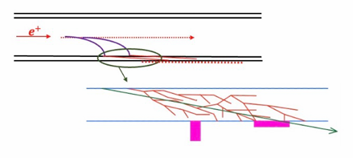
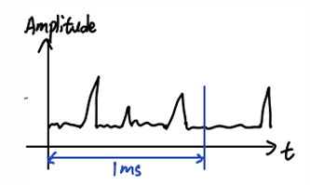

Description for CEPC Fast Luminosity Monitor System
The fast luminosity monitor based on radiative Bhabha at vanishing photon degree
  Very large cross section (127mbarn)
  Bhabha particles produced at the IP are proportional to the luminosity
The low energy Bhabha electrons hit the beam pipe downstream of IP
The detectors put outside the beam pipe to capture secondary particles and provide the luminosity information

Slide 5
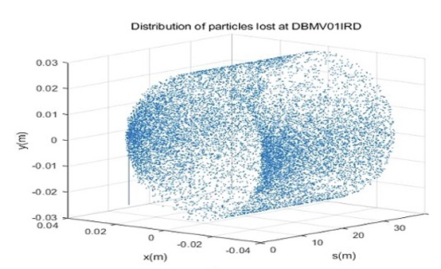
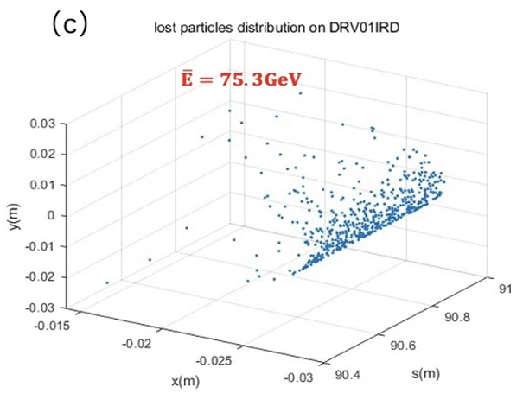
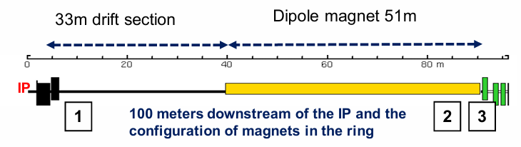
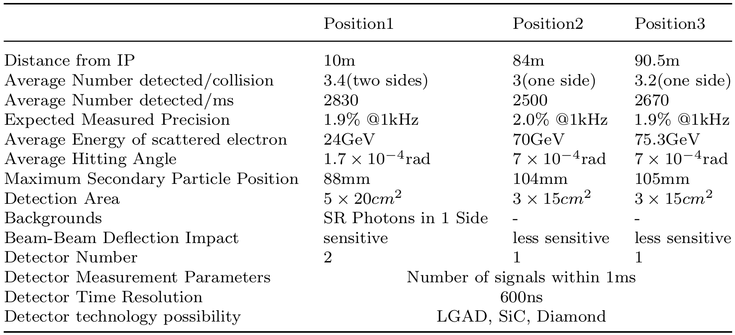
Description for CEPC Fast Luminosity Monitor System
Downstream of IP 100 m :
  3 quadrupoles (strong defocusing in the horizontal direction)
  33 m drift section (some low-energy electrons are likely to be lost)
  51 m dipole magnet (deflects electrons towards inner side)
  Additional drift sections, magnets and other elements….
Detector installed position:
  Position 1 and Position 3
  Position 2 inside the dipole magnet (spatial constraints)
[1]M.Li, P.Bambade, D.Wang, H.Shi, S.Bai, J.He et al. Preliminary design consideration for CEPC fast luminosity feedback system, Radiation Detection Technology and Methods 9 (2025) 41.

Slide 6
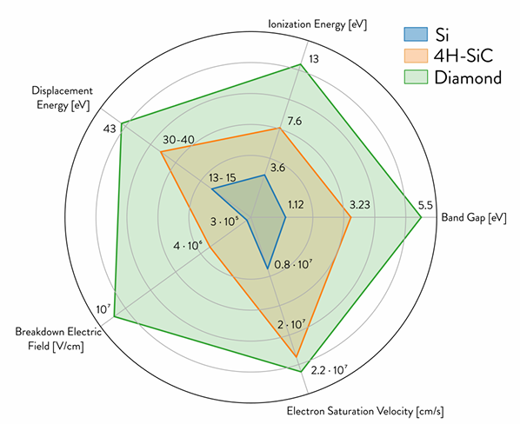
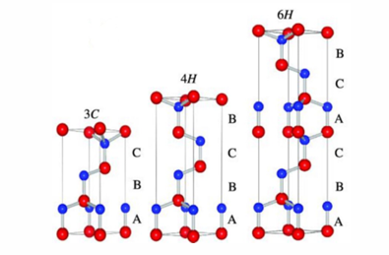
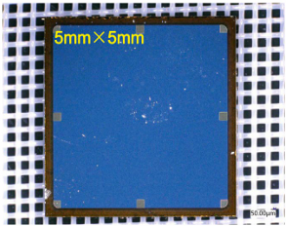
Introduction for 4H-SiC detector
Wide bandgap semiconductor (3.26 eV)
  low leakage current
  insensitivity to visible light
  high breakdown field and saturation velocity
  potentially higher radiation hardness, no cooling needed
  high ionization energy
  limitations in epitaxial layer thickness and resistivity
Material not new but now available in higher quality (MOS technologies)

Slide 7
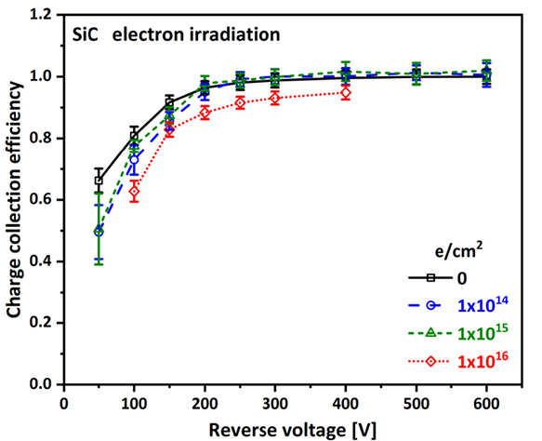
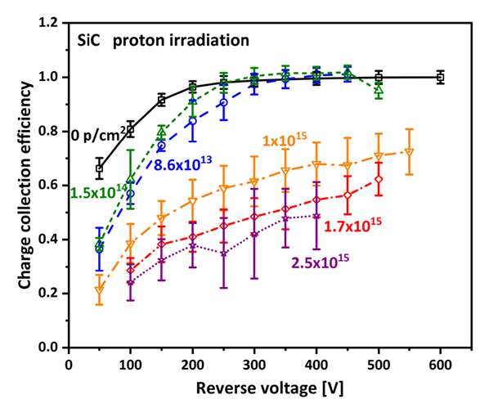
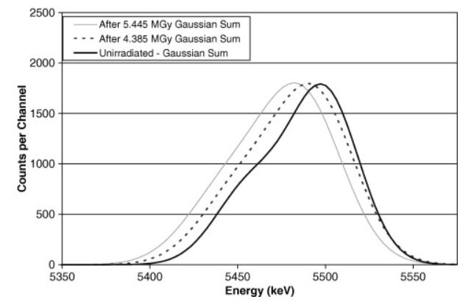
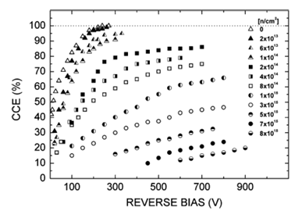
Introduction for 4H-SiC detector
Under 5.445 MGy gamma irradiation:
  The full width at half maximum (FWHM) of the peak increased by 17%
  The energy shifted by 0.24% relative to the unirradiated detector for the 238Pu alpha source.
  Both of these changes are negligible
Electron irradiation at 2 MeV：
  1 × 10¹⁶ e/cm²: CCE decreases to 90%
Neutron irradiation at 1 MeV:
  1 × 10¹⁵ n/cm²: the diodes maintain the charge collection efficiency (CCE) of 80%
  8 × 10¹⁵ n/cm²: CCE decreases to 20%
Proton irradiation at 24 GeV:
  2.5 × 10¹⁵ p/cm²: CCE decreases to 45%
X-ray irradiation indicate that an irradiation dose of 1 MGy does not affect the performance of the 4H-SiC detector.[Poster D01]
[1]F.H. Ruddy and J.G. Seidel, The effects of intense gamma-irradiation on the alpha-particle response of silicon carbide semiconductor radiation detectors, Nuclear Instruments and Methods in Physics Research Section B: Beam Interactions with Materials and Atoms 263 (2007) 163.
[2]F. Nava, A. Castaldini, A. Cavallini, P. Errani and V. Cindro, Radiation Detection properties of 4H-SiC Schottky Diodes Irradiated up to 10¹⁶n/cm² by 1 MeV Neutrons, IEEE Transactions on369Nuclear Science 53 (2006) 2977.370
[3]J.M. Rafí, G. Pellegrini, P. Godignon, S.O. Ugobono, G. Rius, I. Tsunoda et al., Electron, Neutron,371and Proton Irradiation Effects on SiC Radiation Detectors, IEEE Transactions on Nuclear Science 67372(2020) 2481.373

Slide 8
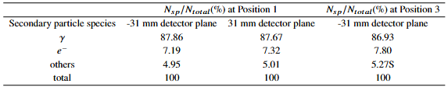
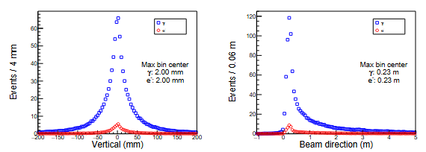
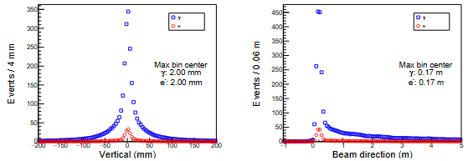
Simulation Discussion for CEPC Fast Luminosity Detector
Secondary particle:
  Generated by the interaction between primary electrons and beam pipe
  Captured by the detector and generates a signal
  Photons dominant (87%), with 7% electrons
Secondary particle distribution:
  Detector plane: tangent to the outer wall of the beam pipe, ±31 mm in horizontal, detector mounting plane
  Statistical distribution of secondary particles in the detector plane
  Vertical distribution: symmetrical distribution with respect to the origin
  Beam direction: 23 cm (Position 1) and 17 cm (Position 3) from one end of the primary electron loss region
@ Position 1
Vertical
Detector plane
detector
Beam direction
Primary particle loss region
23 cm (Position 1)
@ Position 3
17 cm (Position 3)

Slide 9

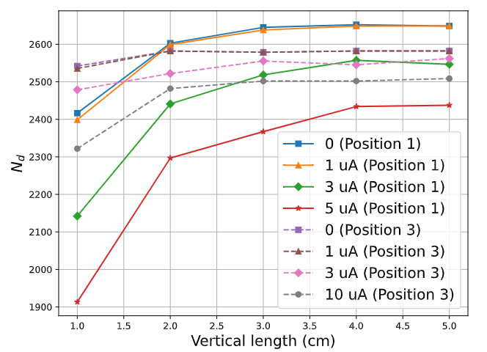
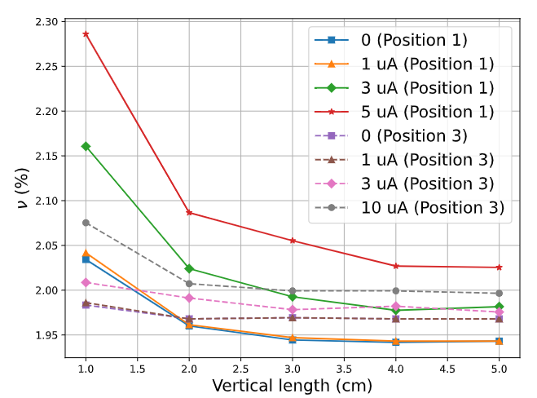
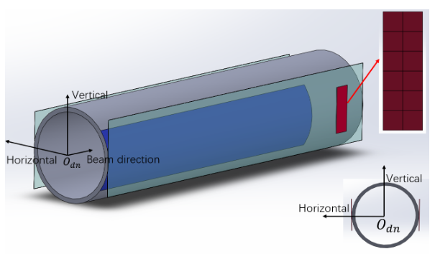
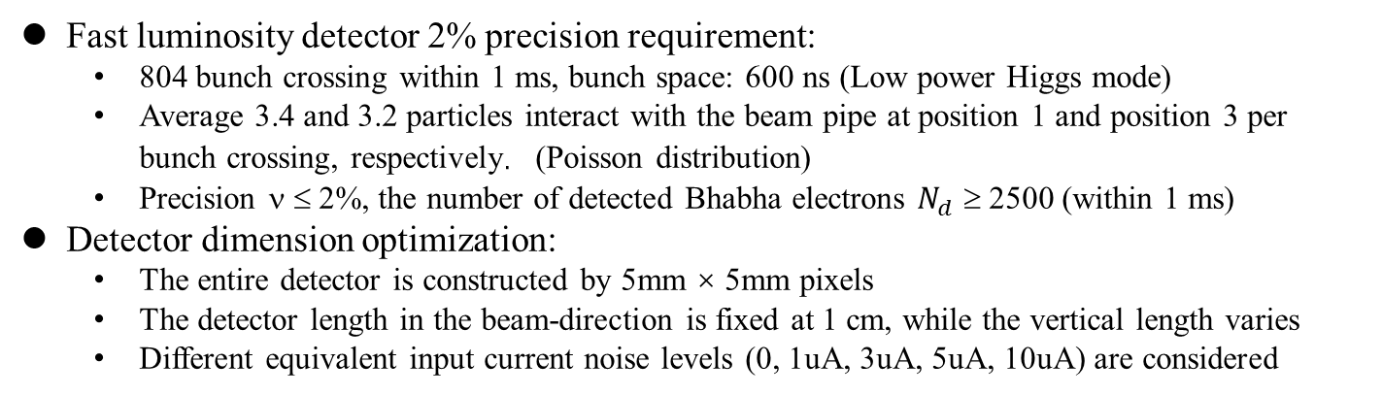
Simulation Discussion for CEPC Fast Luminosity Detector
Fast luminosity detector 2% precision requirement:
  804 bunch crossing within 1 ms, bunch space: 600 ns (Low power Higgs mode)
  Average 3.4 and 3.2 particles interact with the beam pipe at position 1 and position 3 per bunch crossing, respectively. (Poisson distribution)
  Precision ν ≤ 2%, the number of detected Bhabha electrons $N_{d}$ ≥ 2500 (within 1 ms)
Detector dimension optimization:
  The entire detector is constructed by 5mm × 5mm pixels
  The detector length in the beam-direction is fixed at 1 cm, while the vertical length varies
  Different equivalent input current noise levels (0, 1uA, 3uA, 5uA, 10uA) are considered
The final determined detector dimension is 1 cm (beam direction) × 3 cm (vertical length), 12 pixels in total.
The noise threshold at position 1 is 3 μA, while the noise threshold at position 3 is 10 μA.

Slide 10
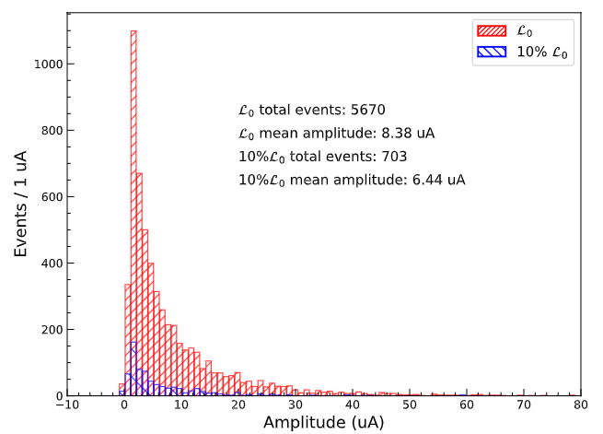
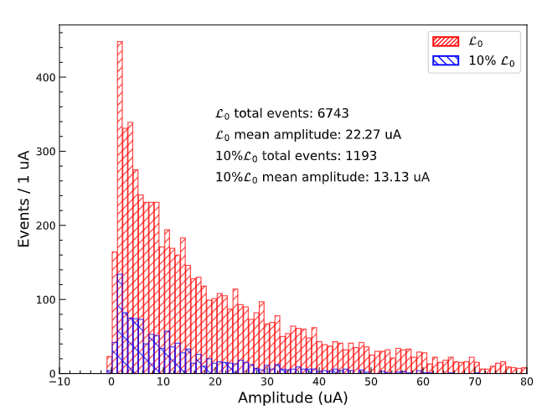
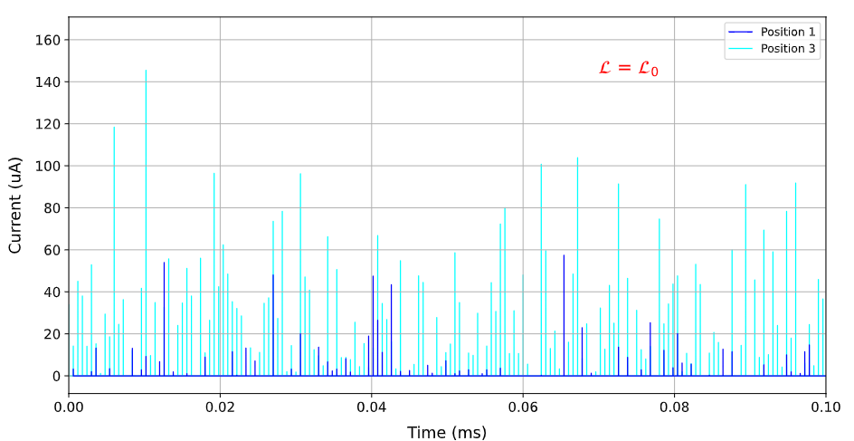
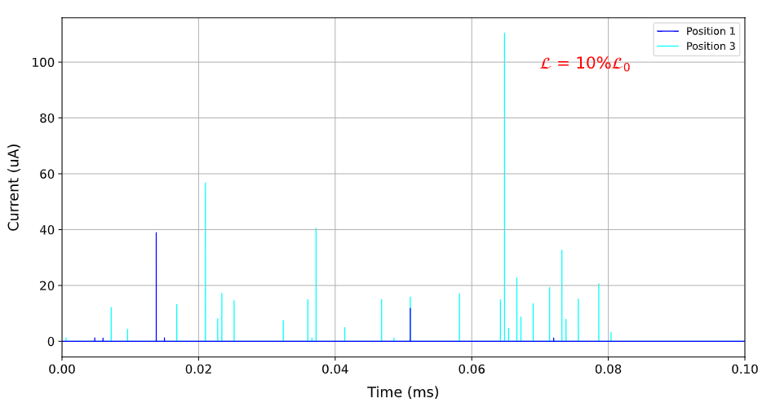
Simulation Discussion for CEPC Fast Luminosity Detector
Luminosity fluctuation detector’ response change
  For a single pixel, different signal responses at nominal luminosity and 10% of nominal luminosity
  For the entire detector, significant differences in the number and amplitude of the signals.
@ Position 1
@ Position 3

Slide 11
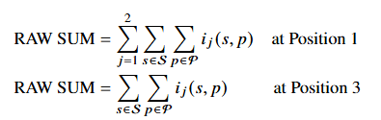
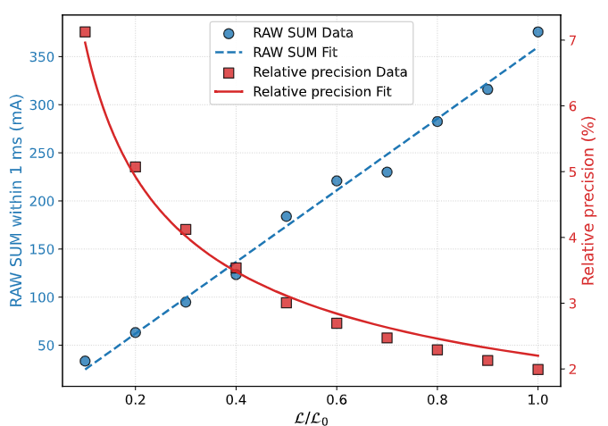
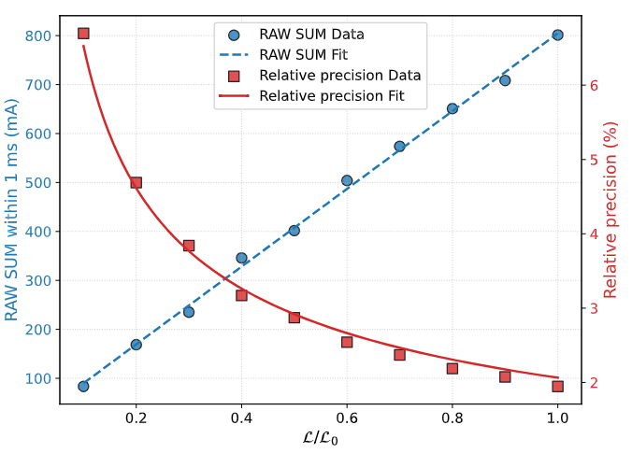
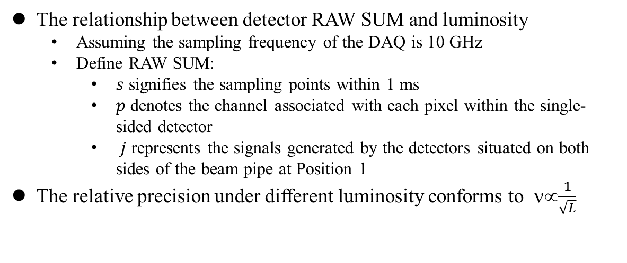
Simulation Discussion for CEPC Fast Luminosity Detector
The relationship between detector RAW SUM and luminosity
  Assuming the sampling frequency of the DAQ is 10 GHz
  Define RAW SUM:
    𝑠 signifies the sampling points within 1 ms
    𝑝 denotes the channel associated with each pixel within the single-sided detector
    𝑗 represents the signals generated by the detectors situated on both sides of the beam pipe at Position 1
The relative precision under different luminosity conforms to ν∝$\frac{1}{\sqrt{L}}$
@ Position 1
@ Position 3

Slide 12


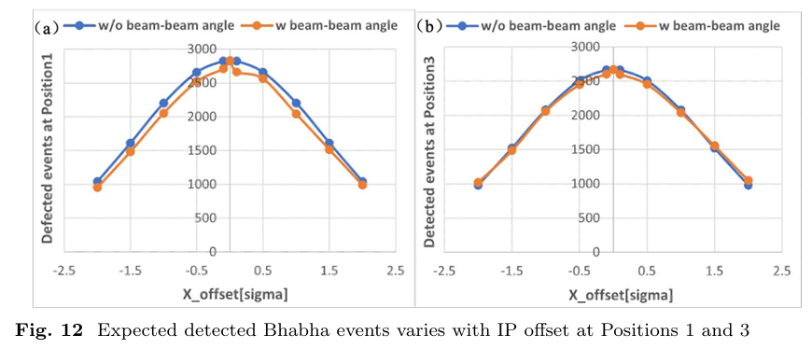
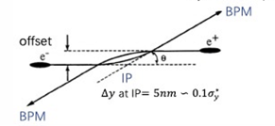
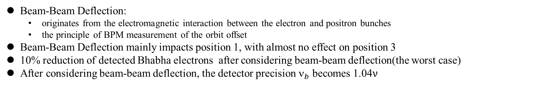
Beam-Beam Deflection and Background Concerns for CEPC Fast Luminosity Detector
Beam-Beam Deflection:
  originates from the electromagnetic interaction between the electron and positron bunches
  the principle of BPM measurement of the orbit offset
Beam-Beam Deflection mainly impacts position 1, with almost no effect on position 3
10% reduction of detected Bhabha electrons after considering beam-beam deflection(the worst case)
After considering beam-beam deflection, the detector precision $_{b}$ becomes 1.04$ν$
[1]M.Li, P.Bambade, D.Wang, H.Shi, S.Bai, J.He et al. Preliminary design consideration for CEPC fast luminosity feedback system, Radiation Detection Technology and Methods 9 (2025) 41.

Slide 13
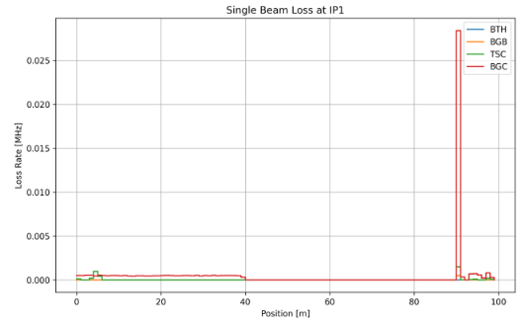
Beam-Beam Deflection and Background Concerns for CEPC Fast Luminosity Detector
Single-Beam background:
  4 single-beam background are concerned: beam-thermal photon scattering (BTH), beam-gas scattering (Coulomb scattering (BGC) and Bremsstrahlung scattering (BGB)), and Touschek scattering (TSC)
  BGC dominants, and the single-beam background has losses at position 1 and position 3
 | Single-Beam background | Primary electrons by radiative Bhabha
Position 1 | 7×10⁻⁵ per bunch crossing | 3.4 per bunch crossing
Position 3 | 2×10⁻² per bunch crossing | 3.2 per bunch crossing
Position 1
Position 3

Slide 14
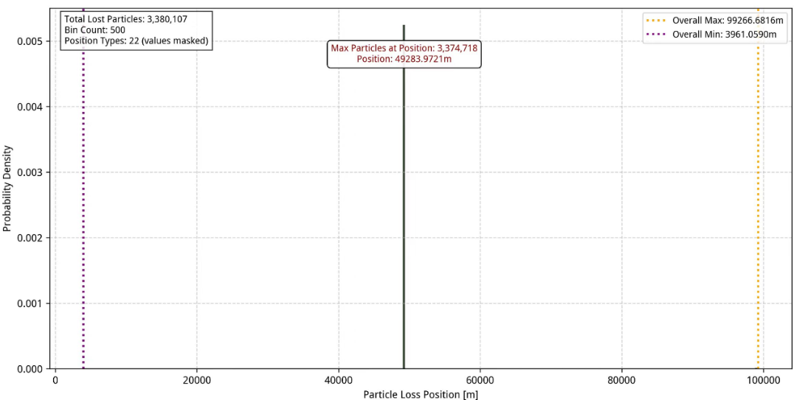
Beam-Beam Deflection and Background Concerns for CEPC Fast Luminosity Detector
Injection background:
  Top-up injection
  Aperture blocks to minimize the impact of injection background on the collision region
  With beam-beam impact concerned
  50 million particles are injected and run around the ring for 200 turns
Particle loss is mainly concentrated at 49.28 km downstream of the IP, with no loss at position 1 and Position 3(10 m and 90.5 m downstream of the IP)

Slide 15
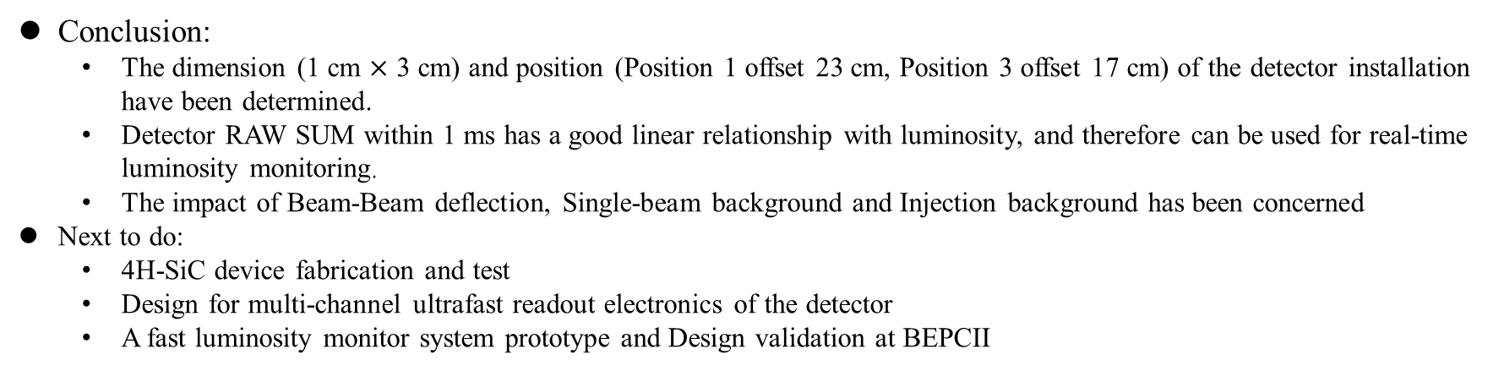
Conclusion and Next to do
Conclusion:
  The dimension (1 cm $×$ 3 cm) and position (Position 1 offset 23 cm, Position 3 offset 17 cm) of the detector installation have been determined.
  Detector RAW SUM within 1 ms has a good linear relationship with luminosity, and therefore can be used for real-time luminosity monitoring.
  The impact of Beam-Beam deflection, Single-beam background and Injection background has been concerned
Next to do:
  4H-SiC device fabrication and test
  Design for multi-channel ultrafast readout electronics of the detector
  A fast luminosity monitor system prototype and Design validation at BEPCII
Thanks

