Slide 1




Luminosity monitoring at SuperKEKB
lessons learned
Philip Bambade IJCLab – Orsay
Acknowledgements: Yoshihiro Funakoshi, Mika Masuzawa, Hiroyuki Nakayama, Yukiyoshi Ohnishi, Sadaharu Uehara, Kenta Uno (KEK – Tsukuba)
Yunyun Fan (IHEP – Beijing), Sandry Wallon (IJCLab – Orsay)
Meng Li, Qiming Li (IHEP – Beijing) ; Shishuan Tang (Fudan – Shanghai)
D. El Khechen (2013-2016), V. Kubytskyi (2016-2017), C.-G. Pang (2016-2019), S. Di Carlo (2017-2019),…
CEPC 2025 International Workshop November 5-10, 2025 Guangzhou - China

Slide 2
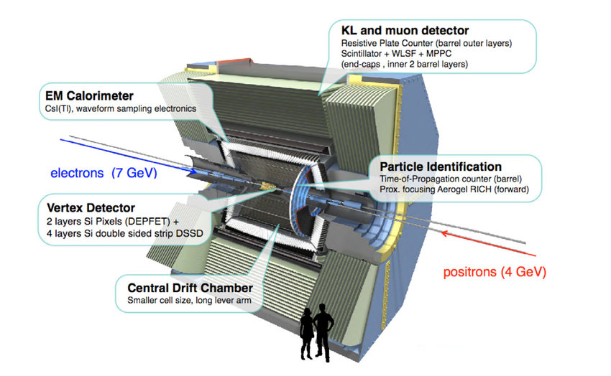
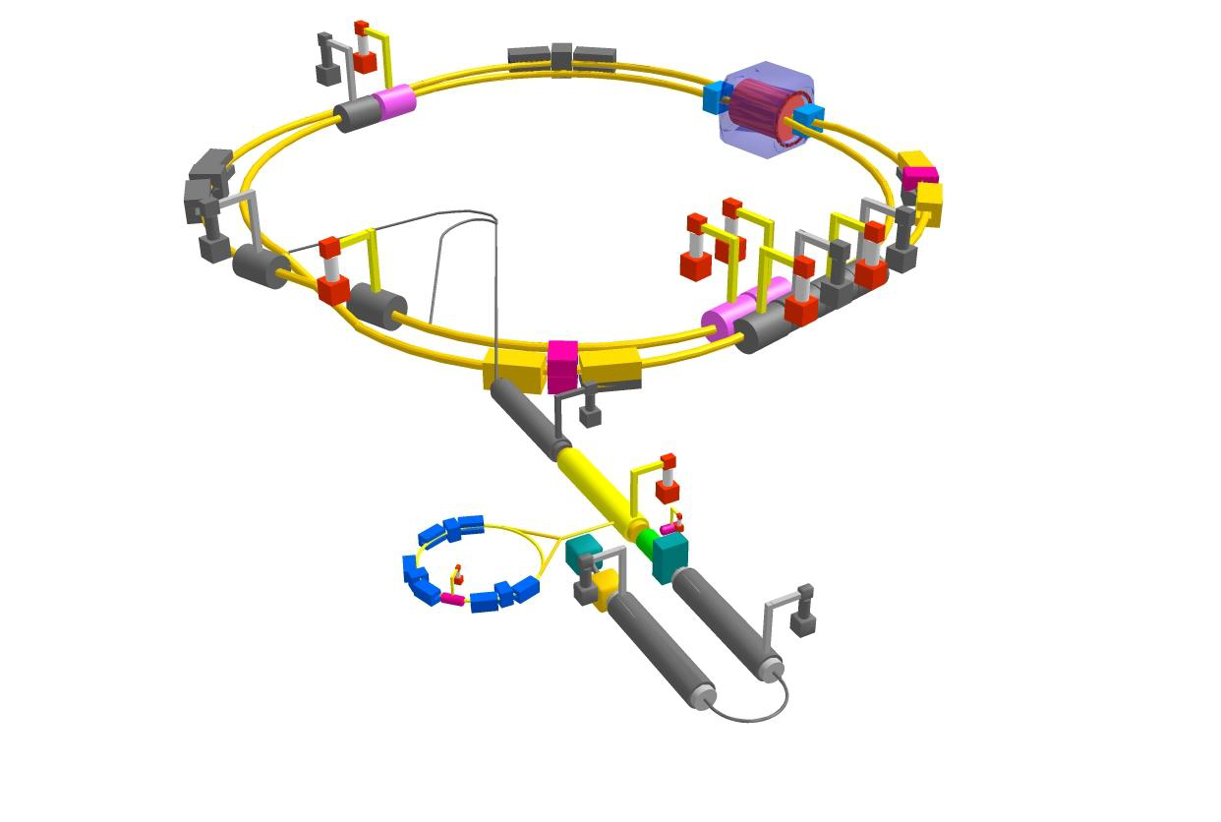
The SuperKEKB/Belle II project
 | Electron | Positron
Energy (GeV) | 7 | 4
Current (A) | 3.6 | 2.6
SuperKEKB (Electron-Positron Collider)
C.M.S. Energy: √s = 10.58 GeV
Luminosity: L → 8 x 10³⁵ cm^{– 2}s^{–1} （Luminosity Frontier Machine）
Achieved in 2024 : L = 5.1 x 10³⁴ cm⁻² s⁻¹
Belle-II
Main Ring
Injector Linac
Belle II (General purpose detector)
Vertex detectors: Pixel Vertex Detector (PXD),
Silicon strip Vertex Detector (SVD)
Tracking: Central Drift Chamber (CDC)
Calorimeter: Electromagnetic CaLorimeter (ECL)
Particle ID: Aerogel Ring Image CHerenkov detector (ARICH)
K-Long and Muon detector (KLM)
Time-Of-Propagation counter (TOP)
Damping Ring

Slide 3
KEKB ↔ SuperKEKB parameters
× 1/20 β_{y}
σ_{y} ≈ 50-60 nm
(similar as ILC/ATF2)
× 2-3 beam currents
similar beam-beam strength
(tune-shift)
→ up to × 40 peak luminosity

Slide 4
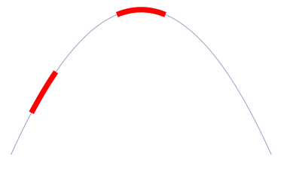
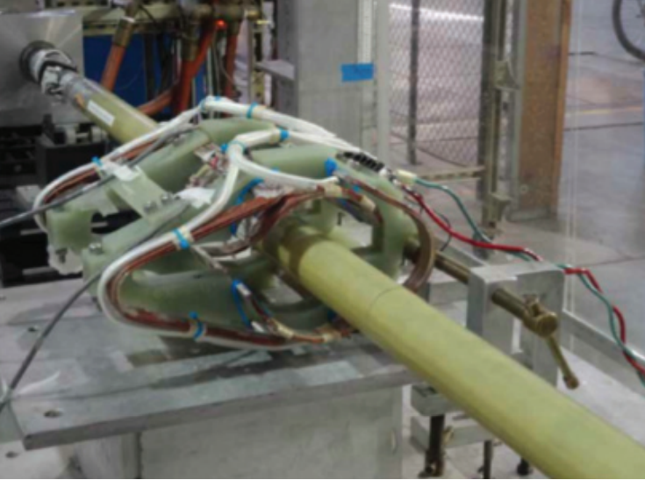
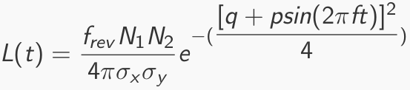
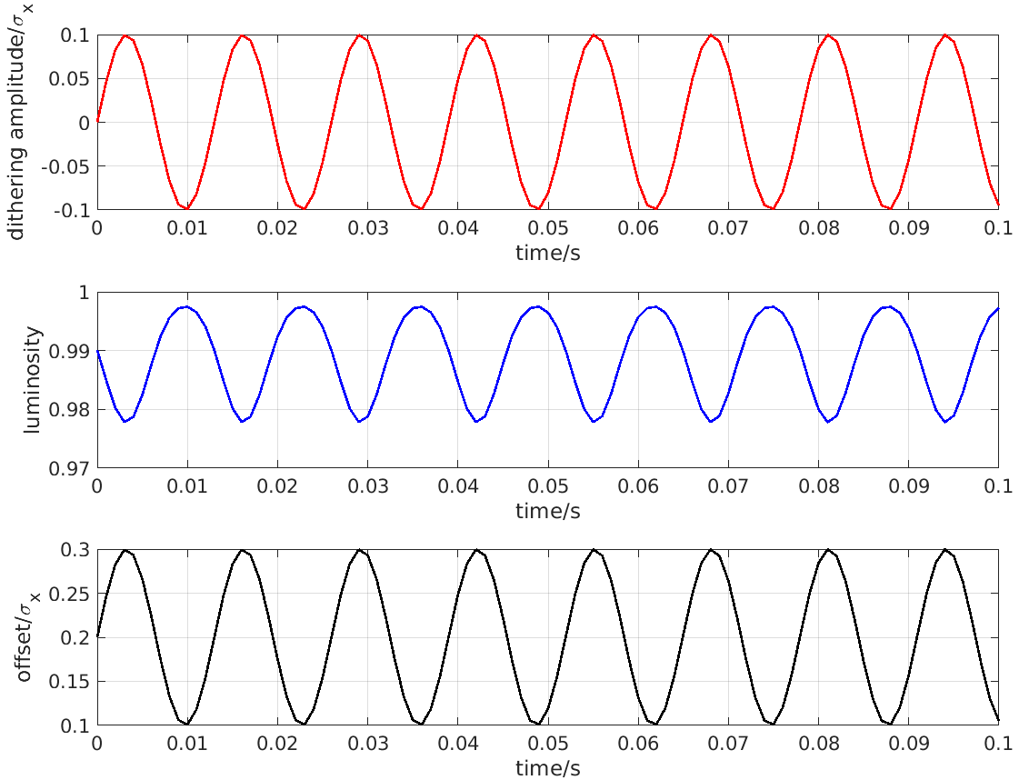
Fast & slow beam position variations at IP require feedback corrections
Beam-beam deflection for fast vertical motion
Luminosity feedback by “dithering” for slower horizontal motion
Δy at IP= ∼ 5nm ∼ 1/10σ_{y}*
BPM
Δy at BPM= ∼ 1.3μm
Vertical vibration ∼ 25-100 Hz
Sampling (BPMs) ∼ 32 kHz
IP
BPM
↔
Horizontal motion ∼ few Hz
Modulation freq. f₀ ∼ 79 Hz
Sampling (lumi. meas.) ∼ 1 kHz
- minimize f₀ output component
- dithering × lumi. signal → phase
2×f₀
Luminosity
↔
f₀
x
Dithering coil x 12
DITHERING
LUMINOSITY

Slide 5
Fast luminosity monitoring specifications
“Dithering” feedback
Correct for few Hz horizontal motion
79 Hz orbit “dithering” + luminosity sampling @ 1 kHz → reconstruct baseline freq. + 2nd harmonic
Efficient separation from other “slow” variations
1% relative precision @ 1 kHz sufficient (cf. C.-G. Pang et al., J.Phys.Conf.Ser. 1067 (2018) no.7, 072023)
Provide analog signal as input to lock-in amplifier
Bunch by bunch luminosity diagnostic
Nominally 4 ns bunch separation → need short signal pulses, ideally < 4 ns
1% or better relative precision @ 1 Hz
IP vertical beam size measurement + tuning at very low currents
Single beam orbit + optics corrections in two rings
Vertical e+ and e- beam size optical tuning → suppress local aberrations in nanobeam final focus
Control of beam-beam blowup → find best spot in tune diagram
Very low current → avoid confusion from beam-beam induced blowup
Dynamic range L ≈ 10³² → 10³⁶ cm⁻² s⁻¹
Non luminosity scaling contamination < 1% (e.g. beam gas bremsstrahlung and Touschek losses)
Manage radiation damage at highest luminosity
Notes:
LGSO (Lu2-xGdxSiO5)

Slide 6
Luminosity related observables
1) Bhabha scattering measured in very forward Belle II calorimeter
- cross section precisely known + detector calibration → absolute measurement
- statistical precision needs averaging
2) Single bremsstrahlung ↔ radiative Bhabha process at zero scattering angle
- cross section not precisely computed
→ effective photon approximation
- beam size and collision offset dependencies
→ QED large impact parameter effects
→ experimental acceptance distorted by beam-beam deflections : pre- and post-scattering
- very high cross section (0.15-0.2 barn) → OK for fast / high precision monitoring
3) Beamstrahlung
- optical detection at large angles (SuperKEKB)
- high photon rate detection (SLC, FCCee, CEPC)
- rates / asymmetries / polarization dependences on beam sizes → indirect reconstruction
Notes:
LGSO (Lu2-xGdxSiO5)

Slide 7
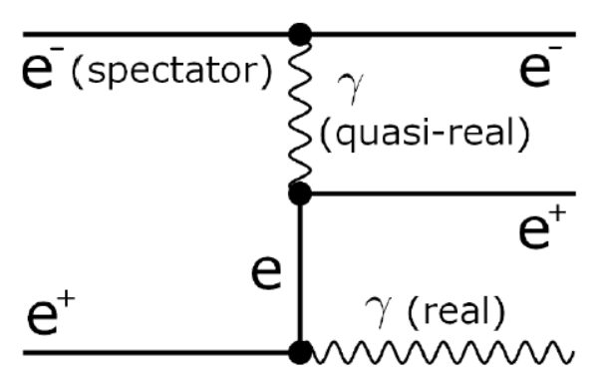
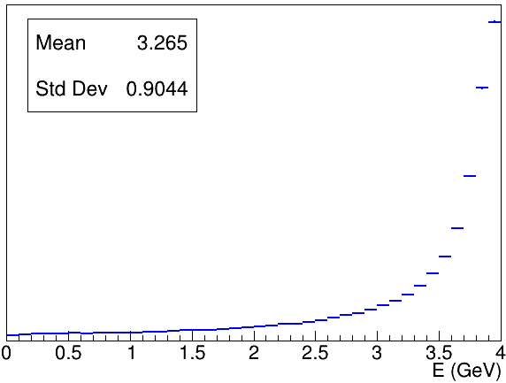
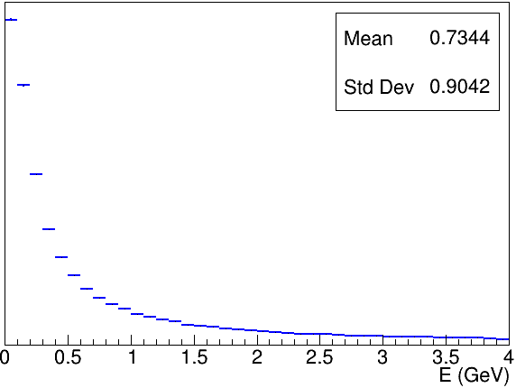
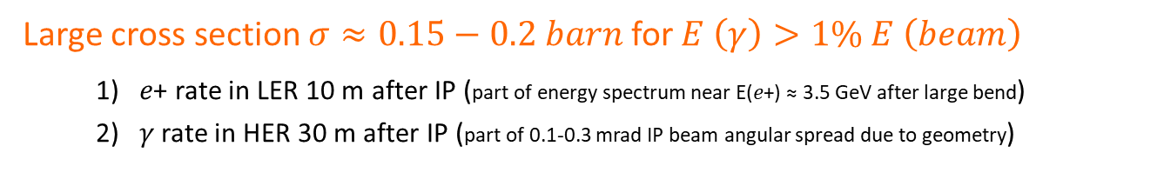






Bhabha process at vanishing scattering angle
a.k.a. Single Bremsstrahlung
Dima El Khechen et al., PRAB 22, 062801 (2019)
Large cross section $σ≈0.15−0.2 barn$ for $E \left(γ\right)>1\% E \left(beam\right)$
    1) 𝑒+ rate in LER 10 m after IP (part of energy spectrum near E(𝑒+) ≈ 3.5 GeV after large bend)
    2) 𝛾 rate in HER 30 m after IP (part of 0.1-0.3 mrad IP beam angular spread due to geometry)
$$E (e^{−})=7GeV$$
$$E (e^{−})=7GeV$$
$$E (e^{+})$$
𝑒+
$$E (e^{+})=4GeV$$
$$E (γ)$$
$$L∝\frac{dN}{dt}$$
Only relative luminosity → with certain conditions…
Acceptance depends on choice of sensor / location
Also some variation with beam parameters…
𝜎_{Bhabha@zero-degree} not precisely computed in QED
➔ OK for usage on “short” enough time-scales
➔ care for beam parameter dependence
𝛾
Notes:
LGSO (Lu2-xGdxSiO5)

Slide 8
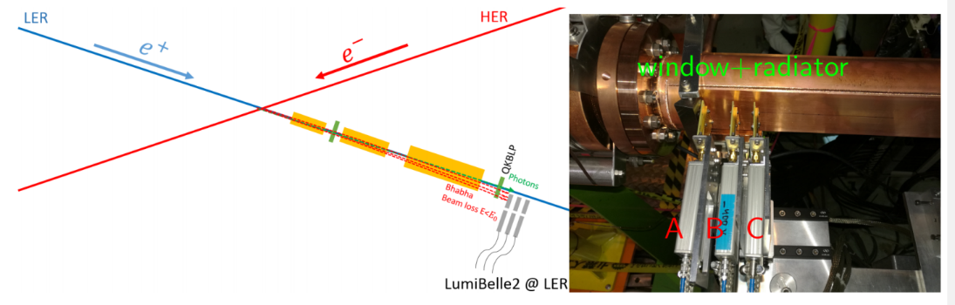
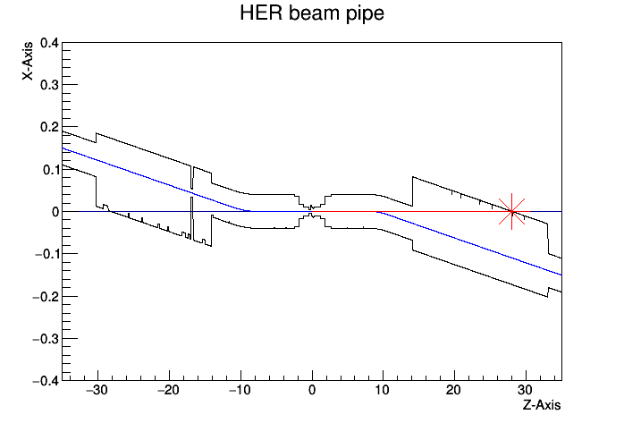
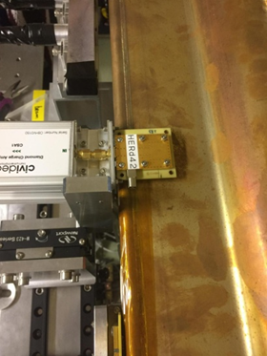
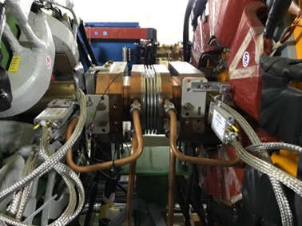
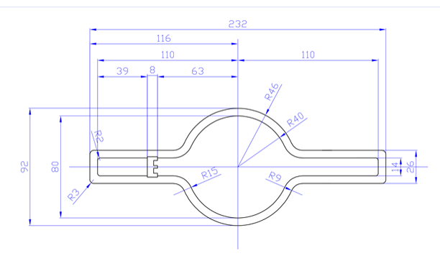

Implementation in LER and HER
Cheng Guo Pang et al., Nucl.Instrum.Meth. A931 (2019) 225-235
POSITRON RING (measure e+)
Optimal position found at 10 m behind IP using SAD
Over-bent Bhabha positrons → vacuum chamber
Special beam pipe with window + Tungsten radiator
Start-to-end simulation (GuineaPig++, SAD, GEANT4)
IP
0.4
ELECTRON RING (measure $γ$)
28 m
Photon ray-tracing in detailed vacuum chamber geometry + GEANT4
Original position at 30 m (2018)
New optimal position found at 28 m with ≈ 10 times higher rate
IP
X(m)
0
loss position distribution
Notes:
Radiation length of Tungsten is 0.3504 cm

Slide 9
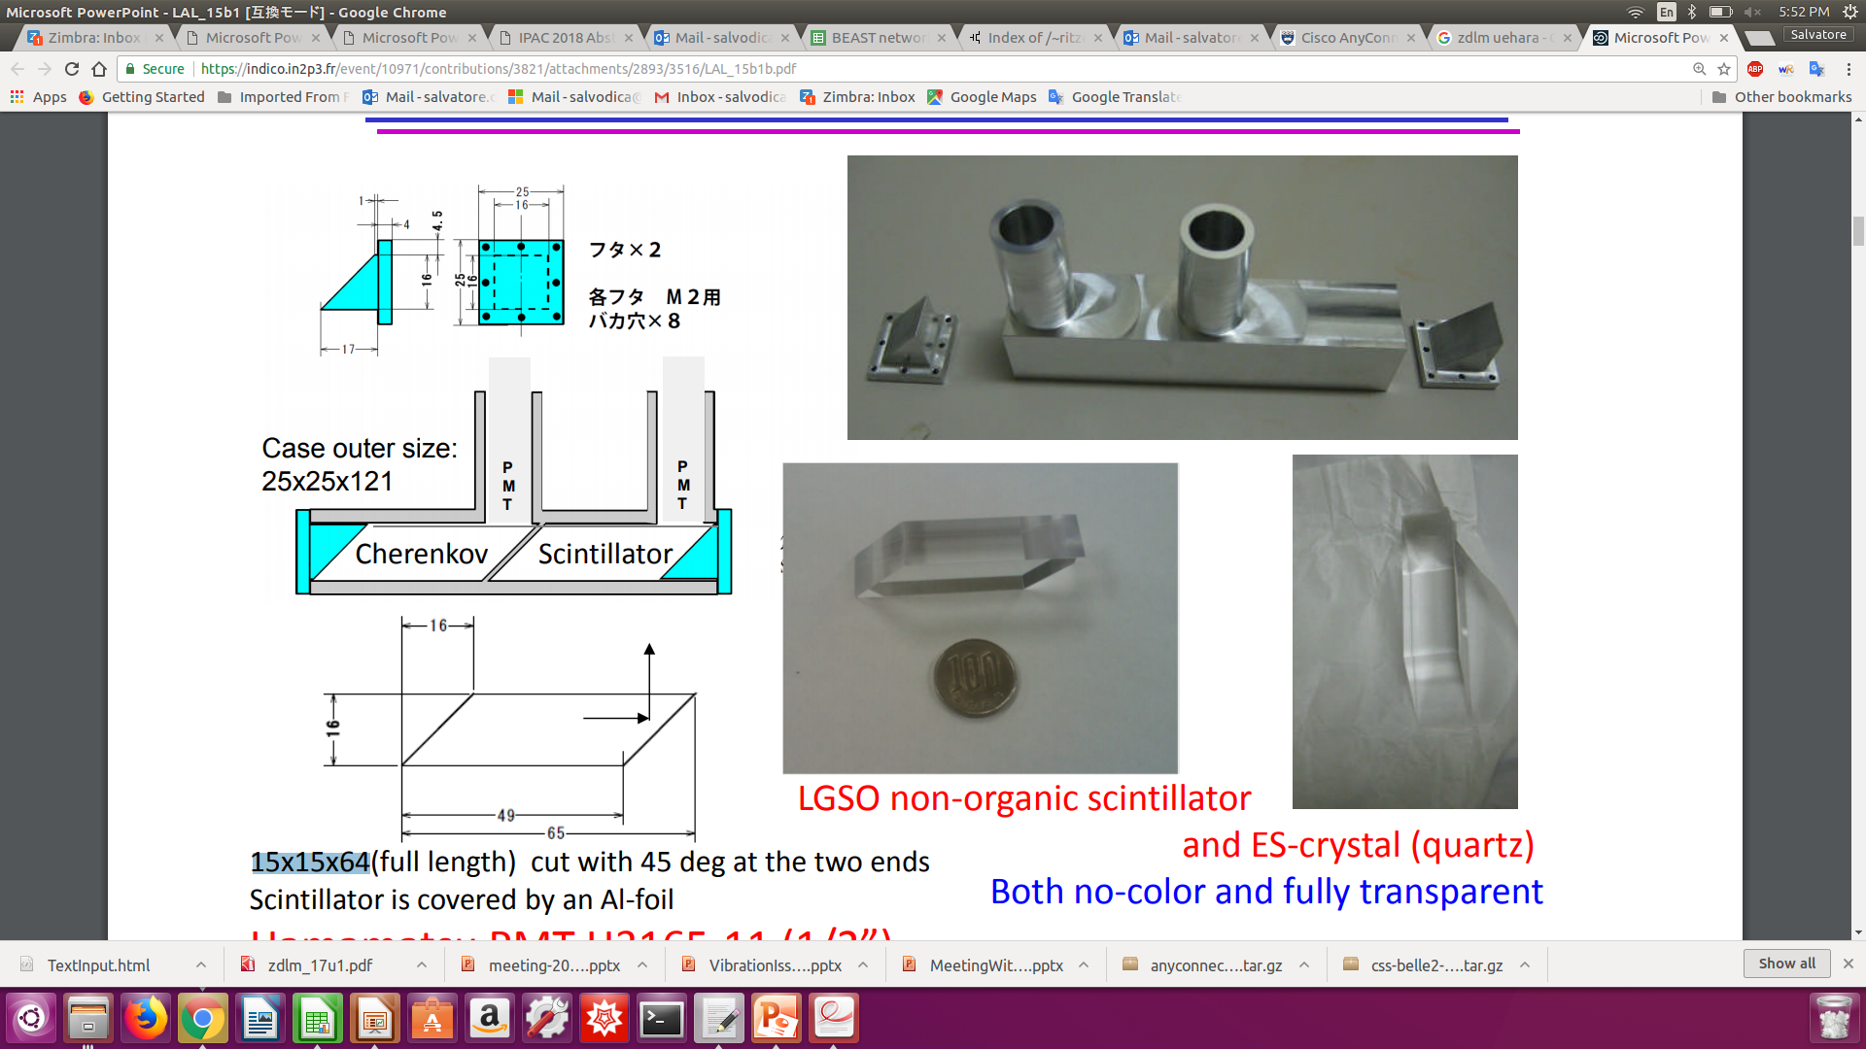

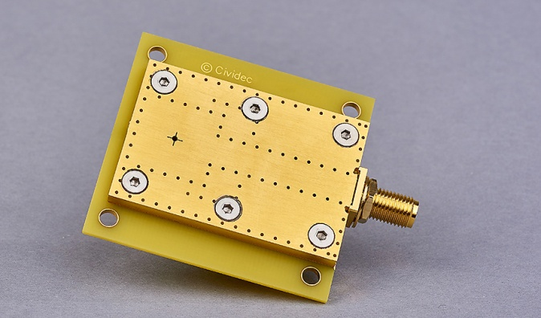
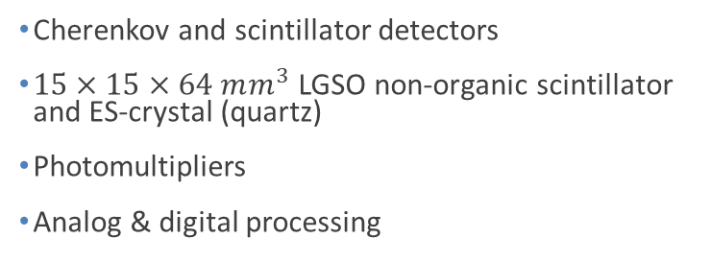

Two complementary techniques for fast luminosity measurements
- compare / collaborate / mutually supporting
- share simulation, mechanics, some data…
- since 2012
LumiBelle2 / IJCLab
ZDLM (Zero Degree Luminosity Monitor) / KEK
single crystal CVD diamond sensors
$4×4×0.5/0.14 mm^{3}$
Fast charge/current amplifiers
Digital electronics and processing
Cherenkov and scintillator detectors
$15×15×64 mm^{3}$ LGSO non-organic scintillator and ES-crystal (quartz)
Photomultipliers
Analog & digital processing
Notes:
LGSO (Lu2-xGdxSiO5)

Slide 10
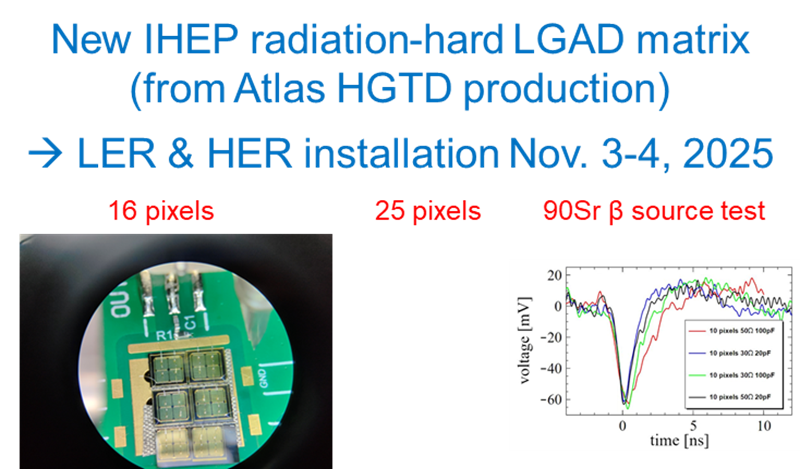
Yunyun FAN
Qiming LI
Xiang LI

Slide 11

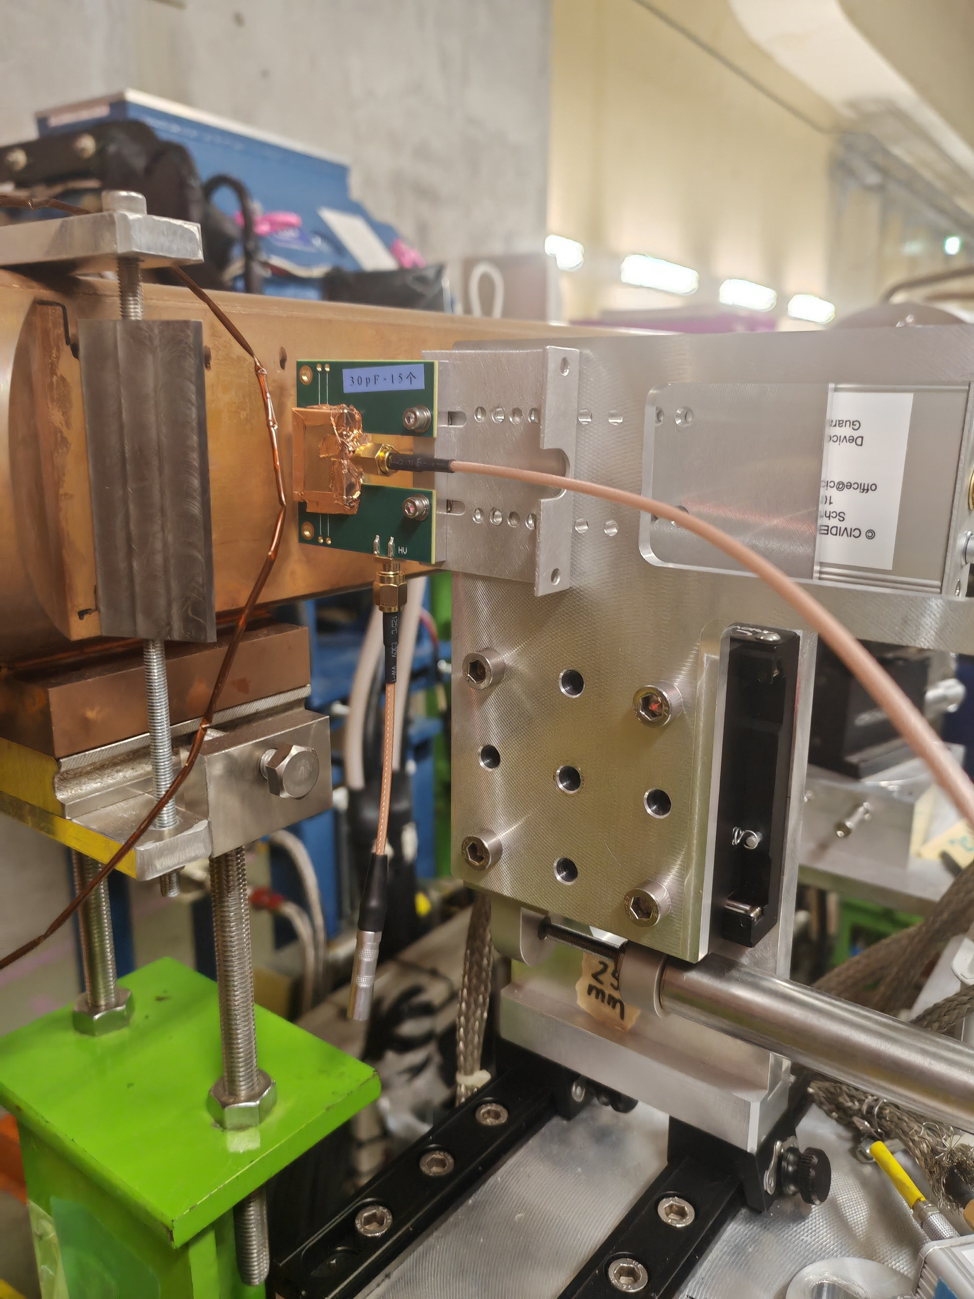
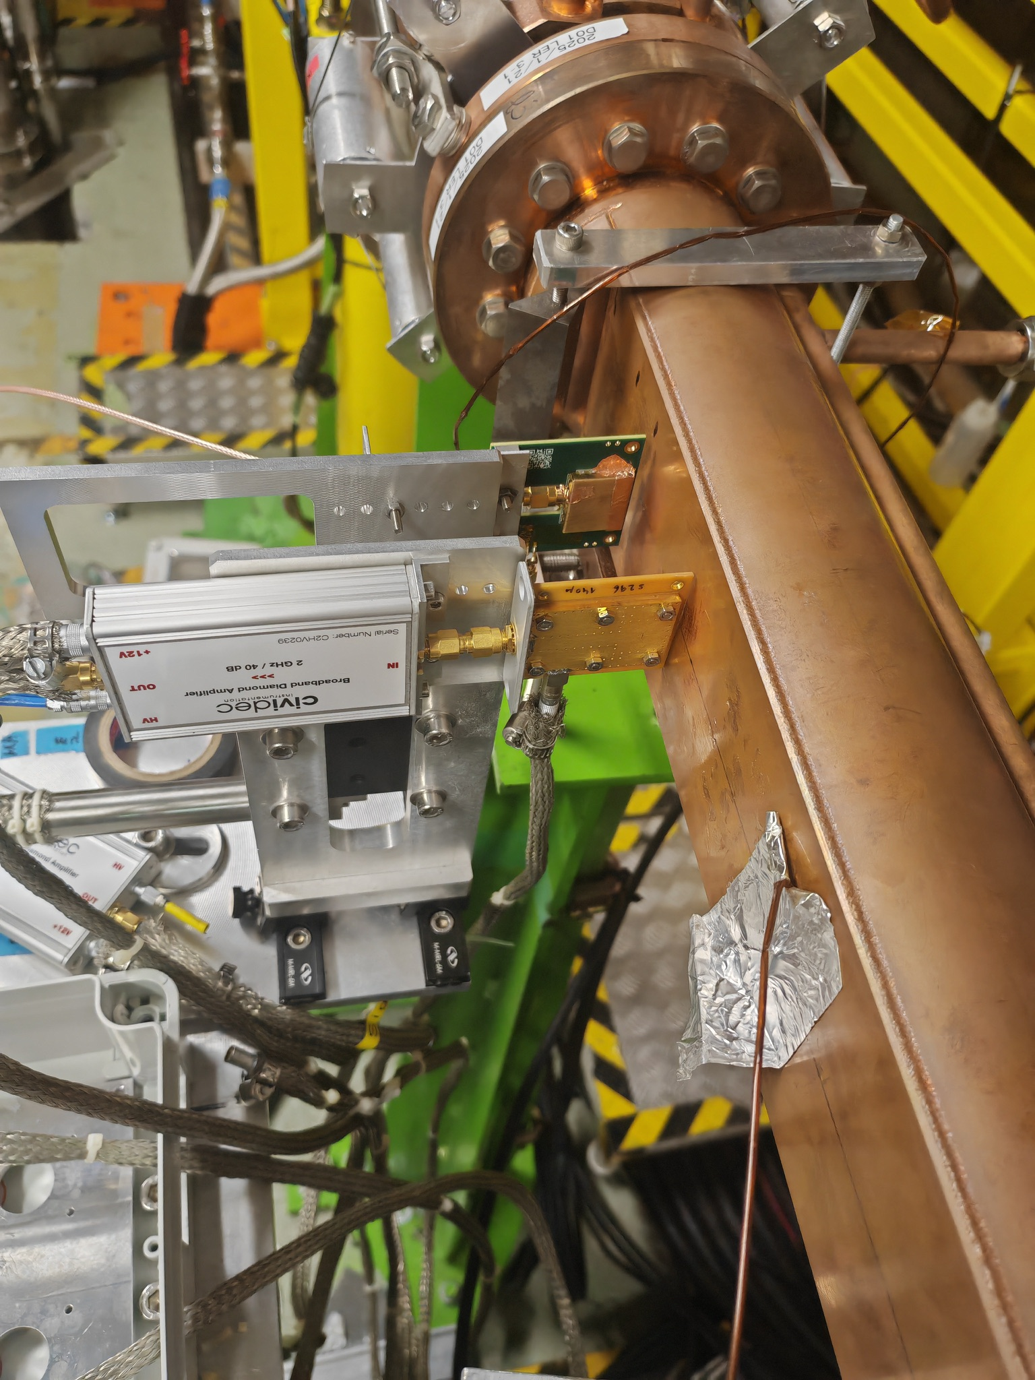
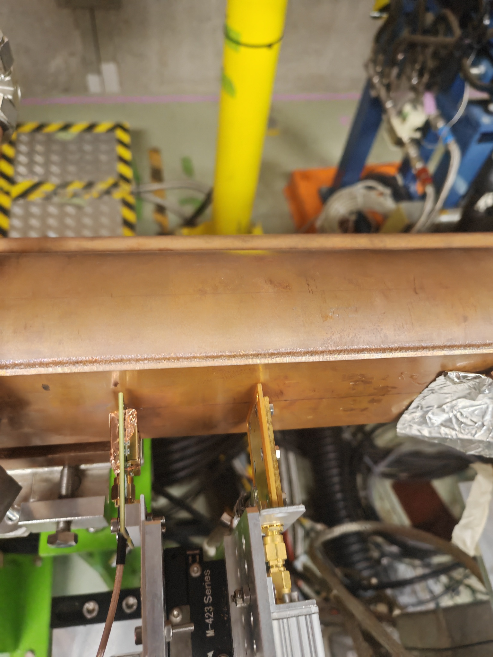
IP
HER
LER
latest setup
2025/11
CH1
CH2
CH3
CH4
ADC Channels
LGAD 16/25 pixel + current amp 2 GHz
140 μm diamond + current amp 2 GHz
500 μm diamond + charge amp 10 ns

Slide 12
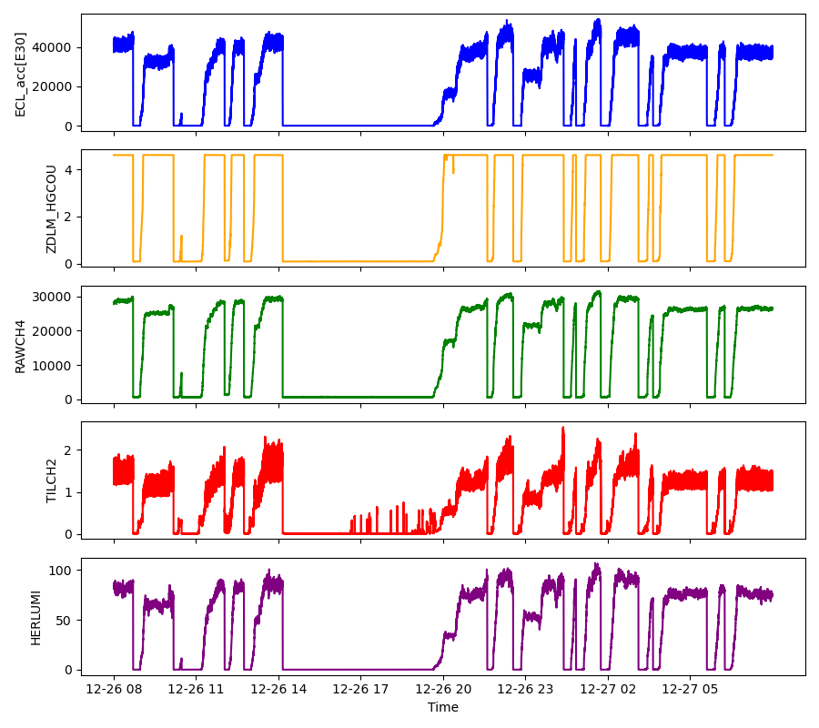
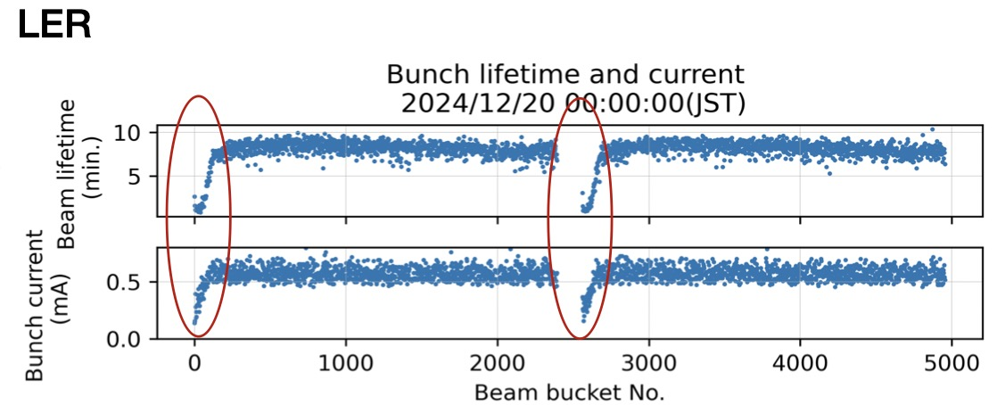
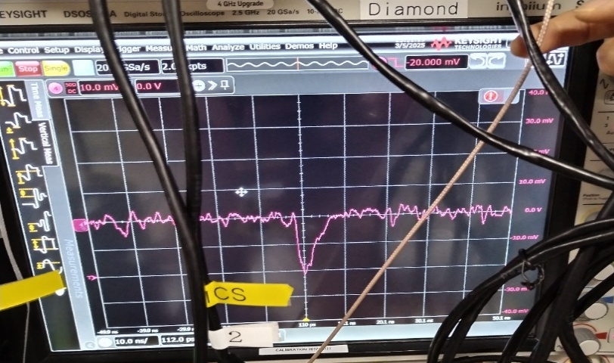
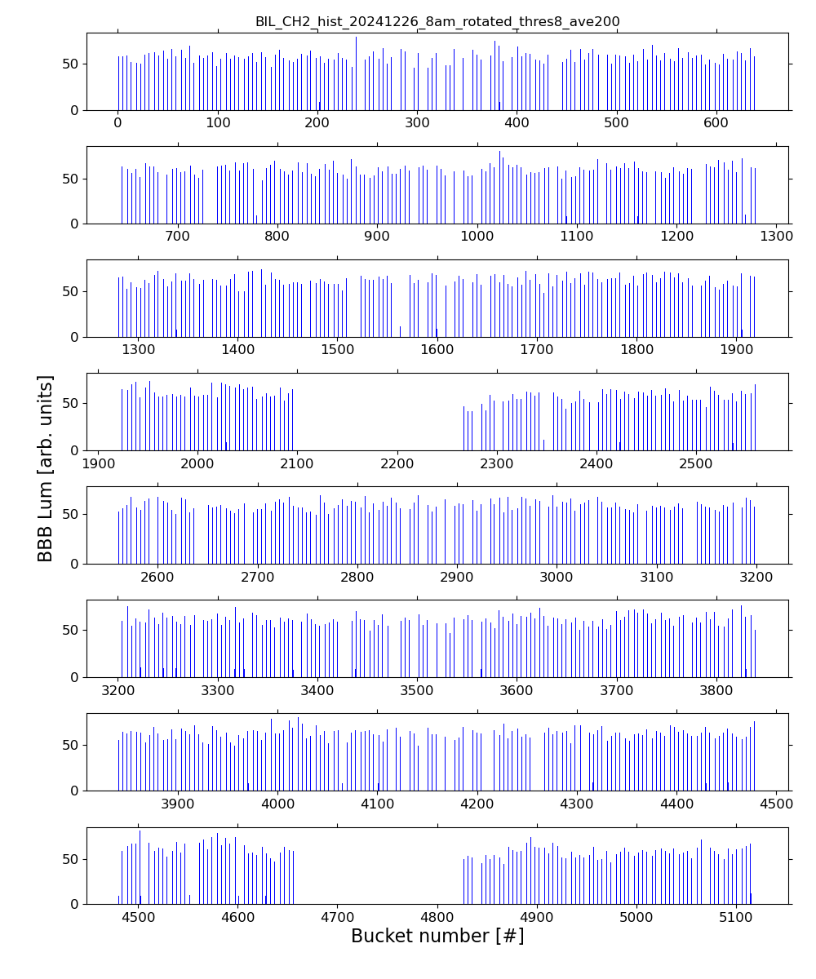
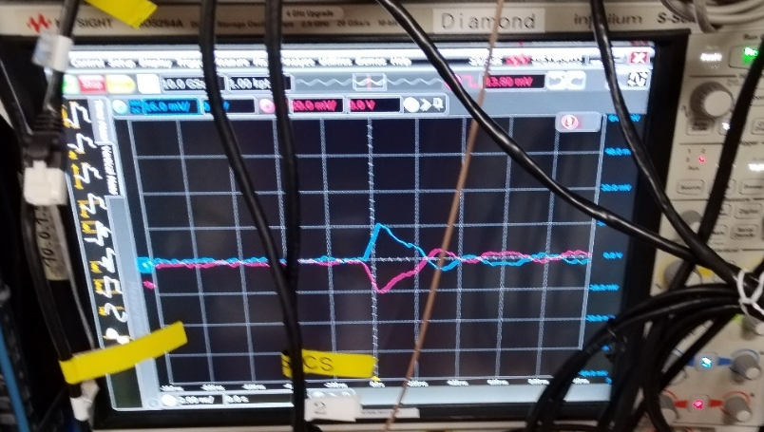
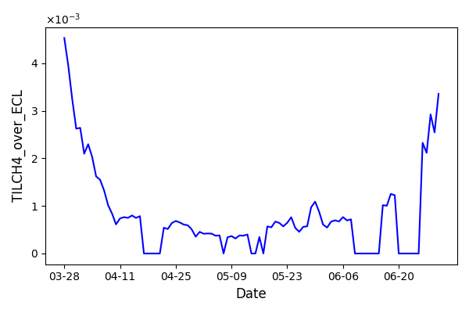
LumiBelle2 fast luminosity monitor in 2024
In 2024, LumiBelle2 was operated successfully at KEK
Data analysis to estimate diamond sensor performance (Meng Li)
- Internal data handling/archiving software instability
- Sensor sensitivity drift in one diamond detector
Observed variation of B-by-B lifetimes -> B-by-B luminosity data for machine tuning required by SuperKEKB group
Install LGAD sensors in LumiBelle2 -> radiation hard version from IHEP-Beijing used in Atlas/HGTD (Yunyun Fan et al.)
500μm diamond herd42 with C2HV0235
Trigger level -20mV
sensitivity@500um diamond
LGAD sensor from IHEP with C2HV0235 and RF splitter / inverter
Trigger level 13.8mV

Slide 13
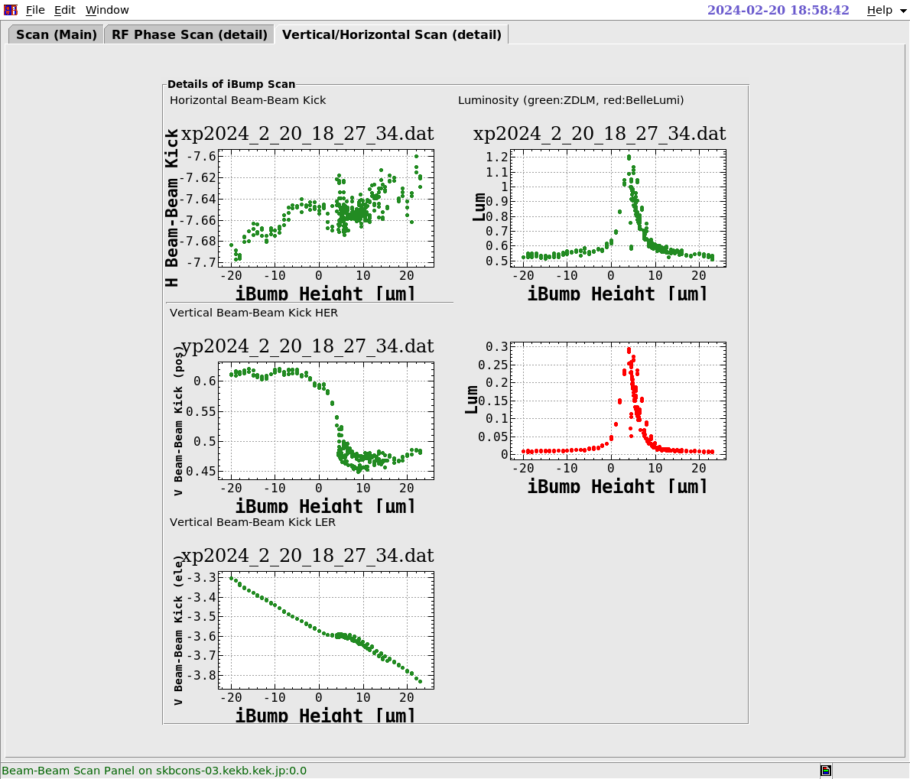
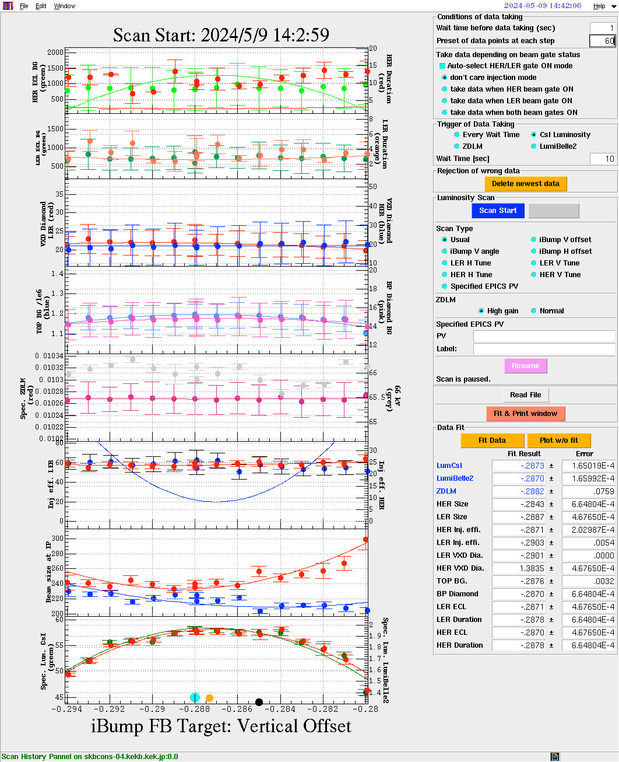
Setting up and optimizing beam collision with LumiBelle2
Initial scanning of IP beam offset to enable Regularly optimizing IP beam offset
collisions at very beginning of the run… to maximize luminosity…

Slide 14
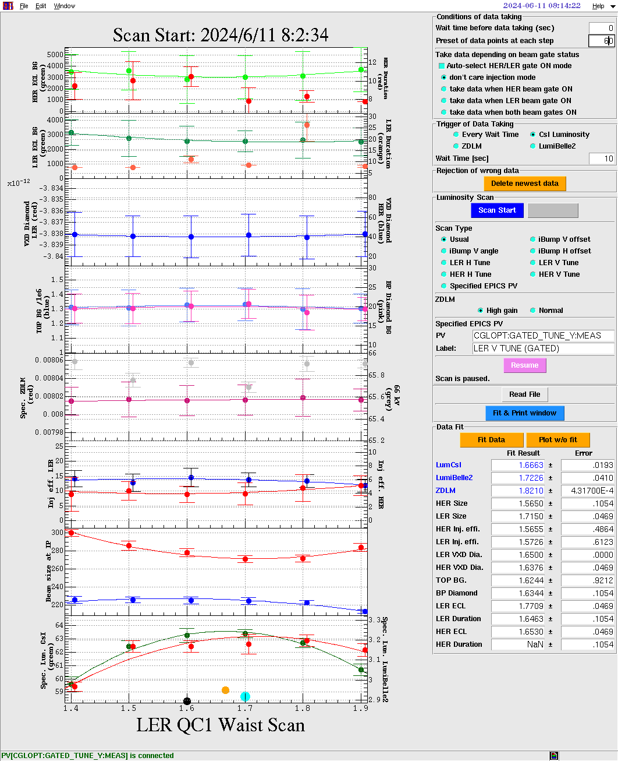
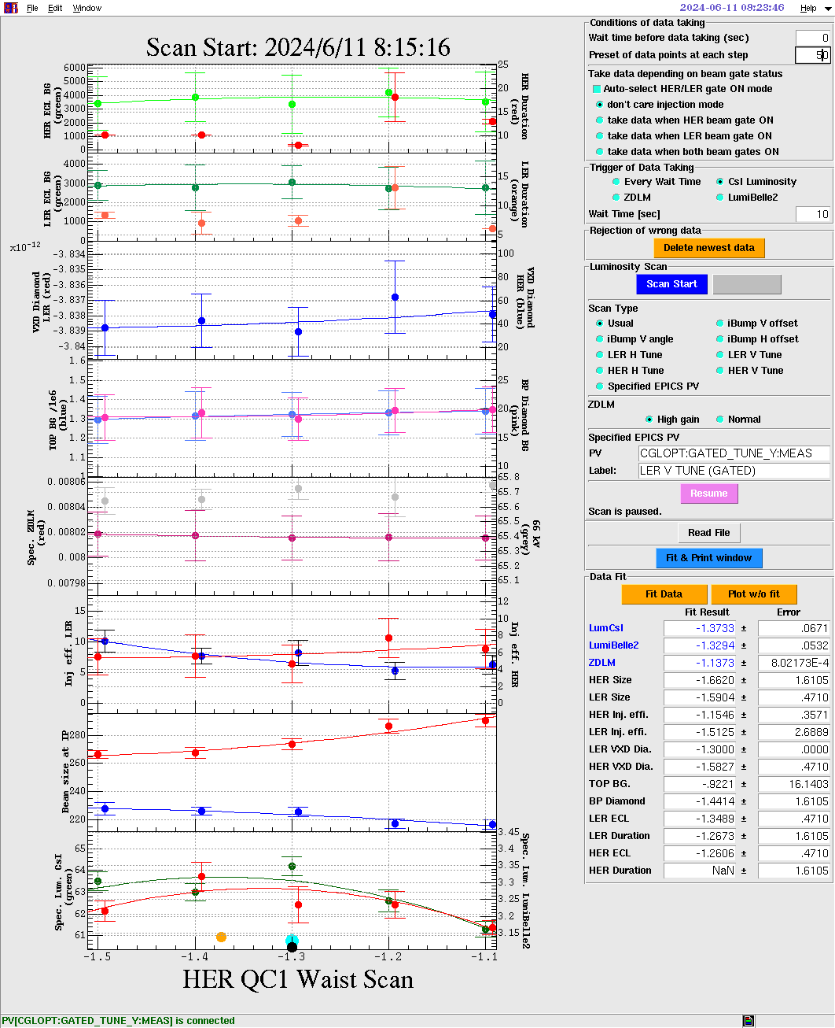
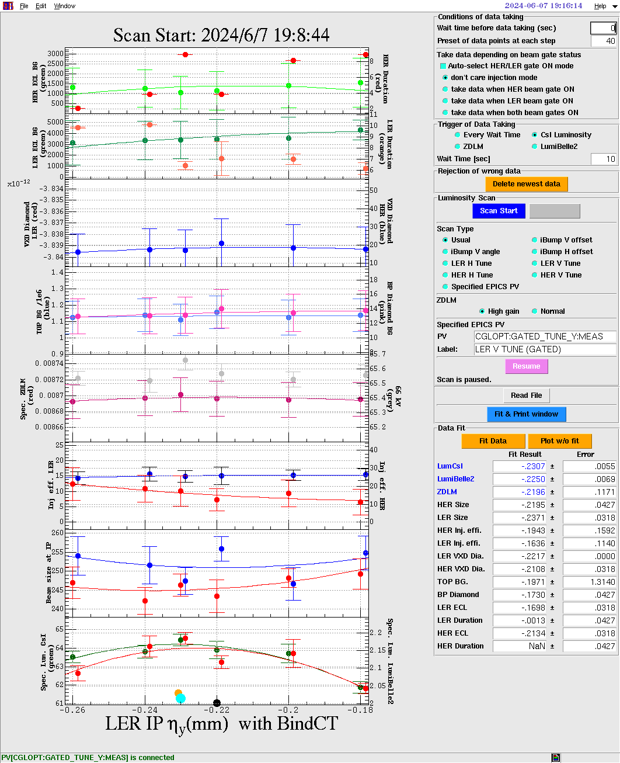
Minimising electron and positron IP beam sizes with LumiBelle2…
→ Machine learning effort for optimizing tuning process…

Slide 15
Concluding remarks
Continuously measure IP beam size & offsets → essential at SuperKEKB, FCCee, CEPC,…
LumiBelle2 and ZDLM used daily → maximize SuperKEKB performance
Bunch-by-bunch on-line monitor prepared at KEK by Junxi Cui
Design challenges → minimize unwanted beam parameter dependences
- unbiased extraction of scattered particle
- beam-beam deflections pre- & post-scattering
→ issue of radiation
- LGAD sensors with Carbon implantation from IHEP/Atlas/HGTD
- amplifier placed 50 cm from sensor
→ dynamic range and precision
- specifications
- combine redundant channels with different sensitivities
R&D activity ↔ long term operational sustainability
- LumiBelle2 has been operated by IJCLab partly remotely and with local help at KEK
- recent prospect of strong CERN & IHEP interest in collaborating on LumiBelle2
- opt for professional / commercial DAQ & electronics rather than in-house designs
Lessons learned

