Slide 1

Overview of BSM
at CEPC
Yongchao Zhang
(张永超)
Southeast University
On behalf of CEPC NP team
CEPC2025, Guangzhou
Nov 8, 2025

Slide 2
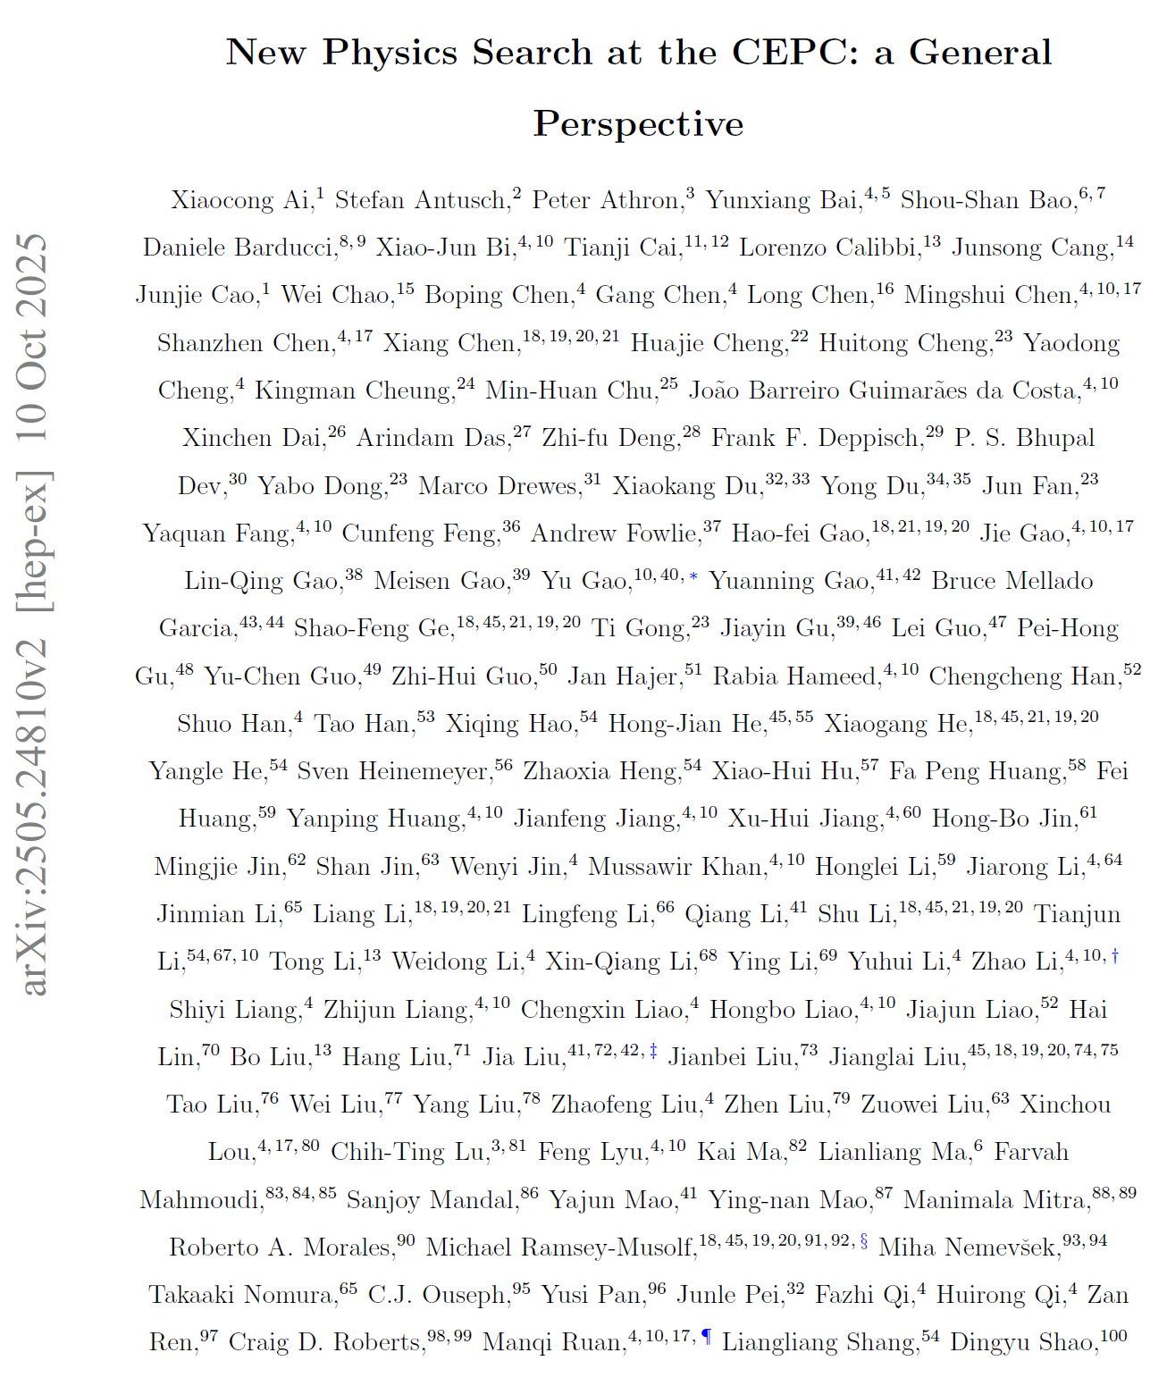
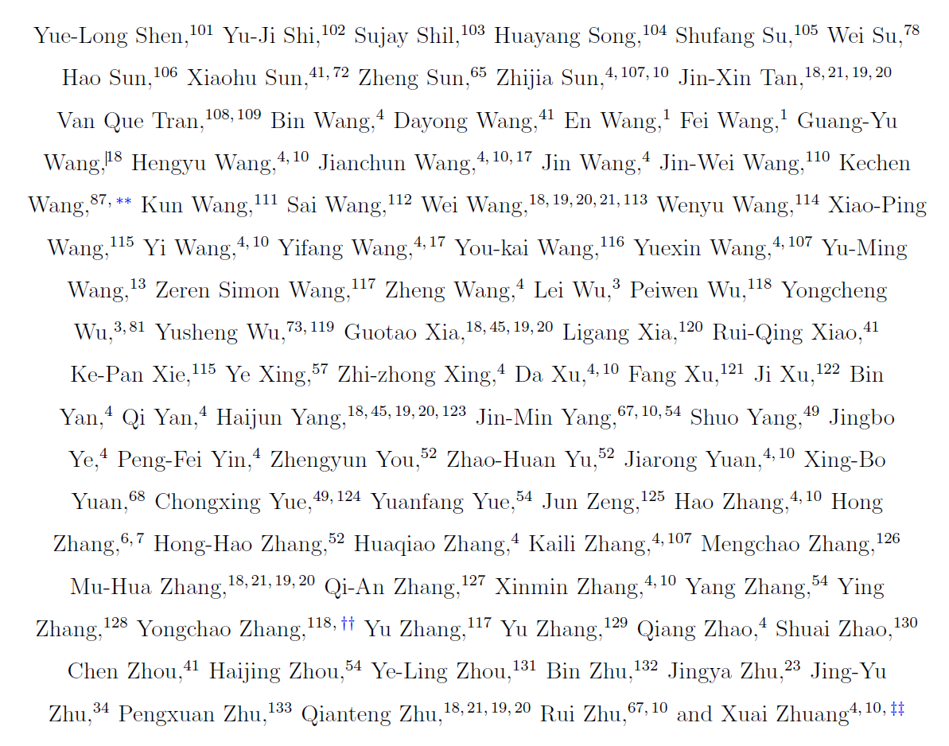
CEPC NP white paper:
https://arxiv.org/abs/2505.24810
Accepted by CPC !
~ 215 authors (38 editors)，
> 130 institutes, ~ 270 pages

Slide 3
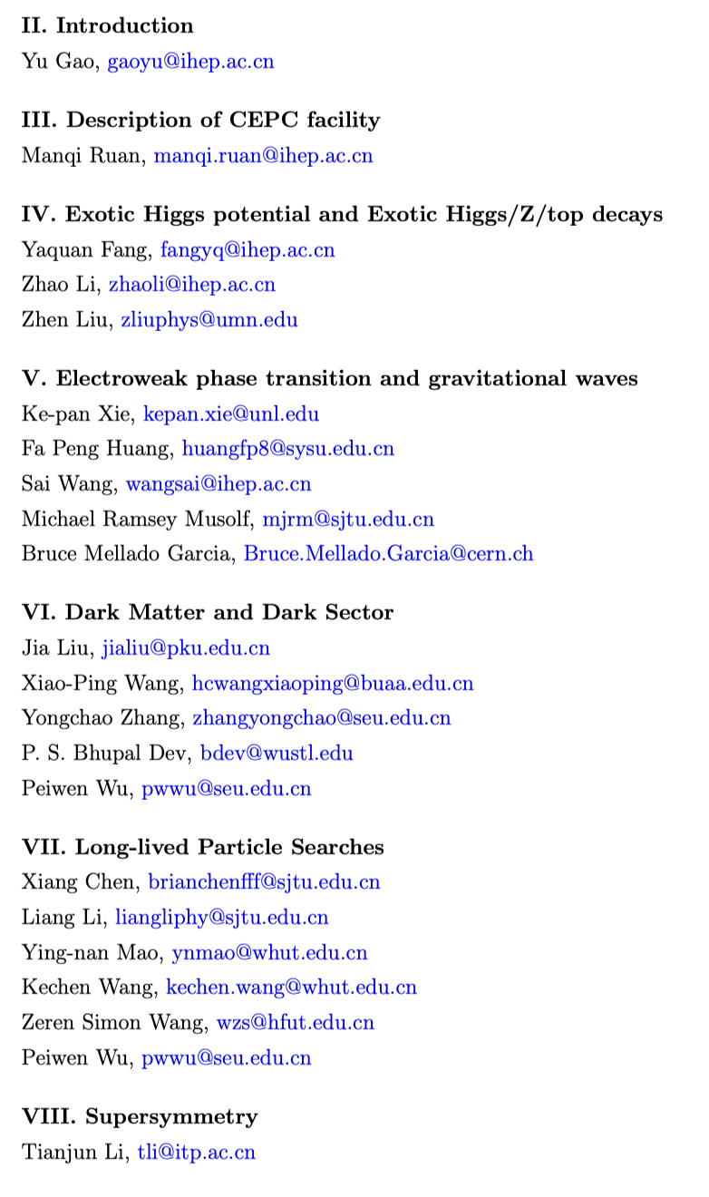
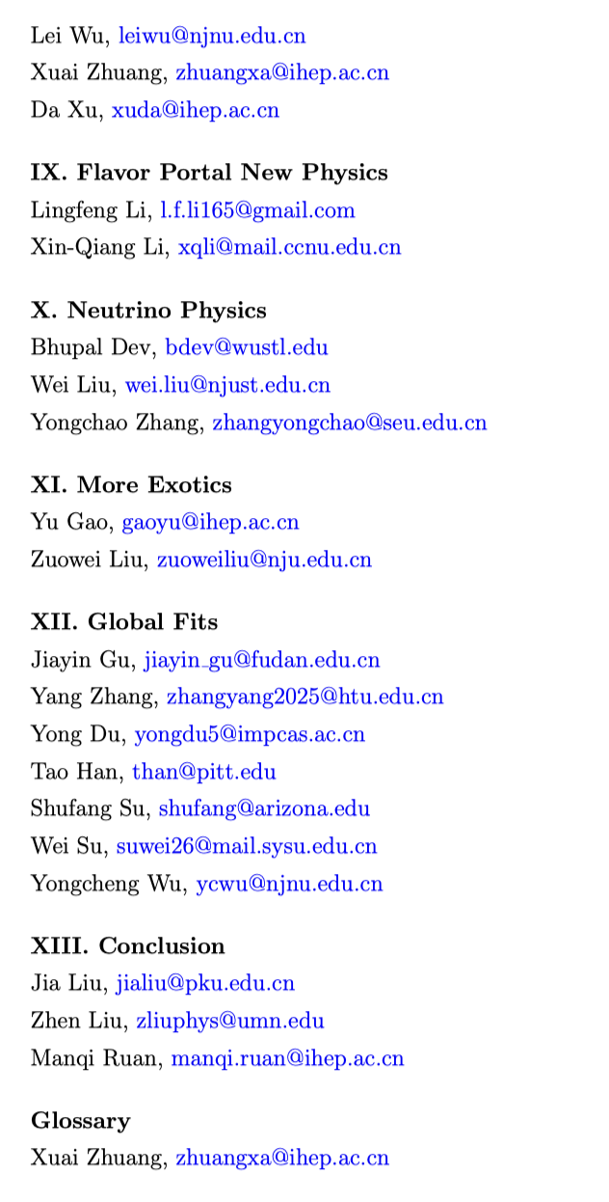
Editors
Thanks a lot for all authors, especially for the paper editors and session conveners !

Slide 4
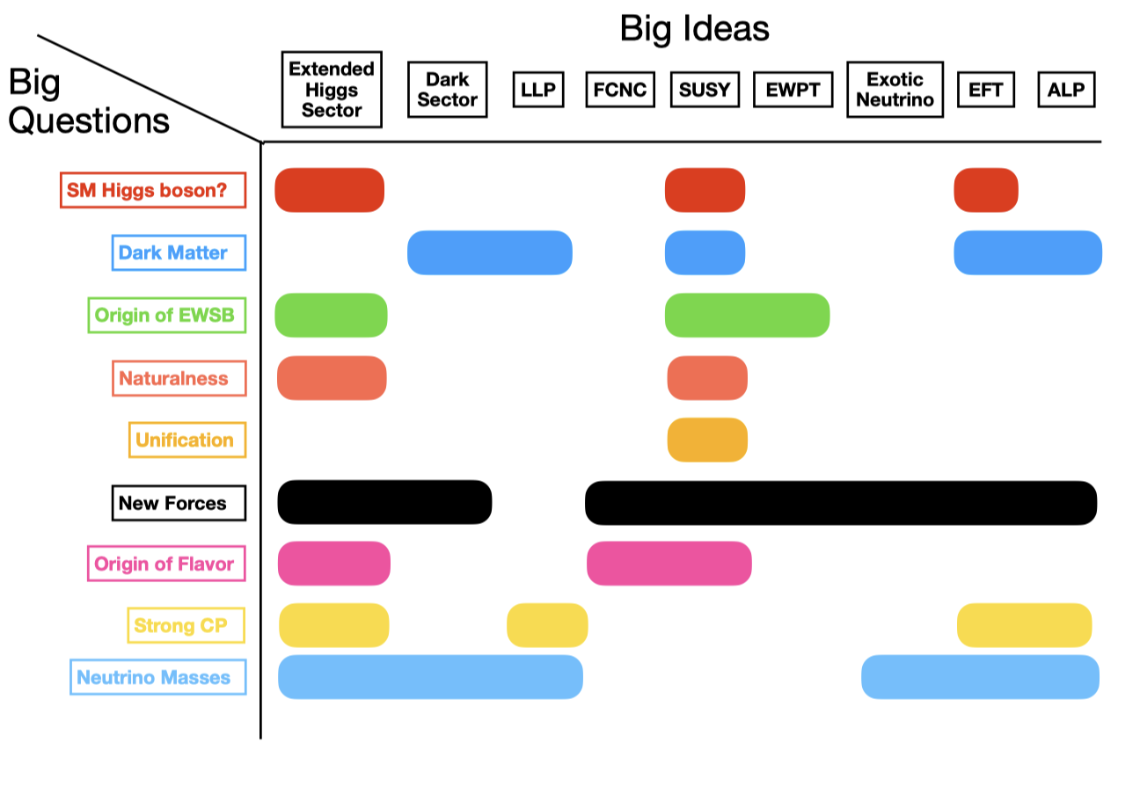
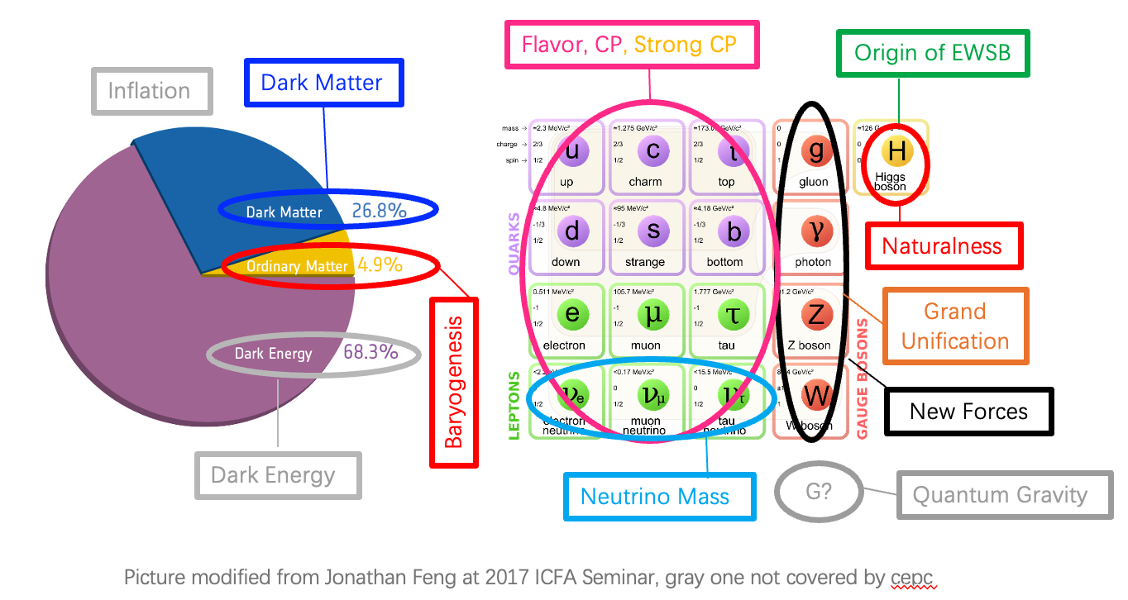
Big Questions and Ideas
in particle physics

Slide 5
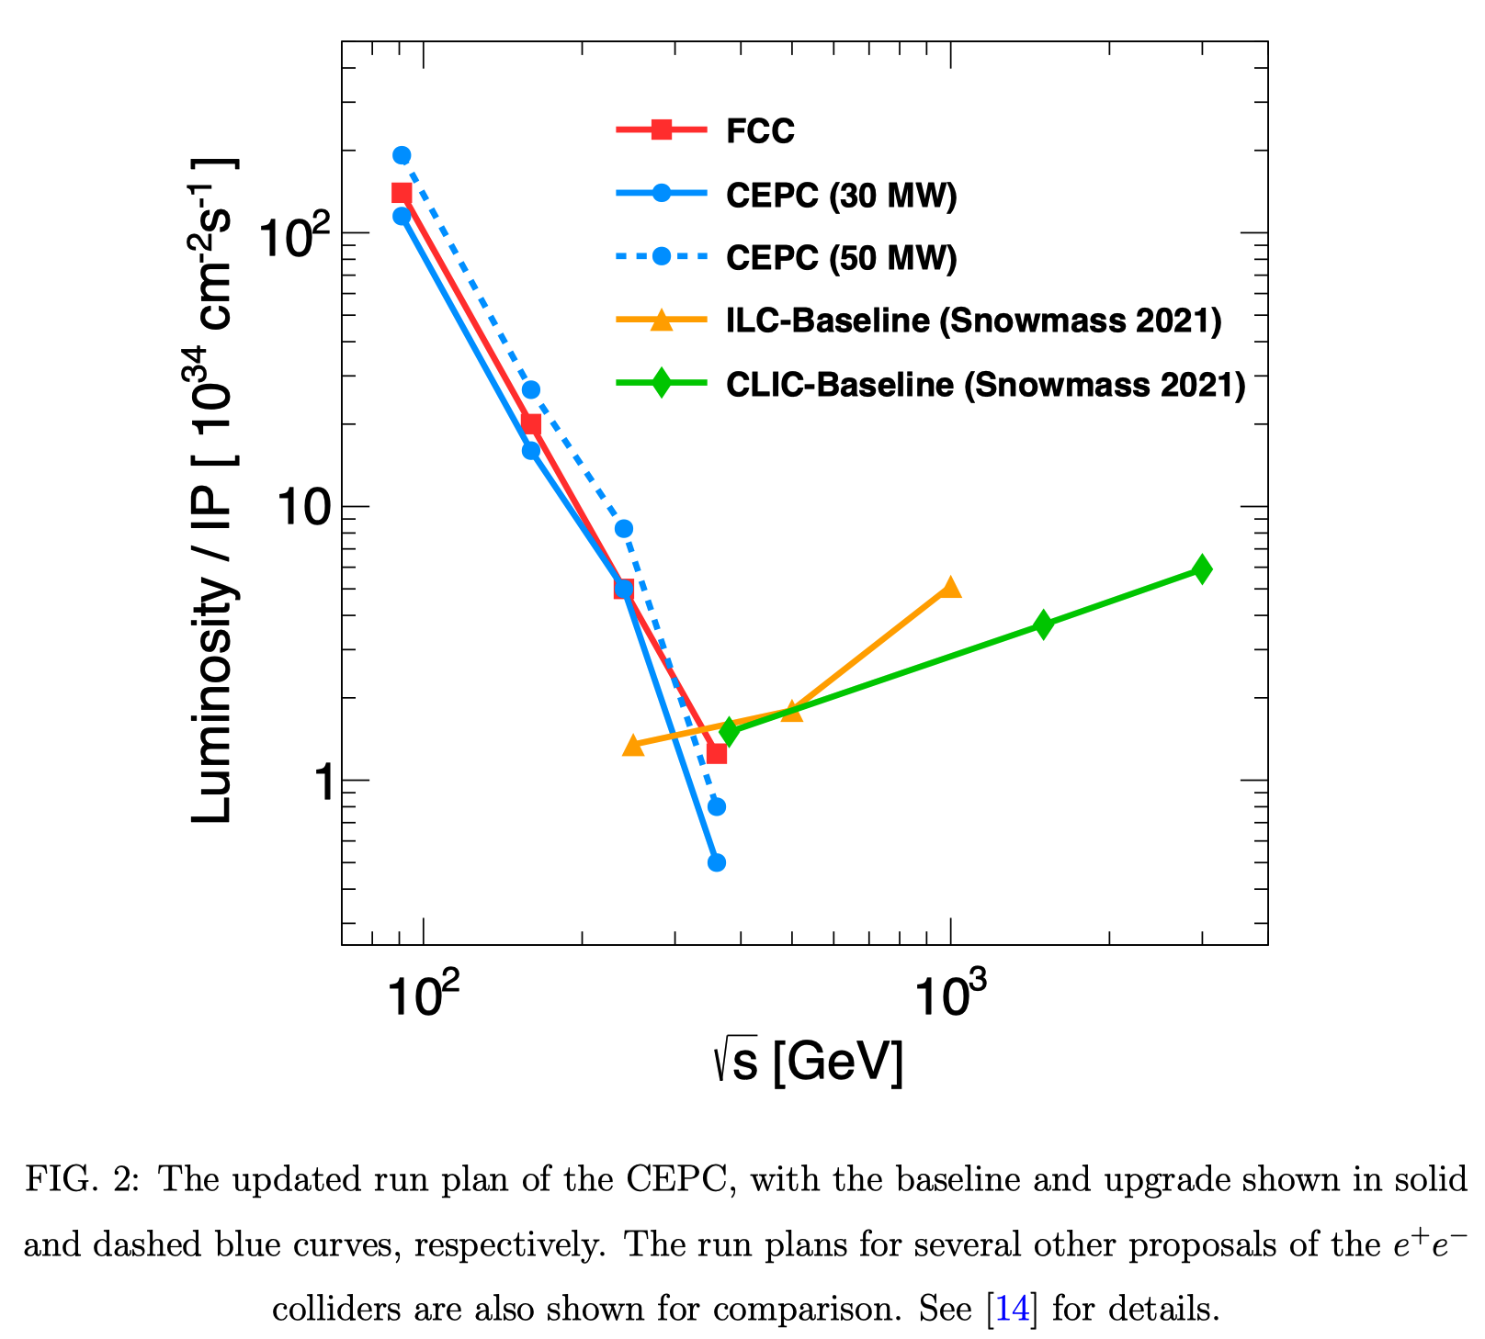
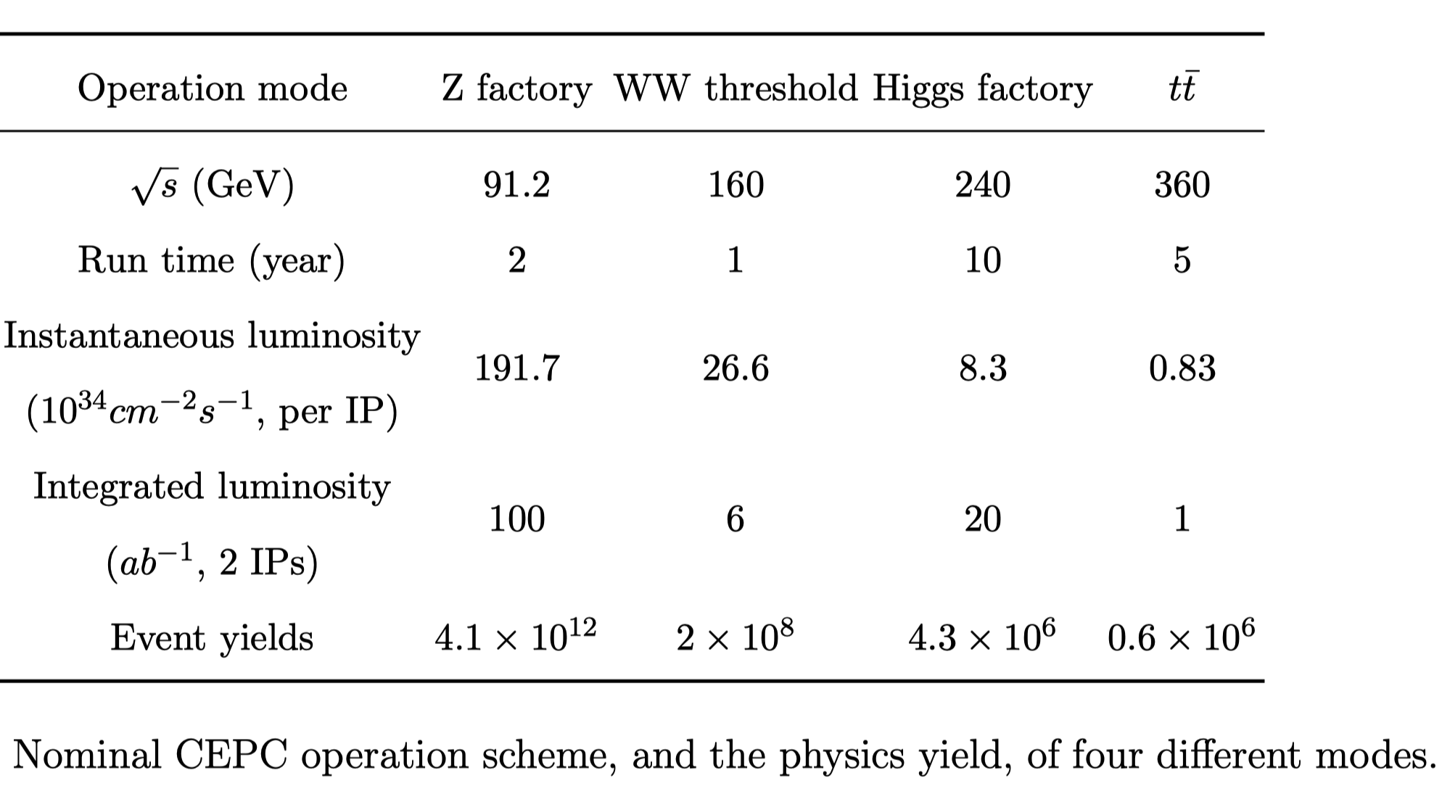
CEPC operation scheme
4 Million Higgs (10 years)
~ 1 Giga W (1 year) + 4 Tera Z (2 years)
Upgradable: Top factory (500 k ttbar)

Slide 6
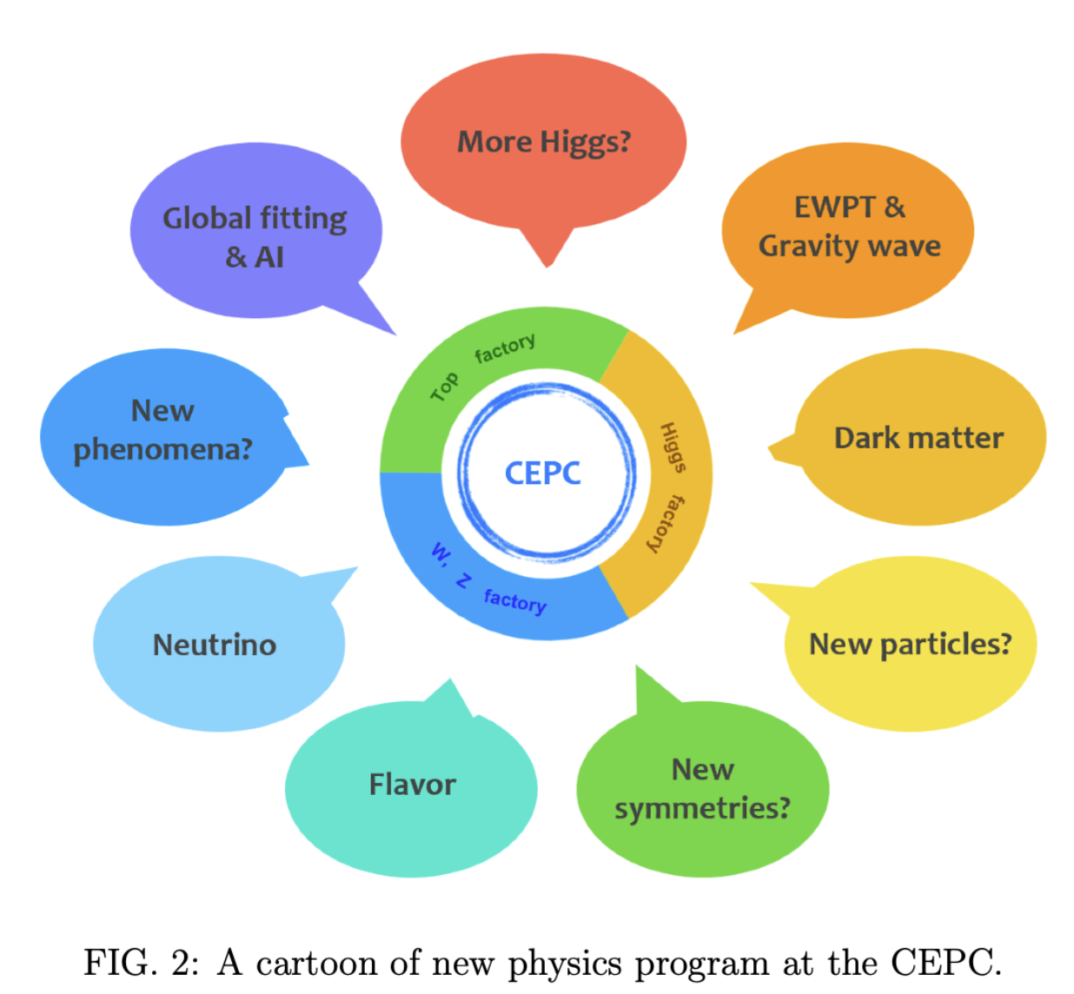
NP Program
Intensity frontier of H/Z…:
  Exotic Higgs/Z, EWPT,…
Dark Matter and Dark Sector
New particles/phenomena:
  LLP, ALP, …
New symmetries:
  SUSY
Flavor frontier :
  Flavor, Neutrino, …
Techniques:
  Global fitting, AI,…

Slide 7
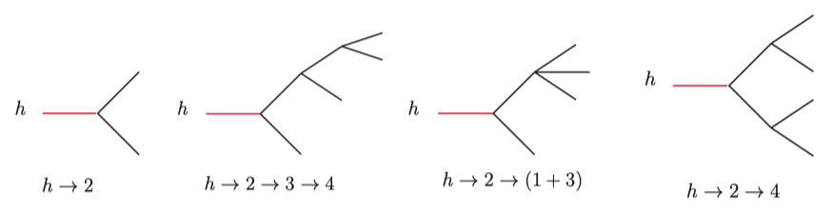
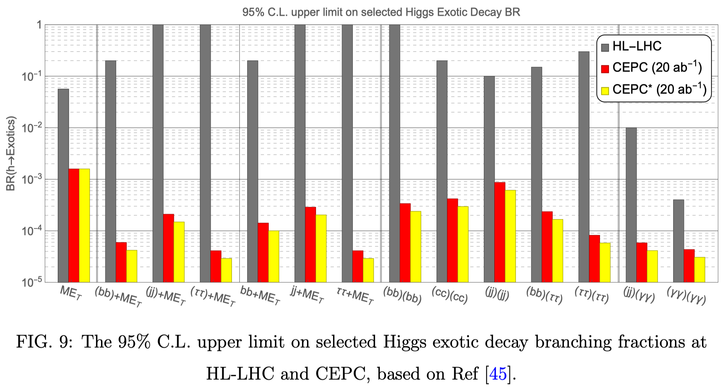
1. Exotic Higgs/Z/top decays （1）
Higgs portal to NP:
  neutrino physics
  DM
  phase transition
  vacuum stability
  …
  → A promising way towards NP.
Representative topologies of the Higgs exotic decays
Exotic higgs
Liu, Wang & Zhang, 1612.09284

Slide 8
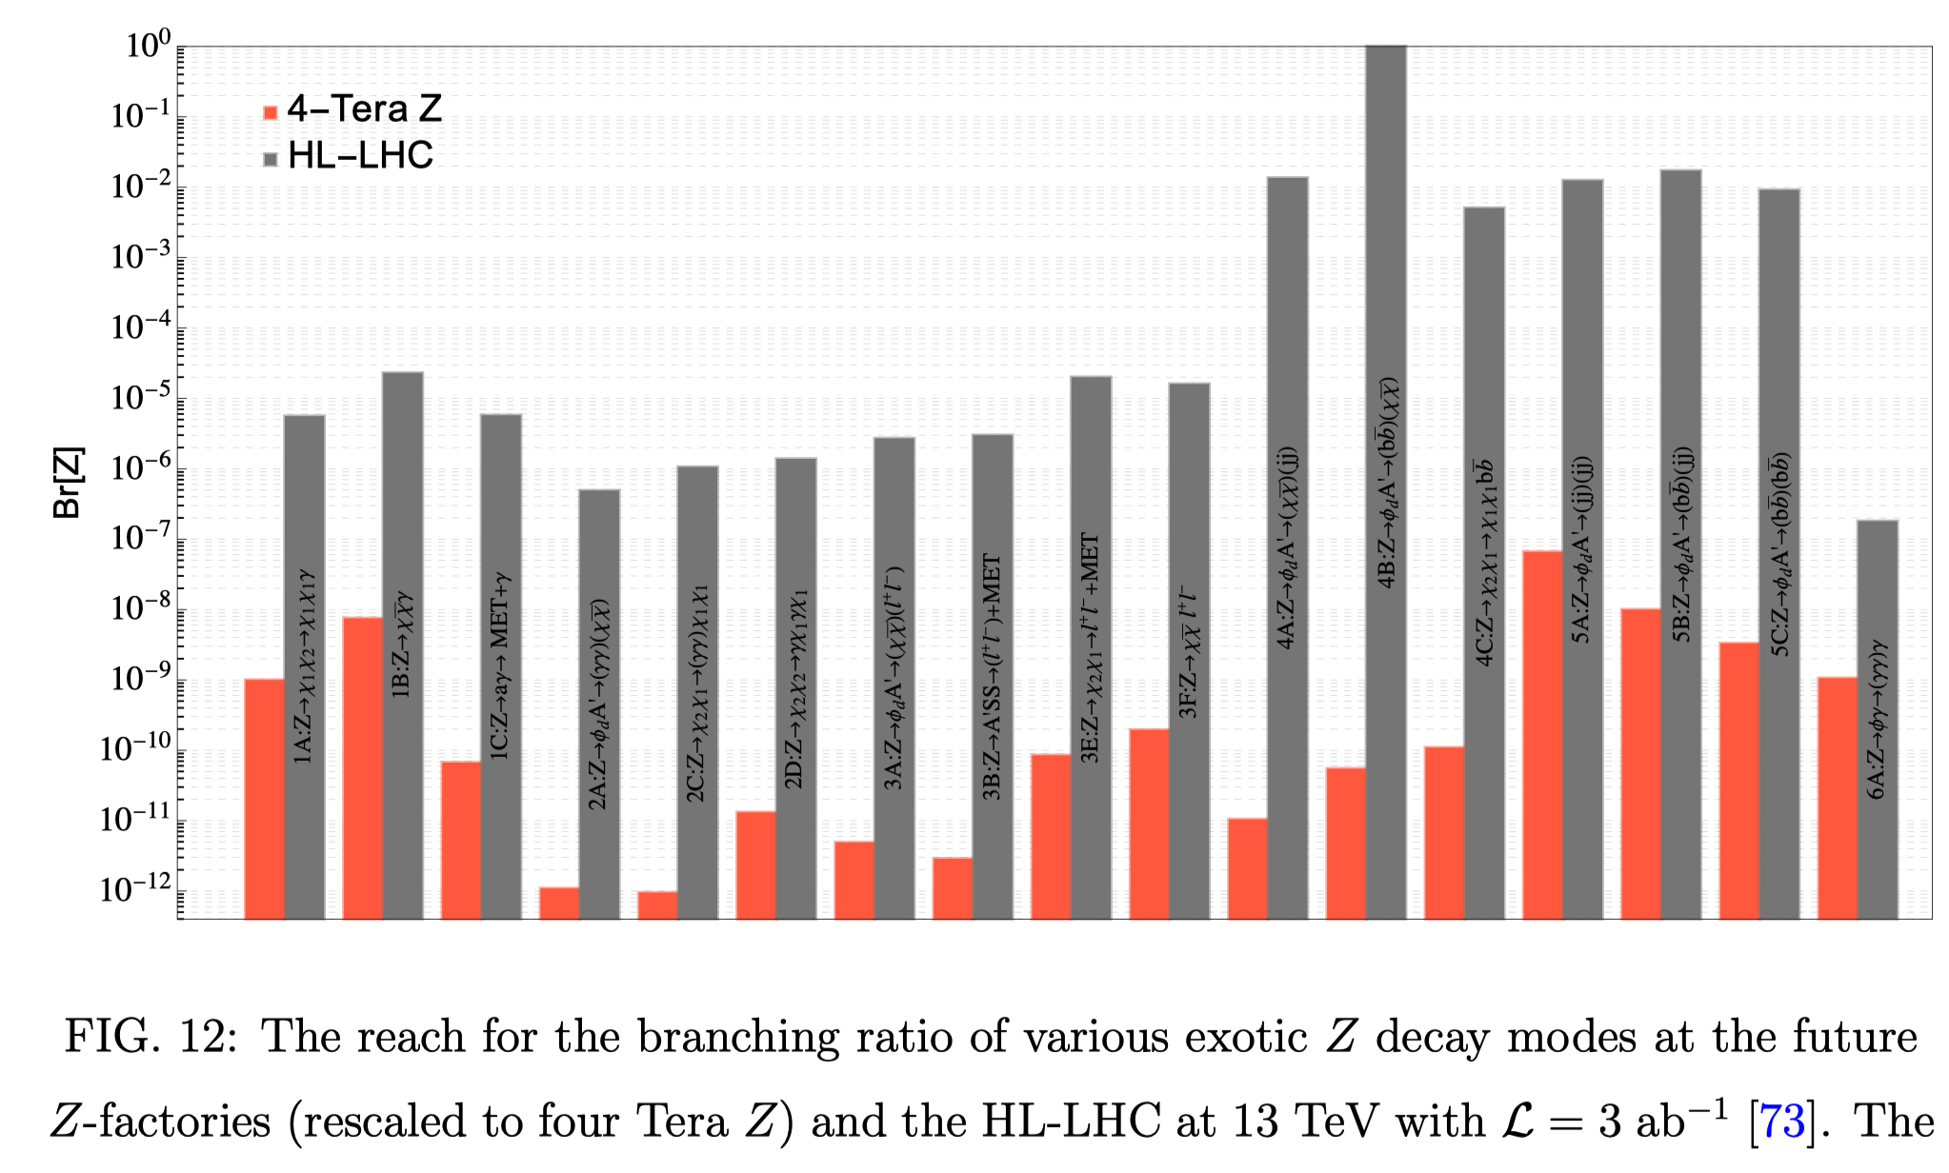
1. Exotic Higgs/Z/top decays （2）
Exotic Z
Exposing NP with Future Z-Factories:
A broad range of dark sector models considered.
Model-independent exotic Z decay channels used.
See the talk by Shao-Feng Ge
(Z/W resonances)
Liu, Wang, Wang & Xue, 1712.07237
➔ As a Higgs (flavor, top) factory, CEPC could search for exotic H/Z/top decays with sensitivities orders of magnitude better than those of existing facilities.

Slide 9
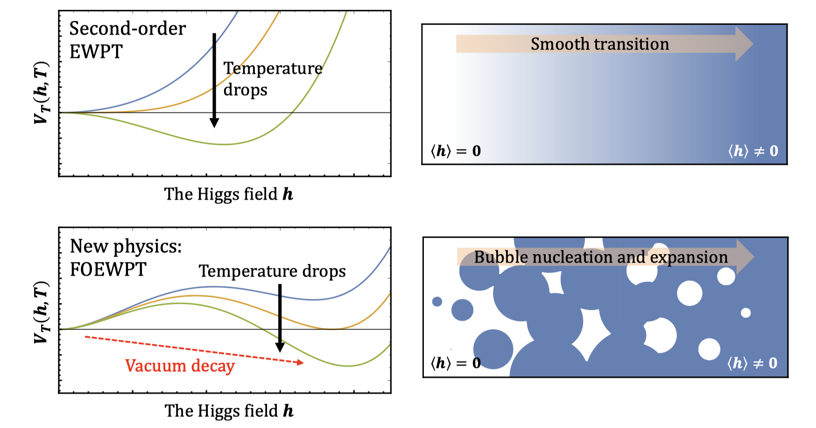
2. EWPT at CEPC (1)
The nature of Electroweak Phase Transition (EWPT) deeply impacts the thermal history of the Universe, closely linked to puzzles of DM, matter-antimatter asymmetry.
In the SM, the transition is a smooth crossover.
In NP, the scalar potential exhibits a barrier, allowing for a first order (FO) EWPT, with bubble nucleation and expansion.
CEPC could study FOEWPT:
  Higgs precision measurements
  Higgs exotic decay
Illustration of EWPT patterns.

Slide 10
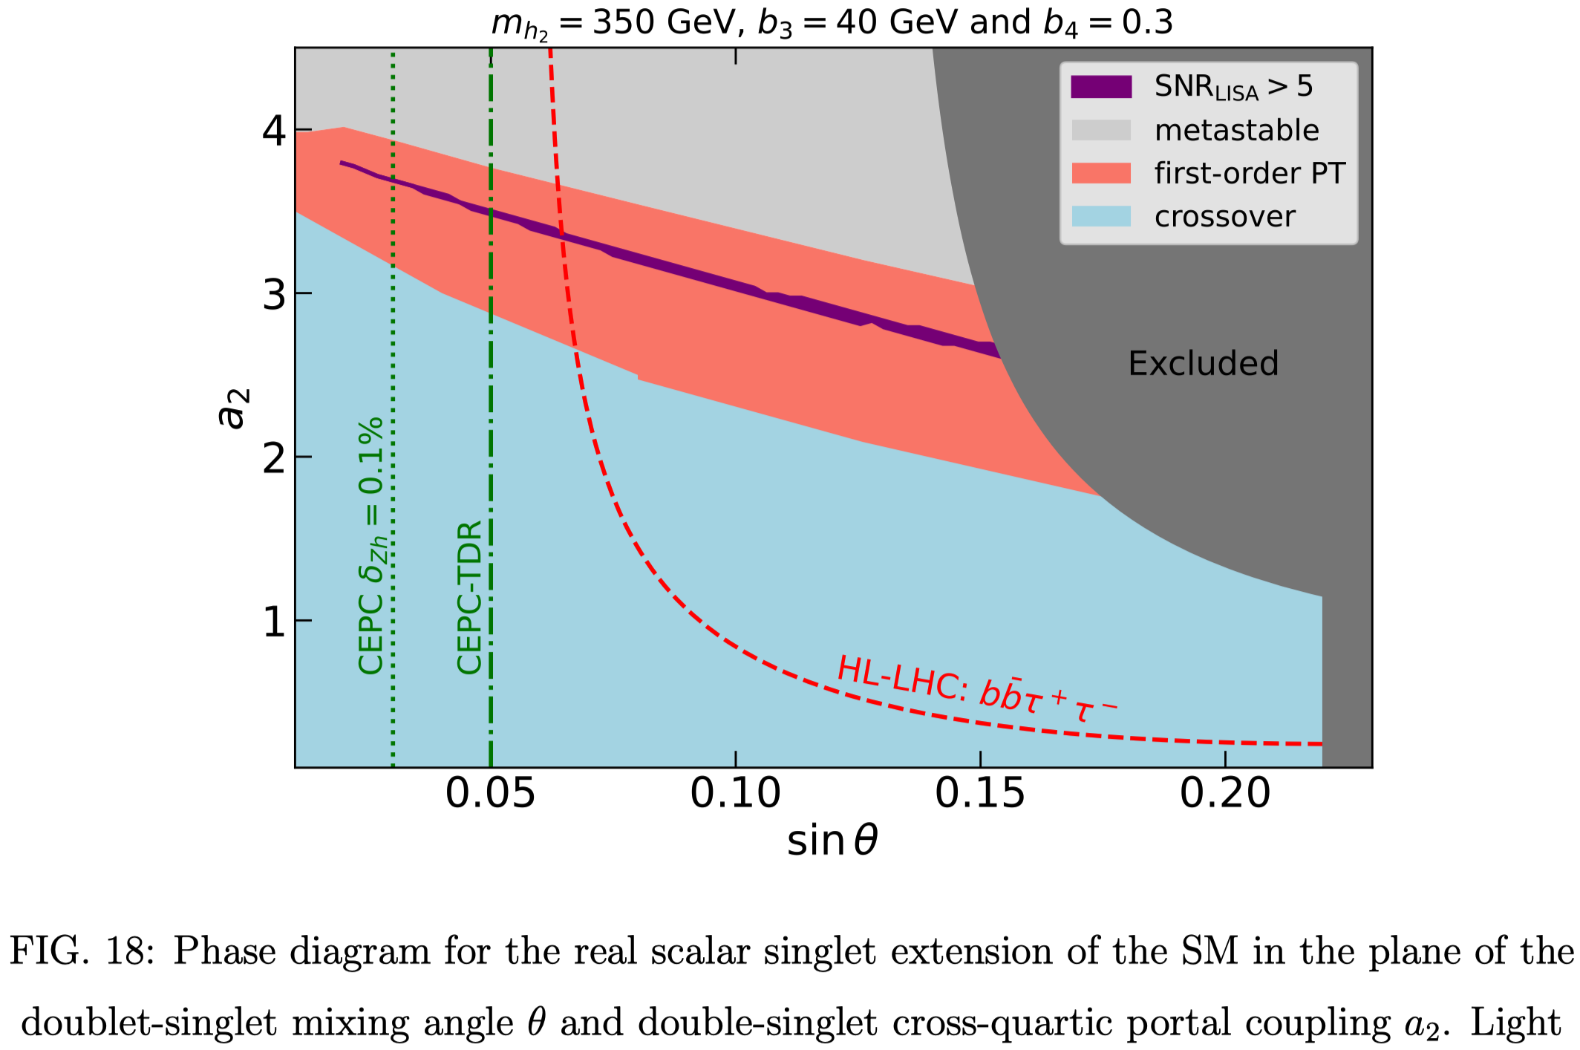
2. EWPT at CEPC (2)
Higgs precision measurements
Higgs exotic decay
A FOEWPT could also generate detectable GW signals.
In the event of a GW observation, and assuming the xSM is realized in nature, one could either anticipate a CEPC discovery of a significant singlet-doublet mixing or identify the narrow region of xSM parameter space consistent with both sets of experiments.
Ramsey-Musolf, Tenkanen & Tran, 2409.17554
See the talk by M. J. Ramsey-Musolf
(Higgs factory & GW)

Slide 11
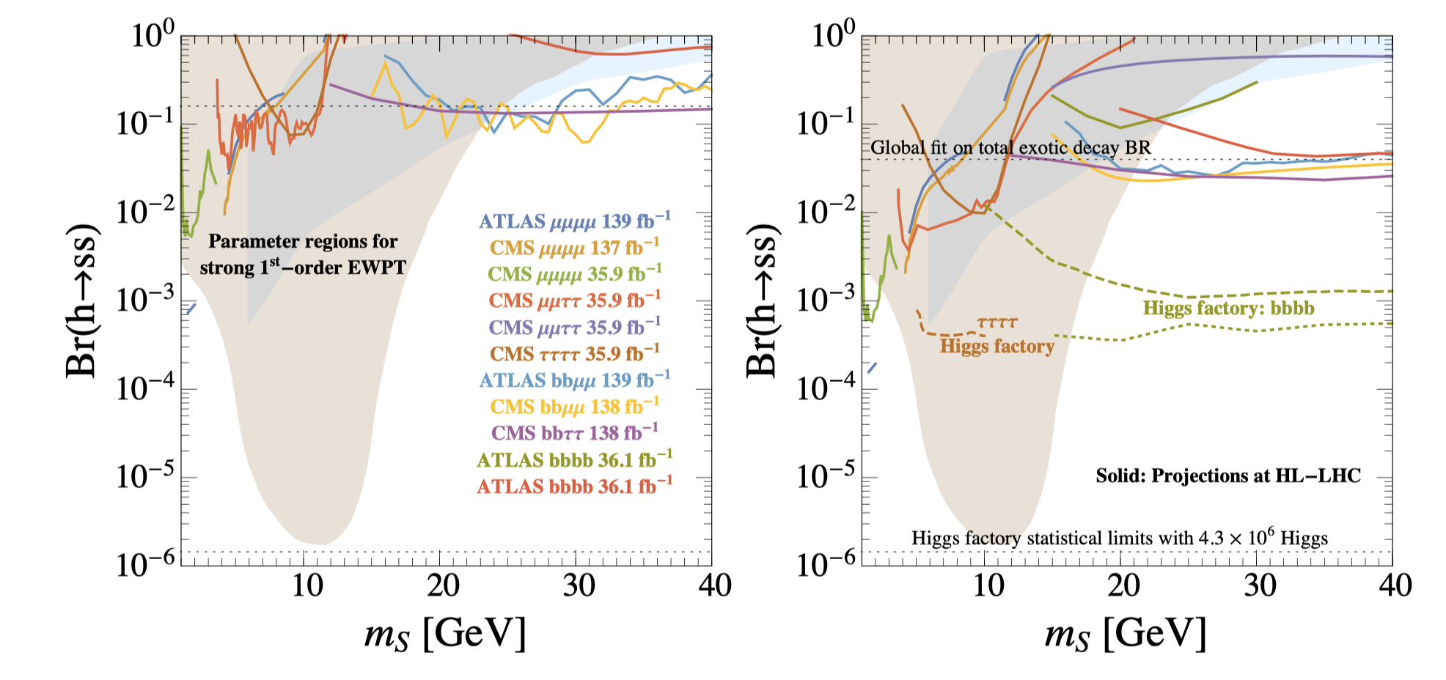
2. EWPT at CEPC (3)
Higgs precision measurements
Higgs exotic decay
Higgs exotic decay h→ss→XXYY as a probe for the FOEWPT.
CEPC has the potential to probe almost the entire FOEWPT parameter space for 4b and 4𝜏 channels.
Carena, Kozaczuk, Liu, Ou, Ramsey-Musolf, Shelton, Wang & Xie, 2203.08206

Slide 12
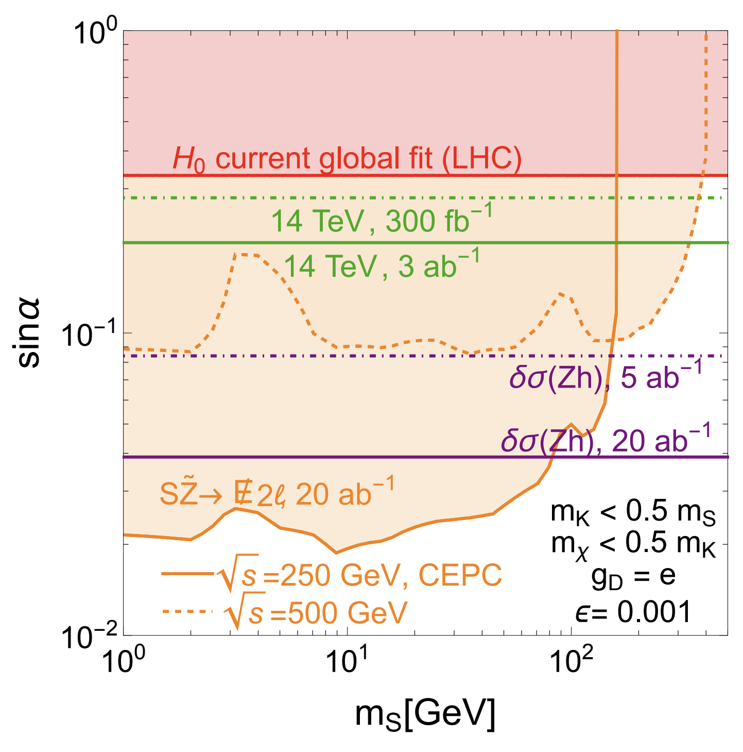
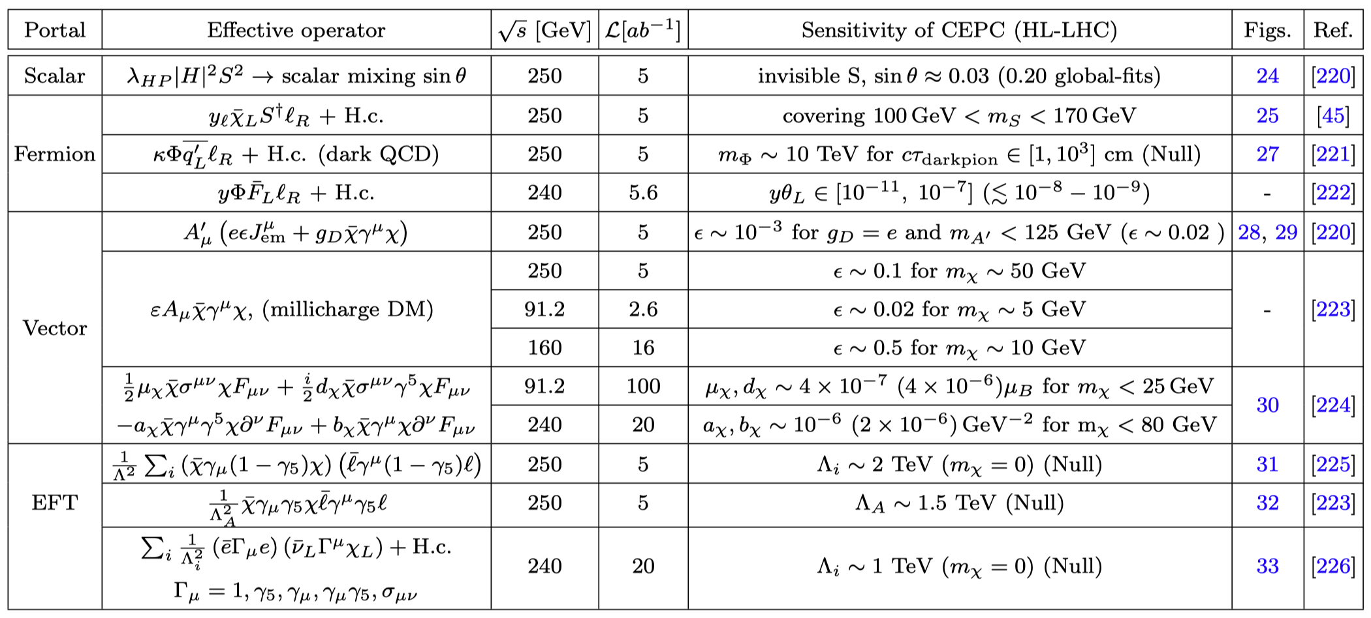
3. Dark Matter and Dark Sector (1)
UV models DM:
  SUSY DM / Double dark portal model /……
Simplified models DM:
  Scalar / Fermion / Vector portal
EFT DM
Double dark portal model: scale and vector-portal DM
See the talks by Jinhan Liang (dark particles twinkle),
& Sahabub Jahedi (freeze-in DM)
Liu, Wang & Yu, 1704.00730

Slide 13
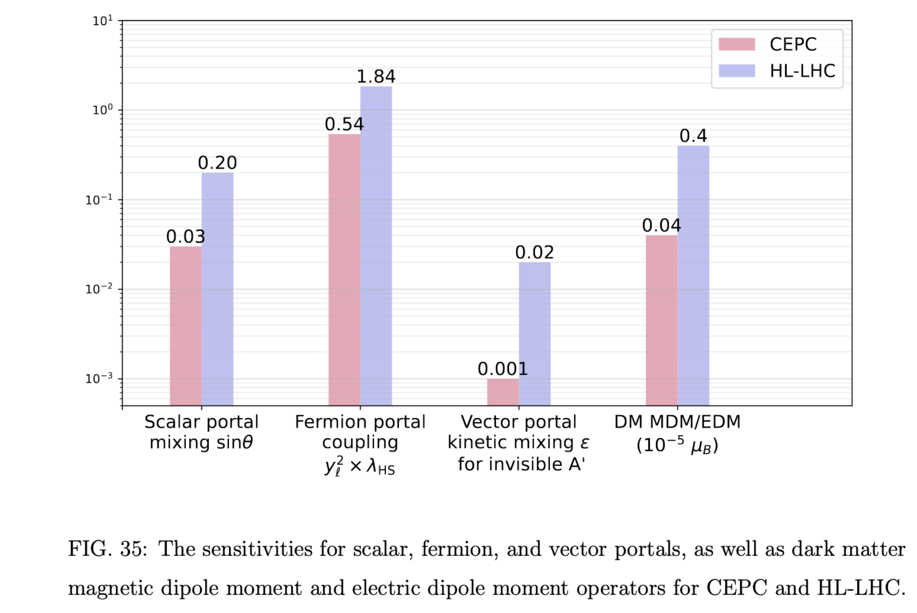
3. Dark Matter and Dark Sector (2)
CEPC can improve the sensitivities by roughly one order of magnitude (vs LHC)

Slide 14
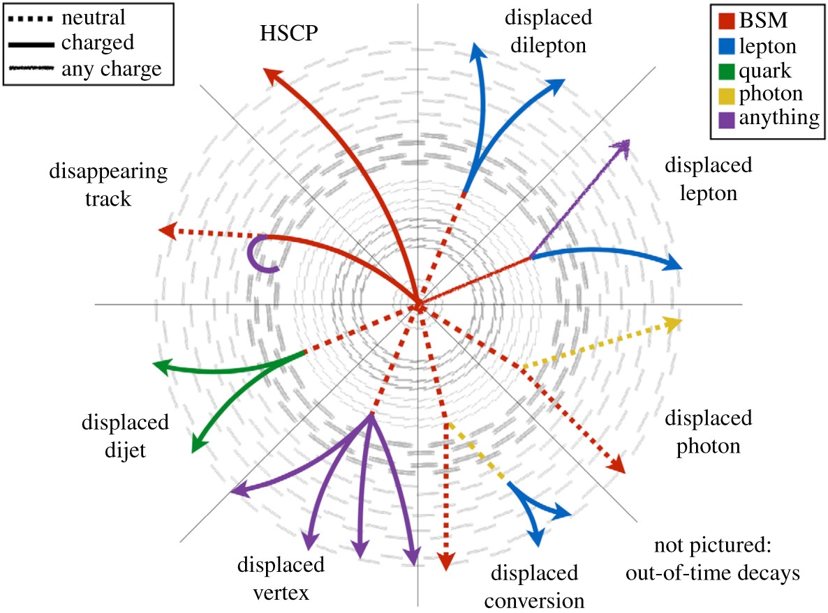
4. Long-lived particles (LLP) (1)
Long lifetimes result from a few simple physical mechanisms:
Small couplings (ex. RPV SUSY )
Limited phase space: small mass splitting (ex. compressed SUSY, …)
Heavy intermediate states
……
New scale particles from higgs decay
SUSY RPV N1 from Z-boson decays
ALP
Dark photons
…
Far Detector can help a lot!
See the talk by Lingfeng Li
(long-lived dark sector)
De Roeck ‘19

Slide 15
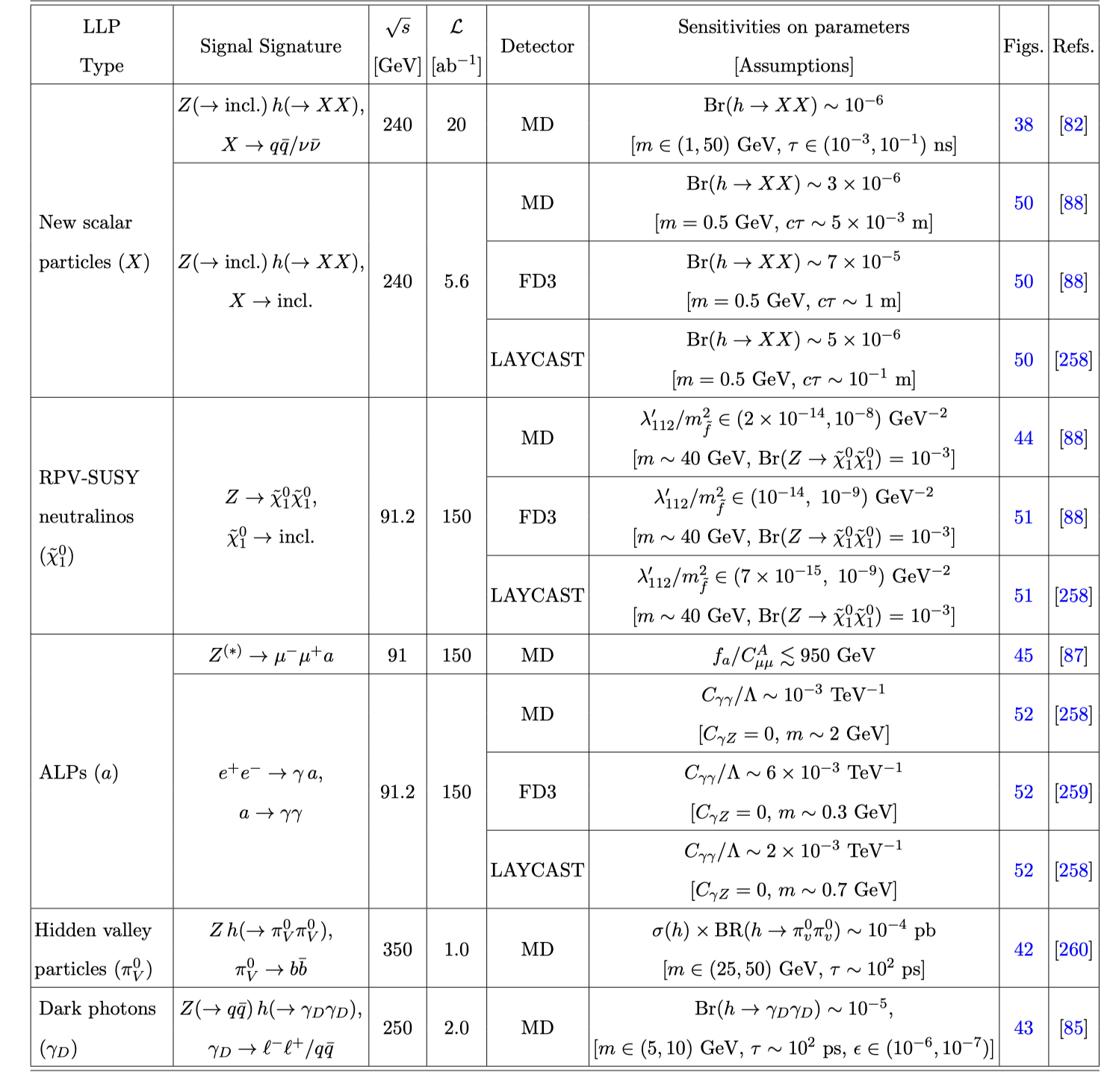
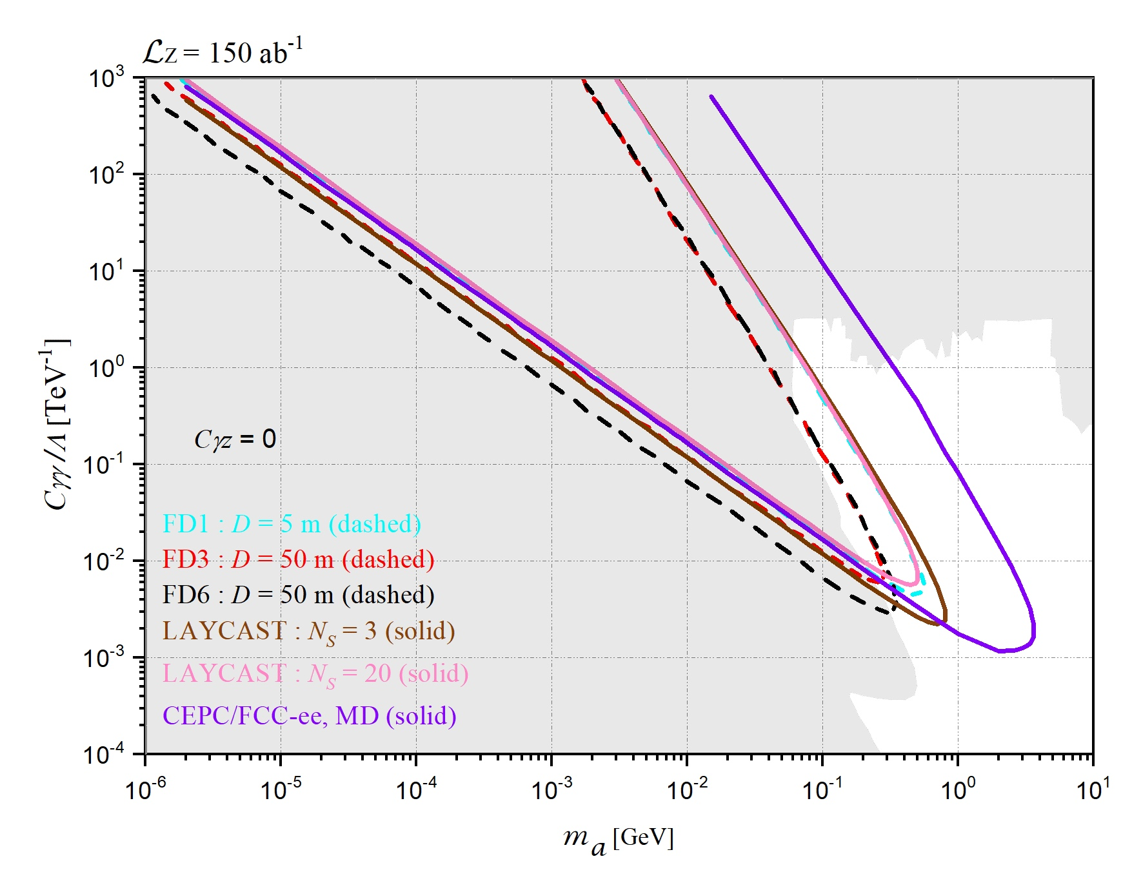
4. Long-lived particles (LLP) (2)
Good sensitivity for ALP
e⁻e⁺→ γ a, a → γγ
Tian, Wang & Wang, 2201.08960

Slide 16
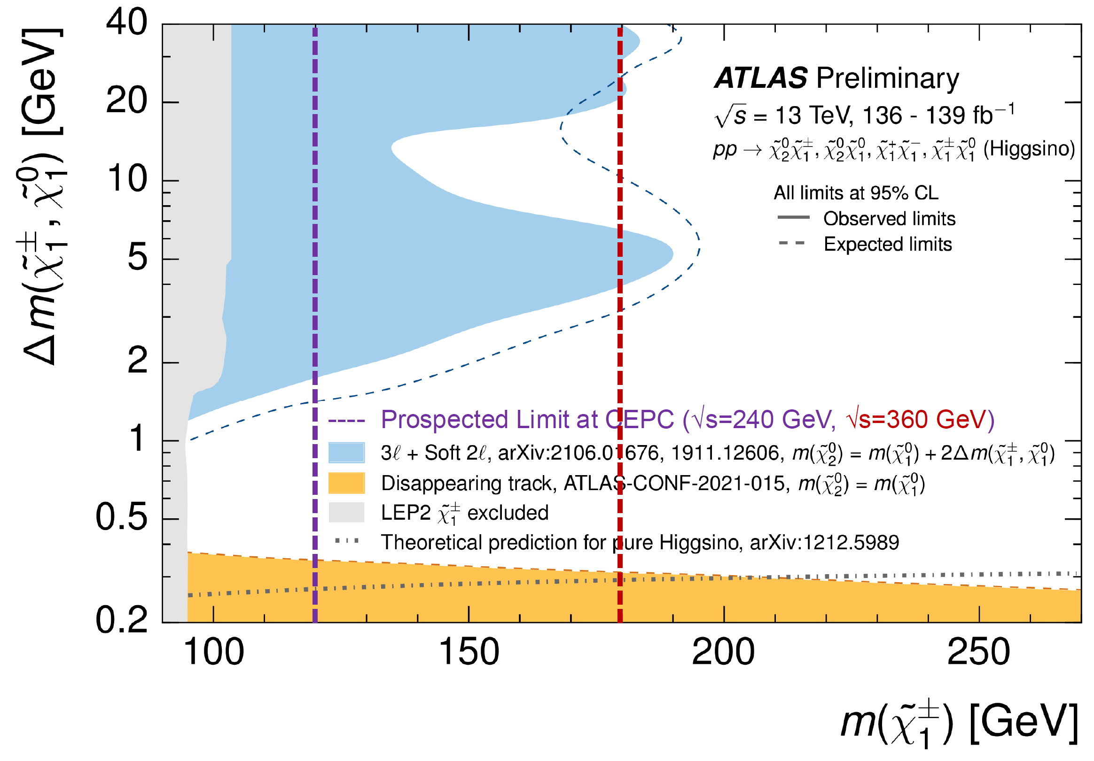
5. SUSY Searches at CEPC (1)
SUSY: establishes a symmetry between fermions and bosons, solve many big questions: unification, DM, Hierarchy, ……
Complementary with LHC: lower mass/soft energy region
  Mainly light EWKino and slepton for CEPC
Yuan, Cheng & Zhuang ‘22
Lepton collider: discovery in all scenarios up to kinematic limit: $\sqrt{s}/2$

Slide 17
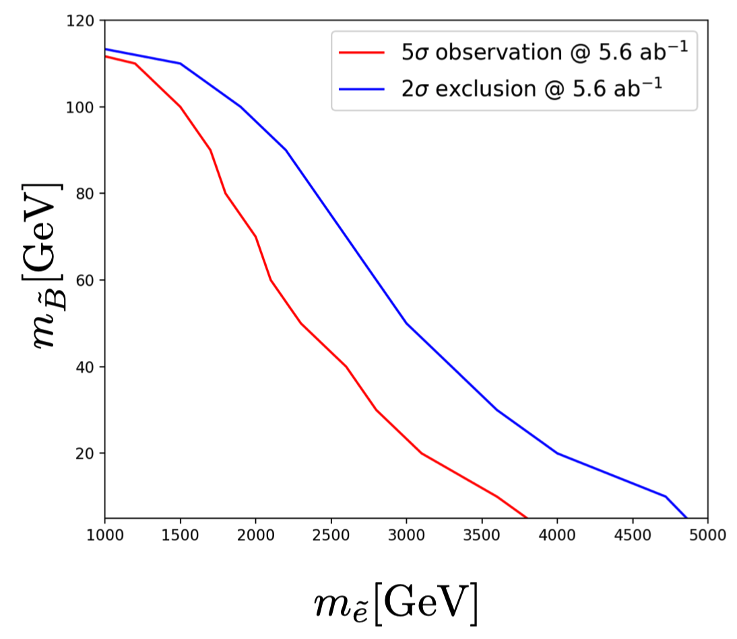
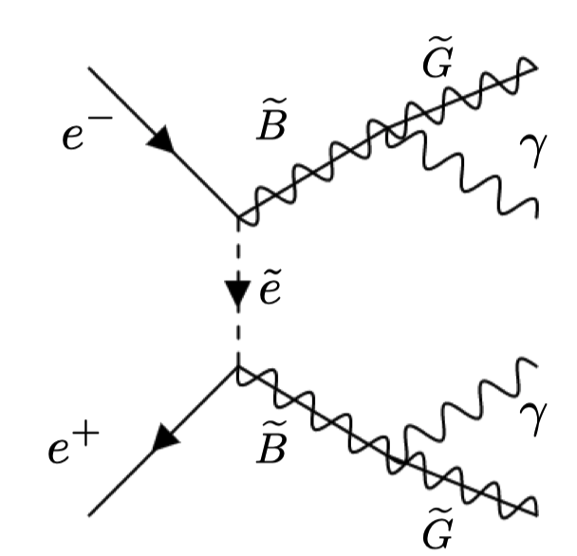
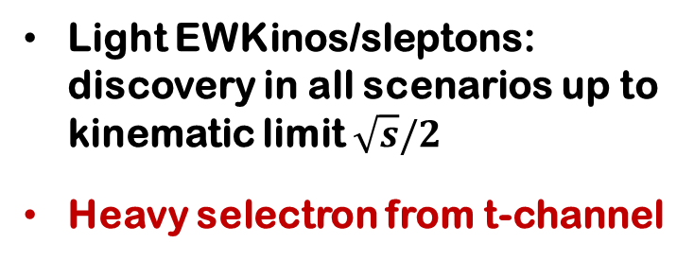
5. SUSY Searches at CEPC (2)
Light EWKinos/sleptons: discovery in all scenarios up to kinematic limit $\sqrt{s}/2$
Heavy selectron from t-channel
Chen, Han, Yang & Zhang, 2101.12131

Slide 18
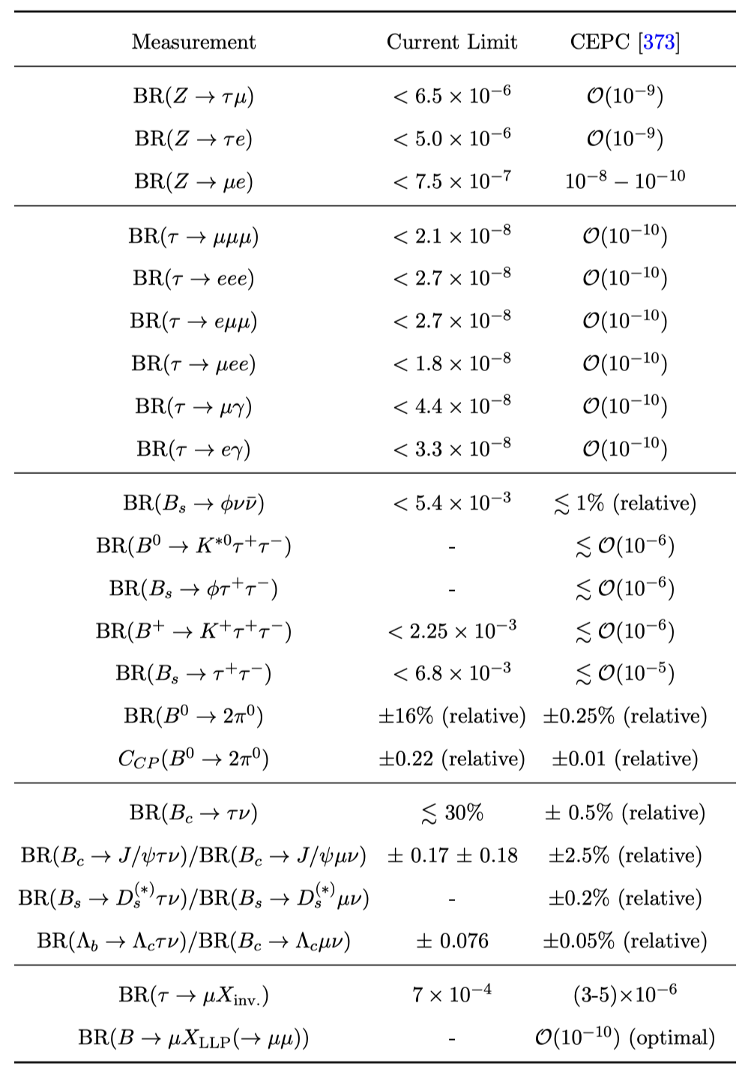
6. Flavor NP (1)
Ai et al., 2412.19743
CEPC is also a flavor factory (b,c,𝜏) when running at Z pole, which has a unique sensitivity for some rare/SM–forbidden decays of leptons and heavy quarks
New Physics scenarios:
  cLFV processes
  Decays of b and c hadrons
  Light BSM particles (e.g. axion) from flavor transitions (cLFV or quark FCNC processes) with inv. BSM states or LLP
> two orders of magnitude improv.

Slide 19
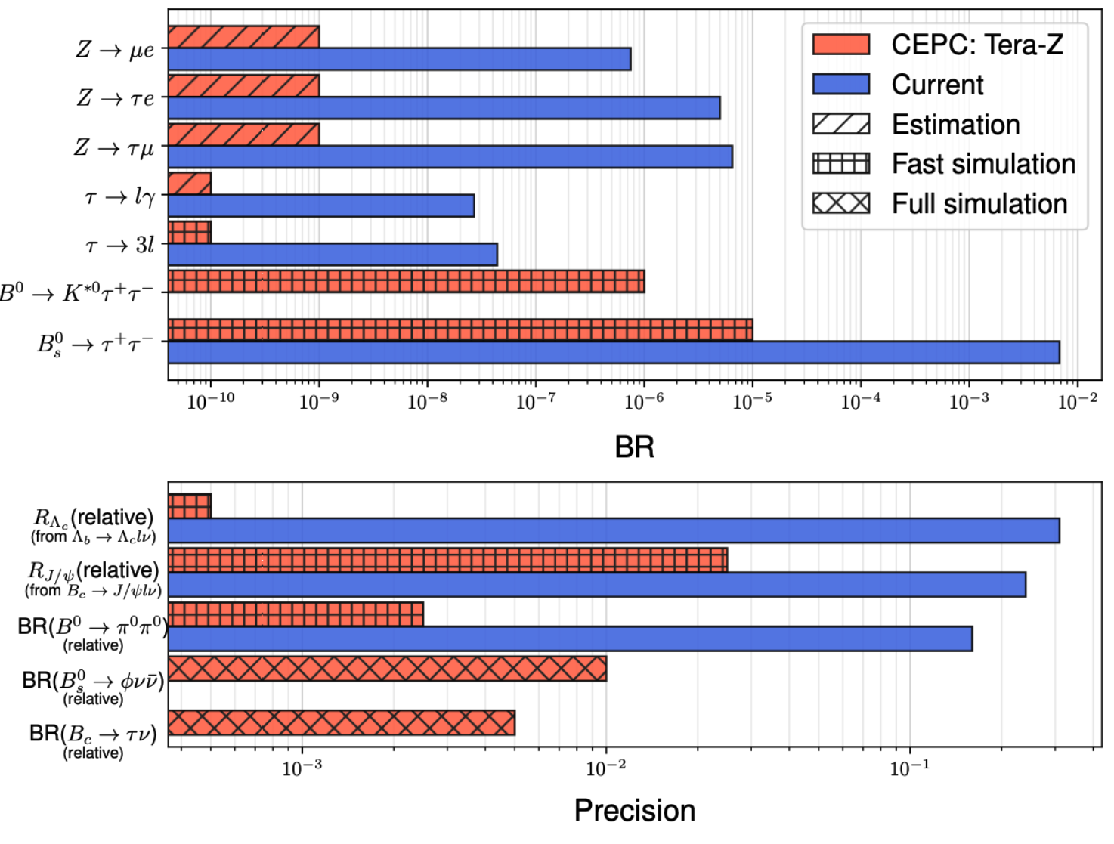
6. Flavor NP (2)

Slide 20
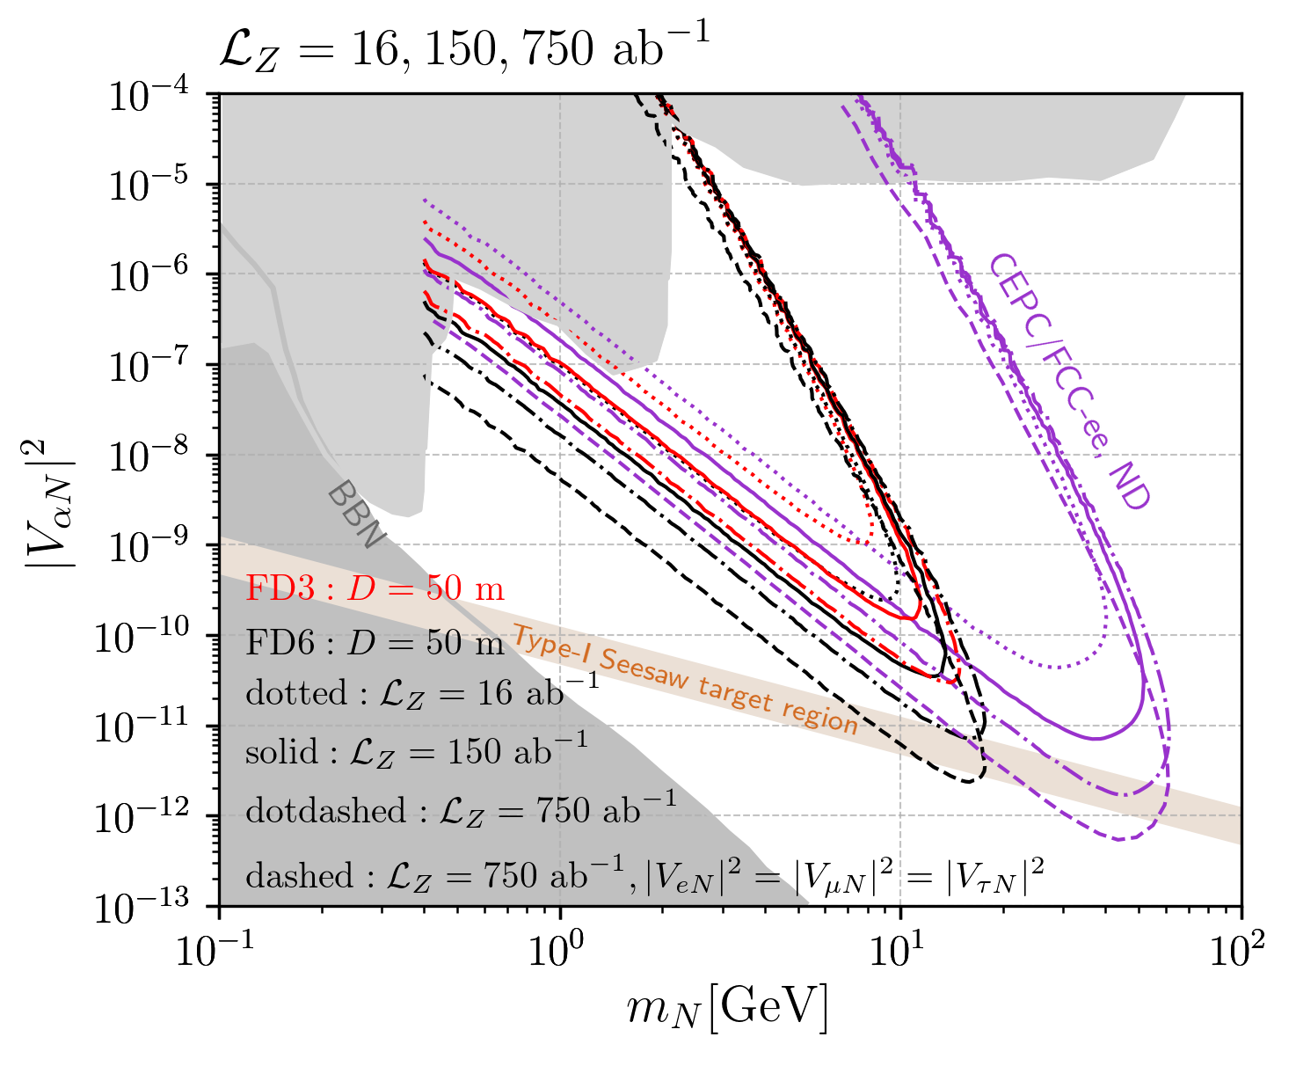
7. Neutrino physics (1)
Studying neutrino mass generation mechanisms will pave the way for discovering underlying BSM physics:
Heavy neutrino (@ND, FD)
Non-standard neutrino interactions (NSI)
Active-sterile neutrino transition magnetic moments
Neutral and doubly-charged scalars in seesaw models
Connection to leptogenesis (collider probes) and dark matter (sterile neutrino in the νMSM)
Z → νN
Wang & Wang, 1911.06576
Discovery potential extends down to mixing values of O(10 ⁻¹¹).

Slide 21
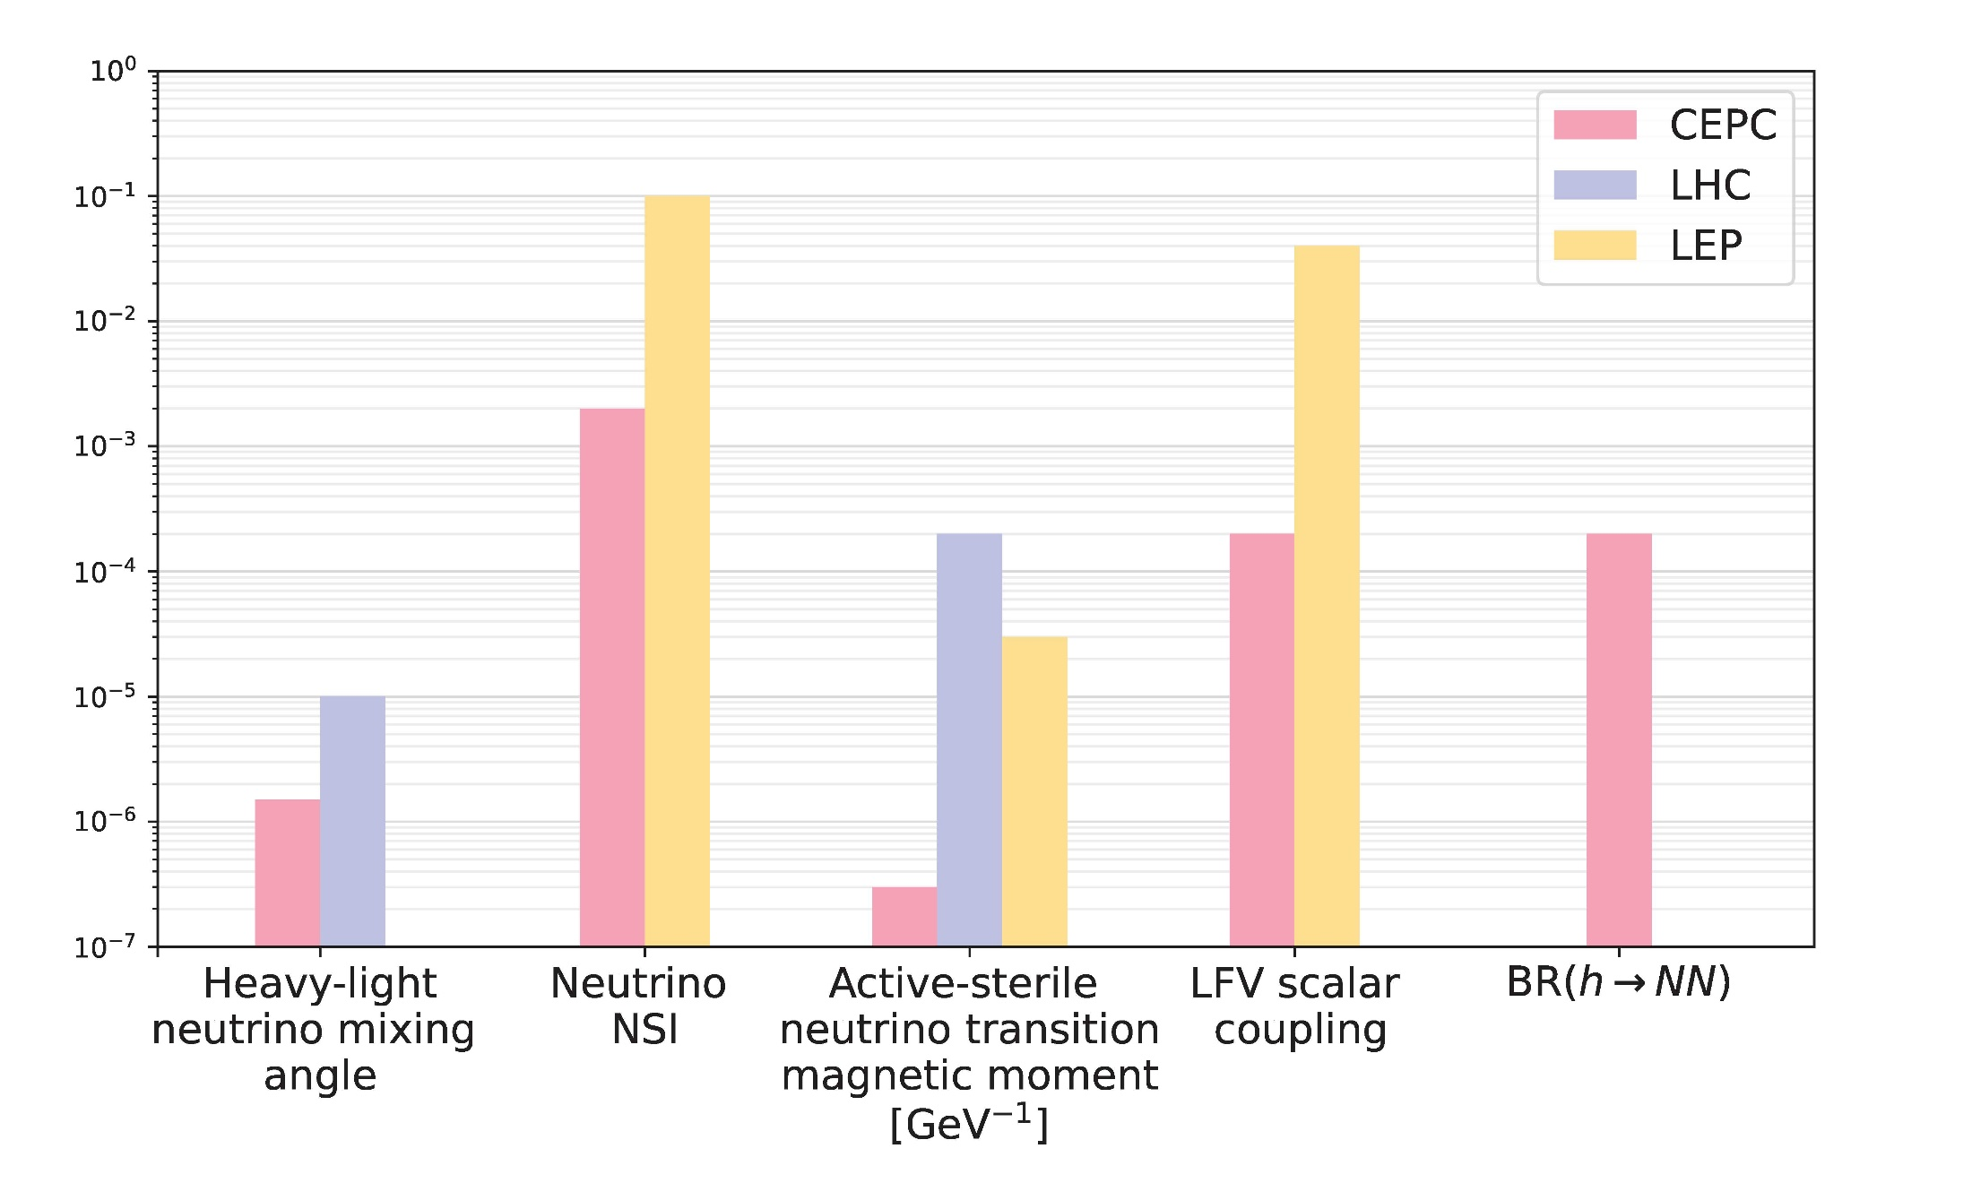
7. Neutrino physics (2)
Summary plot of neutrino relevant models
Studying neutrino mass generation mechanisms will pave the way for discovering underlying BSM physics:
Heavy neutrino (@ND, FD)
Non-standard neutrino interactions (NSI)
Active-sterile neutrino transition magnetic moments
Neutral and doubly-charged scalars in seesaw models
Connection to leptogenesis (collider probes) and dark matter (sterile neutrino in the νMSM)
The sensitivities can be improved by roughly 1 to 2 (or more) orders of magnitude (vs LHC & LEP).

Slide 22
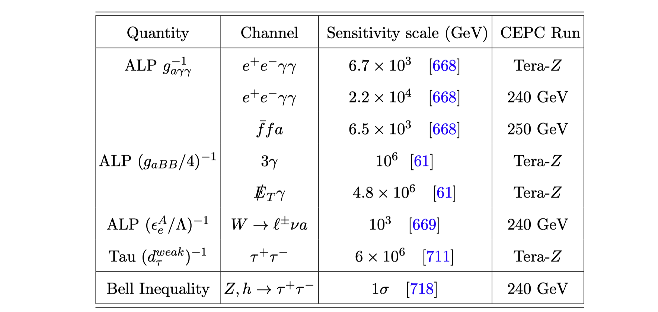
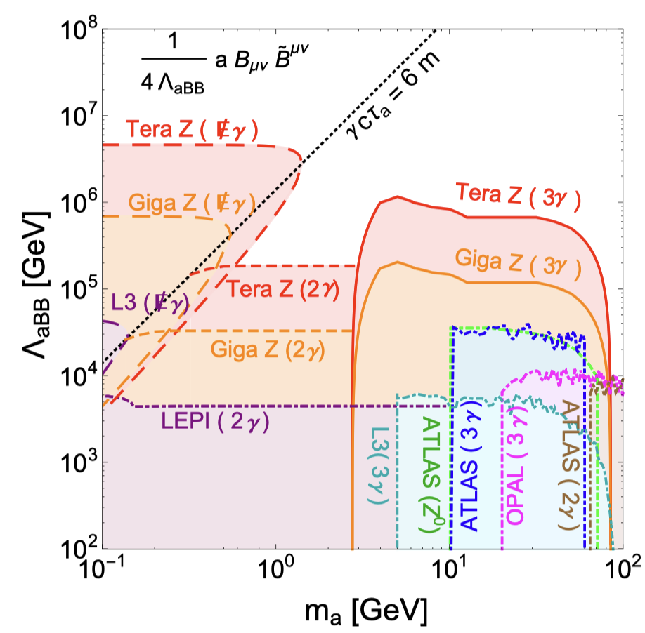
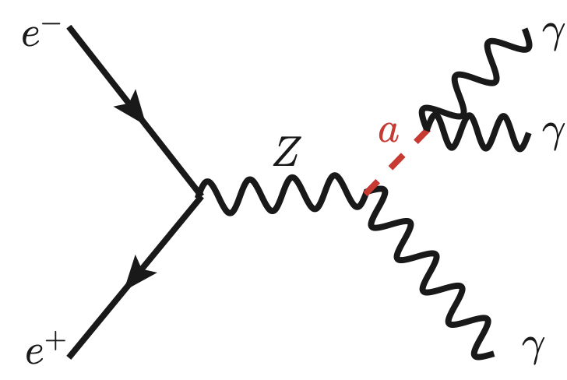
8. More exotics (1)
High precision of Z, h width offers power test of exotics process of Lepton number/flavor violation, Sterile states, Axion-like particles …
Axion-like particles (solve strong CP problem)
Emergent Hadron Mass
Lepton form factors (µ /e g-2, µ /e dipole moments in SUSY, τ weak-electric dipole moments)
Exotic lepton mass models
Spin entanglement
……
See the talk by Shouhan Bao (ALP)
Hao Zhang (entanglement)
Zhang, Yue, Guo & Yang, 2103.05218
22

Slide 23
8. More exotics (2)
Energy reach in representative exotic search channels at the CEPC. Note the maximal energy reach may apply to different model parameter regions between experiments.
23

Slide 24
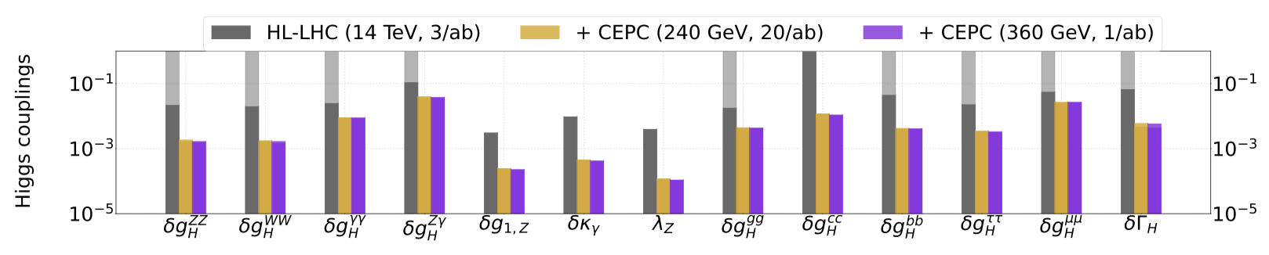
9. Global ﬁts (1)
Global fits: an essential tool to obtaining a thorough understanding of a NP model, and the implications and predictions of the models for future searches and experiments.
  SMEFT
  2HDM
  SUSY
Global fit for SMEFT operators at future colliders
CEPC can improve the Higgs couplings by a factor of a few, or even orders of magnitude （δg_{1,Z}, δκ_{γ}, and λ_{Z}.）
As a Higgs factory, CEPC is expected to improve significantly the SMEFT global analysis due to its high energy and luminosity.
See the talk by Yoshiki Uchida
(EFT for type-II seesaw)
de Blas, Du, Grojean, Gu, Miralles, Peskin, Tian, Vos & Vryonidou, 2206.08326

Slide 25
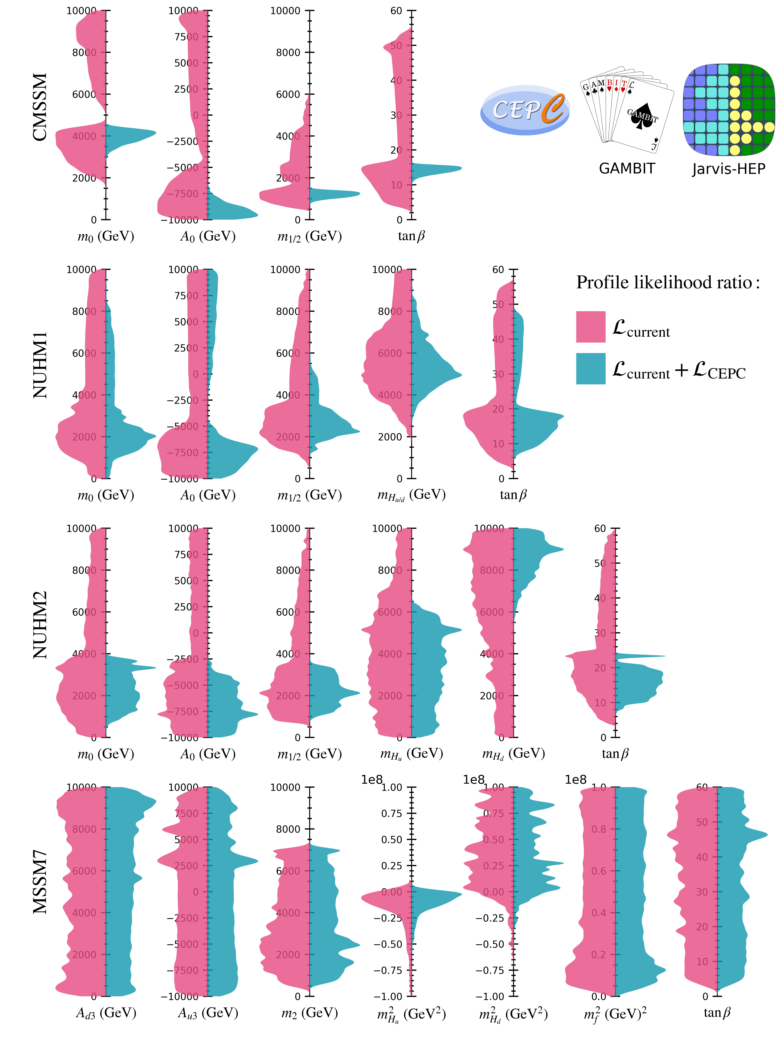
9. Global ﬁts (2)
Global fits: an essential tool to obtaining a thorough understanding of a NP model, and the implications and predictions of the models for future searches and experiments.
  SMEFT
  2HDM
  SUSY
CEPC has the potential to greatly enhance our understanding of the parameter space and mass spectrum in the MSSM.
Athron, Balazs, Fowlie, Lv, Su, Wu, Yang & Zhang, 2203.04828

Slide 26
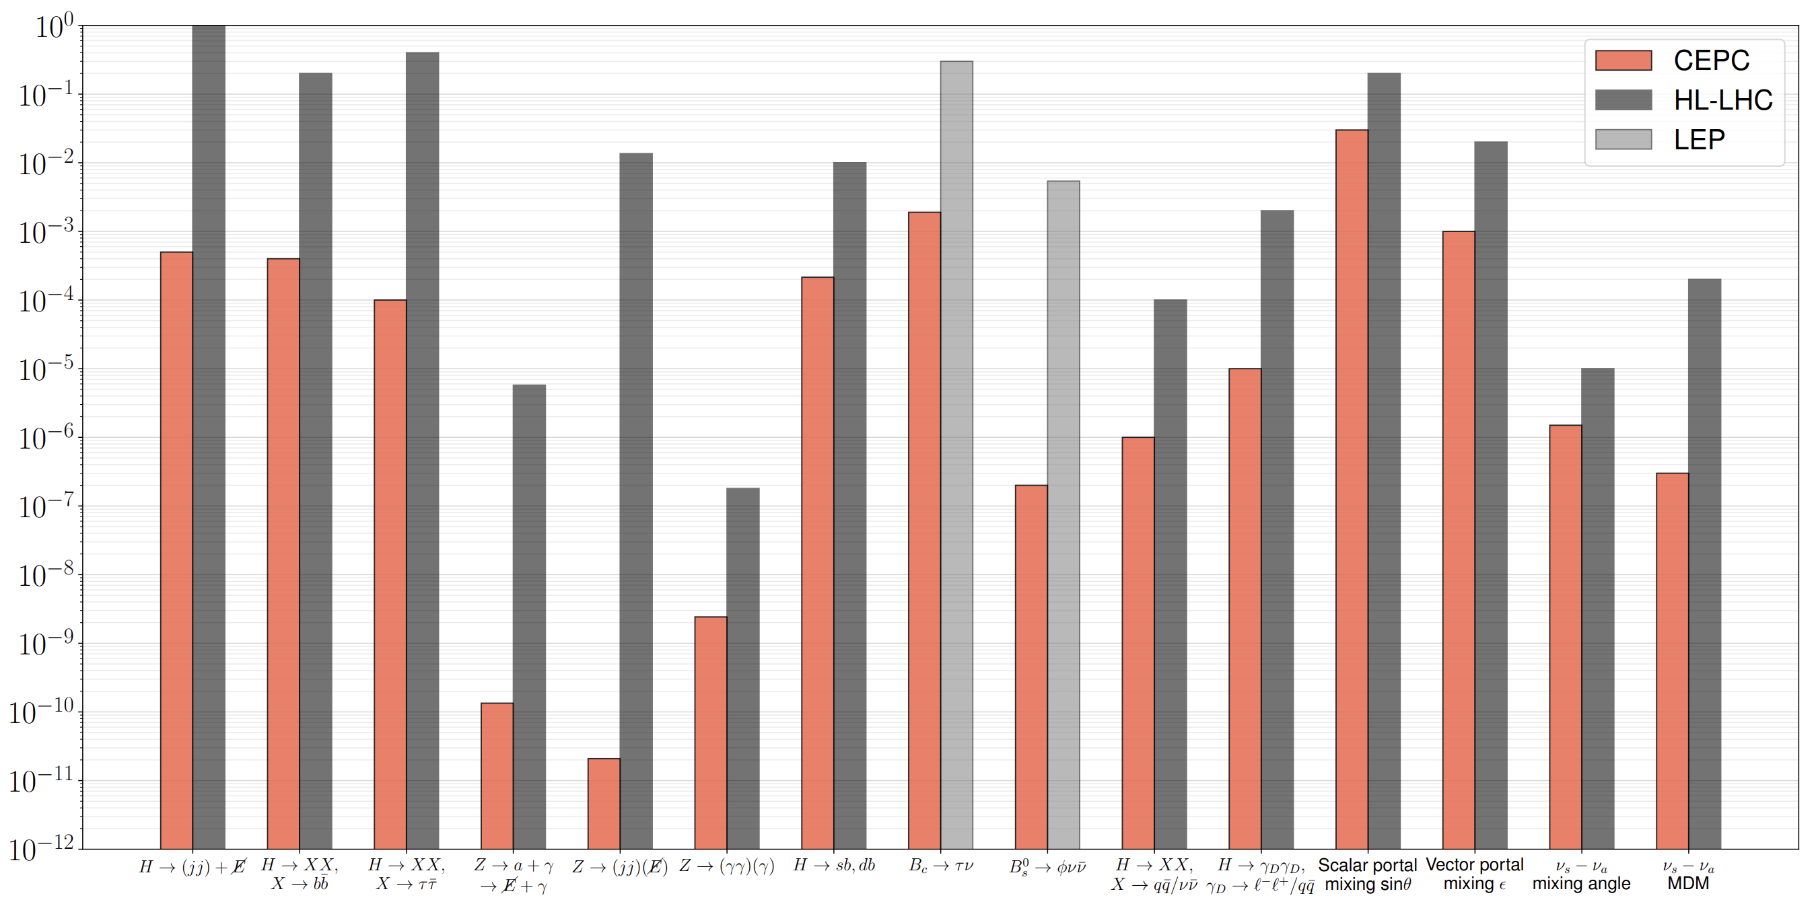
Projected sensitivities of the CEPC and HL-LHC for various new physics scenarios
The sensitivities are orders of magnitude better than the existing facility.
exotic Higgs
exotic Z
Flavor
flavor-violating Higgs and and B-meson decays
DM&DS
scalar and vector portal mixing
Neutrino
sterile-active neutrino mixing and magnetic dipole moment interactions
LLP

Slide 27
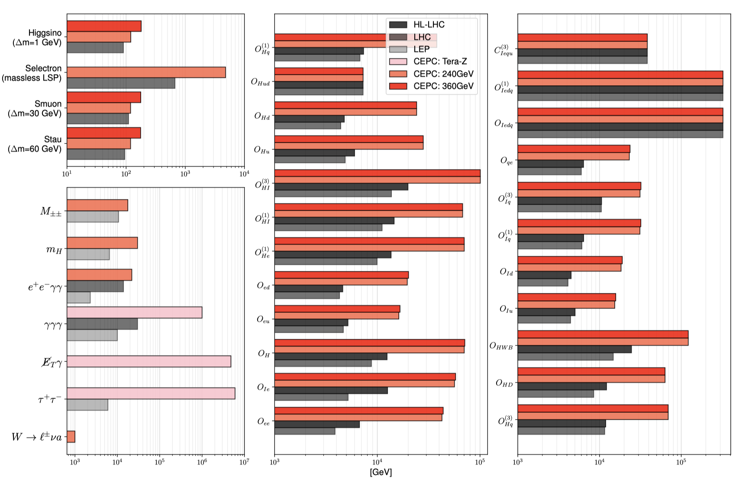
Sensitivity scale of the CEPC and other Exp.
for various new physics scenarios
SUSY
The new physics discovery power could also be expressed in the explorable energy range:
SMEFT: up to 10-100 TeV, improve NP scale by a factor of 3∼10.
SUSY/exotics: from half beam energy to TeV scale.
Exotics
(ALP, Scale particles in seesaw)
NP search via EFT

Slide 28
Executive Summary
As a Higgs (flavor, top) factory, CEPC will provide unprecedented opportunities for looking for new physics Beyond SM. CEPC could:
Identify the origin of matter, especially the mechanism related to the first-order EW phase transition (EWPT) in the early Universe, which could produce a detectable gravitational wave signal.
Discover dark matter, particularly dark matter particles with a mass between one tenth and 100 times the proton mass.
Observe an array of new physics smoking guns, with sensitivities orders of magnitude better than those of existing facilities.

Slide 29
Summary and Outlook
CEPC has excellent discovery potential for NP, especially for light new particles at low energy/mass scale.
It is good complementary to hadron colliders, and DM direct-detection experiments.
More ideas are welcome!

