Slide 1
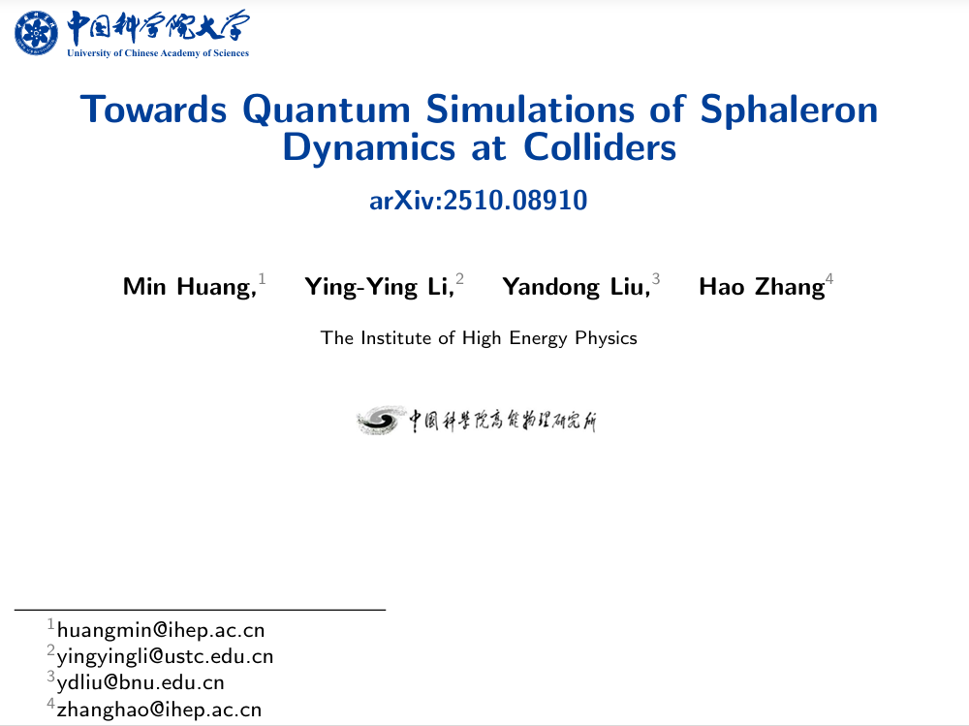

Slide 2
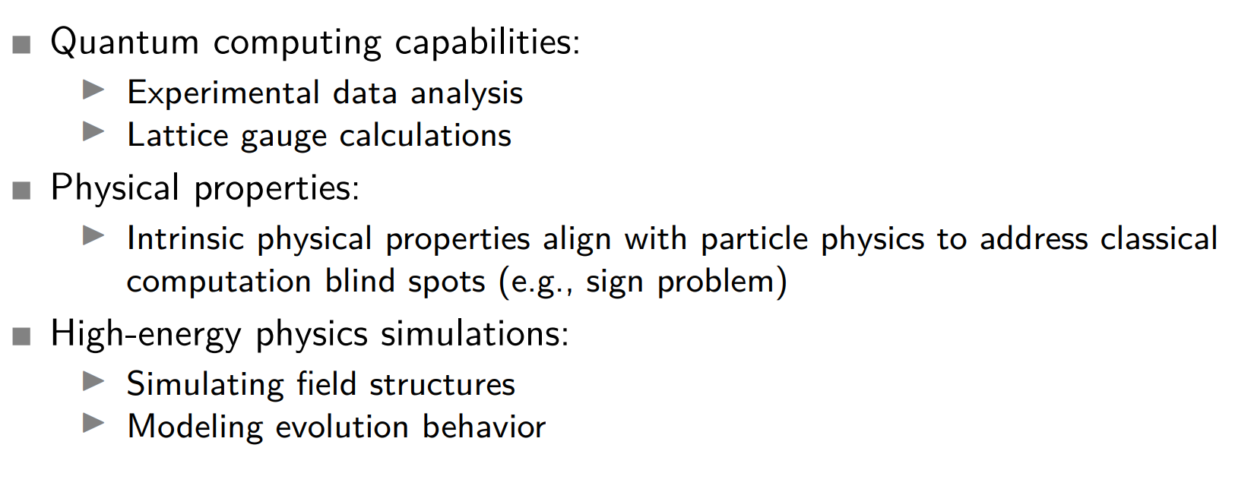
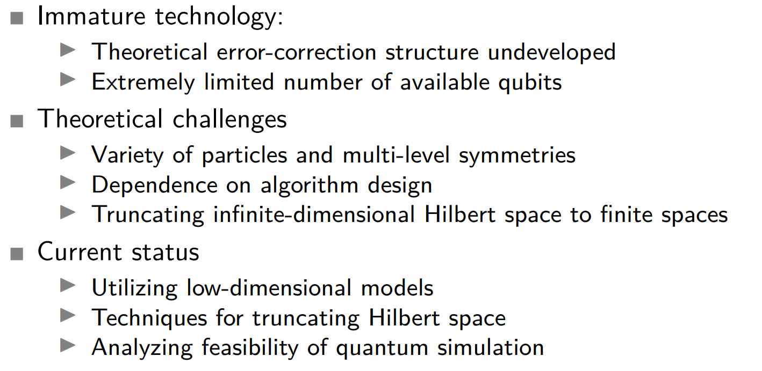
BG OF QUANTUM COMPUTING
The future is bright
The path is superposed

Slide 3
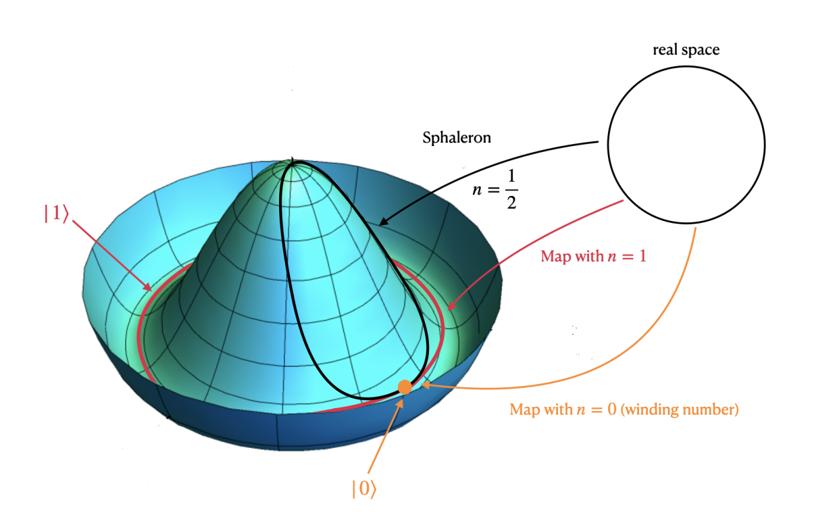
What is Sphaleron
The static unstable vacuum solution at which the non-contractible loop in the field configuration space of the gauge field reaches its saddle point is the generalized sphaleron solution.
A one-dimensional example:

Slide 4
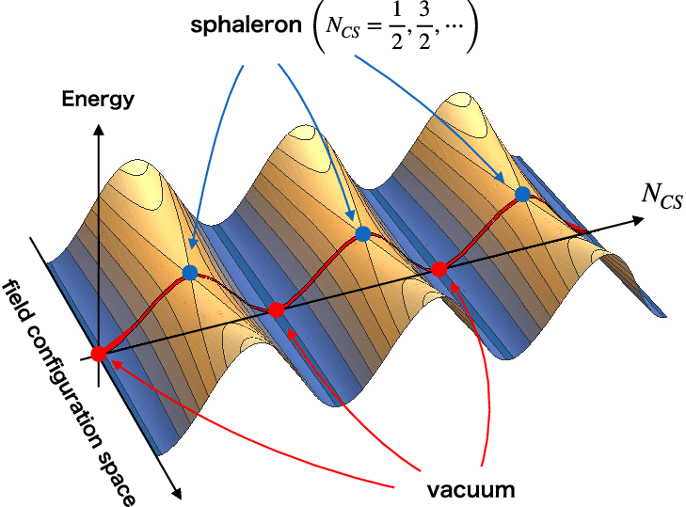
Why is Sphaleron
Sphaleron in EW system is a physically static solution governing the thermal equilibrium dynamics between vacuum states with different looping numbers.

Slide 5
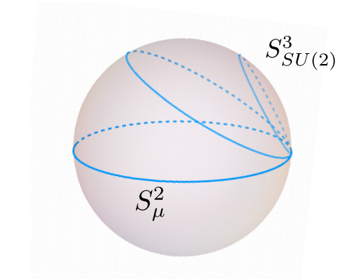
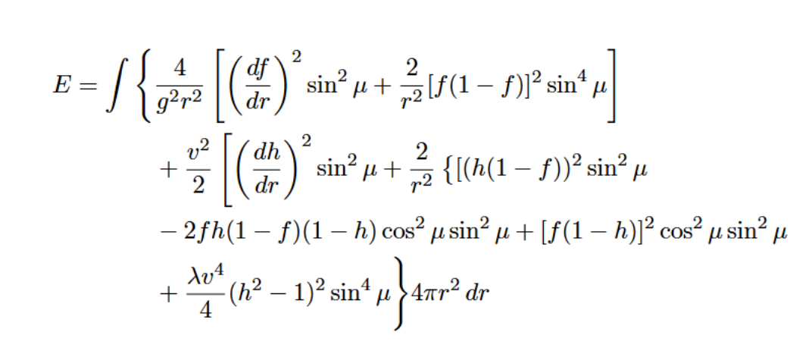
Sphaleron on EW
The sphaleron solution in the Weinberg-Salam model is given by Manton which reach its saddle point has important implications in theories of baryogenesis.
Dynamics are crucial but challenging to simulate on classical computers.
Spherical Symmetry Ansatz

Slide 6

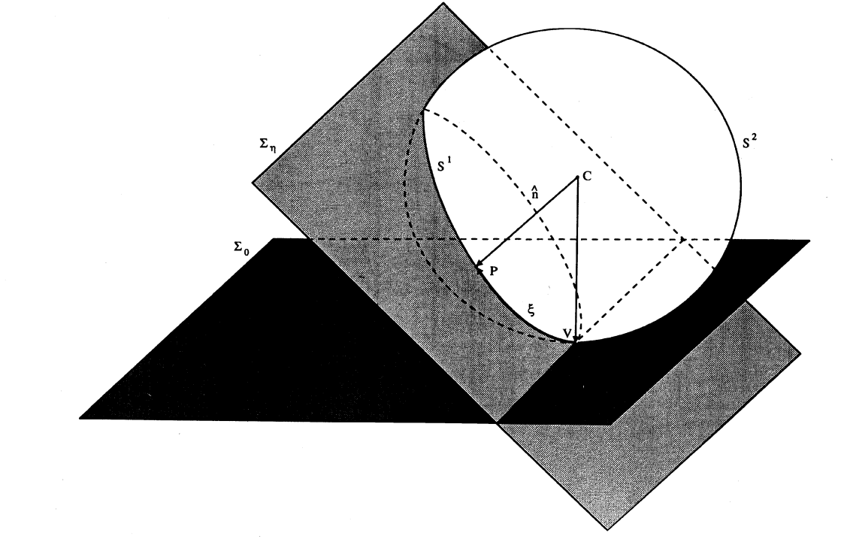
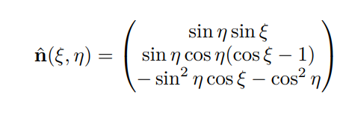
Sphaleron on O(3) non-linear sigma model
E. Mottola and A. Wipf, Phys. Rev. D 39, 588 (1989)

Slide 7
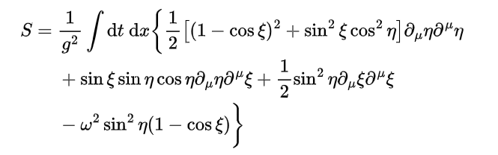
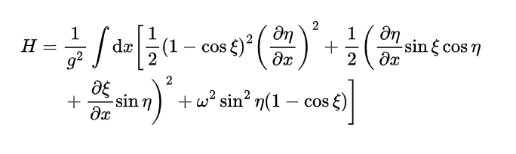
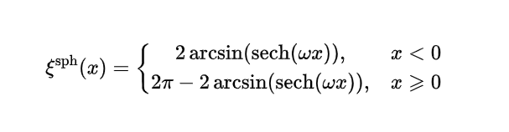
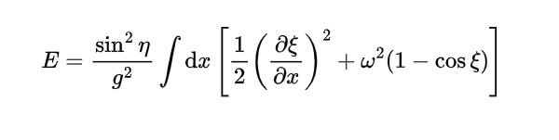


Probe the Sphaleron
Fixed η
Boundary Condition

Slide 8
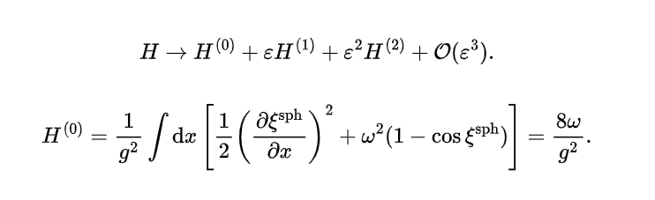



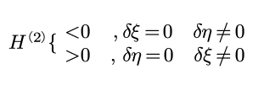


Check the saddle point —— discontinuity treating
Discontinuity at Zero

Slide 9
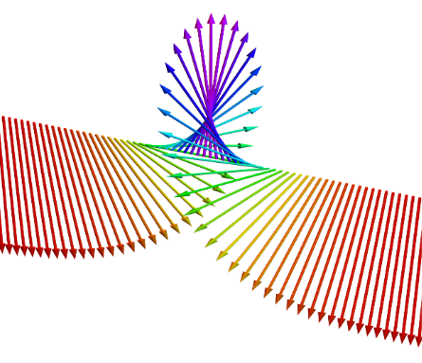
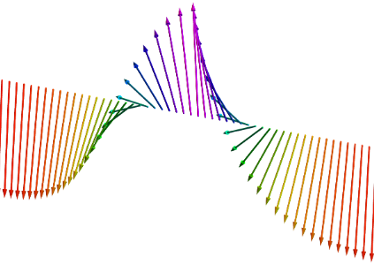
Check the saddle point —— discontinuity treating

Slide 10
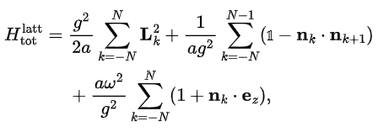
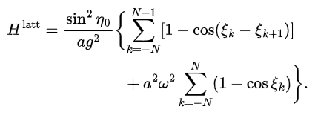
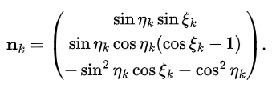
Sphaleron on Lattice
C. J. Hamer, J. B. Kogut, and L. Susskind, Phys. Rev. D 19, 3091 (1979).

Slide 11






ReProbe the Sphaleron on Lattice
Boundary condition and symmetry
Calculus of Variations

Slide 12

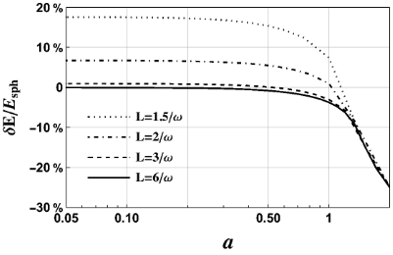
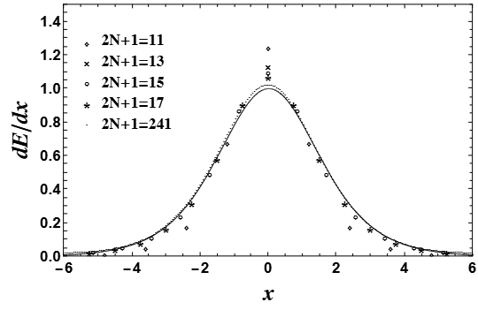
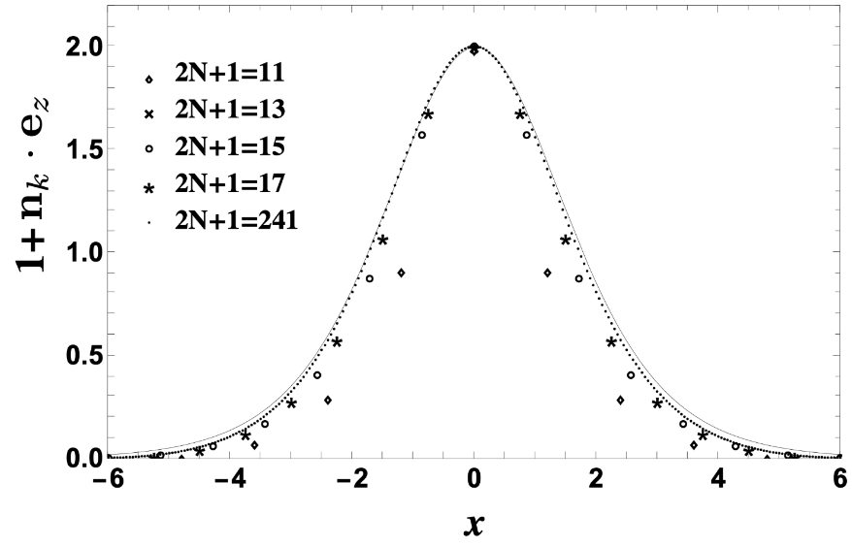
Classical Simulation of the Sphaleron on Lattice
Volume
spacing

Slide 13
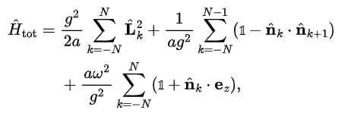

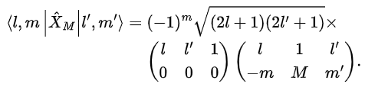



Quantumlize and Qubits Setting
Diagonal

Slide 14
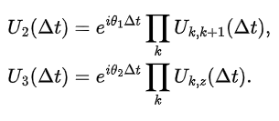
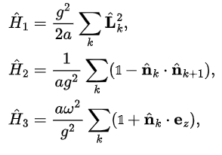






Suzuki Trotterization
Trotterize once more to Pauli strings

Slide 15













Resource & Error
Lenth of Pauli strings
Trotterizing Steps
Error
Resource
circuit depth at least
Still too large!!

Slide 16

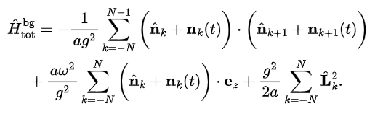

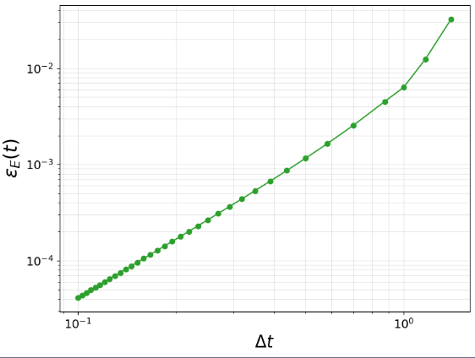
Open question——States for Simulation
generalized coherent states
background field
A.M.Perelomov, Commun.Math.Phys.26,222(1972).
More Classical/Quantum Recourse to Verify:
Physical Structure remained further refined:

Slide 17

THANK YOU!

