Slide 1

The 2025 International Workshop on the High Energy Circular Electron Positron Collider
ClS sensor prototyping with Chinese foundry
XiangMing Sun (孙向明)
Central China Normal University (华中师大)
November 6 , 2025
Notes:
Good morning and good afternoon. This is Yaping Wang, from Central China Normal University.
Today I will talk about the assembly of modules and supermodules for the Inner Tracking System of the NICA/MPD experiment.

Slide 2

Outline
1. Exploration of Domestic Processes for MAPS
2. R&D of MIC6_V3 Chip
3. Design of MIC6_V4 Chip
The 2025 International Workshop on the High Energy Circular Electron Positron Collider
Notes:
Part 1 R&D of MAPS Process

Slide 3
Outline
1. Exploration of Domestic Processes for MAPS
2. R&D of MIC6_V3 Chip
3. Design of MIC6_V4 Chip
The 2025 International Workshop on the High Energy Circular Electron Positron Collider
Notes:
Part 1 R&D of MAPS Process

Slide 4
1. Exploration of Domestic Processes for MAPS
Monolithic Active-Pixel Sensor (MAPS)
Integrate the sensor and readout circuit on the same silicon chip
  Low material budget
  Low cost
  Low input capacitance -> Low power consumption
The 2025 International Workshop on the High Energy Circular Electron Positron Collider
Notes:
MAPS is one of the most advanced charged-particle detection technologies.
It integrates sensor and readout circuit on the same silicon chip, with advantages of low material budget, low cost, and low power consumption.

Slide 5
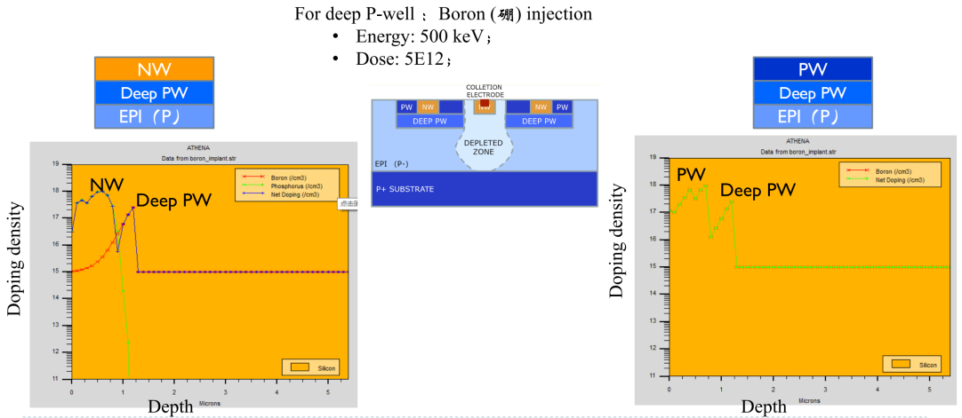
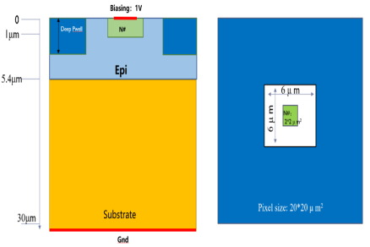
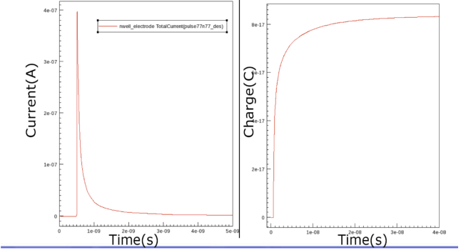
Research on 55nm CIS Process Pixel Chip——Process development
R&D of Domestic Process for MAPS
Simulation of TCAD for increasing deep P-wells
The domestically produced 55 nm CIS process production line only has 3 wells (N-well, P-well, and deep N-well)
Add deep P-wells based on existing production line processes
Deep P-well: A substrate N-well that shields PMOS transistors within the pixel region to avoid charge collection competition, improve charge collection efficiency, and allow pixel circuits to use both N-type and P-type transistors simultaneously, making it suitable for complex pixel circuits.
Deep N-well: A substrate P-well that isolates NMOS transistors in the peripheral circuit region, allowing the entire wafer substrate to be subjected to reverse voltage.
Reverse bias the substrate by 6V~12V, increase the depletion layer region, and improve the charge collection rate.
Simulation of TCAD Devices for Pixels
Determine the impurity concentration and injected energy
The 2025 International Workshop on the High Energy Circular Electron Positron Collider

Slide 6
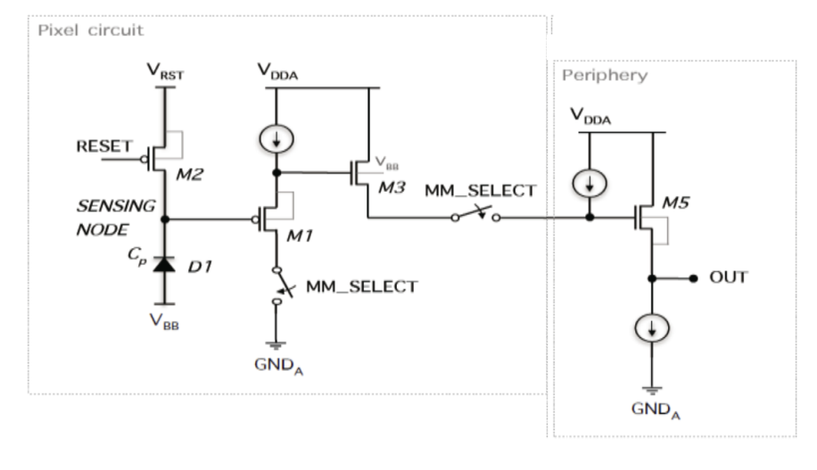
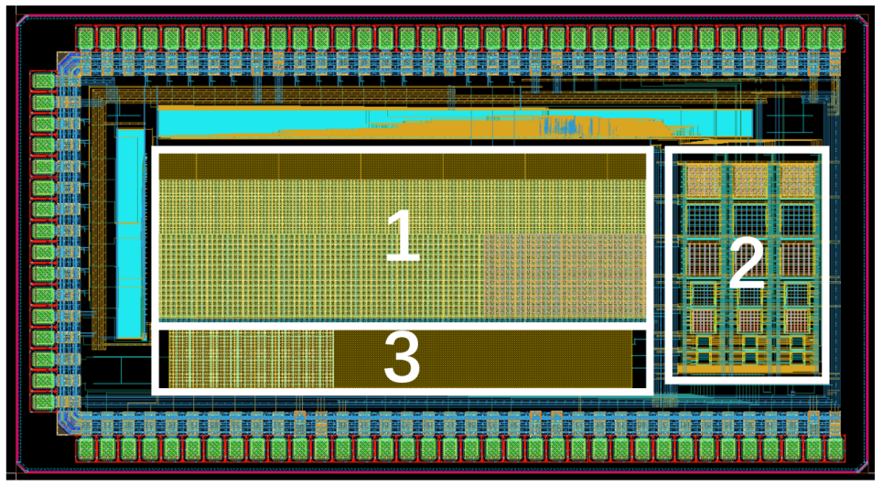
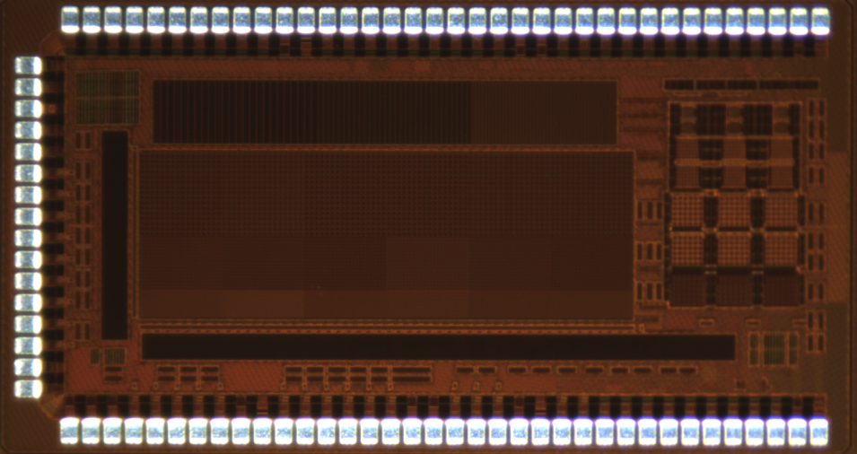
Research on 55nm CIS Process Pixel Chip——Chip Design
Pixel Array Process Validation Chip
Composed of three arrays with different purposes
Includes 3 types of pixel spacing (8um × 8um, 16um × 16um, and 24um × 24um)
Used for studying pixel geometry, charge collection electrodes, charge collection time, leakage current, sensing diode capacitance, and front-end circuit performance
The 2025 International Workshop on the High Energy Circular Electron Positron Collider

Slide 7
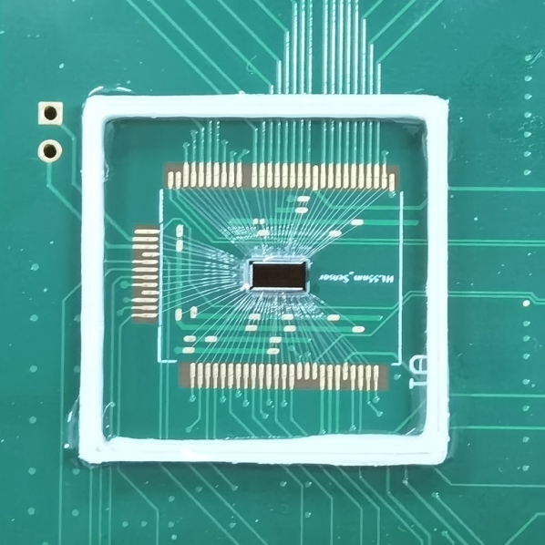
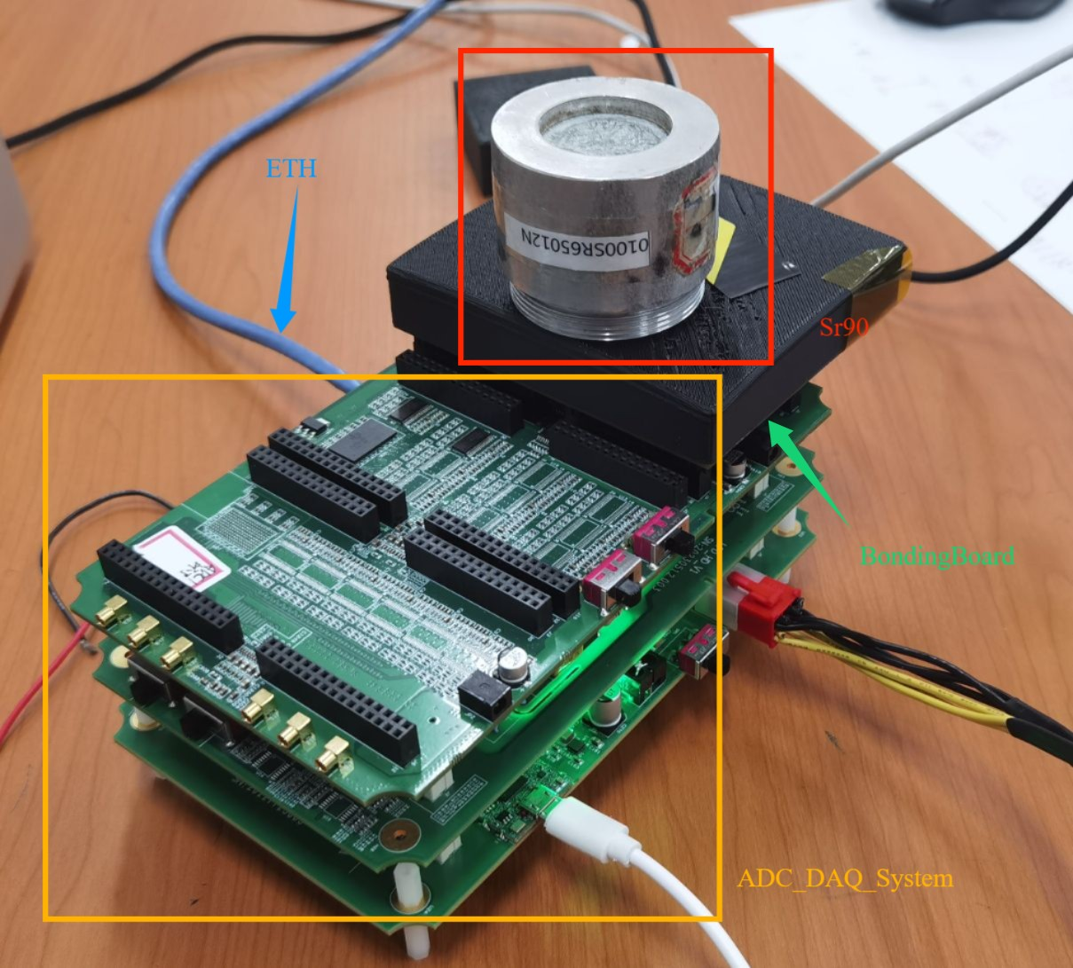
Research on 55nm CIS Process Pixel Chip——Testing System
Pixel array process validation chip testing system
Test System Characteristics:
Equipped with 16 Channel ADC (sampling rate 20MHz, 12 bits)
Provide 8 Channels of DAC Analog Voltage
Cache is 16 bit DDR3 with a Capacity of 256M
Gigabit Ethernet Data Transmission
Firmware Implementation Case Trigger
The 2025 International Workshop on the High Energy Circular Electron Positron Collider

Slide 8
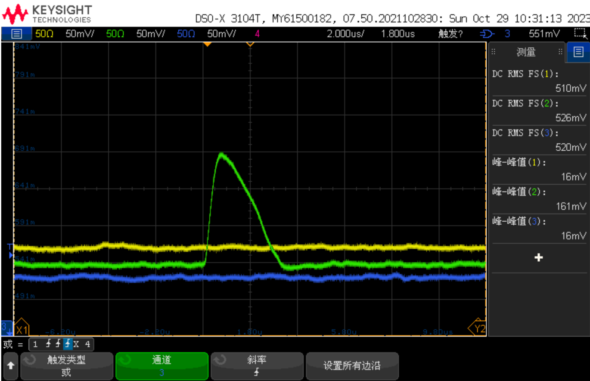
Research on 55nm CIS Process Pixel Chip——Chip Test
⁵⁵Fe Test
For the first time in China, the pixel chip designed based on domestic technology has detected the ⁵⁵Fe signal
⁵⁵Fe signal observed by pixel array chip, 160mV
The 2025 International Workshop on the High Energy Circular Electron Positron Collider

Slide 9
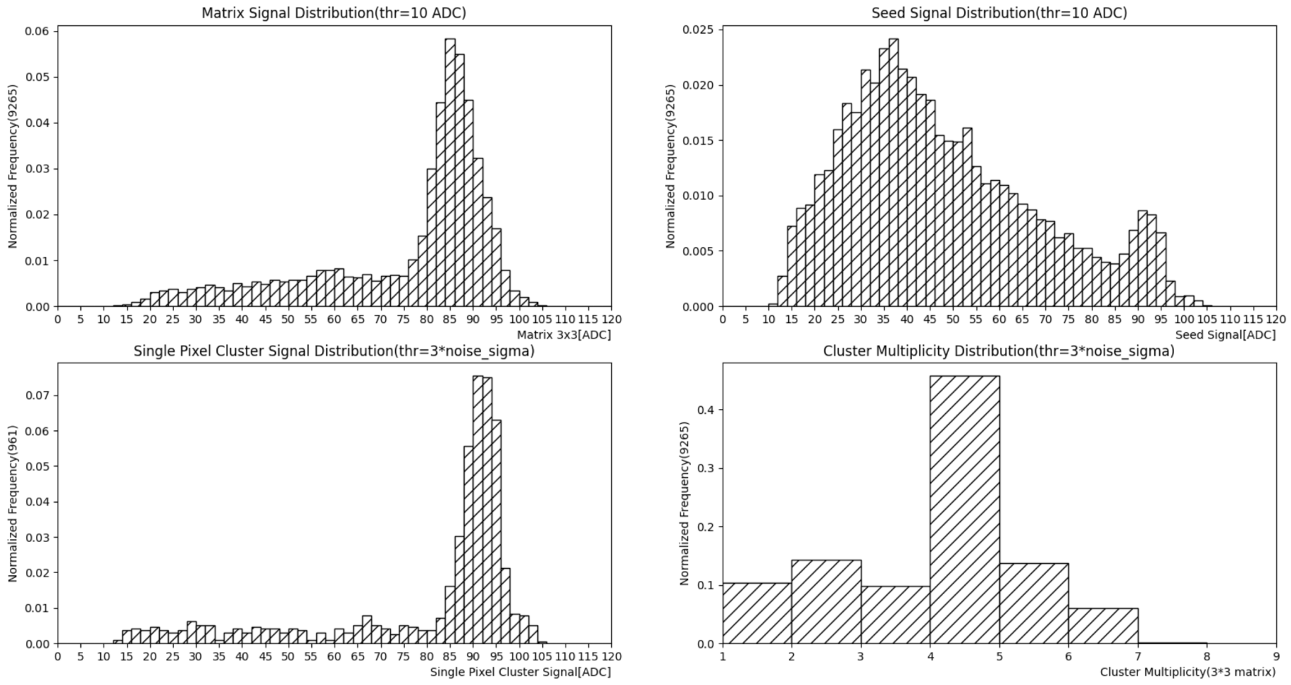
Research on 55nm CIS Process Pixel Chip——Chip Test
⁵⁵Fe Energy Spectrum
Peak value 86
Collecting Peaks
Energy spectrum of cluster seed signals
Energy spectrum of 3x3 matrix signal
Calibration peak92
Energy spectrum of single pixel clusters
Cluster multiplicity
Calibration peak ADC Value 92 -> 1640 e⁻
CCE=86/92=93.5%
The 2025 International Workshop on the High Energy Circular Electron Positron Collider

Slide 10
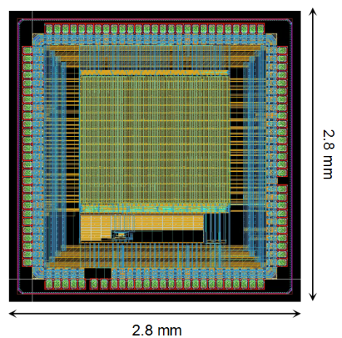
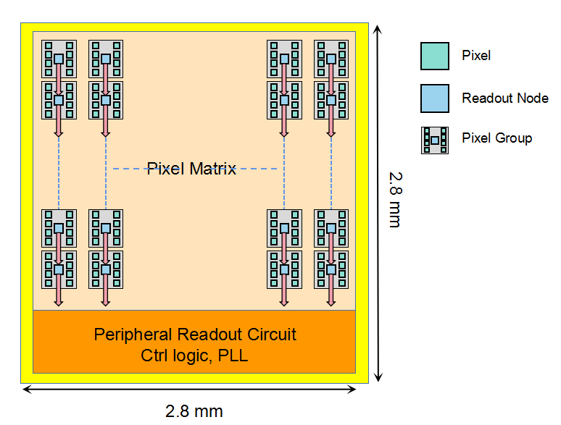
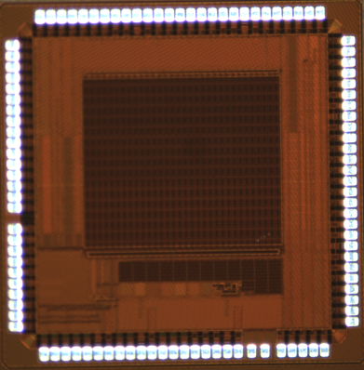
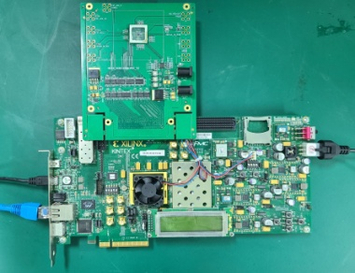
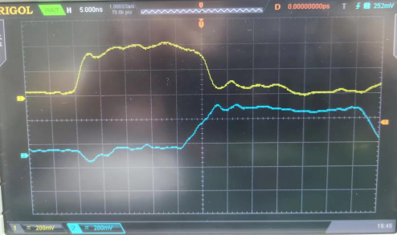
Research on 55nm CIS Process Pixel Chip - Chip Design and Testing
Read architecture verification chip MIC6_V1
Preliminary test results
Multiple dual columns of the chip were tested
Inject the write request signal req at the top of the dual row, and the chip outputs the ack signal normally at the top.
After 25ns, a request signal req appeared at the bottom of the double column, and the 22 bit test data was correctly transmitted to the bottom of the double column. There are 16 asynchronous handshake read nodes in the dual column, and each node requires 25ns/16=1.56ns to complete data transmission, which is 640MHz.
Read out 8 pixels every 1.56ns (under extreme conditions)
Chip Characteristics:
55 nm CIS Process
Pixel Array:64x64
Pixel Size:24umx20um
ENC < 4.4 e-
Arrival Time Resolution:5-10 ns
Node Based Zero Compression, Parallel Readout Architecture
Column Based Asynchronous Readout
The 2025 International Workshop on the High Energy Circular Electron Positron Collider

Slide 11
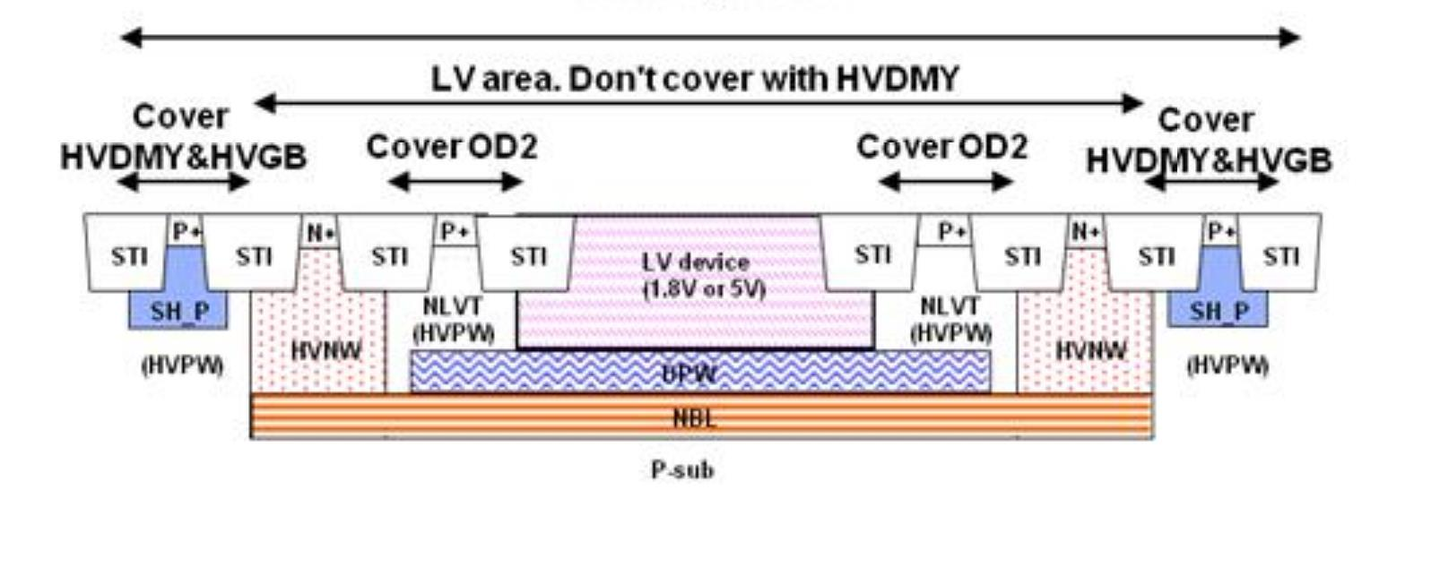
Research on 180 nm High Voltage Process Pixel Chip
High Voltage: 70V, achieving a large depletion layer
Four Well Process: NW, PW, DPW, DNW, achieving high voltage isolation
6 Layers of Metal
Top Metal Thickness: 4 microns, achieving a small voltage drop
Block Resistance: 3Kohm/block, Capacitance: 2fF/um2, Achieving Small Area
Stable Process and Guaranteed Production Capacity
180 nm BCD
Process：
The 2025 International Workshop on the High Energy Circular Electron Positron Collider

Slide 12
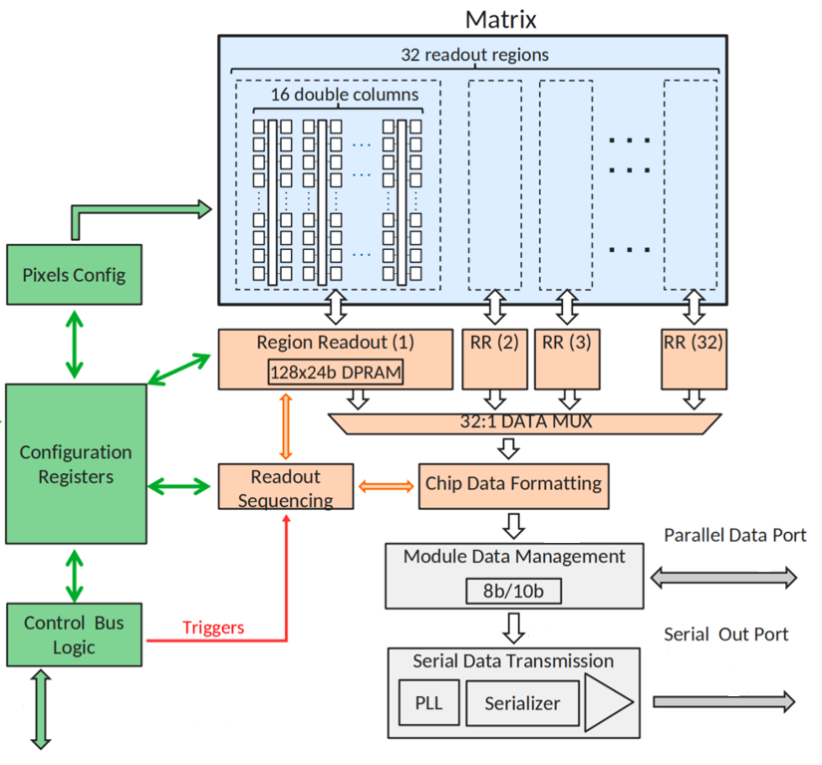
Research on 180 nm High Voltage Process Pixel Chip
MIC6_V2：
Chip Size: 2 cm X 0.695 cm
Divided into Two Regions: low voltage region NW (1.8V) and high voltage region HVNW (70V)
The Pixel Size (25 μ m x 34 μ m) Includes 7 Sizes of Diodes
The Peripheral Module includes a Digital Readout Module Bandgap, VDAC, IDAC, Serilizer And PLL, etc.
The 2025 International Workshop on the High Energy Circular Electron Positron Collider

Slide 13
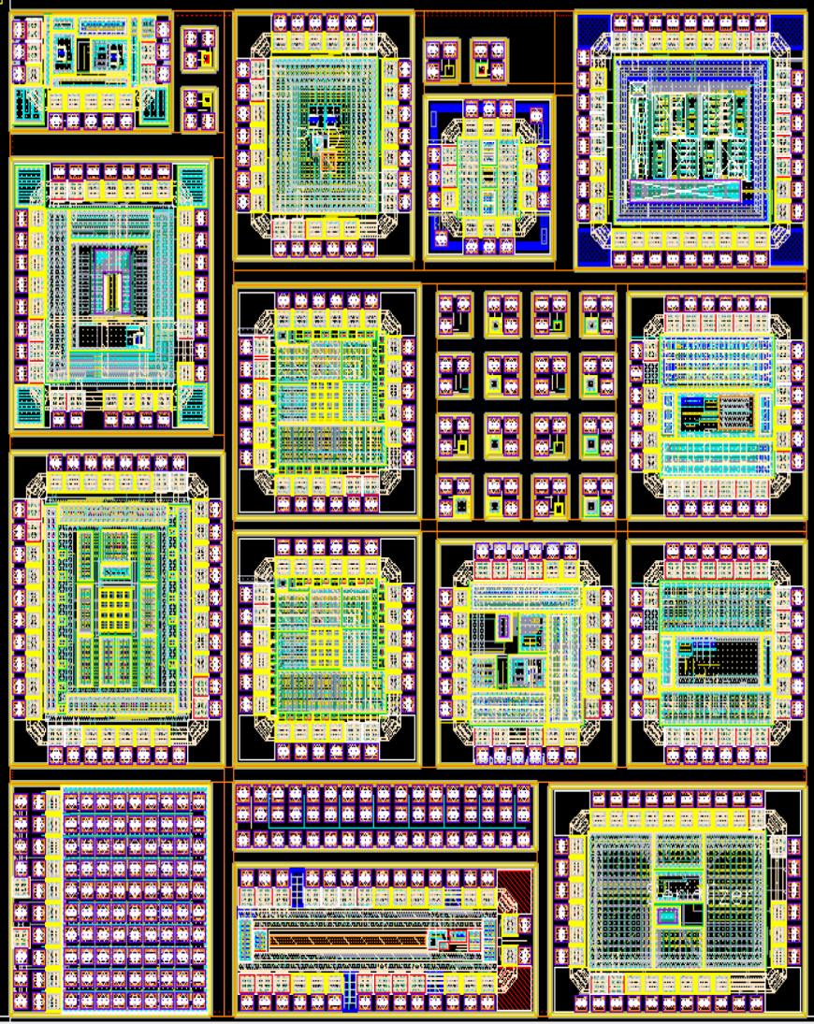
Research on 180 nm High Voltage Process Pixel Chip——Chip Design
 | MPW Chip List
1 | serializer
2 | FEE
3 | MOS radiation
4 | PLL 2.2G
5 | current DAC
6 | diode+SF
7 | diode_ALPIDE
8 | PLL 200M
9 | diode array
10 | diode+SF DT
11 | TDC
12 | ADC
13 | voltage DAC
14 | CSAHIGHHIT
15 | PDH+bandgap+Abuffer
15
14
13
12
11
10
9
8
7
6
5
4
3
2
1
The First Tape-out
The 2025 International Workshop on the High Energy Circular Electron Positron Collider

Slide 14
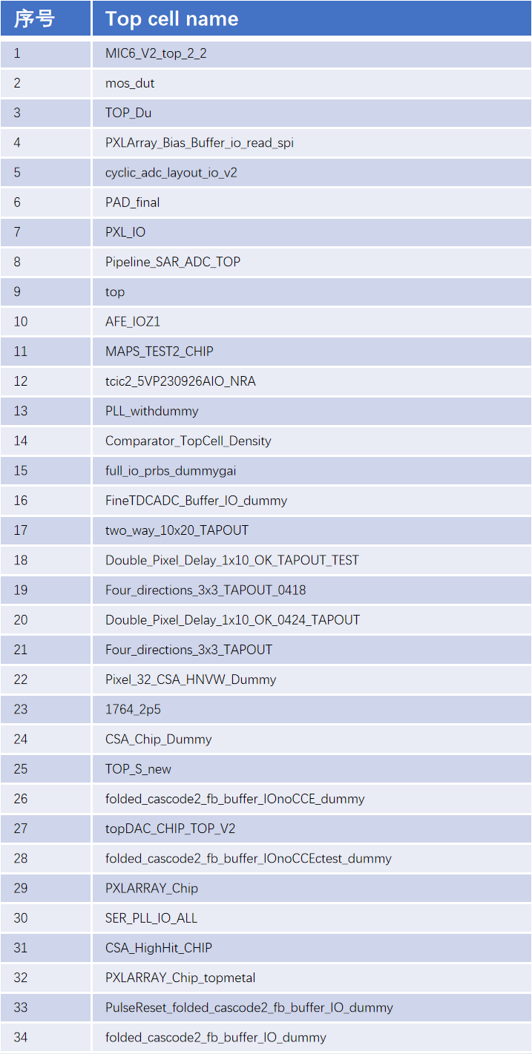
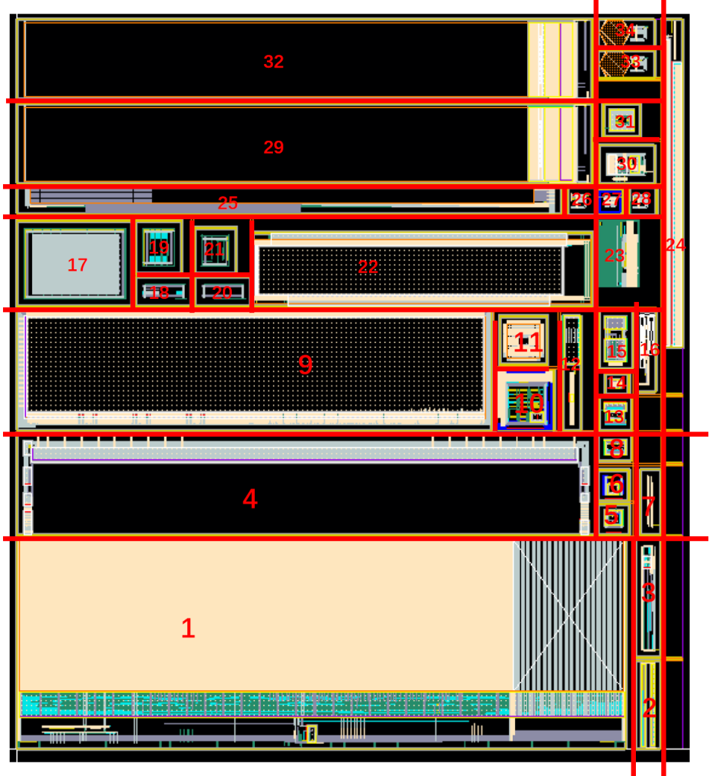
Research on 180 nm High Voltage Process Pixel Chip——Chip Design
The Second Tape-out
The 2025 International Workshop on the High Energy Circular Electron Positron Collider

Slide 15
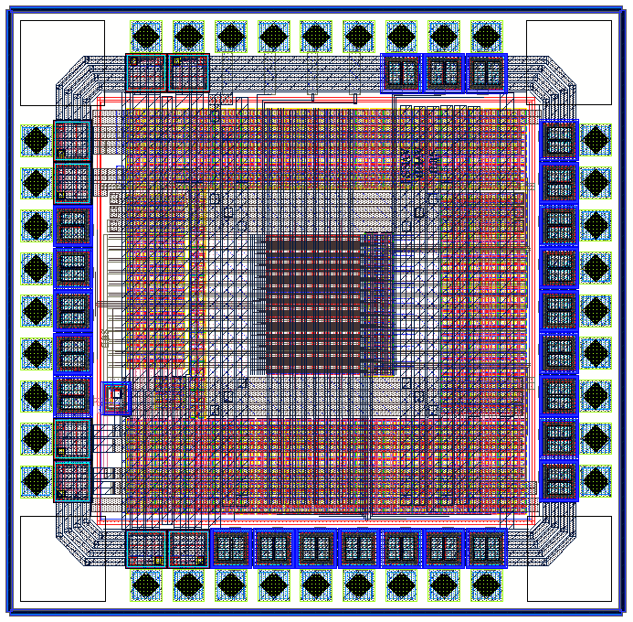
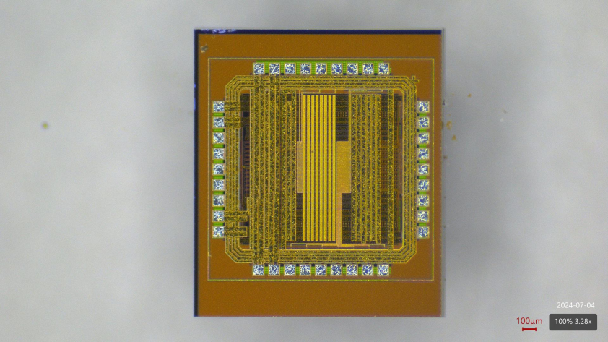
Research on 180 nm High Voltage Process Pixel Chip——Chip Test
Pixel Array Testing Chip
Testing System
Pixel Structure：Diode + SF
Pixel Size：30 × 30 um
Array Size：（4 × 4）× 6
Chip Size：1580um × 1550um
PXL<0:7> : DIODE RESET
PXL<8:15> : PMOS RESET
The 2025 International Workshop on the High Energy Circular Electron Positron Collider

Slide 16
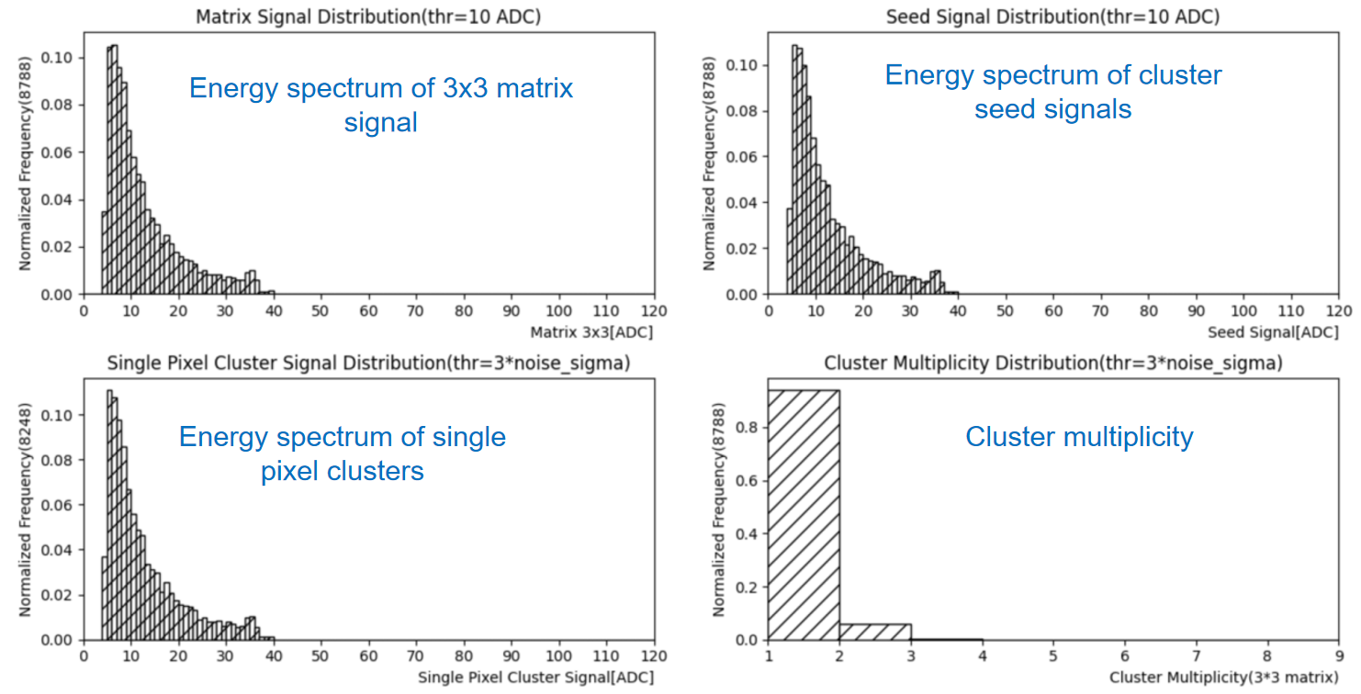
Research on 180 nm High Voltage Process Pixel Chip——Chip Test
⁵⁵Fe Energy Spectrum（Substrate Bias Voltage 0V）
The signal of ⁵⁵Fe source did not fully reach the sensing area, and no calibration peak was measured.
The position of 'calibration peak' is at ADC Value 35.5 -> 1640e⁻.
The 2025 International Workshop on the High Energy Circular Electron Positron Collider

Slide 17
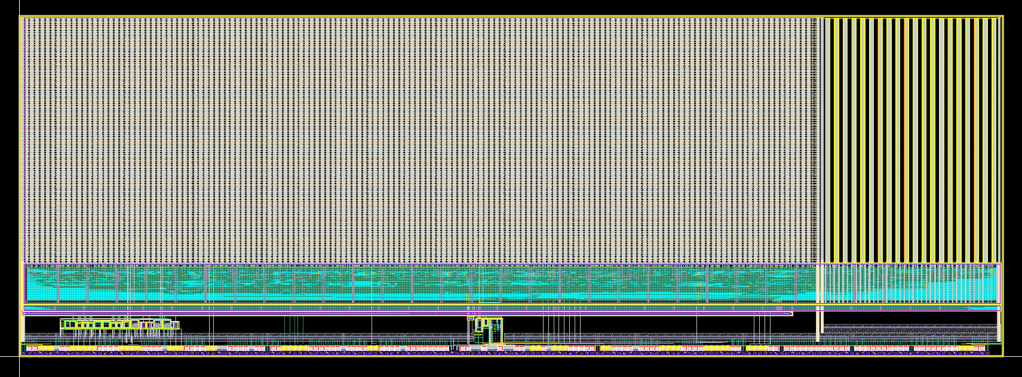
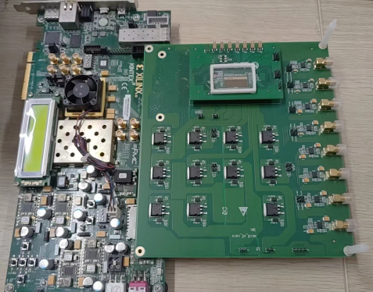
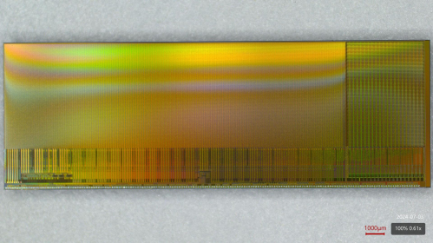
Research on 180 nm High Voltage Process Pixel Chip——MIC6_V2
1
2
0.695 cm
3
2 cm
Chip Size: 2 cm X 0.695 cm
Divided into two regions: low voltage region NW (1.8V) and high voltage region HVNW (70V)
The pixel size (25 μ m x 34 μ m) includes 7 sizes of diodes
The peripheral module includes a digital readout module Bandgap, VDAC, IDAC, Serilizer And PLL, etc.
MIC6_V2 Chip photo
Test system photos
The 2025 International Workshop on the High Energy Circular Electron Positron Collider

Slide 18
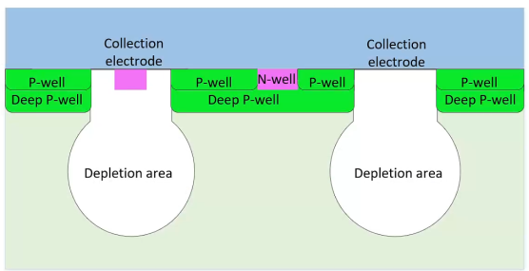
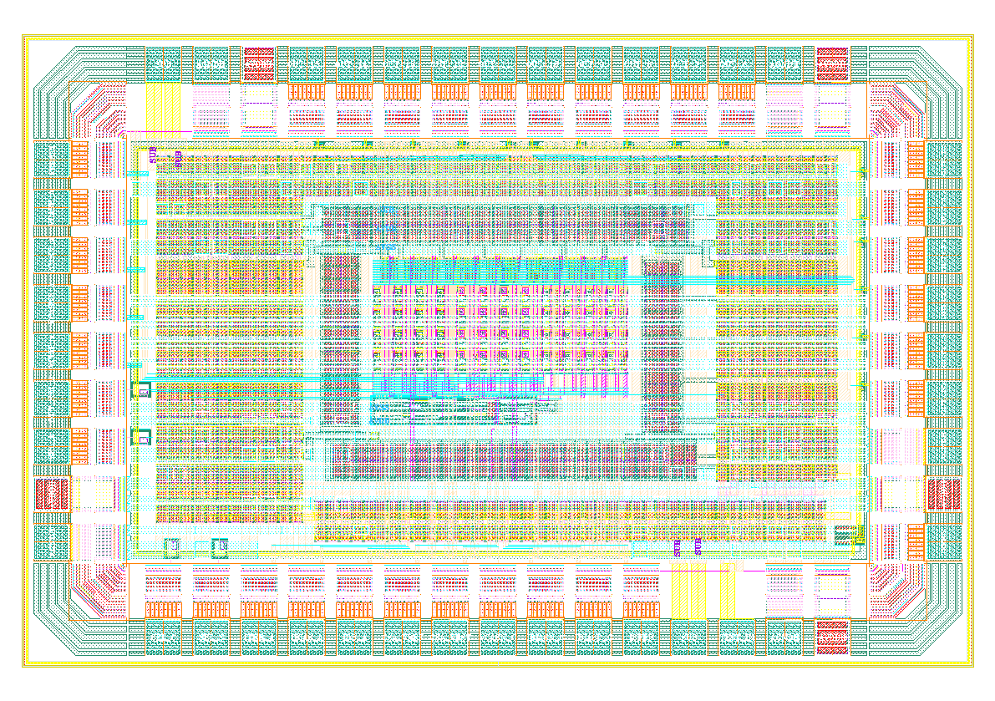
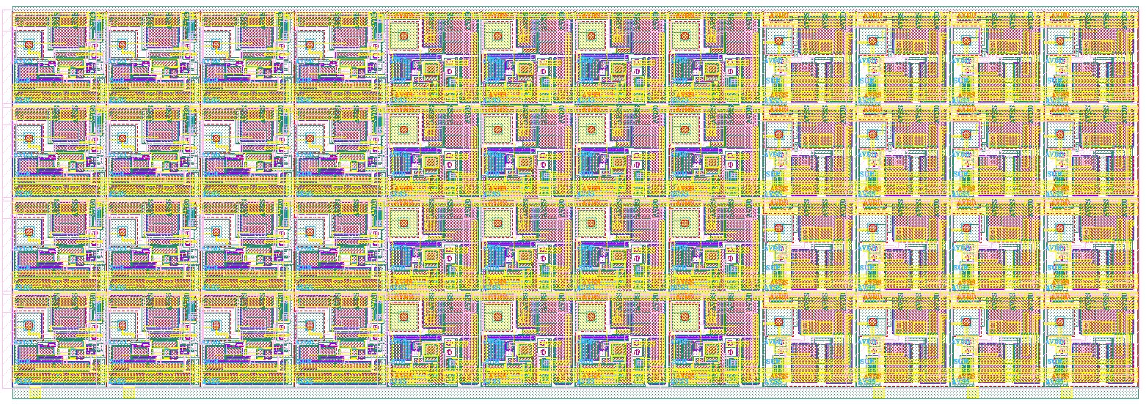
Research on 130nm Bulk CMOS Process Pixel Chip
—Chip Design
130 nm Bulk CMOS Process：
  3 well（NW、PW、DNW） -> 4 well （NW、PW、DNW、DPW）
  6 layers of metal
  Support high resistance silicon substrates
high resistance silicon substrates
Design of Pixel Array Testing Chip
MAPS + ALPIDE
MAPS + CSA
MAPS + SF
Pixel Structure：
  MAPS + ALPIDE
  MAPS + CSA
  MAPS + SF
Array Size：（4 × 4）× 3
Chip Size：1.8mm × 1.2mm
Sensor: Diode
ENC < 50e-
CSA_Av ~ 80mV/ke-
PeakingTime < 10us
FE Power: 300nA × 3.3V
Pixel pitch: 40um
Sensor: Diode
ENC < 8e-
FE Power: 40nA * 3.3V
Threshold < 1ke-
Integration Period < 10us
Pixel pitch: 40um
Sensor: Diode
Pixel pitch: 40um
SFP BIAS: 1uA

Slide 19
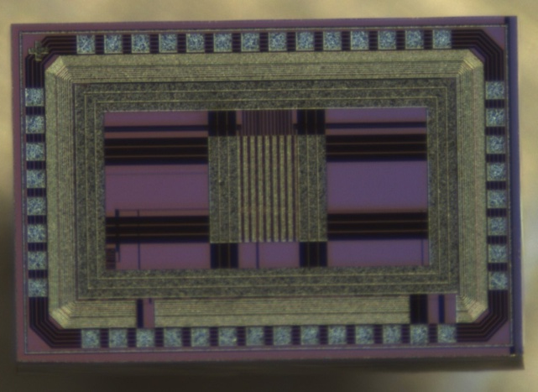
Research on 130nm Bulk CMOS Process Pixel Chip——Chip Test
Pixel Array Testing Chip
补充芯片照片
测试系统照片
Testing System
The 2025 International Workshop on the High Energy Circular Electron Positron Collider

Slide 20
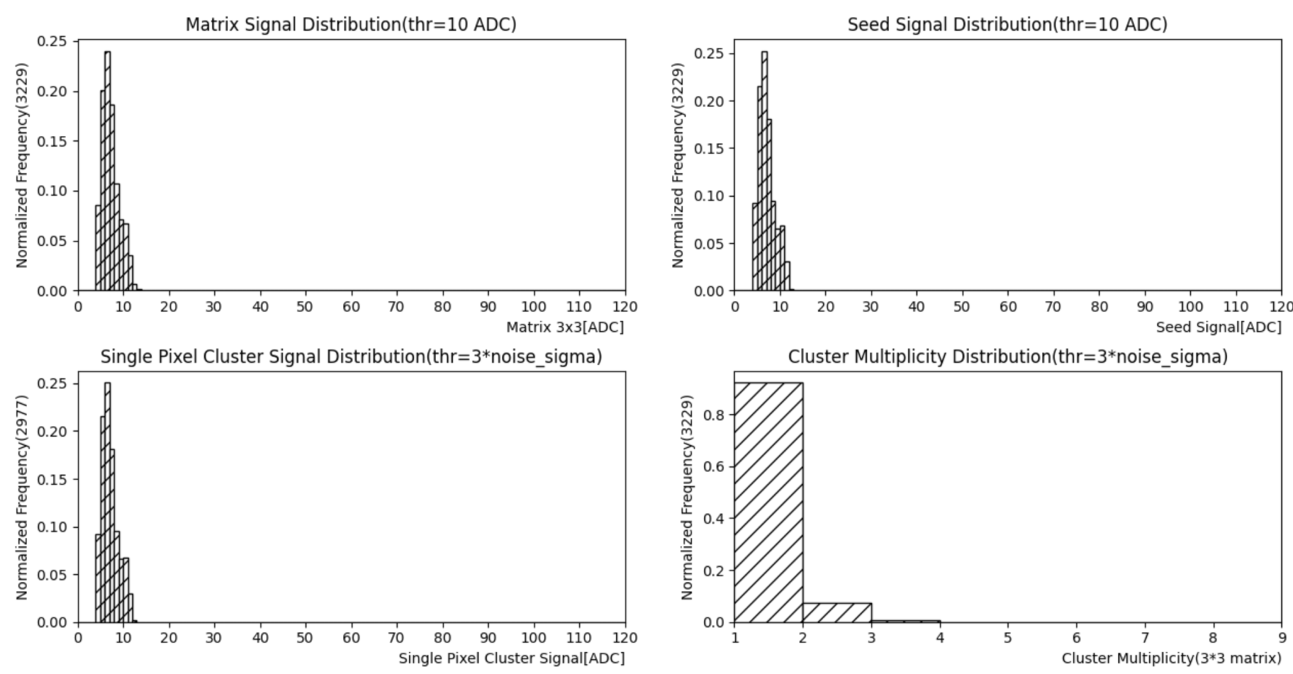
Research on 130nm Bulk CMOS Process Pixel Chip——Chip Test
⁵⁵Fe Energy Spectrum (High Resistance Substrate -9V Bias)
Energy spectrum of 3x3 matrix signal
Energy spectrum of cluster seed signals
Energy spectrum of single pixel clusters
Cluster multiplicity
The signal of ⁵⁵Fe source did not fully reach the sensing area, and no calibration peak was measured.
The 2025 International Workshop on the High Energy Circular Electron Positron Collider

Slide 21
Research on Pixel Technology
⁹⁰Sr test | 55 nm CIS technology | 180 nm High Voltage technology 0V bias | 180 nm High Voltage technology -9V bias | 130 nm Bulk CMOS process Low resistance substrate | 130 nm Bulk CMOS process High resistance substrate 0V bias | 130 nm Bulk CMOS process High resistance substrate -9V bias
MPV (ADC Value) | 10(178e⁻) | 10 (462e⁻) | To be tested | 6.5 | 8.5 | 12
Case rate (per hour) | 4100 | 1440 | To be tested | 840 | 2760 | 11700
Pixel size | 24u×24u | 30u x 30u |  | 40u x 40u
The 2025 International Workshop on the High Energy Circular Electron Positron Collider

Slide 22
Outline
1. Exploration of Domestic Processes for MAPS
2. R&D of MIC6_V3 Chip
3. Design of MIC6_V4 Chip
The 2025 International Workshop on the High Energy Circular Electron Positron Collider
Notes:
Part 1 R&D of MAPS Process

Slide 23
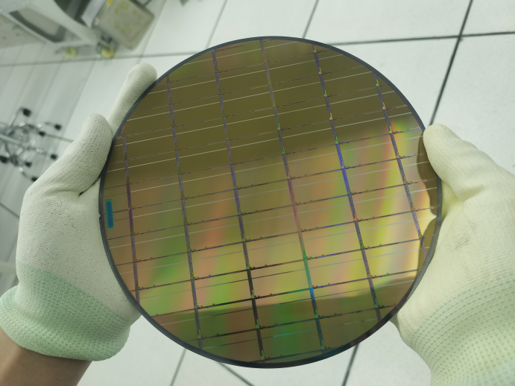
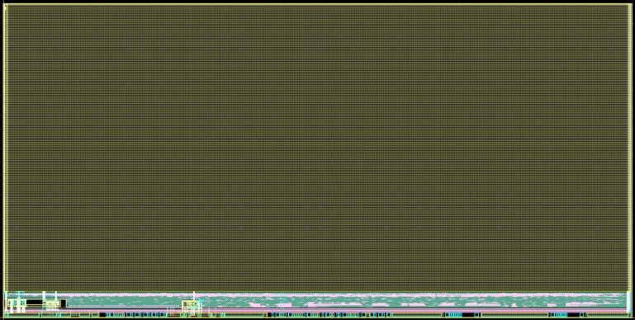
2. R&D MIC6_V3 Chip
MIC6_V3 layout
MIC6_V3 wafer
Features | ALPIDE | MIC6_V3
Process Technology | TowerJazz-180 nm | GSMC-130 nm
Core Voltage | 1.8V | 1.2V
Chip Size | 30 mm×15 mm | 30 mm×15 mm
Pixel Array | 1024×512 | 980×512
Pixel Size | 29.24 um×26.88 um | 30.53 um×26.8 um
Zero Suppression Readout | AERD | AERD
High-Speed Serial Output | 1.2Gbps | 1.1Gbps
Power Consumption | 40 mW/cm² | 32 mW/cm²
MIC6_V3 block diagram
The 2025 International Workshop on the High Energy Circular Electron Positron Collider
Notes:
The top two figures are the layout and wafer of MICA_V1.
The block diagram of MICA_V1 is shown in bottom left.
The table in bottom right compares the performance of ALPIDE and MICA_V1.

Slide 24
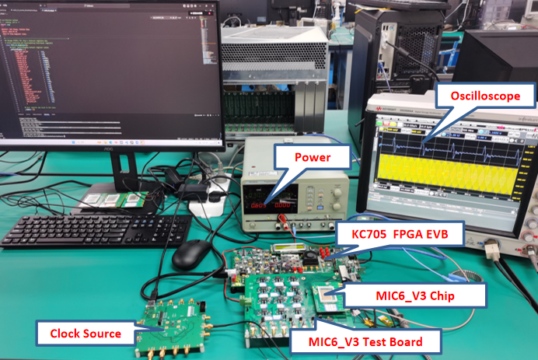
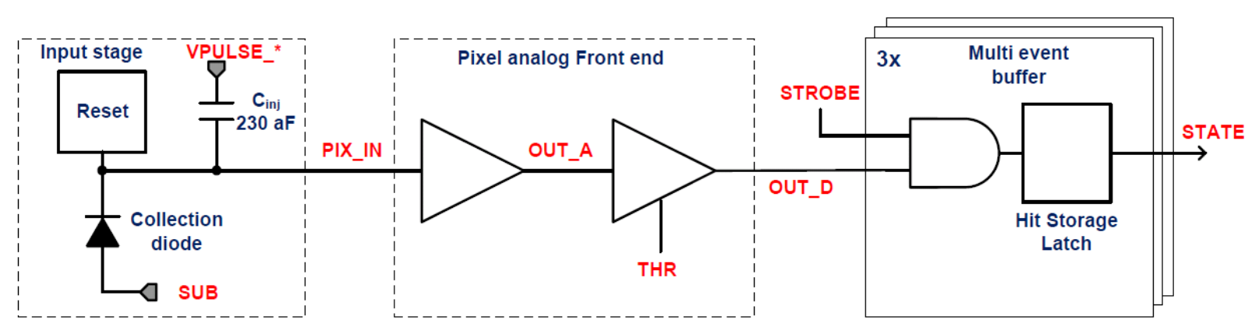
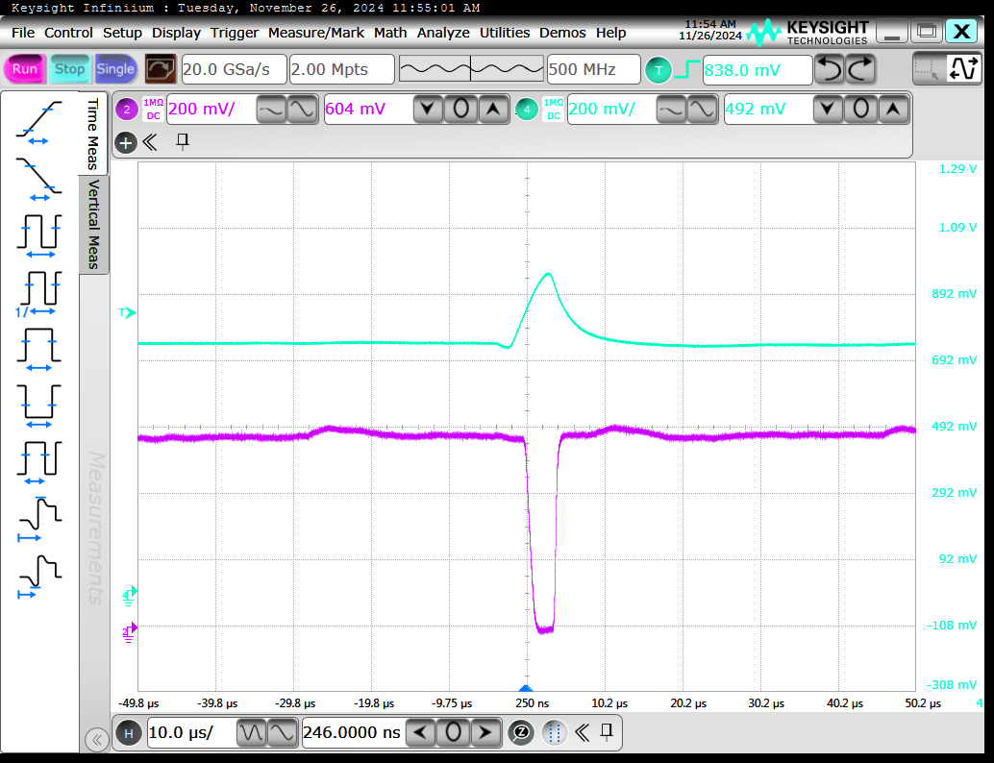
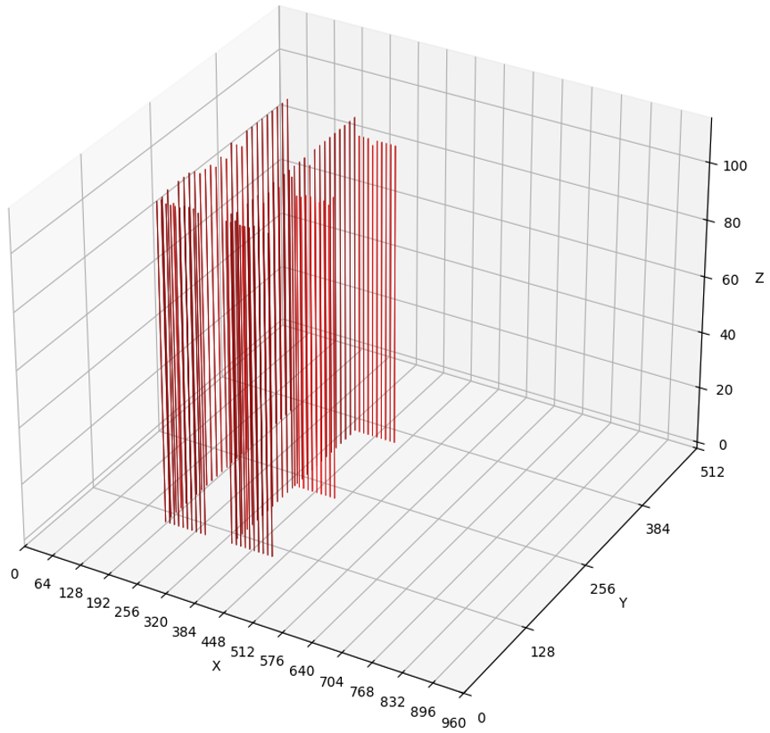
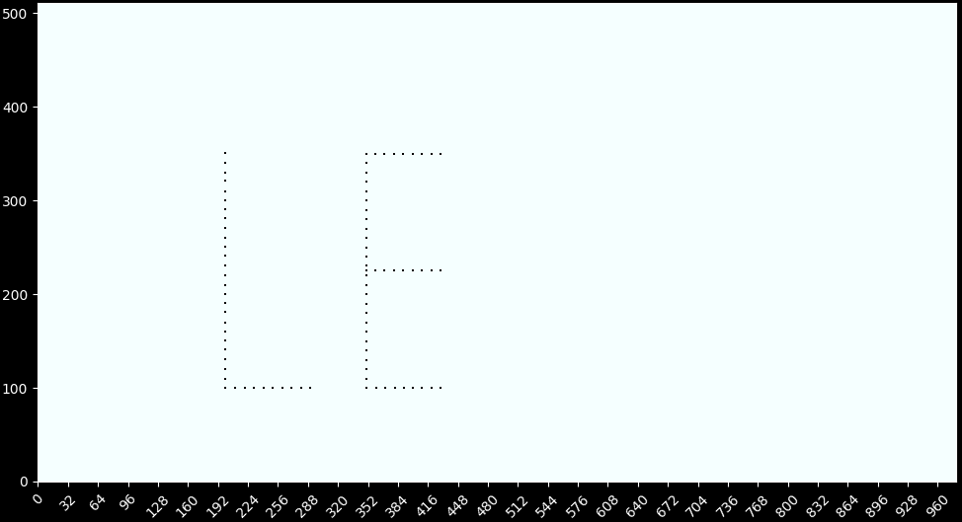
2. R&D MIC6_V3 Chip
Test System of MIC6_V3
Pixel Front-end Test
Pixel Array Readout Test
Readout function test with pixel MASK and Apulse/Dpulse
Notes:
We have developed a test system to test MICA_V1.
The pixel front-end test results are shown in top right.
The Pixel array readout test results are shown in the bottom.

Slide 25
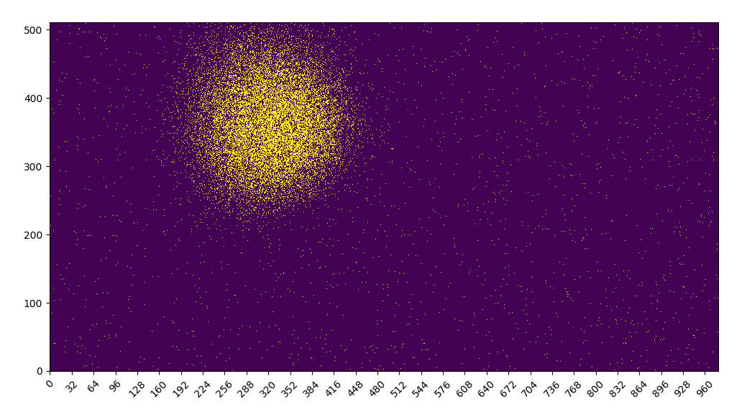
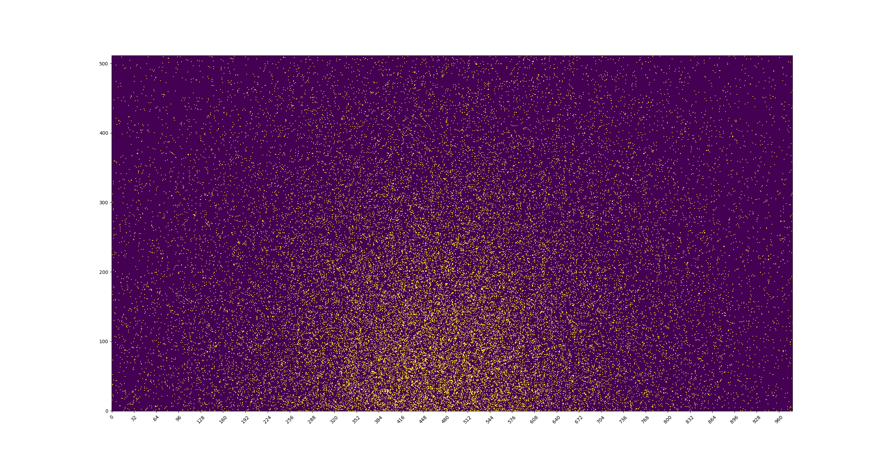
2. R&D MIC6_V3 Chip
²⁴¹Am Test using MIC6_V3
⁹⁰Sr Test using MIC6_V3
The 2025 International Workshop on the High Energy Circular Electron Positron Collider
Notes:
This slice shows the test results of two radiation source using MICA_V1.
The left is the result of Americium 241.
The right is the result of Sr 90.

Slide 26
Outline
1. Exploration of Domestic Processes for MAPS
2. R&D of MIC6_V3 Chip
3. Design of MIC6_V4 Chip
The 2025 International Workshop on the High Energy Circular Electron Positron Collider
Notes:
Part 1 R&D of MAPS Process

Slide 27
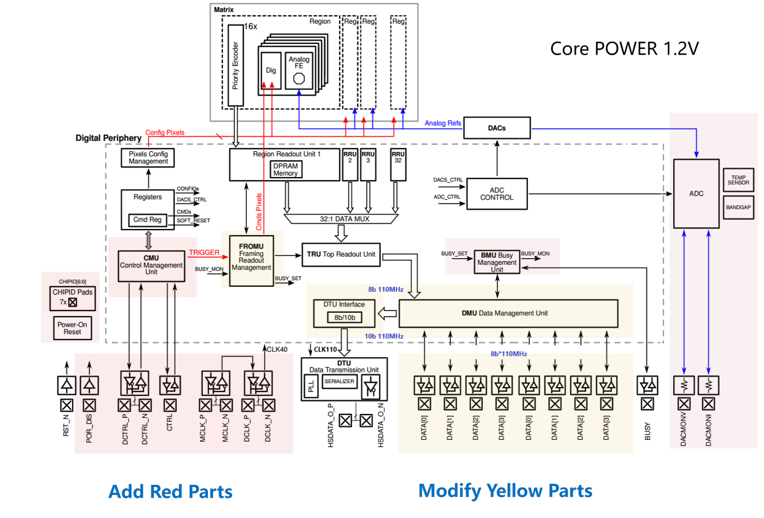
3. Design of MIC6_V4 Chip
MIC6_V4 block diagram
Compared to MIC6_V3
1. Add clock tree interconnection function between chips.
2. Add control management unit (CMU) to replace SPI interface.
3. Modify the data management unit (DMU) to support data transmission between master and slave chips.
4. Modify the framing readout management unit (FROMU) to add chip ID information.
5. Both clock and control signals use differential I/O.
6. Remove the 3.3V power supply and 3.3V I/O. Only has 1.2V power supply.
7. High-speed serial interface has been changed from 1.1Gbps to 1.2Gbps.
8. Add on-chip LDO.
The 2025 International Workshop on the High Energy Circular Electron Positron Collider
Notes:
This figure shows the block diagram of MICA_V2.
Compared to MICA_V1, it add red parts and modify yellow parts.
Specifically, It Add clock tree interconnection function between chips.
Add control management unit (CMU) to replace SPI interface.
Modify the data management unit (DMU) to support data transmission between master and slave chips.
Modify the framing readout management unit (FROMU) to add chip ID information.
Both clock and control signals use differential I/O.
Remove the 3.3V power supply and 3.3V I/O. Only has 1.2V power supply.
High-speed serial interface has been changed from 1.1Gbps to 1.2Gbps.
And add on-chip LDO.

Slide 28
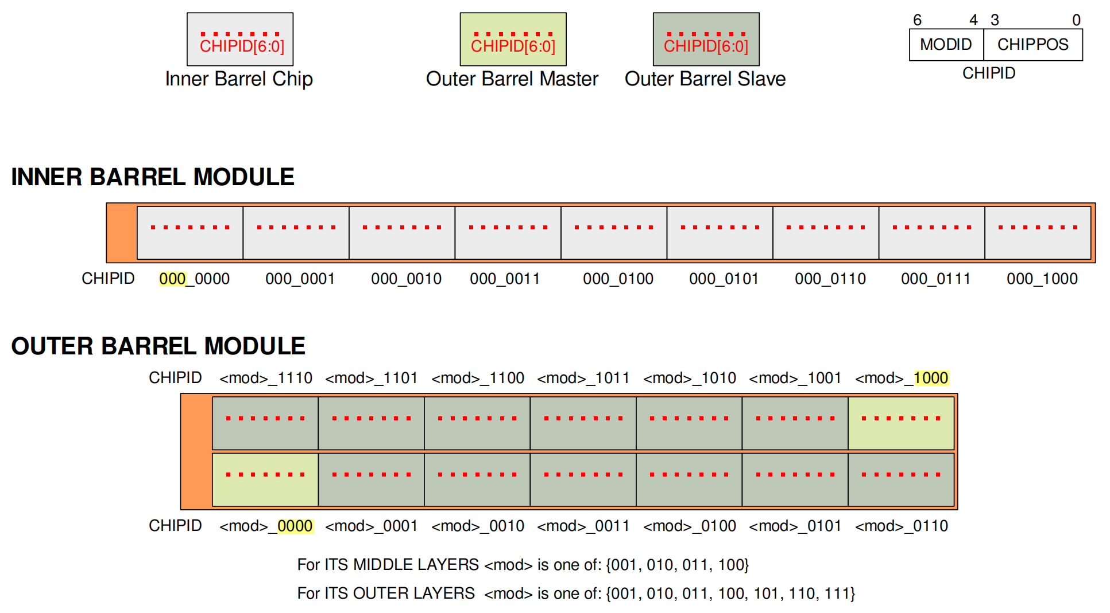
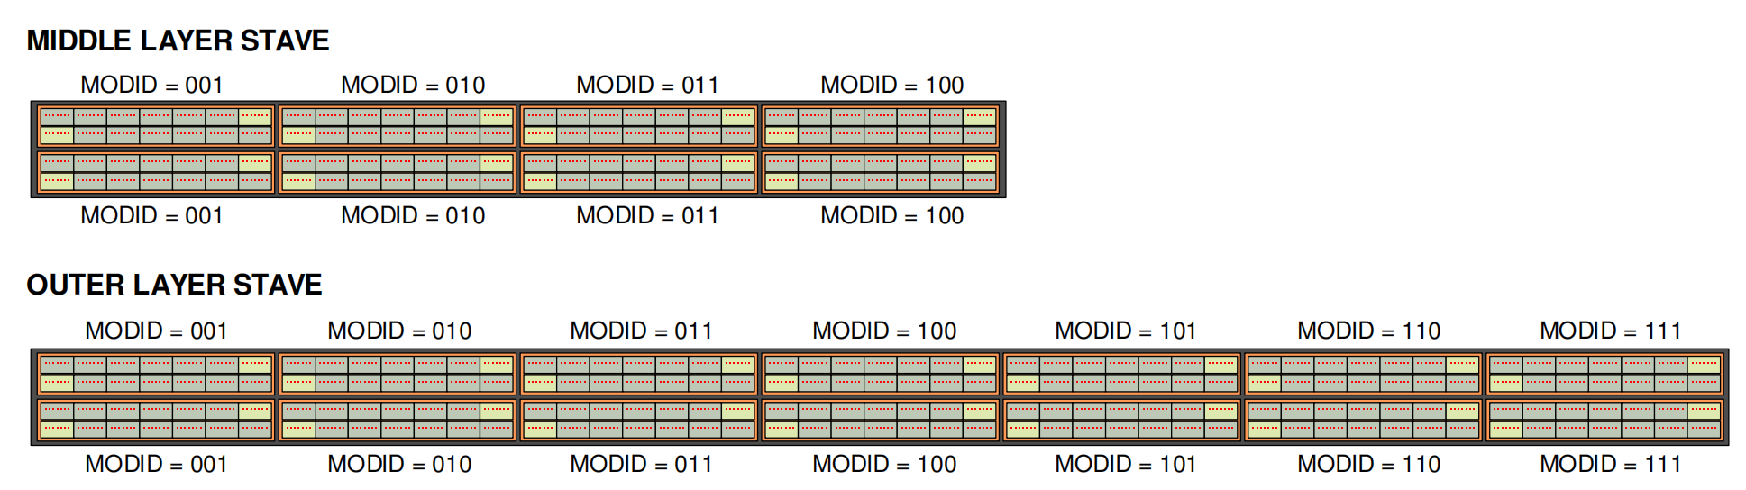
3. Design of MIC6_V4 Chip
Chip identification and geographical address allocation
The 2025 International Workshop on the High Energy Circular Electron Positron Collider
Notes:
This slice shows the Chip identification and geographical address allocation
0f Inner Barrel Module, Outer Barrel Module, Middle layer Stave and Outer Layer Stave.

Slide 29
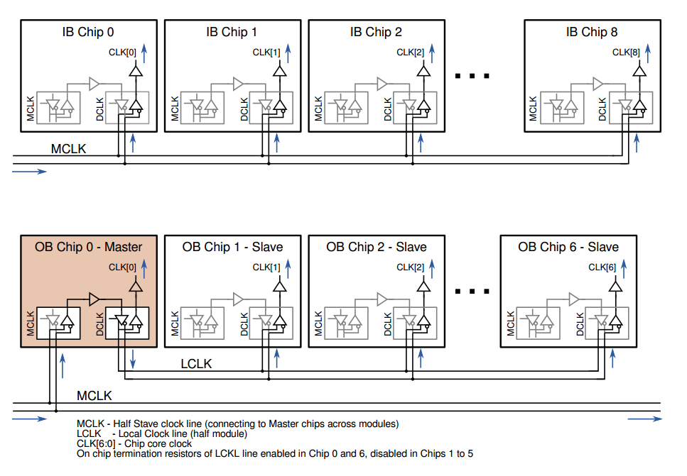
3. Design of MIC6_V4 Chip
Chip and modules clocking schemes
Inner Barrel Modules
The clock signal adopts the MLVDS standard.
Outer Barrel Modules
The local clock line LCLK has on-chip termination resistors.
本地时钟
The 2025 International Workshop on the High Energy Circular Electron Positron Collider
Notes:
This slice shows the chip and modules clocking schemes of Inner Barrel Modules and Outer Barrel Modules.
The clock signal adopts the MLVDS standard.
In Outer Barrel Modules, the local clock line has on-chp termination resistors

Slide 30
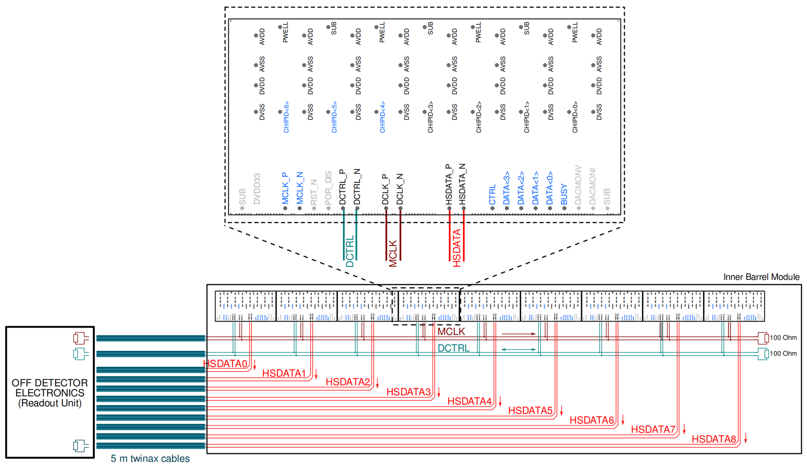
3. Design of MIC6_V4 Chip
Inner Barrel Module
Inner Barrel Module:
All chips' clocks are connected to the global clock line, MLVDS signal standard
All chip control interfaces are connected to the global control bus, MLVDS signal standard
All chips output data directly to the readout unit through the 1.2Gbps high-speed serial interface，CML signal standard
Inner Barrel Module signal connection diagram
The 2025 International Workshop on the High Energy Circular Electron Positron Collider
Notes:
This slice shows the Inner Barrel Module signal connection diagram.
All chips' clocks are connected to the global clock line, MLVDS signal standard.
All chip control interfaces are connected to the global control bus, MLVDS signal standard.
All chips output data directly to the readout unit through the 1.2Gbps high-speed serial interface，CML signal standard

Slide 31
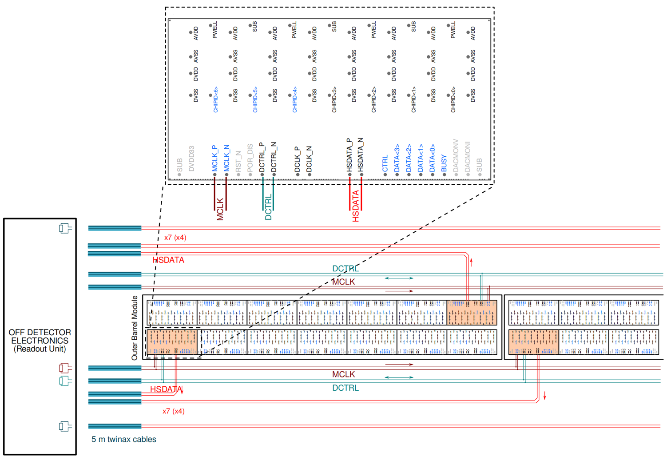
3. Design of MIC6_V4 Chip
Outer Barrel Module - Master Chip
OB Master Chip:
All Master chips' clocks are connected to the global clock line, MLVDS signal standard
All Master chip control interfaces are connected to the global control bus, MLVDS signal standard
All Master chips output data directly to the readout unit through the 300Mbps high-speed serial interface，CML signal standard
Outer Barrel Module Master chip signal connection diagram
The 2025 International Workshop on the High Energy Circular Electron Positron Collider
Notes:
This slice shows the Outer Barrel Module Master chip signal connection diagram.
It is almost the same with inner Barrel Module chip.
The difference is the data rate of the high-speed serial interface.

Slide 32
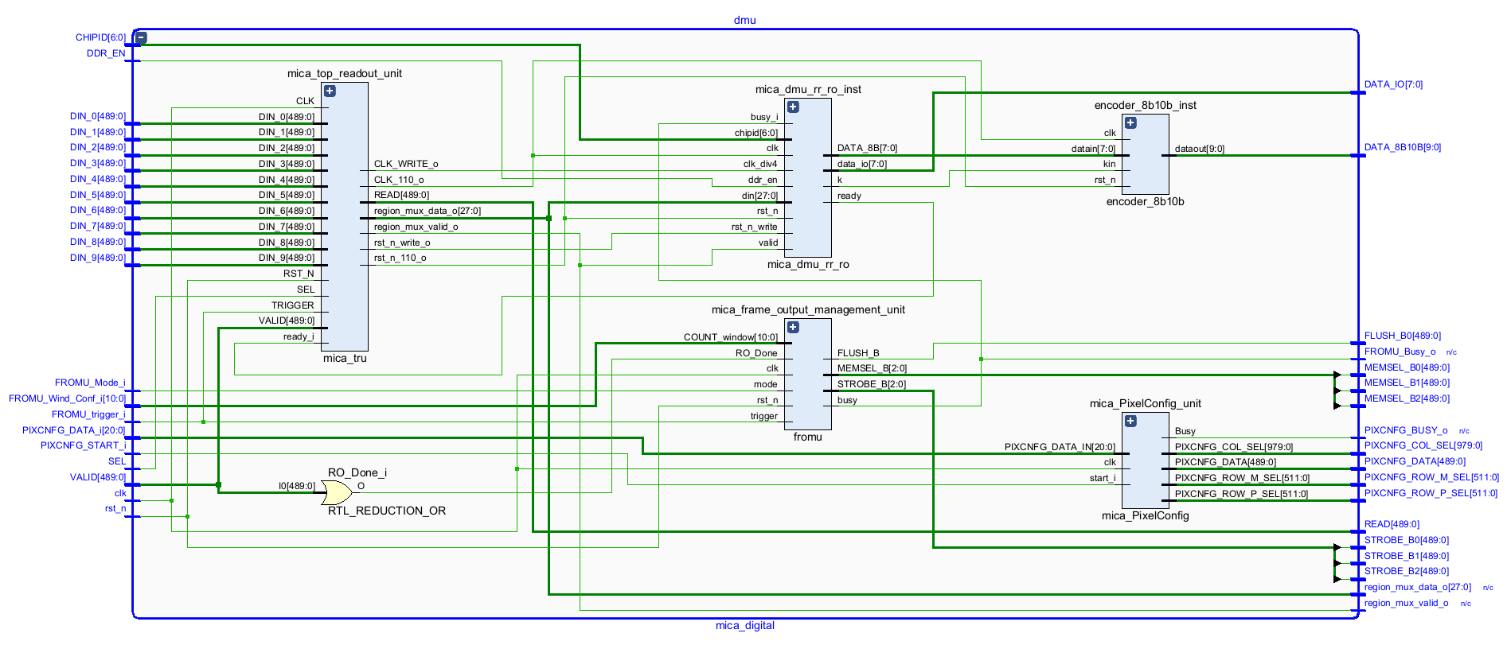
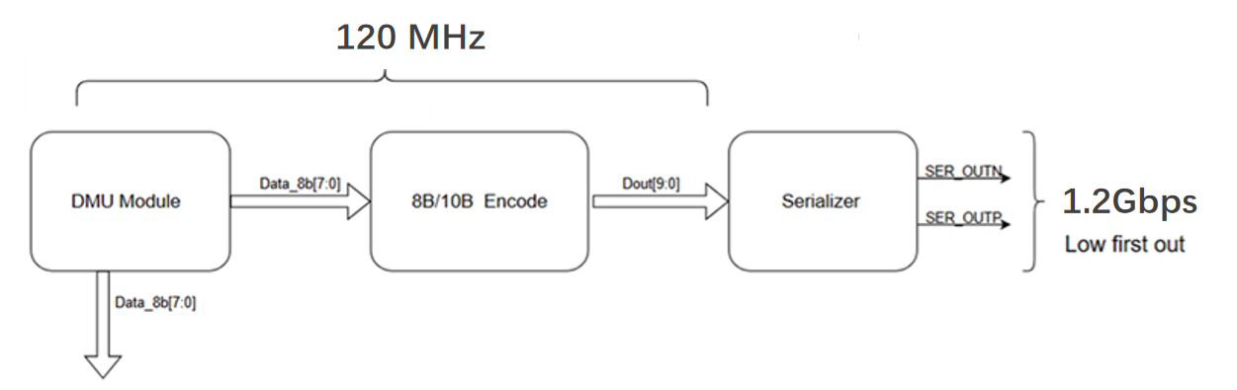
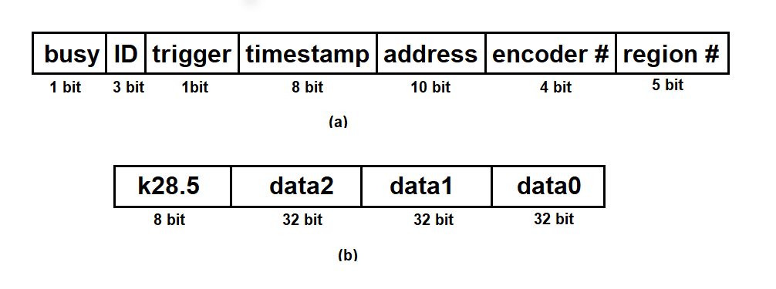
3. Design of MIC6_V4 Chip
Data Management Unit (DMU) Design
DMU module block diagram
Data frame before 8B10B encoding
The 2025 International Workshop on the High Energy Circular Electron Positron Collider
Notes:
The left figure shows the block diagram of Data Management Unit.
The Date frame before 8B10B encoding is shown in the right.

Slide 33

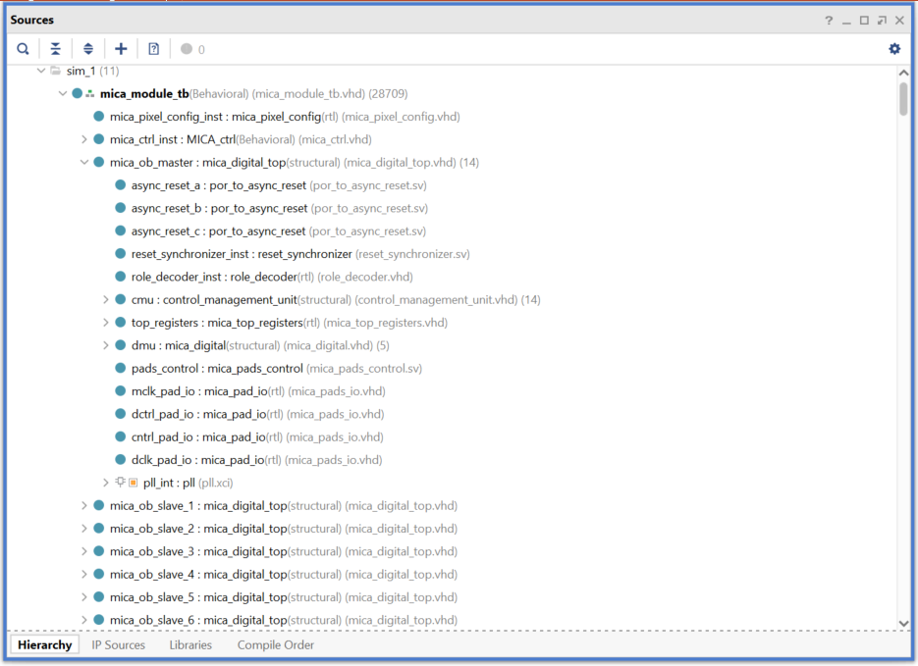

3. Design of MIC6_V4 Chip
CMU and DMU verification
Simulation verification of outer barrel module
FPGA prototype verification of outer barrel module
include:
one read-write controller
one master chip
Six slave chips
include:
one read-write controller
one master
one slave
CMU/DMULayout
The 2025 International Workshop on the High Energy Circular Electron Positron Collider
Notes:
We have implemented the verification of CMU and DMU, through simulation verification and FPGA prototype verification.
The simulation include one read-write controller, one master chip, and Six slave chips.
The FPGA prototype include one read-write controller, one master and one slave.
The right figure shows the Layout of CMU and DMU.

Slide 34


3. Design of MIC6_V4 Chip
MLVDS Design
MLVDS TX
MLVDS RX
MLVDS Layout
1. Speed: 80Mbps
2. Static power consumption: 6.228mW
3. On-chip terminal: 100 ohms
MLVDS Simulation
The 2025 International Workshop on the High Energy Circular Electron Positron Collider
Notes:
We have also implemented the design of submodules, like MLVDS

Slide 35

3. Design of MIC6_V4 Chip
AERD Design
1. Power consumption 0.16mW
Block diagram
Simulation
Layout (partial)
The 2025 International Workshop on the High Energy Circular Electron Positron Collider
Notes:
AERD

Slide 36

3. Design of MIC6_V4 Chip
DAC Design
1. Voltage range 0~1.2V
2. Bandcap temperature drift coefficient < 30 ppm
R-2R DAC
bandgap
Layout
Simulation
The 2025 International Workshop on the High Energy Circular Electron Positron Collider
Notes:
DAC

Slide 37
3. Design of MIC6_V4 Chip
ADC Design
Schematic Diagram
Layout
Power supply: 1.2V
Power consumption: 651.2uA
Measurement interval: 25.6us
Temperature measurement accuracy: 0.5bit at 1 ℃
Simulation
The 2025 International Workshop on the High Energy Circular Electron Positron Collider
Notes:
ADC

Slide 38

3. Design of MIC6_V4 Chip
LDO Design
simulation：Vout vs Vin
LDO Schematic
1. Vin input range: 1.35V~1.8V
2. Load current range: 1-250mA
3. Output voltage: 1.2V
Layout
The 2025 International Workshop on the High Energy Circular Electron Positron Collider
Notes:
LDO

Slide 39
3. Design of MIC6_V4 Chip
PLL Design
c1=1.2, output 600MHz clock
Schematic
c3=1.2,output 150MHz clock
c2=1.2,output 300MHz clock
1. Output clocks:
150MHz,
300MHz,
600MHz
2. Power: 23mW
Simulation
Layout
The 2025 International Workshop on the High Energy Circular Electron Positron Collider
Notes:
PLL

Slide 40
3. Design of MIC6_V4 Chip
Serializer Design
Schematic
Simulation
1. Data rate: 1.2Gbps
2. Power: 15.5mW
Layout
The 2025 International Workshop on the High Energy Circular Electron Positron Collider
Notes:
Serializer

Slide 41

3. Design of MIC6_V4 Chip
Pixel Design
Schematic
Layout
Power Supply: 1.2v
Power consumption :20.5nA per Pixel
ENC < 8e-
Threshold < 200e-(Adjustable)
Peaking Time < 1us(Input > 1ke-)
Analog Output Duration Time < 10us
Digital Output Duration Time < 10us
Time Walk< 50ns(Input > 1ke-)
Simulation
The 2025 International Workshop on the High Energy Circular Electron Positron Collider
Notes:
Pixel

Slide 42

3. Design of MIC6_V4 Chip
MIC6_V4 Layout
Features | MIC6_V4
Process Technology | GSMC-130 nm
Core Voltage | 1.2V
Chip Size | 30 mm×15 mm
Pixel Array | 980×497
Pixel Size | 30.53 um×26.8 um
Zero Suppression Readout | AERD
High-Speed Serial Output | 1.2Gbps
Encoder | 8B10B
Slow Control | MLVDS Control Bus
Parallel Data Interface | master-slave data aggregation and transmission
MIC6_V4 chip layout
The 2025 International Workshop on the High Energy Circular Electron Positron Collider
Notes:
Based on these, we have implemented the integration of MICA_V2 chip.
The right table shows some features of MICA_V2.
The MICA_V2 will be tapeout soon.

Slide 43
Thank you for your attention !
The 2025 International Workshop on the High Energy Circular Electron Positron Collider

